Slide 1

WP1: FE-FRT – report 13.10.2024
HZB, CERN, CNRS, Uni.Lancaster
Convener & deputy: Axel Neumann (HZB) & Alick McPherson (CERN)
Main contacts with other partners: Alick McPherson (CERN), Walid Kaabi (CNRS),
Graeme Burt (Uni.Lanc.)
Task 1.1: Coordination of R&D on FE-FRT – M1-M48
• General coordination by HZB as described above.
Task 1.2: FE-FRT for Transient Beam Loading – M1-M40
• Design a full FE-FRT-based 400 MHz tuner, applicable to LHC transient detuning scenarios.
• Perform full RF, mechanical and cryogenic evaluation of the FE-FRT-equipped . LHC cryo-module.
• Use design lessons learned to design a tuner for transient detuning of FCC 800 MHz multi-cell cavities.
Task 1.3: FE-FRT for Microphonics – M1-M48
• Establish characteristics and performance of FE-FRT ferroelectric material at frequencies ≥1300 MHz.
• Design, fabricate and validate an FE-FRT for microphonics suppression on a single-cell 1.3 GHz cavity.
• Design, fabricate and validate an FE-FRT for multi-cell cavity at 1300 MHz, in a cryomodule-like setup.
Task 1.4: FE-FRT in Energy-Recovery LINAC (ERL) mode – M1-M48
• End-group design study for integration into ERL-type cavity, study HOM+BBU properties.
• FE-FRT design study for RF and mechanical integration into upgraded ERL cavity.

Slide 2
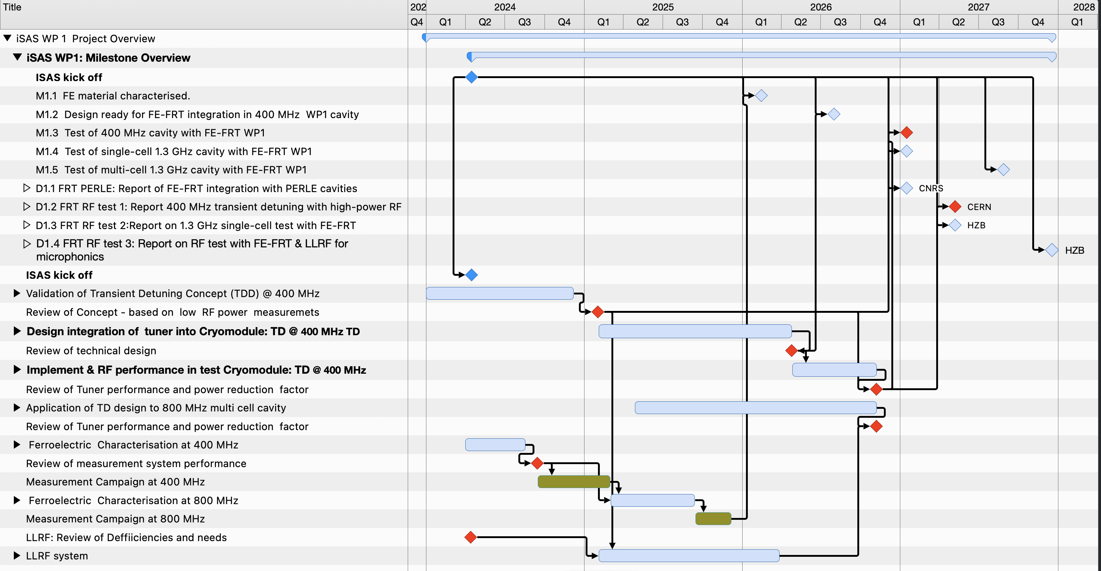
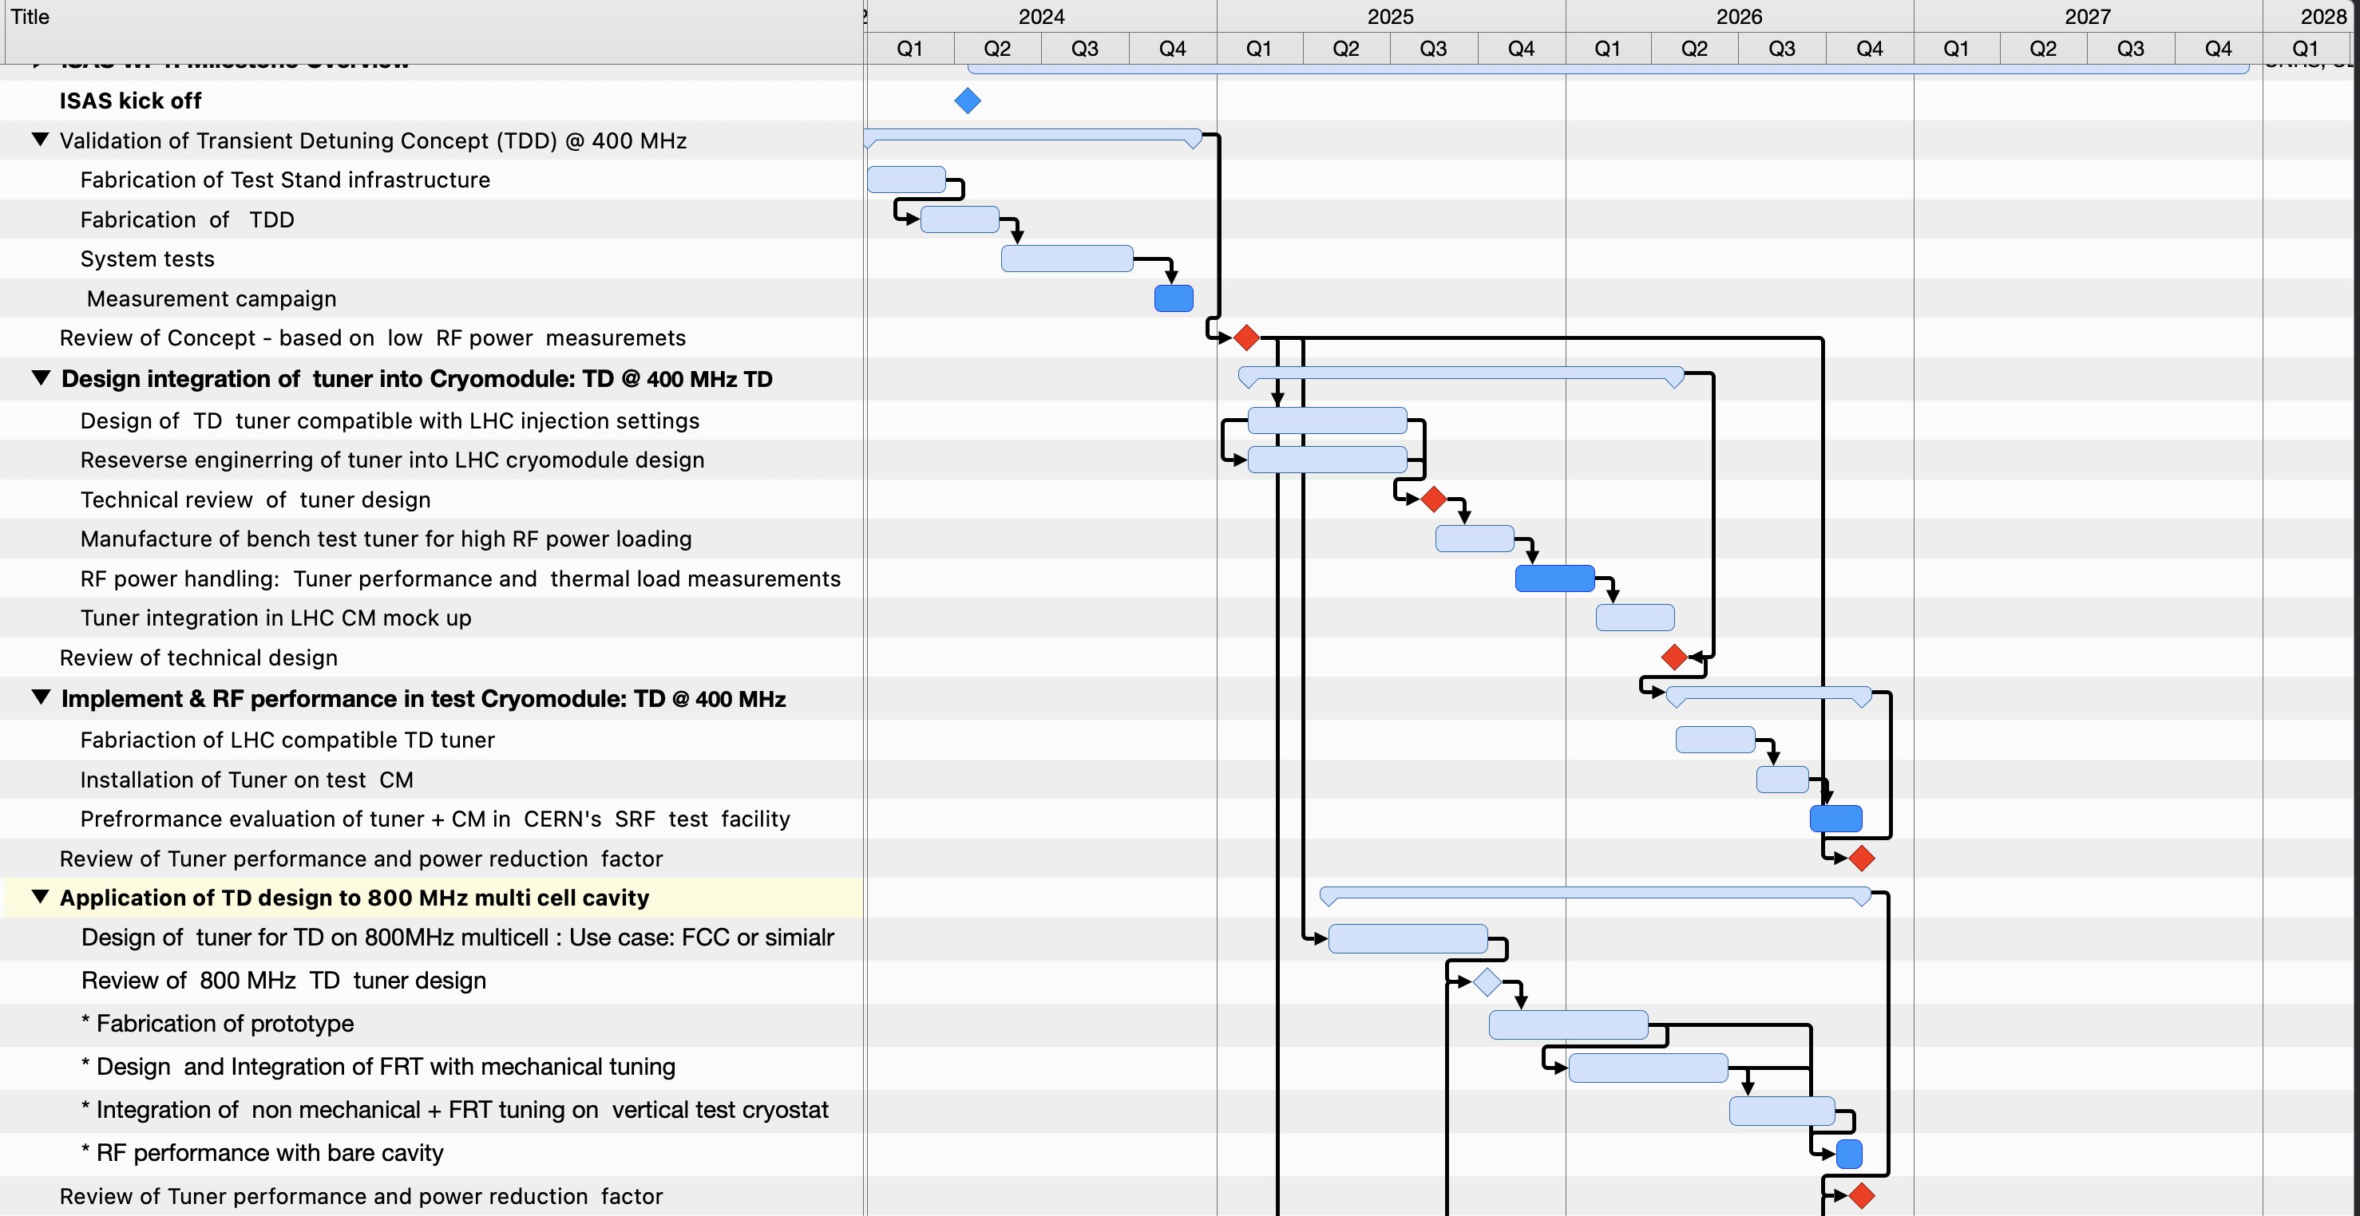
WP1 – FE-FRT: status/evolution of Task 1.2
iSAS milestones
M1.1 Ferro-electric teststand:
  Setup in laboratory completed, vacuum system installed
  → First non-HV scans with temperature using reference
  material and FE ceramics
  RF antenna ready to characterize loss mechanisms vs. RF
  power level
Fixed gap, HV breakdown tests:
  Electrode fabrication ready week 41, test expected to
  happen early November
M1.2/M1.3 TDD tuner with 400 MHz cavity:
  Tuner fabrication on-going, delivery end of this year
  Anti-cryostat tooling (vertical test) delivered, validation
  test on-going
  HV pulser in place, new 2 kW RF amplifier to be procured
Exchange of personnel:
  Visit by HZB engineer scheduled to 14th-16th of October
  → discuss fabrication and mechanical design issues
  of CERN+HZB’s FRT designs
Personnel: iSAS postdoc to be filled in early 2025
Today
Dependent on availability of in-kind infrastructure & resources => TBC

Slide 3
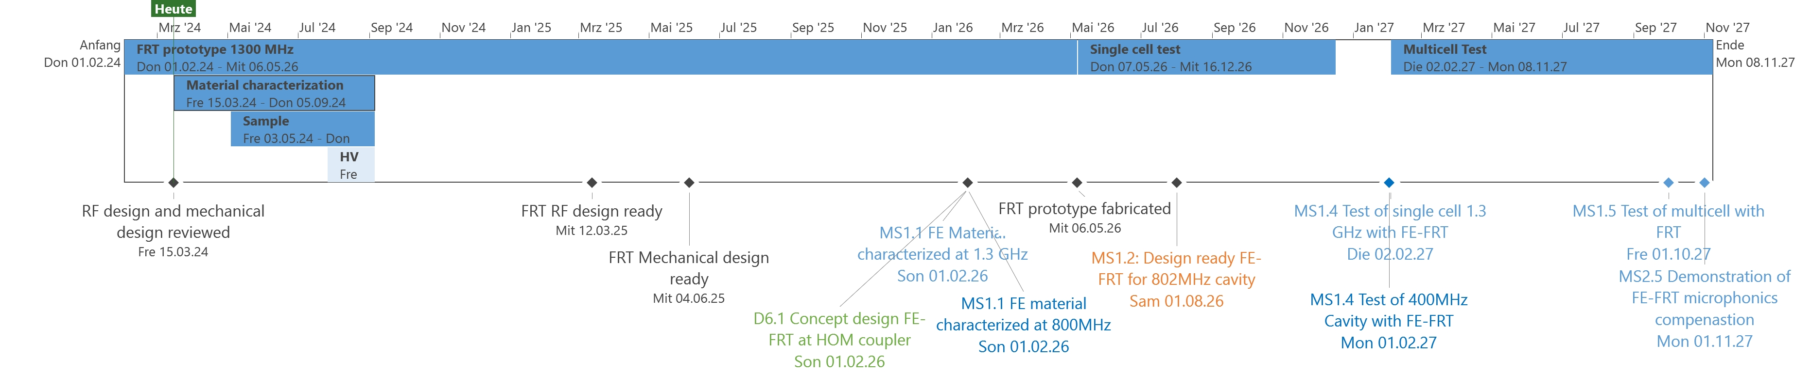
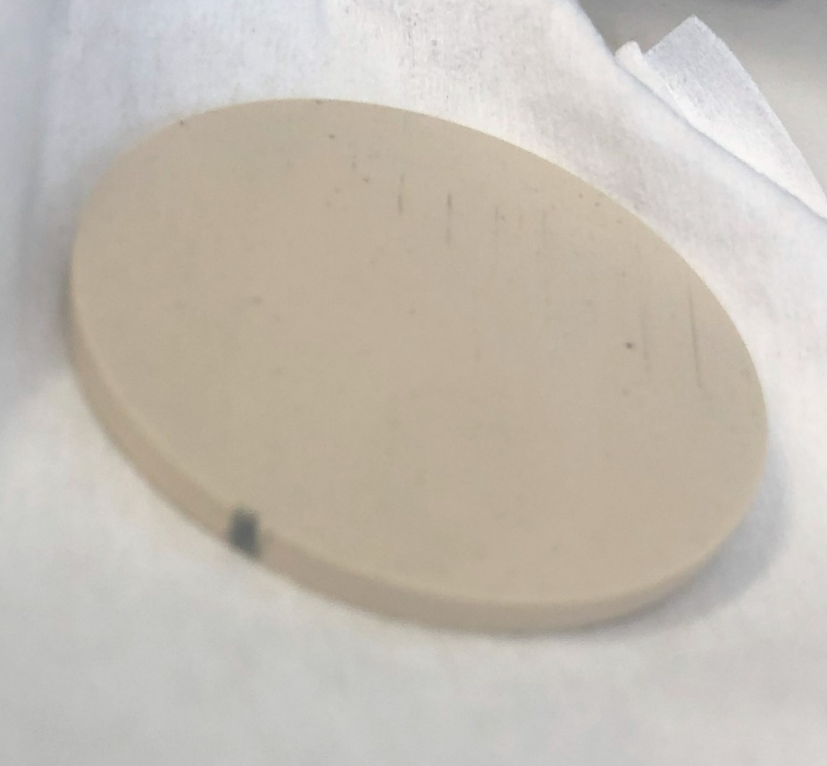
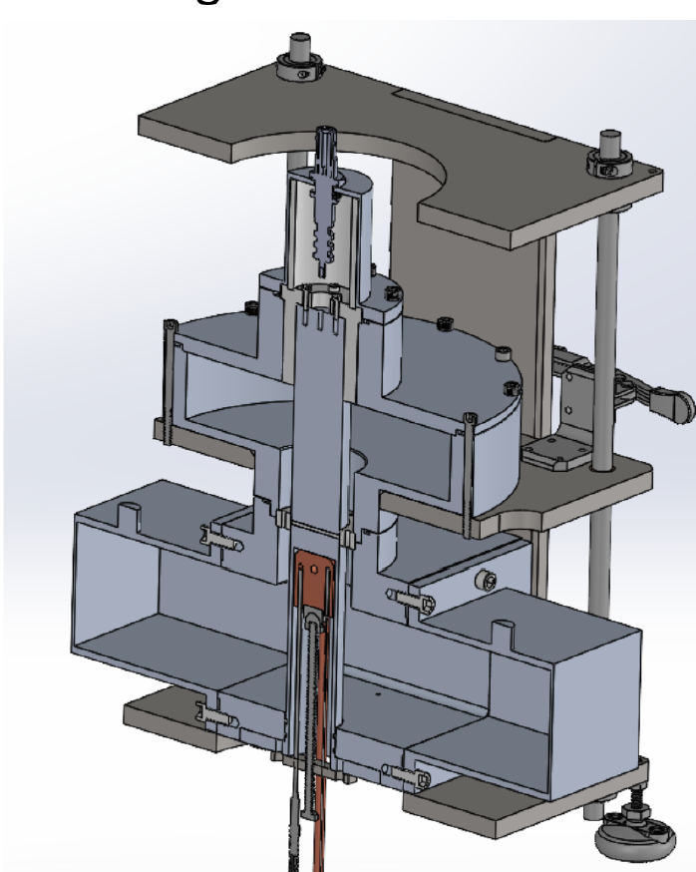
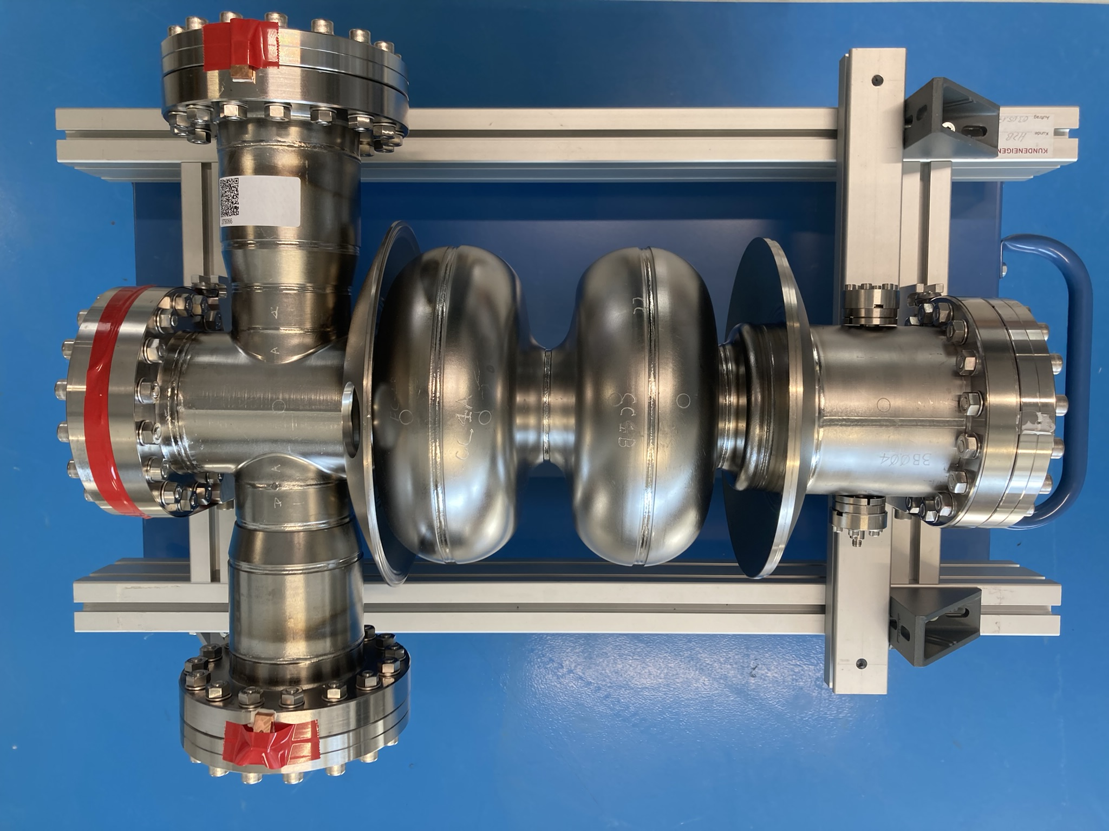
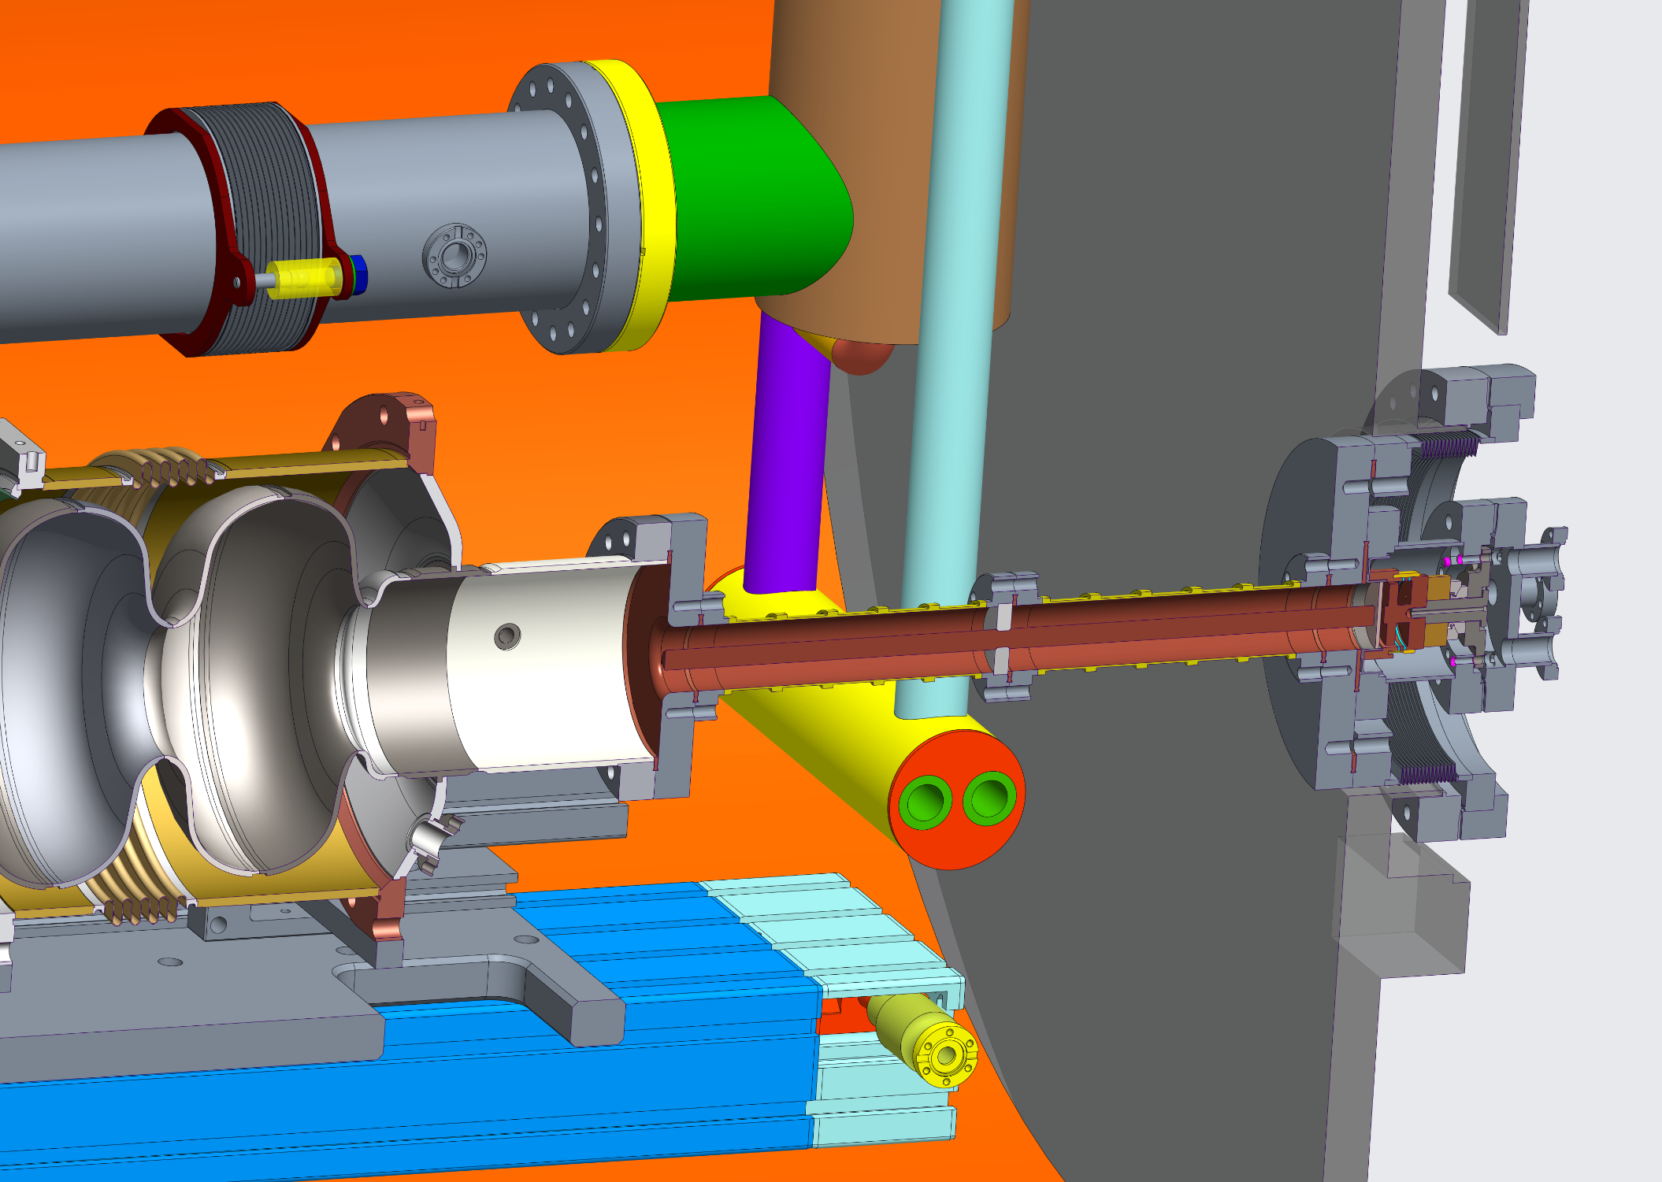
WP1 – FE-FRT: status/evolution of Task 1.3
Today
MS 1.1 FE material teststand/characterization of:
  The teststand was sent back to Euclid Techlab for further analysis of data obtained at HZB
  → re-working of teststand required
MS 1.4 Test of 1.3 GHz single cell cavity:
  Pushing mechanical design and integration into HoBiCaT, RF part works for expected 1.3 GHz material parameters, still need to be checked (see MS 1.1), first parts to be ordered soon
  2-cell Booster as testcase for “single cell” test prepared for Helium vessel welding and BPC treatment → acceptance test of bare cavity w/o FRT planned to study quality of cleanroom assembly (avoid field emission)

Slide 4
WP1 – FE-FRT: status/evolution of Task 1.4
At IJCLab the focus for the first cryo-module is to lower any kind of production risk to
achieve the demanding high Q goals by applying the right cavity treatment recipe
The initial cavity design and the first Linac cryo-module will thus be without any FRT
port for integration
The FRT is still an option for the second cryo-module, which also aligns with the iSAS
plans, that integration studies will be performed at some point taking into account
experiences at HZB and CERN, as well as deliverables by U Lancaster (WP6)
CERN offered to have a look at IJCLab’s PERLE cavity design, as there might be a
common use case for microphonics compensation with FRTs at 800 MHz
→ Potential synergy between FCC and PERLE
IJCLab will continue to join the meetings of WP1 to be kept up to date

Slide 5
WP1 – FE-FRT: points of attention
Collaborations with other WPs and new partners
  There is a strong linkage between LLRF WP task 2.4→ LLRF task 2.4 postdoc started at 1st of September at HZB, since then intensive exchange between task 2.4 and 1.3 at HZB
  WP 6 task 6.2 is a natural collaboration partner for all tasks of WP1, especially task 1.2 based on grown relationship in TD FE-FRT development over the past years, there is quite an invest on-going in UK for
  sustainable SRF, including FE-FRT, e.g. for UK XFEL project
  STFC Daresbury can be a very useful collaboration partner for HV pulsers as needed for e.g. the TDD
  High gradient RF group of W. Wünsch (CERN): HV breakdown test scheduled for early November
  JLab, group of A. Castilla unfortunately did not receive funding, future options to be discussed
Risks:
  So far only one manufacturer of ceramics for FE-FRT (Euclid) identified, but is a project partner
  → Machining of ceramics for final design and assembly might be challenging to achieve,
  tests at CERN and HZB will proceed in the near future
  800 MHz FE-FRT development and testing at CERN: CERN’s interest in these developments are driven by
  FCC use cases: Fast detuning for beam-loaded cavities, microphonics eventually only for 800 MHz cavity → overlap with PERLE: Potential usage of SPL cavity with Helium vessel and mech. Tuner
  → IJCLab has a spare cavity for PERLE after treatment tests are accomplished, possible to be
  used from mid 2026 onwards

Slide 6
WP1 – FE-FRT: plans to achieve milestones & deliverables
Since the before the kick-off meeting at IJCLab, biweekly meetings are held online via the partners
There is a strong exchange on design approaches, manufacturing techniques between the labs,
which are involved in building hardware for testing: CERN and HZB, an HZB engineer visited CERN
between 14th-16th of October to visit the CERN workshop and FRT mechanical designer
So far, the tracking of the progress at each lab follows on the basis of the meeting’s reports.
It is still planned to have a unified work plan on a dedicated common platform.
The first milestone, characterization of the FE ceramics is well within reach and might be achieved right
before the due date, as this work was begun at the early days of iSAS
There is still a remaining risk for delays by priorization of manufacturing of parts in lab’s workshops
or shift of available usage of cold teststands

Slide 7
WP1 – FE-FRT: budget plans
Budget related to hired personnel is within plans so far, CERN will posts its FE-FRT position early
2025
Two labs are only receiving budget for this WP1: CERN and HZB for tasks 1.2 and 1.3 respectively
Both labs roughly assumed 50% matching budget for personnel (already given personnel at labs involved
with the project) and 50% matching budget for consumables and equipment.
Those plans need to be confirmed with the evolution of the lab’s budgets for the coming years.
Increasing costs and eventually shift of lab’s research focus due to new future budget constraints might
impact this project
HZB could already invest some budget from 2023 (60 k€) into the task 1.3

