Slide 1
WP3: Nb₃Sn on Cu films for 4.2K cavity operation
INFN, CEA, HZB, UKRI
Convener: Cristian Pira (INFN), Deputy O. Malyshev (UKRI)
Main contacts with other partners:
T. Proslier (CEA), O.Kugeler (HZB), O. Malyshev (UKRI), R. Valizadeh (UKRI)
Task 3.1: Coordination of R&D on SC Cavities – M1-M48
• General coordination by INFN.
Task 3.2: Flux Trapping – M1-M32
Explore new coating parameters for planar samples and small resonators to minimize flux trapping in SC A15 films.
Upgrade the STFC choke cavity and the HZB QPR to support detailed flux trapping analyses of coated SC films.
Characterize trapped flux, flux viscosity and the interaction with the RF field with SC A15 films in small resonators and planar samples with the upgraded systems.
Task 3.3: RF Tunability – M1-M32
• Explore new coating parameters on planar samples and resonators to enhance the mechanical strength in SC A15 films.
• Mechanical film-stability tests with planar samples.
• Build cavity tuning system and perform vertical cryo-tests of coated cavities to explore RF performance limits and acceptable tuning without incurring film damage.
• Devise cavity tuning schemes for Nb3Sn cavities fulfilling the required tuning parameters while taking into account the constraints of Nb3Sn. The implementation of FE-FRT to assist will be considered.
Task 3.4: Adaptative layers – M1-M40
• Develop adaptative layers by atomic layer deposition on Cu that are stable up to 650 °C.
• Compare performance Nb3Sn on Cu with and without adaptive layers on planar samples and QPR.
Task 3.5: Working Cavity @4.2 K – M1-M48
• Improve I.FAST 1.3-GHz superconducting coating recipe based on Tasks 3.2-3.4 results.
• Prepare 1.3-GHz thin film cavities with an optimized coating recipe.

Slide 2
WP3 – SRF: status/evolution of Task 3.1
Coordination (INFN, CEA, HZB, UKRI) – Cristian Pira
Status:
WP3 Meeting 01 - Task leaders Pre-Kick-Off remote meeting on 21/02/2024
https://agenda.infn.it/event/40107/
WP3 Meeting 02 - Kick-Off meeting in Paris (hybrid) on 16/04/2024 (in collaboration with I.FAST WP9) https://indico.cern.ch/event/1357302/sessions/528505/#20240416
WP3 Meeting 03 - Task Leaders remote meeting on 17/07/2024 (in collaboration with I.FAST WP9) https://indico.cern.ch/event/1437516/
WP3 Meeting 04 – Hybrid meeting in Berlin on 02-03/12/2024 (in collaboration with I.FAST WP9)
https://events.hifis.net/event/1875/

Slide 3
WP3 – SRF: status/evolution of Task 3.2
Flux Trapping (INFN, CEA, HZB, UKRI) – Oleg Malyshev
Deliverable 3.2 Flux trapping Report on flux dynamics study in Nb3Sn on Cu samples - HZB - Report M30
Milestone 3.1 Modification of choke cavity for flux trapping study - Engineering report M12
Status:
ON TRACK FOR Milestone 3.1
At UKRI:
A measurement facility is being moved to a new bunker to enable the measuremets at higher RF power.
New magnet shield procured and delivered to UKRI
New set of Hall probes and a 4-channel controller procured. All items arrived to UKRI. A design of a new sample holder that will accomodate Hall probes is ongoing
At HZB:
Production and procurement of apparaturs to measure temperature-gradient driven flux trapping ongoing. Commissioning expected in October 2024 → November 2024 (delayed by 1 month due to manufacturing issues)
Temperature gradient system @HZB

Slide 4
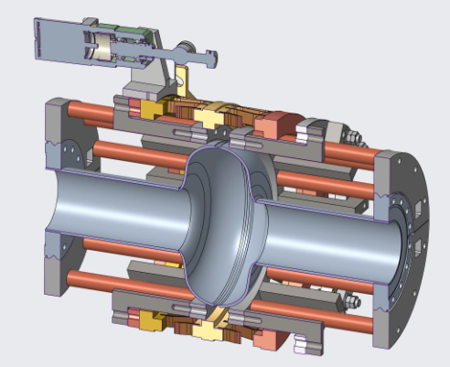
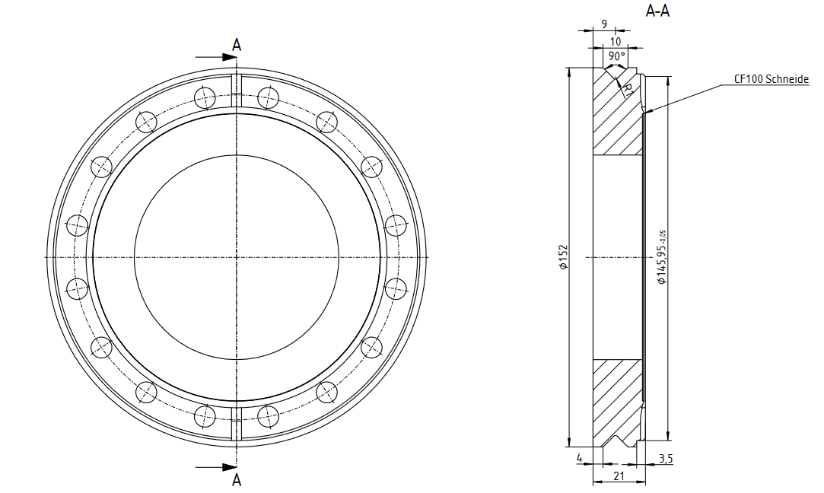
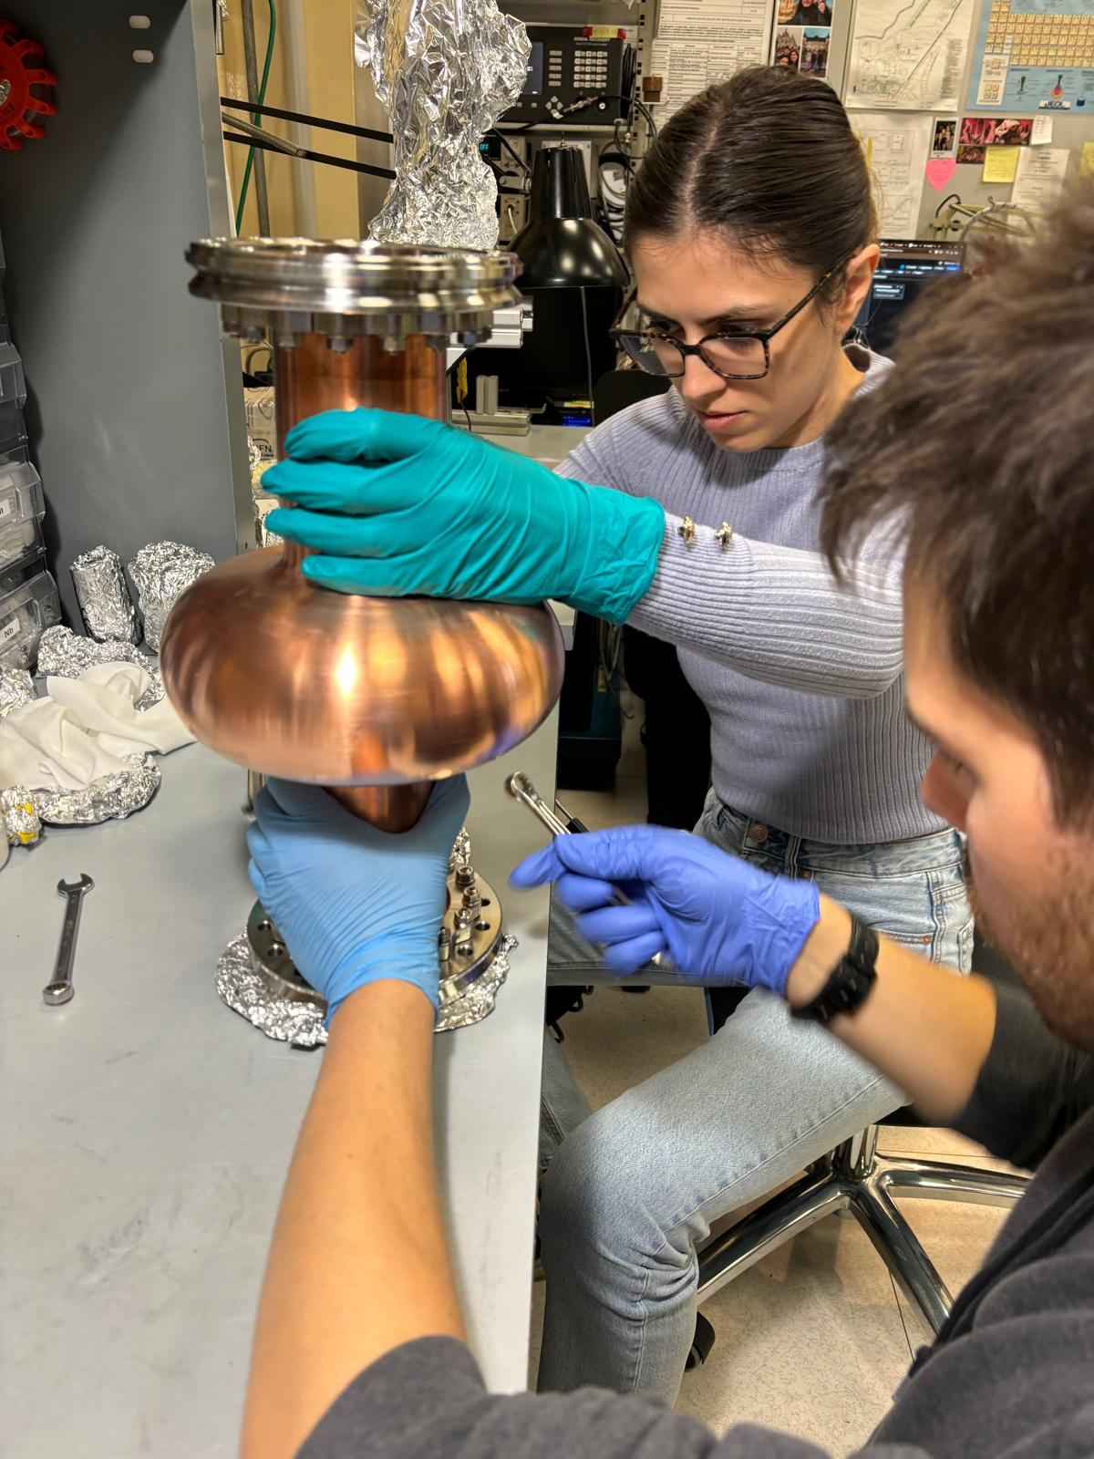
WP3 – SRF: status/evolution of Task 3.3
Tunability (INFN, CEA, HZB, UKRI) – Oliver Kugeler
Deliverable 3.1 Cavity tuning Report on implementation of cavity Q vs F tuning tool - HZB - Report M24
Milestone 3.3 Report on mechanical strength test of SC coatings - Test report M30
Status:
CEA: Preparing protocol for mechanical properties test on Nb3Sn coatings
UKRI and INFN: Coating systems ready for first planar samples deposition
HZB:Design of adapter for blade tuner
Agreement between INFN Legnaro, INFN Milano and HZB on cavity end flange design:
CF type blade, Cu gasket
Stainless steel
Circumferential groove for interface to adapter
Procurement ongoing
Hiring planned: Felix Kramer will occupy postdoc position by 2025
Flange testing in progress @INFN
New cavity flange design test

Slide 5
WP3 – SRF: status/evolution of Task 3.4
Adaptive Layers (INFN, CEA, HZB, UKRI) – Thomas Proslier
Deliverable 3.3 Adapt. Layer Report on QPR study of Nb3Sn on Cu & adaptive layers - CEA - Report M38
Milestone 3.2 Developed ALD adaptive layers on Cu - Test report M24
Status:
UKRI and INFN: Coating systems ready for first planar sample deposition. Substrate polishing in progress
CEA:
Al₂O₃ coatings on EP Cu substrate and subsequent low T Nb deposition by HIPIMS(100-200°C) successfull
ALD coating of a 1.3 GHz Cu cavity with Al₂O₃ for future HIPIMS deposition of Nb at CERN.
Tunneling spectroscopy measurements on Nb/Cu and Nb/Al₂O₃/Cu coupons in progress.
Crystalline ALD oxide layer by ALD for high temperature Nb₃Sn HIPIMS growth. Layer Stable up to 750°C.
Need more Cu coupons and A15 deposition attempts to confirm the trend (UKRI, INFN)
Tunneling spectroscopy measurements completed on Nb₃Sn/Ta/Cu and Nb₃Sn/ALD layer/Cu
New insulating oxide layer deposited on electropolished Cu coupons for High temperature Nb₃Sn deposition. MEB show cracks after annealing in vacuum at 750°C for 2hrs. Other layer thicknesses and composition will be investigated.

Slide 6
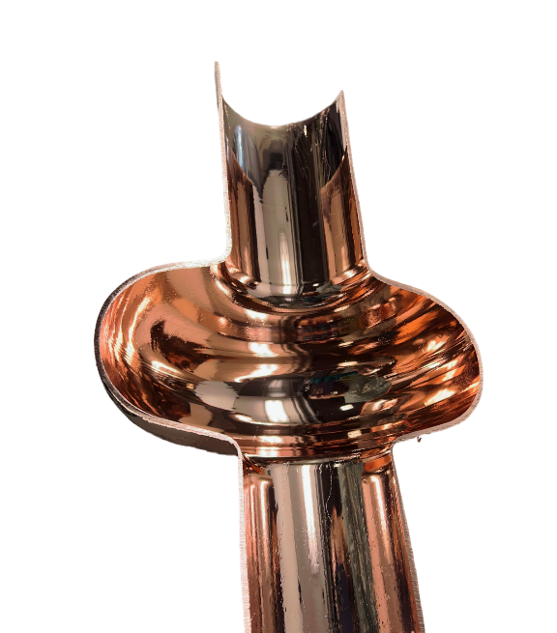
WP3 – SRF: status/evolution of Task 3.5
Working Cavity (INFN, CEA, HZB, UKRI) – Reza Valizadeh
Deliverable 3.4 4.5-K Cavity Report on 4.5-K Cavity performance & tunability tests - INFN - Report M46
Milestone 3.4 Characterization of Nb3Sn reference cavity - Test report M34
Status:
UKRI:
Two potential target manufacturing companies Osaka Asahi Metal and Photon Export has been identified and enquiry for NbTi, Nb3Sn target made as tubes is been made.
Received several halfshell 1.3 GHz copper cavity
Deposition from cylindrical mixed Nb rod and Ti mesh.
Two 1.3 GHz machined cavities has been ordered from CERN
The PVCVD for Nb3Sn coating is been set up and is going through its commissioning phase
Three 1.3 GHz cavities sent to CEA for surface preparation for future deposition
INFN:
1.3 GHz Coating systems in the commissioning phase (part of the I.FAST program)
PEP Succesfully tested on full 1.3 GHz cavity (new synergy ongoing with CERN and KEK)
1.3 GHz seamless cavity Cu substrate in preparation (Cu annealing phase)
First 1.3 GHz successfully polished by PEP

Slide 7
WP3 – SRF: points of attention
Synergy with I.FAST partners at least until 31/04/2025
Nb₃Sn R&D on I.FAST showed the need for an adaptive layer on top of the copper substrate to optimize the lattice parameter of the superconductive Nb₃Sn film that is growing on the substrate in order to maximize the Tc value. Currently, an Nb layer thicker than 30 microns is used for this purpose.
ISAS Task 3.4 gains more importance because, in addition to looking for an adaptive layer via ALD that optimizes the mechanical properties, we will also look for the possibility of replacing the thick Nb layer with an ALD layer that optimizes the lattice parameter of the Nb₃Sn coating and thus maximizes the Tc.
In the grant agreement encountered an error in assigning deliverables (probably occurred during the task numbering change):
Deliverable 3.4 is in charge of CEA and not UKRI
No New Point of Attention

Slide 8
WP3 – SRF: plans to achieve milestones & deliverables
D3.1 Cavity tuning Report on implementation of cavity Q vs F tuning tool - Report M24- HZB
D3.2 Flux trapping Report on flux dynamics study in Nb3Sn on Cu samples - Report M30 – HZB
D3.3 Adapt. Layer Report on QPR study of Nb₃Sn on Cu & adaptive layers - Report M38 – CEA
D3.4 4.5-K Cavity Report on 4.5-K Cavity performance & tunability tests - Report M46 - INFN
M3.1 Modification of choke cavity for flux trapping study - Engineering report M12
M3.2 Developed ALD adaptive layers on Cu - Engineering report M24
M3.3 Report on mechanical strength test of SC coatings - Test report M30
M3.4 Characterization of Nb₃Sn reference cavity - Test report M34
today
M3.1
M3.2
D3.1
M3.3
D3.2
M3.4
D3.3
D3.4
Y0
Y1
Y2
Y3
Y4
TASK
3.1 - Coordination
Task 3.1
3.2 – Flux Trapping
Task 3.2
3.3 – RF Tunability
Task 3.3
3.4 – Adaptive Layers
Task 3.4
3.5 - Working Cavity @4.2K
Task 3.5

