Slide 1
WP4 High-Order Mode dampers and Fundamental Power couplers
CERN : Sebastien Jerome Calvo, Karin Canderan, Marco Garlasche, Eric Montesinos, Vittorio Parma, Calum James Sharp
INFN : Dario Giove – deputy (INFN)
CNRS : Patricia Duchesne (IJCLab), Yolanda Gómez Martínez - convener(LPSC), Gilles Olivier (IJCLab), Guillaume Olry (IJCLab)

Slide 2
WP4 : Main dates (reminder)
CNRS, INFN Task 4.1: General coordination of WP4 March 24 – March 28
INFN, CNRS, CERN Task 4.2: HOM coupler design March 24 – Sept 25
CERN, CNRS, INFN Task 4.3: Fabrication of HOM couplers May 25 – March 28*
CNRS, INFN Task 4.4: Test of HOM couplers Nov 25 – June 26
CERN, CNRS Task 4.5: FP coupler design March 24 – July 25
CERN, CNRS Task 4.6: Fabrication of FP couplers July 25 – June 26
CERN, CNRS Task 4.7: Test of FP couplers Feb 26 – Dec 26
Integration cryomodule- WP6 → 14th December 2026
*800 MHz and 1,3 GHz, including R&D on alternative manufacturing for large productions.
3

Slide 3
WP4: Milestones (M) and deliverables (D) (reminder)
2025
M1 Design report of FPC coupler: 1st July 2025
M2 Design report of HOM coupler: 1st September 2025
2026
M3 Intermediary general rapport : 1st February 2026
M4 Engineering report of the fabrication of HOM couplers : 1st February 2026
M5 Test report of HOM couplers: 1st June 2026
M6 Engineering report of the fabrication of FPCs :1st June 2026
M7 Test report of FPC couplers: 1st December 2026
D1 HOM test ‘Report qualification HOM couplers on cavities at 300 K by CNRS’ : 1st December 2026
2027
D2 RF coupler test ‘Report on RF test of 800MHz FPC at 50 kW by CERN’ : 1st June 2027

Slide 4
WP4: Status/evolution of tasks
Task 4.1 : General coordination
WP4 monthly meetings, 4 meetings hold on:
On 16/05/24 : focus on FP couplers specification and general organisation (Dario Giove deputy, box https://box.in2p3.fr/s/jH3tpNsLgoZ9p8M …)
On 25/06/24 : Focus on HOM coupler for WP6. Patricia Duchesne (IJCLab)’s presentation of the work carried out (EM simulation, RF designs,..)
On 3/09/24 : Focus on planning. WP4 planning compatible with WP6 planning
On 15/10/24 : Focus on FP couplers for WP6. Eric Montesinos (CERN)‘s presentation of the status (preparations and modifications)
Date to be fixed in November
Date to be fixed in December : It will focus on the 1,3 GHz HOM couplers
…
5

Slide 5
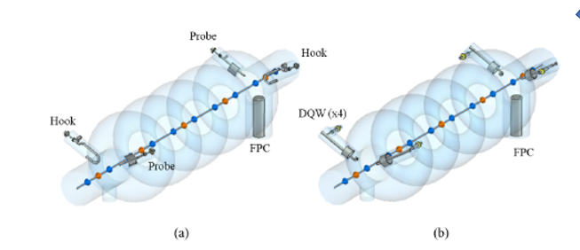
WP4: Status/evolution of tasks
Task 4.2: HOM couplers design
HOM couplers for WP6
RF optimization planned till December 2024 (P. Duchesne)
to check that the damping schemes 2H2P and 4DQW meet requirements in terms of impedances in the new configuration (HOM ports shifted by 25mm towards the tuner)
Mechanical /Thermal optimization planned from January to April 2025 (P. Duchesne)
The first thermal results (only heat loads of the fundamental mode) show that:
For DQW coupler: An active cooling circuit inside the antenna is mandatory to remain superconducting
For HOOK coupler: The antenna without cooling circuit remains superconducting to be verified when adding the HOM heat loads.
The integration of a DQW coupler on the 5-cell cavity with its helium tank needs a modification of the coupler design.
HOM couplers 800 MHz v2 and 1.3 GHz : Specifications ongoing
The 2 damping schemes studied ( a/ 2xH + 2xP and B/ 4xDQW)
From presentation on WP4 of P. Duchesne based on the Carmelo Barbagallo’s work
5

Slide 6
WP4: Status/evolution of tasks
Task 4.3: Fabrication of HOM couplers
Ongoing:
Discuss between Vittorio Parma (CERN), Marco Garlasche (CERN) and Andris Ratkus (RTU) about additive manufacturing.
The study of the possibility of increase from 4 units to 16 units the manufacturing of HOM at CERN (request from WP6).
→Question : Procedure under ISAS for changing the deliverables/milestones.
5

Slide 7
WP4: Status/evolution of tasks
Task 4.3: Test of HOM couplers
Nothing to report
5

Slide 8
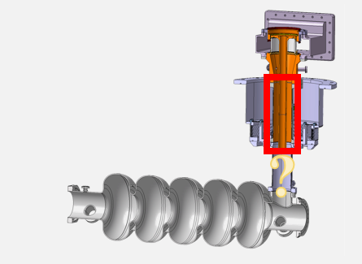
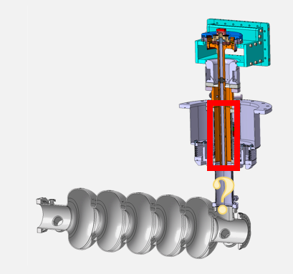
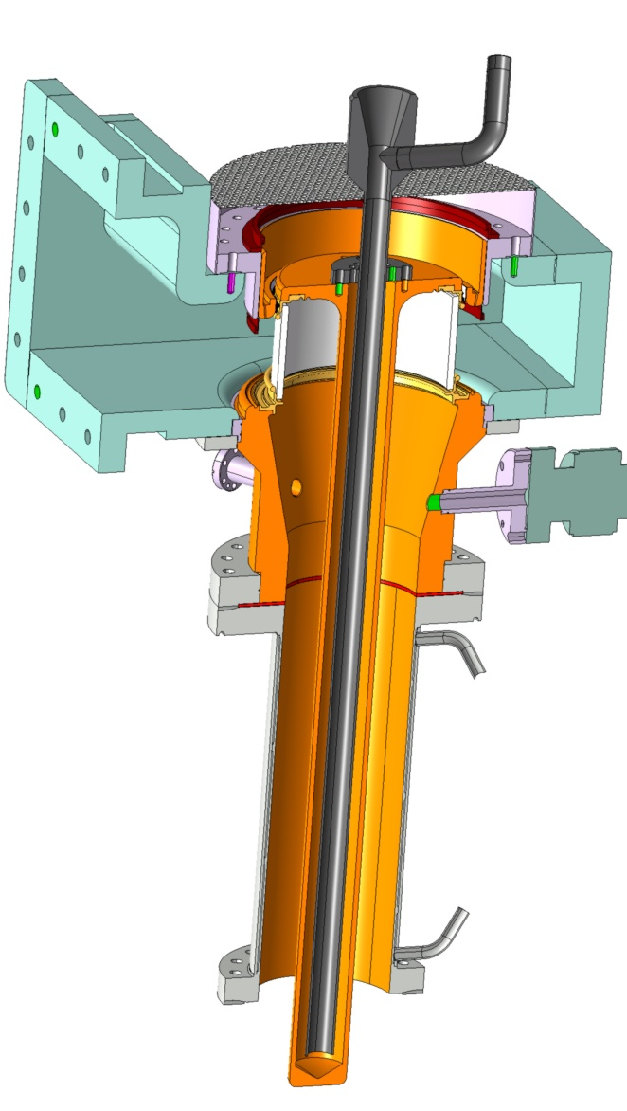
WP4: Status/evolution of tasks
Task 4.5: 800 MHz FP couplers design
Two models : SPL FPC disc window and SPL cylindrical window
Ongoing
the definition of the last parameters (Q_{EXT})
the study of the adaptation to SPL FPC to PERLE FPC
From 704 MHz to 801 MHz ( Waveguide modification)
The adaptation of the antenna (Position and shape)
From E. Montesinos presentation on WP4: SPL Disc window coupler & SPL cylindrical window coupler
5

Slide 9
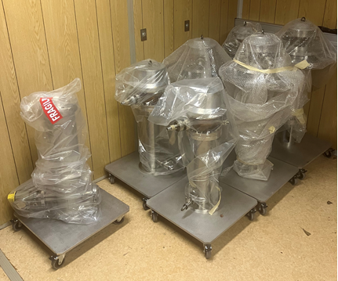
WP4: Status/evolution of tasks
Task 4.6: Fabrication of 800 MHz FP couplers
4 (disc window)+ 4 (cylindrical window) SPL couplers at 704 MHz avalaibles
The antenna will be modified
Ongoing:
With regard of the manufacture of 4 double-walled tubes (cuffs), different possibilities under study:
Re-using the ESS Cryomodules ones with an additional piece of external line
Manufacture them at CERN
From E. Montesinos presentation on WP4: The SPL coupleurs avalaibles
5

Slide 10
WP4: Status/evolution of tasks
Task 4.6: Test of FP couplers
Question: Skip the FPC processing and decides to proceed directly with the FPCs onto the cavities?
5

Slide 11
Thank-you for your attention

