Slide 1

WP6: Integration into Accelerator and Collider Ris – report 18 oct 2024
CNRS/IJCLAB, CEA, ESS, INFN, Lancaster University
Convener: Guillaume Olry (IJCLAB), deputy: Arnaud Madur (CEA)
Task 6.1: Coordination – M1-M48
• General coordination by CNRS.
• Coordination with WP4 on HOM and RF couplers implementation into the cryomodule and WP1 on FE-FRT development.
Task 6.2: Retrofitting Fast Reactive Tuners into existing cryomodules – M1-M24
• Study of frequency domain multiplexor-based HOM coupler.
• Study the effect of HOMs on FE-FRT operation to define max leakage.
• Study the heating due to high fundamental power in the coupler.
Task 6.3: Adapt the existing ESS cryomodule – M1-M18
• Modifications of the existing ESS cryomodule based on feedback from assembly experience at CEA and testing experience at ESS.
• Integration of the HOM couplers and FPC (mechanical and cooling circuit interfaces).
• Study of the modifications of the existing tooling needed for the assembly.
Task 6.4: Fabrication and validation of cryomodule components – M1-M30
• Fabrication of the critical components (SRF cavity, tuning systems, HOM couplers, ...) adapted to the existing ESS cryomodule.
• SRF cavities preparation and qualification test in a vertical cryostat.
• Preparation and qualification test of the tuning systems.
Task 6.5: Assembly and test of adapted cryomodule – M30-M48
• Clean room assembly of the cavity string and cryostating phase.
• Preparation of the test stand.
• Cryogenic and RF test of the cryomodule.

Slide 2
WP6 – task 6.1 Coordination
General coordination:
Deputy appointed: Arnaud Madur (thank you!)
Meetings (not so much)
#1: meeting in april with WP4
#2: joint meeting in September with WP4 & WP5
Next meetings: a poll is in progress to fix the 2 next meetings in November and December

Slide 3
WP6 – task 6.2 Retrofitting FRTs:
→ Linked to the WP1...need Graeme’s inputs

Slide 4
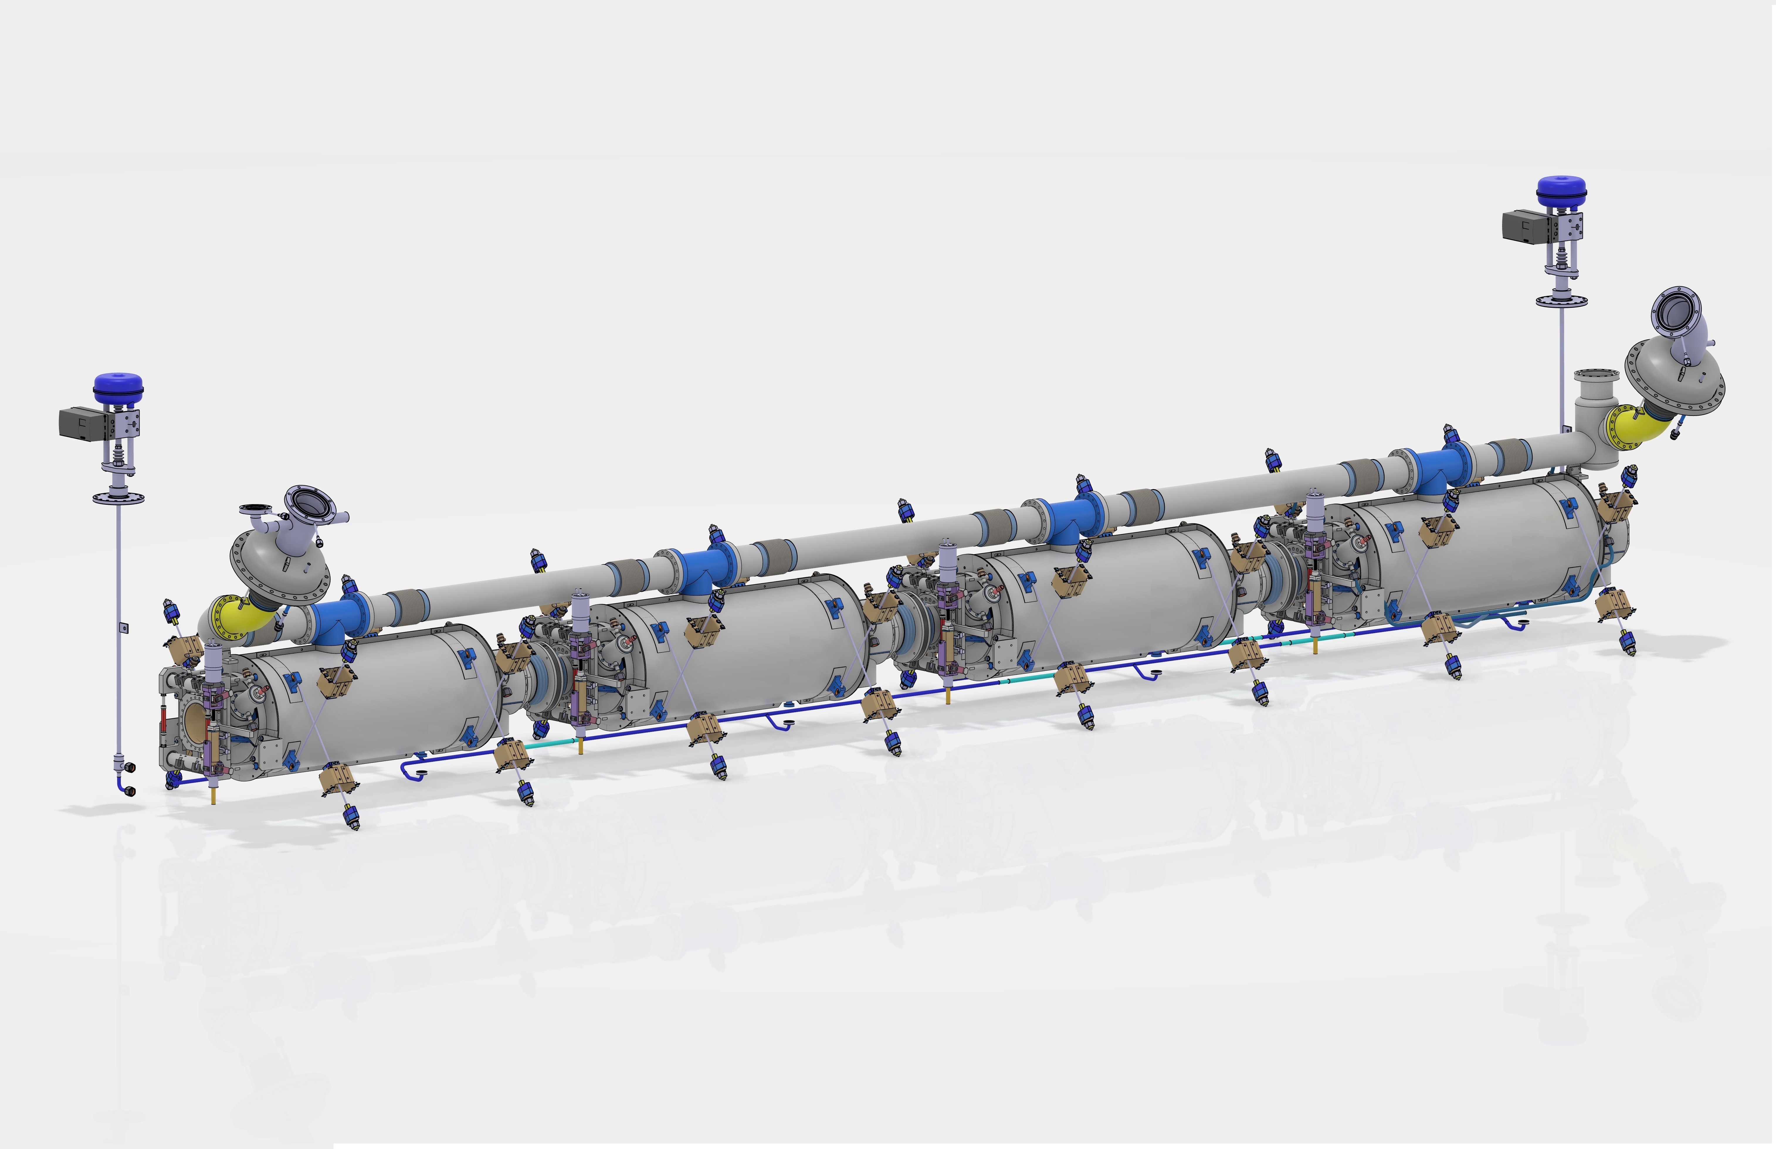
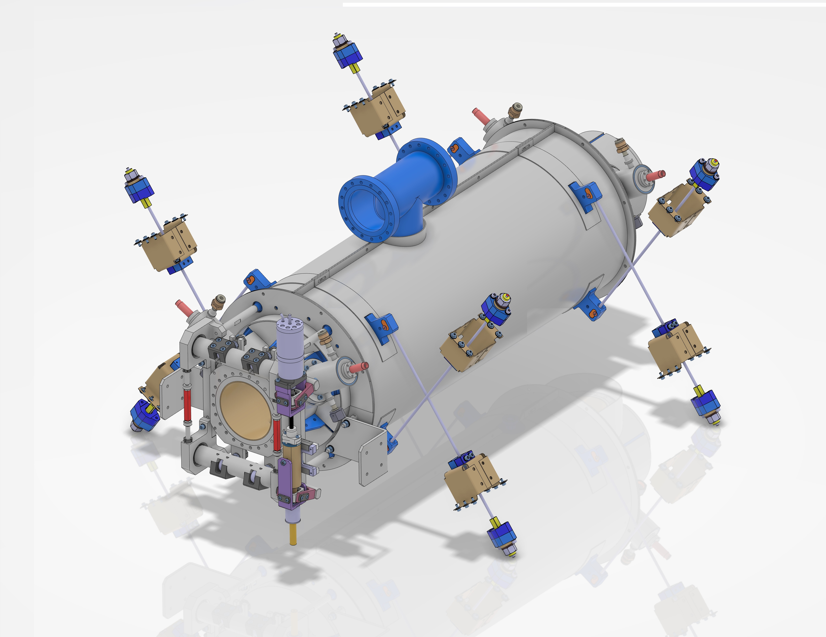
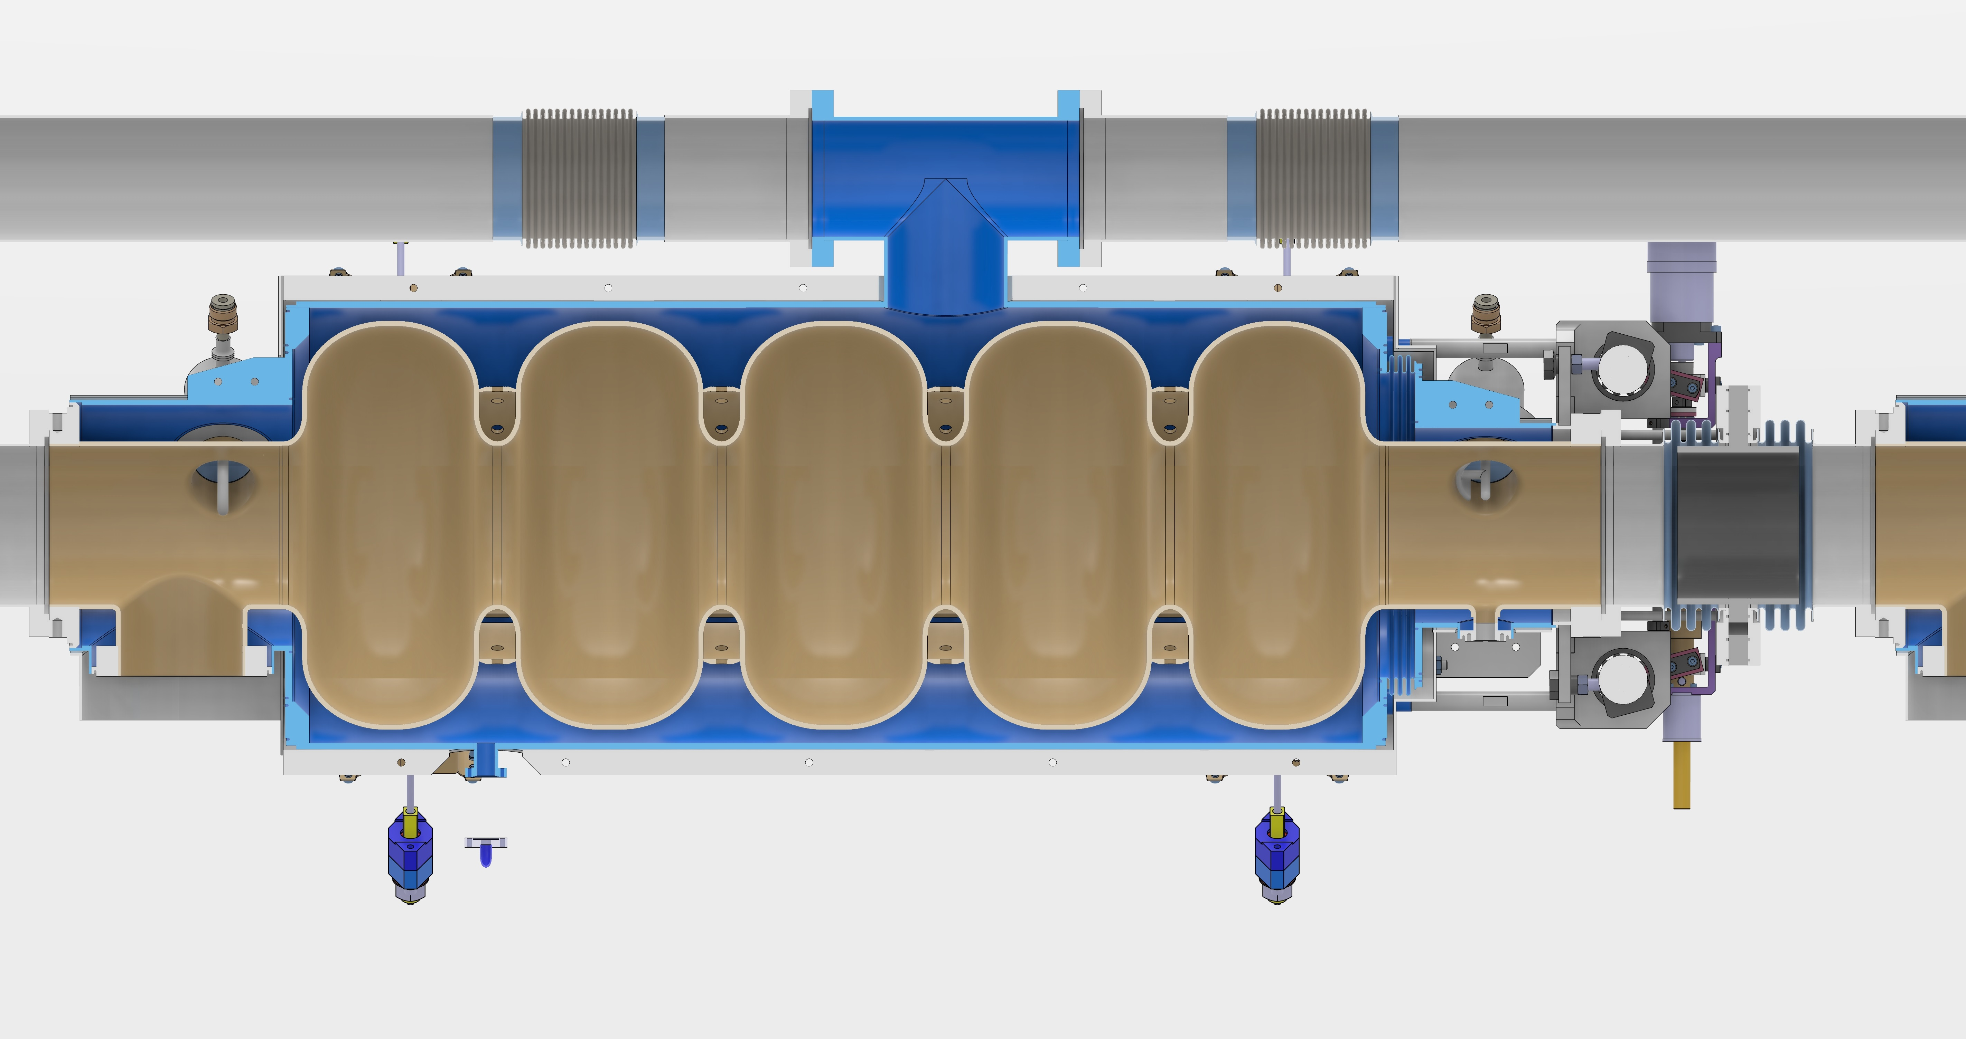
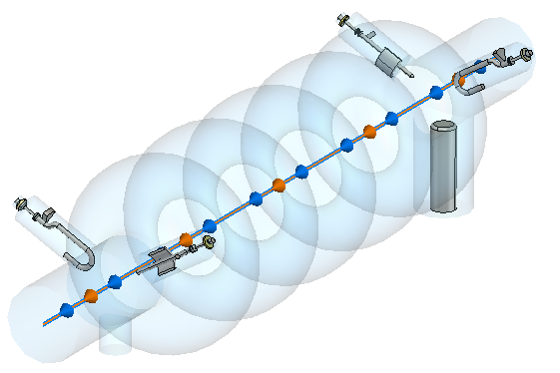
WP6 – task 6.3 Adapt the existing ESS cryomodule
New bi-phase pipe and cryogenic pipes: design started.
New tie rods system.
Integration of the HOM couplers, Cold Tuning System and beam pipe absorbers.
Action: 2nd visit to CEA Saclay to finish the inventory of existing components
Cavity string and its cryogenic piping
He output
Tie-rod
HOM couplers
_{Probe}
_{Hook}
_{Hook}
_{FPC}
_{Probe}
Tuning system
Absorber

Slide 5
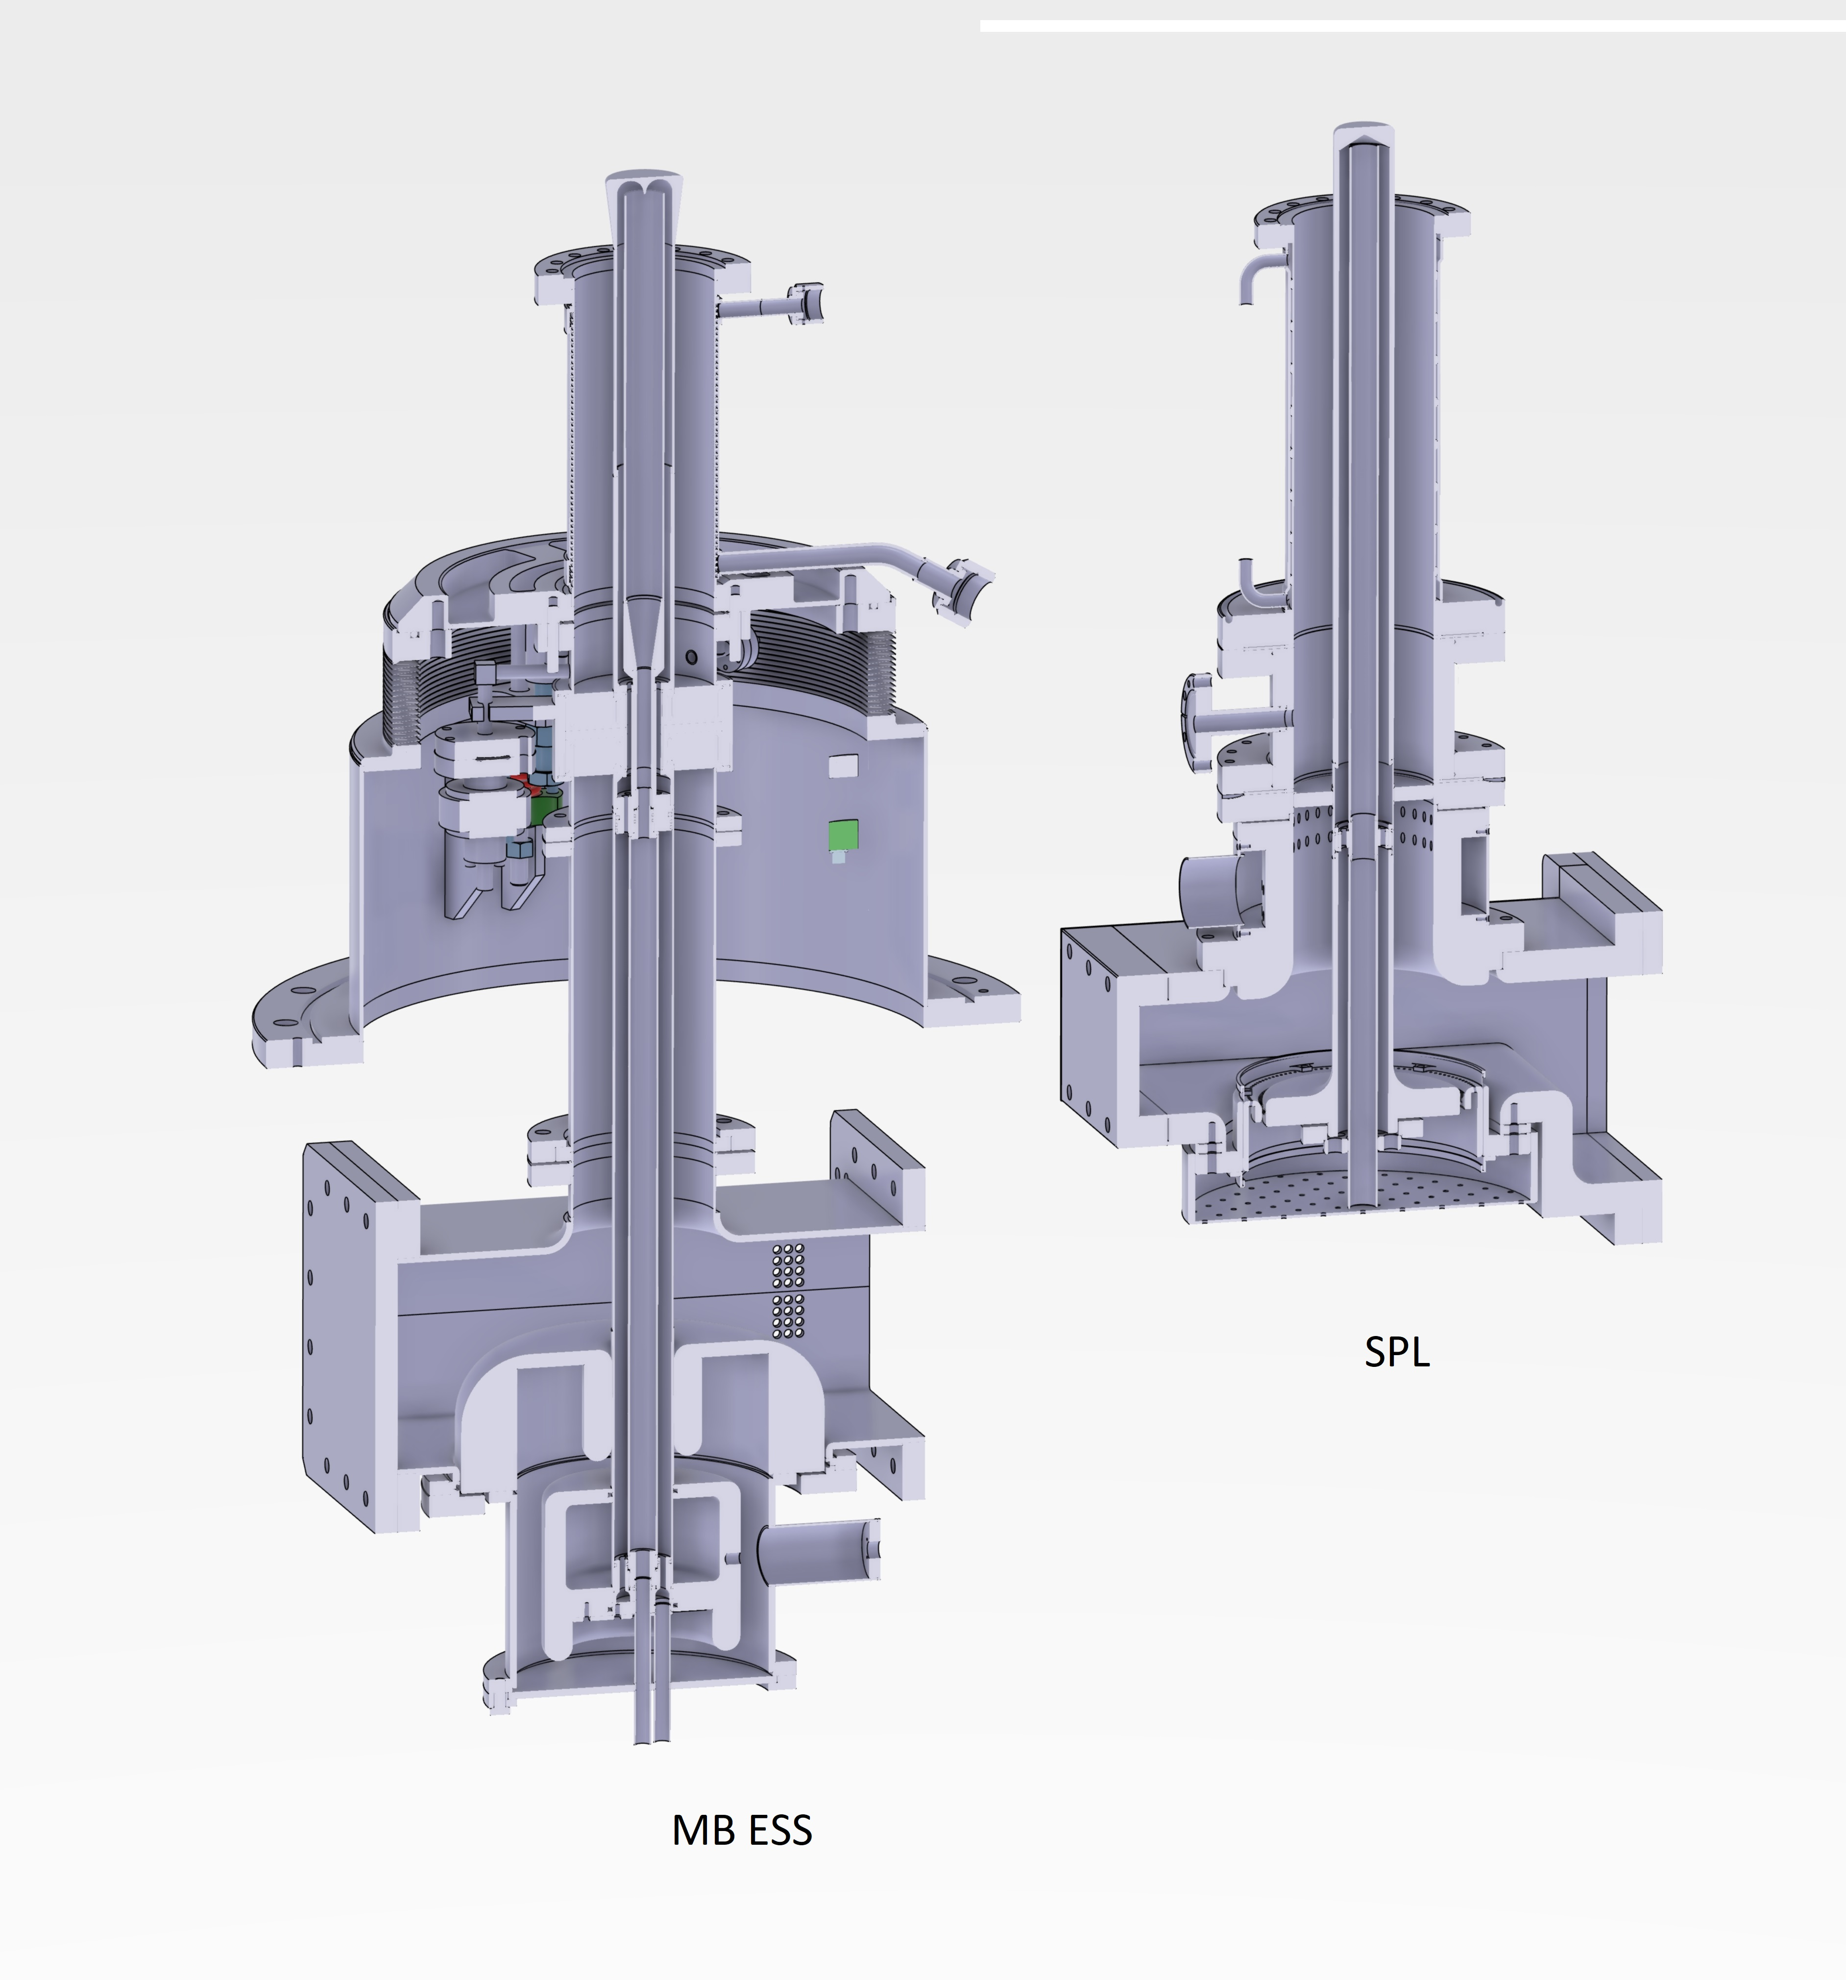
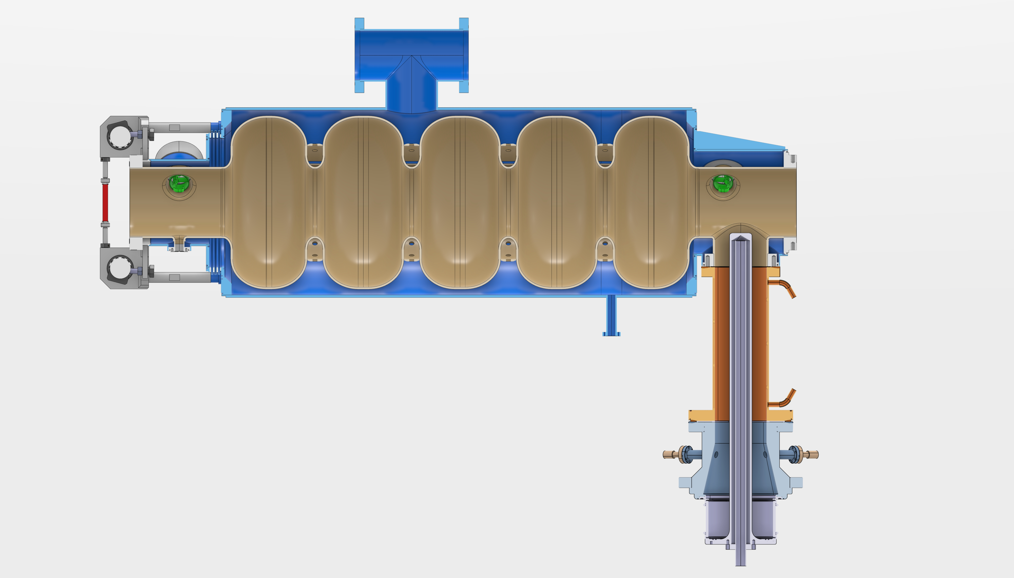

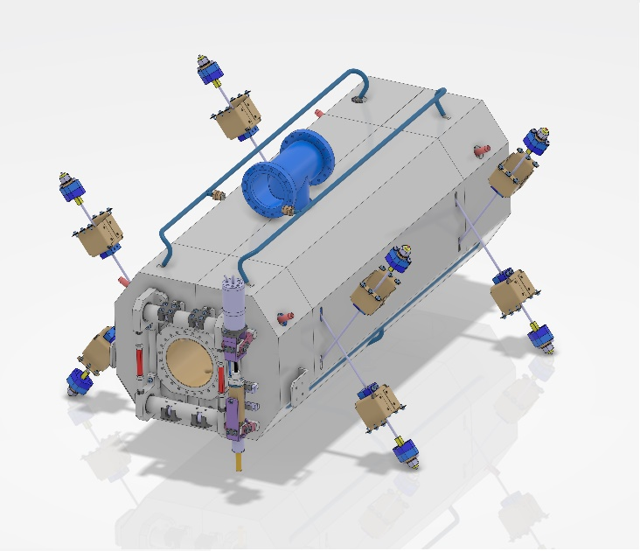
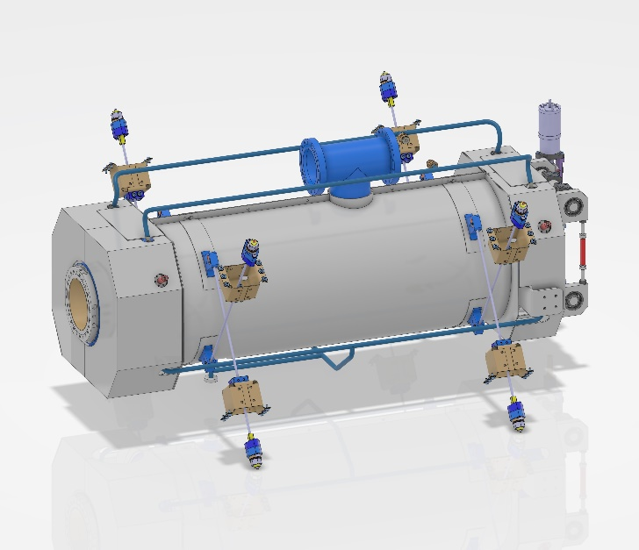
WP6 – task 6.3 Adapt the existing ESS cryomodule
Integration of the SPL Power Couplers with ESS double-wall tubes and ESS vacuum vessel interface.
Optimization of the magnetic shields
→ 2-layer seems mandatory to get B_{res}<1mG. Calculations just started.
SPL Power Coupler 704MHz
ESS Power Coupler
704MHz
« Cylindrical »
« Octogonal »
« Hybrid »

Slide 6
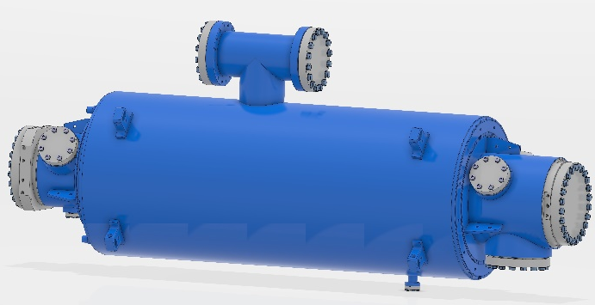
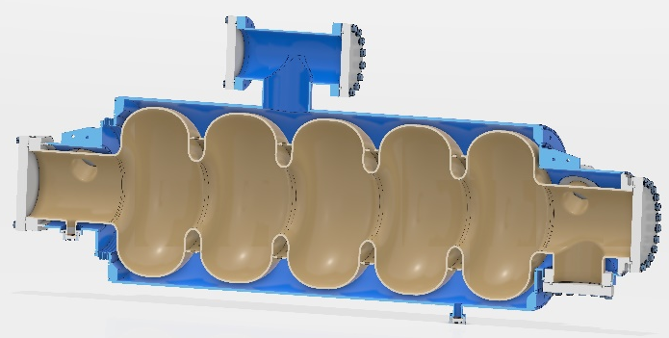
WP6 – Task 6.4: Fabrication and validation of cryomodule components
Cavities
Niobium material: ordered on October 15! Delivery lead-time: 6 months
Cavities fabrication : technical specs validated. Publication before end of October. Contract award most probably mid January. Estimated lead-time for delivery: 18 months.

Slide 7
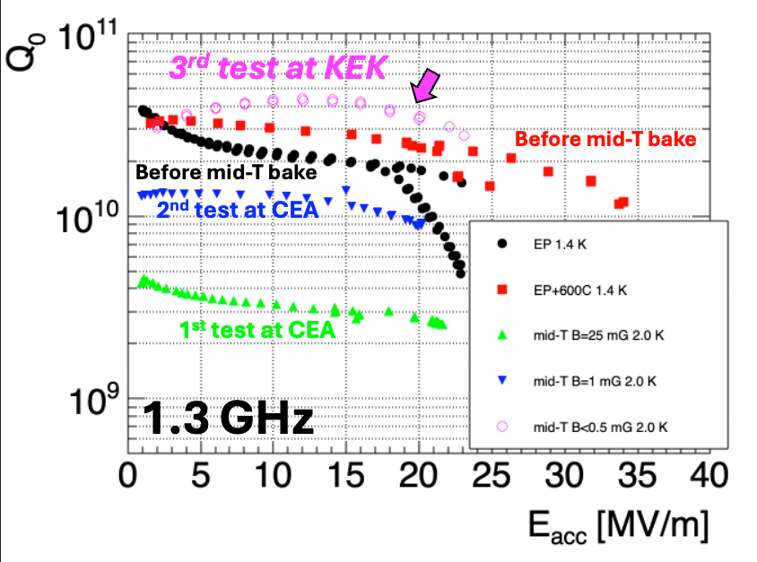
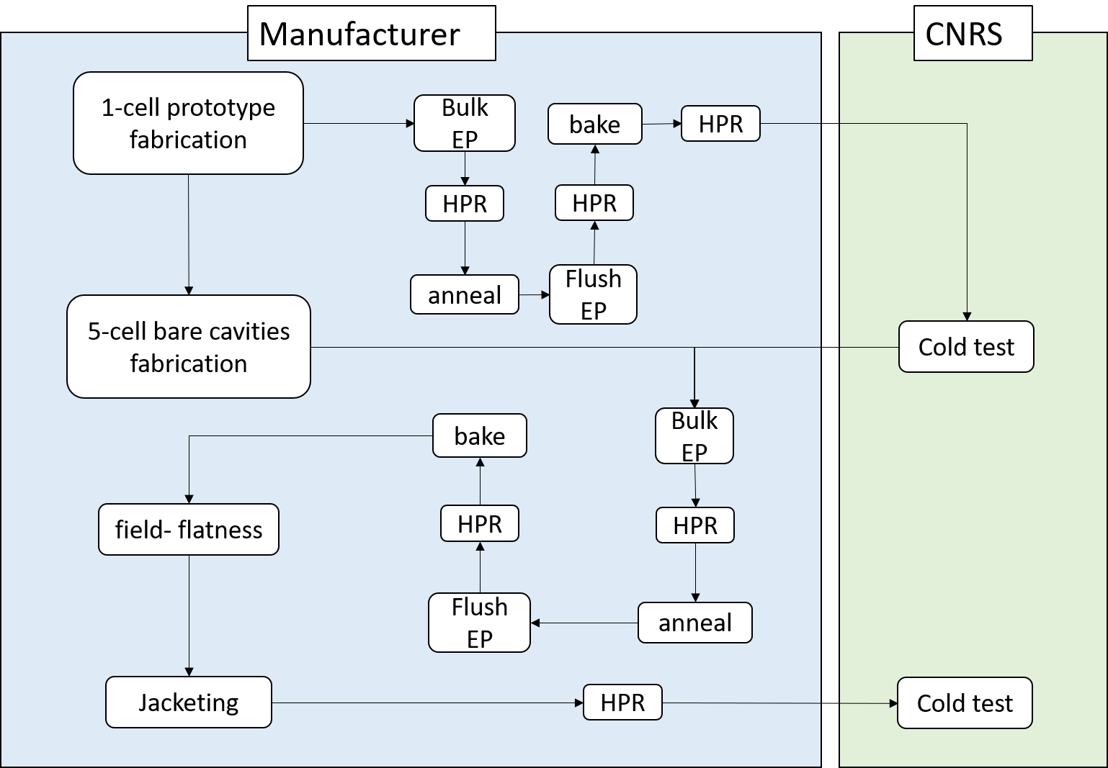
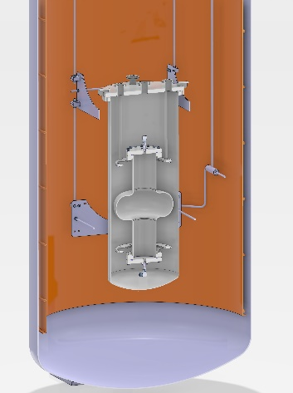
WP6 – Task 6.4: Fabrication and validation of cryomodule components
Cavities preparation plan A
Vertical test of the 1-cell bare cavity in He bath @ IJCLAB
Vertical test of the 5-cell jacketed
Cavities no He bath @ INFN Milano

Slide 8
WP6 – Task 6.4: Fabrication and validation of cryomodule components
Power couplers and HOM couplers(WP4)
→ See WP4 report.
Tuning systems
Adaptation of the MYRRHA tuner is on-going.
Not critical
Absorbers
Need to start this study quite soon.
Action: Could it be done by the post-doc?

Slide 9
WP6: points of attention
Applied to myself: plan more meetings in advance.
With WP4
Key decision on possible 2 major changes
  Do not perform the RF power couplers conditioning. PROs: performances already validated with RF couplers conditioned up to x2 the requested power level for iSAS. Save time (no coupling box study and fabrication, no conditioning test to perform). CONs: risk of pollution during the RF conditioning directly on the cryomodule?
  Include additional HOM couplers (x12) now...PROs: save time (no call for tender needed)
- Start soon the hiring process of the post-doc (to work on beam pipe absorbers? → TBD).

Slide 10
WP6 – Task 6.5: Assembly and test of adapted cryomodule
Status
• Clean room assembly of the cavity string and cryostating phase.
Not started
• Preparation of the test stand.
Not started
• Cryogenic and RF test of the cryomodule.
Not started
Action:
Start to check the interfaces, especially the cryo (cryomodule-to-valve box)and RF connexions (waveguides-to-couplers)

Slide 11
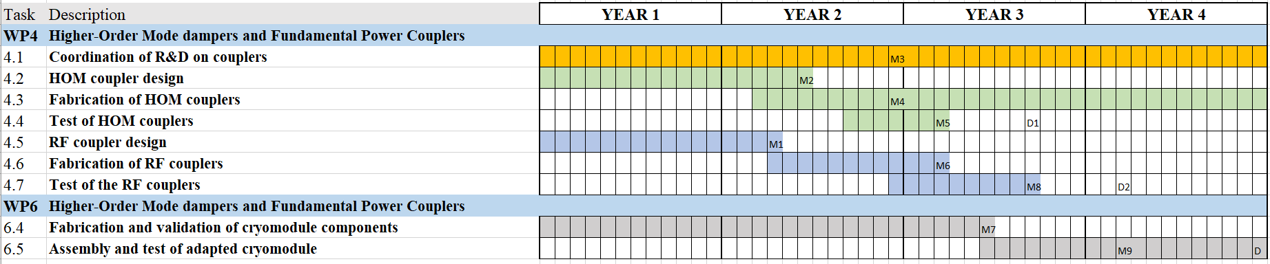
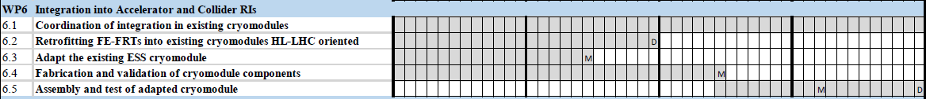
WP6 : plans to achieve milestones & deliverables
Planning
Oct 2024
Milestones
M6.1
August 2025
M6.2
April 2026
M6.3
January 2027
Deliverables

Slide 12
WP6 : plans to achieve milestones & deliverables
April 2026
M6.2
None on the critical path
August 2025
January 2027
M6.1
M6.3
M6.2
expected
M6.1
expected
M6.3
expected

Slide 13
WP1: budget plans
Niobium purchase: 333k€

