Slide 1
iSAS Steering committee meeting
18th October, 2024

Slide 2
iSAS Steering Committee meeting
Agenda
Objectives
To review WP progress & to discuss the scientific coordination of the project
To facilitate cross-coordination between WP
Agenda items
Report from the Coordination Panel - 10 min
Reports from WPs – 10 min each WP
Notes will be found in the meeting Indico page (WP status report template enclosed)
iSAS project Indico page

Slide 3
iSAS Steering Committee meeting
iSAS organisation
The Coordination panel, who leads the scientific coordination of the project, meets every 6 weeks
Every other meeting becomes a Steering committee to review WP progress in cross-coordination with WP Leaders & Deputies, every trimester
Update: Giovanni Bisoffi, Deputy Scientific Coordinator on the iSAS Coordination panel for INFN, will join the team of the Italian proposal for the Einstein Telescope and will hand over his Coordination panel responsibilities to Cristian Pira, who is also iSAS WP3 Leader
Thank you Giovanni for your participation to the iSAS project

Slide 4
iSAS Governing Board meeting

Slide 5
iSAS Steering Committee meeting
Advisory Board
Advisory Board members welcome into the project
Meeting on 20th September at 10 am CET
Mandated: Frederick Bordry (Chair)
Roberto Losito (CERN)
Eugenio Nappi (TIARA)
Maxim Titov (LDG)
Declined: Caterina Biscari (LEAPS)
Pending mandate: 4th member (LEAPS)

Slide 6
iSAS Steering Committee meeting
Consortium agreement
Consortium Agreement (CA) in progress
Comments & questions phase
Until 4th November for the Governing Board meeting
Commented: CERN
CEA
HZB
INFN
EPFL
Pending comments: ESS
DESY
VUB
UKRI
Lancaster University

Slide 7
iSAS Steering Committee meeting
Governing Board
Governing Board next meeting
4th November at 2 pm CET
Member nominated: CNRS UKRI
CERN Lancaster Univ ESS EPFL DESY
VUB
CEA
HZB
INFN
Pending nomination: Accelerators and Cryogenic Systems
Research Instruments GmbH
Cryoelectra GmbH
TFE SRL
Zanon Research & Innovation SRL
Euclid Techlabs LLC

Slide 8
iSAS Steering Committee meeting
Decision on the integration of 3 new partners
Nikhef (The Netherlands)
Riga Technical University (RTU) (Latvia)
Institute of Nuclear Physics (IFJ PAN) (Poland)
Roles/tasks
RTU in WP4
IFJ PAN in WP6
Amendment to integrate them (if validation from Governing Board) to be finalised in November

Slide 9
iSAS Steering Committee meeting
Padova meeting in March 2025
Context
Hosted at LNL, INFN, Padova
From Wednesday 12th to Friday 14th (including travel)
Advisory Board, Industry Board & Governing Board organised at the same time
Visit of LNL to anticipate
Proposal:
"It may be too early now to talk about the organization of the workshop, but in the meantime, I anticipate an idea that has come to me to optimize the schedule compared to the previous edition in Paris. I suggest to anticipate the individual WP meetings at the beginning of the meeting (the first day or first half day), as if they were separate events from the rest of the program. Each WP leader decides whether and how to organize the agenda, with the local organization taking charge of the logistics of the rooms and coffee breaks. Then, on the second day, the plenary session meeting begins. In this way, those who are not involved in WP meetings can optimize travel, and then during the meeting it is possible to optimize the reporting of individual WPs by directly incorporating the outcomes from the parallel meetings of the day before into the main talk”

Slide 10
iSAS Steering Committee meeting
Internal communication
Internal communication plan
Due project month 6 – August 2024
Milestones: Internal communication plan (WP9 M#31) accounted for

Slide 11
External relations
M. Baylac (CNRS-LPSC)

Slide 12
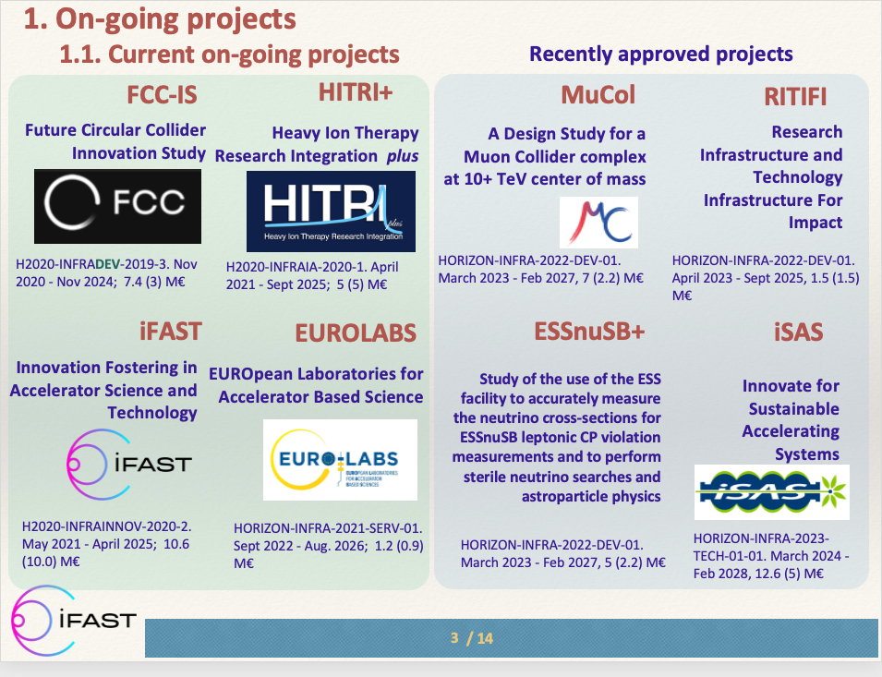
Relations with EU projects
Test Infrastructure and Accelerator Research Area (TIARA)
Presentation of future Horizon Europe projects for Accelerators
iSAS considered as one of the flagship project
Innovation Fostering in Accelerator Science and Technology (IFAST)
Presentation of 3 EU projects at the annual IFAST meeting (April)
TIARA
AMICI
IFAST
Collaboration with the future program, IFAST2, to be considered
J.M. Perez (chair of TIARA), presentation at the IFAST annual meeting (April 2024)

Slide 13
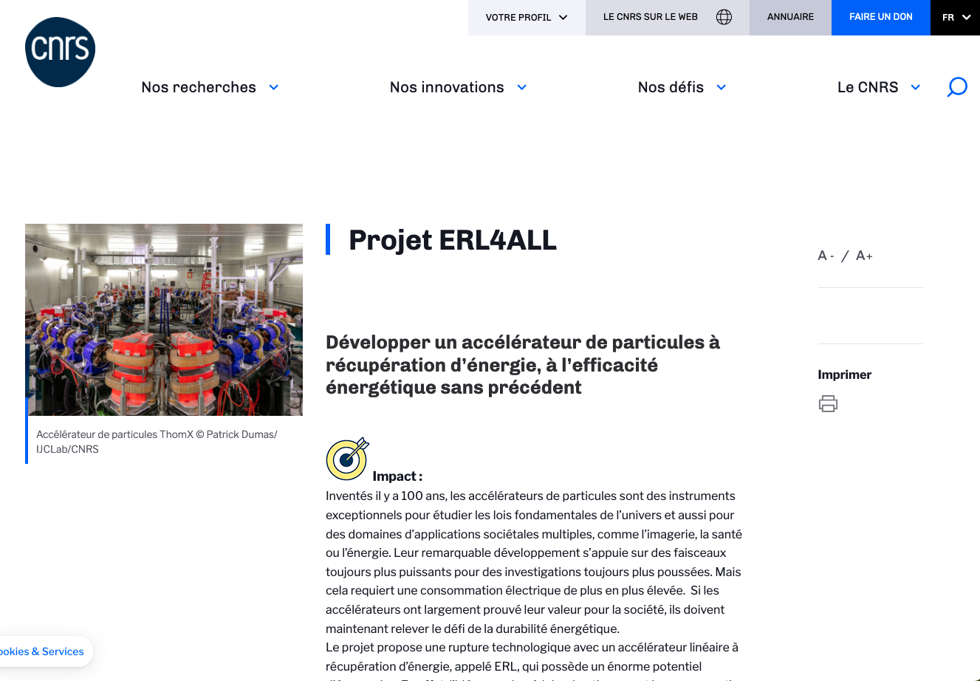
Relations at national level
New budget granted for the PERLE ERL
High risk and impact research program, funded by French ministry through research organization, including CNRS
12 projects within CNRS nationwide (2 within IN2P3)
Project ERL4ALL to finance the PERLE injector

Slide 14
iSAS Steering Committee meeting
With WP7 - Integration into industrial solutions
iSAS Repository host at STFC
Feedback pending from WP7 to finalize the repository structure
iSAS website - industrial section
A website task force created to:
Phase 1: create a finalized skeleton (layout design)
Phase 2: create the added contents (from 12th November)
Industry Board
1st Industry Board to be held 30th October
Milestones: Decision on iSAS repository and its implementation (WP7 M#25) Delayed
Deliverables: Creation of website for the iSAS - industrial section (WP7 D#22) due month 10

Slide 15
iSAS Steering Committee meeting
Work plan
Up to date with Milestones & Deliverables status by timeline for the 1st project year:

Slide 16
Thank you!

