Slide 1
EICROC0 Measurements update
06/17/2024
Adrien Verplancke

Slide 2
Summary
Test setup
S-Curves
ADC
TDC
Conclusion

Slide 3
Test setup : EICROC0 cards
“Classical” test setup with FPGA + EICROC0 PCBs
2 flavors of cards used
  EICROC0 2.2 (ASIC with no sensor)
  EICROC0 2.3B (ASIC with sensor)
  Both cards are from the latest batches of PCBs
Latest firmware (with 160MHz clock fix)
EICROC0 2.2 plots shown for correction values @ 5 fC
EICROC0 2.3B plots shown for correction values @ 5 fC
  Sensor is depleted

Slide 4
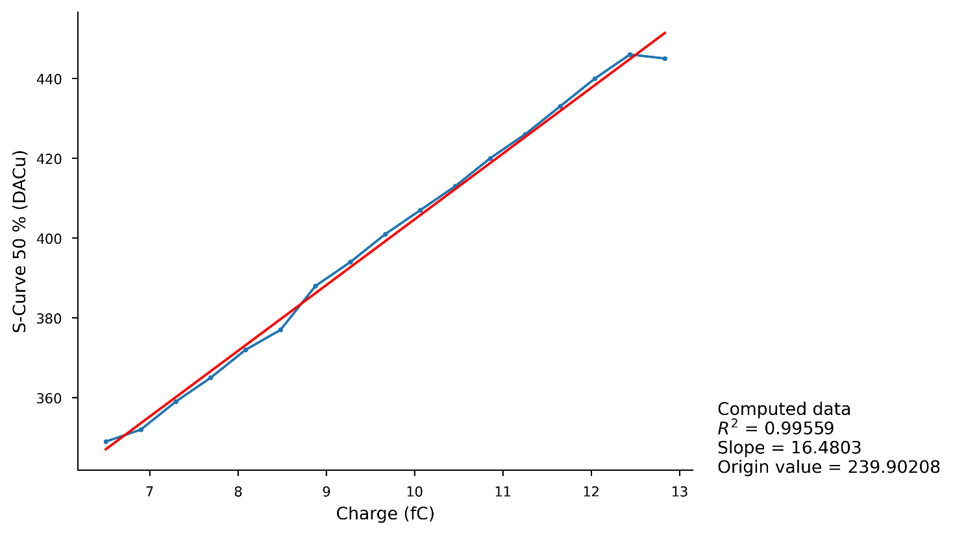
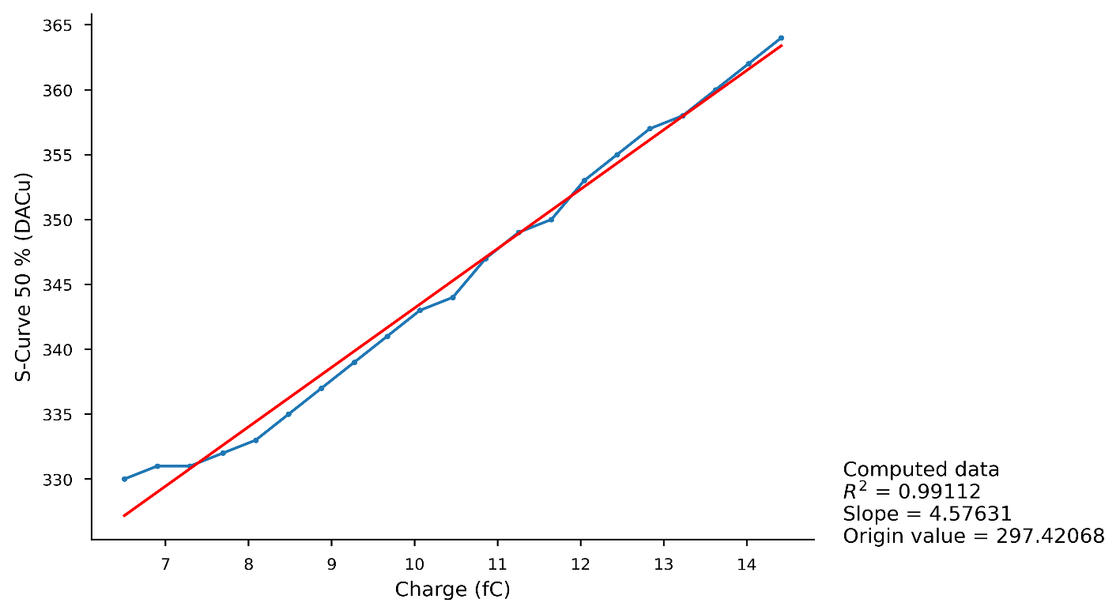
Channel linearity for channel 0
c_{P} = 1
c_{D} = 00 (all channels)
With Sensor
Without Sensor
c_{P} = 1
c_{D} = 00 (all channels)

Slide 5
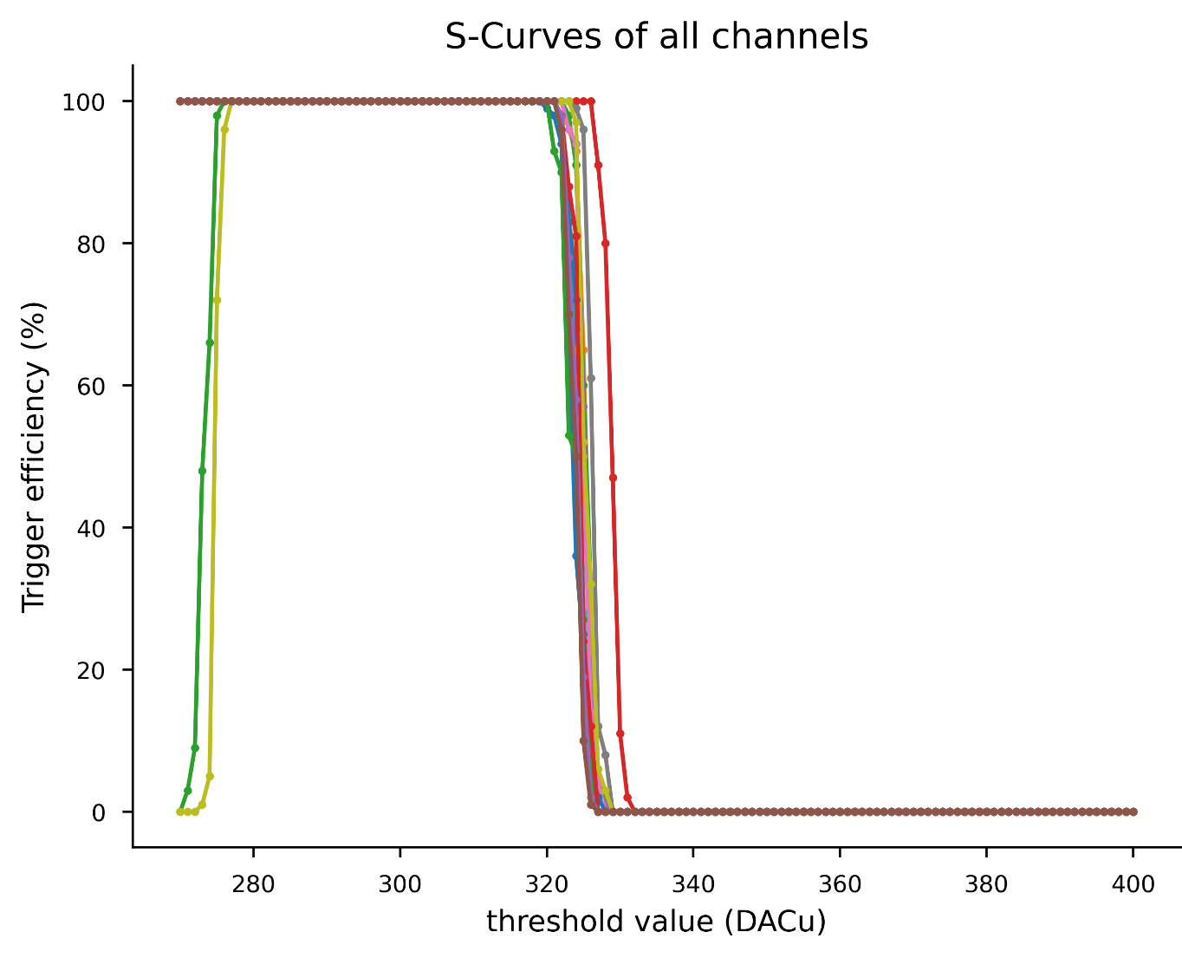
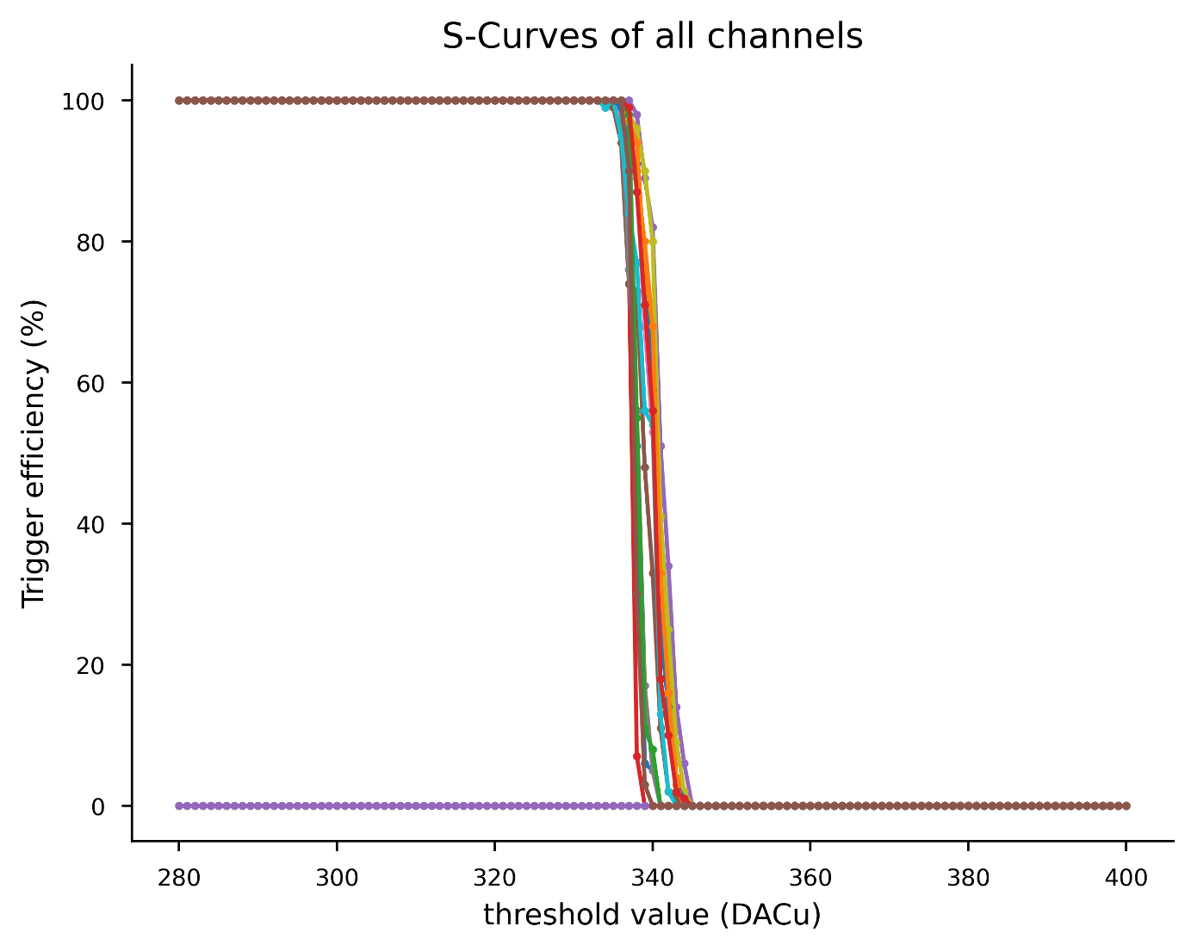
S-Curves @ 5 fC
Without Sensor
c_{P} = 1
c_{D} = 00 (all channels)
With Sensor

Slide 6
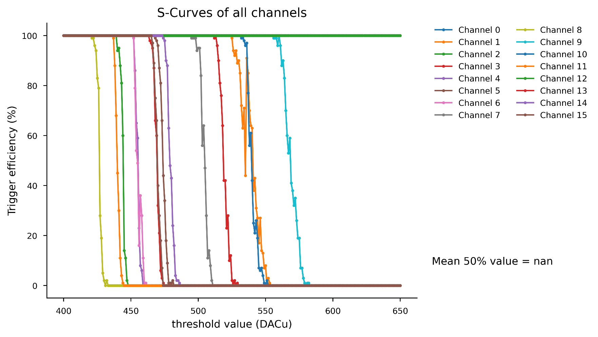
S-Curves @ 25 fC
Large spread of S-Curves
Correction values are not adapted for the whole charge range
Without Sensor
c_{P} = 1
c_{D} = 00 (all channels)

Slide 7
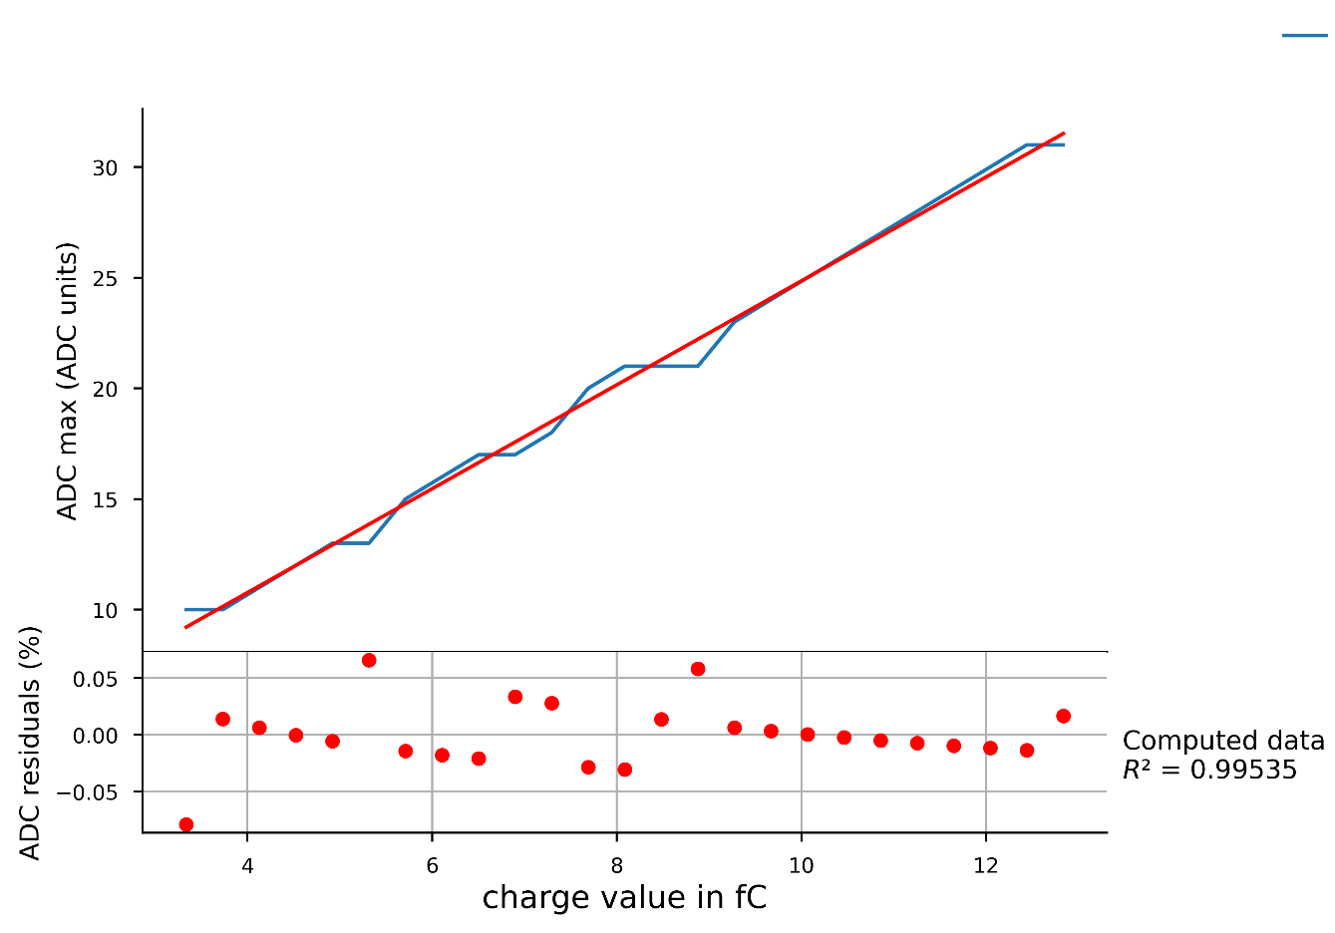
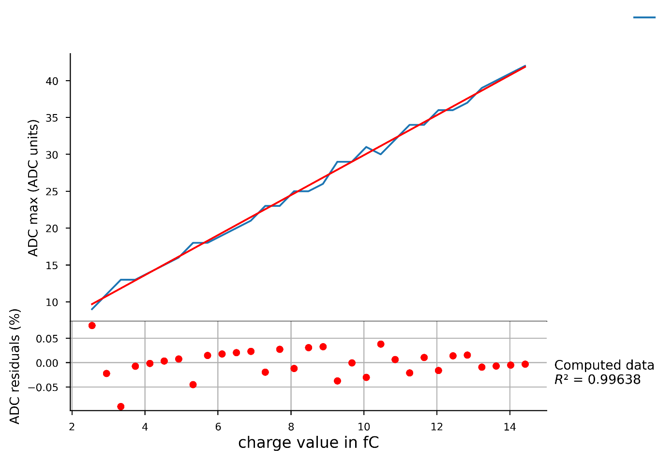
ADC : Channel 0
Without Sensor
With Sensor
c_{P} = 1
c_{D} = 00 (all channels)

Slide 8
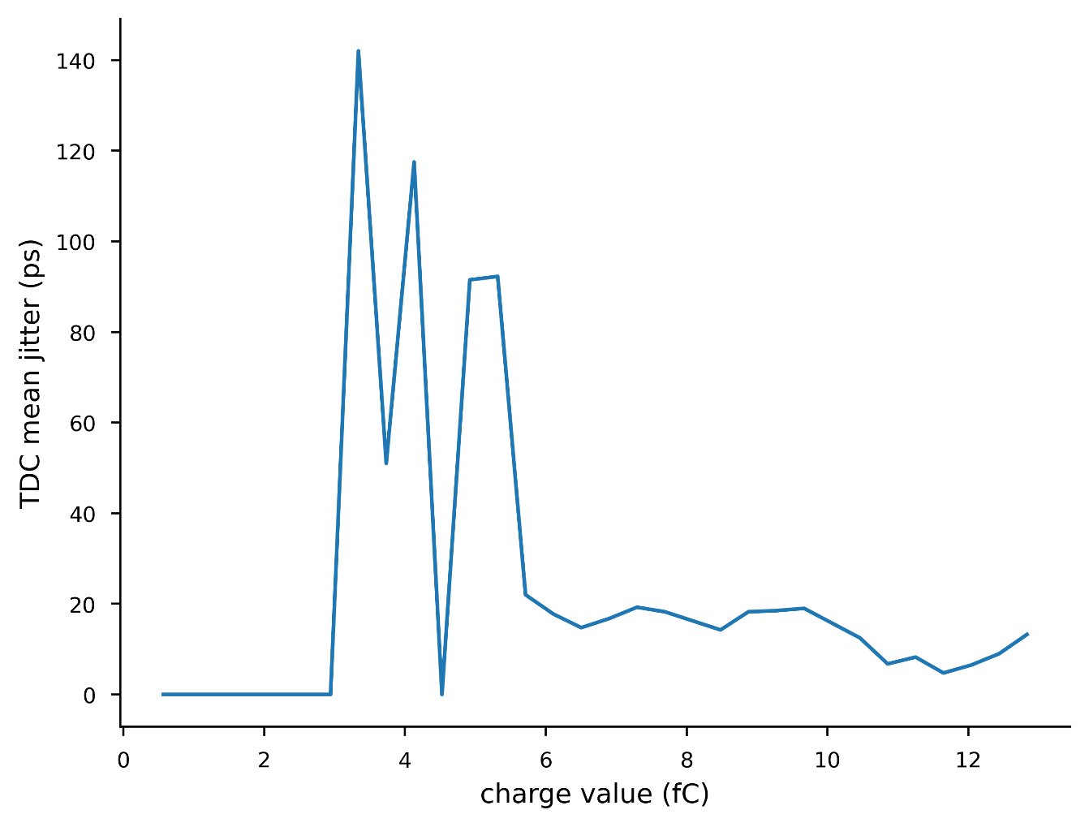
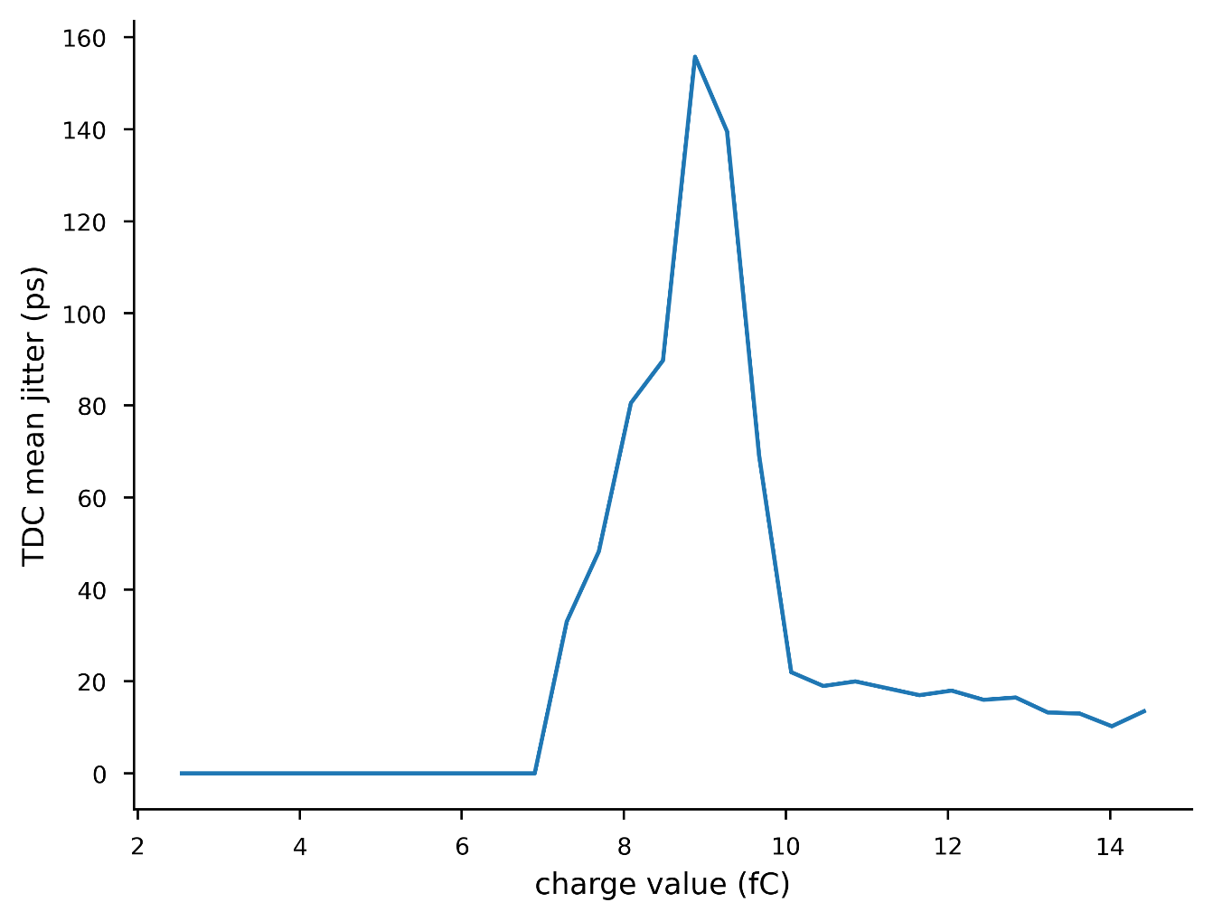
TDC
Without Sensor
c_{P} = 1
c_{D} = 00 (all channels)
With Sensor

Slide 9
Conclusion
Good performance without sensor
Issues to fix :
  Correction values not uniform for entire charge range
  TDC “artefacts”
  ASIC can’t handle large amounts of data

