Slide 1
Beam driven plasma components
Plasma components & systems for EuPRAXIA
27 – 28 January 2025, Desy Hamburg
Angelo Biagioni
On behalf of the Sparc_lab collaboration

Slide 2
Outline
EuPRAXIA@SPARC_LAB design
Plasma components and systems
Long plasma sources (R. Demitra)
Materials (R. Demitra)
HV voltage sources design
Plasma lenses applications (M. Carillo)
A. Biagioni | Plasma components & systems for EuPRAXIA | 27 – 28 January 2025, Desy Hamburg 5

Slide 3
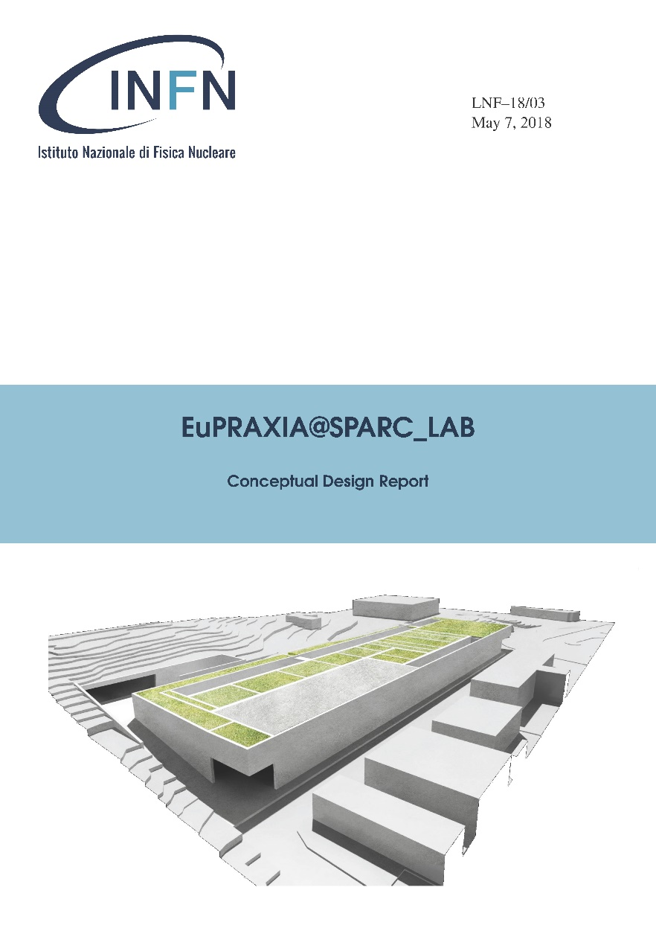
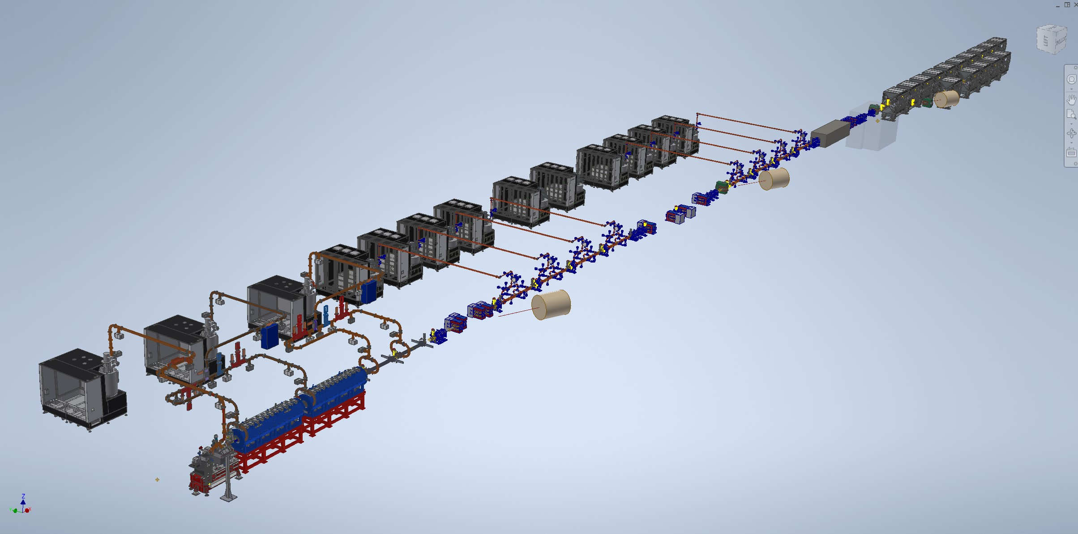
EuPRAXIA_Preparatory Phase
EuPRAXIA@SPARC_LAB (1 – 5 GeV)
FEL
Users
Particle-driven
wakefield acceleration
Plasma module
X-band linac
EuPRAXIA at LNF-INFN (Site 1)
Sparc-like photo injector
Laser-driven
wakefield acceleration
EuPRAXIA at ELI-Beamlines or EPAC or Pisa or Salamanca…(site 2)
Distributed RI
2 FEL Construction Sites
Several Excellence Centers
A. Biagioni | Plasma components & systems for EuPRAXIA | 27 – 28 January 2025, Desy Hamburg 5

Slide 4
Outline
A. Biagioni | Plasma components & systems for EuPRAXIA | 27 – 28 January 2025, Desy Hamburg 5

Slide 5
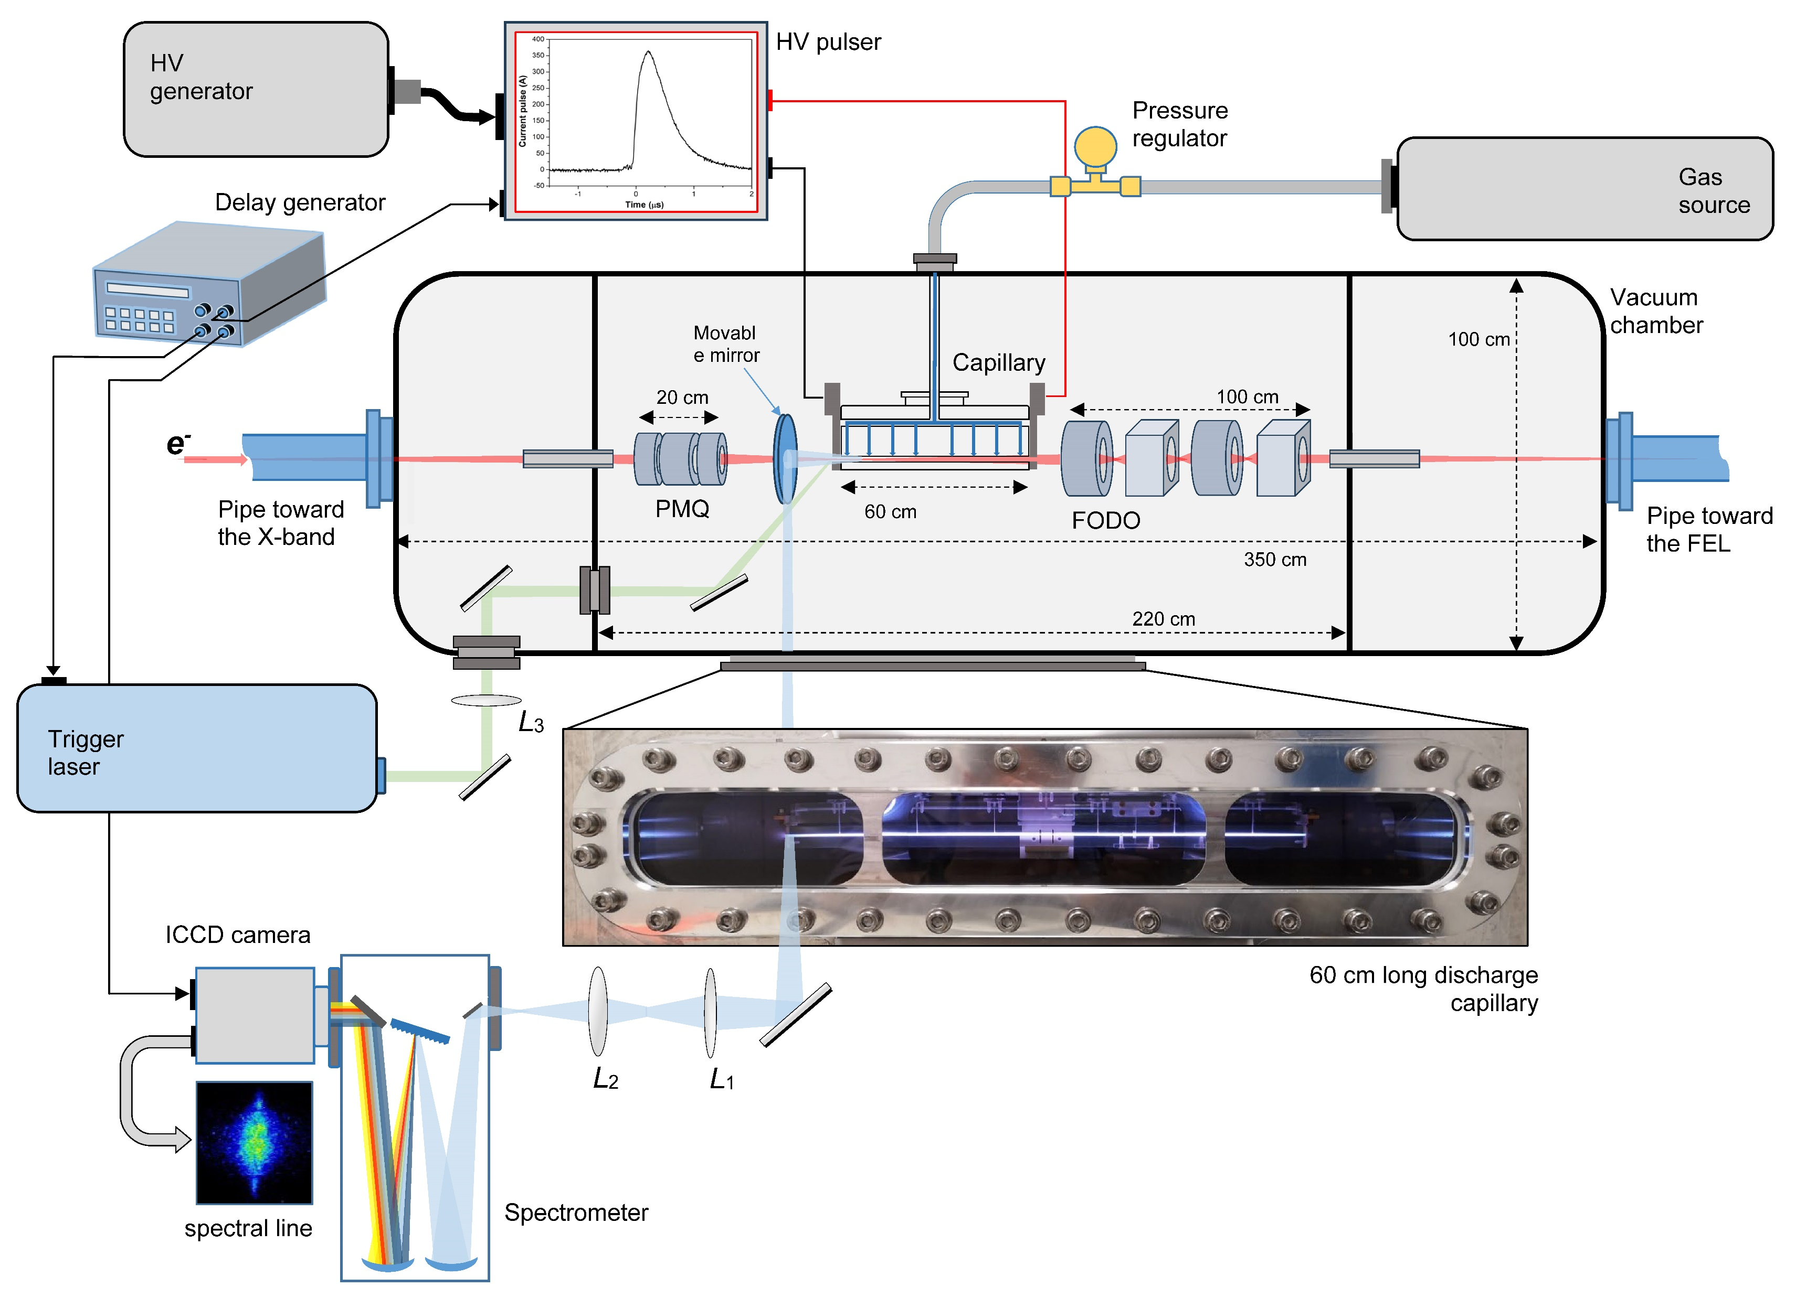
Plasma components for EuPRAXIA@SPARC_LAB
Plasma accelerating module for EuPRAXIA@SPARC_LAB
Direct plasma discharge for 60cm long capillary
Plasma stability
Longitudinal profiles
Plasma sources operating at 100 – 400 Hz
Vacuum system requirements (neutral gas)
Capillary’s longevity
High-voltage sources for plasma formation
Plasma diagnostics
Focusing and extraction system
A. Biagioni | Plasma components & systems for EuPRAXIA | 27 – 28 January 2025, Desy Hamburg 5

Slide 6
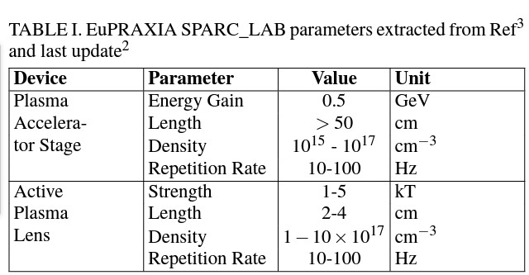
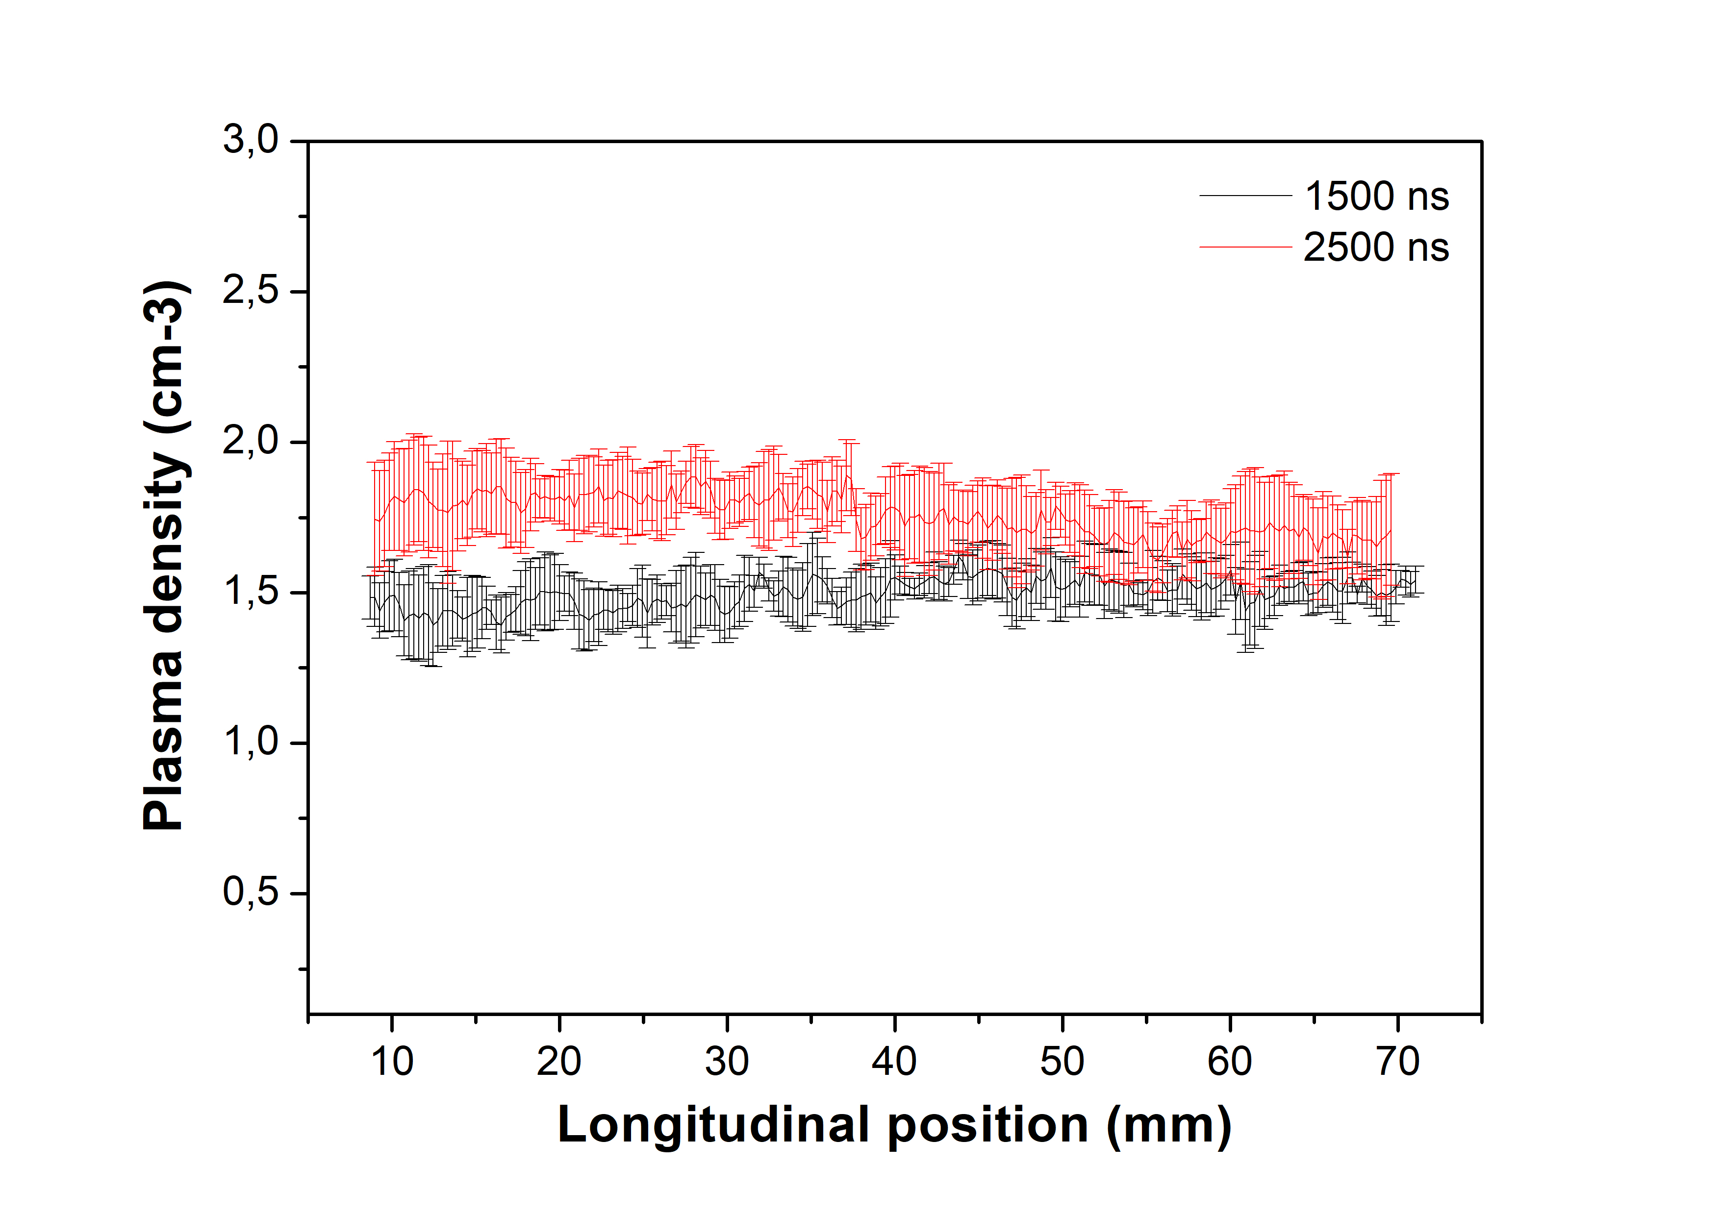
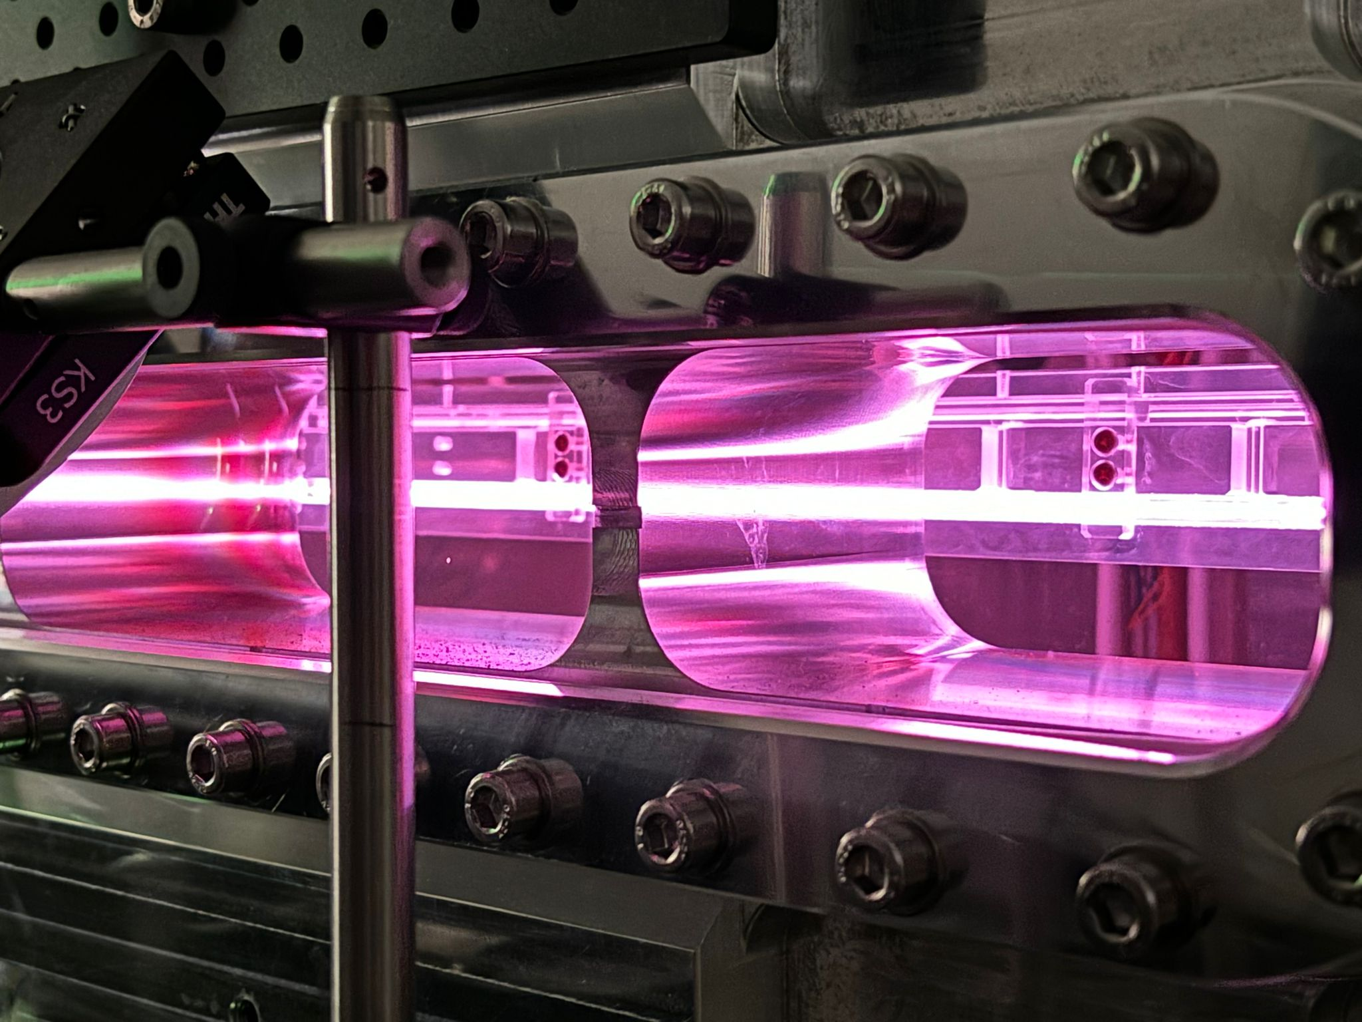
Outline
1.1 GeV (1 GV/m 60cm capillary - density 10¹⁶ cm-3)
100-400 Hz
Fabrication by machining
10 increasing diameter
Density range 10¹⁶ -10¹⁷ cm⁻³
13 kV with 500 A
100 Hz rep Rate (nominal value)
10¹⁷
A. Biagioni | Plasma components & systems for EuPRAXIA | 27 – 28 January 2025, Desy Hamburg 5

Slide 7
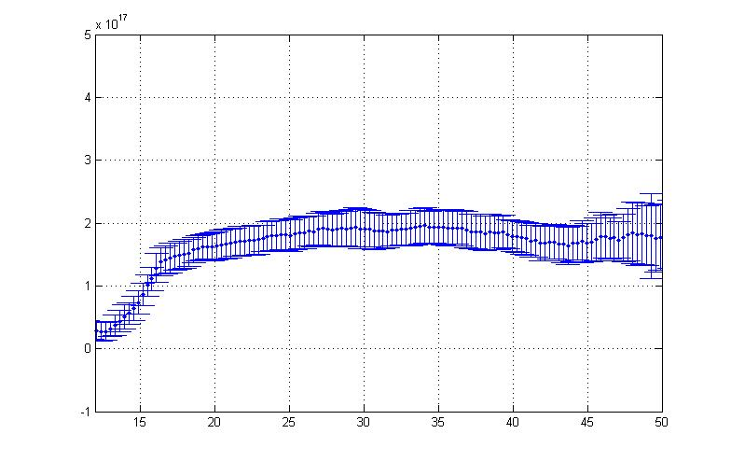
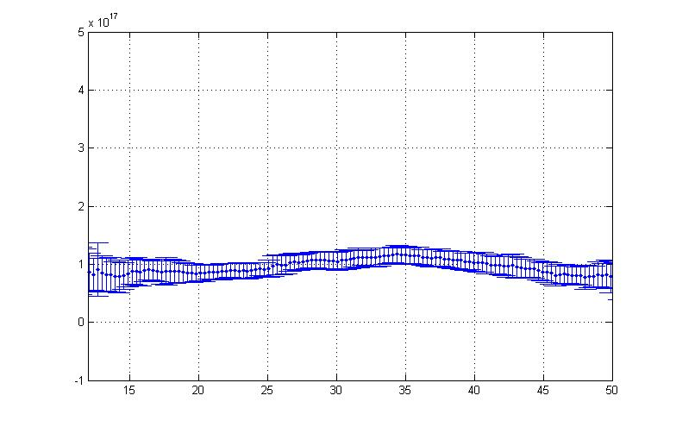
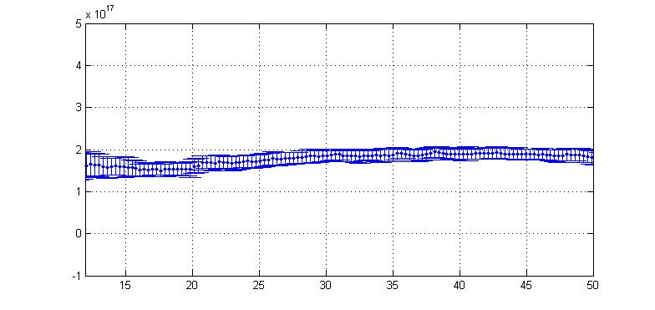
Plasma lenses applicaitons
Plasma lenses for Focusing
Plasma lenses for driver/witness separation
Lens ON Acc ON Lens ON
Acc-200A
Lens-500A
A. Biagioni | Plasma components & systems for EuPRAXIA | 27 – 28 January 2025, Desy Hamburg 5

Slide 8
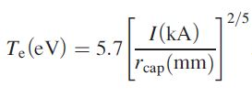
Outline
To operate at high repetition rate with gas-filled capillary-discharge the key point is the thermal dissipation
3D plastic materials
Sapphire
Ceramics
10⁵ shots/1 Hz
7x10⁴ shots/30 Hz
150 Hz repetition rate discharges 2x10⁷ shots No damages observed
~ 4 eV
q $=−k\left(T\right) ∇T$
40 W/mK at 25°C Sapphire
93 W/mK at 25°C Ceramics
k
A. Biagioni | Plasma components & systems for EuPRAXIA | 27 – 28 January 2025, Desy Hamburg 5

Slide 9
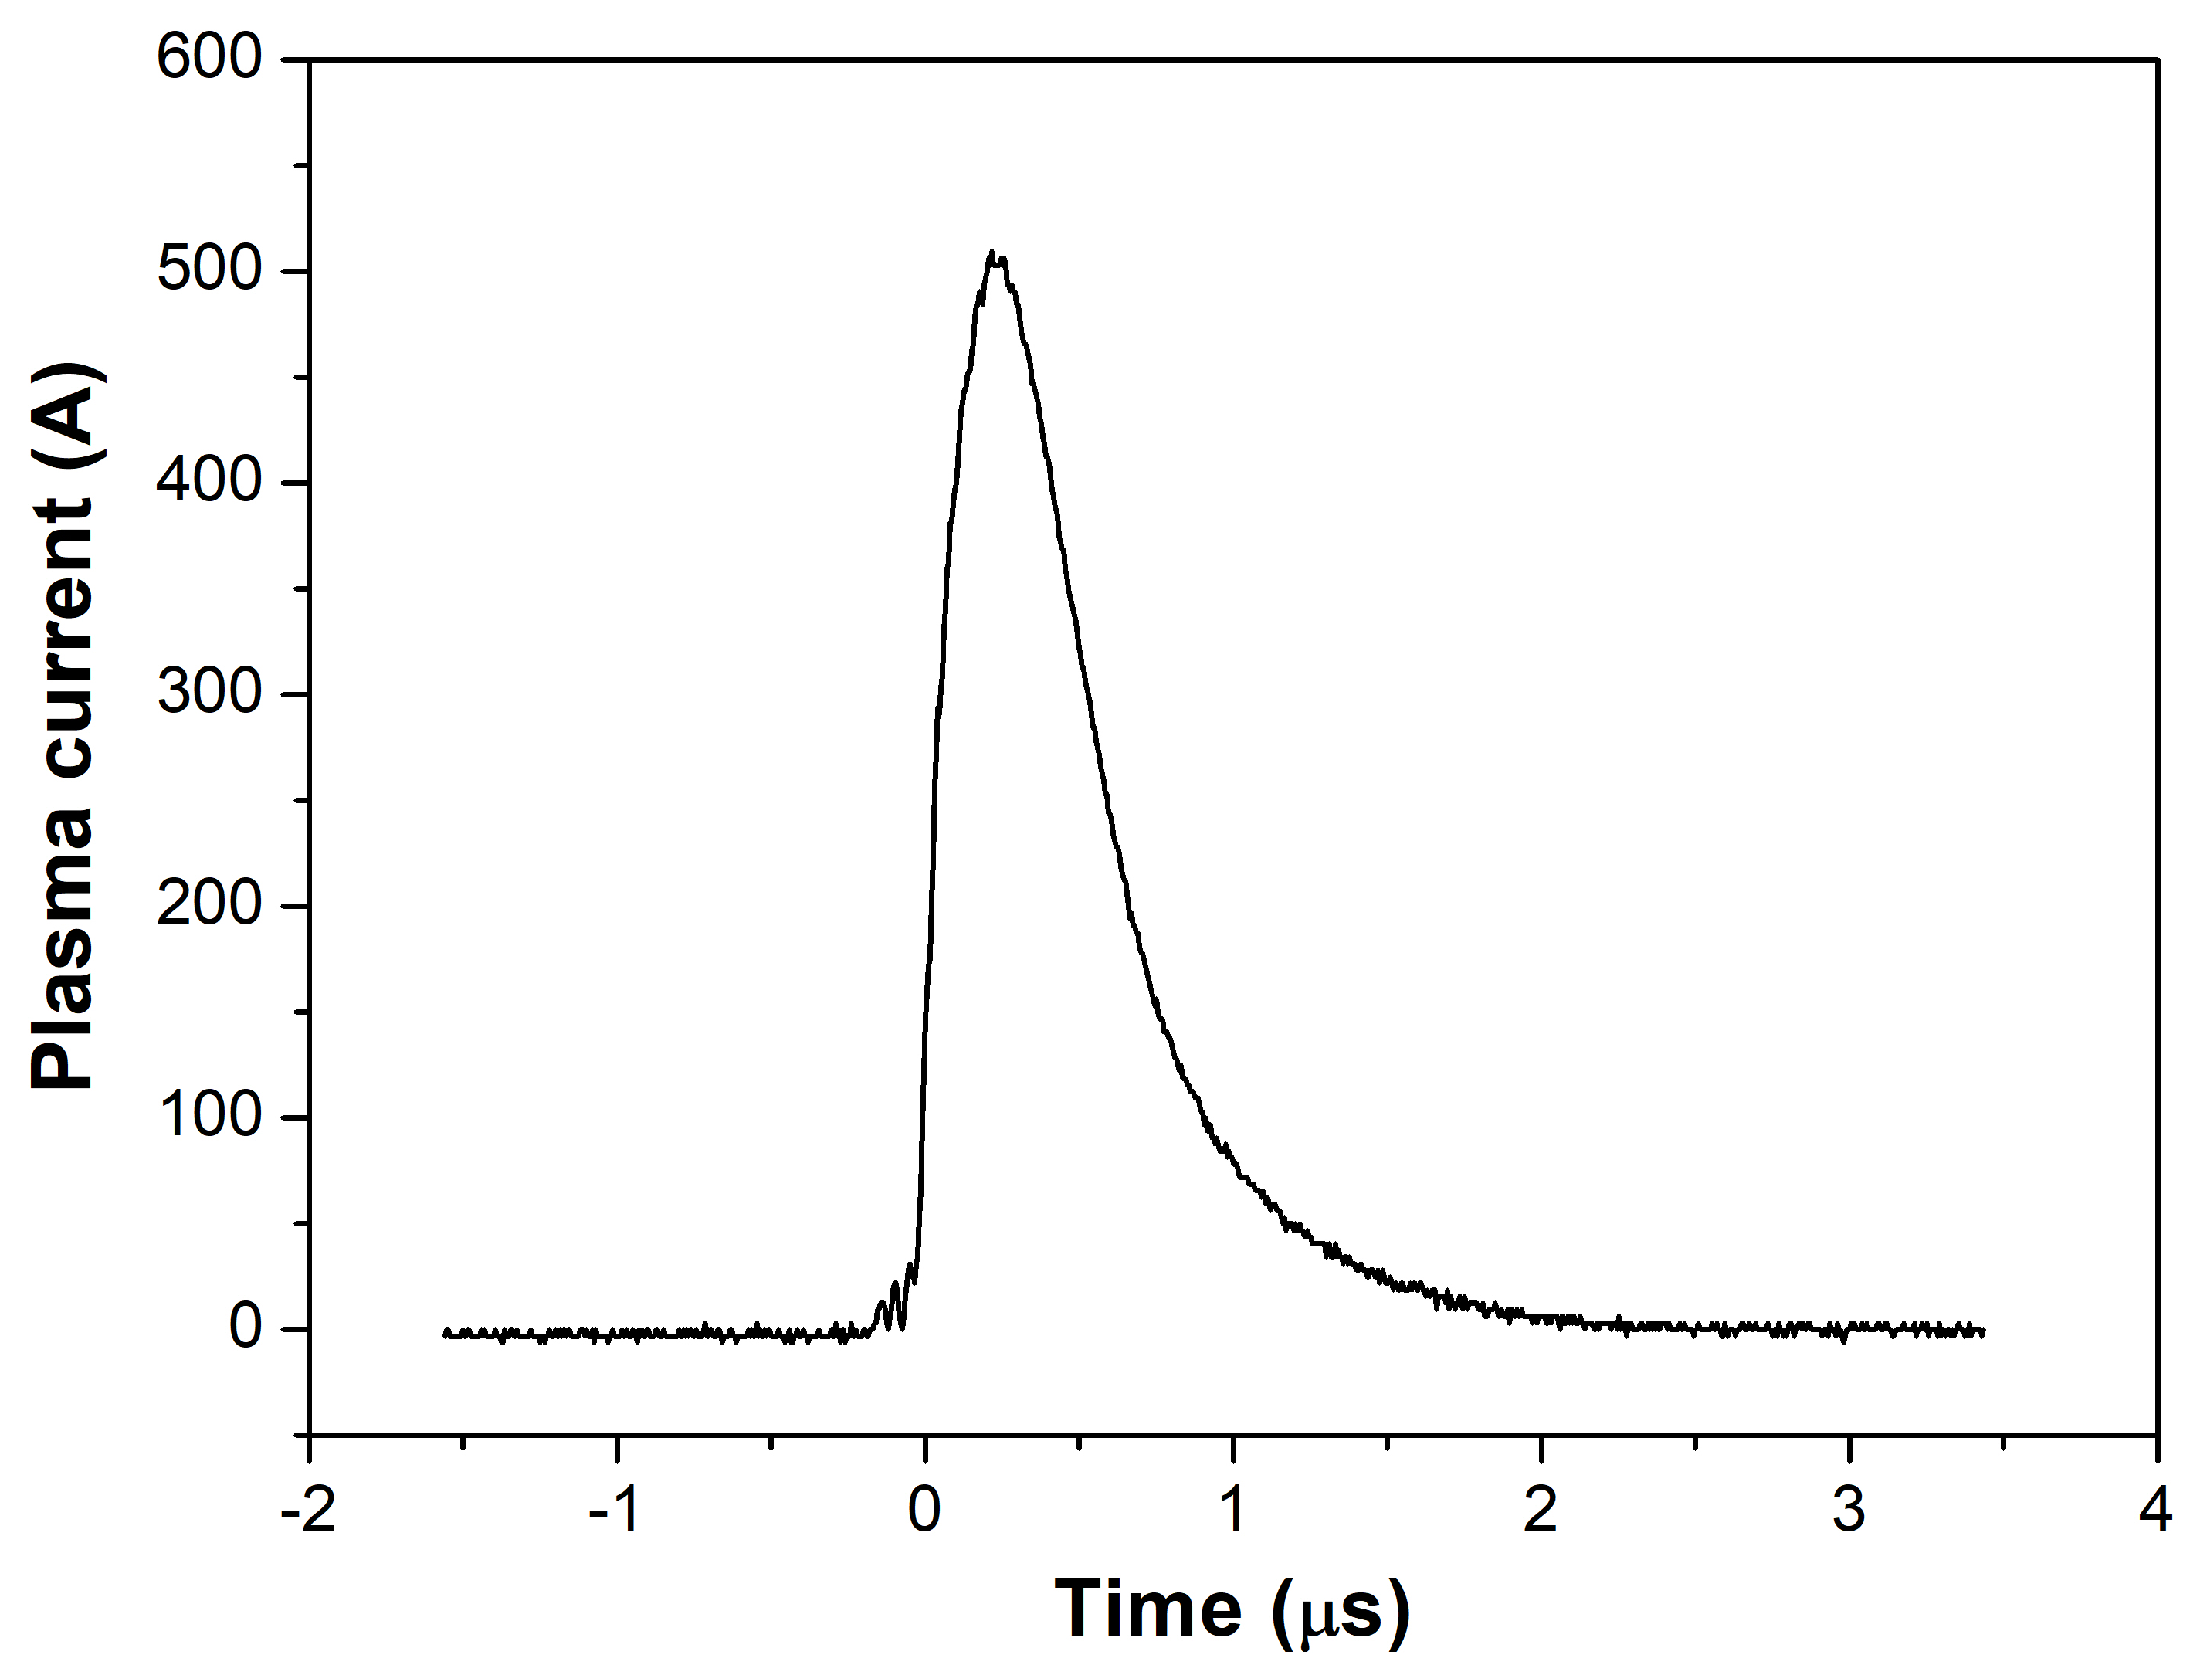
Plasma accelerating module - HV source
HV generator
High voltage for plasma formation (Max 30 kV)
High current output for high repRATE (150-200 mA)
Q=CV=10kV x 40nF = 0.4x10⁻³ C
t_{c} = dQ/I_{c} = 2 ms at 200 mA
Rep Rate <= 500 Hz
V = 10 – 15 kV
Ip = 400 – 500 A
Δt = 600 ns FWHM
100 to 2500 A
1 to 100 Hz
Δt = 600 ns
In principle, there are no limitations to high repetition rate (>400 Hz) for HV generator and pulser but overheating problems could cause damages
Angelo.Biagioni@lnf.infn.it | TDR Review committee 26 – 28 June 2024 | Page 13/17

Slide 10
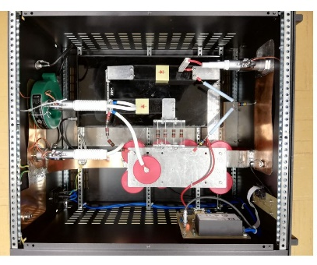
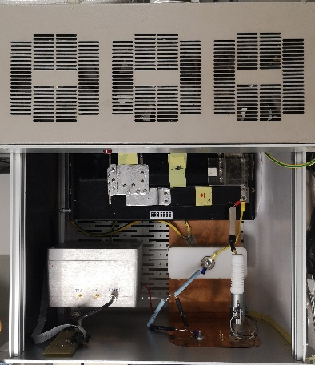
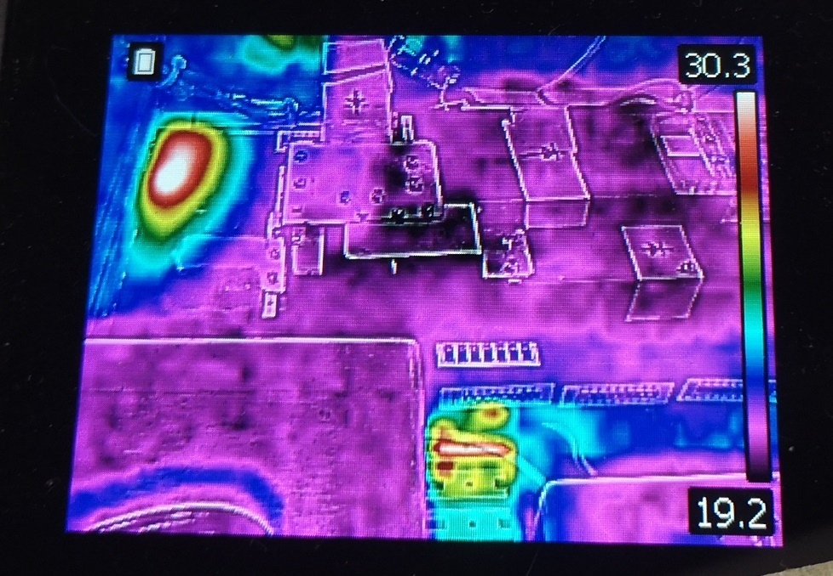
High repetition rate plasma sources- HV source
40@150 Hz
Air cooling system
SCR
SCR
For higher repRATE an oil cooling system for SCR
component will be used (in box)
Angelo.Biagioni@lnf.infn.it | TDR Review committee 26 – 28 June 2024 | Page 14/17

Slide 11
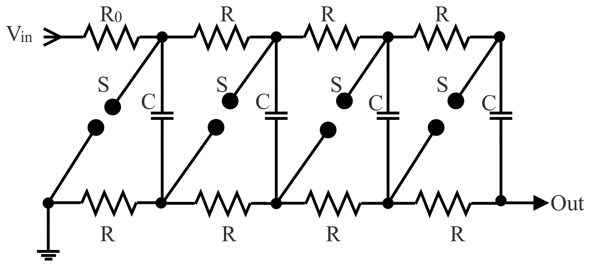
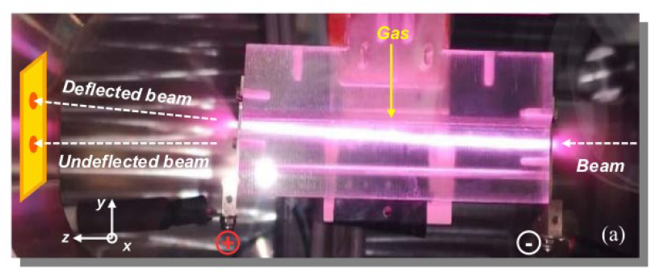
High repetition rate plasma sources- HV source
HV pulses pulse from a low-voltage DC supply
Very short pulses (tens of ns)
charging N capacitors in parallel at Vc (output NVc)
Discharge N capacitors in series (short pulse)
Laser ignition for spark gaps
new high-voltage cable design to limit inductive effects (oscillations and pulse duration)
HV pulses/High currents pulse from a low-voltage DC supply
Very short pulses (tens of ns)
Lower Thermal energy per pulse
Higher repRATE
Marx generator
ABP
Angelo.Biagioni@lnf.infn.it | TDR Review committee 26 – 28 June 2024 | Page 14/17

Slide 12
Thank you for your attention
Angelo.Biagioni@lnf.infn.it

