Slide 1
Plasma lenses applications: Beam Handling and Driver Extraction
Martina Carillo
On behalf of the SPARC_LAB collaboration

Slide 2
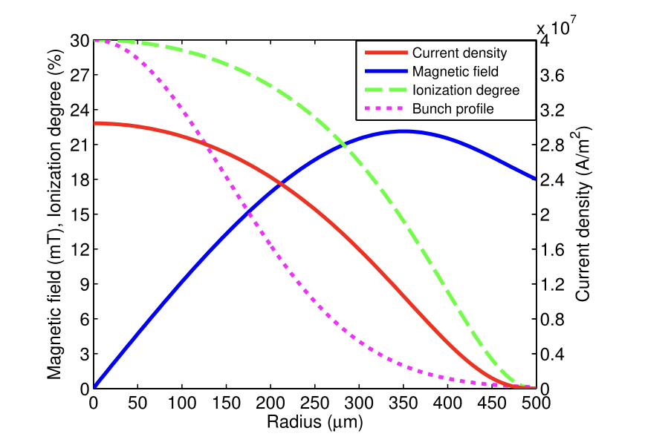
Plasma based solution for beam handling
1. Injection
3. Exctraction
Specific matching conditions are required
Beam handling to reduce large angular divergence and control emittance growth
$$β_{eq}=\sqrt{\frac{γ}{2πr_{e}n_{p}}}$$
$σ_{r}=\sqrt{\frac{β_{eq}ε_{n}}{γ}}$ $\sim μm$
$$G\left[MT/m\right]=\frac{F_{r}}{ecr}∼3n_{p} [O({10}^{15−16} )]$$
2. Acceleration
Two goals:
transport the witness bunch by preserving its charge, normalized emittance, and peak current;
remove the high-charge driver bunch during the transport to completely discard it before the FEL undulator beamline.
The focusing is provided by two active-plasma lenses (APLs)
Collimator remove the driver bunch overfocused to a spot size much larger than the collimator clear aperture.
$$R_{56}=0$$
[*]E. Chiadroni et al. Overview of plasma lens experiments and recent results at SPARC_LAB, Nuclear Inst. and Methods in Physics Research, A 909 (2018) 16–20
[*]R.Pompili, et al., Experimental characterization of active plasma lensing for electron beams, Appl. Phys. Lett. 110 (10) (2017) 104101.
M. Carillo (martina.carillo@lnf.infn.it)

Slide 3
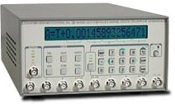
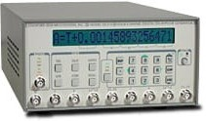
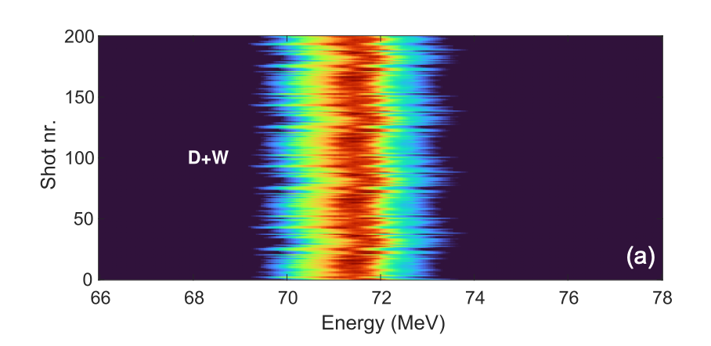
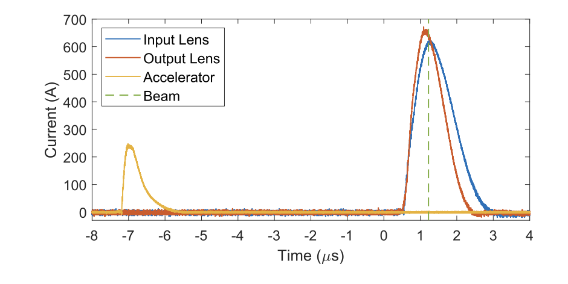
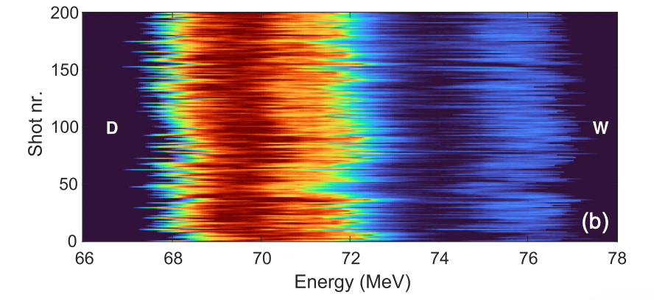
Simulations and experimantal results
[*]R. Pompili et al., Phys. Rev. E 109, 055202 – Published 3 May 2024
*INFN patent by A. Biagioni, R. Pompili, V. Lollo, D. Pellegrini, M. Ferrario.
APL
PWFA
APL
PWF A
e- beam
DDG
DDG
DDG
drift
drift
APL
APL
HV gen
The discharge current and plasma density can be independently tuned and controlled in each plasma stage.
$${n_{p}}_{APL,1}≈2 × {10}^{17}cm^{−3}$$
SPARC_LAB RF photinjector beams:
$${n_{p}}_{PWFA}≈4 × {10}^{15}cm^{−3}$$
 | Driver | Witness
Energy [MeV] | 71.6$±$0.1 | 71.9$±$0.1
Energy spread [MeV] | 0.49 $±$0.03 | 0.72 $±$0.04
Duration [fs] | 185 $±$39 | 55 $±$32
Emittance [$μ$mrad] | 6.2$±$0.7 | 4.8$±0.4$
Dealy [ps] | 1.15$±$0.03
TRL: 5
M. Carillo (martina.carillo@lnf.infn.it)

Slide 4
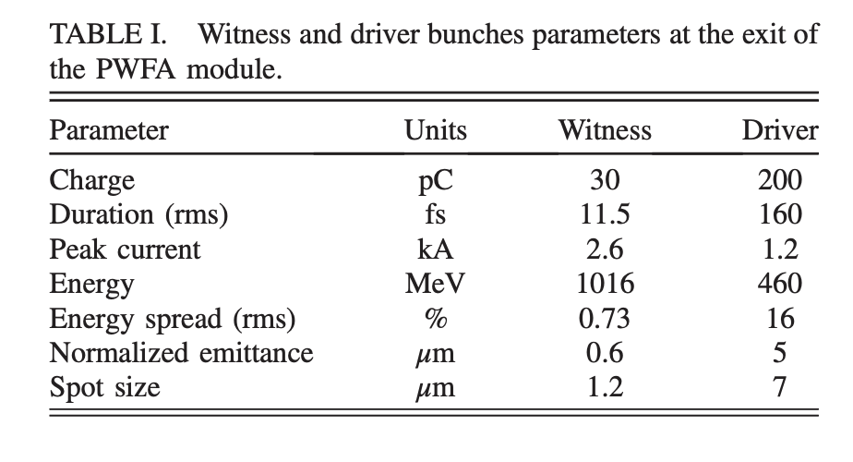
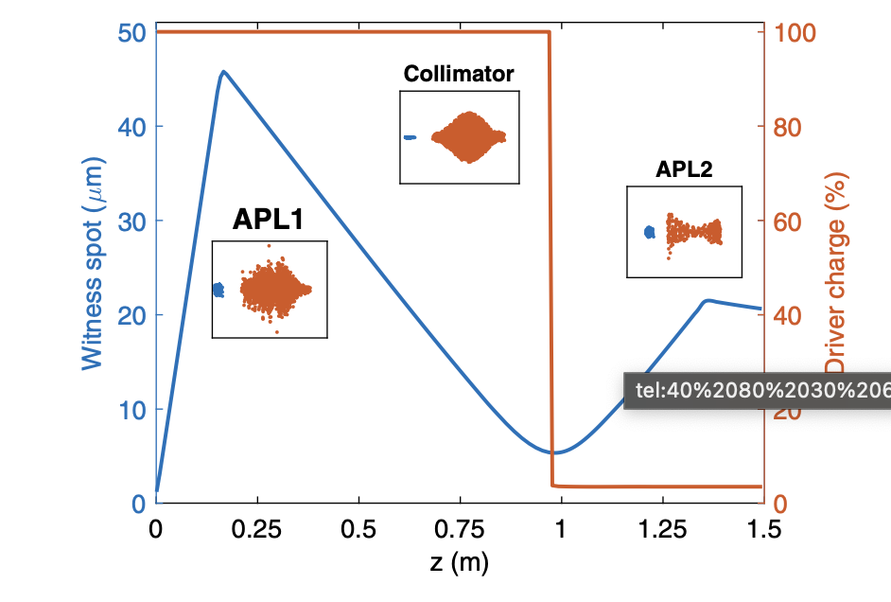
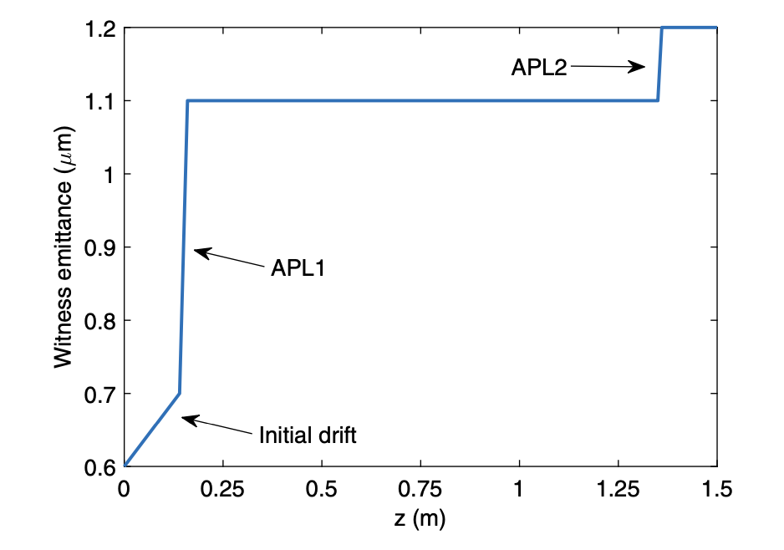
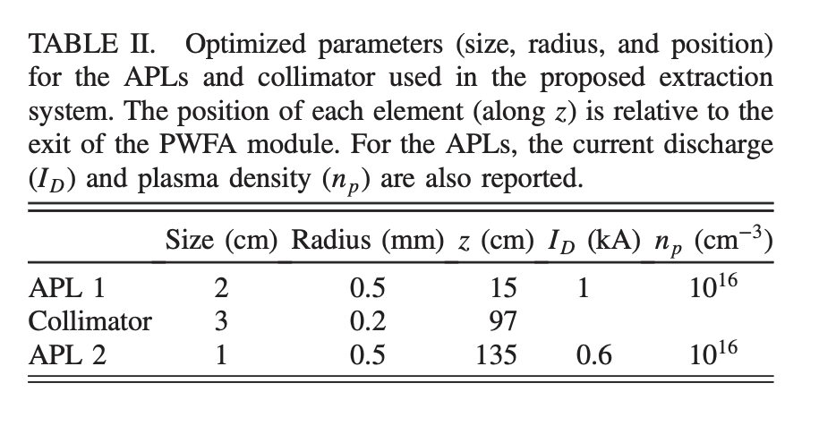
Simulations and experimantal results
[*]P.Iovine, PhD Thesis, Study of the transfer and matching line for PWFA-driven FEL
The dynamics of the beam in the plasma lenses is then computed by a 2D code written to solve the wavefield equations in the linear regime
Considering all the elements and drift spaces involved,
the total length of the system is 1.4 m.
[*]R.Pompili et al., “Plasma lens-based beam extraction and removal system for plasma wakefield acceleration experiments”, Phys. Rev. Accel. Beams 22, 121302
TRL: 3
M. Carillo (martina.carillo@lnf.infn.it)

Slide 5
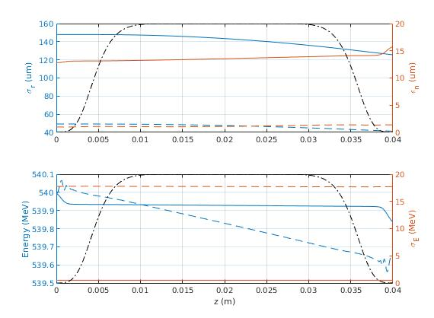
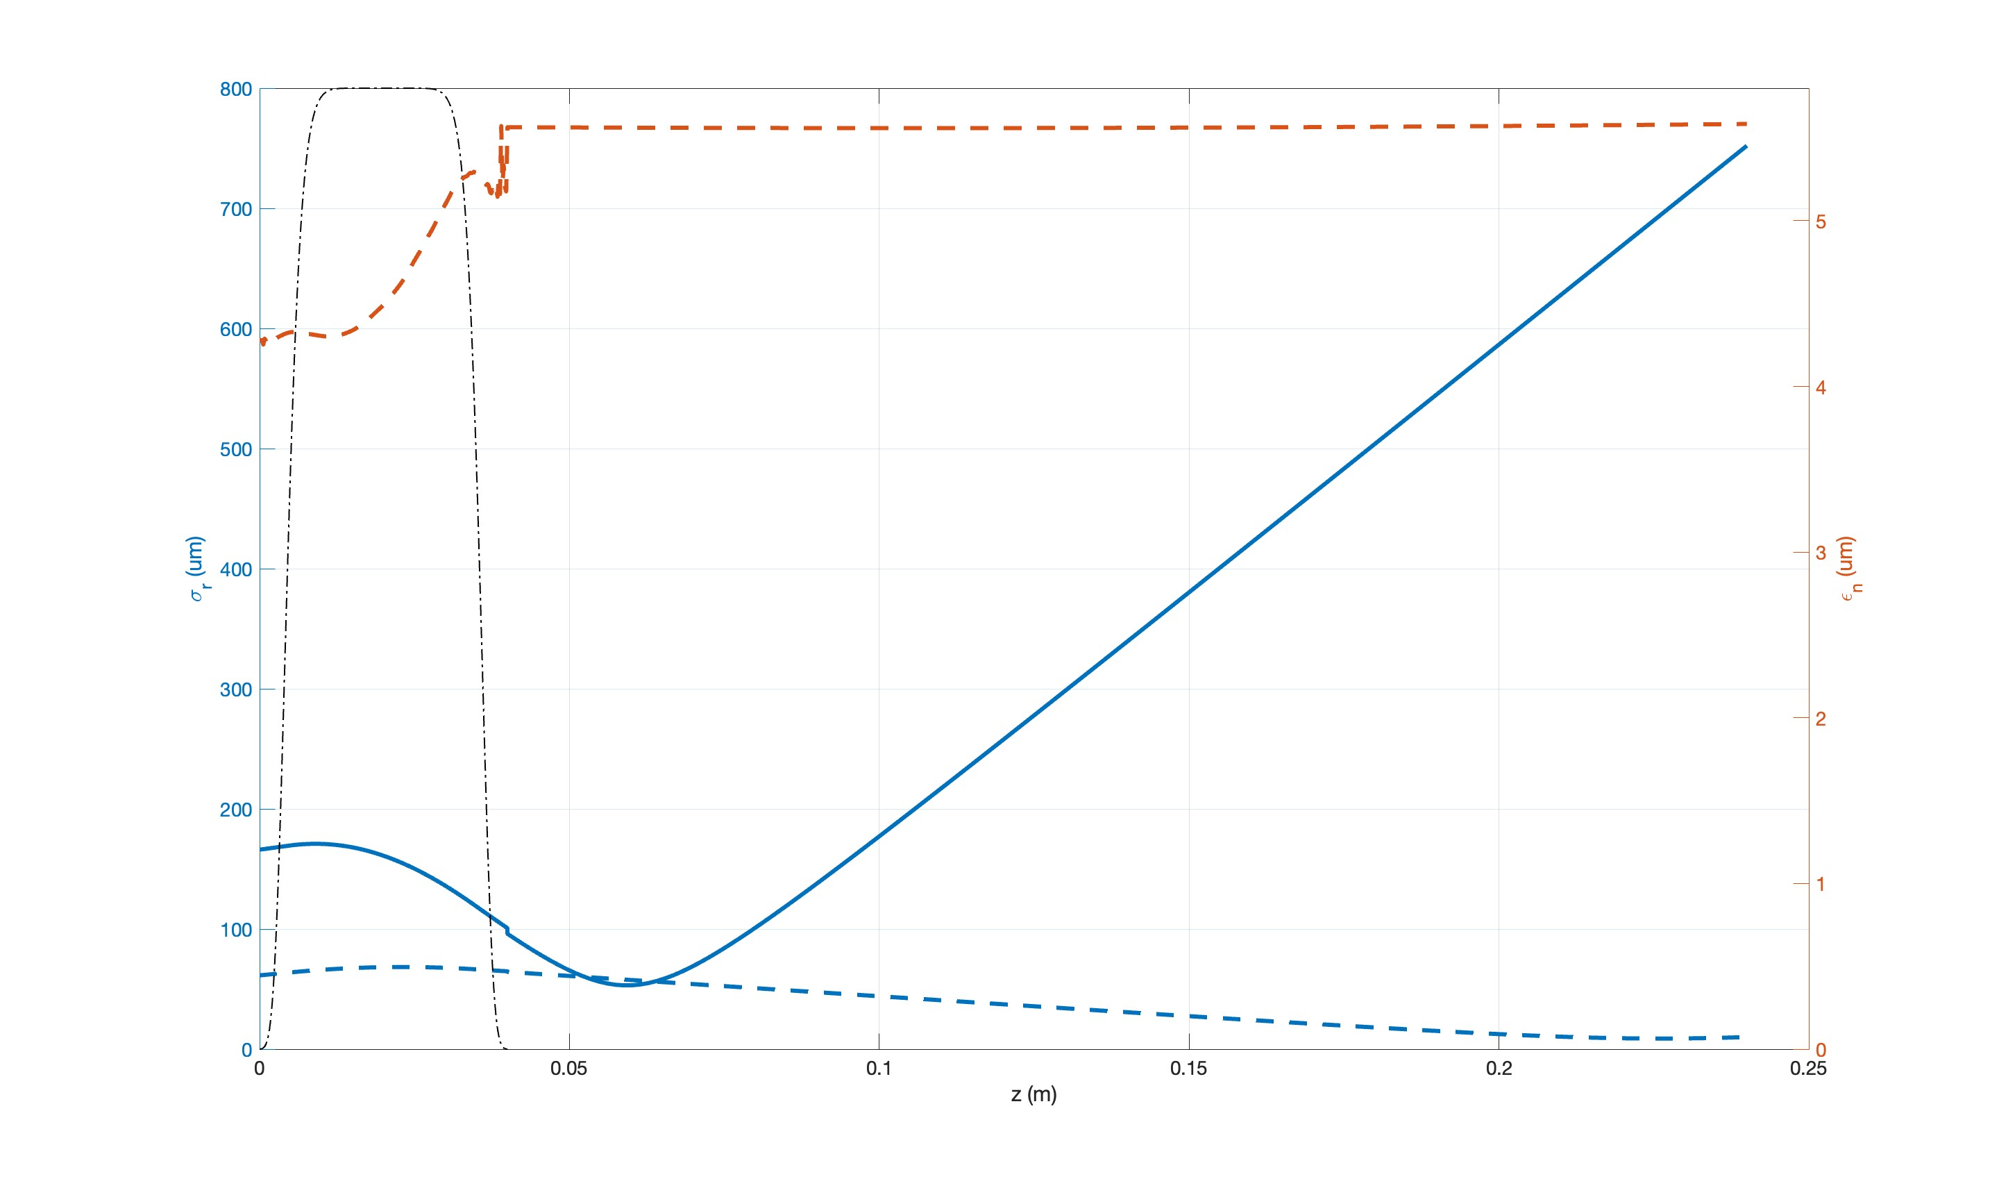
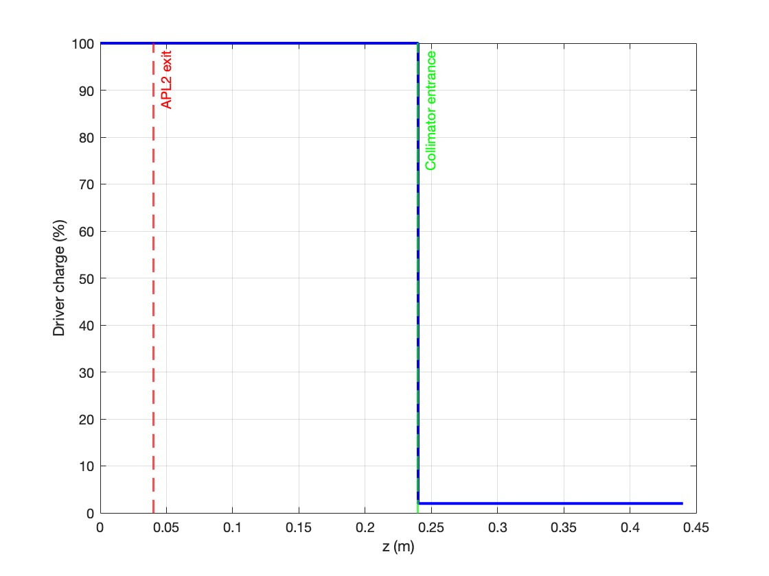
Simulations and experimantal results
Input Beam Parameters:
Bunch distances: $Δt= 0.95 ps$
 | Driver | Witness
Q [$pC$] | 500 | 50
E [$MeV$] | 540 | 540
$σ_{E}$[$MeV$] | 0.5 | 0.4
$σ_{x}$ $[μm$] | 150 | 50
$σ_{t}$[$fs$] | 100 | 20
$ε_{rms}[μmrad$] | 13 | 1
APL1
PWFA
APL2
$$n_{p}$$ | $$5 × {10}^{18} {cm}^{−3}$$
$$L_{APL1}$$ | $3 cm+2∗0.5 cm$(ramps)
$$I$$ | $$2kA$$
$$n_{p}$$ | $$3.8 × {10}^{15} {cm}^{−3}$$
$$L_{PWFA}$$ | $38 cm+2∗3 cm$(ramps)
$$n_{p}$$ | $$5 × {10}^{18} {cm}^{−3}$$
$$L_{APL2}$$ | $3 cm+2∗0.5 cm$(ramps)
$$I$$ | $$5.5kA$$
Accelerating gradient: $∼1.4 GeV/m$
*Beam Gaussian Distribution
98% of the driver charge has been removed
Witness emittance
1.10m
Driver spot size
Witness spot size
TRL: 2
M. Carillo (martina.carillo@lnf.infn.it)

