Slide 1

Long plasma sources and materials studies
Romain DEMITRA (on the behalf of PLASMA_LAB – Sparc_Lab)

Slide 2
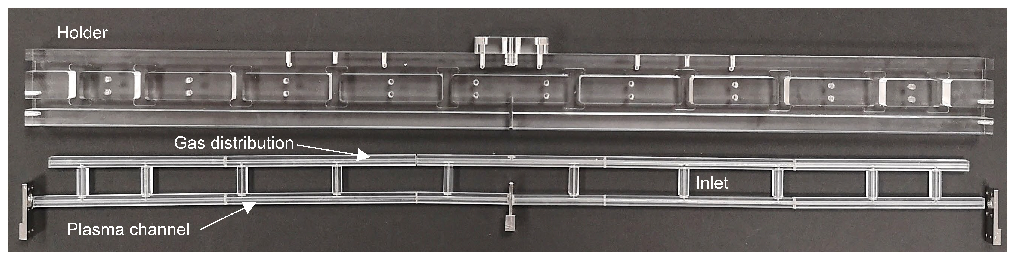
60 cm long capillary tested prototype
Design 60 cm long capillary:
Support for gas injection and attaching electrodes that contains the injectors and plasma channel
Common ground electrode to separate two sections
Prototype in plastic but the final device will be in Macor (holder)/Shapal (channel and inlets)
TRL 6 : Technology validated in laboratory

Slide 3
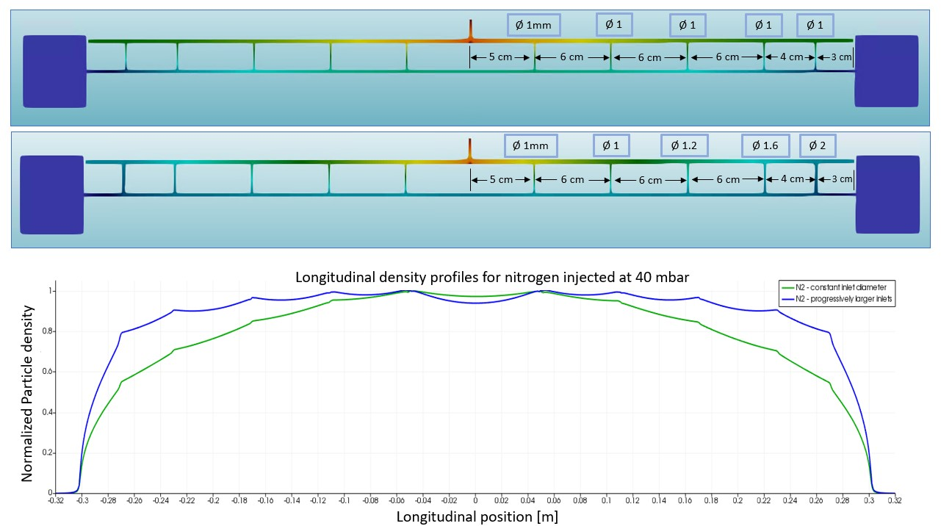
Gas simulation for the tested geometry
10 injectors of constant diameter and progressively closer together
10 injectors progressively closer together and having progressively increasing diameters
Variability of up to 20 % in lateral areas depending on the application
TRL 6 : Technology validated in laboratory

Slide 4
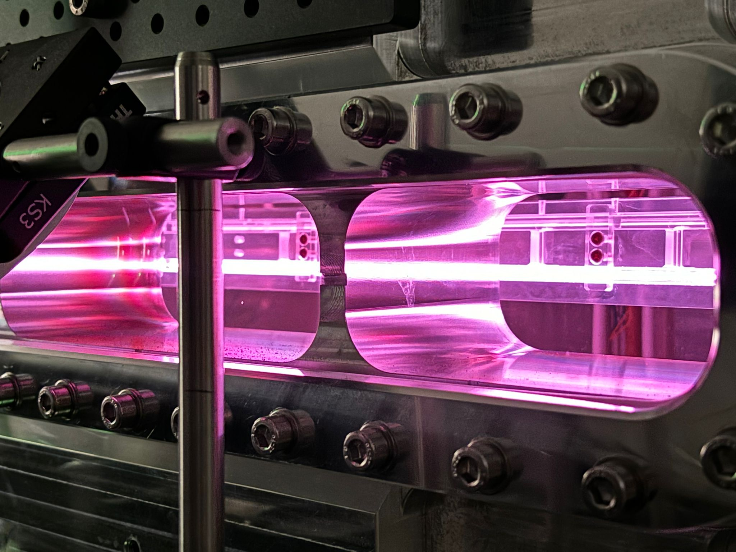
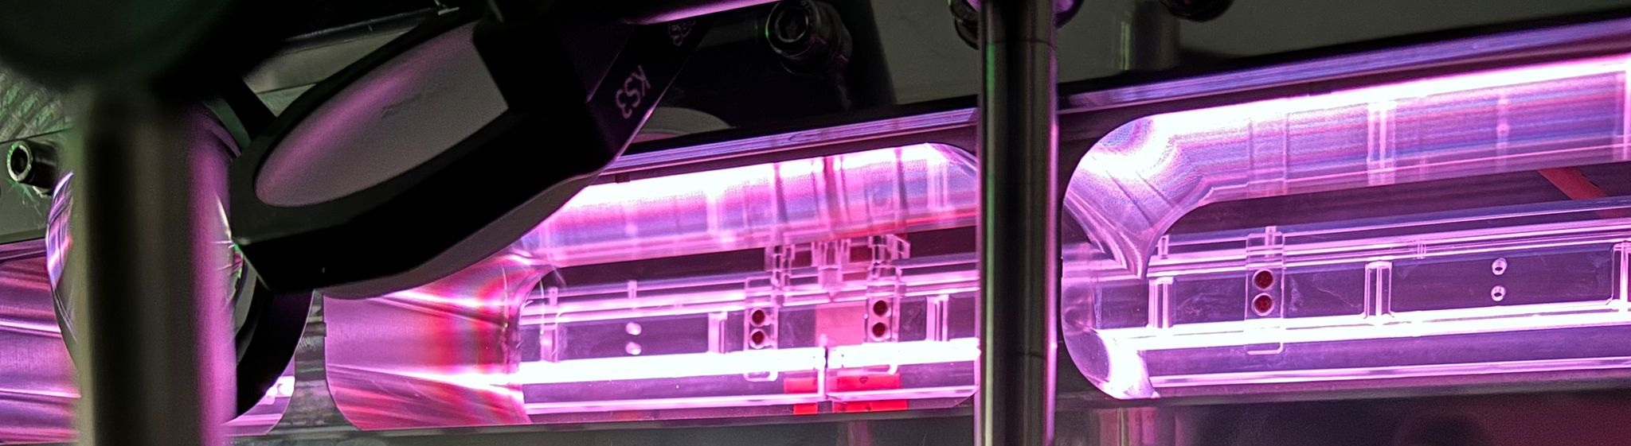
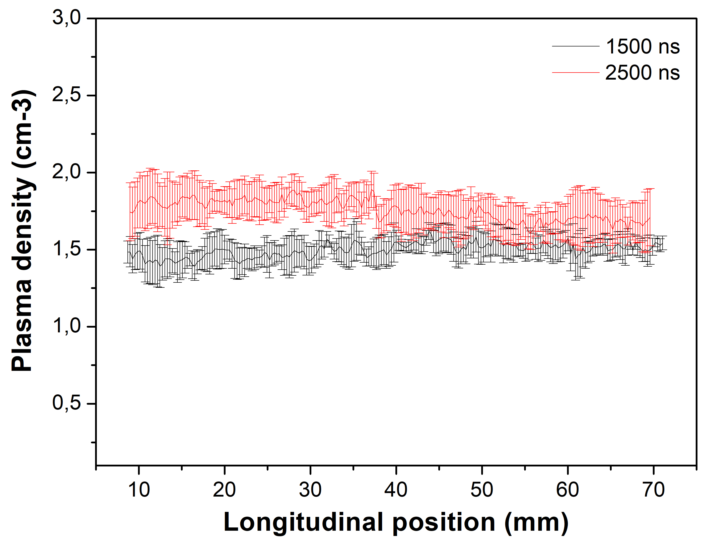
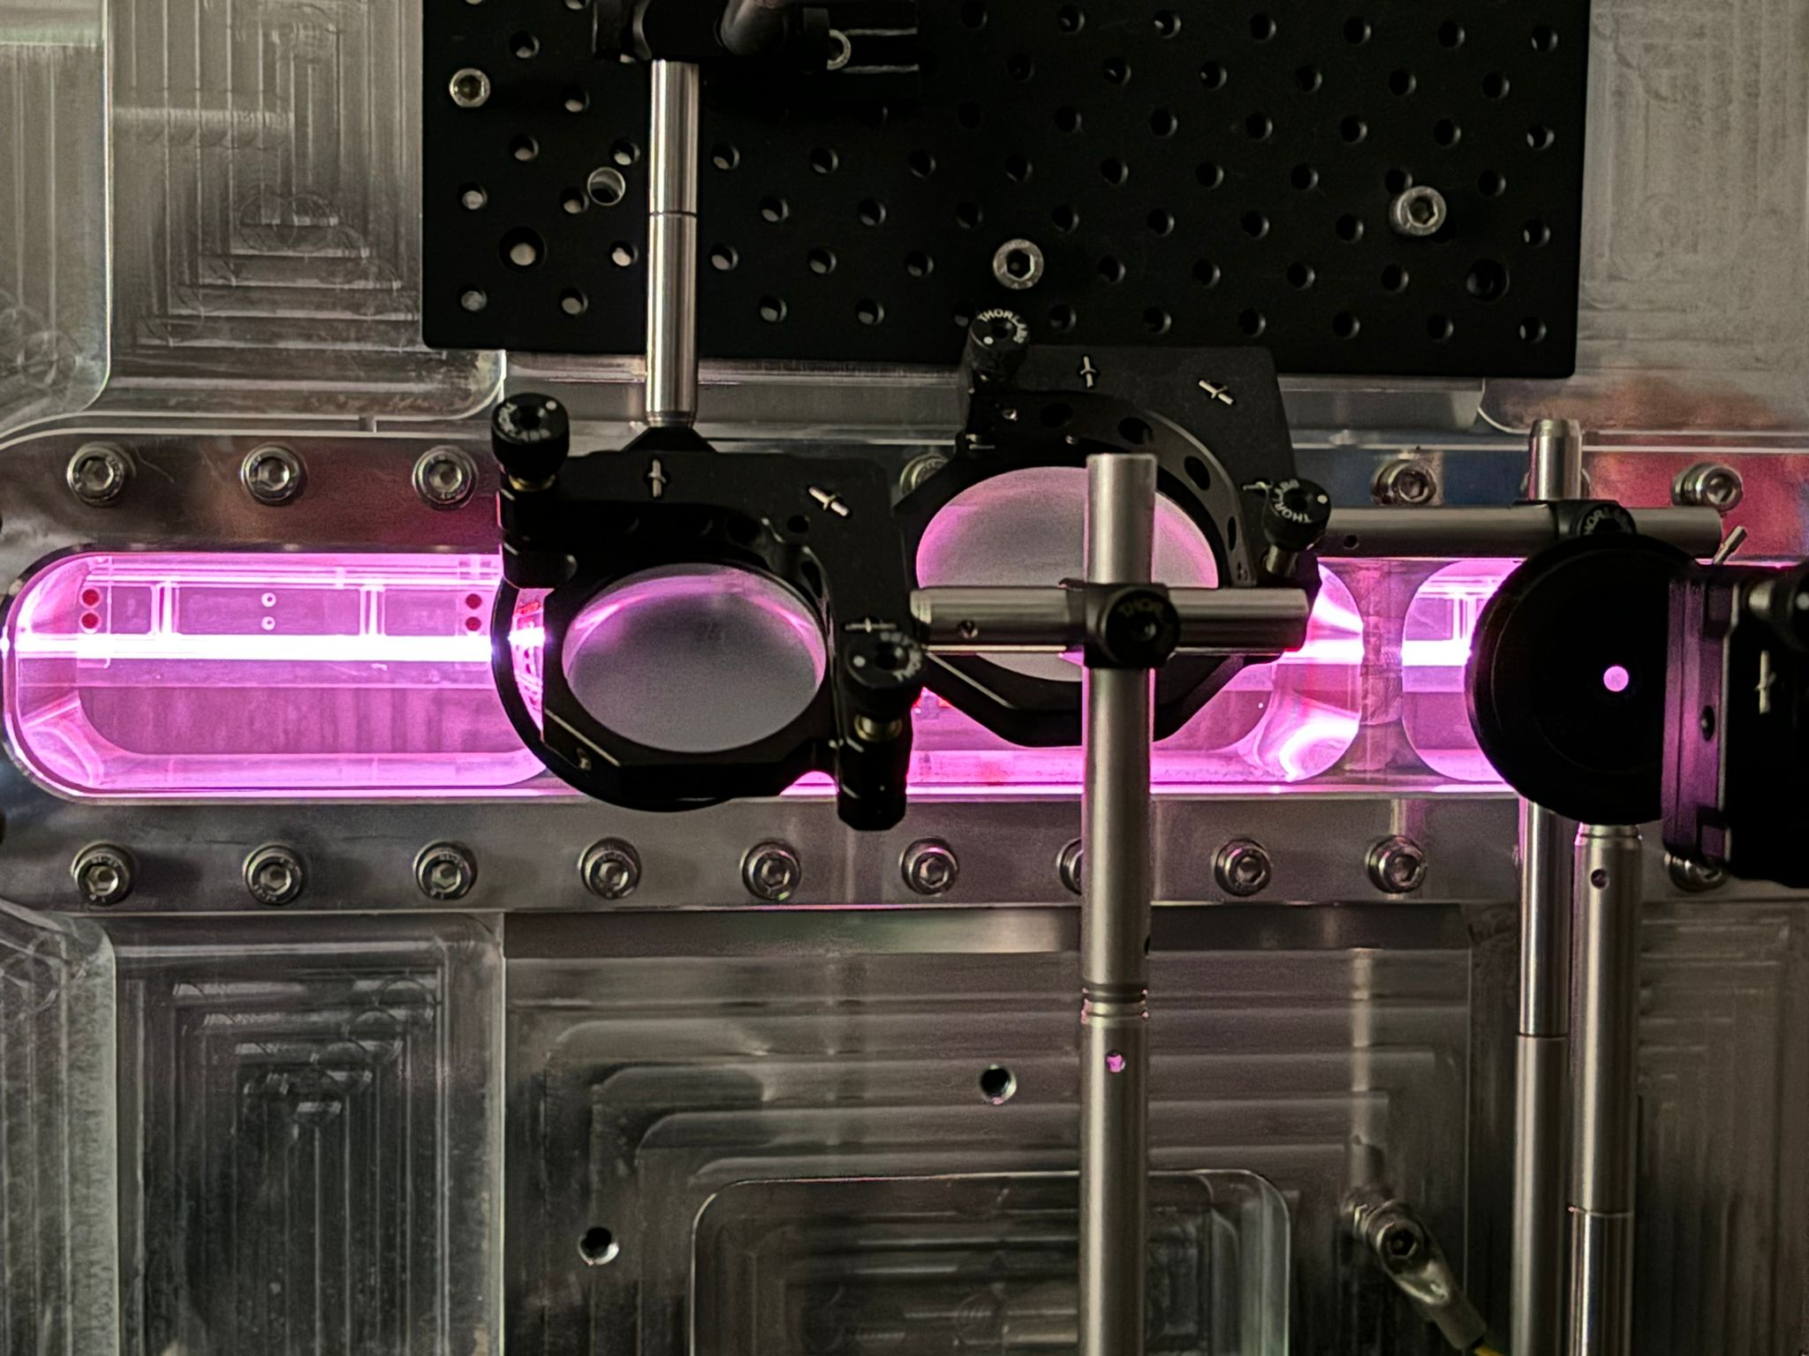
Plasma density measurements
1.1 GeV (1 GV/m 600 MeV in 60cm long capillary - density 10¹⁶ cm-3 ):
  Fabrication by machining
  10 increasing diameter
  Density range 10¹⁶ -10¹⁷ cm⁻³
  13 kV with 500 A
  100 Hz rep Rate
10¹⁷
  V = 13 kV
  Ip = 550 A
60 cm
TRL 6 : Technology validated in laboratory

Slide 5
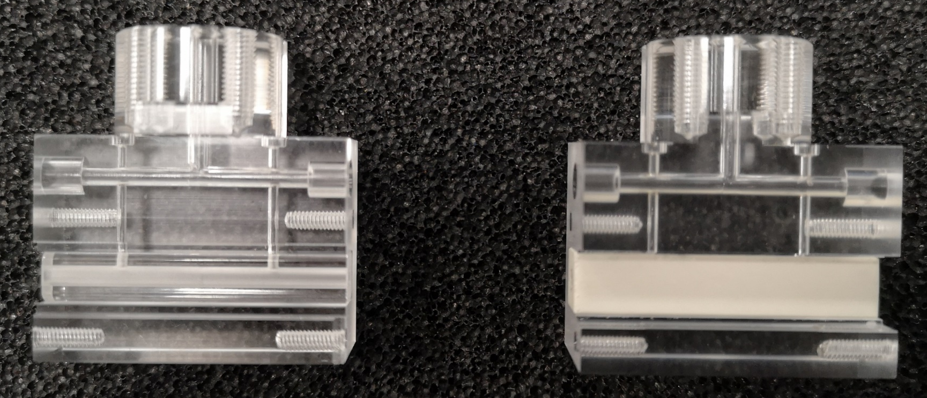
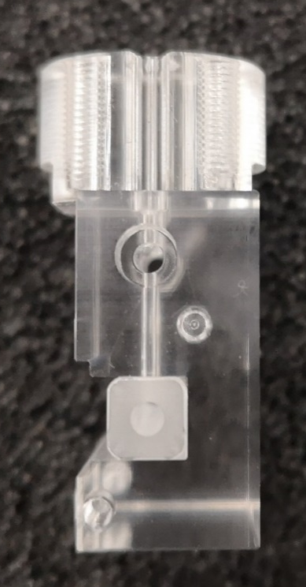
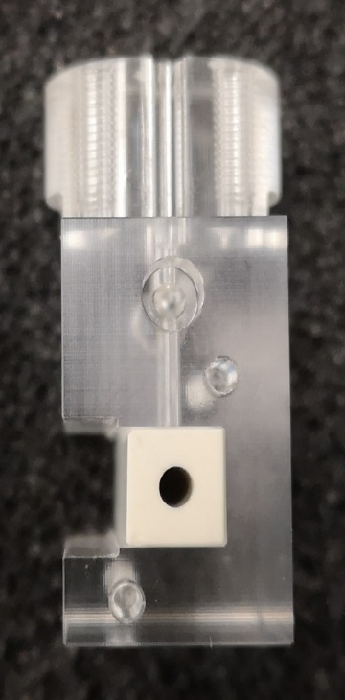
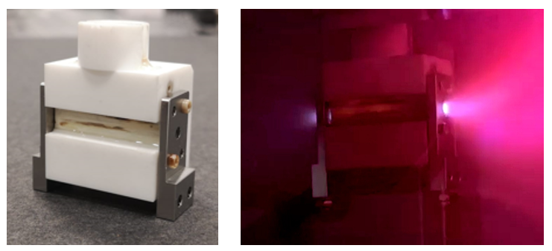
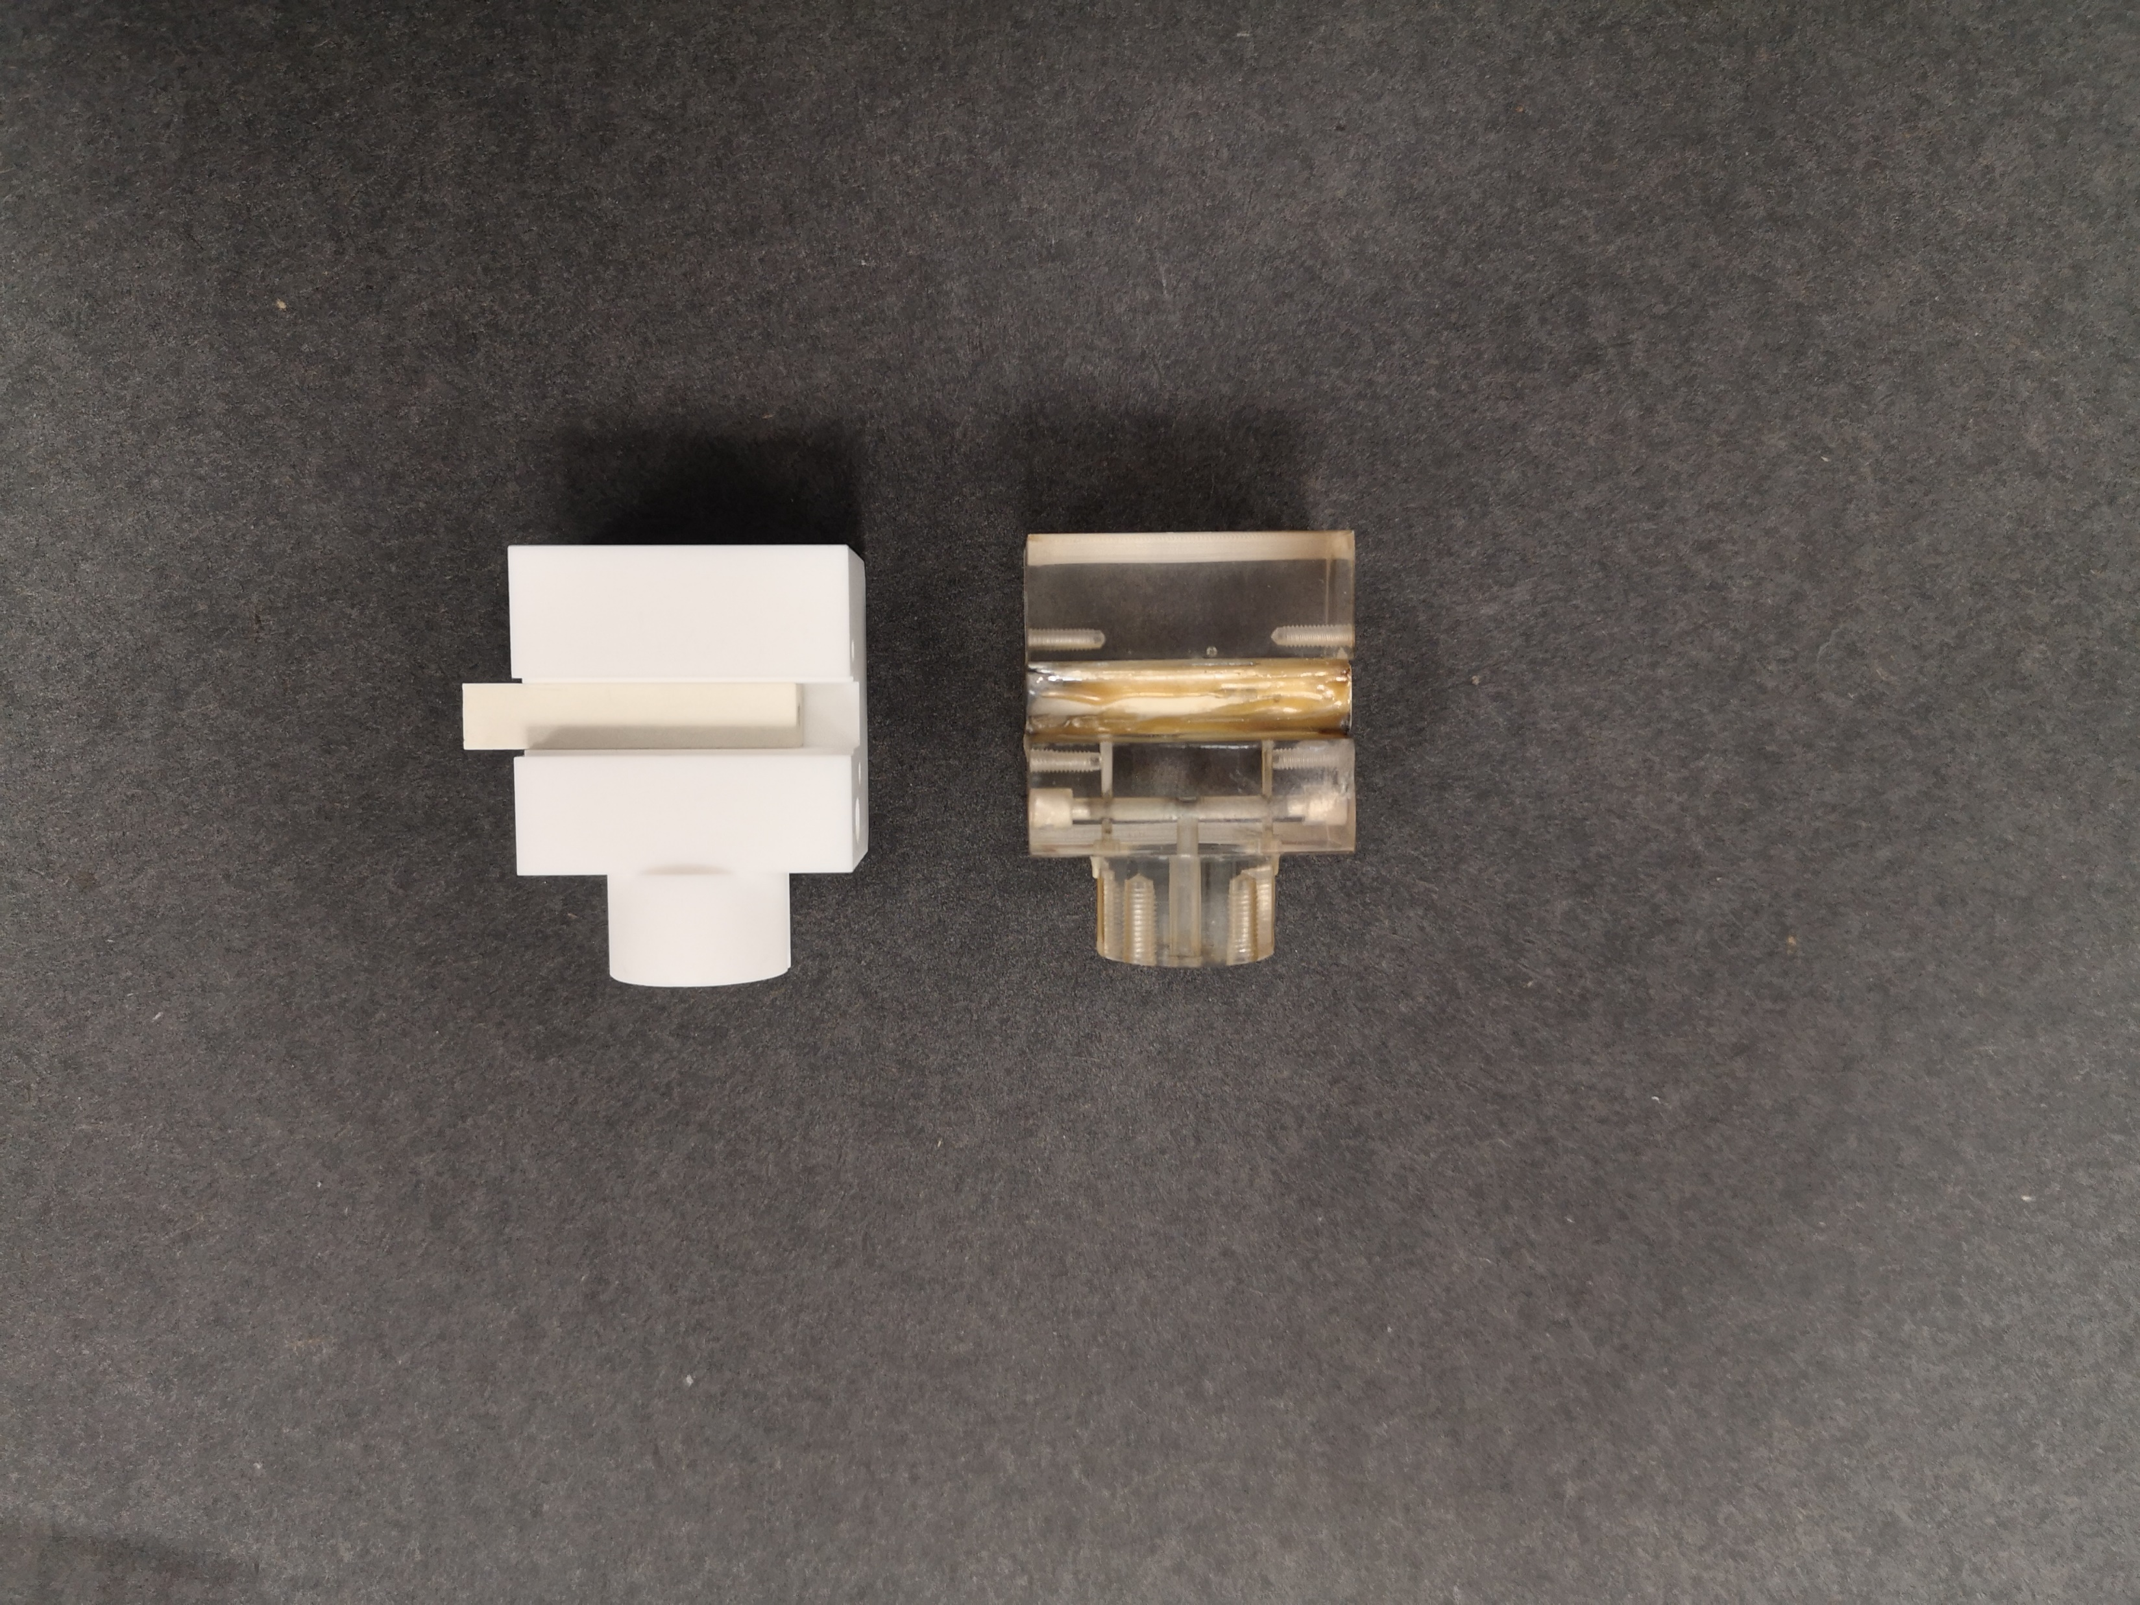
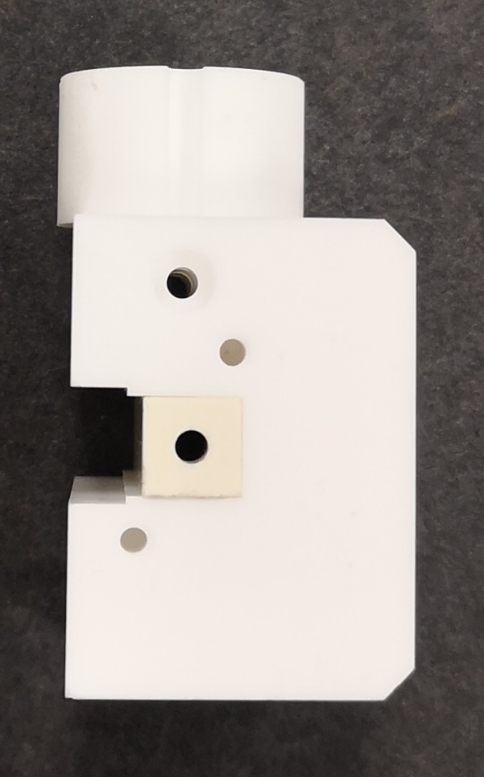
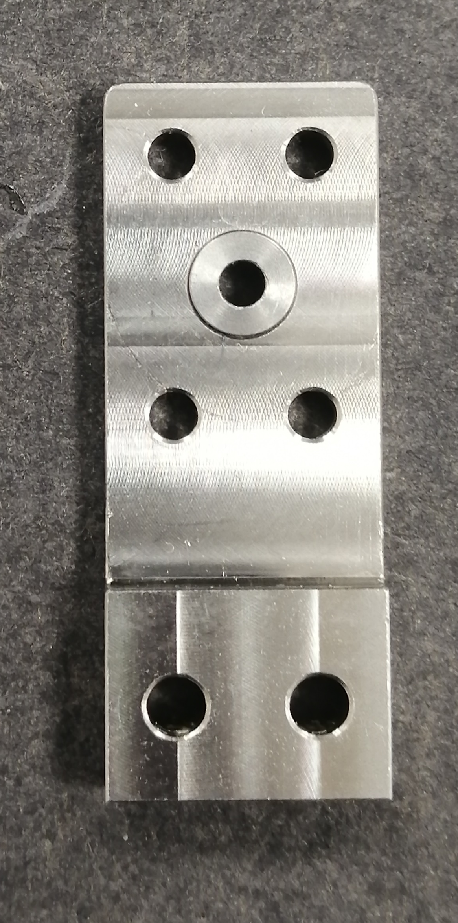
Materials tests
Sapphire
Ceramics
High temperature resistant materials
High thermal conductivity
High max operating temperature
Good machinability, cost-effectiveness and availability for large geometries
Molybdenum
Shapal
Stainless
steel
Macor
3 cm long, 2 mm diameter
TRL 6 : Technology validated in laboratory

Slide 6
Plasma density lifetime measurements
Experimental results
Transverse density profile at the density peak
No alteration in plasma density distribution
TRL 6 : Technology validated in laboratory

Slide 7

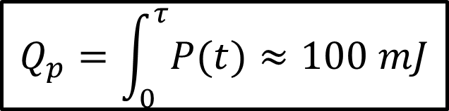


Heat transfer analysis
Analytical estimate
Ohmic heating inside the plasma channel:
$$P\left(t\right)=R_{p}(t)I_{p}^{2}(t)$$
$$Q_{p}=\int_{0}^{τ}{P(t)}≈100 mJ$$
$$f=10, 100, 1000 Hz$$
$$P_{avg}=1, 10, 100 W$$
TRL 6 : Technology validated in laboratory

Slide 8
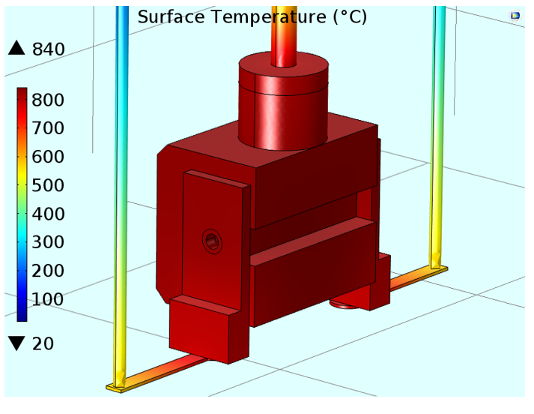
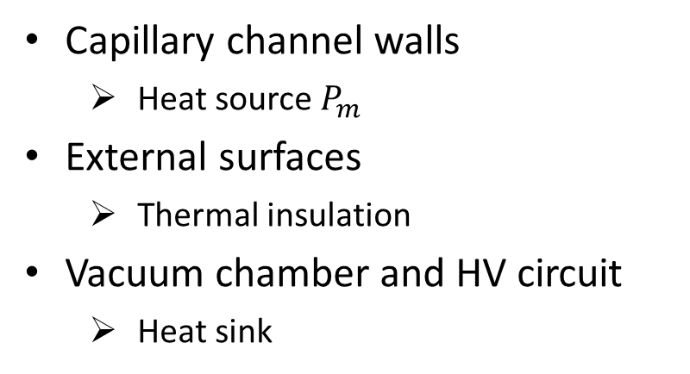
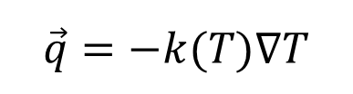
Heat transfer analysis
Macor
Heat transfer simulations
Molybdenum
Fourier’s Law:
Steel
Shapal
$$\vec{q}=−k(T)∇T$$
Capillary channel walls
  Heat source $P_{m}$
External surfaces
  Thermal insulation
Vacuum chamber and HV circuit
  Heat sink
TRL 6 : Technology validated in laboratory

