Slide 1


Coordination panel meeting
iSAS project
29th November, 2024

Slide 2
iSAS Coordination panel meeting
Agenda
Agenda items:
Project status report
WP progress discussion (from Oct 18 Steering Committee feedback)
INFN leadership transitions
AOB
Notes will be found in the Indico page
iSAS project Indico page

Slide 3
iSAS project status report
Coordination panel meeting
29th November, 2024

Slide 4
iSAS Coordination panel meeting
INFN leadership transitions
One transition coming to a close, one to be formalized in the next few days
Coordination panel: Giovanni Bisoffi hands over the baton to Cristian Pira
Transition mostly achieved
Giovanni will keep in touch with the project until Padova 2025
WP7: Giorgio Keppel hands over the baton to Oscar Azzolini
WP Leader Oscar, WP Deputy Giorgio

Slide 5
iSAS Coordination panel meeting
Padova 2025
Practical details
LNL, INFN, Padova, 3 days in-person meeting in March 2025 (including travel) + Zoom link
Save the date sent - registrations in progress
Info up-to-date to be found on this page
Any questions? Organisation team: Cristian Pira, Silvia Martin, Adèle de Valera
Agenda
Day 1 March 12 – Parallel WP meetings
Day 2 March 13 – Plenary session, possibly iFAST 2 invited talk by Maurizio Vretenar
Day 3 March 14 – Industry workshop, Governing board meeting, visit of LNL
Advisory board report to be sent 2 weeks after

Slide 6
iSAS Coordination panel meeting
Industry board
Launched
1st Industry board meeting on Oct 30
Formalisation of the Industry board
2nd Industry board meeting on Dec 4
News from the industrial section of the iSAS website, deliverable due M10 (Dec)
Questions with Julie Gendron-Brundu
3rd Industry Board tbd
Brainstorming session with the companies to structure their participation in the project

Slide 7
iSAS Coordination panel meeting
iSAS digital spaces
3 digital spaces with 3 different purposes
iSAS website: To showcase the project to wider audiences
Skeleton designed, contents phase opened
Project Indico page: To meet – to find upcoming project meetings
To be integrated with WP individual Indico pages
Data repository: To share project documents
Opened on Nov 13 by STFC

Slide 8
iSAS Coordination panel meeting
Context on the Governing board
Nov 4 meeting postponed
No obstacles, just more time needed to come full circle with the project requirements
To prepare in order to hold next Governing board meeting – ambition: final reading in Padova, March 14
  Consortium Agreement (CA)
    Only response from STFC missing among academic partners
    v2 once the question of industrial partners is cleared
    3 new partners can participate in the reviewing process (in parallel to discussions with WP6)
  NDA
    for Advisory board members – can be done anytime – 4th member nomination still on hold
  Amendment to the Grant Agreement - postponed to 1st trimester 2025:
    RTU, IFJ PAN & Nikhef written arguments for their implication in the iSAS project – in progress
    WP4 written arguments for the modification of results, tasks, due dates – discussions in progress

Slide 9
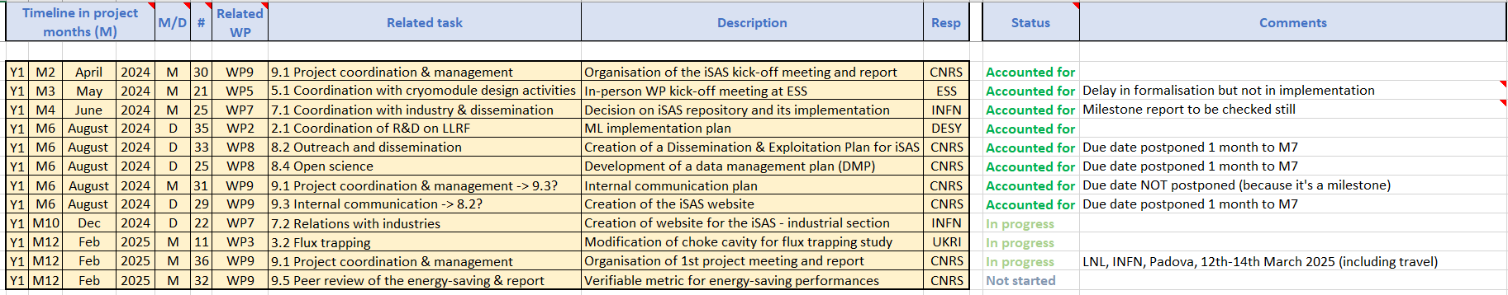
iSAS Coordination panel meeting
Work plan
Up to date with Milestones & Deliverables status by timeline for the 1st project year:

Slide 10
iSAS Coordination panel meeting
Work plan
Milestone “Verifiable metric for energy-saving performances” due Feb 2025
Basis for Deliverable “Report on energy saving performance of iSAS technologies” due Feb 2027
  To anticipate

Slide 11
iSAS Coordination panel meeting
Upcoming related meetings
Every other meeting the Coordination panel becomes the Steering committee (includes the WP leaders & deputies), so as to integrate a cross-coordination of feedback
Indico page for Coordination panel - Steering committee meetings
  Steering committee - January 10 at 10 am CET
  Coordination panel - Feb 21 at 10 am CET
  Steering committee - April 4 at 10 am CET
  Coordination panel - May 16 at 10 am CET
  Steering committee - June 27 at 10 am CET

Slide 12
Thank you!

