Slide 1


Coordination panel meeting
iSAS project
21st February, 2025

Slide 2
iSAS Coordination panel meeting
Agenda
Agenda items
Project status report
  Advisory Board set up
  CA, NDA & AMD update
  Padova meeting organisation
  Work plan w/ up-to-date milestones & deliverables
AOB
Notes will be found in the Indico page
iSAS project Indico page

Slide 3
iSAS project status report
Coordination panel meeting
21st February, 2025

Slide 4
iSAS Steering Committee meeting
Advisory Board
Advisory Board member to welcome into the project
Mandated: Frederick Bordry (Chair)
Roberto Losito (CERN)
Eugenio Nappi (TIARA)
Maxim Titov (LDG)
Declined: Caterina Biscari (LEAPS)
Deepa Angal-Kalinin (LEAPS)
Pending mandate: Wim Leemans (LEAPS)? tbc

Slide 5
iSAS Coordination panel meeting
Consortium Agreement, shared NDA, amendment
Ambition: signature process initiated in Padova, March 14
  Consortium Agreement (CA)
    v2 to be sent asap for last review before signature process
    New partners can participate in the reviewing process
  Shared NDA
    For industrial partners & Advisory board members – can be done at the same time as CA
  Amendment (AMD) to the Grant Agreement - postponed to 1st trimester 2025:
    Nikhef written arguments for their implication in the iSAS project – in progress (w/o RTU & IFJ PAN)
    WP4 written arguments for the modification of results, tasks, due dates – discussions at final stage

Slide 6
iSAS Coordination panel meeting
Lines of internal communication
Question from Governing Board Chair
  Instances
    Governing & Advisory Board Chairs ex-officio members of Coordination panel to better communication between instances
    Advisory Board reports back to the Coordination panel for yearly project meetings and upon ad hoc request
    Coordination panel becomes Steering Committee every other meeting to allow for scientific cross-coordination between Coordination & WP Leaders as well as between WPs
    Industry Board including WP Leaders to enable co-development
    Yearly project in-person meetings strengthen informal dynamics
  Internal communication plan
    Milestone accounted for (can be updated if needed) available in repository
  Website to showcase the project to wider audiences
    Can be found following this link
  Project Indico page to meet – to find upcoming project meetings and presentations
    Can be found following this link
  Project data repository to share project documents
    Can be found following this link
    If you encounter any technical difficulties, please contact Joseph Diakun
  Any remaining questions?
    Ask project management, who can either directly answer or relay any questions to the relevant contributor

Slide 7
iSAS Coordination panel meeting
Padova 2025
Practical details reminder
LNL, INFN, 3 days in-person meeting in March 2025 (including travel) + Zoom link to all meetings
Save the date sent - registrations closed
Info up-to-date to be found on this page
Any questions? Organisation team: Cristian Pira, Silvia Martin, Adèle de Valera
Agenda
Day 1 March 12 – Parallel WP meetings
Day 2 March 13 – Plenary session, iFAST 2 invited talk by Maurizio Vretenar
Day 3 March 14 – Industry workshop, Governing board meeting, visit of LNL
Advisory board report to be sent 2 weeks after

Slide 8
iSAS Coordination panel meeting
Padova 2025 - Status of annual meeting organization
Update from organisation team
Discussion about the annual meeting agenda led by Cristian

Slide 9
iSAS Coordination panel meeting
Padova 2025
Overview of all outstanding items in preparation of the Padova meeting
  Milestone “Verifiable metric for energy-saving performances” due Feb 2025
    Hot topic from Maud online reallocated to March 13 at 2:45-3:30 pm
  Financial & risk mitigation associated slides to add to WP status reports
    To be discussed in Governing Board meeting on March 14
  Industry Workshop agenda
    Cryoelectra, Plasmatherm, RI not registered yet (3 out of 6)
  Governing Board timeslot
    To be modified to include Julie online to answer CA related questions
  Advisory Board role
    Questions for which we require counsel to discuss
    Expectations to set: report 2 weeks after, talk in plenary session as well?

Slide 10
iSAS Coordination panel meeting
"Modification of choke cavity for flux trapping study" due Feb 2025
Question from WP3 Task 3.2 leader Oleg Malyshev (UKRI) to the Coordination panel regarding milestone #11
We realised that it might be not very clear in the description of the iSAS project: what exactly should be done design or operation of an updated facility?
Thus, if the coordination panel feels that to avoid any misunderstanding the new system must be assembled and tested, then we would ask for a 2-month delay to complete this as well
Context from grant agreement
  Objectives of Task 3.2 (GA p69)
  "Task 3.2: Flux trapping – M1-M32
      Explore new coating parameters for planar samples and small resonators to minimize flux trapping in SC A15 films.
      Upgrade the STFC choke cavity and the HZB QPR to support detailed flux trapping analyses of coated superconducting films.
      Characterize trapped flux, flux viscosity and the interaction with the RF field with SC A15 films in small resonators and samples with the upgraded systems."

Slide 11
iSAS Coordination panel meeting
"Modification of choke cavity for flux trapping study" due Feb 2025
Context from grant agreement
  Description of the Task 3.2 Flux trapping (GA p70)
  "Task 3.2 (INFN, CEA, HZB, UKRI)
      This task aims to study how trapped magnetic flux may affect the superconducting properties of the thin film and its RF surface resistance. Initially, copper samples coated with A15 superconductors by PVD techniques will be provided by the INFN and UKRI. Three facilities will be used to characterize the samples: the choke cavity test facility at UKRI and the HZB QPR @SupraLab as well as the magnetometric mapping system at HZB. The facility at UKRI will be upgraded with a magnetic shield and Hall probes, allowing it to study magnetic flux trapping in 100-mm planar samples. At HZB the impact of flux trapping will first be investigated in the QPR equipped with an excitation coil and a fluxgate probe which allows one to correlate flux trapping with the RF performance of the SC film, as well as the study of flux viscosity. In a later step, the existing magnetometric mapping system for 1.3 GHz cavities at HZB will be used to investigate cavities from Task 3.5. The results will feed back on the cavity coating procedures."

Slide 12
iSAS Coordination panel meeting
"Modification of choke cavity for flux trapping study" due Feb 2025
Context from grant agreement
  Means of verification
    "engineering report" (GA p91)
  Among other elements to consider
    It's a milestone, and milestones are typically designed to be a step towards a deliverable, so not an end in itself - an operational item is usually going to be a deliverable
    The deliverable #11 related to this task 3.2 Flux trapping "Report on flux dynamics study in Nb3Sn on Cu samples" is due project month 30, so August 2026
    Is there an obvious need for an operational upgrade at this specific date that would cause difficulties if there is a delay, i.e. because other tasks or WPs need it operational now in order to further their own work?

Slide 13
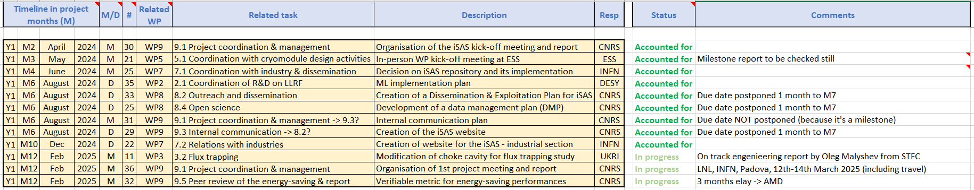
iSAS Coordination panel meeting
Work plan
Up to date with Milestones & Deliverables status by timeline for the 1st project year closing down:

Slide 14
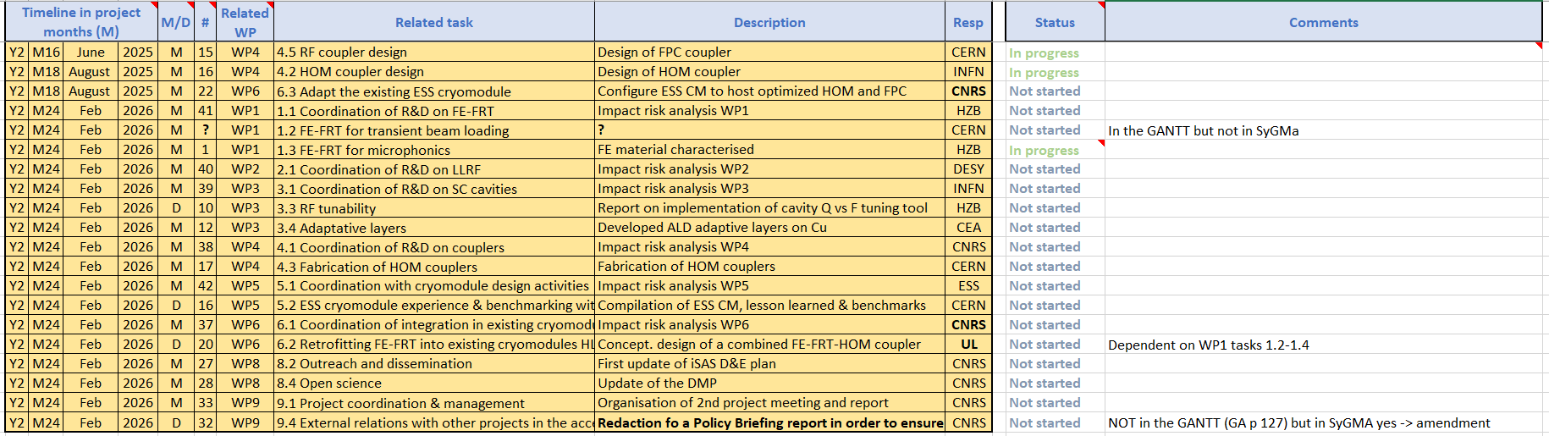
iSAS Coordination panel meeting
Work plan
Up to date with Milestones & Deliverables status by timeline for the 2nd project year opening up:

Slide 15
iSAS Coordination panel meeting
Work plan
Up to date with Milestones & Deliverables status by timeline for the 2nd project year opening up:
    3 for WP4 & WP6 in project months 16-18, June-August 2025
    17 in project month 24, Feb 2026, including 6 impact risk analyses for WP1-6, the update of D&E and DMP
    End of the 1st reporting period (RP) M24: periodic report expected 60 days after end of RP

Slide 16
iSAS Coordination panel meeting
Upcoming related meetings
Every other meeting the Coordination panel becomes the Steering committee (includes the WP leaders & deputies), so as to integrate a cross-coordination of feedback
Indico page for Coordination panel - Steering committee meetings
  Steering committee - April 4 at 10 am CET
  Coordination panel - May 16 at 10 am CET
  Steering committee – July 9 at 2 pm CET

Slide 17
Thank you!

