Slide 1


Coordination panel meeting
iSAS project
16th May, 2025

Slide 2
iSAS Coordination panel meeting
Agenda
Agenda items
Project status report
  Integration of Advisory Board recommendations
  CA, NDA & AMD update
  WP4 Fabrication of HOMs delay
  Work plan w/ up-to-date milestones & deliverables
AOB
Notes will be found in the Indico page
iSAS project Indico page

Slide 3
iSAS project status report
Coordination panel meeting
16th May, 2025

Slide 4
iSAS Coordination panel meeting
Integration of Advisory Board recommendations
WP7 response after the steering committee enclosed
  “The second part of the workshop showcased new industrial partners directly contacted by WP7. The aim was to broaden participation and introduce novel technologies not currently covered by the existing iSAS industrial partners”
  “The initial industrial workshop was also intended to establish preliminary contact between Research Infrastructures (RIs) and companies. In the coming months, WP7 will focus on strengthening these collaborations. A key objective is to organize industrial reviews of the project specifically to intensify this activity and foster closer cooperation.”

Slide 5
iSAS Coordination panel meeting
Integration of Advisory Board recommendations
Follow-up tools templates created to adjust the project coordination to integrate more granular info on:
  -> informal subtasks with their own timeline & status to pave the achievement path to get to formal milestones & deliverables
  -> test infra preparation & availability linked to subtasks for which they are going to be needed to get a better sense of the precise time sequencing that means
  -> interconnexions with other WPs including impact direction to anticipate cascading risks
The idea is to have the same follow up expectations for each WP to be on the same page and facilitate the coordination across WPs
The updating frequency would be every 2 months in the project data repository, so every odd-numbered project month, starting M15 May 2025

Slide 6
iSAS Coordination panel meeting
Integration of Advisory Board recommendations
Follow-up tools templates created:
  WPs work plans
    "WPX work plan M15 to be detailed" by May 30
    "WP4 work plan M15 update“ as an illustration for other WPs

Slide 7
iSAS Coordination panel meeting
Integration of Advisory Board recommendations
Follow-up tools templates created:
  Budget coordination level follow-up
    1 aggregating all WPs (tabs per WPs & per beneficiaries so it can be read either way) for the coordination follow-up
    1 template to send to conveners for internal reporting (here ex for WP1), a simpler version to make it easier to fill in
  To be discussed
    EPFL & UKRI to follow-up? They have separate dedicated funding (not EU grant beneficiaries)
    Matching funds evolutions to follow up?
    Updating frequency

Slide 8
iSAS Coordination panel meeting
Consortium Agreement, shared NDA, amendment
Ambition: signature process initiated in Padova, March 14
  Consortium Agreement (CA)
    v3 to be sent with shorter due date for last review before signature process
    New partners can participate in the reviewing process
  Shared NDA
    For industrial partners – can be done at the same time as CA
    Cryoelectra, Plasmatherm, Zanon not signed yet
  Amendment (AMD) to the Grant Agreement - postponed to 2nd trimester 2025:
    Nikhef written arguments for their implication in the iSAS project – in progress)
    WP4 written arguments for the modification of results, tasks, due dates – in progress

Slide 9
iSAS Coordination panel meeting
WP4 Fabrication of HOMs delay
CERN feedback relating to WP4 work plan, specifically Task 4.3 Fabrication of HOM couplers milestone 17 due M24 Feb 2026:
  “Regarding the HOM production, reporting the input we received from Marco Garlasche regarding production, we need to consider:
  To+4 months for procurement of Nb;
  Then 9 months for the fabrication of the 4 HOMs;
  The additional 4, if funded through iSAS, would need the same time, minus the procurement of Nb if the decision of procurement of material if made in time;”
Inclusion into AMD?

Slide 10
iSAS Coordination panel meeting
Work plan
Up to date with Milestones & Deliverables status by timeline:

Slide 11
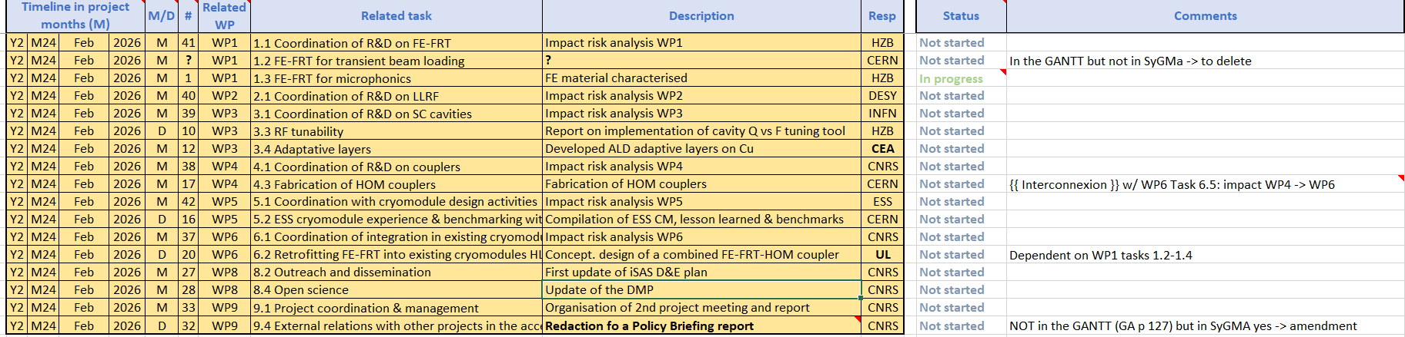
iSAS Coordination panel meeting
Work plan
Up to date with Milestones & Deliverables status by timeline:

Slide 12
iSAS Coordination panel meeting
Upcoming related meetings
Every other meeting the Coordination panel becomes the Steering committee (includes the WP leaders & deputies), so as to integrate a cross-coordination of feedback
Indico page for Coordination panel - Steering committee meetings
  Steering committee - July 9 at 2 pm CET
  Coordination panel - Sept 30 at 10 am CET
  Steering committee – Nov 4 at 10 am CET
  Coordination panel - Dec 16 at 10 am CET
  Steering committee – Jan 27 at 10 am CET
  Coordination panel – March 10 at 10 am CET
  Steering committee – April 21 at 10 am CET
  Coordination panel – June 2 at 10 am CET

Slide 13
iSAS Coordination panel meeting
Upcoming other project meetings
Governing Board meeting
  Online, Oct 1 at 2 pm CET
Mid-term Advisory Board meeting
  Online, Oct 7 at 9:30 am CET
2nd yearly project meeting
  Hosted by HZB in Berlin (w/ online connection as well), March 18-20, 2026
  To be cross-checked with KIT to coordinate with INFRATECH event

Slide 14
Thank you!

