Slide 1
Subjet structure as a Higgs search tool
Jonathan Butterworth
University College London
Paris, 30/7/2010

Slide 2
Subjets
Jets
Why now?
Jet substructure and QCD
Subjets and the Higgs

Slide 3
What is a Jet?
Protons are made up of quarks and gluons.
Quarks and gluons are coloured and confined – we only ever see hadrons.
A jet of hadrons is the signature of a quark or gluon in the final state.
The gross properties (energy, momentum) reflect the properties of the quark or gluon, and stand out above the rest of the event.
Jets algorithm.
Picture from Rick Field

Slide 4
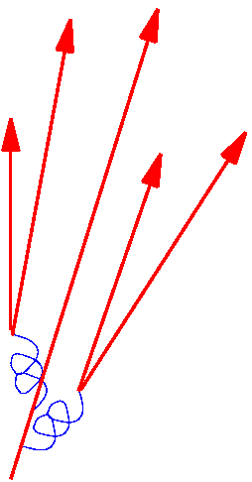
What is a Jet?
Evolution from a hard parton to a jet of partons takes place in a regime where:
Energy scale is high enough to use perturbation theory
X (momentum fraction of particles) is not very small
Collinear logarithms are large
Multiplicities can be large
This is largely understood QCD, and can be calculated
Hadronisation (non-perturbative) stage has a small effect (sub-GeV level) and is well modelled by tuned Monte Carlo simulation (e.g. Lund string)

Slide 5
Jet Algorithms
“Cluster” algorithms
Generally start from the smallest objects available, and perform an iterative pair-wise clustering to build larger objects (using either geometric or kinematic properties of the objects)
Sort of inverts the QCD parton shower idea
Lend themselves most naturally to substructure studies.

Slide 6
Cluster algorithms
Each has a distance measure, and merges the “closest” objects by this measure until some criteria is reached (could be a specified multiplicity, or “distance”)
Modern ones (k_{T}, Cambridge, anti-k_{T}) belong to a general class where the distance parameter is given as
p=1 for k_{T}, 0 for Cam/Aachen, -1 for anti-k_{T}

Slide 7
k_{T} algorithm
Catani et al Phys Lett B269 (1991); Nucl. Phys. B406 (1993); Ellis and Soper Phys Rev D48 (1993).
p=1
Successively merge objects with low relative k_{T}
If the k_{T}² of an object w.r.t the beam is lower than k_{T}² w.r.t anything else in the event divided by R², don’t merge any more; call it a jet.
Mimics (inverts) the QCD parton shower.
Soft stuff merged into the nearest hard stuff.
Can undo merging. Last merge is the hardest.

Slide 8
Cambridge/Aachen algorithm
Dokshitzer, Leder, Morretti, Webber (JHEP 08 (1997) 01; Wobisch and Wengler hep-ph/9907280
p=0
Successively merge objects with low relative Δ.
Objects with Δ² > R² not merged
Can undo merging. Last merge is the furthest away (so is often the softest).

Slide 9
Anti-k_{T} algorithm
Cacciari, Salam, Soyez JHEP 0804:063,2008
p=-1
Successively merge objects with high relative k_{T}
d_{ij} is determined soley by the k_{T} of the harder of i & j, and by Δ. Soft stuff within R² of a high k_{T} object will be merged with it. If two hard jets are close the energy will be shared based on Δ.
Shape of jet is unaffected by soft radiation.
Can undo merging but the order is not very meaningful since the hardest object sucks in everything around it regardless of the relative hardness of the splitting.

Slide 10
Why (are subjets suddenly more interesting) now?

Slide 11
Scales in the experiment
Proton mass ~ becomes possible to accurately calculate using perturbative QCD
around 1 - 5 GeV.
W, Z mass / electroweak symmetry-breaking scale / Higgs mass if it exists
around 50-250 GeV
Phase space
A few TeV

Slide 12
Scales in the experiment
For the lifetime of the experiment, there will be interesting physics objects around the electroweak scale.
Production of multiple EW-scale particles (W,Z,H,t…) and jets either directly or in cascade decays
Means we need the new calculations, especially Monte Carlos which match many-leg matrix elements to partons showers/resummations.
Copious production of EW-scale particles well above threshold
Means highly collimated decay products, and therefore interesting sub-jet structure for hadronic decays.
The LHC will be the first place we have ever seen this.

Slide 13
Subjets and QCD

Slide 14
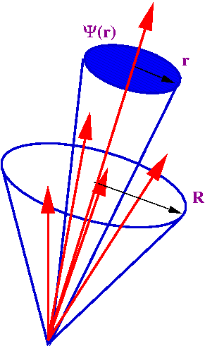
Jet shape
A way of measuring the energy distribution within a jet
Can be defined for any algorithm
Generally well modelled by leading-log parton showers
Understood well enough to be used to measure α_{s}

Slide 15
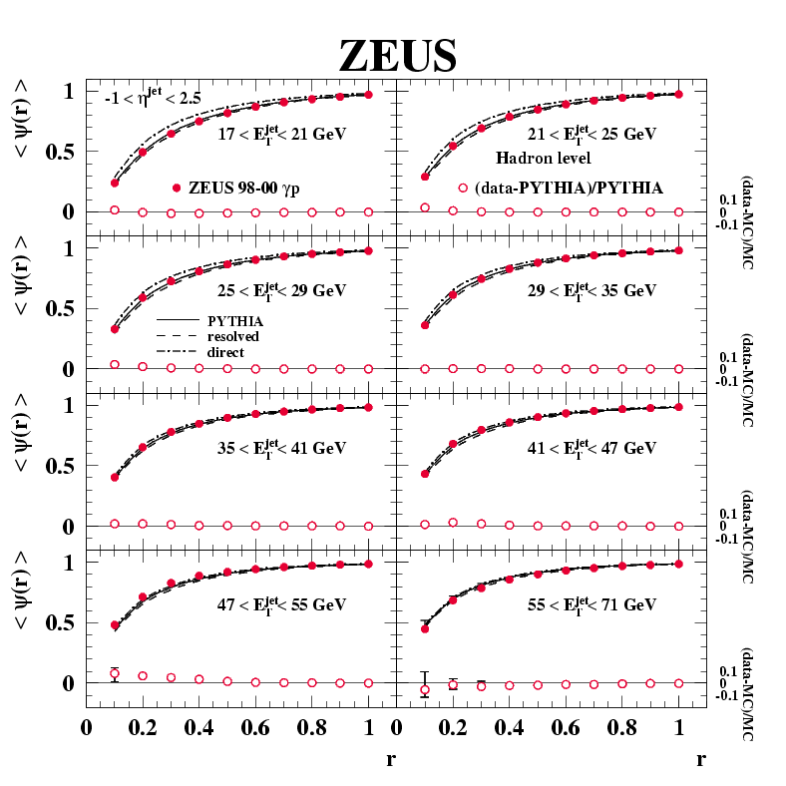
Jet shape
Example: Photoproduction (ZEUS, Nucl.Phys.B700:3-50,2004.)

Slide 16
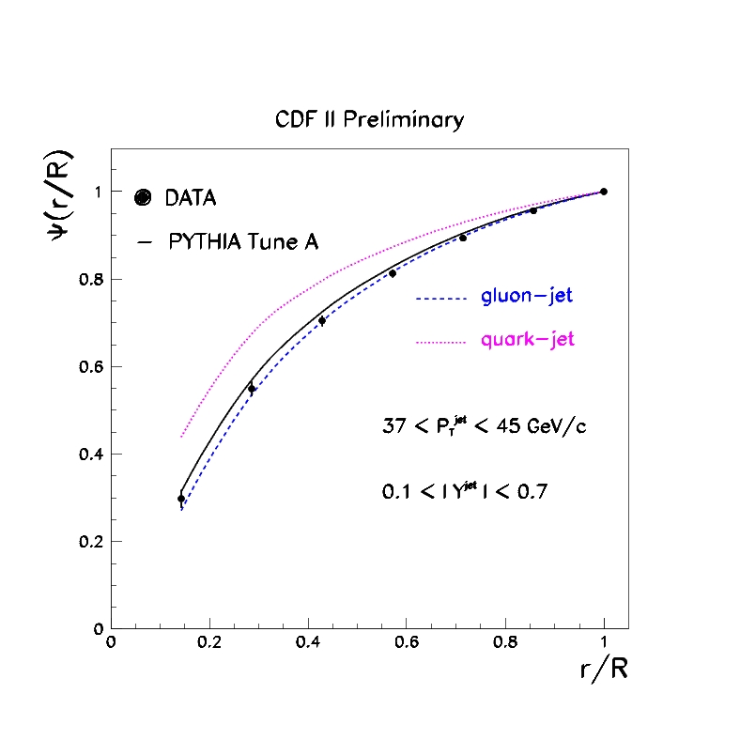
Jet shape
Example: proton-antiproton (CDF, Phys. Rev. D 71, 112002 (2005) hep-ex/0505013)

Slide 17
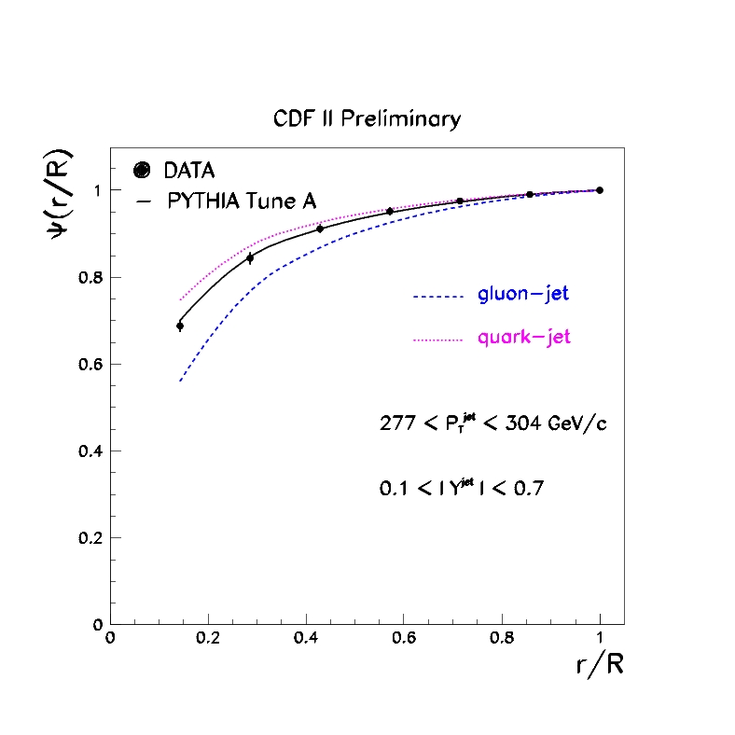
Jet shape
Example: proton-antiproton
(CDF, Phys. Rev. D 71, 112002 (2005) hep-ex/0505013)

Slide 18
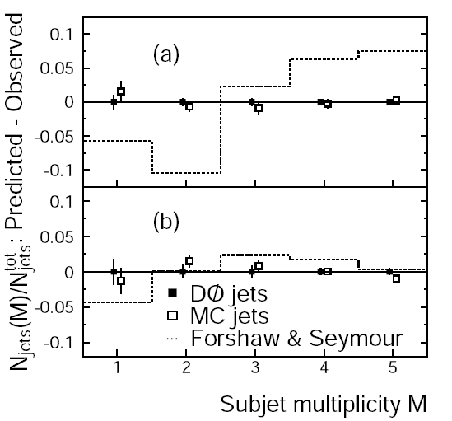
Subjets
Proton-antiproton Also well described by LL parton shower simulation.
(D0, Phys.Rev.D65:052008,2002. )

Slide 19
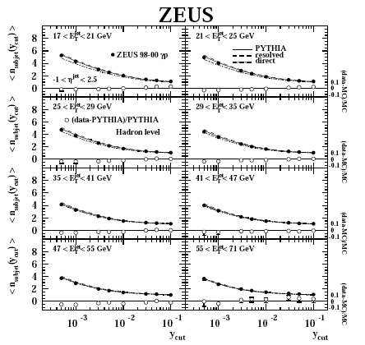
Subjets
Photoproduction Also well described by LL parton shower simulation.
(ZEUS, Nucl.Phys.B700:3-50,2004)

Slide 20
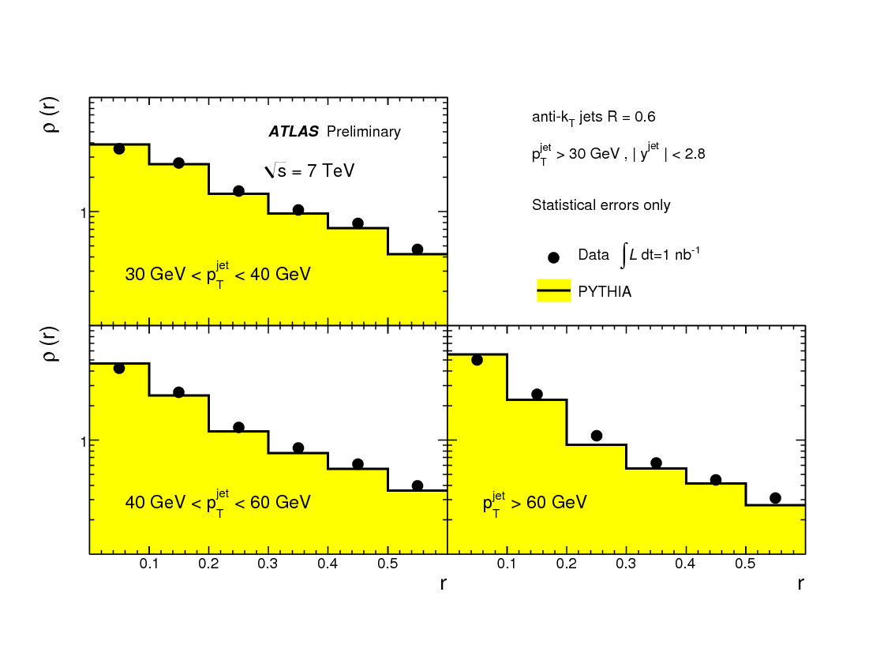
Jet substructure in ATLAS data

Slide 21
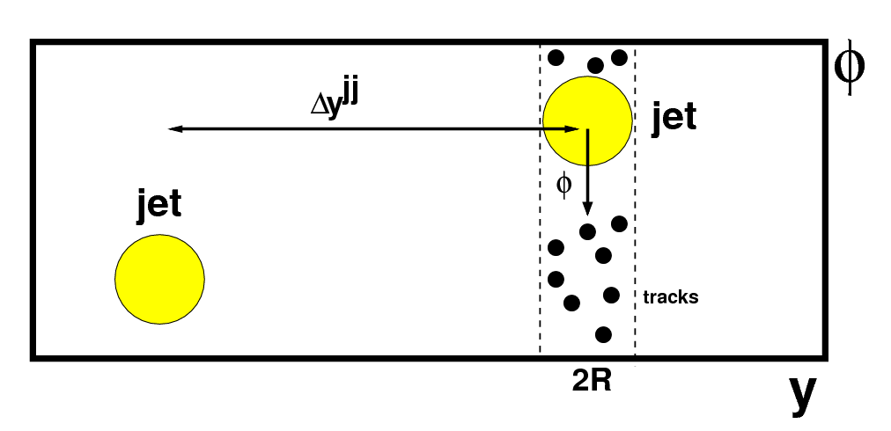
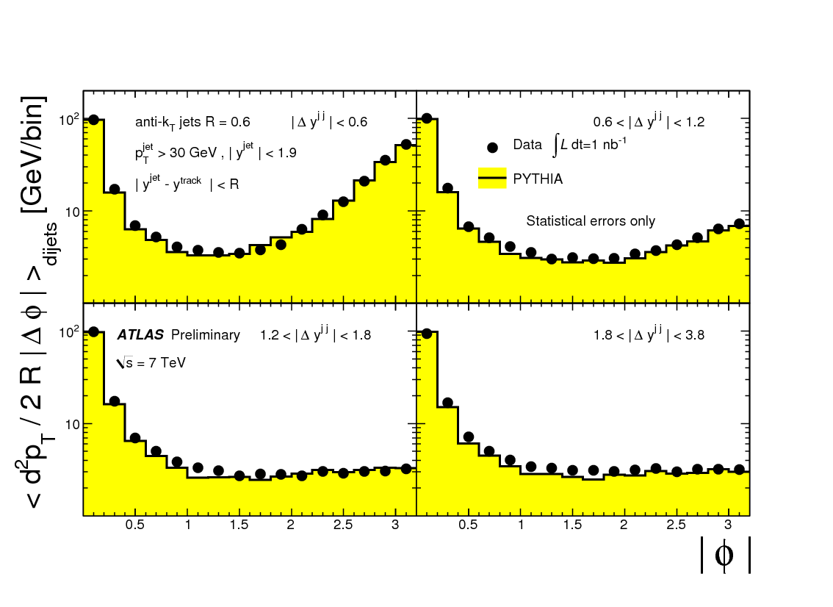
Jet substructure in ATLAS data

Slide 22
Jet Substructure
Two goals of the recently developed techniques
Improve the single jet mass resolution
Background suppression
Distinguish between QCD-generated high mass jets and those due to heavy object decays

Slide 23
Improved single jet mass resolution
First unclustering stages in C/A, throw away softer or more distant partner
JMB, Davison, Rubin, Salam, PRL 100, 242001 (2008).
Kaplan, Rehermann, Schwartz, Tweedie, PRL 101, 142001 (2008).
JMB, Ellis, Raklev, Salam, PRL 103, 241803 (2009).
“Filtering”: Rerun algorithm with tighter distance resolutions
JMB, Davison, Rubin, Salam
Variable R parameter
Krohn, Thaler, Wang, JHEP 0906:059,2009.
“Pruning” or “Trimming”: Remove soft splittings in (re)clustering
S. Ellis, Vermilion, Walsh, PRD 80, 051501 (2009).
Krohn, Thaler, Wang, arXiv:0912.1342 [hep-ph].

Slide 24
Background Suppression Distinguish between QCD-generated high mass jets and those due to heavy object decays
None-strongly order k_{T} scale
JMB, Cox, Forshaw, PRD 65; 096014 (2002).
Symmetric splitting
Kaplan et al, JMB et al
Anomalously large mass drop
JMB et al
Analytic jet shapes (planar flow etc)
Almieda et al PRD 79:074017,(2009).

Slide 25
Low Mass Higgs
Around 115 GeV no single channel is (was) above 3σ with 10fb⁻¹@14TeV
Need a combination of channels
WH, ZH with H ➔bb
Principal search channel at Tevatron
Not competitive at LHC…

Slide 26
Higgs + (W or Z)
q
Z
Z
_
q
H

Slide 27
Higgs + (W or Z)
Example: ATLAS Physics TDR (1999)
Poor acceptance
Cuts introduce artificial mass scale into the background
Top anti-top has a similar mass scale
Large combinatorial background
Signal swamped by backgrounds
“very difficult … even under the most optimistic assumptions”
Background
Signal + background

Slide 28
High p_{T} Higgs and Vector Boson
By requiring that the Higgs and Vector Boson have a high transverse momentum, we lose a factor of ~20 in cross section
However, much of this would have failed other analysis cuts anyway
Background cross sections fall by a bigger factor (typically t-channel not s-channel)
W/Z and H are all central
Better b-tagging, better jet resolution
W/Z and H decay products collimated
Simpler topology, fewer combinatorials
Difficult for tops to fake this
Z ➔ neutrinos becomes visible
High missing E_{T}
JMB, Davison, Rubin, Salam, Phys. Rev. Lett. 100, 242001 (2008)
“mono”-Jet
m_{H}
b
H
W
υ
l

Slide 29
Sub-jet analysis
Cambridge/Aachen algorithm
Dokshitzer et al ‘97, Wengler and Wobisch ‘98
Like “k_{T} without the k_{T}”
Work out ΔR_{ij} = √(Δφ² + Δy²) between all pairs of objects
Recombine the closest pair
Repeat until all objects are separated by ΔR_{ij} > R
We tried several values for R;
Main value chosen: R = 1.2
best value depends on p_{T} cut
Sensitivity not strongly dependent on the p_{T} / R combination
Having clustered an event this way, can then work through backwards to analyse a particular jet.

Slide 30
Sub-jet analysis
Start with Higgs candidate jet (highest p_{T} jet in acceptance) with mass m)
Undo last stage of clustering (reduce radius to R₁₂)
J ➔ J₁, J₂
If max(m₁,m₂) < 2m/3
Call this a “mass drop”. This fixes the optimal radius for reconstructing the Higgs decay. Keep the jet J and call it the Higgs candidate.
Else, go back to 2
Require Y₁₂ > 0.09
Dimensionless rejection of asymmetric QCD splitting
Else reject the event
Require J₁, J₂ to each contain a b-tag
Else reject the event

Slide 31
Sub-jet analysis
Define R_{filt} = min(0.3, R_{bb}/2)
Make use event-by-event of the known Higgs decay radius
Angular ordering means this is the characteristic radius of QCD radiation from Higgs products
Stuff outside of this is likely to be underlying event and pileup.
Recluster, with Cambridge/Aachen, R = R_{filt}
Take the 3 hardest subjets and combine to be the Higgs
b, anti-b and leading order final state gluon radiation
Plot the mass

Slide 32
Improved subjet analysis

Slide 33
Improved subjet analysis

Slide 34
Improved subjet analysis

Slide 35
Improved subjet analysis

Slide 36
Improved subjet analysis

Slide 37
Improved subjet analysis

Slide 38
Analysis Overview
Consider three cases
HZ, Z ➔ ee, μμ
HZ, Z ➔ νν
HW, W➔ e/μ + ν
Three non-overlapping selections
l + missing E_{T} + jet (“Leptonic W case”)
l⁺ l⁻ + jet (“Leptonic Z case”)
Missing E_{T} + jet (“Z ➔ neutrinos case”)
Common cuts
p_{T} Higgs candidate > 200 GeV, p_{T} VB candidate > 200 GeV
|η| < 2.5 (Higgs candidate and leptons)
p_{T} > 30 GeV, |η| < 2.5 (leptons)
No extra b jet (p_{T} >30 GeV, |η| < 2.5 ) or lepton passing these cuts.

Slide 39
Combined particle-level result
Note excellent Z peak for calibration
5.9 σ; potentially very competitive
bb branching information critical for extracting Higgs properties
“Measuring the Higgs sector” Lafaye, Plehn, Rauch, D.Zerwas, Duhrssen, arXiv:0904.3866 [hep-ph]
Studies within ATLAS are promising and nearly public.

Slide 40
Fully simulated detector
Included trigger, real ATLAS b-tagging algorithm, detailed tracking & calorimeter
Also include Wt background omitted from initial study.
Also included study of Wbb ME vs Wg->Wbb
Slight degradation w.r.t particle level, but still very promising

Slide 41
High p_{T} top and tt resonances
Kaplan, Rehermann, Schwartz, Tweedie
Use C/A technique, optimise b-tagging, use helicity information from top decay

Slide 42
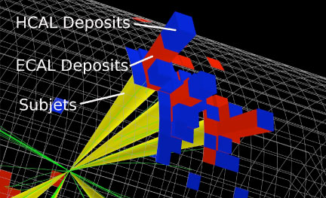
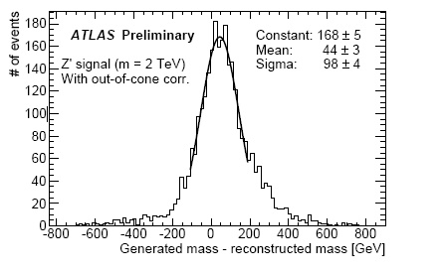
High p_{T} top and tt resonances
Ysplitter technique used by ATLAS (ATLA-PHYS-PUB-2009-081)
Improved C/A technique used by CMS ----------->
Both feasible, and some kind of subjet analysis is required to obtain best sensitivity.

Slide 43
Higgs and top together
Combine techniques for top and Higgs tagging to improve sensitivity to Higgs in ttH channel
Plehn, Salam, Spannowsky arXiv:0910.5472 [hep-ph]
Also use Higgs techniques in new physics events
Kribs, Martin, Roy, Spannowsky arXiv:0912.4731 [hep-ph]

Slide 44
Summary
Jet finding, jet mass, sub-jet technology, and the associated understanding of QCD, have come a long way since (and because of) the previous round of colliders.
Subjet analysis has dramatic benefits in H->bb search channels; looks very promising and practical, even after full detector simulation. (7 TeV needs more investigation)
At the LHC we have interesting physics at O(100 GeV), and phase space open at O(1 TeV). This means that a single jet often contains interesting physics. We probably haven’t yet appreciated all the consequences of this qualitatively new feature of physics beyond the EWSB scale

Slide 45
EXTRAS

Slide 46
Extra

Slide 47
Leptonic Z case
Common cuts, plus require
dilepton mass between 80 and 100 GeV

Slide 48
Z ➔ neutrinos case
Common cuts, plus require
Missing E_{T} greater than 200 GeV

Slide 49
Leptonic W case
Common cuts, plus require
missing E_{T} > 30 GeV
Lepton and missing E_{T} consistent with a W
No extra jets |η| < 3, p_{T} > 30 GeV

Slide 50
Combined result
Note excellent Z peak for calibration
5.9 σ; potentially very competitive
Also, unique information on relative coupling of H to Z and W.
Reasonably good up to about 130 GeV.

Slide 51
Combined result
Strong dependence of b-tag performance
Significance about 4.5σ for 60% efficiency/factor 50 rejection
Also strong dependence on jet mass resolution (not shown)

Slide 52
EXTRAS
Todo: )
Reduce LSP
Include ttH

Slide 53
Infrared Safety?
Adding an arbitrarily soft gluon to the event should not change the jets.
Non-infrared-safe jet algorithms cannot be used in higher order calculations.
so if we use them in the experiment we cannot compare to the best theory (at least without making some intermediate model-dependent correction).
Actually, infrared instabilities undermine the claim of a jet algorithm to be telling us about the short distance physics.
We should also worry about sensitivity to arbitrarily low noise, or arbitrarily soft pions, for example.
An example of an infrared instability is the “seed” in old cone algorithm. But there are others (e.g. in the splitting/merging)

Slide 54
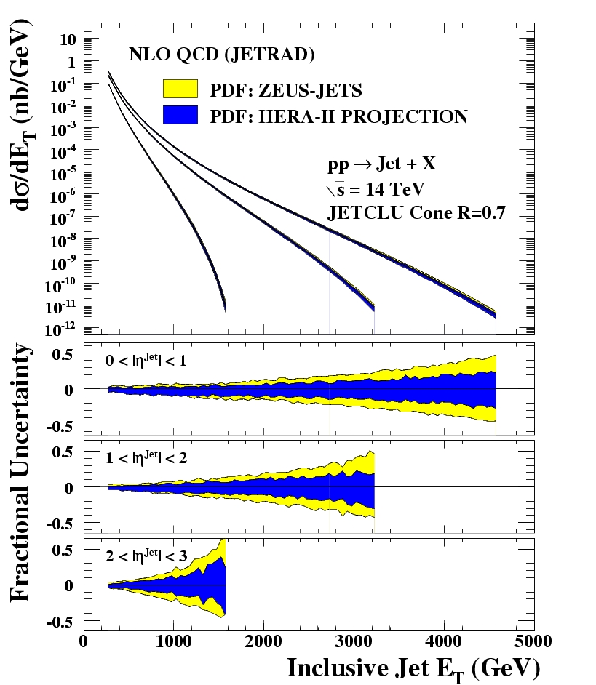
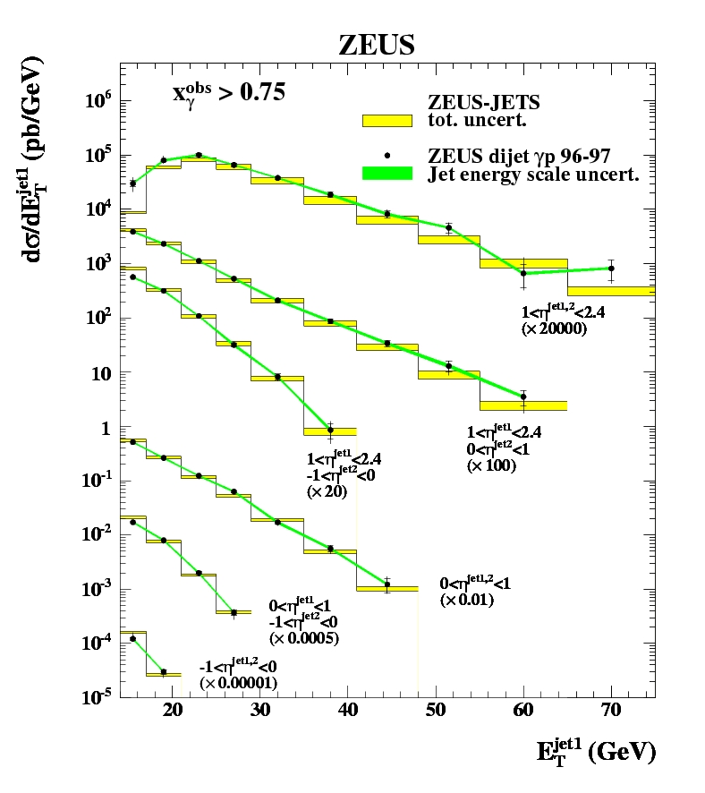
Precision Application
ZEUS Jet measurements
1% energy scale, k_{T} algorithm
Compared to NLO QCD, used in NLO PDF fits
Extrapolation: A. Cooper-Sarkar, C.Gwenlan, C.Targett-Adams, HERA-LHC Workshop, hep-ph/0509220

Slide 55
What is a Jet?
Jets are not just less-well-measured leptons or “smeared” partons.
Hard radiation interference at amplitude level
Matching at high scales with Matrix element
Matching at low scales with parton densities and hadronisation model
potentially useful information in the internal jet structure, and in particle/energy flow between the jets
Jets have no existence independent of the algorithm
even if the “algorithm” = event display + physicist

Slide 56
What is a Jet?
So jet algorithms don’t so much find a pre-existing jet as define one.
A “jet” (or a pattern of jets) is a complex QCD event shape, designed to reflect as closely as possible the short distance degrees of freedom (quarks, gluons, H, Z, W…)
The degrees of freedom themselves are generally not physical observables, but can only be extracted within some theory or model
The cross section for quark production in the final state at LHC is zero (unless we find something very exciting…)

