Slide 1
Generative AI at Carl ZEISS: Riding the runaway train
Now -- Dr. Ben Hoyle
Carl ZEISS
Advanced Technologies;
Scouting new cool ideas
Building early prototypes, getting people excited
AI [ML] /GenAI/ data modelling / Statistics / Databases
Then -- Dr. Ben Hoyle
PhD ICG Portsmouth Astro-statistics
Postdocs UK/ES/DE
Clusters of galaxies, correlation functions,
Machine learning, photometric redshifts
Biases in data! Doing new stuff with old data
SDSS/DES/Euclid/XXM/LOFAR/??

Slide 2
GenAI and why you should care
Why work for a company like ZEISS
How to prepare yourself now for a potential future transistion
Preparing the ZEISS workforce
Conclusions

Slide 3
What is Generative AI?
Jump on, in, and start using it right now.
”In the short term: GenAI will not replace experts. Experts who use GenAI will replace experts who don’t.”
-- A bunch of people.
"GenAI improvements are accelerating in their frequency.
A few months is a long time and the landscape changes drastically.
Constantly update any prior you have about this tech.” -- Ben

Slide 4
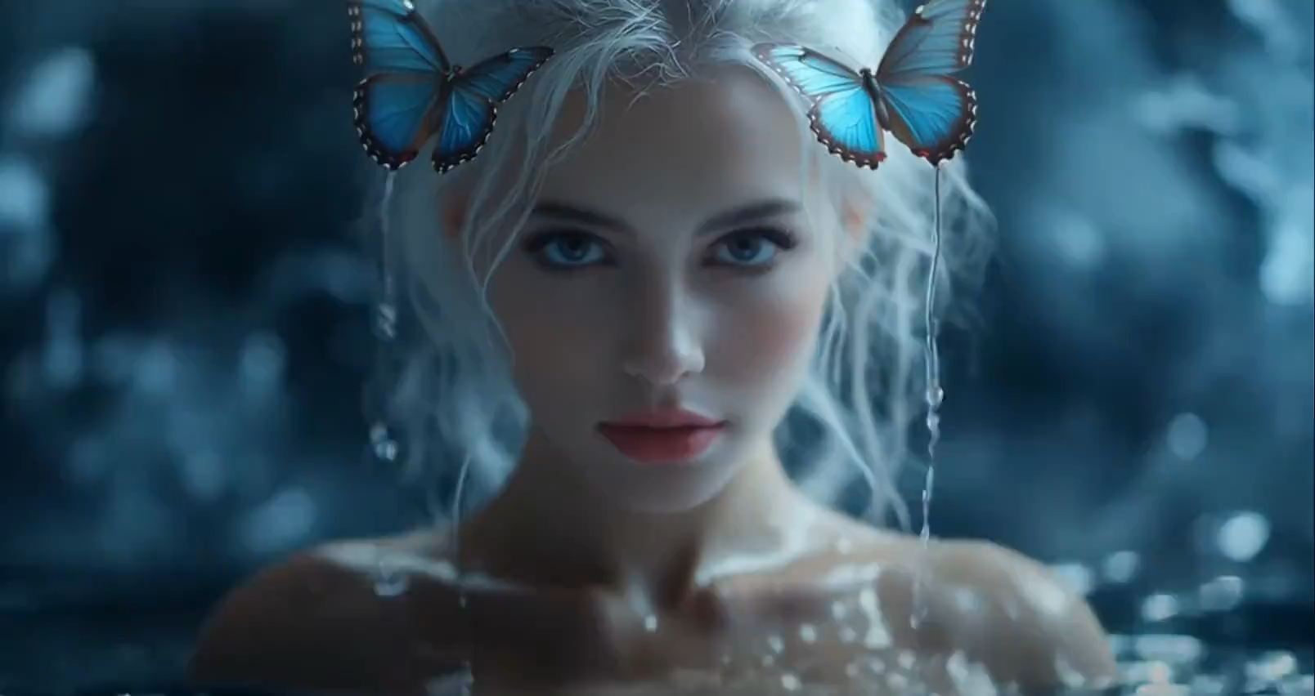
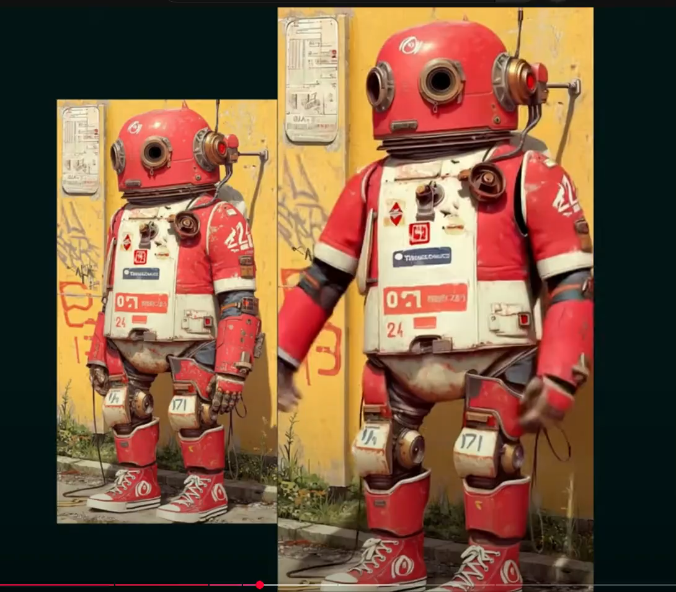
GenAI will keep getting better/scarier!
How can you use this tech?
Food for thought
Astro examples: Cool outreach videos in ~0 time.
ZEISS examples: not yet realised. Marketing materials, training videos.

Slide 5
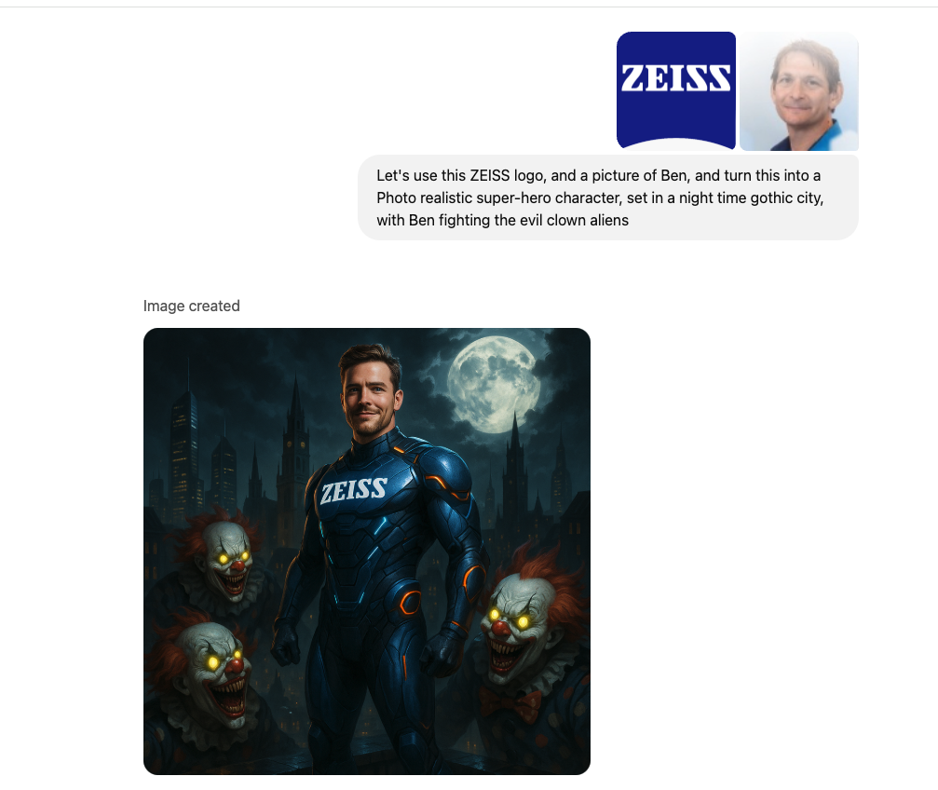
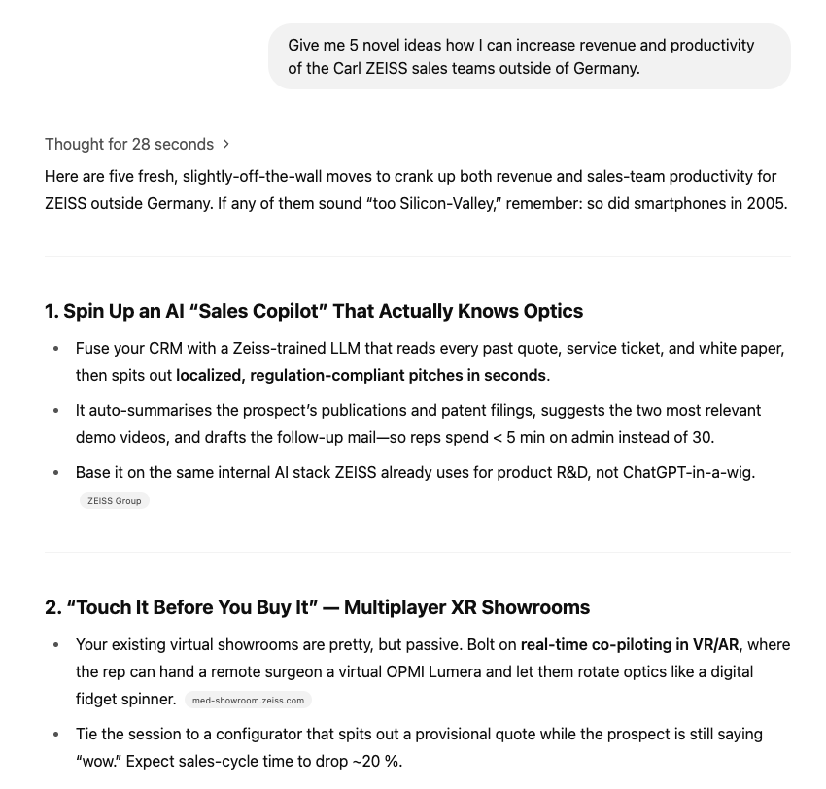
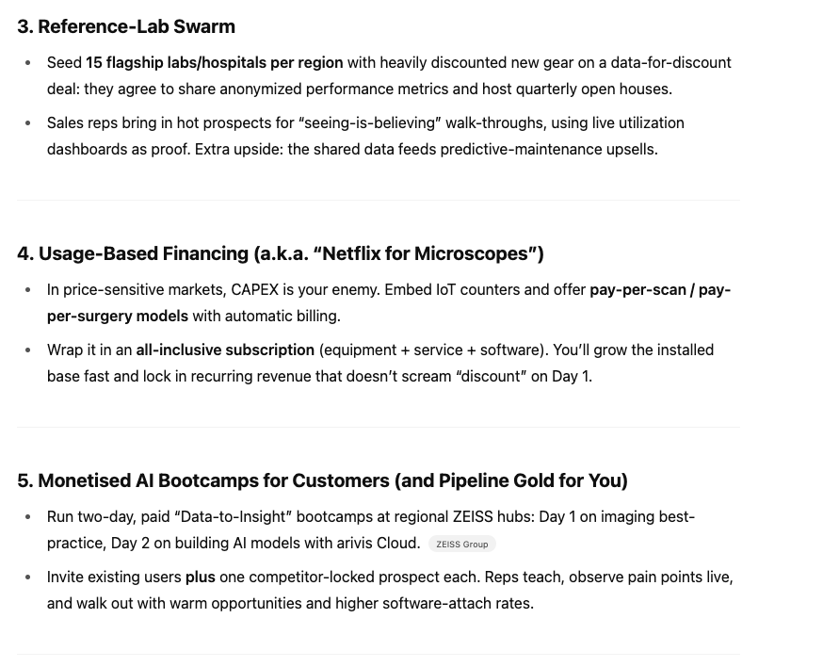
GenAI will keep getting better!
ZEISS example
Food for thought
Astro Example: Have it help write (and personalise) your job applications, proposals, research papers! Thesis! Introduction (e.g. deep research)

Slide 6

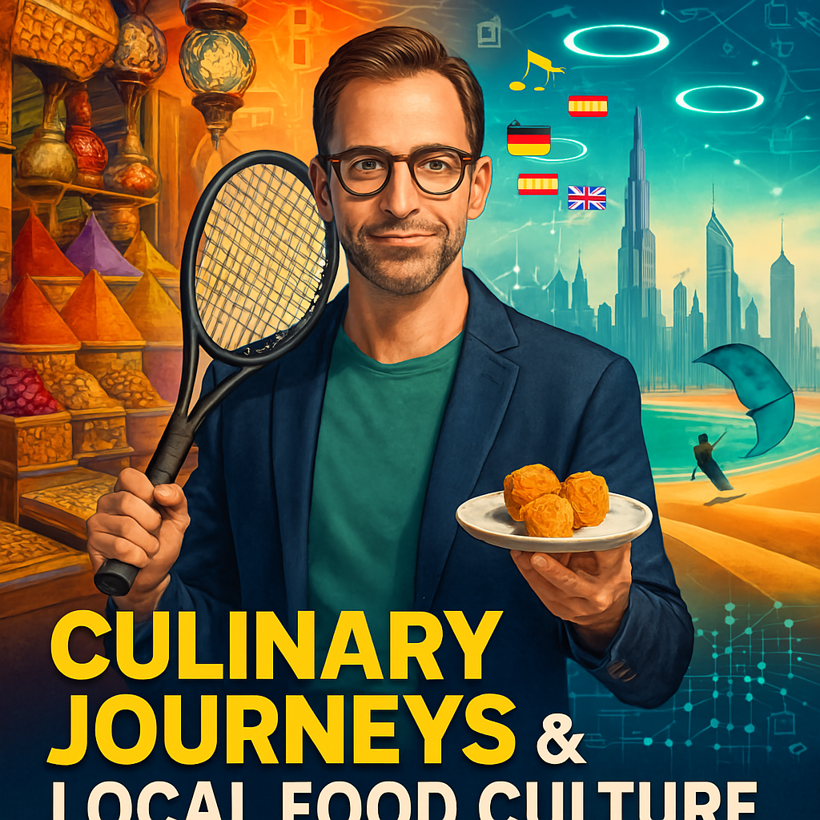


GenAI use-case @ ZEISS
ZEISS Example: Automatically generate podcasts, based on Ben’s interests: trip to Dubai in May 2025
Food for thought
Astro example: Create podcasts about your work for outreach
ZEISS example: Create training material, specific to a user, target knowledge base

Slide 7
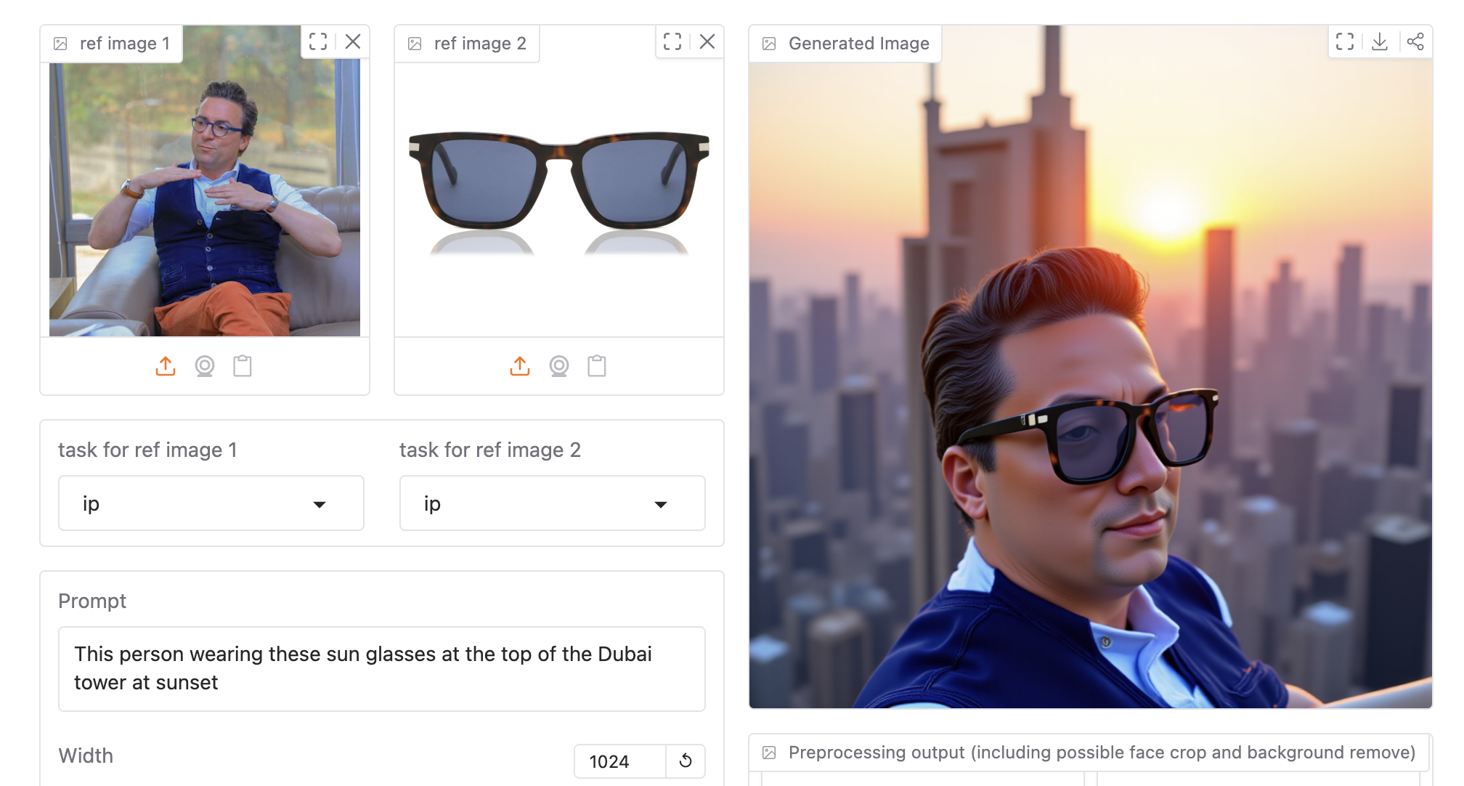
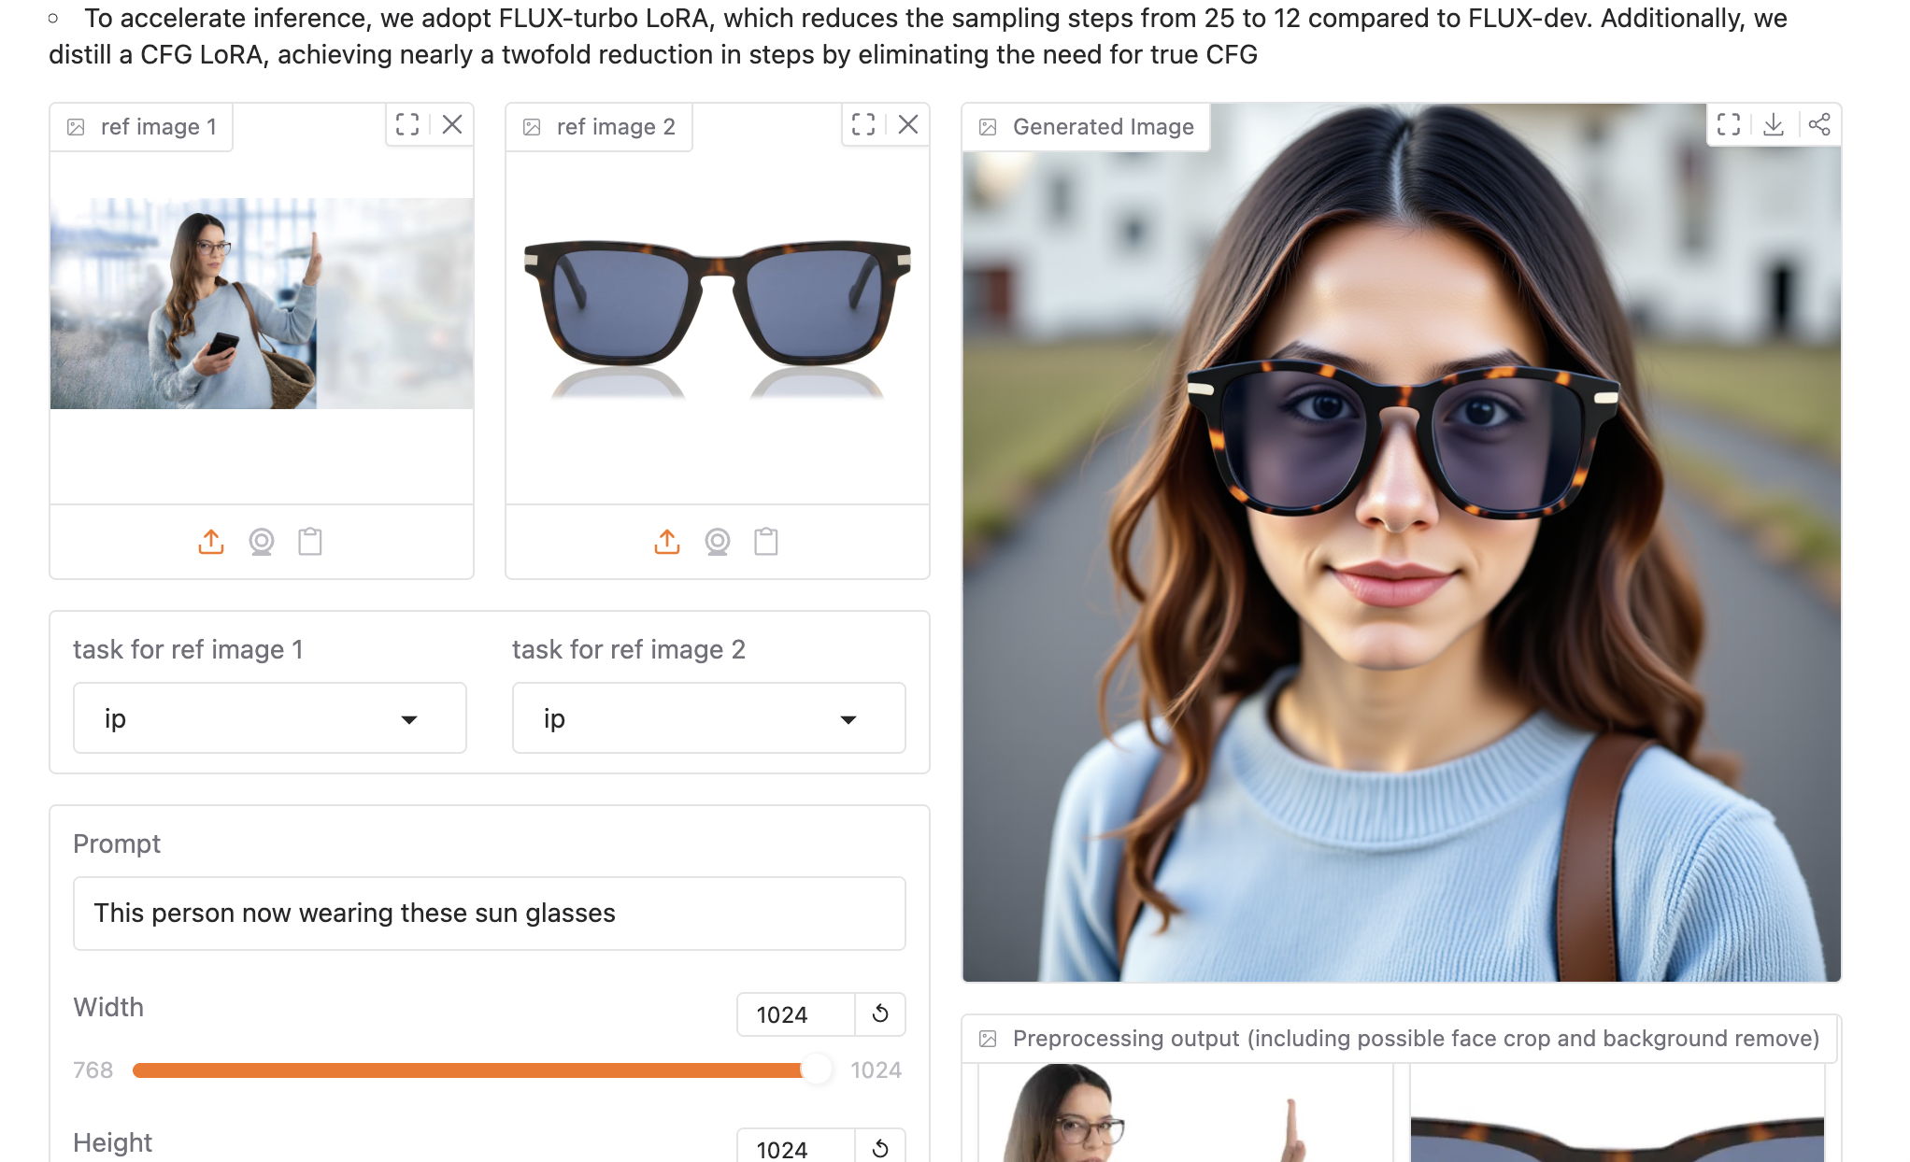
New tools coming online every day
Think about tomorrow’s tech today!
Food for thought
https://huggingface.co/spaces/ByteDance/DreamO
Within ~1-2 months, we will be able to make any image & even video editing changes that we like from refrence images/videos
https://framepack.co/
Astro example: Data inpainting, with correct properties → can this be extracted by e.g. S-eXtractor?
7
7

Slide 8
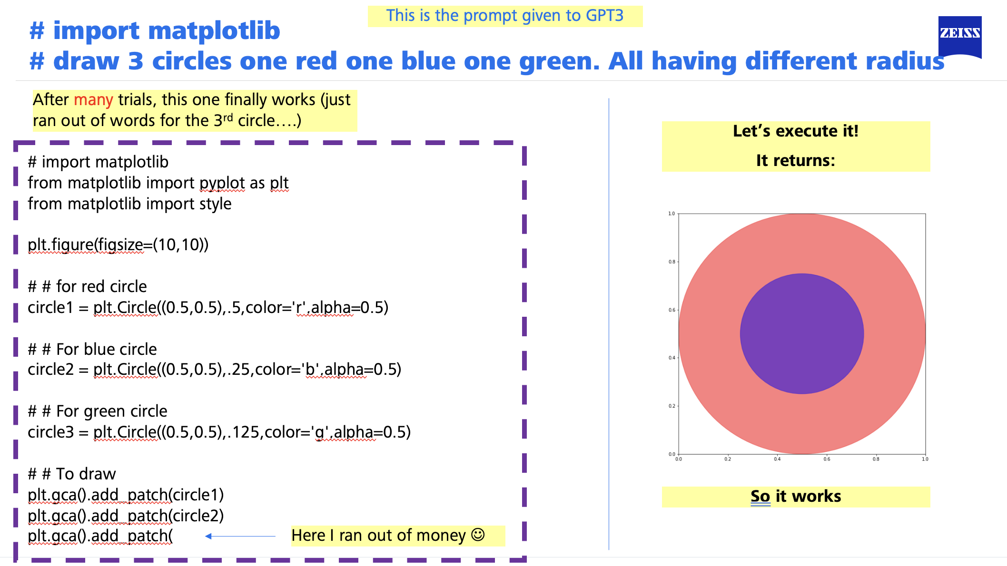
Nov ‘22: GPT 3 landed
ZEISS example: try to write a function
Food for thought
o1 + 20 seconds + 5 mins
implementation

Slide 9
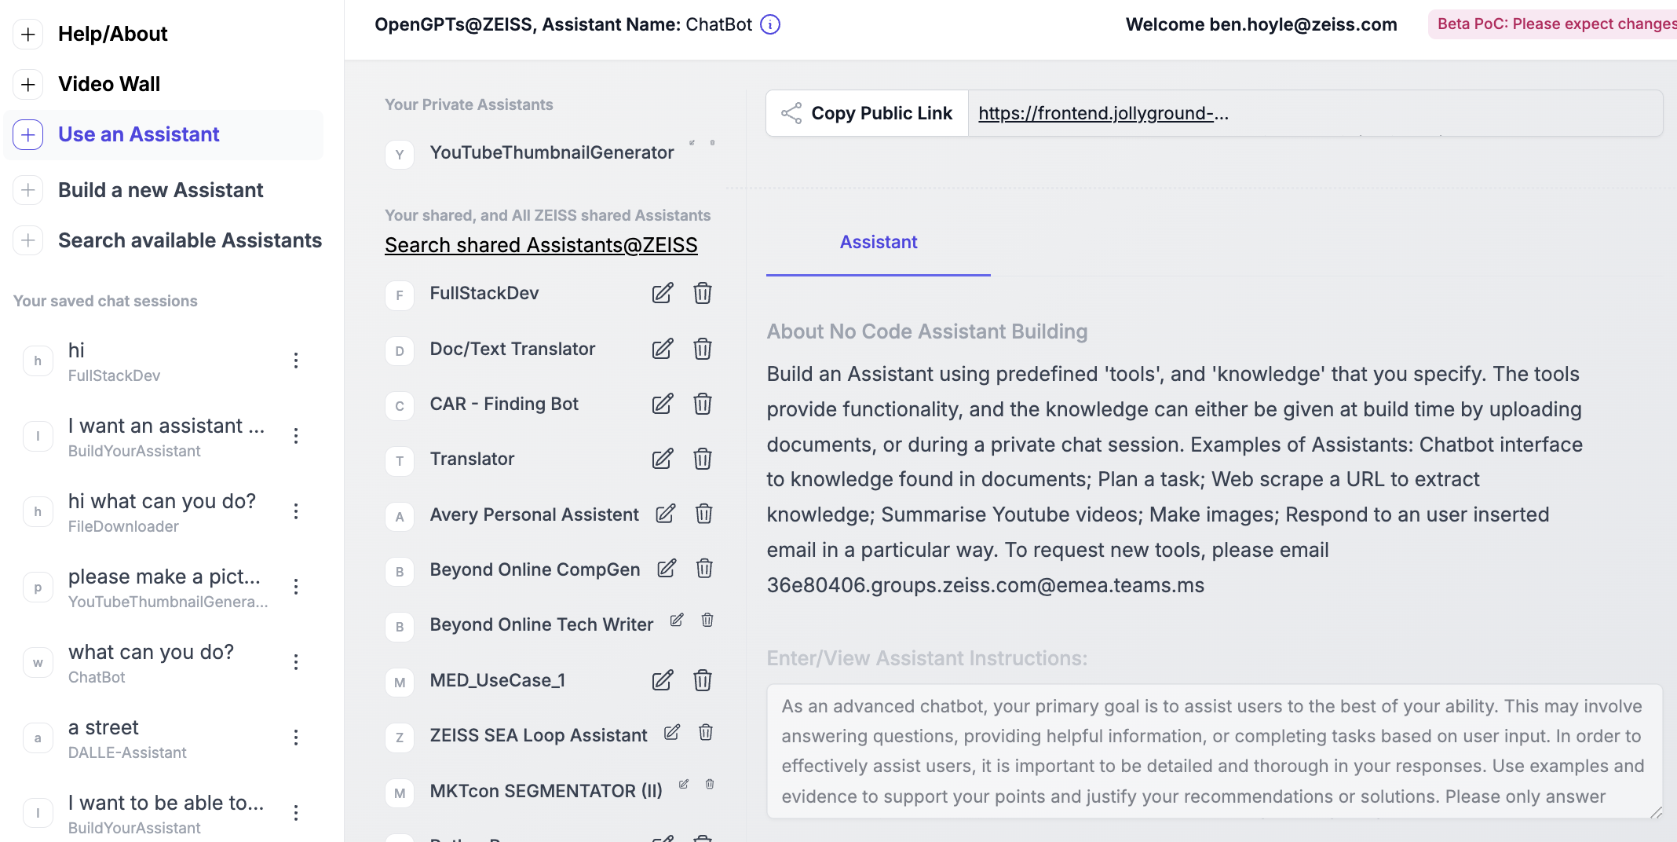
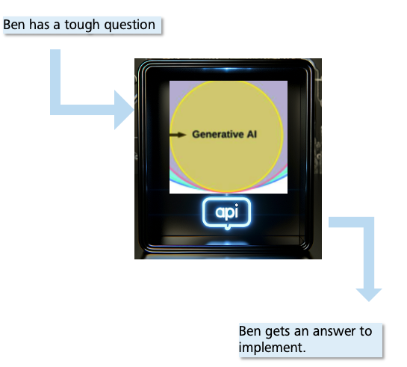
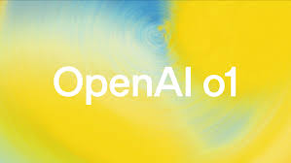
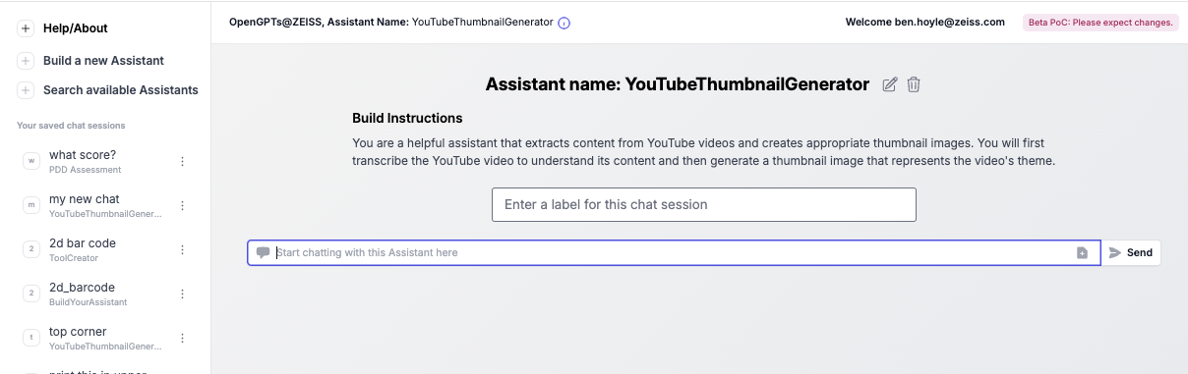
Dec ’24: GPT o1 landed
ZEISS example: 20 seconds of o1 thinking --> out of the box solution
Food for thought
Front end rebuild was as complex task that Ben had been putting off for 3 months. o1 solved it in 20 secs. With its eyes closed!
o1 + 20 seconds + 5 mins
implementation
Astro example: bug fixes in complex codes like CLASS/CAMB, particle mesh simulations,…

Slide 10
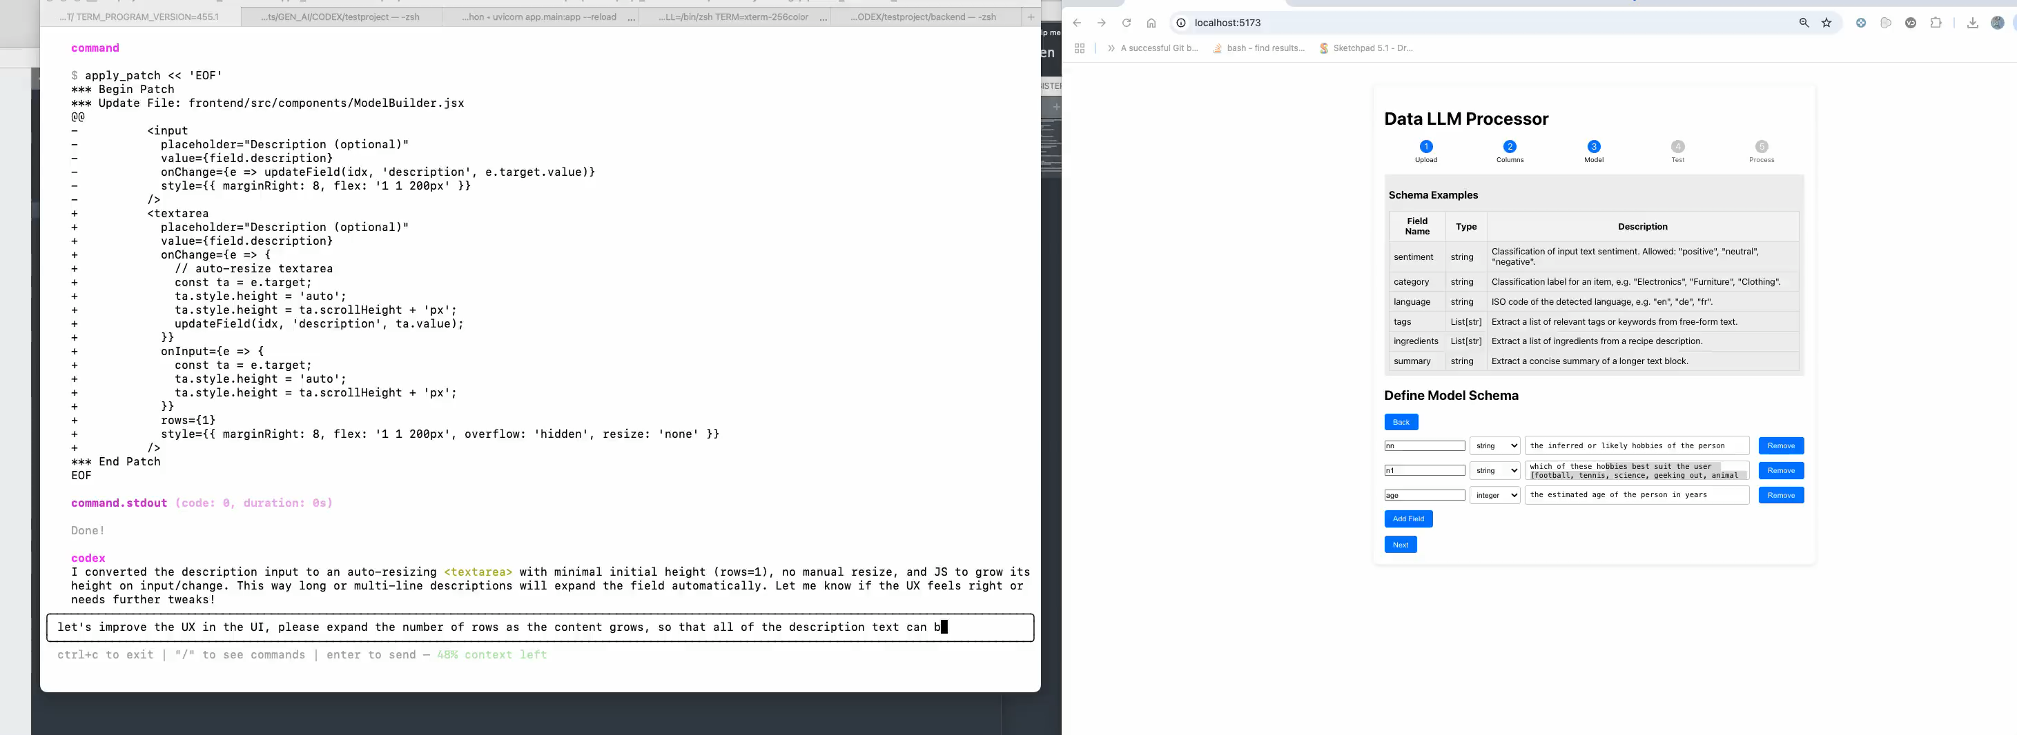
”Natural language VIBE coding”
ZEISS example Process tabular data *any-way* you define.
Food for thought
Astro example: re-write your crappy code! Add tests, documentation, refactor, add features. Rewrite from Fortran to Python!

Slide 11
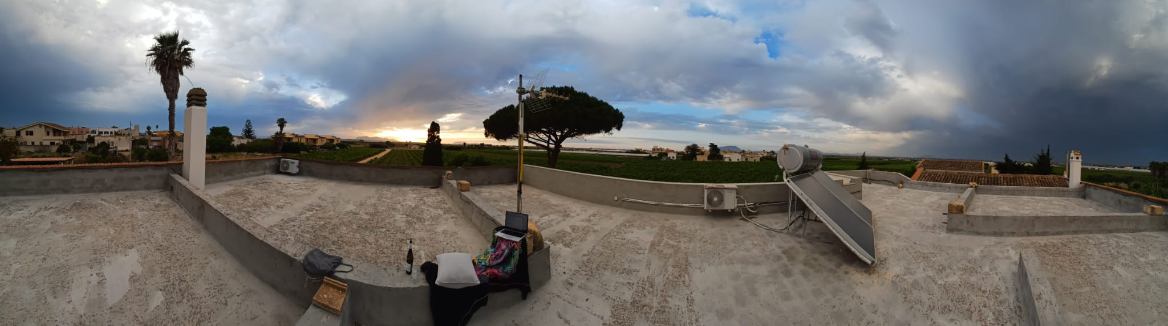
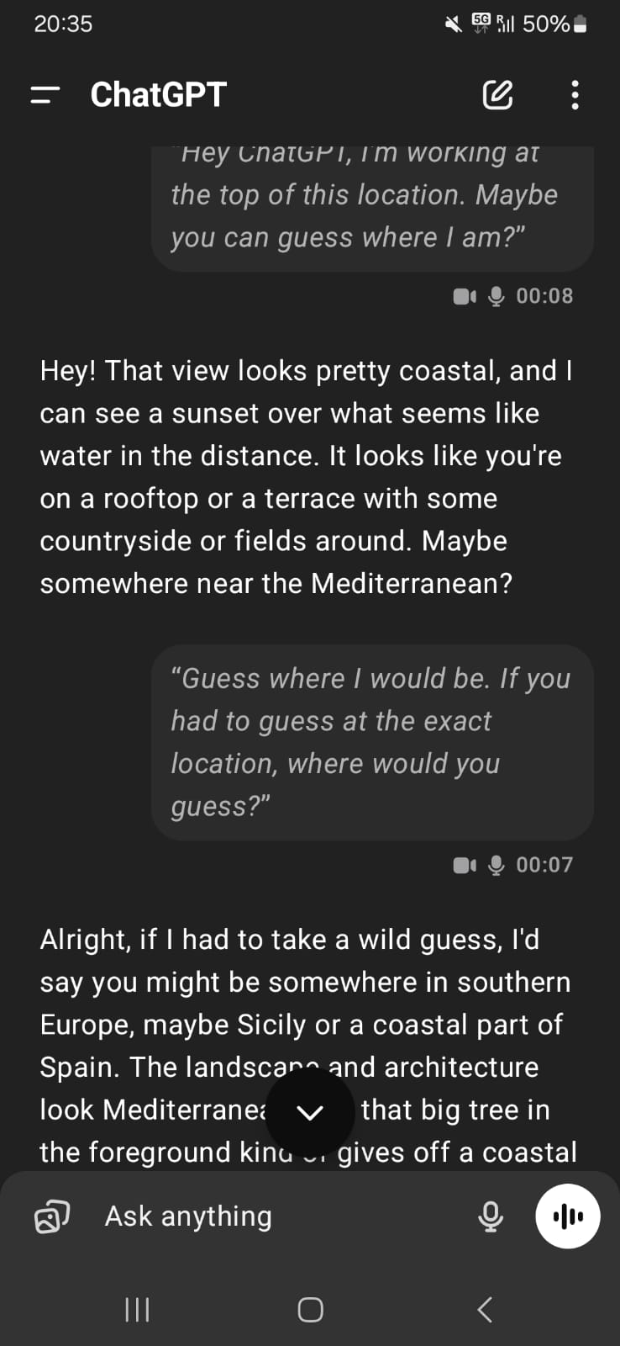
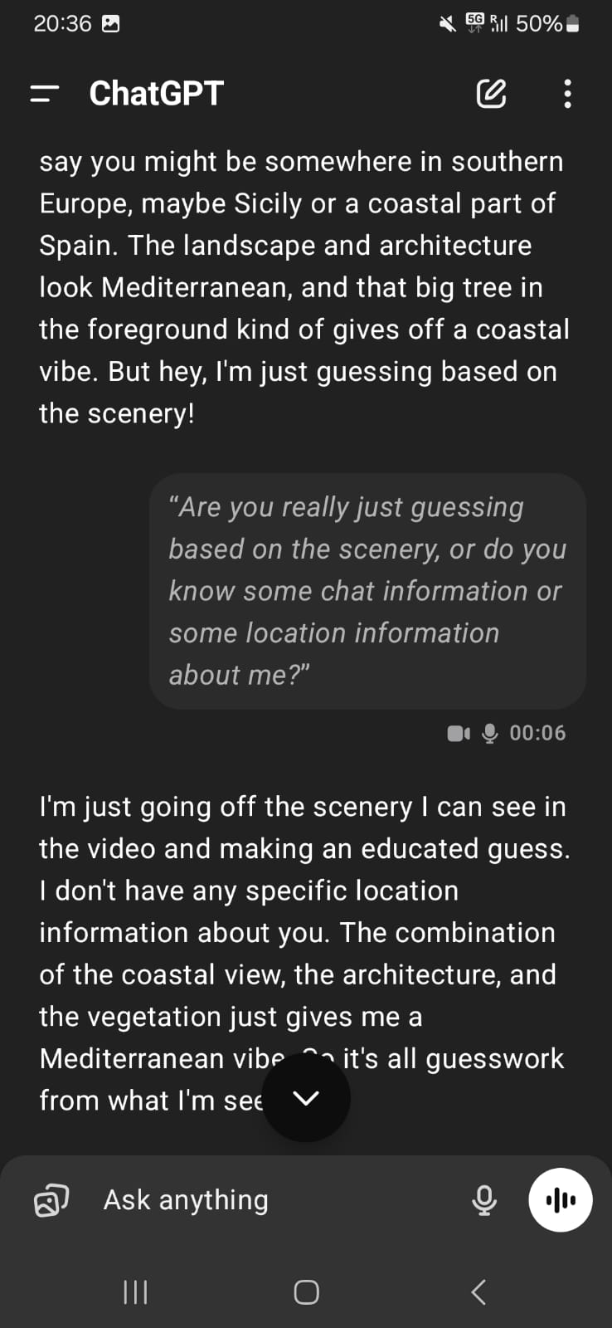
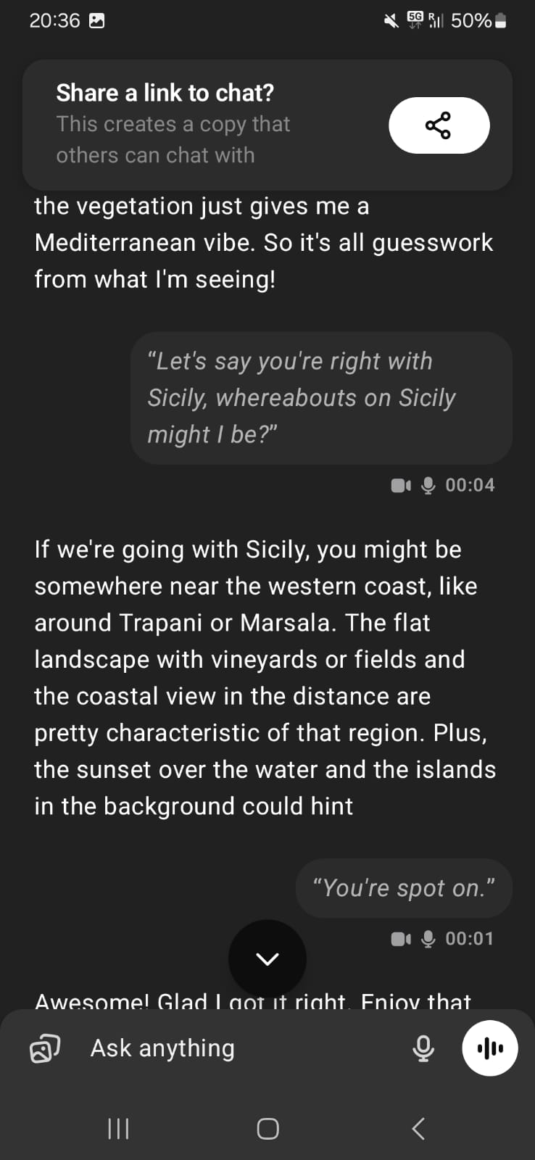
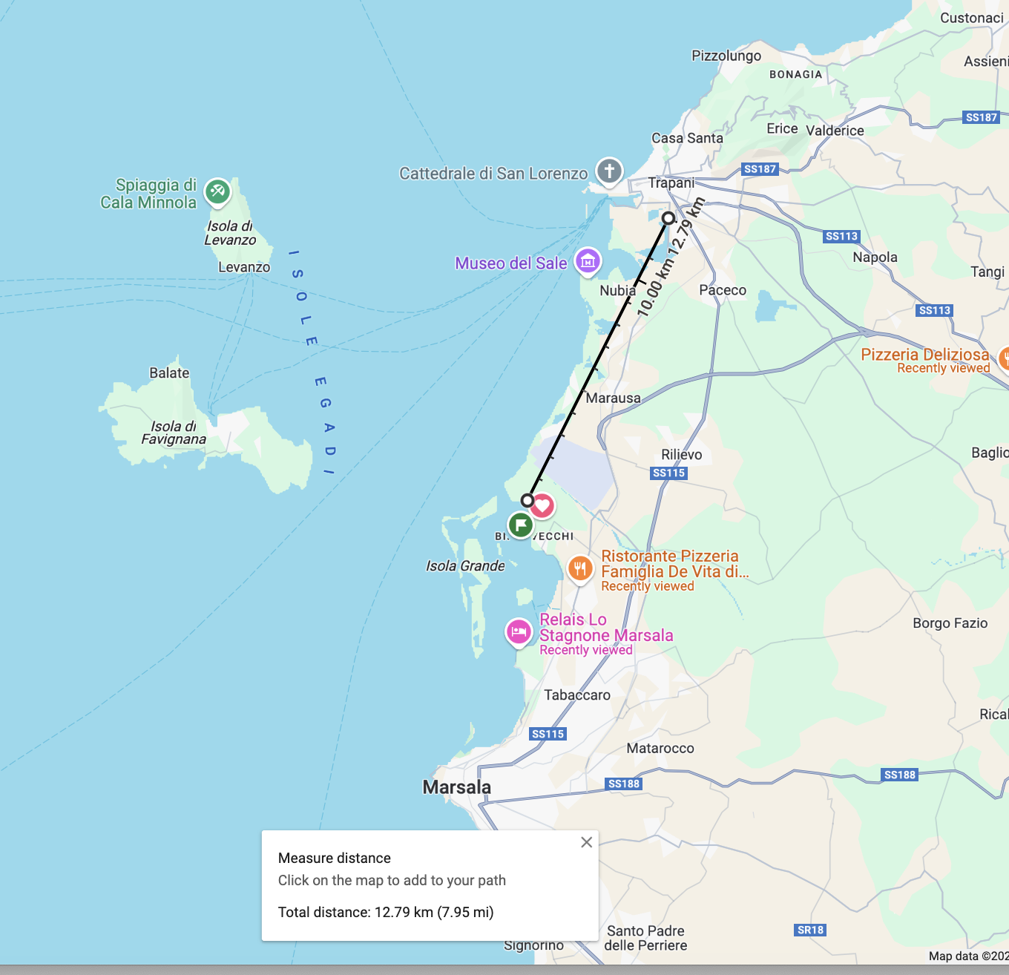
“Real Time Video Calls”
OpenAI’s ChatGPT video understanding is insane!
Ben was here: having a real time video call with his friend “ChatGPT”
Food for thought
Where’s Wally?
Ben also had it help him fix his bike!
Ben’s actual location!
13km
Astro example: no idea!

Slide 12
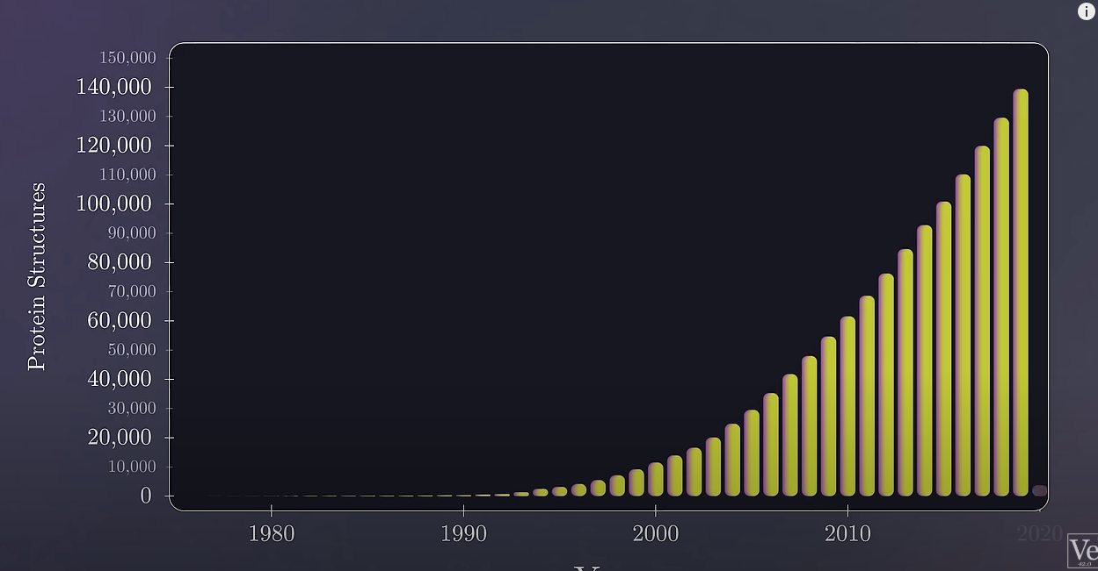
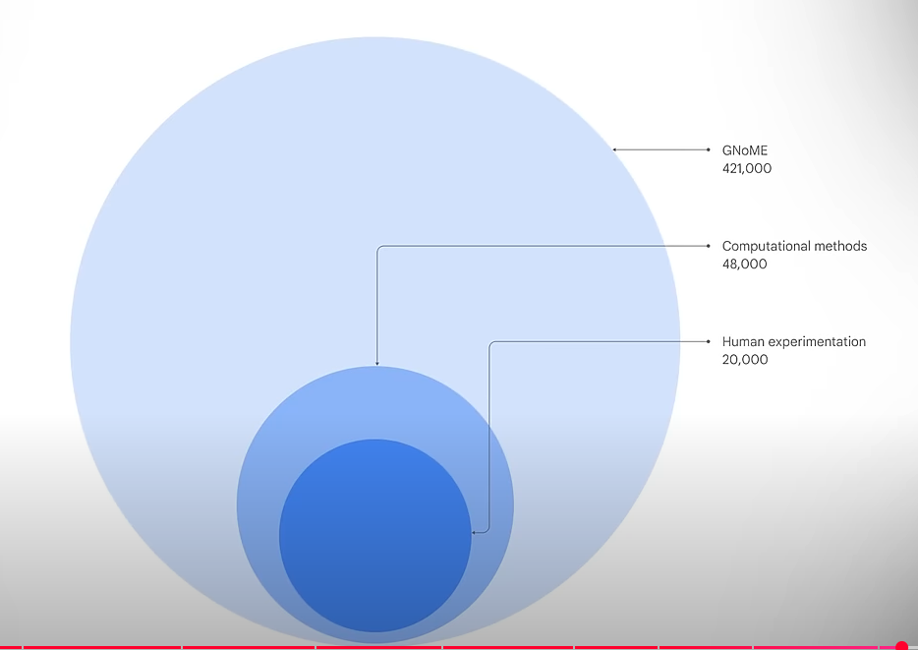
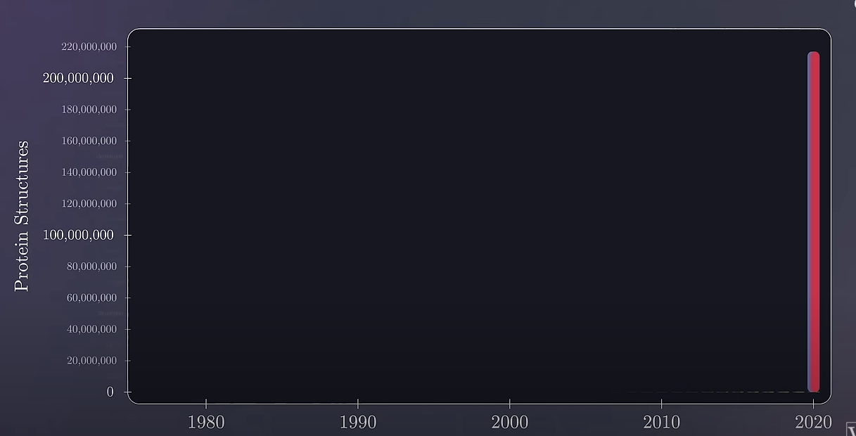
There is so much more!
Cost of compute <50% every 6 months.
Alpha fold 3
GNoME – Crystalline structures
o4-mini/o3
Field level medalist level mathematic reasoning & problem solving.
Oh! And the [~] best coder on the planet. – c.f. CODEX
Astro Example: Give it your paper / Idea and have it critique it, and do a literature search!

Slide 13
GenAI and why you should care
Why work for a company like ZEISS
How to prepare yourself now for a potential future transistion
Preparing the ZEISS workforce
Conclusions

Slide 14
Why work for a company like ZEISS
Generative AI will change jobs:
Find companies who protect their employees (Workers council in DE, Strong Trade Union presence)
Find companies who have ”technical expert progression paths” Expert ladder (Fachlaufbahn) e.g. Siemens/Bosch/ZEISS
Find companies which are owned by foundations, or employee owned, not share holder owned…. * -best guess
Find companies who want to adopt new technology early on, and invest in tech. 10% of ZEISS $$$ -> RnD

Slide 15
How do you prepare yourself for transitioning into Industry
Lack of Jobs at the top ==> likely to have to leave academia at some point.
Prepare yourself with tools/knowledge that will be useful both inside and outside of academia
Python! Go, other useful programming languages [COBOLT!!] and SOTA algorithms.
Write better code! GenAI can help train you.
Use as much AI (ML) in your day-to-day work as possible.
Adopt and be a heavy user of GenAI. Think how you can use it in novel ways
Stay up to date on newest changes in tech.
Improve your presentation skills (you are a salesman!)
Network: Meet ups, hackathons, LinkedIn!
Check job websites, see what cool jobs might be interesting
-> ask GPT what skills are needed for those roles
-> start upskilling
The future is bright! You are smart! You will find a nice job, in a nice company and be valued for your intelligence, and contributions

Slide 16
GenAI and why you should care
Why work for a company like ZEISS
How to prepare yourself now for a potential future transistion
Preparing the ZEISS workforce
Conclusions

Slide 17
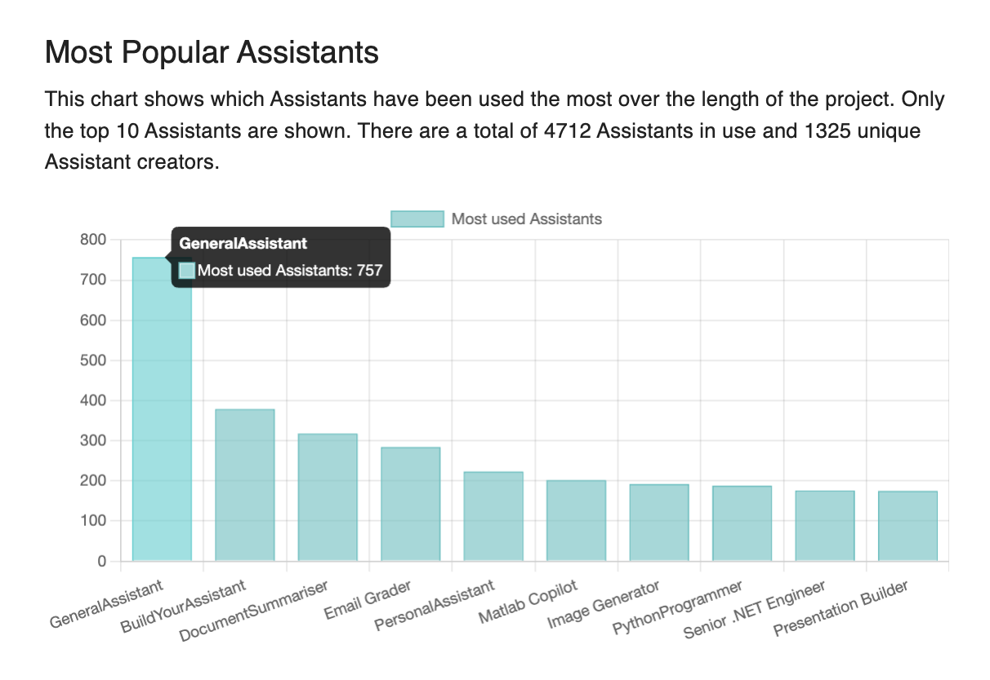
How are we upskilling the ZEISS workforce
45k employees, globally. Scared of GenAI -- and change ;)
We have grown an internal [Teams] Slack channel/community with 10% (4,500+) of employees
Monthly update meetings (recorded for all time Zones) of the workforce interested in staying up to date on GenAI activites
Secure ChatGPT interface used ~150k times a week
GPTs-like assistant builder used to create 5k assistants, by >1k employees
RAG type chatbots, embedded in existing workflows
-- every man and their dogs wants this.
Employee guidelines for compliant usage.
Assigned/optional Learning courses:
Prompt engineering, beginner, mid, advanced courses
Tool landscape
Natural language coding
Brining new tools to the company in a complaint way.
Sharing API keys to enable programmatic access to devs

Slide 18
GenAI and why you should care
Why work for a company like ZEISS
How to prepare yourself now for a potential future transistion
Preparing the ZEISS workforce
Conclusions

Slide 19
Conclusions.
”In the short term: GenAI will not replace experts. Experts who use GenAI will replace experts who don’t.”
-- A bunch of people.
"GenAI improvements are accelerating in their frequency.
A few months is a long time and the landscape changes drastically.
Constantly update any prior you have about this tech.” -- Ben
Think [ask o3] about how cheap, available, intelligence will change the problems facing humans/companies/science.
Keep your arms tucked in, and ride that wave!

Slide 21
Why GenAI at ZEISS?
Generative AI’s rapid evolution since 2022 has inspired new ways to innovate, collaborate, and work more effectively across ZEISS.
Our Response: A company-wide Knowledge Sharing initiative to unlock GenAI’s power for all employees—responsibly and securely.
Equip & Empower: Demystifying GenAI with courses, workshops, Datathons, and hands-on tools so employees can improve what matters most in their daily work.
Foster Collaboration: Connecting developers, “citizen developers,” and end-users through multi-role events, shared projects, and peer learning.
Ensure Compliance & Trust: Embedding responsible AI values through robust guidance, anonymization tools, and continuous partnership with the RAI Office and compliance teams.

Slide 22
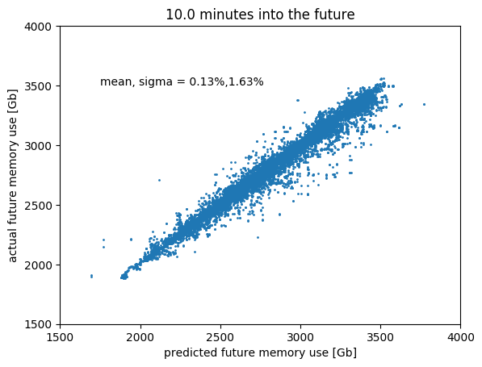

Carl Zeiss other types of Data Science
Predictive maintence:
When will production line machine fail?
When will countries shut down/open up Covid?
When will computing clusters run out of memory?

Slide 23
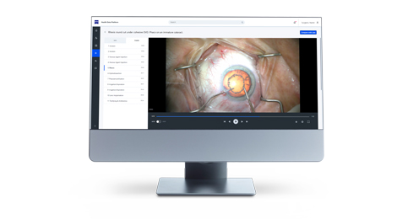
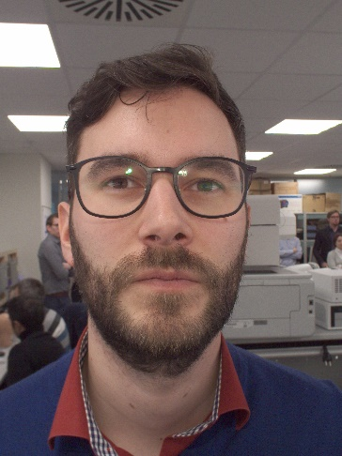
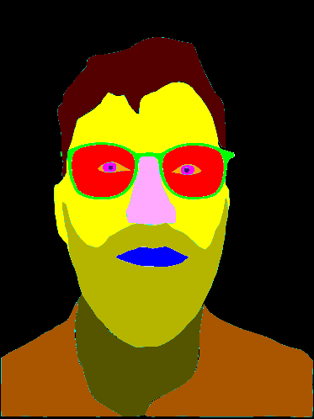
Carl Zeiss other types of Data Science
Predictive maintence:
When will production line machine fail?
When will computing clusters run out of memory?
Image based Deep ML:
Segmentation: helping opticians/surgens with AR highlighting of body parts
Fault detection of lenses during manufactoring
A.R. labelleing of features during surgery, using live video feeds
Hoyle: Carl Zeiss

Slide 24
Carl Zeiss other types of Data Science
Predictive maintence:
When will production line machine fail?
When will computing clusters run out of memory?
Image based Deep ML:
Segmentation: helping opticians/surgens with AR highlighting of body parts
Fault detection of lenses during manufactoring
A.R. labelleing of features during surgery, using live video feeds
Recommender Systems:
Glasses/Frames for consumers
Products that can run on different machines
Hoyle: Carl Zeiss

Slide 25
Carl Zeiss other types of Data Science
Predictive maintence:
When will production line machine fail?
When will computing clusters run out of memory?
Image based Deep ML:
Segmentation: helping opticians/surgens with AR highlighting of body parts
Fault detection of lenses during manufactoring
A.R. labelleing of features during surgery, using live video feeds
Recommender Systems:
Glasses/Frames for consumers
Products that can run on different machines
Automation of repeated human tasks:
A task “input -> (human) -> output” has been performed many times
→ can we use ML/Algorithms to approximate (human)?
– yes/no/some of time. – speed up processes, save costs.
Hoyle: Carl Zeiss

