Slide 1

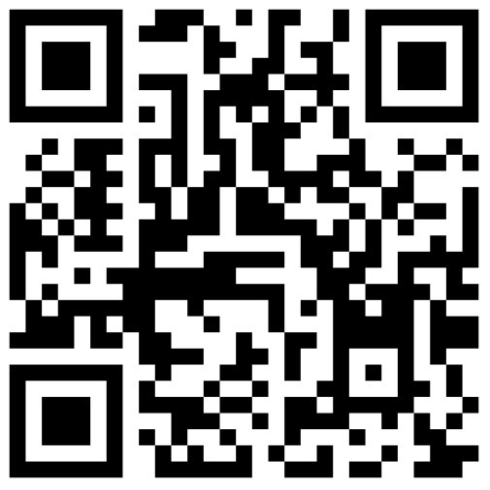
BARYON-FREE S₈ TENSION WITH STAGE IV COSMIC SHEAR SURVEYS
Ottavia Truttero, Joe Zuntz, Alkistis Pourtsidou, Naomi Robertson​
2410.18191​
COLOURS Workshop - 11/06/2025

Slide 2
Context and goal
Non-linear effects play a crucial role at small scales
Stage IV surveys will be very precise → important to investigate small scales, but large-scales only can also be quite informative
Goal: what can we learn from scales non affected by baryonic feedback considering a LSST Y1 like shear survey?
COLOURS Workshop - 11/06/2025
Notes:
Studying NL effects such as baryonic effects is becoming more and more important as they play a crucial role at small scales.
However, since stage IV as Rubin is such a precise instrument, we hope to find that even by masking out the small scales, we will still be able to effectively constrain cosmological parameters.
For this reason, we explored the remaining constraining power of these scales when discarding the scales affected by baryonic feedback, considering LSST Y1-like shear survey.

Slide 3
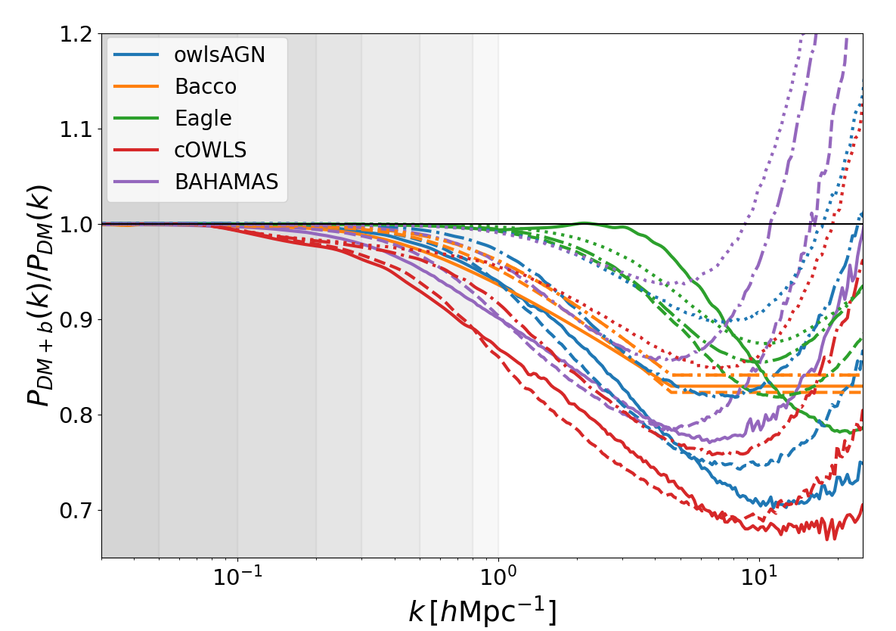
Weak lensing and baryonic feedback
Baryons affect small scales (dominant for k≳0.1 hMpc⁻¹)
Suppression factor in the power spectrum
Baryonic model considered:
  BAHAMAS
  OWLS-AGN
  cOWLS
  Eagle
  Bacco emulator
  DM-only
Fixed baryonic parameters
Scale cuts considered in this work
AGN
gas cooling
14/01/2025
COLOURS Workshop - 11/06/2025
Notes:
Modelling baryonic feedback is crucial for Stage-IV surveys, as it is required for accurate interpretation of cosmological data. It's been proven that ignoring these effects can lead to biased result for Ωm and σ8.
A variety of different simulation campaigns have been built to quantify and model the effect of baryons in cosmological analyses.
In general, the feedback net effect is quantified by a boost factor obtained by comparing the matter power spectrum from a full baryonic physics simulation with a dark matter-only scenario.
[plot] -> effect of the boost factor on the power spectrum at different redshift. In grey are represented the scale cuts we used in this work (I'll explain better in the next few slides).

Slide 4
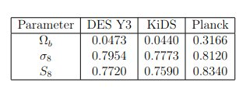
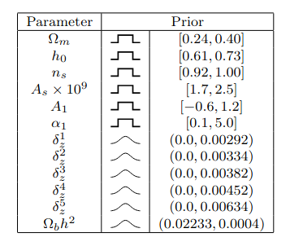
Analysis – mock data
Fiducial values
Priors
LSST Y1-like cosmic shear mock data
  Linear P(k) computed with CAMB
  Non-linear corrections added with EuclidEmulator2
  Baryonic model as described previously
  NLA-z as IA model
Analysis performed with nautilus sampler, with different baryonic models
14/01/2025
COLOURS Workshop - 11/06/2025
Notes:
Only omega_m and sigma8 for fiducial + planck

Slide 5
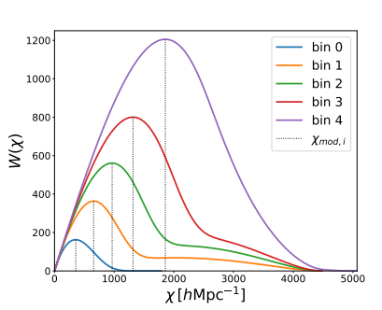

Analysis – scale cuts
Advantage: model independent
Disadvantage: discards a (significative) fraction of the data
Our physical description of scale cuts:
l_{min} = 20 (fixed)
k^{eff}_{max} = [0.05, 0.10, 0.20, 0.30, 0.50, 0.80, 1.00]
14/01/2025
COLOURS Workshop - 11/06/2025

Slide 6
Analysis – tension metric
We want to estimate the tension between our results and Planck measurements
S₈ tension measured with the parameter shift method, using tensiometer code by Raveri&Hu2019
→ Monte Carlo estimator which calculates the parameter difference probability density – i.e. probability of having a shift between two parameters – and the corresponding effective number of sigma
14/01/2025
COLOURS Workshop - 11/06/2025

Slide 7
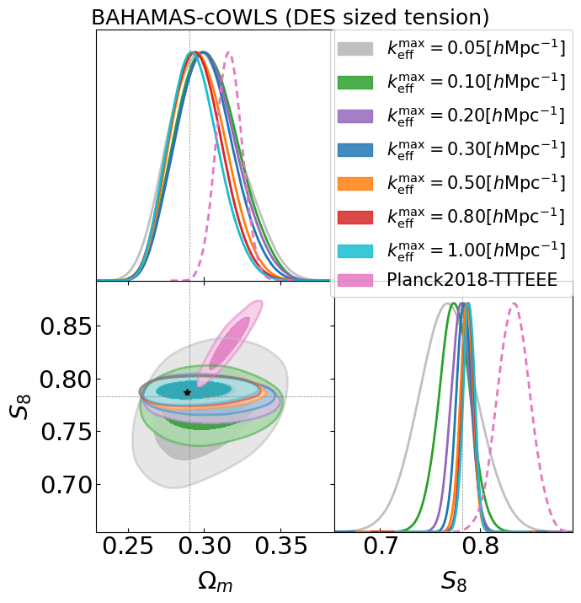
Results 1 - constraints
Constraining power decreases
Tension visible even with stringent scale cuts
Unambiguous tension assuming KiDS-like fiducial values
Shift due to the different baryonic model assumed in the mock data and the analysis
Error on parameters smaller or comparable to results from DES Y3
14/01/2025
COLOURS Workshop - 11/06/2025

Slide 8
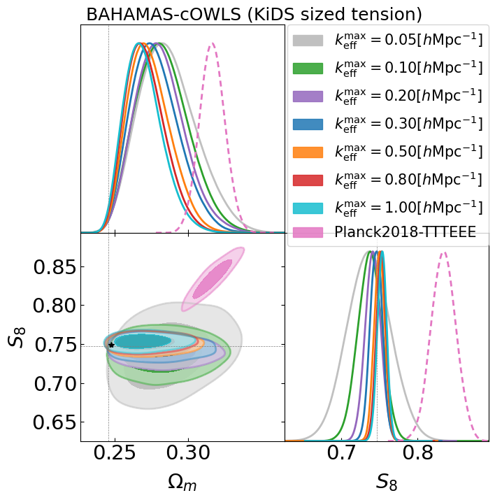
Results 1 - constraints
Constraining power decreases
Tension visible even with stringent scale cuts
Unambiguous tension assuming KiDS-like fiducial values
Shift due to the different baryonic model assumed in the mock data and the analysis
Error on parameters smaller or comparable to results from DES Y3
14/01/2025
COLOURS Workshop - 11/06/2025

Slide 9
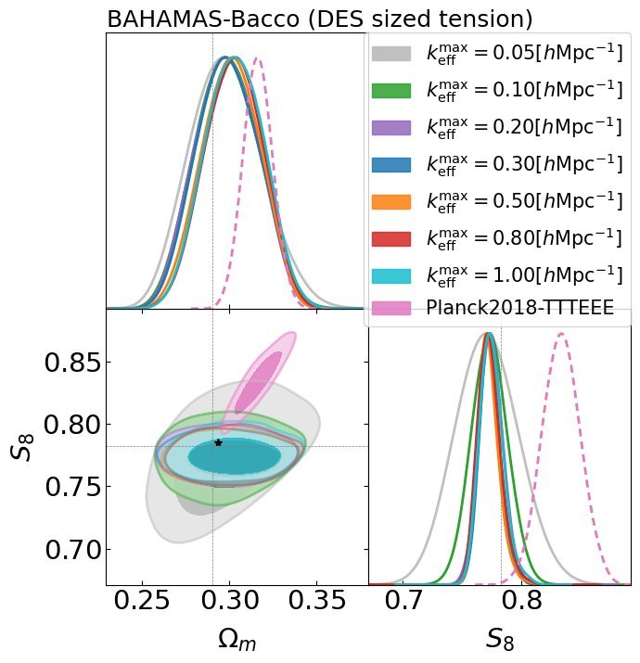
Results 1 - constraints
Bacco as analysis model:
Less idealistic
Similar behavior at large scales, less constraining power (especially at small scales) due to unfixed baryonic parameters
14/01/2025
COLOURS Workshop - 11/06/2025

Slide 10
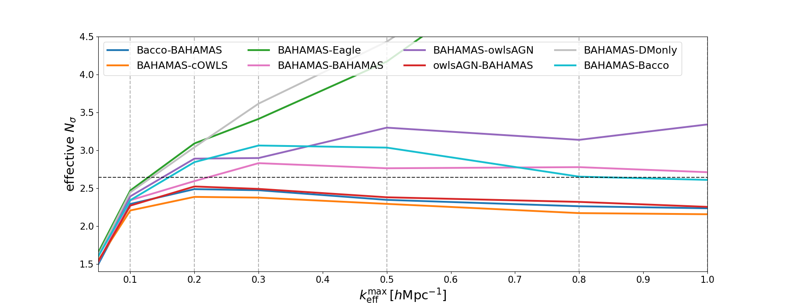
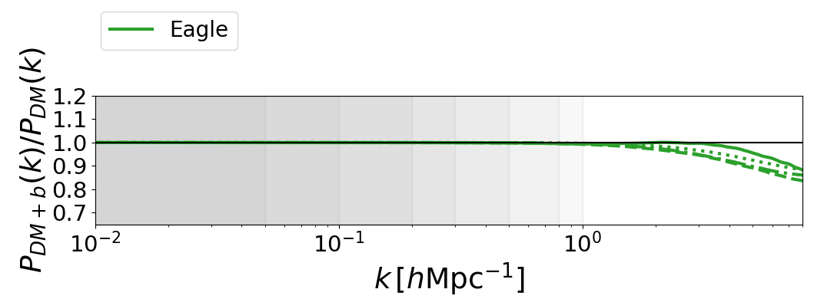
Results 2 - tension metrics
Baryons affect data for k^{max}_{eff} ≳ 0.2hMpc⁻¹
Choice of baryonic model does not strongly influence the measured tension with Planck (excluding Eagle and DM only)
true tension
mock data – analysis model
14/01/2025
COLOURS Workshop - 11/06/2025
Notes:
Put boost and mock-analysis
Ntrue = from bahamas-bahamas and no scale cuts

Slide 11
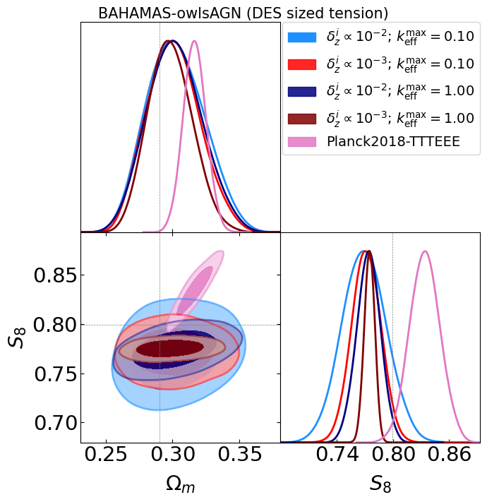
Results 3 – photo-z caveat
LSST needs high precision redshift distribution measurements (with uncertainties δz ∝ 10⁻³).
14/01/2025
COLOURS Workshop - 11/06/2025

Slide 12
Conclusions
S₈ tension is clearly detectable at k^{max}_{eff} = 0.20 hMpc⁻¹ in the analysis where we imposed a DES-sized tension, and at k^{max}_{eff} = 0.10 hMpc⁻¹ with a KiDS-sized tension, regardless of whether an incorrect model for baryons is assumed.
LSST will need high precision measurement of the redshift distributions, otherwise the ability to constrain cosmological parameters independently of baryonic feedback - particularly regarding the S₈ tension - will be compromised.
Thank you!
14/01/2025
COLOURS Workshop - 11/06/2025

