Slide 1
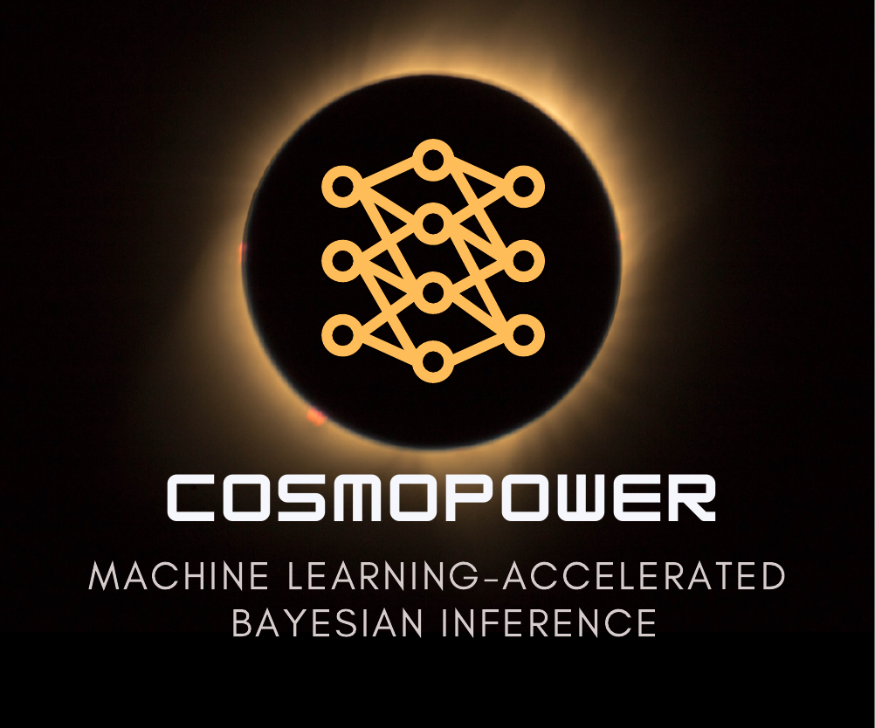



Machine learning in cosmology
Ivan Sladoljev
PhD student at Royal Holloway, university of London
Colours workshop, 13.06.2025, institute Pascal, Paris

Slide 2
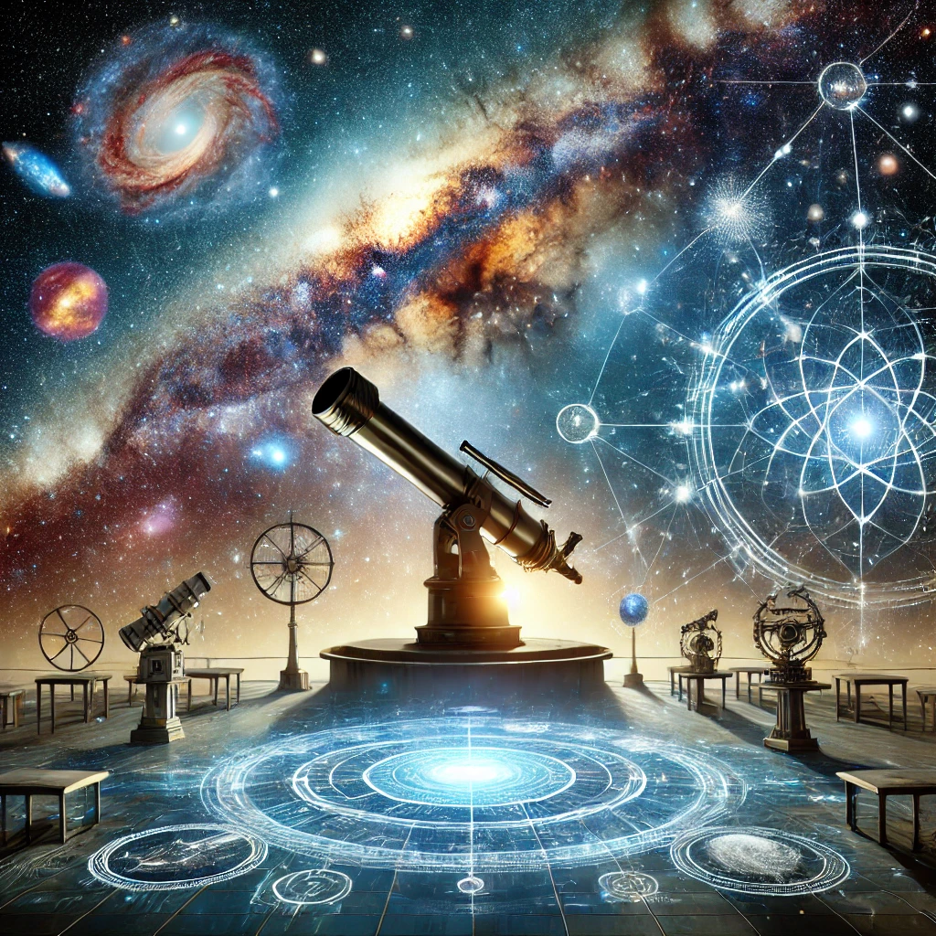
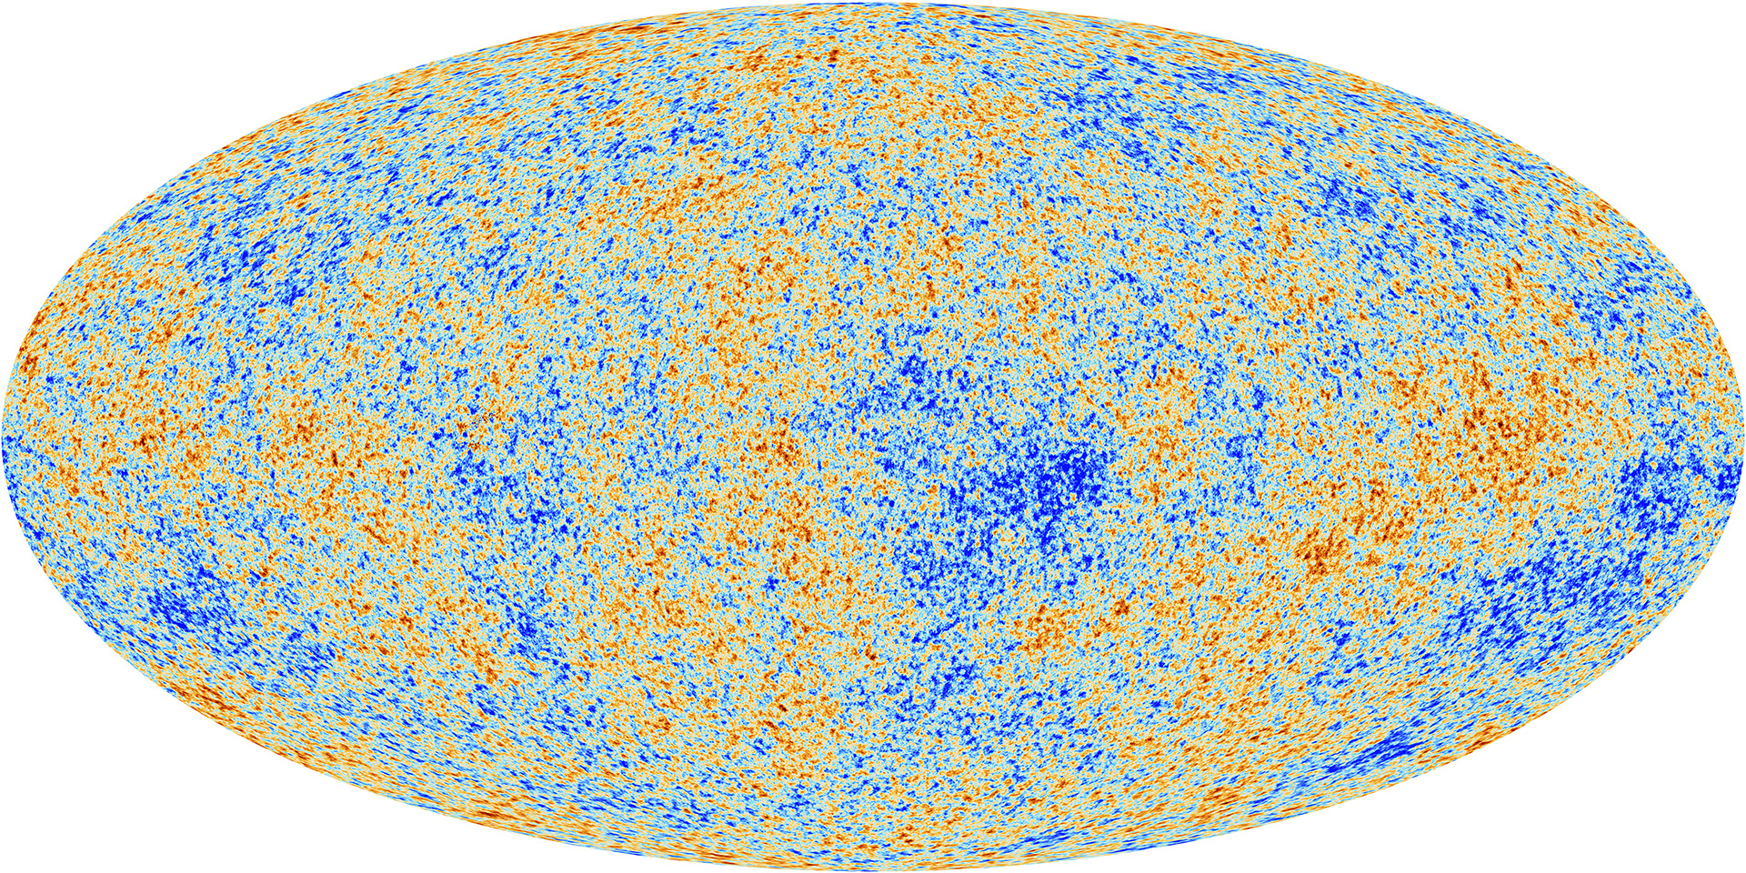
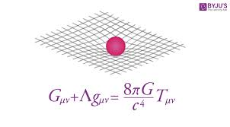
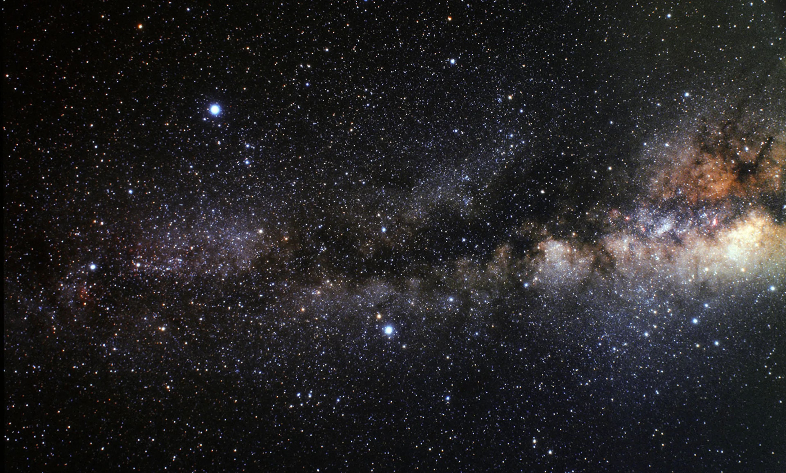
How it evolves ?
How it began ?
There is still a lot we don’t know about our universe
What is it made of ?

Slide 3
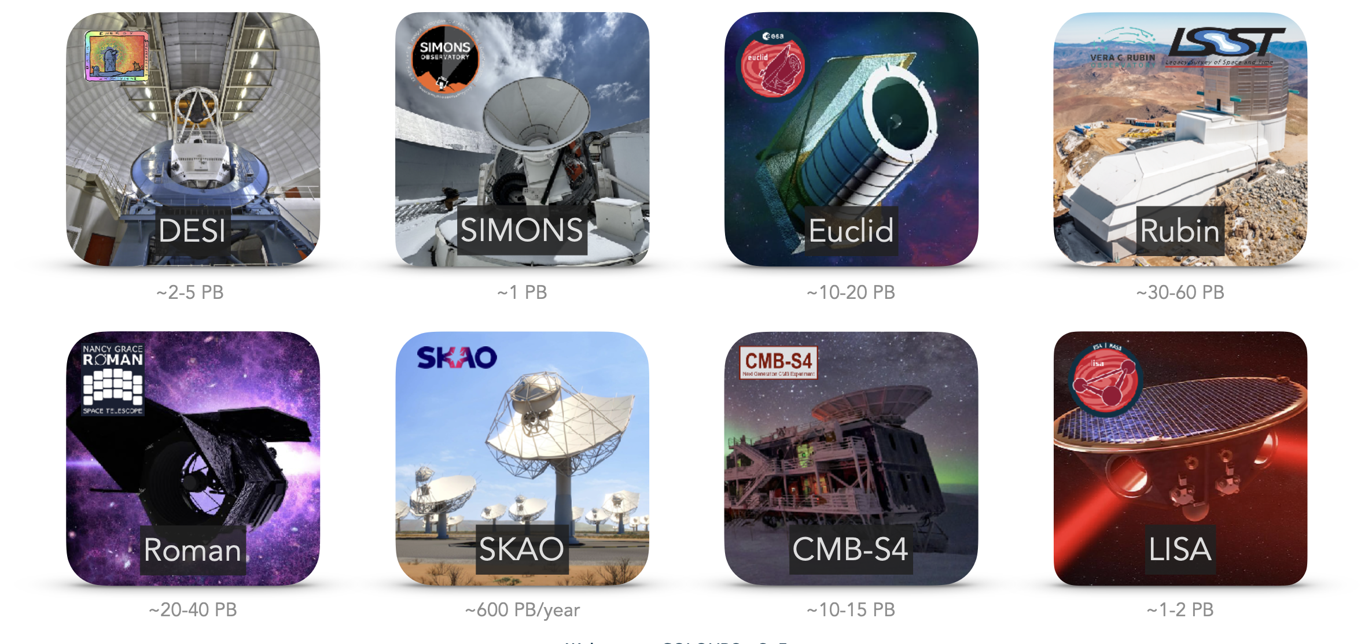
WE are living in an age of discovery
Thank you, Sam Farrens, for the slide !

Slide 4
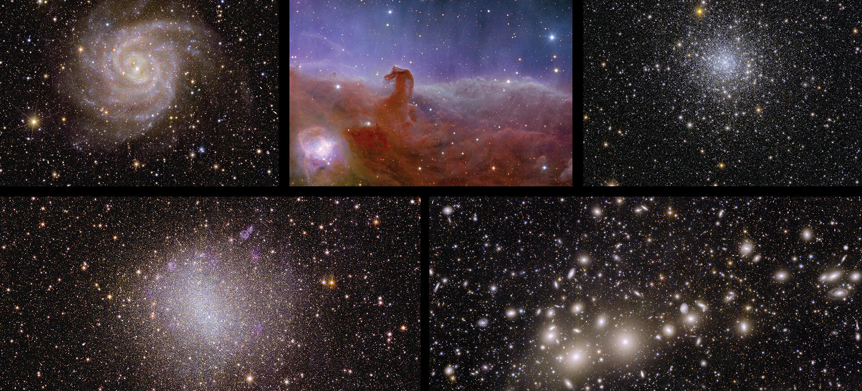
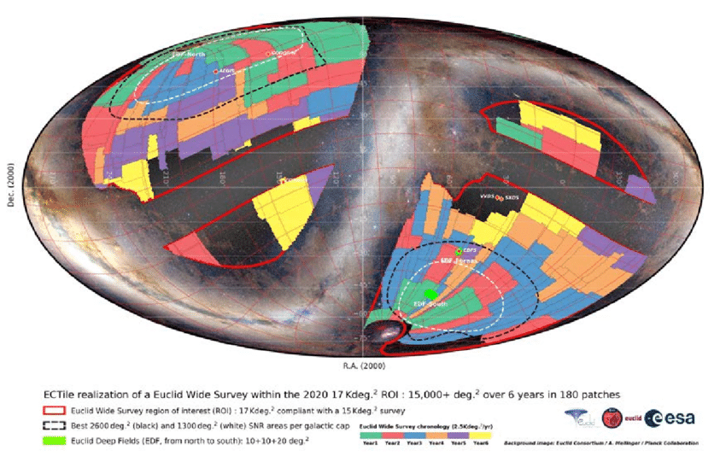
Euclid mission
European Space Agency mission that will take the spectroscopic and photometric data from 30% of the night sky
Will do a 3D map of the sky spanning billions of galaxies
(up to 10 billion lightyears)
Credit: Laureijs et al. 2020

Slide 5

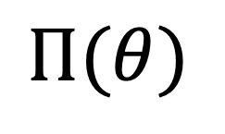
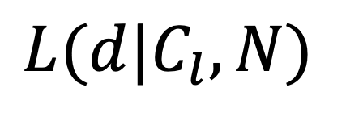


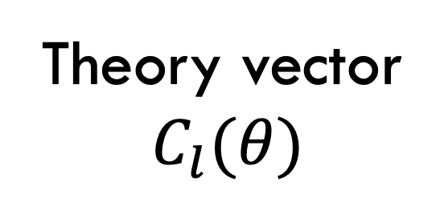


{$θ\}$
What to do with all that data ?
We choose our cosmological model:
LCDM, w0wa, modified gravity…
Use it in analysis and inference of cosmological parameters
$$P\left(θ\right|d)\sim L\left(d | θ\right)Π(θ)$$
We define our priors:
$U\left(θ_{min} ,θ_{max}\right), G\left(μ_{θ},σ_{θ}\right)$…
$$Π(θ)$$
We construct our theory vector:
Boltzmann solvers, simulations, emulators …
Theory vector
$$C_{l}(θ)$$
We add noise, covariance matrix, masks…
$$N$$
We construct the likelihood:
$L \left(d | C_{l}, N\right)\sim \exp\left[−\frac{1}{2}{\left(d−C_{l}\right)}^{T}N(d−C_{l})\right]$
$$L(d|C_{l},N)$$

Slide 6
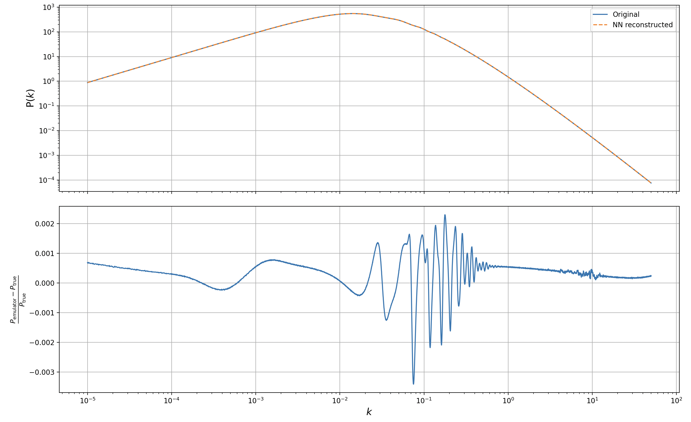
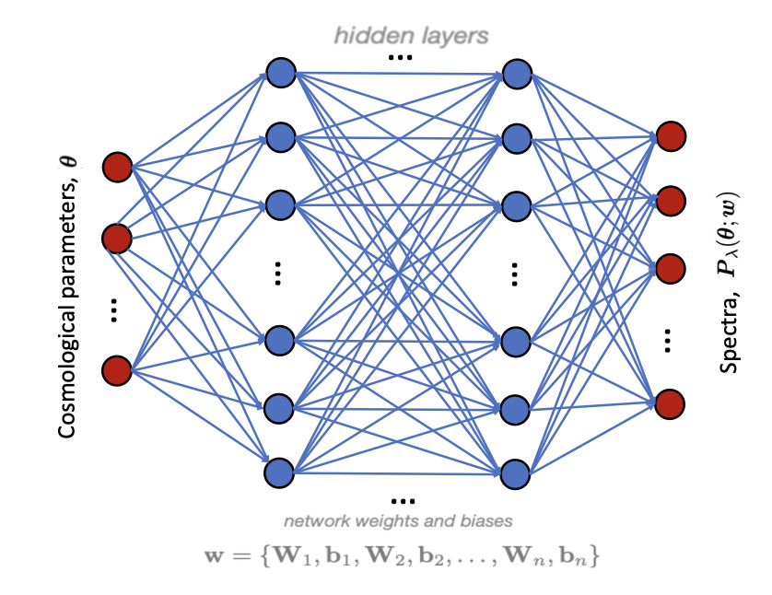
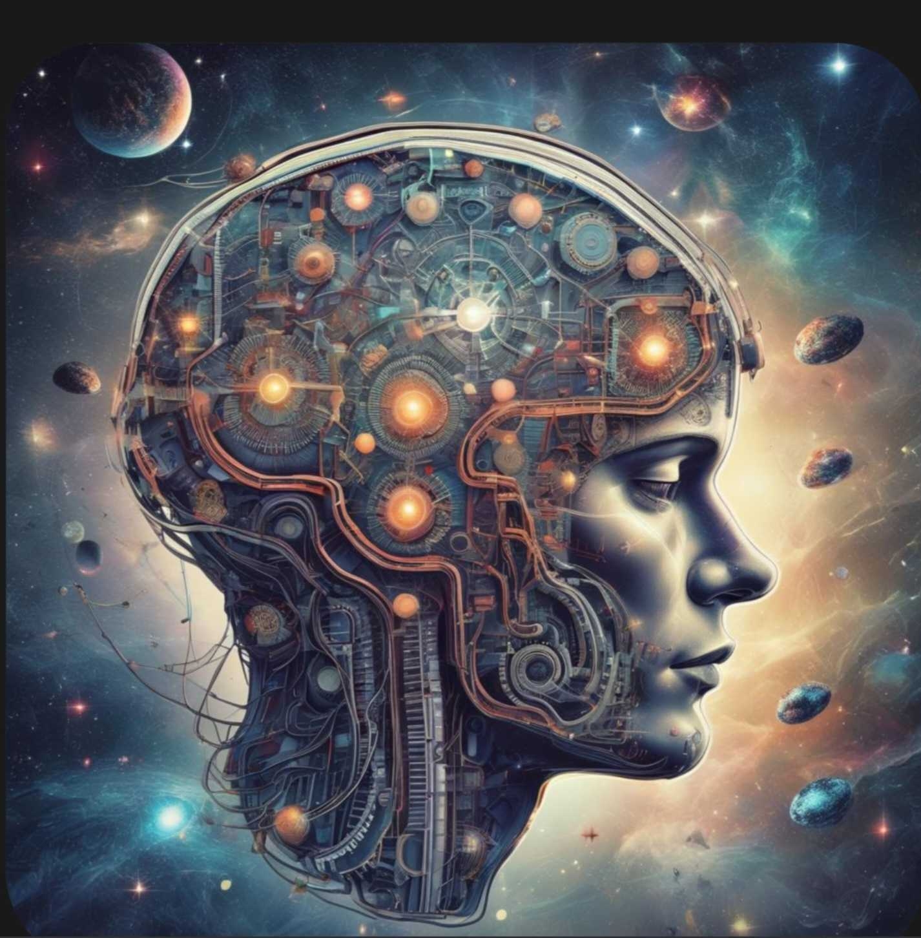
What is an emulator
(multi-layer perceptron)
Basically a machine that does regression
COSMOPOWER : Spurio Mancini et al. (2022)

Slide 7
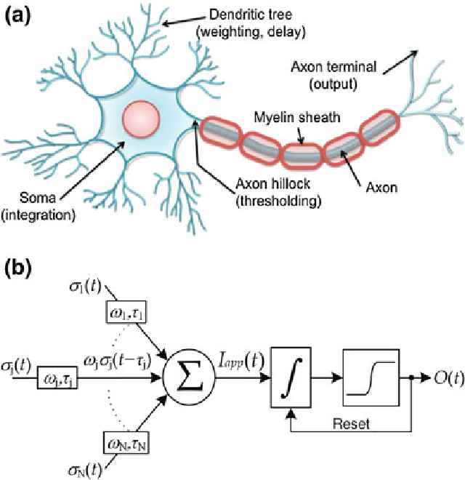
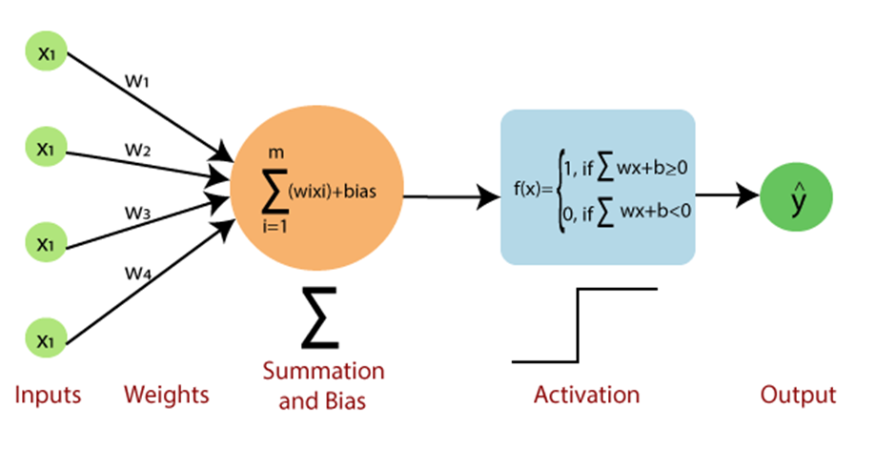



A neural emulator mimics the infrastructure of a human brain
It takes some input:
{$x_{1}, x_{2}…x_{n}$}
Measures its importance using weights and biases
{$w_{1}, w_{2}…w_{n} \} \& \{b_{1}, b_{2}…b_{n}$}
Sums over all the inputs:
$$\sum_{i=0}^{n}{w_{i,j}x_{j}}+b_{i}$$
Passes that value into a nonlinear function and gives you an output

Slide 8


And then it does it all over again
The network then compares the predicted output with the real one:
the results are correct
GREAT !
- if they are not – RETRAIN ITSELF
$$w_{i,k}+α\frac{∂L_{k}}{∂w_{i}} →{w′}_{i,k}$$
Training set

Slide 9
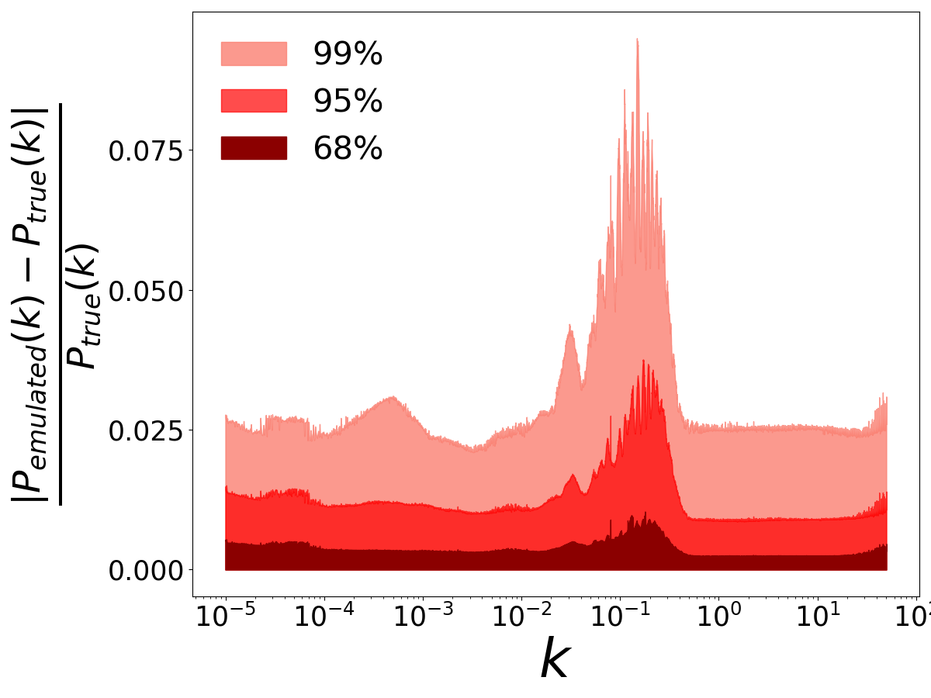
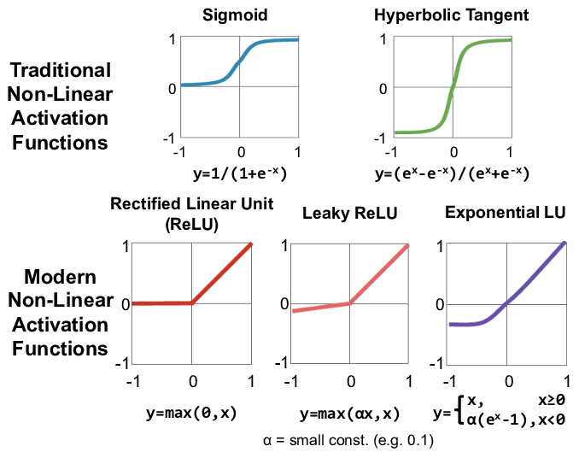
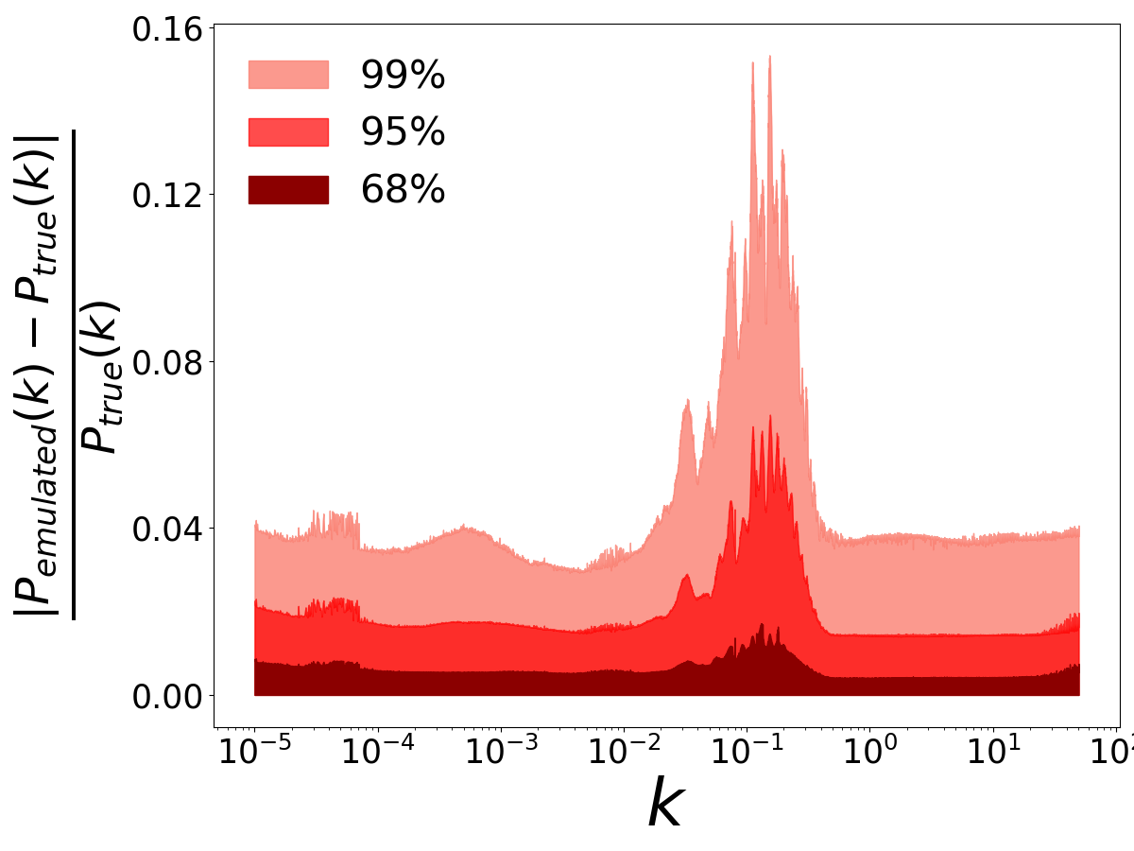
Making a good emulator is an art of itself
Choosing a good activation function
Choosing a network architecture and type of network
Working with good data
Credit: Sze et al 2017

Slide 10

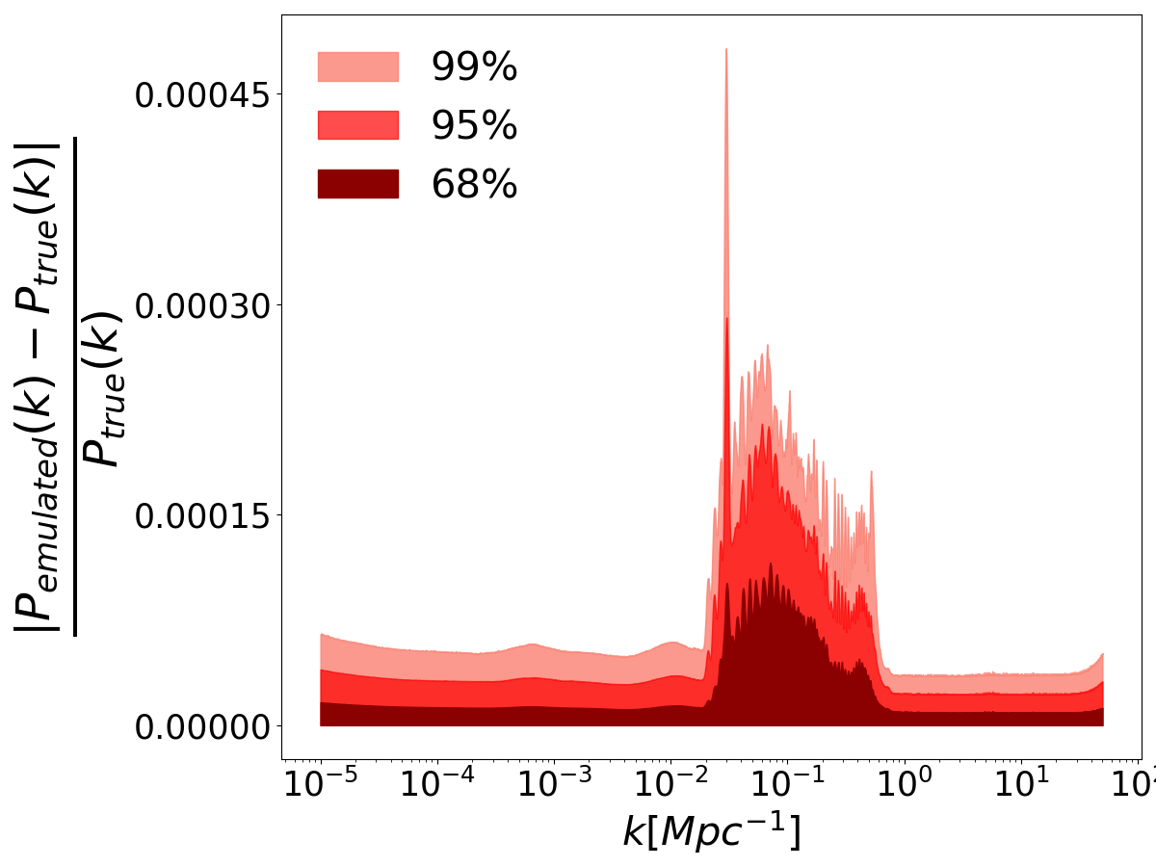
Our goals
Making an extensive neural emulator library spanning different cosmological models
Implement them into the Euclid DR1 analysis pipeline

Slide 11
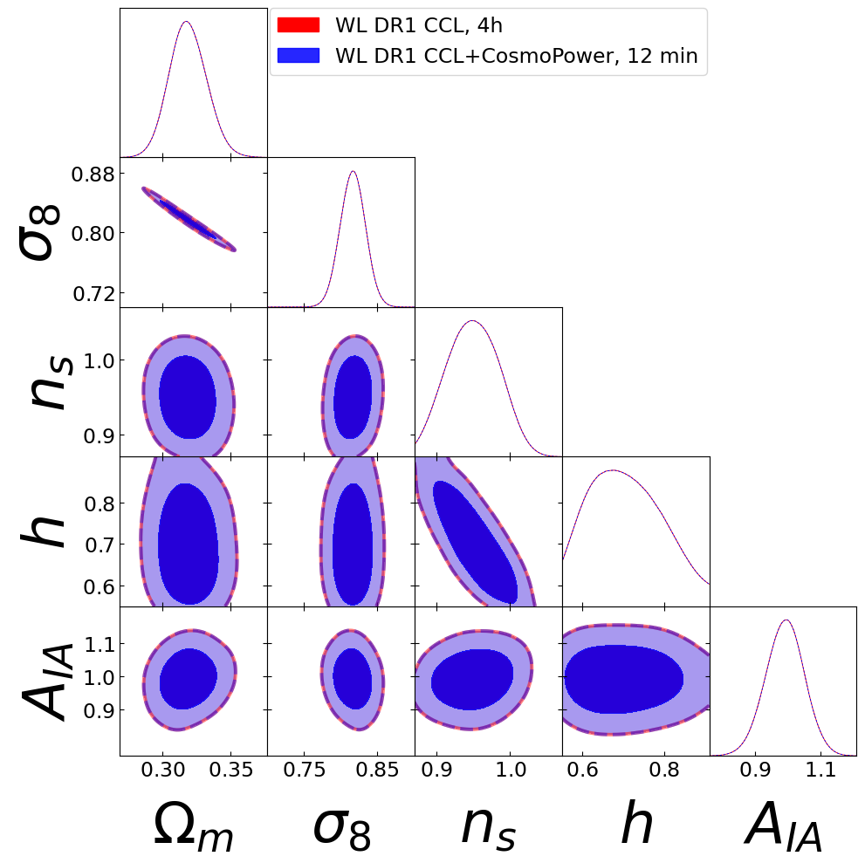
Results
Using our emulators, we can get up to 20-50 times increase in speed for a small dataset
We continue working on improving accuracy of our emulators, as well as expanding the number of models we aim to include

Slide 12


Thank you for your attention

