Slide 1


1

Slide 2
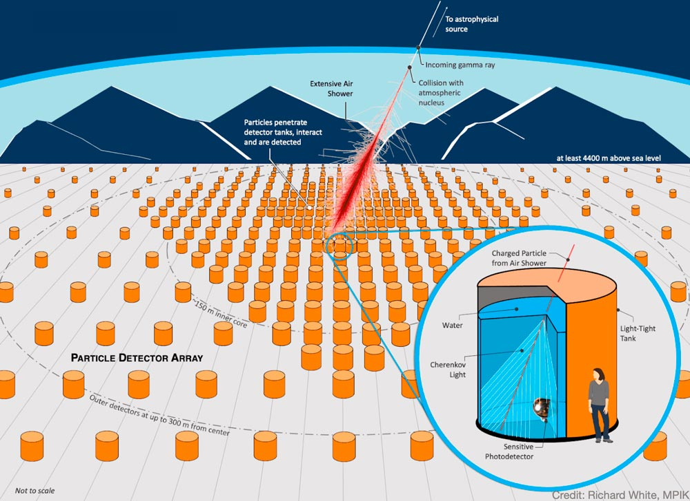
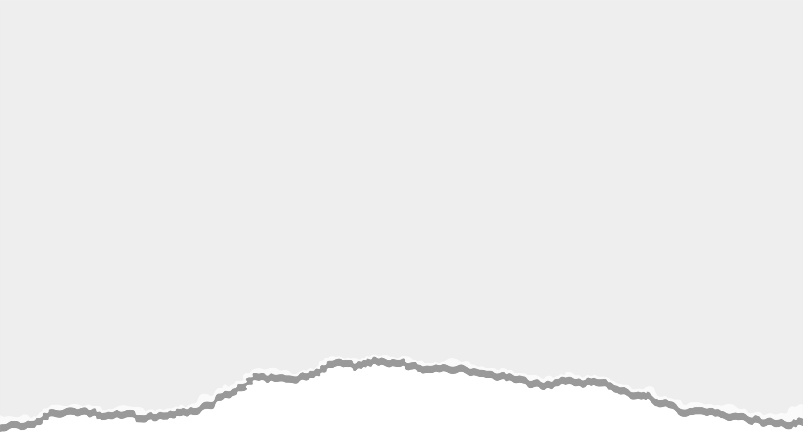
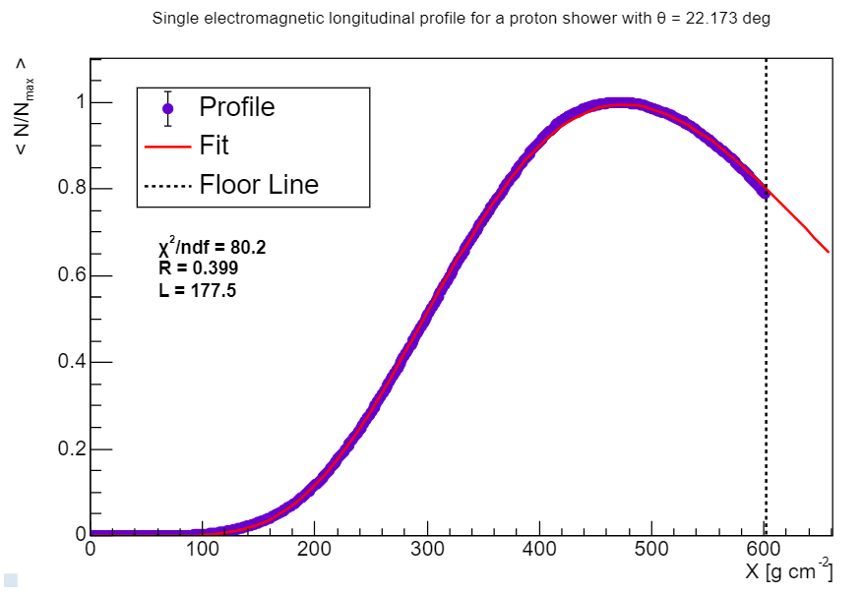
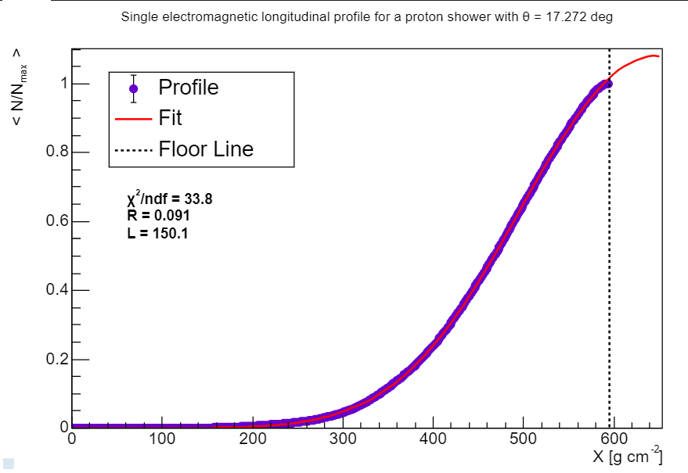
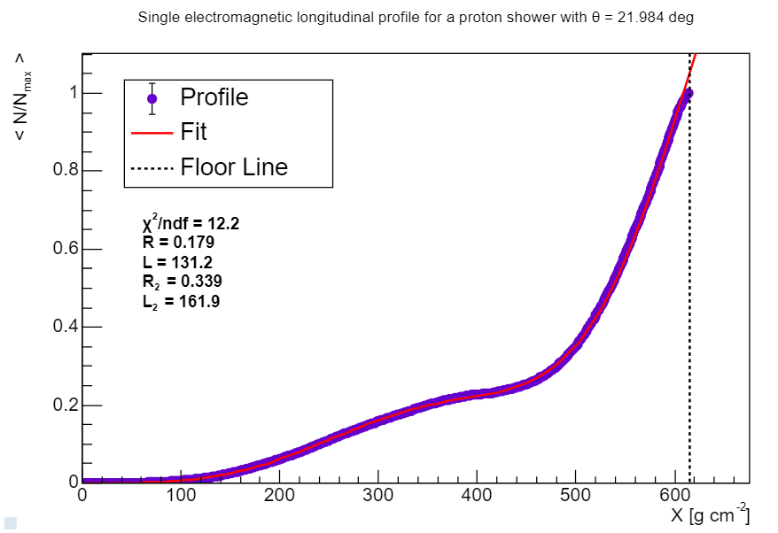
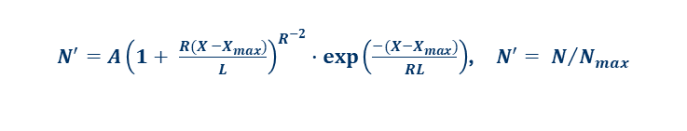
Aim of the Project
Analysis of Cosmic and Gamma Ray simulations;
Study of significant parameters to the shower development;
Study Anomalous showers;
Optimization of γ/h discrimination methods for the future “Southern Wide-field Gamma-ray Observatory” (SWGO).
Fig. 1 - Representation of the operation of the Observatory, with its WCDs filled with ultra-pure water.
Gaisser-Hillas fit function:
$N^{′}=A{\left(1+ \frac{R(X −X_{max})}{L}\right)}^{R^{−2}}∙exp⁡\left(\frac{−(X−X_{max})}{RL}\right)$, $N^{′}= N/{N_{max}}$
Normal event
Floor event
Anomalous event
Fig. 2 - Electromagnetic longitudinal profile (purple) of different proton showers with a Gaisser-Hillas fit (red) and the indication of the floor (dashed black line).
2

Slide 3
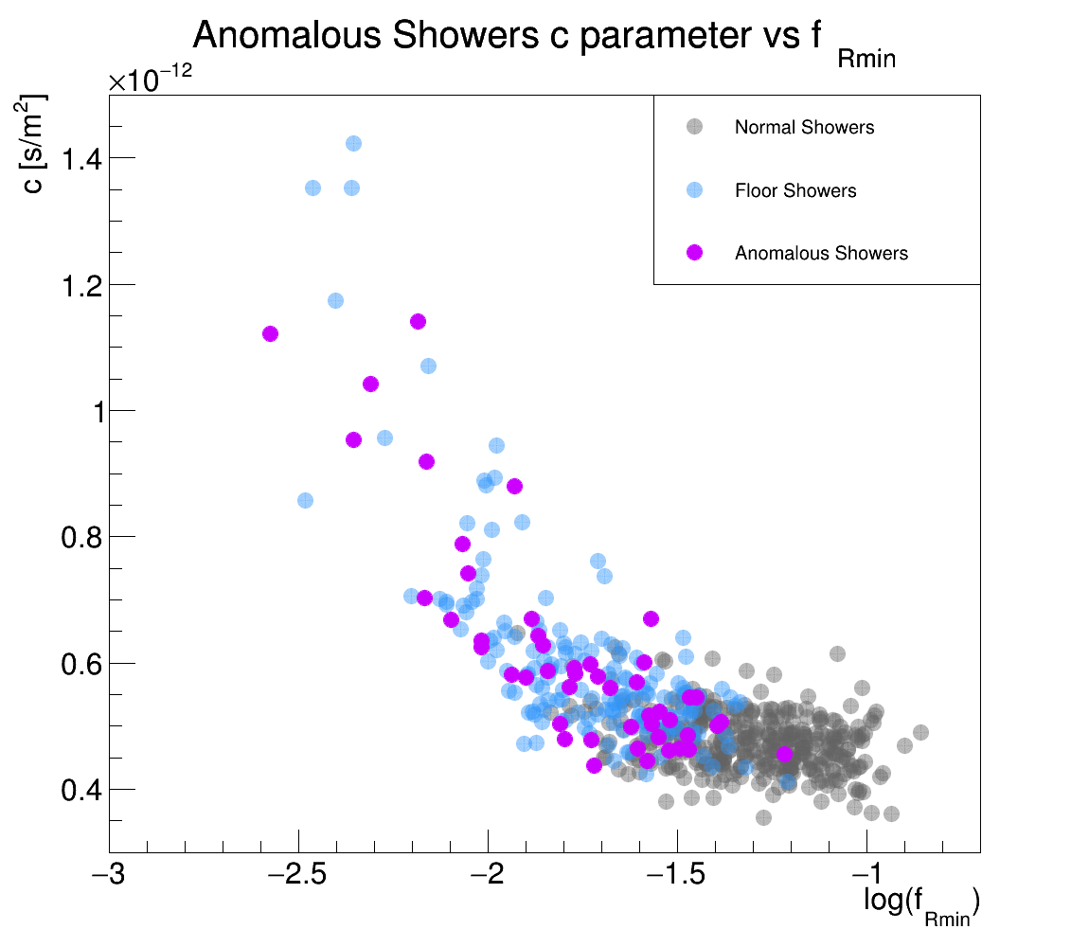
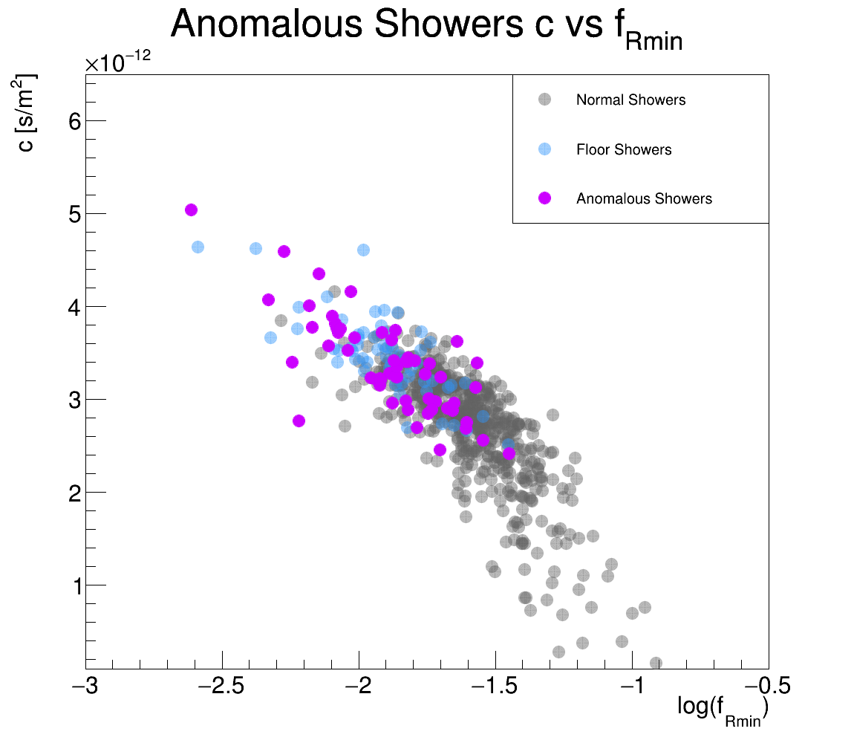
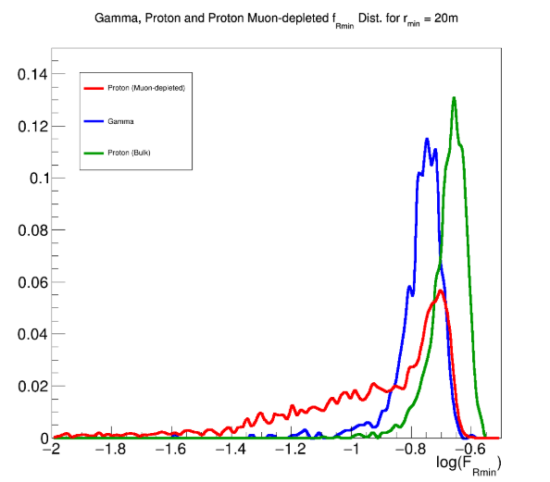
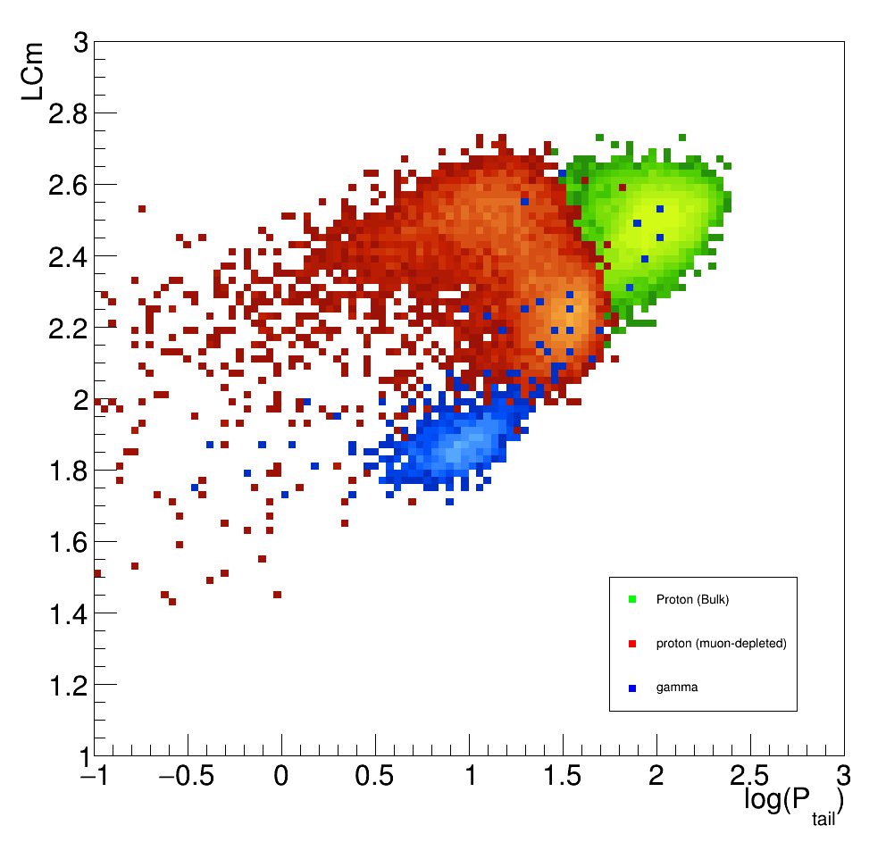
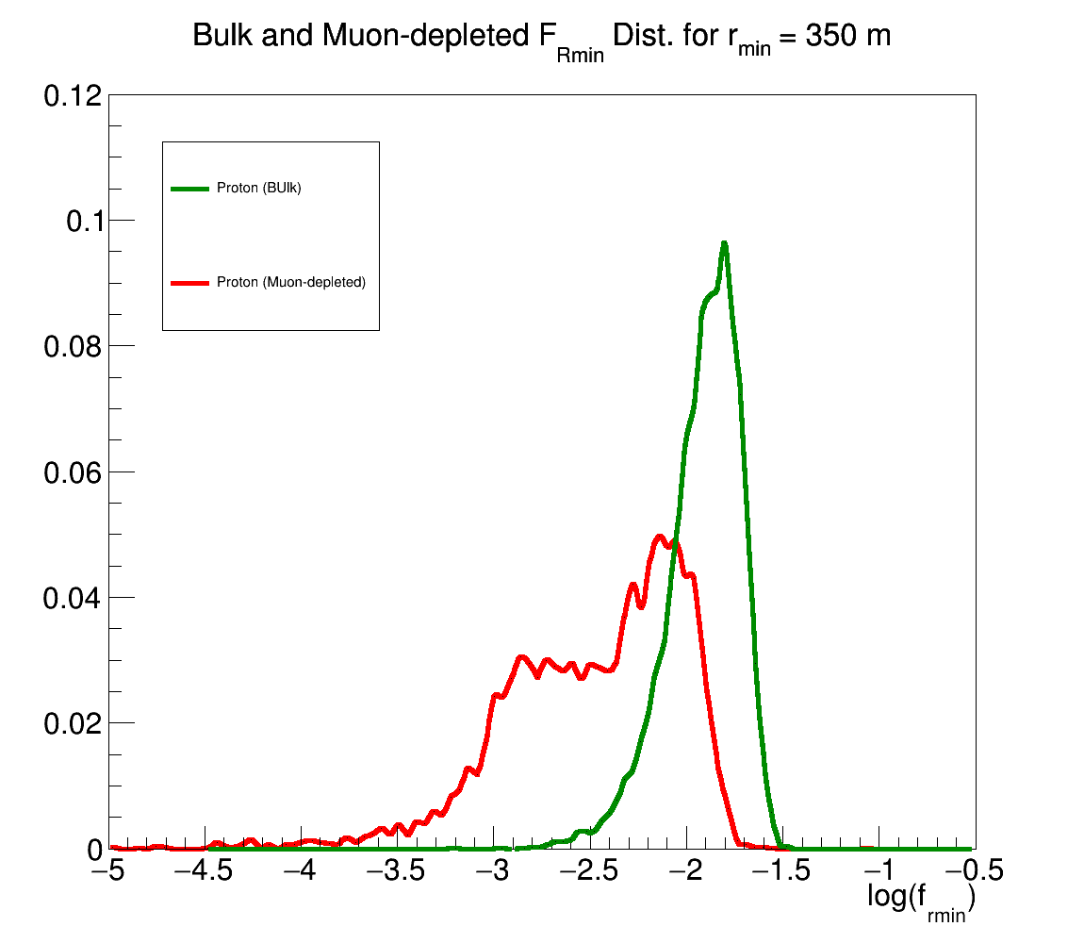
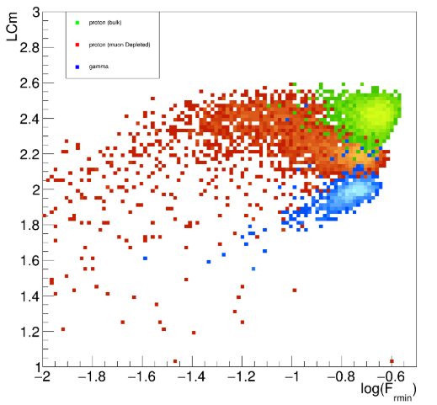
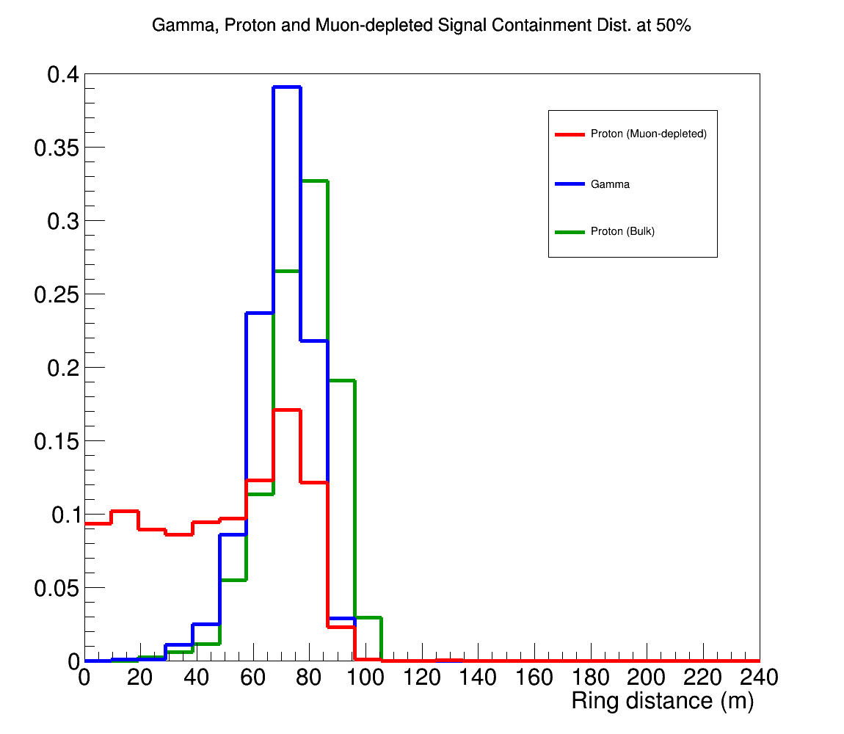
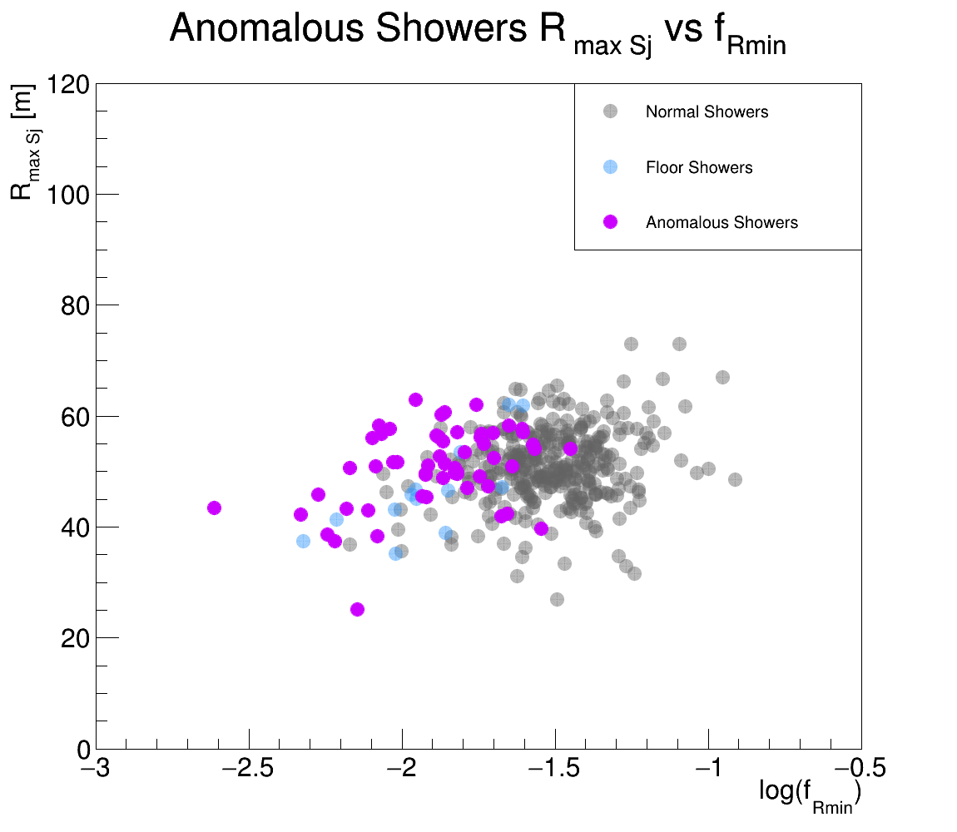
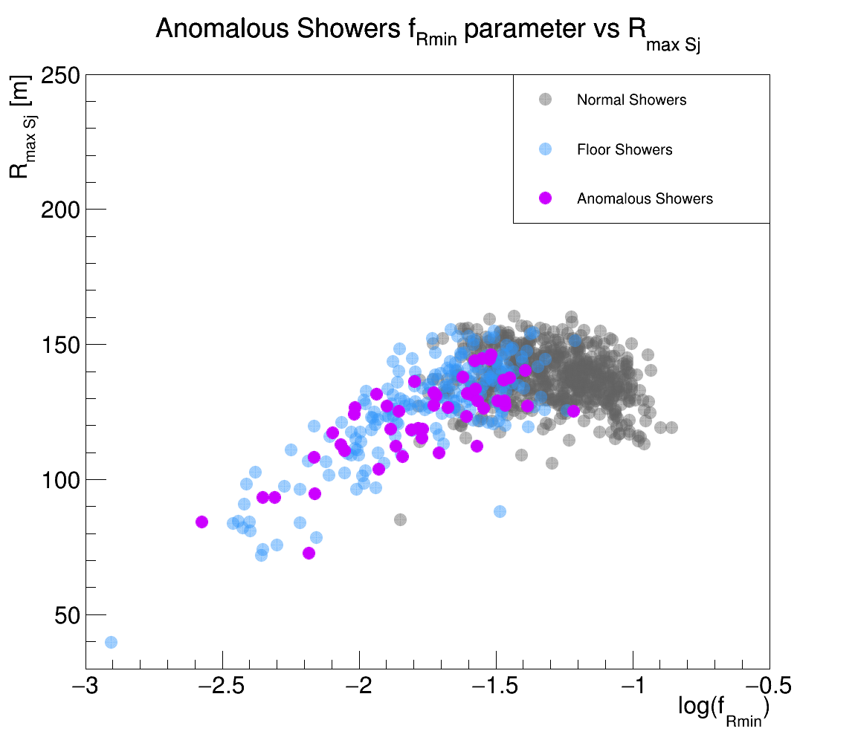
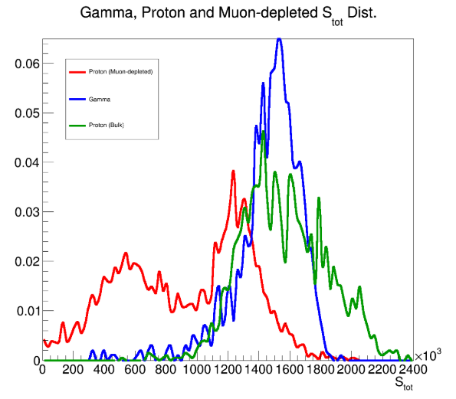
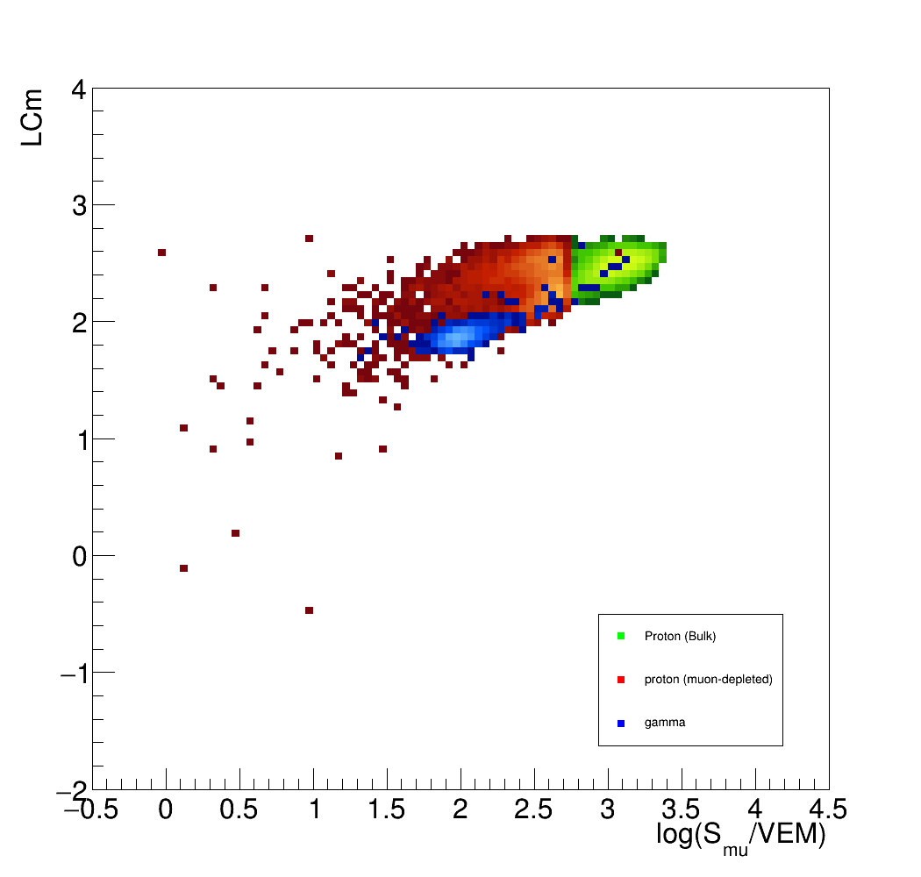
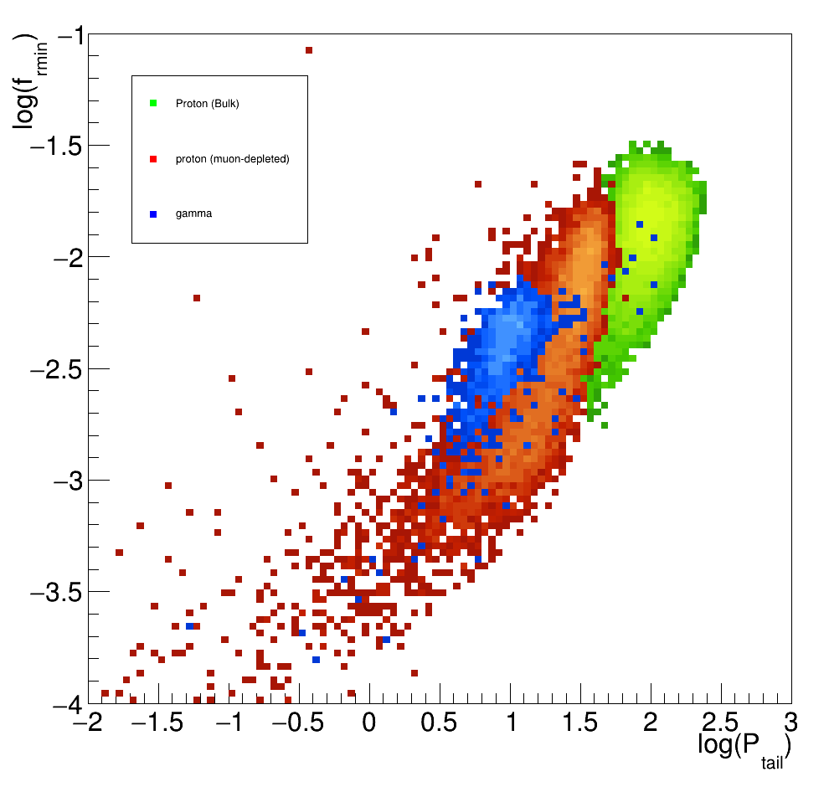
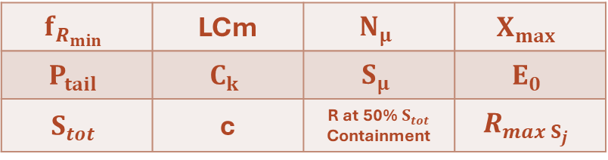
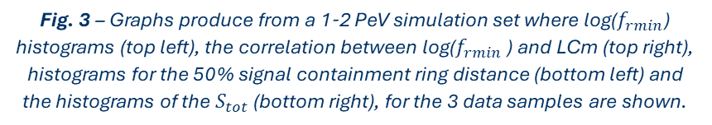
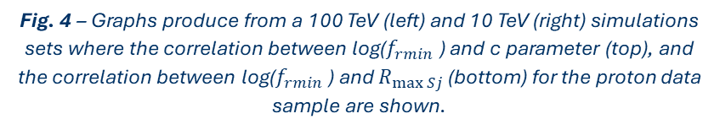
Project Development
Analysis of γ/h discriminator parameters;
$$f_{R_{min}}$$ | LCm | $$N_{μ}$$ | $$X_{max}$$
$$P_{tail}$$ | $$C_{k}$$ | $$S_{μ}$$ | $$E_{0}$$
$$S_{tot}$$ | c | R at 50% $S_{tot}$ Containment | $$R_{max S_{j}}$$
Fig. 3 – Graphs produce from a 1-2 PeV simulation set where log($f_{rmin}$) histograms (top left), the correlation between log($f_{rmin}$ ) and LCm (top right), histograms for the 50% signal containment ring distance (bottom left) and the histograms of the $S_{tot}$ (bottom right), for the 3 data samples are shown.
Evaluation of longitudinal profiles;
Characterization of rare and anomalous events.
Fig. 4 – Graphs produce from a 100 TeV (left) and 10 TeV (right) simulations sets where the correlation between log($f_{rmin}$ ) and c parameter (top), and the correlation between log($f_{rmin}$ ) and $R_{\max{Sj}}$(bottom) for the proton data sample are shown.
3

Slide 4
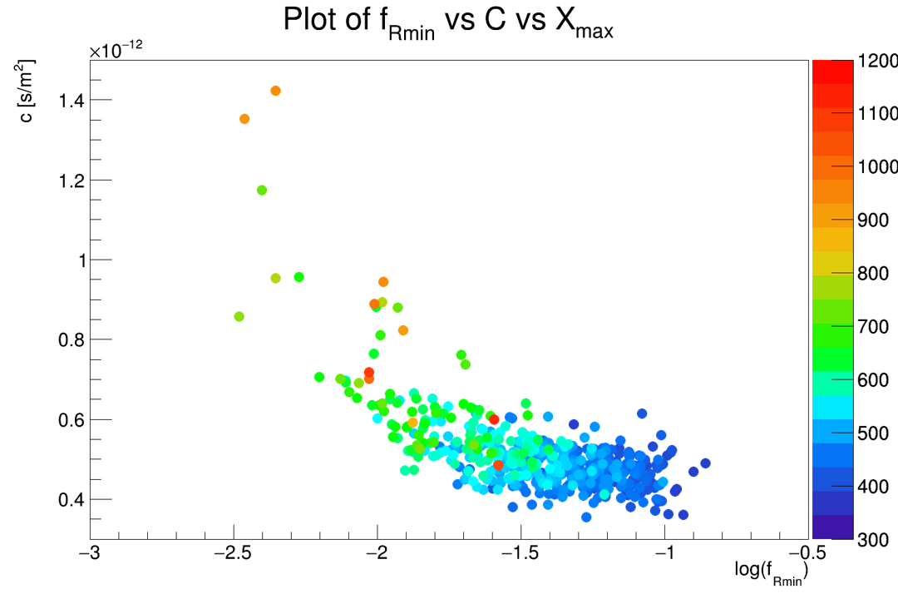
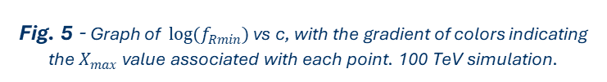
The future of the Project
Study the link between the anomalous air showers and the hadronic multiparticle production properties of the first interaction;
Study of deep penetrating showers;
Improve the γ/h discrimination;
Reduce γ background;
Identify anomalous events trough the use of ground-base variables.
Fig. 5 - Graph of $log(f_{Rmin})$ vs c, with the gradient of colors indicating the $X_{max}$ value associated with each point. 100 TeV simulation.
4

