Slide 1
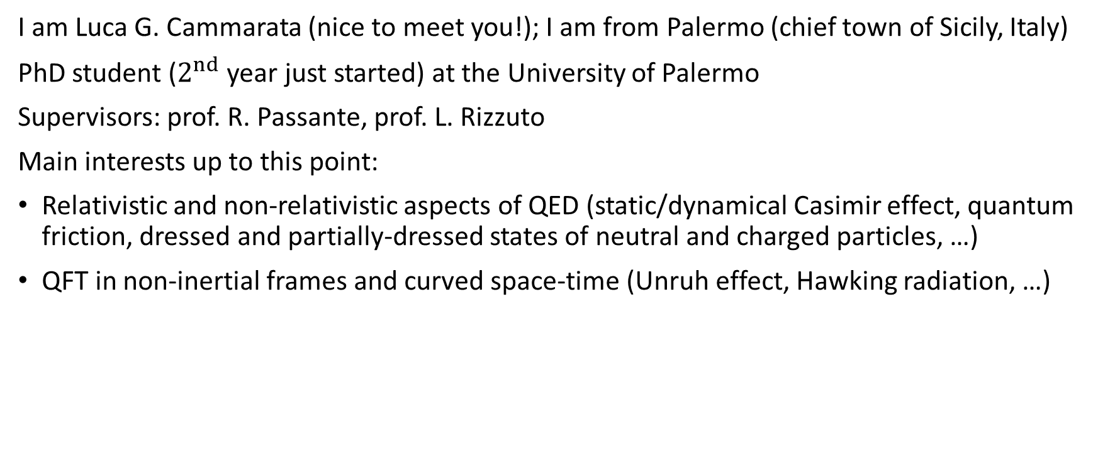
A brief presentation
I am Luca G. Cammarata (nice to meet you!); I am from Palermo (chief town of Sicily, Italy)
PhD student ($2^{nd}$ year just started) at the University of Palermo
Supervisors: prof. R. Passante, prof. L. Rizzuto
Main interests up to this point:
Relativistic and non-relativistic aspects of QED (static/dynamical Casimir effect, quantum friction, dressed and partially-dressed states of neutral and charged particles, …)
QFT in non-inertial frames and curved space-time (Unruh effect, Hawking radiation, …)

Slide 2
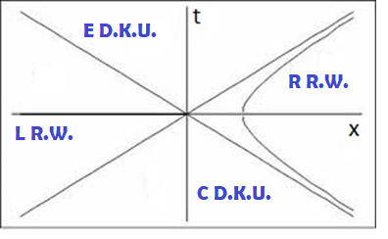
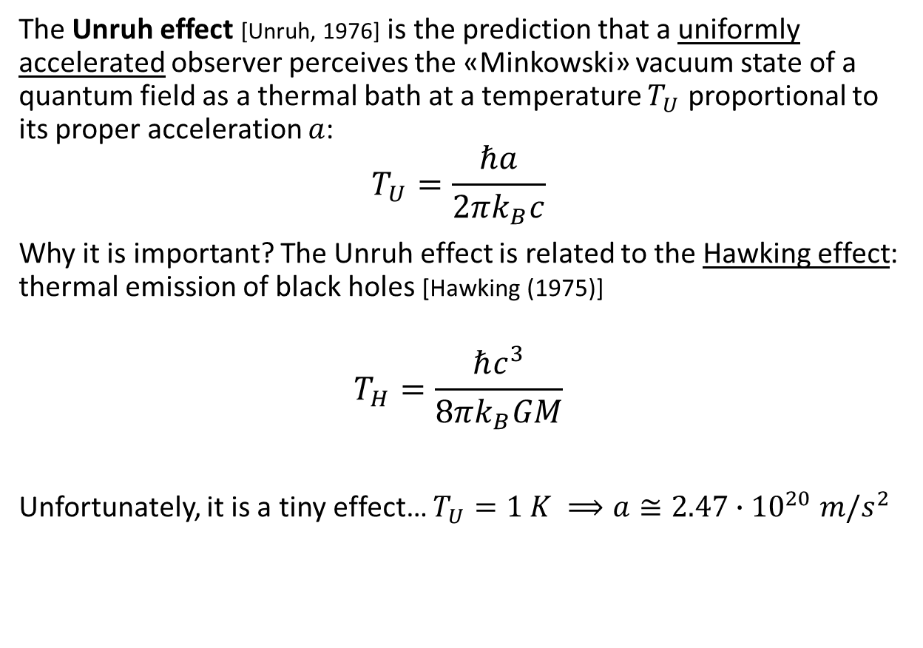
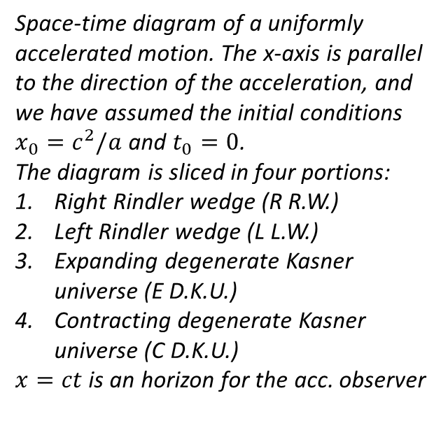
The Unruh effect
The Unruh effect [Unruh, 1976] is the prediction that a uniformly accelerated observer perceives the «Minkowski» vacuum state of a quantum field as a thermal bath at a temperature $T_{U}$ proportional to its proper acceleration $a$:
$$T_{U}=\frac{ℏa}{2πk_{B}c}$$
Why it is important? The Unruh effect is related to the Hawking effect: thermal emission of black holes [Hawking (1975)]
$$T_{H}=\frac{ℏc^{3}}{8πk_{B}GM}$$
Unfortunately, it is a tiny effect… $T_{U}=1 K ⟹a≅2.47∙{10}^{20} m/s^{2}$
Space-time diagram of a uniformly accelerated motion. The x-axis is parallel to the direction of the acceleration, and we have assumed the initial conditions $x_{0}=c^{2}/a$ and $t_{0}=0$.
The diagram is sliced in four portions:
Right Rindler wedge (R R.W.)
Left Rindler wedge (L L.W.)
Expanding degenerate Kasner universe (E D.K.U.)
Contracting degenerate Kasner universe (C D.K.U.)
$x=ct$ is an horizon for the acc. observer

Slide 3

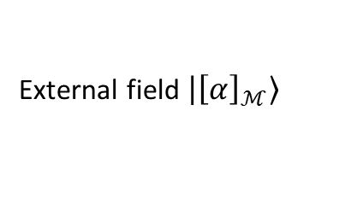
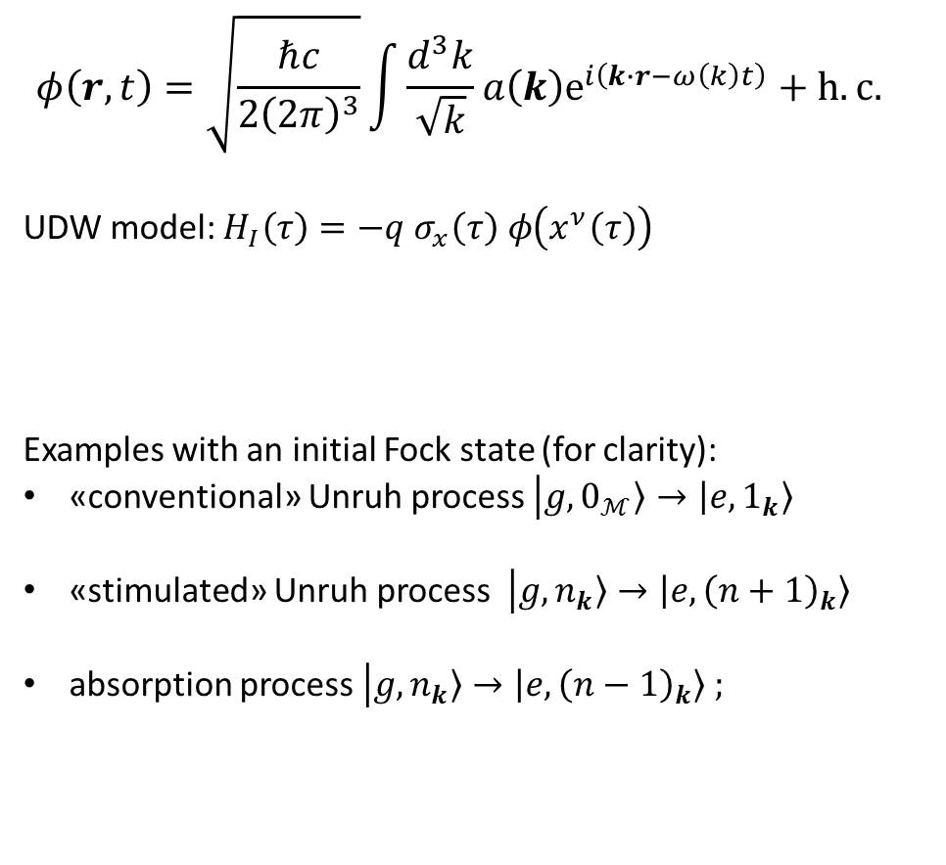
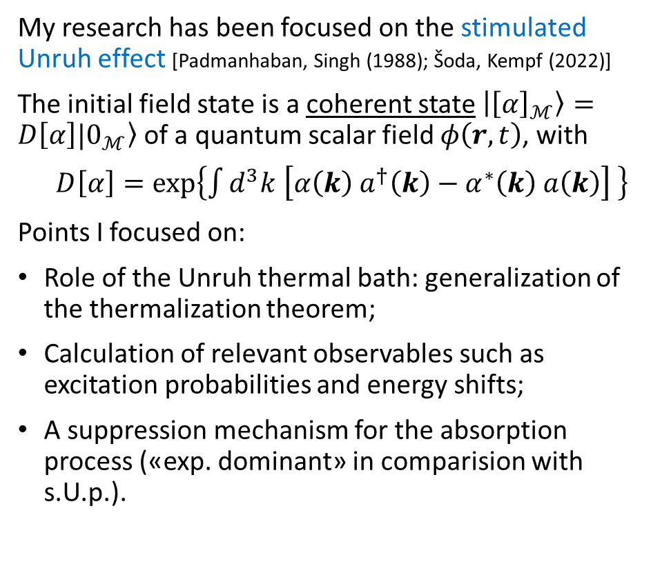

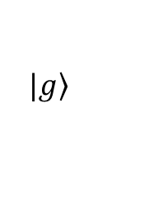


The stimulated Unruh effect
$$φ\left(r,t\right)=\sqrt{\frac{ℏc}{2{\left(2π\right)}^{3}}}\int{\frac{d^{3}k}{\sqrt{k}}a\left(k\right)e^{i\left(k∙r−ω\left(k\right)t\right)}+h.c.}$$
UDW model: $H_{I}\left(τ\right)=−q σ_{x}\left(τ\right) φ\left(x^{ν}\left(τ\right)\right)$
Examples with an initial Fock state (for clarity):
«conventional» Unruh process $\left|g,\left.0_{ℳ}\right\rangle →\left|e,\left.1_{k}\right\rangle \right.\right.$
«stimulated» Unruh process $\left|g,\left.n_{k}\right\rangle →\left|e,\left.{\left(n+1\right)}_{k}\right\rangle \right.\right.$
absorption process$\left|g,\left.n_{k}\right\rangle →\left|e,\left.{\left(n−1\right)}_{k}\right\rangle \right.\right. ;$
My research has been focused on the stimulated Unruh effect [Padmanhaban, Singh (1988); Šoda, Kempf (2022)]
The initial field state is a coherent state $\left|\left.{\left[α\right]}_{ℳ}\right\rangle \right.=D\left[α\right]|\left.0_{ℳ}\right\rangle$ of a quantum scalar field $φ\left(r,t\right)$, with
$D\left[α\right]=exp\left\{\int{d^{3}k \left[α\left(k\right) a^{†}\left(k\right)−α^{∗}\left(k\right) a\left(k\right)\right]} \right\}$
Points I focused on:
Role of the Unruh thermal bath: generalization of the thermalization theorem;
Calculation of relevant observables such as excitation probabilities and energy shifts;
A suppression mechanism for the absorption process («exp. dominant» in comparision with s.U.p.).
$$|\left.e\right\rangle$$
$$x^{ν}\left(τ\right)$$
$$ℏΩ$$
$$|\left.g\right\rangle$$
External field $\left|\left.{\left[α\right]}_{ℳ}\right\rangle \right.$

Slide 4
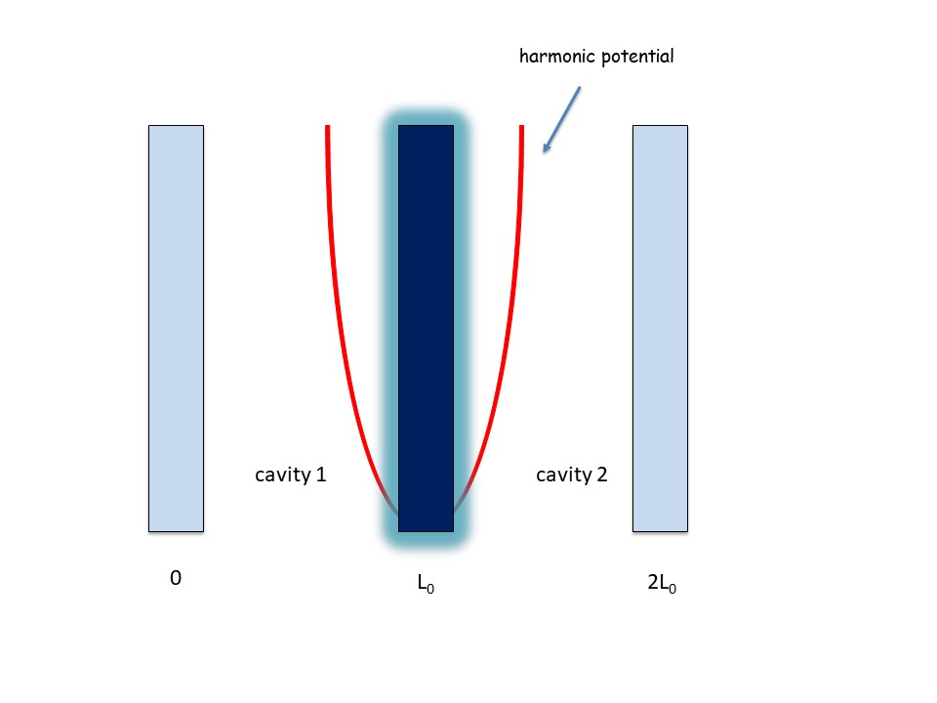




Future perspectives
Consider the setup represented in the figure, which is a generalization of the one considered in the Law model [Law (1995)].
Fixed central plate $⇒$ no correlations between the fields.
It was shown that there are correlations between squared fields defined in ideal cavities induced by a fluctuating boundary [Montalbano, Armata, Rizzuto, Passante (2023)] when considering the dressed ground state of the overall system.
Are the two fields entangled?
$$\left\langle φ_{1}^{2}φ_{2}^{2}\right\rangle −\left\langle φ_{1}^{2}\right\rangle \left\langle φ_{2}^{2}\right\rangle ≠0$$
$$φ_{1}$$
$$φ_{2}$$
Thank you for the attention!

