Slide 1

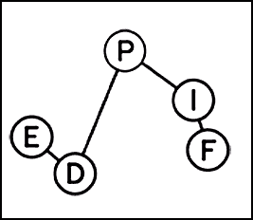
Presentation IDPASC
Recherche de particule de type axion de longue durée de vie au LHC dans l’expérience ATLAS
Serch for long lived axion like particules at LHC in the ATLAS experiment
Candidat: Frédéric DEJEAN - Laboratoire: LPNHE - Directeur de thèse: Pr. Bertrand LAFORGE​
1
Notes:
Contenu sans photo avec accroche modifiable

Slide 2
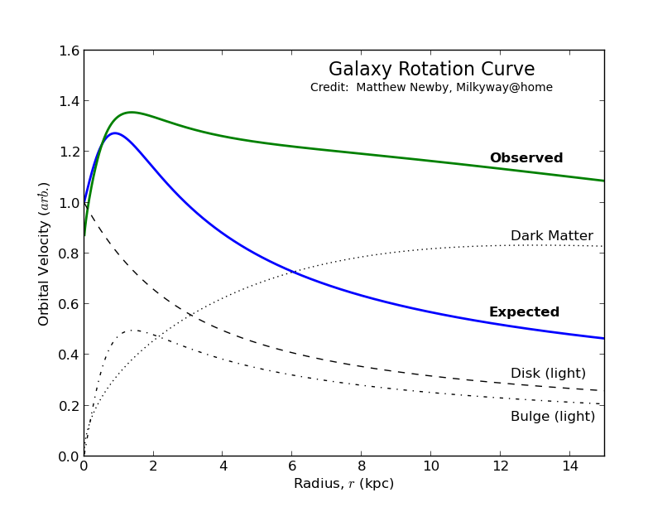
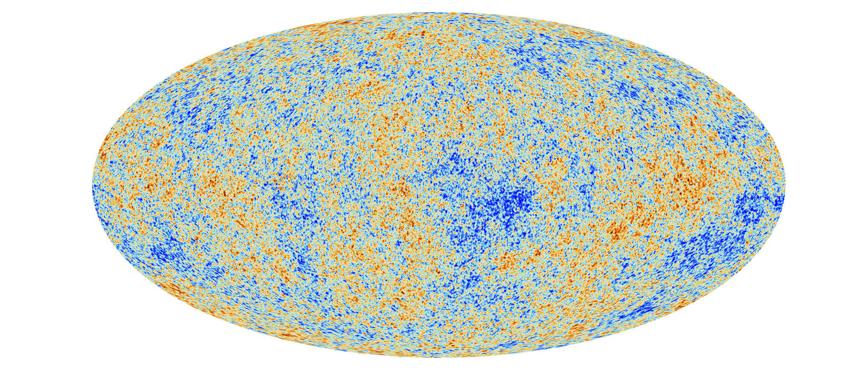
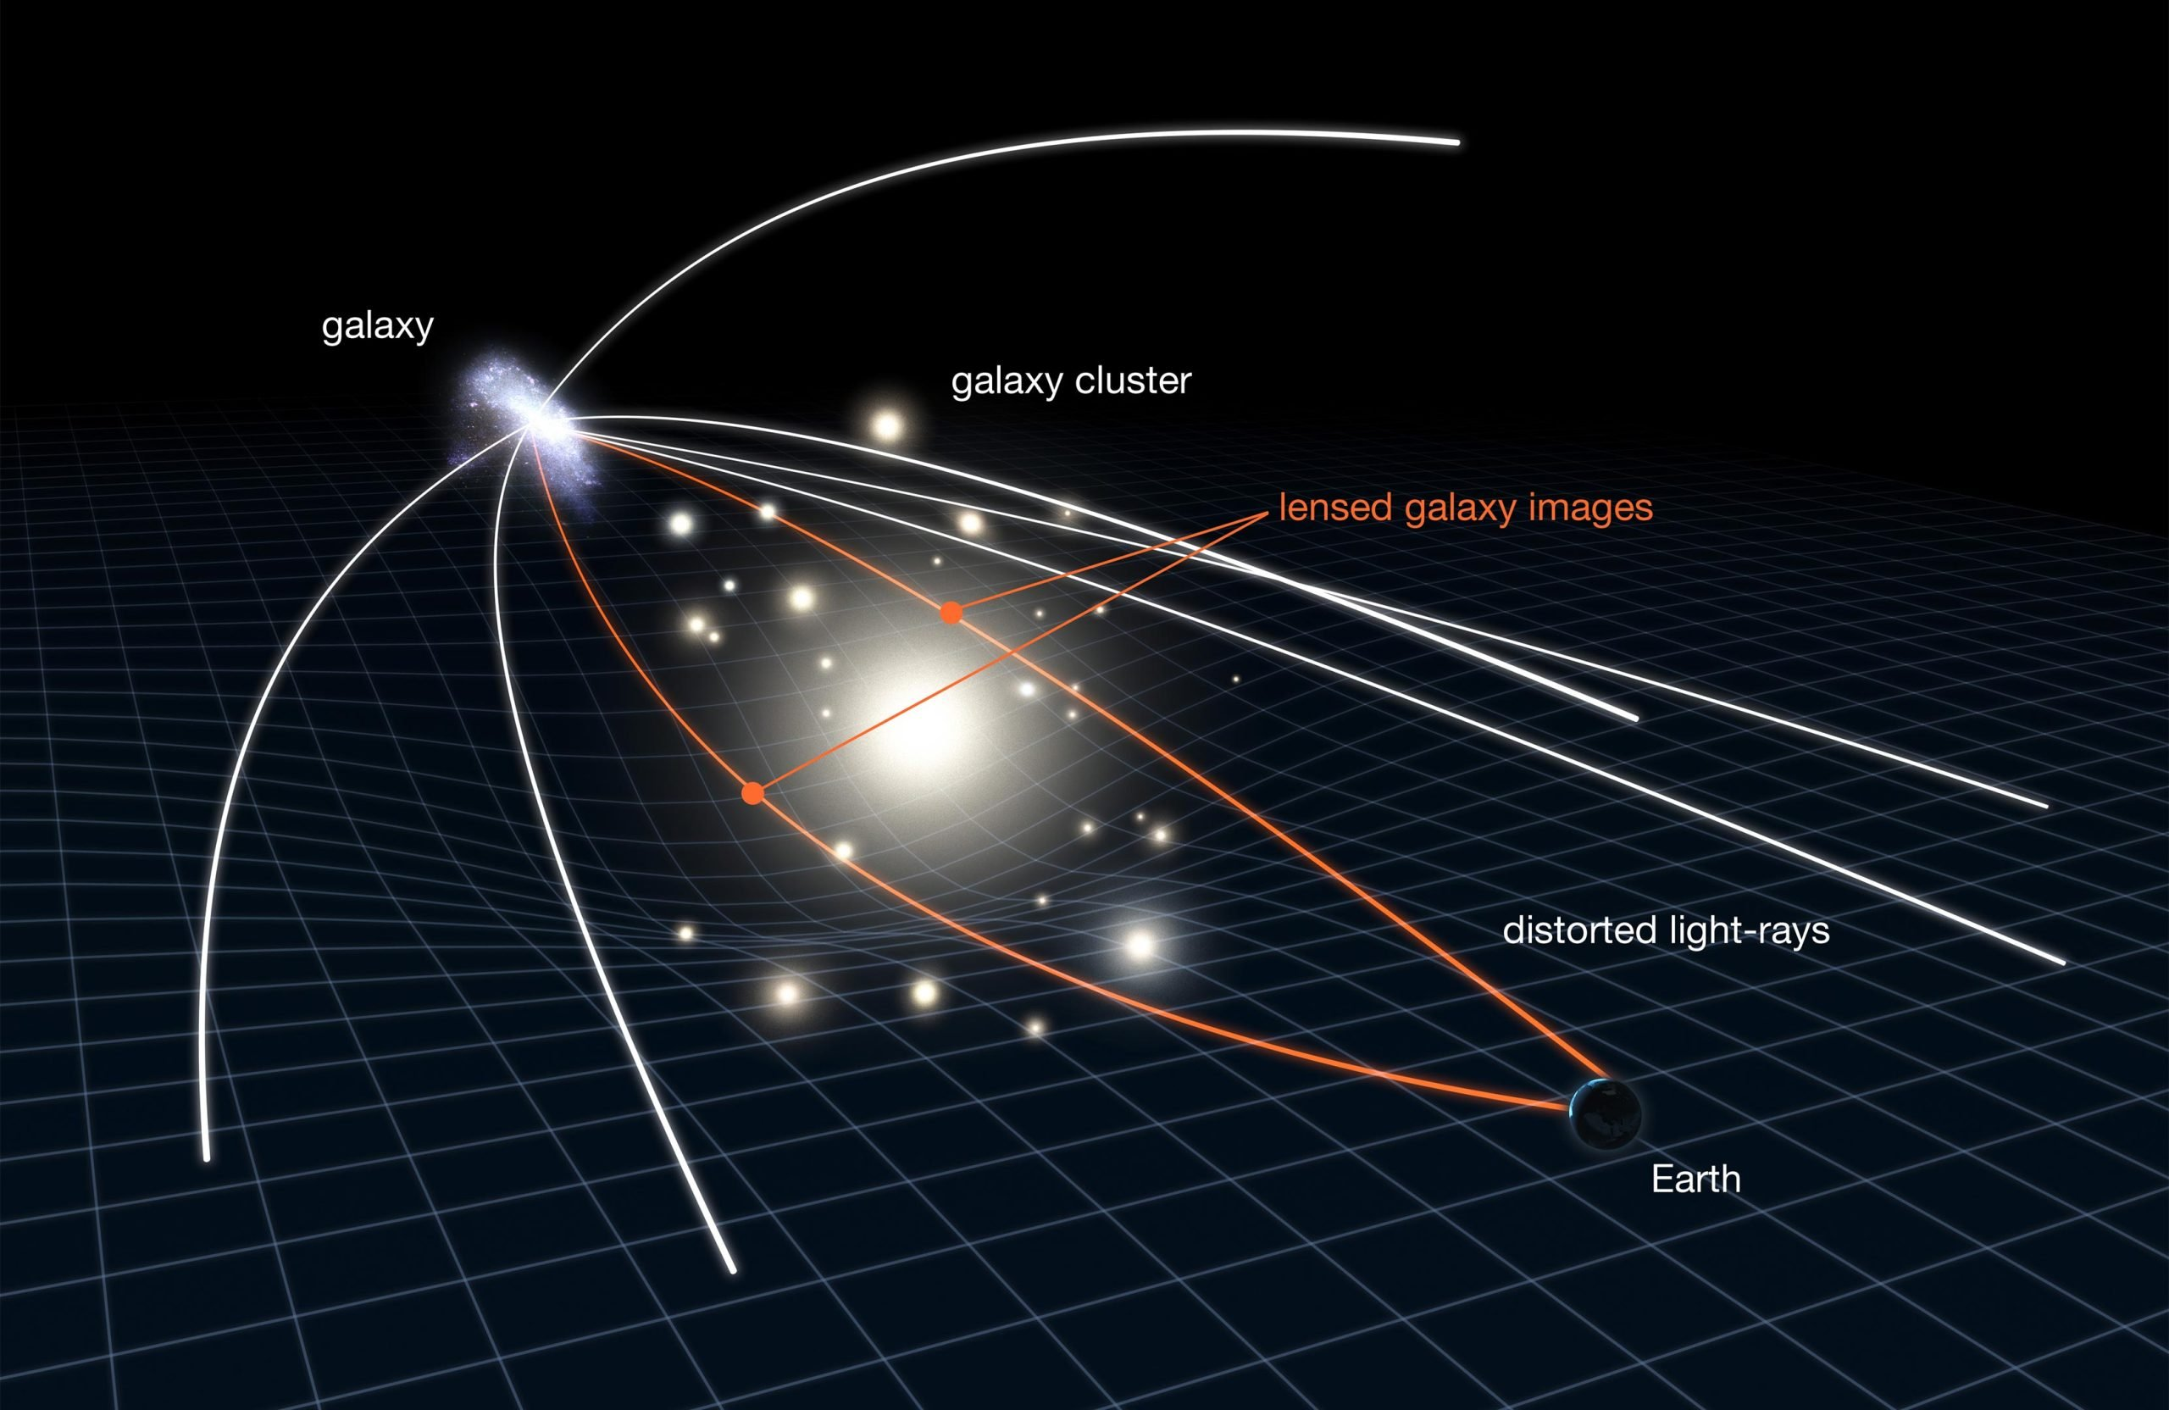
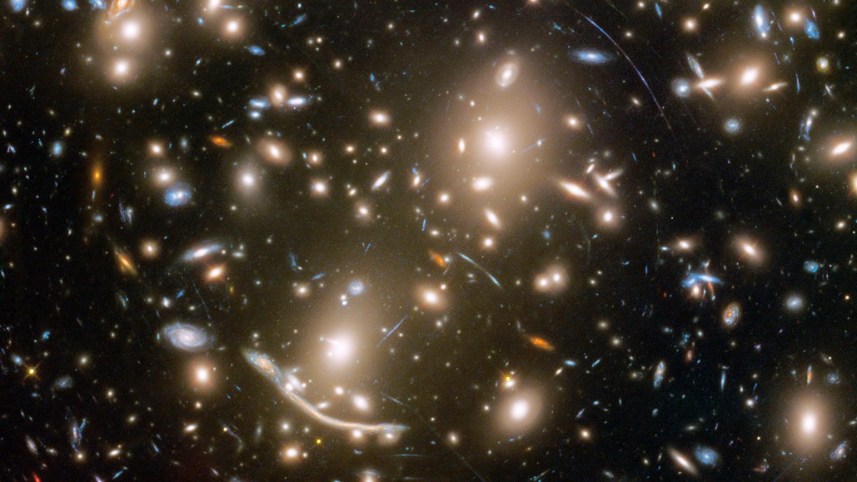
Introduction
Do we need to give up general relativity or is there a new kind of non baryonic ?
éné
Four proofs of dark matter: EMB, Galaxy rotation, stellar lensing and galaxy clusters
Where is dark matter?
2
Notes:
Contenu sans photo : génie physique et systèmes embarqués

Slide 3
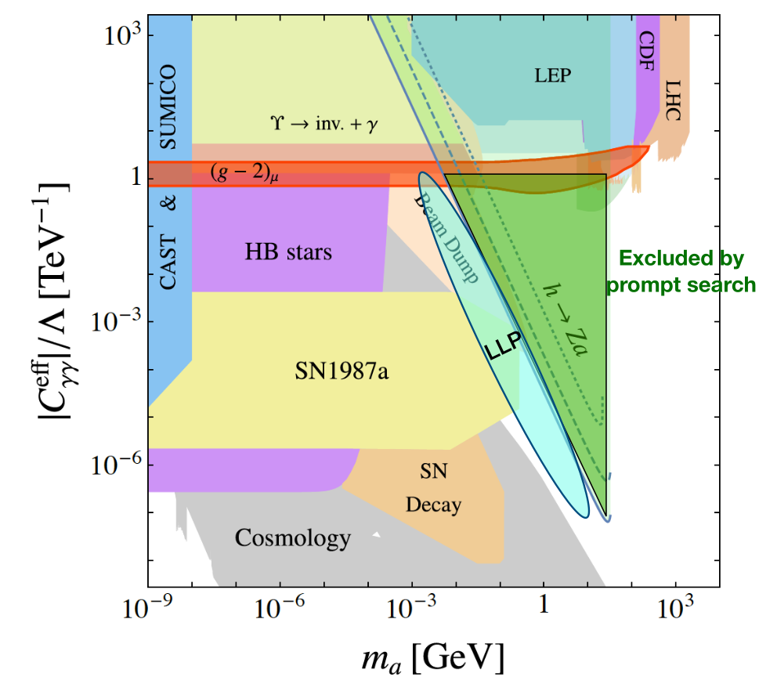
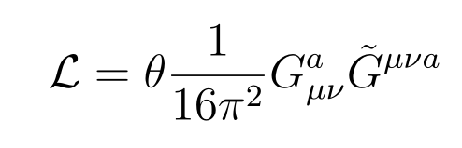
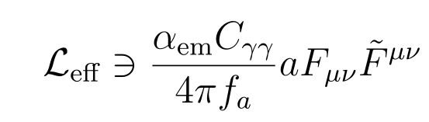
Phd topic
Search for long lived axion like particle at LHC in the ATLAS experiment
Initial issue :
QCD predicts the strong CP violation
Not observed in practice (θ <10¹⁰)
A theoretical explanation :
Peccei-Quinn’s idea: transform θ in a field protected by an U(1) symetry
New particle, the axion
Experimental challenges:
Axions can desintegrate into two colimated photons that are hard to distinguish
Effective Lagrangien for a -> γ γ
Current constraints on ALPs
3
Notes:
Contenu sans photo : génie physique et systèmes embarqués

Slide 4
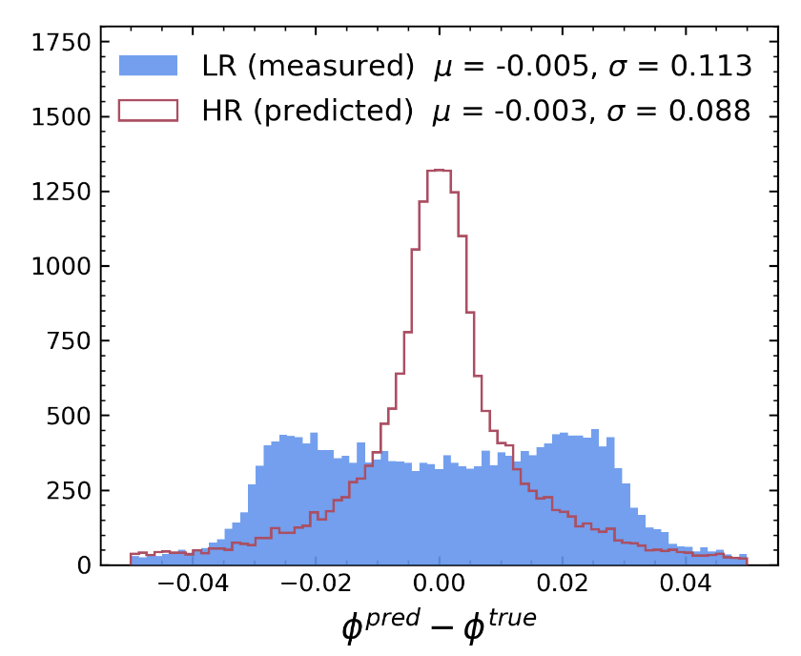
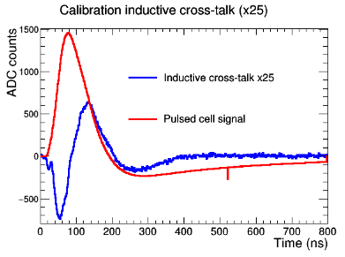
PHD topic
Qualification Task : Cross talk extraction
Use data driven machine learning to extract crosstalk and improve the timing
Find late particles (that could be due to ALPs disintegration)
Super resolition for the detector:
Improve the granularity of the electromagnetic barrel
Study new phenomena : H-> Za
Distinguish isolated pions
3
Notes:
Contenu sans photo : génie physique et systèmes embarqués

Slide 5
Thank you!

