Slide 1
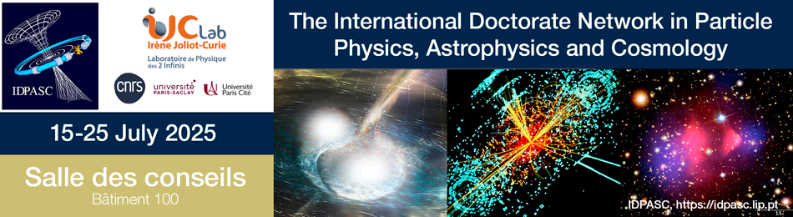
History and basic principles of particle accelerators
Nicolas Delerue
(CNRS and Université de Paris-Saclay)

Slide 2
Lectures content
History of particle accelerators
Basic principles:
- Particle sources
- Particle acceleration
- Magnets
- Emittance and beam dynamics
- Beam diagnostics
Challenges for present and future accelerators

Slide 3
About myself
Researcher at IJCLab in the accelerator Department
Working on:
- beam instrumentation and diagnostics (how to measure what happens in an accelerator) and
- new acceleration techniques (how to reach higher energy over shorter distances).

Slide 4
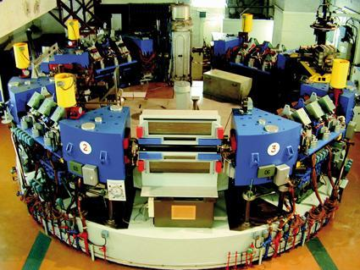
Lecture content
History of particle accelerators
Basic principles:
- Particle sources
- Particle acceleration
- Magnets
- Emittance and beam dynamics
- Beam diagnostics
Challenges for present and future accelerators

Slide 5
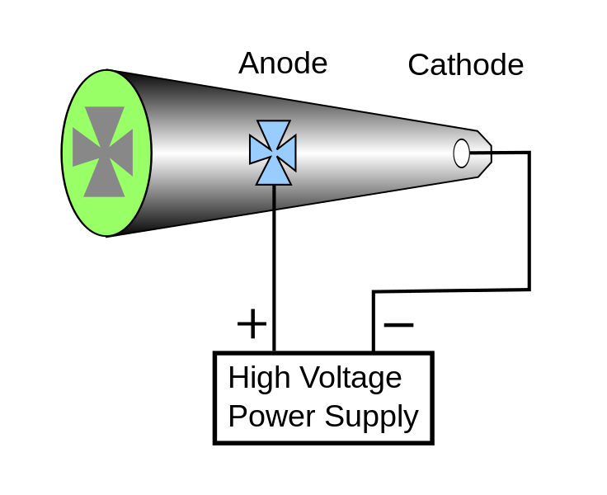
The first accelerator:
Crookes tubes
First ever particle accelerator:
Crookes (1869) – Cathode Ray tubes.
Discovery of the electron:
J. J. Thomson (1897).
X-rays Roengten (1895) – The first accelerator was already used a source of X-rays!

Slide 6
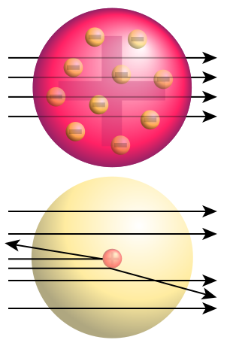
Rutherford scattering experiment (1)
In the early 20th century the structure of the atoms
In 1909 Rutherford was studying the structure of the atom.
He proposed to use alpha particles on a gold foils to probe the structure of the atom.
This experiment shows that by using an appropriate probe it was possible to study very small objects.
Trajectory of alpha particles in a uniformly charged sphere (top) and in a real gold nucleus (bottom) (image source: wikipedia)

Slide 7
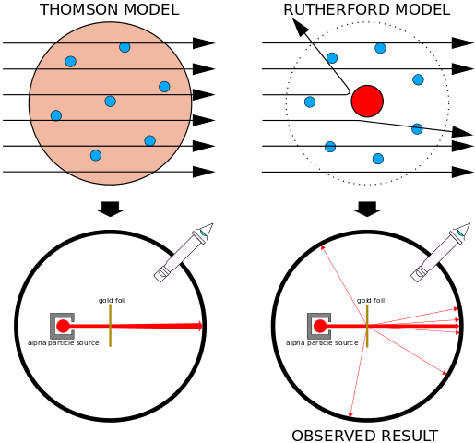
Rutherford scattering experiment (2)
Geiger and Marsden carried out the experiment proposed by Rutherford and recorded the scattering pattern.
The best explanation of the scattering pattern observed was that gold atoms were made of a hard core (now known as the nucleus) surrounded by a cloud of electrons.
The idea of using « small »probes to study the structure of particles is the basis of many accelerator.
The resolution depends on the probe size which is inversely proportional to its energy.

Slide 8
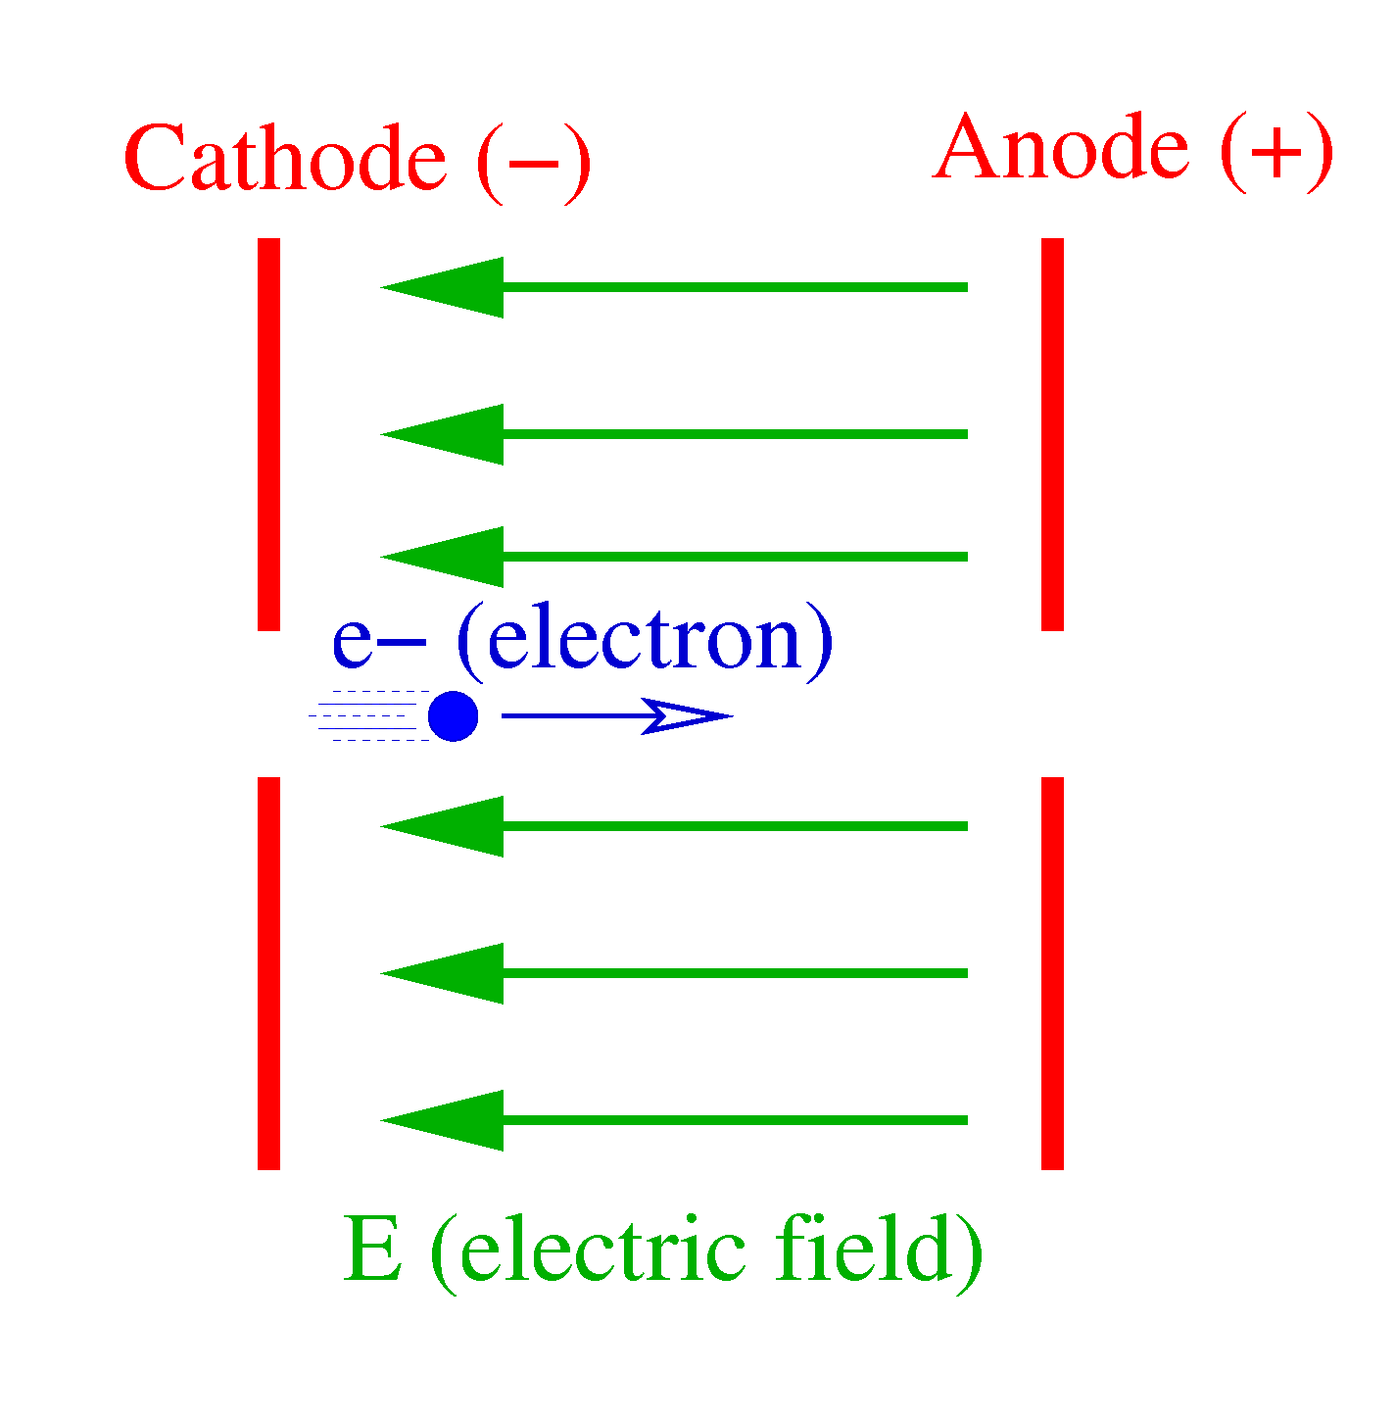
Beyond the
Geiger-Marsden experiment
The Geiger-Marsden experiment used alpha particles that were not accelerated.
To get a better resolution one needs a higher energy .
To go beyond what is available naturally it is necessary to accelerate the particles.
Charged particles can accelerated with an electric field (as was done in the Crookes tubes).
However the electric fields needed to study sub-nuclear matter are in the Megavolt range or beyond!

Slide 9
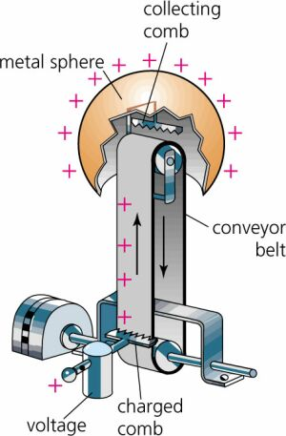
Van de Graaff generator
In 1929 Van de Graaff proposed a generator capable of producing such high voltages.
In a Van de Graaff generator charges are mechanically carried by a conveyor belt from a low potential source to a high potential collector.
Van de Graaff generators can reach several MV and are still used as static accelerators especially for ions.
Image courtesy of
http://people.clarkson.edu/~ekatz/scientists/graaff.html

Slide 10
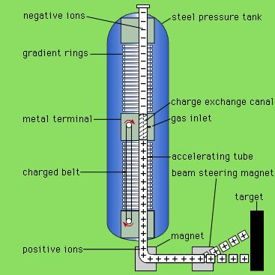
Tandem accelerators
It is possible to increase the energy reach of a Van de Graaff accelerators by using a “tandem” accelerator.
Such accelerator has two stage:
- In the first stage negative ions (with extra e-) are accelerated from ground to a positive high voltage.
- These ions are then stripped of 2-3 electrons in a stripper and become negative.
- They are then accelerated further by going from the positive high voltage to DC.
There is a Tandem Van de Graaff at IPN Orsay (now IJCLab).
Example: 10MV Van de Graaff can accelerate C⁻ to 10 MeV and then C²⁺ to 30 MeV.
Image source: http://people.clarkson.edu/~ekatz/scientists/graaff.html

Slide 11
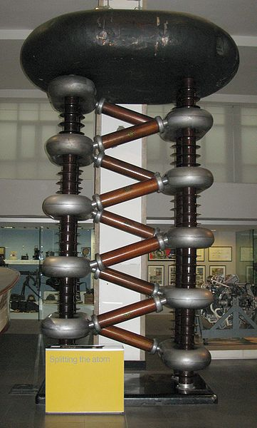
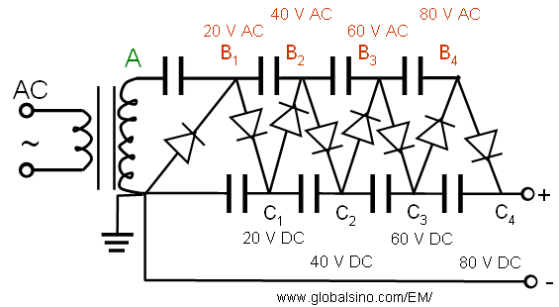
Cockroft-walton generator
To reach higher energies, the particles can be accelerated in an electric field.
Cockroft and Walton used a voltage multiplier made of diodes and capacitors.
The first half-cycle will load the first capacitor to its peak voltage. The second half-cycle loads the second capacitor and so on...
=> high voltage pulses
A Cockroft-Walton generator
(image source: wikipedia)

Slide 12
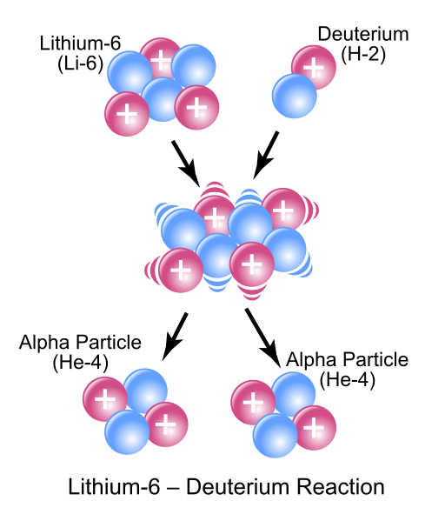
Splitting the atom
By using their generator Cockroft and Walton were able to accelerate protons to hundreds of keV.
In 1932 they bombarded Lithium with 700 keV hydrogen nuclei and transmuted it into Helium and other elements.
This was the first time that a particle accelerator had been use to trigger a nuclear reaction.
Cockroft and Walton were awarded the Nobel prize for this work in 1951.

Slide 13
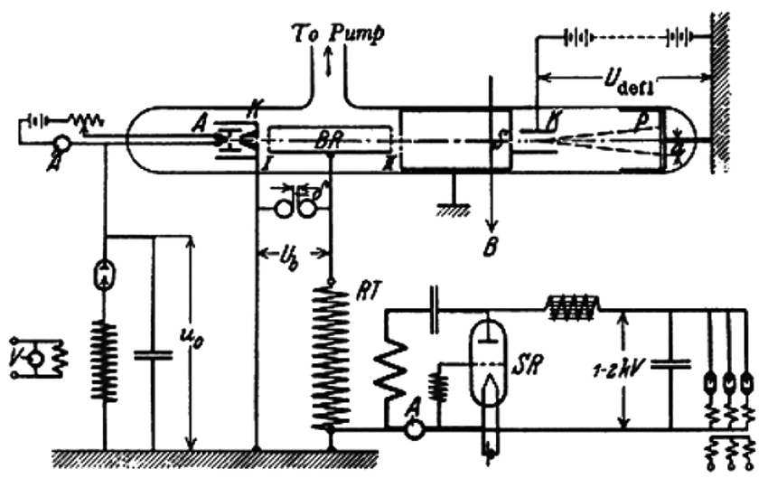
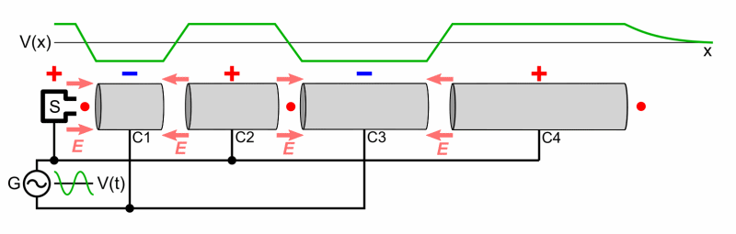
First varying field accelerator
To reach higher energy Ising proposed in 1925 to used a varying field.
This was realised by Wideroe in 1928.

Slide 14
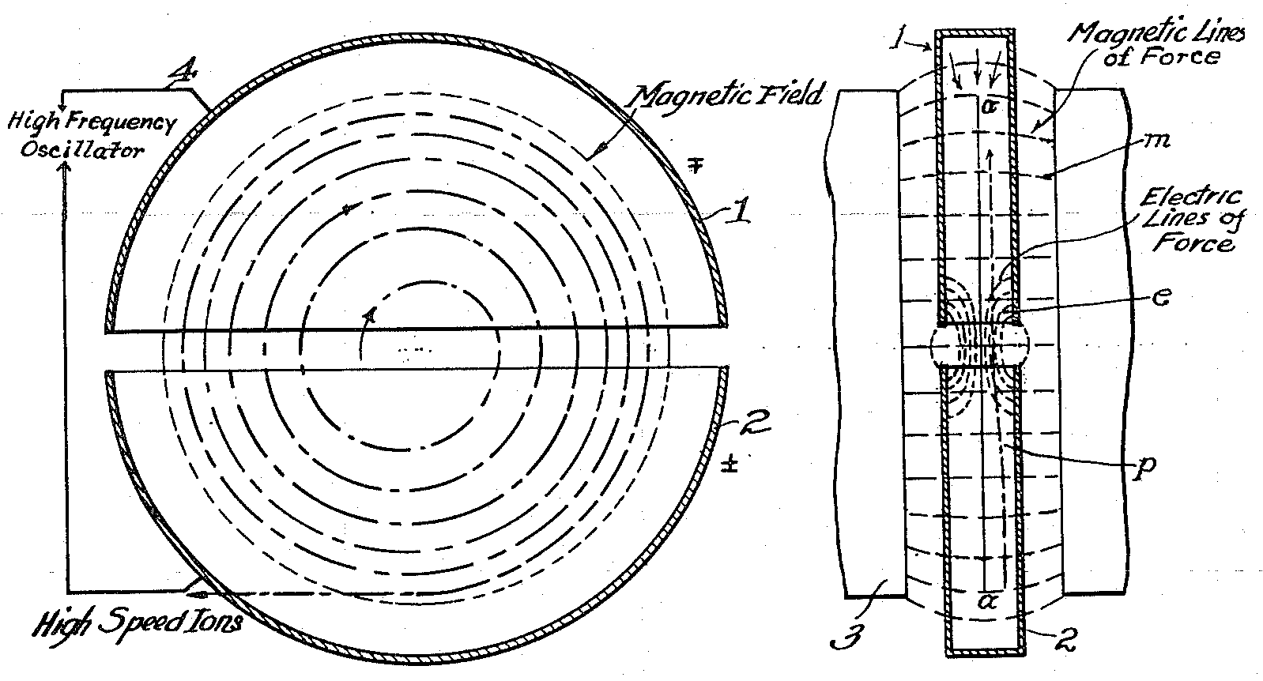
Cyclotron
Ising’s accelerator was limited by the need of having many accelerating sections after each other.
To overcome this a magnet can be used to loop the particles back on the accelerating section.
In 1931 Lawrence designed a “cyclotron”, a circular device made of two electrodes placed in a magnetic field that used AC field to accelerate the particles.

Slide 15
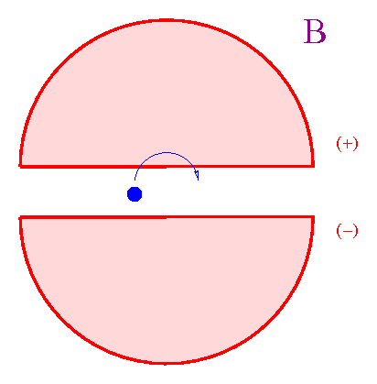
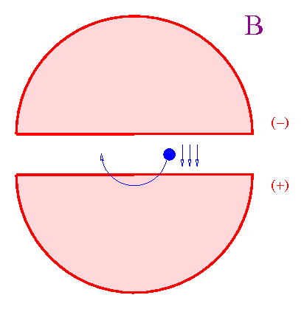
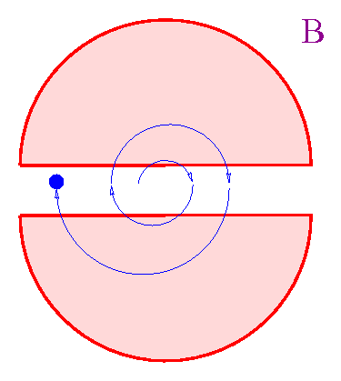
Cyclotron (2)
The particle source is located in the middle of the cyclotron.
Due to the magnetic field the particles follow a circular trajectory
By reversing the electric field of the electrode between two gap crossing it is possible to accelerate the particles.
With an AC potential of only 2000V Lawrence accelerated protons to 80kV!
Lawrence received the Nobel prize in 1939 for this work.
However, Cyclotrons can only accelerate non-relativistic particles…

Slide 16
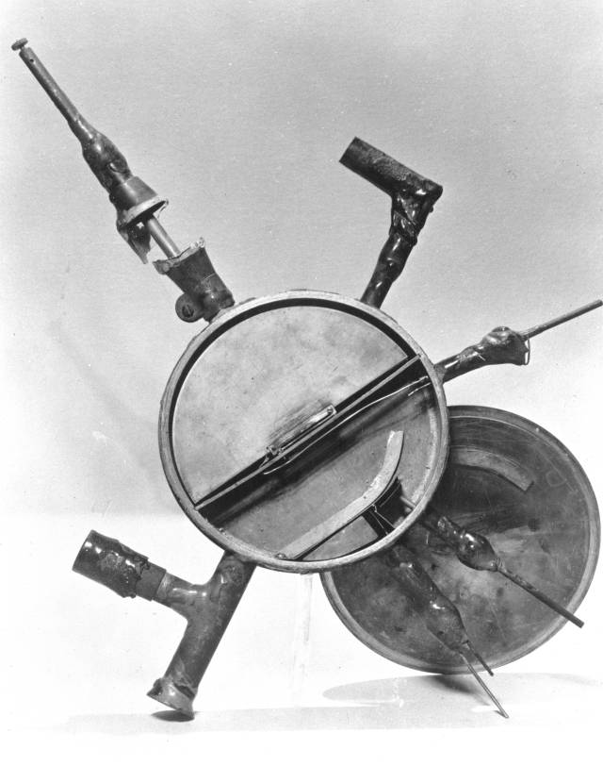
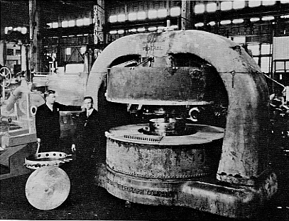
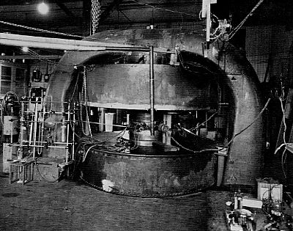
Size limits…
11-inch → 27-inch → 60-inch (16 MeV) → 100 MeV?!
Relativistic limits!
IFAST
16

Slide 17
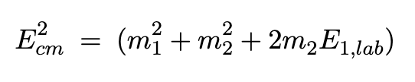
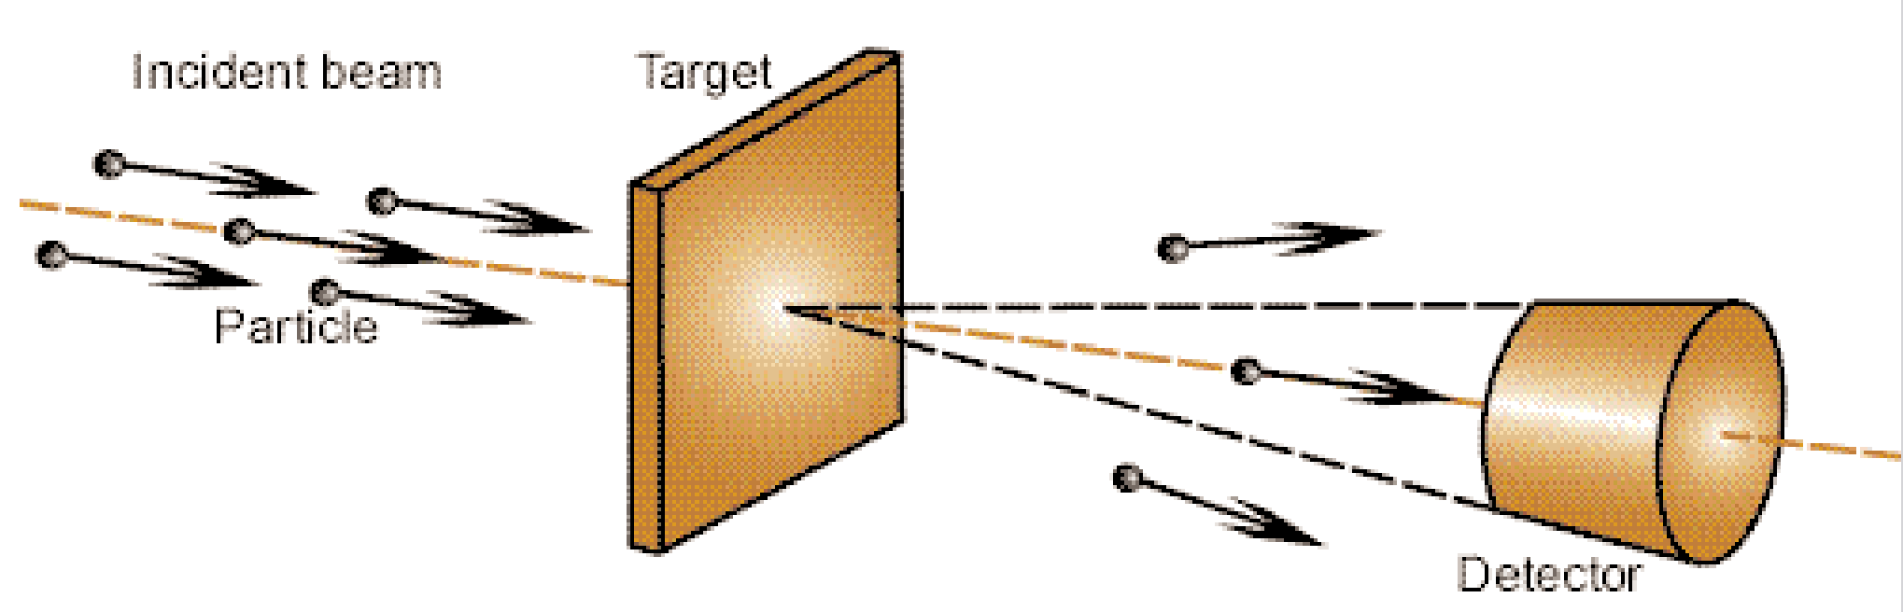
Fixed target experiments…
Until then all “nuclear physics” experiments were done on a fixed target.
In such experiment, the energy in the centre of mass is:

Slide 18

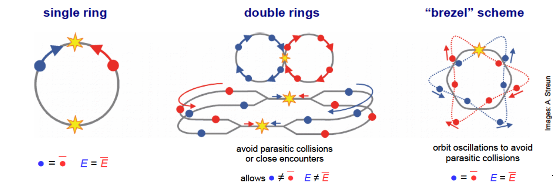
… versus colliding beam
Energy with fixed target:
With colliding beams the centre of mass energy is:
At high energy (E>>m) gain of having colliding beams is significant!
But how to collide beams?

Slide 19
Quizz: fixed target
Let’s compare fixed target and colliding beams.
Assuming that the mass of a proton is 1GeV/c².
You have an accelerator than can accelerate protons to
400 GeV.
What will be the energy in the centre of mass of a 400 GeV proton hitting a proton in a fixed target?
(a) 28.3 GeV
(b) 400 GeV
(c) 800 GeV
(d) 802 GeV

Slide 20
Answer (a)
Let’s compare fixed target and colliding beams.
Assuming that the mass of a proton is 1 GeV/c².
You have an accelerator than can accelerate protons to 400 GeV.
What will be the energy in the centre of mass of a
400 GeV proton hitting a proton in a fixed target?
Ecm²=1²+1²+2*1*400=802 GeV²
Ecm=sqrt(802)=28.3GeV

Slide 21
Quizz
Let’s compare fixed target and colliding beams.
Assuming that the mass of a proton is 1GeV/c².
You have an accelerator than can accelerate protons to 400 GeV.
What will be the energy in the centre of mass of two 400 GeV protons hitting each other?
(a) 28.3 GeV
(b) 400 GeV
(c) 800 GeV
(d) 802 GeV

Slide 22
Answer (c)
Let’s compare fixed target and colliding beams.
Assuming that the mass of a proton is 1GeV/c².
You have an accelerator than can accelerate protons to 400 GeV.
What will be the energy in the centre of mass of two 400 GeV protons hitting each other?
Ecm²=(400+400) ²=800² GeV² Ecm=800GeV
Fixed target: 28.3 GeV Colliding beams: 800 GeV
A similar comparison for 7 TeV protons gives:
114.6 GeV for fixed target beams against 14 TeV for colliding beams!

Slide 23
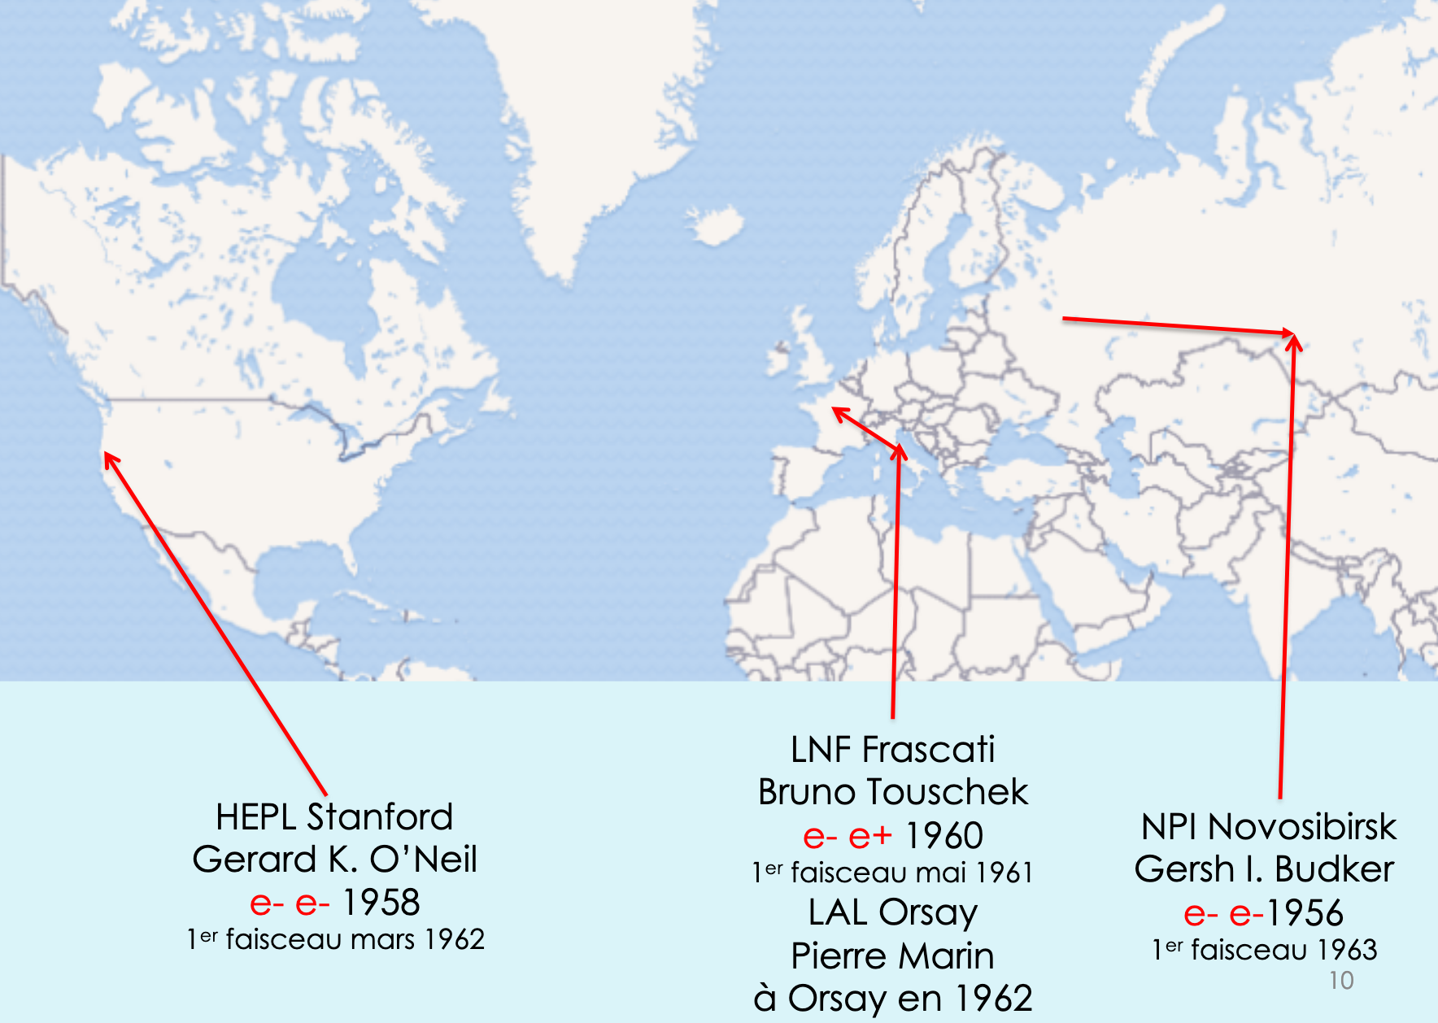
Back to history…
Most work in new accelerators stopped during WWII.
After the war the work resumed and several groups tried to build a collider…
Courtesy of Jacques Haïssinski

Slide 24
e+ e- versus e- e-
A critical choice for a collider was to decide the type of collisions.
Positrons are difficult to produce hence Kurchatov and Stanford choose e- e-.
The Frascati group (led by B. Touschek) was convinced that collisions would be easier (CT invariance).
e+ e- collisions had several advantages:
  Single ring
  More interesting physics with the collisions

Slide 25
First generation colliders
(storage rings)
Laboratory | Proposal date | Name | Collision type | Energy | First beam
Kurchatov institute (Moscow) then Novosibirsk | 1956 | VEP-1 | e- e- | 2 x 160 MeV | 1963
High Energy Physics Laboratory (Stanford) | 1958 | Princeton-Stanford e- e- storage rings | e- e- | 2 x 500 MeV | 1962
Frascati National Laboratory | 1960 | Ada (Ring of accumulation) | e- e+ | 2 x 220 MeV | 1962

Slide 26
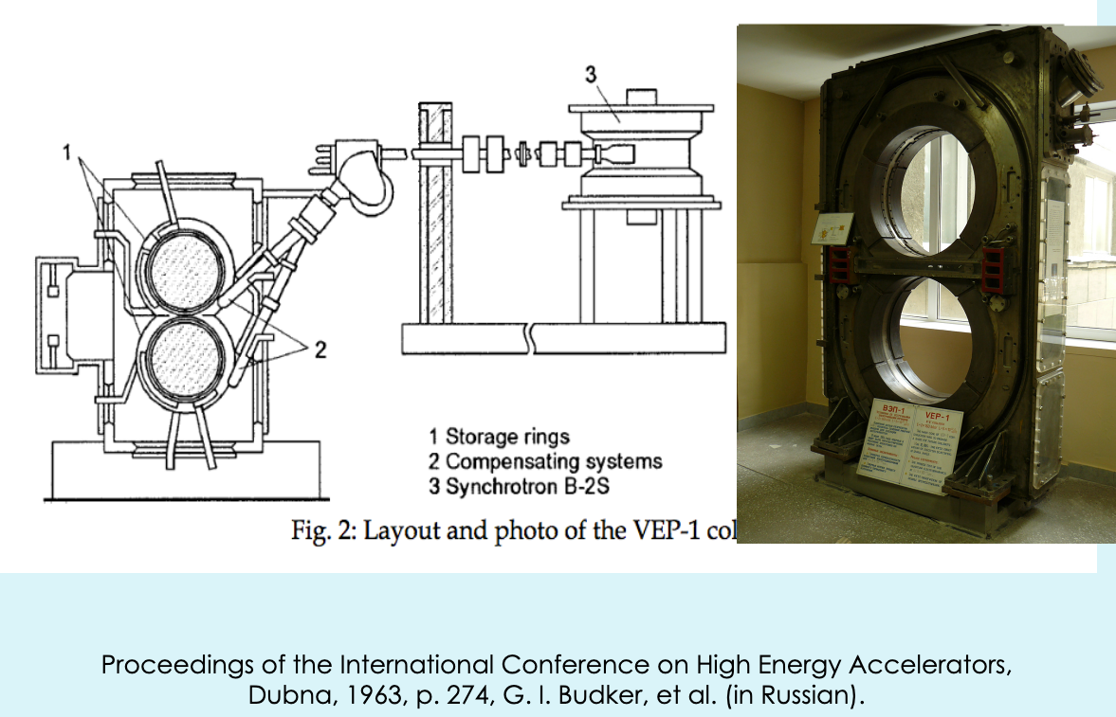
VEP-1 (Dubna, Russia)
Courtesy of Jacques Haïssinski

Slide 27
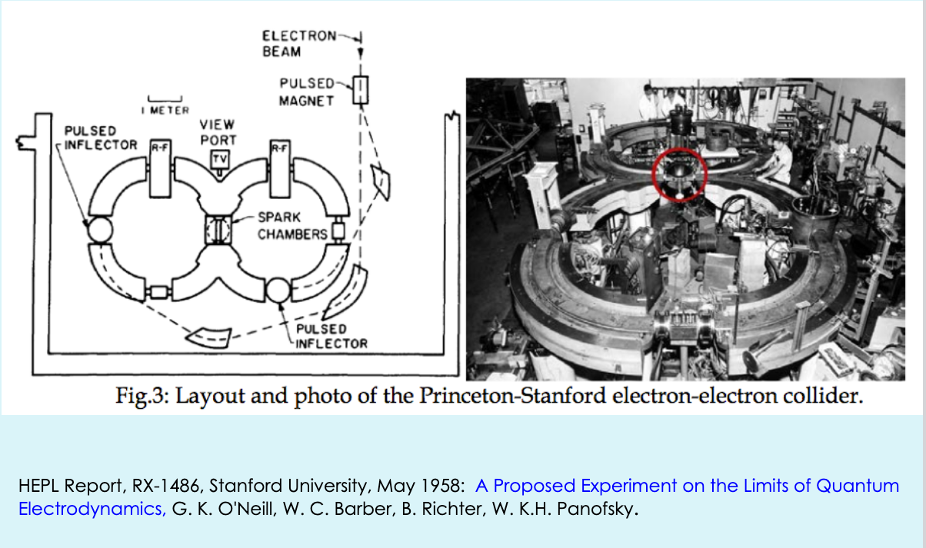
The Princeton-Stanford collider
Courtesy of Jacques Haïssinski

Slide 28
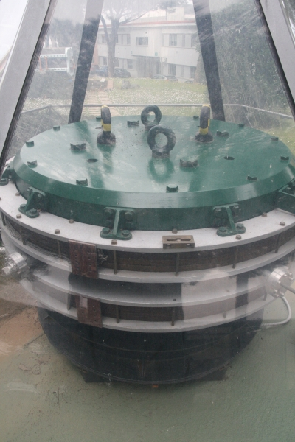
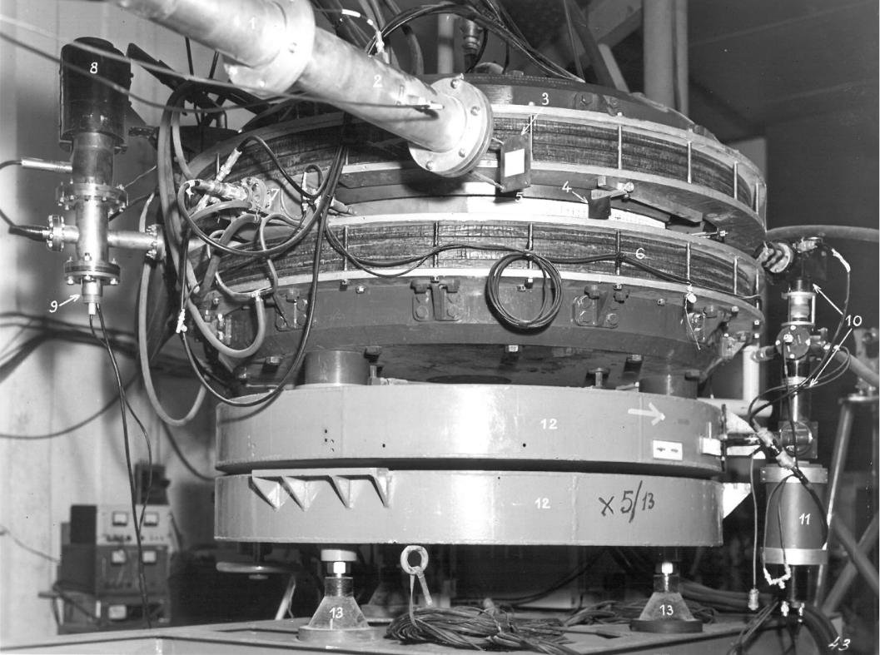
AdA
Anello di Accumulazione
After unsuccessful attempts in Frascati, AdA was brought to Orsay where the positron source was stronger.
AdA in a glass case at
Frascati National Laboratory

Slide 29
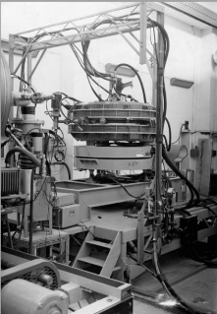
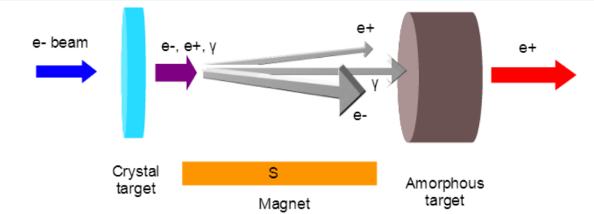
AdA
Anello di Accumulazione
In Orsay the flux of electrons was sufficient to get a good number of positrons.
The choice of e+ e- then proved good.
Despite being the last project to start, it was the first to see collisions.
AdA in a Orsay

Slide 30
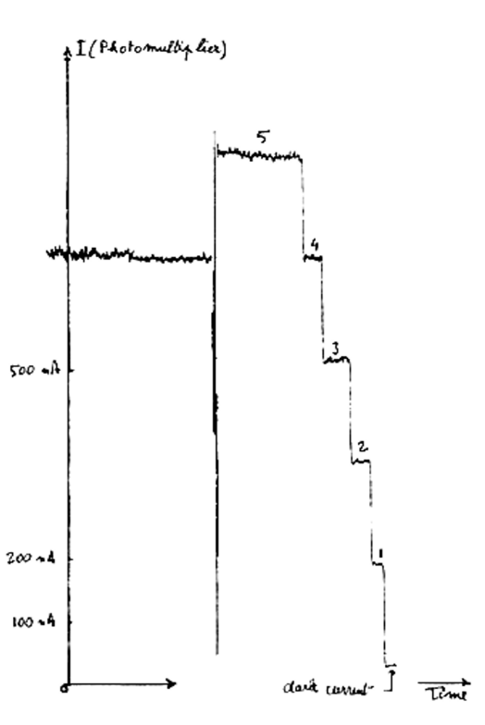
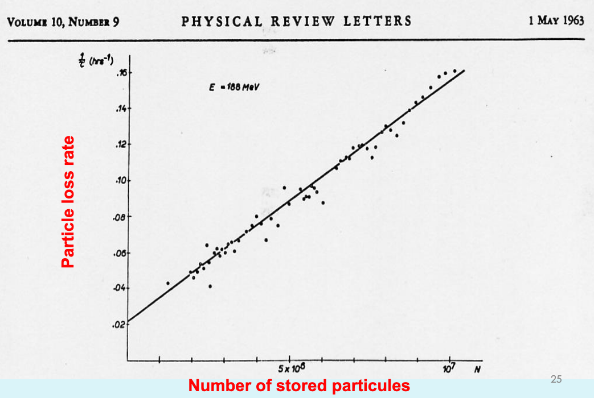
Some results from AdA
Touschek effect
Single electrons
Courtesy of Jacques Haïssinski

Slide 31
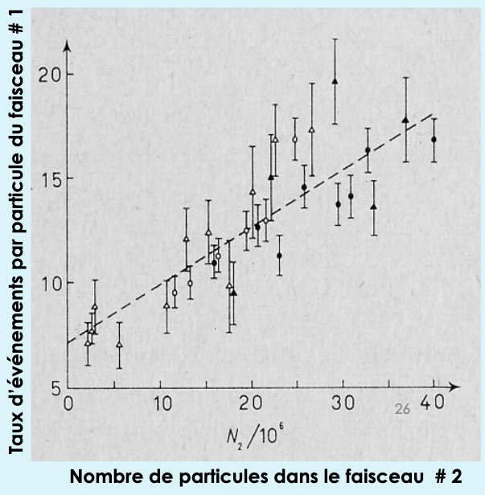
First collisions
First collisions at AdA: autumn 1963.
VEP-1 (e- e-):
May 1964
Princeton-Stanford electron-electron collider:
March 1965.
Courtesy of Jacques Haïssinski

Slide 32
Second generation colliders
Initial colliders had strong limitation (focussing, beam size,…)
Even before their success a second generation was planned:
  VEP-2 (Novossibirsk): 2 x 700 MeV
  ADONE (Frascati): 2 x 1,5 GeV
  ACO (Anneau de Collisions d’Orsay): 2 x 510 MeV
  CEA (Cambridge Electron Accel., USA): 2 x 3,5 GeV

Slide 33
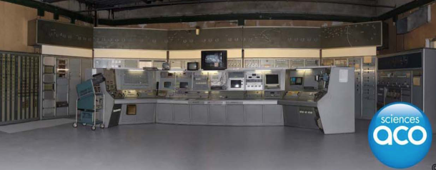
L’Anneau de Collision d’Orsay
The AdA success led to the construction of the first French collider, ACO in 1962 (first collision in 1965).
ACO ceased as a collider in 1975. After it served as a light source until 1988.
Another collider, DCI (Dispositif de Collision dans l’Igloo), was used on site from 1975 until 1985 (and as synchrotron source until 2001).
ACO is now a museum that can be visited.

Slide 34
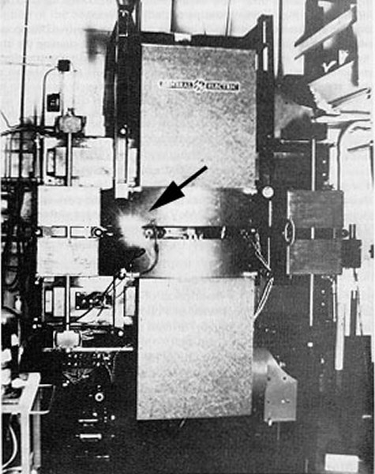
A second life for colliders: light sources
Colliders were the first rings able to store beams for several hours (storage rings).
The opened the way for the exploitation of the synchrotron radiation they produced.
After the end of their time as collider they were converted to 1st generation light sources.

Slide 35
CERN
End of second world war: need to restore Science in Europe and share work on nuclear physics.
Early proposal: Louis De Broglie (1949), UNESCO (1950)…
1952: First CERN (Conseil Européen pour la Recherche Nucléaire) council meeting.
1954: European Organization for Nuclear Research (CERN) is established.

Slide 36
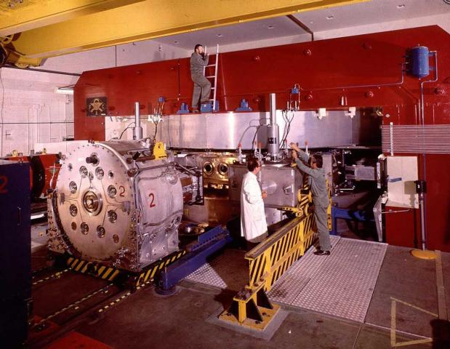
The synchrocyclotron
Cyclotrons are limited by relativistic effects.
To reach higher energies CERN built in 1957 a synchrocyclotron that could reach 600 MeV.
Works like a cyclotron but the RF frequency is changed when the particles reach high energy.
1967: Used for ISOLDE.
1990: Decommissioned
You can still visit the SC today at CERN.
Image courtesy of CERN
https://home.cern/about/who-we-are/our-history

Slide 37
Quizz: Relativistic effects
Assuming the mass of a proton is 1 GeV/c².
What is the Lorentz factor of a proton with a kinetic energy of 600 MeV?
(a) gamma = 1
(b) gamma = 1,2
(a) gamma = 1,6
(a) gamma = 600

Slide 38
Answer: (c)
Assuming the mass of a proton is 1 GeV/c².
What is the Lorentz factor of a proton with a kinetic energy of 600 MeV?
Gamma= Etot/Mass
Etot=1 GeV + 600 MeV =1,6 GeV
Gamma= Etot/Mass=1,6/1=1,6
Beta ~0,78

Slide 39
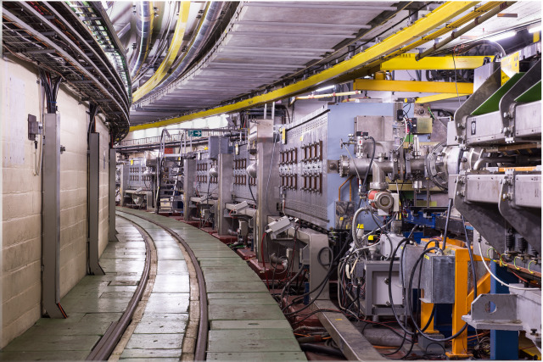
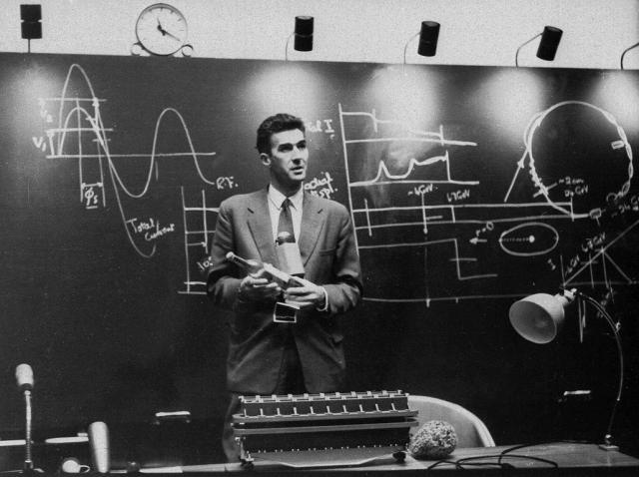
The proton synchrotron
1959: The Proton Synchrotron starts and reaches 24 GeV (later 28 GeV), beating Dubna’s 10GeV accelerator.
The PS is still in use nowadays.

Slide 40
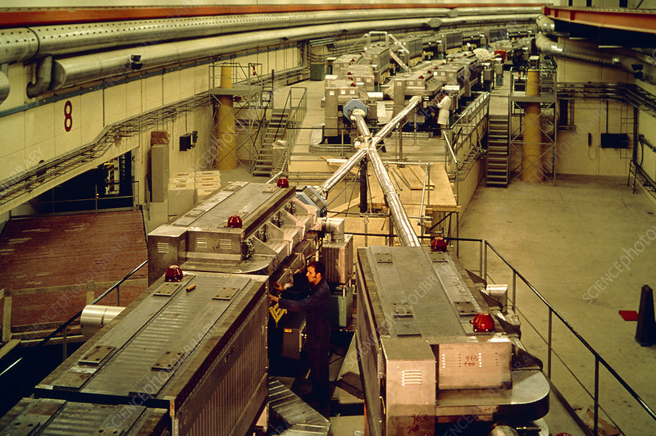
The Intersecting Storage Rings
Building up on the success of AdA CERN decided to build a collider.
The Intersecting Storage Rings started in 1971 and observed the world first proton proton collisions.
Decommissioned in 1984.

Slide 41
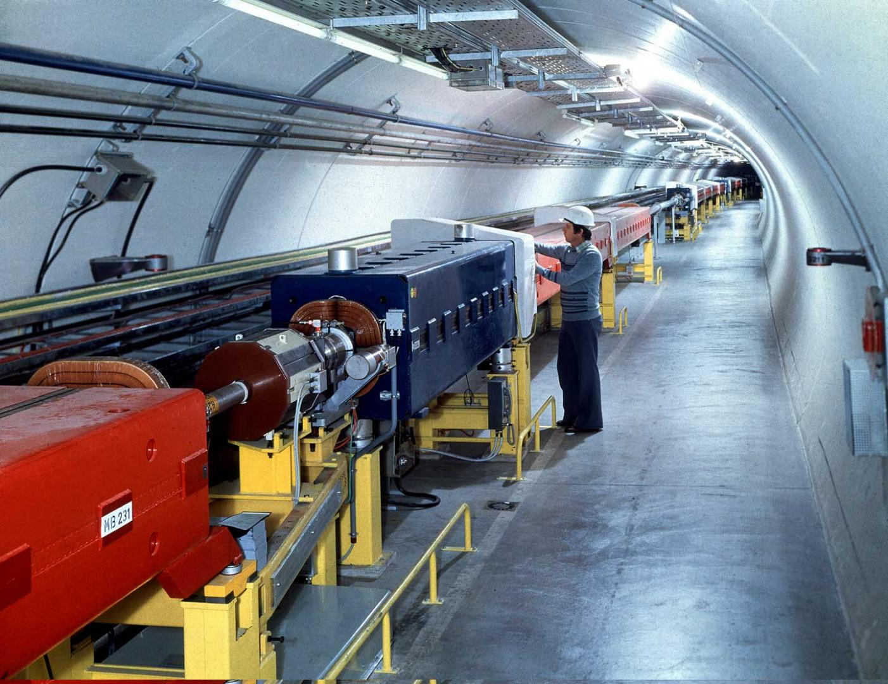
The Super Proton Synchrotron (SPS)
In 1976, a 7-kilometer ring was started: the SPS.
Control room uses touch screens!
Energy: 400 GeV
Converted to proton antiproton collider in 1981
=> discovery of W and Z.
Still in operation.

Slide 42
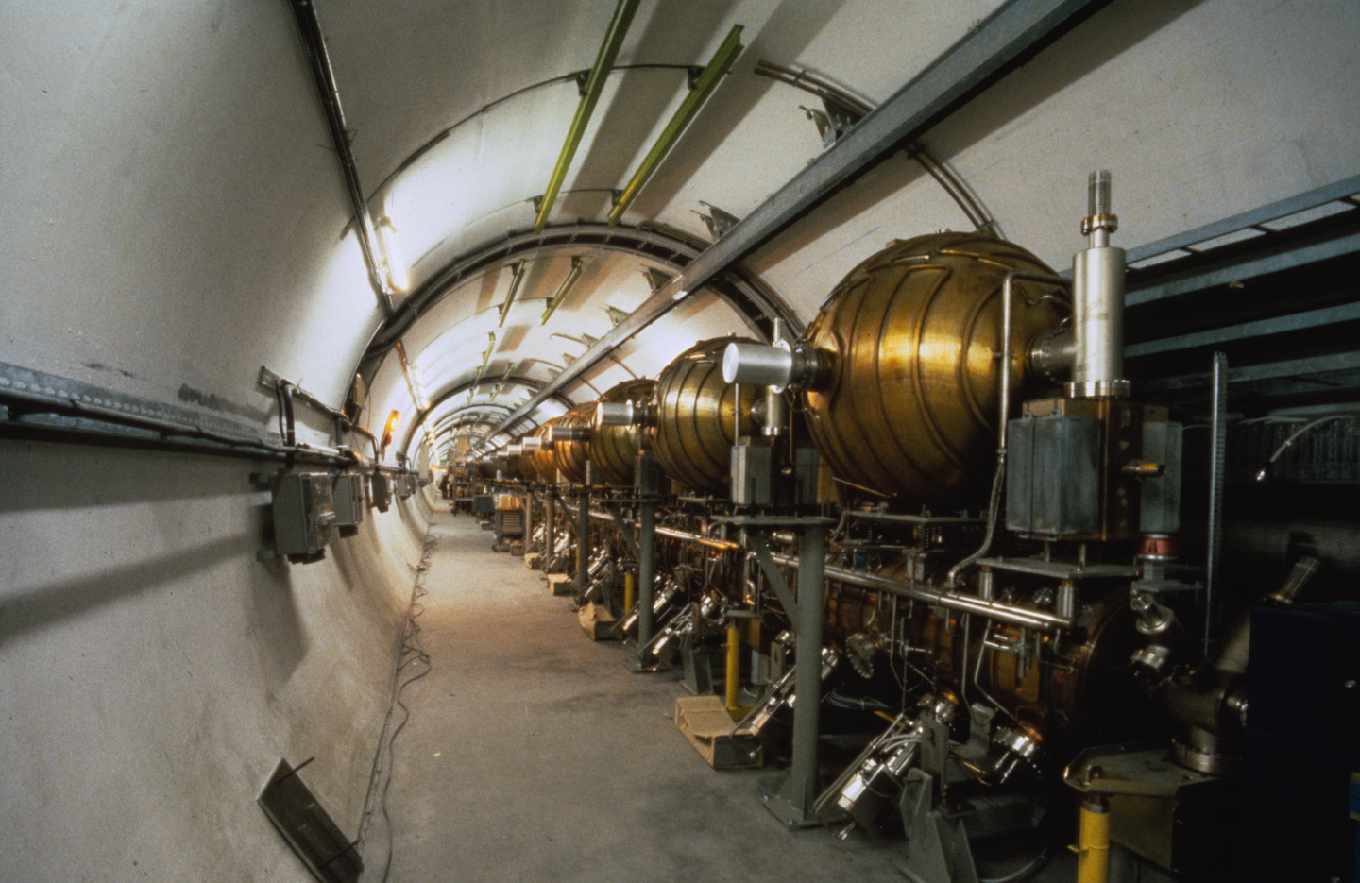
The Large Electron-Positron collider
In 1989, LEP started.
27-kilometer ring!
Energy: ~100 GeV (electrons)
209 GeV in the center of mass
Closed and dismantled in 2000.

Slide 43
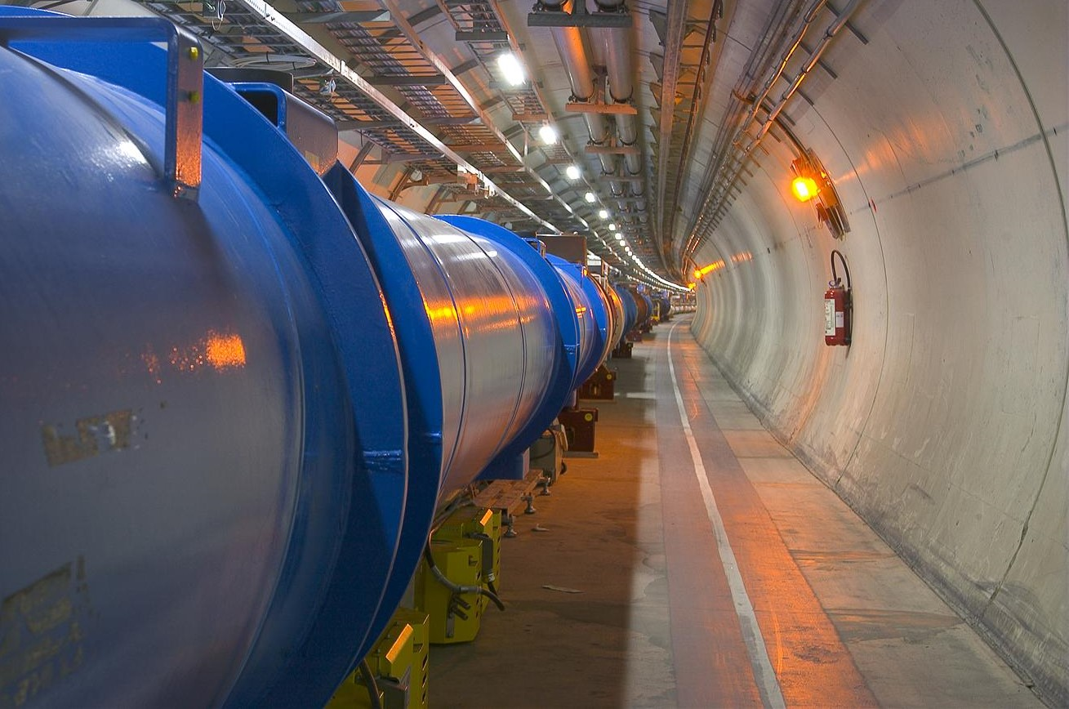
The Large Hadron Collider (LHC)
Built in LEP’s tunnel.
First beam in 2008.
Initial energy limitation to 3,5TeV/beam.
Later increased to 7TeV/beam (14 TeV cm).

Slide 44
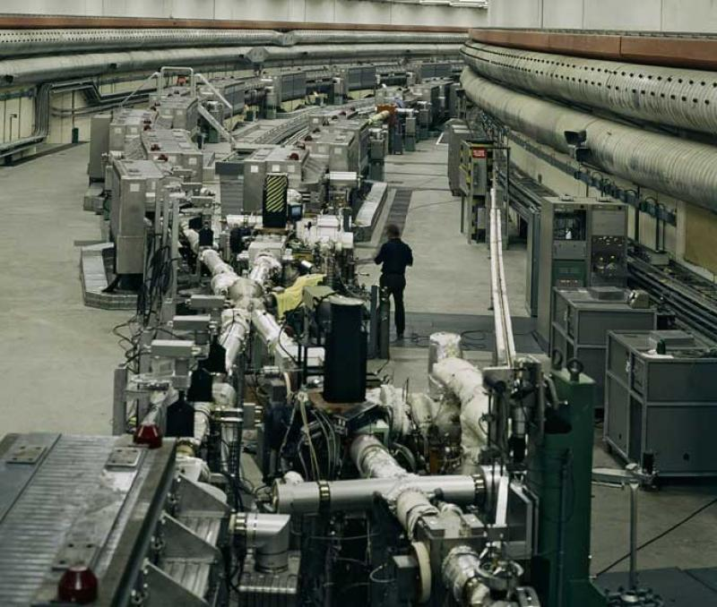
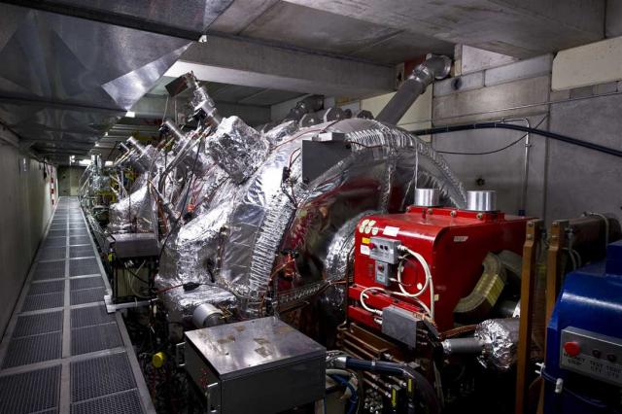
Accelerators at CERN
1957: Synchrocyclotron (SC), 600 MeV, protons/ions
(closed in 1990).
1959: Proton Synchrotron (PS), 28 GeV, still in use!
1971: Intersecting Storage Ring (ISR), first CERN collider, 62 GeV protons (closed 1984)
1976: Super Proton Synchroton (SPS), 7km,
up to 400 GeV (now 450 GeV).
{Discovery of neutral currents and the Z boson in 1983}
1989: Large Electron Positron collider (LEP), 27 km,
up to 209 GeV e- (stopped in 2000)
1997: Antiproton Decelarator (down to 100MeV/c) for antimatter studies.
2008: Large Hadron Collider (LHC), 7 TeV protons…
Source: http://timeline.web.cern.ch/timelines/CERN-accelerators

Slide 45
Quizz
Why CERN built a 200 GeV electron position collider after building a 400 GeV proton collider?
(a) Because of budget cuts: they could no longer afford to go to 400 GeV
(b) Stability (and hence luminosity) is better at 200GeV than at 400 GeV
(c) The physics potential of a 200 GeV lepton collider is higher than that of a 400 GeV proton collider.

Slide 46
Answer (c)
The physics potential of a 200 GeV lepton collider is higher than that of a 400 GeV proton collider.
For example to discover the Higgs only twice the Higgs mass was need in the cm with leptons (but they did not reach that energy).

Slide 47
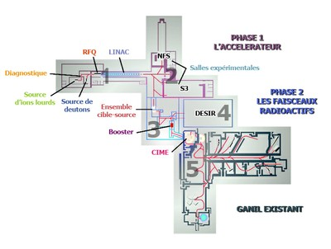
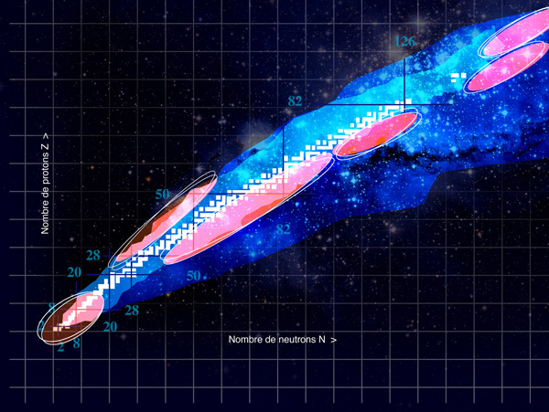
GANIL and SPIRAL2
GANIL is a laboratory dedicated to radioactive ions, initially using cyclotrons.
SPIRAL2 is an upgrade using a linear RF accelerator.
There is another large heavy ions research facilty in Darmstadt (Germany): GSI.

Slide 48
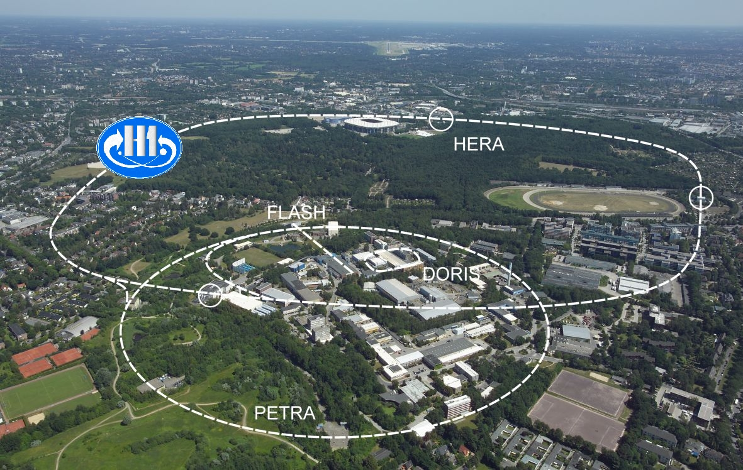
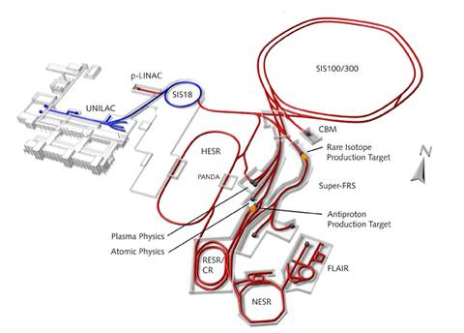
Other HEP accelerators in Europe
Frascati (near Rome, Italy):
ADONE: e+/e- collider (1969-1993) 1.5 GeV
DAFNE (since 1999): e+/e- collider; 1 GeV, Kaon studies.
DESY (Hambourg Germany):
e+/e- collider (1960-1980)
Electron-proton collider (HERA; 1990-2007) up to 920 GeV protons on 27 GeV electrons.
GSI/FAIR:
GSI is a heavy ions accelerator in Darmstadt, Germany (11.4 MeV/nucl.) since 1975. It is being upgraded as FAIR.

Slide 49
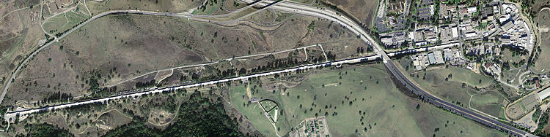
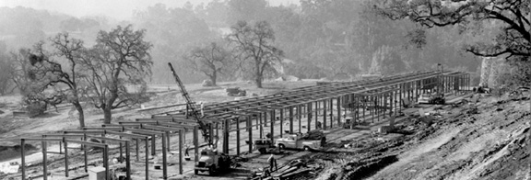
Accelerators at SLAC
1962: Construction of the « 2 miles accelerator », the Stanford Linear Accelerator at SLAC (for e+/e- up to 45 GeV). {1968: Evidence for quarks}
1980: PEP: Positron-Electron Project at 29 GeV until 1990.
1989: Stanford Linear Collider (90 GeV cm) until 1998 (Detector: SLD).
1999: PEP-II, ~10 GeV B-Factory until 2008 (Detector: BaBar).

Slide 50


Other HEP accelerators in North America: Proton/ions
1969: Proton Linac at Fermilab near Chicago (200 MeV)
1974: TRIUMF, H- cyclotron (500MeV) in Vacouver, Canada
1976: 500 GeV ring at Fermilab.
1989: Tevatron (1 TeV cm then 2 TeV cm) @ FNAL.
{Discovery of the top quark in 1995}
1983-1993: Superconducting Super Collider: attempt to build a 20 TeV collider in Texas (aborted in 1993 due to budget problems).
2001: RHIC, Brookhaven, heavy ions,
up to 100GeV/nucleon

Slide 51


Other HEP accelerators in North America: CSER and JLAB
Cornell (NY state):
1979 CESR 3.5-12 GeV ring; B and C physics
CESR has been converted into a test facility for rings. Cornell is also working (with other labs) on a new kind of accelerators called “Energy recovery Linacs”).
Jefferson Lab (Virginia):
1984: CEBAF Up to 6 GeV electrons; fixed target experiments; high intensity (still in operation).

Slide 52


HEP Accelerators in (former) Soviet Union
Novosibirsk, Budker institute:
- 1964: VEP, e+/e-, 130 MeV in Novosibirsk
- 1994: VEPP-4M, e+/e-, 6 GeV, Meson physics
Dubna, JINR:
- 1957: 10 GeV protons (closed 2003)
- NICA: Nuclotron Based Ion Collider Facility.
Commissioning expected soon…

Slide 53

HEP Accelerators in Asia
KEK (Tsukuba, Japan):
Proton synchroton (1976-2005), 12 GeV
TRISTAN (1986-1995): e+/e- collider at 26 GeV
KEKB (1998-2010): e+/e- collider 8 GeV on 3.5GeV
SuperKEKB (2016+): e+/e- collider: 7GeV on 4 GeV.
BEPC-II:
Beijing Electron Positron Collider (started 2008) 4.6 GeV; charm quark studies.

Slide 54
Quizz
Why did KEK downgrade its TRISTAN collider from 26 GeV to 8 on 3.5 GeV?
(a) Because the physics is more interesting at low energy
(b) Energy is not the only interesting parameter, luminosity is more important and they could reach a higher luminosity at lower energy.

Slide 55
Answer (b)
To reach a high energy the peak current in the accelerator has to be reduced.
There is a case for high energy accelerators to discover new particles.
However lower energy accelerators can do “precision” physics by studying some rare particle with a very large statistics and studying more accurately their properties.
KEKB (and SuperKEKB) study CP violation.

Slide 56

Livingston chart
Note: did not mention all accelerators for high energy physics or nuclear physics.
Since 1962 there has been a constant progress in c.m. energy.
However in the recent years this progress has slowed down…

Slide 57
Colliders energy growth…
From AdA until 1989 lepton colliders tripled their energy every 6 years!
From ISR to the 2009, hadron colliders doubled their energy every 6 years!

Slide 58
Colliders size
From AdA to LEP, Colliders doubled their size every two years!

Slide 59
Quizz
On the livingston chart:
Give the name of proton accelerator with a beam energy
> 500 GeV
ISR
SppS (Super Proton Synchroton)
Tevatron
LHC

Slide 60
Answer: (d)
On the livingston chart:
Give the name of proton accelerator with a beam energy
> 500 GeV
ISR
SppS (Super Proton Synchroton)
Tevatron
LHC

Slide 61
Quizz
What was the highest energy in the center of mass reached to date by an electron accelerator?
209 MeV
100 GeV
209 GeV
14 TeV

Slide 62


Light sources
Circular accelerators emit radiation.
With some tuning it is possible to make them emit an intense flux of radiation at a useful wavelength.
Some machines have been built entirely for this purpose, including several in the area
- Super-ACO (now decommissioned)
- SOLEIL near SACLAY
Source: SOLEIL

Slide 63
1st generation light source
Synchrotron radiation was discovered in 1946.
It was first seen as a nuisance as it makes the beam loose energy.
In the 1960 it was recognised that it could be used as a powerful source of radiation (X-rays)
Some accelerators started to make this radiation available to other users.
Discovery of Synchrotron radiation
in 1946. Source: wikipedia

Slide 64

2nd generation light sources
In the 1980s machine dedicated to the production of light were built.
The first one in France was Super-ACO.
In these machines the light is extracted from the bending magnets and delivered to users.

Slide 65



3rd generation light sources
With the increasing need for synchrotron radiation extracting the light from bending magnets was not enough.
Special arrays of magnets called “wigglers” or “undulators” can be used to improve the radiation produced by a light source.
3rd generation light source were also design with brilliance optimisation in mind (smaller beams, large rings...).
SOLEIL (in Saint-Aubin, near Saclay) is
a 3rd generation light source.
Source: Wikipedia
Undulator, Source: Diamond
Source: Diamond

Slide 66

Free electron lasers
The photons emitted in an undulator can stimulate the emission of more photons from the bunch.
Free electron lasers (FEL) use this phenomena to generate photon beams with an even higher brilliance.
FEL form the 4th generation of light source. Some have started to operate in the past few years.
FEL use a linac (not a storage ring, unlike synchrotrons).
Source: SRS

Slide 67


Energy Recovery Linacs
Rings have the advantage of recycling the particles turn after turn
=> High efficiency
FEL produce ultra-short light pulses
=> Interesting physics potential
To combine the advantages of rings and FEL the concept of « Energy Recovery Linac »has been invented:
after being used to produce light the particles are decelerated and the energy recycled to accelerate other particles.

Slide 68
Summary of the history
The first particle accelerators were invented
~150 years ago.
The first man made collisions took place ~60years ago.
LHC is the largest scientific instrument on earth!
Many Nobel prizes are connected with the discovery made at particle accelerators.
How do they work? Let’s discuss it on Monday!

Slide 69
Recommended reading
« Accelerators for pedestrians » CERN-AB-Note-2007-014
Available for free online at http://cdsweb.cern.ch/record/1017689
An introduction to particle accelerators, Edmund Wilson
The physics of Particle accelerators, Klaus Wille
If you want to learn much more:
Handbook of Accelerator Physics and Engineering,
by Alex Chao and Maury Tigner ISBN-10: 9810235003
Charged Particle Beams, by Stanley Humphries
http://www.fieldp.com/cpb/cpb.html
Principles of Charged Particle Acceleration by Stanley Humphries,
http://www.fieldp.com/cpa/cpa.html

