Slide 1

History and basic principles of particle accelerators
Nicolas Delerue
(CNRS and Université de Paris-Saclay)

Slide 2
Lectures content
History of particle accelerators
Basic principles:
- Particle sources
- Particle acceleration
- Magnets
- Emittance and beam dynamics
- Beam diagnostics
Challenges for present and future accelerators

Slide 3
About myself
Researcher at IJCLab in the accelerator Department
Working on:
- beam instrumentation and diagnostics (how to measure what happens in an accelerator) and
- new acceleration techniques (how to reach higher energy over shorter distances).

Slide 4
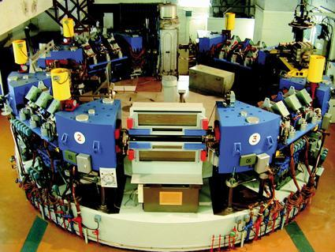
Lecture content
History of particle accelerators
Basic principles:
- Particle sources
- Particle acceleration
- Magnets
- Emittance and beam dynamics
- Beam diagnostics
Challenges for present and future accelerators

Slide 5
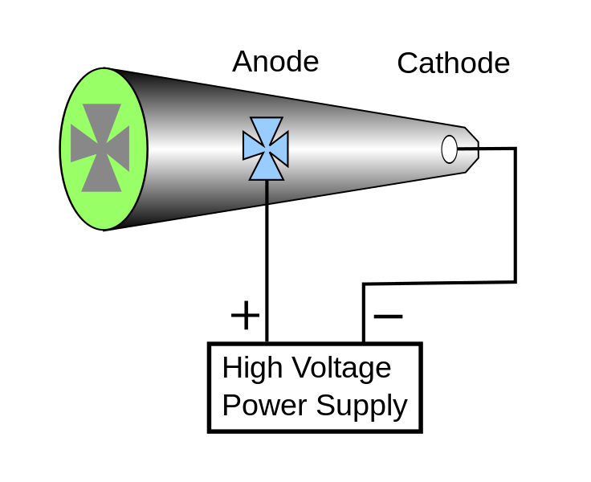
The first accelerator:
Crookes tubes
First ever particle accelerator:
Crookes (1869) – Cathode Ray tubes.
Discovery of the electron:
J. J. Thomson (1897).
X-rays Roengten (1895) – The first accelerator was already used a source of X-rays!

Slide 6
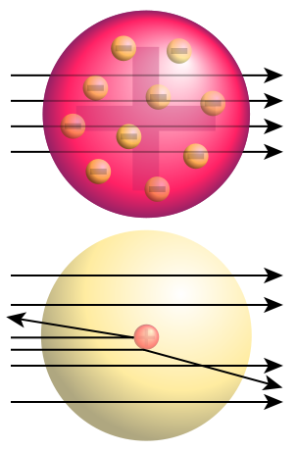
Rutherford scattering experiment (1)
In the early 20th century the structure of the atoms
In 1909 Rutherford was studying the structure of the atom.
He proposed to use alpha particles on a gold foils to probe the structure of the atom.
This experiment shows that by using an appropriate probe it was possible to study very small objects.
Trajectory of alpha particles in a uniformly charged sphere (top) and in a real gold nucleus (bottom) (image source: wikipedia)

Slide 7
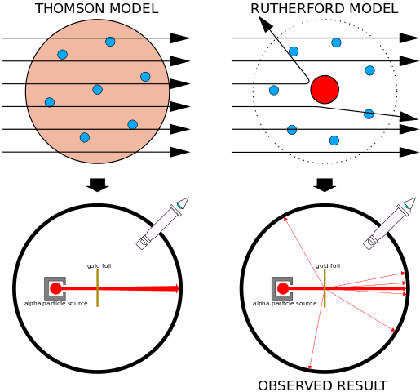
Rutherford scattering experiment (2)
Geiger and Marsden carried out the experiment proposed by Rutherford and recorded the scattering pattern.
The best explanation of the scattering pattern observed was that gold atoms were made of a hard core (now known as the nucleus) surrounded by a cloud of electrons.
The idea of using « small »probes to study the structure of particles is the basis of many accelerator.
The resolution depends on the probe size which is inversely proportional to its energy.

Slide 8
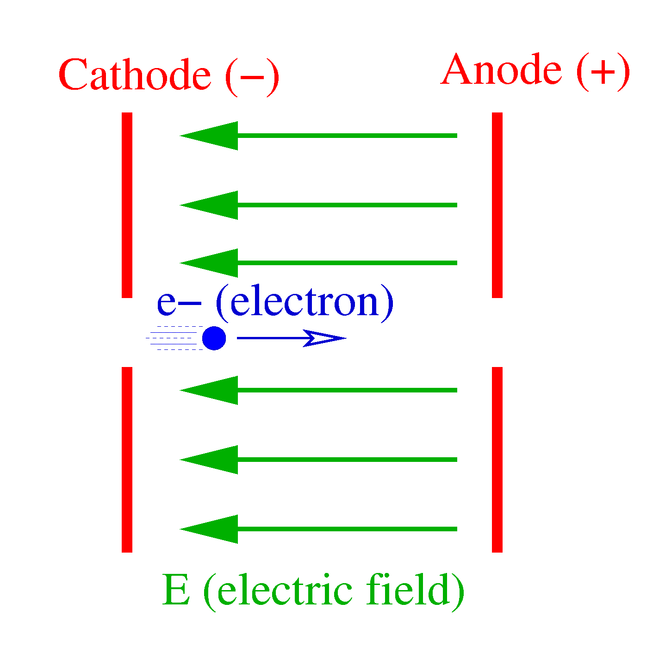
Beyond the
Geiger-Marsden experiment
The Geiger-Marsden experiment used alpha particles that were not accelerated.
To get a better resolution one needs a higher energy .
To go beyond what is available naturally it is necessary to accelerate the particles.
Charged particles can accelerated with an electric field (as was done in the Crookes tubes).
However the electric fields needed to study sub-nuclear matter are in the Megavolt range or beyond!

Slide 9
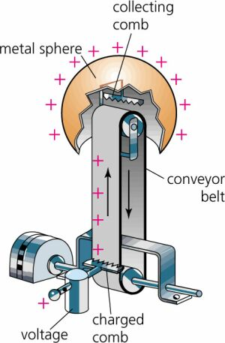
Van de Graaff generator
In 1929 Van de Graaff proposed a generator capable of producing such high voltages.
In a Van de Graaff generator charges are mechanically carried by a conveyor belt from a low potential source to a high potential collector.
Van de Graaff generators can reach several MV and are still used as static accelerators especially for ions.
Image courtesy of
http://people.clarkson.edu/~ekatz/scientists/graaff.html

Slide 10
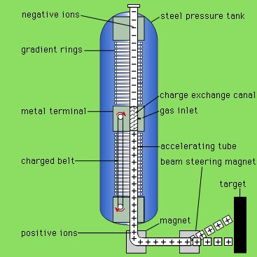
Tandem accelerators
It is possible to increase the energy reach of a Van de Graaff accelerators by using a “tandem” accelerator.
Such accelerator has two stage:
- In the first stage negative ions (with extra e-) are accelerated from ground to a positive high voltage.
- These ions are then stripped of 2-3 electrons in a stripper and become negative.
- They are then accelerated further by going from the positive high voltage to DC.
There is a Tandem Van de Graaff at IPN Orsay (now IJCLab).
Example: 10MV Van de Graaff can accelerate C⁻ to 10 MeV and then C²⁺ to 30 MeV.
Image source: http://people.clarkson.edu/~ekatz/scientists/graaff.html

Slide 11
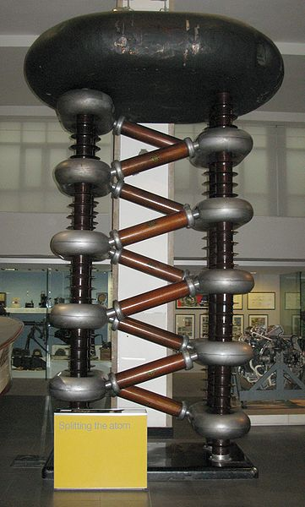
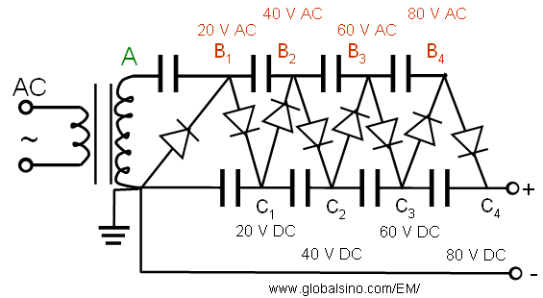
Cockroft-walton generator
To reach higher energies, the particles can be accelerated in an electric field.
Cockroft and Walton used a voltage multiplier made of diodes and capacitors.
The first half-cycle will load the first capacitor to its peak voltage. The second half-cycle loads the second capacitor and so on...
=> high voltage pulses
A Cockroft-Walton generator
(image source: wikipedia)

Slide 12
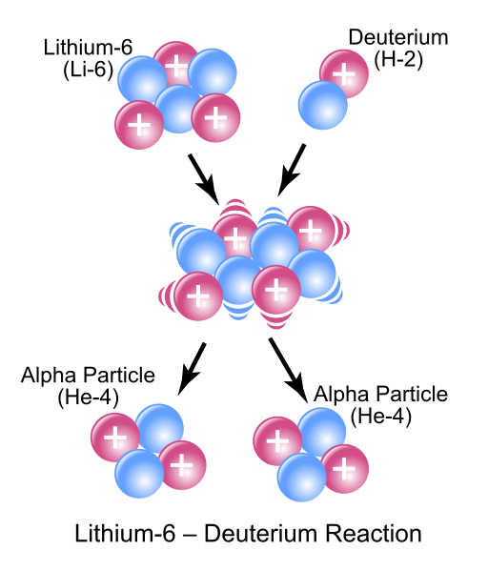
Splitting the atom
By using their generator Cockroft and Walton were able to accelerate protons to hundreds of keV.
In 1932 they bombarded Lithium with 700 keV hydrogen nuclei and transmuted it into Helium and other elements.
This was the first time that a particle accelerator had been use to trigger a nuclear reaction.
Cockroft and Walton were awarded the Nobel prize for this work in 1951.

Slide 13
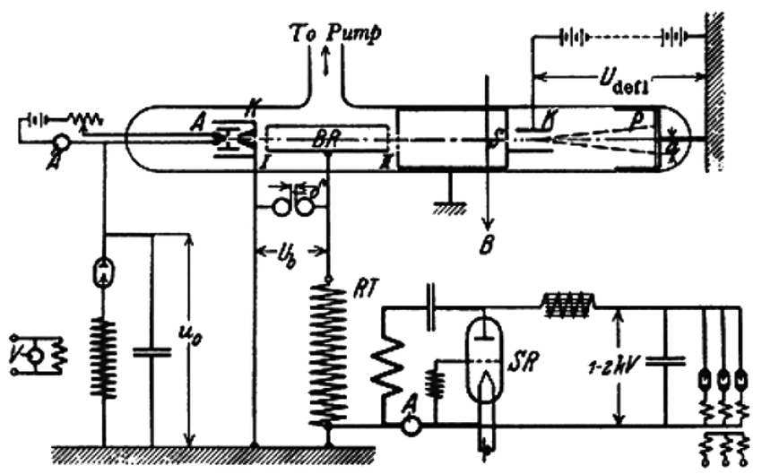
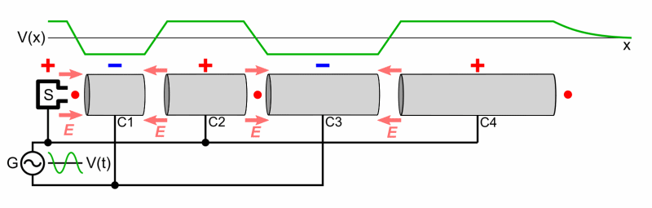
First varying field accelerator
To reach higher energy Ising proposed in 1925 to used a varying field.
This was realised by Wideroe in 1928.

Slide 14
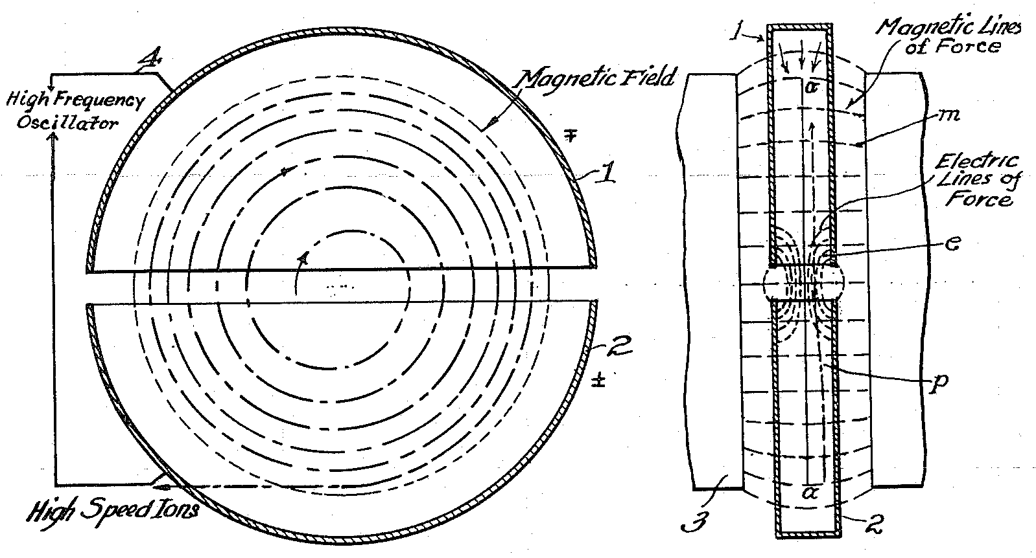
Cyclotron
Ising’s accelerator was limited by the need of having many accelerating sections after each other.
To overcome this a magnet can be used to loop the particles back on the accelerating section.
In 1931 Lawrence designed a “cyclotron”, a circular device made of two electrodes placed in a magnetic field that used AC field to accelerate the particles.

Slide 15
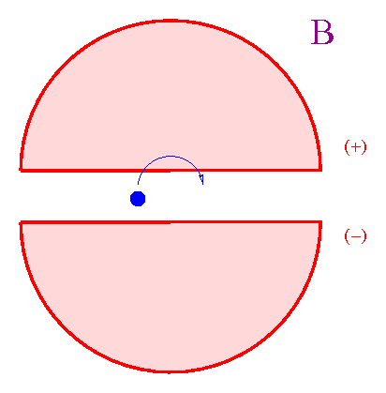
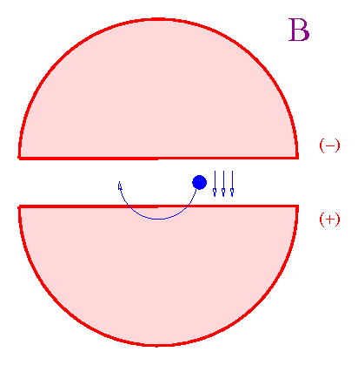
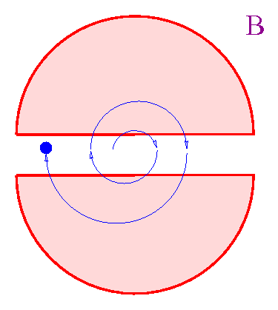
Cyclotron (2)
The particle source is located in the middle of the cyclotron.
Due to the magnetic field the particles follow a circular trajectory
By reversing the electric field of the electrode between two gap crossing it is possible to accelerate the particles.
With an AC potential of only 2000V Lawrence accelerated protons to 80kV!
Lawrence received the Nobel prize in 1939 for this work.
However, Cyclotrons can only accelerate non-relativistic particles…

Slide 16
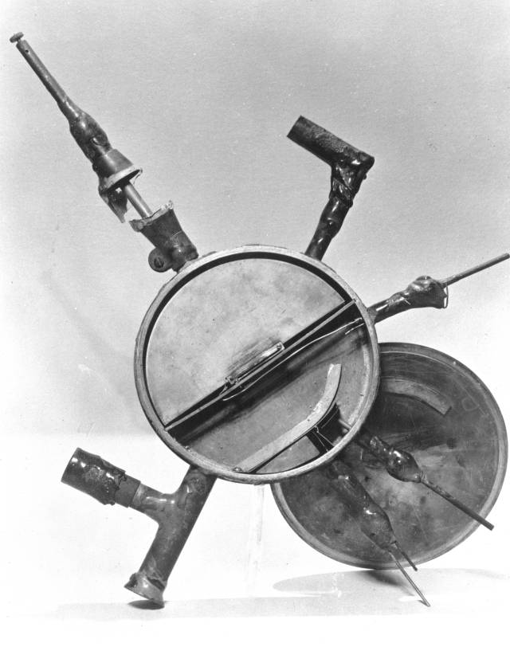
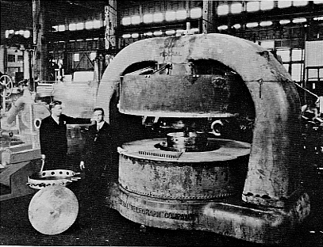
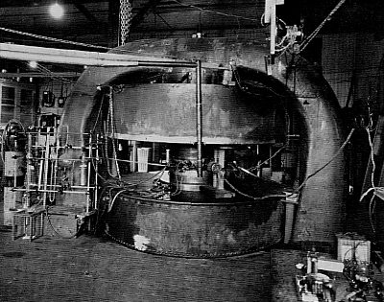
Size limits…
11-inch → 27-inch → 60-inch (16 MeV)
→ 100 MeV?!
Relativistic limits!
IFAST
16

Slide 17
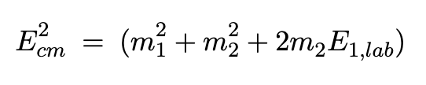
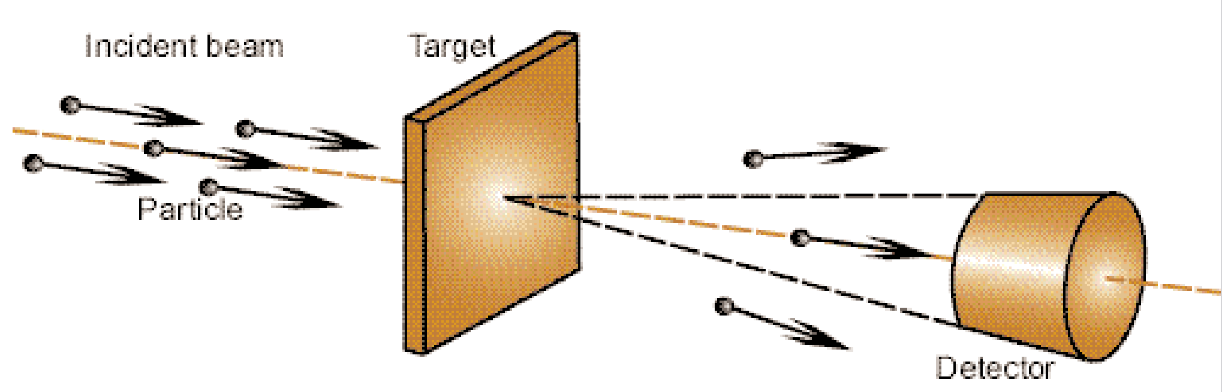
Fixed target experiments…
Until then all “nuclear physics” experiments were done on a fixed target.
In such experiment, the energy in the centre of mass is:

Slide 18

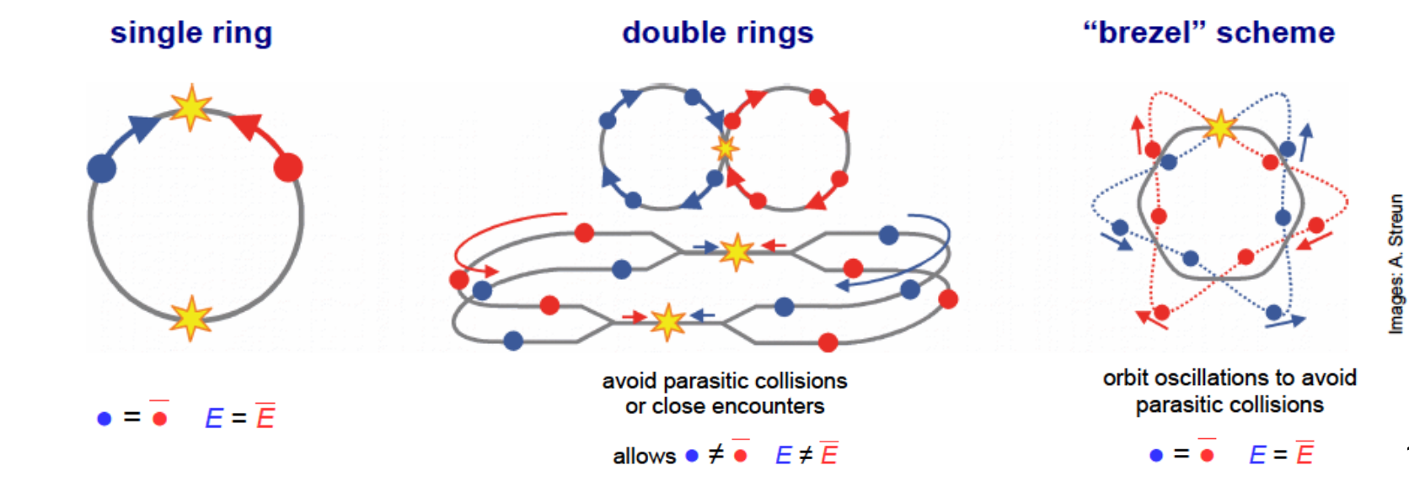
… versus colliding beam
Energy with fixed target:
With colliding beams the centre of mass energy is:
At high energy (E>>m) gain of having colliding beams is significant!
But how to collide beams?

Slide 19
Quizz: fixed target
Let’s compare fixed target and colliding beams.
Assuming that the mass of a proton is 1GeV/c².
You have an accelerator than can accelerate protons to
400 GeV.
What will be the energy in the centre of mass of a 400 GeV proton hitting a proton in a fixed target?
(a) 28.3 GeV
(b) 400 GeV
(c) 800 GeV
(d) 802 GeV

Slide 20
Answer (a)
Let’s compare fixed target and colliding beams.
Assuming that the mass of a proton is 1 GeV/c².
You have an accelerator than can accelerate protons to 400 GeV.
What will be the energy in the centre of mass of a
400 GeV proton hitting a proton in a fixed target?
Ecm²=1²+1²+2*1*400=802 GeV²
Ecm=sqrt(802)=28.3GeV

Slide 21
Quizz
Let’s compare fixed target and colliding beams.
Assuming that the mass of a proton is 1GeV/c².
You have an accelerator than can accelerate protons to 400 GeV.
What will be the energy in the centre of mass of two 400 GeV protons hitting each other?
(a) 28.3 GeV
(b) 400 GeV
(c) 800 GeV
(d) 802 GeV

Slide 22
Answer (c)
Let’s compare fixed target and colliding beams.
Assuming that the mass of a proton is 1GeV/c².
You have an accelerator than can accelerate protons to 400 GeV.
What will be the energy in the centre of mass of two 400 GeV protons hitting each other?
Ecm²=(400+400) ²=800² GeV² Ecm=800GeV
Fixed target: 28.3 GeV Colliding beams: 800 GeV
A similar comparison for 7 TeV protons gives:
114.6 GeV for fixed target beams against 14 TeV for colliding beams!

Slide 23
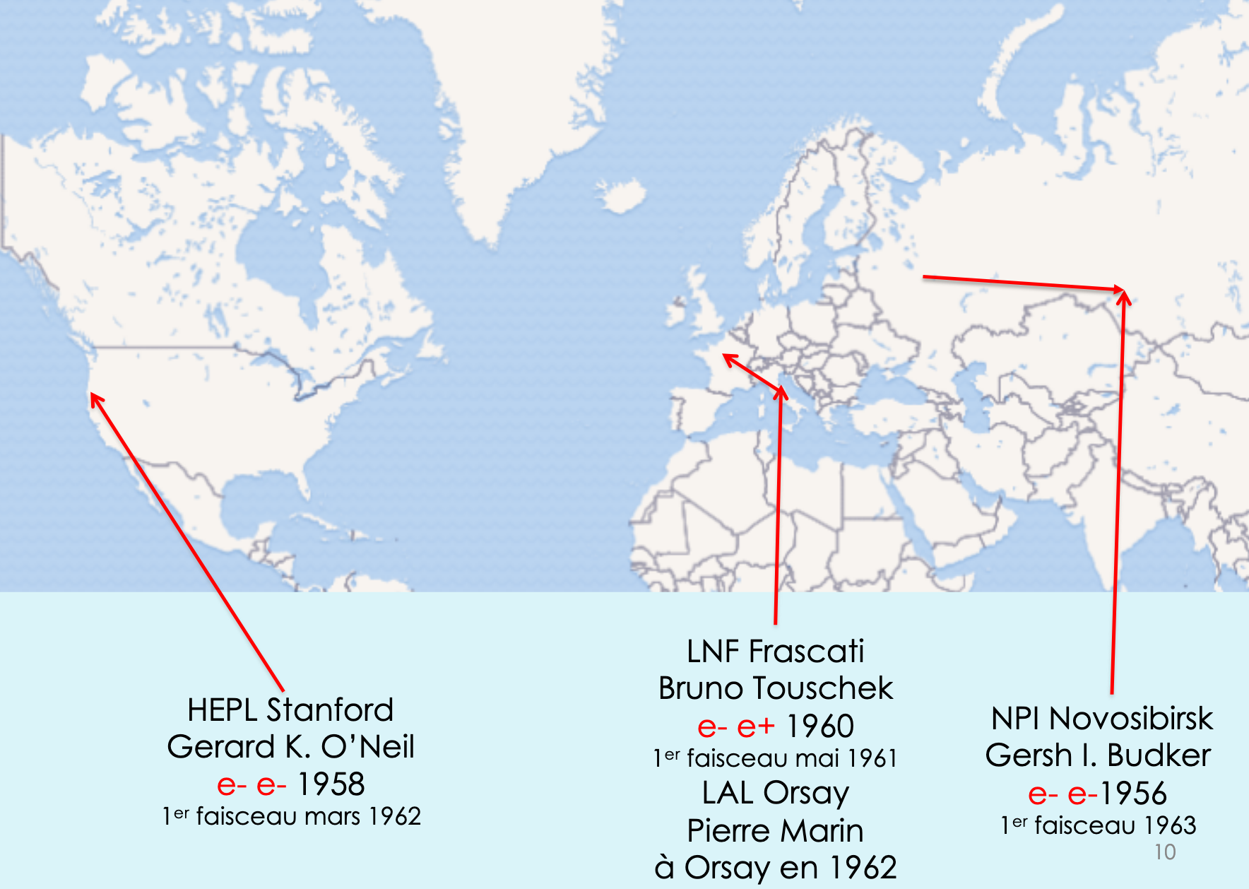
Back to history…
Most work in new accelerators stopped during WWII.
After the war the work resumed and several groups tried to build a collider…
Courtesy of Jacques Haïssinski

Slide 24
e+ e- versus e- e-
A critical choice for a collider was to decide the type of collisions.
Positrons are difficult to produce hence Kurchatov and Stanford choose e- e-.
The Frascati group (led by B. Touschek) was convinced that collisions would be easier (CT invariance).
e+ e- collisions had several advantages:
  Single ring
  More interesting physics with the collisions

Slide 25
First generation colliders
(storage rings)
Laboratory | Proposal date | Name | Collision type | Energy | First beam
Kurchatov institute (Moscow) then Novosibirsk | 1956 | VEP-1 | e- e- | 2 x 160 MeV | 1963
High Energy Physics Laboratory (Stanford) | 1958 | Princeton-Stanford e- e- storage rings | e- e- | 2 x 500 MeV | 1962
Frascati National Laboratory | 1960 | Ada (Ring of accumulation) | e- e+ | 2 x 220 MeV | 1962

Slide 26
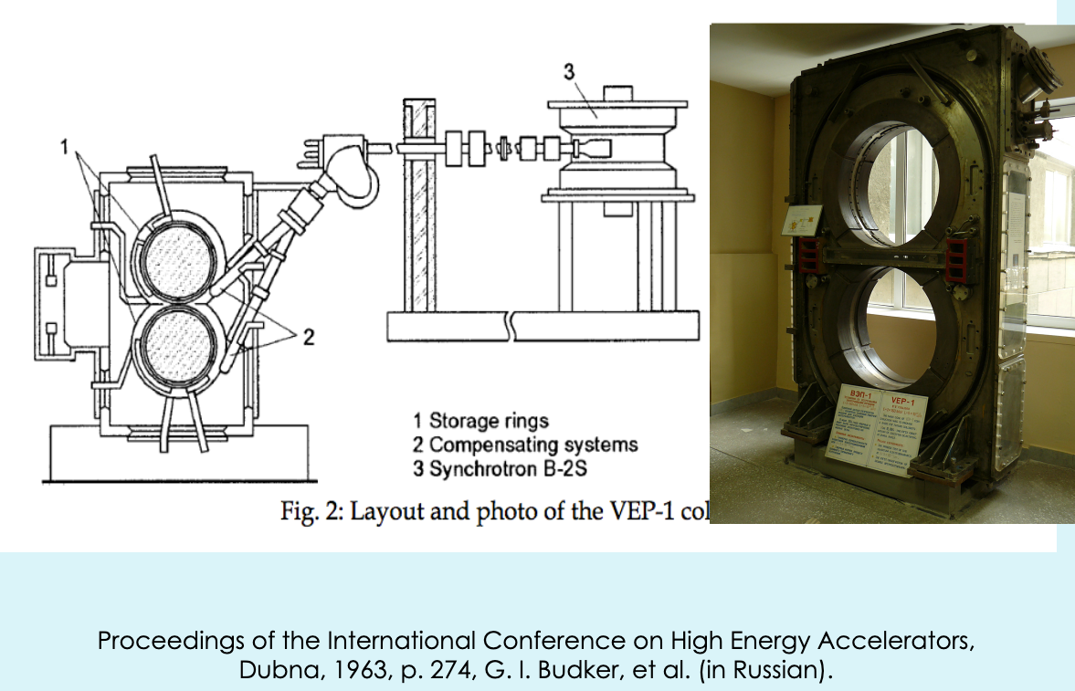
VEP-1 (Dubna, Russia)
Courtesy of Jacques Haïssinski

Slide 27
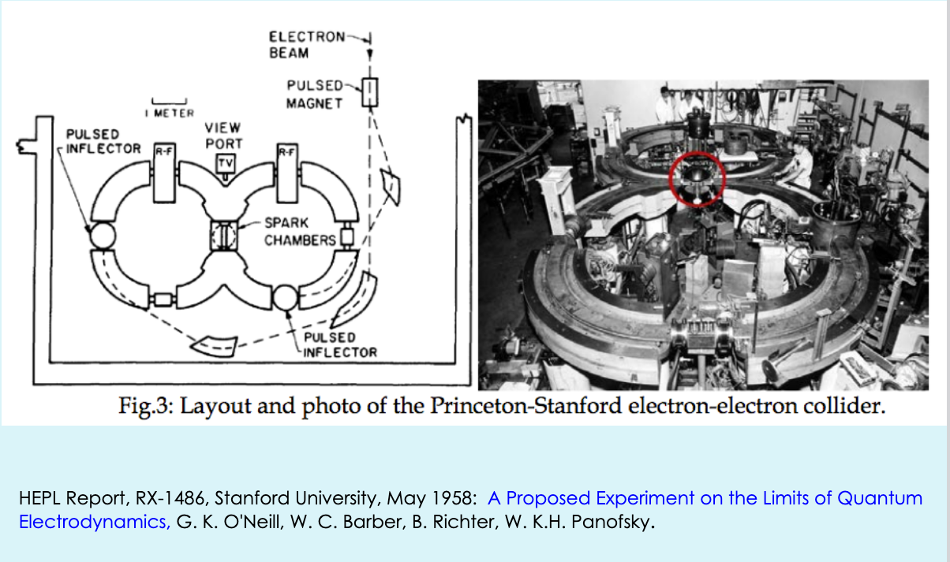
The Princeton-Stanford collider
Courtesy of Jacques Haïssinski

Slide 28
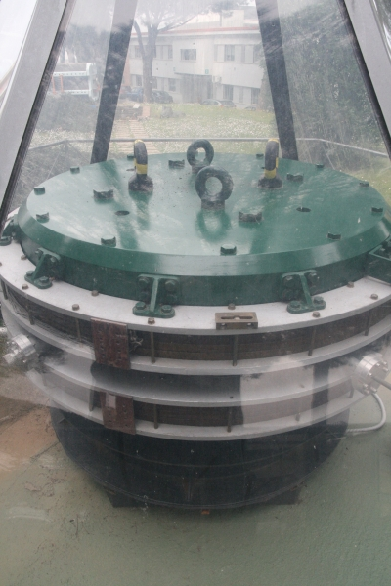
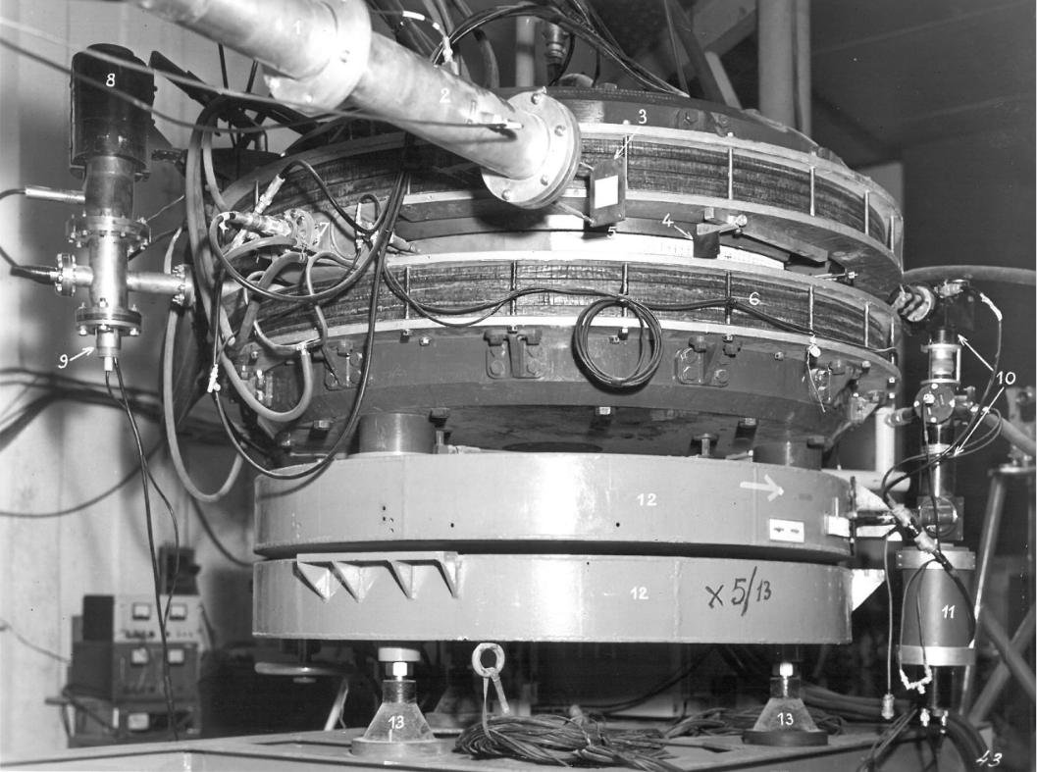
AdA
Anello di Accumulazione
After unsuccessful attempts in Frascati, AdA was brought to Orsay where the positron source was stronger.
AdA in a glass case at
Frascati National Laboratory

Slide 29
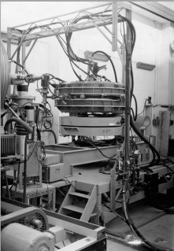
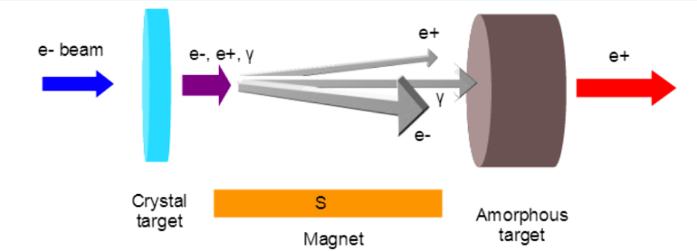
AdA
Anello di Accumulazione
In Orsay the flux of electrons was sufficient to get a good number of positrons.
The choice of e+ e- then proved good.
Despite being the last project to start, it was the first to see collisions.
AdA in a Orsay

Slide 30
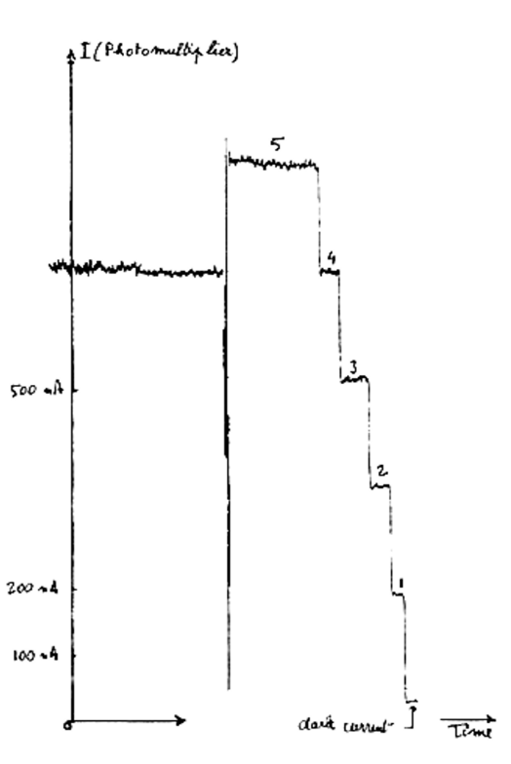
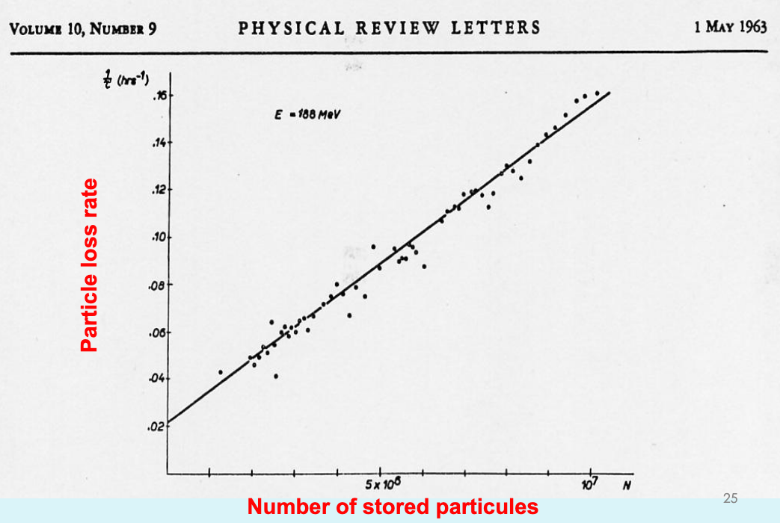
Some results from AdA
Touschek effect
Single electrons
Courtesy of Jacques Haïssinski

Slide 31
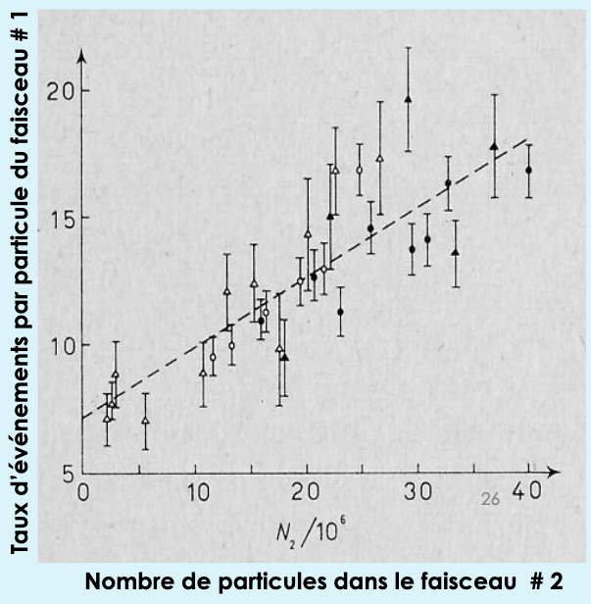
First collisions
First collisions at AdA: autumn 1963.
VEP-1 (e- e-):
May 1964
Princeton-Stanford electron-electron collider:
March 1965.
Courtesy of Jacques Haïssinski

Slide 32
Second generation colliders
Initial colliders had strong limitation (focussing, beam size,…)
Even before their success a second generation was planned:
  VEP-2 (Novossibirsk): 2 x 700 MeV
  ADONE (Frascati): 2 x 1,5 GeV
  ACO (Anneau de Collisions d’Orsay): 2 x 510 MeV
  CEA (Cambridge Electron Accel., USA): 2 x 3,5 GeV

Slide 33
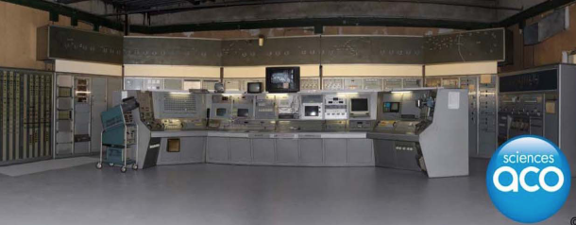
L’Anneau de Collision d’Orsay
The AdA success led to the construction of the first French collider, ACO in 1962 (first collision in 1965).
ACO ceased as a collider in 1975. After it served as a light source until 1988.
Another collider, DCI (Dispositif de Collision dans l’Igloo), was used on site from 1975 until 1985 (and as synchrotron source until 2001).
ACO is now a museum that can be visited.

Slide 34
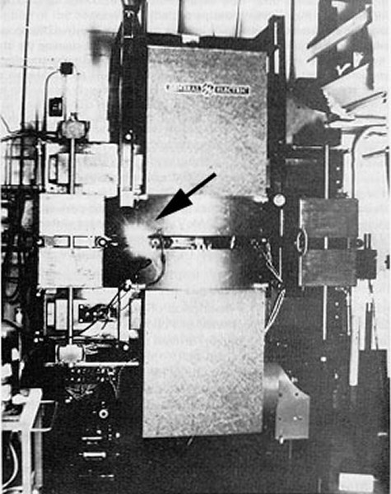
A second life for colliders: light sources
Colliders were the first rings able to store beams for several hours (storage rings).
The opened the way for the exploitation of the synchrotron radiation they produced.
After the end of their time as collider they were converted to 1st generation light sources.

Slide 35
CERN
End of second world war: need to restore Science in Europe and share work on nuclear physics.
Early proposal: Louis De Broglie (1949), UNESCO (1950)…
1952: First CERN (Conseil Européen pour la Recherche Nucléaire) council meeting.
1954: European Organization for Nuclear Research (CERN) is established.

Slide 36
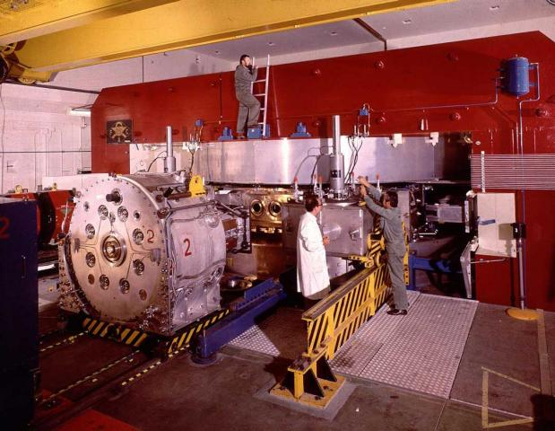
The synchrocyclotron
Cyclotrons are limited by relativistic effects.
To reach higher energies CERN built in 1957 a synchrocyclotron that could reach 600 MeV.
Works like a cyclotron but the RF frequency is changed when the particles reach high energy.
1967: Used for ISOLDE.
1990: Decommissioned
You can still visit the SC today at CERN.
Image courtesy of CERN
https://home.cern/about/who-we-are/our-history

Slide 37
Quizz: Relativistic effects
Assuming the mass of a proton is 1 GeV/c².
What is the Lorentz factor of a proton with a kinetic energy of 600 MeV?
(a) gamma = 1
(b) gamma = 1,2
(a) gamma = 1,6
(a) gamma = 600

Slide 38
Answer: (c)
Assuming the mass of a proton is 1 GeV/c².
What is the Lorentz factor of a proton with a kinetic energy of 600 MeV?
Gamma= Etot/Mass
Etot=1 GeV + 600 MeV =1,6 GeV
Gamma= Etot/Mass=1,6/1=1,6
Beta ~0,78

Slide 39
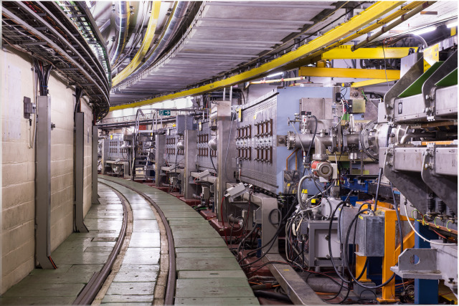
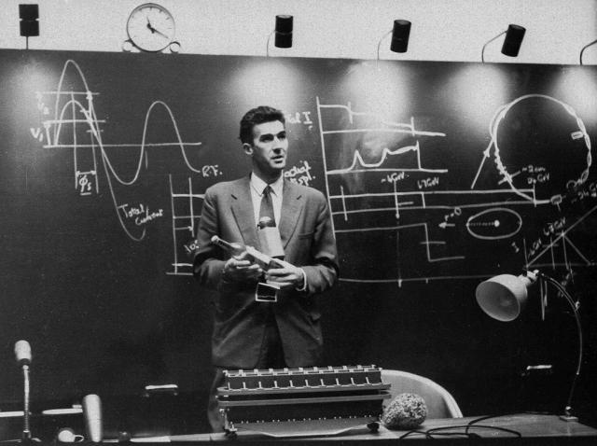
The proton synchrotron
1959: The Proton Synchrotron starts and reaches 24 GeV (later 28 GeV), beating Dubna’s 10GeV accelerator.
The PS is still in use nowadays.

Slide 40
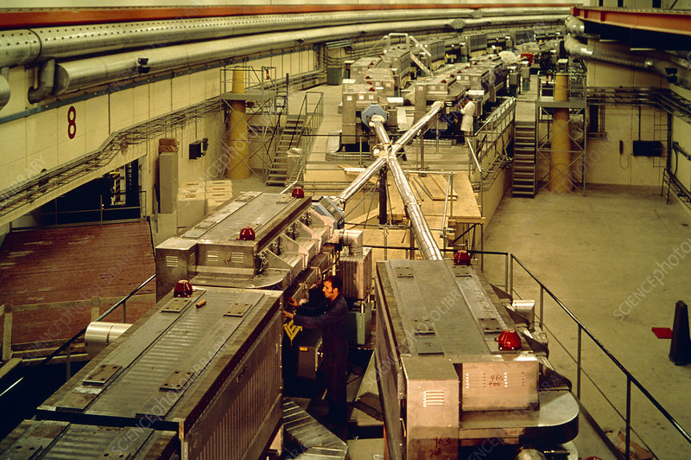
The Intersecting Storage Rings
Building up on the success of AdA CERN decided to build a collider.
The Intersecting Storage Rings started in 1971 and observed the world first proton proton collisions.
Decommissioned in 1984.

Slide 41
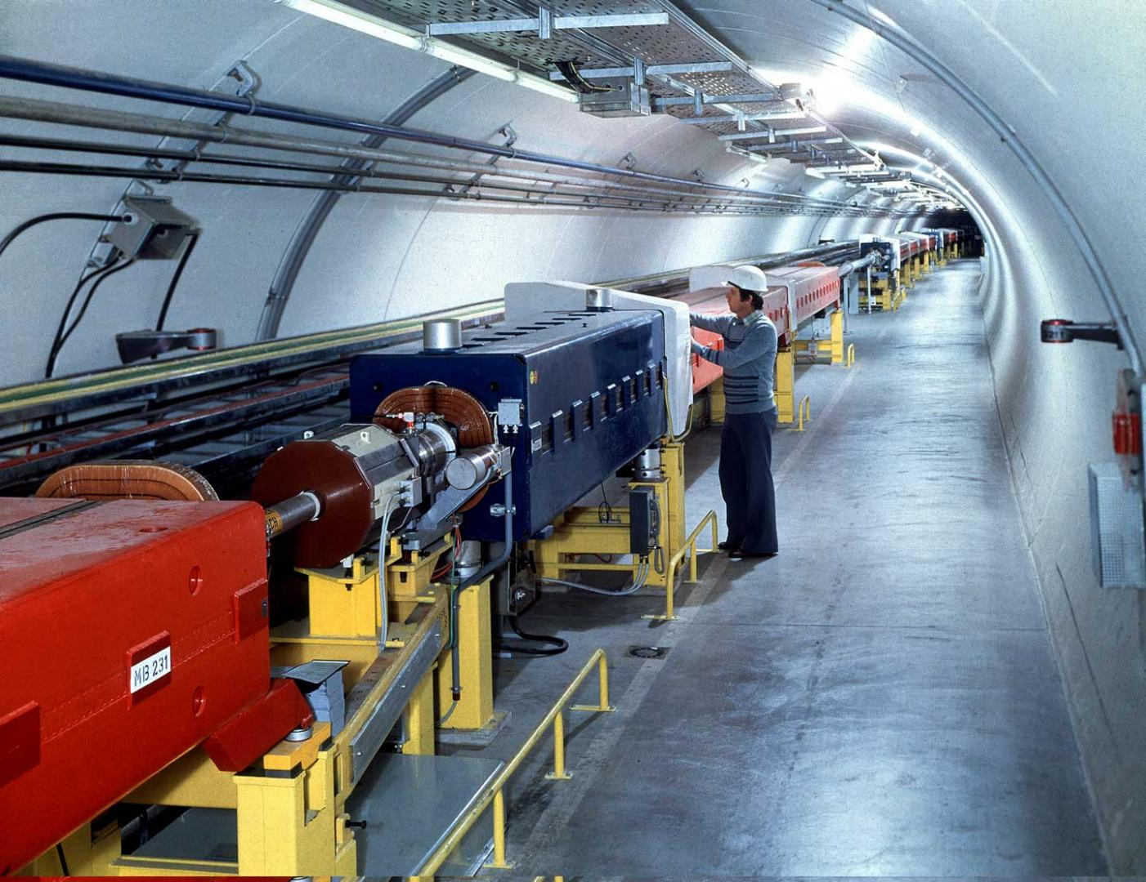
The Super Proton Synchrotron (SPS)
In 1976, a 7-kilometer ring was started: the SPS.
Control room uses touch screens!
Energy: 400 GeV
Converted to proton antiproton collider in 1981
=> discovery of W and Z.
Still in operation.

Slide 42
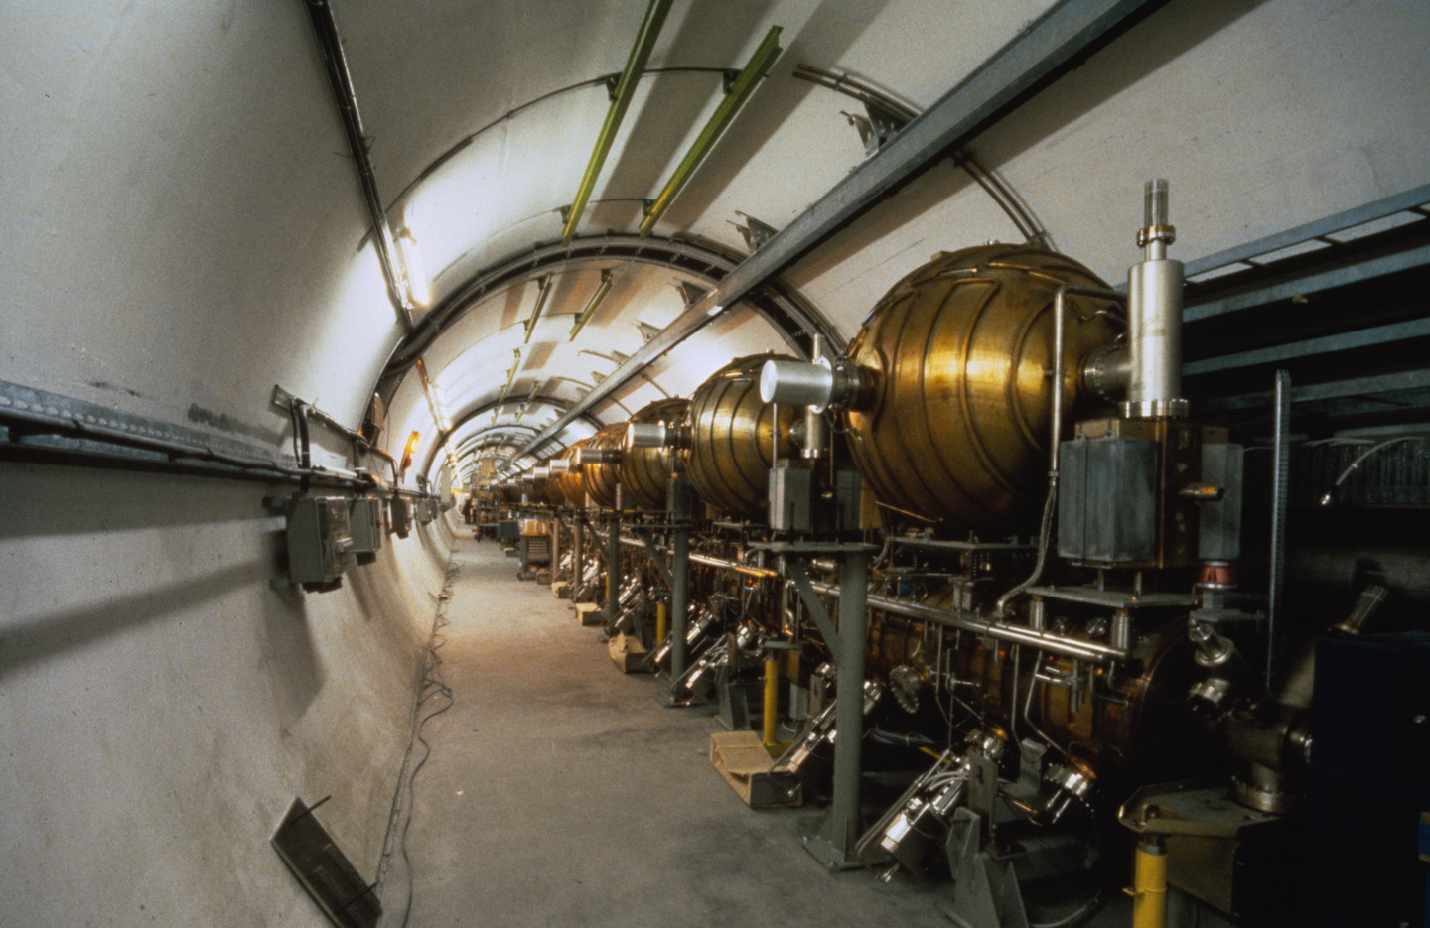
The Large Electron-Positron collider
In 1989, LEP started.
27-kilometer ring!
Energy: ~100 GeV (electrons)
209 GeV in the center of mass
Closed and dismantled in 2000.

Slide 43
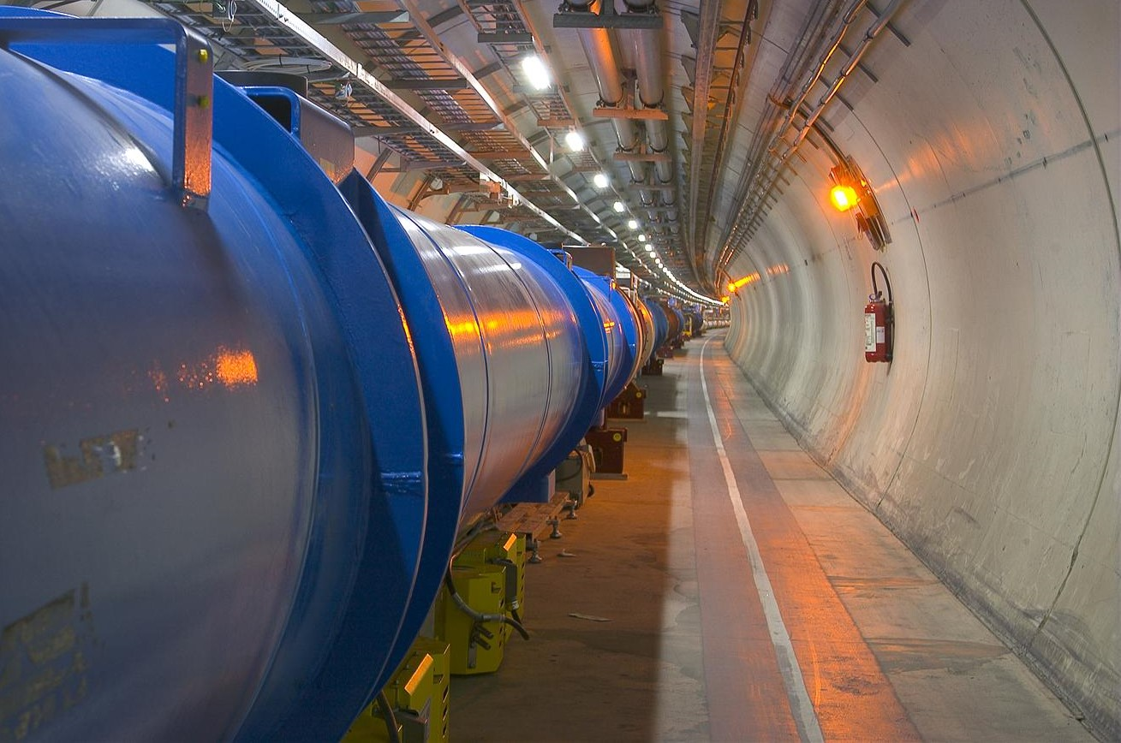
The Large Hadron Collider (LHC)
Built in LEP’s tunnel.
First beam in 2008.
Initial energy limitation to 3,5TeV/beam.
Later increased to 7TeV/beam (14 TeV cm).

Slide 44
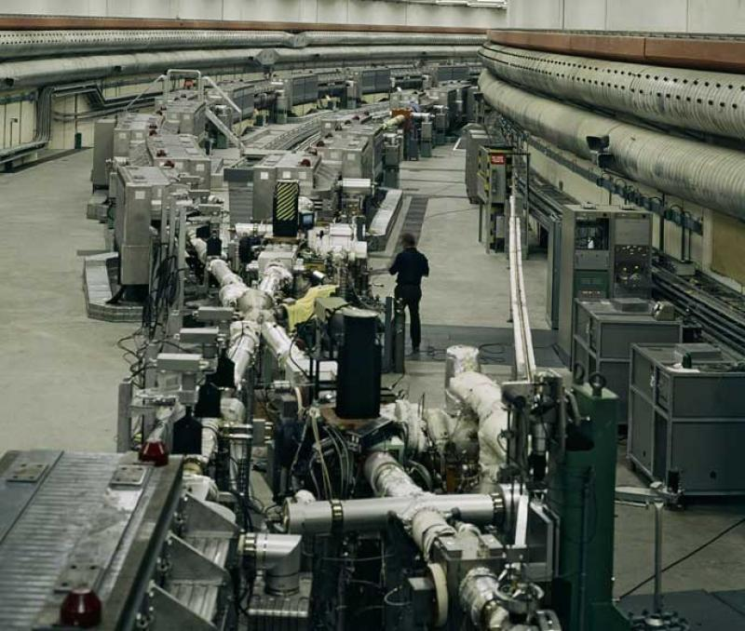
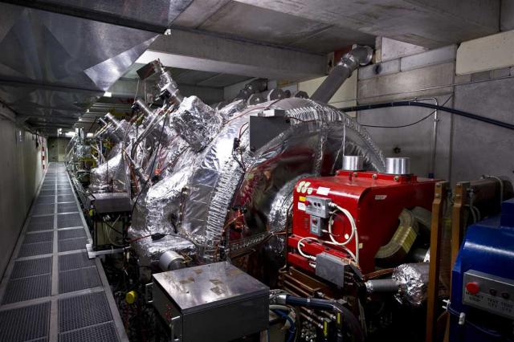
Accelerators at CERN
1957: Synchrocyclotron (SC), 600 MeV, protons/ions
(closed in 1990).
1959: Proton Synchrotron (PS), 28 GeV, still in use!
1971: Intersecting Storage Ring (ISR), first CERN collider, 62 GeV protons (closed 1984)
1976: Super Proton Synchroton (SPS), 7km,
up to 400 GeV (now 450 GeV).
{Discovery of neutral currents and the Z boson in 1983}
1989: Large Electron Positron collider (LEP), 27 km,
up to 209 GeV e- (stopped in 2000)
1997: Antiproton Decelarator (down to 100MeV/c) for antimatter studies.
2008: Large Hadron Collider (LHC), 7 TeV protons…
Source: http://timeline.web.cern.ch/timelines/CERN-accelerators

Slide 45
Quizz
Why CERN built a 200 GeV electron position collider after building a 400 GeV proton collider?
(a) Because of budget cuts: they could no longer afford to go to 400 GeV
(b) Stability (and hence luminosity) is better at 200GeV than at 400 GeV
(c) The physics potential of a 200 GeV lepton collider is higher than that of a 400 GeV proton collider.

Slide 46
Answer (c)
The physics potential of a 200 GeV lepton collider is higher than that of a 400 GeV proton collider.
For example to discover the Higgs only twice the Higgs mass was need in the cm with leptons (but they did not reach that energy).

Slide 47
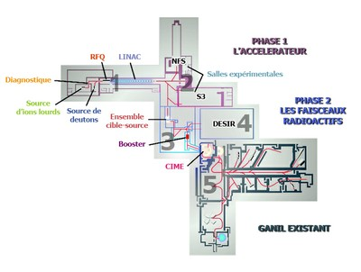
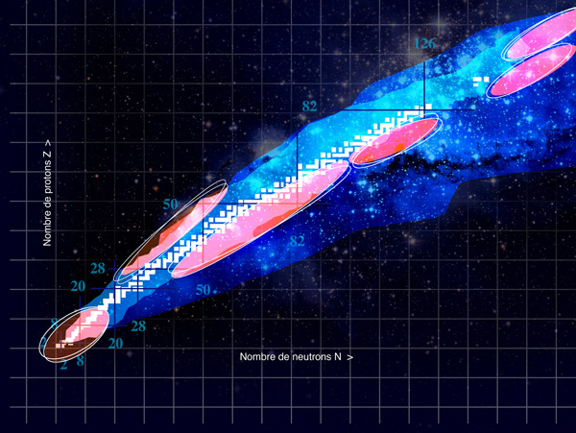
GANIL and SPIRAL2
GANIL is a laboratory dedicated to radioactive ions, initially using cyclotrons.
SPIRAL2 is an upgrade using a linear RF accelerator.
There is another large heavy ions research facilty in Darmstadt (Germany): GSI.

Slide 48
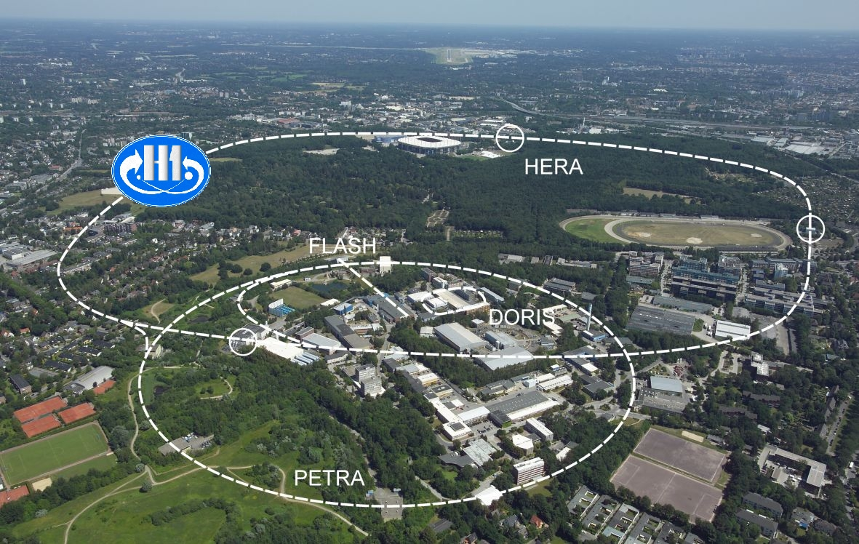
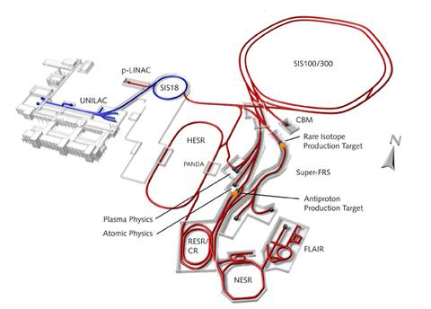
Other HEP accelerators in Europe
Frascati (near Rome, Italy):
ADONE: e+/e- collider (1969-1993) 1.5 GeV
DAFNE (since 1999): e+/e- collider; 1 GeV, Kaon studies.
DESY (Hambourg Germany):
e+/e- collider (1960-1980)
Electron-proton collider (HERA; 1990-2007) up to 920 GeV protons on 27 GeV electrons.
GSI/FAIR:
GSI is a heavy ions accelerator in Darmstadt, Germany (11.4 MeV/nucl.) since 1975. It is being upgraded as FAIR.

Slide 49
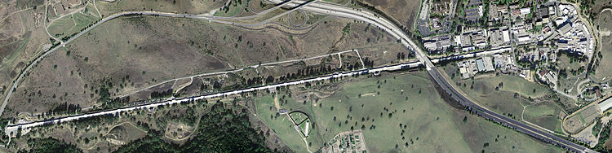
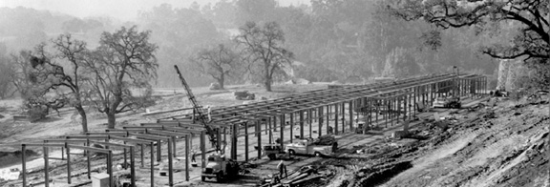
Accelerators at SLAC
1962: Construction of the « 2 miles accelerator », the Stanford Linear Accelerator at SLAC (for e+/e- up to 45 GeV). {1968: Evidence for quarks}
1980: PEP: Positron-Electron Project at 29 GeV until 1990.
1989: Stanford Linear Collider (90 GeV cm) until 1998 (Detector: SLD).
1999: PEP-II, ~10 GeV B-Factory until 2008 (Detector: BaBar).

Slide 50
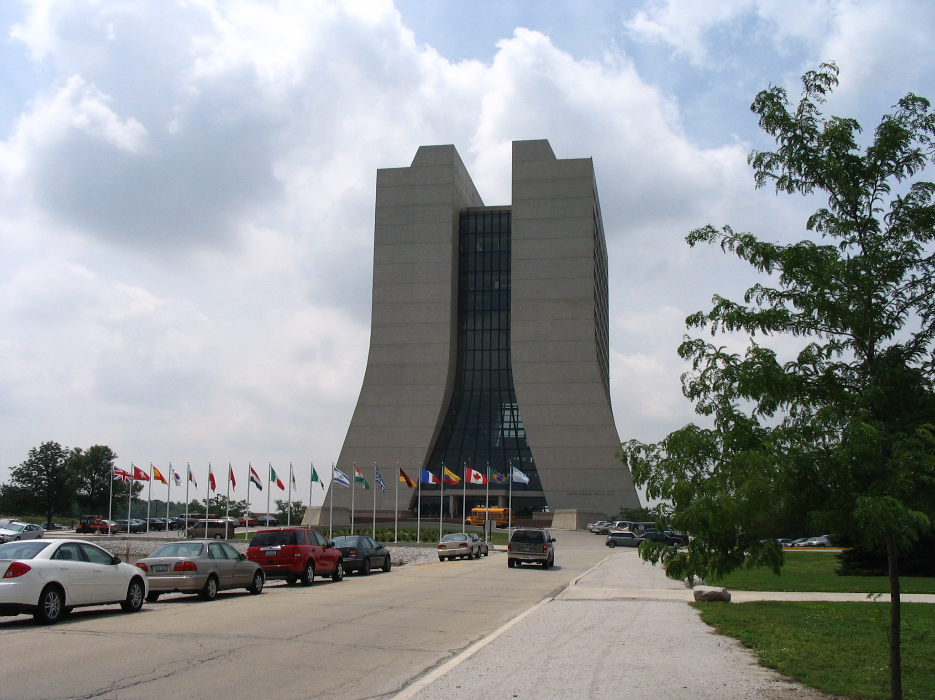

Other HEP accelerators in North America: Proton/ions
1969: Proton Linac at Fermilab near Chicago (200 MeV)
1974: TRIUMF, H- cyclotron (500MeV) in Vacouver, Canada
1976: 500 GeV ring at Fermilab.
1989: Tevatron (1 TeV cm then 2 TeV cm) @ FNAL.
{Discovery of the top quark in 1995}
1983-1993: Superconducting Super Collider: attempt to build a 20 TeV collider in Texas (aborted in 1993 due to budget problems).
2001: RHIC, Brookhaven, heavy ions,
up to 100GeV/nucleon

Slide 51


Other HEP accelerators in North America: CSER and JLAB
Cornell (NY state):
1979 CESR 3.5-12 GeV ring; B and C physics
CESR has been converted into a test facility for rings. Cornell is also working (with other labs) on a new kind of accelerators called “Energy recovery Linacs”).
Jefferson Lab (Virginia):
1984: CEBAF Up to 6 GeV electrons; fixed target experiments; high intensity (still in operation).

Slide 52


HEP Accelerators in (former) Soviet Union
Novosibirsk, Budker institute:
- 1964: VEP, e+/e-, 130 MeV in Novosibirsk
- 1994: VEPP-4M, e+/e-, 6 GeV, Meson physics
Dubna, JINR:
- 1957: 10 GeV protons (closed 2003)
- NICA: Nuclotron Based Ion Collider Facility.
Commissioning expected soon…

Slide 53

HEP Accelerators in Asia
KEK (Tsukuba, Japan):
Proton synchroton (1976-2005), 12 GeV
TRISTAN (1986-1995): e+/e- collider at 26 GeV
KEKB (1998-2010): e+/e- collider 8 GeV on 3.5GeV
SuperKEKB (2016+): e+/e- collider: 7GeV on 4 GeV.
BEPC-II:
Beijing Electron Positron Collider (started 2008) 4.6 GeV; charm quark studies.

Slide 54
Quizz
Why did KEK downgrade its TRISTAN collider from 26 GeV to 8 on 3.5 GeV?
(a) Because the physics is more interesting at low energy
(b) Energy is not the only interesting parameter, luminosity is more important and they could reach a higher luminosity at lower energy.

Slide 55
Answer (b)
To reach a high energy the peak current in the accelerator has to be reduced.
There is a case for high energy accelerators to discover new particles.
However lower energy accelerators can do “precision” physics by studying some rare particle with a very large statistics and studying more accurately their properties.
KEKB (and SuperKEKB) study CP violation.

Slide 56

Livingston chart
Note: did not mention all accelerators for high energy physics or nuclear physics.
Since 1962 there has been a constant progress in c.m. energy.
However in the recent years this progress has slowed down…

Slide 57
Colliders energy growth…
From AdA until 1989 lepton colliders tripled their energy every 6 years!
From ISR to the 2009, hadron colliders doubled their energy every 6 years!

Slide 58
Colliders size
From AdA to LEP, Colliders doubled their size every two years!

Slide 59
Quizz
On the livingston chart:
Give the name of proton accelerator with a beam energy
> 500 GeV
ISR
SppS (Super Proton Synchroton)
Tevatron
LHC

Slide 60
Answer: (d)
On the livingston chart:
Give the name of proton accelerator with a beam energy
> 500 GeV
ISR
SppS (Super Proton Synchroton)
Tevatron
LHC

Slide 61
Quizz
What was the highest energy in the center of mass reached to date by an electron accelerator?
209 MeV
100 GeV
209 GeV
14 TeV

Slide 62


Light sources
Circular accelerators emit radiation.
With some tuning it is possible to make them emit an intense flux of radiation at a useful wavelength.
Some machines have been built entirely for this purpose, including several in the area
- Super-ACO (now decommissioned)
- SOLEIL near SACLAY
Source: SOLEIL

Slide 63
1st generation light source
Synchrotron radiation was discovered in 1946.
It was first seen as a nuisance as it makes the beam loose energy.
In the 1960 it was recognised that it could be used as a powerful source of radiation (X-rays)
Some accelerators started to make this radiation available to other users.
Discovery of Synchrotron radiation
in 1946. Source: wikipedia

Slide 64

2nd generation light sources
In the 1980s machine dedicated to the production of light were built.
The first one in France was Super-ACO.
In these machines the light is extracted from the bending magnets and delivered to users.

Slide 65



3rd generation light sources
With the increasing need for synchrotron radiation extracting the light from bending magnets was not enough.
Special arrays of magnets called “wigglers” or “undulators” can be used to improve the radiation produced by a light source.
3rd generation light source were also design with brilliance optimisation in mind (smaller beams, large rings...).
SOLEIL (in Saint-Aubin, near Saclay) is
a 3rd generation light source.
Source: Wikipedia
Undulator, Source: Diamond
Source: Diamond

Slide 66

Free electron lasers
The photons emitted in an undulator can stimulate the emission of more photons from the bunch.
Free electron lasers (FEL) use this phenomena to generate photon beams with an even higher brilliance.
FEL form the 4th generation of light source. Some have started to operate in the past few years.
FEL use a linac (not a storage ring, unlike synchrotrons).
Source: SRS

Slide 67


Energy Recovery Linacs
Rings have the advantage of recycling the particles turn after turn
=> High efficiency
FEL produce ultra-short light pulses
=> Interesting physics potential
To combine the advantages of rings and FEL the concept of « Energy Recovery Linac »has been invented:
after being used to produce light the particles are decelerated and the energy recycled to accelerate other particles.

Slide 68
Summary of the history
The first particle accelerators were invented
~150 years ago.
The first man made collisions took place ~60years ago.
LHC is the largest scientific instrument on earth!
Many Nobel prizes are connected with the discovery made at particle accelerators.
How do they work? Let’s discuss it on Monday!

Slide 69

Lecture content
History of particle accelerators
Basic principles:
- Particle sources
- Particle acceleration
- Magnets
- Emittance and beam dynamics
- Beam diagnostics
Challenges for present and future accelerators

Slide 70

Particle sources
Electrons
  Thermionic emission
  Field emission
  Photo-emission
  Beam quality
  Space-charge
Protons and ions

Slide 71
Particle sources
How particles are first produced?
How to extract particles with the right properties?
What are the limitations of the sources?
The quality of the source is very important. If the particles emitted by the source do not have the right properties, it will be very difficult and/or expensive to rectify it later.

Slide 72

Producing beams of electrons:
Thermionic effect
Most particle accelerators in the world accelerate electrons.
Remember the Maxwell-Boltzmann energy distribution:
Electrons (fermions) obey a different but similar law.
When a metal is heated more electrons can populate high energy levels.
Above a certain threshold they electrons can break their bound and be emitted:
This is thermionic emission.
(image source: wikipedia)‏

Slide 73


Electrons in solids
(image source: http://cnx.org/content/m13458/latest/
At low temperature all electrons are in the lowest possible energy level, below the Fermi level.
As the temperature increase some electrons will go above the Fermi level.
But only those with an energy greater than the “work function” are “free”.

Slide 74


Electrons extraction
Once the electrons are free they may fall back on the cathode.
To avoid this an electric field needs to be applied.
If a negative potential is applied to the cathode the electrons will be attracted away from the cathode after being emitted.
The potential the electrons must overcome to escape is called the “work function”.
(image source:
Masao Kuriki, ILC school)‏

Slide 75

Work function
To escape from the metal the electrons must reach an energy greater than the edge of the potential well.
The energy that must be gained above the Fermi energy is called the “work function” of the metal.
The lower the work function, the easier it will be for an electron to escape.
The work function is a property
specific to a given metal. It can
be affected by many parameters
(eg: doping, crystaline state,
surface roughness,...)‏
Example values:
Fe: 4.7 eV ; Cu: ~5eV; Al: ~4.1 eV; Cs: ~2 eV
(image source: wikipedia)

Slide 76
Quizz
Which of these materials would give the highest thermionic emission current (at the same temperature)?
  Iron (Fe); W=4.7 eV
  Gadolinium (Gd); W=2.90 eV
  Cobalt (Co); W=5 eV

Slide 77
Answer: (b)
The lower the work function, the easier it will be for an electron to escape.
=> more electrons will escape at a lower work function.
Gadolinium (b) has the lowest work of this example function and thus it will give a higher current.

Slide 78

Schottky emission
The application of an electric field F to a material modifies the work function, this is called the Schottky effect:
This will lead to a reduction of the work function. The higher the field the lower the work function. The Richardson-Dushman equation becomes:
This formula is valid only up to 10⁸V/m. For more intense fields additional phenomena happen.
(image source:
Masao Kuriki, ILC school)

Slide 79

Photo-electric emission
A photon incident on a material will transfer its energy to an electron present in the metal.
If the energy of this electron becomes bigger than the work function of the material, the electron can be emitted.
This is called photo-electric emission.
(image source:
Masao Kuriki, ILC school)‏

Slide 80

Photo-electric emission (2)
A UV photon at 200nm carries an energy of about 6 eV, this is enough to “jump” over the work function of most metals.
As seen in electromagnetism, electromagnetic waves (photons) can penetrate inside a metal.
The photo-electric
emission may thus
take place away from
the surface.
(image source: Dowell et al., Photoinjectors lectures)‏

Slide 81

The 3 steps of photo-electric emission
Photo-electric emission takes place in 3 steps:
1) Absorption of a photon by an electron inside the metal. The energy transferred is proportional to the photon energy.
2) Transport of the photon to the physical surface of the metal. The electron may loose energy by
scattering during this process.
3) Electron emission (if
the remaining energy is
above the work function;
including Schottky effect)
The efficiency of this process is
called “quantum efficiency”.

Slide 82
Quizz
Which of these laser will give the best quantum efficiency (photon yield) for photoelectric emission?
An infrared Nd:YAG laser (wavelength 1064nm) with 10 MW power
A CO₂ laser (wavelength 10um) with 1 GW power
A frequency quadrupled Nd:YLF laser (wavelength 200nm) with 1MW power

Slide 83
Answer (c)
The most important parameter is the photons wabelength.
The laser with 200nm wavelength will have a better yield!

Slide 84

Example of thermionic gun
Spring 8 SCSS thermionic gun.
(images source: T. Shintake, Spring-8)‏

Slide 85
RF Gun
The high voltage of a DC gun can be replaced by a RF cavity.
This can provide much higher accelerating gradients and hence limit the space charge.
RF guns are often coupled with a photo-cathode.
RF gun can generate shorter bunches (using short laser pulses).
(images source:Masao Kuriki, ILC school)

Slide 86
Principle of a RF Photo-gun
Courtesy Jom Luiten, TUV Eindhoven

Slide 87
Principle of a RF Photo-gun
Courtesy Jom Luiten, TUV Eindhoven

Slide 88
Principle of a RF Photo-gun
Courtesy Jom Luiten, TUV Eindhoven

Slide 89

Principle of a RF Photo-gun
Courtesy Jom Luiten, TUV Eindhoven

Slide 90

RF photocathode gun

Slide 91



Space-charge limitation
Emitted electrons shield the cathode from the anode
=> reduced field
This limits the intensity of the emission.
Child-Landmuir law (potential V, area S, distance d)

Slide 92


Space-charge effect
Now let's consider two particles with similar charges travelling in the same direction.
Due to their charge these particles will push each other away (Coulomb's law).
What is the intensity of the force with
which they repel each other?
What is the effect of a full bunch?

Slide 93
Coulomb force between two electrons
Assume d=1micrometre.
f=2 10⁻¹⁶N
This may look small but an electron is not very heavy
f/me=2.5 10¹⁴N/kg
This force is very intense on the scale of the electrons.
Typical charge in a bunch: ~1nC = 1.6 10¹⁰ electrons
This force has to be taken into account to mitigate beam blow up due to space-charge.

Slide 94


Proton source: the duoplasmotron
At CERN linac 2 the protons were produced in a duoplasmotron source.
Hydrogen is injected in a plasma chamber at a high electric potential (100kV)
Inside the plasma chamber a cathode emits electrons.
These electrons hit the gas atoms and ionise them into protons.
The protons are attracted toward lower potential areas and are ejected from the source.
Magnets are used to minimise transverse momentum of the particles and focus them at the exit.

Slide 95


Other proton and ion sources
An electric discharge creates a plasma in which positively and negatively charged ions are present (as well as neutrals).
If such plasma experiences an intense electric field ions will separate in opposite directions.
This is a rather crude and inefficient (but very simple) way of producing any sort of ions.
(images source: CERN)

Slide 96


H- RF source
In a Radiofrequency ion source an RF field is used to break the gas (hydrogen) into a plasma.
This RF field is brought in the plasma chamber by an antenna.
An intense electric field is used to separate the positive ions from the negative ions.
The negative ions are then extracted and accelerated.
http://linac4ionsource.web.cern.ch/
Courtesy Richard Scrivens, CERN

Slide 97

Why a H- source to produce protons?
H- is a proton with 2 electrons
However the 2 electrons can be stripped easily by sending the H- through a foil.
Can be injected on already existing proton bunches in a ring more easily (we will see why later).
This is how it is done at CERN now.

Slide 98

ECR sources
In addition to pp collisions the LHC will also be used for Pb-Pb collisions.
The Pb ions are produced in an “Electron Cyclotron Resonance” source.
Electrons magnetically confined in a plasma chamber are excited by an electric field.
Lead is heated and brought in the chamber.
When the electrons collide with the lead they strip it from some of its electrons.
Under the influence of the electric field the Pb ions are slowly extracted.

Slide 99
... Particle sources
We have discussed how to produce the particles used in accelerators.
The requirement of the next generation of electron accelerators impose strong constraint on the quality of the beam produced by electron sources. Several recent development aim at improving this quality.
Ion machine are limited by the beam intensity that can reliably be extracted form the source.
For both electrons and ions the quality of the particle source has a strong impact on the overall accelerator performance.

Slide 100
Antiparticles sources

Slide 101

Question
How can positrons be produced?
How can antiprotons be produced?

Slide 102



Positron sources
Electron-Positrons pairs can be produced by high energy (>2xMe) photons.
These photons can be produced by bremstrahlung of high energy electrons in a target.
More advanced techniques are being investigated to produce polarised pairs of electron-positrons.

Slide 103

Anti-proton sources
The creation of anti-protons is similar to that of positrons but at higher energy (>2Mp).
Typical targets use copper or iridium.
Anti-protons production is very inefficient so fermilab had built a special ring to “recycle” its anti-protons.
CERN antiproton target

Slide 104

Anti-particles capture
After the target the anti-particles are emitted from the target with a very large spread.
They need to be captured by special sections.
They also need to be “cooled”.
The whole chain: target/capture/cooling tends to have a low efficiency. That is why in particle vs anti-particles colliders the anti-particles bunches tend to have a lower charge.

Slide 105

Quizz
Why does the LHC not use anti-protons as did Fermilab?
CERN does not have the infrastructure to produce antiprotons.
At the energy scale of the LHC to physics yield for pp or ppbar is almost the same.
Antimatter production is forbidden in Switzerland

Slide 106


Answer
Producing anti-protons is very inefficient.
QCD tells us that protons at high energy also contain anti-quarks.

Slide 107

Lecture content
History of particle accelerators
Basic principles:
- Particle sources
- Particle acceleration
- Magnets
- Emittance and beam dynamics
- Beam diagnostics
Challenges for present and future accelerators

Slide 108
Special relativity reminder
In a particle accelerator particles travel at very high speed.
Special relativity can not be ignored.
Typical RF gun (electrons): few MeV => gamma = 5-10
Typical proton/H- source: hundred kV => gamma ~ 1!
Electrons are very quickly relativistic, protons are not!
Typical synchrotron light source: 3 GeV => gamma = 6000
LEP energy 100 GeV/beam => gamma = 200 000.
LHC Energy 7 TeV/beam => gamma = 7000.
Relativistic phenomena are much more important in electron accelerators than in proton accelerators.

Slide 109

Electrostatic acceleration
Charged particles can be accelerated in an electrostatic field.
This works up to a few MV but we have seen yesterday that intense electric fields can be dangerous.
To reach more than a few MeV, alternating current accelerators must be used.

Slide 110




Particle acceleration
Particles can be accelerated in a static electric field, however such fields are limited to a few megavolts.
To go beyond these limits it is necessary to use cavities in which the fields is alternatively accelerating and decelerating. Radio-frequency (RF) cavities use such AC field to accelerate particles to very high energies.
In a RF cavity the particles “surf” on an electromagnetic wave that travels in the cavity.
(source: Spring-8, Japan)‏

Slide 111

RF accelerators (2)
The first stages of an AC accelerator are quite complicated because the speed of the particles keeps changing and thus the spacing between cavities is changing.
Once the particles reach the speed of light, the cavities can be evenly spaced.
First stage of a proton
RF accelerator

Slide 112

RF accelerators (3)
Because after each cavity the particles return to ground potential there is no theoretical limit on the length of a RF accelerator.
String of accelerating cavities are usually called “Linac” (Linear Accelerator).
Linacs are mostly limited by their length: to accelerate electrons up to 1 TeV, each linac would be ~20km long!
Artist view of the ILC
(source: KEK)

Slide 113


RF: Phase stability and cavity quality
In an RF accelerator the field felt by the particles depend on the exact phase a which the particle is injected.
In a linac the phase of all accelerating cavities must be controlled very accurately.
The shape of the cavity is also very important to ensure a homogeneous field in the center.
After a while cavities dissipate the energy they store
=> the design must optimise the Q factor.

Slide 114

Lecture content
History of particle accelerators
Basic principles:
- Particle sources
- Particle acceleration
- Magnets
- Emittance and beam dynamics
- Beam diagnostics
Challenges for present and future accelerators

Slide 115

How to control where the particles go?
Electric and magnetic fields can deflect charged particles.
In an electric field the particles get accelerated.
In magnetic field the direction of the particles is changed but not their energy.
=> it is preferable to use magnetic field (usually electromagnets) to control a beam.
Magnets are also more efficient.

Slide 116

Beam focussing
A regular magnet (dipole) will create a field that will bend the beam in one direction.
To change the size of the beam a different type of magnets called quadrupoles need to be used.
Quadrupoles create intense fields for off-axis particles but do not disturb particles on the axis.

Slide 117



FODO cell
A quadrupole will focus the beam in one plane but defocus it in the other plane.
To have a net focussing effect, 2 quadrupoles are used, one focussing in one plane and the other one focussing in the other plane.

Slide 118



Accelerator lattice
An even better effect is reached with 3 quadrupoles. This is called a “triplet”.
In an accelerator there is a large number of quadrupoles to keep the beam size under control.
This is called the lattice of the accelerator.
The magnet strength are characterised by a “beta” function.

Slide 119


Synchrotrons
Dipole magnets are then used to make the particles follow a circular orbit.
This can be used instead of having a large number of cavities to accelerate the particles, by using a single cavity in which the particles pass several times.
As the particles gain energy the radius of curvature of their orbit in a constant field increases
=> The field of the dipoles has to be increased as the particles gain energy to keep a constant orbit.
119

Slide 120
Magnetic rigidity
The bending power of a magnet depends on the beam energy.
It is often useful to use the “magnetic rigidity” of a beam.
One should note that rings often have straight section. So the magnetic radius of an accelerator is smaller than its geometrical radius.
The LHC has a magnetic radius of 2804m.

Slide 121



LHC Magnets

Slide 122
Superconductivity
Accelerating structures and magnets can use a lot of electrical power with a very low plug to beam conversion ratio.
To improve minimise power consumption, LHC uses superconducting accelerating structure and superconducting magnets.
Some accelerators are investigating the use of permanent magnets.

Slide 123

Beam injection/extraction
Injecting (or extracting) particles from a ring is not easy.
The particles must be inserted on the correct orbit.
However the deflector must not affect the trajectory of other bunches in the ring (or of the same bunch after one turn).
Courtesy of Andy Wolski

Slide 124


Septum magnets
Insertion/extraction are usually done by combining 2 types of deflectors:
- Ultra fast kickers use an intense electric field to deflect the particles (but beware to ripples)
- A septum magnet is used to separate neighbouring trajectories (thanks to a magnetic shield).
This explain why producing H- ions to store protons is interesting.

Slide 125

Magnets summary
Magnets are used to control particles in an accelerator.
Dipole magnets are used to change the direction of the beam.
Quadrupoles are used to control the size of the beam.
Septum magnets are used to inject extract the beam.

Slide 126

Lecture content
History of particle accelerators
Basic principles:
- Particle sources
- Particle acceleration
- Magnets
- Emittance and beam dynamics
- Beam diagnostics
Challenges for present and future accelerators

Slide 127

Let's look at a particle bunch
An observer in the laboratory frame looking at a particle bunch will only see particles travelling at the speed of light, apparently all in the same direction.
It is very different if one looks in the bunch's centre of mass frame...

Slide 128
Let's look at a particle bunch
In the centre of mass of the bunch, the particles do not look so well organised...
This should remind you other statistical systems that you have already studied: Gases!

Slide 129
Perfect gas law
You have studied earlier that a perfect gas obeys the law: PV=nRT
V is the volume term (V=xyz)
P is a dynamic term: P, the pressure is proportional to the amount of scattering experienced by atoms as they travel in the volume. It is proportional to the momentum of the gas atoms (P~x'y'z').
Hence it is possible to write that for gas atoms the product of their position by their momentum is expressed by their temperature (times a constant).
We have seen that in the CoM particles look like a perfect gas. The product of their position by their momentum is called the “emittance” of the beam.

Slide 130
6D Trace space
The position-momentum 6D space is called the trace space.
To help visualisation the trace space can be decomposed in 3 orthogonal position-momentum planes:
It is also often useful to look separately at the transverse and longitudinal planes.

Slide 131


Liouville's theorem
The volume occupied in the phase space by a system of particles is constant.
This is a general physics theorem, not limited to accelerators.
The application of external forces or the emission of radiation needs to be treated carefully.
Joseph Liouville
1809-1882
(source: wikipedia)

Slide 132

Emittance
We have defined the emittance as the volume occupied by the beam in the trace space.
Liouville's theorem tells us that such volume must be constant.
Hence the emittance of a beam is constant (unless external forces are applied).
The total volume occupied by the bunch in trace-space is usually dominated by a few far-outlying particles.
Instead of giving the volume occupied by all the particles, it is common to give the volume occupied by 90% or 60% of the particles or to give the RMS emittance.
The fraction of particles included in the emittance is usually quoted.

Slide 133
Quizz:
Gun emittance
A particle gun emits particles with a x divergence of 0.5mrad.
It is fitted with an exit collimator with a hole with a dimension of 1mm in x.
What is the geometrical x-emittance of the bunch produced by this gun?
5mm.mrad
1mm. rad
500m.nrad
50mm.urad

Slide 134
Answer (c)
The x-emittance at a waist is given by x*x’.
Here we have x=1mm, x’=0.5mm
That is:
0.5 mm.mrad or 500mm.urad or 500m.nrad.

Slide 135


Emittance ellipse
A random Gaussian distribution of particles forms a straight ellipse.
By choosing the right set of coordinates this ellipse can be transformed in a circle (do not forget that the two axis are orthogonal!).
As the beam propagates, the shape of this ellipse will change.

Slide 136


Beam drift
When the beam “drifts” that is, propagates in space, over a length L with no external forces applied:
  The momentum of the particles is constant
  The position changes by the momentum times L.
Hence, the emittance ellipse is sheared.

Slide 137


Focussing
In a focussing section (typically a quadrupole), in the thin lens approximation:
  The position of the particles is not affected
  The momentums are reversed, hence a waist (at which all x'=0) is formed.
The ellipse is unsheared and then sheared in the other direction

Slide 138
Beam waist
After the focussing section the beam will drift again, decreasing the shearing of the emittance ellipse.
At some point the momentums will again average to 0, the beam will be forming a waist.
At the waist the shearing of the emittance ellipse flips and starts increasing again.
The beam size is the smallest at the waist.

Slide 139
Beta function
It is convenient to define the “beta function” to relate the beam size to the emittance.

Slide 140


Acceleration
When the beam is accelerated, its longitudinal momentum is increased,
But the transverse momentum remains the same.
Hence the beam divergence decreases.
Accelerating the beam leads to a reduction the volume occupied in phase space.
This reduction is proportional to the increase of the relativistic gamma.
=> The beam size is reduced when the beam is accelerated!

Slide 141
Normalised emittance
It is convenient to define the normalised emittance of a beam: it is the volume of phase space occupied by the beam multiplied by gamma.
The actual volume of phase space occupied by the beam is called the geometric emittance.
The normalised emittance of a beam is constant under acceleration.

Slide 142


Impedance issues
Charged particles travelling near a conductor induce image charges (induced current).
This image current dissipate power in the beam pipe (Joule effect).
The smaller the beam pipe, the higher the induced charge and thus the highest the losses.
The impedance of a beam pipe must be carefully controlled!
Impedance changes may create reflexion of the image current and perturbate the beam.

Slide 143
Quiz
In the example below, which particle will create the highest induced current on the beam pipe?
a) The particle on the left hand-side
b) The particle on the right hand-side
c) Both will induce the same current

Slide 144
Answer (c)
Apply Gauss’s law:
The total charge going through the beam pipe is the same for both particles.
Hence the total current induced on the beam pipe by both particles will be the same.

Slide 145

Wake field issues
Electrons produce an electromagnetic wave behind them.
This can be compared the to wake of a boat and is called wake field.
Imagine what would happen if there was a second surfer on the picture below...
How good is the wake for the walls of the canal?
It is not good for the beam pipe either!
Source: Reuters

Slide 146

Beam size and magnet aperture
One of the motivations for keeping the beam small is that magnets have a limited aperture.
The larger the aperture the more difficult it is to keep a uniform field (and the bigger/more expensive the magnet is).
It is recommended to have a beam pipe 5 times larger than the RMS size of the beam.

Slide 147

Magnet aperture
Clipping, wake field and impedances issues lead to poor accelerator performances.
To avoid these effects the trajectory of the beam in the accelerator must be simulated.
Tracking software are used to do this: they study how particles move from one location to the next.
Instead of tracking each particle individually it is enough to track the envelope of the beam.

Slide 148

Betatron oscillations
We have seen that as it travels along the lattice the beam is focussed alternatively in both planes.
For individual particles this leads to oscillations called “betatron oscillation”.
This occurs in both planes at the same time.
If the particles perform an integer number of betatron oscillations in one turn, they come back at the same position turn after turn.
Be careful, you should not confuse the number of lattice periods with the number of betatron oscillations.

Slide 149

Integer betatron oscillations
If one of the magnets in the accelerator has a field error a particle coming turn after turn at the same position will accumulate the effect of this field error.
After a large number of turns (millions…) what was initially a very small error can lead to large orbit changes and eventually to the loss of the beam.
=> avoid integer betatron oscillations…
http://www.fnrf.science.cmu.ac.th/

Slide 150


Half-integer betatron oscillations
Using an optic with an half-integer number of oscillations avoids first order problems.
However a similar effect may accumulate every other turn…

Slide 151
Tune
To avoid cumulative effects in the accelerator over a large number of turns all rational numbers should be avoid for betatron oscillations in both planes
=> choose an irrational number!
Choosing an incorrect tune can significantly increase the particle loss rate.
Q_{y}
Q_{x}

Slide 152
Intra-beam scattering
We have seen that inside the beam the particles behave somewhat like a gas.
Coulomb collisions do occur between the particles.
These collisions lead to a momentum transfer between the particles and thus an emittance coupling and emittance growth.
Beams with a larger emittance will experience more IBS.

Slide 153

Touschek effect
In addition to Coulomb scattering, hard scattering can also occur.
In most cases this will lead to one particle being pushed out of the acceptable beam orbit and thus being lost soon after.
Touschek scattering occurs in high current beams.

Slide 154

Radiation damping
The energy lost du to synchrotron radiation emission has to be compensated by a RF cavity that tops-up the energy of the beam at each turn.
This additional acceleration at each turns results in a decrease of the beam transverse emittance.
By storing a beam in a ring for several milliseconds it is possible to significantly reduce its transverse emittance.
The reduction of emittance in a ring due to SR emission is called “radiation damping”.
As the radiation is emitted in the plane of the accelerator, radiation damping is faster in the direction orthogonal to the accelerator.
=> very flat beams

Slide 155

Quizz
The particles in the beam do not all have the same energy. This is the “energy spread” of the beam.
Let’s consider a ring with no focusing element (only dipoles).
(1) How will the trajectory of the particle with more energy compare to that of particles with less energy?
(a) they will have a larger orbit
(b) they will have a narrower orbit
(c) their orbit will be similar
(d) can not tell

Slide 156


Answer (1a)
Particles with a higher energy will be less deflected by the dipole magnets so they will have a larger orbit.
(2) How is this result changed if there are 4 quadrupoles in the ring?
(a) they will have a larger orbit
(b) they will have a narrower orbit
(c) their orbit will be similar
(d) Can not tell

Slide 157
Answer (2d): Can not tell
To know which particles have a larger orbit and which particles have a narrower orbit the lattice must be taken into account.
The momentum compaction factor gives the relation between momentum and orbit radius.
It is dependant on the beam optics.

Slide 158

Longitudinal dynamics
As there is a relation between momentum and orbit, the particles that do not have the correct momentum will experience a phase slippage.
This will in turn induce a change in their energy.

Slide 159

Longitudinal dynamics (2)
Only a certain area of the phase vs energy plan is stable.
Particles outside this stable area will drift away and eventually get lost.
The position and size of this area will depend on the RF cavity voltage, the energy lost per turn (SR) and momentum compaction factor.

Slide 160
Summary emittance and beams dynamics
The behavior of the beam is very important to understand what happens in the accelerator.
Many phenomena can disrupt the beam, reducing its quality and hence the luminosity produced.

Slide 161

Lecture content
History of particle accelerators
Basic principles:
- Particle sources
- Particle acceleration
- Magnets
- Emittance and beam dynamics
- Beam diagnostics
Challenges for present and future accelerators

Slide 162

Diagnostics
Which diagnostics do we need?
Particles interactions with matter
Charged particles detection

Slide 163
What do you want to know about the beam?
?

Slide 164
What do you want to know about the beam?
Intensity (charge) (I,Q)
Position (x,y,z)
Size/shape (transverse and longitudinal)
Emittance (transverse and longitudinal)
Energy
Particle losses

Slide 165
Properties of a charged beam
Almost all accelerators accelerate
charged particles which interact with matter.
That's almost all what you need to use to build diagnostics (together with some clever tricks).

Slide 166

Particles interact with matter
When a particle enters (nuclear) matter, it loses energy.
It will scatter off the nuclei that form the nuclear matter.
Particles produced when such scattering occur will carry a significant energy and scatter themselves.

Slide 167

Example: Electron shower (1)
The distance after which an electron or a photon interacts is called the “radiation length”
Radiation length vary from material to material and can be found in tables.
X₀(Pb)= 0.56cm
X₀(Ta)= 0.41cm
X₀(Cu)= 1.44cm
X₀(Fe)= 1.76cm
X₀(C graphite)= 19.32cm

Slide 168

Example: Electron shower (2)
Particles loose 1/e of their energy after each radiation length.
The reality is a bit more complex but statistically this picture is true...
Heavy particles such as protons will loose some energy as they travel in matter and suddenly stop when their energy slow enough.

Slide 169

Example: Electron showers (3)
After loosing enough energy the electrons are finally absorbed.
The energy at which they are absorbed depends on the absorber
(see Particle Data Group booklet for more details).
Image source: Particle Data Group

Slide 170
Quiz: shower depth
A 1 GeV electron hits a 4.1cm thick plate of Tantalum.
X₀(Ta)= 0.41cm
How many particles (approximately) will be present in the shower at the exit of the plate?
a) 10
b) 10*10
c) 2¹⁰
d) 1 (the original electron)

Slide 171

Answer: (c)
The number of particles double after each radiation length.
There are 4.1cm/0.41=10 radiation length
So there will be approximately 2¹⁰ particles after the plate.

Slide 172
Faraday cup (1)
Let's send the beam on a piece of copper.
What information can be measured after the beam has hit the copper?

Slide 173


Faraday cup (2)
Two properties can be measured:
  Beam total energy
  Beam total charge
By inserting an ammeter between the copper and the ground it is possible to measure the total charge of the beam.
At high energy Faraday cups can be large:
More than 1m at Diamond for a 3 GeV electron beam.
Image source: Pelletron.com

Slide 174

Screen (1)
If a thin screen is inserted in the path of the particles, they will deposit energy in the screen.
If this screen contains elements that emit light when energy is deposited then the screen will emit light.
Example of such elements; Phosphorus, Gadolinium, Cesium,...

Slide 175



Screen (2)
It is not possible for the operators to stay in the accelerator while the beam is on so the screen must be monitored by a camera.
To avoid damaging the camera the screen is at
45 degrees.
On this screen you can see both the position of the beam and its shape.
Note the snow on the image.

Slide 176


Wire-scanner
By inserting a thin wire in the beam trajectory (instead of a full screen) it is possible to sample parts of the beam.
By moving the wire in the transverse direction one can get a profile of the beam.
It is possible to use wire diameters of just a few micrometres.
However, a too strong beam current can lead to damages to the wire (requiring replacement of the wire).

Slide 177

Longitudinal properties
It is not possible to directly image the longitudinal profile of a bunch.
By giving longitudinal impulsion to the beam it is possible to make it rotate and observe its longitudinal profile.

Slide 178


Slide 179


RF deflector off and on

Slide 180

Beam losses
It is important to monitor the beam losses directly:
Small beam losses may not be detected by other systems
Beam losses are a source of radiation and activation
Most beam losses indicate that there is a problem somewhere.

Slide 181
Limitation of these monitors
Monitors in which the matter interacts are prone to damage.
With high energy high intensity colliders such damages are more likely to occur.
To the left: hole punched by a 30 GeV beam into a scintillating screen.

Slide 182


Charged particle
Any charged particle “radiates”
These electromagnetic radiations can be detected without disrupting the beam.
One need to remember that the beam travels at high speed: the radiations will be contained in a 1/gamma cone.

Slide 183

Beam current monitor
Remember: as the charge travelling in the beam pipe is constant the current induced on the walls (of the beam pipe) will be independent of the beam position.
By inserting a ceramic gap and an ammeter the total charge travelling in a beam pipe can be measured.

Slide 184
Beam current monitor vs Faraday cup
Both devices have pros and cons.
A Faraday cup destroys the beam but it gives a very accurate charge measurements
A Beam current monitor does not affect the beam but must be calibrated.
Both tend to be used at different locations.

Slide 185


Beam position monitor
If instead of measuring the charge all around the beam pipe, two electrodes are positioned at opposite locations, they will be sensitive to the beam position.
Here the electrodes act as antennas.
Such device is called a beam position monitor.
Many flavours of BPM exist.

Slide 186



Beam Position Monitor (2)
BPM are one of the most common diagnostic at an accelerator.
They exist on many different configurations.
At synchrotrons it is not possible to have electrodes in the horizontal plane so the electrodes have to be above or below the beam.
Although the basic principle is simple, very advanced electronics are used to get he best possible precision.
At Diamond there are 220 BPMs, about 1 every 4 meters in the ring!

Slide 187

Synchrotron radiation
Synchrotron radiation carries information about the beam which emitted it.
It is commonly used to study the beam transverse profile.

Slide 188


Optical Transition Radiation
When a charged particle experiences a transition between two different media continuity equations require some EM signal to be emitted.
This radiation can be observed by using a 45 degrees screen.
By imaging the radiation emitted from the screen it is possible to know the beam transverse shape (and possibly other things).

Slide 189

Longitudinal profiles
Longitudinal profiles of short beams are one of the most difficult measurement.
In the Smith-Purcell method a grating is used.
The beam interacts coherently with the grating and emits radiation.
The intensity and wavelength of this radiation depends on the longitudinal profile of the beam.
Several other bunch profile measurement methods rely also on the radiation emitted by the beam.

Slide 190


Energy measurements
To measure (or select) the energy of the particles a bending magnet is often the best solution.
This can be done in an “energy chicane”.

Slide 191
Diagnostics overview

Slide 192

Diagnostics summary
There are two ways of measuring the properties of a beam:
  By forcing it to interact with matter
  By looking at the EM radiation emitted.
How to build the best diagnostic is then a matter of imagination!

Slide 193

Lecture content
History of particle accelerators
Basic principles:
- Particle sources
- Particle acceleration
- Magnets
- Emittance and beam dynamics
- Beam diagnostics
Challenges for present and future accelerators

Slide 194

Challenges: the energy frontier
To discover new particles one often needs higher energy.
There are 3 main limiting factors:
- for linear accelerators the energy gradient is limited.
- for lepton circular, accelerators the energy lost by syncrotron radiation can be equal to the turn by turn acceleration,
- for hadron rings, one needs magnets strong enough to bend the higher energy particles.
=> The LHC energy upgrade is limited by the magnetic field that can be reached (R&D is in progress).
=> The next lepton collider will either have a very long linac (~20km?) or a very large radius (~100km?)

Slide 195


Challenges: the energy frontier
New acceleration technique
To reach higher beam energy for leptons new techniques are studied such as plasma wakefield acceleration driven either by a laser or by a particle beam.

Slide 196
Challenges: the intensity frontier
Some particles or isotopes have a very low production cross-section.
To produce them high intensity accelerators are needed.
Such accelerators have their own challenges: beam dynamics, heating, activation,…

Slide 197

Challenges: the reliablity frontier
Particle accelerators could be used to drive sub-critical nuclear reactors (ADS).
However this requires a very stable particle accelerator with large redundancy.

Slide 198
Accelerators in the Euopeean strategy
3 types of facilities:
  Wakefield acceleration
  Muons beams
  Energy recovery
2 technologies
  High field magnets
  High gradient accelerating structures

Slide 199
Next accelerator R&D project
R&D priorities for accelerators:
  Superconducting thin film cavities
  Superconducting RF surface treatement
  High Temperature Superconducting magnets
  Permanent magnets for accelerators
  Laser driven accelration
  Additive manufacturing
  High brightness electron injectors

Slide 200
Summary

Slide 201
Summary: History
Particles accelerators were first devised as a way to probe the smallest elements known in matter.
As the scale of these elements became smaller probes had to be accelerated to higher energy.

Slide 202
Summary: particle sources
Particles are extracted from matter either using ionisation or by creating a plasma.
Guns can be very complex to provide the necessary current and beam quality.

Slide 203
Summary: particle acceleration
The acceleration of the particles is done by using electric field.
The most often it is alternating field and this can reach very higher power.

Slide 204
Summary: Magnets
The particles are controlled by complicated arrangements of magnets.
Quadrupoles are used to focus the beam.

Slide 205
Summary: dynamics
There are many physical phenomena that act on and in the beam.
Understanding them is important to control and improve beam quality.

Slide 206
Summary: diagnostics
Particles will deposit energy in matter.
They will also radiate part of their energy.
This can be used to learn about their properties in the accelerator.

Slide 207
Summary: challenges
Accelerators are very complex.
Recent challenges have limited the growth in performance of the accelerators.

Slide 208
Recommended reading
« Accelerators for pedestrians » CERN-AB-Note-2007-014
Available for free online at http://cdsweb.cern.ch/record/1017689
An introduction to particle accelerators, Edmund Wilson
The physics of Particle accelerators, Klaus Wille
If you want to learn much more:
Handbook of Accelerator Physics and Engineering,
by Alex Chao and Maury Tigner ISBN-10: 9810235003
Charged Particle Beams, by Stanley Humphries
http://www.fieldp.com/cpb/cpb.html
Principles of Charged Particle Acceleration by Stanley Humphries,
http://www.fieldp.com/cpa/cpa.html

