Slide 1
Update on - Beam measurement @injector - Ring commissioning - Beam Loss Monitor

Slide 2
Emittance measurements with QP3 scan on 20.09.2024
Conditions
Q=-50 pC, Gun phase = 121°, Sect. Phase = 141°, Solenoid 220 A
Li/PS/STR.01-H.01 = 2.2 A
Li/PS/STR.01-V.01 = -1.7 A
Li/PS/STR.02-V.01 = 2.08 A
Li/PS/STR.02-H.01 =-3.9 A
QP1- QP3 =0, TL/SST1 Hor. = 351, Ver. = 280, TL/BPM1 X=0.4, Y=0.3
QP3 scan ±4 A, 30 steps.
The latest calibration from Nicolas for TL/SST1: Vert. 28 um/pix, Horiz. 29 um/pix

Slide 3
Results
 | RMS values calculated as the second central moments of beam image |  | RMS beam sizes calculated by Gaussian fittings of beam profiles
 | Horizontal | Vertical | Horizontal | Vertical
Normalized emittance, mm⋅mrad | 4.9 | 3.2 | 3.2 | 3.2
α | -2.1 | -2.3 | -2.7 | -1.9
β, m | 10.2 | 13.3 | 14.4 | 9.4

Slide 4


Dispersion measurements:
$$D= \frac{∆X}{{∆P}/P},$$
$${∆\text{P}}/P\text{=}{\text{10}}^{\text{(}\text{A}\text{−}\text{A}\text{0)/20}}\text{−1}$$
QP4 = 2.0 A, MADX yields D = -0.9 m at TL/BPM2
Measurement with a script manually manually
${∆\text{P}}/P\text{=}\text{−0.0126}\text{, }∆X=6 mm, D=−0.48 m$
From bending magnet current change by ±1 A:
The measured dispersion with TL/BPM2 is at least a factor of two lower than the calculated one. It is necessary to carry out measurements more systematically, since the measured data are unreliable (it should not depend on attenuation).

Slide 5
In any case it appears there are problems with dispersion.
The beam can be directed through the transfer line, ensuring that the bending angle of the magnets matches the intended design.
Possible causes of dispersion discrepancies may include:
BPM calibration (check with TL/SST2)?
Multipole components of bending magnets that is not included in the calculations (considering cross talking of the adjacent magnets)?
Others???

Slide 6
Ring studies
We had 3 shifts: October, 1 (first turns, w/o RF), October, 4 and October, 6
Our priority was to establish the beam storage in order to measure the X-ray production.
After the restart:
Injection in the ring has changes (due to the new beam transport)
Absence of betatron oscillations (injection ?)
RF frequency and energy should be adjusted
Overall, the injection-to-injection jitter reduced (by eye observation, should be quantified)

Slide 7
Ring commissioning: next steps
Precise scan of the RF frequency => find the non-dispersive orbit
Orbit correction (currently the orbit is in average around ~ 2 mm)
Optics studies (betatron oscillations, tunes)
Data taking => to do the comparative studies (not enough data yet)
Optimization of the injection to maximize the stored charge.
Ring shifts: October, 30, October, 31

Slide 8
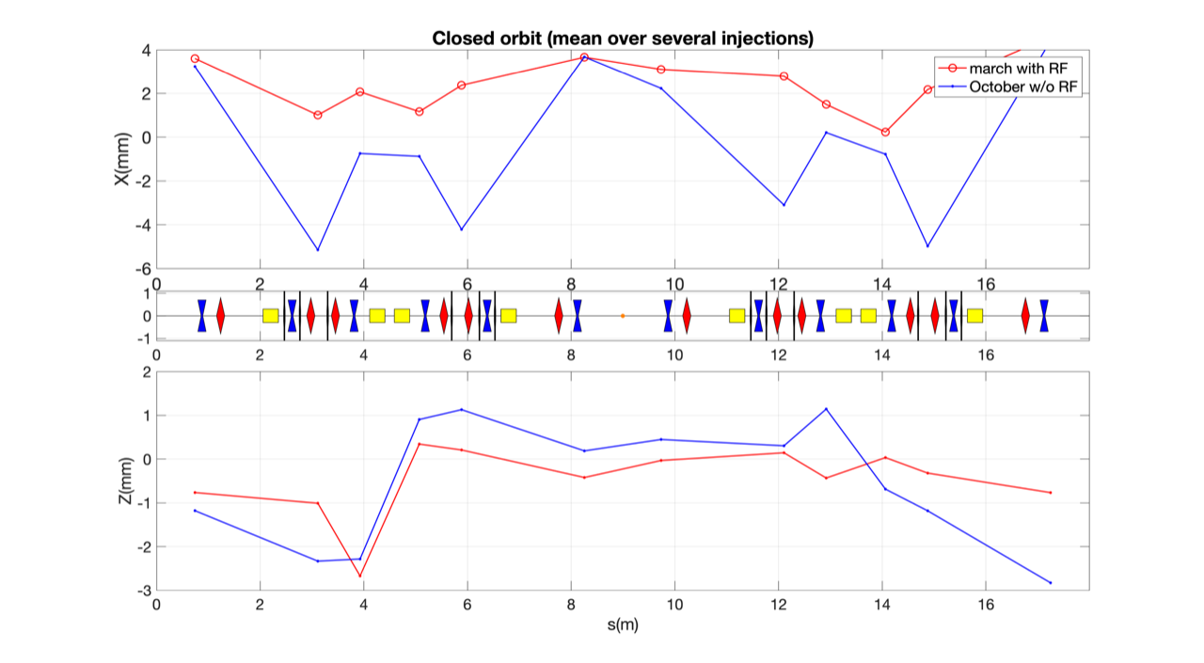
Orbit measurement in the ring
Studies are in progress

Slide 9
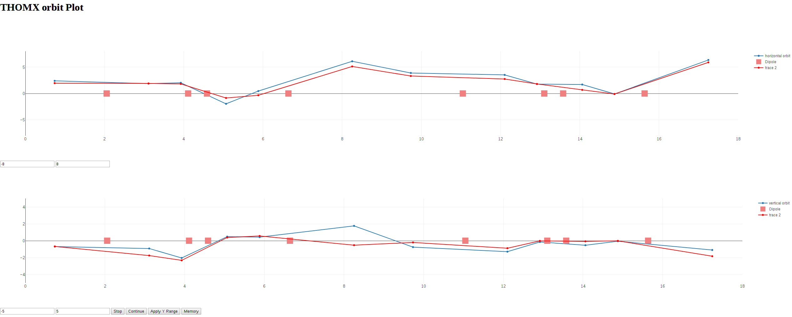
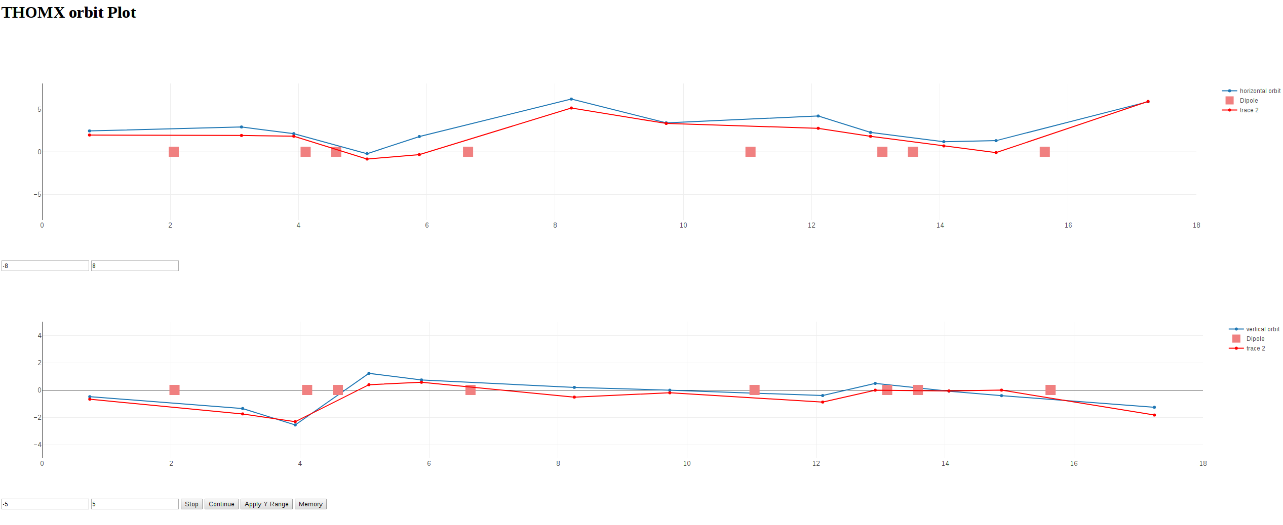
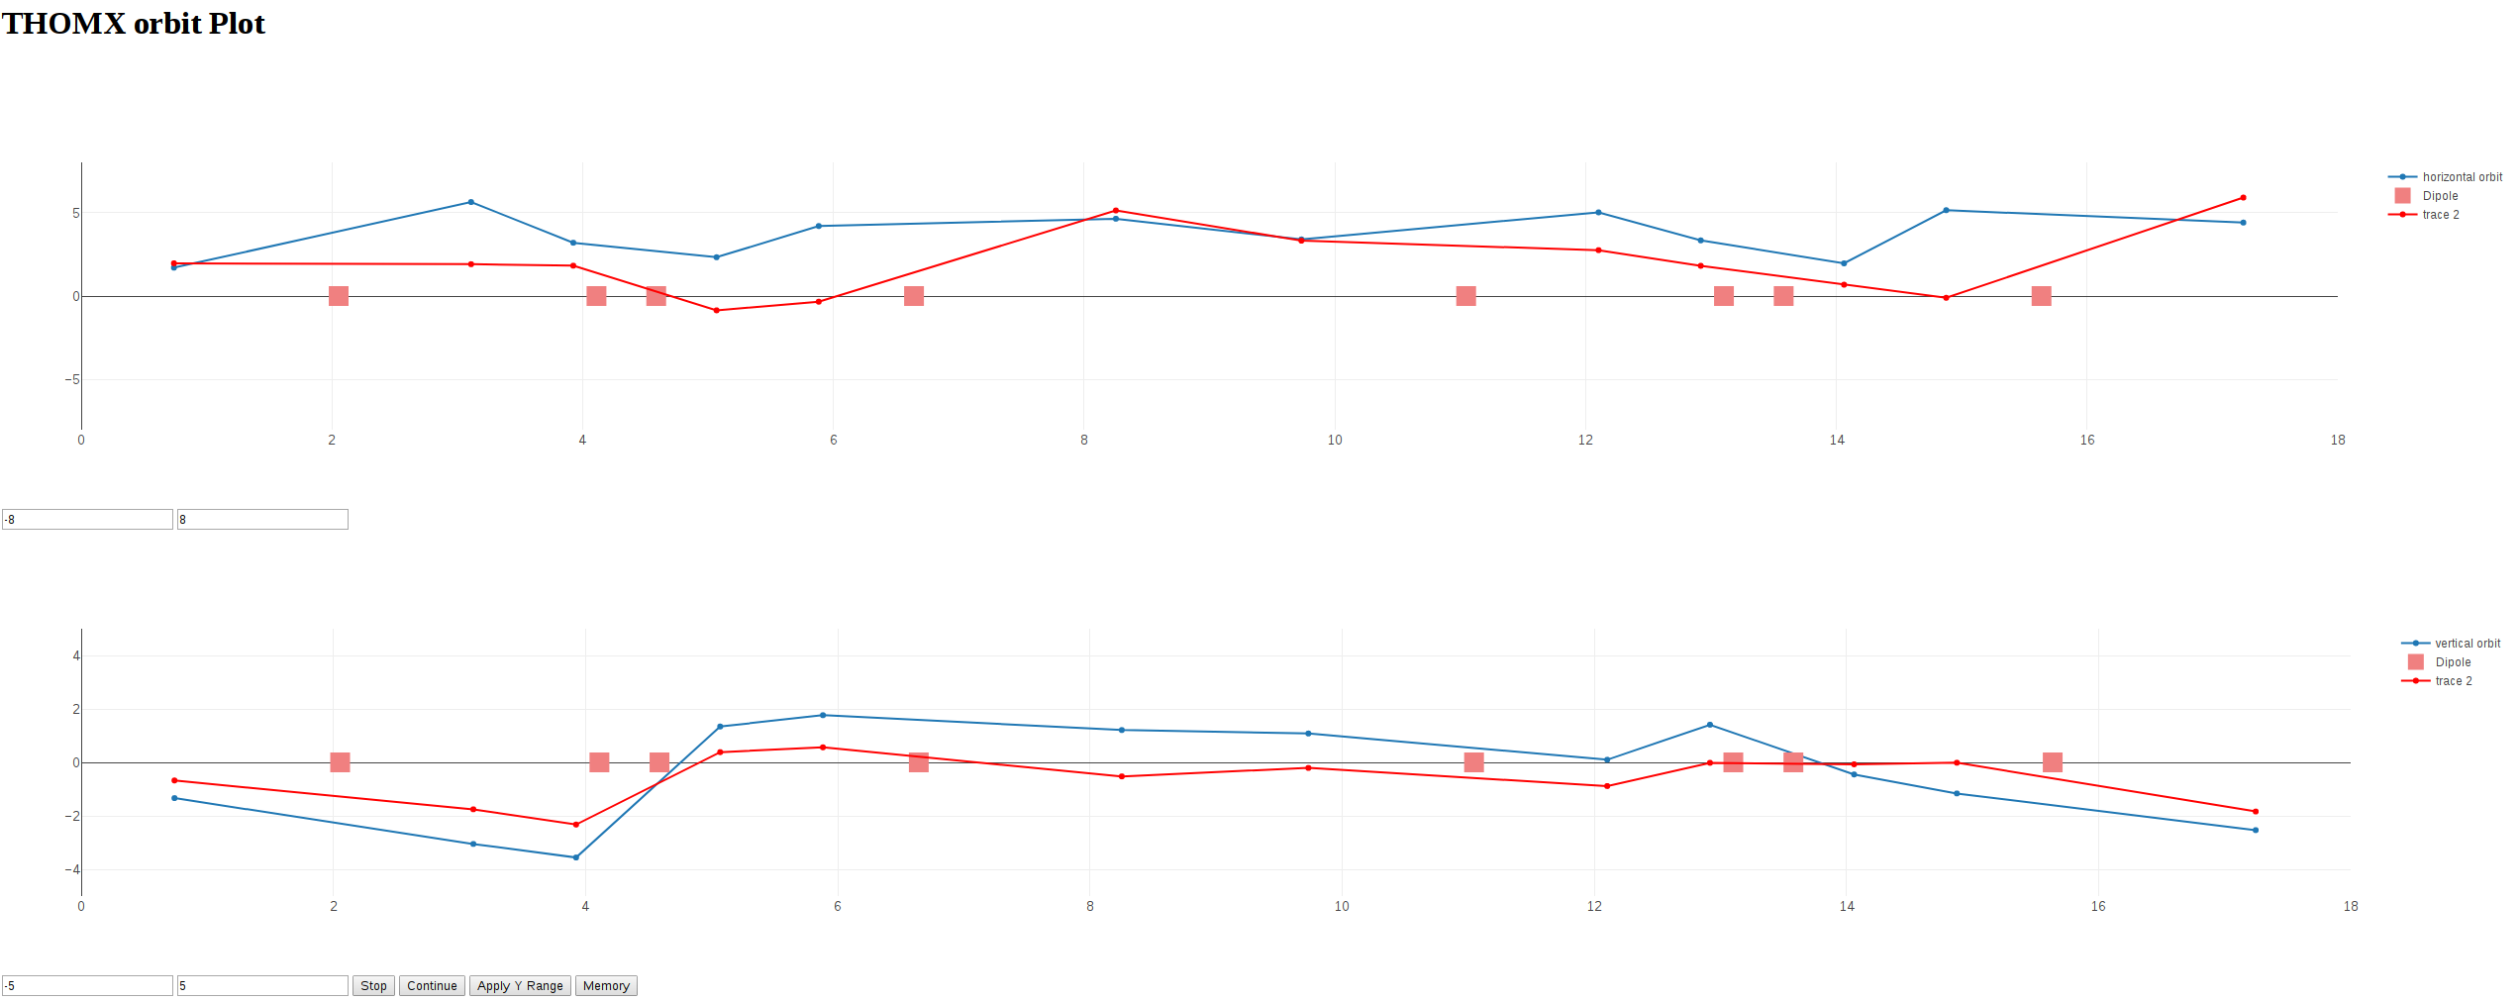
Orbit measurement in the ring w/o RF
Studies are in progress
TL/BPM2 X=4 mm
TL/BPM2 X=5.9 mm
TL/BPM2 X=6.8 mm

Slide 10
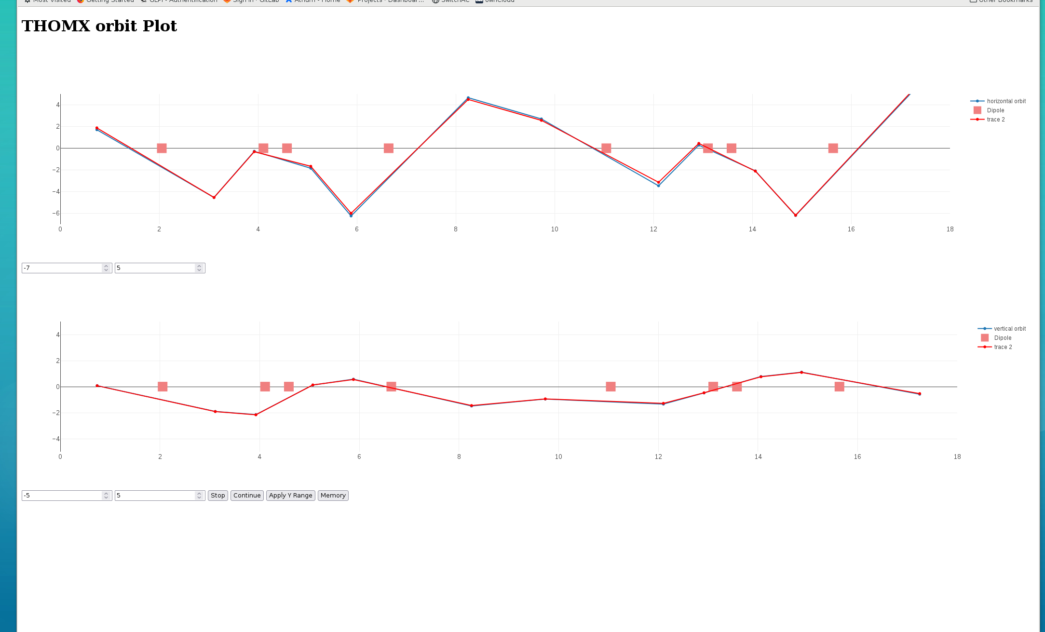
Orbit measurement 07/10 with RF (after correction)
Studies are in progress

Slide 11
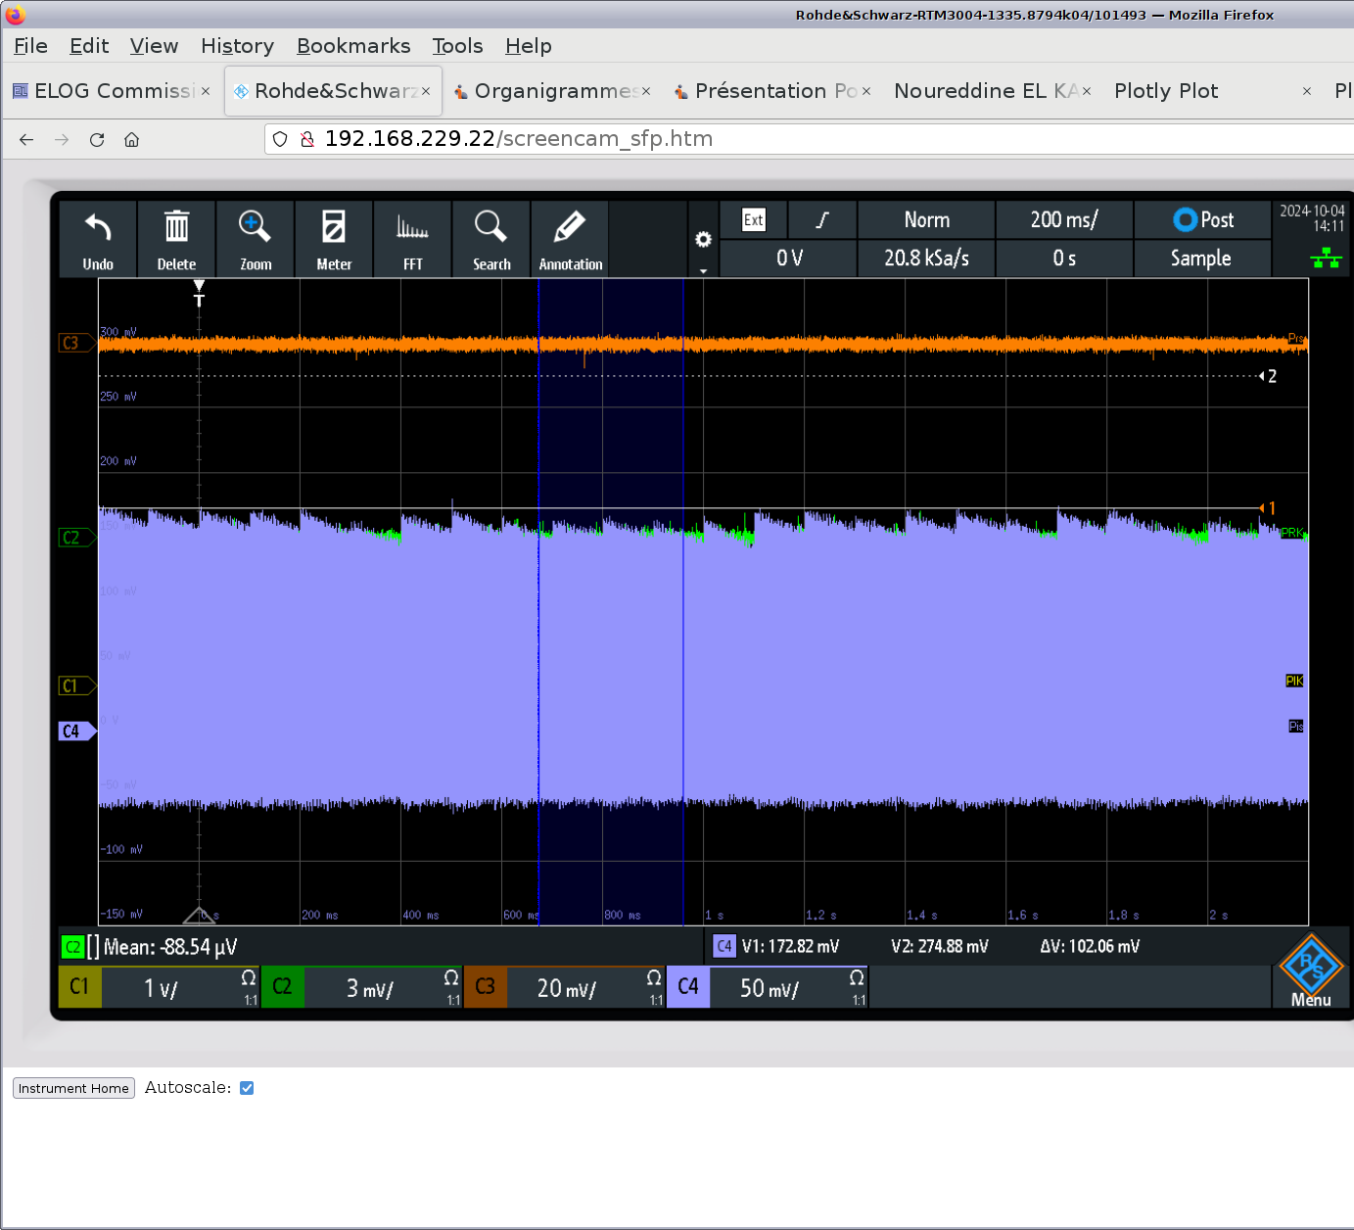
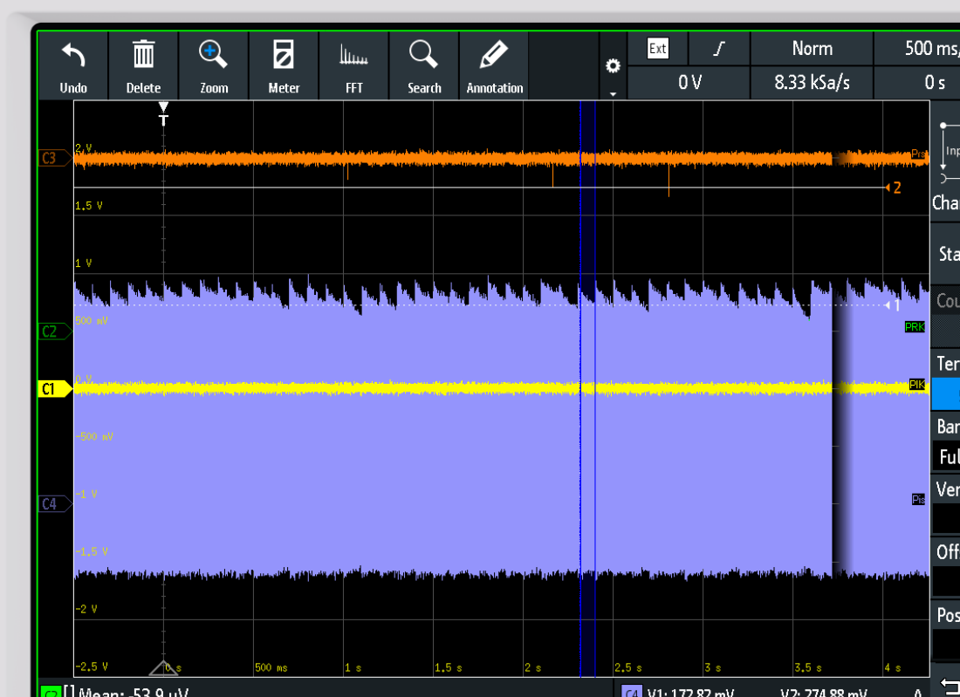
Storage on two days
Very good storage for X-rays studies

Slide 12
Beam Loss Monitor
Linac: install fiber along the new RF structure.
TL: installed and operational
EL: installed and operational
Ring: installed. We currently read out 2 fibers.
Scintillators: find the detection box, which was attached to the LIL girder. In general, a few scintillators are available. We use the one, installed at the septum. In October, no signal. We should check the PMT.
Signals can be read out by scope or RedPitaya.
We can show where are the cables and how to use.

