Slide 1
WP5: Integration into a new LINAC Cryomodule Padova meeting, March 13, 2025 WP Leader: Nuno Elias (ESS) WP Deputy: Vittorio Parma (CERN)
All information contained in this presentation and any accompanying documents is for iSAS project only, and must be treated as strictly confidential.
Any dissemination, distribution or other use of this information without the consent of its owner is prohibited.
Funded by the European Union. Views and opinions expressed are however those of the authors only and do not necessarily reflect those of the European Union or the European Commission. Neither the European Union nor the granting authority can be held responsible for them.

Slide 2
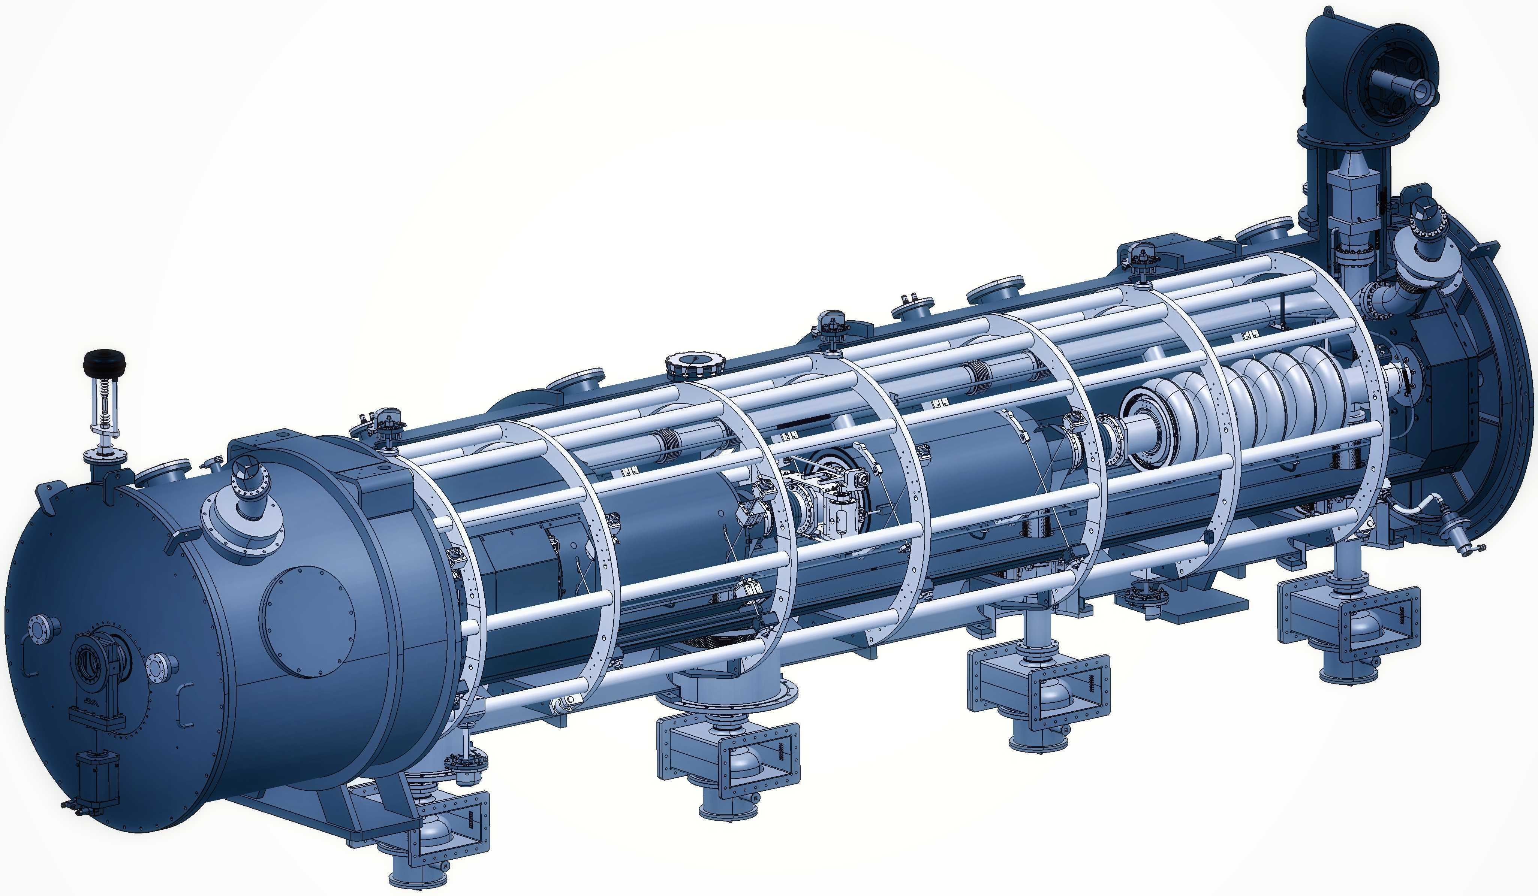
WP5: Integration into a new LINAC Cryomodule
ESS | CNRS | CERN | EPFL
Convener: Nuno Elias (ESS)
Main contacts with other partners: G. Olry (CNRS), V. Parma. CERN); M. Siedel (EPFL)
The design of any LINAC cryomodule is optimised to meet the specific research objectives of the accelerator facility, while addressing common challenges such as high-power electric fields, ultra-low temperatures, ultra-high vacuum, precise alignment, etc.
WP5's main goal is to tackle the common engineering challenges of integrating iSAS technologies into a parametric design of a new cryomodule, building on developments made with ESS cryomodules whilst benchmarking against other facilities.
In addition, to unlock the full energy-saving capability of this cryomodule, the objective of WP5 is to also address the challenging beam dynamics requirements when operating the new cryomodule in Energy Recovery Linacs with recirculating beams.

Slide 3
WP5: Integration into a new LINAC Cryomodule
ESS | CNRS | CERN | EPFL
Convener: Nuno Elias (ESS)
Main contacts with other partners: G. Olry (CNRS), V. Parma. CERN); M. Siedel (EPFL)
Task 5.1: Coordination on cryomodule design activities– M1-M48
• General coordination by ESS as described above.
Task 5.2: ESS cryomodules experience and benchmarking with other recent facilities– M1-M36
• Compile the lesson learned from the ESS CM testing activities, technical commissioning, and initial operation.
• Benchmarking with projects in the implementation phase (worldwide).
• Develop a roadmap to develop a new, sustainable CM design.
Task 5.3: Sustainable criteria for LINAC cryomodule design– M24-M48
• Integrate findings from the other iSAS WPs into a generic CM design.
• Explore the sustainability criteria for the design.
Task 5.4: Beam Dynamics for ERL-based accelerators with energy-efficient cryomodules – M1-M48
• Simulate the beam dynamics of ERL-based accelerators when the energy efficient CM is included.
• Study the lattice design to optimize the beam and energy saving performances.

Slide 4
WP5 – Coordination: status/evolution of Task 5.1
Task 5.1: Coordination on cryomodule design activities– M1-M48
• General coordination by ESS as described above.
Past developments
Regular WP5 meetings + dedicated meetings task specific
Mar24; Apr24; Jul24; Sep24; Jan25 + (12-19)Nov24_T5.2 ; (7)Mar25_T5.4
Milestone 5.1 : “In-person WP kick-off meeting at ESS” : Completed
Recruitment PhD student (EPFL): Started: (Apr-2024) ; Completed (Oct-2024)
Current developments
Ongoing Recruitment of junior engineer/ scientist (ESS) : Start: (Mar-24) ; Complete (Jun-24)
Assignment of 2 years to be supporting activities related to WP5 and WP6
Possible extension to be considered, to cover up to the end of project

Slide 5
WP5 – Coordination: status/evolution of Task 5.1
Task 5.1: Coordination on cryomodule design activities– M1-M48
• General coordination by ESS as described above.
Milestone 5.1 : In-person WP kick-off meeting at ESS (Due date: M3 or Jun-2024)
Deliverable 5.1 : Compilation of ESS CM lessons learned & benchmarks (Due date: M24 or Feb-2026)
Deliverable 5.2 : Roadmap for the CM design (Due date: M36 or Feb-2027)
Deliverable 5.3 : Parametric design for a sustainable CM with iSAS tech. (Due date: M48 or Feb-2028)
Deliverable 5.4 : Report on beam dynamics study for ERL with iSAS CM (Due date: M48 or Feb-2028)
M5.1
D5.3
D5.1
D5.2
D5.4
Y0
Y1
Y2
Y3
Y4
Task 5.1
Task 5.1
M
Task 5.2
Task 5.2
D
D
Task 5.3
Task 5.3
D
Task 5.4
Task 5.4
D
Mar
2024
Mar
2025
Mar
2026
Mar
2027
Feb
2028

Slide 6
WP5 – Experience/Benchmark CMs: status of Task 5.2
Task 5.2: ESS cryomodules experience and benchmarking with other recent facilities – M1-M36
• Compile lesson learned from the ESS CM testing activities, technical commissioning, initial operation.
• Benchmarking with projects in the implementation phase (worldwide).
• Develop a roadmap to develop a new, sustainable CM design.
Past developments
Discussions with relevant people: ESS CM lifecycle
Gathering of relevant high-level information
Preliminary table-of-contents for ESS CM lessons learned report
Current developments
Developing of on the ‘ESS CM lessons learned’ report structure
Alignment with CM ‘benchmarking template’
• Compile lesson learned from the ESS CM testing activities, technical commissioning, initial operation.
Deliverable 5.1 : Compilation of ESS CM lessons learned & benchmarks (Due date: M24 or Feb-2026)
Deliverable 5.2 : Roadmap for the CM design (Due date: M36 or Feb-2027)

Slide 7
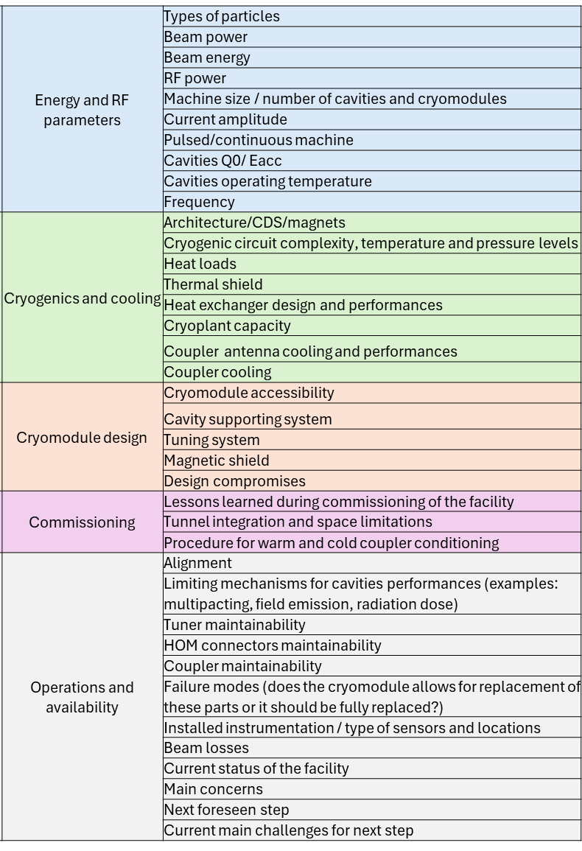
WP5 – Experience/Benchmark CMs: status of Task 5.2
Task 5.2: ESS cryomodules experience and benchmarking with other recent facilities – M1-M36
• Benchmarking with projects in the implementation phase (worldwide).
Past developments
Benchmarking parameters defined in the previous point (5.2.1)
Benchmarking facilities: SNS, LHC, PIP-II, XFEL, LCLSII
Definition of a questionnaire to receive a uniform response from the facilities
Identification of the contact people in the different facilities
Bibliographic search completed to propose a suggestion to every answer (reviewing can be easier than completing a blank questionnaire)

Slide 8
WP5 – Experience/Benchmark CMs: status of Task 5.2
Task 5.2: ESS cryomodules experience and benchmarking with other recent facilities – M1-M36
• Benchmarking with projects in the implementation phase (worldwide).
Current developments
Questionnaire finalization
First trial with LHC and ESS to get a feedback on the proposed questions
Distribution of the questionnaire to the facilities
Follow-up meeting foreseen to discuss the answer / elaborate on more complex topic after 2/3 weeks
Last part of the questionnaire focuses on lessons learned in the implementation or upgrade phases (PIP-II, XFEL CW upgrade - topics presented at TTC)

Slide 9
WP5 – Experience/Benchmark CMs: status of Task 5.2
Task 5.2: ESS cryomodules experience and benchmarking with other recent facilities – M1-M36
• • Develop a roadmap to develop a new, sustainable CM design.
Past developments
Definition of the guidelines focus:
Application for proton/electrons linac/circular super conductive accelerators,
High beta elliptical cryomodules.
In which terms is sustainability defined? OPEX or CAPEX?
In the iSAS proposal sustainability is defined in terms of energy savings, so the guidelines roadmap will focus on the minimization of the operational costs.
Definition of integration roadmap – what not to forget in the definition of tunnel space occupation in conceptual design phase
Current developments
Guidelines will be sketched after the collection of the filled questionnaires

Slide 10
WP5 – Design new CM: status/evolution of Task 5.3
Task 5.3: Sustainable criteria for LINAC cryomodule design – M24-M48
• Integrate findings from the other iSAS WPs into a generic CM design.
• Explore the sustainability criteria for the design.
Past developments
This task is set to start on M24 (Mar26)
Current developments
Attention to Sustainability criteria strategies applied to “Technology Areas”.
Attention to implementation of performance criteria of technology areas and its integration.
Breakdown of CM sub-systems (<- input from benchmarking)
Discussions on KPI associated with each sub-system.
Deliverable 5.3 : Parametric design for a sustainable CM with iSAS tech. (Due date: M48 or Feb-2028)

Slide 11
WP5 – Design new CM: status/evolution of Task 5.4
Task 5.4: Beam Dynamics for ERL-based accelerators with energy-efficient cryomodules – M1-M48
• Simulate the beam dynamics of ERL-based accelerators when the energy efficient CM is included.
• Study the lattice design to optimize the beam and energy saving performances.
Past developments:
Meetings with PERLE collaboration, discussing details on the RF structure and HOM’s
Evaluated and tested beam dynamics codes to enable ERL simulations
Written code to enable flexible simulations and gathering of results
Current developments:
General SRF cavity beam dynamic studies
short-range and long-range wakefields (HOM’S)
single- and multi-bunch instabilities
General energy recovery efficiency studies after the degrading of beams throughout an ERL or ERL collider
Evaluate ERL collider/light source applications for iSAS technology and perform studies on these applications

Slide 12
WP5 – Design new CM: status/evolution of Task 5.4
Task 5.4: Beam Dynamics for ERL-based accelerators with energy-efficient cryomodules – M1-M48
Wakefields:
Wakefields: Perturbation in the beam pipe ➔ perturbation in the particle EM field
➔ RF cavity: excitation of higher order modes
Single- and multi-bunch instabilities:
Longitudinal instabilities:
Bunch Lengthening: Longitudinal (monopole) wakefields can influence the length of the bunch
Beam loading: Longitudinal wakefields travelling through RF cavity influence the accelerating gradient
Transverse instabilities:
Single-bunch beam breakup (SBBU): Transverse (dipole, quadrupole ) wakefields of the head of a single bunch influencing the tail causing transverse offsets in the tail, leading to unstable particles
Multi-bunch beam breakup (MBBU): Transverse wakefields that persist long enough to influence subsequent bunches, leading to unstable bunches

Slide 13
WP5 – Design new CM: status/evolution of Task 5.4
Task 5.4: Beam Dynamics for ERL-based accelerators with energy-efficient cryomodules – M1-M48
Past developments:
Relevant beam dynamics codes:
Bmad/Tao (Cornell)
Large accelerator Fortran toolkit containing single and multi--particle beam dynamics; collective effects; wakefields; linacs and circular machines; multi-pass recirculation ➔ great comparison tool for CERN codes
Xsuite (CERN)
Large accelerator Python toolkit containing single and multi--particle beam dynamics; collective effects; wakefields, beam-beam effects; optimised for circular machines; no multi-pass recirculation
BLonD (CERN)
Fork of PyHEADTAIL with additional longitudinal diagnostic and feedback tools. ➔ plans for implementation in Xsuite
PLACET2 (CERN)
Wakefields in linacs + single- and multi-bunch effects; multi-pass recirculation
RF-Track (CERN)
Wakefields in linacs + single- and multi-bunch effects (same model as PLACET2); no multi-pass recirculation; interfaced to Xsuite
➔ Combination of RF-Track and Xsuite at CERN with future implementation of multi-pass recirculation

Slide 14
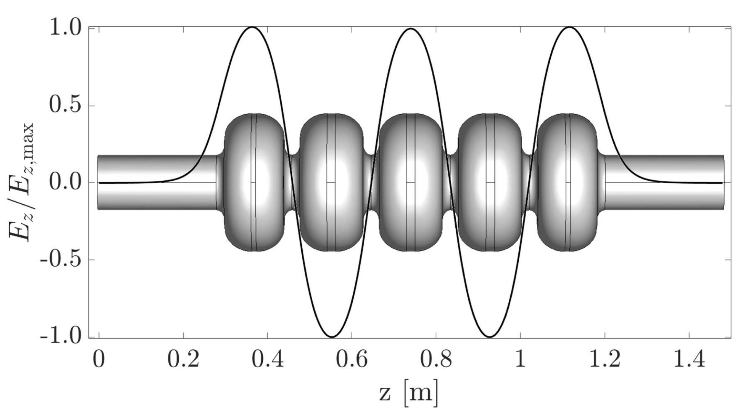
WP5 – Design new CM: status/evolution of Task 5.4
Task 5.4: Beam Dynamics for ERL-based accelerators with energy-efficient cryomodules – M1-M48
Current developments:
Benchmarking of RF-Track
iSAS/PERLE SW SRF 5-cell cavity:
1D axial electric ${TM}_{010 }$field in $π$-mode fieldmap
Monopole and dipole cavity eigenmodes
Cavity geometry
Single-bunch through iSAS/PERLE cavity / lattice in RF-Track:
Single bunch at transverse normalised emittance of 6 mm mrad and bunch energy of 7 MeV (PERLE injection)
Short-range wakefields: beam loading, SBBU
Search for instabilities: parameter scans for dependency of bunch charge, distribution, etc.
Developing RF-Track/Xsuite Wrapper: PyERL
➔ Fast and customisable beam dynamics simulations
Figure 5: Normalised axial electric field amplitude of the TM010-π mode at 801.58 MHz in the 5 half-wave cell bare-cavity for PERLE, with an energy gain of 20.5 MeV [C. Barbagallo, “Design and optimization of higher order mode couplers for the superconducting cavities of the PERLE energy recovery linac”].

Slide 15
WP5 – Design new CM: status/evolution of Task 5.4
Task 5.4: Beam Dynamics for ERL-based accelerators with energy-efficient cryomodules – M1-M48
Timeline
Current/future developments:
Single- and multi-bunch iSAS/PERLE cavity / lattice in RF-Track
Beam loading, BBU, etc.
Benchmarking tracking codes and BBU codes
Comparison study between iSAS/PERLE and similar FCC-ee (version 3795) cavities
Development of multi-pass recirculation in RF-Track or Xsuite
End-to-end multi-bunch multi-pass recirculation simulation in RF-Track /Xsuite (PERLE)
Multi-bunch effects at different bunch energies
Degradation of bunches due to synchrotron radiation
➔ Stability / energy recover efficiency studies
Multi-bunch colliders in RF-Track and Xsuite
Degradation of bunches due to collisions and beam-beam effects
➔ Stability / energy recover efficiency studies
Consider and find applications in the various ERL proposals
Within next 4 months
Starting summer 2025
2026?
Deliverable 5.4 : Report on beam dynamics study for ERL with iSAS CM (Due date: M48 or Feb-2028)

Slide 16
WP5 – Title: points of attention
Points of attention: None
e.g. important collaborations with other WPs and/or the broader accelerator R&D landscape
e.g. ongoing (or upcoming) communications with industry partners
e.g. new challenges for the implementation of the tasks
e.g. new opportunities potentially leading to revisited tasks/milestones/deliverables
…

Slide 17
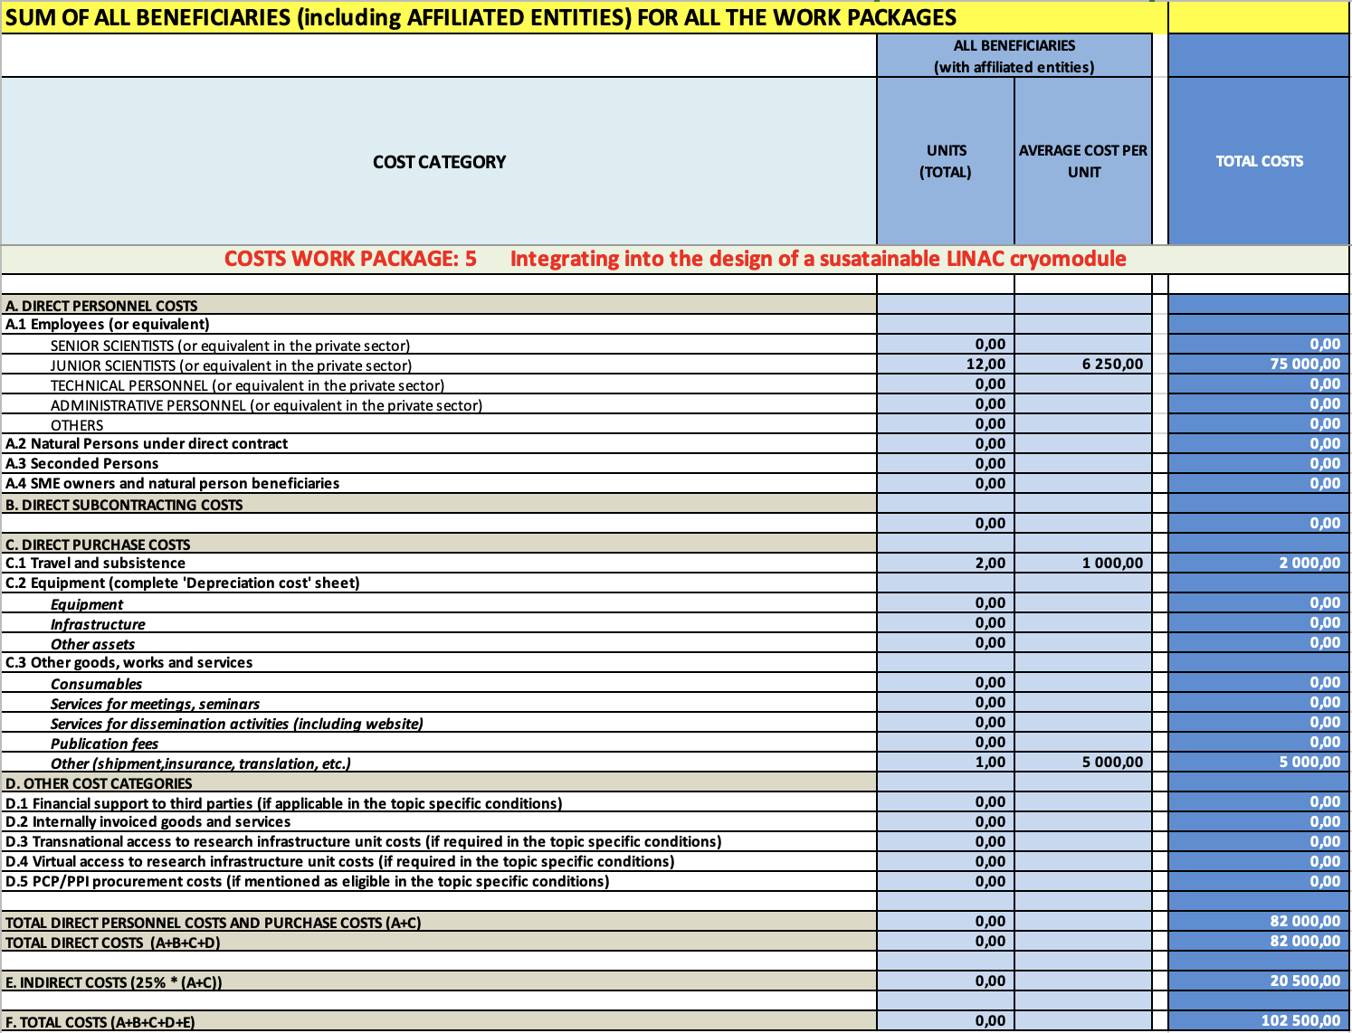
WP5 – Title: financial status
Financial status : no deviations on projections
Funds engaged in the WP by institute to date, differentiating EU-budget from matching funds
With highlight of staff dedicating time on the iSAS project, to date & projections if possible
The PhD student for Task 5.4 is not on the EU budget but is a budget directly from EPFL
Junior Scientist [ESS] WP5 (12m) + WP6 (12m) ; Recruitment starting soon + extension to be analysed*
Deviations?
No Deviations
ESS:
8K (travels for meetings on CM developments) + 3K (Licenses) + 2K (Workshop organization)
CERN:
2K (travels to collaborating institutes)

Slide 18
WP5 – Title: plans to achieve milestones & deliverables
Milestones & deliverables on track?
YES. Milestones for WP5 Completed
D5.1 in 12Mo: YES. Good progress, Actors Defined. Good collaboration between institutions.
D5.2 in 24Mo: YES. Good progress, Actors Defined. Depending on D5.1
D5.3 in 36Mo: Task not started. Good discussions on the topic taking place
D5.4 in 36Mo: YES. Good progress. PhD student well guided.
Plans to achieve milestones & deliverables
Delay risks to be anticipated? Expediting the Recruitment of ESS Junior Engineer
Cooperation with other WP(s) to be reactivated? Good cooperation
Risk mitigation measures to be implemented? No risks identified
…

Slide 19
Thank you

