Slide 1
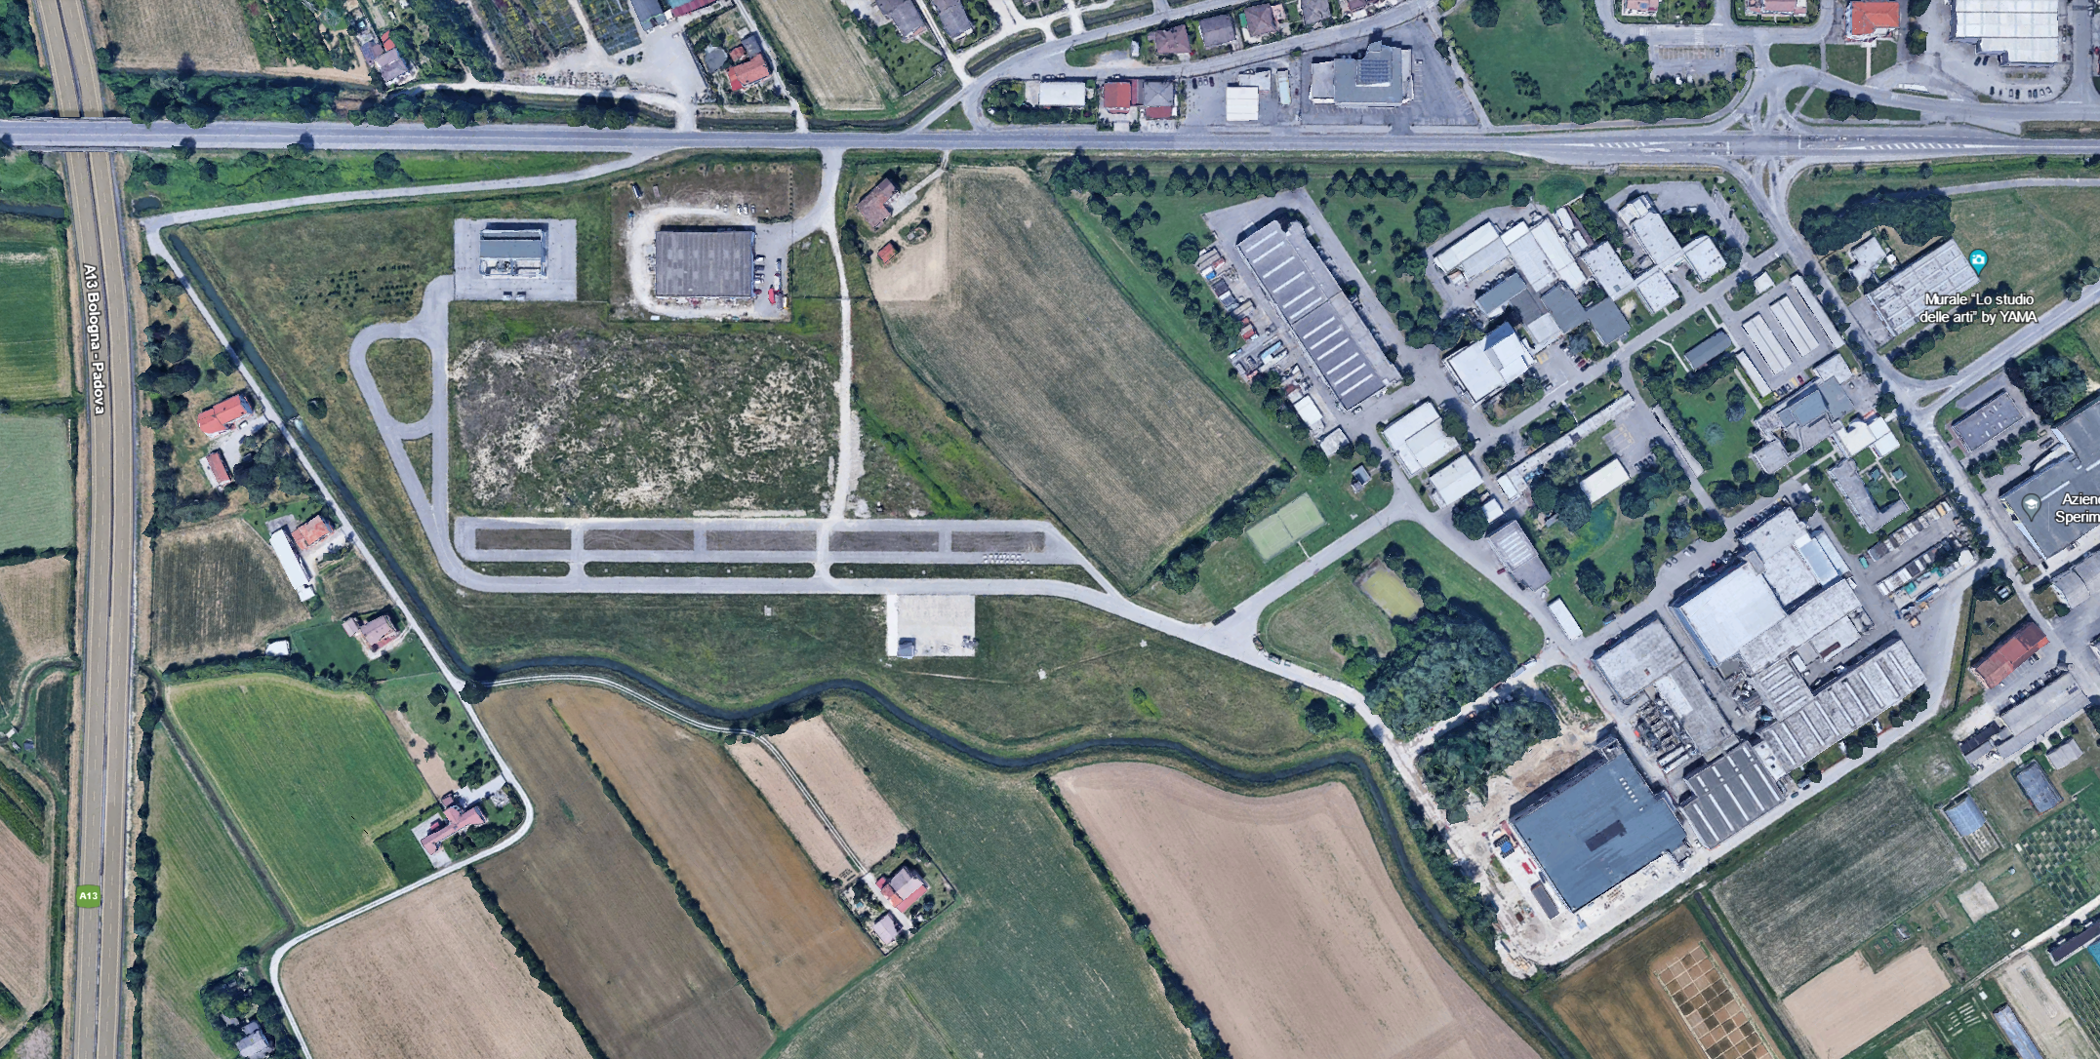

WELCOME TO

Slide 2

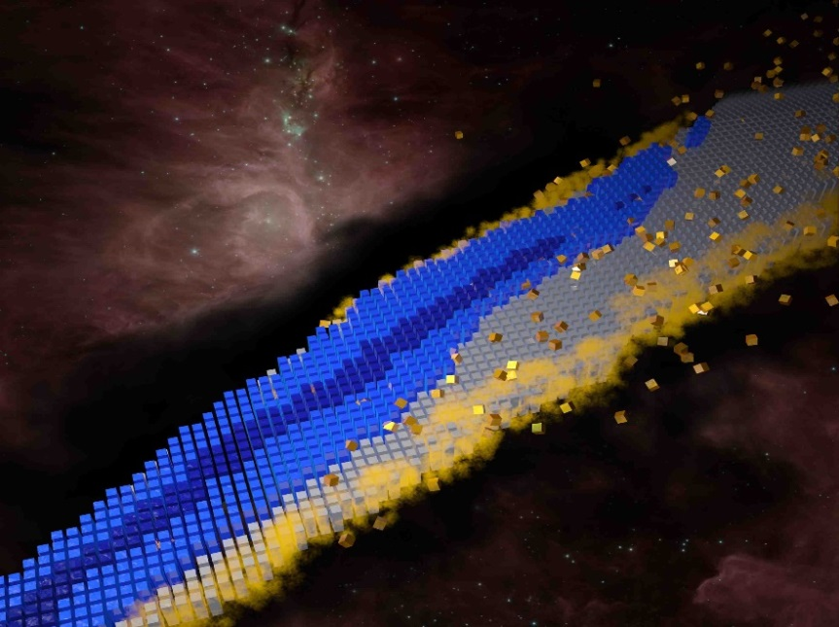
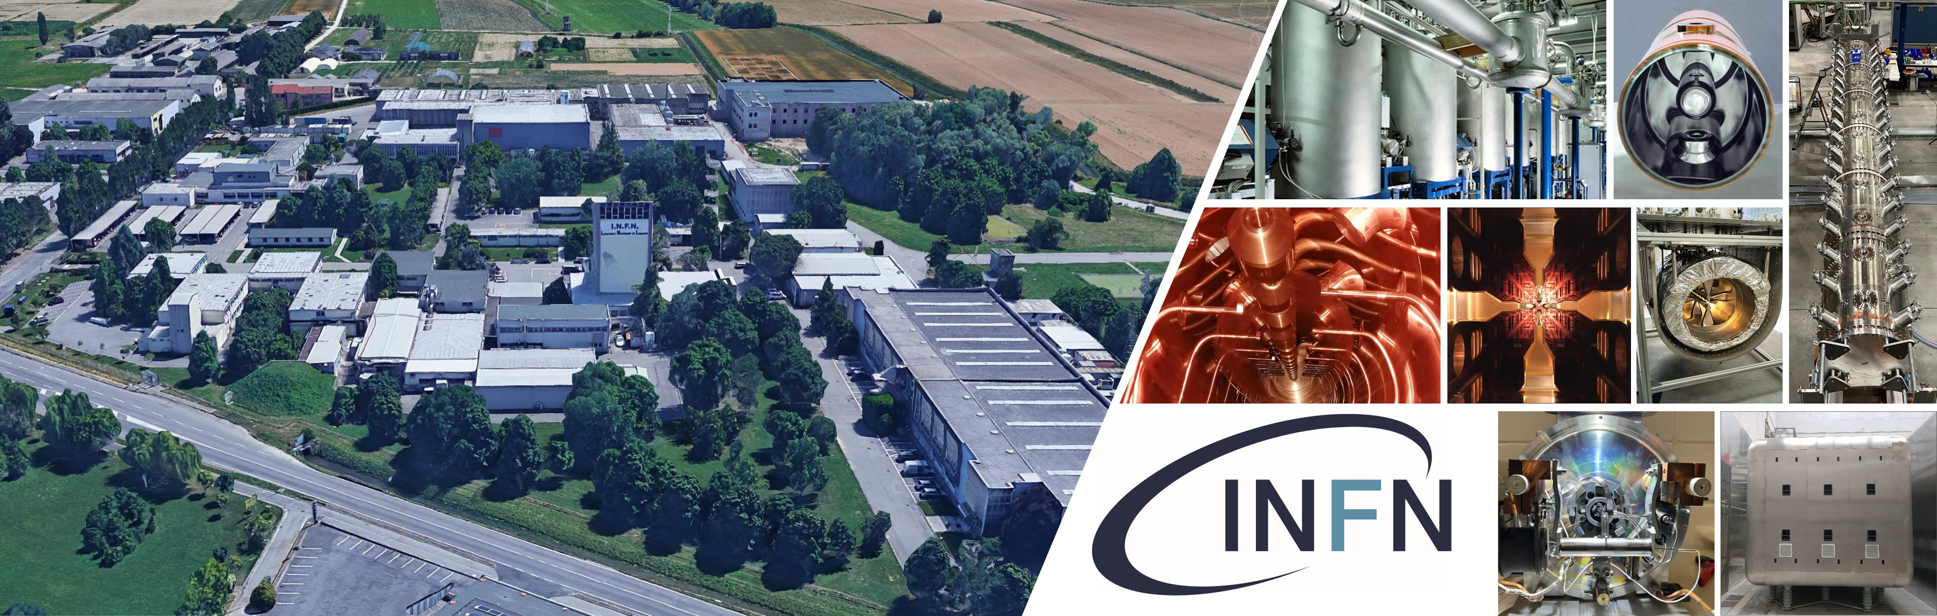
Nuclear Physics : the core of matter, the fuel of stars
Nuclear Physics for medicine
    The Science :
    Accelerator Based Research (Basic and Applied)
    The Technology:
    Accelerators Physics and Technology

Slide 3
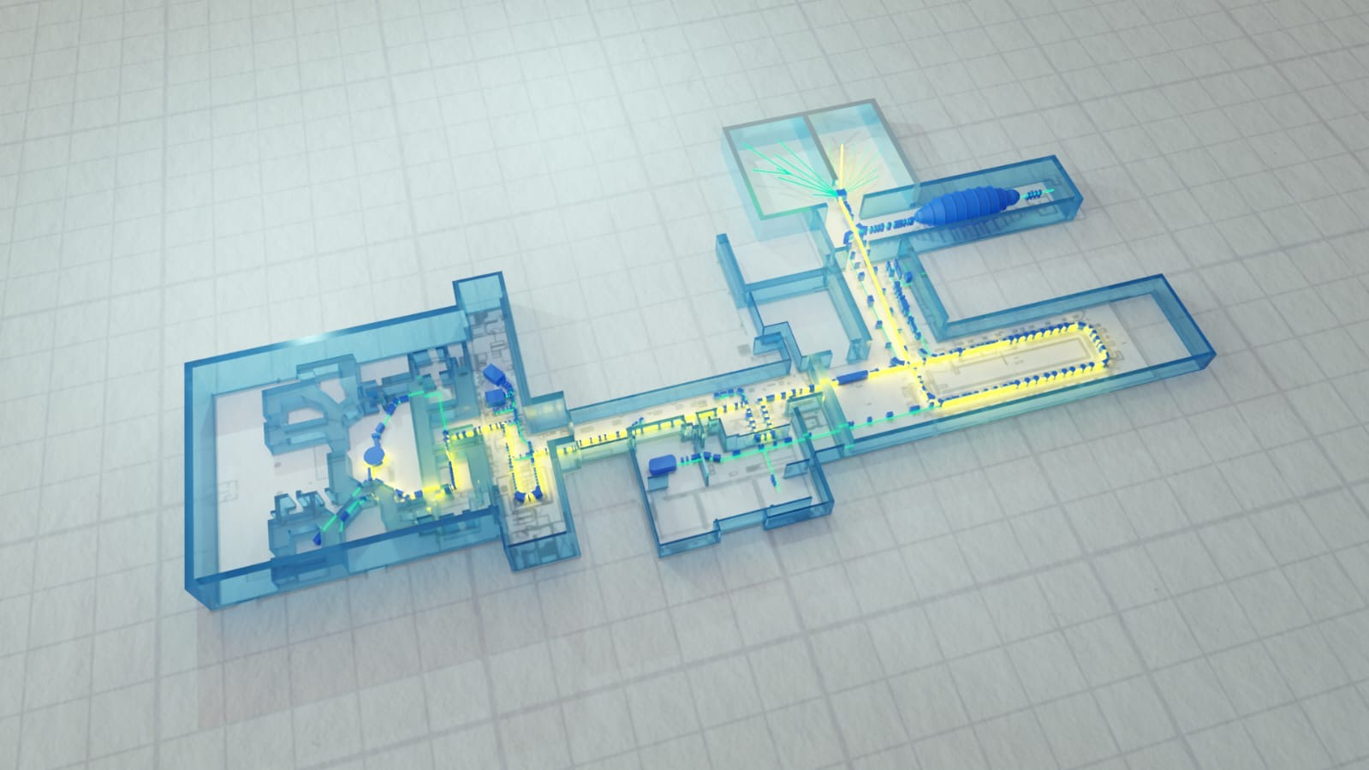
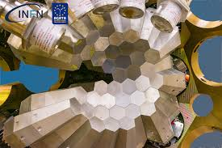
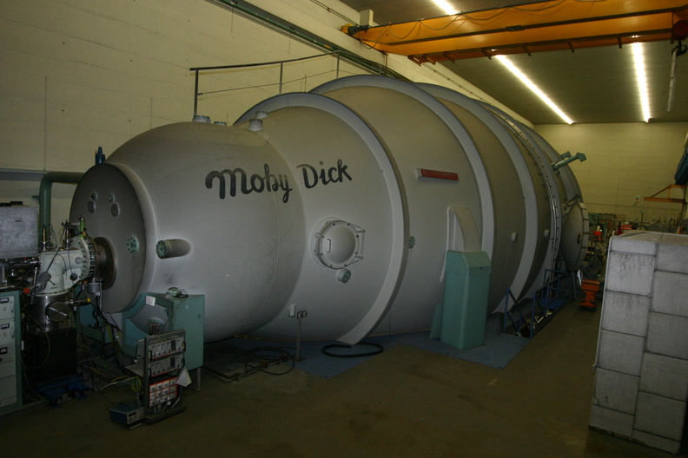
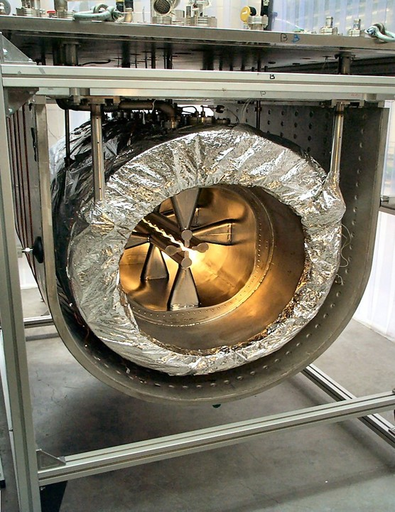
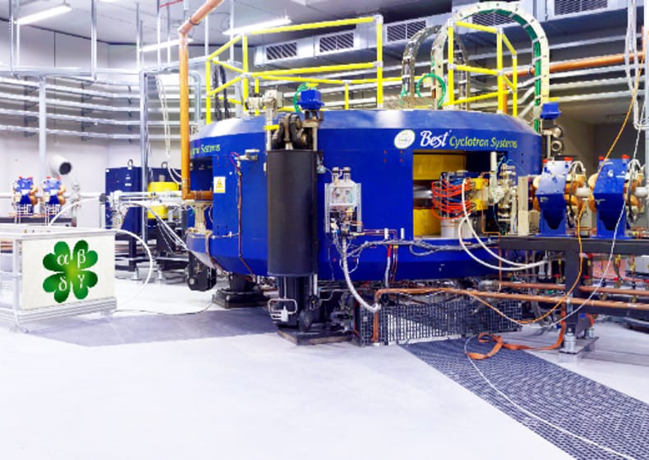
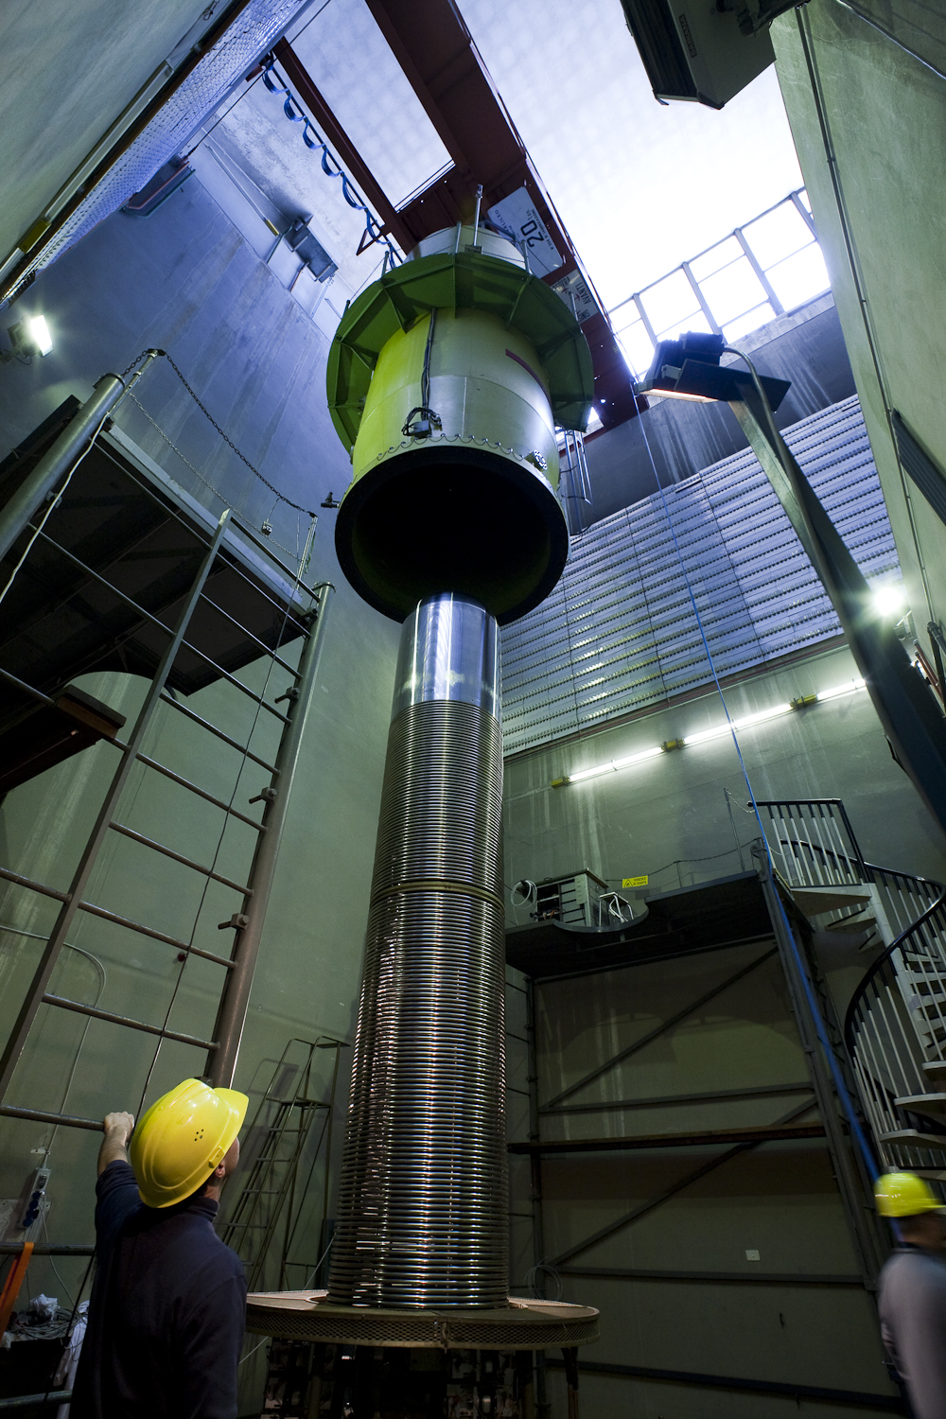
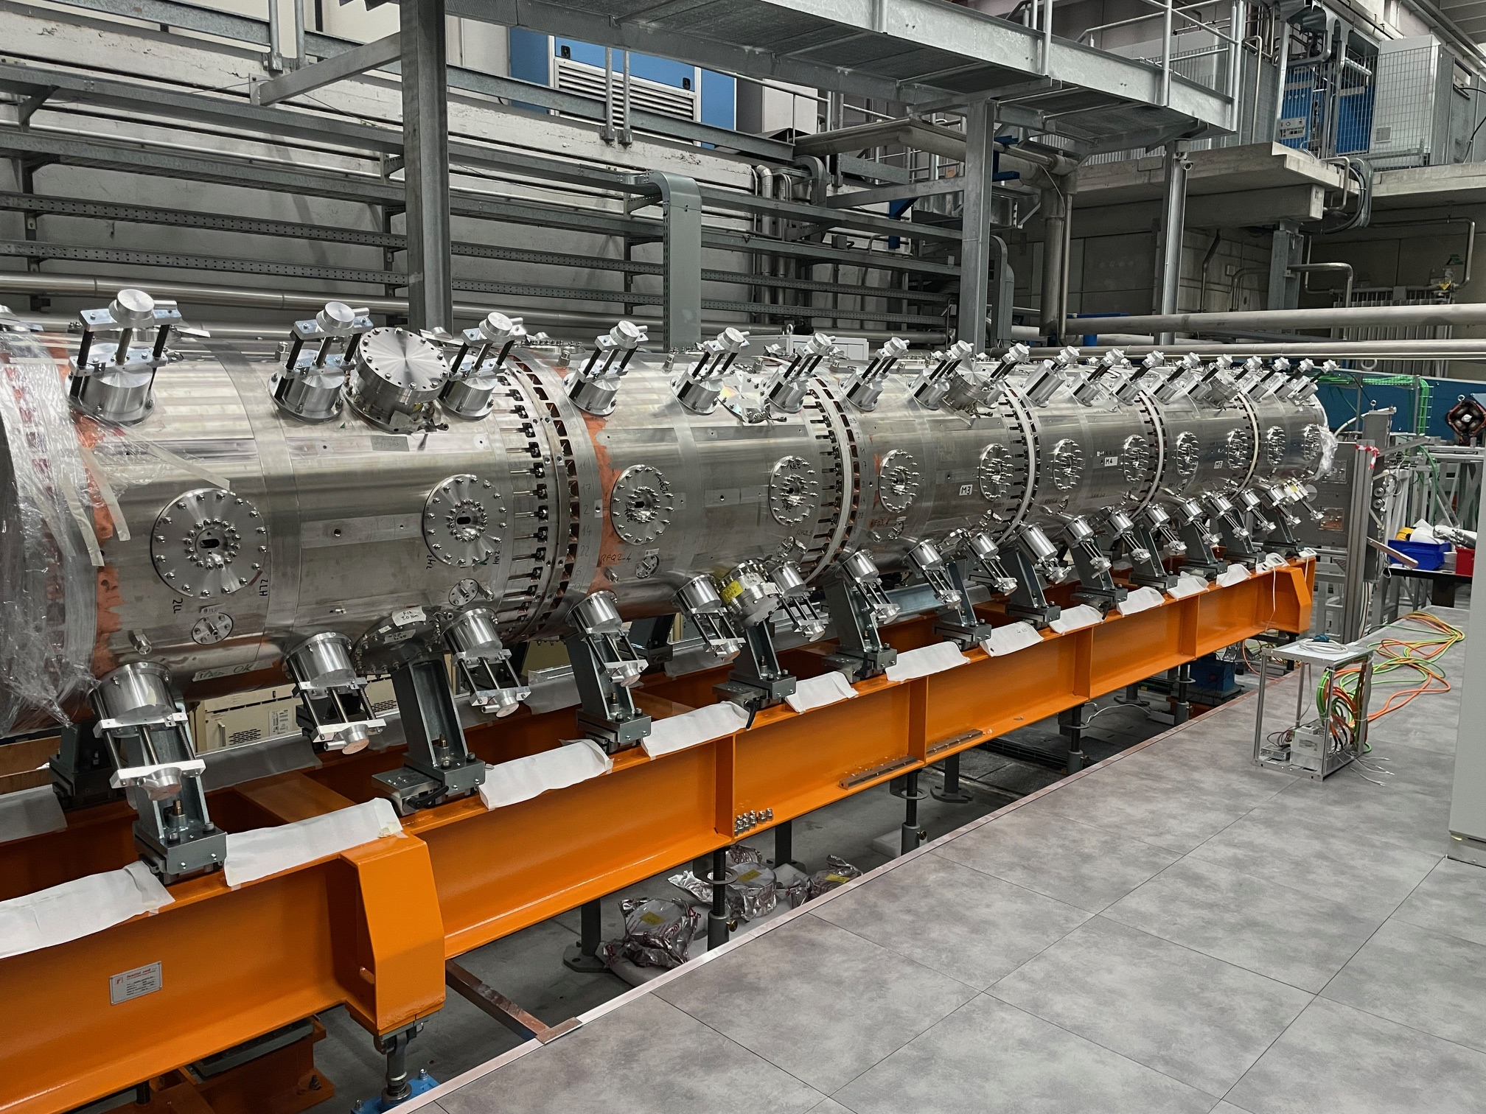
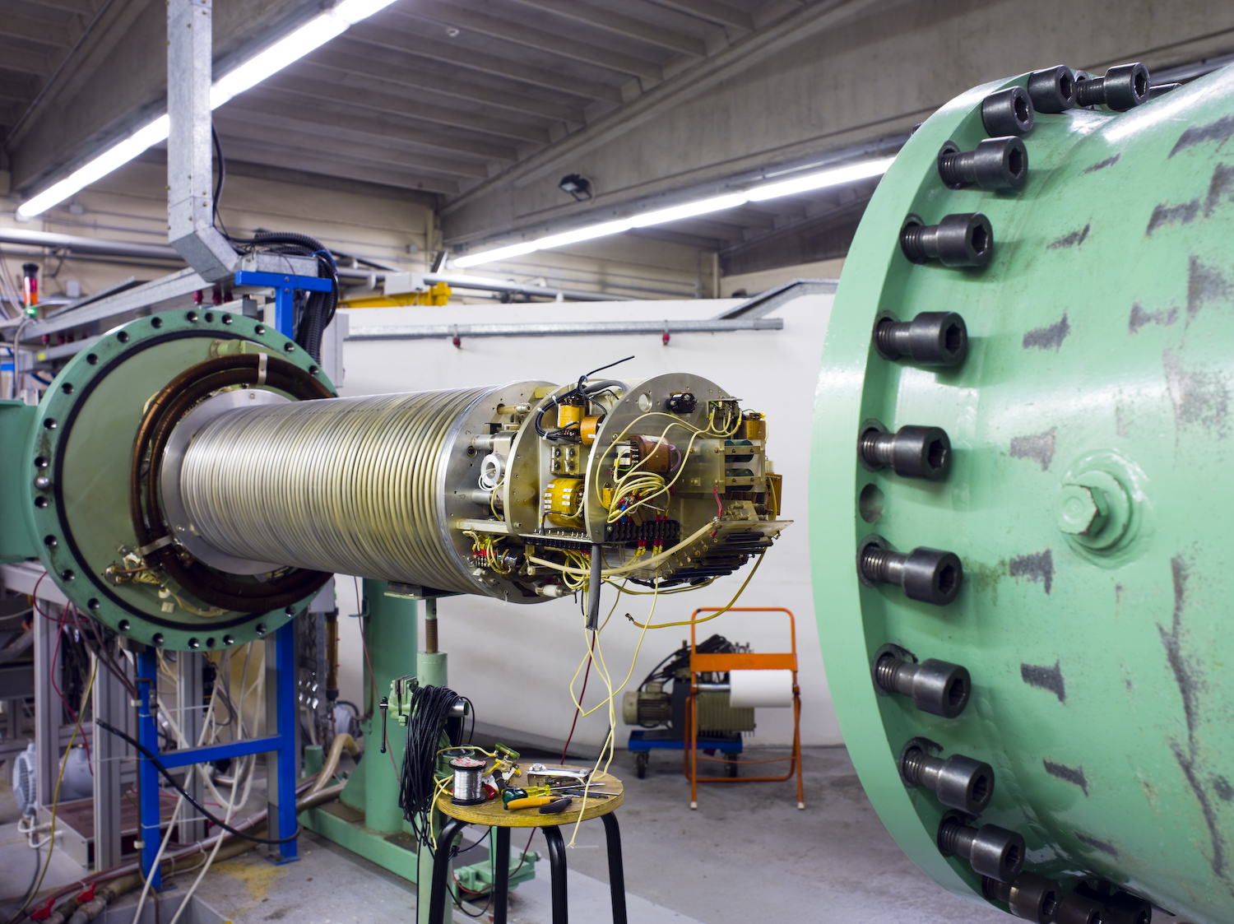
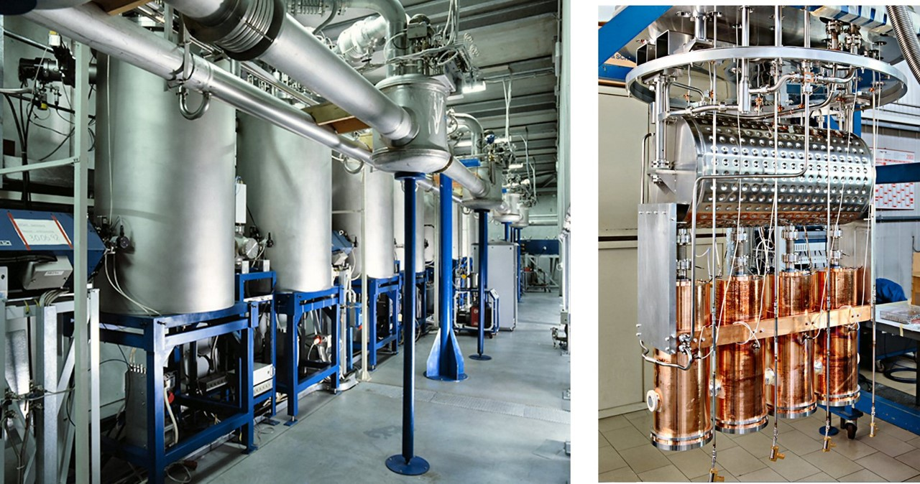
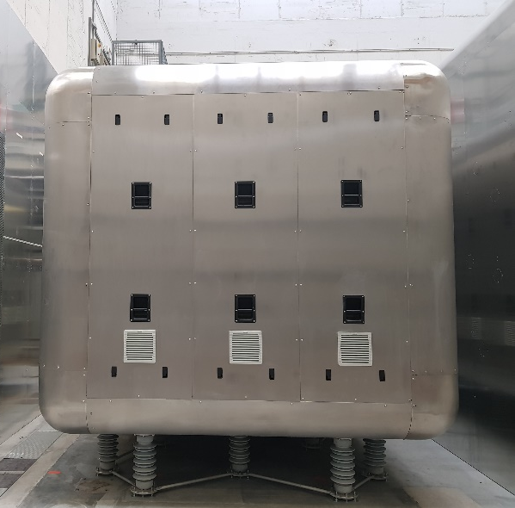
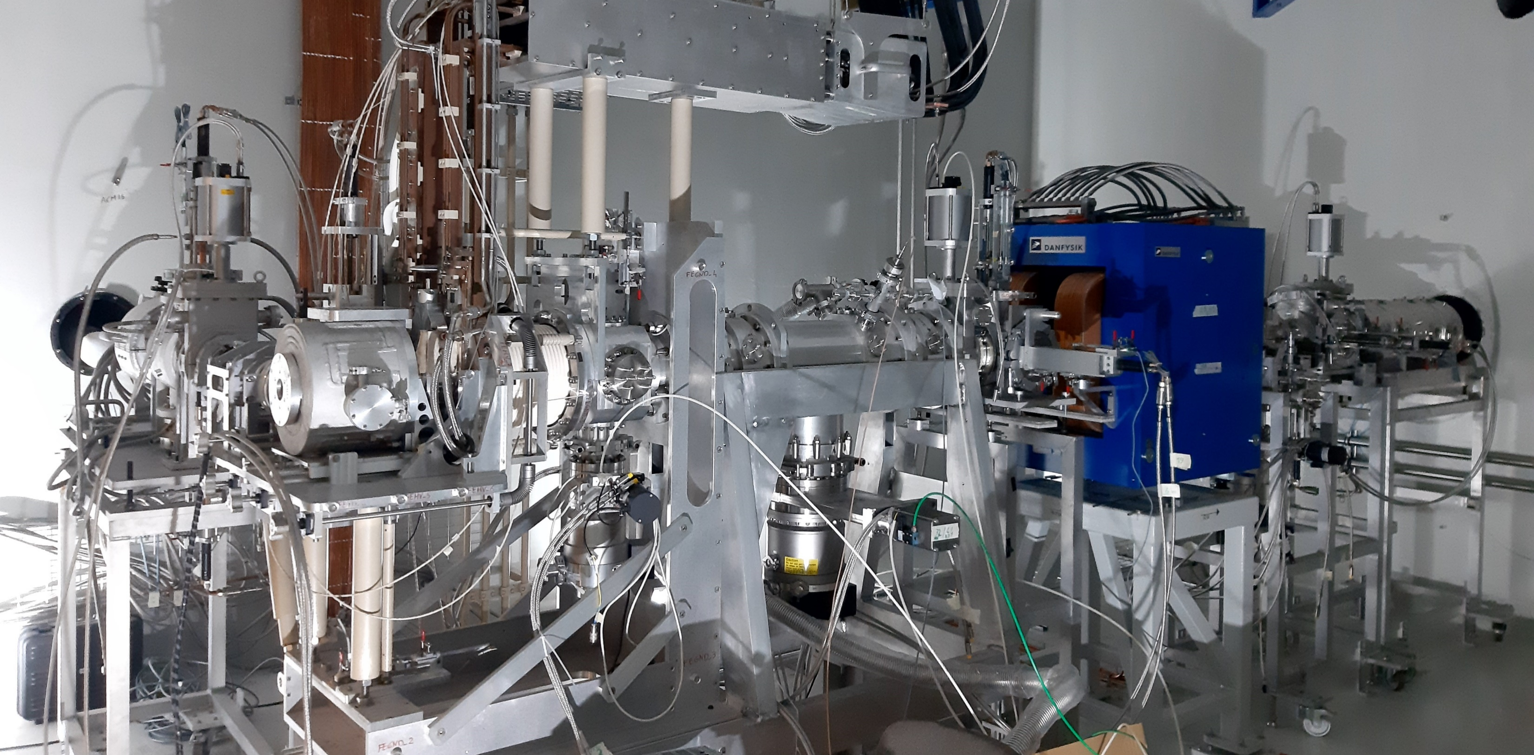
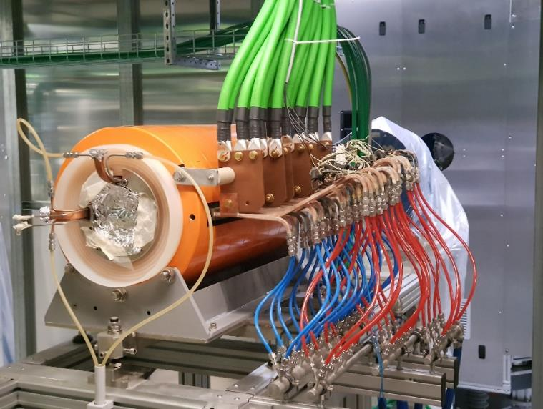

AGATA
TANDEM
The LNL accelerators complex
PIAVE
SC RFQ
SPES
CYCLOTRON
SPES
RFQ
ALPI
SC LINAC
SPES
MRMS
SPES
Target Ion Source
SPES
Charge Breeeder

Slide 4
LNL-INFN Strategy and priorities
Operate in the most effective way the accelerators complex and Provide the best access possible to the users. In this context LNL has committed to host the European Multidetector Array AGATA and subsequently committed to provide good quality and quantity of beam time to the community.

Slide 5
PTA performances

Slide 6
AGATA Beam on Target

Slide 7
LNL-INFN Strategy and priorities
Complete a long-standing project SPES in a timely manner by both completing
the Radioactive Ion Beam (RIB) facility (low-energy and post-accelerated)
and build the Radioisotope Production facility .

Slide 8
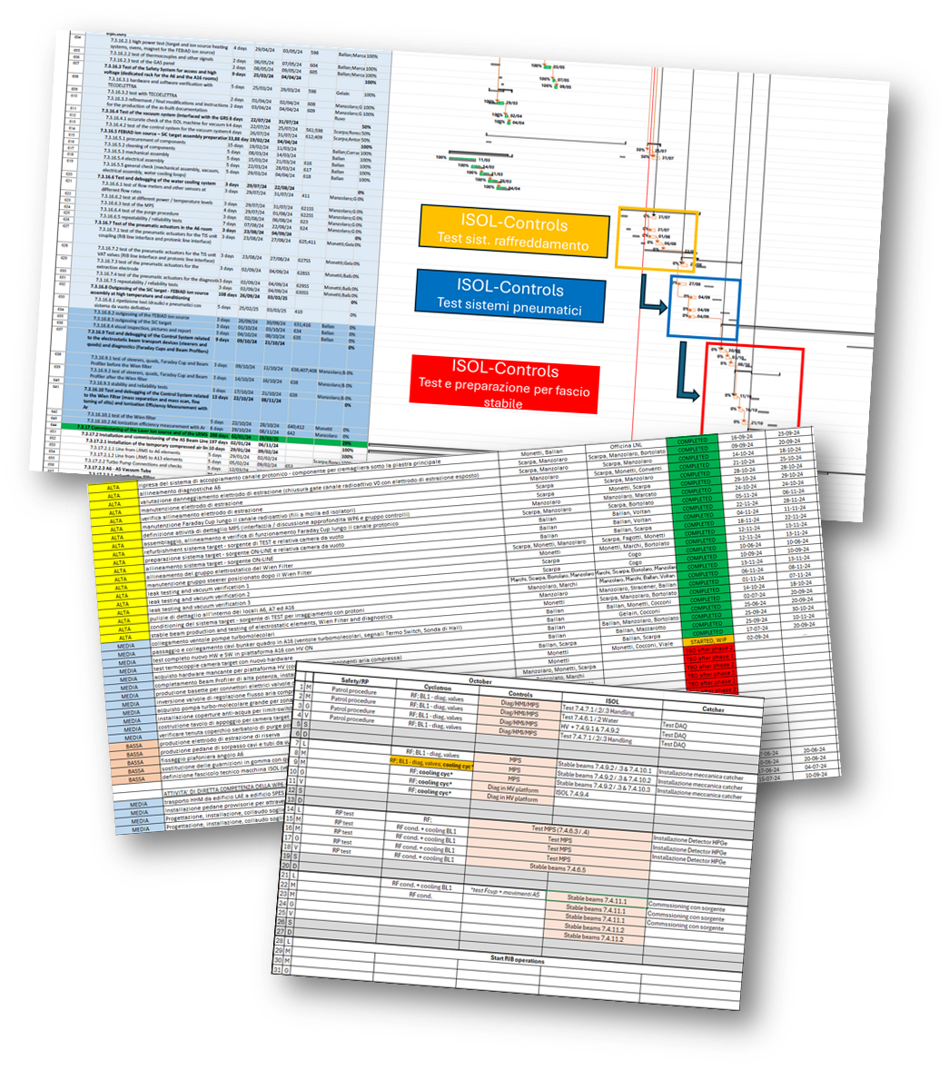

Driving SPES to completion…
- Mitigation of limited human resources : A phased approach
- Detailed planning of the implementation of each phase
- Daily short (10mn) briefing of the planned work
- A weekly follow-up meeting with the Director

Slide 9
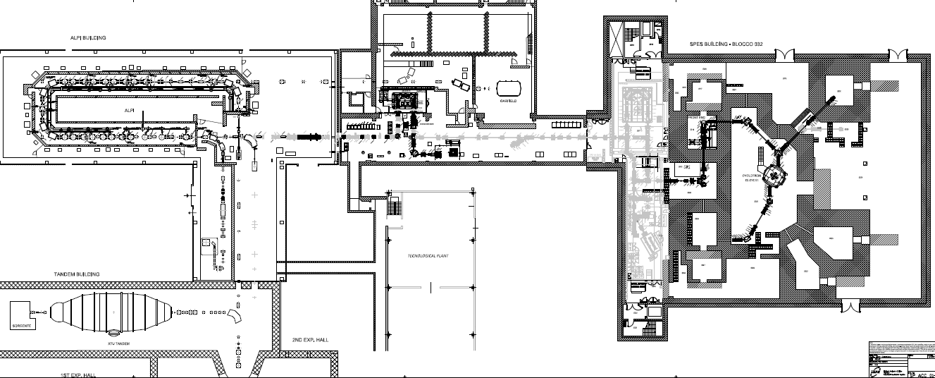
SPES : New Phased Approach
Phase 4
SPES Radioisotope production
Phase3
SPES
Accelerated RIB
Phase2
SPES
LERIB
Phase5
SPES
RIB selection
Phase1
SPES
Driver
9
9

Slide 10
Phase 1 completed with beam delivered for experiment (May 2024)
10
10

Slide 11
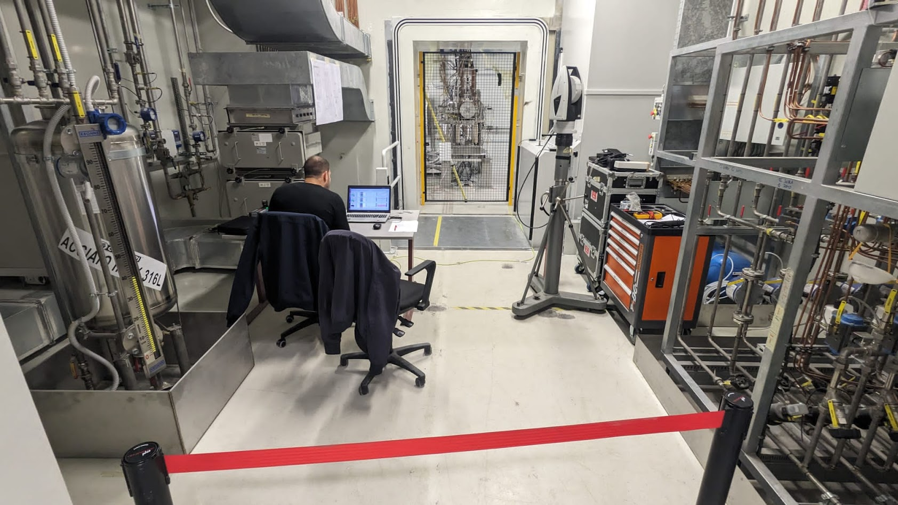
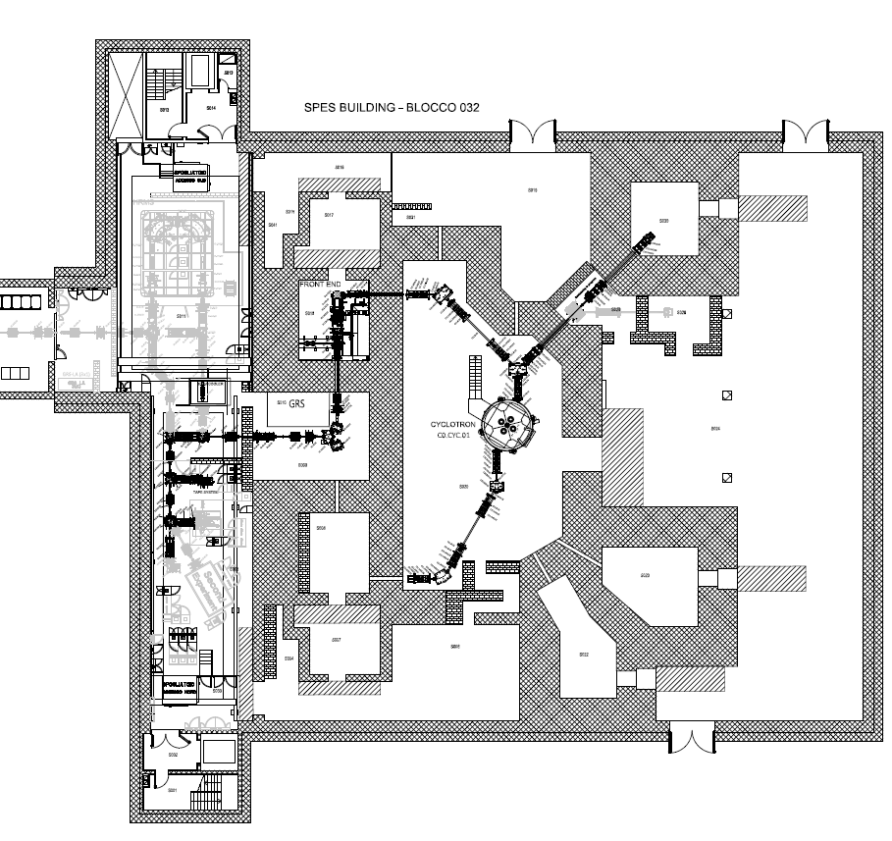
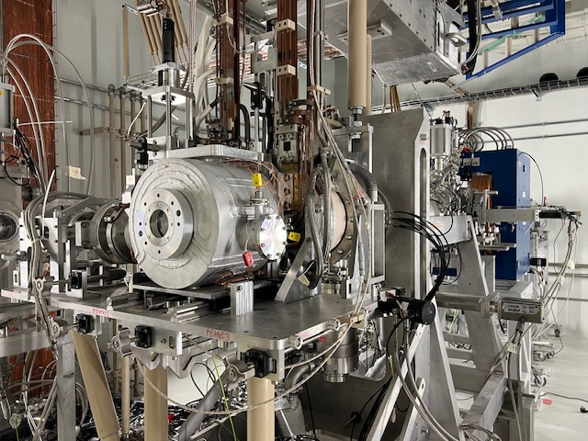
Phase 2:
ISOL Target Ion-Source and Production Vault completed and commissioned :
First SPES Radioactive ion beam produced (November 2024)
Phase 2
TIS
11
11

Slide 12

Summary of SPES project status and future plans
- Phase1: operation of the SPES cyclotron and first experiment May 2024
- Phase2: Commissioning of the ISOL Low-Energy Radioactive Ion Beams: November 2024
- Phase3: Complete the ADIGE new injector and RFQ for ALPI (SPES post-accelerator): end 2025/early 2026
- Phase4: Radioisotope production facility: mid 2027
- Phase 5:Commissioning of post-accelerated Radioactive Ion Beams: mid 2027
Phase 4
SPES RadioIsotope production
Phase2
SPES
LERIB
Phase1
SPES
cyclotron
Phase3
SPES
injector (ADIGE)
Phase5
SPES
RIB selection/
transport

Slide 13
LNL-INFN Strategy and priorities
Deliver all the projects that has been started these last few years such as the New Data Center (CED)
Deliver our contribution to all international and national accelerator projects (ESS, IFMIF, ANTHEM, etc..)

Slide 14
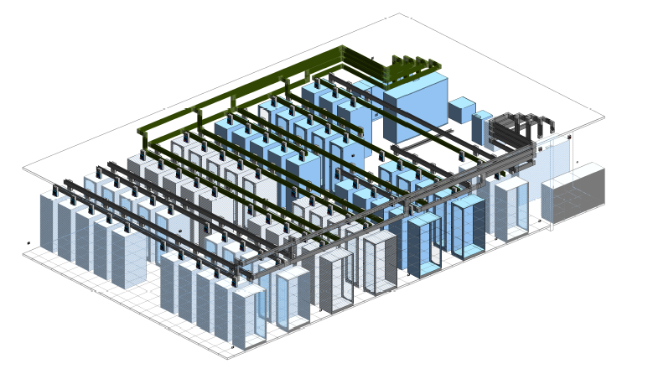
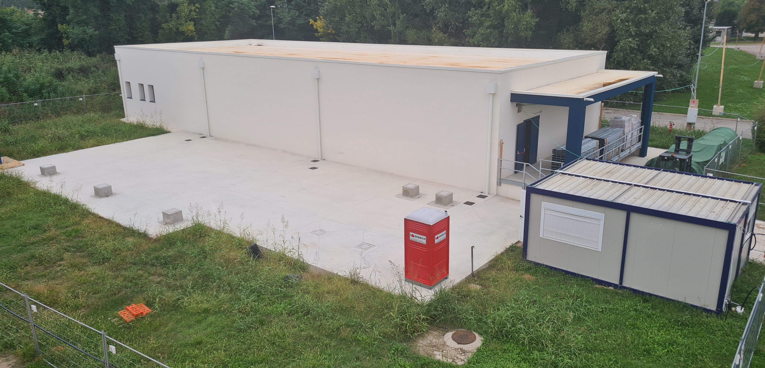
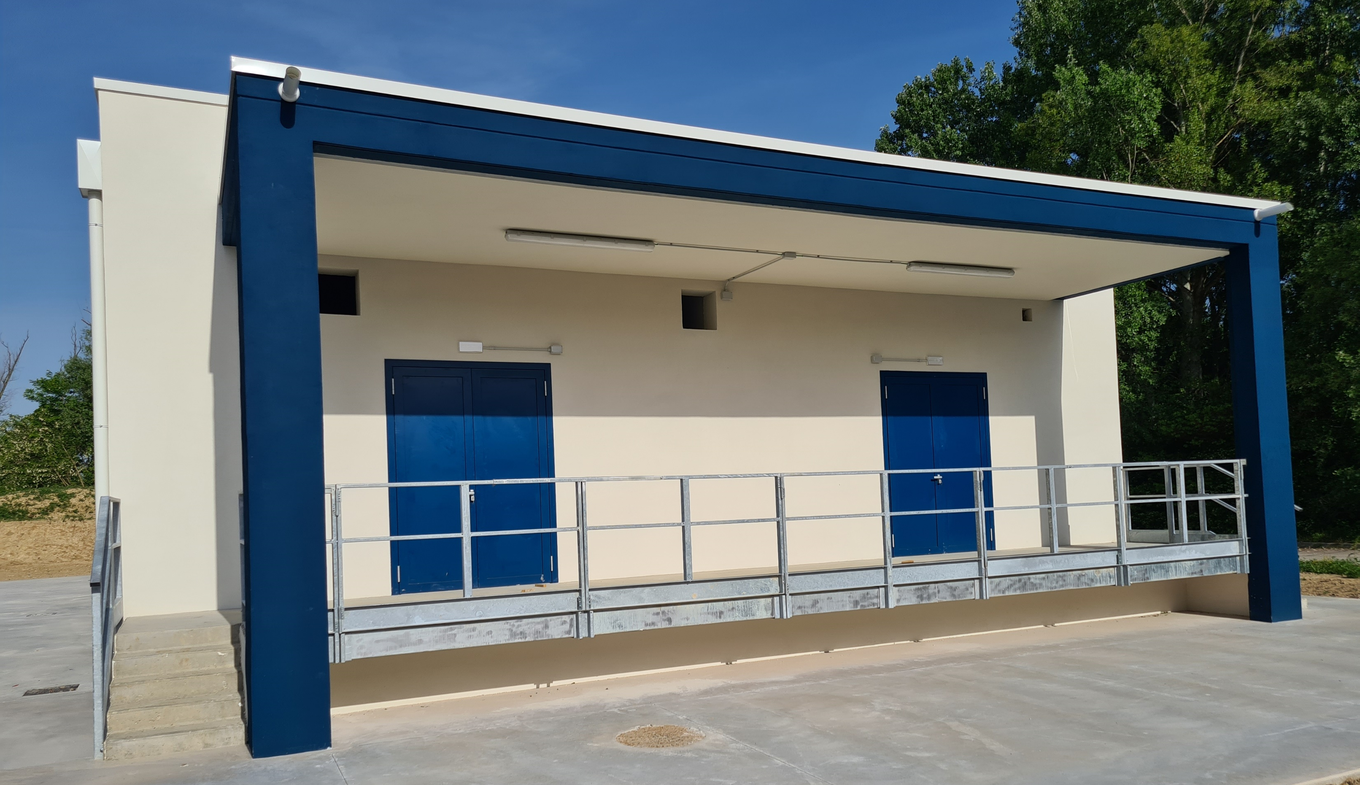
The New Data Center (CED)
Fase 01
Fase 02
Fase 01 - Programma Nazionale per la Ricerca (PNR)
500 kW power supply
10 server rack, 180 kW
1 Chiller
Fase 02 – PNRR (High Performance Computing, Big Data and Quantum Computing)
10 server rack 180 kW
1 Chiller
Building construction completed March 2024
DATA CENTER – Technological plants (phase1 and 2) : April 2025
DATA CENTER – fase 1 + 2 CPU and Storage installation: October 2025

Slide 15
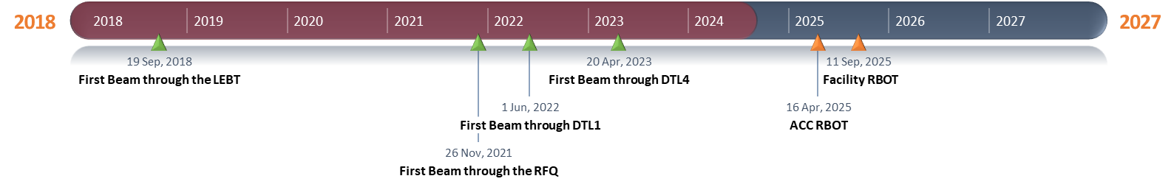
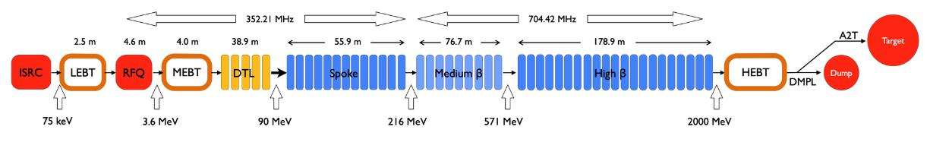
Now ongoing
DTL5 and ScLinac under RF conditioning to be prepared for Beam commissioning from 74MeV to 890 MeV
Beam commissioning done up to DTL4 (74 MeV)
INFN-LNS
CEA
ESS
Bilbao
INFN-LNL
Orsay
INFN-LASA
STFC
CEA (cryomodules)

Slide 16
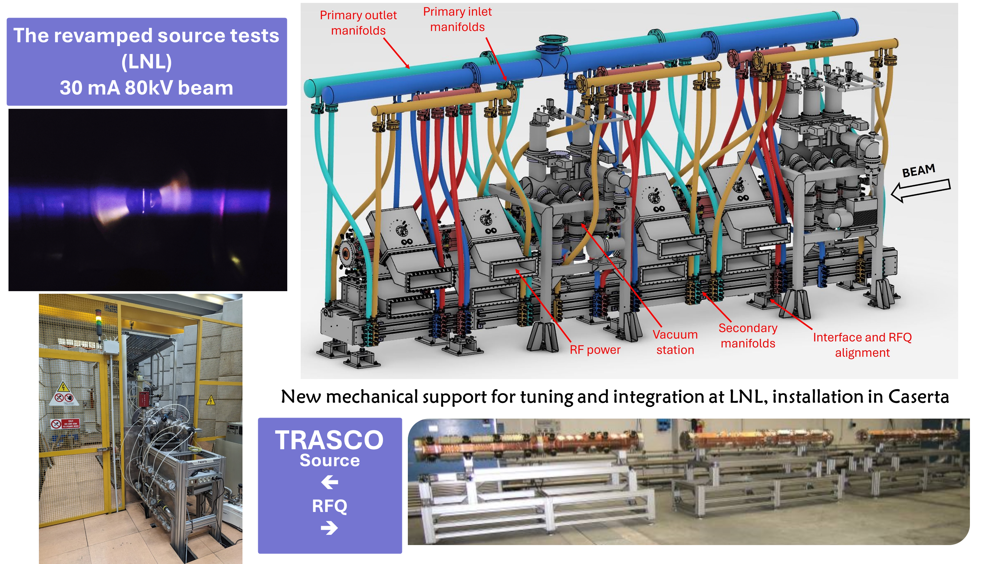
External projects – PNRR ANTHEM
ANTHEM PROJECT, CONSTRUCTION OF A RFQ DRIVEN BNCT NEUTRON SOURCE
The BNCT irradiation facility concept epithermal neutrons for deep tumors (like glioblastoma)

Slide 17
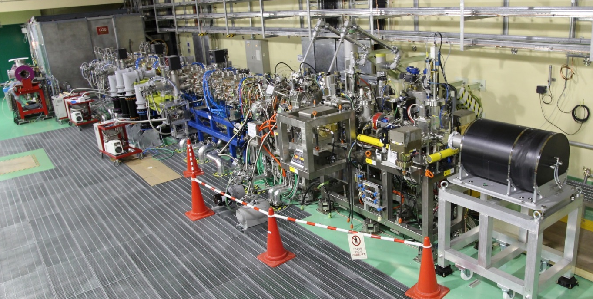
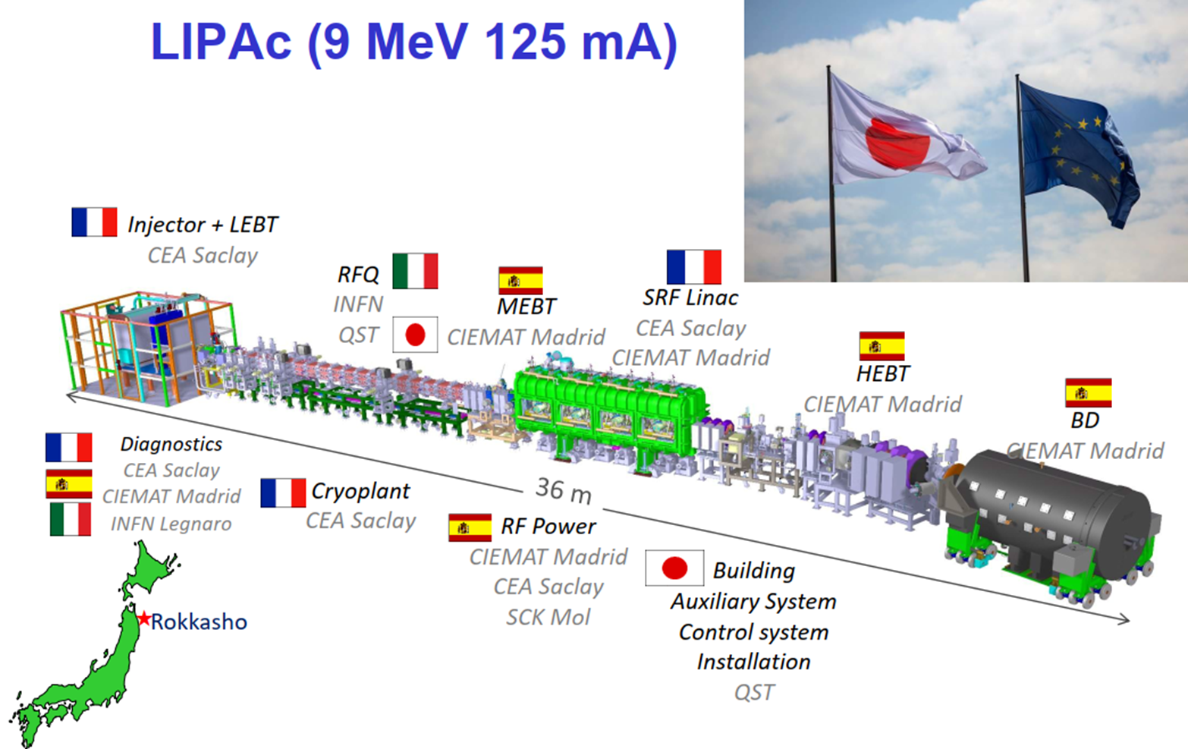
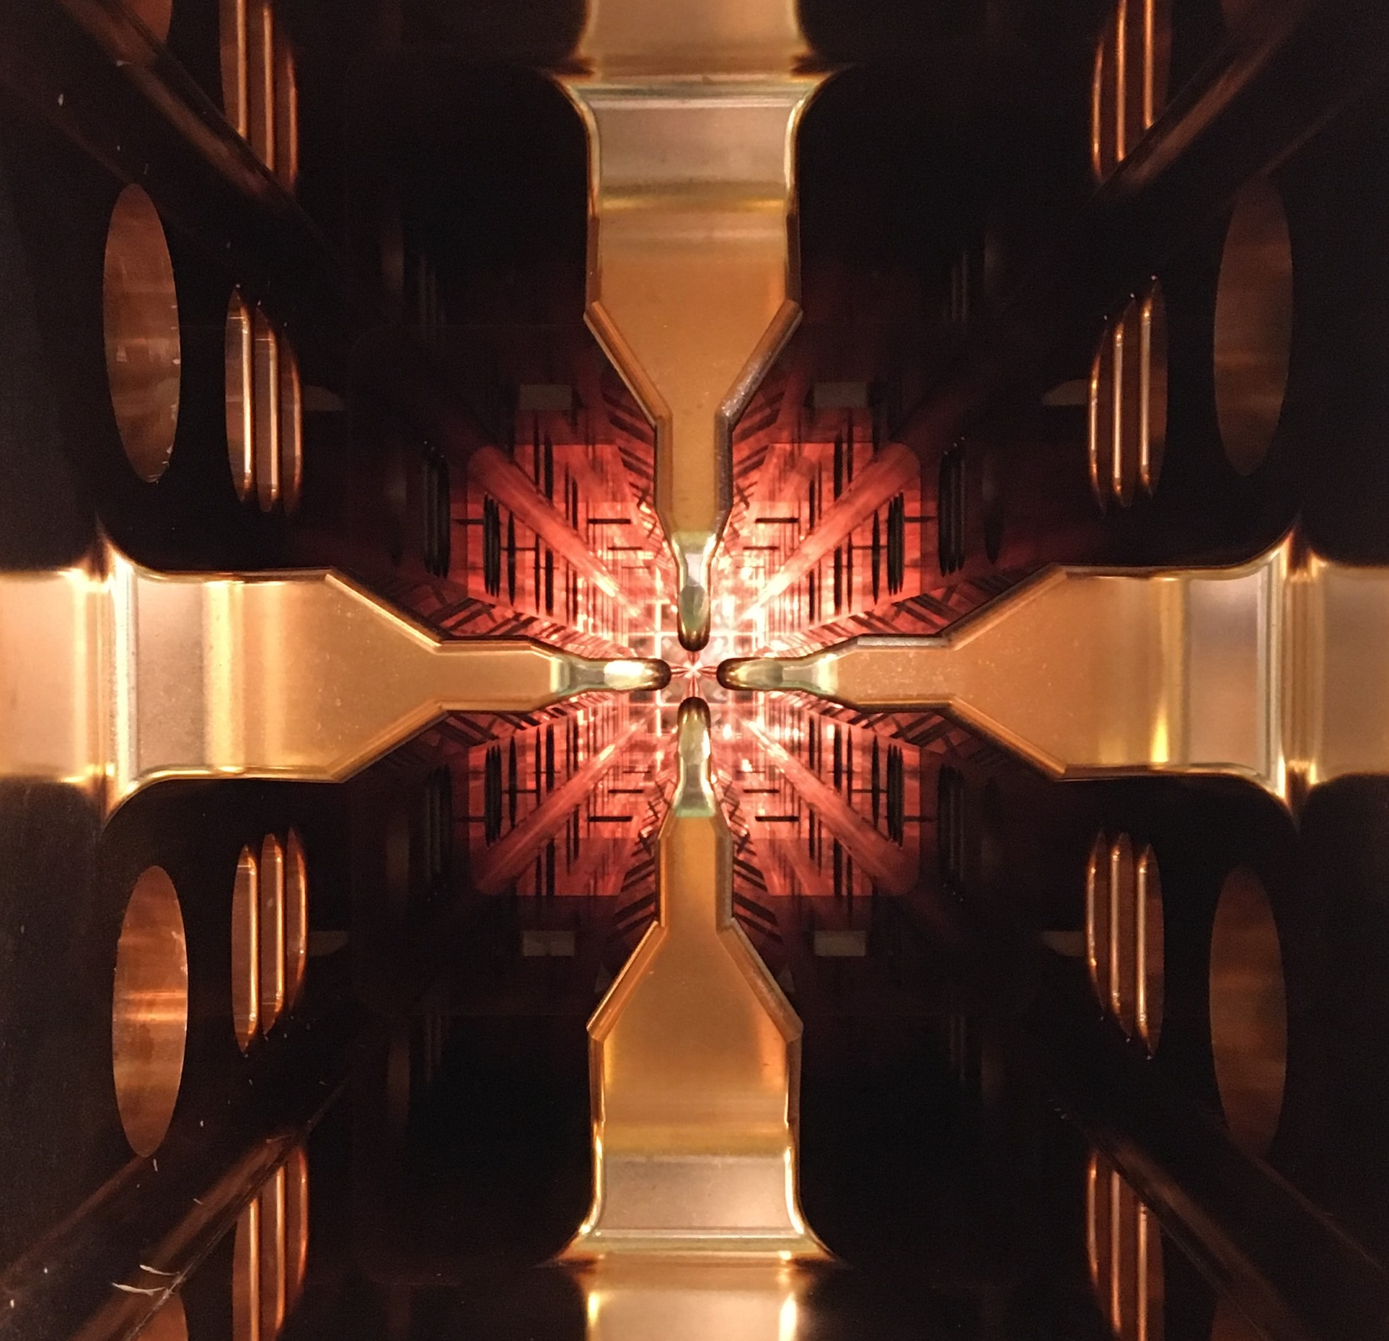
IFMIF-LIPAc RFQ
RFQ nominal beam parameters successfully reached in pulsed mode
RFQ conditioning reached 105 kV CW tested (80% nominal)
RFQ water frequency tuning loop tested

Slide 18
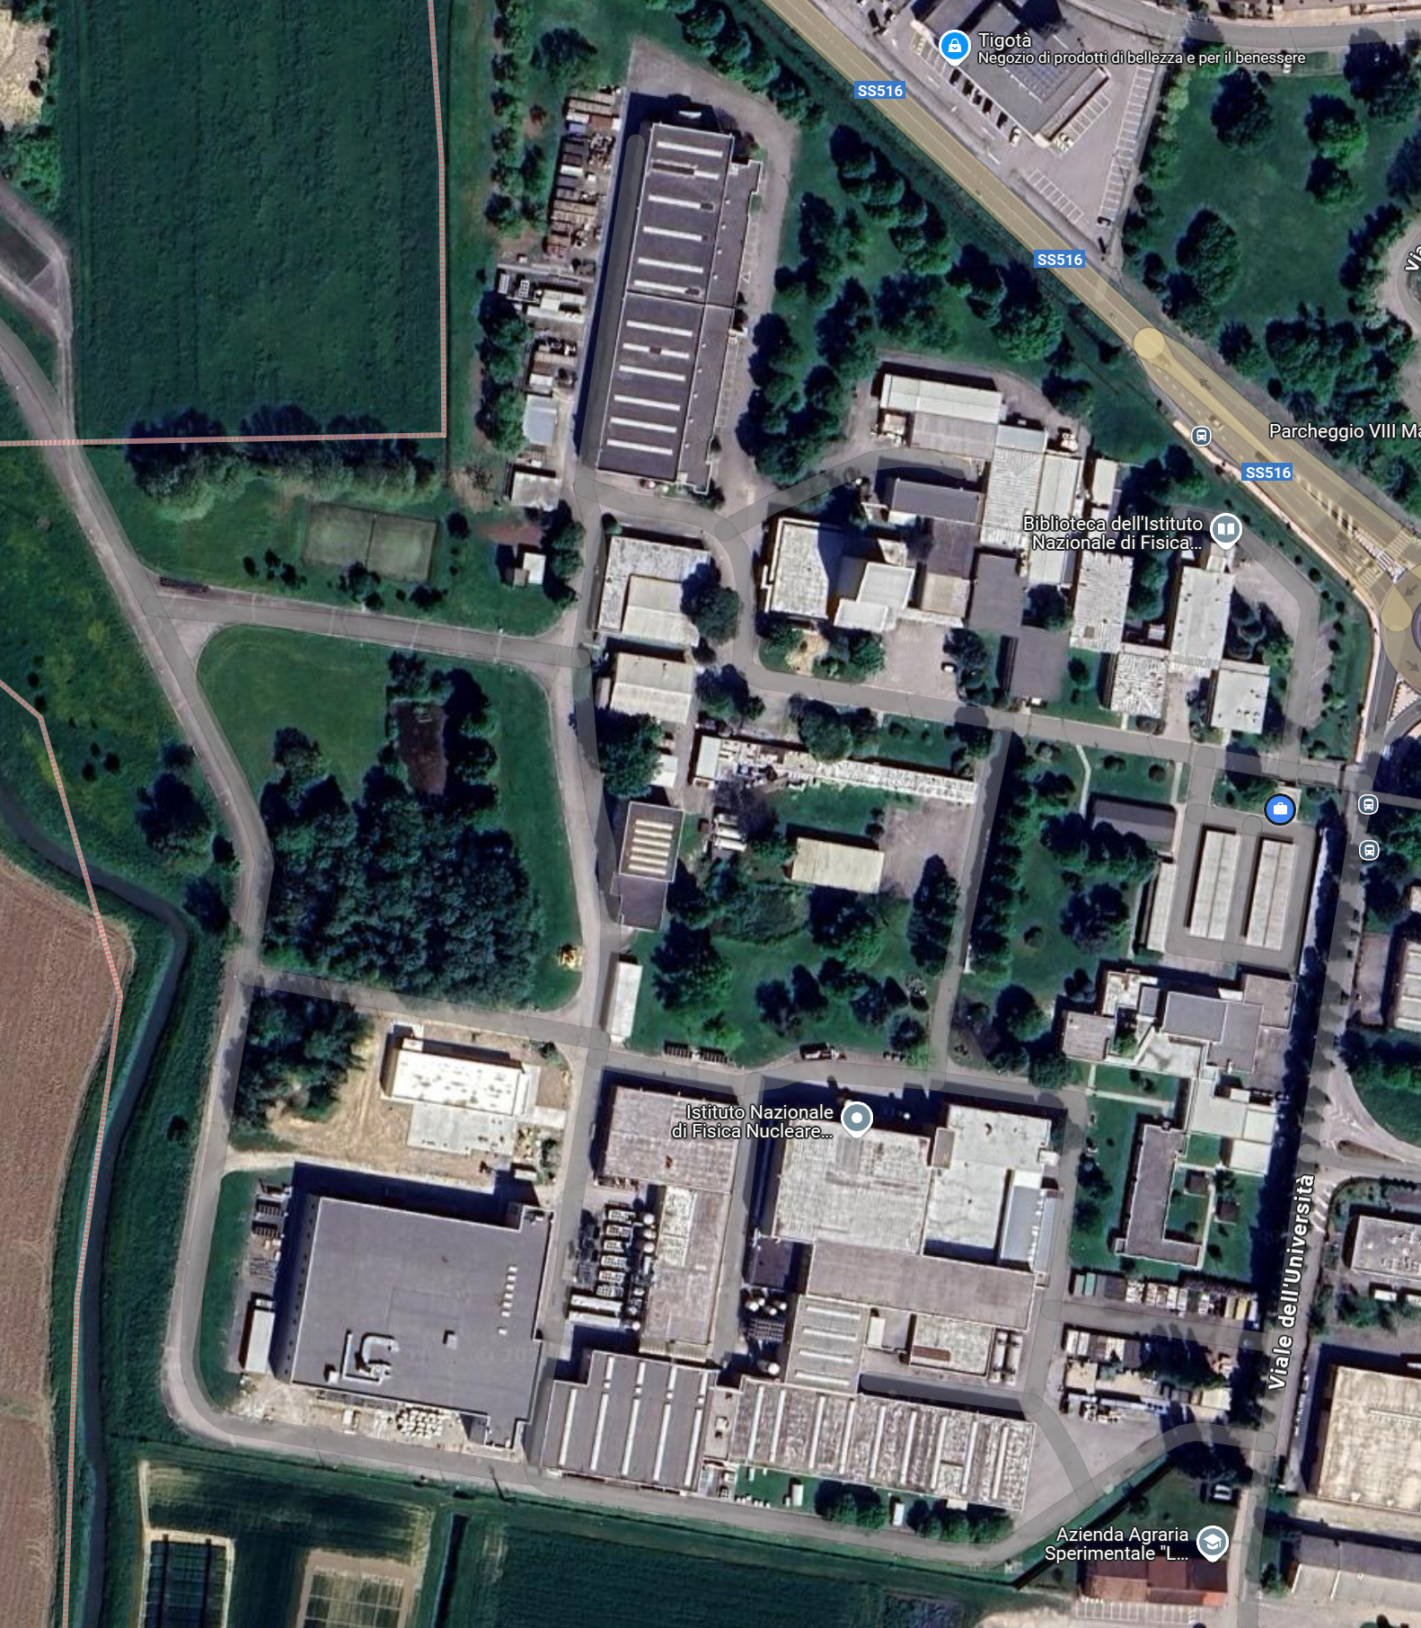
LNL-INFN Strategy and priorities
The ATIP (Accelerator Technology and Innovation Platform) project to start soon….
ATIP
CED
SPES

Slide 19
Enjoy the WS!

