Slide 1
WP6:Integration into Accelerator and Collider RIs Padova meeting, March 13, 2025
All information contained in this presentation and any accompanying documents is for iSAS project only, and must be treated as strictly confidential.
Any dissemination, distribution or other use of this information without the consent of its owner is prohibited.
Funded by the European Union. Views and opinions expressed are however those of the authors only and do not necessarily reflect those of the European Union or the European Commission. Neither the European Union nor the granting authority can be held responsible for them.

Slide 2
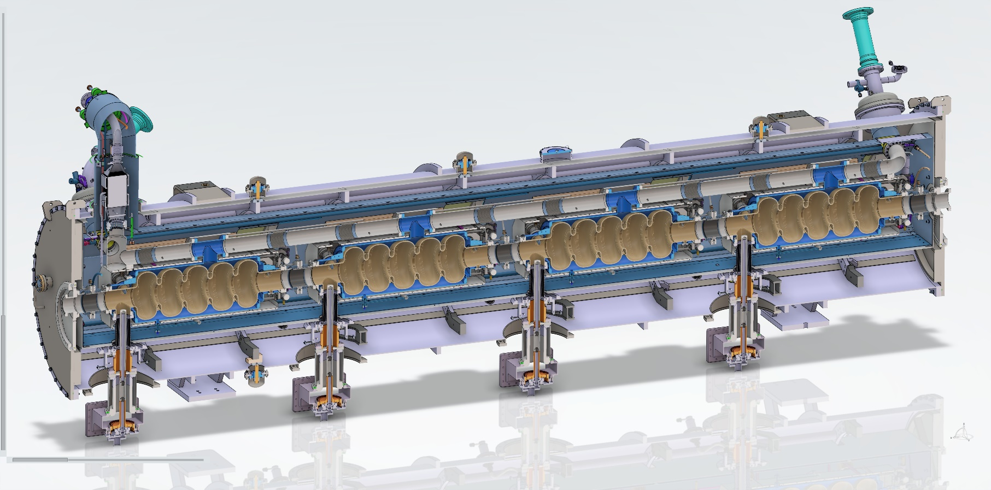
WP6: Integration into Acc&Collider RIs
Institutes participating: CNRS, CEA, ESS, INFN, Uni. Lancaster
Convener: G. Olry (CNRS/IJCLab)
Main contacts with other partners : A. Madur, deputy (CEA), N. Elias (ESS), D. Giove (INFN), G. Burt (UL) + in WP4: Y. Gomez Martinez (CNRS/LPSC) and V. Parma (CERN)
Main objective of the WP6: “while various RIs envisage upgrades, the objective is to expedite the technical integration of energy-saving technologies by retrofitting existing accelerating systems. A cryomodule will be adapted, ready to demonstrate energy recovery of high-power recirculating beams in the PERLE research facility, paving the way for high-energy, high-intensity electron beams with minimal energy consumption.”
Main people involved
CNRS: Guillaume Olry, Gilles Olivier, Sébastien Blivet, Patricia Duchesne, Patxi Duthil, Christophe Joly, Akira Miyazaki, Nicolas Gandolfo, Hervé Saugnac
CEA: Arnaud Madur, Fabien Eozénou
ESS: Nuno Elias, Paolo Pierini, Cecilia Maiano, Henry Przybilski, Marek Skiba,
INFN: Dario Giove, Maria Rosaria Masullo, Luigi Celona, Gino Sorbello, Paolo Spruzzola
Uni. Lancaster: Graeme Burt
Design in progress of the
iSAS-PERLE cryomodule design
c/o S.Blivet

Slide 3
WP6: Integration into Acc&Collider RIs
Institutes participating: CNRS, CEA, ESS, INFN, Uni. Lancaster
Convener: G. Olry (CNRS/IJCLab)
Main contacts with other partners : A. Madur, deputy (CEA), N. Elias (ESS), D. Giove (INFN), G. Burt (UL) + in WP4: Y. Gomez Martinez (CNRS/LPSC) and V. Parma (CERN)
Task 6.1 (CNRS): Coordination – M1-M48
• General coordination in collaboration with WP4 on HOM and RF couplers and WP1 on FE-FRT development.
Task 6.2 (UL, CNRS): Retrofitting Fast Reactive Tuners into existing cryomodules HL-LHC oriented – M1-M24
• Investigate if the existing cavity end group can be used with an FE-FRT by combining the FE-FRT and a HOM coupler into a single device.
Task 6.3 (CNRS, CEA, ESS): Adapt the existing ESS cryomodule – M1-M18
• Adaptation of the existing ESS cryomodule into a new configuration which will integrate a completely new cavity string equipped with the optimized HOM and FPC couplers developed in WP4
Task 6.4 (INFN, CNRS, ESS, UL): Fabrication and validation of cryomodule components – M1-M30
• Fabrication, preparation and test of the critical components (SRF cavity, tuning systems, HOM couplers, ...)
Task 6.5 (CEA CNRS, ESS): Assembly and test of adapted cryomodule – M30-M48
• Assembly and cryogenic & RF test of the cryomodule.

Slide 4
WP6 : status/evolution of Task 6.1 – general coordination
Done
5 meetings. Only 2 in 2024...but now it is more regular. Meeting is planned the 1st Wednesday on each month.
Several joint meetings with mostly WP4 and also WP5.
Data repository: documents shared on a box (IJCLAB).
On-going:
Discussion just started with WP4 on PostDoc position (initially for HOM couplers dvpt but may be reallocated to absorbers studies in WP6).
Short term (before summer 2025):
Technical review on HOM and FPC integration into the adapted cryomodule

Slide 5
WP6 : status/evolution of Task 6.2 – retrofitting FRT
Past developments
…
Current developments
…
See Axel’s presentation (WP1)

Slide 6
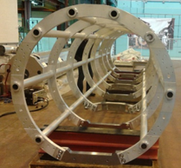
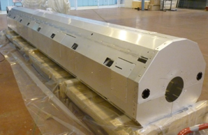
WP6 : status/evolution of Task 6.3 – adapt the existing cryomodule
Main objectives:
Design & Integration of a new cavity string (option to be studied: composed of cold beam line absorbers)
Design & Integration of 2 new magnetic shields
Design & integration of a new cryogenic circuit for CW operation (not pulsed as ESS)
Main constraints:
Cavity design compatible with vertical cryostat environment at INFN Milan
Cryogenic circuit and RF interfaces compatible with ESS test stand environment and PERLE cryogenic infrastructure at Orsay
Vacuum vessel
Exiting ESS cryomodule parts
Thermal Shield
Spaceframe
Past developments
5cell cavity: helium vessel design taking into account the inputs from WP4 (HOM couplers & FPC designs)
Mechanical integration of the HOM & FPCs, Cold tuning Systems and (possible) BLAs
Warm + Cold magnetic shields design
Current developments
Cold BLAs: thermal calculations
Cryogenic circuit design
Cryomodule Process and Instrumentation Diagram (PID) update (based on ESS one)

Slide 7
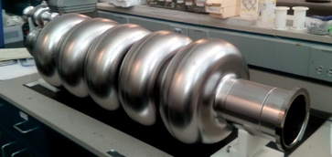
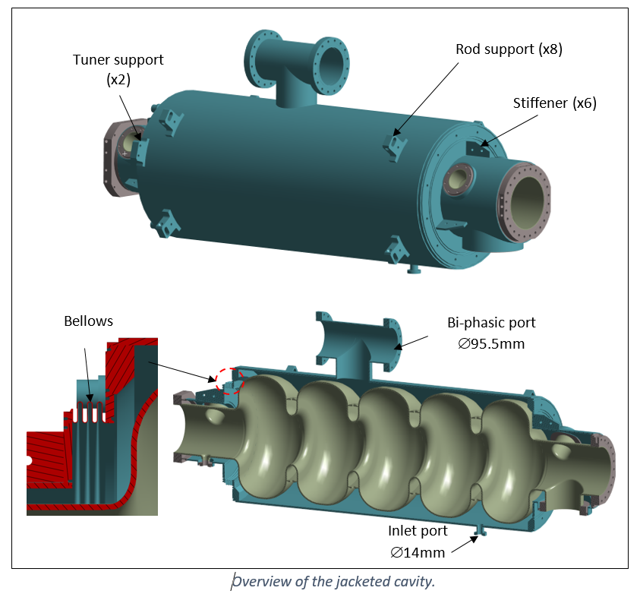
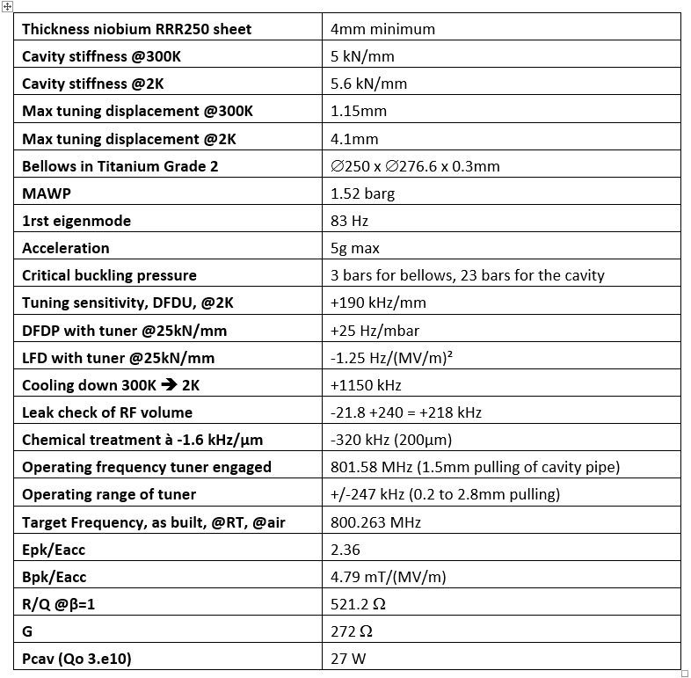
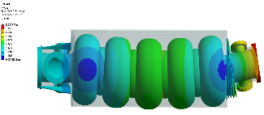
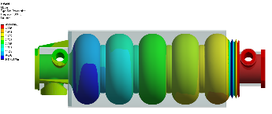
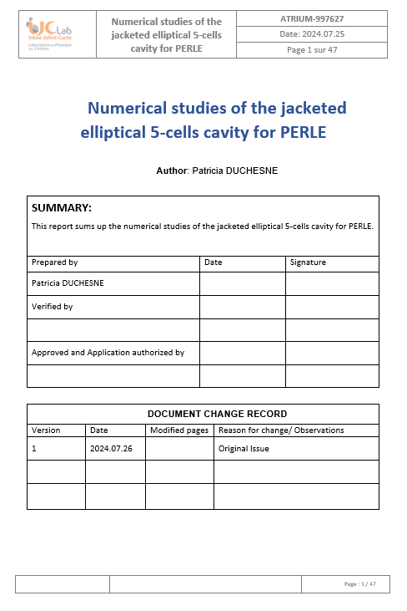
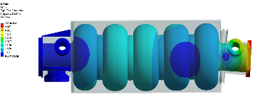
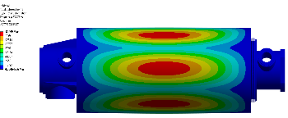
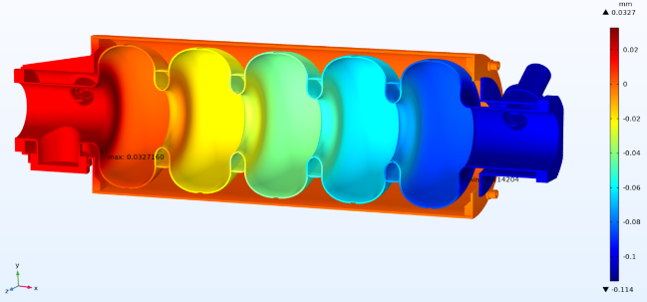
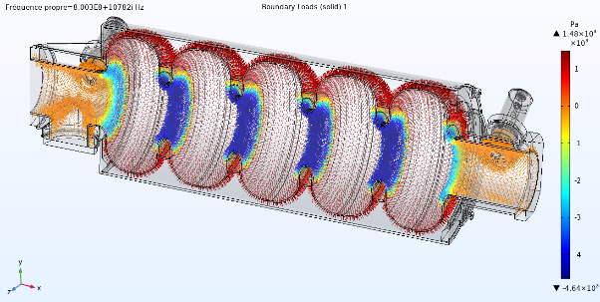
WP6 : status/evolution of Task 6.3 – adapt the existing cryomodule
5cell cavity: helium vessel design taking into account the inputs from WP4 (HOM couplers & FPC designs). Mechanical and thermal calculations
Baseline: 800MHz, 5cell JLAB RF design
Parameters of the 5cell cavity
Modal analysis
c/o P.Duchesne
Stress analysis
cavity under vacuum @RT
Lorentz force detuning
Static results

Slide 8
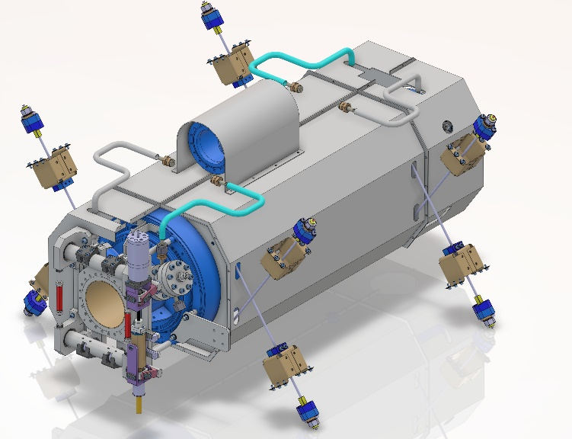
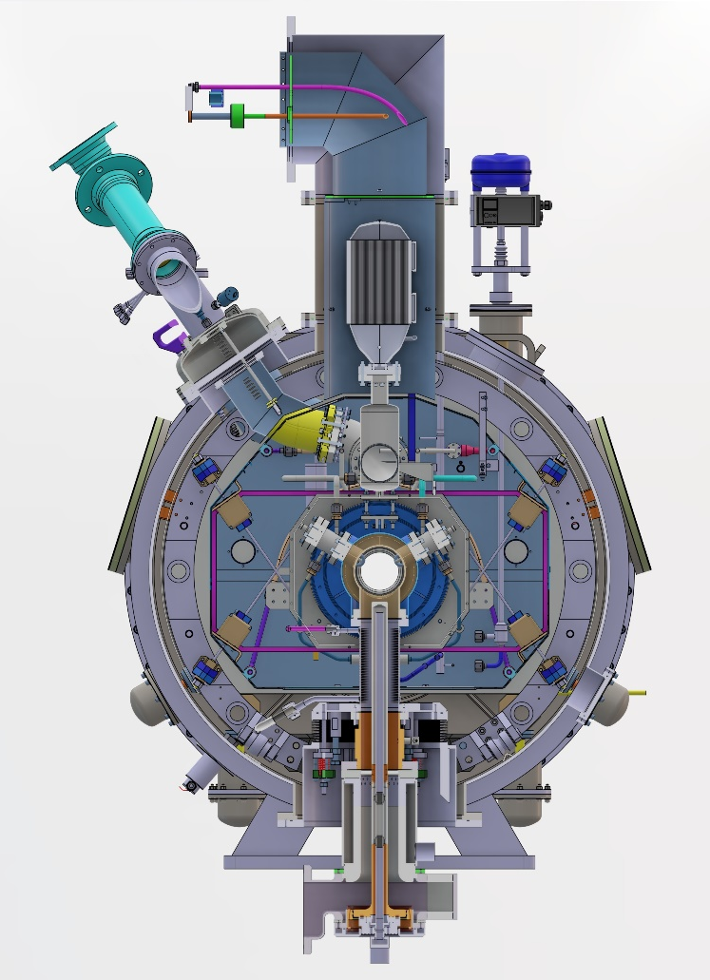
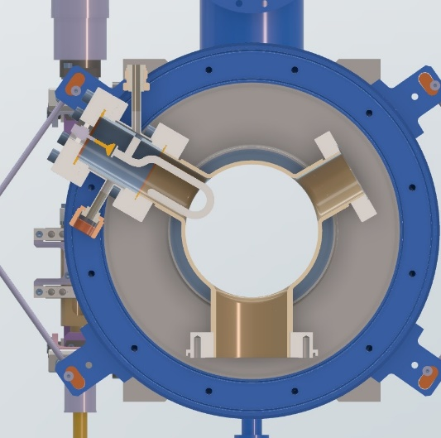
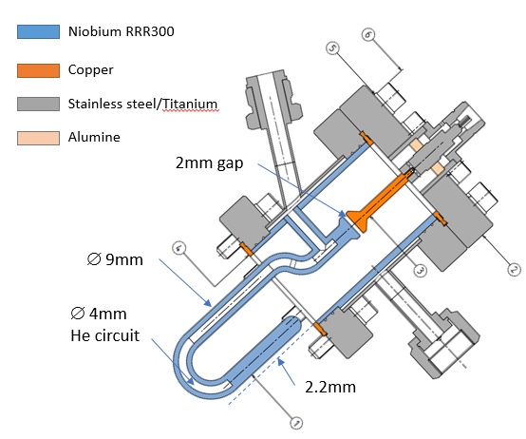
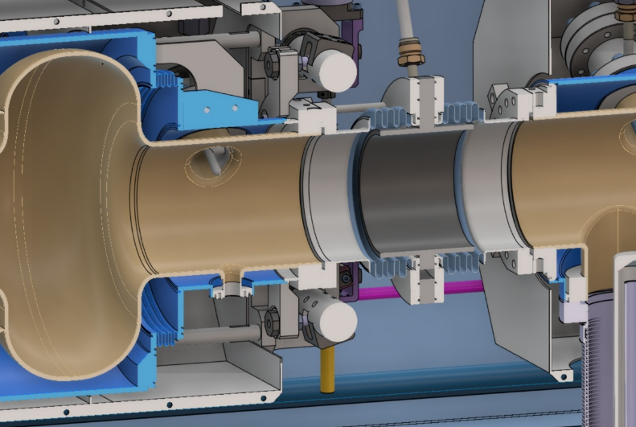
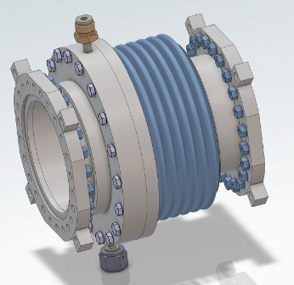
WP6 : status/evolution of Task 6.3 – adapt the existing cryomodule
Mechanical integration of the HOM & FPCs, Cold Tuning Systems and (possible) BLAs
Tuning system integration
FPC integration
HOM integration
c/o S.Blivet
BLA integration
c/o P.Duchesne
c/o S.Blivet
c/o S.Blivet

Slide 9
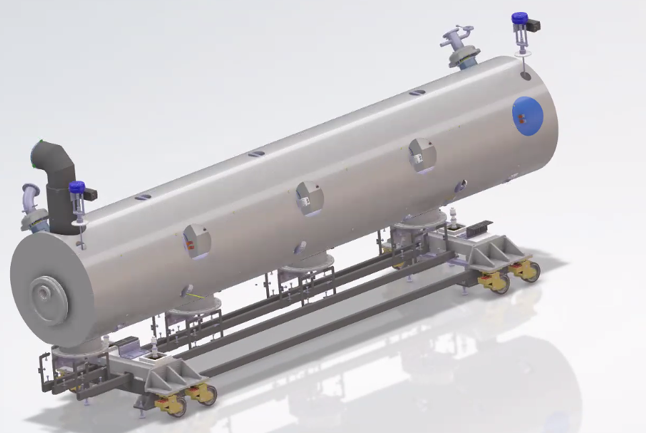
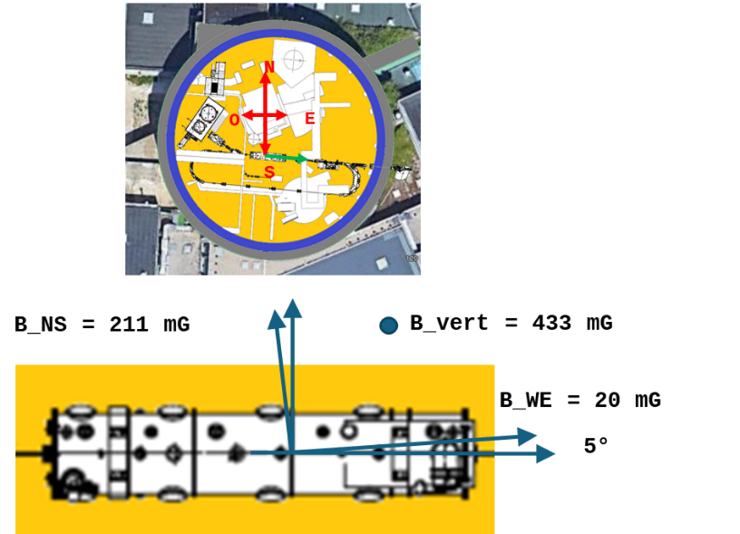
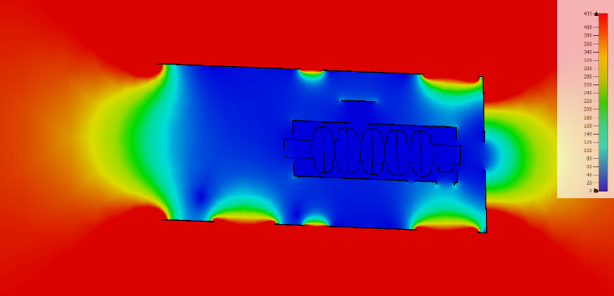
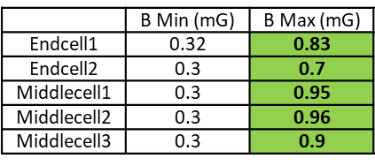
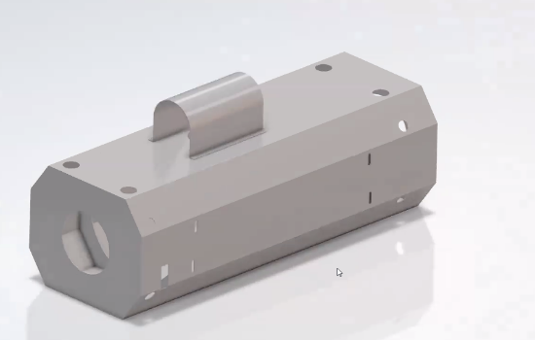
WP6 : status/evolution of Task 6.3 – adapt the existing cryomodule
Warm + Cold magnetic shields design
Goal: residual B field < 1mG at the cavity surfaces (due to high sensitivity to trapped flux after mid-T bake). No fast cool-down planned for effective magnetic flux expulsion.
Baseline: A double magnetic shield composed of a 2mm thick µ metal + a 2mm thick Cryophy around the cavities
Cryomodule@Orsay
Shielding calculation
Mu metal @ ~300K
(spaceframe Temp)
c/o P.Duchesne
c/o P.Duchesne
With µ=30000
Cryophy @ 2K
c/o P.Duchesne

Slide 10
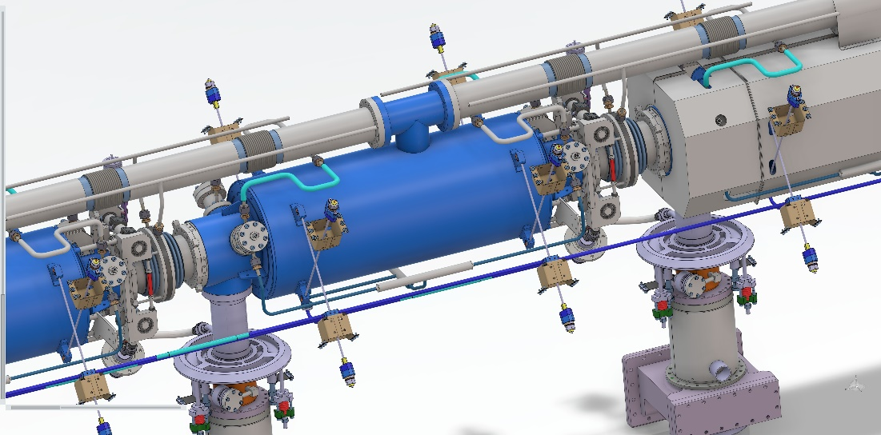
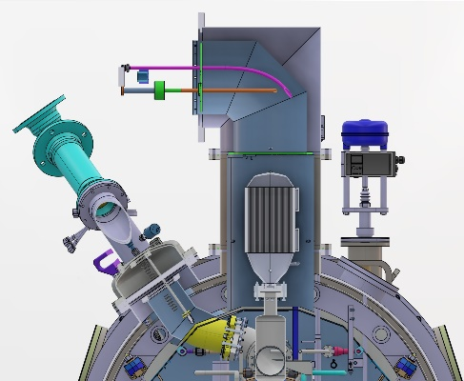
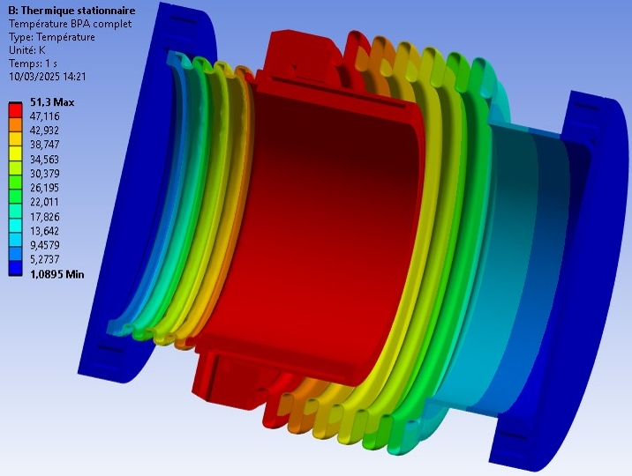
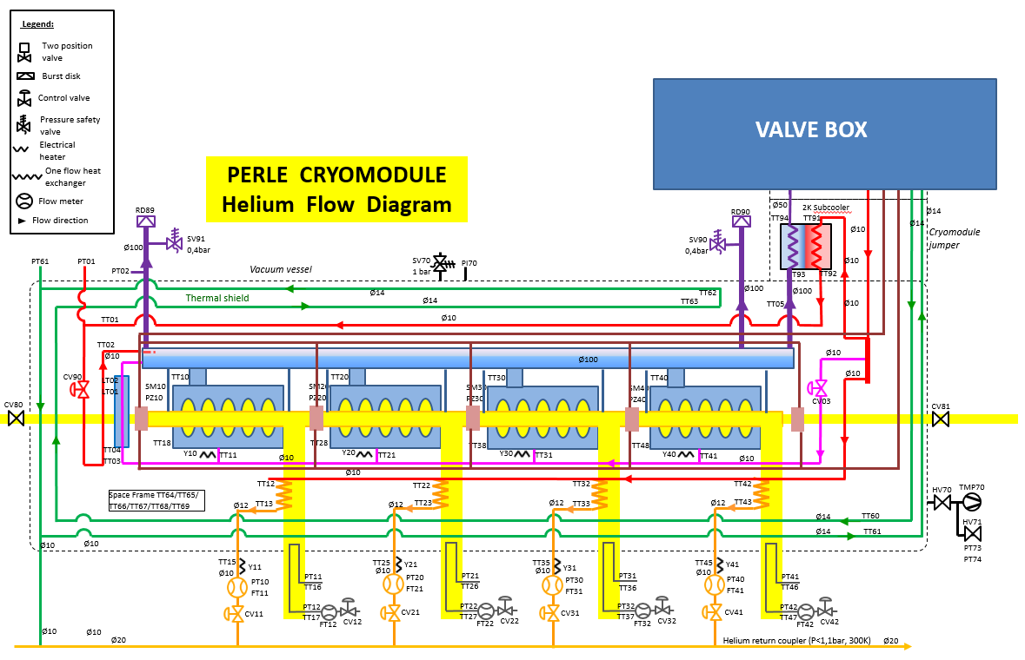
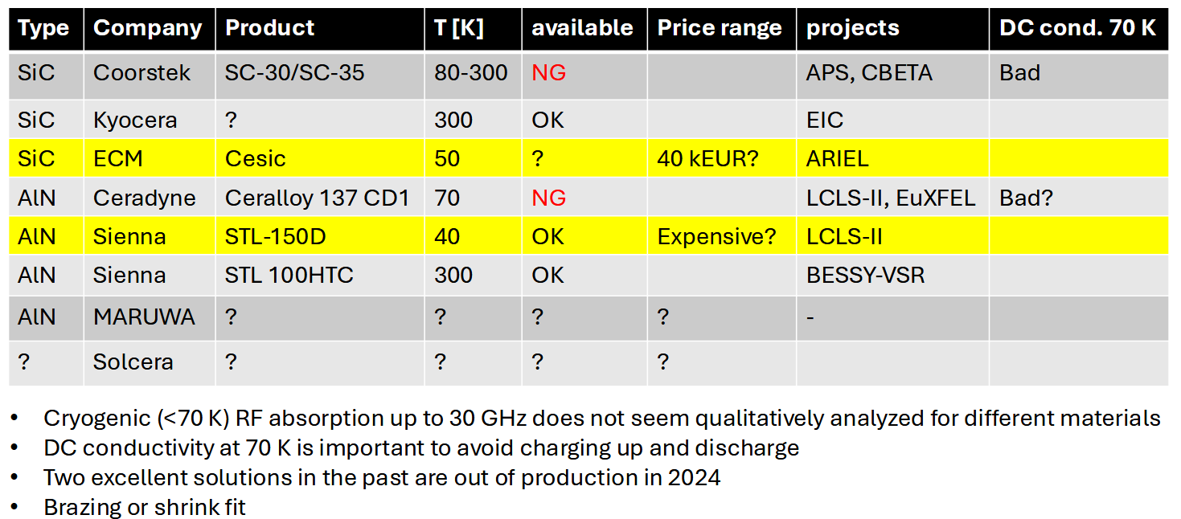
WP6 : status/evolution of Task 6.3 – adapt the existing cryomodule
Cold BLAs: thermal calculations
Preliminary results with 50K cooling
Pabsorber→cavity ~1W
Cryogenic circuit & PID
c/o S.Blivet
Jumper connexion
c/o G.Olivier
Preliminary PID
With a dedicated circuit for BLAs
c/o A.Miyazaki
c/o G.Olivier

Slide 11
WP6 : status/evolution of Task 6.4 – Fabrication & validation of cryomodule components
Past developments
Procurement of the Niobium material done: waiting for the delivery end of March (Supplier is Tokyodenkai).
5-cell cavities procurement: call for tender published end 2024 and offers received in Dec, 19. Because of technical changes (on helium vessel, HOM flanges, recipe for the preparation) the specifications must be modified → new call for tender in April.
Current developments
5-cell cavities procurement: preparation of the new technical specifications
Magnetic shields: discussions on cost estimate and feasibility will start next week.

Slide 12
WP6 : status/evolution of Task 6.5 – assembly and test of the cryomodule
Clean room assembly and cryostating phase.
Not started yet. Task 6.3 needs to be more advanced.
Preparation of the test stand @ Lund.
Not started yet.
Cryogenic and RF test of the cryomodule.
Not started but first thoughts on cryogenic distribution. Example: heat exchanger located in the CM is not compatible with the PERLE Cryo distribution (2K produced in the 2K box) but mandatory for the test @ Lund. Heat Exchanger must be removed when the CM goes back to IJCLAB.

Slide 13
WP6: points of attention
Fabrication of 5-cell cavities almost already on critical path → Purchase before the summer is planned, so as not to overly impact the schedule
Linked to WP4 activity:
Follow the HOM couplers & FPC developments and fabrication
New opportunity with a PhD student with ACS (“CIFRE thesis”) who will start the studies on (warm &) cold absorbers, possibly with the postdoc originally planned to work on HOM couplers (iSAS funding). It will be an asset to boost this topic.

Slide 14
WP6: plans to achieve milestones & deliverables
Milestones
Due date
M6.1
August 2025
M6.2
April 2026
M6.3
January 2027
Deliverables
D6.1
Feb 2026
D6.2
Feb 2028
Plans to achieve milestones & deliverables
5-cell cavity fabrication to be follow-up with care in order not to add additional delay
M6.3

Slide 15
WP6: financial status
Financial status
Material
iSAS Funds engaged by CNRS: purchasing of the Niobium material for 5cell cavities (“few” hundreds of k€)
iSAS + matching funds to be engaged in 2025 by CNRS: purchasing of the 5cell cavities + (if possible) magnetic shields.
Human resources
No staff hired with iSAS funds in WP6
Deviations
No

