Slide 1
PROJECT OVERVIEW & STATUS Achille Stocchi, Jorgen D’Hondt on behalf of the Coordination panel iSAS First Annual Meeting Legnaro National Laboratory March 13, 2025
Funded by the European Union. Views and opinions expressed are however those of the authors only and do not necessarily reflect those of the European Union or the European Commission. Neither the European Union nor the granting authority can be held responsible for them.
All information contained in this presentation and any accompanying documents is for iSAS project only, and must be treated as strictly confidential. Any dissemination, distribution or other use of this information without the consent of its owner is prohibited.

Slide 2
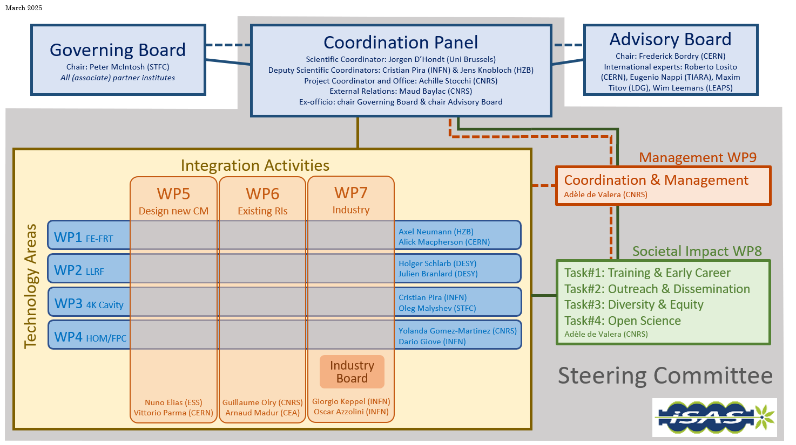
Instances (as formalised in the CA)
Governing Board & Advisory Board Chairs ex-officio members of Coordination panel to better communication between instances
Advisory Board reports back to the Coordination panel for yearly project meetings and upon ad hoc request in counsel
Coordination panel becomes Steering Committee every other meeting to allow for scientific cross-coordination between Coordination & WP Leaders as well as between WPs
Industry Board including WP Leaders to enable co-development

Slide 3
Governing Board
Beneficiaries: Peter McIntosh (Chairperson)
Jérôme Schwindling (CEA)
Vittorio Parma (CERN)
Achille Stocchi (CNRS)
Hans Weise (DESY)
Nuno Elias (ESS)
Jens Knobloch (HZB)
Attilio Sequi (INFN)
Michael Tytgat (VUB)
Associated partners: Oleg Malyshev (UKRI)
Graeme Burt (University of Lancaster)
Mike Seidel (EPFL)
Jorgen D'Hondt (Nikhef)
Tomas Junquera (ACS)
Birger Nordmann (Cryoelectra)
Alexei Kanareykin (Euclid Techlabs)
Filippo Casazza (Plasmatherm)
Alexander Navitski (Research Instruments)
Ambra Gresele (Zanon)
Coordination panel
Mandated: Achille Stocchi (Chairperson)
Jorgen D'Hondt (Scientific Coordinator)
Cristian Pira (Deputy Scientific Coordinator)
Jens Knobloch (Deputy Scientific Coordinator)
Maud Baylac (External Relations)
Peter McIntosh (Ex-officio)
Frederick Bordry (Ex-officio)
Steering committee
Mandated: Coordination panel (Ex-officio)
Axel Neumann & Alick MacPherson (WP1)
Julien Branlard & Christian Schmidt (WP2)
Cristian Pira & Oleg Malyshev (WP3)
Yolanda Gomez-Martinez & Dario Giove (WP4)
Nuno Elias & Vittorio Parma (WP5)
Guillaume Olry & Arnaud Madur (WP6)
Oscar Azzolini & Giorgio Keppel (WP7)
Adèle de Valera (WP8)
Adèle de Valera (WP9)
Advisory Board
Mandated: Frederick Bordry (Chairperson)
Roberto Losito (CERN)
Eugenio Nappi (TIARA)
Maxim Titov (LDG)
Wim Leemans (LEAPS)

Slide 4
FOCUS on Padova Industry Workshop
Friday March 14, 10:00-13:30 am CET
Industry Board Chair: Oscar Azzolini
INFN Technology Transfer speaker: Diego Tonini
Industry workshop speakers: Arthur Iziquel (Accelerators and Cryogenic Systems)
Alexei Kanareykin (Euclid Techlabs)
Alexander Navitski (Research Instruments)
Ambra Gresele (Zanon Research & Innovation)
Invited companies speakers: Massimo Rossi (DB Elettronica Telecomunicazioni)
Matteo Querini (Eurolls)
Giorgio Olivieri (Meltio 3D)
Stafano Franco (Novatech)
Marco Urbano (Strumenti Scientifici Cinel)

Slide 5
Digital spaces opened
iSAS Website to showcase the project to wider audiences
Can be found following this link
Where to announce job postings & new hires linked to iSAS, e.g. Lode Vanhecke on WP5 at EPFL
Project Indico page to meet
Can be found following this link
Where to find upcoming project meetings and presentations
Project data repository to share project documents
Can be found following this link
Where Conference Coordinator Nicholas Shipman collects conferences presentations & where to submit abstracts**
If you encounter any technical difficulties, please contact Joseph Diakun
**anyone who has given a talk please email Nick with the details

Slide 6
Consortium Agreement, shared NDA, amendment
Consortium Agreement (CA)
CA v2 sent by Julie Gendron-Brundu on March 7 for review before signature process
Comments expected until March 28
Shared NDA
For industrial partners, sent by Julie Gendron-Brundu on Feb 19, comments sent until Feb 26
Signatures phase has opened
Amendment (AMD) to the Grant Agreement - 1st trimester 2025 or 2nd trimester 2025
To welcome Nikhef to the project
To adjust to minor changes

Slide 7
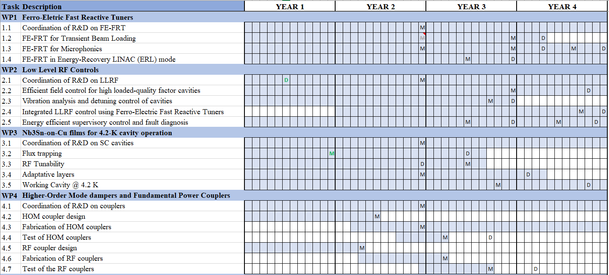

Slide 8
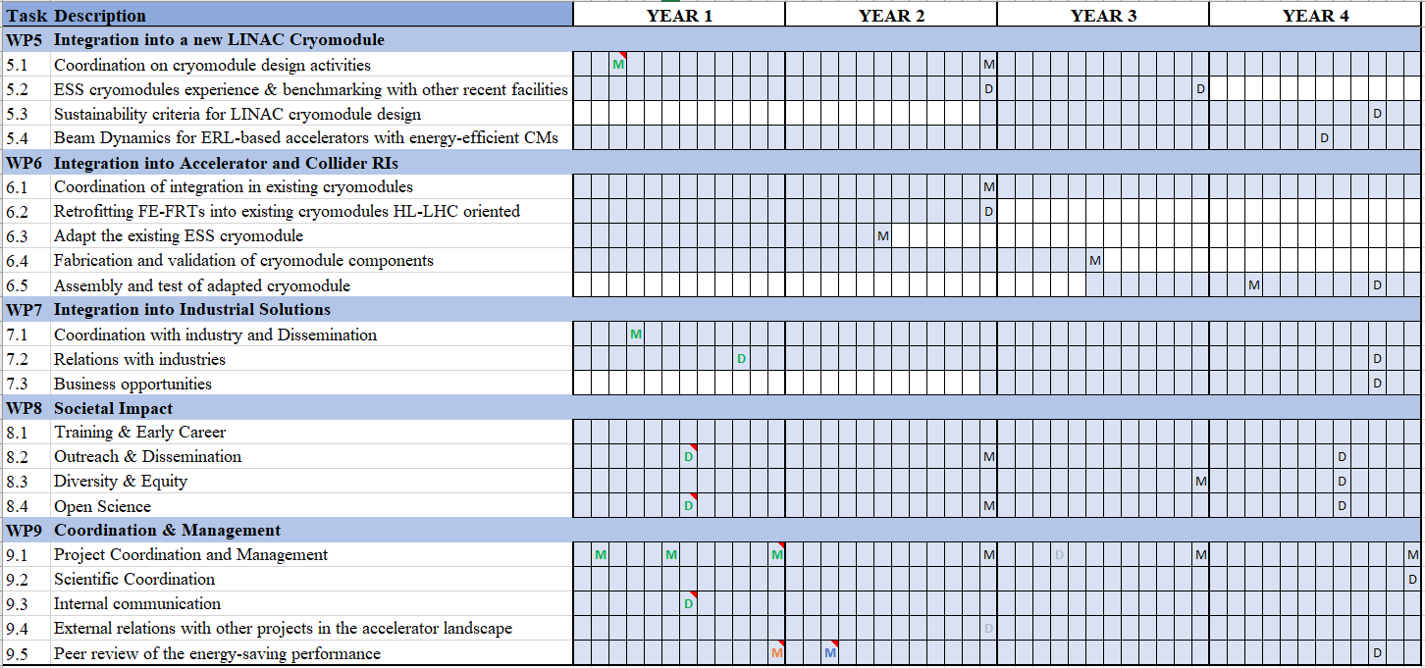

Slide 9
Work plan
Up to date with Milestones & Deliverables status by timeline for the 1st project year closed:

Slide 10
Work plan
Up to date with Milestones & Deliverables status by timeline for the 2nd project year opening up:

Slide 11
Work plan
Up to date with Milestones & Deliverables status by timeline for the 2nd project year opening up:
3 for WP4 & WP6 in project months 16-18, June-August 2025
17 in project month 24, Feb 2026, including 6 impact risk analyses for WP1-6, the update of D&E and DMP
End of the 1st reporting period (RP) M24: periodic report expected 60 days after end of RP

Slide 12
Thank you!

Slide 13
External relations
M. Baylac (CNRS-LPSC)

Slide 14
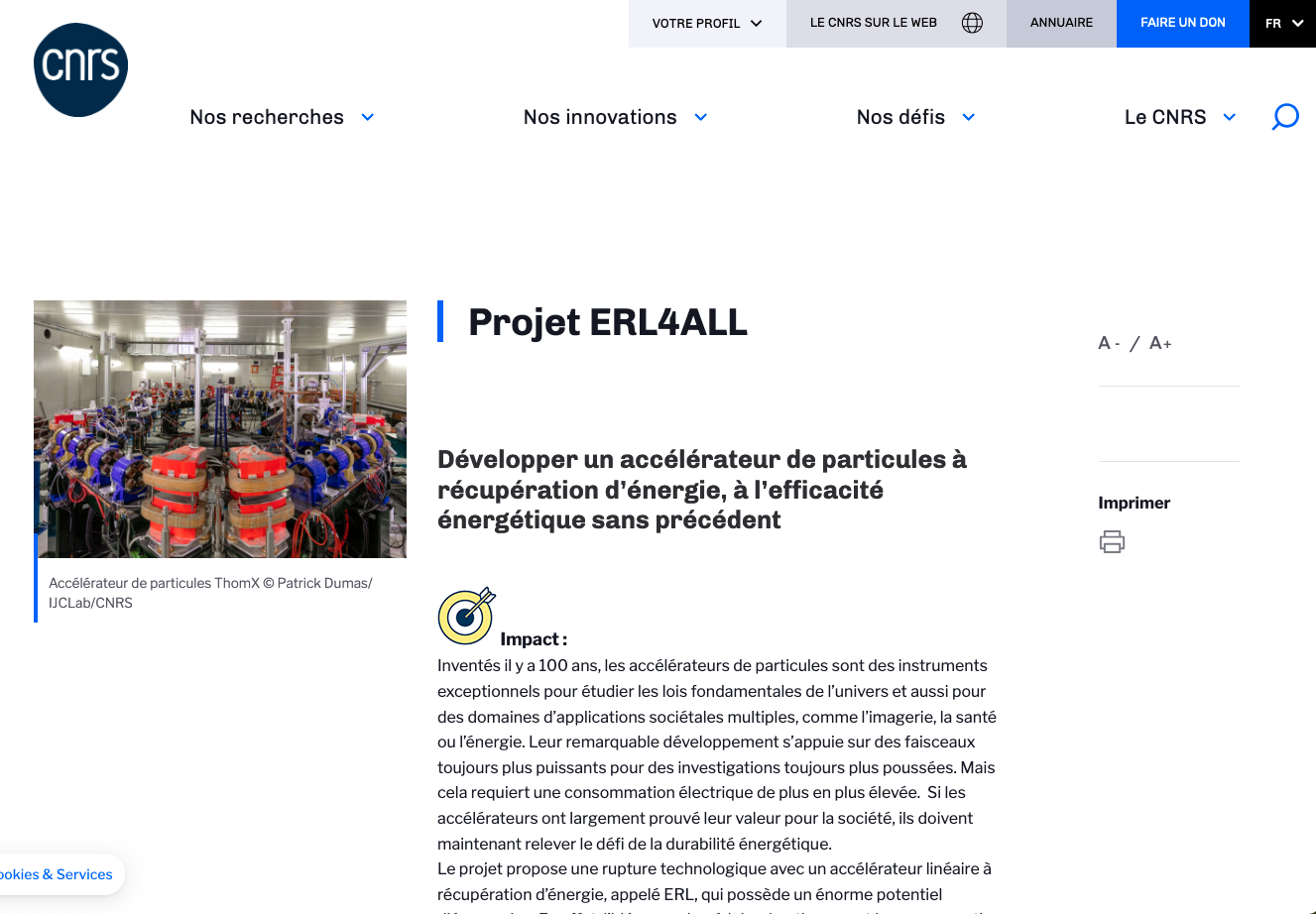
Relations at national level
New budget granted for the PERLE ERL
High risk and impact research program, funded by French ministry through research organization, including CNRS
12 projects within CNRS nationwide (2 within IN2P3)
Project ERL4ALL to finance the PERLE injector

Slide 15
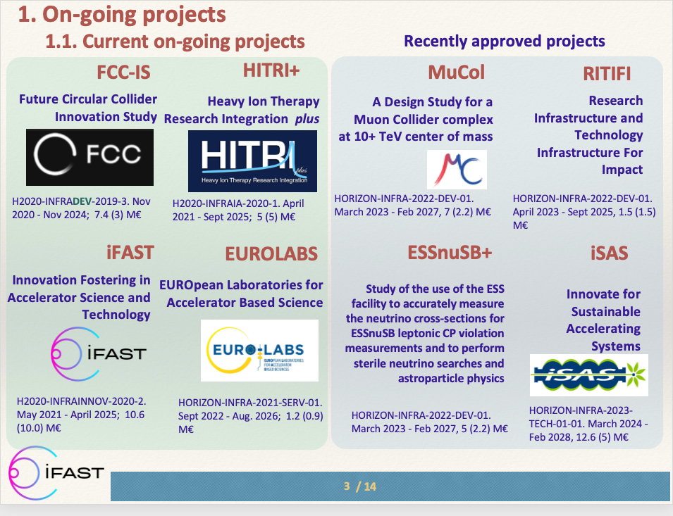
Relations at EU/international level
Test Infrastructure and Accelerator Research Area (TIARA)
Presentation of future Horizon Europe projects for Accelerators
iSAS considered as one of the flagship project
Innovation Fostering in Accelerator Science and Technology (IFAST)
Presentation of 3 EU projects at the annual IFAST meeting (April)
TIARA
AMICI
IFAST
Collaboration with the future program, IFAST2, to be considered
Invited presentation at 15th conference Heavy Ion Accelerator Technology (HIAT), Michigan, June 2025
J.M. Perez (chair of TIARA), presentation at the IFAST annual meeting (April 2024)

