Slide 1
From I.FAST to the new proposal for accelerator R&D
Maurizio Vretenar, CERN
I.FAST Coordinator
13.03.2025

Slide 2
20 years of general accelerator R&D in the European Programmes
CARE 01/2004 – 12/2008
5 years, 15.2 M€ EC contribution
EC support to accelerator R&D via Research Infrastructure programmes of the Horizon FP’s:
Support to multiple R&D topics within large multi-national collaborations (INFRA-IA, INFRA-INNOV): 5 projects in 20 years, 53 M€ EC funding and >50 M€ co-funding from partners.
Design of new accelerator-based infrastructures (INFRA-DEV).
Support to specific accelerator technologies (INFRA-TECH).
FP6
EuCARD 04/2009 – 03/2013
4 years, 10.0 M€ EC contribution
FP7
Integrating Activities
EuCARD-2 05/2013 – 04/2017
4 years, 8.0 M€ EC contribution
Integrating Activities, Innovation Pilot: cross-boundary technology subjects, not directly followed by large laboratories, added value from collaboration and sharing of resources.
ARIES 05/2017 – 04/2022
4 years, 10.0 M€ EC contribution
H2020
Innovation Pilot
I.FAST is a new step in this progress, including for the first time a large industry representation (1/3 of Consortium)
I.FAST 05/2021 – 04/2025
4 years, 10.0 M€ EU contribution
I.FAST = Innovation Fostering in Accelerator Science and Technology

Slide 3
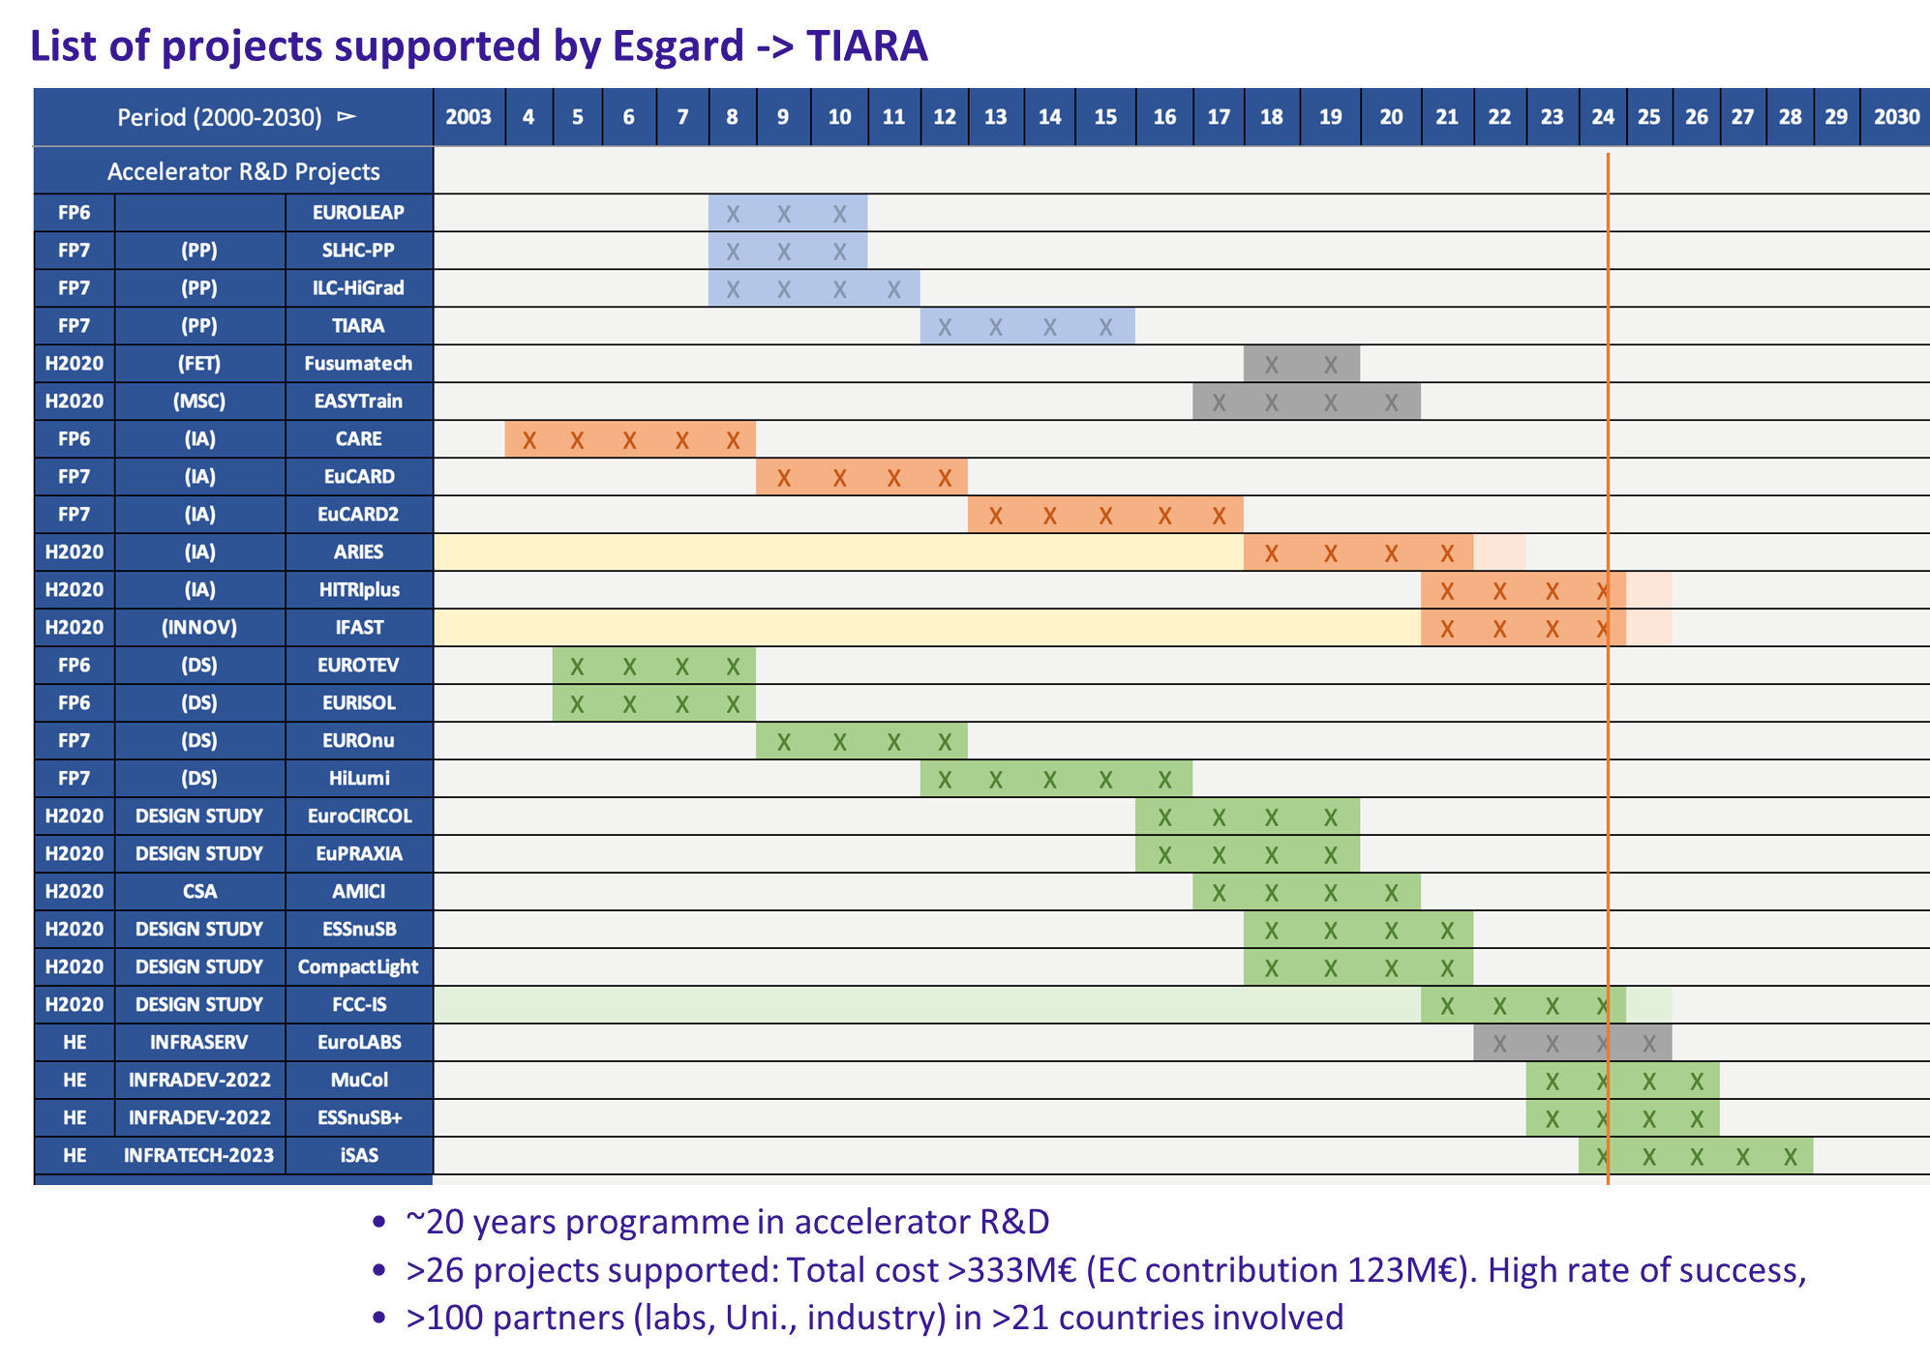
The role of TIARA
The TIARA Collaboration Board supervises the preparation of the large “community” projects, and coordinates and supports the other submissions from the accelerator community (design studies and technologies).
Test Infrastructure and Accelerator Research Area (TIARA)
TIARA is a Consortium of European Research Institutions operating significant R&D Infrastructures in the European Particle Accelerator Research Area. Its aim is to create a dedicated structure to exchange expertise and to facilitate and support the setting-up of joint R&D programmes and education and training in the field of Accelerator Science and Technology in Europe.

Slide 4
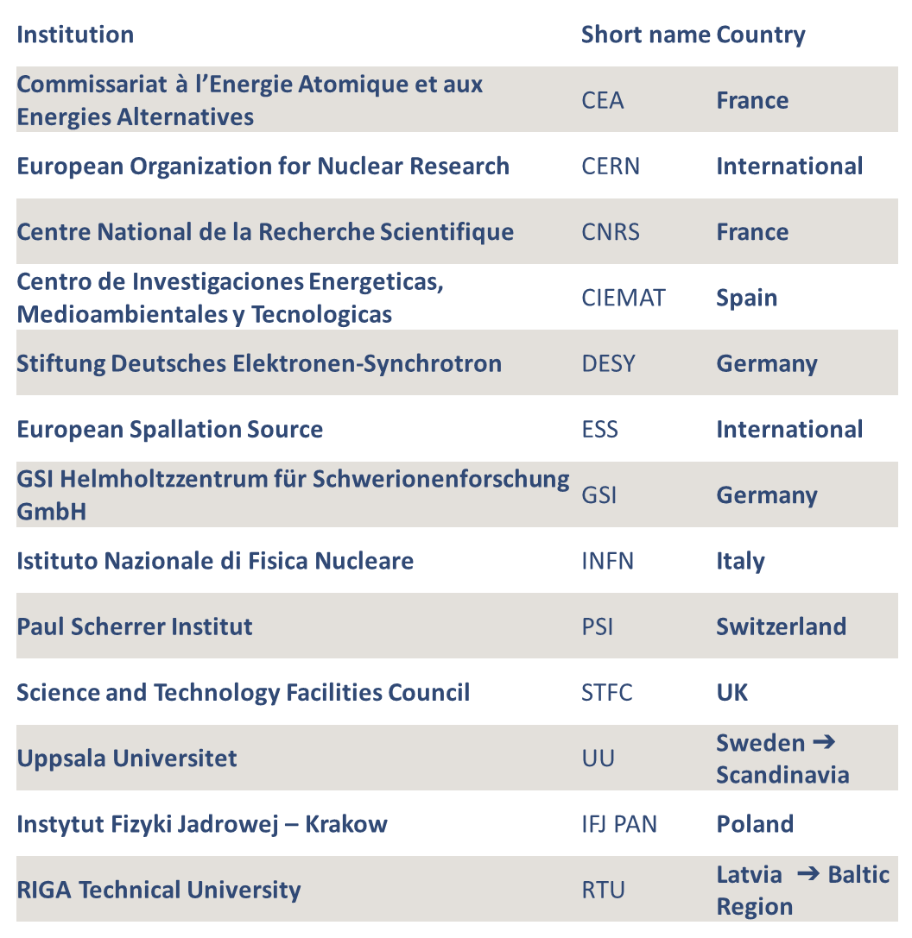
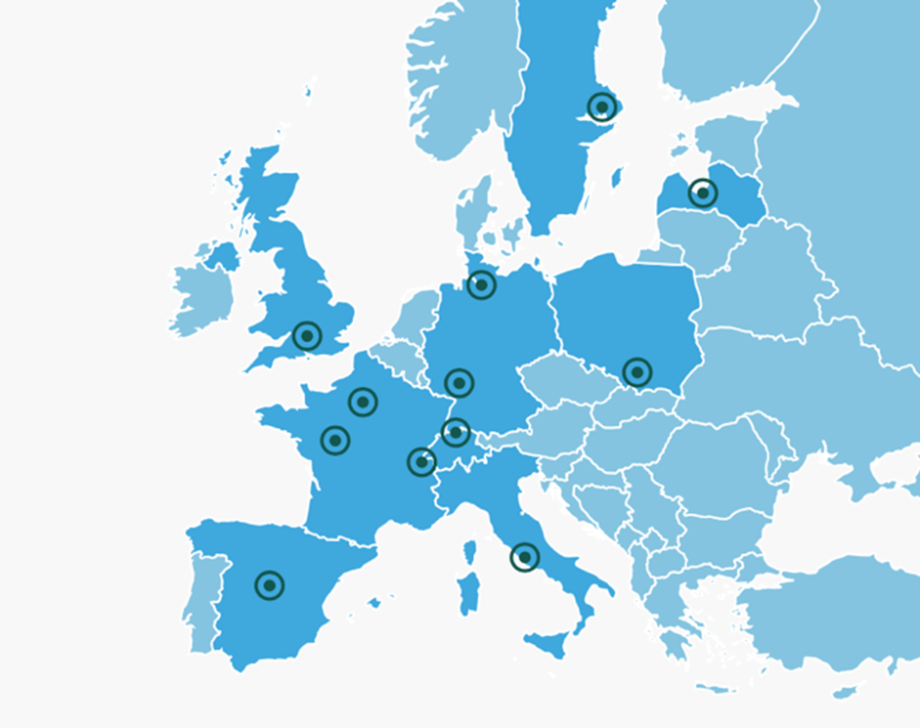
TIARA composition
TIARA main aim is to support the implementation of Accelerator R&D activities.
Aim: to cover Trans-Field Activities (no only Particle Physics), since R&D in AS&T is transverse.
TIARA uses the roadmaps and priorities of the accelerator-related communities as it base, to contribute to a more integral strategy
13 members, representing key actors on Acc Sc & Tech in Europe.

Slide 5
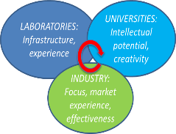
I.FAST
A collaborative European project for the development of advanced particle accelerator technologies in collaboration with industry, supported by the European Commission under Horizon 2020.
10 M€ EU funding, total budget 18 M€, 48 partners from 15 European countries.
Goal: translate the particle accelerator community towards Open Innovation.
Programme focus on sustainability and innovation in 9 thematic areas strategic for the future of particle accelerators.
For the first time, a large industry participation (1/3 of beneficiaries).
Project duration 4 years, recently extended by 6 months:
Termination 31.10.2025

Slide 6
I.FAST as a transverse project, from science to society
Particle accelerators are sophisticated instruments used in a wide range of domains, from basic science to applied science to medicine and industry.
Traditionally, the strongest demands in terms of technologies and performance are coming from particle physics, from which new technologies extend to other applications and finally reach the society.
The main goal of I.FAST is the translation of accelerator technology across scientific fields and to society, engaging industry from the earlier possible stage.
Basic science
Applied science
Applications

Slide 7
Workpackages and content of I.FAST
Mixture between exploratory work and prototyping of deep-tech technologies to higher TRL
new ideas
integration
new concepts
HTS
new techniques
additive manufacturing, ML
strategies
strategies
policy, procedures
exploratory work
slow extraction
targets, stabilization
deposition techniques
SC AM cavities
ML models
biohazards
med. cyclotron
SS RF amplifier
experimental activities
variable field dipole
combined function CCT magnet
AM-RFQ
high-efficiency klystron
high-level prototyping
RF guns
variable-field PMQ
compactlight accelerator
HTS CCT magnet

Slide 8
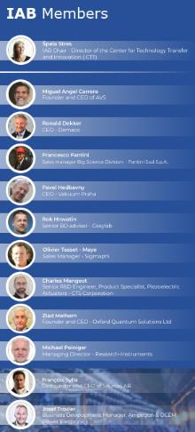
Industry in I.FAST
RHP Technology Gmbh
Bergoz Instrumentation
Sigmaphi
Thales AVS France SAS
Bilfinger Noell GmbH
Barthel HF-Technik GmbH
Comeb S.R.L.
KYMA S.R.L.
Piccoli S.R.L.
VDL Enabling Tech. Group
CYCLOMED Technologies
Elytt Energy S.L
Nanoker Research
GEMS PET Systems AB
Scanditronix Magnet AB
TRUMPF
TMD Technologies Limited
17 industrial partners
12 industries in the I.FAST Industry Advisory Board
Creation of Accelerator Science and Technology Permanent Industry Forum.
3 Thematic Industry Workshops.
IFAST Industrial partners:

Slide 9
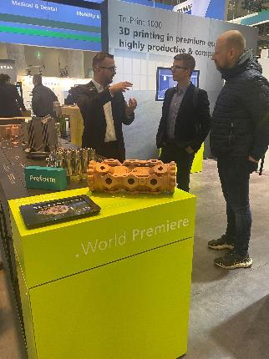
Highlights: additive manufactured RFQ
iFAST has reserved a small budget for a “proof-of-principle” of Additive Manufacturing for accelerators.
Evolved into the idea of 3D-printing a complete small linear accelerator (Radio Frequency Quadrupole, RFQ) – never tried before!
The novelty of the idea attracted additional funding from industry and from universities, much beyond what available in iFAST.

Slide 10
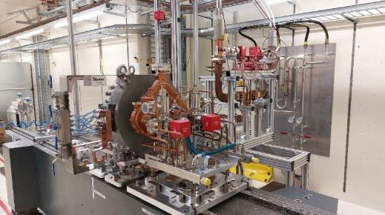
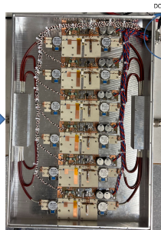
Highlights: I.FAST high-level prototypes
in co-innovation laboratories - industry (TRL 4/5):
Variable dipole for synchrotron light sources, CERN-CIEMAT-ELETTRA with KYMA
RF guns for FEL, INFN-PSI with COMEB-VDL
X-band structures for FEL, ELETTRA-CERN with COMEB-VDL-TMD
CCL Superconducting magnets for medical synchrotrons (combined functions and HTS), INFN-CERN-UU-Wigner with Elytt
High efficiency klystron, CERN-ULAN with Thales
Variable PMQ for synchrotron lights, UKRI-DLS with KYMA

Slide 11
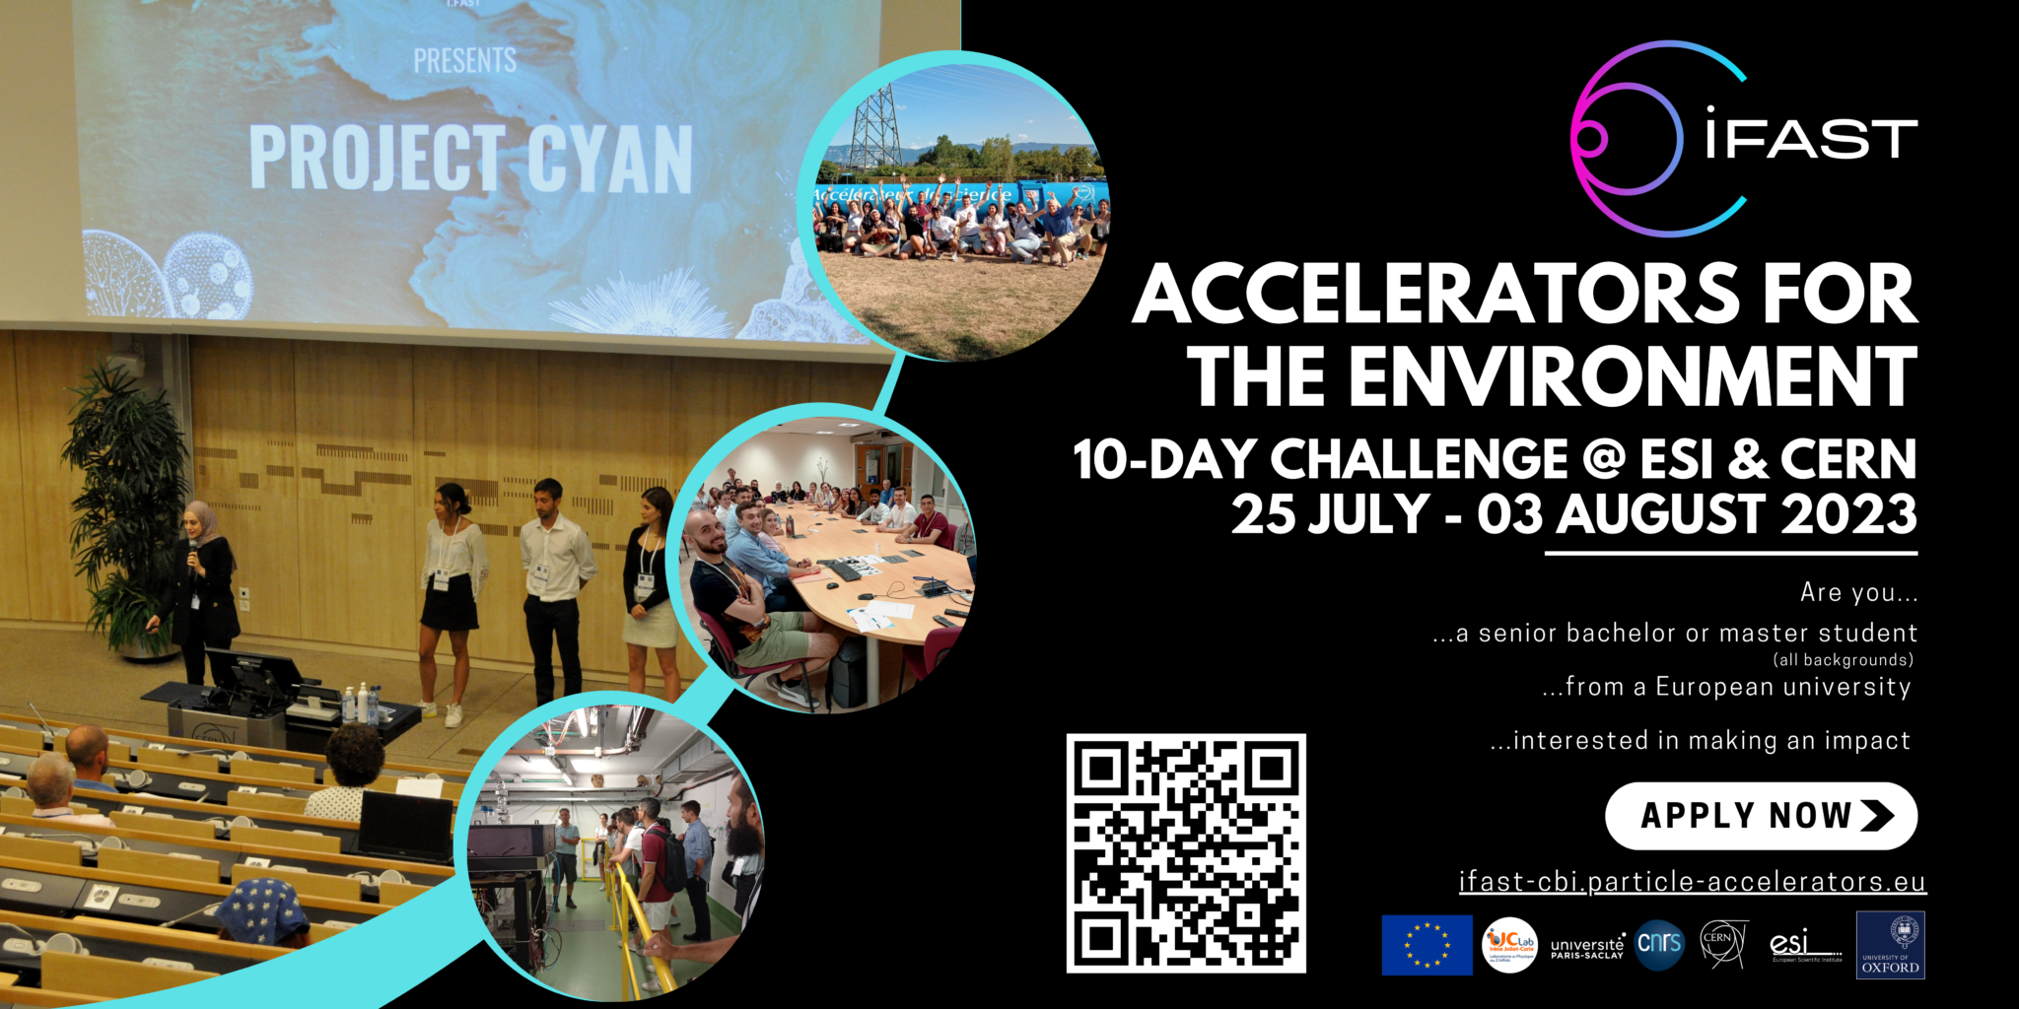
Highlights: the Challenge Based Innovation
During 10 days, 4 multidisciplinary teams of 6 students each gather at ESI Archamps, near Geneva, to propose innovative solutions based on accelerator technologies to address a specific societal challenge.
On the last day they present their work in front of a jury at CERN.
Targeting students (and young professionals) sufficiently advanced in their studies but not yet too specialized.
Students in their 2nd cycle of studies (typically 3rd to 5th year of University), before the start of doctoral studies.
1st edition (2022) challenge:
Accelerators for the environment
2nd edition (2023) challenge:
Accelerators for the environment (2)
3rd edition (2024) challenge:
Accelerators for healthcare
4th edition (2025, in preparation) challenge:
Accelerators for healthcare (2)

Slide 12
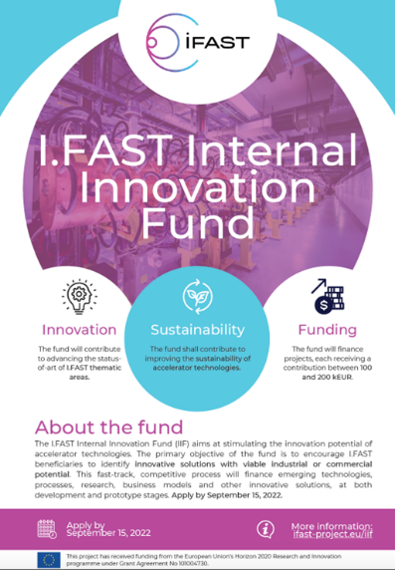
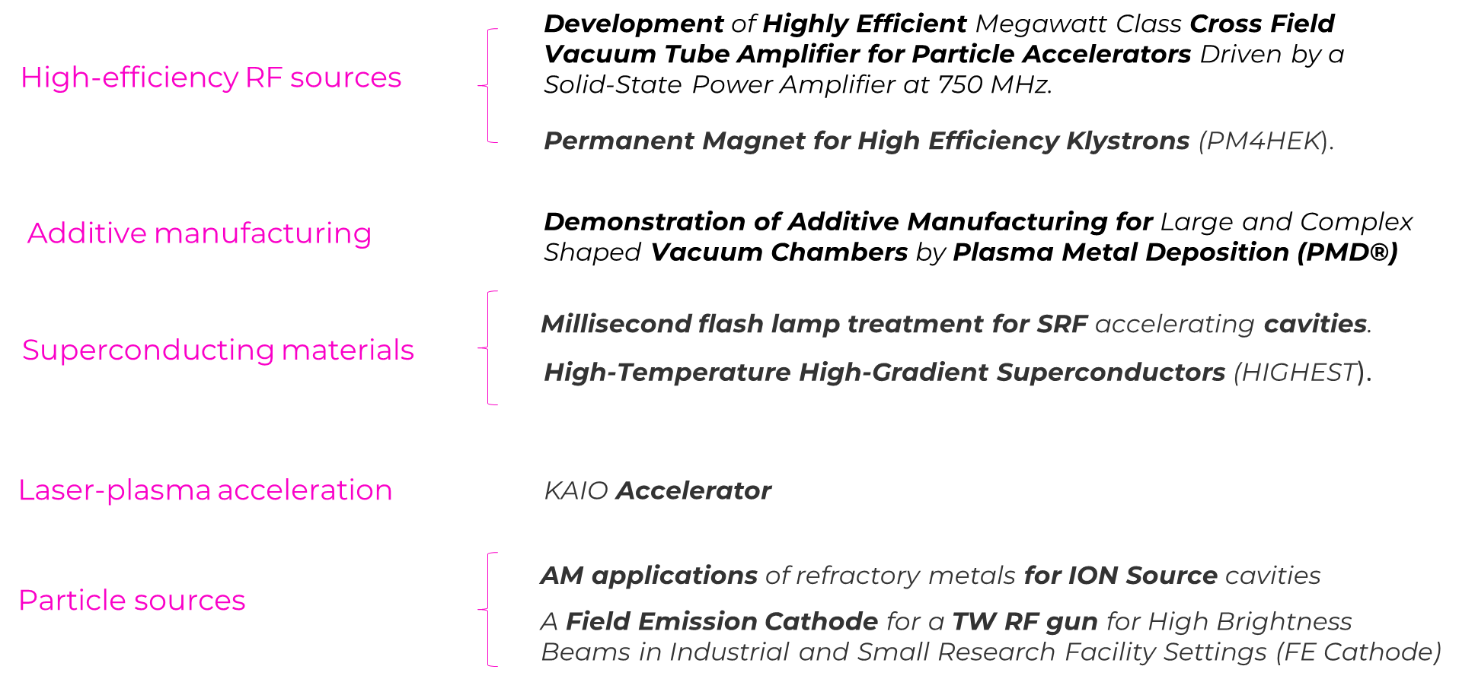
Highlights: I.FAST Innovation Fund
1 M€ funding to an internal competitive call for innovative projects with industry, starting early 2023, for a duration of 2 years (to match termination of I.FAST in April 2025)

Slide 13
Preparation of the new accelerator R&D proposal
No more “Innovation Pilot” but “Implementing research infrastructure technology roadmaps” – but the new call incorporates many aspects and results of I.FAST.
Name still to be defined, for the moment “I.FAST2”
The next flagship of our accelerator R&D projects!

Slide 14
HORIZON-INFRA-2025-01-TECH-02
Implementing research infrastructure technology roadmaps
From “confidential” draft Work Programme 2025 for Research Infrastructures (to be published in April?)
Expected EU contribution: 10 – 15 M€ (to be confirmed)
Total budget for the call: 45 MEUR (to be confirmed).
Deadline for submission: 18 September 2025 (to be confirmed).
For infrastructure and technology communities with already developed research infrastructure technology roadmaps: accelerators, light sources, astronomy, etc.
Projects should implement significant parts of, or entire research infrastructure technology roadmaps through co-creation with industrial partners from the earliest possible stage. The technology roadmaps should be the result of a community or cross-community effort already undertaken. The technological solutions developed should respond to the needs of several research infrastructures, and in some cases the needs of different types of research infrastructures.
Project must include at least 2 Research Infrastructures (ESFRI, ERIC, or International European org.).
funding will depend on decisions on the EC budget

Slide 15
Requirements, from draft call description
All R&D topics included in the portfolio must:
implement significant parts of a research infrastructure technology roadmap (ESPP, LEAPS, others) or develop new advanced applications.
address prototyping of high-performance systems needed to upgrade the involved research infrastructures or construct their next generation.
Include co-creation with industrial partners from the earliest possible stage (as beneficiaries, subcontractors, PCP partners, or with letters of engagement) .
respond to the needs of several research infrastructures, possibly of different types.
possibly build on results from previous projects and avoid overlaps with ongoing projects.
consider resource efficiency (e.g. raw material and energy consumption) and environmental (including climate-related) impacts.

Slide 16
TIARA guidelines for the proposal
Different from previous projects, the new project should have:
A mixture of top-down and bottom-up topics: explore recognised critical R&D topics with appropriate funding, while keeping the creativity and innovation dimension of a bottom-up call to the community.
Less partners than in I.FAST, avoid beneficiaries with less that 100k EC funding. Ideal team one or 2 academic, one industry.
Rate of matching funds (now 50% for academia, 30% for industry) reduced to 1/3 (33%) for research institutions, 20% for industry.
Less space for Networks, possibly only in the frame of defining Technology Roadmaps – and more space to prototyping with industry.

Slide 17
Structure of the proposal
From I.FAST experience and discussions with EC
Project based on 4 pillars (groups of Work Packages):
 | Pillar | Content | EC contribution per activity (guideline)
1 | Instruments | General WP’s covering all activities
2 | Enabling technologies | 6 key technologies, selected top-down, higher TRL | 1 M€
3 | Emerging technologies | About 10 selected technologies after bottom-up call, lower TRL | 200-500 k€
4 | Innovation Fund | Internal call after project start | 100-200 k€
Note: EC contribution as total cost, including the 25% overheads

Slide 18
Options for total budget repartition
 | Pillar | Baseline: 12M | Maximum: 15M | Minimum: 10M | Number of activities
1 | Instruments | 2.4 M€ | 2.5 M€ | 2.0 M€
2 | Enabling technologies | 5.6 M€ | 6.0 M€ | 5.0 M€ | 5 - 6
3 | Emerging technologies | 3.0 M€ | 4.0 M€ | 3.0 M€ | 10 – 14
4 | Innovation Fund | 1.0 M€ | 2.5 M€ | 0 M€ | 0 - 10
 | Totals | 12 M€ | 15 M€ | 10 M€
We will decide on the total number of “activities” in each pillar when we will know the total budget.

Slide 19
Status of preparation
TIARA meeting on January 10th enlarged to the accelerator user communities (with and without roadmaps), to define topics for enabling technologies.
Selected 7 “enabling technologies” for the top-down part. Conveners identified, preliminary proposals submitted, under scrutiny from TIARA.
Documentation and web site for “emerging technologies” call ready.
Call for proposals for emerging technologies will be opened on Monday 16 March, with deadline for submission of proposals 30 April.
An evaluation committee set up by TIARA will select the activities during the month of May.
The results of the selection will be announced at early June.
All information will be available on https://ifast-project.eu/proposal-infra-tech-02

Slide 20
Enabling Technologies Pillar
WP |  | Initial Convener (to be confirmed) | Institute | Country
1 | SC thin films for RF cavities | O. Malyshev / C. Antoine | UKRI/CEA | UK/FR
2 | HTS magnets | E. De Matteis | INFN | IT
3 | Additive manufacturing | T. Torims | RTU | LV
4 | SCRF Surface treatments | D. Longuevergne | CNRS | FR
5 | Permanent magnets for accelerators | R. Geometrante | KYMA | IT/ind.
6 | Laser driven acceleration | A. Maier | DESY | D
7 | High brightness electron injectors |  | PSI | CH

Slide 21
The Instruments Pillar
WP | Task | Title | Content
1 | 1 | Management, coordination
 | 2 | Dissemination
 | 3 | Risk Management
2 | 1 | Training | Support to schools
 | 2 | Communication, outreach | CBI, Acc. News, Social media
3 | 1 | Industry | Support to AIPF
 | 2 | Technology transfer | Support start-ups
 | 3 | Societal applications | Medical and industrial
4 | 1 | Far future accelerators | Exploratory work
 | 2 | Sustainability | Methodologies (LCA)
 | 3 | Roadmap follow-up | Contact with communities.
4 Work Packages, supporting all other activities

Slide 22
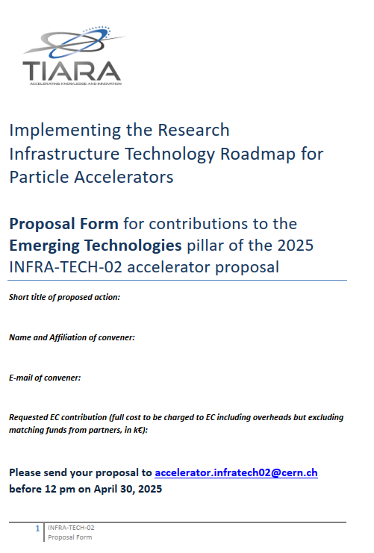
Submission form for emerging techs
Goal: a 10-page document with all information needed by the Evaluation Committee

Slide 23
Guidelines - financial
EC contribution for emerging technologies between 200k and 400k, may go up to 500k in justified exceptional cases.
Higher requests will not be considered.

Slide 24
Evaluation criteria
 | Criterion | Points
1 | Scientific and technological excellence, innovation content | 10
2 | Coherence with the roadmaps of accelerator communities and continuity with previous EC projects | 5
3 | Impact on Research Infrastructures, their users and/or society | 5
4 | Methodology and planning | 5
5 | Transnationality and integration of partners | 5
6 | Capacity to attract additional matching funds | 5
7 | Correspondence between cost and objectives | 5
8 | Extent and quality of industry involvement | 5
9 | Improve use of resources and reduce environmental impact | 5
 | TOTAL | 50
In preparation an evaluation guide to explain the criteria and to help obtaining harmonized scores.

Slide 25
Timeline for the new proposal
Timeline: Enabling technologies
January 2025: define common roadmap with other accelerator communities, with priority topics and guidelines for internal call.
Early February nominate Conveners for enabling technologies and invite to set up collaborations.
March deadline for presenting WP’s to TIARA, first reactions.
30 April content and budget approved by TIARA.
May start writing.
Timeline: Emerging technologies call.
Early March 2025 send letter and submission form to all institutes having participated in previous programmes.
30 April submission deadline, nominate selection committee.
15 May pre-analysis and classification of submissions completed.
31 May selection of projects completed, start writing.
First draft of proposal ready by end of June
Revised draft and budget frozen end of July
Complete proposal for final revision end of August

Slide 26
Thank you for your attention!

Slide 27
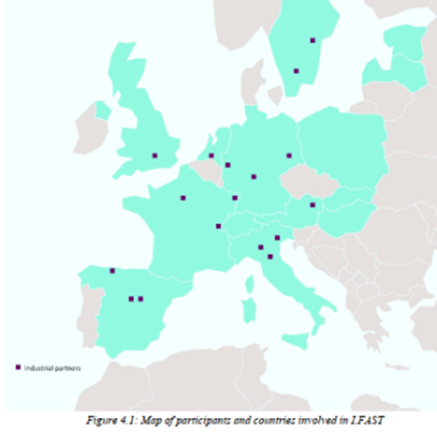
The European accelerator R&D landscape
Translation of accelerator technologies is a particular challenge in the fragmented European accelerator environment.
> 100 entities (research laboratories, universities, industry) active in research development and production of accelerator technologies, across 23 EU countries and UK.
Only CERN stands up as a reference – but CERN’s contribution is institutionally limited to particle physics.
Industrial landscape is even more fragmented, with many SME’s producing accelerator components, but few with critical mass and even fewer capable of delivering a “beam”.
An impactful R&D can be only achieved via large collaborations, in particular academia-industry.
The European Commission Programmes plays a strategic role in setting up and supporting collaborations and co-innovation with industry.
The iFAST EU Project for accelerator R&D includes 48 partners (8 accelerator laboratories, 12 national research centres, 12 universities, 16 industrial partners (11 SMEs) - from 15 European Countries.

