Slide 1


WP1: FE-FRT
Padova meeting, March 13, 2025
All information contained in this presentation and any accompanying documents is for iSAS project only, and must be treated as strictly confidential.
Any dissemination, distribution or other use of this information without the consent of its owner is prohibited.
With material from Nick Shipman, Alick Macpherson, Graeme Burt, Sam Smith et al.
Further Members: André Frahm, Maleesh Dissanayake, Hingpong Jiang, Alexei Kanareykin et al., Walid Kaabi
Funded by the European Union. Views and opinions expressed are however those of the authors only and do not necessarily reflect those of the European Union or the European Commission. Neither the European Union nor the granting authority can be held responsible for them.

Slide 2
Legnaro: A good place for WP 1
Reactive tuning at INFN-Legnaro
using PIN diode switches
Piave SRF RFQ
G. Bassato, S. Canella, A. Battistella
10th ICALEPCS Int. Conf. on Accelerator & Large Expt. Physics Control Systems. Geneva, 10 - 14 Oct 2005, WE4B.1-2O (2005)

Slide 3
WP1: FE-FRT (Official overview)
HZB, CERN, CNRS, Uni.Lancaster
Convener: Axel Neumann (HZB), deputy Alick Macpherson (CERN)
Main contacts with other partners: Alick Macpherson (CERN), Walid Kaabi (CNRS),
Graeme Burt (Uni.Lanc.), industry: Alexei Kanareykin (Euclid Techlabs)
Task 2.4 Integrated LLRF control using FE-FRT
Task 3.3 RF tunability, FE-FRT for Nb3SN coated cavities?
Task 1.1: Coordination of R&D on FE-FRT – M1-M48 (HZB)
• General coordination by HZB as described above.
Task 1.2: FE-FRT for Transient Beam Loading – M1-M40 (CERN)
• Design a full FE-FRT-based 400 MHz tuner, applicable to LHC transient detuning scenarios.
• Perform full RF, mechanical and cryogenic evaluation of the FE-FRT-equipped . LHC cryo-module.
• Use design lessons learned to design a tuner for transient detuning of FCC 800 MHz multi-cell cavities.
Task 1.3: FE-FRT for Microphonics – M1-M48 (HZB)
• Establish characteristics and performance of FE-FRT ferroelectric material at frequencies ≥1300 MHz.
• Design, fabricate and validate an FE-FRT for microphonics suppression on a single-cell 1.3 GHz cavity.
• Design, fabricate and validate an FE-FRT for multi-cell cavity at 1300 MHz, in a cryomodule-like setup.
Task 1.4: FE-FRT in Energy-Recovery LINAC (ERL) mode – M1-M48 (CNRS)
• End-group design study for integration into ERL-type cavity, study HOM+BBU properties.
• FE-FRT design study for RF and mechanical integration into upgraded ERL cavity.
Task 6.2: Retrofitting Fast Reactive Tuners into existing cryomodules HL-LHC oriented – M1-M24
Study of frequency domain multiplexor-based HOM coupler
Study the effect of HOMs on FE-FRT operation to define max leakage
Study the heating due to high fundamental power in the coupler
Strong link to
Tasks 1.2-1.4

Slide 4

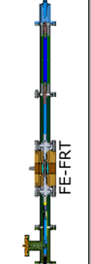
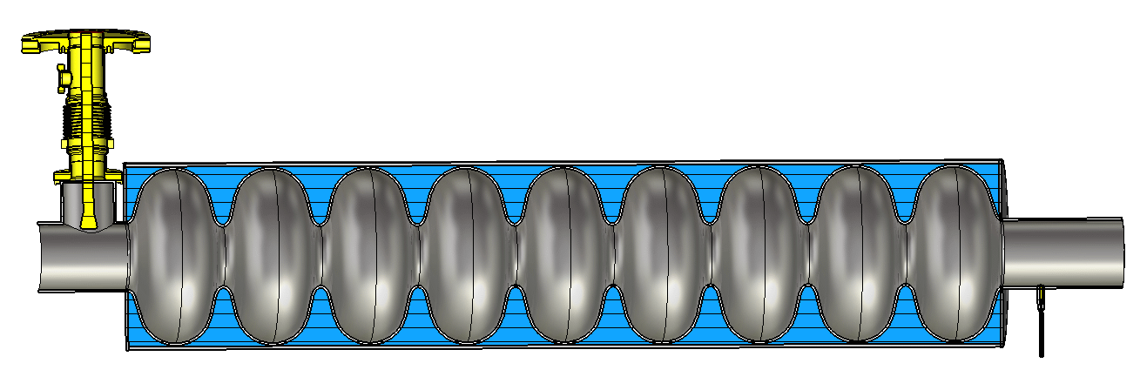
Ilan Ben-Zvi
WP1 – FE-FRT: Reality of WP1
New applications
FE-FRT
for microphonics detuning
1300 MHz
bERLinPro
FE-FRT for transient beam-loading compensation
400-800 MHz LHC HiLumi
FCC use cases
Emerging non
iSAS partners…
WP6: Retrofitting fast reactive tuner, beam effects
FE-FRT for ERLs
1300 MHz, UK-XFEL
400-800 MHz, FCC use cases
800 MHz PERLE

Slide 5
Task#1 Energy Savings from RF power
How do we aim to demonstrate sustainable, thus lower carbon footprint low-RF power operation?
Increase the efficiency of intrinsically efficient RF power source by better integrating them in cavity
LLRF field control and requirements by accelerator/beam settings → WP2
Develop novel fast tuning systems compensating detuning by mechanical vibrations or beam induced
transients, which both are usually compensated by adding a significant power overhead
→ WP1 aka FE-FRT
All this should of course not compromise the stability and reliability of operation, better even improve
it beyond current state of the art.
The savings in RF power should be significant, to justify any required modification to a cavity system
→ retro-fitting to existing systems would be pure gold

Slide 6
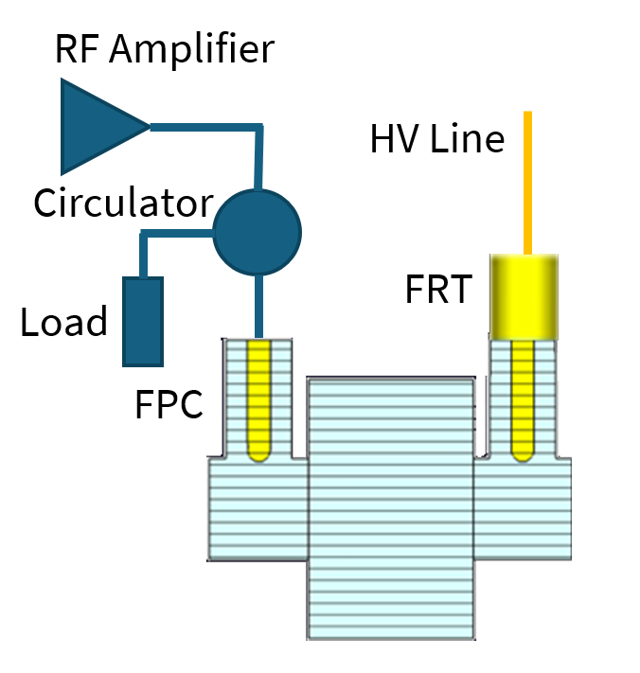
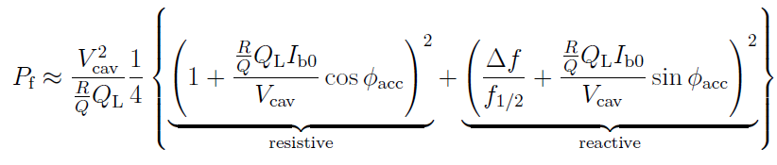
Functioning of an FE-FRT
FE-FRT tuner are an alternative to classic mechanical cavity tuner, however,
require an additional RF port, but circumvent the complexity of control algorithms
needed for damping the highly resonant mechanical-RF cavity-tuner system
They form a coupled system of cavity and an usually coaxial line with
ferro-electric material, which changes its permittivity with HV
This change of impedance can thus control the resonance frequency of the
coupled system
Required power to operate a cavity at voltage V_{cav} scales
with (Δf/f_{1/2})² in low beam loading machines
→ microphonics case
In beam-loaded accelerators, the phasing dictates the
power demands and the impact on field stability.
→ Closer to zero-crossing, proper tuning can compensate
reactive beam-loading
The lower Δf, the higher Q_{L} can be, the lower the required
power to drive the cavity (f_{1/2}=f/(2Q_{L})
Scheme by N. Shipman
Variations of microphonics or bunched beam pattern
in time domain dictates switching of HV in time and amplitude!

Slide 7
WP1 – FE-FRT: status/evolution of Task 1.1
coordination
Past developments
  Monthly meetings to organize and discuss the WP tasks
  Started exchange of personnel, here HZB engineer (A. Frahm) visited CERN to discuss
  design and fabrication of FE-FRT parts
  Participation in several workshops to advertise iSAS based FRT development:
  E.g., ERL workshop 2024 at KEK, Tsukuba, TTC meeting at Lund 2024, both sustainability working
  groups
Current developments
  Intensified the exchange by moving to a biweekly meeting schedule
  See last slide: Prepare to organize a dedicated FE-FRT workshop at HZB in November
  with applications within iSAS and beyond
  Potentially more partners identified outside iSAS (e.g. University Mainz, MESA)
  Ongoing discussions with WP3 about FE-FRT tuner for coated cavities
  Lancaster increased its personnel with external (UK) funding to work on various FRT topics
  New applications appear: Ilan Ben-Zvi driving force for new proposals with N. Shipman

Slide 8
WP1 – FE-FRT: status/evolution of Task 1.2
FE-FRT for transient beam-loading

Slide 9
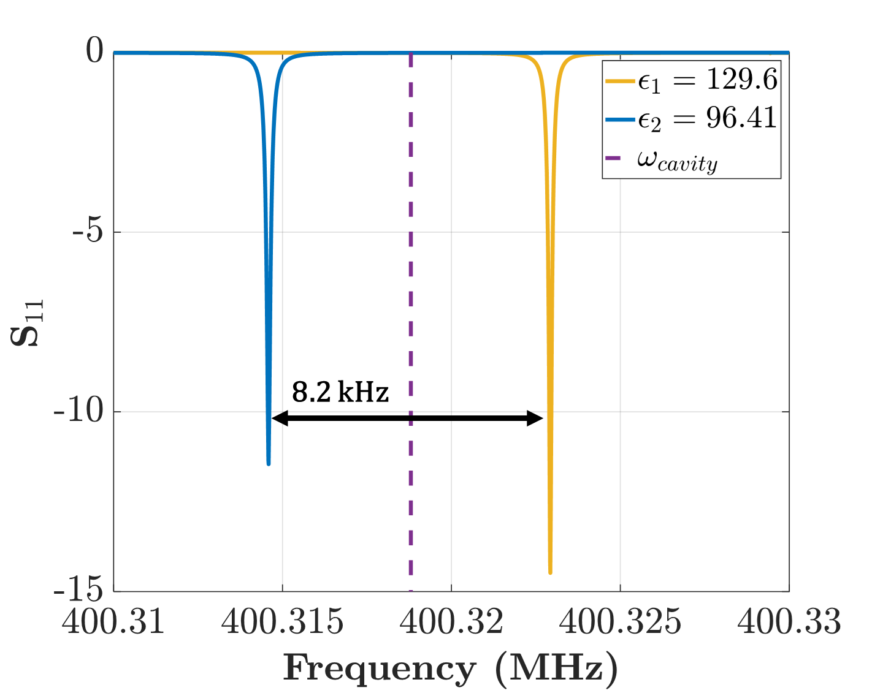
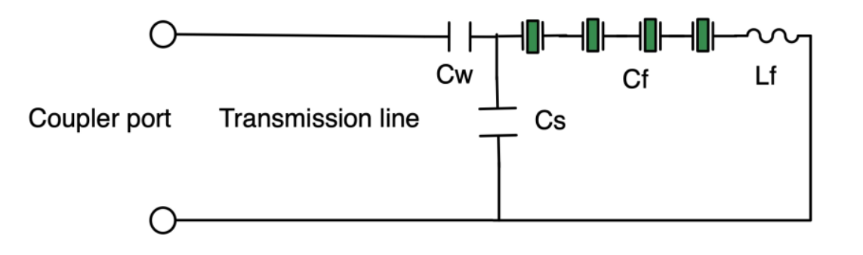
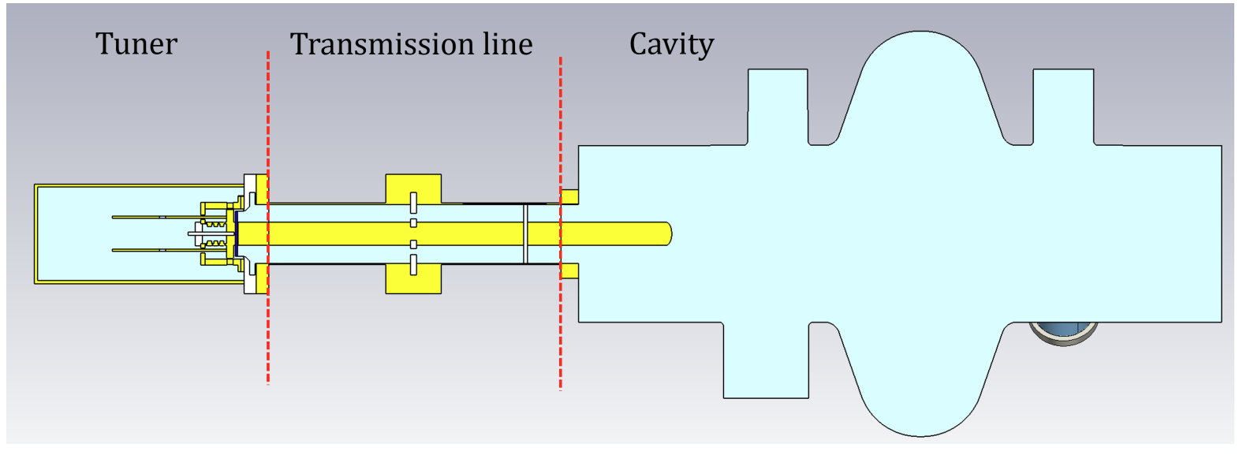
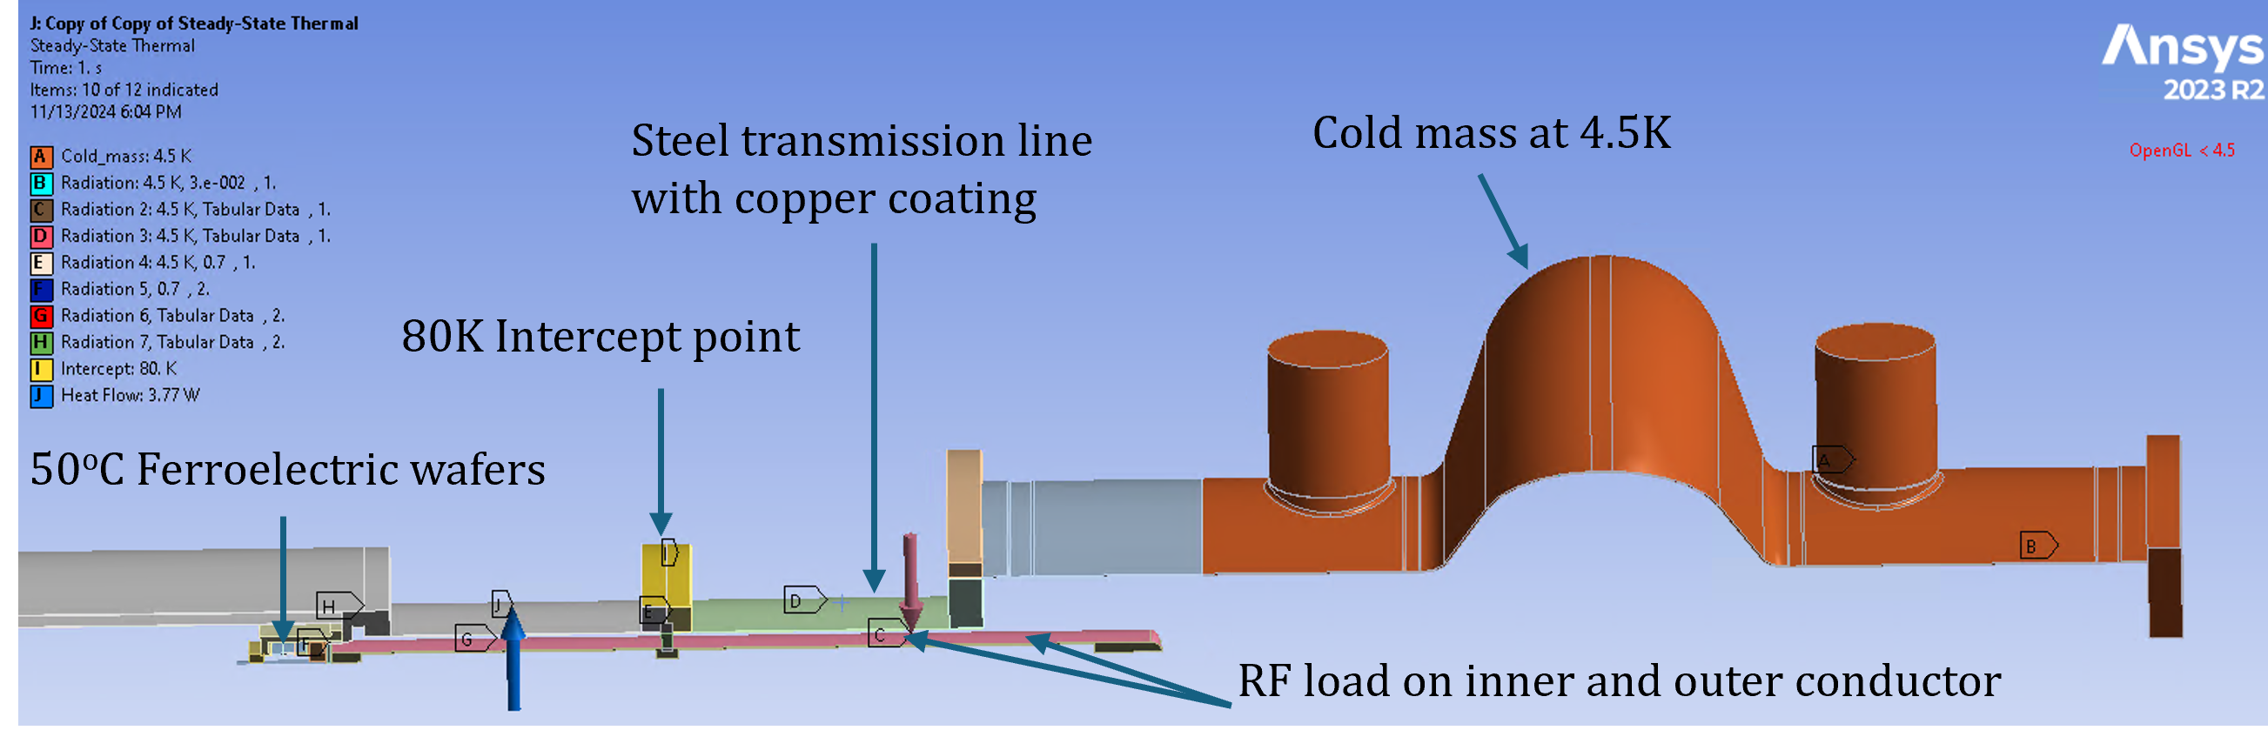
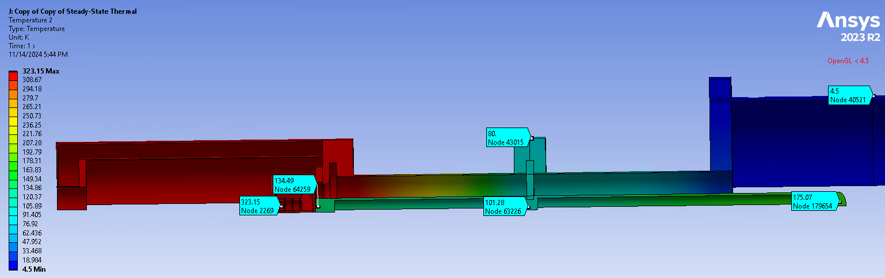
Transient Detuning Demonstrator (TDD)
Transient detuning:
  Validation of frequency switching on LHC 400 MHz Cavity
Transient Detuning Demonstrator (TDD)
  Target: Δf = 8 kHz, switching time <100 ns & switching rate up to 150 KHz
  New: Mechanical & coupled RF-thermal design complete
    RF Measurement: July/August 2025 @ CERN
Tuner design
  Thermal Design
Expected Cavity response - CST
Courtesy Ilan Ben-Zvi, Paul Schneider, & Sam Smith (CERN)

Slide 10
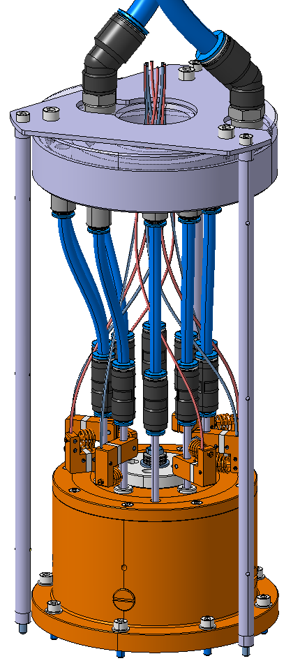
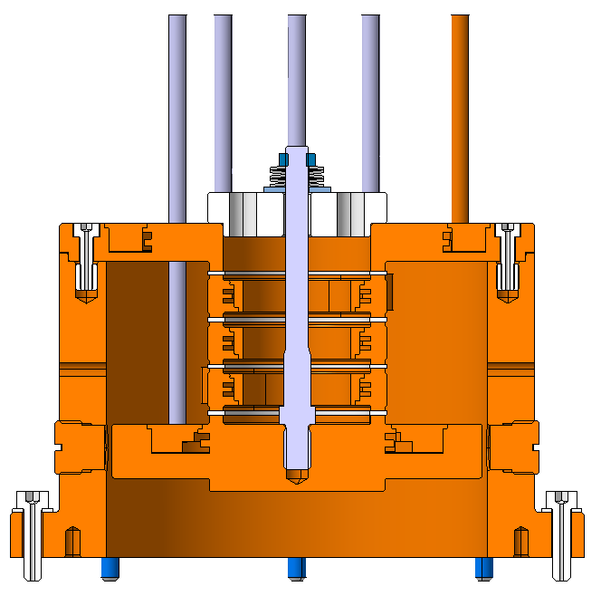
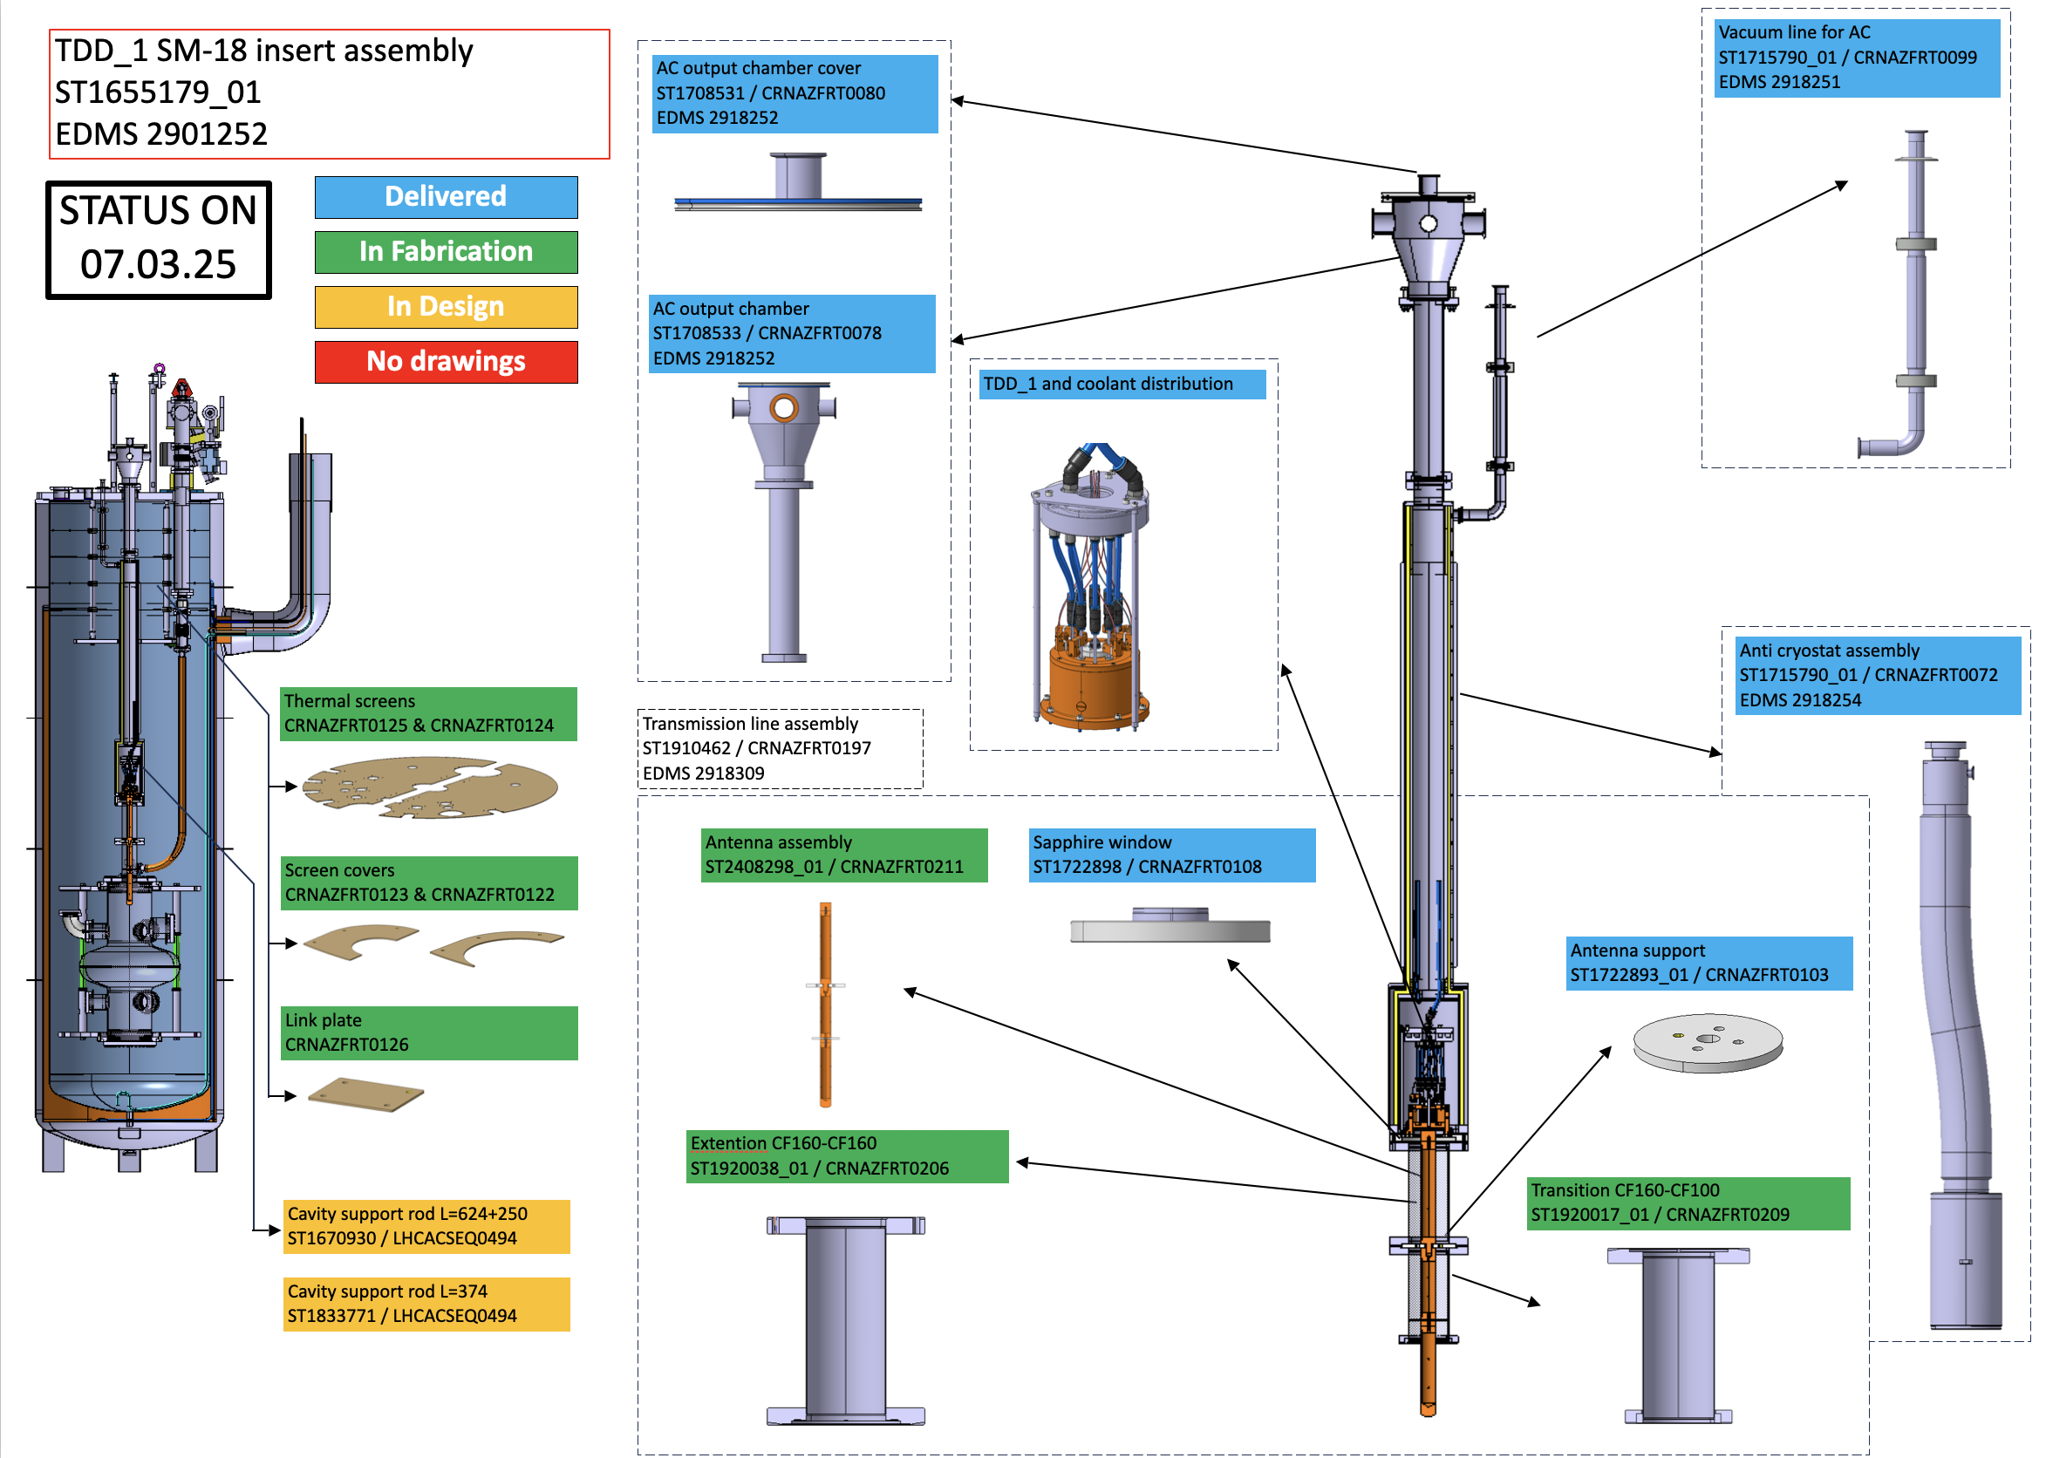
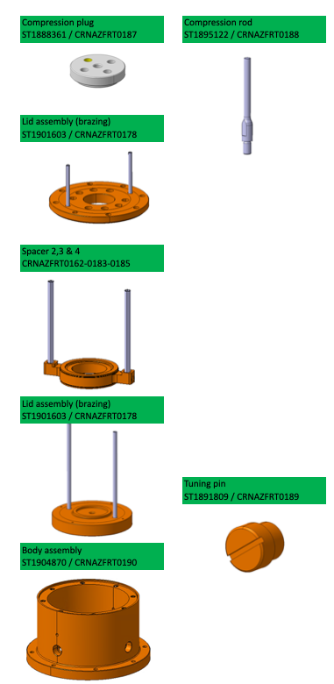
TDD: Fabrication Dashboard
Fabrication: Ongoing at CERN main workshop
Assembly and System testing: May + June 2025
Courtesy Paul Schneider (CERN)

Slide 11
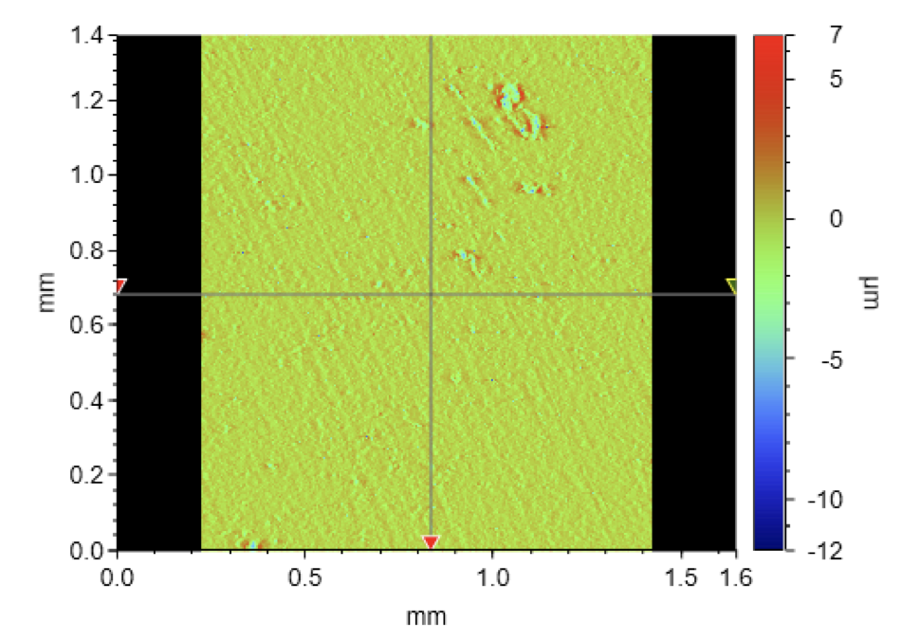
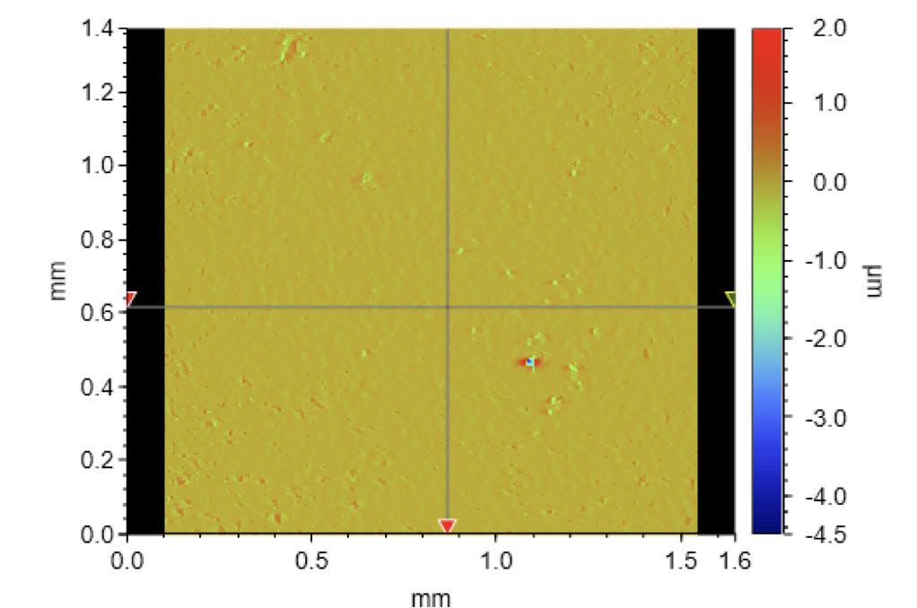
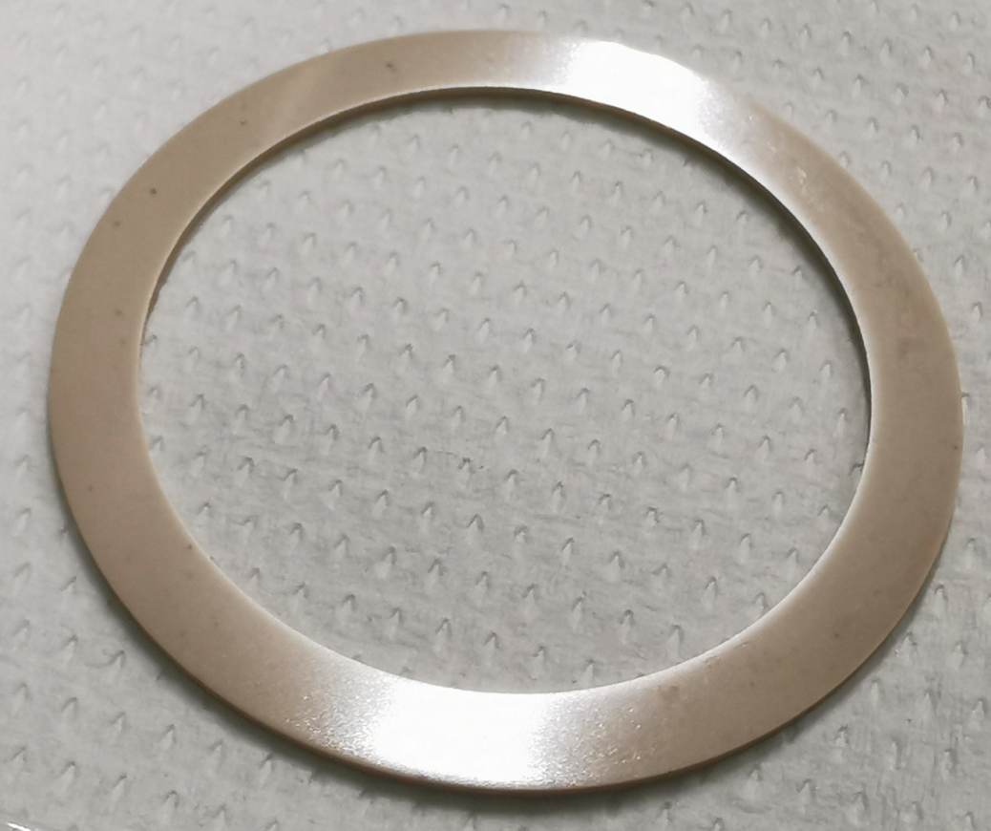
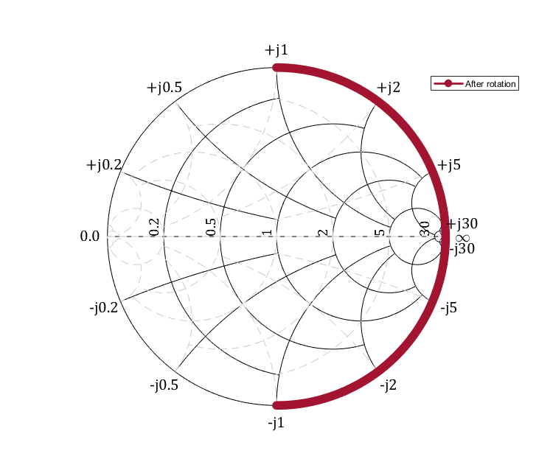
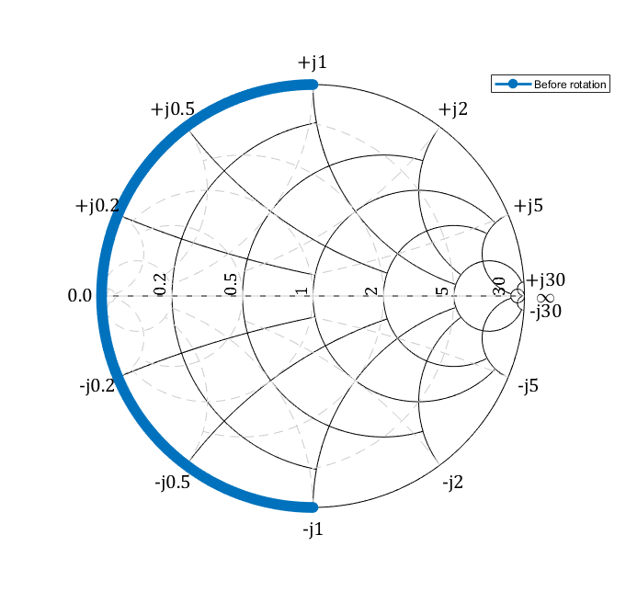
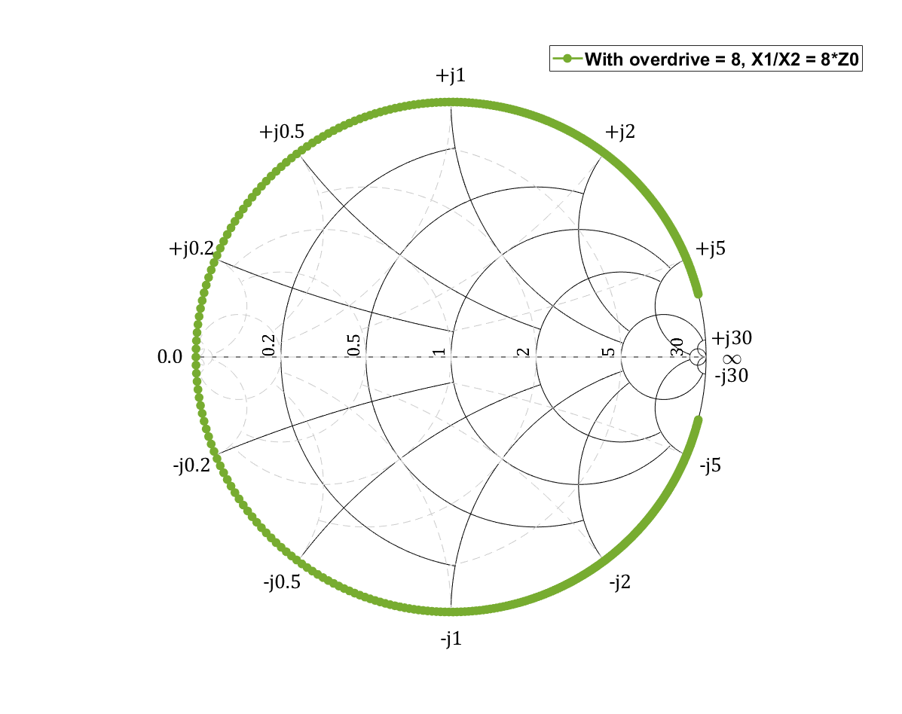
Examples: some iSAS- WP1 advances
Ferroelectric ceramics: In-house Sample preparation sequence now in place
Supplied by Euclid TechLabs water jet cutting (±25µm) surface polish & vacuum bake
Surface finish: For brazing-less compression assembly with diamond machined Copper
As supplied
Surface Roughness Measurements
Material | Rt [nm] | Ra [nm]
FE (as supplied) | 5600 ± 2180 | 382 ± 65
FE (polished) | 711 ± 95 | 40 ±9.4
Copper (diamond machined) | 172 ± 29 | 33 ±1.3
Stainless steel surface | 427 ± 248 | 13 ± 2.2
Polished - optical finish
40mm
Courtesy Mickael Crouvizier (CERN)
RF design:
  Enhanced performance by design strategy
    Optimise & position tuner impedance
      Called Overdrive
  Overdrive
    Boosts tuner Figure of Merit
    Increase Tuner Q_ext
  New: FRT Design Paper: Archive link follows
Bare Tuner
Tuner + TL
Overdrive
Tuner Impedance Smith chart
Courtesy Sam Smith (CERN) & Ilan Ben-Zvi

Slide 12
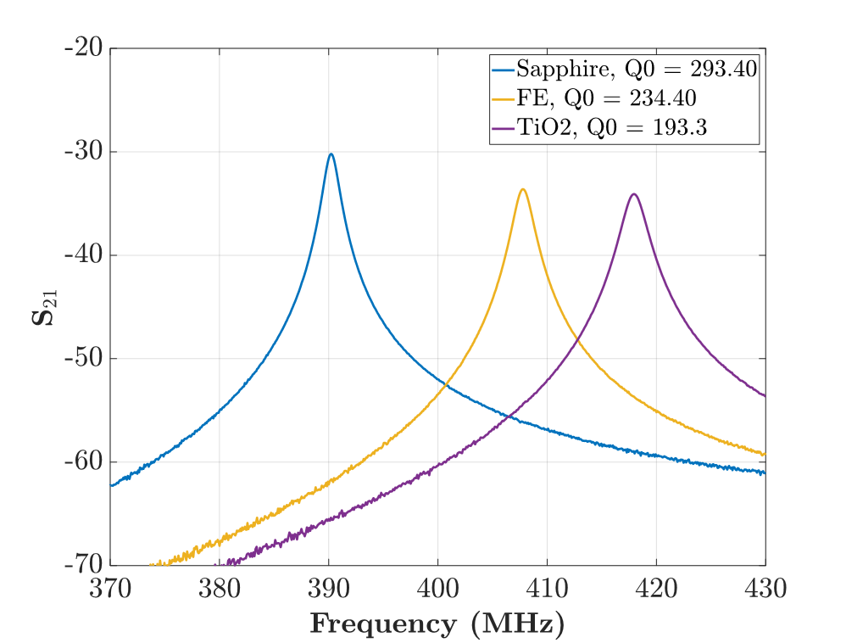
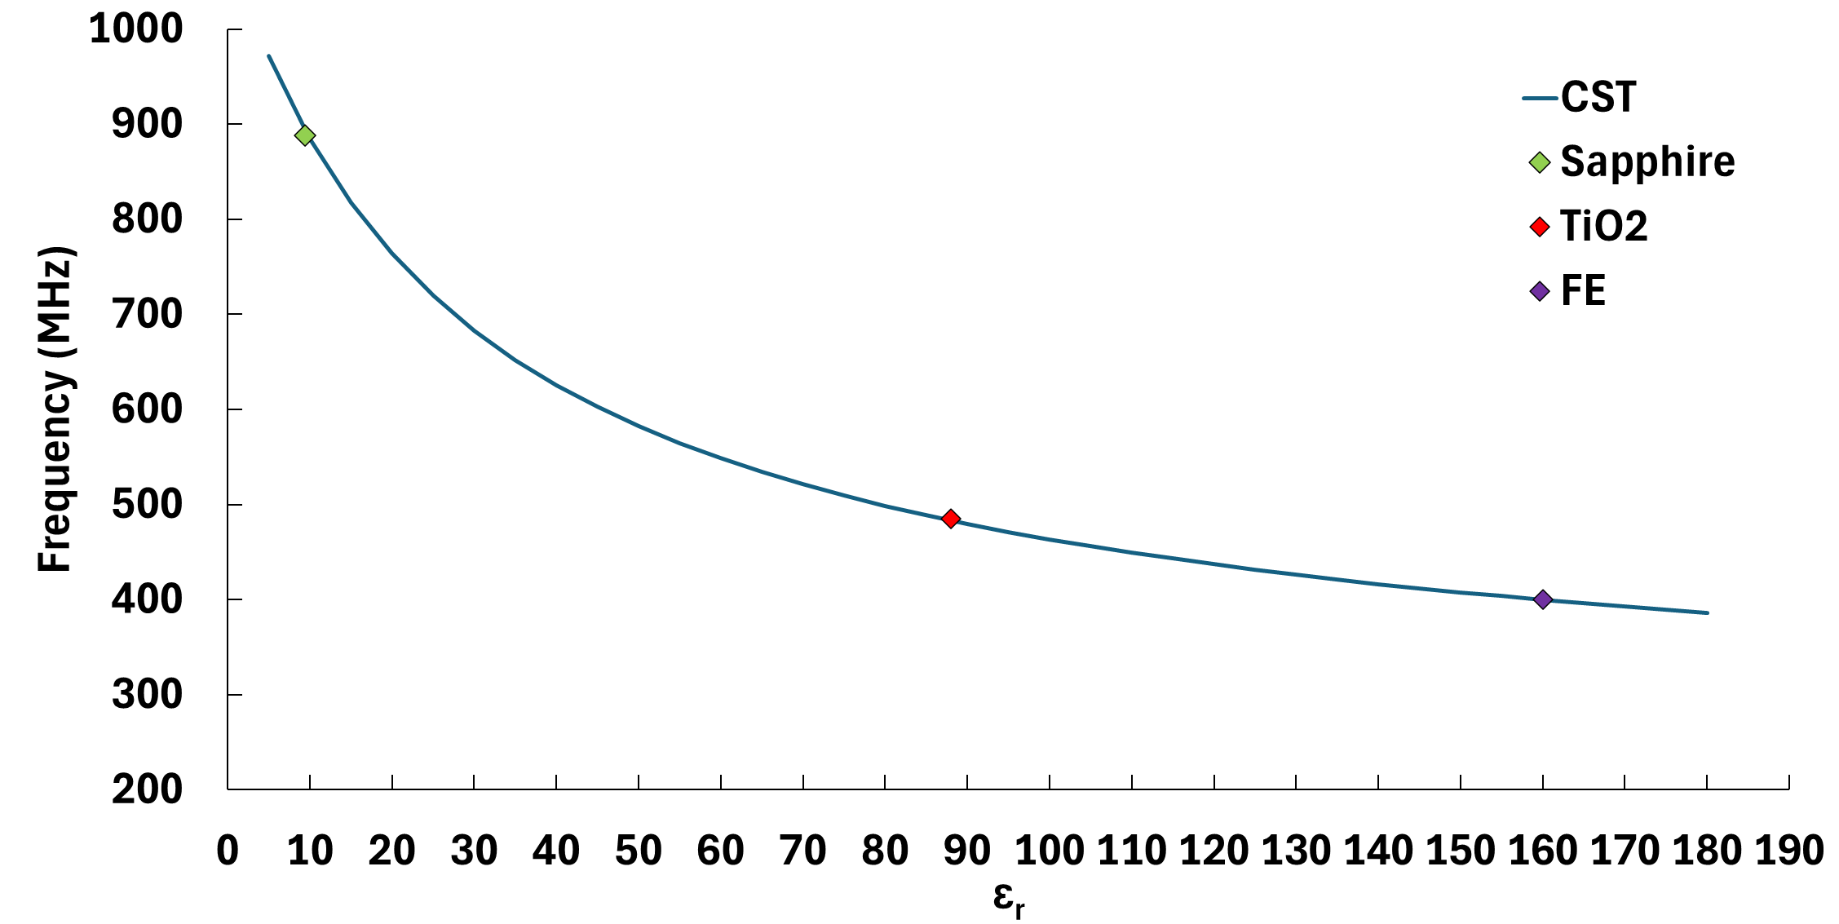
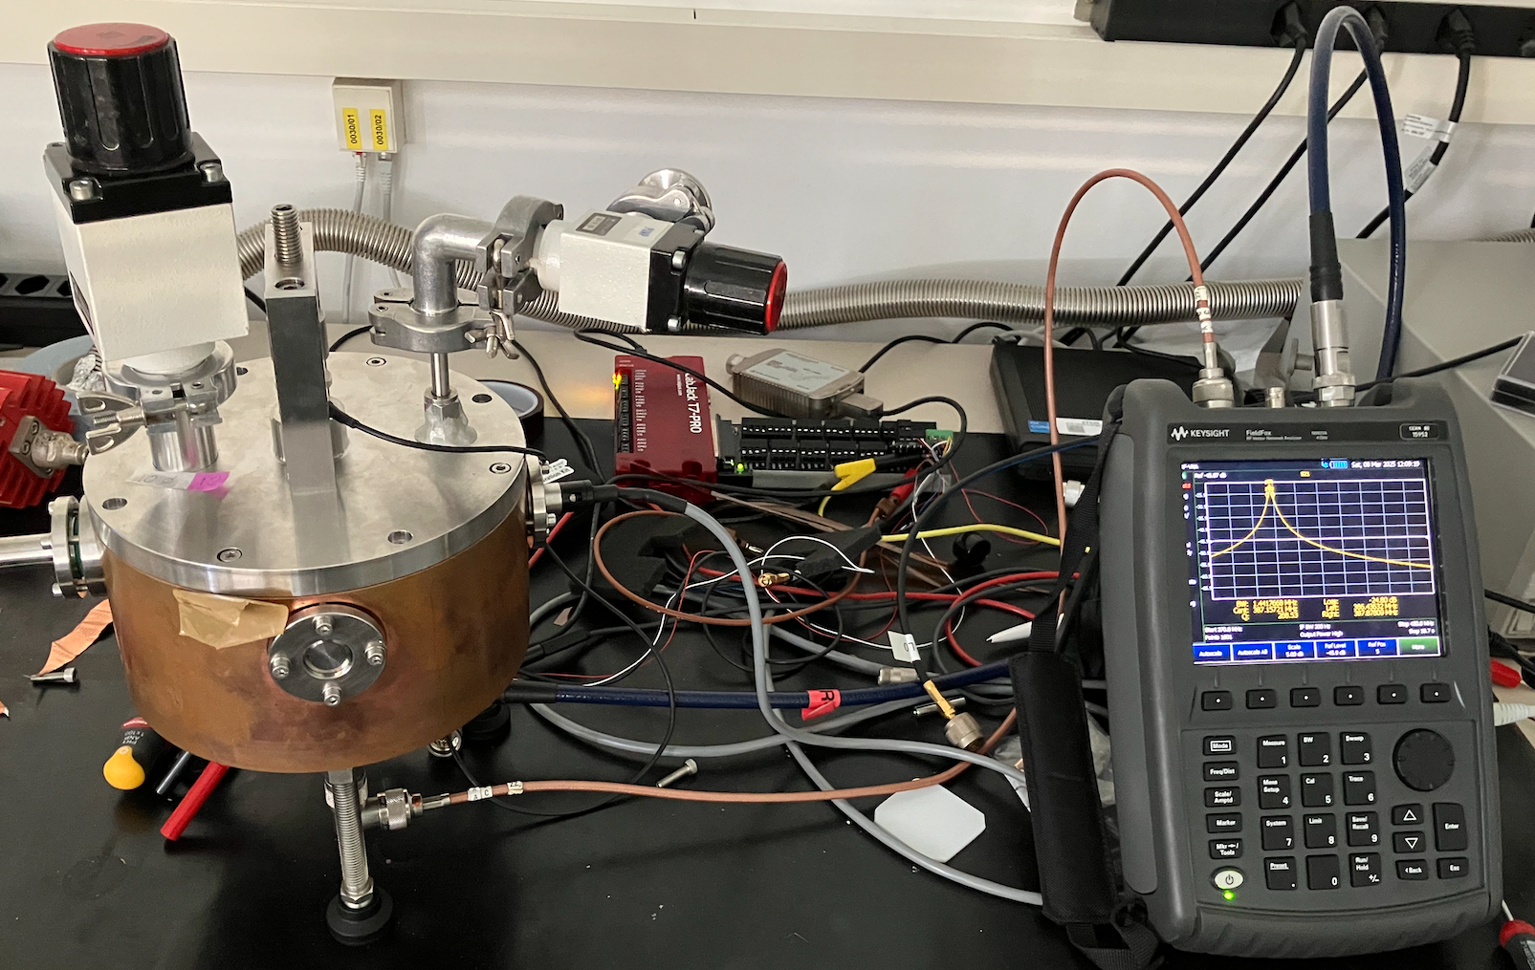
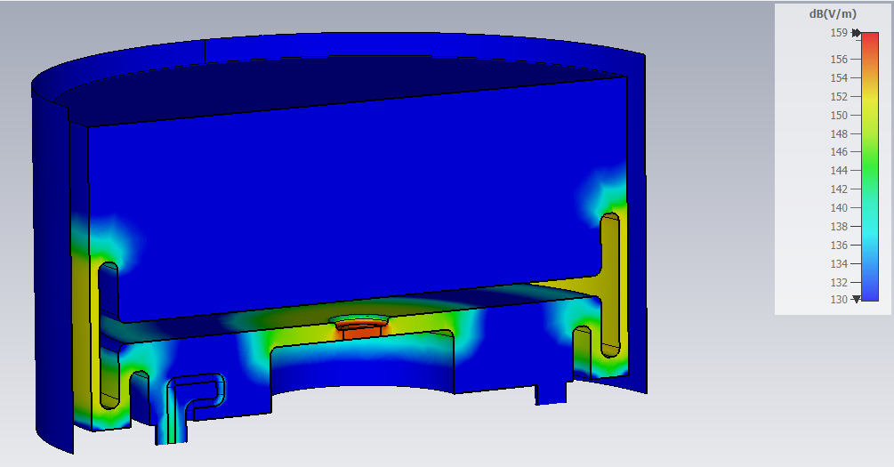
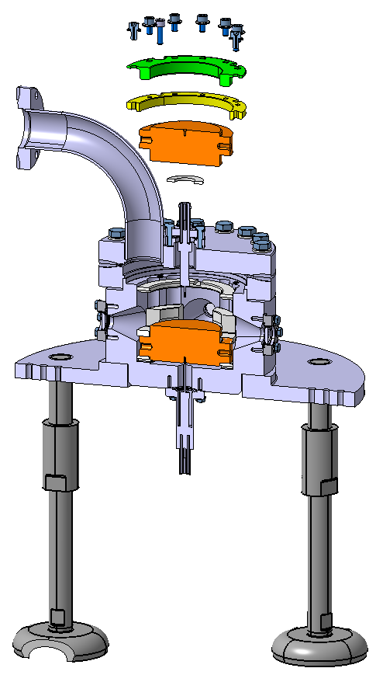
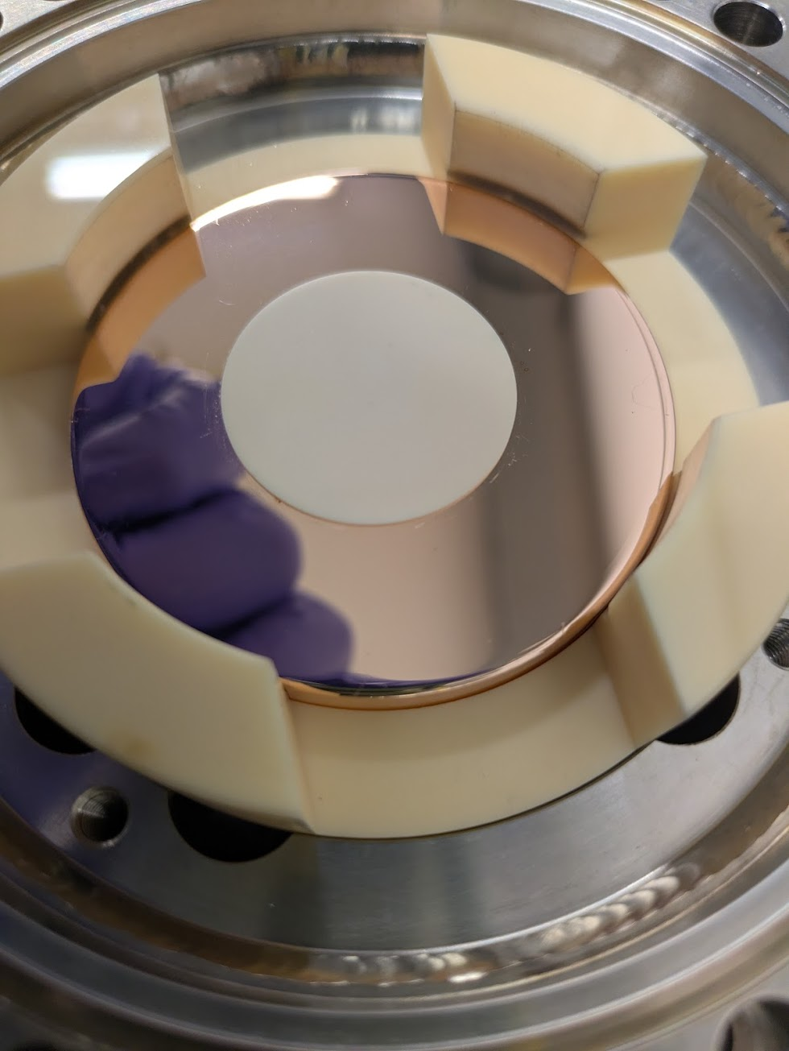
Ferroelectric Characterisation
Material Characterisation - Ferroelectric
  Dedicated quasi-quarter wave test stand for sample testing
    Measurement of ε= ε’ - jε’’ as a function of DC bias, temperature, and RF power
      Evaluating material performance with RF; frequency range 400 -800 MHz
High Voltage breakdown tests- CERNs Pulsed DC system
  System modified for iSAS samples:
    compression system for un-metalised ceramics
      compression force up to 8.4 kN
  Status: System validated with Al203 ceramics => measure FE in week 13
    Outcome
      DC breakdown threshold & Optimisation edge geometry
      Validation of FE machining and cleaning procedure
Courtesy Walter Wuensch & Victoria Bjelland (CERN)

Slide 13
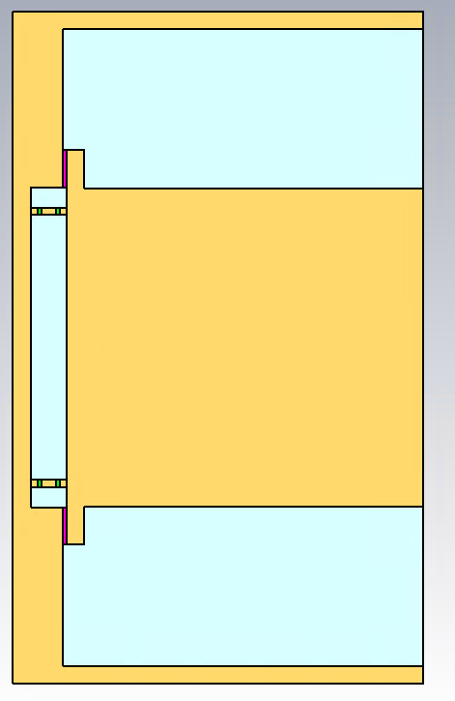
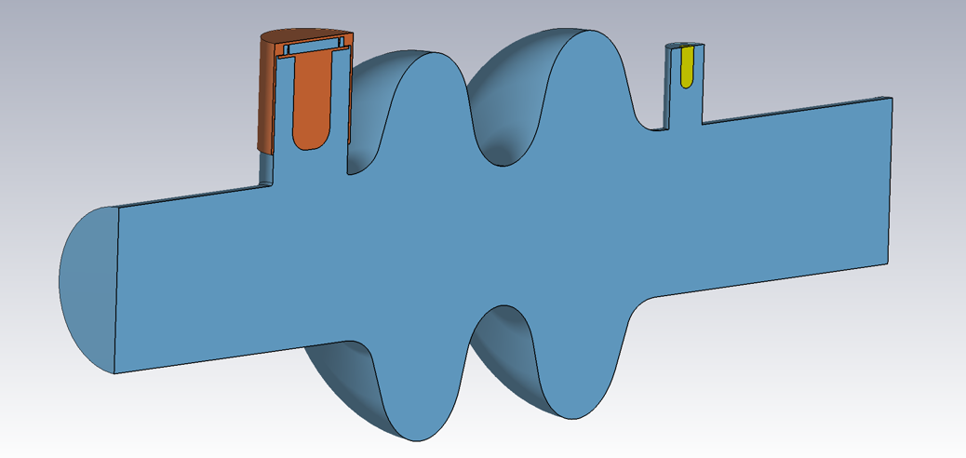
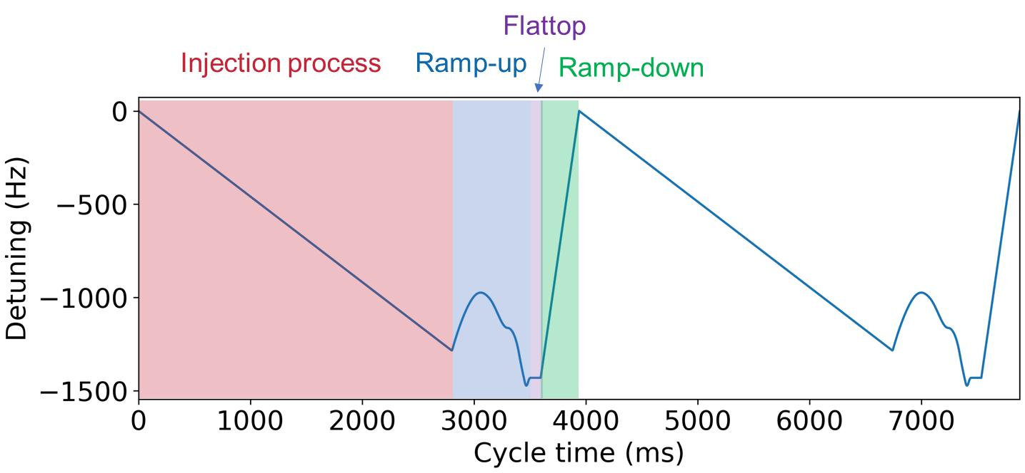
iSAS WP1: possible FCC use cases
Use case 1: Fast frequency shifting for rapid cavity detuning
  Applicable to 400 MHz Nb-on-Cu 2-cell cavities
  Request: Rapid detuning of failed cavity => target: Δf = 1 kHz in <1µs
  FRT Conceptual design: resonant 2-wafer ferroelectric stack
    Overdrive: 13 % increase in FoM & Qe = 8 x Qe(no Overdrive)
  Lessons Learnt
    2 wafer design: Simplifies DC bias and cooling schemes for ferroelectric wafers
    RF design: Simplified tuner resonance circuit
      retain tuner - cavity vacuum separation
  Status: On Hold: FRT design is good, but instabilities (optics) invalidates use case
Use case 2: Beam loading compensation during filling
  Applicable to 800MHz 6-cell bulk Nb cavities
  Request: Controlled detuning during injection cycle of FCC booster
    Continuous detuning over 3s filling time & during ramp and flattop
  Status: Ongoing - Conceptual 2-wafer design
    Analytics and preliminary CST simulations done
    Jan 25: launched WP1 UK-CERN sub-group
      WP1 Task 1.2 and WP1 Task 6.2
= ferroelectric
Case 1
Case 2

Slide 14
WP1 – FE-FRT: status/evolution of Task 1.3
FE-FRT for microphonics

Slide 15







FE-FRT Research Plan @ HZB
Loss tangent and permittivity vs electric field and temperature at 1.3GHz. Compression and breakdown.
Check RF performance as built vs simulation. Re-machine critical components to tune as necessary.
Test FE-FRT with 9-cell tesla cavity in HoBiCaT. Demonstrate full tuning range with full cavity stored energy.
9
Principle challenges:
  Obtain high FoM at 1.3GHz
  Don’t significantly impact heat load
  High electric bias field without breakdown
  Machining/compression of FE
  Integration into HoBiCaT
  Keep design simple/feasible
Test FE-FRT with jacketed 2 cell booster cavity in HoBiCaT. Low cavity stored energy. Mechanical tuner, microphonics control and full LLRF optional.
Test FE-FRT with 9-cell tesla cavity in HoBiCaT. With full LLRF control and microphonics control including piezo tuner. Demonstrate significant RF power reduction.

Slide 16
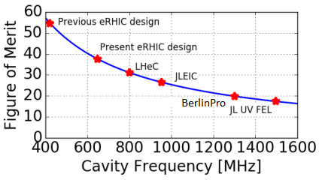


Designing an FE-FRT at 1.3 GHz for bERLinPro
Bad news:
Dielectric $α_{d}$ and conductive $α_{c}$ losses both increase with frequency
More losses means lower FoM
Estimated material FoM @ 1.3GHz:
Good news:
Microphonics only needs small tuning range
  compared to transient detuning
  => low power handling, no cooling lines, only 2 wafers etc.
HV driver is easy, can use off the shelf amplifiers
Parameter | Value
Relative Permittivity | 114-160
Loss Tangent | 1-2.10⁻³
Tunability | 1.4
Field for max. tuning | 8 Vµm⁻¹
Breakdown Strength | 20 Vµm⁻¹
Thermal Conductivity | 7.02 Wm⁻¹K⁻¹
Estimated Max. Temperature Rise | 50 K
Top: Estimation of coaxial design FoM based on equivalent circuit Monte Carlo method and material losses.
Below: Estimated material parameters at 1.3GHz

Slide 17
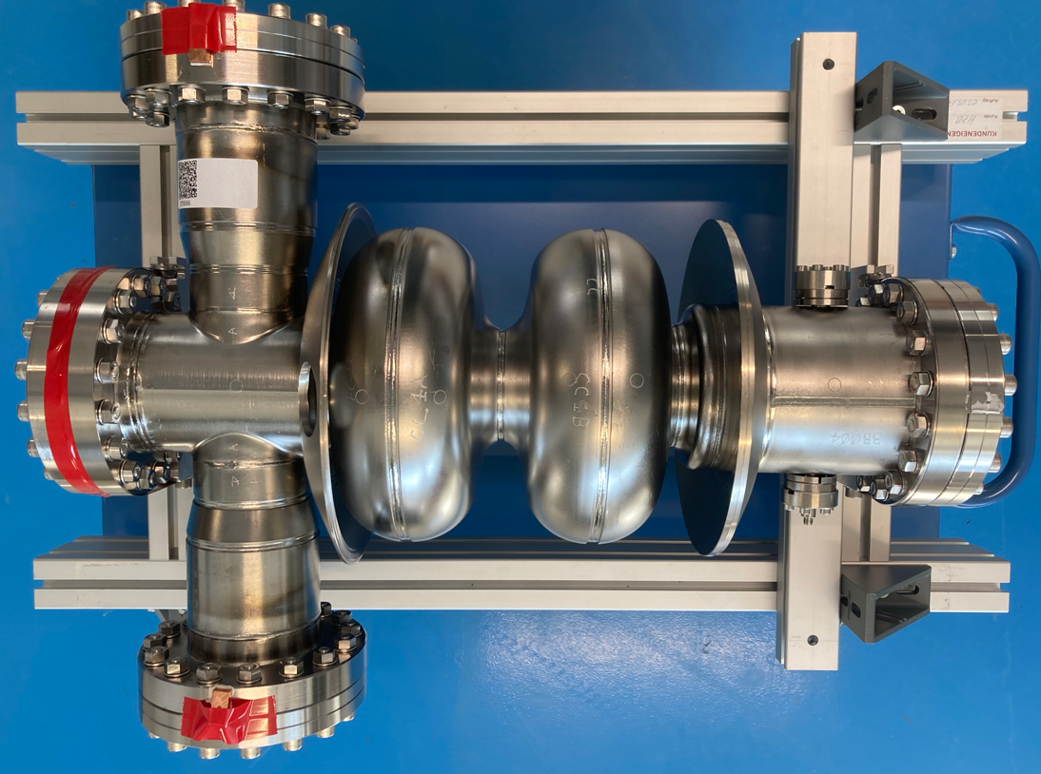
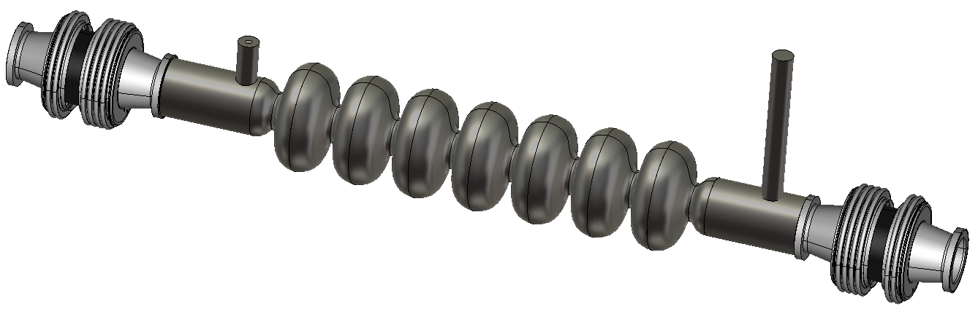

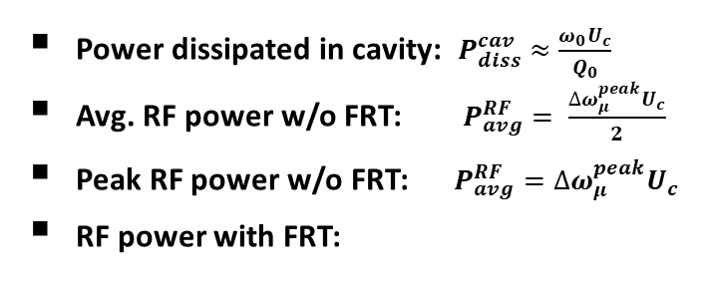
BE-FRT – Power and Temperature Estimates
Tuning Range = 20Hz
FoM = 25 (assumed)
FoM_{mat} ~ 125 (estimated)
FE thickness t = 1.25mm
Electrode contact area A $≈2.2×{10}^{−4}$
Number of wafers = 2
Power dissipated in FRT: $P_{diss}^{FRT}≈\frac{\left|∆ω_{12}\right|U_{c}}{FoM}$
Power dissipated in FE: $P_{diss}^{FE}≈\frac{\left|∆ω_{12}\right|U_{c}}{{FoM}_{mat}}$
Power dissipated in cavity: $P_{diss}^{cav}≈\frac{ω_{0}U_{c}}{Q_{0}}$
Avg. RF power w/o FRT: $P_{avg}^{RF}= \frac{{∆ω}_{μ}^{peak}U_{c}}{2}$
Peak RF power w/o FRT: $P_{avg}^{RF}={∆ω}_{μ}^{peak}U_{c}$
RF power with FRT:
Temperature rise in FE: $∆T= \frac{P_{diss}^{FE}t}{6kA}$
Booster Cavity
7 cell bERLinPro LINAC Cavity
Parameter | Value
f0 | 1.3 GHz
Q0 | 2 10^10
R/Q | 219
Stored Energy | 2.5 J
Voltage | 2.1 MV
Parameter | Value
f0 | 1.3 GHz
Q0 | 2 10^10
R/Q | 788
Stored Energy | 36 J
Voltage | 15 MV
Peak µphopnics Detuning | 30 Hz
Peak LF Detuning | 520 Hz
Booster
LINAC
12.6 W
180 W
2.5 W
36 W
Power dissipated in cavity: $P_{diss}^{cav}≈\frac{ω_{0}U_{c}}{Q_{0}}$
Avg. RF power w/o FRT: $P_{avg}^{RF}= \frac{{∆ω}_{μ}^{peak}U_{c}}{2}$
Peak RF power w/o FRT: $P_{avg}^{RF}={∆ω}_{μ}^{peak}U_{c}$
RF power with FRT:
1 W
15 W
15 W
200 W
3.4 kW
3.4 kW
400 W
6.8 kW
6.8 kW
N.B. idea is to use piezo tuner to reduce peak microphonics from 30 to 20Hz
195 W
13.6 W
195 W
2.1K
8.5K

Slide 18
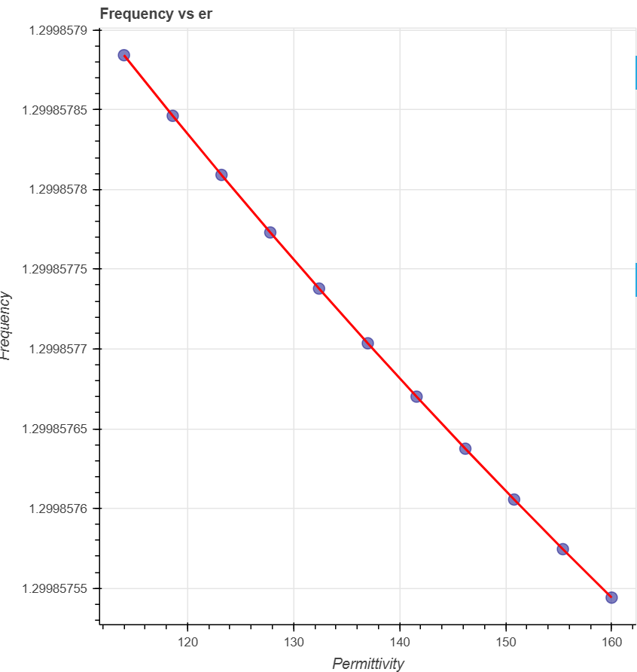
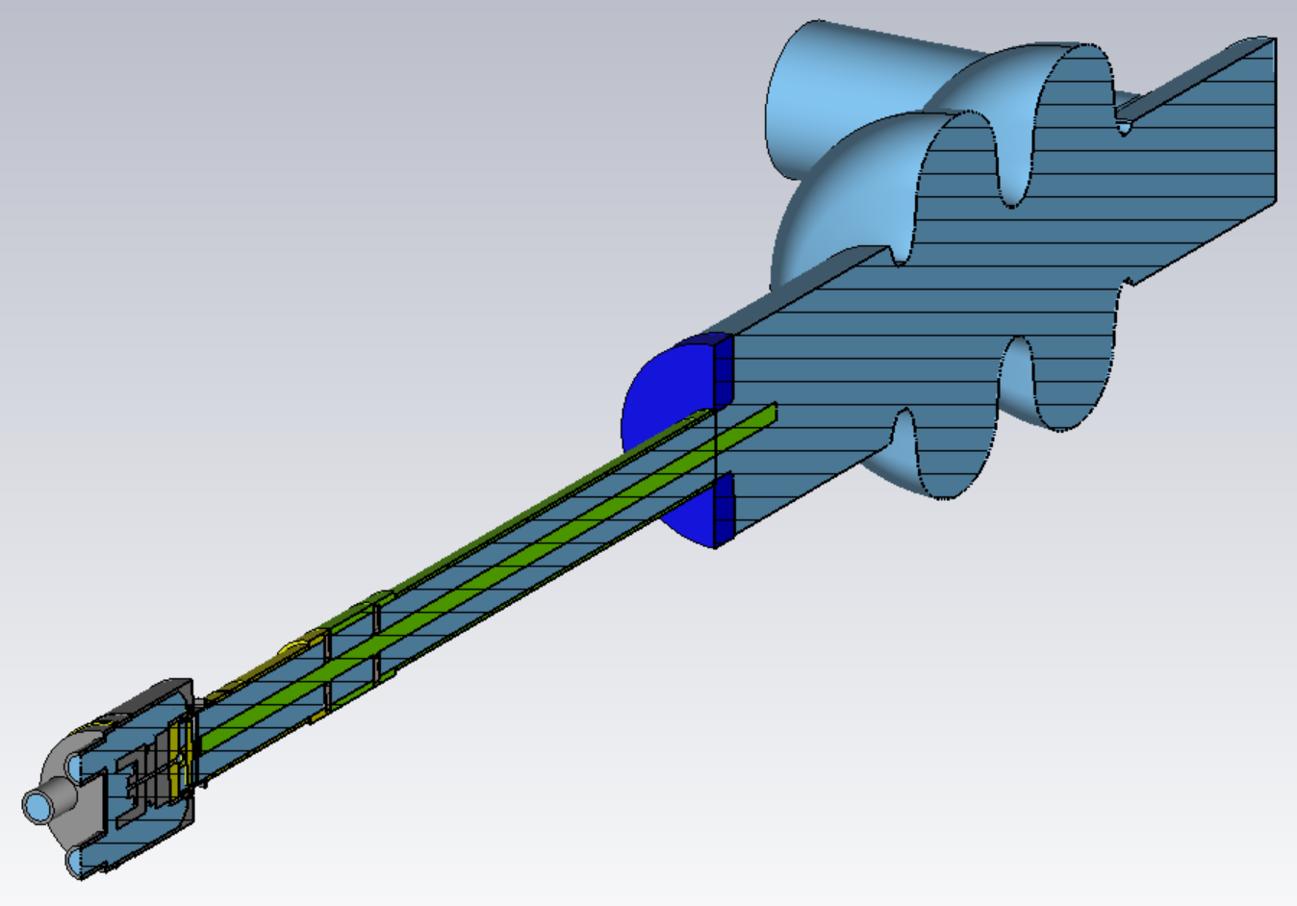
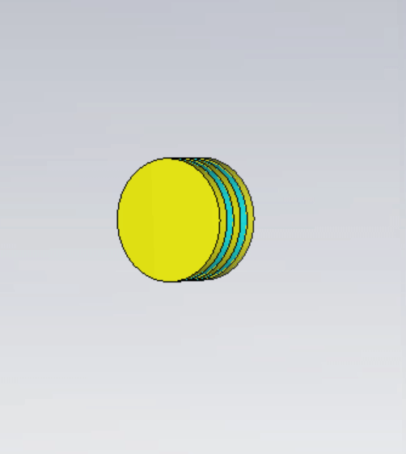
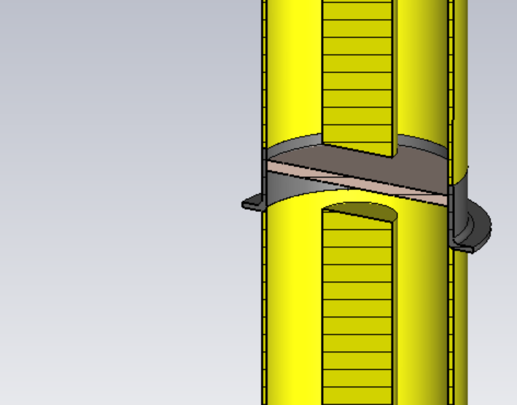
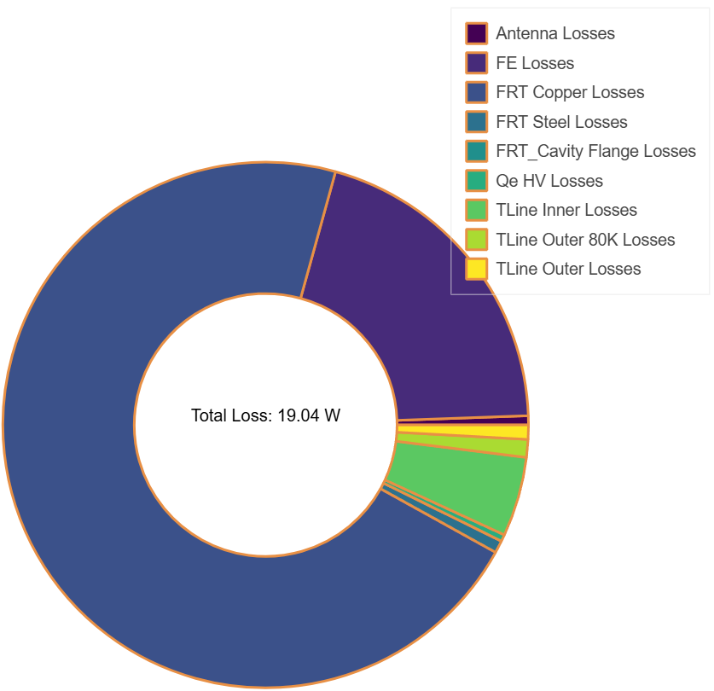
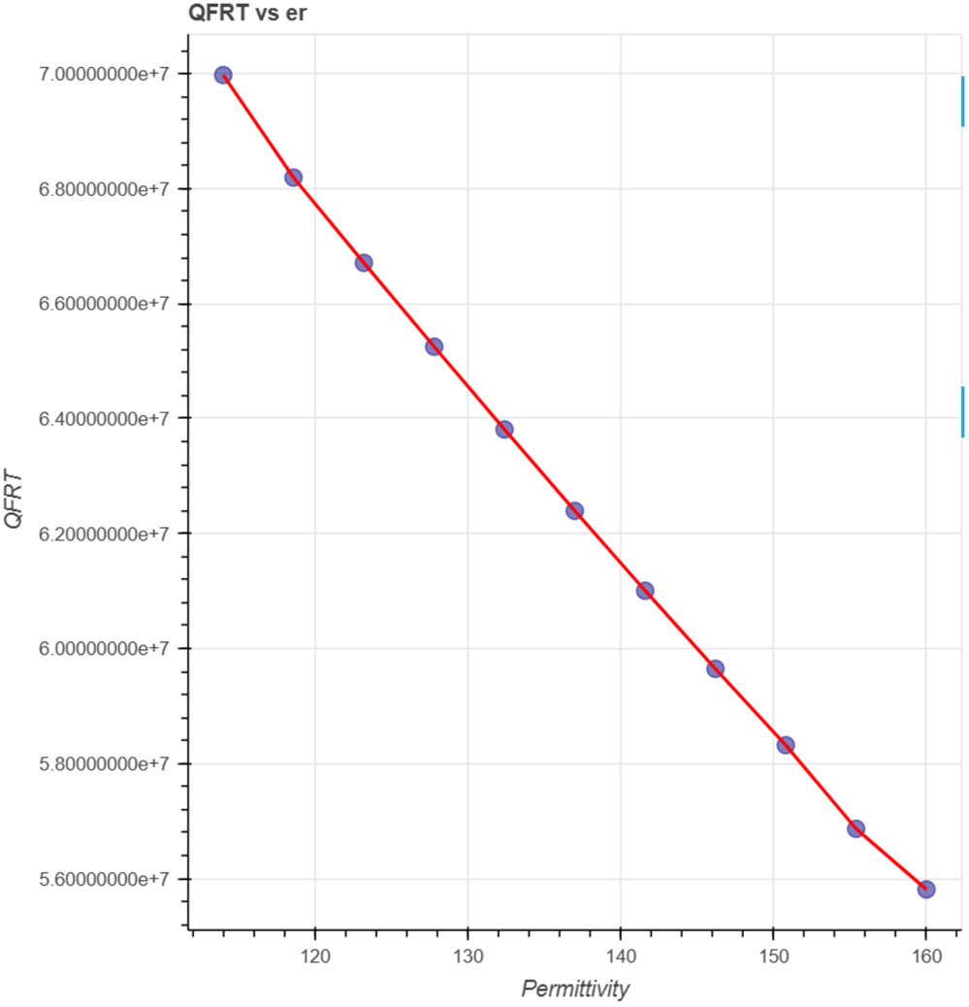

BE-FRT features
FoM ~ 16
Bi-Resonant
  FRT is resonant near cavity frequency
  Large phase change -> larger tuning range with smaller antenna
  Add $λ/4$ transmission line -> bi-resonance avoids losses in center of tuning range
Only two FE wafers
  Simplifies HV biasing issues
  Increases power dissipated per wafer
High aspect ratio annulus FE wafers
  Minimises losses/maximises FoM
Simple as possible
  Few parts requiring tight mechanical tolerances
  Capacitive coupling through off the shelf vacuum window
  No other ceramic or FE brazing
Capacitive coupling through vacuum window
FRT Vacuum
Analysis of losses for 30Hz tuning range in booster cavity at nominal voltage
Ferro-electric
Copper
Cavity Vacuum
Copper
Alumina
Compressive force
Steel
RF and Mechanical design complete and fabrication started!

Slide 19
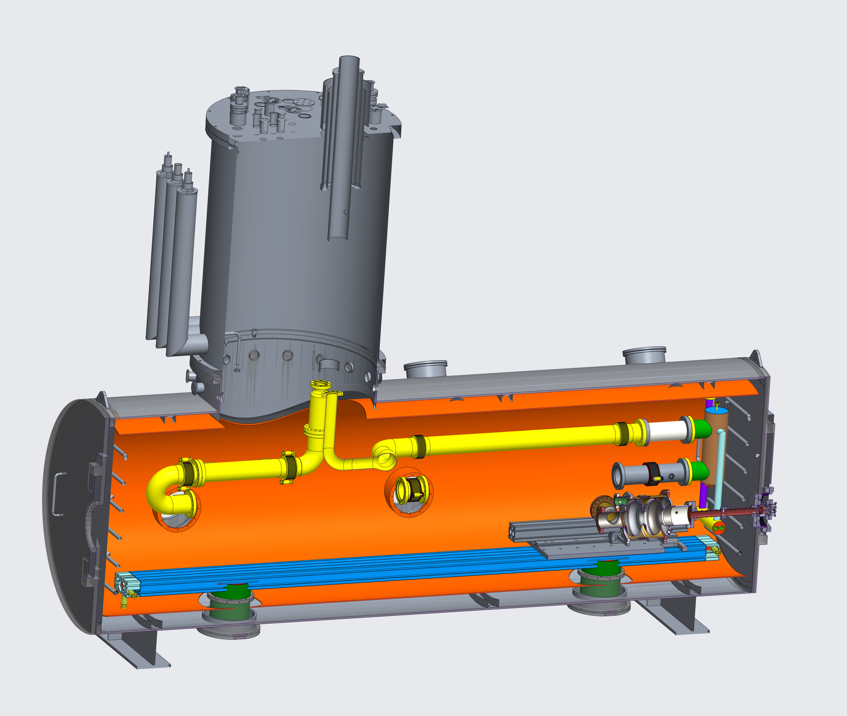
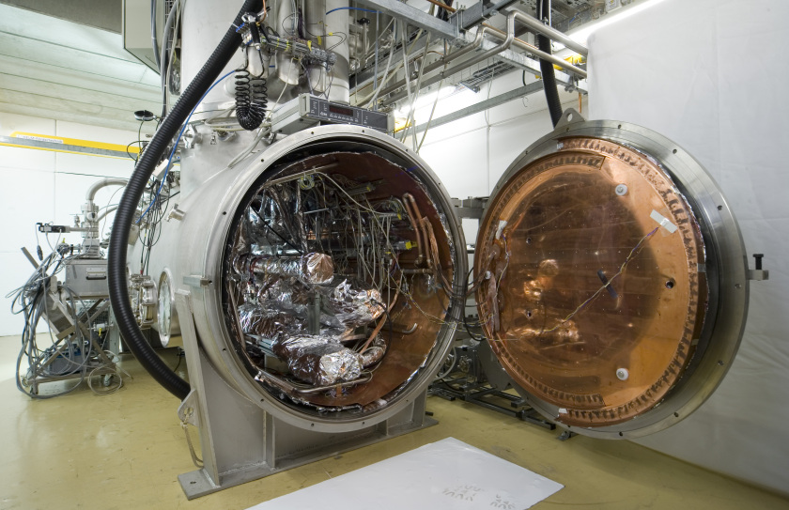
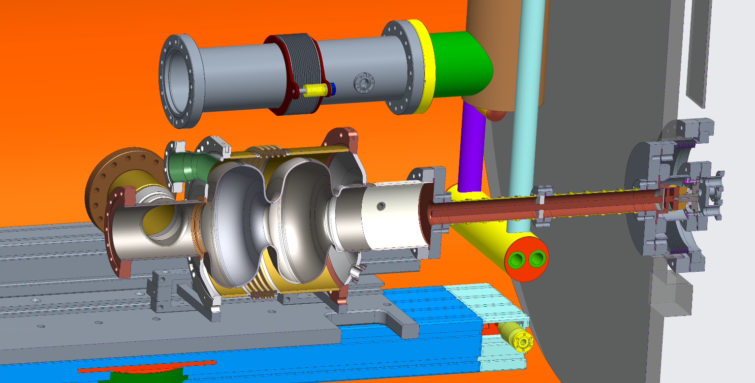
Mechanical Design and HoBiCaT Integration
HoBiCaT – Horizontal Bi-Cavity Testing
Designed for tests of fully dressed cavities in CW mode
Cavities can be equipped with all components needed for SRF module e.g. tuners, high power input coupler etc.
Both 2-cell and 9-cell cavity FRT tests will use HoBiCaT
Mechanical design and integration ~complete
Port in HoBiCaT door used to allow FRT to be placed at room temperature outside of HoBiCaT
  Avoids need for anti-cryostat
80K and 4K intercept to reduce heat load to cavity
Assembly procedure:
  Cavity, Tline and window assembled in clean room
  Slid onto table, HoBiCaT door closed
  FRT and vacuum chamber assembled
Courtesy Andre Frahm
Courtesy Andre Frahm

Slide 20
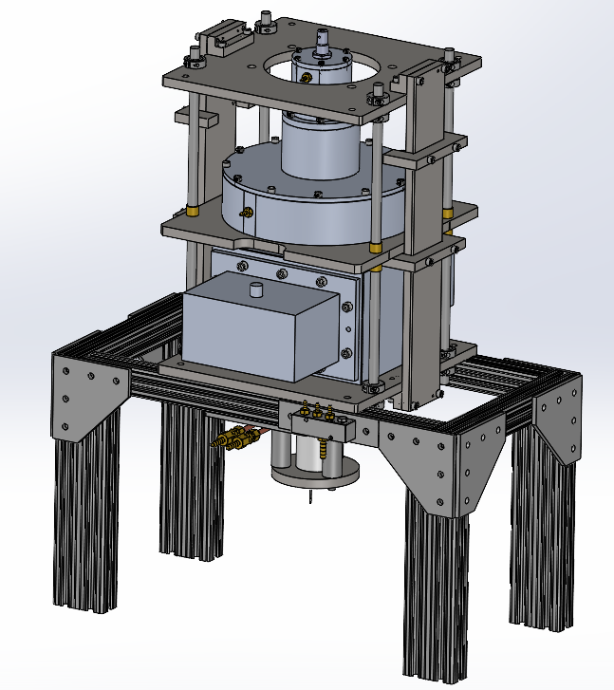
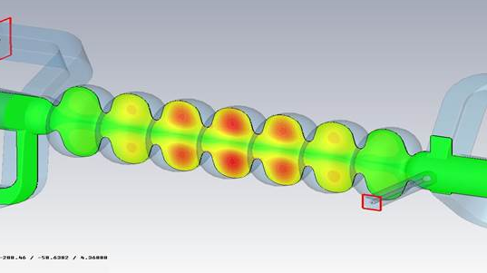
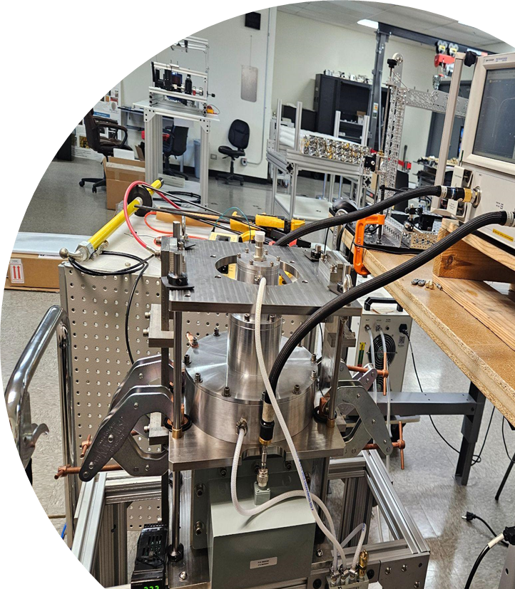
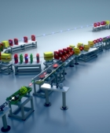
Ferro-electric Sample Characterisation

Slide 21

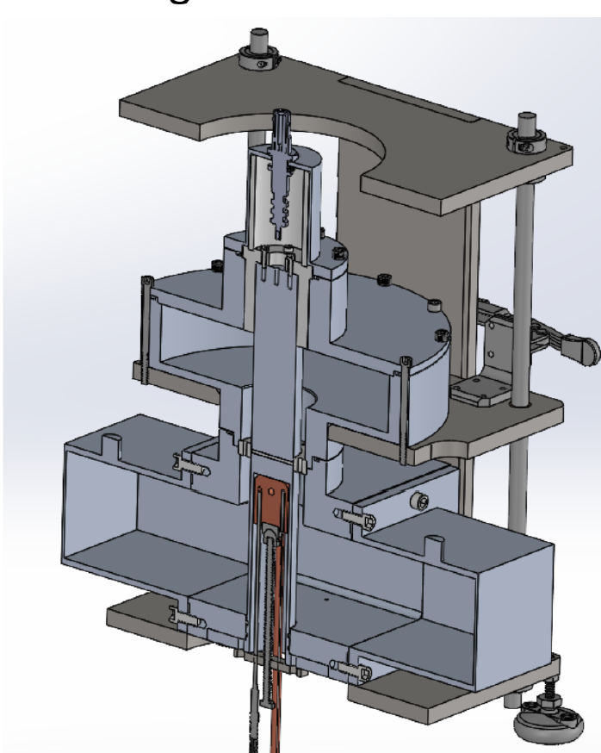
FERMAT Design
Designed and built by:
High Voltage feedthrough
Ferro-electric sample
High Voltage insulation
Dual use heating block
  Heater
  Thermocouple
  Coolant
Lifting system
Co-axial-waveguide adapter
Compression system
  ball and socket joint
Gas tight to allow pressurised N₂ atmosphere

Slide 22
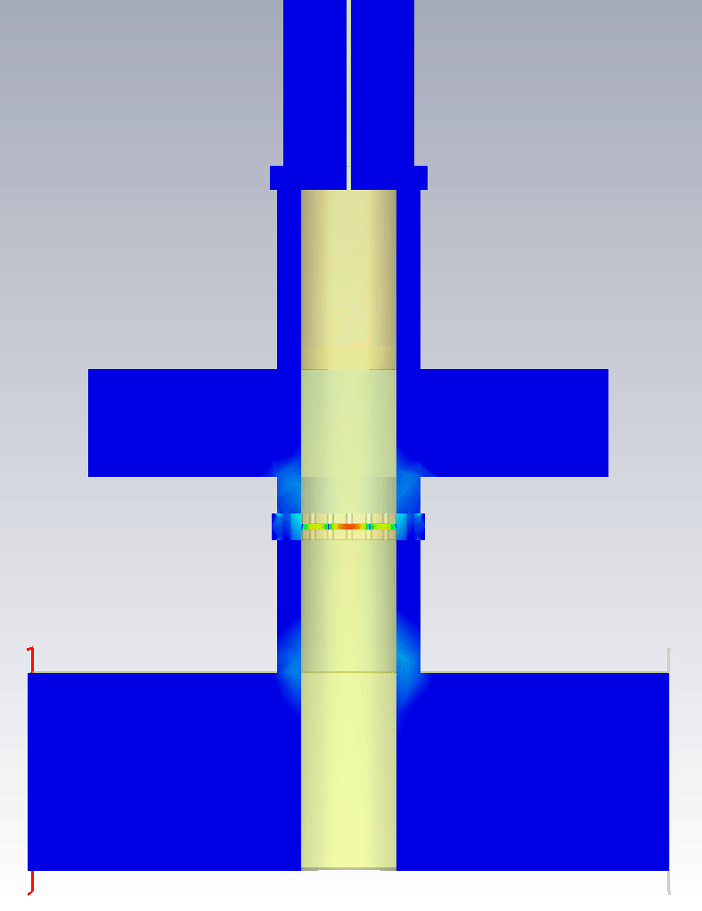
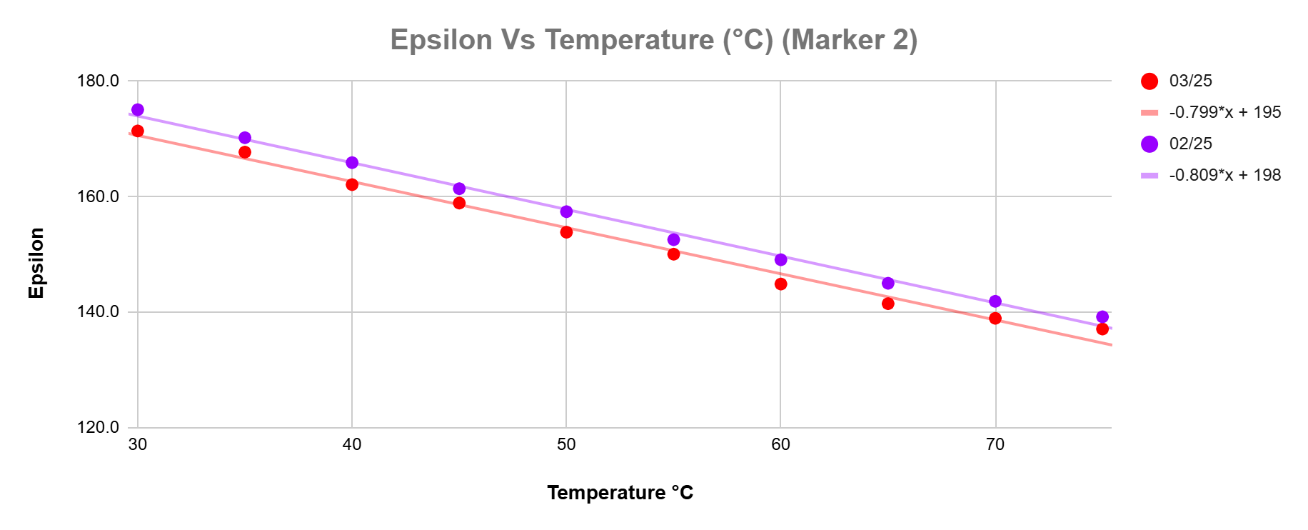




FERMAT Preliminary Results
Mode 1
Commissioning ongoing:
  First S-param meas. not close enough to simulation to allow accurate extraction of tan$δ$ and $ε_{r}$
Results so far:
  $ε_{r}$ decreases with T
  $ε_{r}$ decreases with E
${\text{Δ}ε}_{r}$higher with less compression
  Opposite to expected
17kN compressive force applied
  ~nominal pressure
  No damage to sample
  Compression system damaged
Euclid providing full support
  Compression system fixed
  Better clamping system added
  First $ε_{r}$ vs T and E measured
Expected mode 1 range
Expected mode 2 range
Mode 2
Plot courtesy of E. Atrill
2.5mm thick sample
E-field is what matters
Example of measured mode 1
Example of measured mode 2

Slide 23
WP6 – task 6.2 Retrofitting FRTs: status/evolution
Status
Study of frequency domain multiplexor-based HOM coupler.
Looking into hybrid eigenmode/circuit model simulations to allow faster optimisation.
• Study the effect of HOMs on FE-FRT operation to define max leakage (also look at harmonic generation by the FRT).
Analytical calculations almost complete, discussing with non-linear crystal THz source experts about FDTD FRT simulations.
• Study the heating due to high fundamental power in the coupler.
Not started
Evolution
PDRA and PhD student both in post
Collaborating with STFC-ASTeC on FRT for UK-XFEL

Slide 24


FRT-HOM Hybrid
Numerical methods for faster FRT optimization
Optimize FRT for higher FOM (reduce ohmic losses in copper)
Design frequency selective filter to separate FRT and HOM damping functions on a single port
HOM-FRT complete design and thermal/multipactor calculations
Effect of HOM power in FRT
Non-linear FDTD FRT simulations
Nov 24
Nov 25
Nov 26
Analytical calculations show that any HOM close to the 2nd harmonic of the fundamental will mix with the fundamental to create significant sidebands around the RF drive increasing phase noise
Investigating the use of eigenmode simulations of FRT units without the cavity to build accurate equivalent circuit models for fast FRT design

Slide 25

WP1 meeting hot topics
Treatment of ceramics, surface quality:
  Impact on teststand results, impact on FE-FRT performance
  Does treatment harm/alter material characteristics?
  How does surface geometry/roughness etc. add to discharge
  problem?
  Do we have a common understanding of these steps, especially
  with regards to HV breakdown tests at CERN?
Cutting/grinding of ceramics towards FE-FRT geometry
  Best methods, impact of method on surface, material properties
Upcoming Milestones: Still in time, but in 02/2026 material characterized
by CERN and HZB, …..
Damage from breakdown in FERMAT at 9kV (3.6V/µm) in 2.3bar N₂ atmosphere.

Slide 26
WP1– FE-FRT: points of attention
Points of attention
  Strong interaction with U Lancaster (WP6), several labs work on FE-FRT for 1300 MHz microphonics application: HZB, U Lancaster (UK XFEL), U Mainz (external iSAS, MESA)
  Clarification of IJCLab involvement for WP1 required to secure MS fulfillment and to allow benefit for PERLE 2nd cryo-module (energy saving as selling argument?)
  Euclid is a strong partner for WP1, as being expert in FE ceramics and manufacturer of FRT prototypes, ceramics teststand → Continuous exchange of know-how
  FCC use cases will impact, how much 800 MHz developments align with PERLE
  FRT designs. Current beam-loading filling for multi-cell cavity a bit closer
  to microphonics like design.
  The collaboration with W. Wünsch group at CERN for the HV breakdown tests are under
  way and a great example of expanded collaboration driven by iSAS/CERN and European RF accelerator roadmap panel

Slide 27

WP1 – FE-FRT: plans to achieve milestones & deliverables
Milestones on track, first ML for Task 1.2 and 1.3 nearly completed already, ML 3 will happen this year, ML 4
is being worked on (Cavity preparation, ordering parts)
Measurements to minimize risks with ceramics started with external partners and in-house expertise
HV breakdown measurements, ceramics surface characterization, new surface treatments by CERN, HZB and
Euclid
Open point: MS 2, need a discussion how IJCLab will work on this, do we need input from U Lancaster?
How much is an involvement of CERN needed (use case FCC close to PERLE 800 MHz design)
→ MS is only about integration, is that foreseen for 2nd cryo-module studies?

Slide 28
WP1 – FE-FRT: financial status
Financial status
  In WP 1 funding was officially only for CERN and HZB as beneficiaries with about 50% of matching funds for
  personnel and invest/consumables
  So far only smaller spendings happened for invest/consumables
  Of the two positions, one is filled at HZB since beginning of iSAS, CERN is still working on filling their position
  We still need to make a full funding analysis, which requires input from the lab’s administrations, which takes time
Deviations
  So far not identified, but there might be more in kind budget needed at HZB to prepare cavities for the
  FE-FRT tests

Slide 29

WP1 – FE-FRT: Thanks for listening
Thanks for your attention
and mille grazie to all collaboration
partners of this work package
Alick Macpherson, Sam Smith, Graeme Burt, Walid Kaabi, André Frahm,
Nick Shipman, Alexei Kanareykin and Co., Jens Knobloch, Axel Neumann,
Maleesh Dissanayake, Hingpong Jiang
WP2 members, Ilan Ben-Zvi, Alena Prudnikava, Paul Schneider, Mickael
Crouvizier and more involved co-workers at CERN, HZB
Stay focused

Slide 30

FE-FRT workshop at HZB
When? 13th to 14th of November
Where? At Berlin, Germany, at Helmholtz-Zentrum
Berlin, Adlershof Campus
How to join? Just register here:
https://events.hifis.net/event/2275/
What about? Not limited to iSAS programm, includes
FE-FRT applications for other systems
Do you want to know more? Ask Nick Shipman, contact on the website

