Slide 1
WP2: Low level RF controls Padova meeting, March 13, 2025
All information contained in this presentation and any accompanying documents is for iSAS project only, and must be treated as strictly confidential.
Any dissemination, distribution or other use of this information without the consent of its owner is prohibited.
Funded by the European Union. Views and opinions expressed are however those of the authors only and do not necessarily reflect those of the European Union or the European Commission. Neither the European Union nor the granting authority can be held responsible for them.

Slide 2
WP2: Low Level RF controls 10.01.2025
DESY, HZB, CNRS
Convener & deputy: Holger Schlarb (DESY) & Julien Branlard (DESY)
Main contacts with other partners: Axel Neumann (HZB), Christophe Joly (CNRS)
Task 2.1: Coordination of R&D on LLRF – M1-M48
Task 2.2: Efficient field control for high loaded-quality factor cavities – M1-M48
Task 2.3: Vibration analysis and detuning control of cavities – M1-M36
Task 2.4: Integrated LLRF control using Ferro-Electric Fast Reactive Tuners– M13-M48
Task 2.5: Energy efficient supervisory control and fault diagnosis– M1-M48

Slide 3
WP2 – LLRF: status/evolution of Task 2.1
Task 2.1: Coordination of R&D on LLRF – M1-M48
Past developments
WP2 coordination meetings in place
Status update of the different labs
Reporting about iSAS project activities (website, industrial board, next in-person meeting)
Communication structure established
Email distribution list
Shared repository (meeting minutes, status reports, presentations)
Identified test possibilities in each lab
Test stands, facilities, type of cavities, tuning systems, power sources, etc.
Current developments
New position
HZB: postdoc for iSAS
DESY : new position opening to support with tests (100% iSAS)
DESY : new senior LLRF to support R&D, start in May 25 (not directly iSAS but will help)
Change in WP2 management
Lead Holger Schlarb → Julien Branlard
Deputy Julien Branlard → Christian Schmidt

Slide 4
WP2 – LLRF: status/evolution of Task 2.1
Task 2.1: Coordination of R&D on LLRF – M1-M48
Past developments
WP2 coordination meetings in place
Status update of the different labs
Reporting about iSAS project activities (website, industrial board, next in-person meeting)
Communication structure established
Email distribution list
Shared repository (meeting minutes, status reports, presentations)
Identified test possibilities in each lab
Test stands, facilities, type of cavities, tuning systems, power sources, etc.
Current developments
New position
HZB: postdoc for iSAS
DESY : new position opening to support with tests (100% iSAS)
DESY : new senior LLRF to support R&D, start in May 25 (not directly iSAS but will help)
Change in WP2 management
Lead Holger Schlarb → Julien Branlard
Deputy Julien Branlard → Christian Schmidt

Slide 5
WP2 – LLRF: status/evolution of Task 2.2
Task 2.2: Efficient field control for high loaded-quality factor cavities – M1-M48
Past developments
Evaluate methods for changing Q_{L} (at the cavity coupler and waveguide level)
(HZB) Tests done at HoBiCat with 3-stub tuner
(DESY) Modify test stand for operation with SSA : done and approved by German authority (TUEV)
Current developments
Test with Q-tuner last month
Developed new devices to extend Qext range
First result with high power look promising, but need to investigate heating of couplers

Slide 6
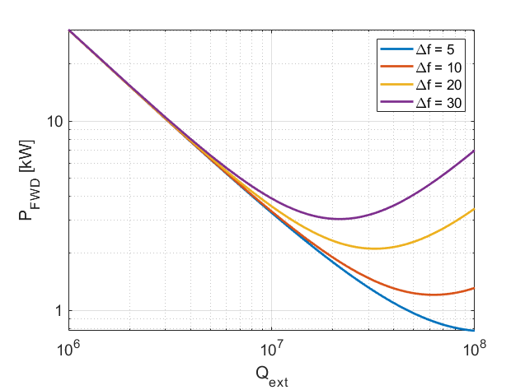
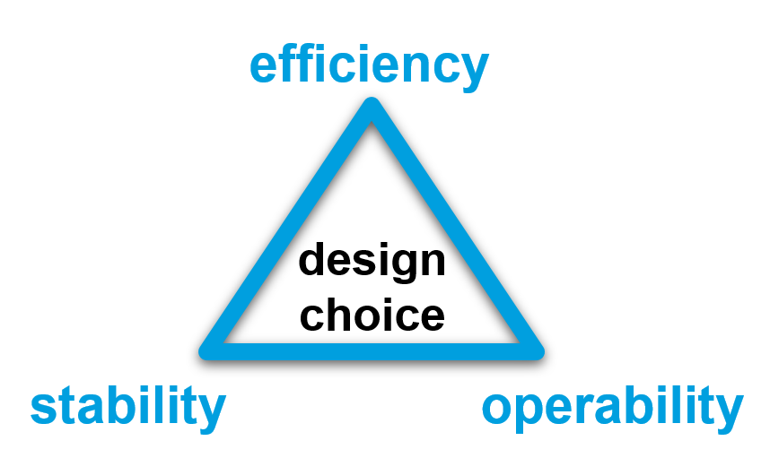
Why is bandwidth and resonance control crucial for efficiency
Bandwidth (Qext) and Resonance (Δf) control
Operating at higher Qext (narrower bandwidth)
reduces the power needs IF resonance control can be guaranteed
makes resonance control extremely challenging
Parameters for SRF gun
r/Q = 208 Ohm V_{acc} = 5 MV (energy gain from the gun at 50 MV/m -> 5 MeV) I_{b} = 100 uA (100 pC at 1 MHz)
φ_{b} = 0 deg.
4 kW
3.3 kW
2 kW
1.3 kW
The challenge is to find the highest Qext one can operate the cavity at while still meeting the resonance control goals and without compromising operability and reliability of the system.
1 kW
Q_{ext} = 1e7
Q_{ext} = 4e7

Slide 7
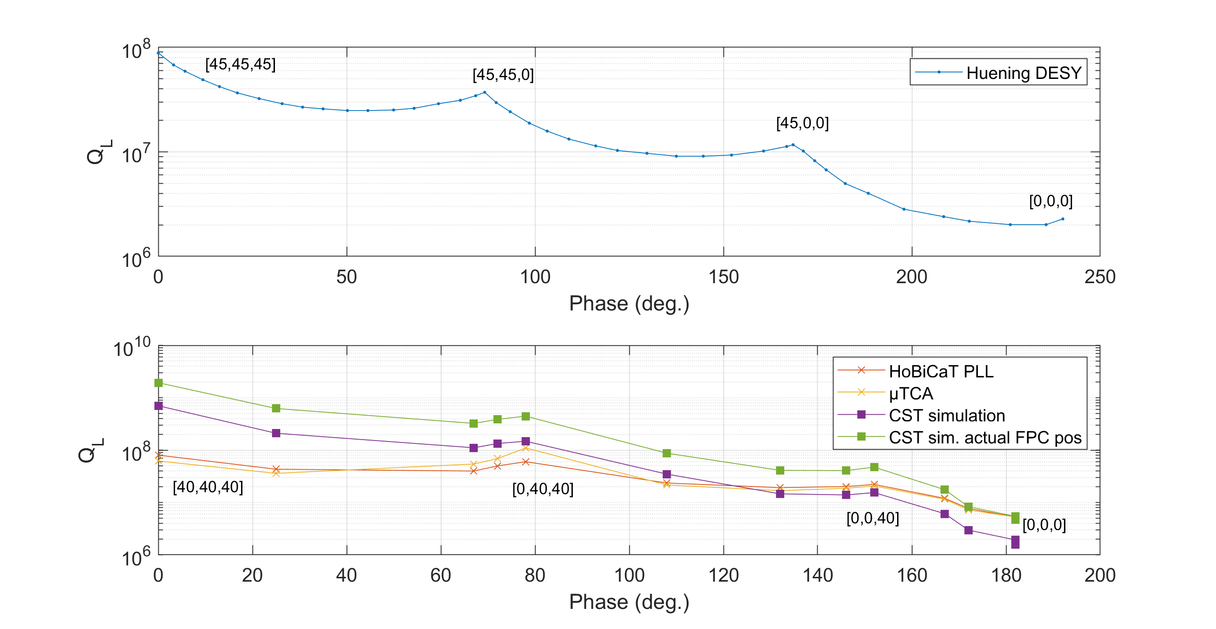
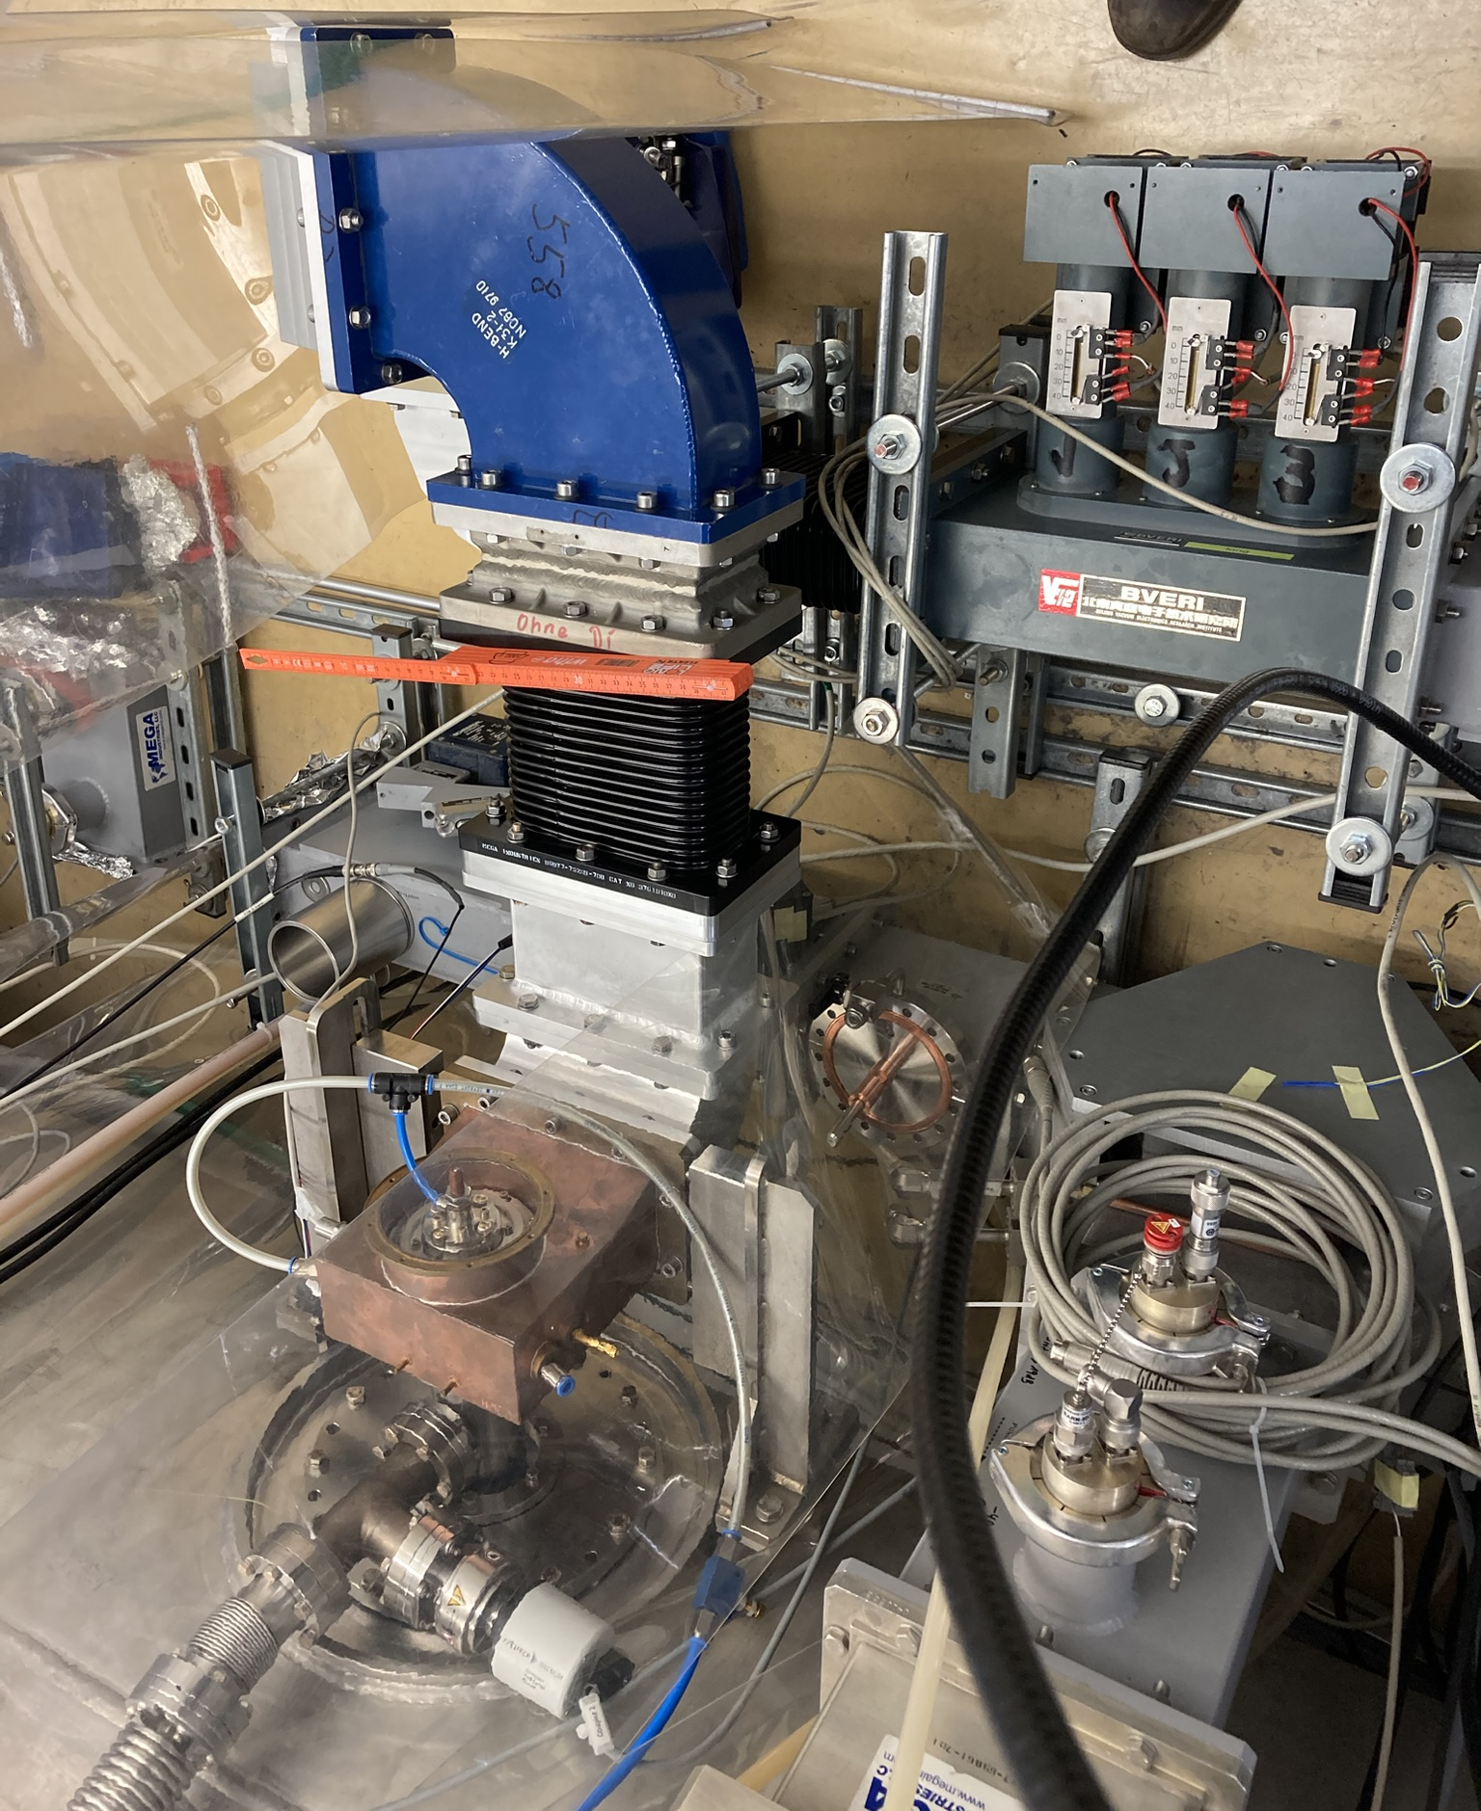
Extending the Qext range
First test with 3-stub tuner at HobiCat
(HZB) re-measured Qext change with 3-stub tuner at HobiCat (had already been done a long time ago…)
Cross checked results with CST simulations.
3-stub tuner
CST simulation
Courtesy A. Neumann

Slide 8
WP2 – LLRF: status/evolution of Task 2.2
Task 2.2: Efficient field control for high loaded-quality factor cavities – M1-M48
Past developments
Evaluate methods for changing Q_{L} (at the cavity coupler and waveguide level)
(HZB) Tests done at HoBiCat with 3-stub tuner
(DESY) Modify test stand for operation with SSA : done and approved by German authority (TUEV)
Current developments
Test with Q-tuner last month
Developed new devices to extend Qext range
First result with high power look promising, but need to investigate heating of couplers

Slide 9
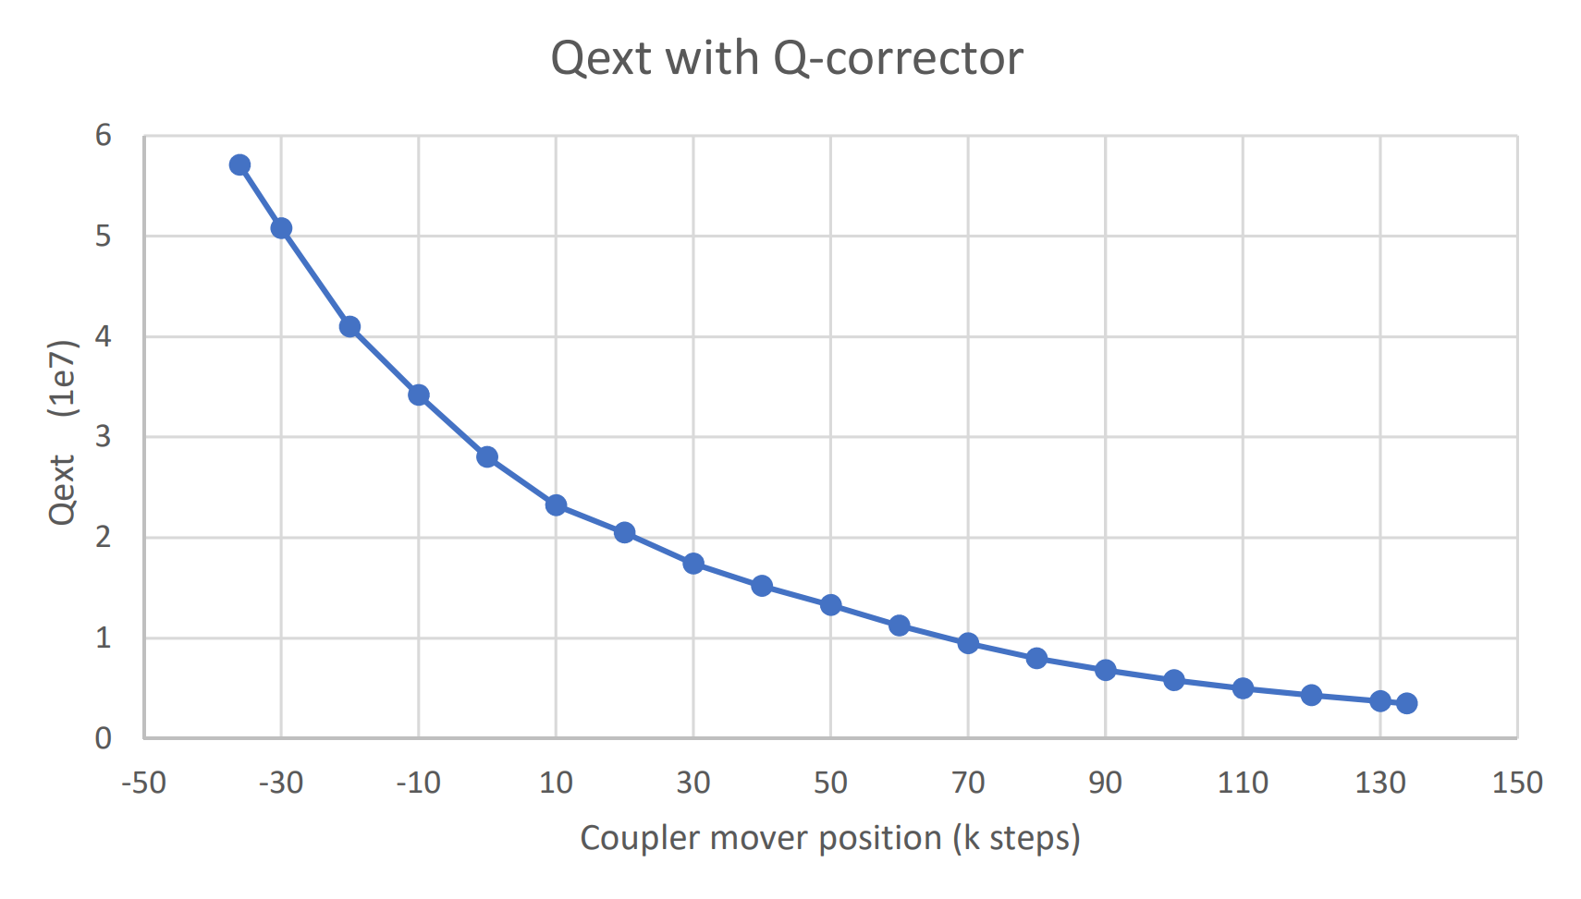
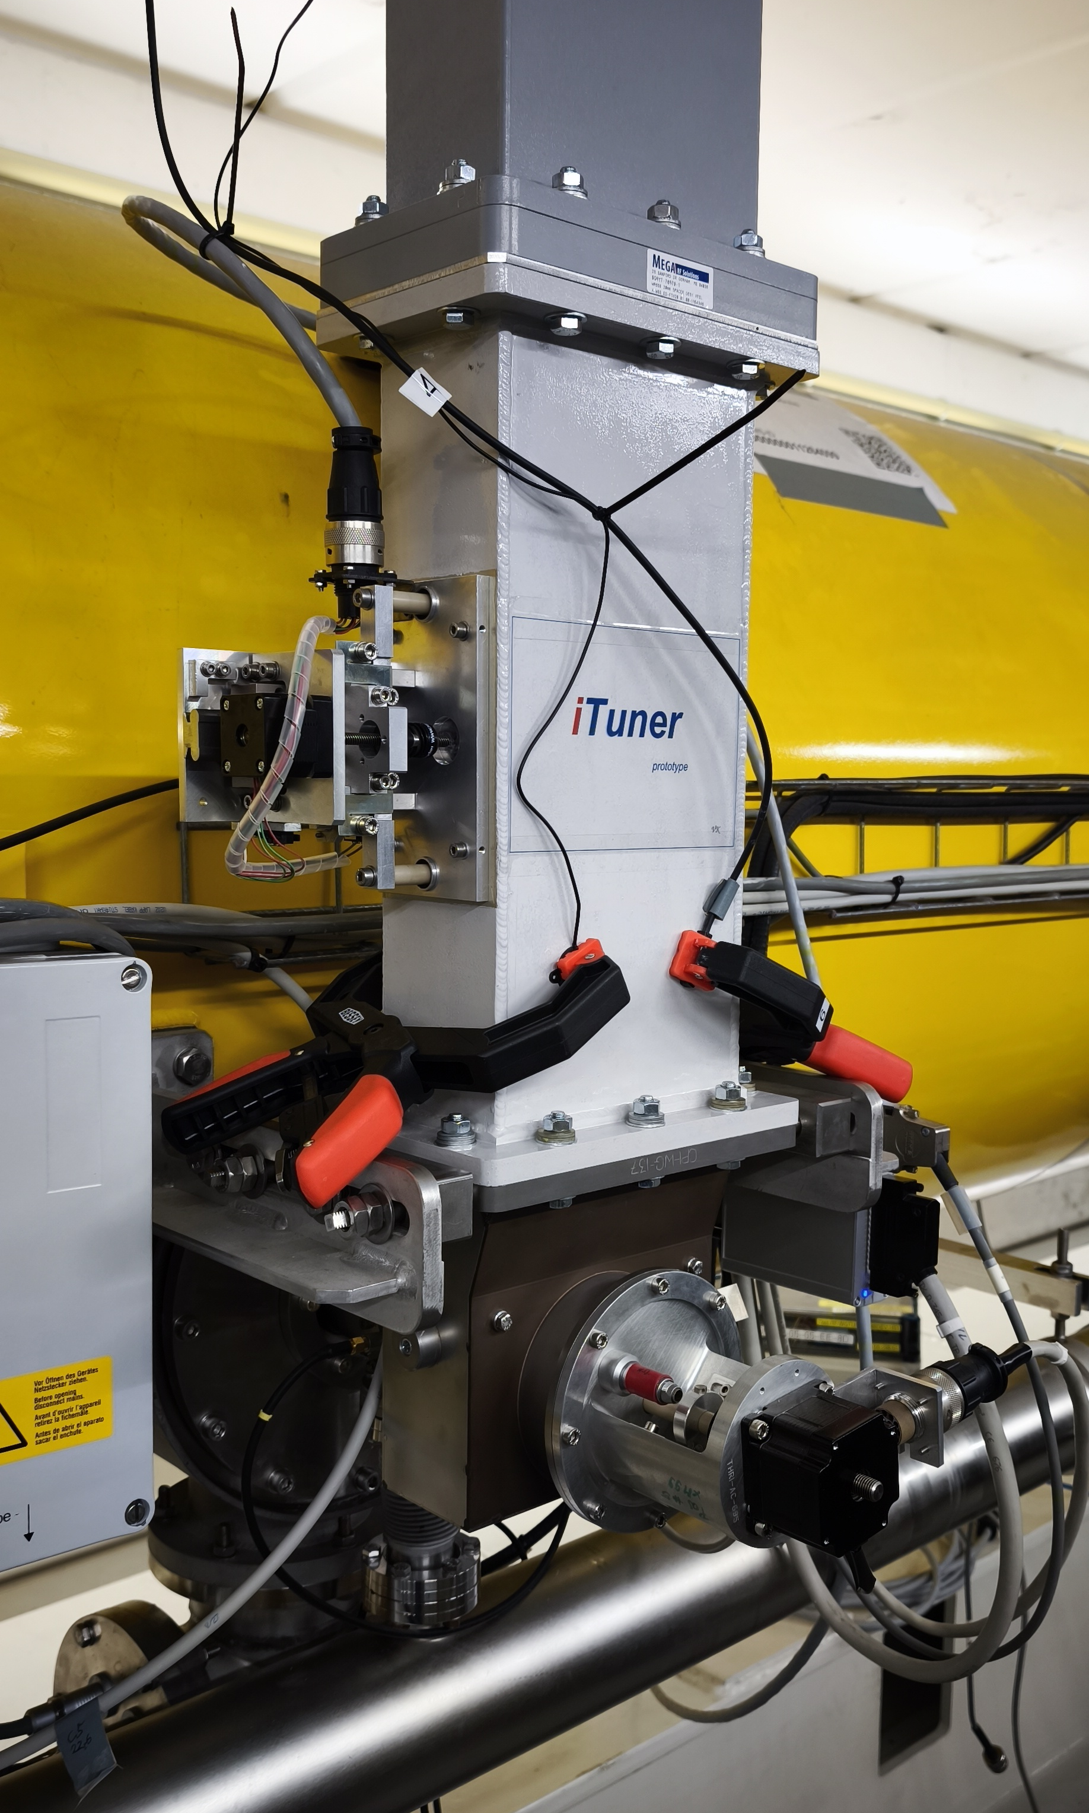
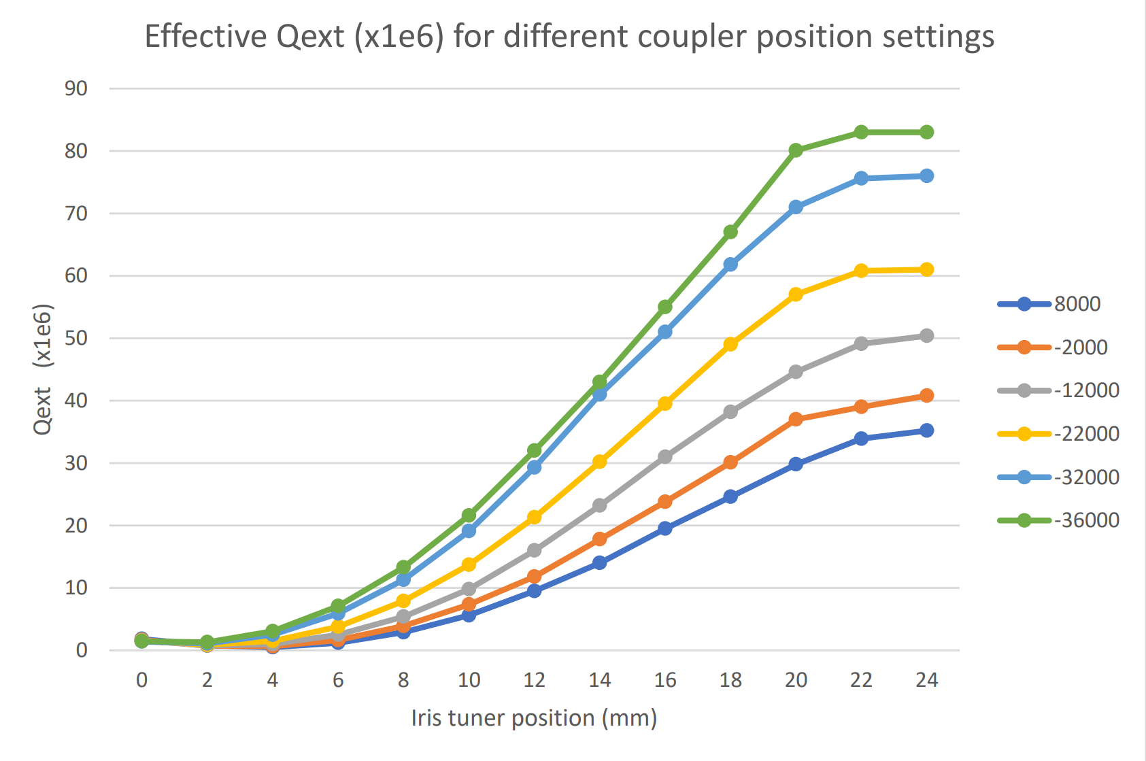
Developed 2 prototypes to extend the Qext range
Waveguide components to increase Qext range
Q-corrector (fixed)
Iris-tuner (variable)
I-tuner motor
coupler motor
fixed stud
coupler motor
coupler motor
Courtesy V. Katalev
Several devices are being developed to increase or shift the Qext tuning range
High-power test started
Currently investigating induced heating of coupler
T300K heating
T70K heating

Slide 10
WP2 – LLRF: status/evolution of Task 2.3
Task 2.3: Vibration analysis and detuning control of cavities – M1-M36
Past developments
Characterize environmental disturbances and transfer to the cavity perturbation.
First estimation of EuXFEL microphonics indicate +/- 3Hz
First RF tests at SeaLab (BerLinPro SRF gun), repeat with beam before summer 2025
Current developments
Investigate and develop detuning counter measures based on advanced feedforward, feedback and active noise cancellation including AI methods.
(DESY) Implementation of Luenberger Observer to estimate bandwidth and detuning
(HZB) Estimating cavity detuning using Neural Network
(DESY) Demonstrated RF phase modulation to achieve stable cavity ramp up in pulsed mode
(DESY) Demonstrated a more efficient Lorentz Force Detuning compensation at EuXFEL

Slide 11
WP2 – LLRF: status/evolution of Task 2.3
Task 2.3: Vibration analysis and detuning control of cavities – M1-M36
Past developments
Characterize environmental disturbances and transfer to the cavity perturbation.
First estimation of EuXFEL microphonics indicate +/- 3Hz
First RF tests at SeaLab (BerLinPro SRF gun), repeat with beam before summer 2025
Current developments
Investigate and develop detuning counter measures based on advanced feedforward, feedback and active noise cancellation including AI methods.
(DESY) Implementation of Luenberger Observer to estimate bandwidth and detuning
(HZB) Estimating cavity detuning using Neural Network
(DESY) Demonstrated RF phase modulation to achieve stable cavity ramp up in pulsed mode
(DESY) Demonstrated a more efficient Lorentz Force Detuning compensation at EuXFEL

Slide 12
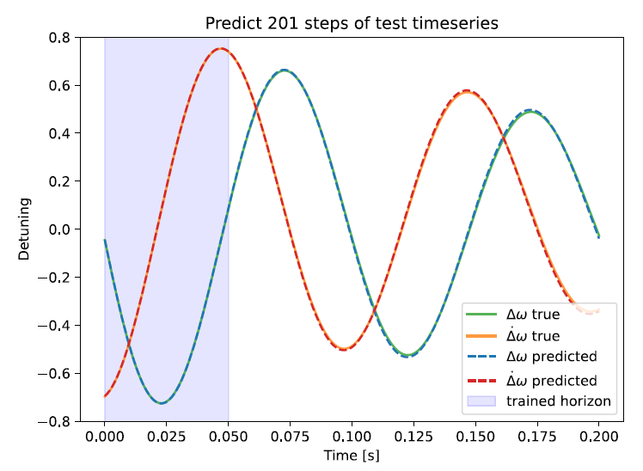
Detuning estimation using ML
Deep learning of cavity detuning (HZB)
Primary goal is to see if one can use machine learning, specifically auto-encoders, to predict detuning in CW
Use deep learning to adapt the cavity model to real-time variations
Use Koopman filter to make dynamics of the system appear linear
Simulated detuning data, then used to train and test model
Next, get experimental data (at Hobicat) to re-train model
Courtesy Andrei Maalberg

Slide 13
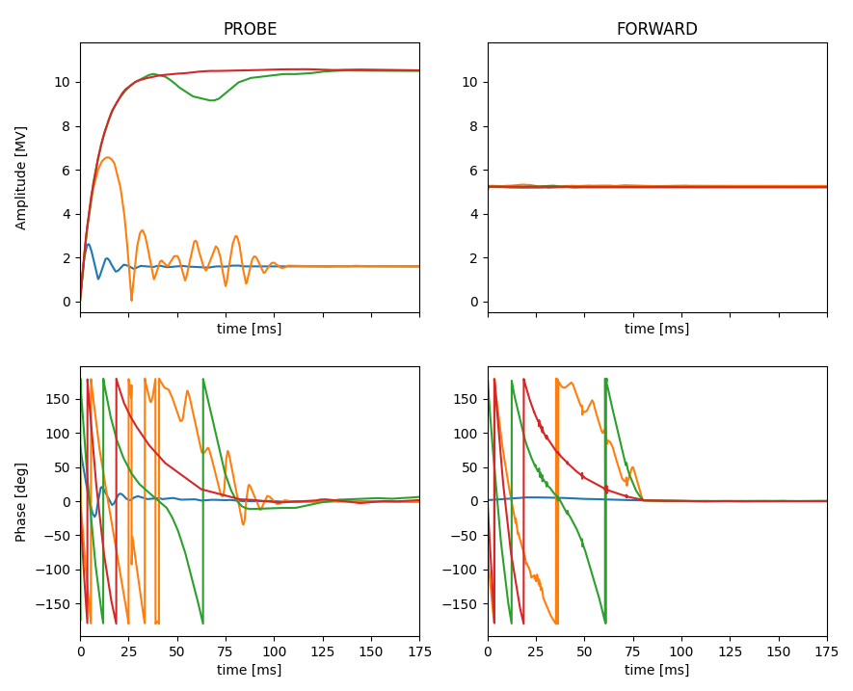
Resonance control
Demonstrated RF phase modulation to achieve stable cavity ramp up in pulsed mode
Operating high-Qext cavities in pulsed mode
Ramp-up
Iterative learning to match the drive signal (amplitude and phase) to the cavity resonance
i.e. like Self-Excited-Loop (SEL) but with Generator Driven (GDR) approach
Better suited for pulsed and vector-sum operation
4
3
Qext = 4e7
BW = 32 Hz
2
1
Courtesy Bozo Richter

Slide 14
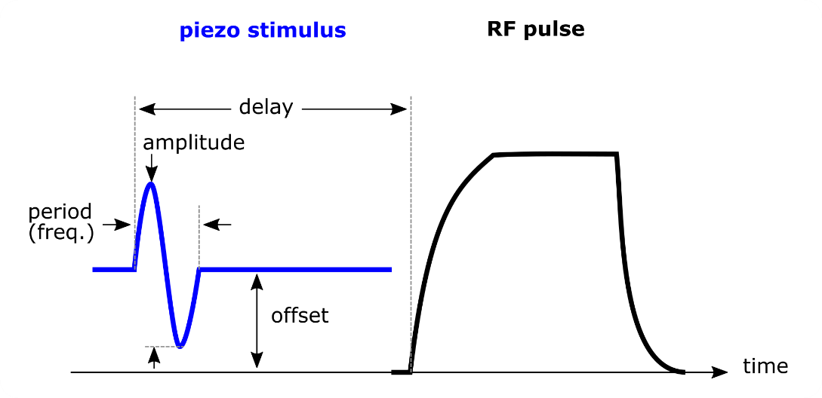
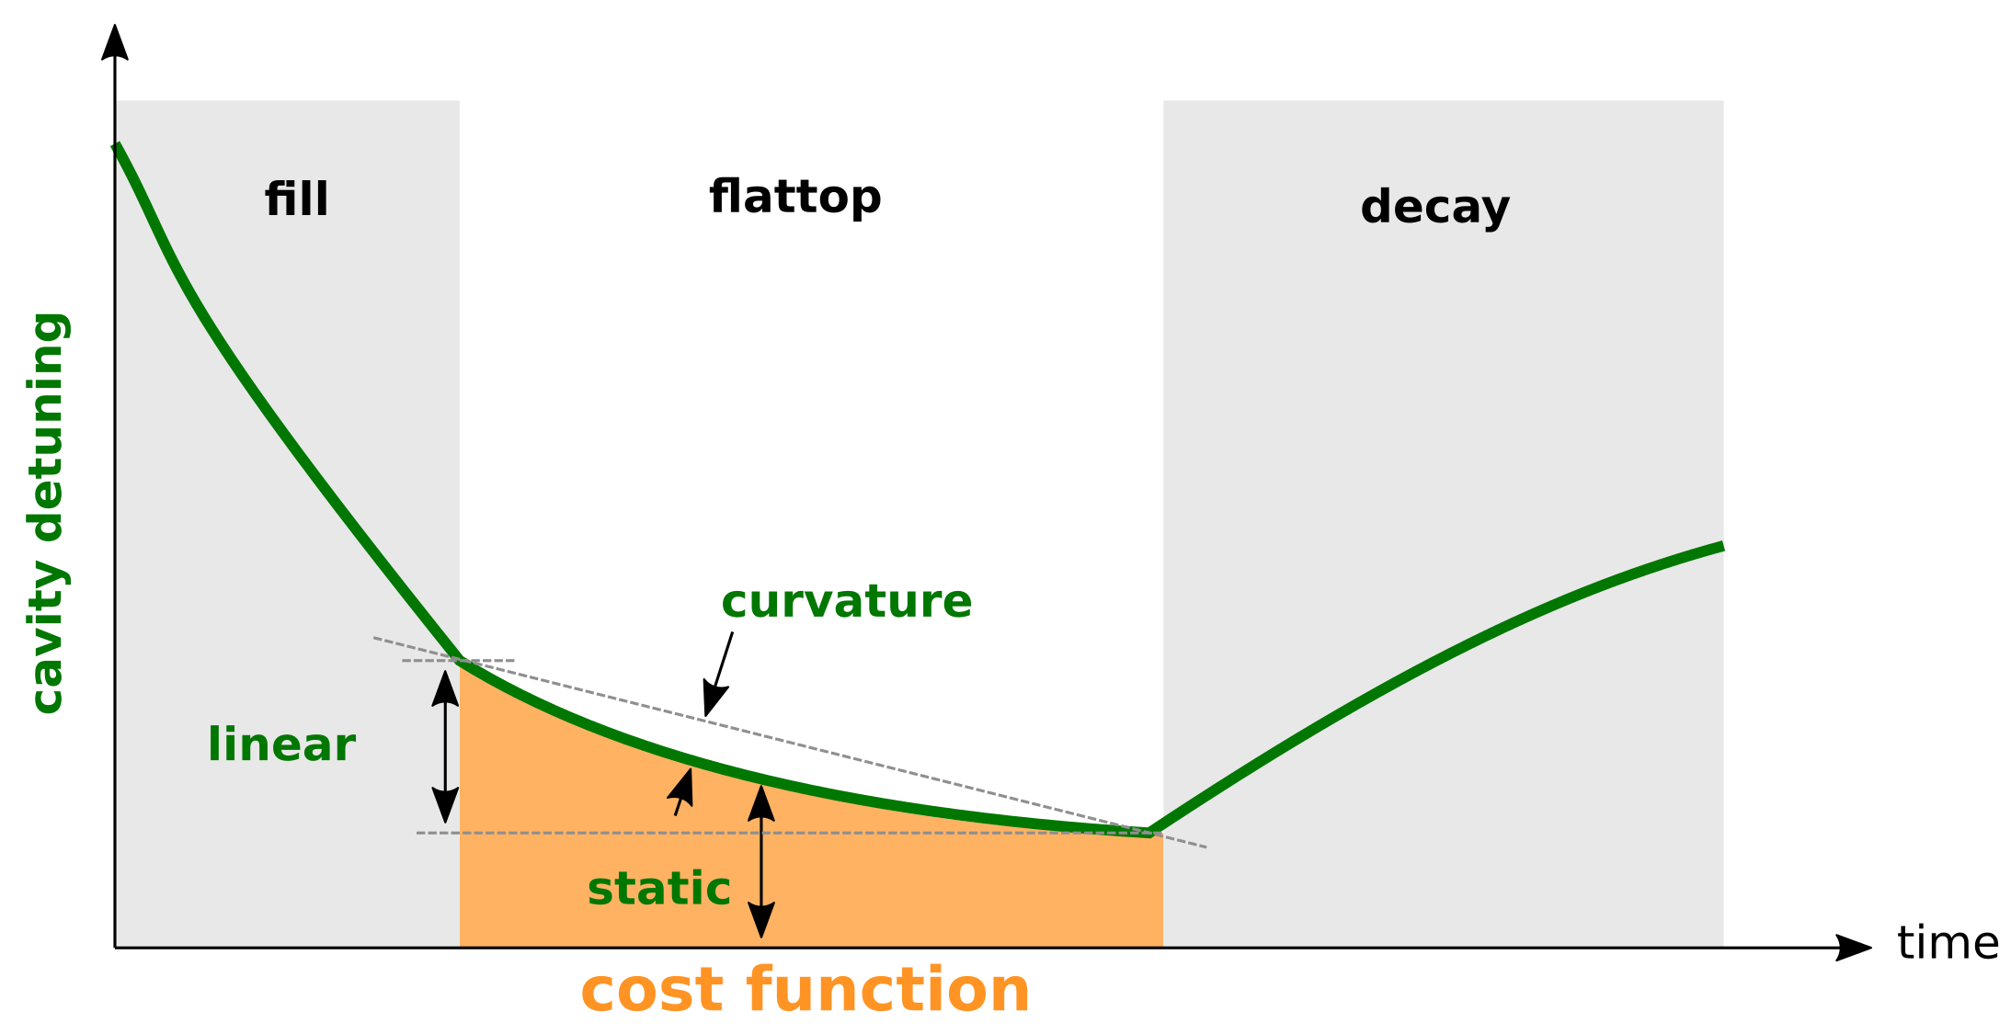
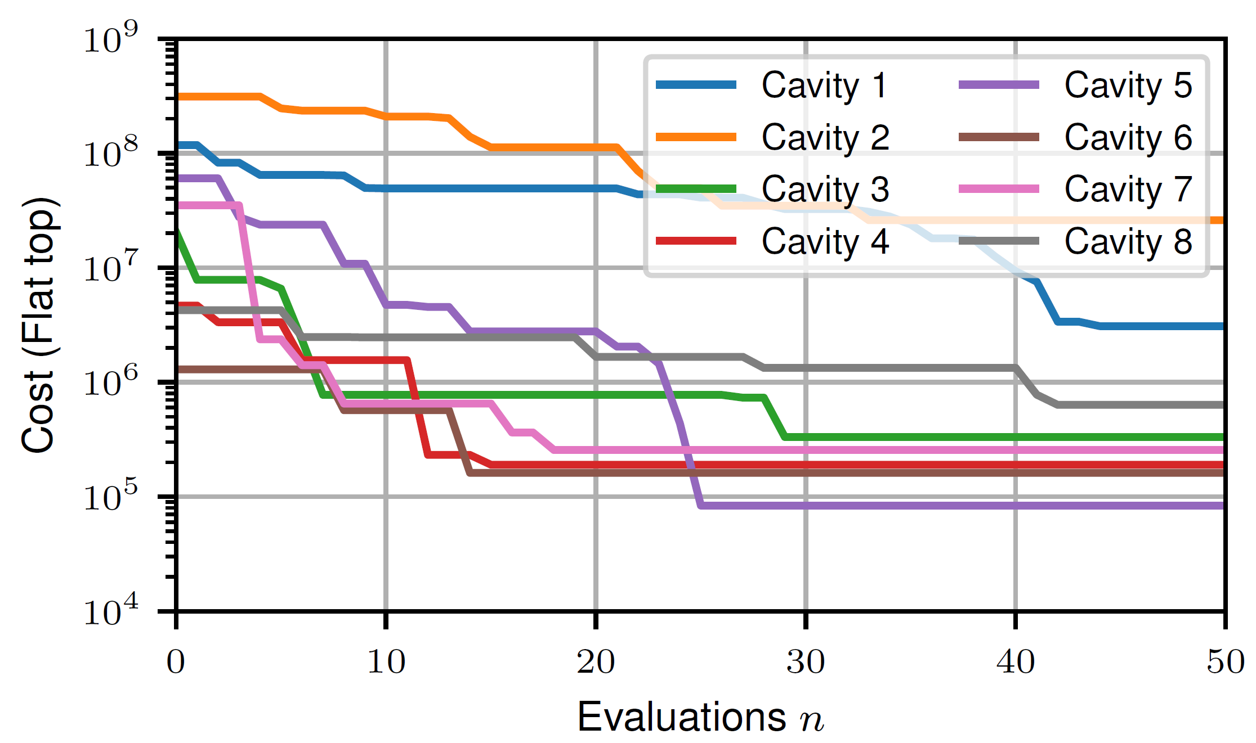
Optimizing Lorentz force detuning at EuXFEL
Parameter optimizer
1. Bayesian optimization of piezo stimulus parameters:
delay
amplitude
offset
Courtesy Jannis Luebsen

Slide 15
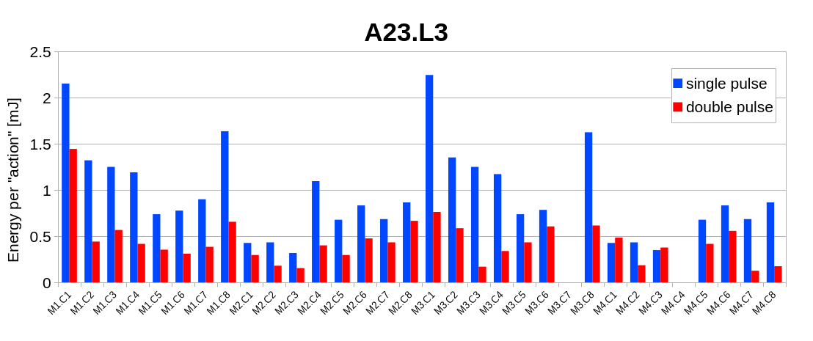
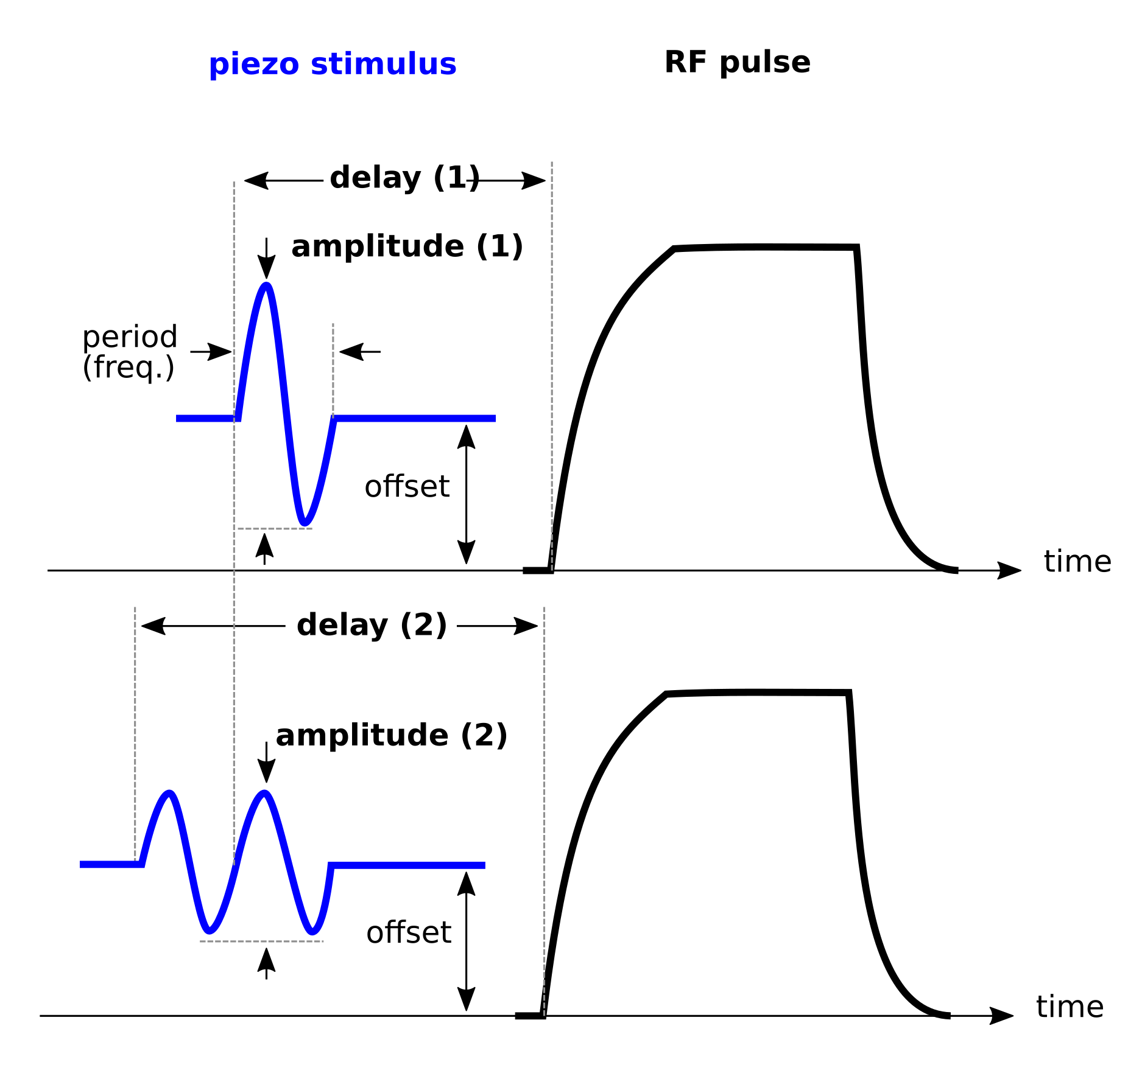
Optimizing Lorentz force detuning at EuXFEL
Use double instead of single sine
2. Using a double sine excitation
doubles the stimulus time → ×2 energy
requires half of the amplitude → ÷ 4 energy
= net energy saving factor of 2
Courtesy Mariusz Grecki

Slide 16
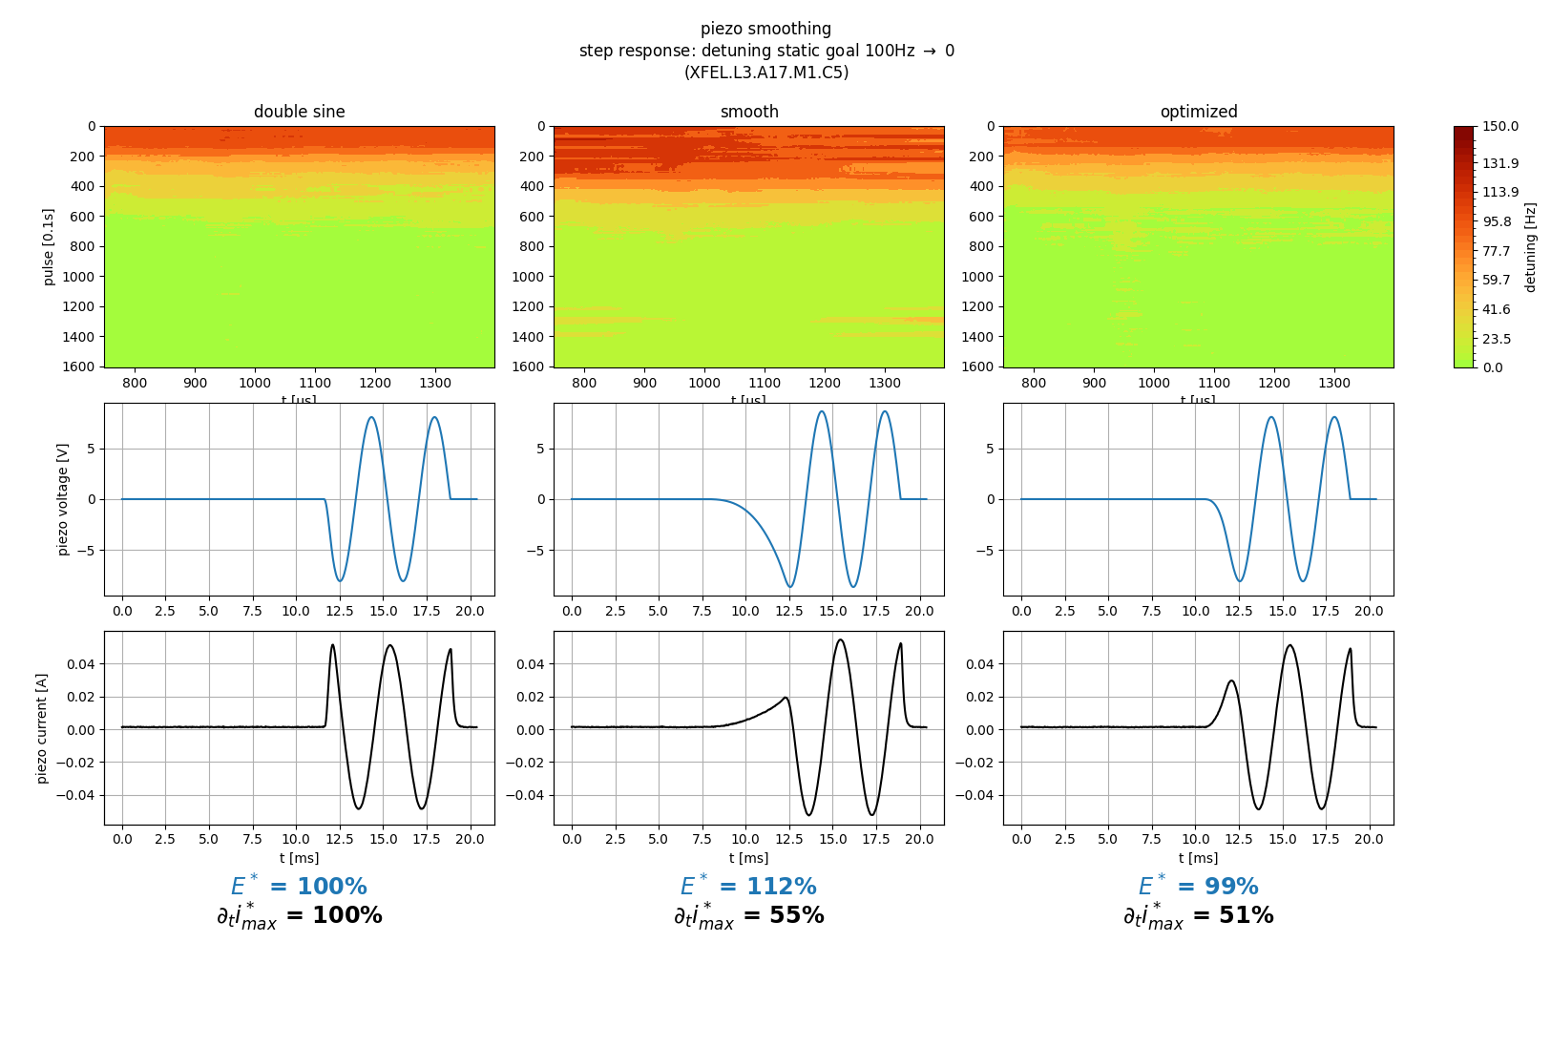
Optimizing Lorentz force detuning at EuXFEL
Minimizing the in-rush current reduction
Smoothing the leading edge of a double sine piezo pulse to reduce the in-rush current
reduces energy
Increase piezo life time
Courtesy Max Herrmann

Slide 17
WP2 – LLRF: status/evolution of Task 2.4
Task 2.4: Integrated LLRF control using Ferro-Electric Fast Reactive Tuners– M13-M48
Past developments
FE-FRT development at HZB → see WP01
Seminar last week at DESY (Nick Shipman) to present latest FE-FRT results at HZB
Current developments
Goal is to integrate a ferro-electric fast reactive tuner (FE-FRT) with a digital LLRF system
Hardware development 2026/27 within WP1
Simulation on effect and operation range can be carried out
When type and actuation is defined, digital interface can be defined
Demonstrate microphonics compensation using a FE-FRT at a horizontal test stand
Demonstration at HoBicat
Development of Matlab/Simulink model of RF control loop to simulate resonance control for PERL (ICJLab)
FE-FRT can be included in model

Slide 18
WP2 – LLRF: status/evolution of Task 2.4
Task 2.4: Integrated LLRF control using Ferro-Electric Fast Reactive Tuners– M13-M48
Past developments
FE-FRT development at HZB → see WP01
Seminar last week at DESY (Nick Shipman) to present latest FE-FRT results at HZB
Current developments
Goal is to integrate a ferro-electric fast reactive tuner (FE-FRT) with a digital LLRF system
Hardware development 2026/27 within WP1
Measure FE-FRT voltage response and temperature dependence
Evaluation of existing MTCA hardware as potential FE-FRT driver
Development of Matlab/Simulink model of RF control loop to simulate resonance control
Using FE-FRT voltage response, include it in LLRF control simulation environment
Demonstrate microphonics compensation using a FE-FRT at a horizontal test stand
First demonstration at HoBicat
Roadmap toward milestone

Slide 19
WP2 – LLRF: status/evolution of Task 2.5
Task 2.5: Energy efficient supervisory control and fault diagnosis– M1-M48
Past developments
1st milestone delivered and approved : (D35) ML implementation plan
Current developments
Develop fault diagnosis and anomaly detection of LLRF systems using ML approaches
Demonstration of quench detection in CW using Luenberger Observer
Development of a machine learning-based anomaly detection
Software implementation deployed in 1 RF station at XFEL (fast development)
Firmware (FPGA) implementation deployed on ALL stations at XFEL (observation phase)

Slide 20
WP2 – LLRF: status/evolution of Task 2.5
Task 2.5: Energy efficient supervisory control and fault diagnosis– M1-M48
Past developments
1st milestone delivered and approved : (D35) ML implementation plan
Current developments
Develop fault diagnosis and anomaly detection of LLRF systems using ML approaches
Demonstration of quench detection in CW using Luenberger Observer
Development of a machine learning-based anomaly detection
Software implementation deployed in 1 RF station at XFEL (fast development)
Firmware (FPGA) implementation deployed on ALL stations at XFEL (observation phase)

Slide 21
Anomaly detection
Machine-learning assisted anomaly detection
1. Benchmarking of FW implementation using off-line quench data
2. Testing FW implementation at EuXFEL by triggering anomaly (incorrect trace scaling)
FW
SW
References:
Anomaly detection at the European X-ray Free Electron Laser using a parity-space-based method
A. Eichler, et al, Phys. Rev. Accel. Beams 26, 012801 – Published 4 January, 2023
A Two-Stage Machine Learning-Aided Approach for Quench Identification at the European XFEL
L. Boukela, et al. arXiv:2407.08408
Courtesy B. Dursun & Ch. Schmidt
Will be presented at IPAC 2025

Slide 22
WP2 – LLRF: status/evolution of Task 2.5
Task 2.5: Energy efficient supervisory control and fault diagnosis– M1-M48
Past developments
1st milestone delivered and approved : (D35) ML implementation plan
Current developments
Develop fault diagnosis and anomaly detection of LLRF systems using ML approaches
Demonstration of quench detection in CW using Luenberger Observer
Development of a machine learning-based anomaly detection
Investigate energy saving options, based on RF solutions
Applying techniques modulator shaping techniques to support longer RF pulses
Development of an SSA test stand
Software implementation deployed in 1 RF station at XFEL (fast development)
Firmware (FPGA) implementation deployed on ALL stations at XFEL (observation phase)

Slide 23
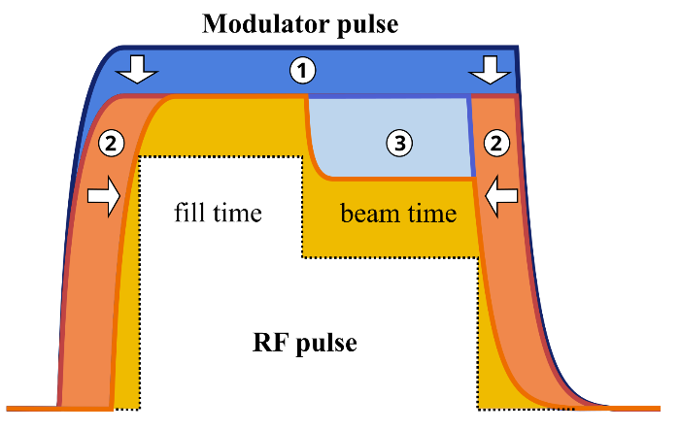
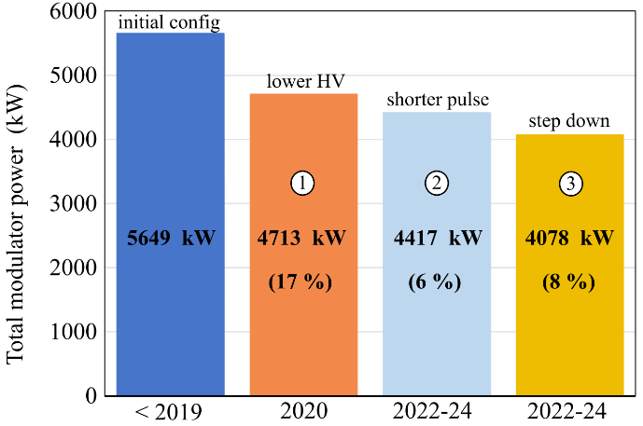
Saving energy with RF
Shaping modulator pulses (and compensate with LLRF) to keep AC consumption to its bare minimum
Now implemented on all RF stations at EuXFEL
Ref. “RF-based energy savings at the FLASH and European XFEL LINACs”
J.Branlard et al. in proc. of LINAC 2024
Power savings > 1 MW (i.e. Mio €)
Example:
How shaping the modulator pulse can save power
→ LLRF development to compensate introduced non-linearities

Slide 24
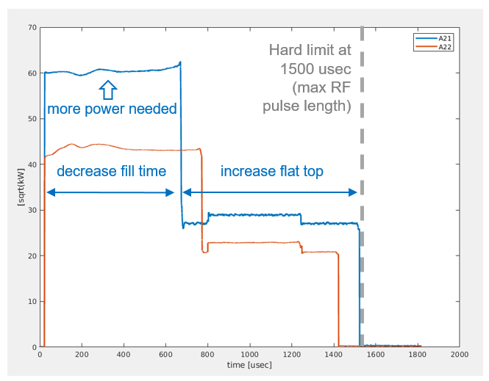
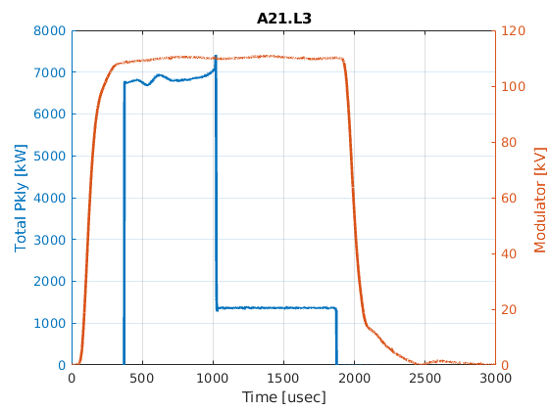
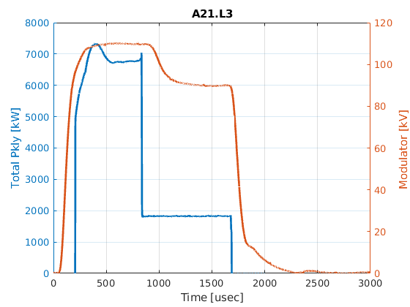
Applying the same technique to offer longer beam time
Studied at several stations at EuXFEL
Configuration | Tfill (usec) | Tflat (usec) | Ttotal (usec) | AC power (kW) | Max energy (MV)
Short flat top with energy saving | 750 | 650 | 1400 | 182 | 845
Long flat top (no energy saving) | 650 | 850 | 1400 | 283 | 845
Long flat top with energy saving and Qext optimization | 630 | 850 | 1480 | 200 | 845
disaster
only 10%
No energy saving, no Qext adjustment
Energy saving measures, Qext adjustment
Further optimization possible by starting modulator slope earlier (“final tweaking”)
850 usec beam time
650 usec beam time
+200 usec = 30% more beam
Lower Qext also increase the power during beam time

Slide 25
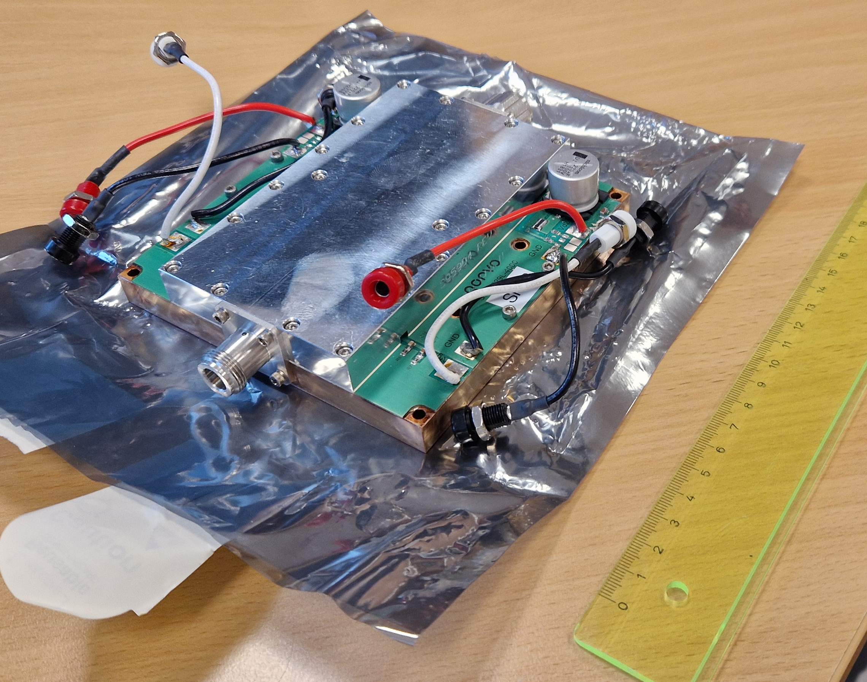
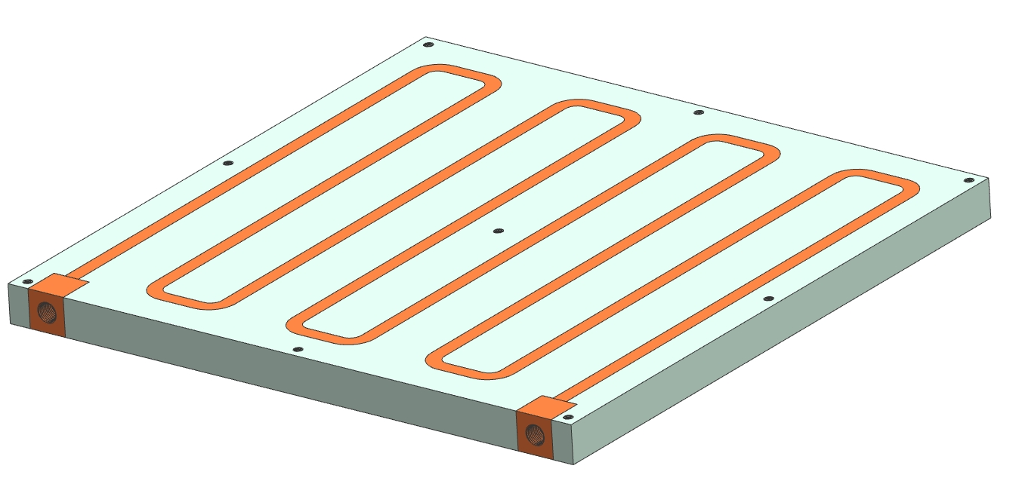
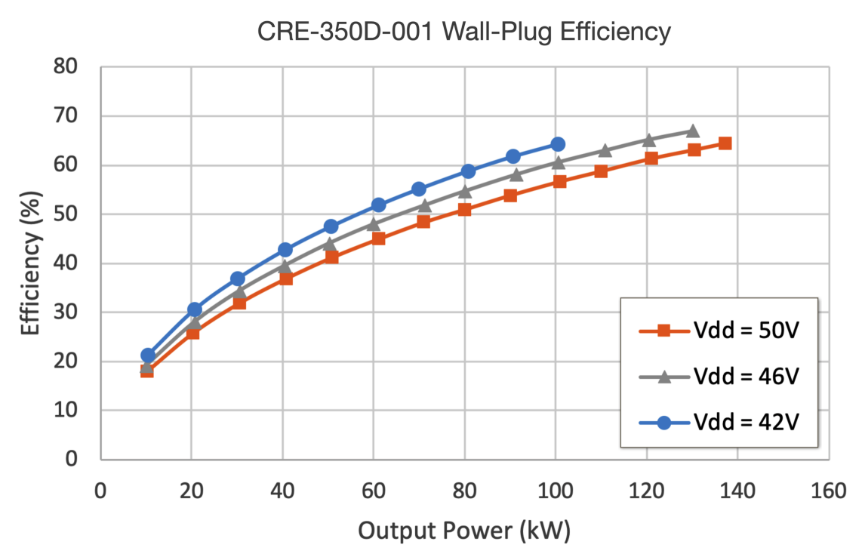
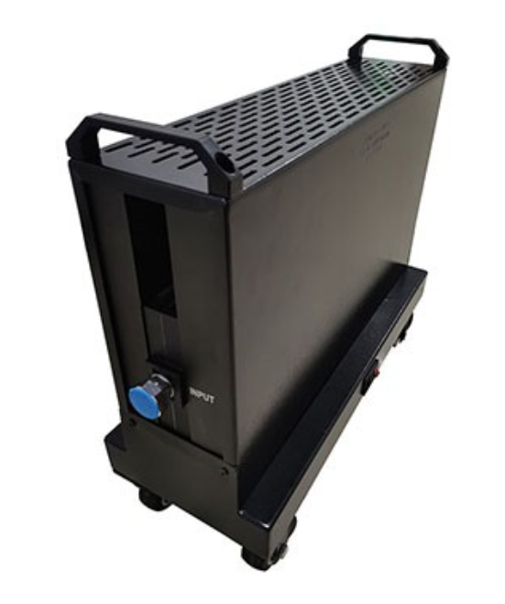
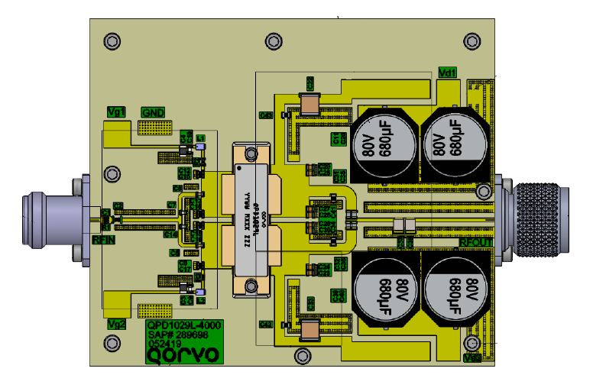
SSA R&D at DESY
SSA test stand (1 kW amplifier)
Preparation of a SSA test stand
GaN 1 kW prototype
Cooling / load / power supply
Experiment with pulsed/CW operation
Understand efficiency optimization with drain voltage adjustments
Cooling plate
Example
GaN technology
1.3 GHz
130 kW SSA
drain voltage (Vdd) adjustments
1 kW dummy load
Reference: “High-efficiency industrial 130 KW CW solid-state RF amplifier for 1.3 GHz”, M. Nedos, N. Pupeter et al. in proc. IPAC 2023

Slide 26
WP2 – LLRF: points of attention
Points of attention
Personnel setback
key person for R&D left DESY in Fall 2024
mitigation: opened replacement position but challenging to find qualified personnel
Dependence of iSAS R&D on laboratory schedule
availability of test stands is not always predictable (delay, warm up, etc..)
mitigation: compiled a list of tests capabilities in partner labs
Future hardware development – on going
“Evolution” step : Development of next generation digitizers (heterodyne detection mode)
“Revolution” step : First successful test of CSI (carrier suppression interferometer) integration with LLRF system at test stand with cavity

Slide 27
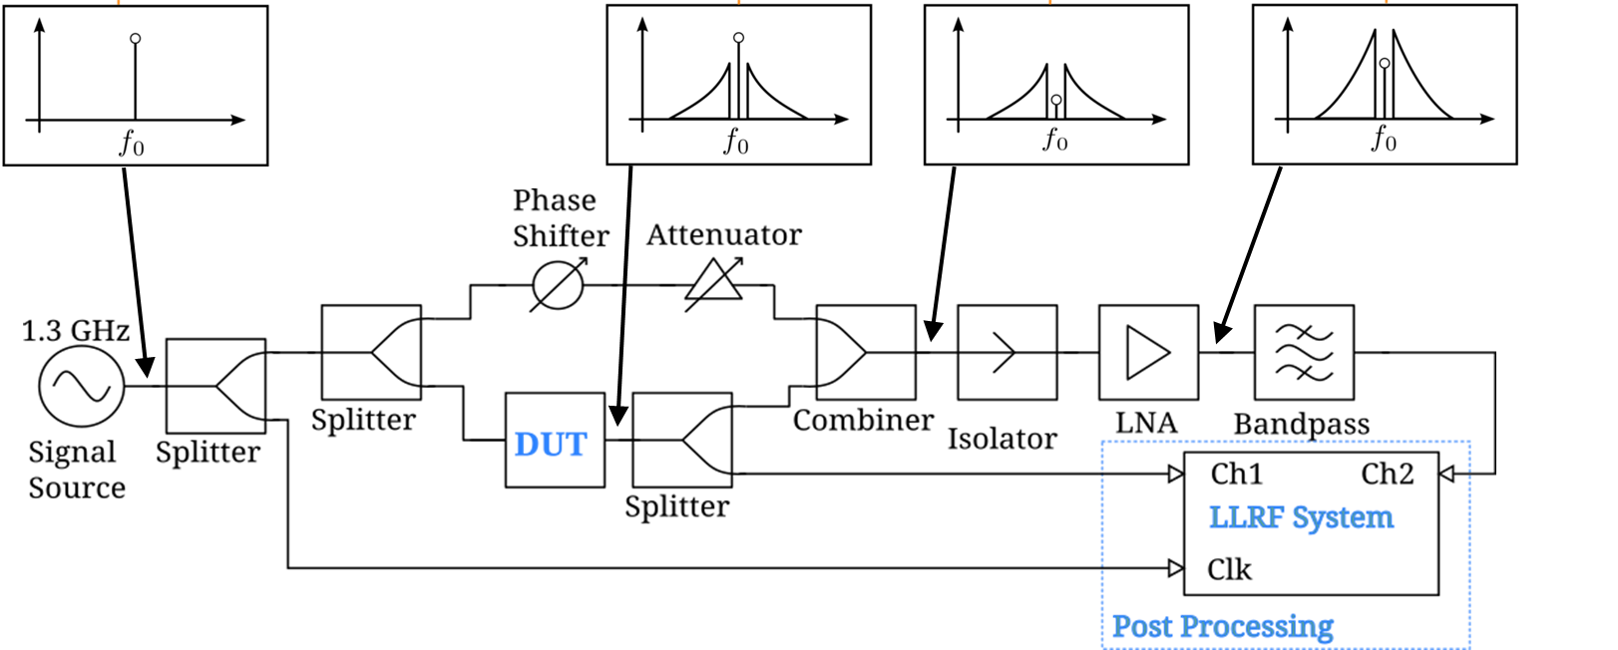
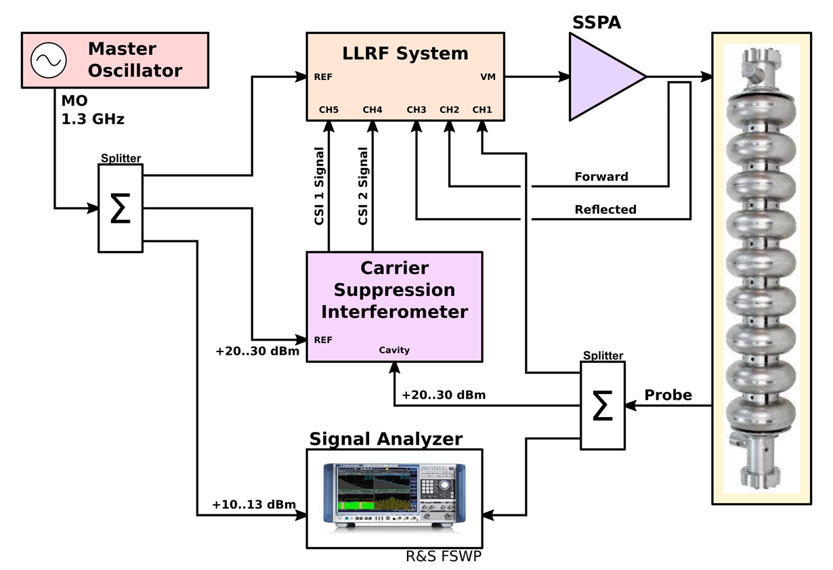
Carrier Suppression Interferometer
Courtesy: M. Hoffmann
Concept
Overcome noise limits of the post-IQ system
CSI performance scales with RF input power
Source → very low amplitude noise !
Replace the DUT with the LLRF system
CSI signal contains no carrier
no absolute information of amplitude and phase
CSI signal as amplified error signal
Combination of CSI and standard measurement as controller input

Slide 28
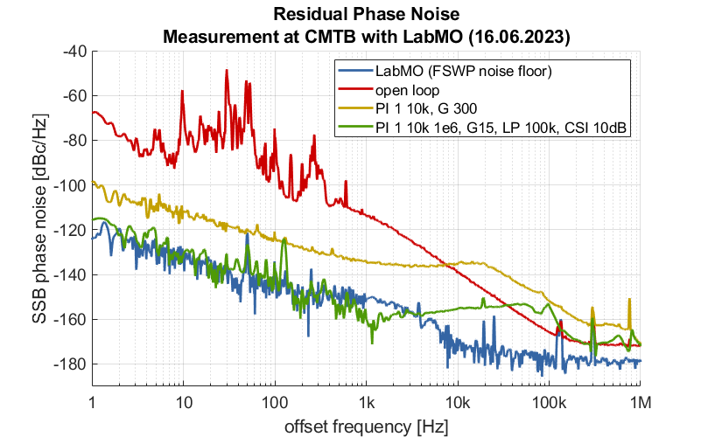
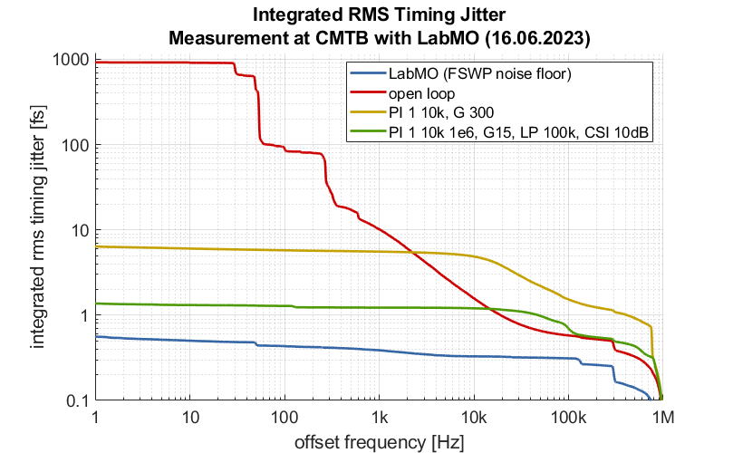
Measurement Results from CMTB
Lab MO as Reference (best results)
Cavity at Q_{L} ~ 10⁷ (f₁₂ = ~ 65 Hz)
Open loop vs. PI controller vs. CSI with PI
Reached noise floor of FSWP
Requires stable condition of the cavity (steady state CW)
Cavity tuning (PZT) to maintain operation at resonance
Courtesy: M. Hoffmann

Slide 29
WP2 – LLRF: plans to achieve milestones & deliverables
Milestones & deliverables on track? → yes
Plans to achieve milestones & deliverables
Delay risks to be anticipated? → some unknowns but nothing critical. Plan B as back up
Cooperation with other WP(s) to be reactivated? → clearly potential to increase collaboration, not always easy in practice due to daily “emergency” in home institute + budget / travel restrictions
Risk mitigation measures to be implemented? → develop official impact risk analysis Feb. next year

Slide 30
WP2 – LLRF: financial status
Financial status
Funds engaged in the WP by institute to date, differentiating EU-budget from matching funds
With highlight of staff dedicating time on the iSAS project, to date & projections if possible
Deviations? → I think still on track
WP 2 | EU-Budget | Matching funds
2024 | 7,050.55 | 111,687.13
2025 | 2,147.25 | 5,862.23
Total | 9,197.80 | 117,549.36
Most of the budget is foreseen to hire personnel.
iSAS position to be released this month + advertised on iSAS
Money already spent was to pay personnel to bridge the gap

Slide 31
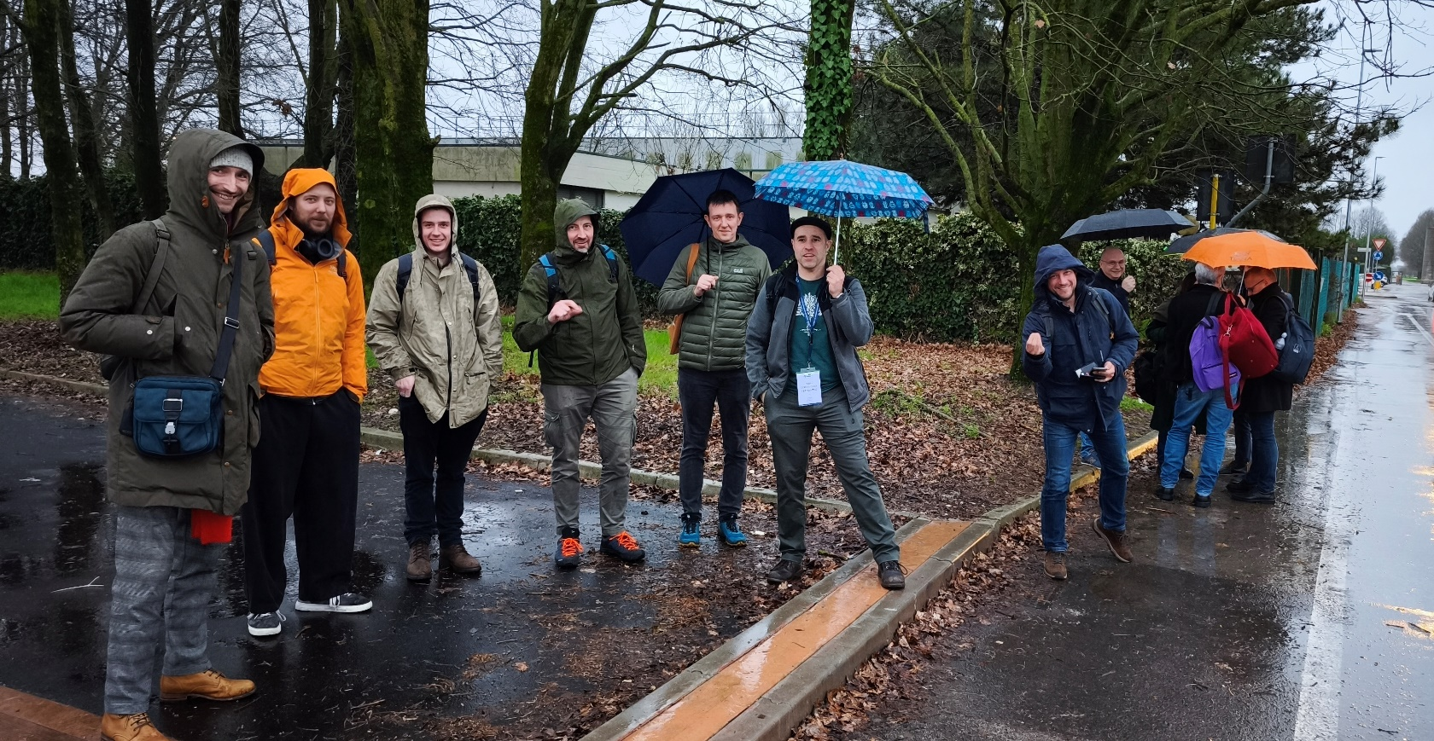
WP2: Low Level RF controls 10.01.2025
DESY, HZB, CNRS
Convener & deputy: Holger Schlarb (DESY) & Julien Branlard (DESY)
Main contacts with other partners: Axel Neumann (HZB), Christophe Joly (CNRS)
THANK YOU
FOR YOUR ATTENTION !

Slide 32
BACKUP

Slide 33
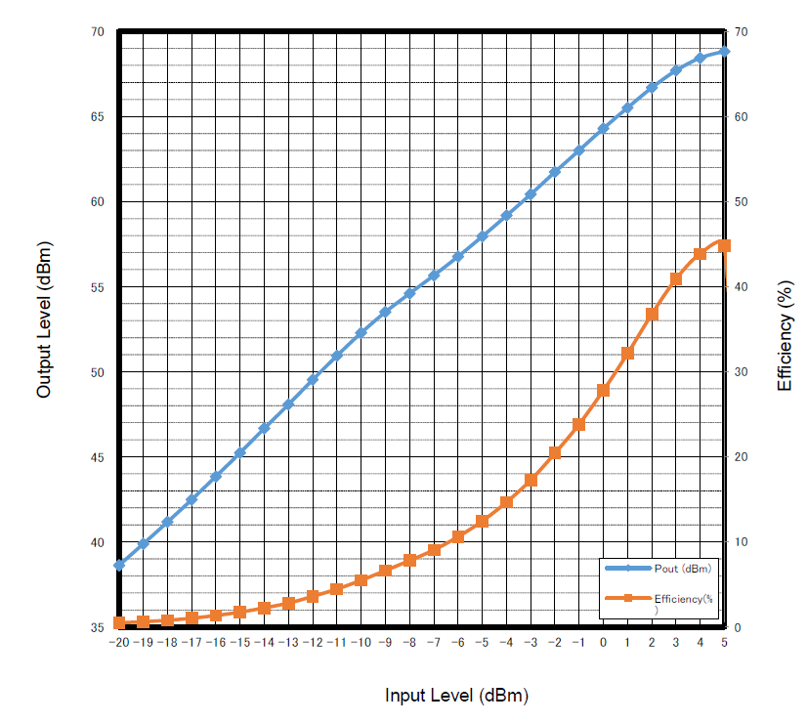
Example 3a
Metric: AC-to-RF efficiency
What is the wall plug AC-to-RF power efficiency?
Example data from LCLS-II SSAs
Example 1 LDMOS technology
1.3 GHz
4 kW SSA
Reference: “Tutorial: RF amplifiers Overview and Impact on LLRF control loops”, E. Montesinos, LLRF workshop 2017
Pout (dBm)
Efficiency (%)
Example: How the choice of amplifier class can affect efficiency → LLRF development to compensate non-linearities

Slide 34
Example 3b
Metric: DC-to-RF efficiency
Can we optimize the efficiency by keeping the amplifier in saturation ?
Example2
GaN technology
1.3 GHz
130 kW SSA
drain voltage (Vdd) adjustments
Example : How adjusting the drain voltage (Vdd) can improve the DC-to-RF efficiency
→ LLRF development to control Vdd & optimize efficiency
Note that efficiency alone doesn’t tell the whole story
efficiency
design
choice
stability
operability
Reference: “High-efficiency industrial 130 KW CW solid-state RF amplifier for 1.3 GHz”, M. Nedos, N. Pupeter et al. in proc. IPAC 2023

