Slide 1
First Annual Meeting
March 12-14, 2025
Funded by the European Union. Views and opinions expressed are however those of the authors only and do not necessarily reflect those of the European Union or the European Commission. Neither the European Union nor the granting authority can be held responsible for them.

Slide 2
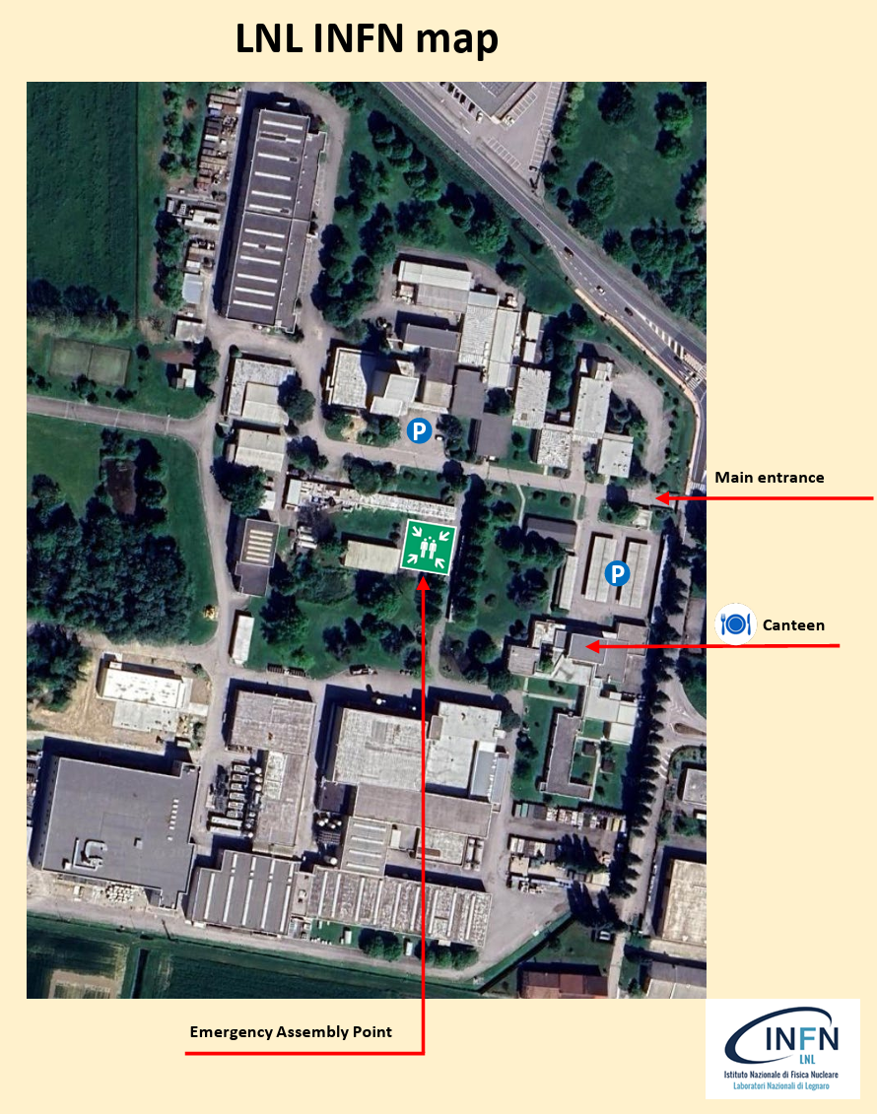
First Annual Meeting @LNL
Safety Rules
In case of Alarm Stop any activity and reach the Emergency Assembly Point
In case of emergency call (24h a day):
888 from internal LNL phones
049 8068 888 from mobile phones
Everytime you call for an emergency,
please always detail exactly:
Who you are;
the Precise Place where you are;
the Nature of the accident.
Villi Room

Slide 3
First Annual Meeting @LNL
Villi Room
Meeting Program Locations
Registration
WC
Registration Desk: Entrance
Plenary Session: Villi Room
Group Picture: 10:40
Coffee Breaks: Cafeteria
Rest Rooms:
Near registration desk
Near Cafeteria
Lunch: Canteen
Governing Boarding Meeting: Ceolini Room
Canteen
v
v
WC
Cafeteria
Ceolini Room
Group
Picture

Slide 4
First Annual Meeting @LNL
Villi Room
From LNL to Social Dinner
Registration
WC
Plenary Session ends at 17:30
Governing Board Meeting from 17:35 to 18:35 in Ceolini Room
Bus leaves at 18:45 from LNL Meeting Point
Dinner starts at 19:30
Who is not participating in Governing Board:
Can stay in Villi Room or Cafeteria
Possible visits of SRF Thin Film Facilities (only for who is not only for those who will not participate in the Full Lab visit organized on Friday)
Canteen
WC
Cafeteria

Slide 5
First Annual Meeting @LNL
Villi Room
Shuttle from
LNL to Airport
Registration
WC
If you need to arrange a Shuttle to the Airport on Friday,
you can refer to Silvia Martin at the Registration Desk

Slide 6
First Annual Meeting @LNL
Villi Room
Registration
WC
Enjoy the meeting!

