Slide 1



Presentation of ACS
ISAS Padova meeting
Arthur IZIQUEL – arthur.iziquel@acsfrance.com
ACS – 21 rue Jean Rostand,
91400 – Orsay (FRANCE)
12/03/2025

Slide 2
ACS expertise
SC cavities Linear Accelerator Technology;
Cryogenic Systems for Accelerators, Physics detectors and experiments;
Cryogenic systems design (3D, cryostats, cryofluids distribution, interfaces to He liquefiers and refrigerators, instrumentation, cryocoolers);
FEM mechanical analysis (thermal and electromagnetic origin) on the components;
FEM thermal analysis;
Interfaces and integration studies (mechanical, electrical, radiological, etc);
Command & Control specifications (sensors and actuators interfaces, control and acquisition procedures, supervision and interfaces to networks and data storage systems);

Slide 3
ACS Team
Our team comprises 10 dedicated members, each contributing unique skills and expertise as detailed below:
  1 President
  1 Administrative Coordinator
  4 CNRS Researchers and Engineers
  1 Cryogenics Engineer
  1 Cryogenics Doctor
  1 Mechanical Engineer
  1 PhD Thesis Co-financed

Slide 4
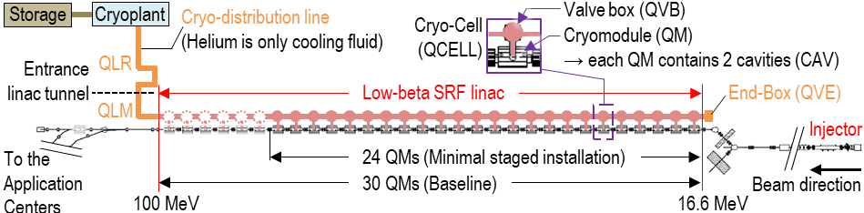
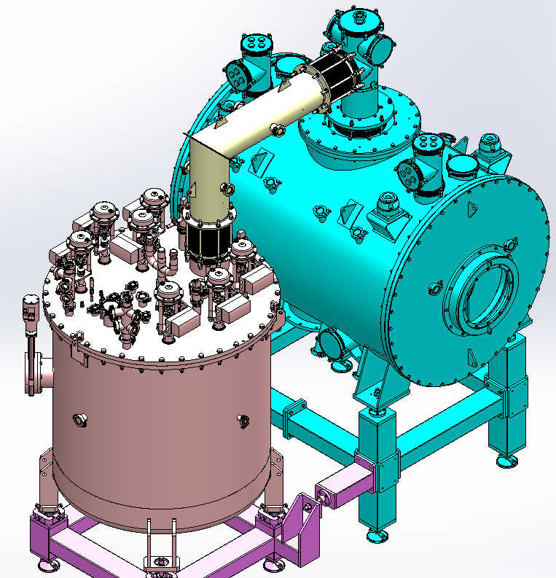
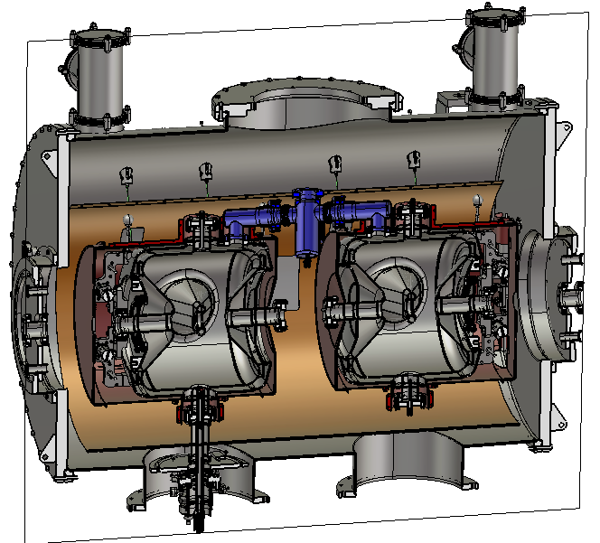



ACS R&D work for MYRRHA / MINERVA
Started in 2009 within European Collaborations Framework MAX, MYRTE
Multi-year ACS/SCK contract since 2016 for :
Preliminary studies for the Minerva project;
Design valve box for their QM-prototype;
Participation in the prototype tests at IJClab;
Design of the MINERVA series valve boxes and end box;
MINERVA accelerator project
View of the prototype valve box and cryomodule

Slide 5


Work for Uppsala University
Several contracts since 2012 for :
Design, follow-up and commissioning of a Horizontal Cryostat for Superconducting Cavities tests HNOSS -ESS project (2012 – 2015);
Design, follow-up and commissioning of a vertical cryostat for SRF cavities and Superconducting Magnets GERSEMI (2016 – 2021);
Design of a vacuum insert for cavity testing in GERSEMI (2024-2025)

Slide 6
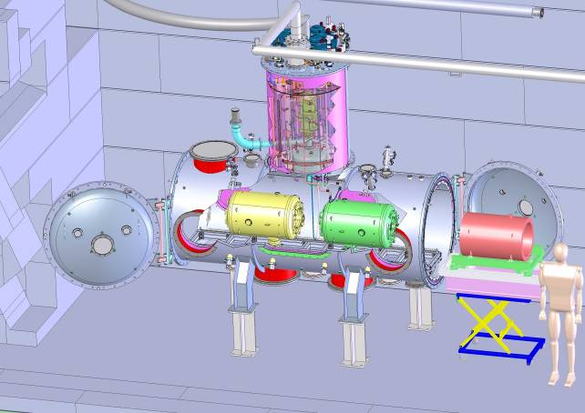
HNOSS – Cryostat for SC cavity, RF coupler and tuner testing
View of HNOSS
Picture of HNOSS

Slide 7
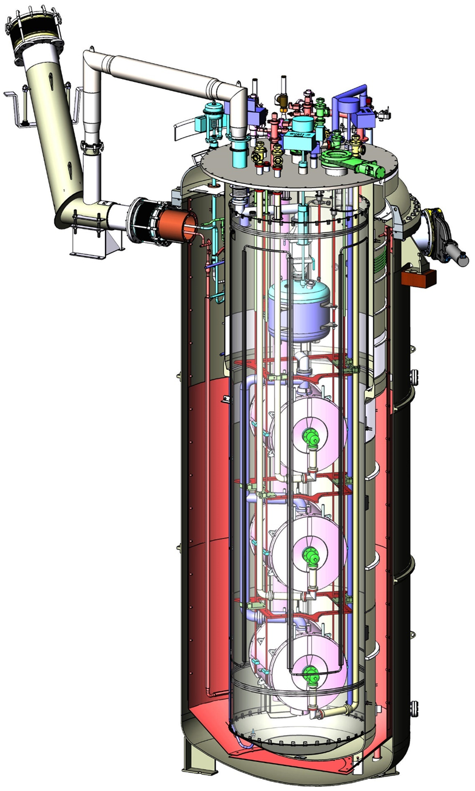
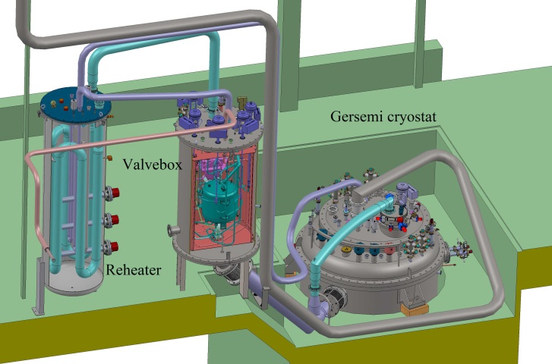
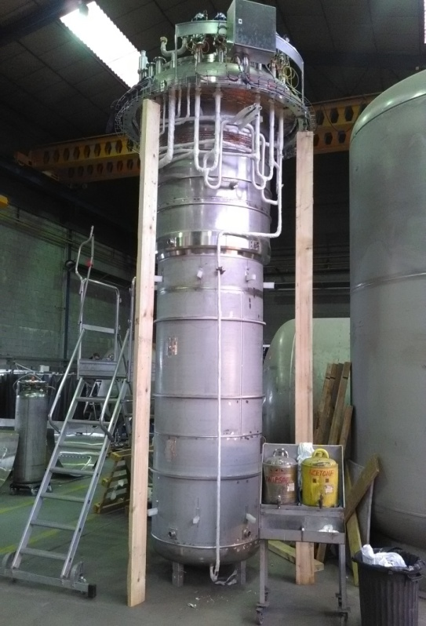
GERSEMI – Cryostat for SC magnet, SC cavity testing
Installation layout of the GERSEMI cryostat and its cryogenic infrastructure.
Picture of the GERSEMI liquid insert.
View of the preliminary design of the vacuum insert in the GERSEMI cryostat

Slide 8
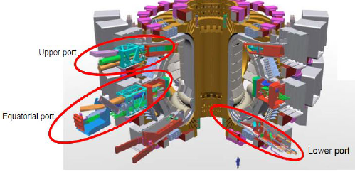


Participation to ITER as a subcontractor of IDOM
Contracts between 2014 and 2016 for Electro-mechanical analysis of the diagnostic ports
Position of the diagnostic ports

Slide 9
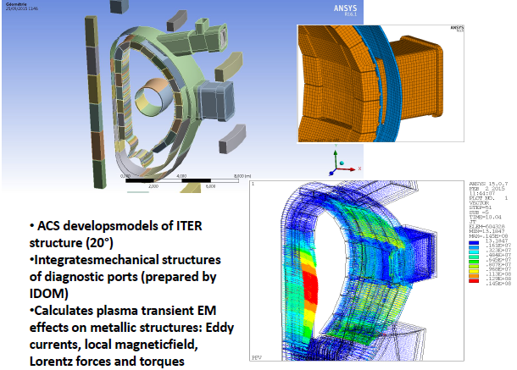
Participation to ITER as a subcontractor of IDOM

Slide 10
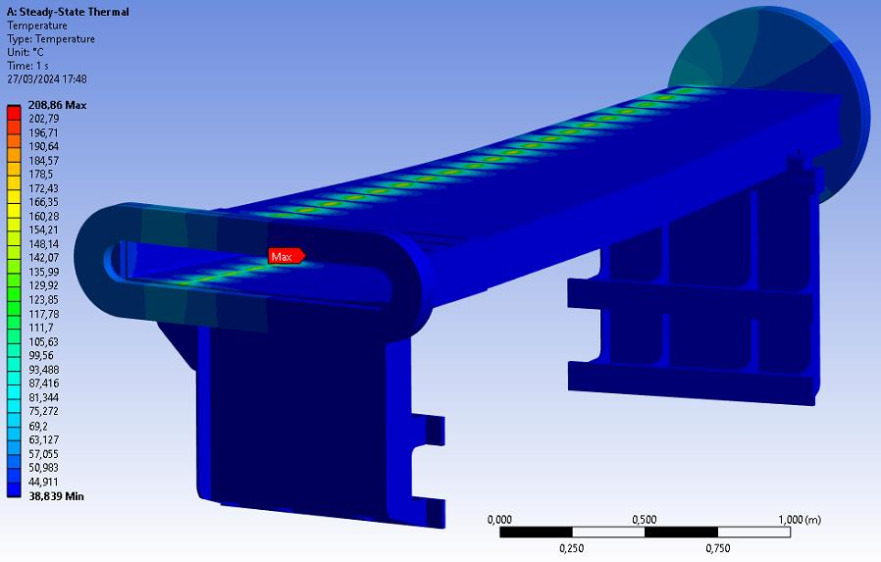
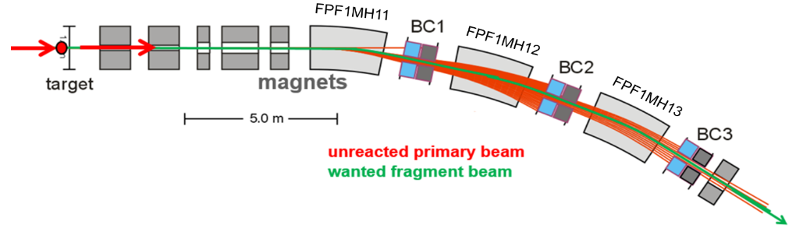


Super-FRS vacuum chamber study
Thermo – mechanical analysis of the dipole vacuum chamber for the SUPER FRS project at FAIR (Germany)

Slide 11
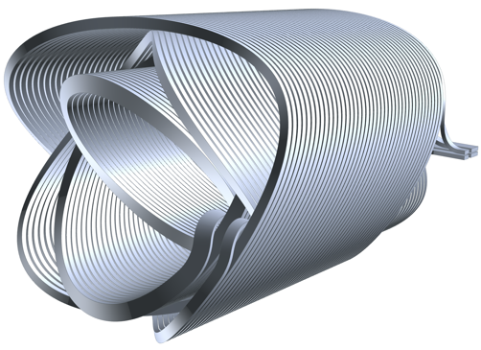
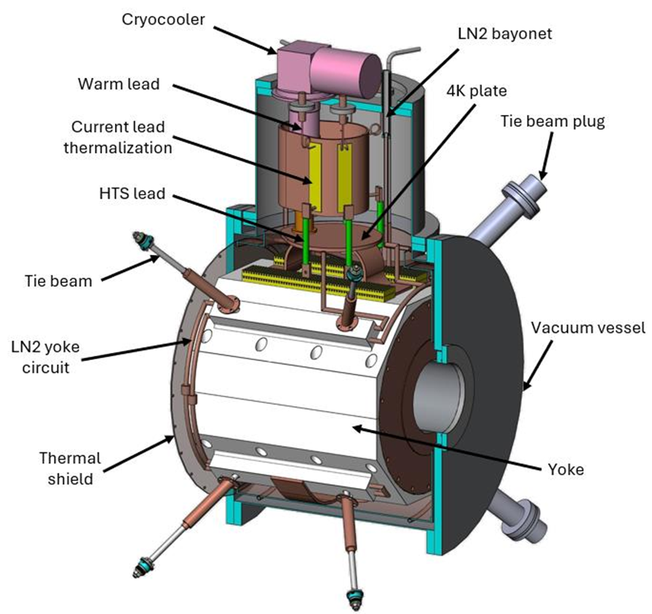
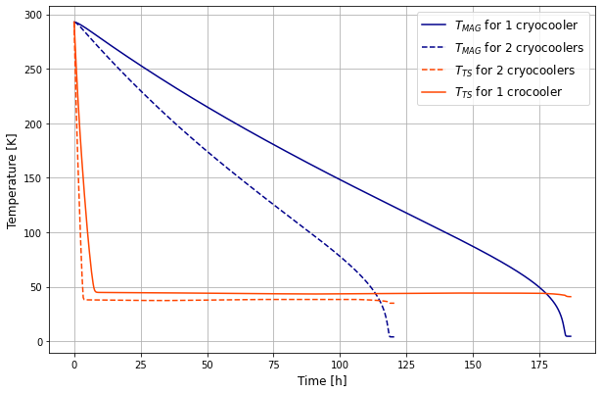



ISRS project - MAGDEM Cryostat design
Development of a cryostat cooled by cryocooler for a superconducting CCT short magnet;
Related papers :
A. IZIQUEL and al., Development of a cryogen-free test cryostat for a superconducting CCT short magnet, 29th International Cryogenic Engineering Conference International Cryogenic Materials Conference 2024;
View of the magnet wiring
Cryostat designed by ACS in the framework of the ISRS project (2023-2024)
Magnet cool-down time simulation

Slide 12
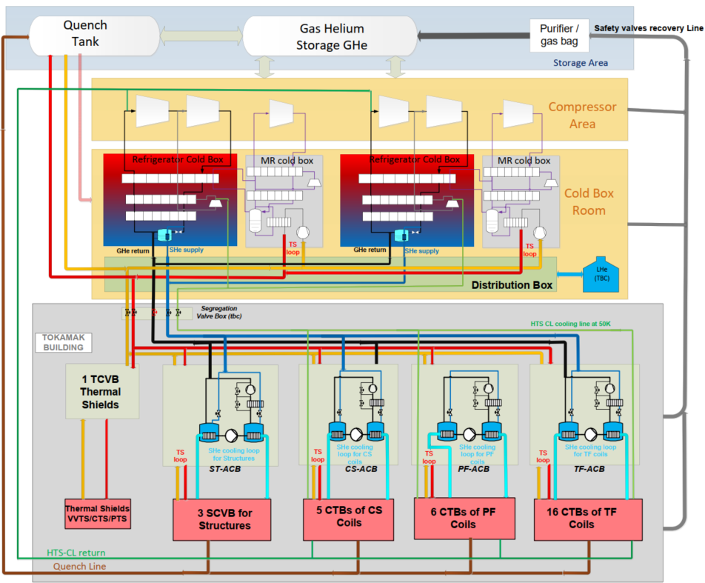


DEMO cryogenic distribution study
Content of the work :
  PFD drawing;
  Safety analysis;
  3D preliminary drawing of the cryogenic distribution components;
General bloc diagram of DEMO cryogenic system

Slide 13
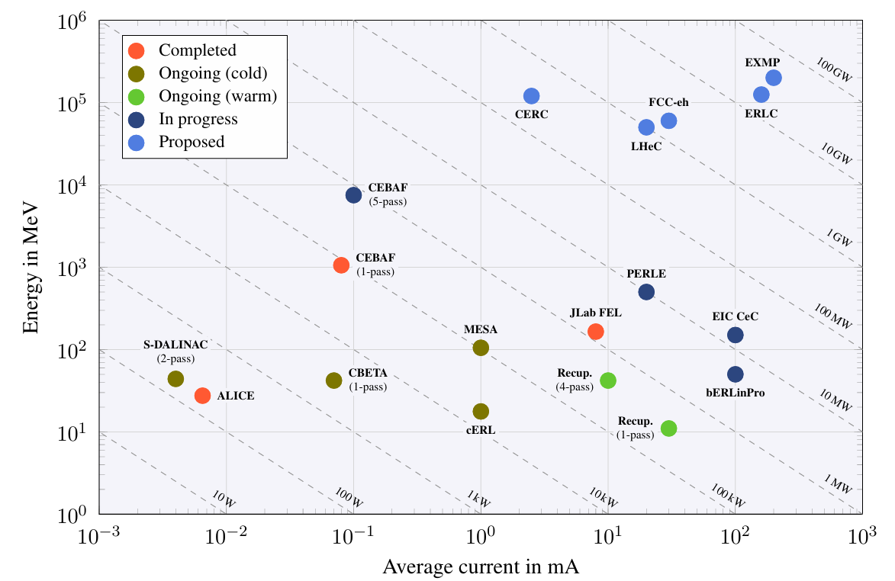

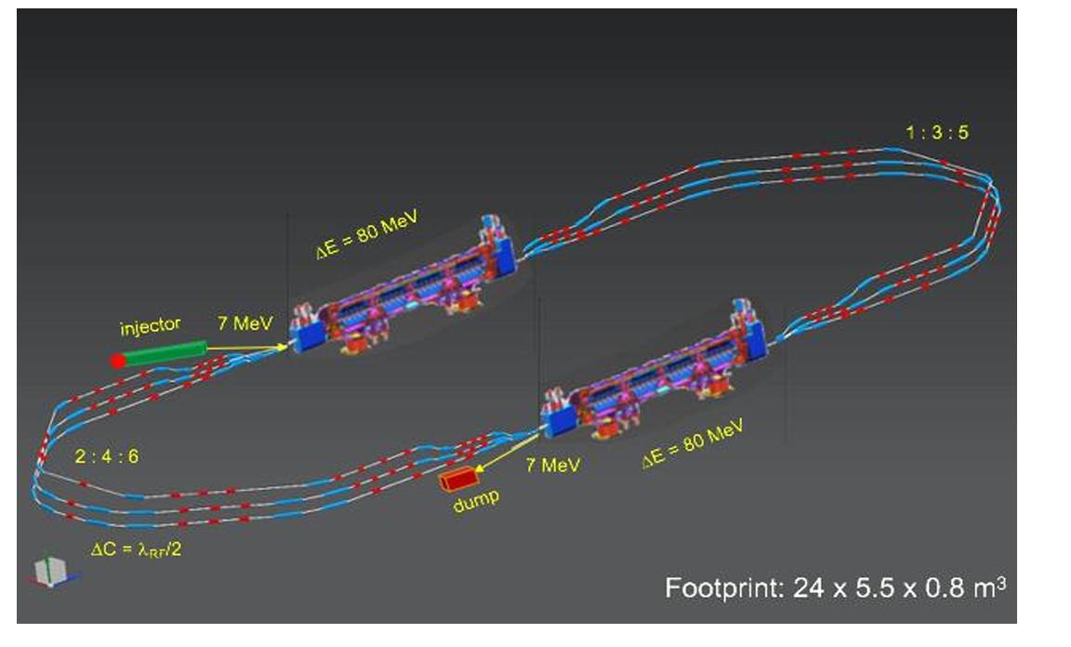
PhD co-financed ACS – IJClab : optimization of LLRF systems
Project context : Development of new ERL in Europe
PERLE: Three pass, 10 MW Power Energy Recovery Linac based on SRF technology (2K – 4K), developed at IJCLAB.
Student : N. Belouchrani; Director : A. Stocchi (IJClab); Supervisors : C.Joly (IJClab) and T. Junquera (ACS)
Thesis objectives:
Optimize LLRF systems for phase, amplitude & frequency control;
Development of an embedded digital cavity simulator.
Simulation of RF systems;
Develop adaptive algorithms for automatic control & regulation;
Applications overview medical isotope production, lithography, material analysis;
Aligns with ISAS’ goals in improving accelerator efficiency for sustainable accelerators;
PERLE Layout featuring two parallel linacs each hosting a cryomodule housing four 5-cell SC cavities, achieving 500 MeV in three passes.

Slide 14
Looking forward
Collaboration and Partnerships:
  We would be delighted to collaborate with you, whether within the framework of the ISAS project or beyond;
  We’re interested in exploring new ideas in the field of particle accelerator (cryogenics, mechanical study, …);
For any inquiries, please feel free to reach out to me at:
  arthur.iziquel@acsfrance.com
Thank You!

