Slide 1


Euclid Techlabs Capabilities for iSAS Program
iSAS First Annual Meeting @ Legnaro National Laboratories
March 12 – 14, 2025 INFN LNL Padova Italy
Alexei Kanareykin
On behalf of Euclid’s team
March 14, 2025

Slide 2
Outline
Introduction Euclid Techlabs and Euclid Beamlabs
Products & Capabilities Snapshot
SRF Technologies at Euclid
NC Accelerator Technologies at Euclid
Ferroelectric Fast Reactive Tuner
    Advanced Microwave Ceramics for Accelerators
www.euclidtechlabs.com

Slide 3
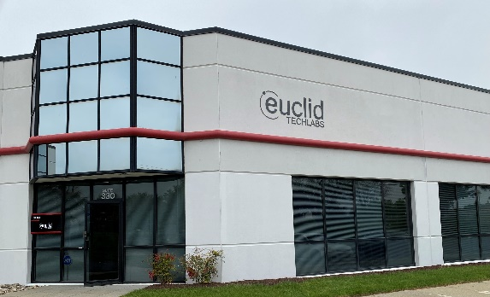
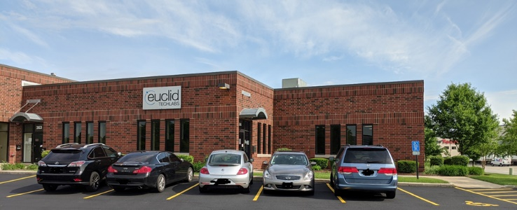
Euclid Techlabs
Euclid Techlabs is a U.S.-based firm specializing in electron devices and advanced materials. After 20+ years serving the particle accelerator R&D market, we now ship a much wider-ranging product portfolio around the globe, from semiconductor photocathodes and superconducting photoinjectors, to ultrafast electron microscopy, to domestically-grown technical diamonds, ferroelectric fast tuners to arc-free high power microwave windows using our proprietary ceramic technologies.
EUCLID EAST • DC HQ and Materials
EUCLID WEST • Chicago Central Shops and Test Labs
As pioneers in advanced electron device engineering, we excel in tackling complex design challenges. Our agile, milestone-driven project management approach ensures optimal resource allocation and timely delivery. We collaborate with leading accelerator laboratories across the United States, the Department of Defense, CERN, and numerous global institutions. Our innovative solutions have garnered a diverse clientele spanning North America, Europe, and Asia.
www.euclidbeamlabs.com

Slide 4
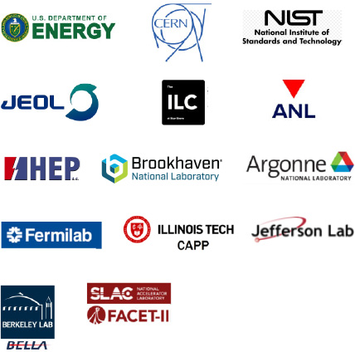
















Global Customer Base

Slide 5
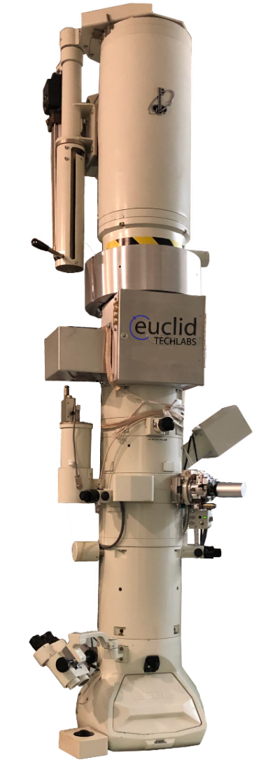
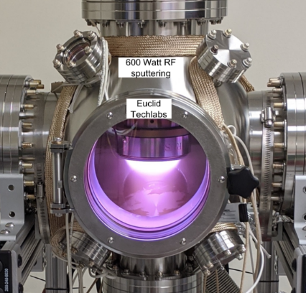
Products & Capabilities Snapshot
Products
UltraFast Pulser (UFPTM) for TEM
Compact X-Ray Source
L-band High Peak Current Linac
RF high power windows
Fast reactive tuners for SRF
BPMs other accelerator components
CVD and HPHT diamonds,
Electron sources and cathodes
Capabilities
Femtosecond Laser Ablation System
Thin Film Deposition Lab
TEM Testing Lab
High precision 4-axis turning/milling
Radiation Shielding/Testing Lab
Diamond Growth Lab
Photocathode Lab
Ceramic/ferroelectric Lab

Slide 6
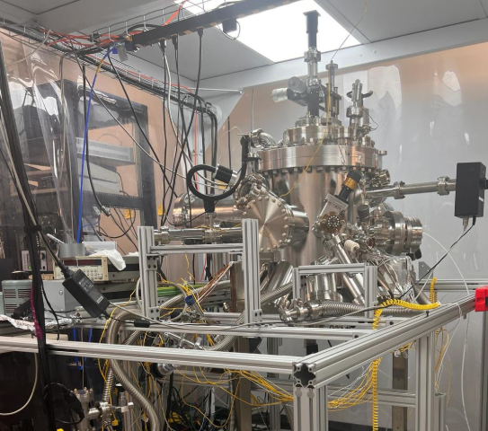
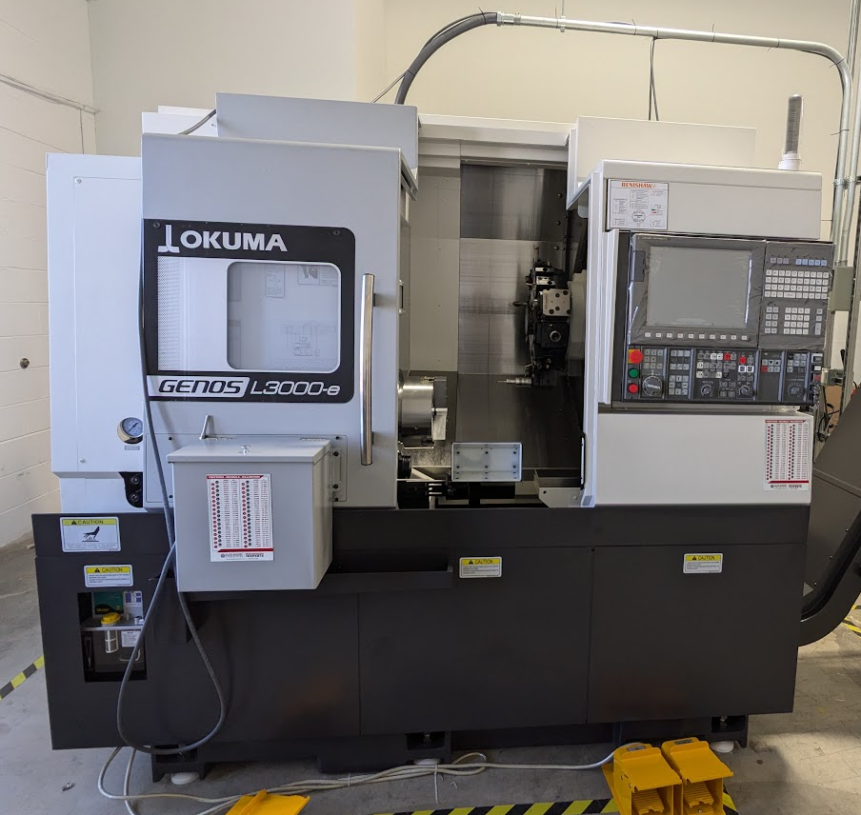
In-house Capabilities
MBE system for Cs₃Sb/Cs₂Te growth
High precision 4-axis turning/milling

Slide 7

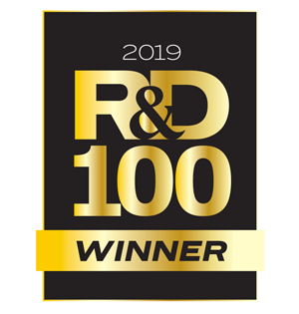
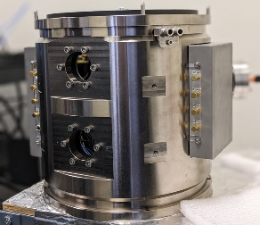
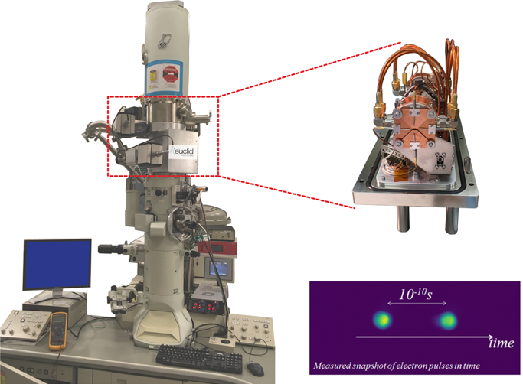
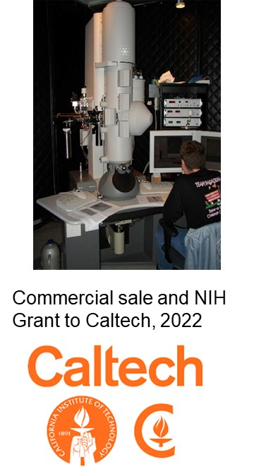
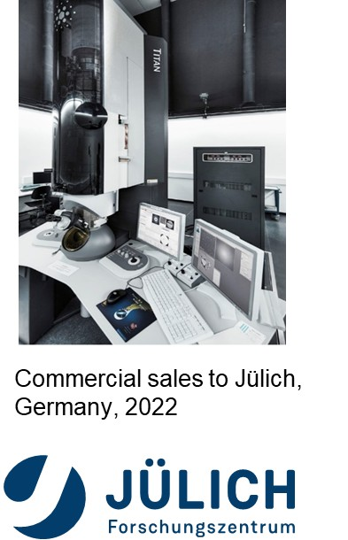




Ultrafast Pulser for Transmission Electron Microscopy (in collaboration with BNL, NIST)
As a successful result of the DoE SBIR “Stroboscopic TEM Pulser” project, Euclid was awarded a Phase III contract for Transmission Electron Microscope (TEM) modification at NIST in 2016-2018. The NIH and Chan-Zuckerberg awards started in 2021.
(G1)

Slide 8
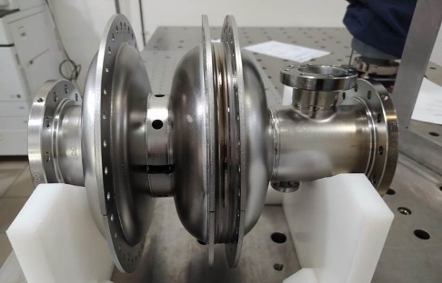
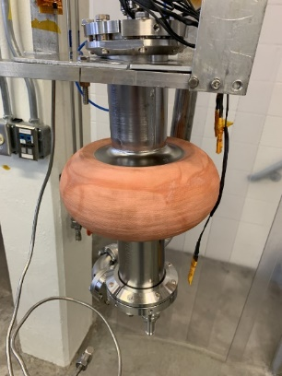
SRF Technologies for Big Science and Industrial Accelerators
Development of MeV-range ultrafast electron diffraction/microscopy (UED and UEM) is a priority for the DOE. Euclid is developing the SRF photocathode gun that is a promising candidate to produce highly stable electrons for UEM/UED applications
Euclid is developing SRF technology for conduction cooled industrial Nb3Sn accelerator: cold spray copper on Nb.
1.3 GHz SRF Photogun
(in collaboration with FNAL, BNL and Jlab)

Slide 9
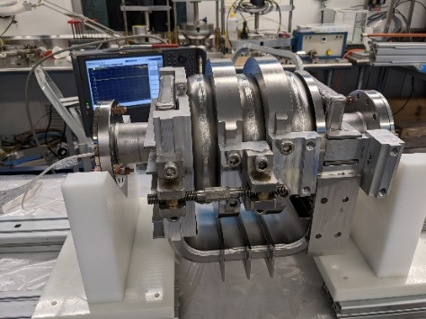
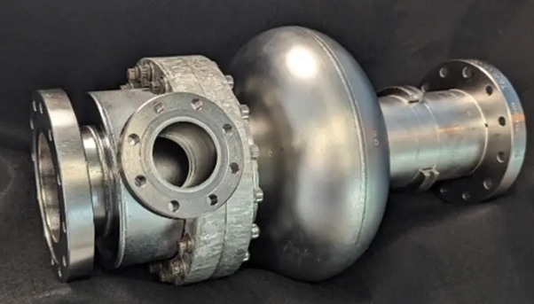
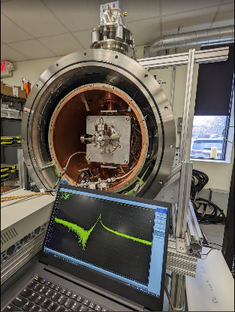
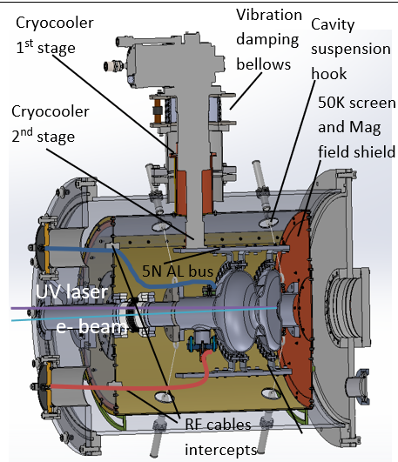
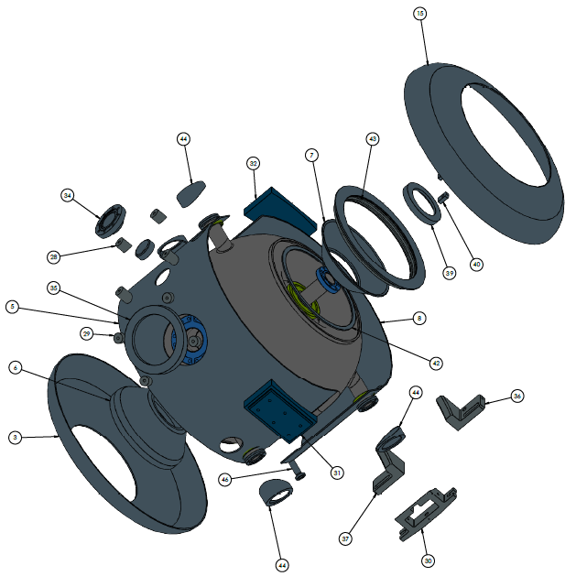
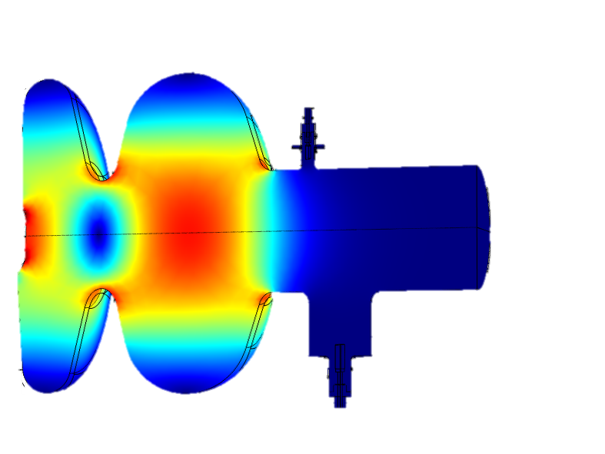
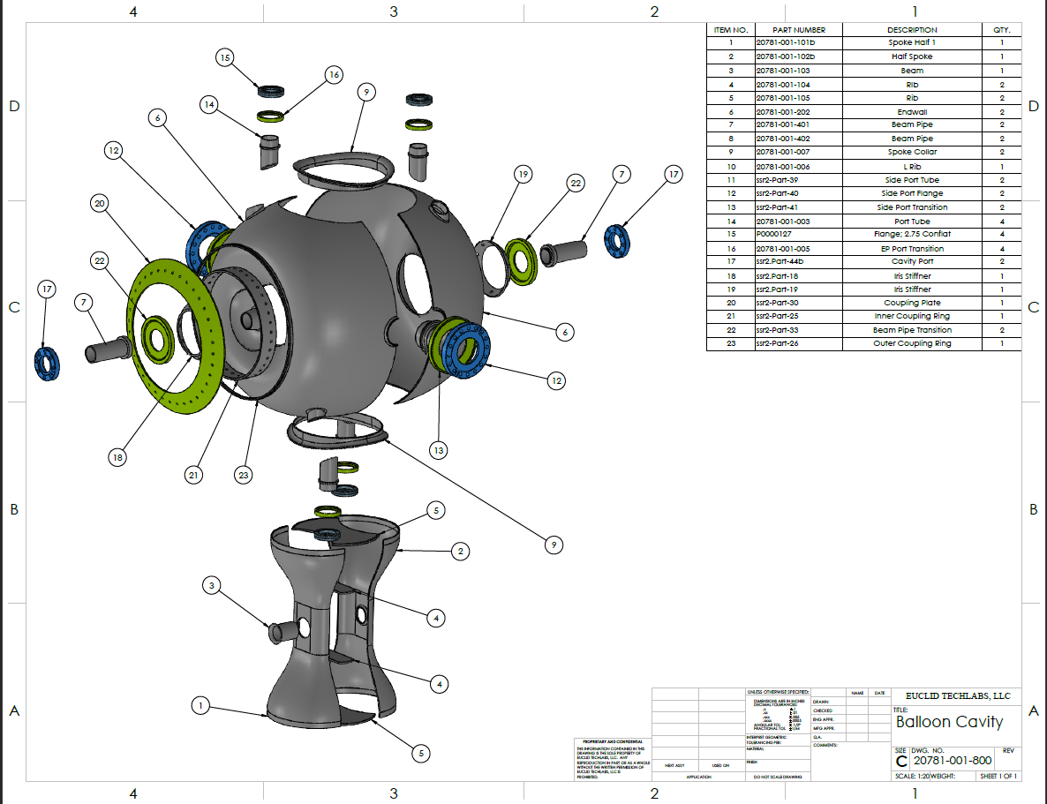
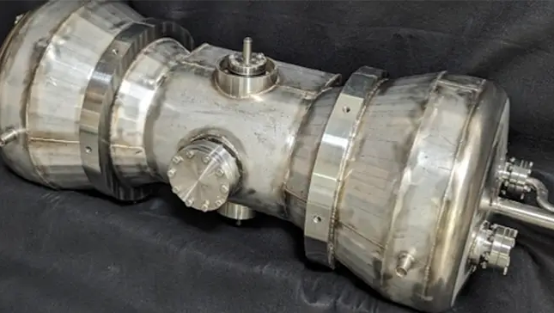
SRF Technologies for Big Science and Industrial Accelerators
e⁻
Coaxial QW on axis Coupler
3-Cell Traveling Wave Cavity
p⁺
Conduction Cooled Cryomodule
Conical QWR
Balloon Spoke Cavity
Notes:
Euclid develops cavity and couplers for electrons and protons machines ranging from low to high beta as well as conduction cooled cryostats. Our coupler design is Crucial for conduction cooling apps with limited cooling capacity

Slide 10
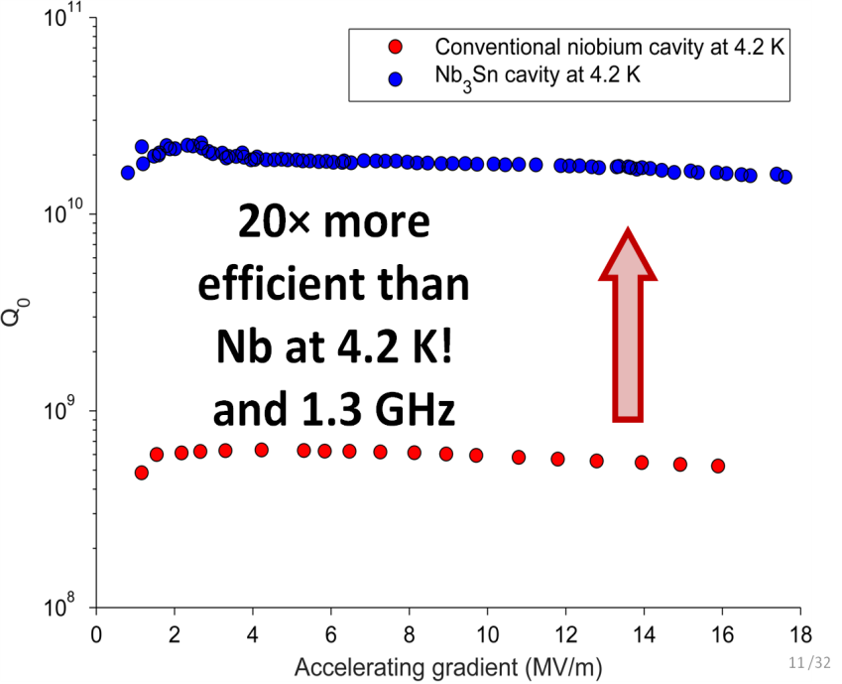
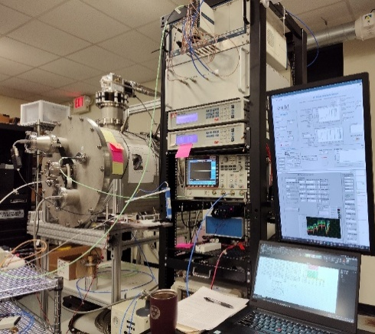
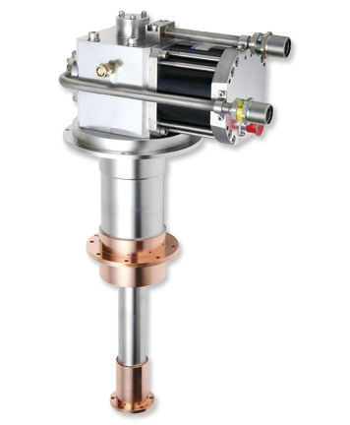
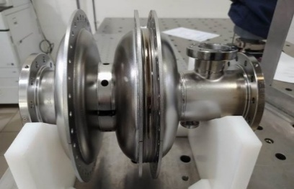
SRF at 4K
Motivation:
Significantly more efficient cryogenics:
1000W AC to remove 1W at 2K
250W AC to remove 1W at 4K!
Problem:
Nb cavity losses increases due to Rbcs
Solution:
Higher Tc superconductor
Nb3Sn x20 more efficient that Nb at 4K
Side benefit:
Can be cooled by commercially available cryocoolers making system independent, simple, portable.
QvsE for Nb vs Nb3Sn@4K
Nb3Sn Cavity
4K cryocooler
Transportable He-free system

Slide 11
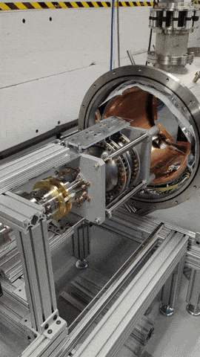
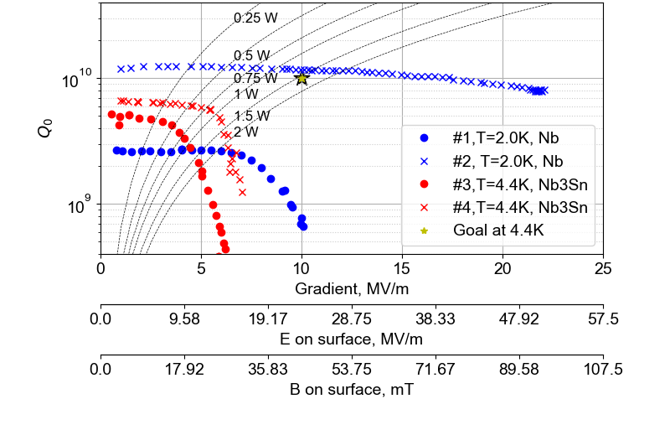
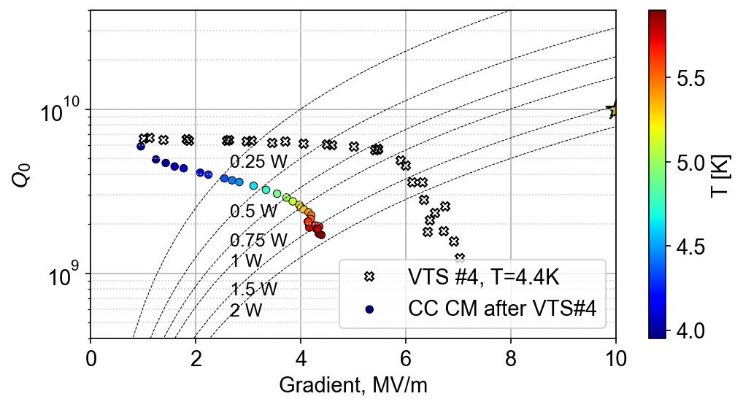
Euclid’s Conduction cooled 4K photoinjector for UEM/UED
The cryomodule was fully commissioned:
  Magnetic field below 5mG
  Cavity was successfully cooled according to specs
LLRF system developed in house and successfully commissioned
Pure Nb SRF gun was tested at 2K resulted in Q0=10¹⁰ and reached Ez=47MV/m on axis field and Eacc=22MV/m with just BCP
Nb3Sn test in VTS at 4.2K revealed contamination, nevertheless, was tested in conduction cooled cryomodule (CC CM).
Eacc=4.3MV/m achieved in CC CM
Beam test at ANL AWA facility is scheduled May 2025
in collaboration with FNAL, BNL and ANL
Euclid’s Conduction Cooled Cryomodule
Pure Nb cavity tests: Eacc>20MV/m
Nb3Sn test in He_{L} and CM

Slide 12
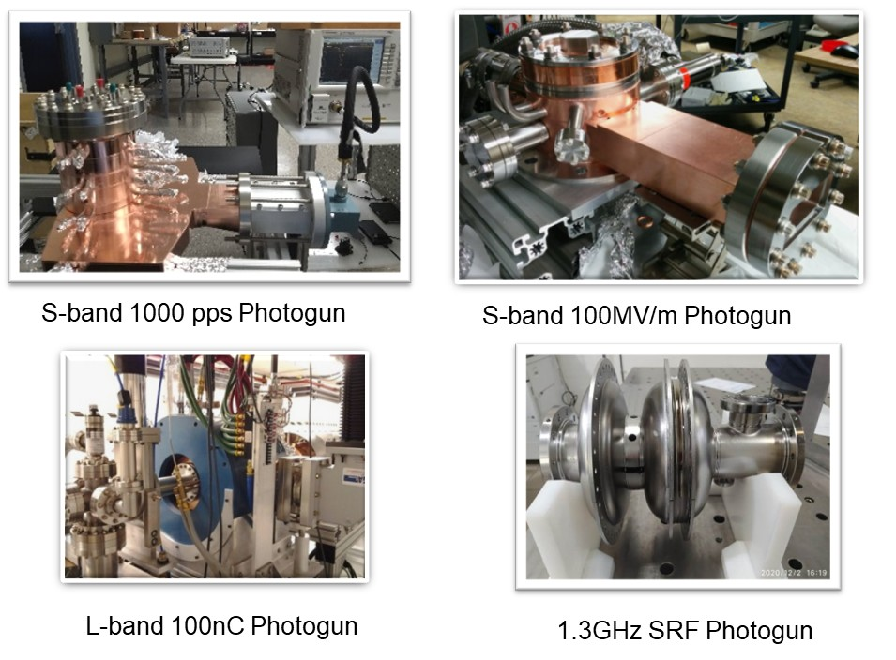
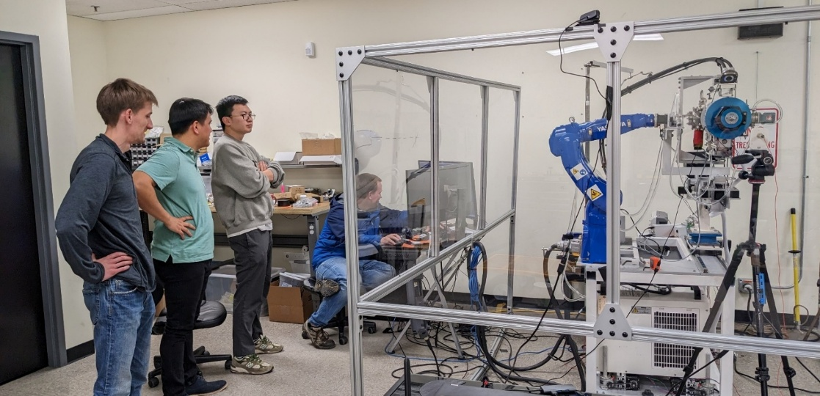
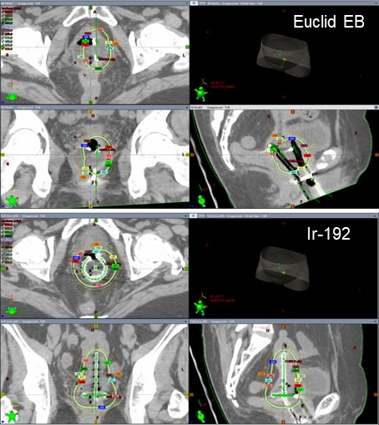
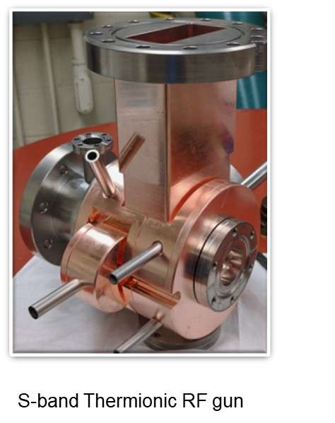
Normal conducting LINACs and Electron Sources
Photoguns and Thermionic guns
Brachytherapy linac system
Tight engagement with Chicago Proton Center oncologists, NWU.
Established the expertise in radiation simulation and dosimetry measurement.

Slide 13
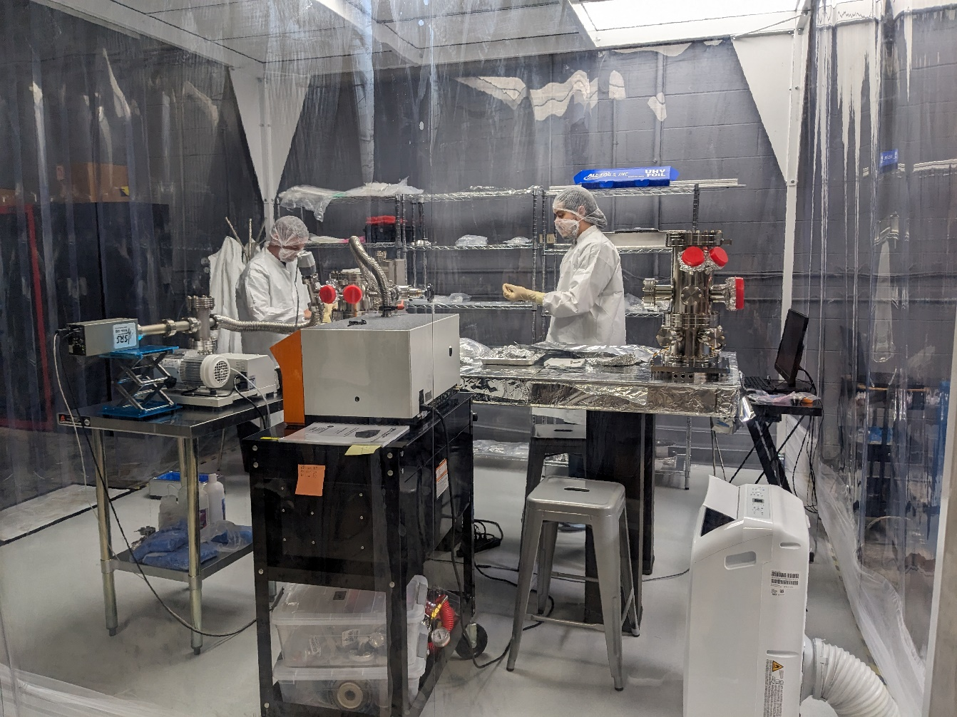
Euclid Plays an essential role in critical components assembly for ANL-SLAC Cavity-based FEL Experiment at LCLS-II
The X-ray FEL oscillator (XFELO) and the X-ray regenerative amplifier FEL (XRAFEL) concepts use this technique
Both schemes require a high repetition rate electron beam, an undulator to provide FEL gain, and an X- ray cavity to recirculate and monochromatize the radiation.
A joint Argonne National Laboratory (ANL) and SLAC National Laboratory (SLAC) collaboration aimed at enabling these schemes at LCLS-II.
Euclid has been actively participating this project by assembling, testing, and QA all critical components in Euclid Class10k cleanroom at Euclid West facility.
Clean room facility at Bolingbrook IL

Slide 14
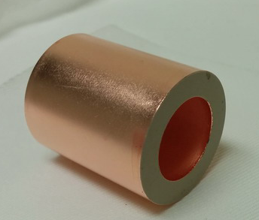

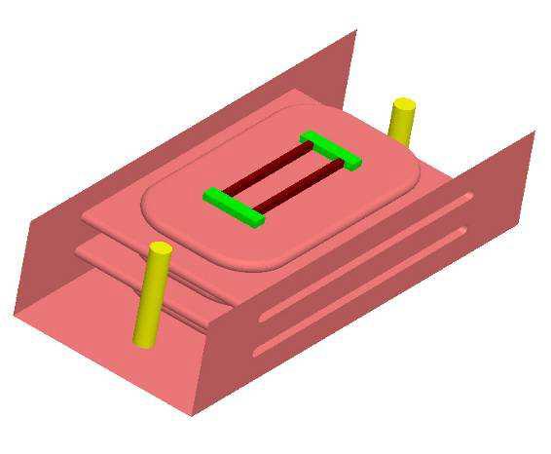
History of the Fast Ferroelectric Tuner Development
Ferroelectric phase and amplitude control was developed during the 1990’s, in 2003 V. Yakovlev proposed RF switching by changing the frequency of a ’switching NC cavity’ containing ferroelectric material. In 2006 Ilan Ben-Zvi initiated F-FRT research at BNL whereby the frequency of a SRF cavity would be controlled by an external ferroelectric tuner
Initial project to develop an ultra-fast (~1us) phase shifter/tuner using ferroelectric was carried out in collaboration with Omega-P/Yale University (V. Yakovlev, S. Kazakov) and BNL (I. Ben-Zvi) in 2004-2010. The phase shifter/tuner was intended to control of coupling of accelerating structures ( phase/amplitude), and to tune resonance frequency of the cavity. With this project, Euclid developed a ferroelectric material with dielectric constant ɛ~ 500, tanδ~2x10⁻³ at 1.3GHz but low tuning range, ~2/ kV/cm.
In 2013, I. Ben-Zvi (BNL) proposed a new topic for the DOE SBIR/STTR program on the ferroelectric fast reactive tuner (F-FRT) development for microphonics compensation. It allowed Euclid to develop a new improved ferroelectric ceramic with ɛ~ 150, tanδ<1x10⁻³ at 1.3GHz and the tuning range up to Δε/ε~10% at 15 kV/cm.
A new, simple coaxial tuner design (S. Kazakov) for the F-FRT became feasible, and the 400 MHz tuner prototype was fabricated by Euclid and tested at CERN in 2019 with the 400 MHz SRF cavity.

Slide 15
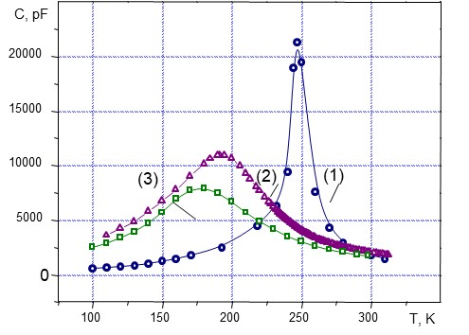
Fast tuning ferroelectric elements
Dielectric constant has to be low (~ 100-150)
Loss factor has to be low ~ 1x10⁻³ at 1 GHz and ~1x10⁻⁴ at 100 MHz
Tuning range has to be high ~ 6-8% at 15kV/cm
Can be done with (Ba, Sr)TiO₄+Mg oxides
Dielectric constant of pure BST ~ 1000, and it’s lossy. To reduce both eps and tanδ, one has to develop a mixture (solid solution) of BST ferroelectric and low loss linear ceramic
Curie temperature dependence on Mg-oxide content. Curie temperature shift with Mg based oxide increase

Slide 16
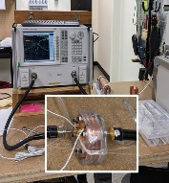

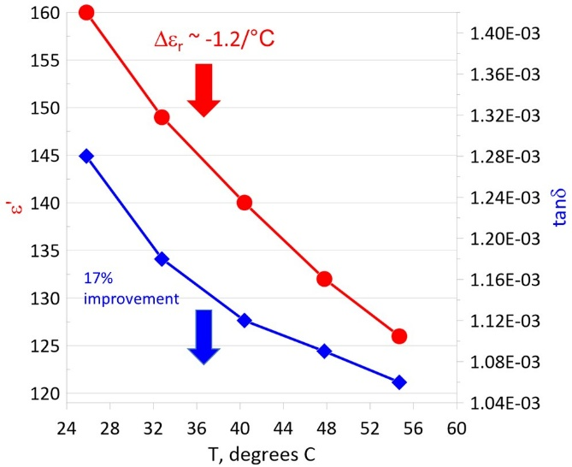
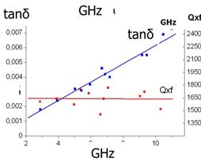
ε and tanδ vs. temperature and frequency
For lower dielectric constant, tanδ is significantly reduced.
Q×f (GHz)=const
tanδ=1/Q
for ~1 GHz and ε~150
Q×f~1,000, tanδ~1x10⁻³
Dielectric constant and tanδ measurements in the temperature range T=20⁰С-60⁰С at 400 MHz for the BST(M) ferroelectric material: tanδ=1.3×10⁻³ T=22⁰С and ~ 17% improvement at T=55⁰С.
Dielectric constant weakly depends on the frequency
Loss tangent increase linearly with frequency

Slide 17
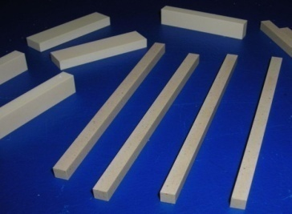
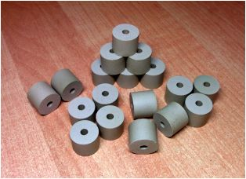
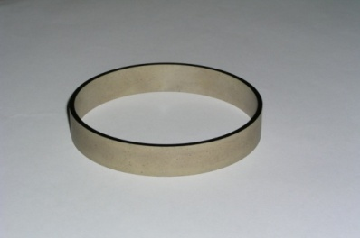
Progress on BST Material Development
(Ba, Sr)TiO₄+Mg oxides
Q*f
BST(M), ε~50-150
record low values of dielectric constant and loss tangent at relatively high tunability level required for high power bulk tuner operating in air (< 30 kV/cm) and in vacuum ( up to 80 kV/cm).

Slide 18
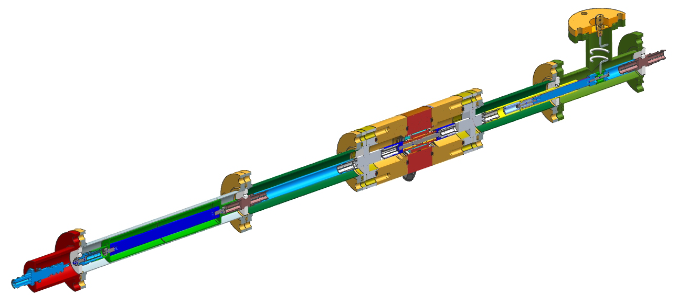
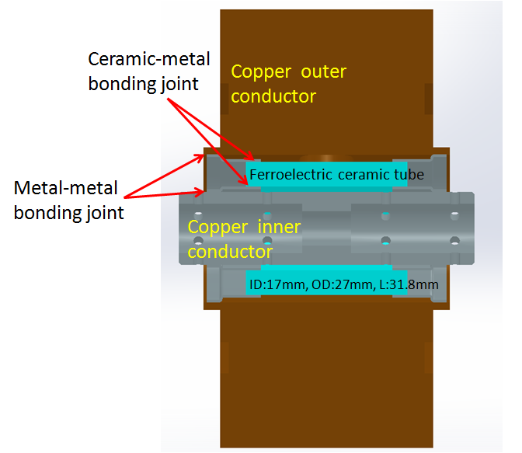
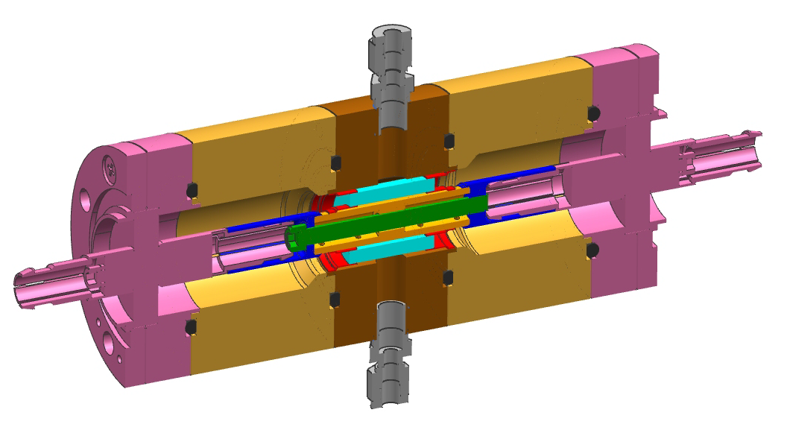
BST Based Tuner Design (assembly)
design of S. Kazakov and V. Yakovlev
Funded by DOE SBIR Nuclear Physics, DE-SC0007630

Slide 19
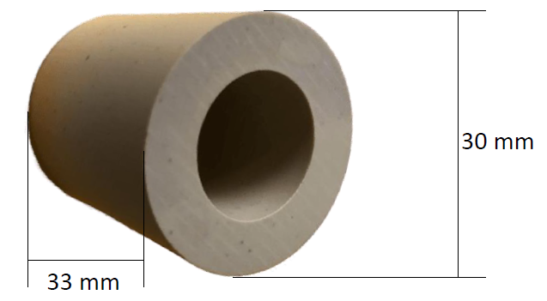
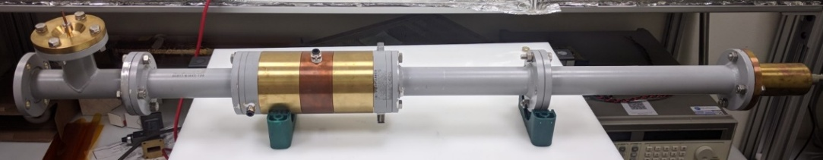
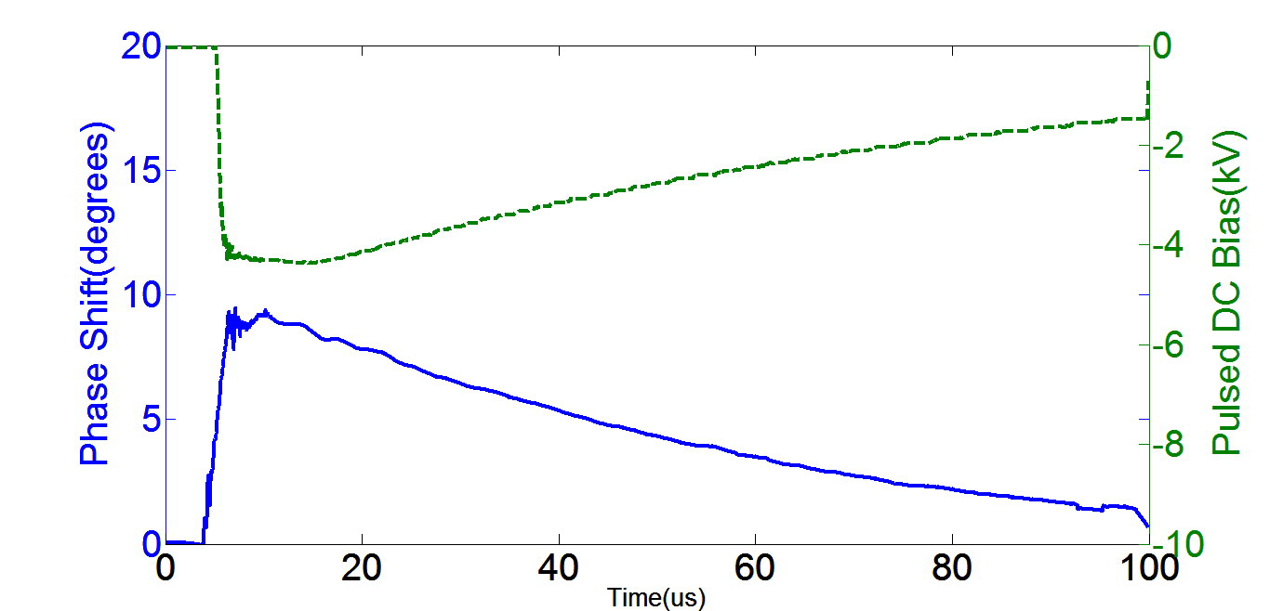
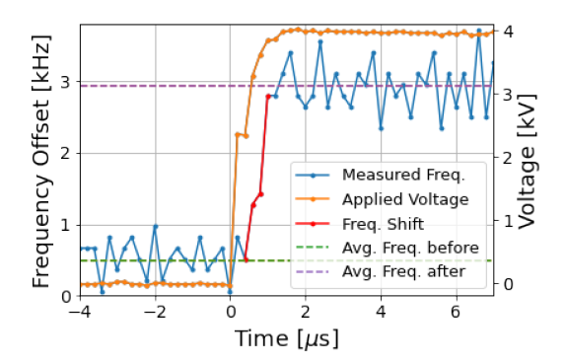
F-FRT low power tests at Euclid at CERN
Assembled F-FRT
Ferroelectric element before metallization
N. Shipman, et al., IPAC’21, 1305, 2021
Measured at CERN frequency response at 600 ns of a cavity to a 4 kV high voltage pulse (orange) applied to the connected FE-FRT.
Measured at Euclid phase shift vs. time at biasing voltage applied (~ μs range response time)

Slide 20


Microphonic Suppression
N. Shipman, et al., IPAC’21,
First ever Ferroelectric Fast Reactive Tuner (FE-FRT) test with a superconducting cavity

Slide 21

Robust Rf Window Solution - Conductive Ceramic
Funded by DOE SBIR Nuclear Physics DE-SC0017150
Mitigate charge accumulation on RF windows by using a conductive ceramic
What is new: a ceramic material with a finite DC electrical conductivity and low loss tangent that can be incorporated into high power couplers
Why it is important: the electrical conductivity will drain the induced and built-up charge away. The low loss tangent will allow for high efficiency RF power transmission.

Slide 22




High-Power Test at Fermilab
270°
80 kW CW reached for two phases
  Not fundamental limit, only hesitant to damage window
Max. temp. on flanges:
  Left:
    Conductive Ceramic = 41.8 C
    Alumina = 38.7 C
  Right:
    Conductive Ceramic = 37.5 C
    Alumina = 32.3 C
180°
Max. Conductive Ceramic window temp. 61.8 C at 80 kW!

Slide 23




High-Power Test at Fermilab Inspection
Before – Conductive Ceramic
Before – Alumina
No visual signs of damage on conductive ceramic window after high power test
Alumina window and antenna discolored / damaged after high power test
After – Conductive Ceramic
After – Alumina

Slide 24
In conclusion,
New ferroelectric ceramic material was developed with the set of parameters satisfying the Ferroelectric Fast Reactive Tuner (F-FRT) requirements for microphonic compensation, transient detuning, and fast switching. First F-FRT prototype was designed, fabricated and successfully demonstrated at CERN
Euclid has developed a new conductive low loss ceramic for high power RF windows. 650 MHz windows made of this type of ceramic overperformed the standard alumina window at ~90kW CW tests at Fermilab.

