Slide 1
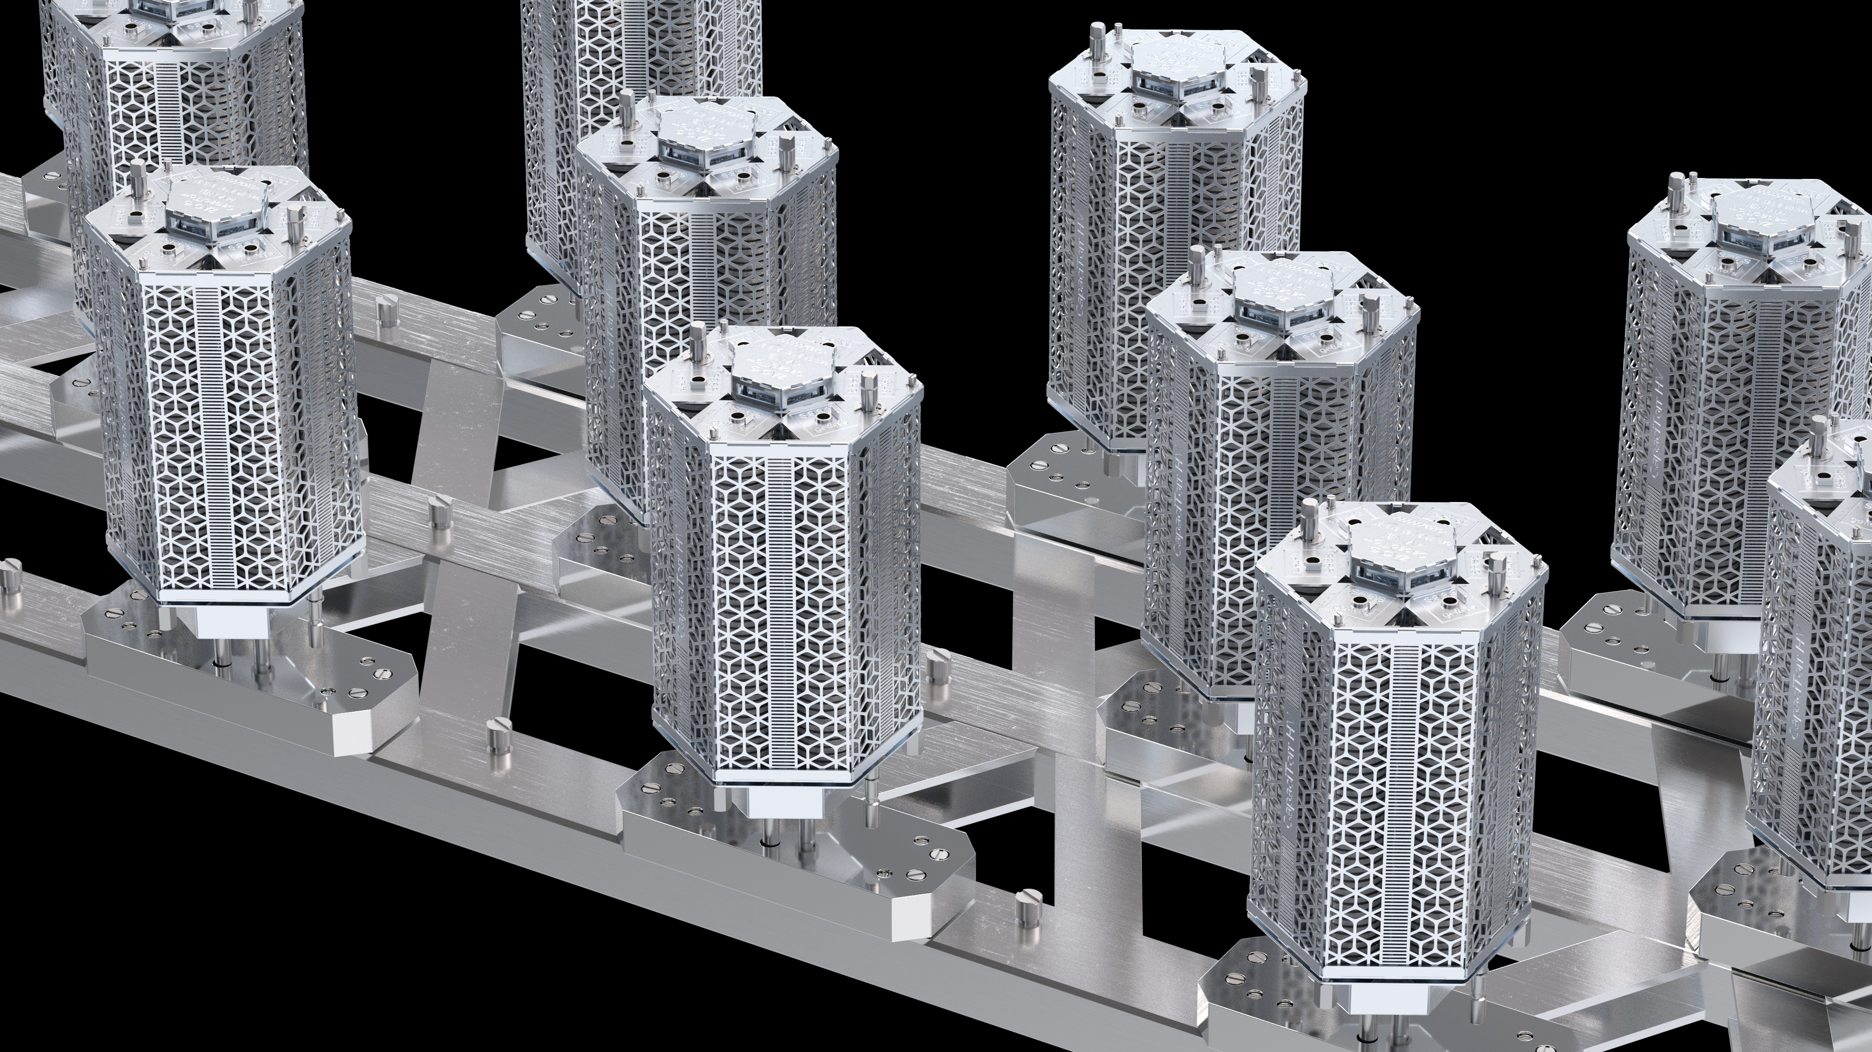

The contribution of the SAES high vacuum division
to the particle accelerator industry
iSAS – Padova Meeting: 12-14 March 2025

Slide 2
Outline
CONTENT
01. SAES Group Overview
02. The High Vacuum Division
  > NEG pumps
  > Vacuum chambers for storage rings
  > Scientific Instrumentation for beamlines, RF cavities and RFQ
03. Focus on two Technologies
> RFQ and NC RC at Cinel
> NEG coating at SAES Getters
04. Possible Partnership with iSAS?

Slide 3
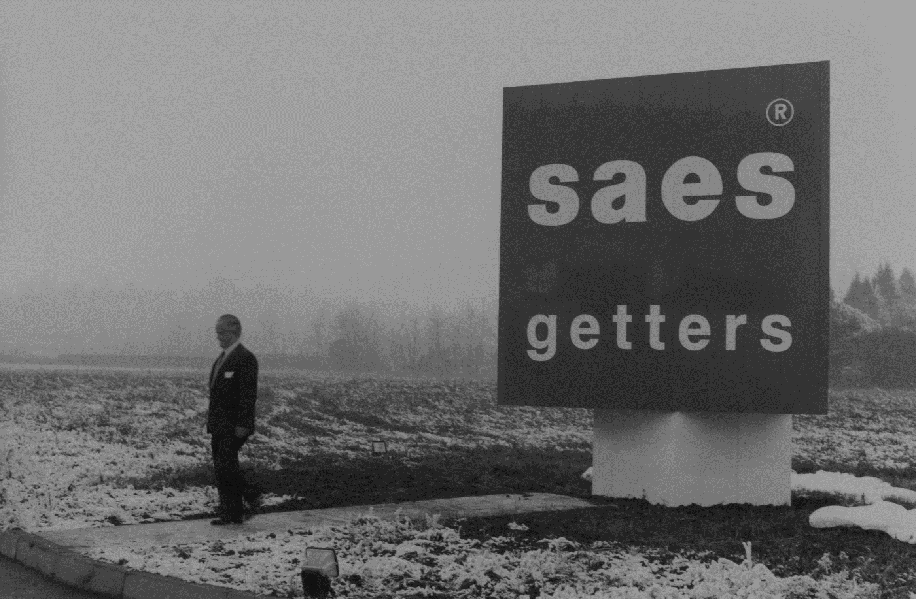
SAES Group / High Vacuum Division
01
SAES Group Overview

Slide 4
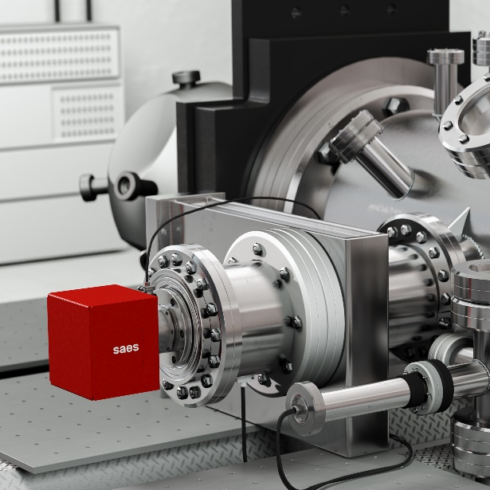

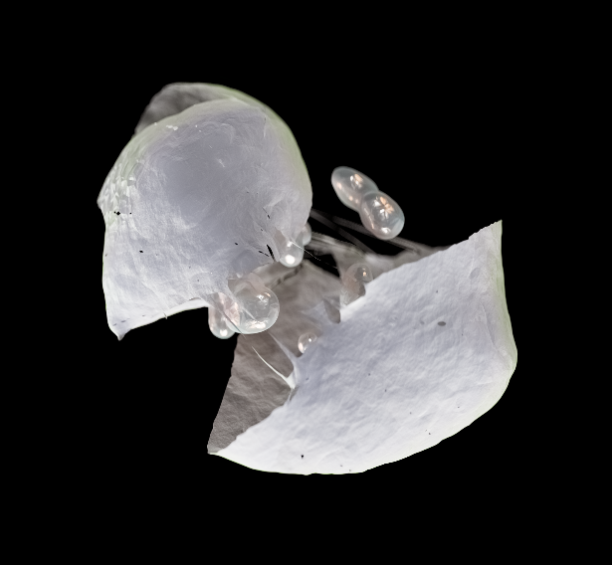
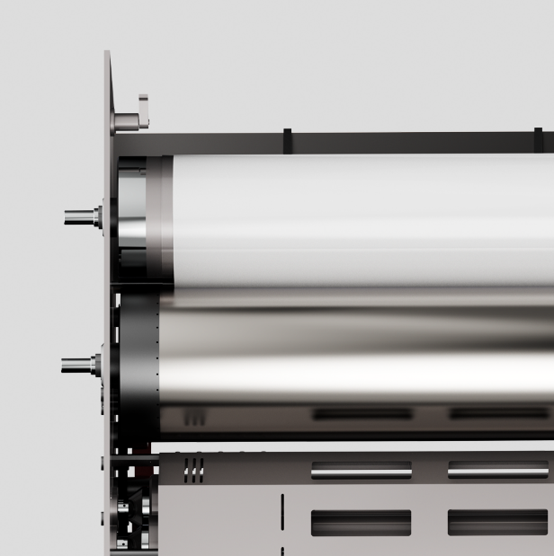
SAES Group Core Business
SAES Group / Corporate Overview
SAES® is an advanced functional materials Group, specializing in the development and production of engineered solutions for industrial and scientific applications.
Key areas of focus include:
GETTERS COMPONENTS & PUMPS for high and ultra-high vacuum conditions in particle accelerators, analytical instrumentation, semiconductor processing, vacuum systems, and consumer electronics.
SHAPE MEMORY COMPONENTS & SYSTEMS for various industries, including automotive and consumer electronics, encompassing wires, springs, actuators, and valves.
FUNCTIONAL COMPOSITES & COATED FILMS for protective packaging solutions.
ZEOLITES for Innovative Applications: Zeolites are versatile, non-toxic materials used in protective formulations for electronics, high-barrier packaging, antibacterial coatings, and UV boosters for cosmetics.

Slide 5
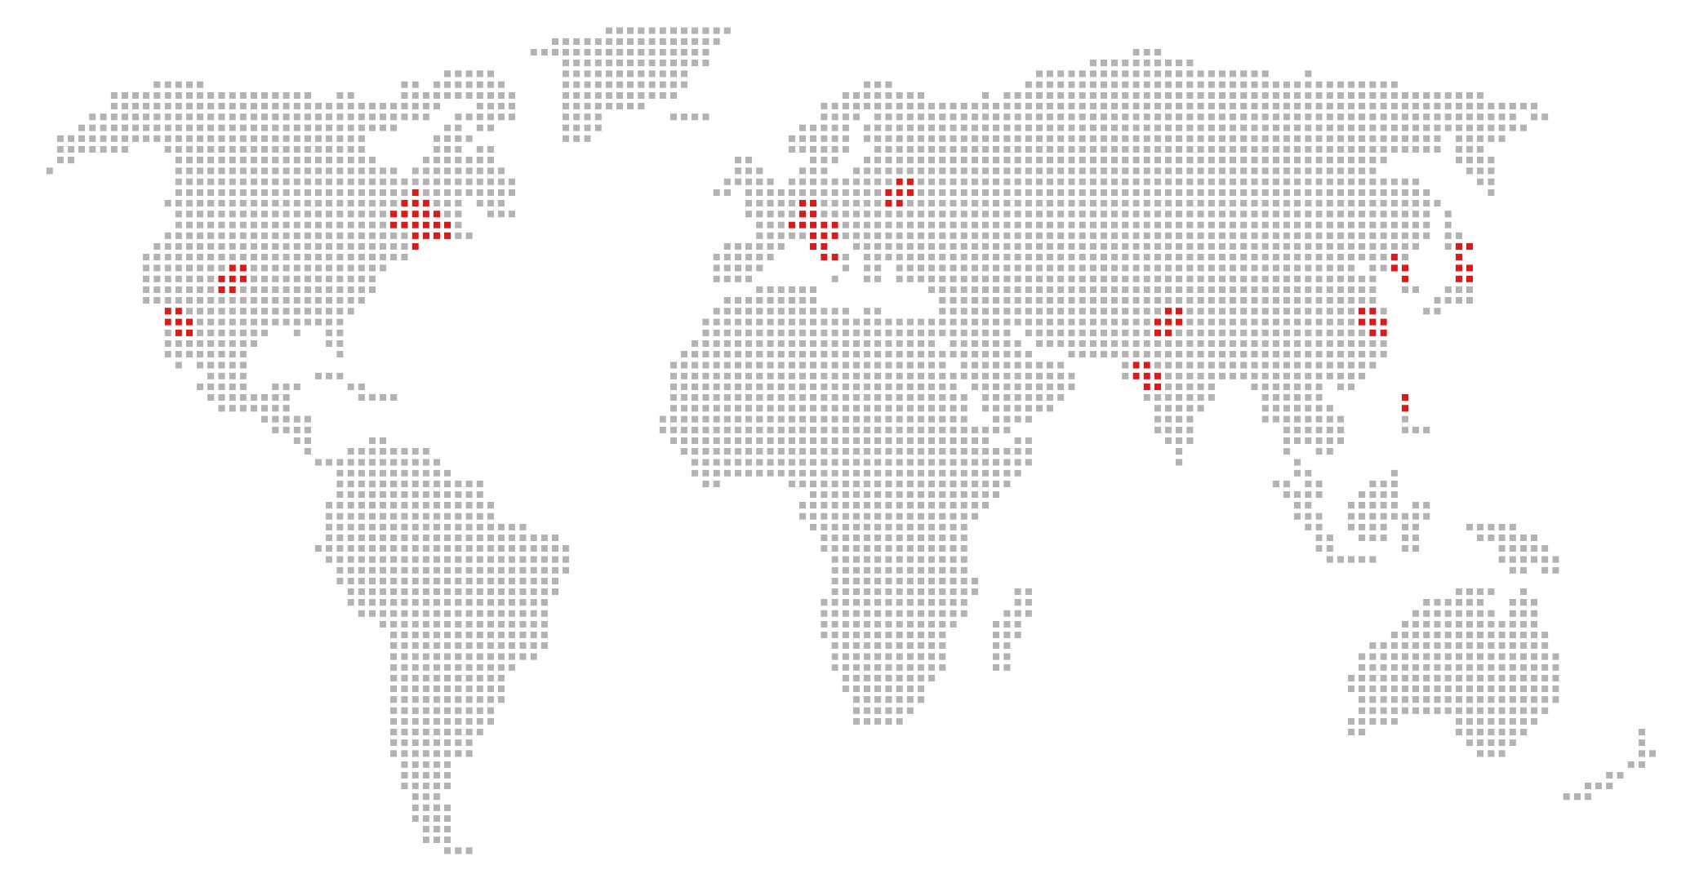
SAES Group Worldwide coverage
SAES Group / Corporate Overview
~670
employees
~120 Mio €
total revenues of the Group
8
production sites worldwide
Total quality management
all the Group factories are certified according to proper ISO/DIN standards related to their own business field.

Slide 6
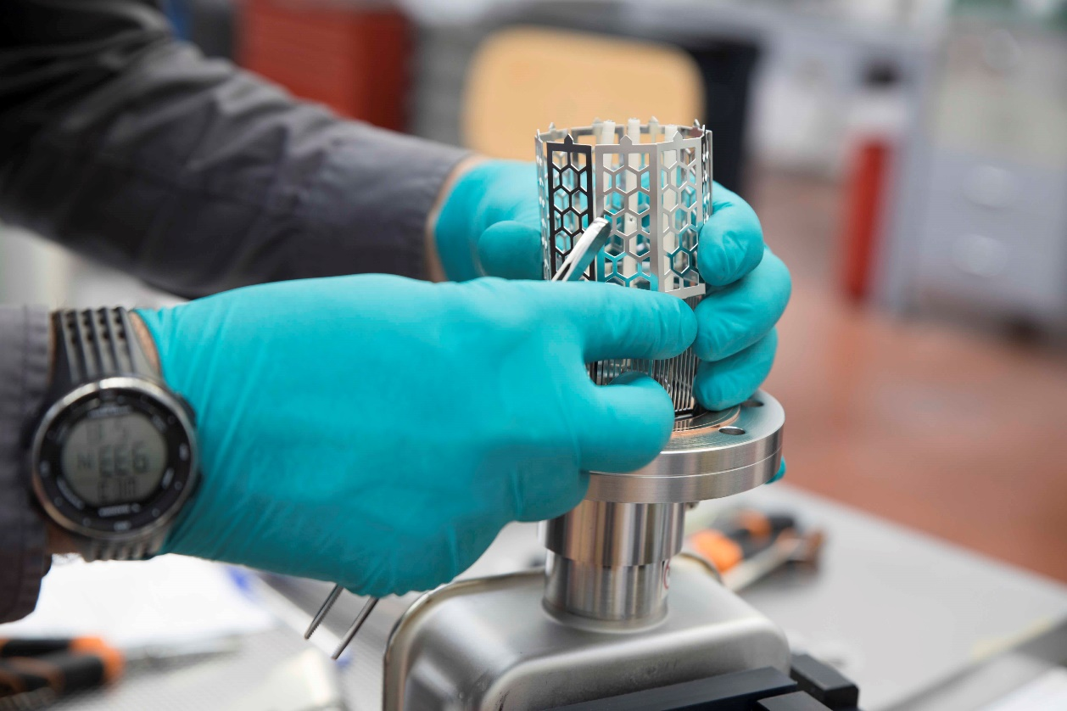
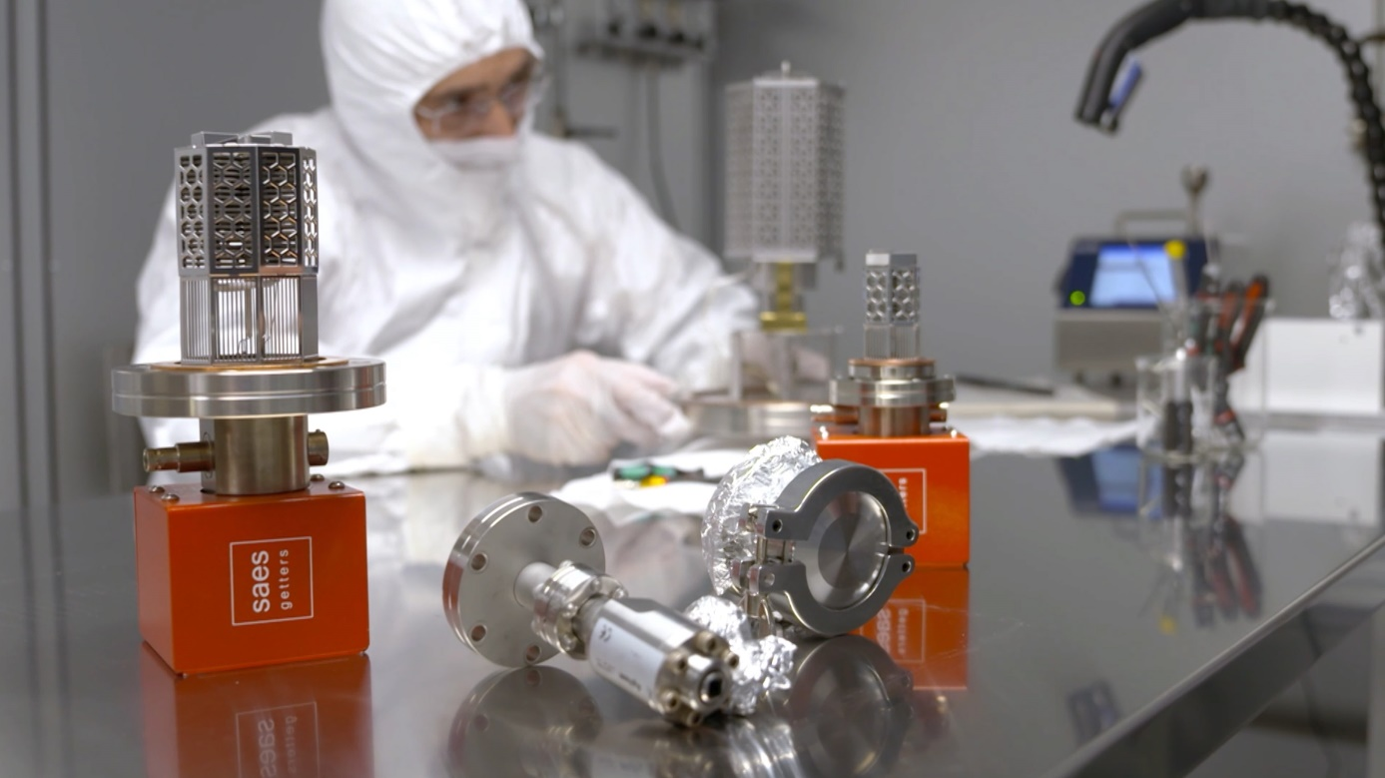
SAES Group / Corporate Overview
Our Research and Innovation
7-10% of revenue
R&D investments
+150 employees
R&D workforce
3.300 sqm
Labs size
233
Publications
Collaborations
With universities and R&D centers

Slide 7







Main Final Markets
SAES Group / Corporate Overview
Healthcare
Consumer Electronics
Automotive
Advanced Packaging
Security and Defense
Scientific and Research Areas
Other Industries

Slide 8
SAES Divisional Organization
SAES Group / Corporate Overview
SAES Group is organized in 4 Divisions, each leveraging on specific technologies & product families and addressing dedicated market segments.
INDUSTRIAL | HIGH VACUUM | SPECIALTY CHEMICALS | ADVANCED PACKAGING
Getters, SMA wires&devices | Getter pumps, Vacuum solutions Vacuum Instruments | Zeolite nano structured materials, Glues, Pastes, Dryers | High barrier coatings, laquer, Barrier polymers & materials
Space & Defense, Telecom, Semiconductor Automotive, Appliances | OEM, Particle Accelerators Infrastructures, Research Laboratories, Nuclear Fusion Infrastructures | Mobile telecom, Display industry | Food and packaging

Slide 9
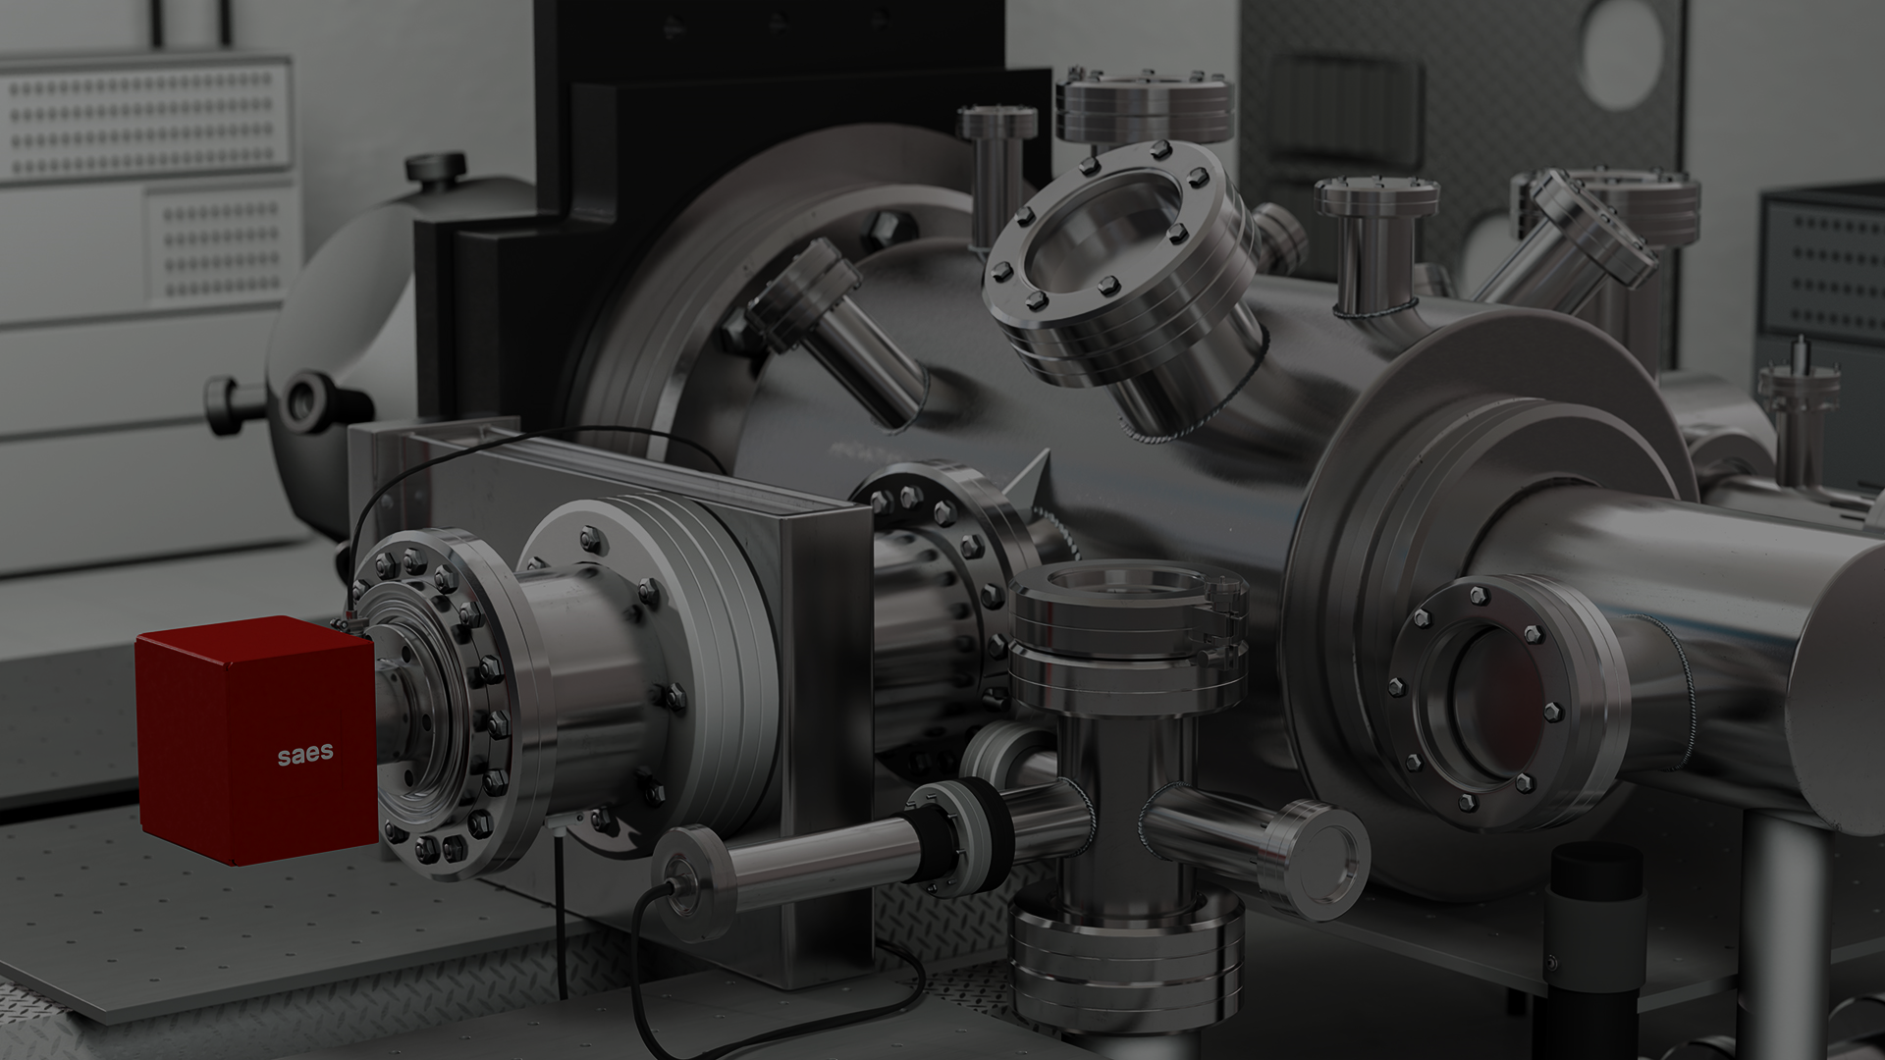

SAES Group / High Vacuum Division
02
The High Vacuum Division

Slide 10
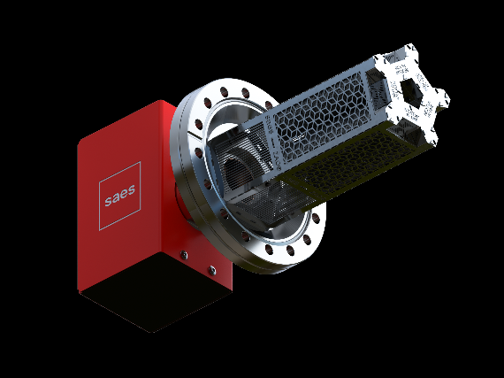
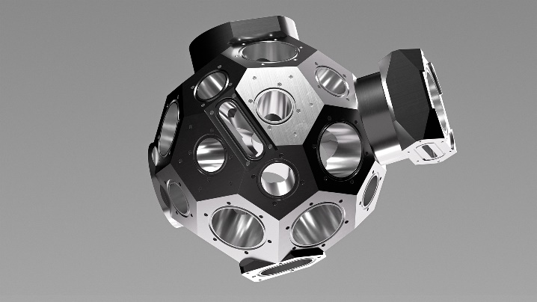
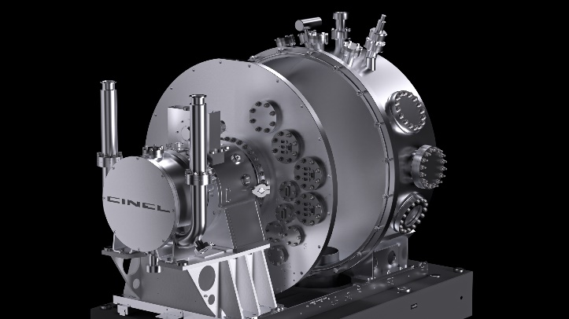
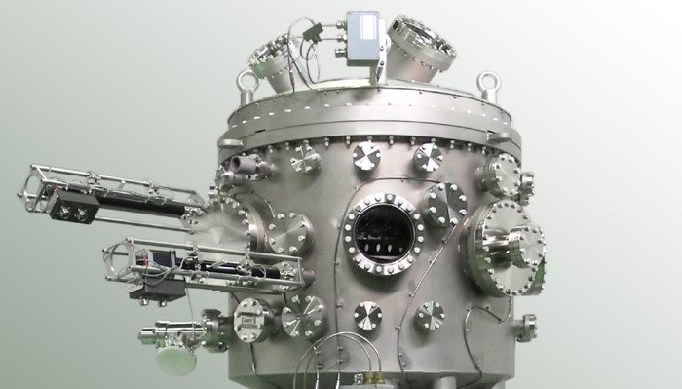
High Vacuum Division | Four pillars
SAES Group / High Vacuum Division
1970
2015
2021
2024
Pumps and getter solutions per high and ultra-high vacuum for accelerators, synchrotrons, research and industry.
Vacuum chambers and components for the synchrotron ring through SAES RIAL Vacuum (Parma)
Vacuum chambers, monochromators, mirror systems, front end, beamlines and scientific instrumentations for synchrotrons through Strumenti Scientifici Cinel (Vigonza).
Vacuum chambers, soft X-ray onochromators, mirror systems, front end, beamlines and scientific instrumentations for synchrotrons through FMB Berlin (Berlin.

Slide 11

High Vacuum Division Facilities
SAES Group / High Vacuum Division
HQ in Milano;
SRV in Parma;
CINEL in Padova;
FMB in Berlin
SAES Getters (NEG pumps) in Avezzano
With 5 manufacturing sites (Parma, Vigonza, Lainate, Berlin, Avezzano) and 150 headcounts, the High Vacuum Division is well positioned to provide integrated solutions to new accelerator facilities.

Slide 12
SAES Group / High Vacuum Division
03
Focus on two Technologies: RFQ and NC RC (at Cinel)

Slide 13
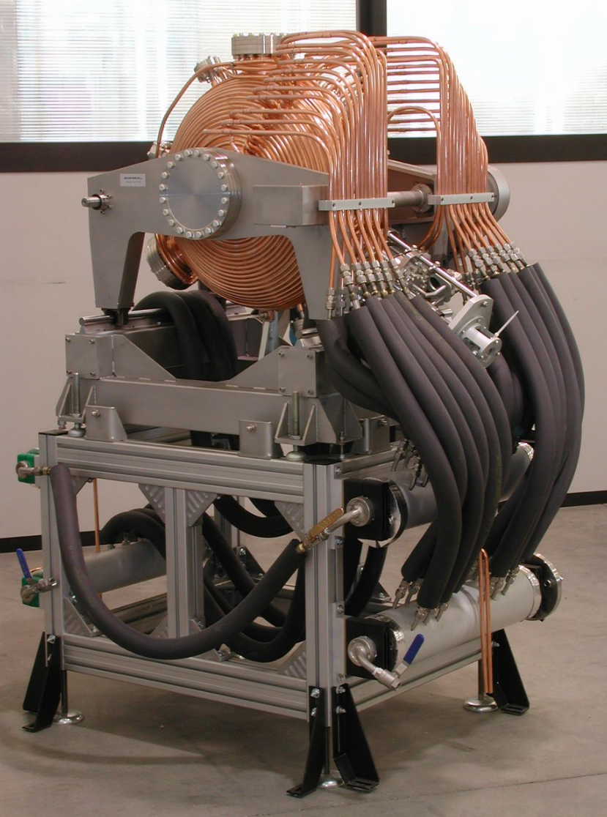
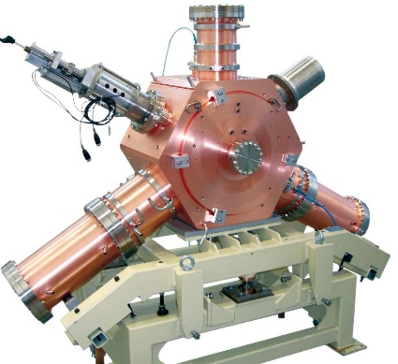
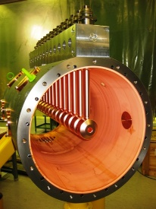
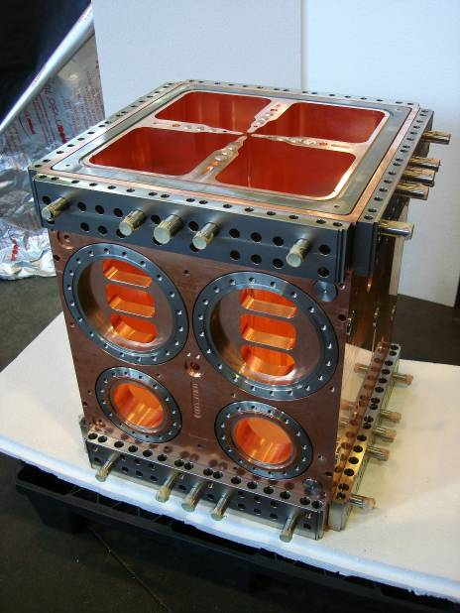
Cinel: RF cavities and RFQ
SAES Group / High Vacuum Division
A significant curriculum Vitae in RF cavities and RFQ manufacturing

Slide 14
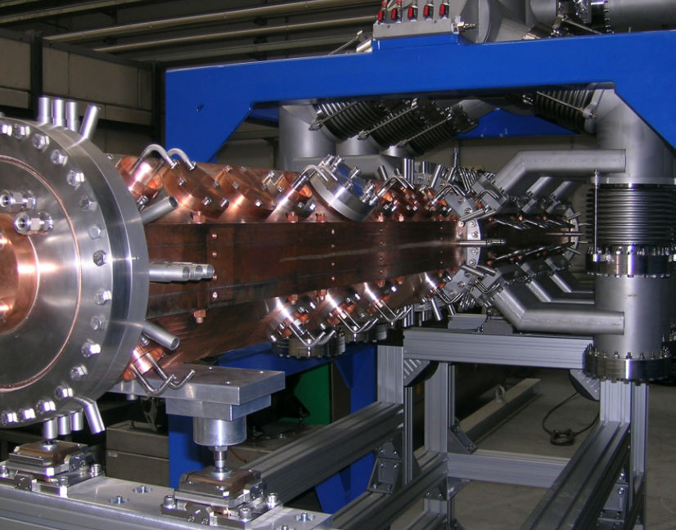
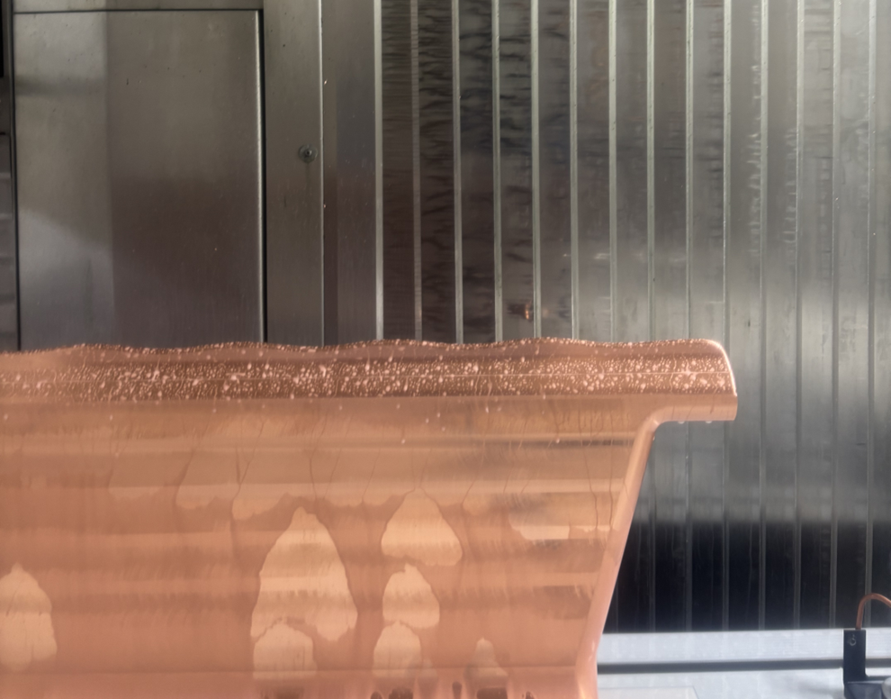
On going NC RF components projects
SAES Group / High Vacuum Division
Ancillaries components for TRASCO RFQ (Anthem project for BNCT INFN Torino)
7 RFQ modules for the Newgain LINAC (CEA)
Icone prototype cavity (CEA)

Slide 15
On going NC RF components projects
SAES Group / High Vacuum Division
Prerogatives for NC RF components construction
high precision machining
high precision assembly or joining, welding or brazing engineering (iterations CMM-milling machine)
clean environment

Slide 16
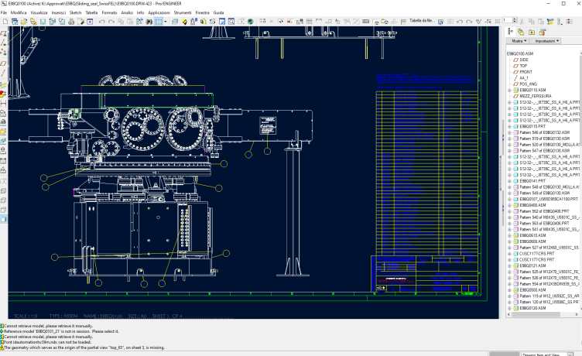
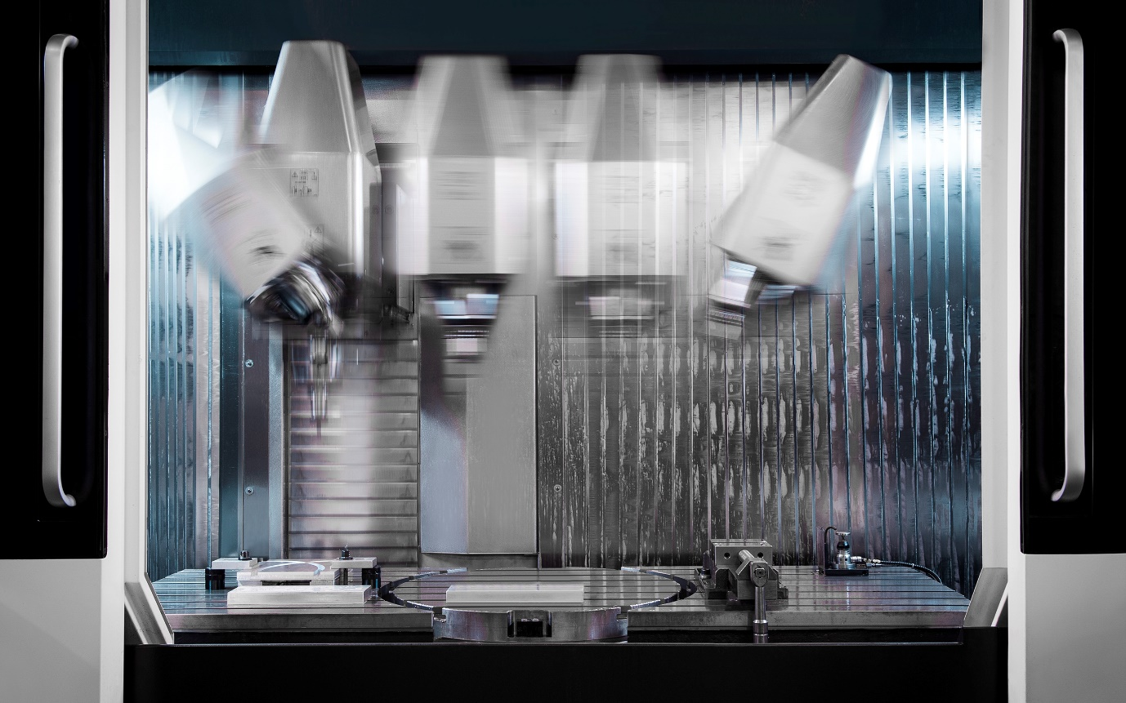
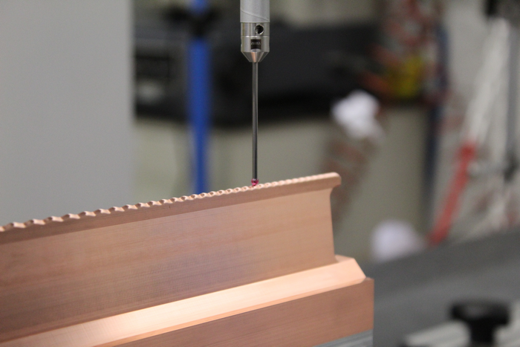
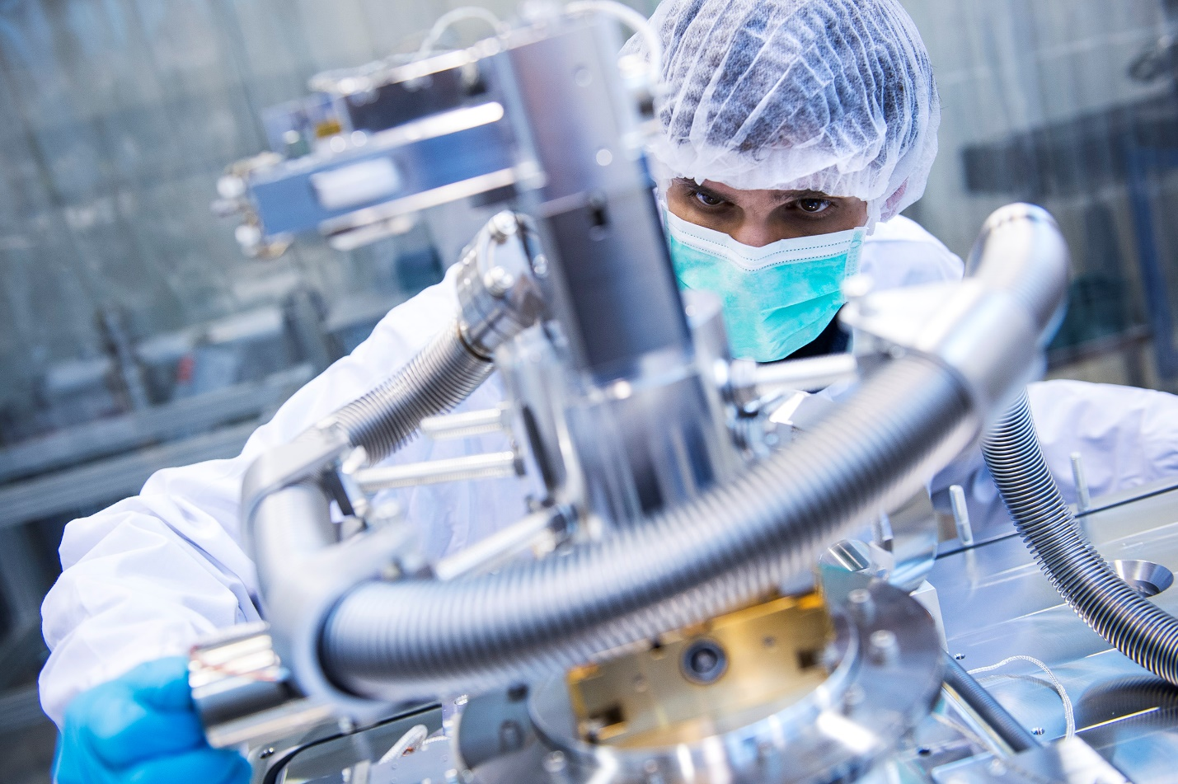
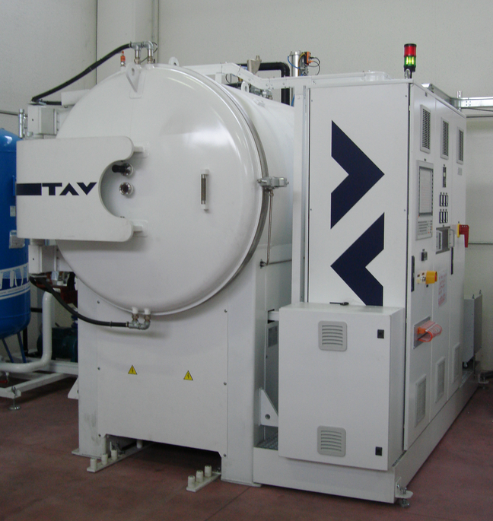
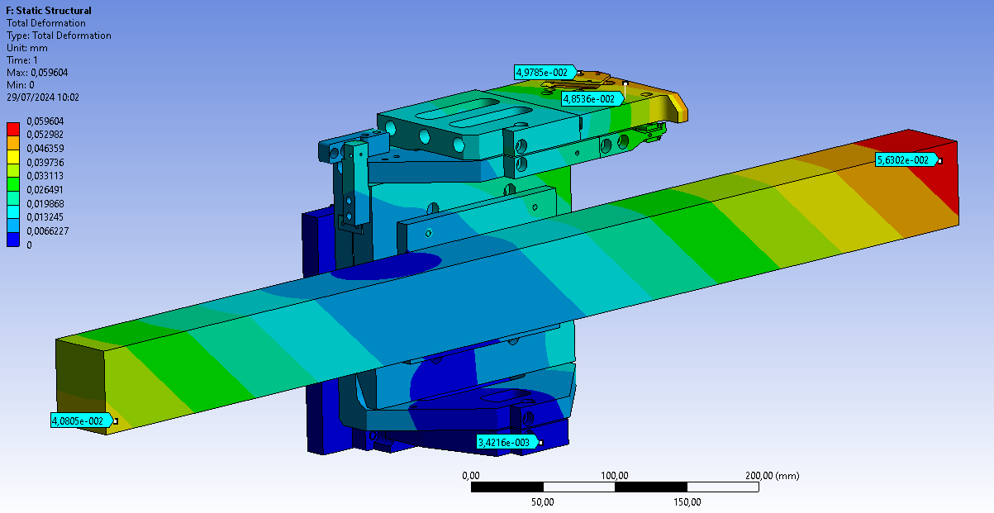
On going NC RF components projects
SAES Group / High Vacuum Division
Prerogatives for NC RF components construction
high precision machining
high precision assembly or joining, welding or brazing (iterations CMM-milling machine)
clean environment
Cinel has a verticalized production with
Design and simulation capabilities
High precision machining
CMM and functional testing capabilities
Welding and brazing
ISO 5 clean enviroment
These are necessary ingredients to have a full control on the manufatcuring process and to guarantee the required quality standards

Slide 17
SAES Group / High Vacuum Division
03
Focus on two Technologies NEG coating (at SAES Getters)

Slide 18
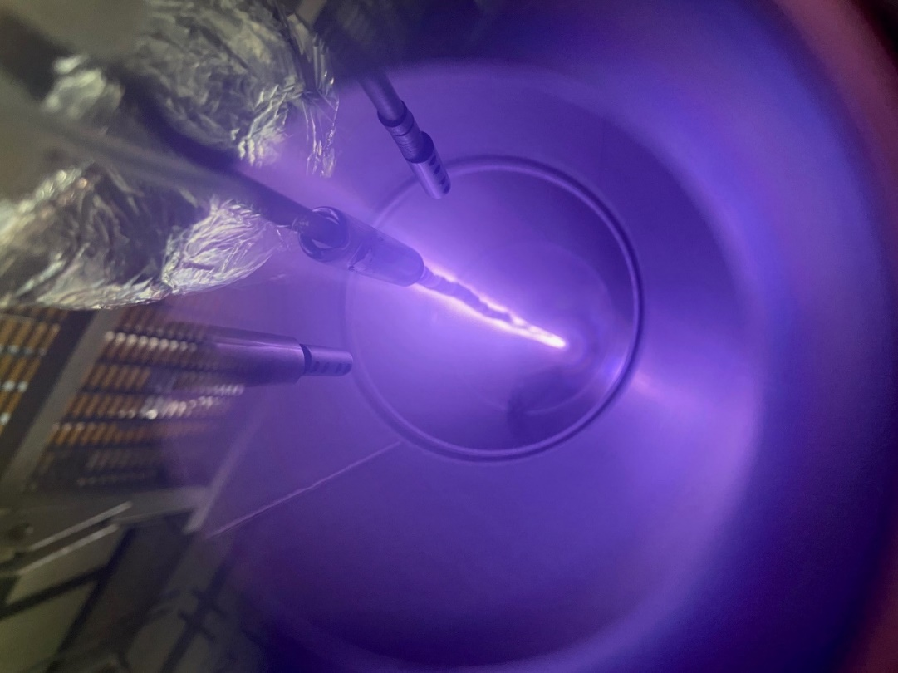
Basics of NEG coating technology
NEG coating as a vacuum pump for particle accelerators was developed at CERN and widely used in the LHC
Typical NEG coatings are ~1 μm TiZrV, deposited by magnetron sputtering
TiZrV is the most popular NEG coating composition --> best compromise between cost and performance
TiZrV NEG coating can be activated at low temperature (e.g., 180 °C x 24 h) during machine bake-out
Several machines worldwide have already implemented this technology to boost machine performance and design
NEG coating:
Provides a distributed pumping solution
Mitigates the effect of small conductances on pumping speed
Transforms the pipe wall, from a source of gas to a pumping surface
Can effectively pump most gases (H₂, H₂O, CO, N₂, O₂, CO₂), except for noble gases and hydrocarbons
Has a low SEY, mitigates PSD and ESD

Slide 19
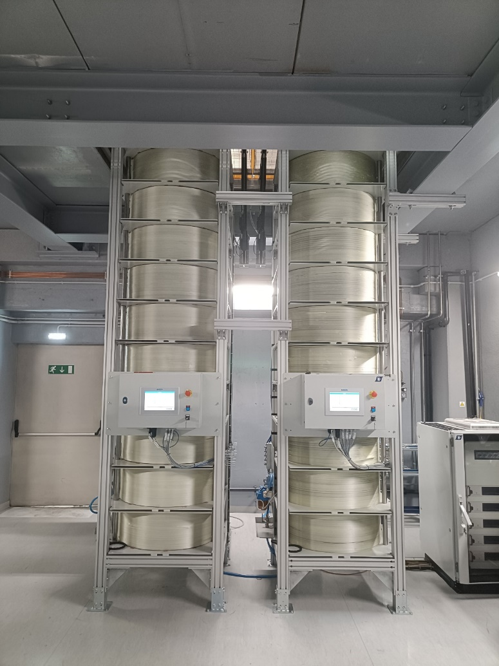
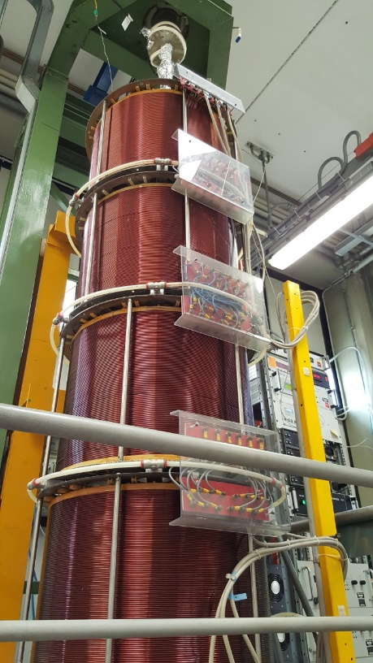
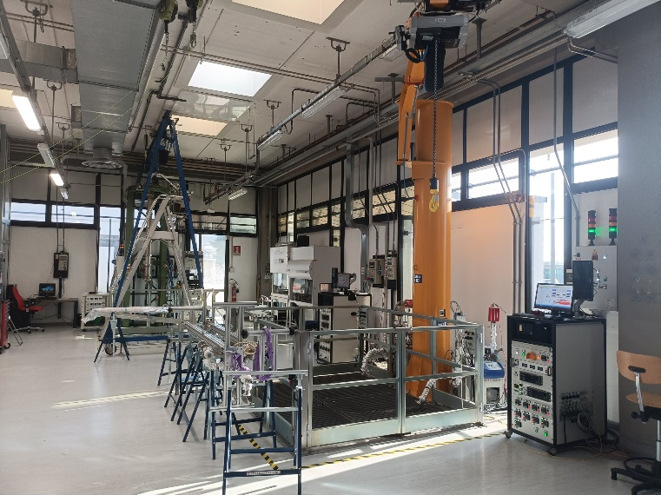
NEG coating at SAES today
SAES has coated several hundreds of vacuum chambers and gained a lot of experience about NEG coating over the years
Substantial R&D efforts have been made to deepen the expertise in this field
The NEG coating lab has been progressively expanded, to be able to efficiently deal with large NEG coating productions in an efficient and effective way
However…
vacuum chambers to be NEG coated and their technical requirements have also evolved through the years!

Slide 20
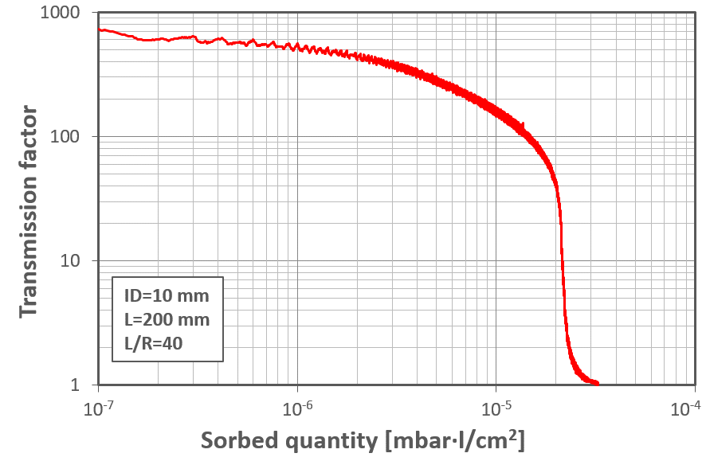
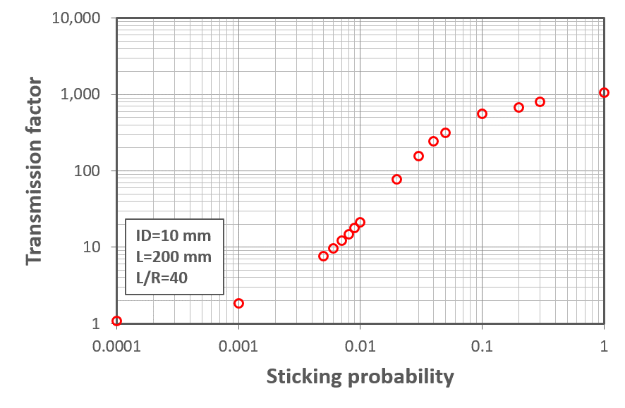
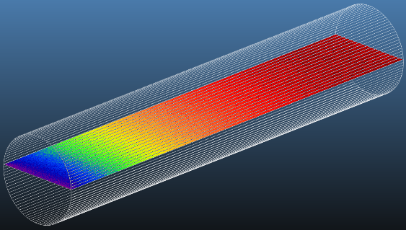

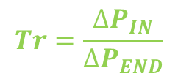
NEG coating properties and fine tuning: pumping measurements
Experiment
Simulation
From experiments:
Through MolFlow+ simulations [1]:
$$Tr=\frac{∆P_{IN}}{∆P_{END}}$$
Initial CO sticking probability $α>0.1$
Making pumping experiments on high aspect ratio NEG-coated vacuum chambers may be quite challenging!
Pay attention to outgassing and auxiliary pumping during activation, CH₄ production by hot filaments, very high expected Tr factors especially for CO/CO₂, …
[1] R. Kersevan, J.-L. Pons, JVSTA 27, 1017 (2009)

Slide 21
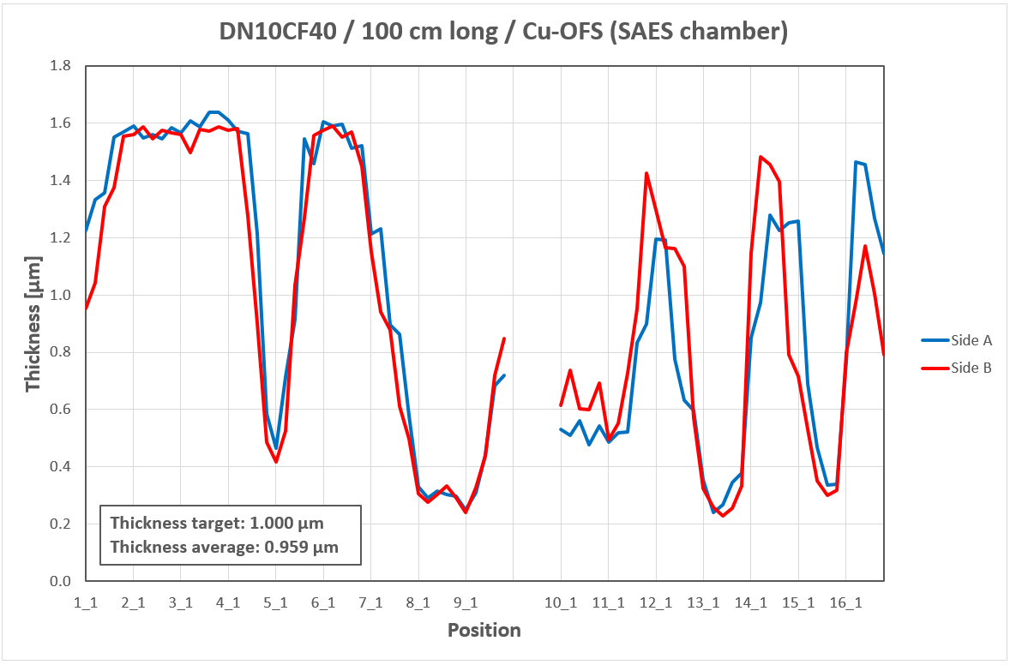
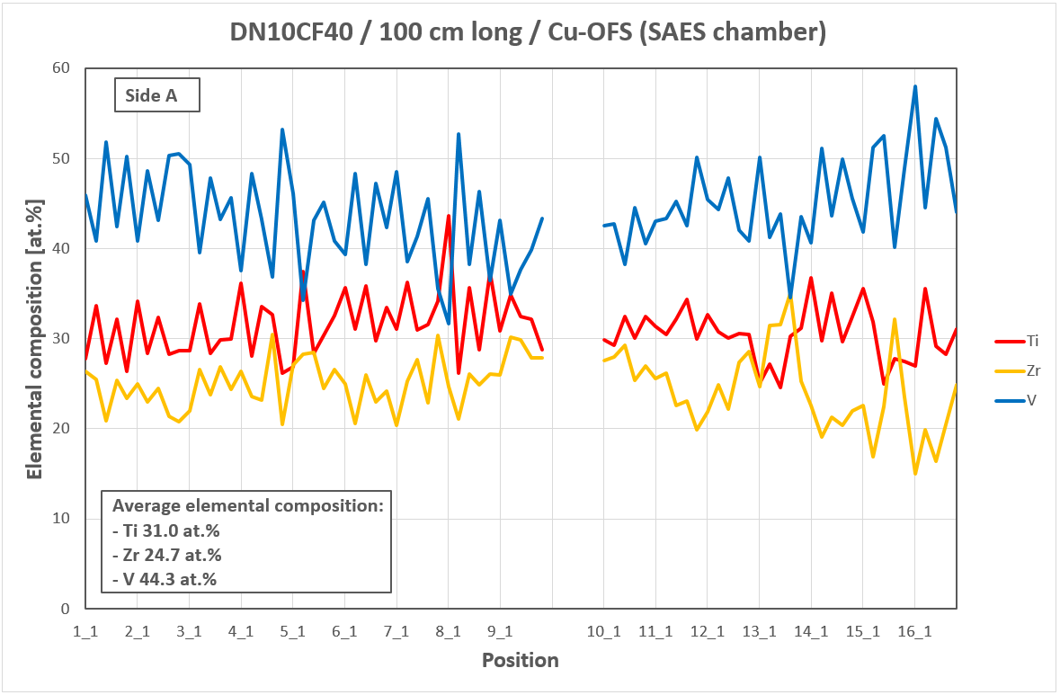
Achieving a uniform thickness is not straightforward…
Low impedance is a key requirement of new synchrotron light sources
A thin and uniform NEG film is needed to meet such requirement
It is necessary to fine tune the sputtering process
When coating chambers with complex shapes and high aspect ratios, this is not always easy
Coupons near the flanges are not enough to study thickness uniformity:
  A more accurate mapping is needed
Example #1: ID 10 mm, 1 m long chamber
Average thickness ok
Average elemental composition ok
Thickness uniformity is not ideal (250–1600 nm)
need for an optimised sputtering process in terms of NEG uniformity
EDS analysis – The chamber itself is cut in two longitudinally and then into several pieces (80 analysis points per each side)

Slide 22
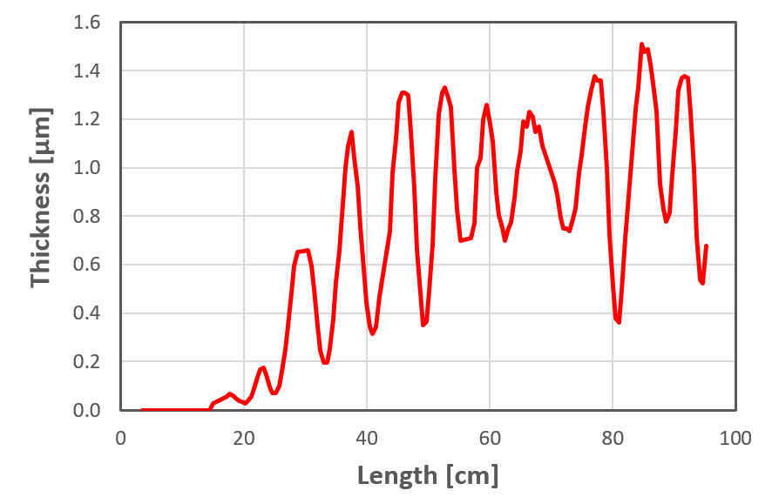
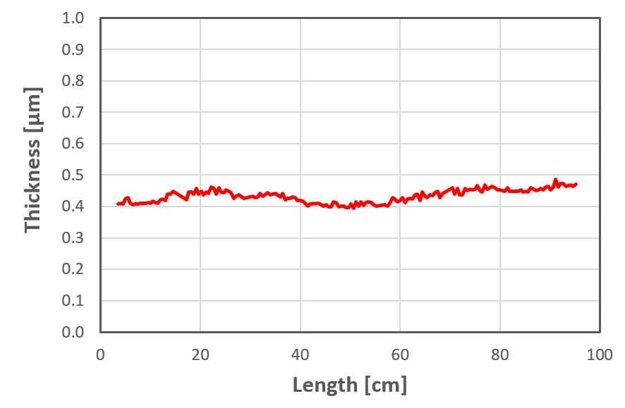
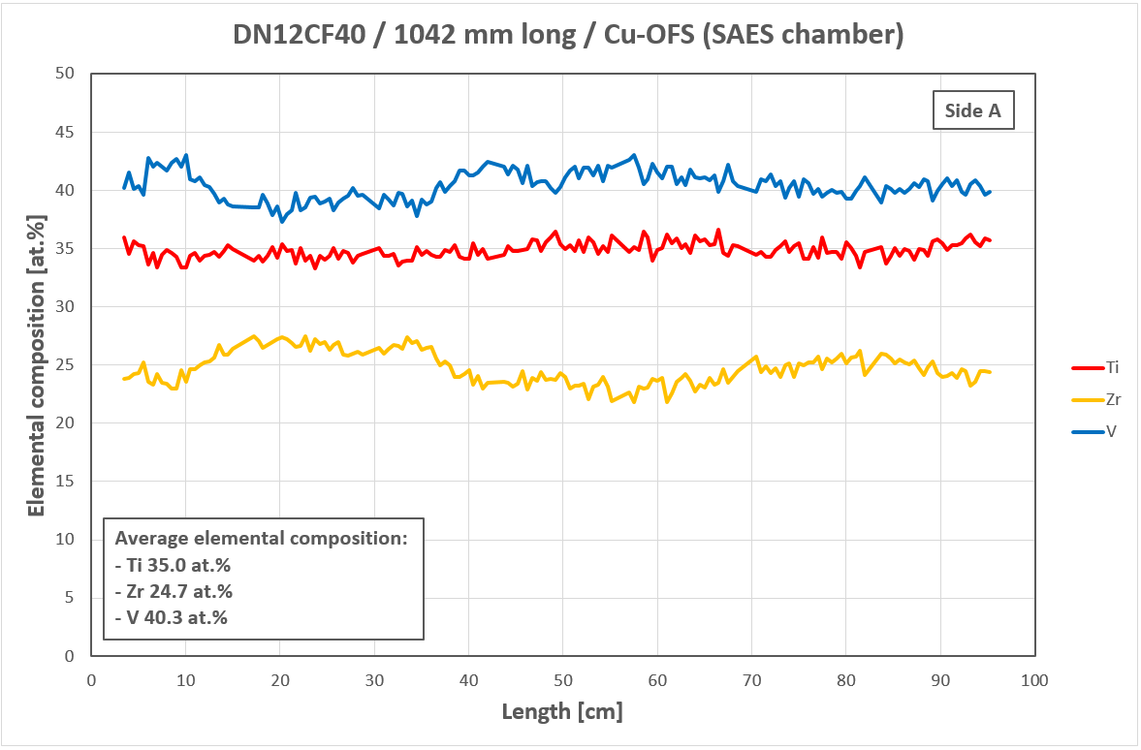
Fine tuning of NEG coating thickness
ID=12 mm
L=1000 mm
ID=12 mm
L=1000 mm
Sample 1: before process optimisation
Sample 2: after process optimisation
SAES proprietary process --> NEG film thickness control
Example #2: ID 12 mm, 1 m long chamber
A good thickness uniformity is achieved
NEG thickness is well within the 0.5 µm maximum threshold
The elemental composition is also uniform and adherent to the nominal one
µ-XRF analysis (171 points per each side, 1 measurement every 5 mm)

Slide 23
SAES Group / High Vacuum Division
04
Possible partenrship with iSAS

Slide 24
Possible partenership of SAES High Vacuum Division to iSAS
SAES Group / High Vacuum Division
iSAS is an ambitious and articulated projects with several work packages encompassing very diversified technological fields
Among all the work-packages, WP3 is the closest to SAES High vacuum division expertise
To do what? Clear and well-defined topics should be identified
Partners of the project are at the same time competitors, customers e suppliers. Potential IP issues should be addressed in advance
So, partnership, maybe…but the “market is growing”?

Slide 25




MISSION
Leverage on the Division core competences in vacuum, material science, engineering, vacuum chambers and instrumentation manufacturing to support the accelerator and research community
Thank you for your attention
  EDM machining, brazing, CNC machining, metrology
  NEG coating, broad R&D support, analytical services, mathematical/physical tools (ANSYS, MOLFLOW…)
  Cleaning services, welding technologies, metrological testing
  NEG coating, brazing, welding, machining metrology
www.saesgroup.com

