Slide 1



The leading manufacturer of rolls and accessories
for tube and wire industry
Notes:
Good morning, everyone, Thank you for the invitation and for giving us the opportunity to showcase the work of our wear protection division at Eurolls.

Slide 2

The Company
Established in 1987, Eurolls is one of the top players in the design and implementation of rolls and accessories for the tube and wire industry.
For more than 30 years Eurolls has been producing custom made solutions for tube and open profile manufacturers worldwide, while being also able to provide a full range of products and services for the wire industry, such as wire rolls and patented rolling cassettes.
Furthermore, Eurolls is also specialized in "high technology" coating installations, thanks to the collaborative efforts between our engineers and the most accredited International Research Institutes in Italy.
Custom tailored design solutions
Advanced technologies
Limitless range of rolls for different applications
Total quality
An outright service
Notes:
Let me start with a brief introduction to our company. Eurolls was founded in 1987 as a roll manufacturing company for the tube and wire industry.

Slide 3
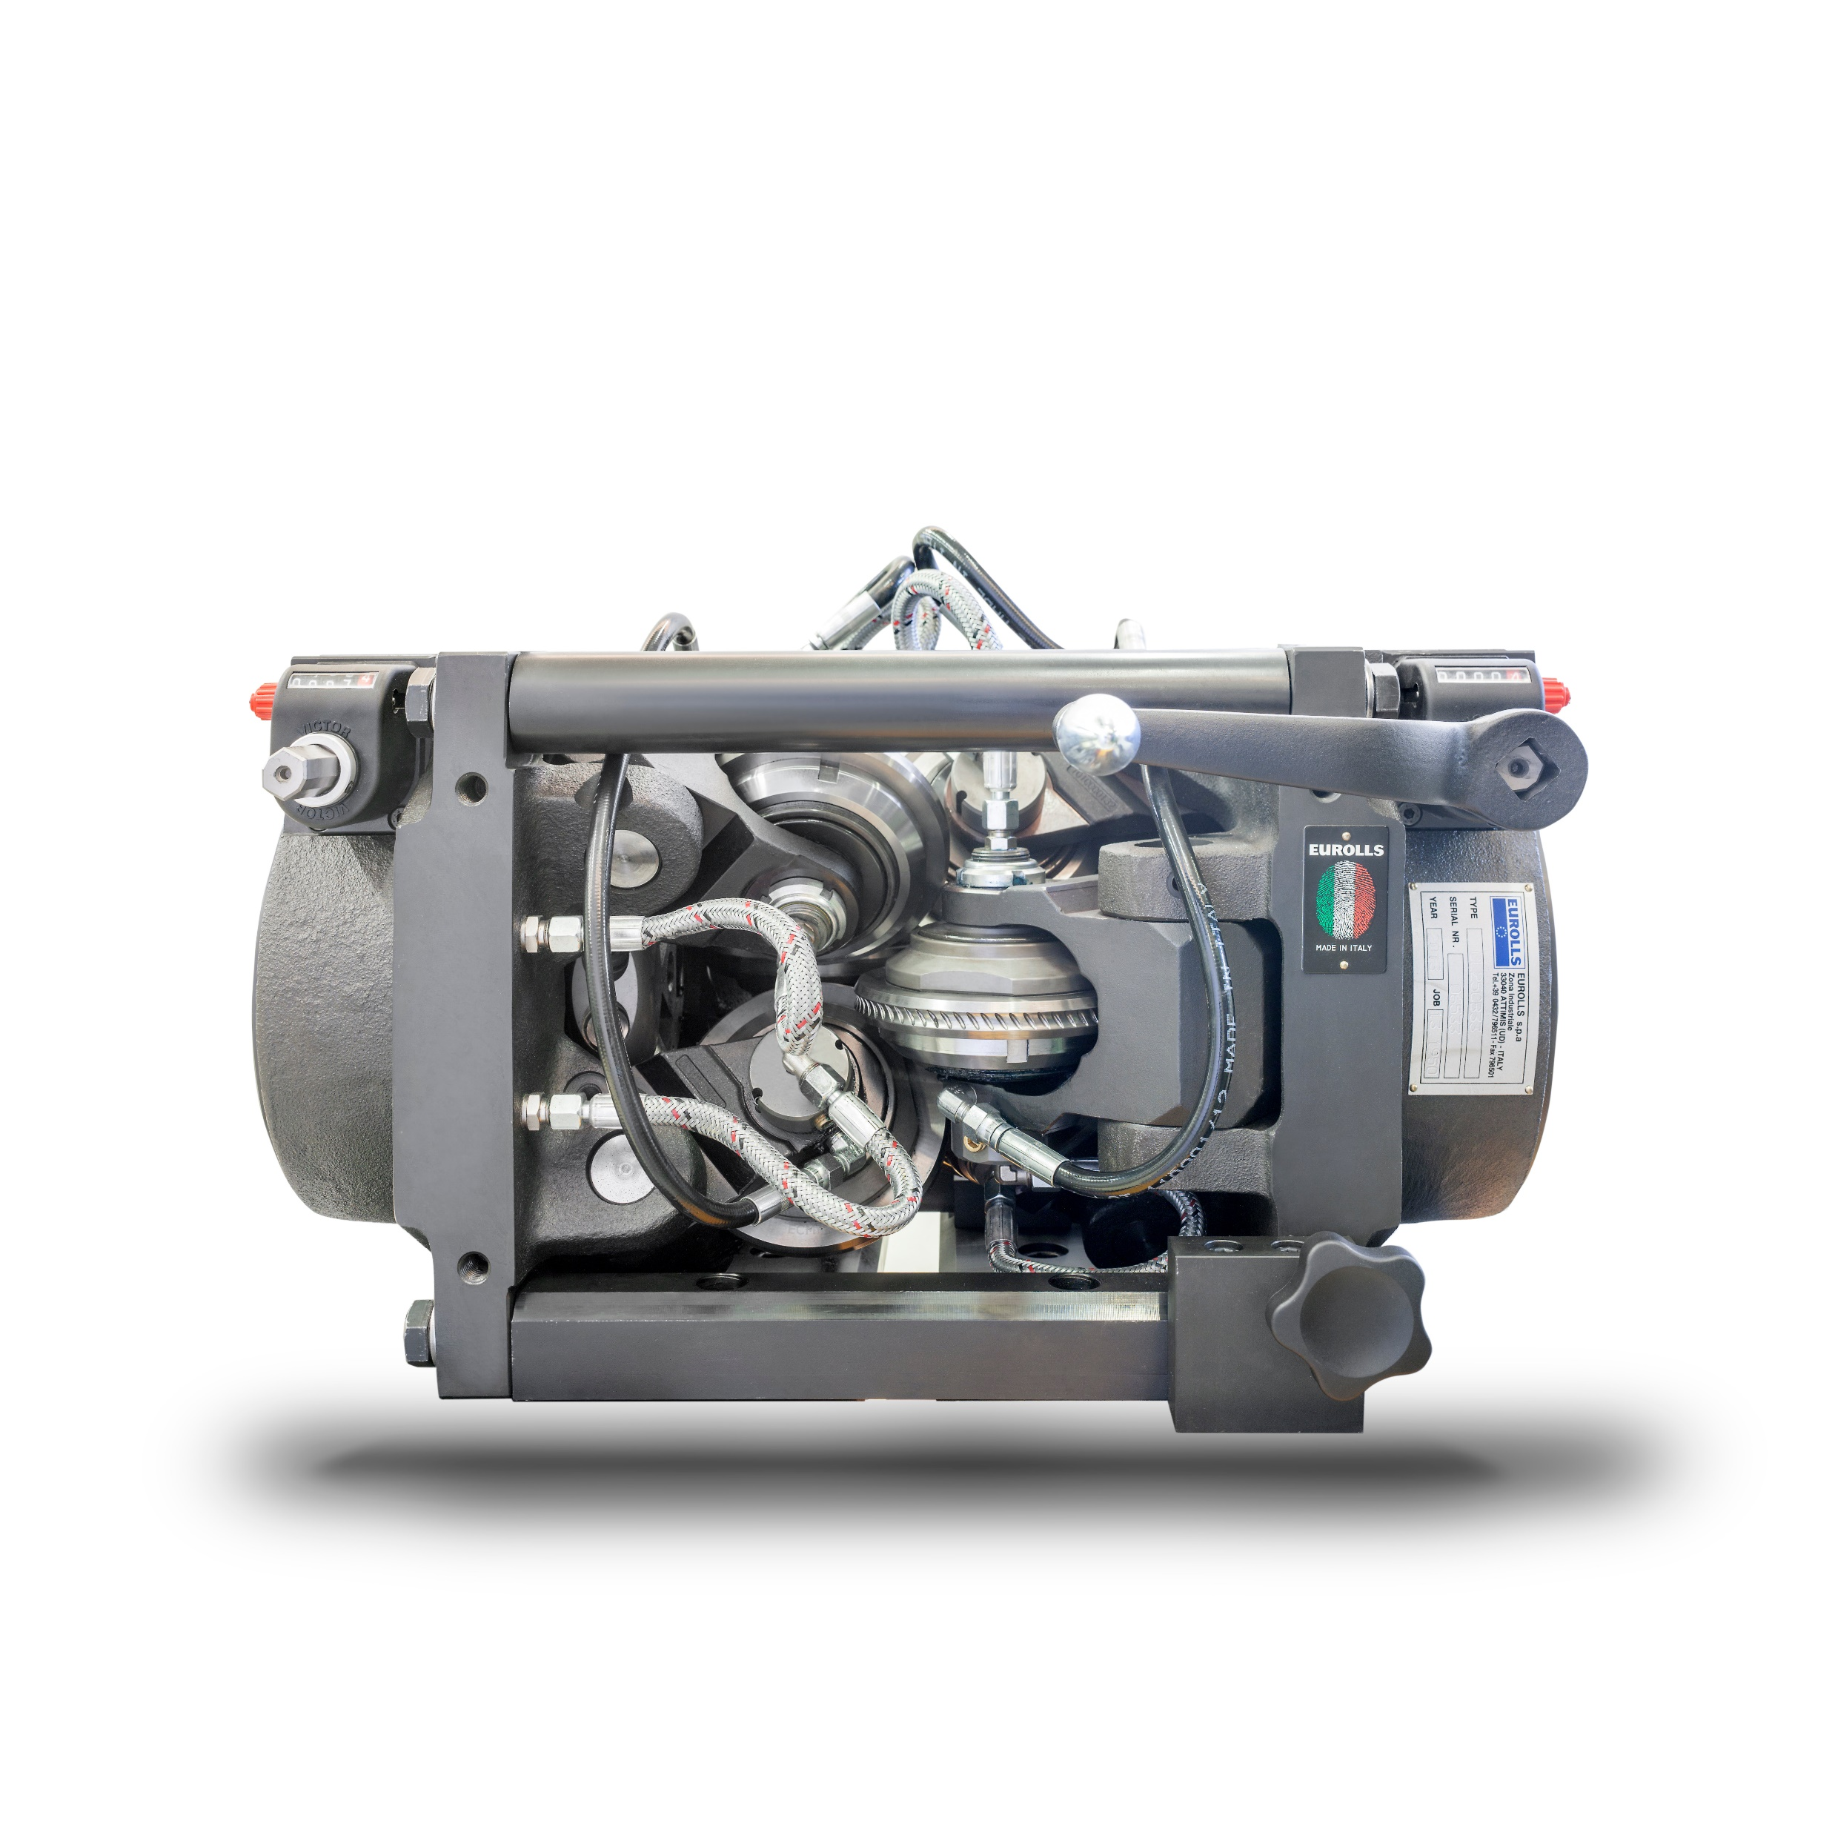
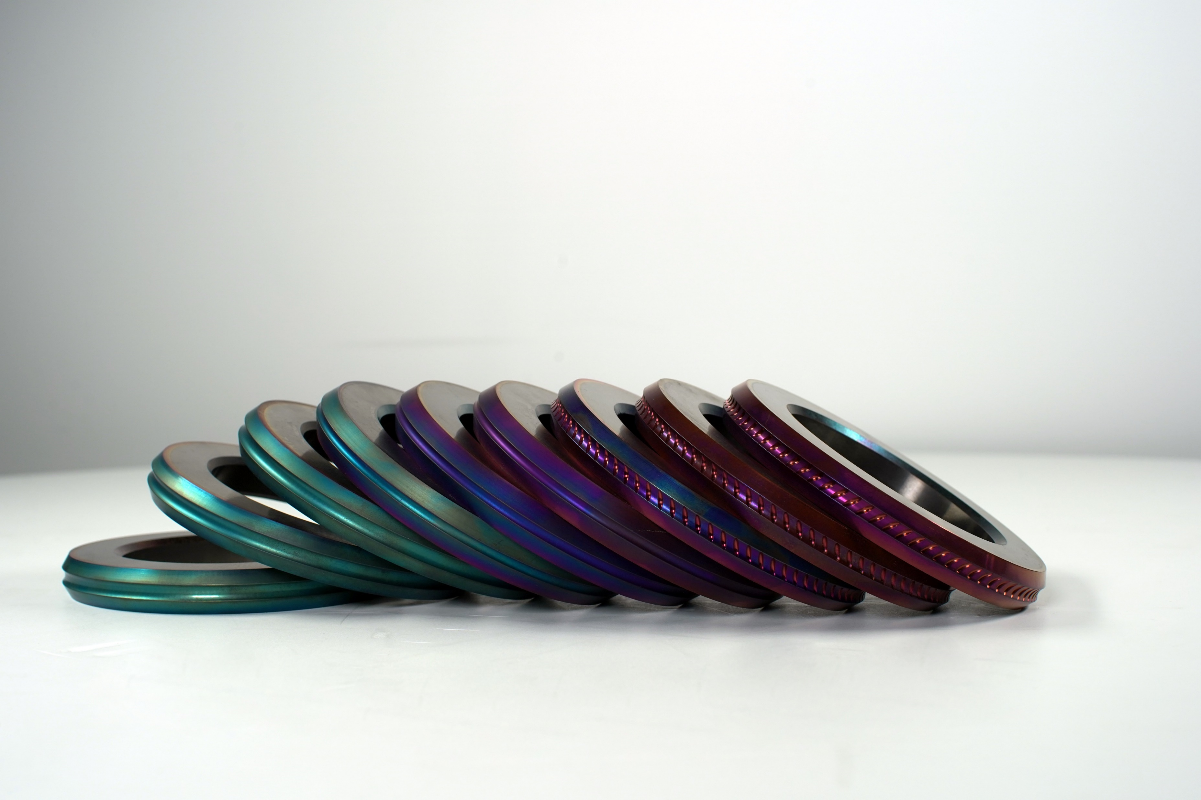
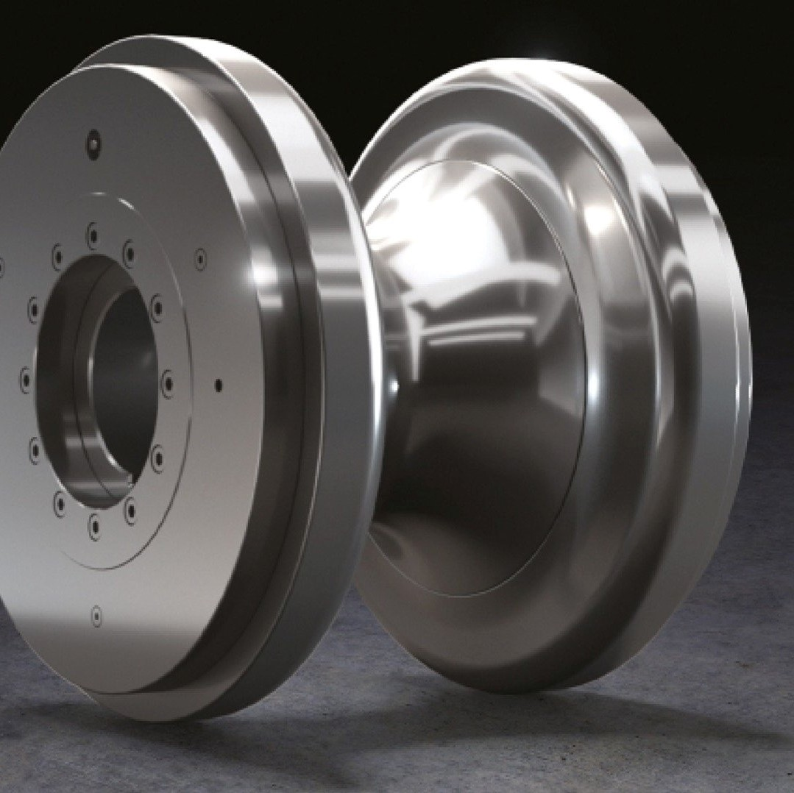
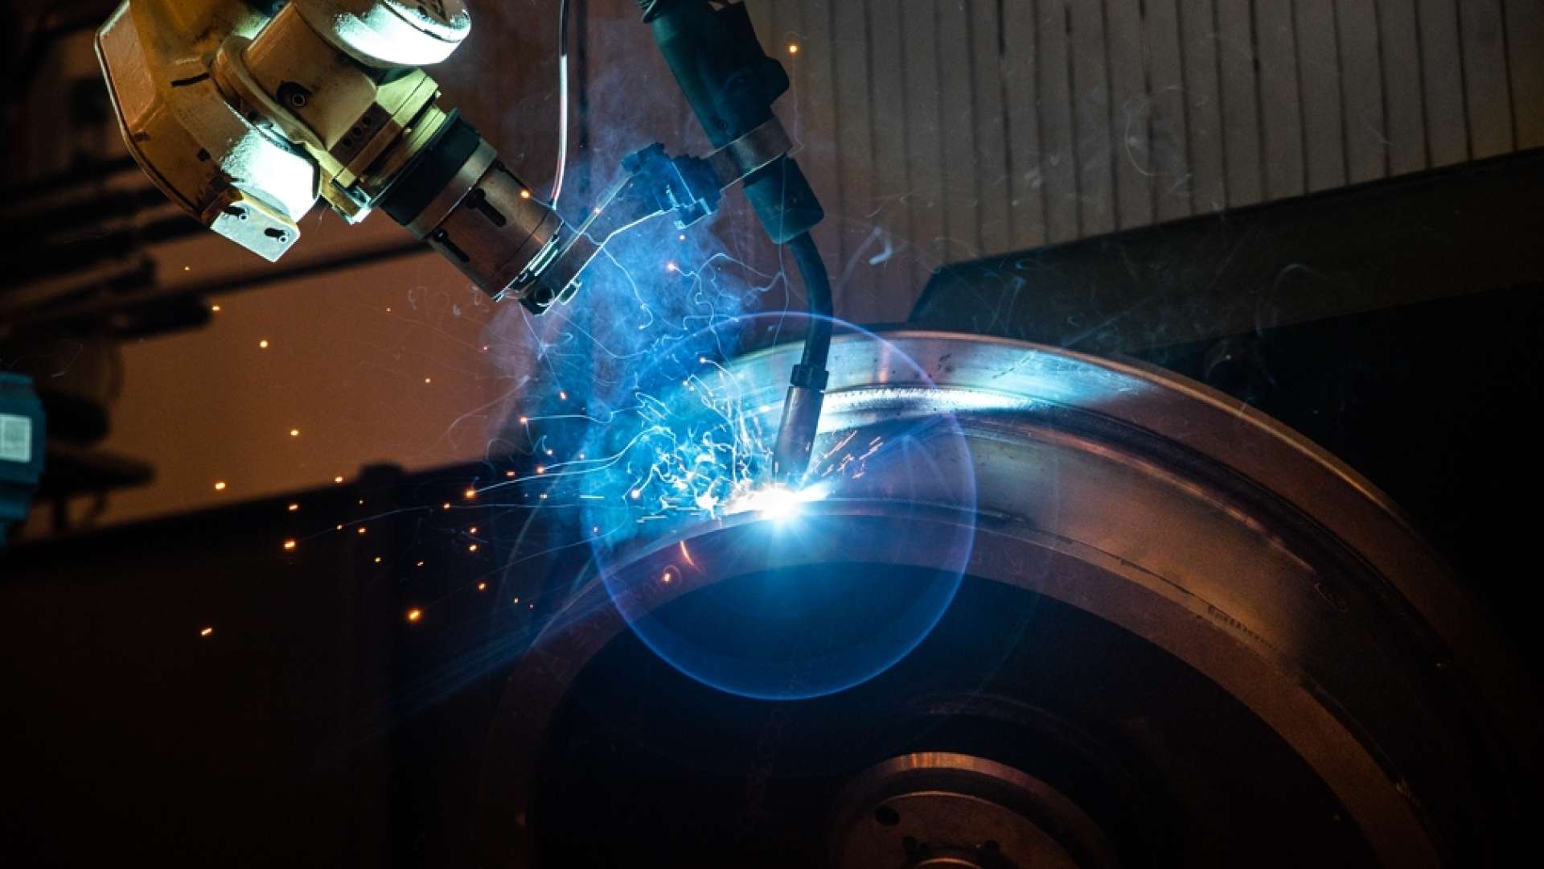
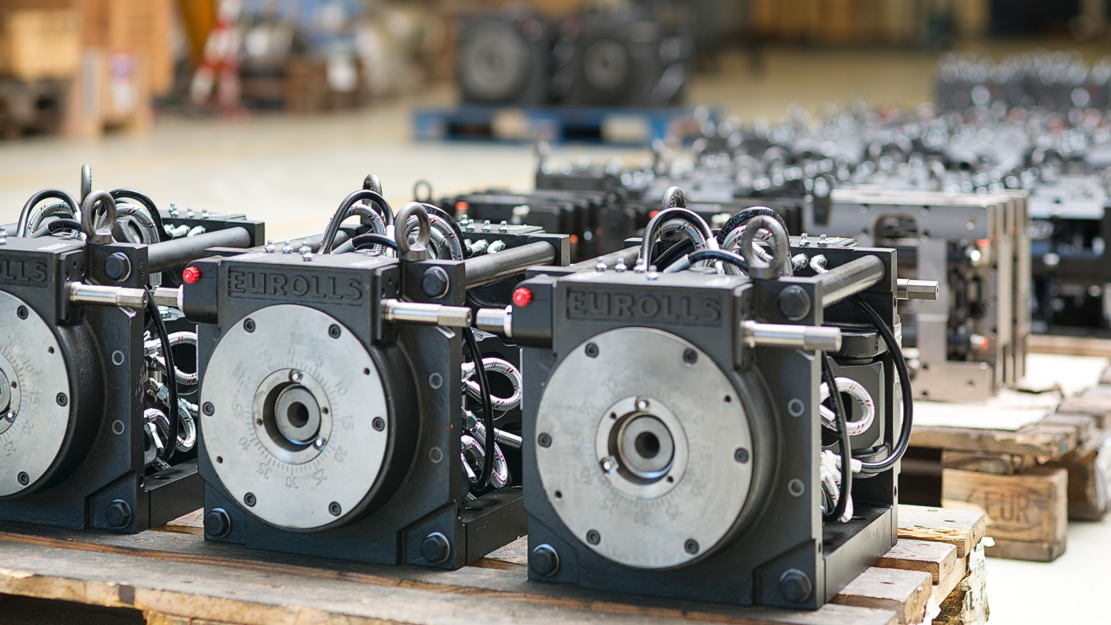
Main Business
TUBE SECTOR (Automotive, Structural, Furniture, Electrical, API Tube) | WIRE SECTOR (Construction wire, industrial wire, carbon wire and rope) | SPECIAL TREATMENTS, COATINGS, R&D
Production of rolls and accessories for welded tube and seamless tube sector | Production of rolls and rolling cassettes | High technology coating installations that increase products performances
Notes:
Our revenue comes from three main sectors:
The design and production of rolls for welded tube manufacturing
The design and production of rolls for wire manufacturing
And finally, special treatments and coatings, which we apply both to our own products and to third-party components—this is the reason why we are here today.

Slide 4
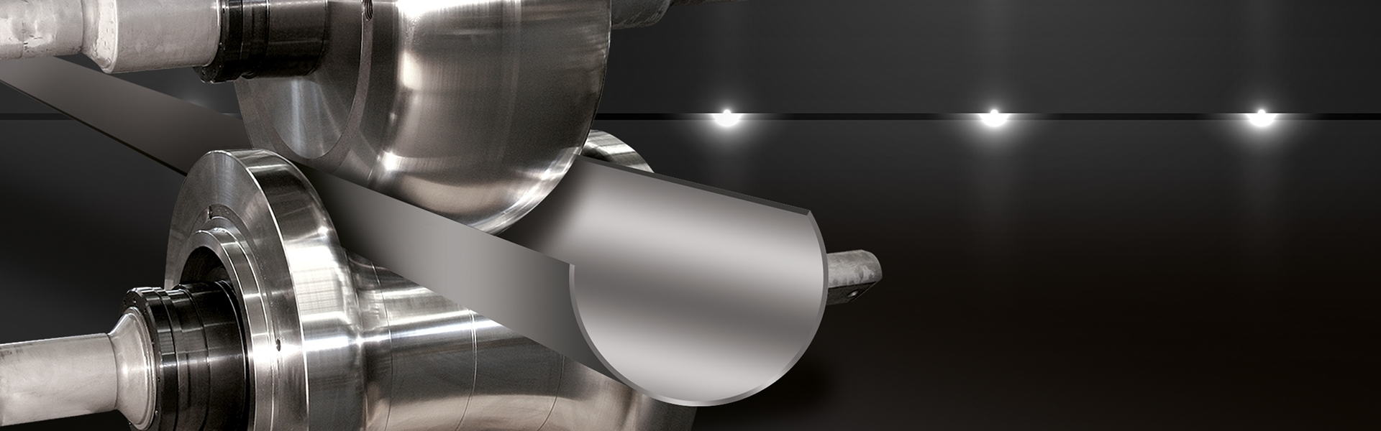
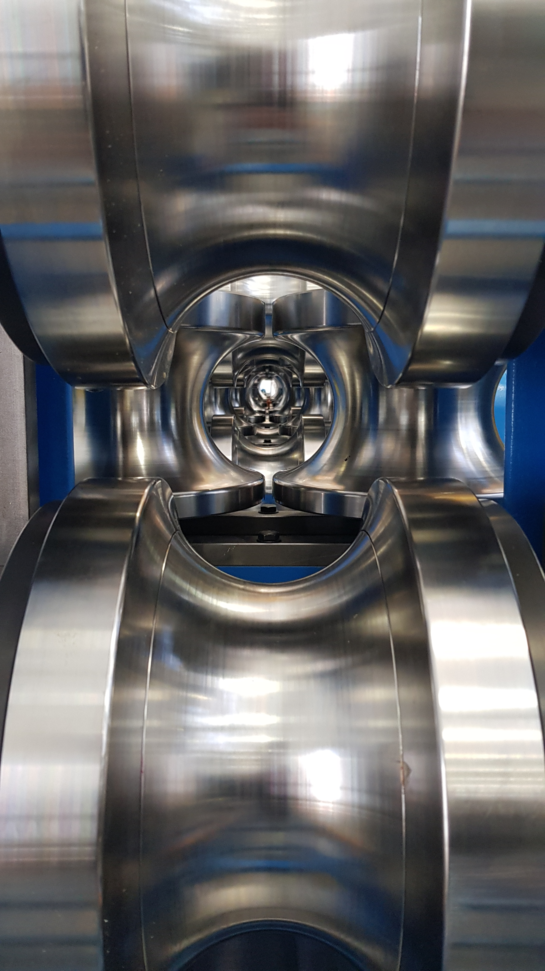
Tube Sector
Eurolls is worldwide leader in design and production of tooling for welded tube production. The biggest machine around the world are equipped with Eurolls rolls.
Notes:
For the tube sector, we mainly produce rolls made entirely of steel or with a hard metal insert.

Slide 5
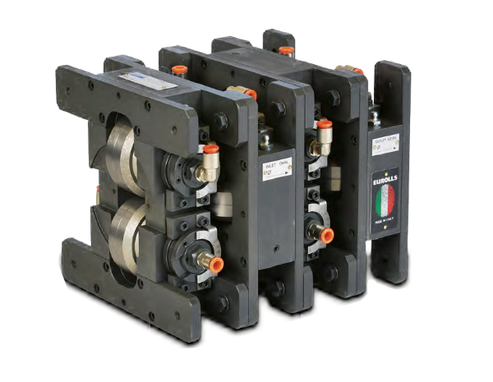
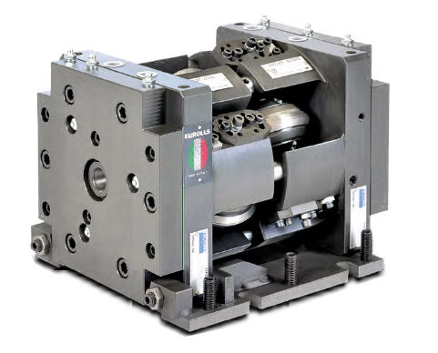
Wire Sector
CONSTRUCTION SECTOR
INDUSTRIAL SECTOR
Eurolls is worldwide leader in wire industry process, in design of rolls, cassettes and machinery for special wire production.
Notes:
For the wire sector, we manufacture rolls made entirely of hard metal, which we sinter in-house. The vast majority of our rolls feature a PVD coating that enhances component lifespan, allowing us to supply the highest-quality rolls on the market.

Slide 6
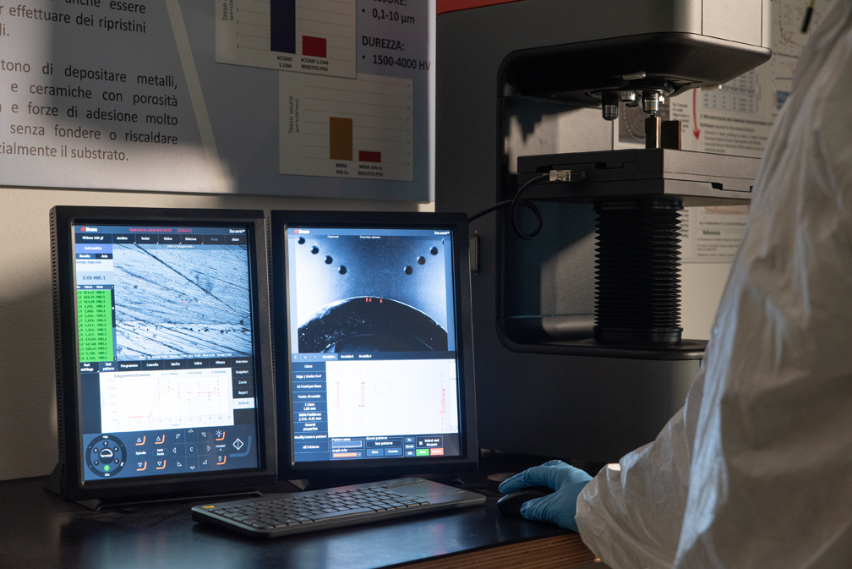
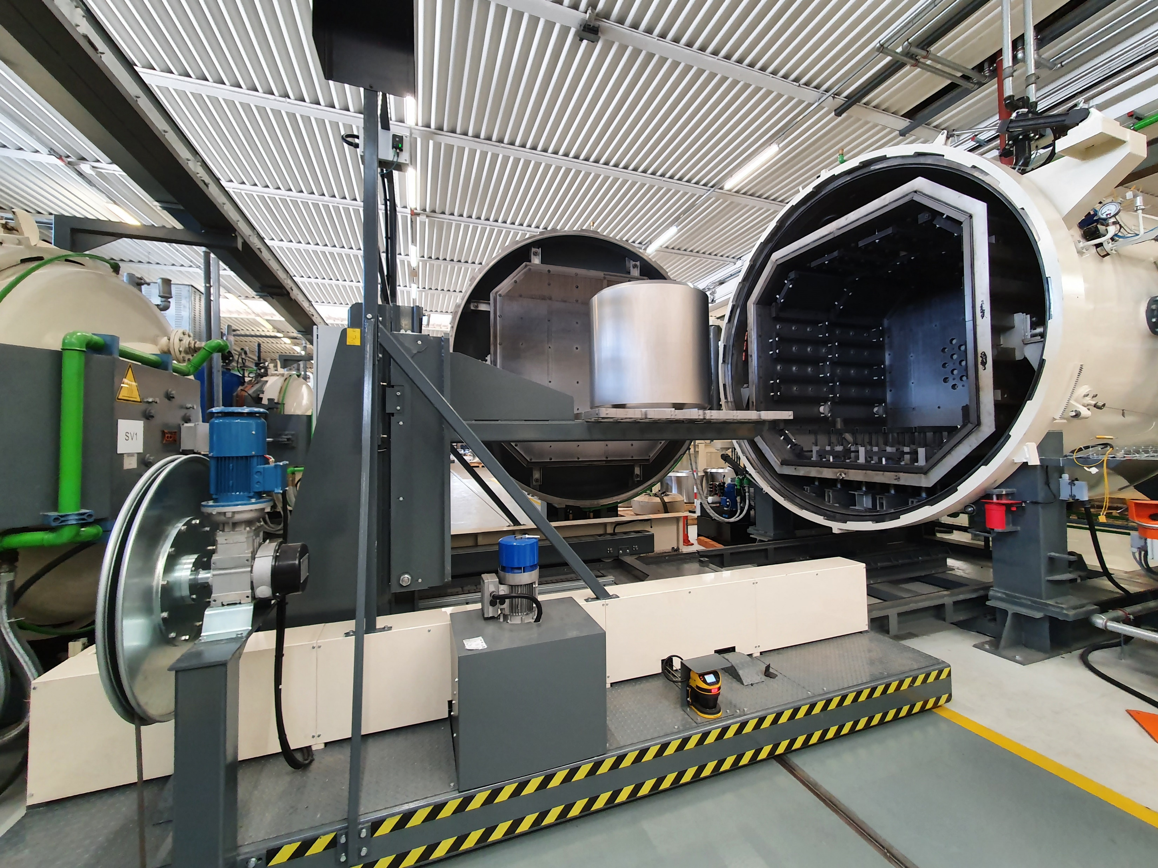
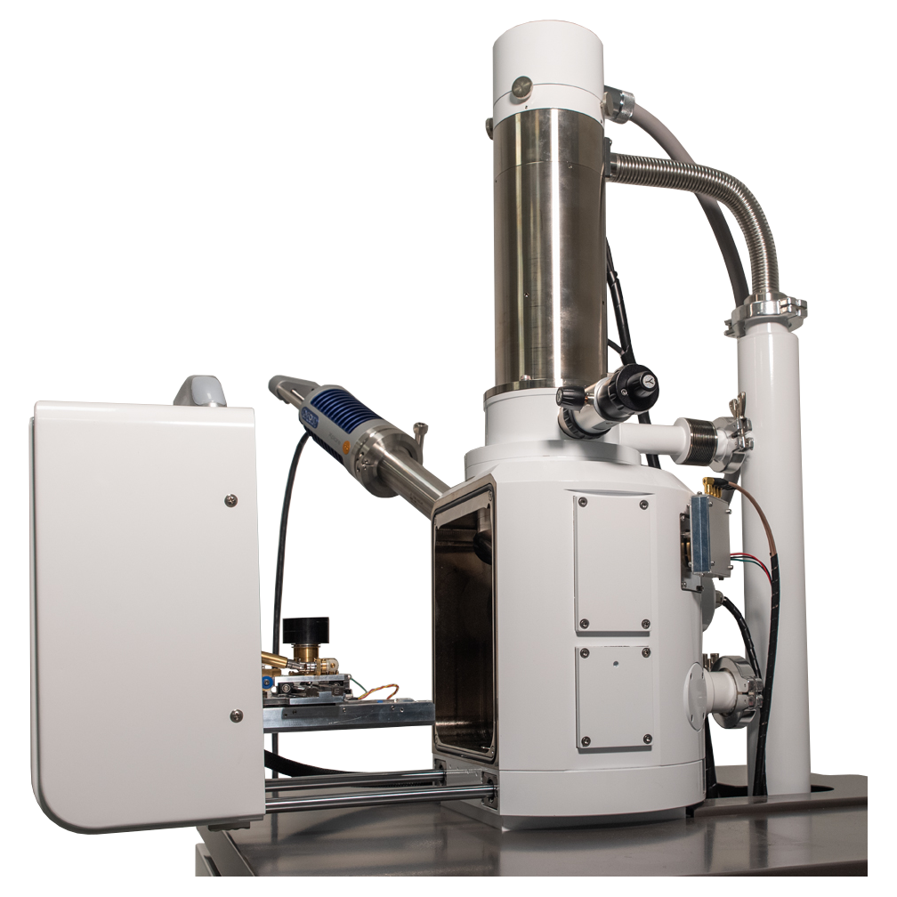

Special treatments and R&D
SEM ANALYSIS
Notes:
Regarding surface treatments and coatings, we offer a wide range of solutions. Our mission is to enhance the durability and performance of industrial components through advanced surface technologies. These solutions provide high resistance to wear, corrosion, and mechanical stress, extending the lifespan and efficiency of critical equipment.
Today, we will give you an overview of our expertise, processes, and real-world applications, demonstrating how Eurolls can be your ideal partner for component optimization.

Slide 7
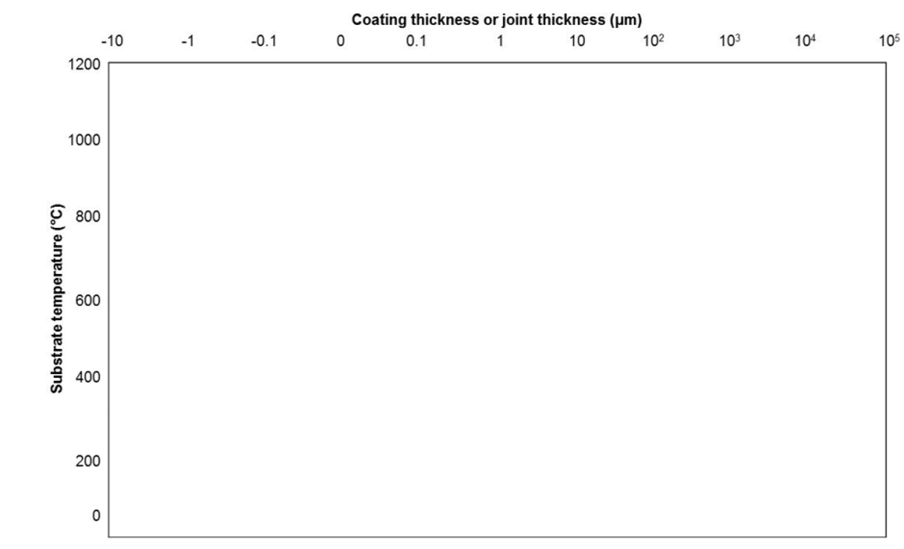
EUROLLS Coatings
Not in EUROLLS Portfolio
CVD
Welding
MIG
TIG
LC
Diamond Coatings
Thermal Spray
Plasma Nitriding
PVD
Cold Spray
DLCs
Ion Implant
Electroplating
Notes:
Now, let’s take a look at this chart, which provides a clear comparison of different coating technologies in terms of substrate temperature and coating thickness. As you can see, the coatings and processes offered by Eurolls are highlighted in blue. These include:
Plasma Nitriding, which enhances surface hardness and wear resistance at moderate temperatures.
PVD (Physical Vapor Deposition) and DLC (Diamond-Like Coatings), which provide excellent wear resistance and low friction for precision applications.
Thermal Spray, a versatile technology that enables the deposition of coatings with high wear and corrosion resistance over a wide range of thicknesses.
Electroplating, commonly used for corrosion resistance and surface enhancement.
Welding techniques such as MIG, TIG, and Laser Cladding (LC), which provide thick, highly durable coatings for heavy-duty applications.
This chart demonstrates how Eurolls offers a comprehensive range of wear protection solutions, from thin, high-precision coatings to thick, high-performance surface treatments.

Slide 8
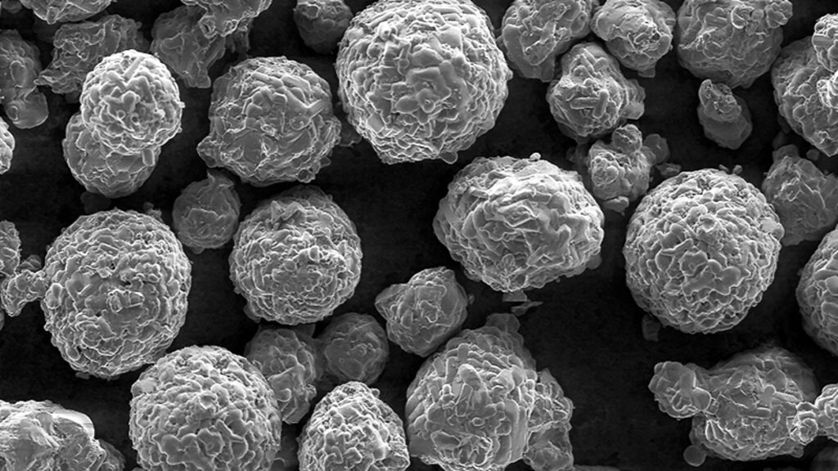
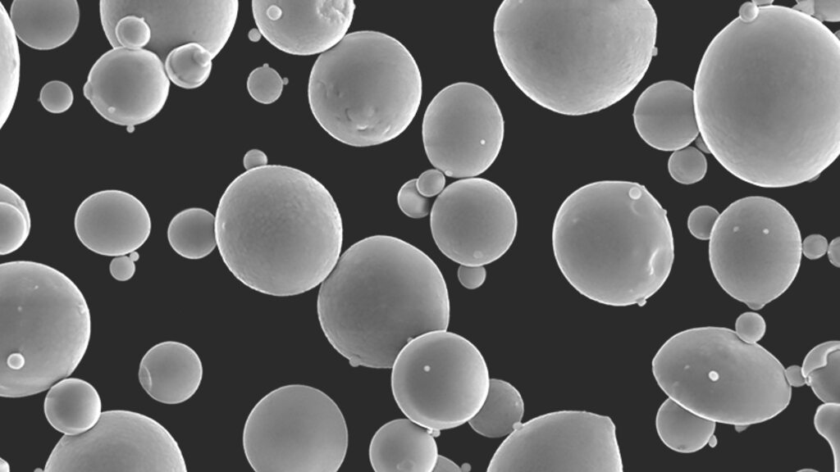
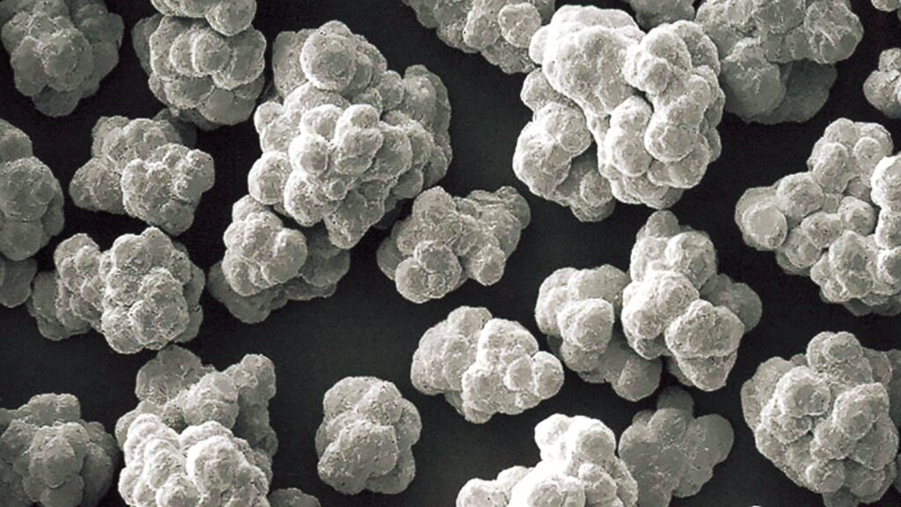
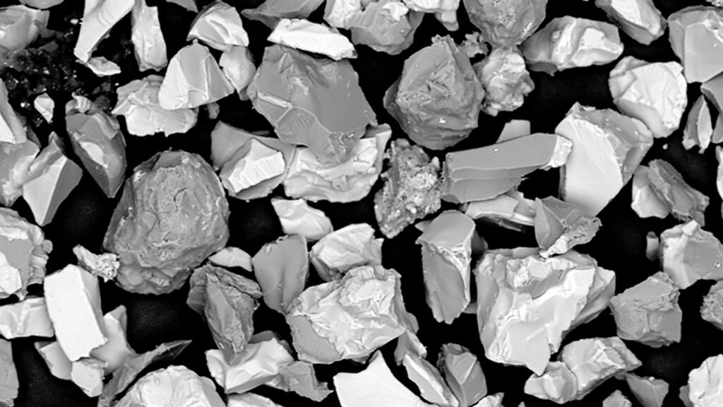
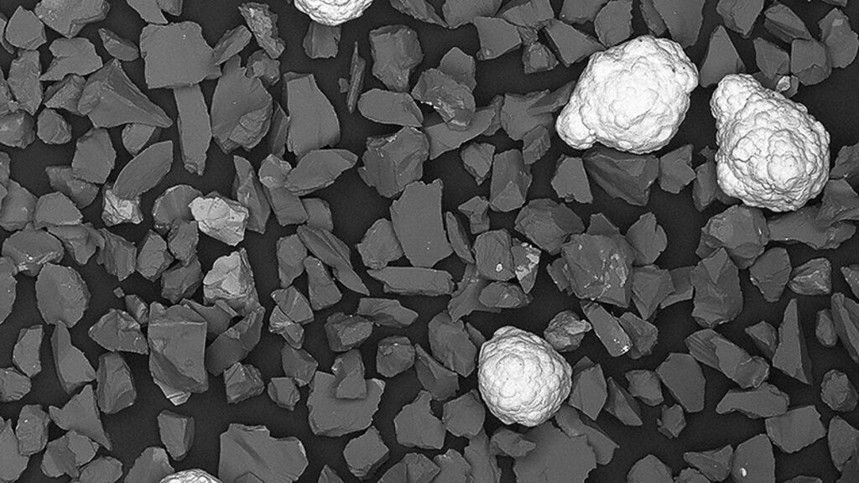
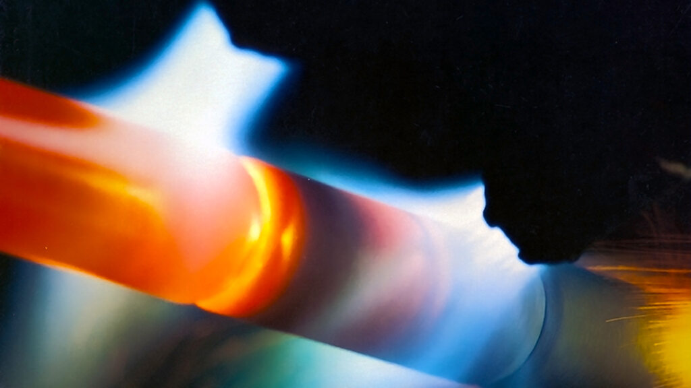
Carbide Materials for Wear Resistance
MCrAlY Materials for High Temperature Applications
Pure Metals, Alloys, Composites and Blends
Oxide Ceramic Materials for a Wide Range of Uses
Cermet Materials for Intermediate Coating Layers
Self-Fluxing and Self-Fusing Alloys for Dense Coatings
Notes:
The materials we use are specifically designed to enhance wear resistance, high-temperature performance, corrosion resistance, and overall durability across various industrial applications.
Carbides (e.g., WC, CrC) provide exceptional wear resistance.
MCrAlY alloys ensure high-temperature oxidation protection.
Pure metals & composites offer tailored solutions for conductivity and strength.
Oxide ceramics excel in thermal insulation and corrosion resistance.
Cermets combine toughness and wear resistance.
Self-fluxing alloys create dense, durable coatings via thermal spray or laser cladding.
Selecting the right material optimizes performance and longevity while reducing maintenance costs.

Slide 9
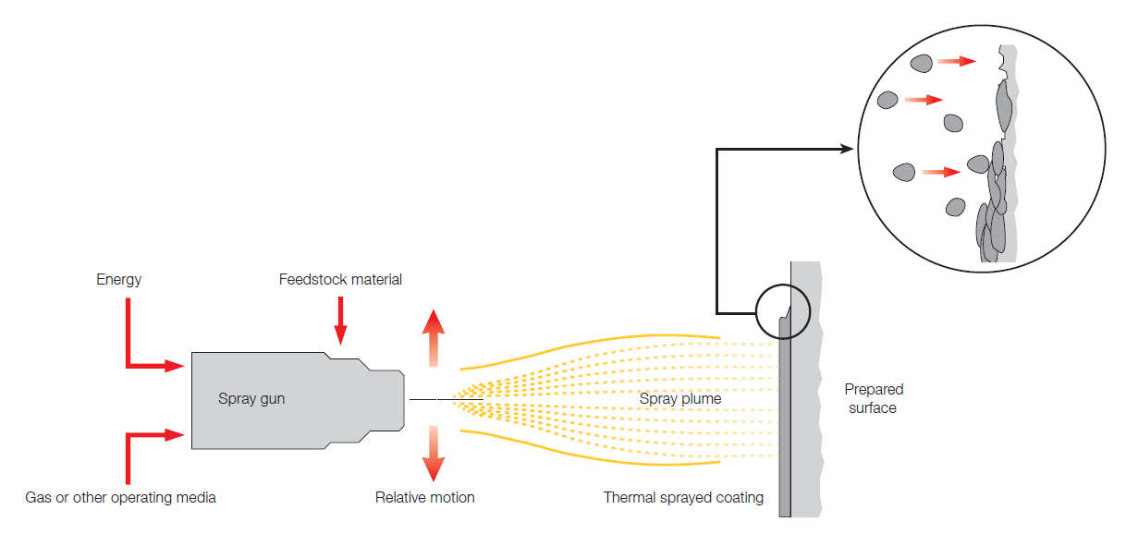
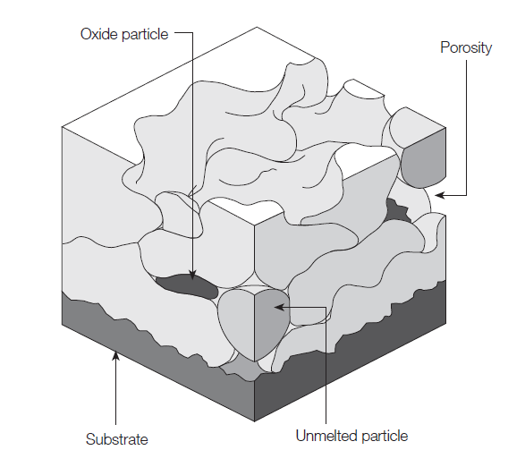
WHAT IS THERMAL SPRAY?
Industry Challenges
Demand: “Better, faster, cheaper” – increasing production demands and aggressive service conditions.
Problem: Premature wear and failure of components, leading to costly downtime.
Example: A Pelton turbine nozzle needle worn out after just a few thousand hours of service
Process:
Coating material is heated by a heat source (flame, plasma, or arc).
Molten or softened particles are propelled onto the substrate.
Particles solidify on impact, forming a protective layer.
Notes:
What is Thermal Spray?
Thermal spray is a process in which coating material is heated by a heat source—whether flame, plasma, or arc. The molten or softened particles are then propelled onto a prepared substrate, where they solidify upon impact, forming a protective layer.
Let’s break the process down in detail:
A spray gun receives energy and feedstock material.
A gas or other operating medium generates a spray plume.
The relative motion between the gun and the substrate enables the formation of a thermally sprayed coating.
On the right, an enlarged diagram shows the coating’s structure, where oxide particles, porosity, and unmelted particles are visible.

Slide 10
KEY ADVANTAGES
Parameter | HVOF | APS
Process Temperature | 2500 - 3000 °C | 10,000 - 15,000 °C
Particle Velocity | 600 - 1200 m/s | 200 - 400 m/s
Coatable Materials | Carbides (WC-Co, WC-CoCr, Cr3C2-NiCr), metals, special alloys | Ceramic oxides (Al₂O₃, ZrO₂, TiO₂), metals, alloys
Coating Porosity | <1% (high density) | 5 - 15% (more porous)
Substrate Adhesion | 70 - 100 MPa (high mechanical adhesion) | 30 - 60 MPa
Typical Hardness | 900 - 1400 HV (for carbides) | 400 - 1300 HV (depending on material)
Surface Roughness (Ra) | 2 - 5 µm (before grinding) | 5 - 15 µm
Typical Coating Thickness | 50 - 500 µm | 100 - 1000 µm
Wear Resistance | Excellent (especially for carbides) | Good (material dependent)
Corrosion Resistance | Very good | Excellent for ceramic oxides
Main Applications | Wear and erosion protection (rollers, turbines, valves, pumps) | Thermal barrier coatings (TBC), electrical insulation, oxidation protection
🔹 Lower Heat Input & Less Distortion – No substrate melting, reducing thermal stresses. 🔹 Wider Material Compatibility – Can deposit ceramics, metals, and polymers. 🔹 Higher Deposition Rates – Faster coating of large surfaces. 🔹 Lower Equipment & Maintenance Costs – Simpler and more affordable setup. 🔹 Suitable for Heat-Sensitive Materials – No risk of substrate melting. 🔹 No Heat-Affected Zone (HAZ) – Preserves substrate properties. 🔹 Ideal for On-Site Repairs – Quick application without disassembly.
Notes:
Now, let’s briefly compare the two main thermal spray technologies: HVOF and APS.
HVOF operates at 2,500–3,000°C, whereas APS exceeds 10,000°C.
This means each process is suited for different materials:
HVOF is ideal for depositing carbides (e.g., tungsten carbide, chromium carbide).
APS is suited for ceramic oxides (e.g., chromium oxide, aluminum oxide).
Particle velocity differs significantly:
HVOF: 600–1,200 m/s → results in dense coatings (<1% porosity) with excellent adhesion (>70 MPa).
APS: 200–400 m/s → results in coatings with higher porosity (5–15%) and lower adhesion (30–60 MPa).
Both technologies can deposit coatings a few tenths of a millimeter thick.
Substrate temperatures remain below 100°C, minimizing distortion.
Each method has its strengths—the choice depends on specific project requirements.

Slide 11
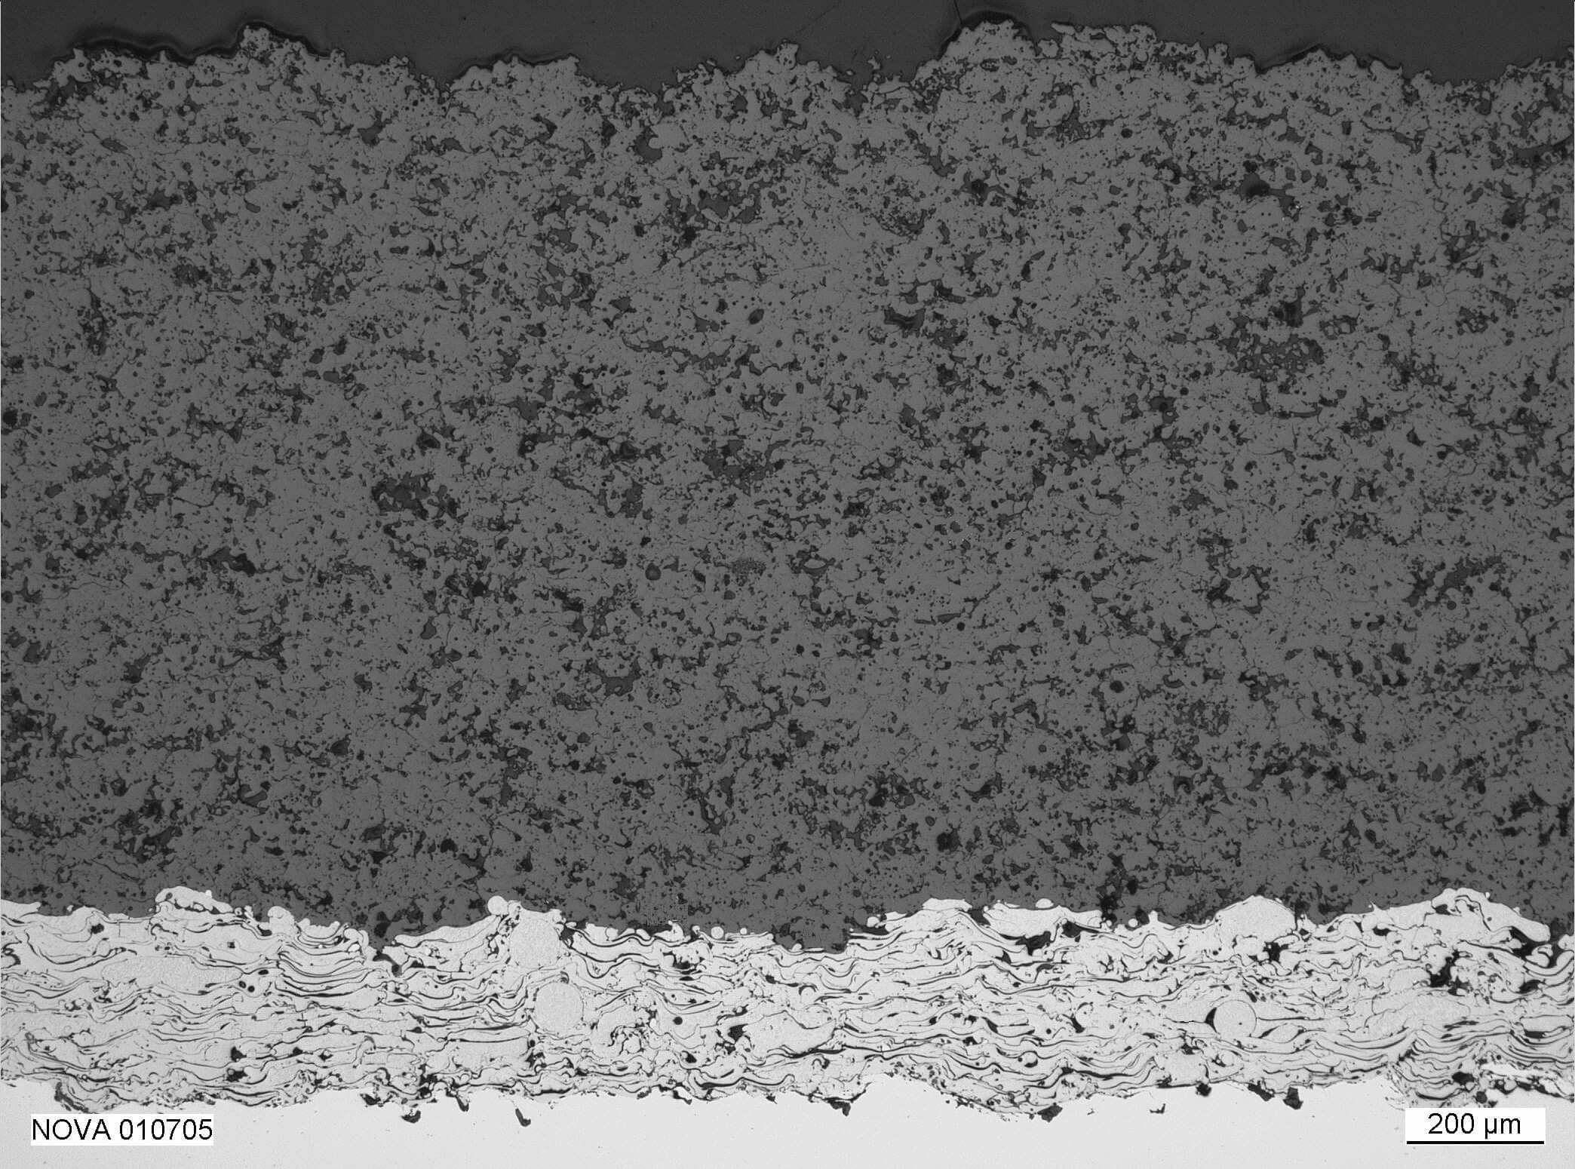
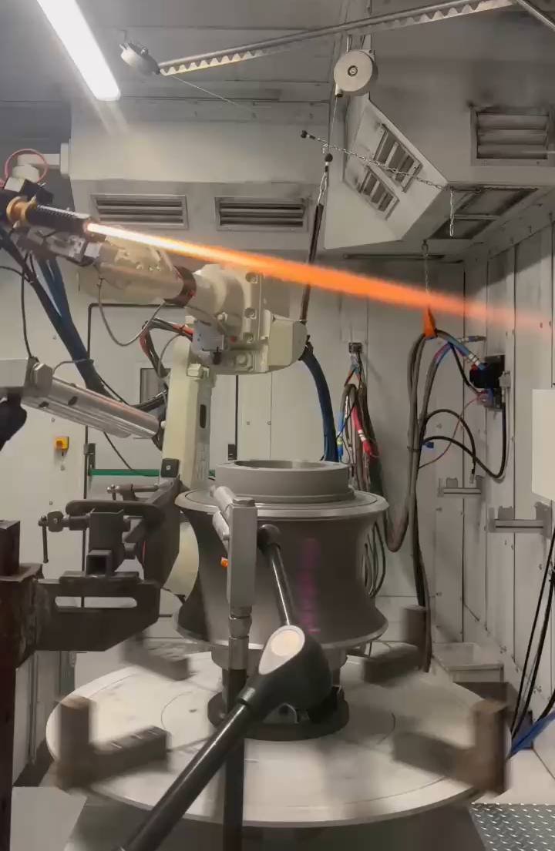
PROCESS AND CROSS SECTION
Notes:
On the left, we have a magnified cross-section of a thermally sprayed coating, revealing:
Coating microstructure: A lamellar structure typical of thermal spray.
Substrate interface: A mechanically interlocked interface ensuring adhesion.
On the right, we see the thermal spray process in action, with a spray gun mounted on a robotic arm applying the coating onto a cylindrical component. The bright orange flame indicates the high temperatures necessary for melting the coating material.

Slide 12
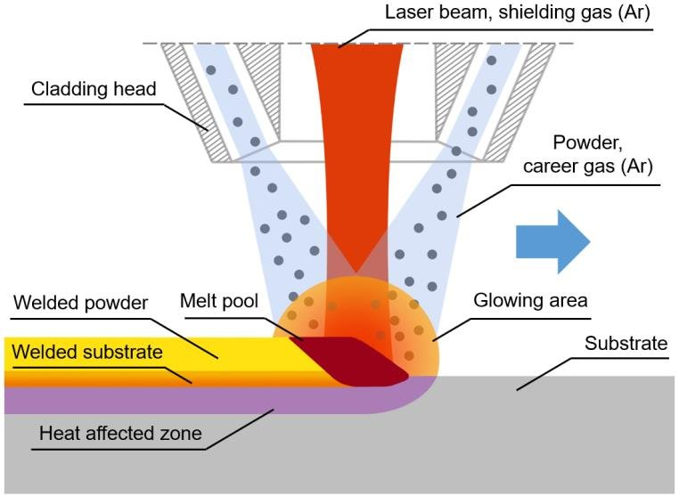
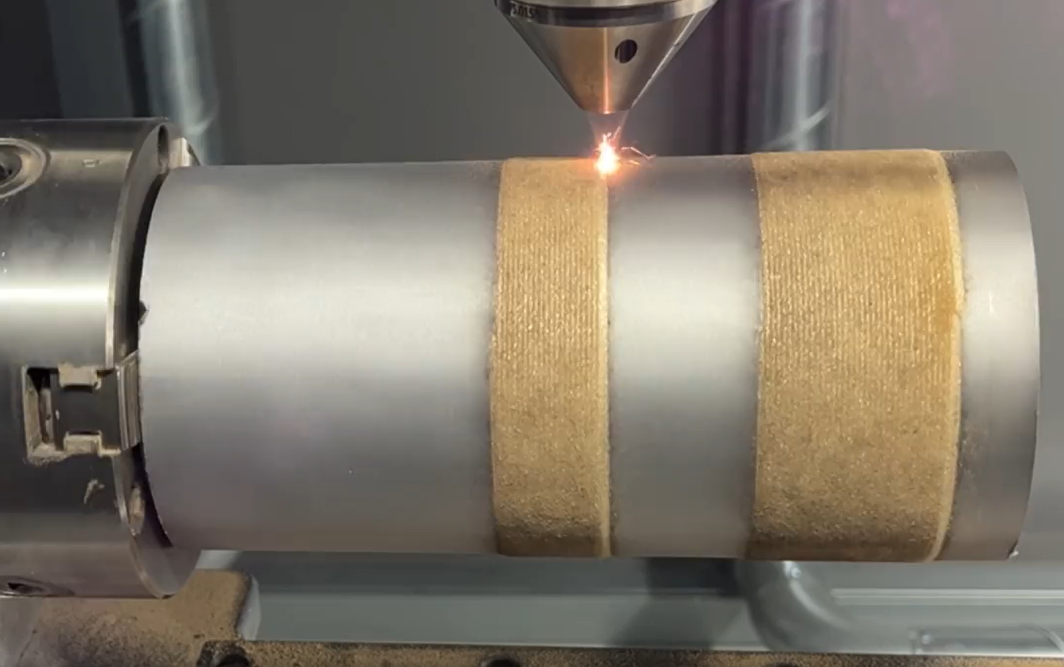
WHAT IS LASER CLADDING?
Powder
Direction Of Motion
Laser Beam
Melt pool
Deposit
Substrate
Notes:
How Does Laser Cladding Work?
Laser Cladding is an advanced additive manufacturing process that metallurgically bonds a coating material onto a substrate. It provides superior wear resistance, corrosion protection, and component repairability while minimizing heat input and dilution.
As shown in the video, laser cladding utilizes a high-energy laser beam to create a melt pool on the substrate. A metallic powder, transported by an inert carrier gas (argon, in this case), is injected into the melt pool, forming a metallurgically bonded coating with superior properties compared to conventional methods.
This technology is widely used in aerospace, oil & gas, automotive, and heavy industry to restore and enhance parts such as turbine blades, hydraulic cylinders, and molds. Its precision allows for extended component lifespan, improved performance, and reduced manufacturing downtime.

Slide 13
KEY ADVANTAGES
Source: Fraunhofer IWS, 2011 | PTA Welding | Laser Cladding | Thermal Spray
Bonding Strength [MPa] | Metallurgical bond ≤800 | Metallurgical bond ≤800 | Physical bond ≤80
Density [%] | 100% | 100% | 95+%
Build-up Rate [kg/h] | ≤12 | ≤6 | ≤20
Typical Thickness [mm] | 0.5 - 4 | 0.2 - 2+ | 0.05 - 0.5
Heat Input | High | Medium | Low
Dilution [%] | 8-18 | <5 | 0
Additional Points on Laser Cladding (LC):
LC is a complementing technology to thermal spray.
LC is becoming more competitive against PTA welding.
In advanced weld repair applications, LC outperforms conventional TIG welding.
Notes:
This table compares PTA Welding, Laser Cladding, and Thermal Spray, highlighting key differences:
Advantages of Laser Cladding (LC) vs. Thermal Spray (TS) and PTA Welding (PTA):
Metallurgical Bonding: LC produces fully dense coatings, unlike TS.
Minimal Heat-Affected Zone: LC has lower dilution than PTA.
Extended Weldability: LC enables better processing of sensitive materials (e.g., C-rich steels, Ni superalloys).
Near Net-Shape Build-Up: LC requires less finishing compared to PTA.
Coating on Edges: LC can coat and build up material on edges, unlike TS.
Fine, Homogeneous Microstructure: LC achieves a refined microstructure due to high solidification rates.

Slide 14
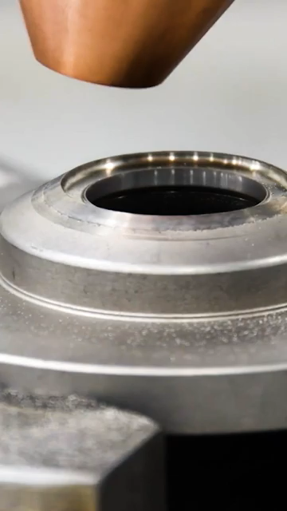
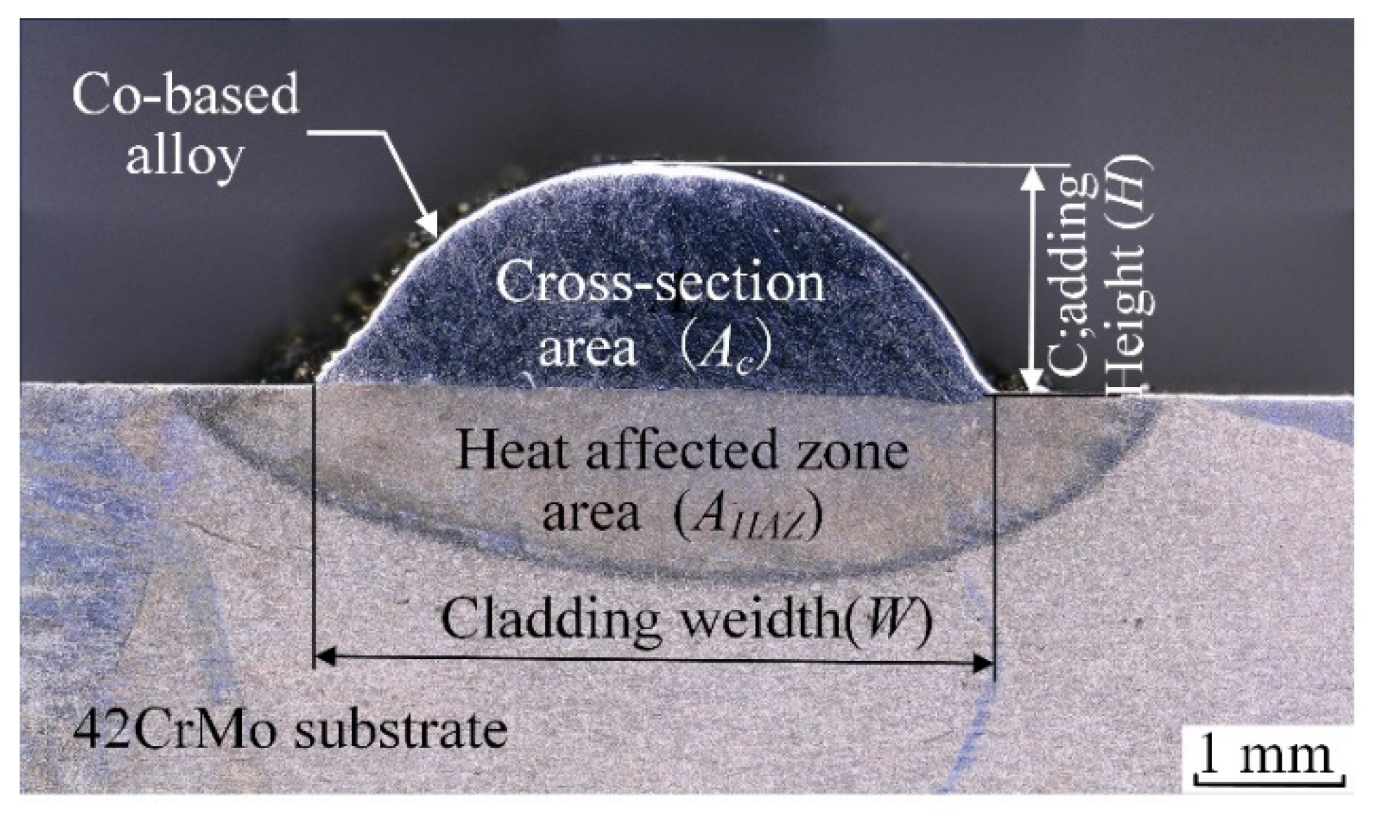
PROCESS AND CROSS SECTION
(*) Yue, H.; Lv, N.; Guo, C.; Zhai, J.; Dai, W.; Zhang, J.; Zhao, G. Multi-Objective Process Optimization of Laser Cladding Co-Based Alloy by Process Window and Grey Relational Analysis. Coatings 2023, 13, 1090. https://doi.org/10.3390/coatings13061090
Notes:
On the left, we see a magnified cross-sectional view of a laser-clad layer:
Cladding Material: Co-based alloy, forming the deposited layer.
Cross-sectional Area (Ac), Height (H), and Width (W): Key parameters for thickness control.
Heat-Affected Zone (AHAZ): Critical for evaluating substrate impact.
Substrate: 42CrMo steel, known for its strength and toughness.
On the right, we see the laser cladding setup in action, with the nozzle precisely delivering powder onto the substrate.

Slide 15
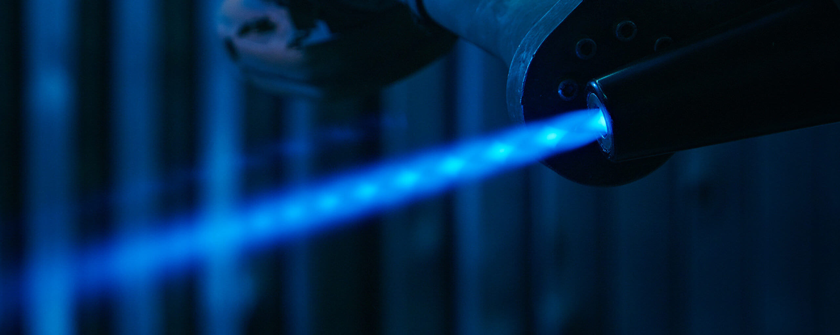
CONCLUSION
👉 USE THERMAL SPRAY FOR FAST, COST-EFFECTIVE COATINGS ON LARGE AREAS.
👉 CHOOSE LASER CLADDING FOR METALLURGICAL BONDING AND HIGH-DENSITY COATINGS.
Notes:
Key Takeaways:
Thermal Spray: Ideal for high-speed, large-area applications.
Laser Cladding: The best choice for superior adhesion and durability.
By leveraging these technologies, Eurolls provides tailored solutions for optimizing component performance and longevity.

Slide 16
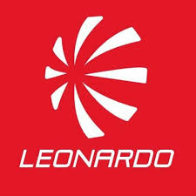
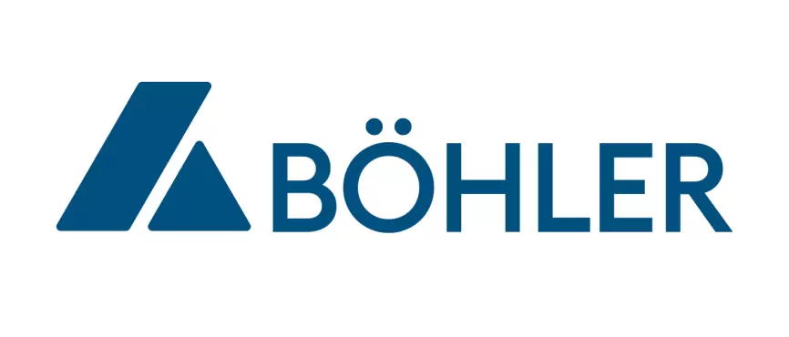

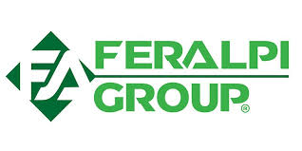

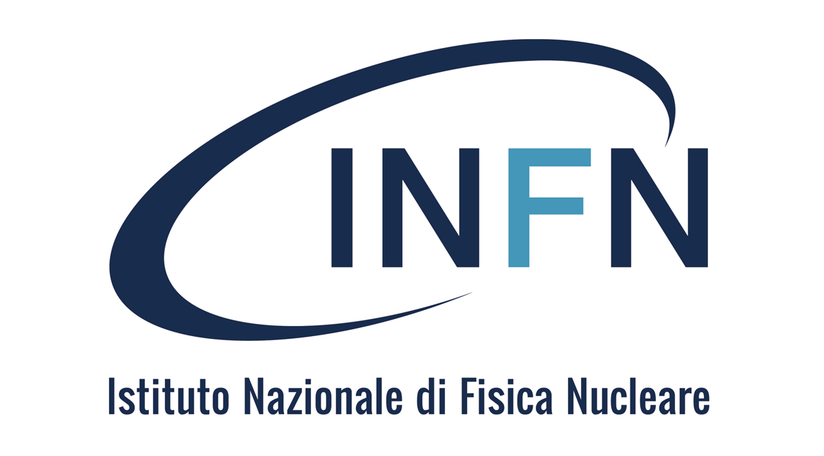
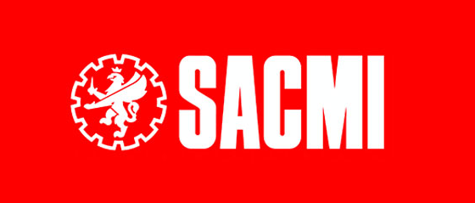
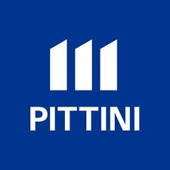
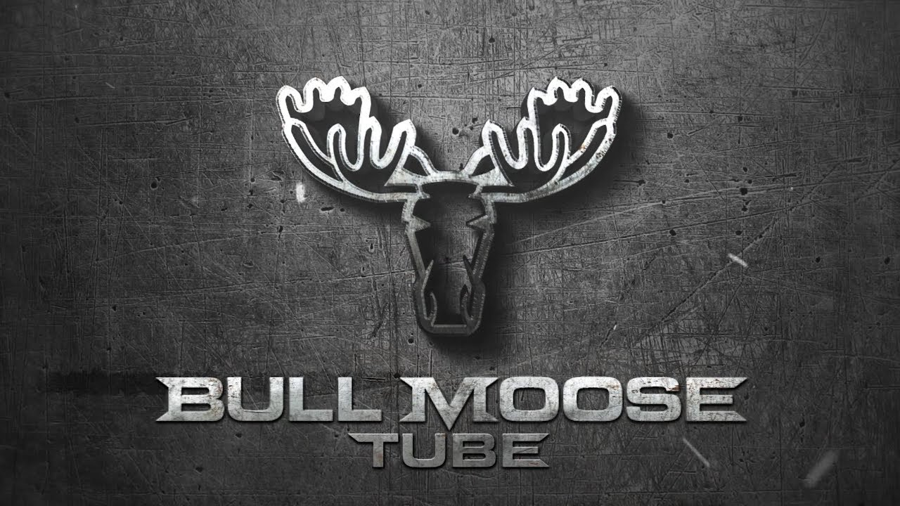

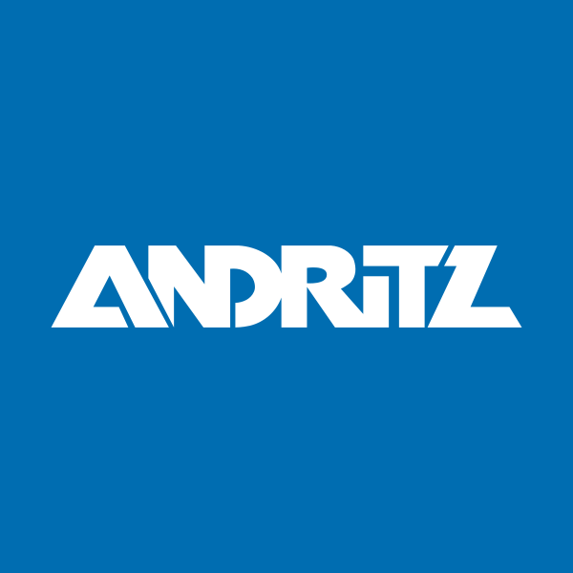
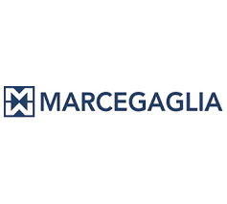
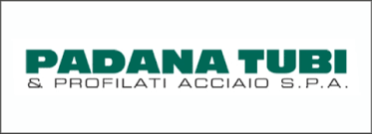
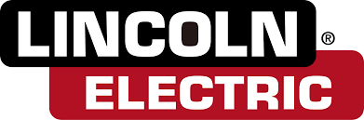
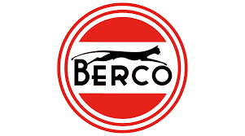
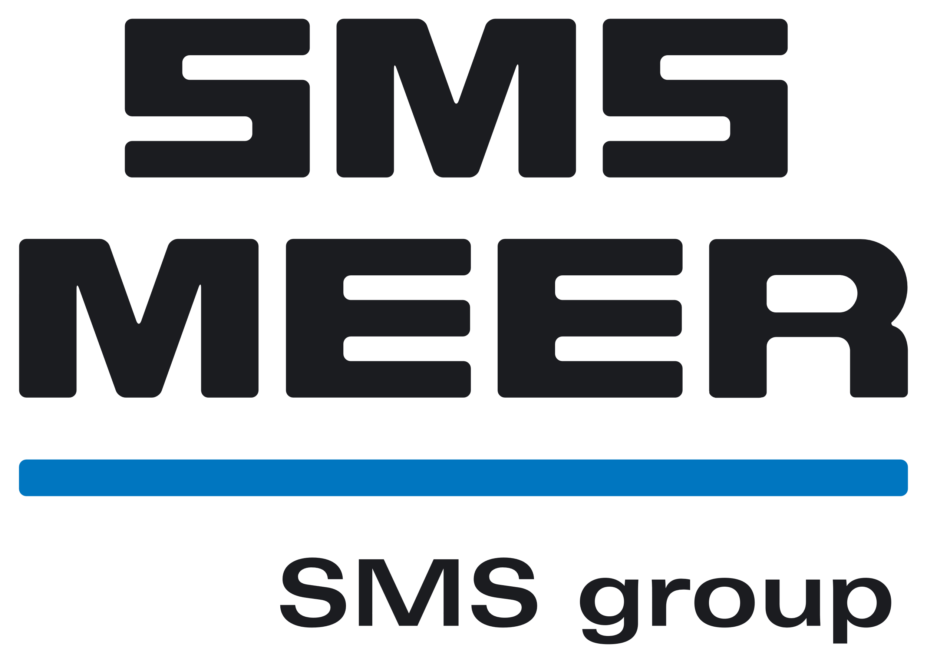
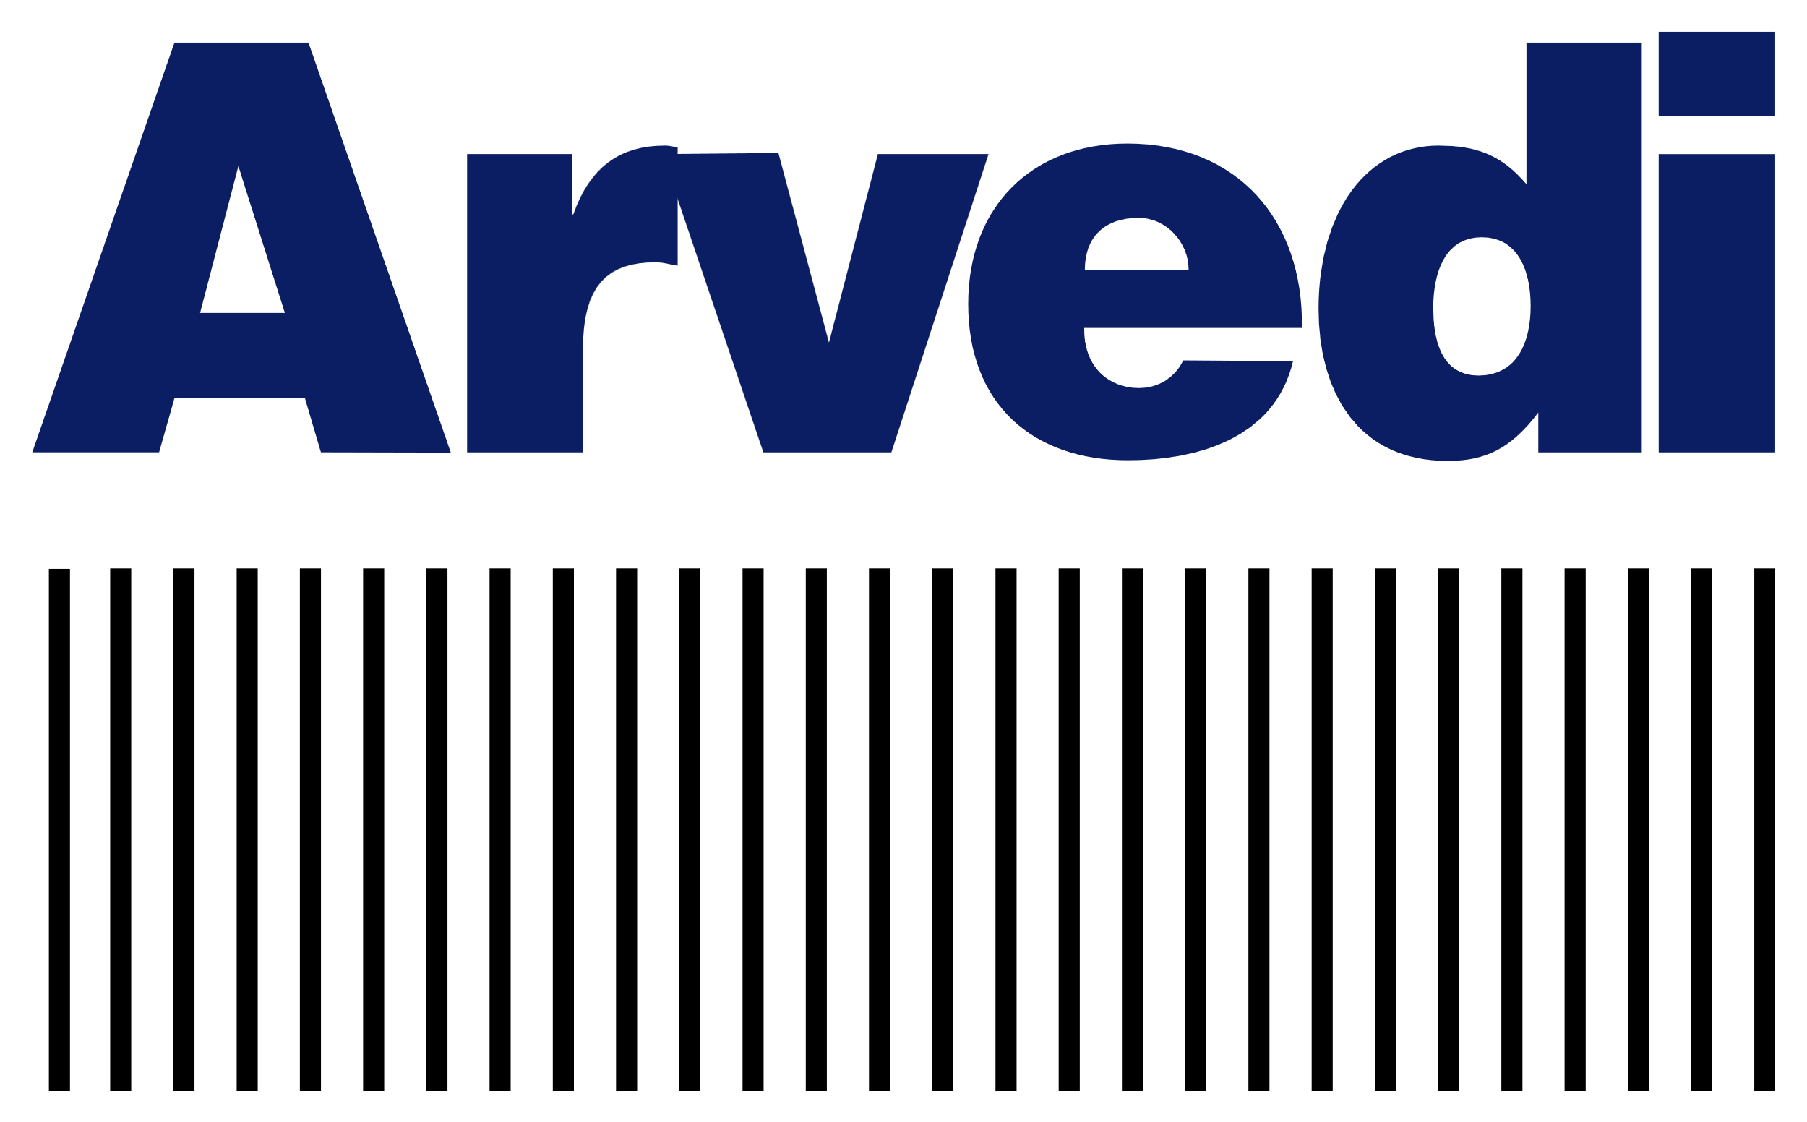

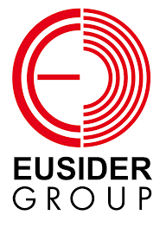
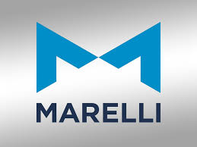
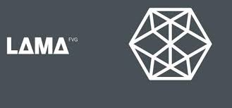
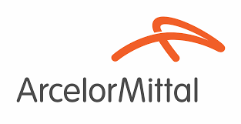
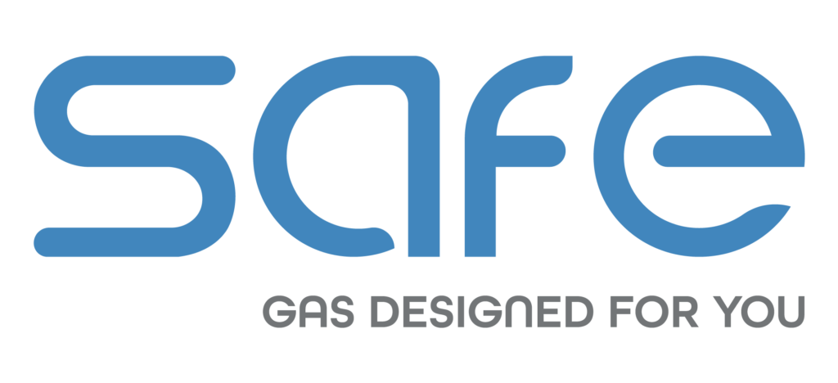

References
Notes:
We are proud to collaborate with leading companies across various industries, delivering high-performance surface solutions tailored to their needs.

Slide 17


Contacts
@ eurolls.commerciale@eurolls.com
www.eurolls.com
+39 0432 796511
eurolls-s-p-a
Notes:
Thank you for your time and attention. We appreciate the opportunity to share our expertise with you.

