Slide 1

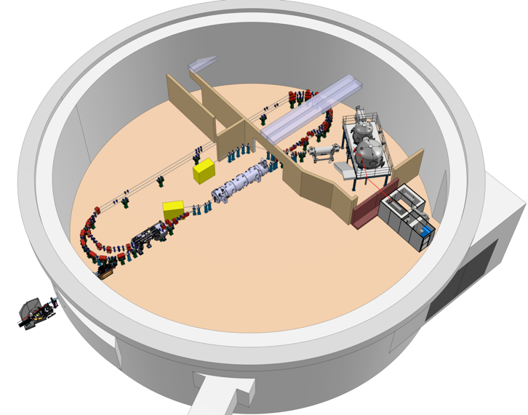













Perle Buncher AG du Pôle Ingénierie Orateur : S. Marchal
+ Contributions through iSAS of

Slide 2
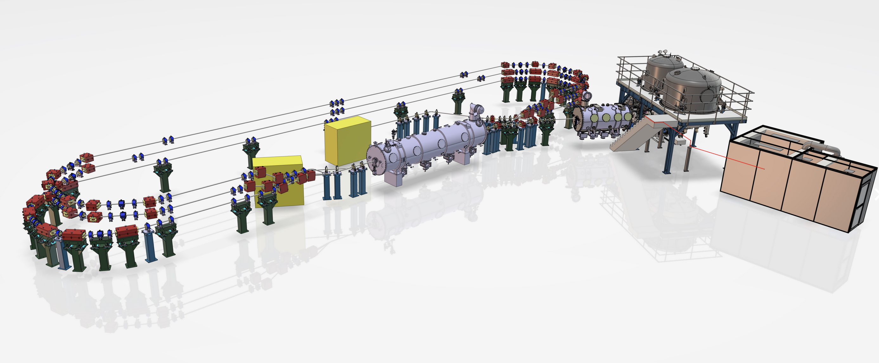
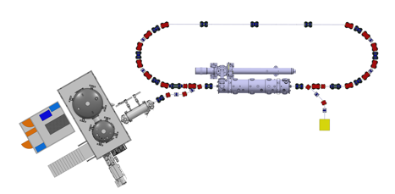
PERLE @250 MeV 3-turns
Two phases :
1-turn ; 3-turns
Parameters | Values
Injection Energy | 7 MeV
Electron beam energy PHASE 1 (single turn) | 89 MeV
Electron beam energy PHASE 2 (three turns) | 250 MeV
Normalised Emittance γε_{x,y} | 6 mm.mrad
Average beam current | 20 mA
Bunch charge | 500 pC
Bunch length | 3 mm
Bunch spacing in injector | 25 ns
RF frequency | 802 MHz
Duty factor | CW
PERLE @89 MeV 1-turn

Slide 3
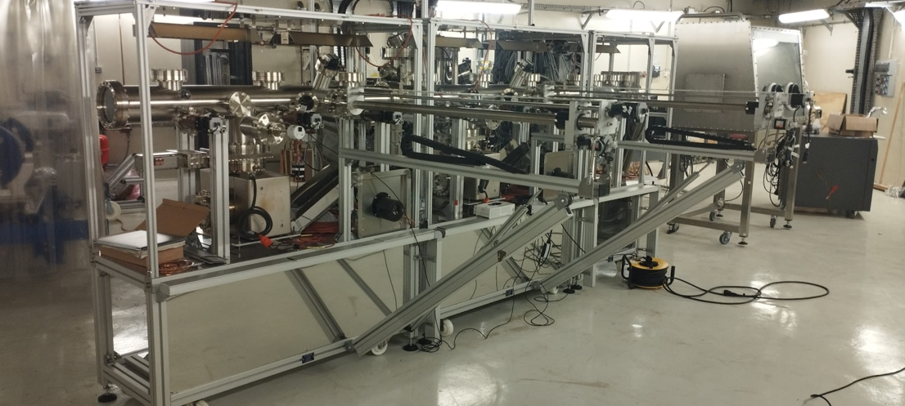
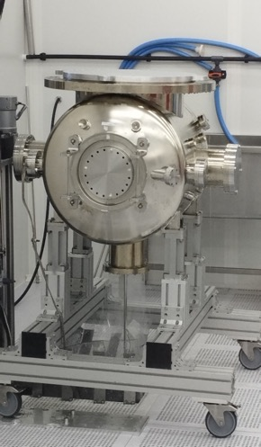
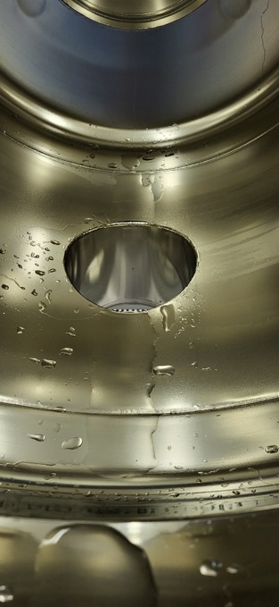
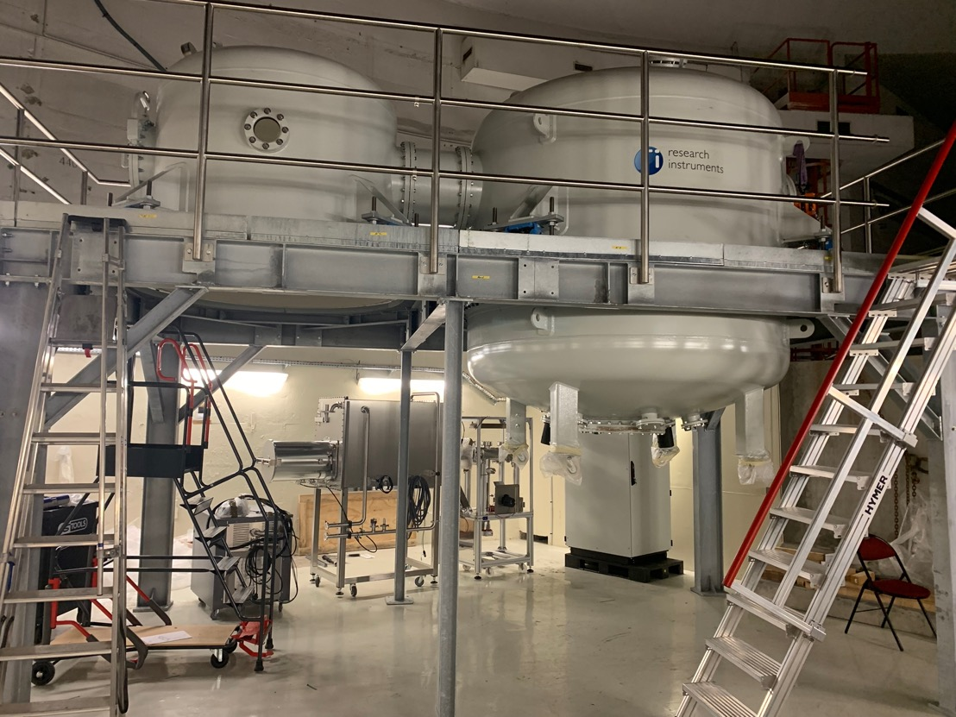
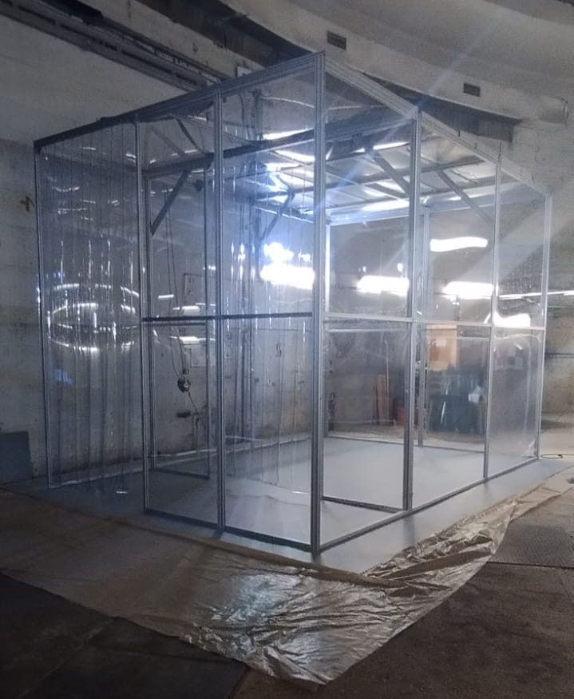
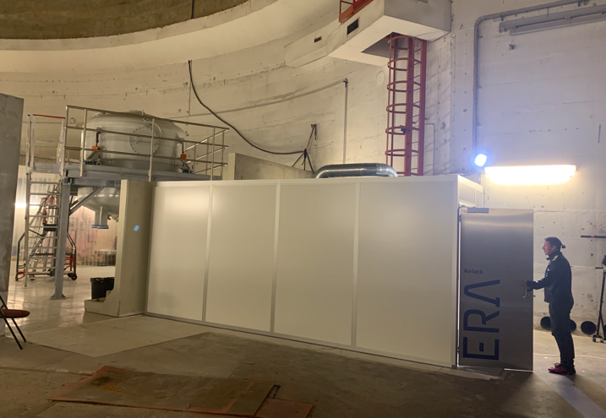
DC Gun installation status LASER room
Progress
In the installation of
The DC-gun complex
Photocathode Production Facility (PPF) assembly
Gun chamber HPR cleaning in clean room
Mobile clean room
05/02/2025

Slide 4
Project Phasage - Macro view with milestones
Design
DC Gun @350 keV
Procuirement / Construction / Installation
DC gun
operation
20 mA
Commissioning
Injector @ 7MeV
Injector installed
20 mA
PERLE 1-LOOP 89MeV
IGLOO ready
ERL 1-LOOPS
Cryomodule
tested
First ERL
demonstration
2MW
PERLE 3-LOOPS 250MeV
Cryogenic
installed
Cryomodule
Installed
ERL 3-LOOPS
TDR
3-loop ERL
demonstration
5MW
2024
2025
2026
2027
2028
2029
2030
2031

Slide 5
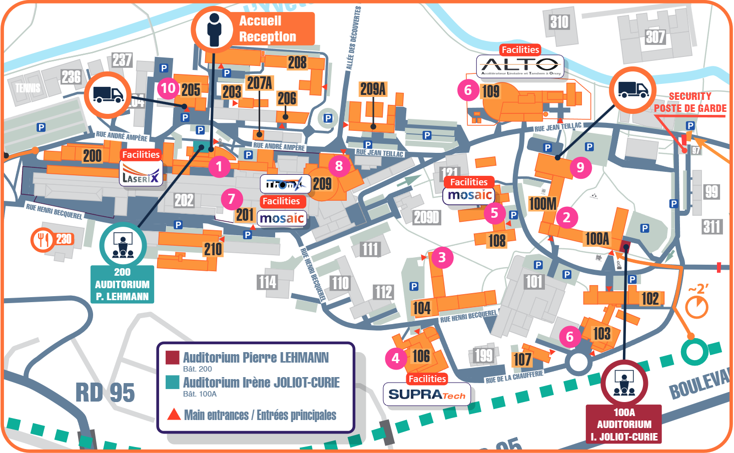
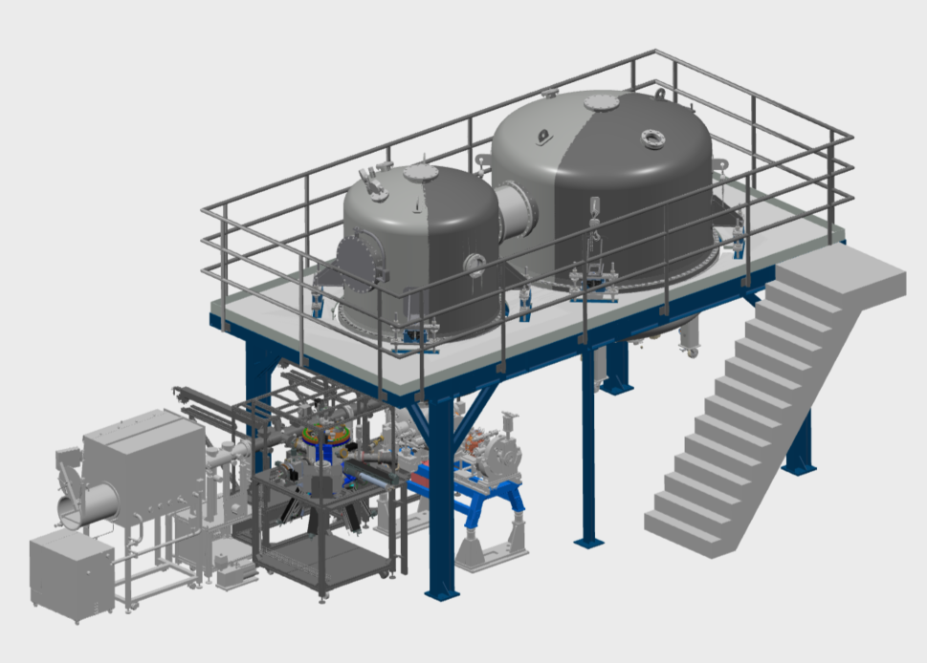
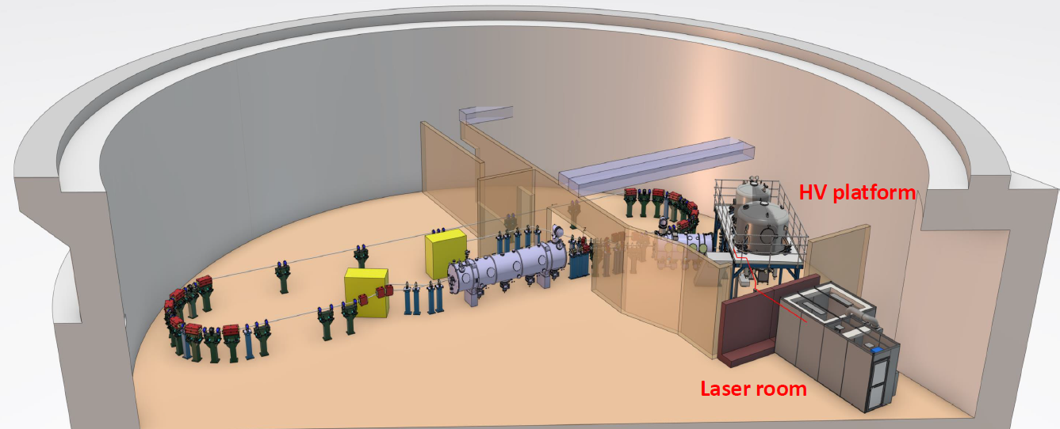
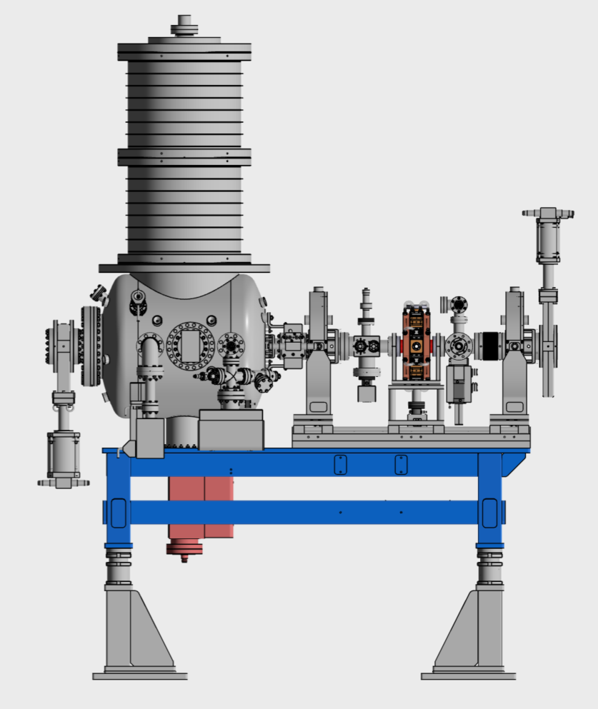
Buncher localisation
Buncher

Slide 6
Buncher specifications
Specifications :
Frequency = 801 MHz
Maximum length = 200 mm
Targeted temperature = 30°C
Power dissipated = 1,6kW or 5kW
Material : OFHC
Beam axes flange : CF50
2 ports : CF 16
Vacuum port : CF40
RF power coupler port : ?

Slide 7
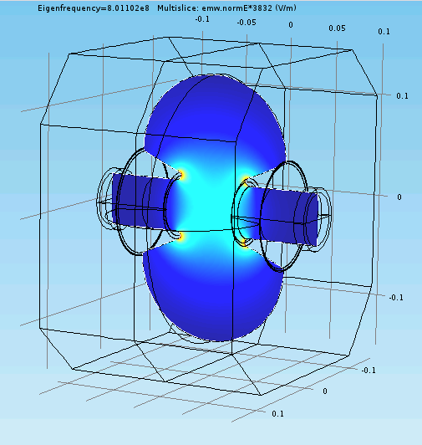
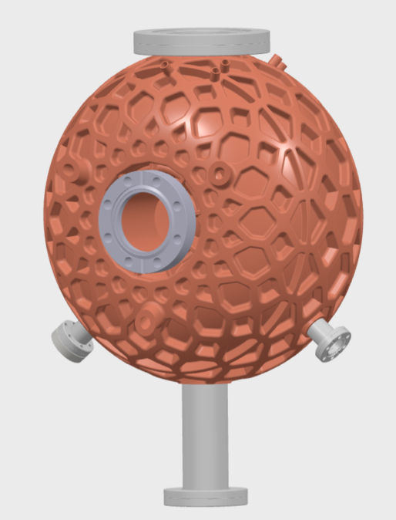
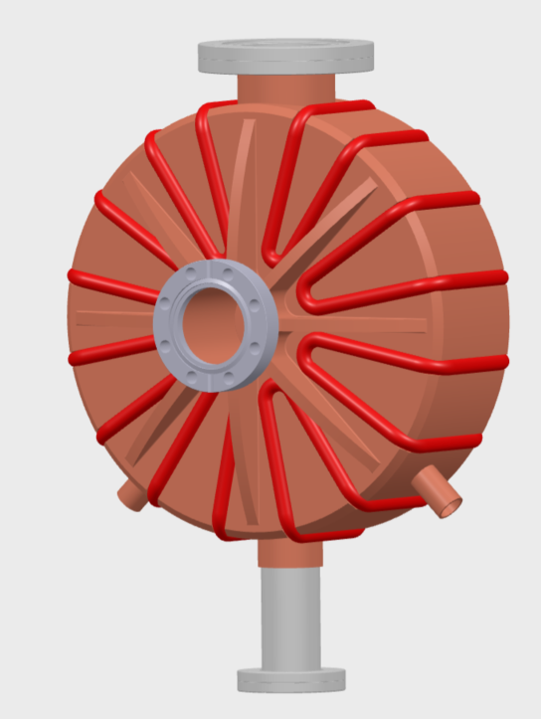
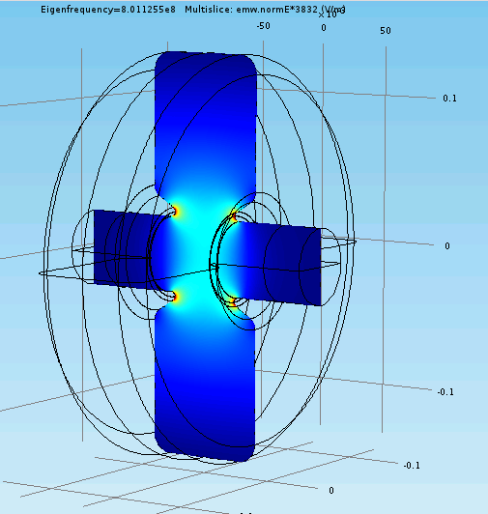
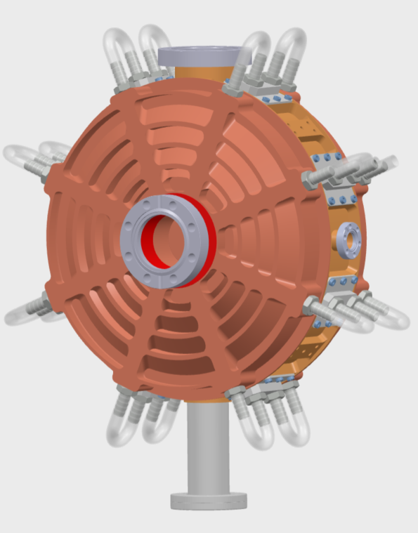
Buncher design review
Cerl Type buncher :
Manufacturing with 3D printed copper
Cerl type
Nose Cone type buncher with cooling system brazed :
Classic machining
Cooling system brazed
Buncher
Nose Cone type buncher with cooling system machined :
Classic machining
Cooling system machined
Nose Cone type

Slide 8
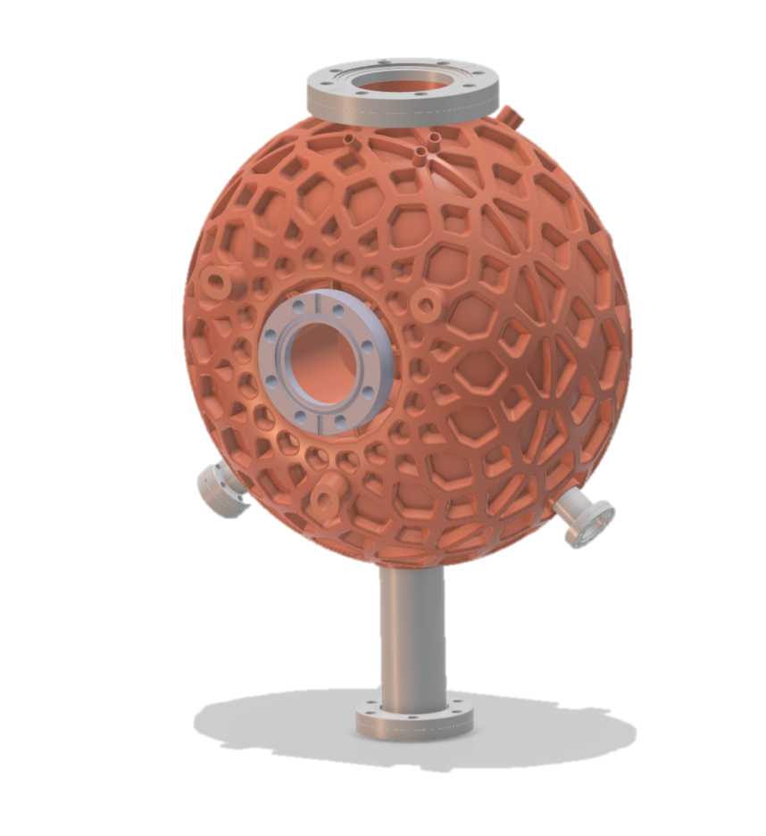
Cerl Type buncher
3D printed

Slide 9
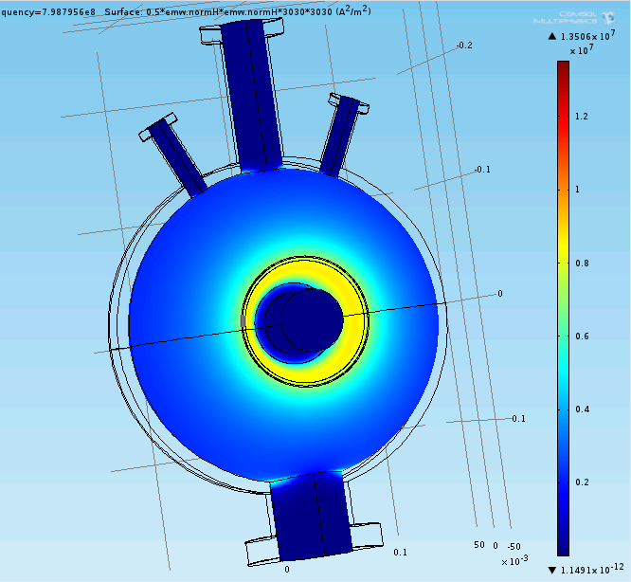
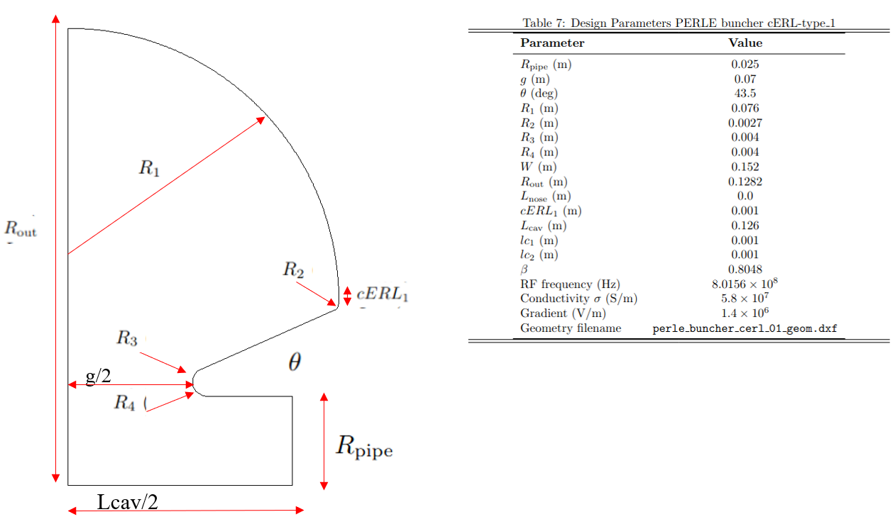
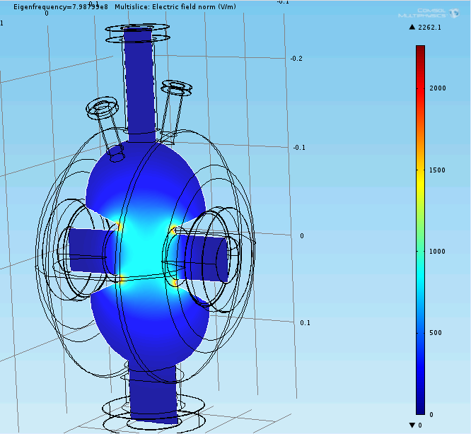
Buncher RF characteristics
Jean Louis Munoz from ESS Bilbao Simulation’s

Slide 10
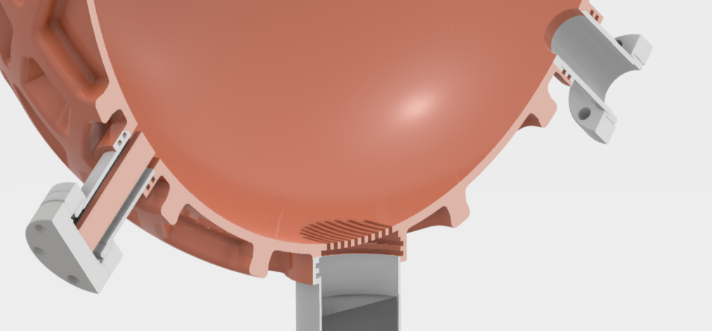
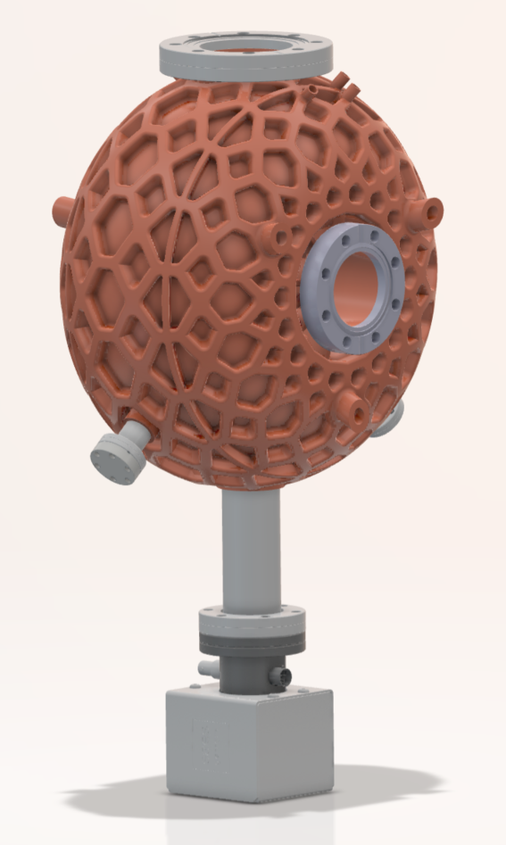
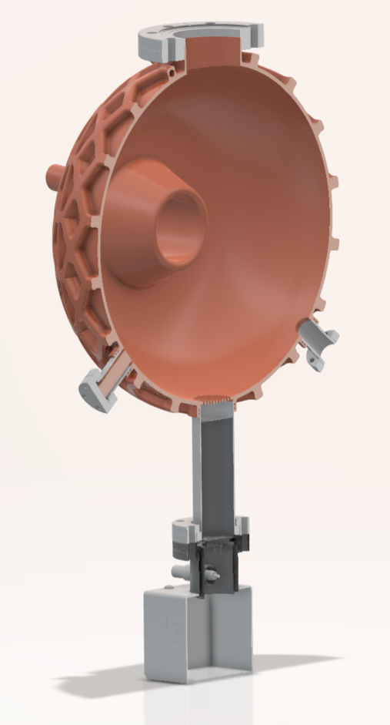
Buncher equipment
CF50
Plunger
Grid
Antenna
Vacuum pump

Slide 11
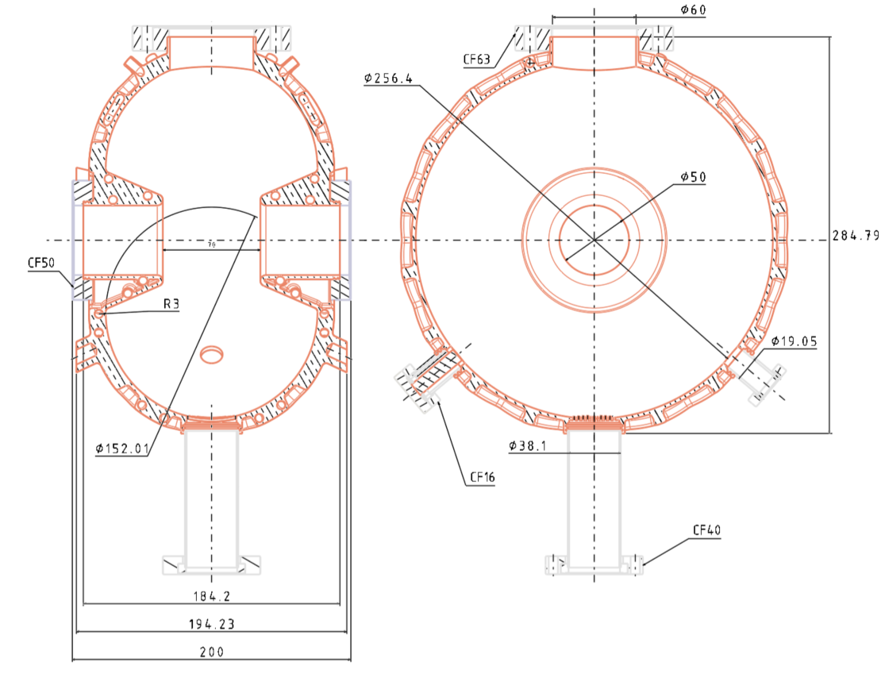
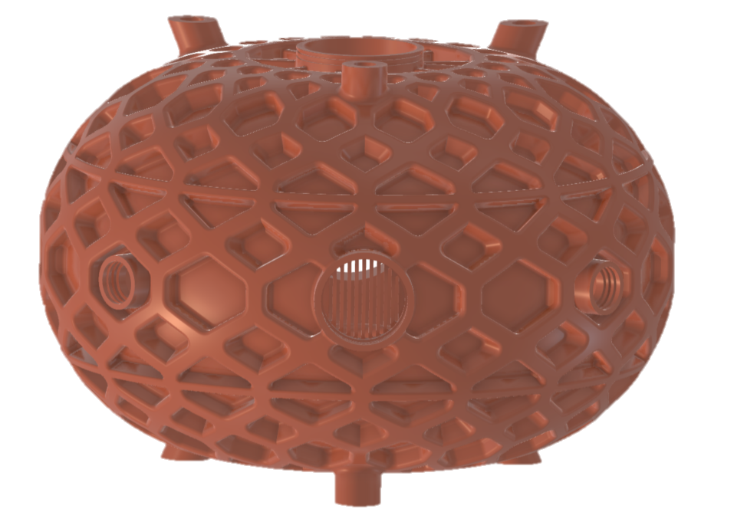
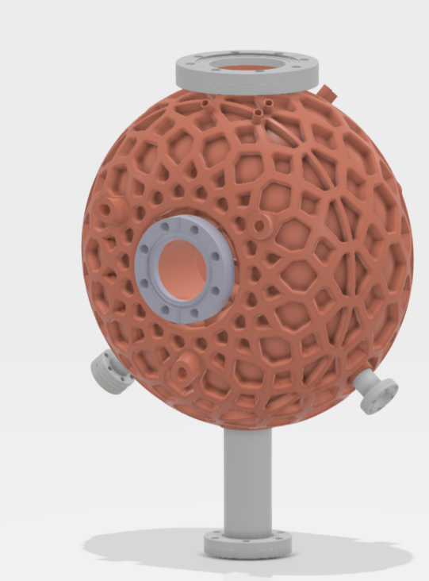
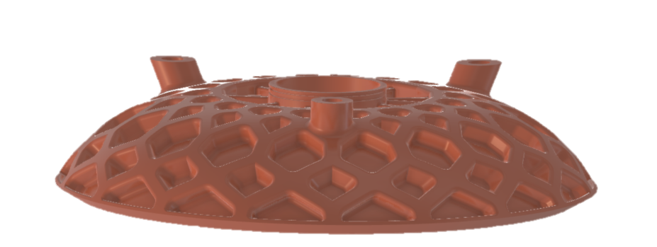
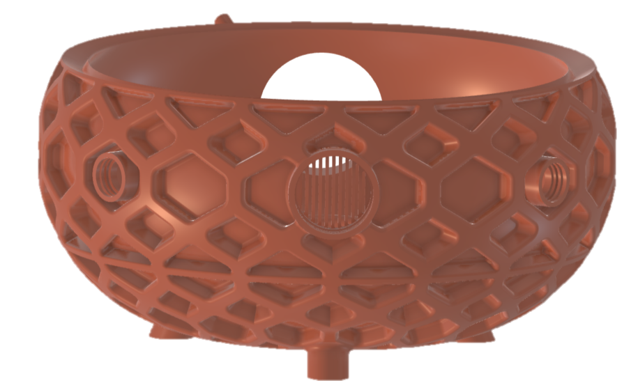
Buncher design

Slide 12
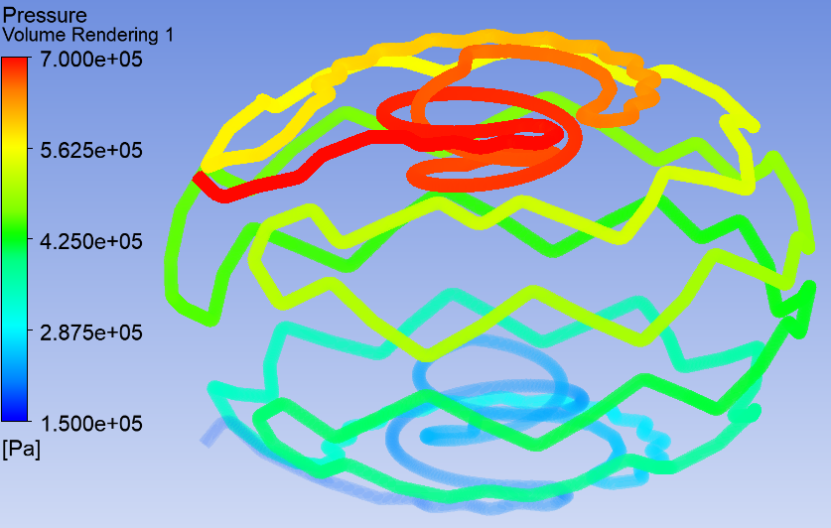

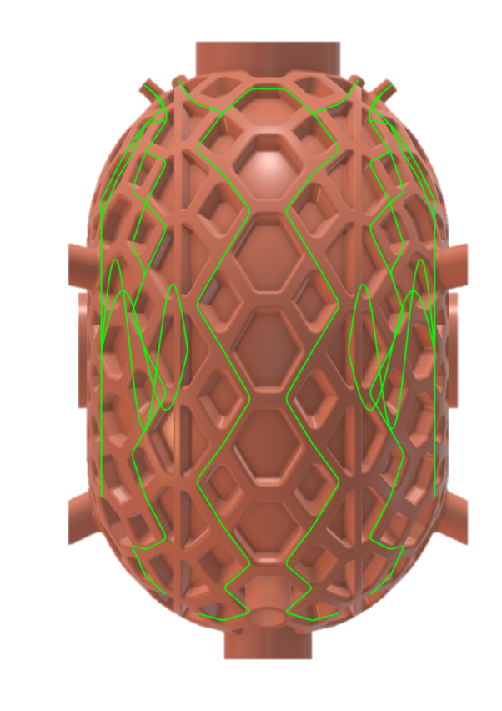
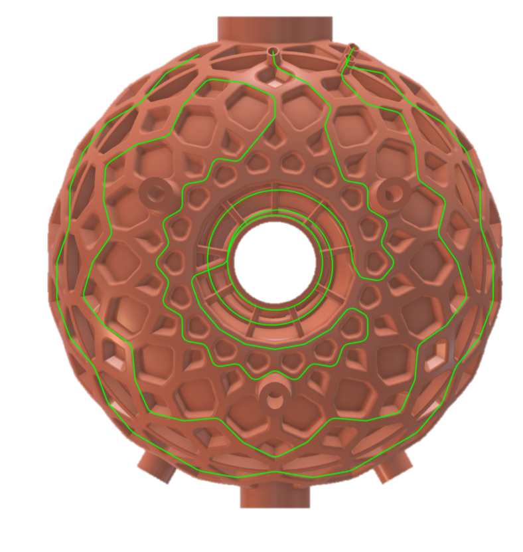
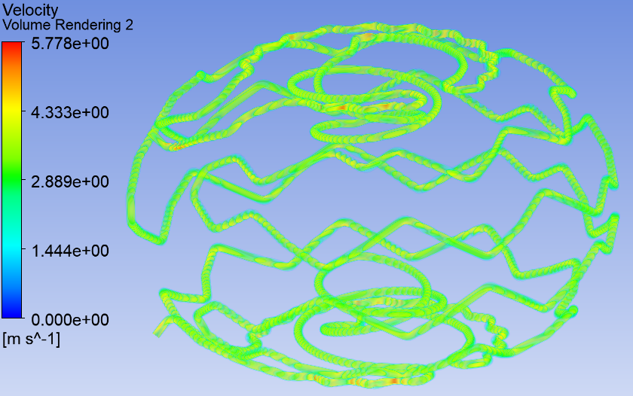
Cooling system pressure losses
Characteristics :
3 circuits in //
Pipe of Ø6 mm (internal)
min radius of 5mm
Inputs :
Inlet velocity of 3,5 m/s (0,1L/s)
Outlet pressure of 0,2 MPa
Ra of 25 μm
Results :
Pressure losses = 0,5 MPa (5 bar) for three circuit in series
0,17 MPa per circuit

Slide 13
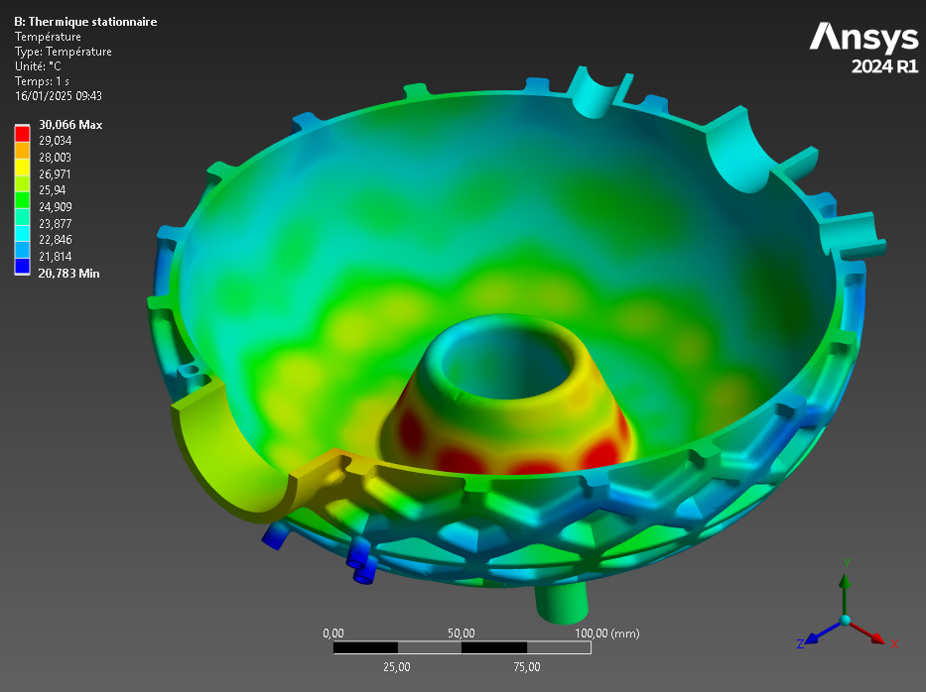
Thermal simulations
Inputs :
Inlet water temperature at 20°C and a flow of 0,1 L/s
Absorbed power of 5kW distributed according to the heat flow field (simulated by Patricia Duchesne)
Results :
T max < 30°C

Slide 14
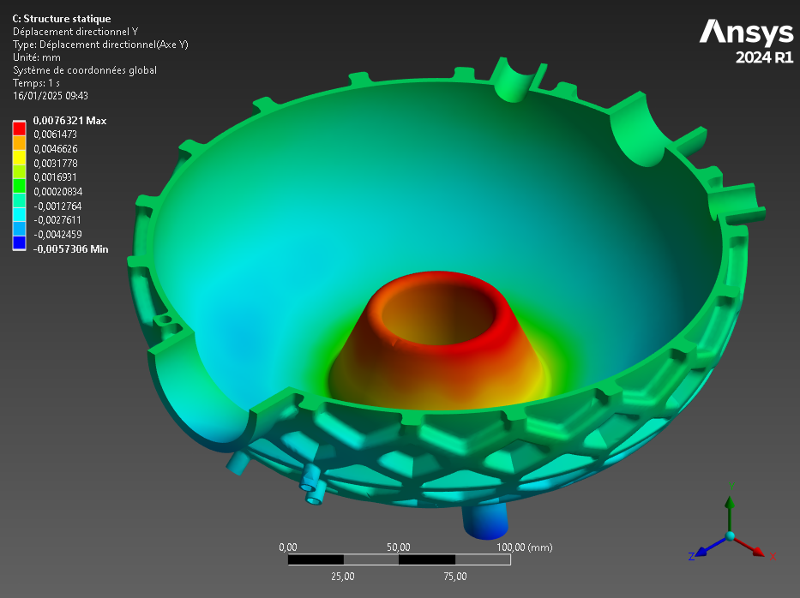
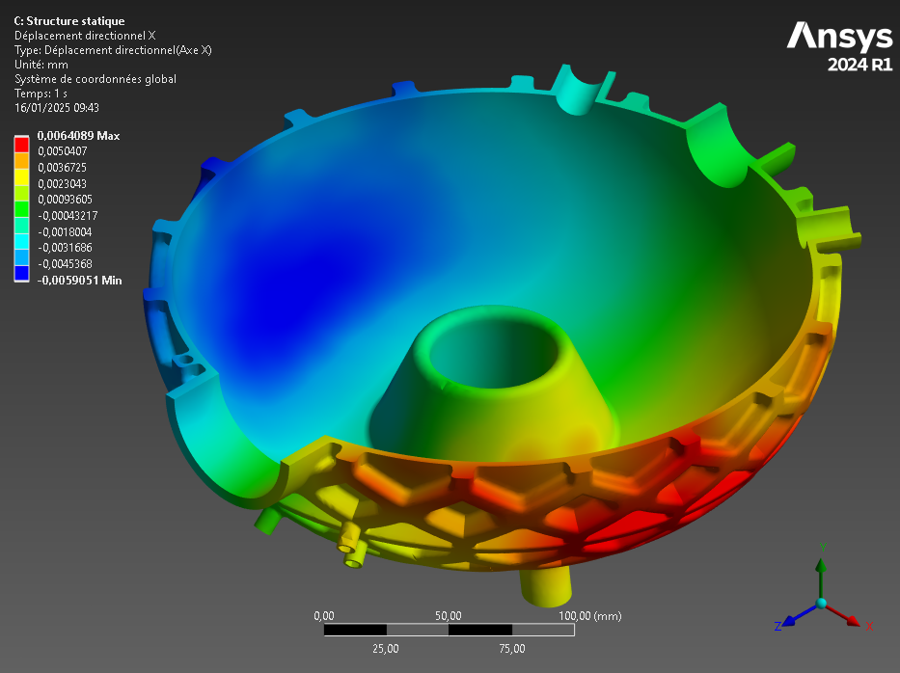
Mechanical simulations
Inputs :
Intern pressure : -0,10132 MPa
Thermal dilatation based on thermal simulation
Pipes pressure : 1MPa
Pump weight : 50 N
Gravity
Results :
Y Deformation (Beam axes) : 0,008 mm
X Deformation : 0,006 mm

Slide 15
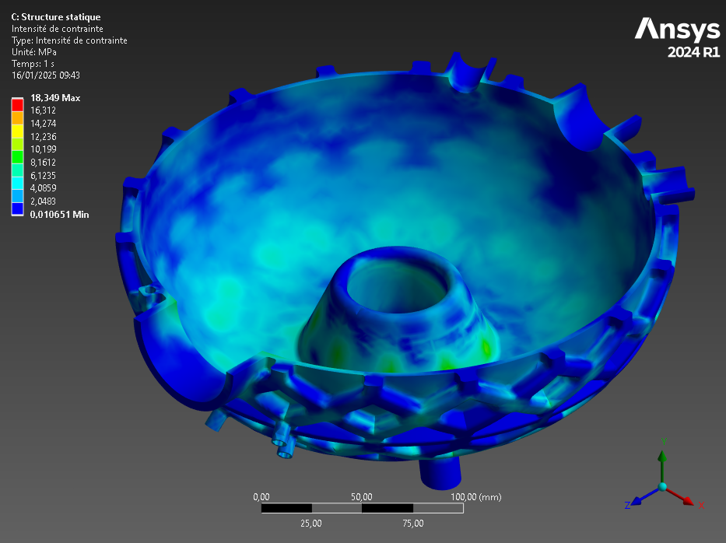
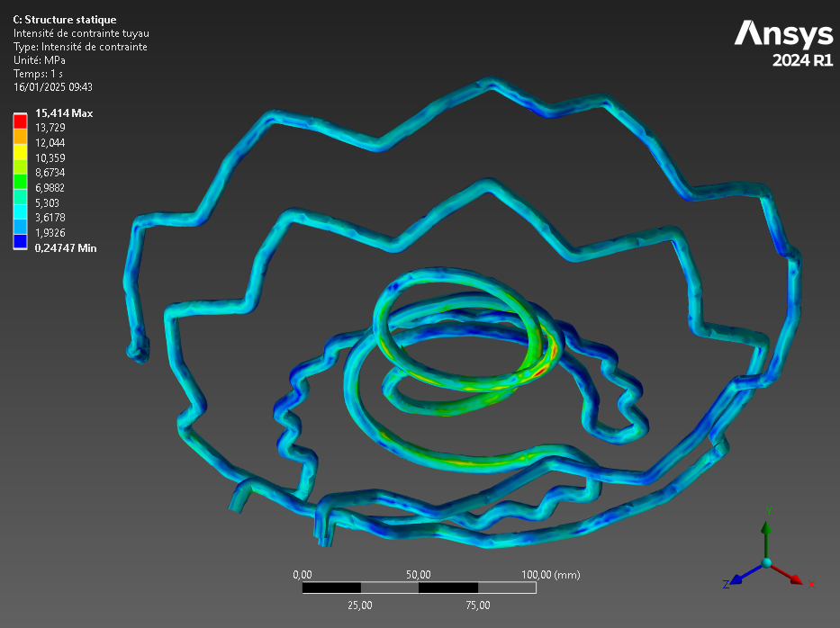
Mechanical simulations
Results :
Constraint < 33 MPa

Slide 16
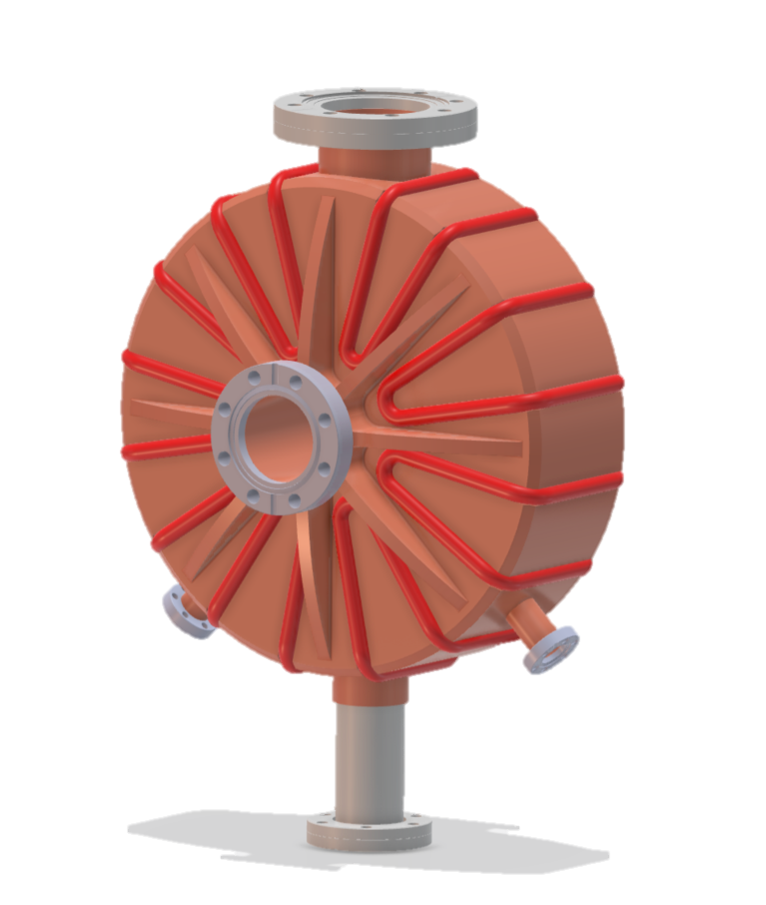
Nose Cone type buncher
Cooling system brased

Slide 17
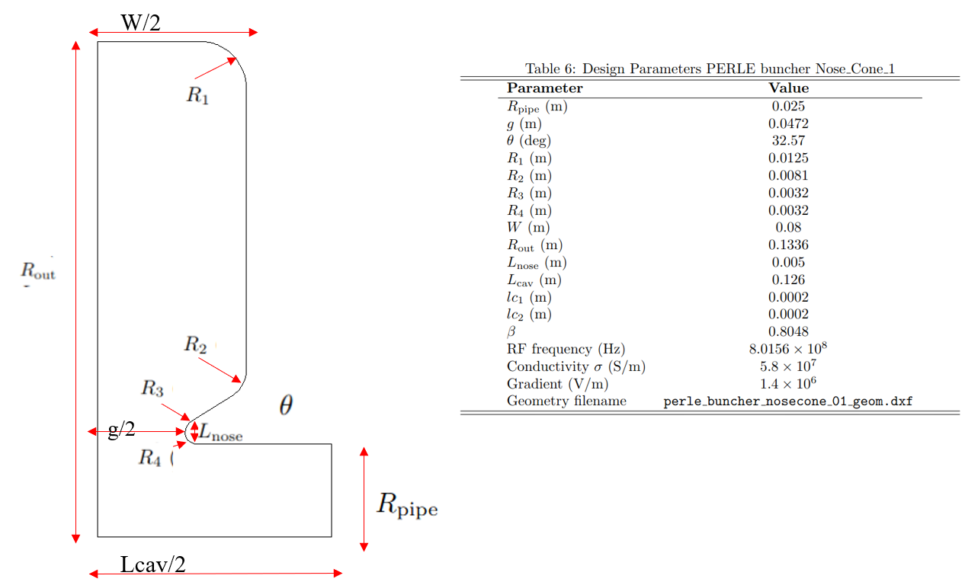
Buncher RF characteristics
Jean Louis Munoz from ESS Bilbao Simulation’s

Slide 18
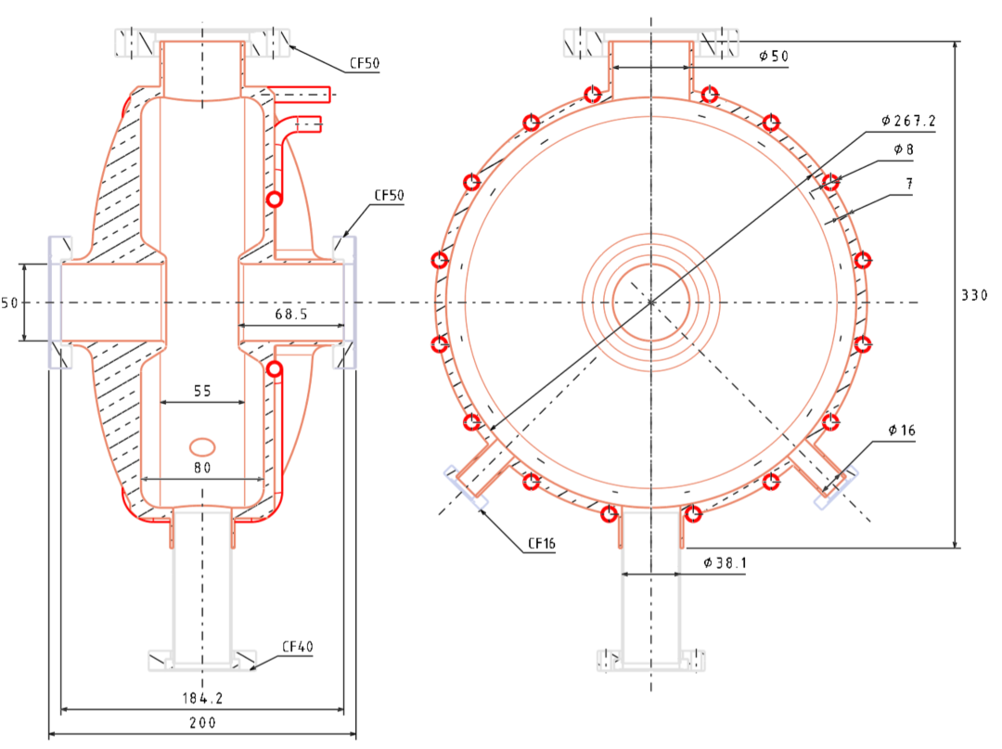
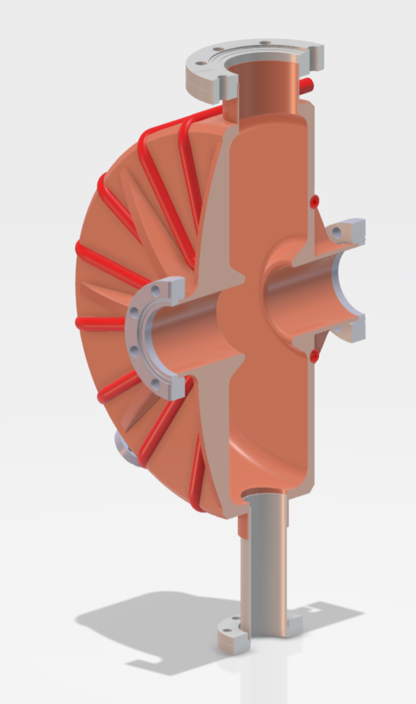
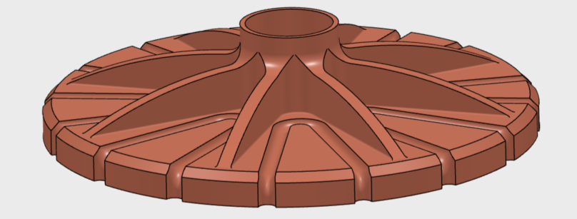
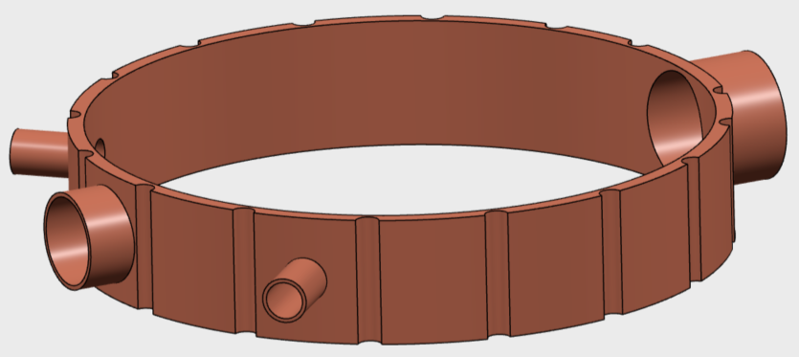
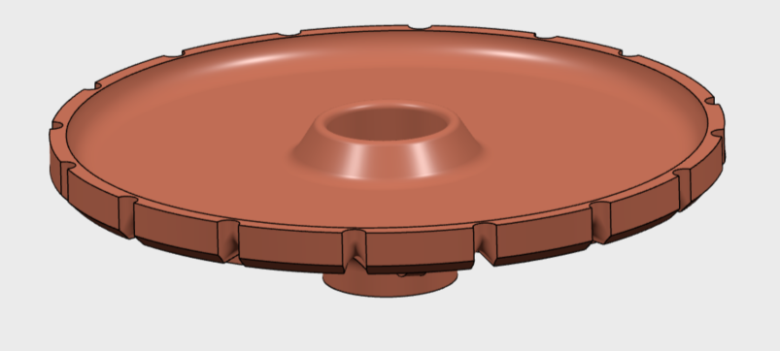
Buncher design

Slide 19
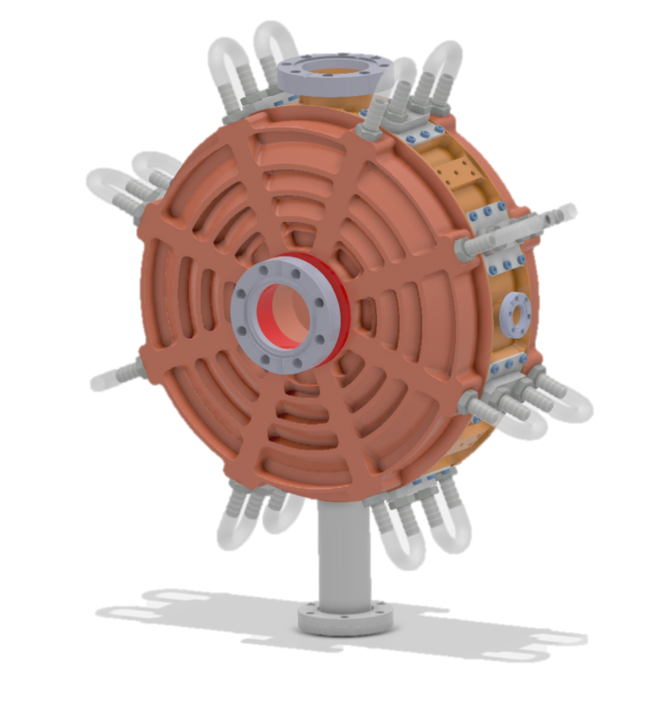
Nose Cone type buncher
Cooling system machined

Slide 20

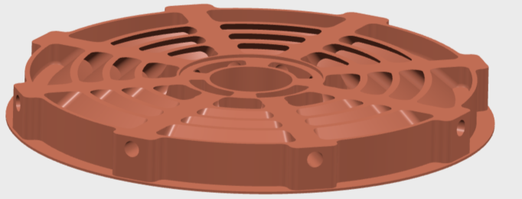
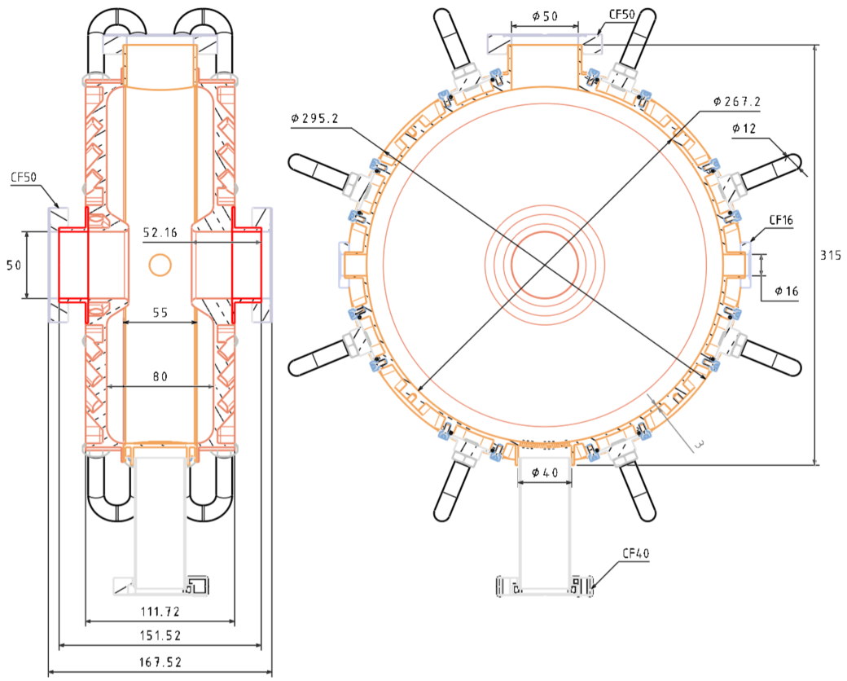
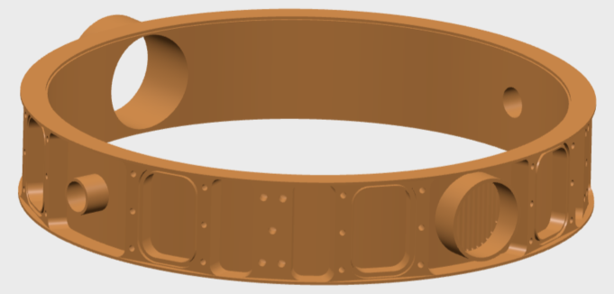




Buncher design review

Slide 21





Frequency shift
R out at ± 1mm
W/2 at ± 1mm
G/2 at ± 1mm
θ at ± 1 degre

Slide 22


Results
5kW
1,6kW
*Frequency shift due to the mechanical constraint and thermal dilatation only

Slide 23
Next steps
2025
2026
Research on the feasibility
FINAL DESIGN
Technical drawings
INSTALATION
Estimation of the cost
Call for tenders
Fabrication
Finalisation of the design
Adjustment
Estimation of the cost
Tests
RF tests
Mechanical tests
Cooling system tests
Vacuum tests
Simulations
Finalisation of the design
Estimation of the cost
Simulations
RF Power coupler
design
Technical drawings
Fabrication
Estimation of the cost
Call for tenders

Slide 24
MERCI
Contributions :
D. Reynet, R. Roux, J.L. Muñoz (ESS Bilbao), P. Duchesne, C. Joly, A. Blot, T. Proslier (CEA), W Kaabi, F. Bouly (LPSC)…

Slide 26

Thermal results
Input :
Inlet water temperature at 20°C and a flow of 0,1 L/s
Absorbed power of 5kW evenly distributed
Results :
T max < 35°C

Slide 27


Mechanical result
Input :
Intern pressure : -0,10132 MPa
Thermal dilatation based on thermal simulation
Pipes pressure : 0,5 MPa
Gravity
Results :
Y Deformation (Beam axes) : 0,032 mm
X Deformation : 0,005 mm

Slide 28

Mechanical result
Results :
Constraint < Elastic Limit*
* The copper elastic limit is 33MPa, in some point of this simulations, the constraint is > 33 MPa. It’s due to the mesh, not the real constraint

Slide 29

Thermal results
Input :
Inlet water temperature at 20°C and a flow of 0,1 L/s
Absorbed power of 5kW evenly distributed
Results :
T max < 42,5°C

Slide 30


Mechanical result
Input :
Intern pressure : -0,10132 MPa
Thermal dilatation based on thermal simulation
Pipes pressure : 0,5 MPa
Gravity
Results :
Y Deformation (Beam axes) : 0,047 mm
X Deformation : 0,040 mm

Slide 31

Mechanical result
Results :
Constraint < Elastic Limit

Slide 32



Buncher in stainless with copper coating
Stainless VS copper
Can be bolted instead of brazed
Similar efficiency of the mechanical strength
CF flanges can be integrated in the 3D model
Lower efficiency of the cooling system

Slide 33


Buncher with or without reinforcement
Results :
without reinforcement Deformation = 3,75 x with reinforcement Deformation

Slide 34



Buncher with full or inclined reinforcement
Results :
Deformation : Full = 0,87 x inclined
Weight : Full = 1,33 x inclined

Slide 35


Buncher with vertical or inclined reinforcement
Results :
Deformation : Vertical = 1,28 x inclined
Constraint : Vertical = 1,04 x inclined

Slide 36



Simulations with 1,6kW

Slide 37



Simulations with 1,6kW

Slide 38



Simulations with 1,6kW

