Slide 1
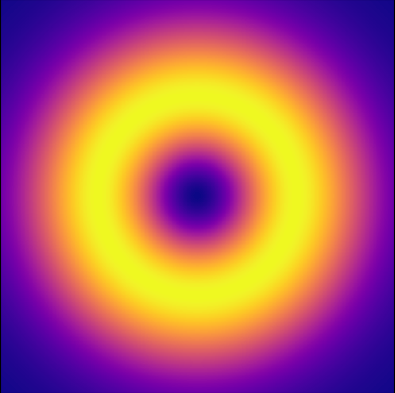





General assembly of the Accelerators Department at IJCLAB
19/12/2024
Amplification and characterisation of extreme ultraviolet optical vortices
Speaker: Marie-Hélène CARRON, 2nd year PhD student in the ALPHA team
Supervisors: Olivier GUILBAUD (main supervisor) and Sophie KAZAMIAS

Slide 2
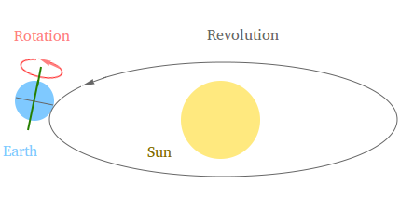
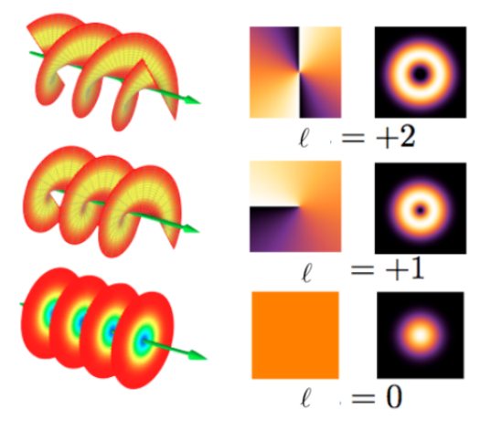
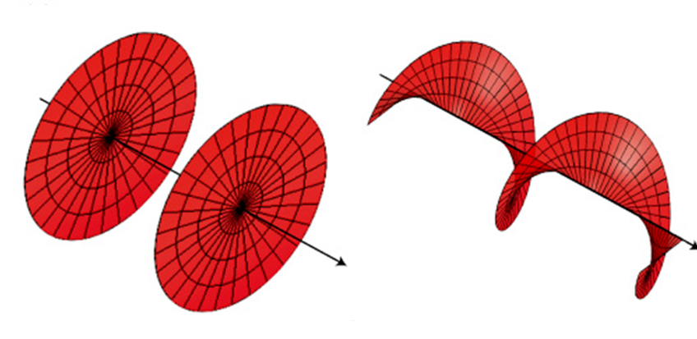
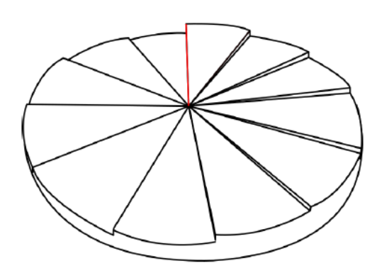
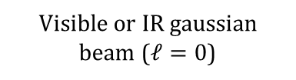
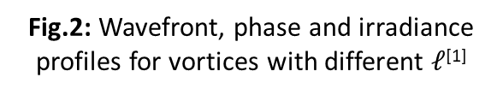
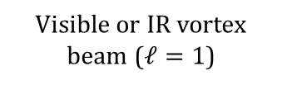
What are optical vortices?
1
Light possesses 2 angular momenta:
Spin angular momentum (polarisation) = rotation
Orbital angular momentum (OAM) = revolution
Fig.1: Difference between rotation and revolution in a planetary model
Optical vortex = beam carrying OAM ($ℓ≠0$)
An example of how to generate a vortex beam in the lab:
Fig.3: Using a spiral phase plate to generate a vortex, adapted from ^{[2] [3]}
Fig.2: Wavefront, phase and irradiance profiles for vortices with different $ℓ$^{[1]}
Visible or IR gaussian beam ($ℓ=0$)
Spiral phase plate
Visible or IR vortex beam ($ℓ=1$)
^{[1]} Chris Lee. Twisted light beats quantum light. [EB/OL].
^{[2]} Fabrice Sanson. “Génération et optimisation d’harmoniques d’ordres élevés portant un moment angulaire orbital pour l’injection dans un plasma de laser X-UV”. 2021UPASP026. PhD thesis. 2021.
^{[3]} Alison M. Yao and Miles J. Padgett, “Orbital angular momentum: origins, behavior and applications”, Advances in Optics and Photonics 3, 161-204, 2011

Slide 3
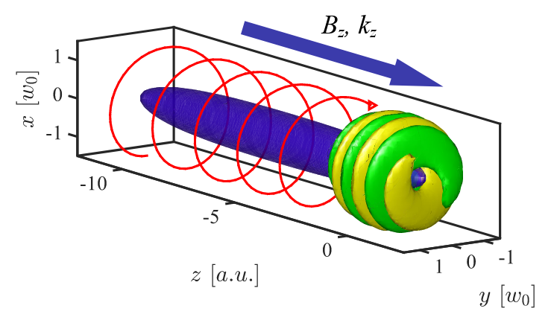
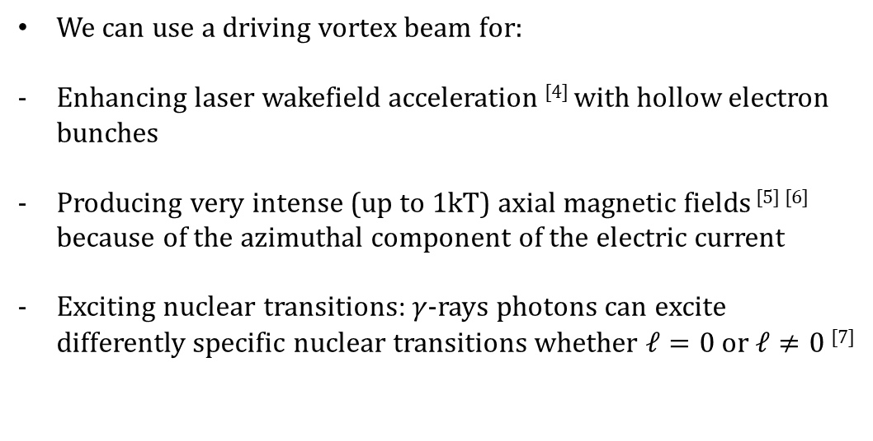
A few applications of optical vortices
2
We can use a driving vortex beam for:
Enhancing laser wakefield acceleration ^{[4]} with hollow electron bunches
Producing very intense (up to 1kT) axial magnetic fields ^{[5] [6]} because of the azimuthal component of the electric current
Exciting nuclear transitions: $γ$-rays photons can excite differently specific nuclear transitions whether $ℓ=0$ or $ℓ≠0$^{[7]}
Fig.4: Illustration of an IFE driven B-field with a $ℓ=1$^{[5]}
Our team is specialised in coherent XUV sources ($\sim$10fs to 1ps, $λ\sim 10$-100nm scales)
I am studying XUV vortices
^{[4]} Vieira, J., et J. T. Mendonça. « Nonlinear Laser Driven Donut Wakefields for Positron and Electron Acceleration ». Physical Review Letters 112, nº 21 (27 mai 2014): 215001.
^{[5]} Longman, Andrew, et Robert Fedosejevs. « Kilo-Tesla Axial Magnetic Field Generation with High Intensity Spin and Orbital Angular Momentum Beams ». arXiv, 25 novembre 2021.
^{[6]} Ali, S., J. R. Davies, et J. T. Mendonca. « Inverse Faraday Effect with Linearly Polarized Laser Pulses ». Physical Review Letters 105, nº 3 (12 juillet 2010): 035001.
^{[7]} Lu, Zhi-Wei, Liang Guo, Zheng-Zheng Li, Mamutjan Ababekri, Fang-Qi Chen, Changbo Fu, Chong Lv, et al. « Manipulation of Giant Multipole Resonances via Vortex $γ$ Photons ». arXiv, 21 juillet 2023.

Slide 4
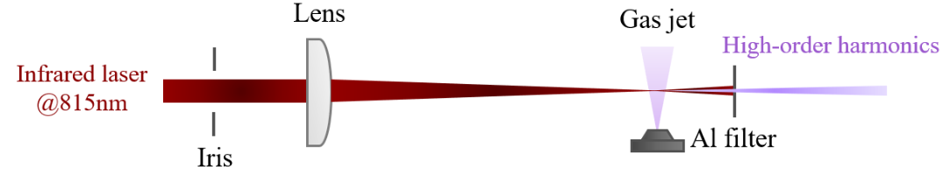
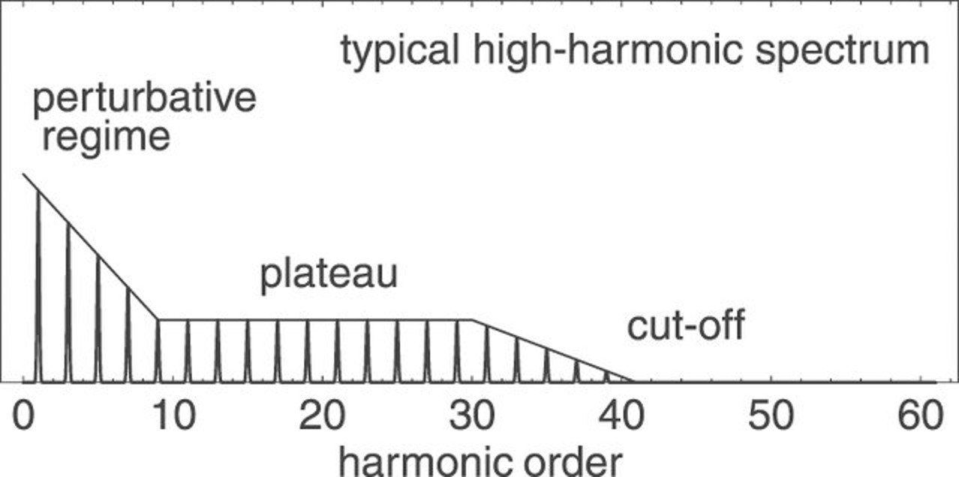
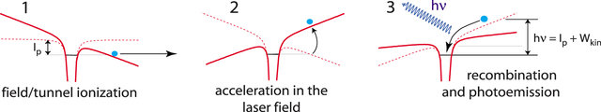
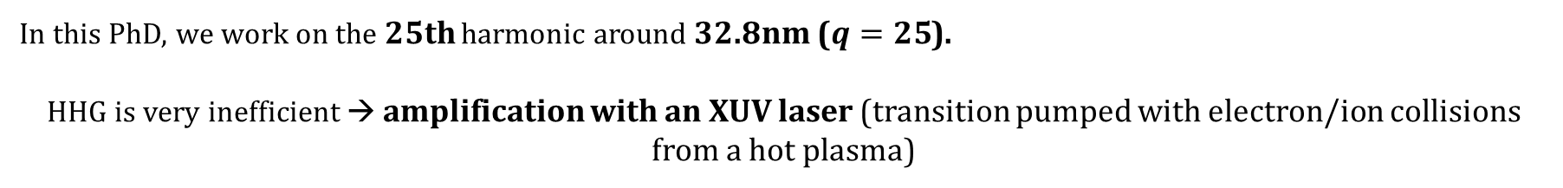

How to get XUV optical vortices?
3
XUV light : from to 10 to 100nm (12 to 120 eV)
We use non-linear optics : High Harmonic Generation
Fig.5: Typical HHG spectrum ^{[8]}
Fig.6: Sketch of an experiment of HHG
Basic understanding of the process: the 3 step model ^{[9]} :
Fig.7: Sketch of the 3 step model^{[10]}
Maximum order depends on $\left|E_{IR}\right|²$ and $λ$
In this PhD, we work on the 25th harmonic around 32.8nm ($q=25$).
HHG is very inefficient → amplification with an XUV laser (transition pumped with electron/ion collisions from a hot plasma)
^{[8]} Carsten Winterfeldt, Christian Spielmann, and Gustav Gerber. “Colloquium: Optimal control of high-harmonic generation”. In: Rev. Mod. Phys. 80 (1 Jan. 2008), pp. 117–140.
^{[9]} P. B. Corkum. “Plasma perspective on strong field multiphoton ionization”. In: Phys. Rev. Lett. 71 (13 Sept. 1993), pp. 1994–1997.
^{[10]} Liran Hareli et al 2020 J. Phys. B: At. Mol. Opt. Phys. 53 233001

Slide 5
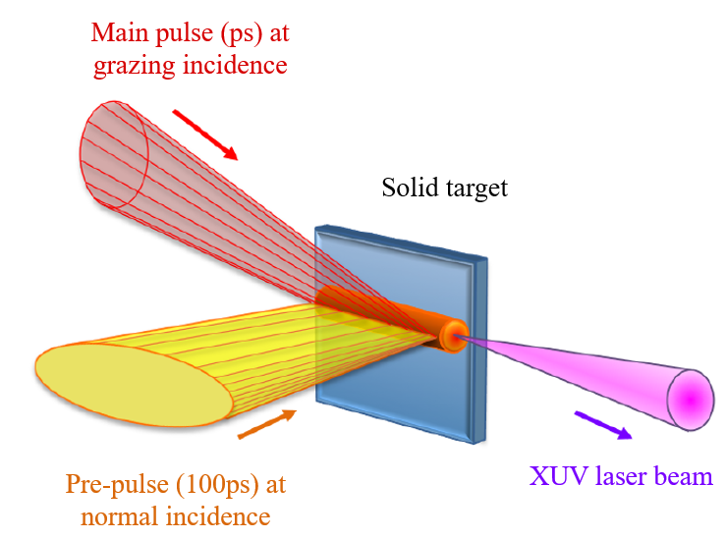
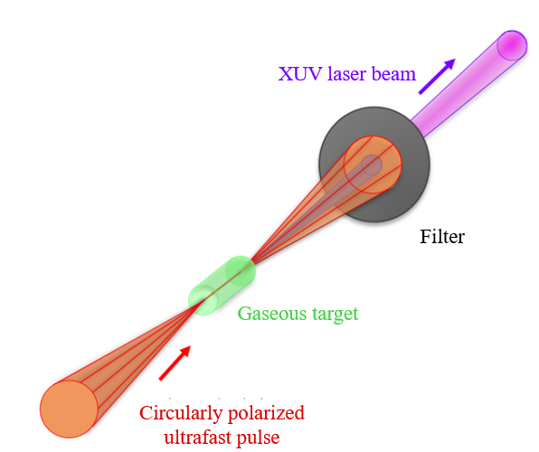

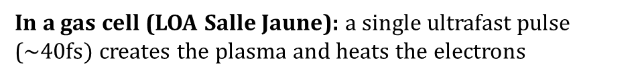
Amplifying medium: the plasma-based XUV laser
4
On a solid target (LASERIX platform): the 1st pulse creates the plasma, the 2nd pulse heats the plasma electrons
In a gas cell (LOA Salle Jaune): a single ultrafast pulse ($\sim 40fs)$creates the plasma and heats the electrons
Fig.8: Sketch of a collisional XUV laser on a solid target ^{[11]}
Fig.9: Sketch of a collisional XUV laser in a gas cell ^{[11]}
The type of XUV laser that I have used so far in the experiments
XUV laser with poor spatial quality BUT if used as an amplifying medium:
Energy is multiplied by orders of magnitude
Both temporal ^{[12]} and spatial ^{[13]} coherences of the harmonic are preserved → high quality beam
BUT perfect spatial and spectral synchronisations of the seed and the XUV laser are mandatory
^{[11]} Fabien Tissandier. “Caractérisation spatio-temporelle d’une chaîne laser à 32. 8 nm par plasma laser et perspectives vers une source ultrabrève et intense”. 2011EPXX0026. PhD thesis. 2011, 1 vol. (244).
^{12]} O. Guilbaud et al. “Fourier-limited seeded soft x-ray laser pulse”. In: Opt. Lett. 35.9 (May 2010), pp. 1326–1328.
^{[13]} Y. Wang et al. “High-Brightness Injection-Seeded Soft-X-Ray-Laser Amplifier Using a Solid Target”. In: Phys.Rev. Lett. 97 (12 Sept. 2006), p. 123901.

Slide 6
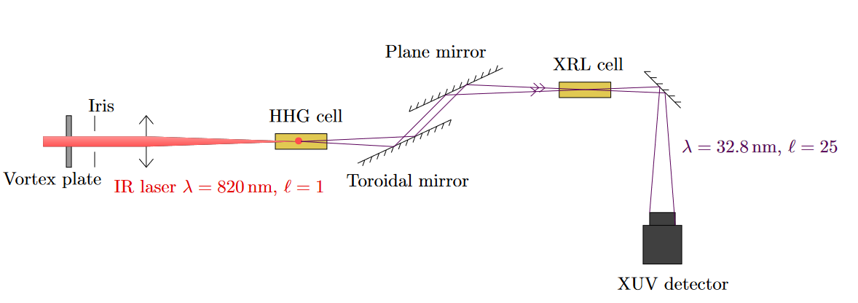
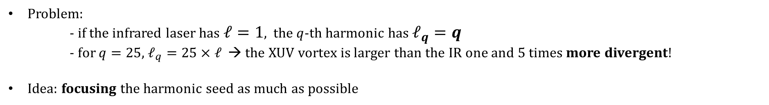
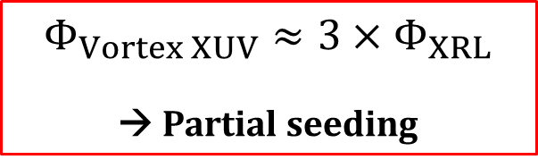
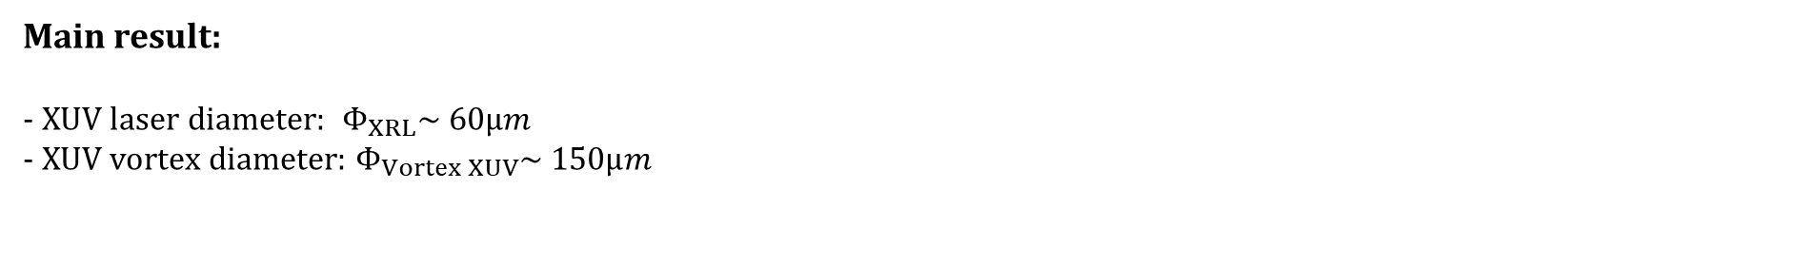
5
Experimental setup and results: LOA 2023 (1/3)
Problem:
- if the infrared laser has $ℓ=1$, the $q$-th harmonic has $ℓ_{q}=q$
- for $q=25$, $ℓ_{q}=25×ℓ$ → the XUV vortex is larger than the IR one and 5 times more divergent!
Idea: focusing the harmonic seed as much as possible
Fig.10: Sketch of the setup used for the harmonic vortex seeding at LOA
Main result:
- XUV laser diameter: $Φ_{XRL}\sim 60µm$
- XUV vortex diameter: $Φ_{Vortex XUV}\sim 150µm$
$${Φ_{Vortex XUV}≈3×Φ}_{XRL}$$
→ Partial seeding

Slide 7
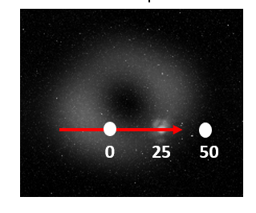
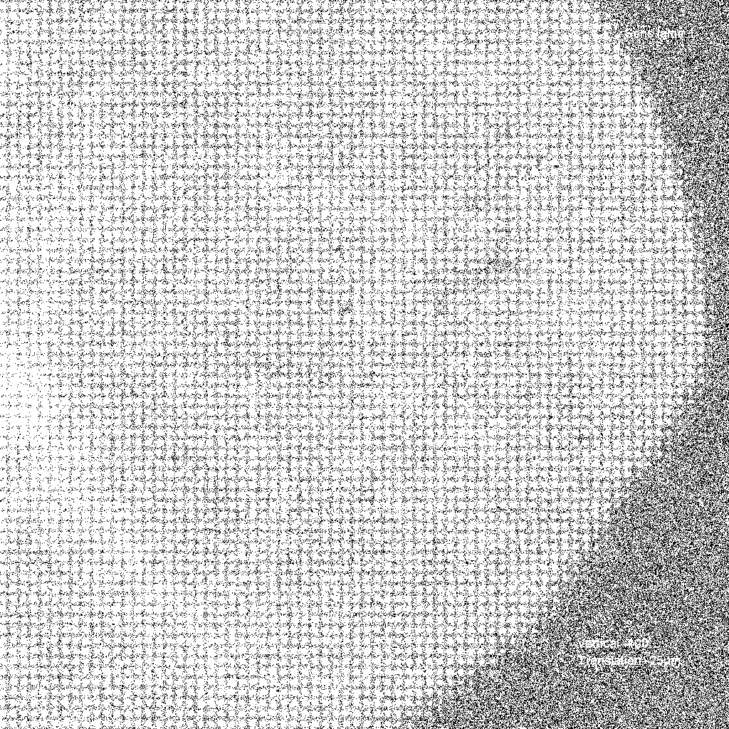
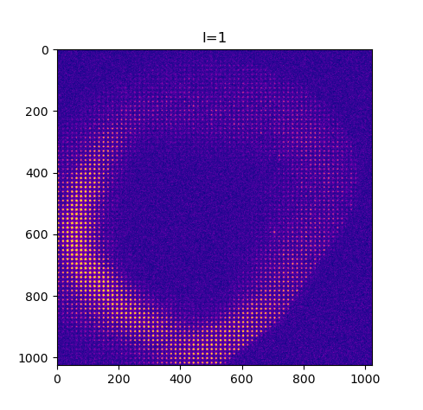
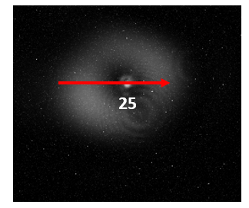
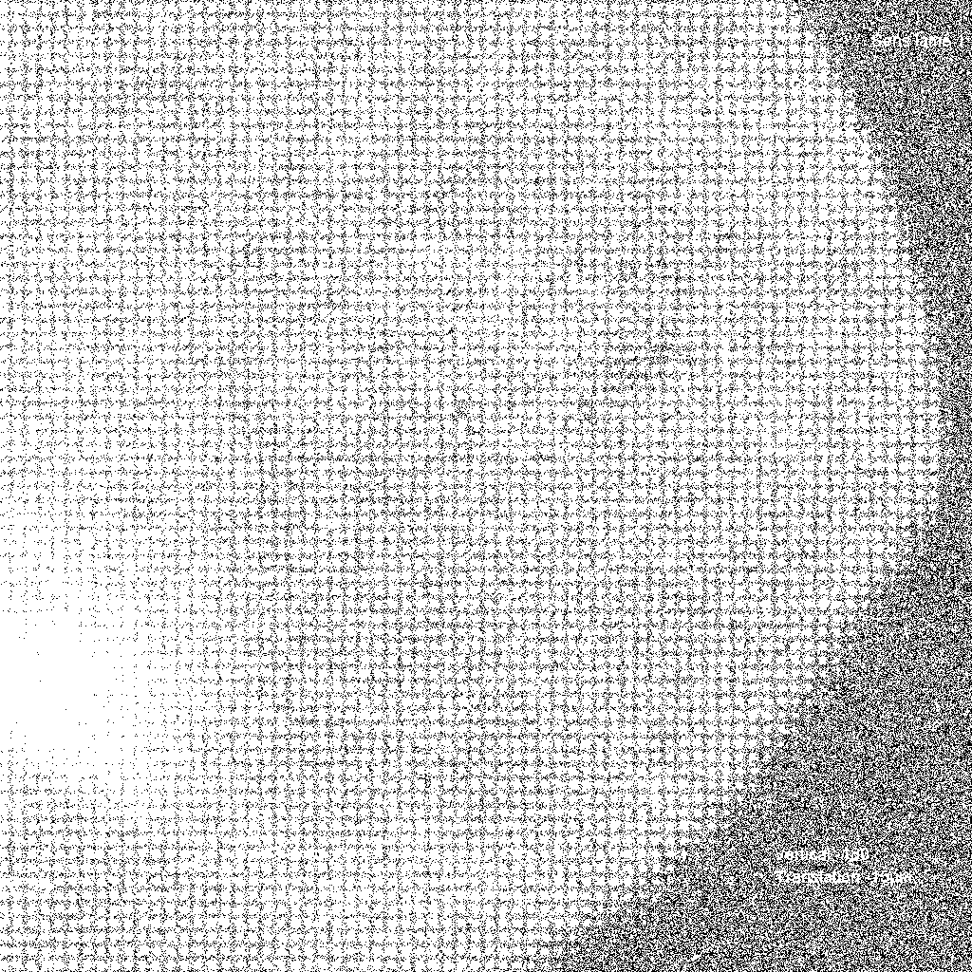

6
Experimental setup and results: LOA 2023 (2/3)
Not at the center (horizontal scan):
$${Φ_{Vortex XUV}≈3×Φ}_{XRL}$$
→ Partial seeding
Clear evolution
At the center (horizontal scan):
Follows the shape of the input harmonic

Slide 8
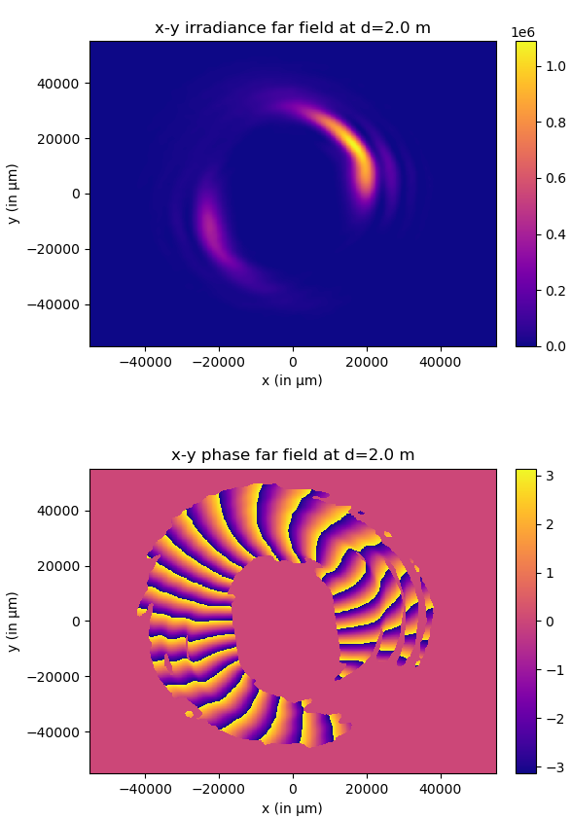
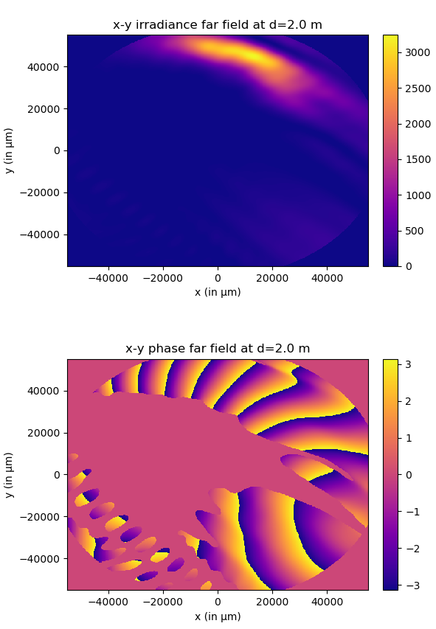
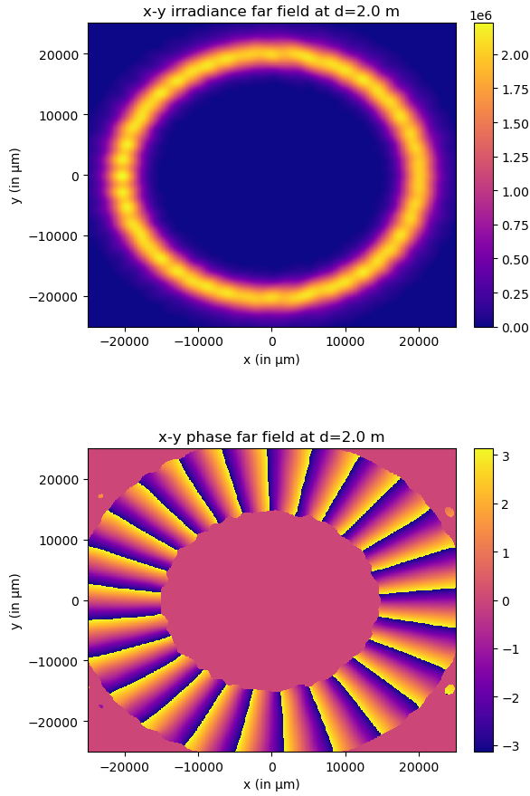
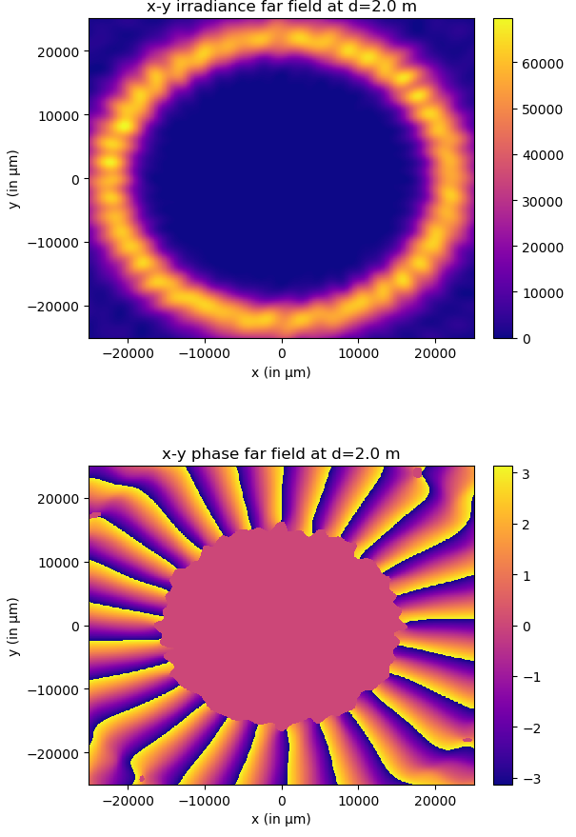
7
Experimental setup and results: LOA 2023 (3/3)
Is it consistent with theory?
→ DAGON^{[14]} code, collaboration with Eduardo Oliva Gonzalo, Universidad Politécnica de Madrid
Fig.11: left: perfect vortex before seeding, right: perfectly seeded vortex
Fig.12: left: realistic vortex before seeding, right: partially seeded realistic vortex
^{[14]} Eduardo Oliva, Manuel Cotelo, Juan Carlos Escudero, Agustín González-Fernández, Alberto Sanchís, Javier Vera, Sergio Vicéns, and Pedro Velarde "DAGON: a 3D Maxwell-Bloch code", Proc. SPIE 10243, X-ray Lasers and Coherent X-ray Sources: Development and Applications, 1024303 (16 June 2017);

Slide 9
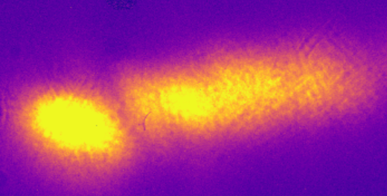
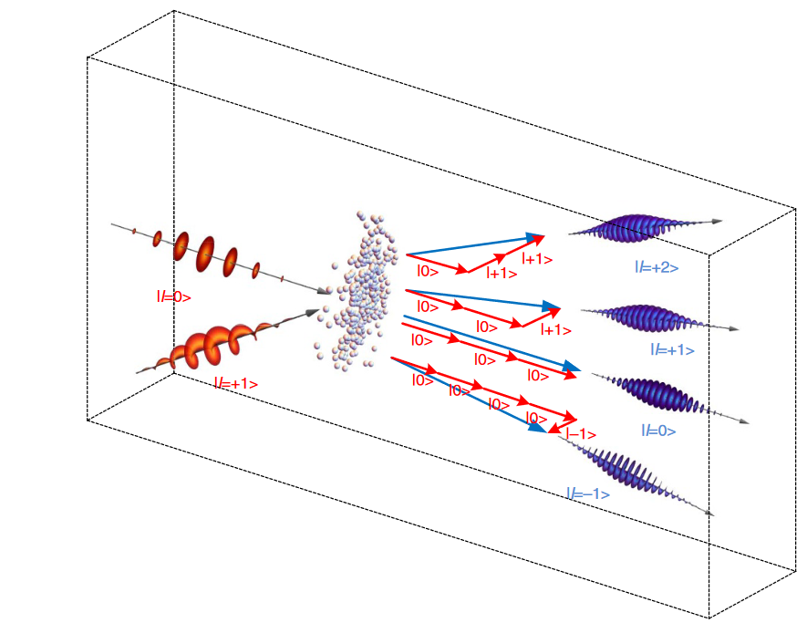
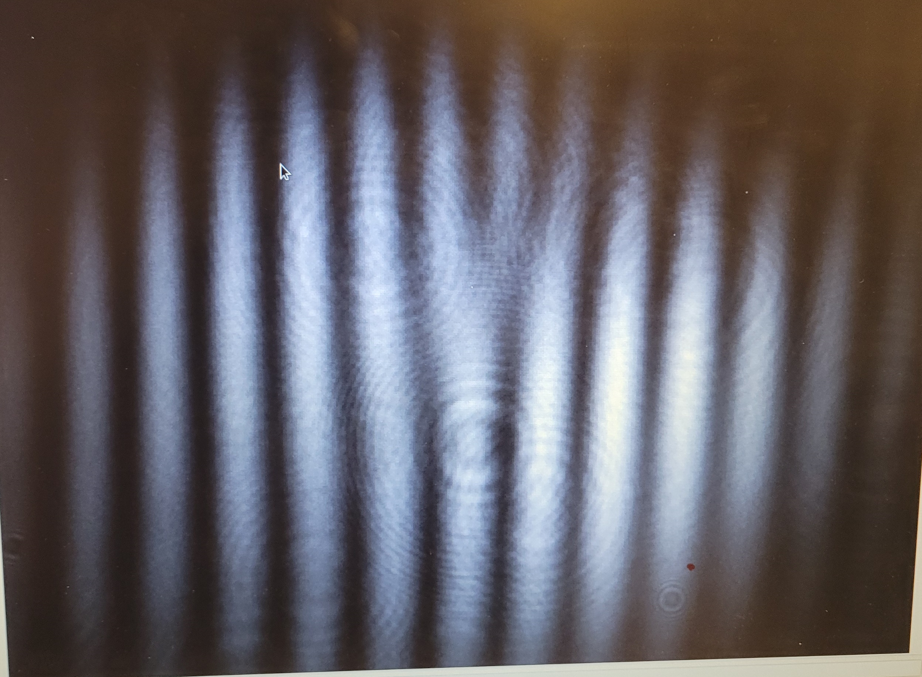
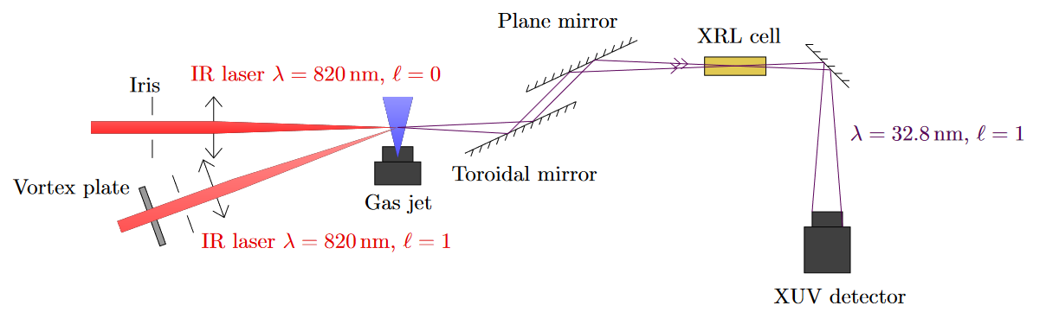



8
Experiments and simulations: LASERIX + LOA 2024 (1/2)
Idea: vortex divergence doesn’t depend on $q$ but on $\sqrt{ℓ}$ → we want $ℓ$=1 in the XUV
Solution: two non-colinear beams HHG:
Fig.14: Sketch of the setup used for the 2 beams HHG seeding at LOA
Fork pattern at the focus: diffraction grating
Signature of 2 beams HHG (studied on LASERIX)
$$ℓ=1$$
$$ℓ=0$$
Fig.13: Principle of the two non-colinear beams HHG ^{[15]}
$$ℓ=−1$$
^{[15]} Kong, F. et al (2017). Controlling the orbital angular momentum of high harmonic vortices. Nature Communications, 8(1). .

Slide 10
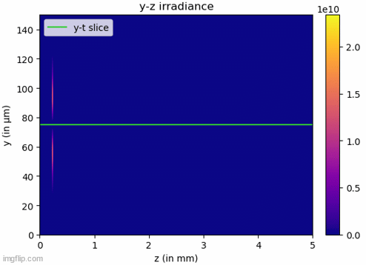
9
Experiments and simulations: LASERIX + LOA 2024 (2/2)
What is expected from this experiment?
We are working in a very specific regime: the harmonic is not amplified but triggers a wake ^{[16]} with Rabi’s oscillations ^{[17]}
^{[16}I. R. Al’miev et al. , “Dynamical Description of Transient X-Ray Lasers Seeded with High-Order Harmonic Radiation through Maxwell-Bloch Numerical Simulations”, Phys. Rev. Lett. 99, 123902 – Published 21 September, 2007
^{[17]} Olivier Larroche, Limin Meng, Andréa Le Marec, and Annie Klisnick, "Inversion density threshold for Rabi oscillations and modified small-signal gain in extreme-ultraviolet lasers," Opt. Lett. 38, 2505-2508 (2013)

Slide 11
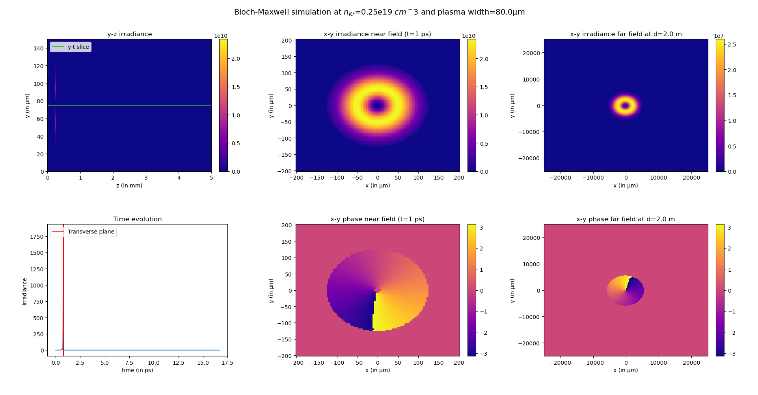
9
Experiments and simulations: LASERIX + LOA 2024 (2/2)
What is expected from this experiment?
We are working in a very specific regime: the harmonic is not amplified but triggers a wake ^{[16]} with Rabi’s oscillations ^{[17]}
Fig.15: Simulation of the seeding of a perfect vortex with $ℓ=1$ (before amplification)
^{[16}I. R. Al’miev et al. , “Dynamical Description of Transient X-Ray Lasers Seeded with High-Order Harmonic Radiation through Maxwell-Bloch Numerical Simulations”, Phys. Rev. Lett. 99, 123902 – Published 21 September, 2007
^{[17]} Olivier Larroche, Limin Meng, Andréa Le Marec, and Annie Klisnick, "Inversion density threshold for Rabi oscillations and modified small-signal gain in extreme-ultraviolet lasers," Opt. Lett. 38, 2505-2508 (2013)

Slide 12
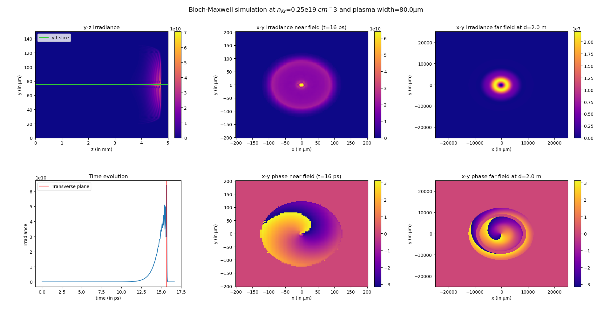
9
Experiments and simulations: LASERIX + LOA 2024 (2/2)
What is expected from this experiment?
We are working in a very specific regime: the harmonic is not amplified but triggers a wake ^{[16]} with Rabi’s oscillations ^{[17]}
Fig.16: Simulation of the seeding of a perfect vortex with $ℓ=1$ (after amplification)
^{[16}I. R. Al’miev et al. , “Dynamical Description of Transient X-Ray Lasers Seeded with High-Order Harmonic Radiation through Maxwell-Bloch Numerical Simulations”, Phys. Rev. Lett. 99, 123902 – Published 21 September, 2007
^{[17]} Olivier Larroche, Limin Meng, Andréa Le Marec, and Annie Klisnick, "Inversion density threshold for Rabi oscillations and modified small-signal gain in extreme-ultraviolet lasers," Opt. Lett. 38, 2505-2508 (2013)

Slide 13
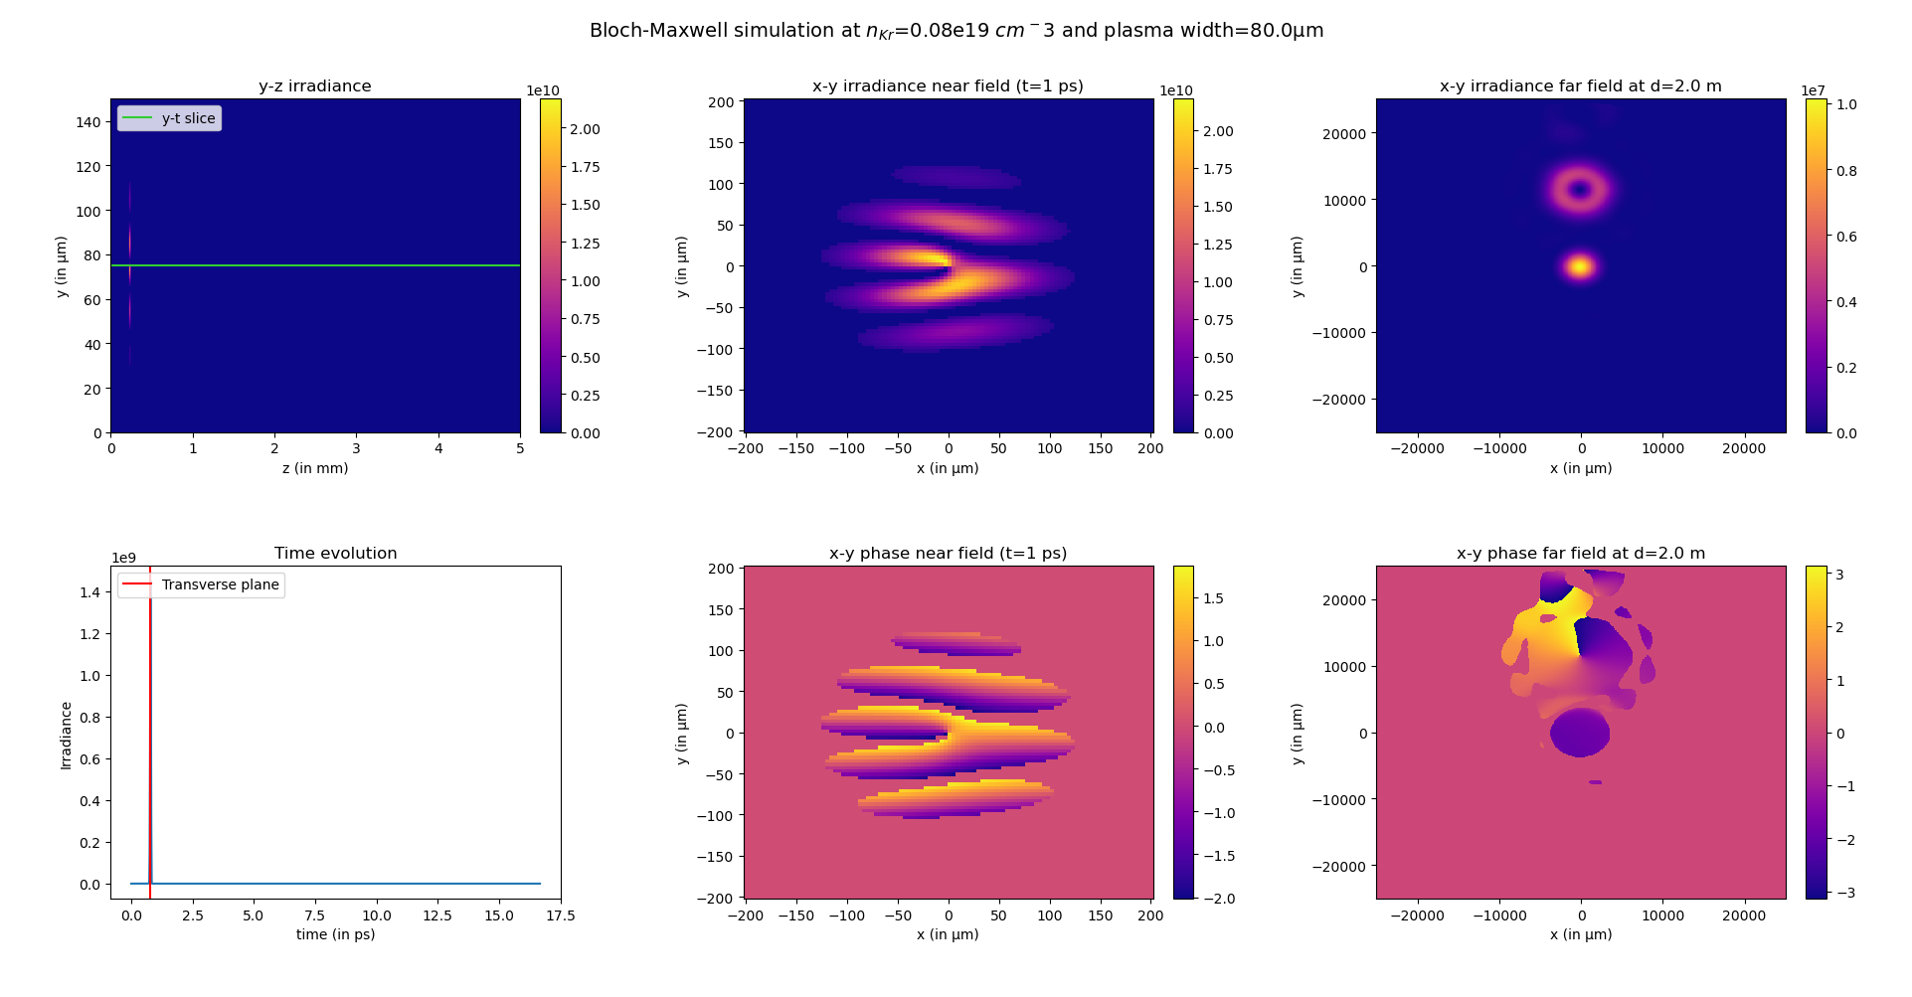
9
Experiments and simulations: LASERIX + LOA 2024 (2/2)
What is expected from this experiment?
We can also seed a more complex pattern:
Fig.17: Simulation of the seeding of a fork pattern (before amplification)

Slide 14
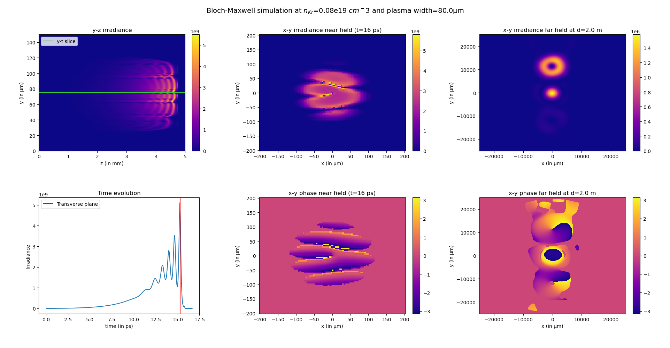
9
Experiments and simulations: LASERIX + LOA 2024 (2/2)
What is expected from this experiment?
We can also seed a more complex pattern:
Fig.18: Simulation of the seeding of a fork pattern (after amplification)

Slide 15
10
Summary and next steps
To summarise:
Only partial amplification achieved with a single focused driving beam, consistent with simulations ?????? À tester)
Set-up for 2-beams HHG built and tested extensively
Bloch-Maxwell simulations can be performed with any kind of input using homemade Python scripts
Seeding and amplification of structured beams are not trivial
To be done during this academic year:
Seeding with 2-beams HHG on LASERIX
Deeper investigation of pattern preservation by the XUV laser using DAGON

Slide 16
SUPPLEMENTARY MATERIALS

Slide 17

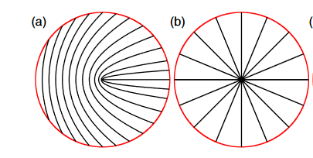


Other ways to generate IR optical vortices
Spiral Zone Plate: add OAM and focuses the beam at the same time using diffraction around the opaque zones. Diffracted light then interferes constructively at focus.
q-plate: for a circularly polarized beam, it applies an OAM of ℓ = 2q using the transfer of spin and OAM to matter in a both inhomogeneous and anistropic medium
Spiral Zone Plate pattern for $ℓ=1$^{[i]}
$q$-plates for (a): $q=\frac{1}{2}$ and (b): $q=1$^{[ii]}
^{[i]} N. R. Heckenberg et al. “Generation of optical phase singularities by computer-generated holograms”. In: Opt.Lett. 17.3 (Feb. 1992), pp. 221–223. abstract.cfm?URI=ol-17-3-221.
^{[ii]} L. Marrucci, C. Manzo, and D. Paparo. “Optical Spin-to-Orbital Angular Momentum Conversion in Inhomogeneous Anisotropic Media”. In: Phys. Rev. Lett. 96 (16 Apr. 2006), p. 163905.

Slide 18
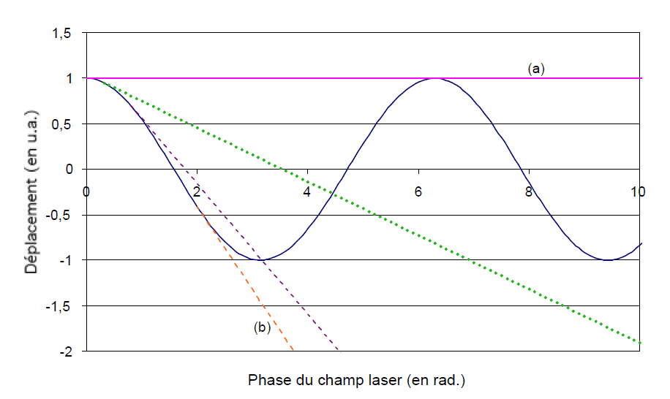
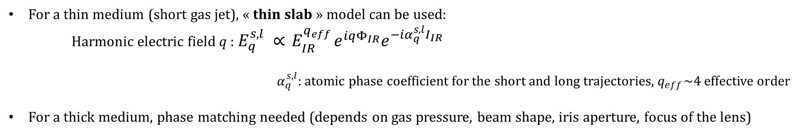

More information about High Harmonic Generation
Typical HHG spectrum ^{[iii]}
For each harmonic, 2 different trajectories (short & long):
Long
Ionisation potential
Short
Cut-off: ordre harmonique maximal $q_{max}=\left(I_{p}+3.17U_{p}\right)/ℏω$
Ponderomotive potential $∝Iλ²$
Electronic trajectories at different ionisation times regarding the laser oscillation ^{[iv]}
For a thin medium (short gas jet), « thin slab » model can be used:
Harmonic electric field $q$ : $E_{q}^{s,l} ∝{ E}_{IR}^{q_{eff}}e^{iqΦ_{IR}}e^{−iα_{q}^{s,l}I_{IR}}$
$α_{q}^{s,l}$: atomic phase coefficient for the short and long trajectories, $q_{eff}\sim 4$ effective order
For a thick medium, phase matching needed (depends on gas pressure, beam shape, iris aperture, focus of the lens)
^{[iii]} Carsten Winterfeldt, Christian Spielmann, and Gustav Gerber. “Colloquium: Optimal control of high-harmonic generation”. In: Rev. Mod. Phys. 80 (1 Jan. 2008), pp. 117–140.
^{[iv]} Sophie Kazamias-Moucan. Optimisation d'une source d'harmoniques d'ordres élevés pour l'optique non-linéaire dans l'extrême UV. Physique Atomique [physics.atom-ph]. Ecole Polytechnique X, 2003. Français. ⟨NNT : ⟩. ⟨tel-00008285⟩

Slide 19
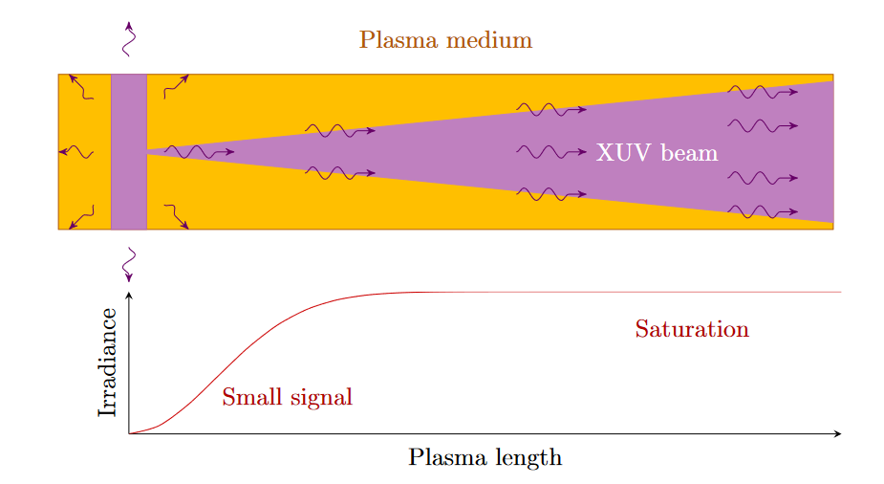
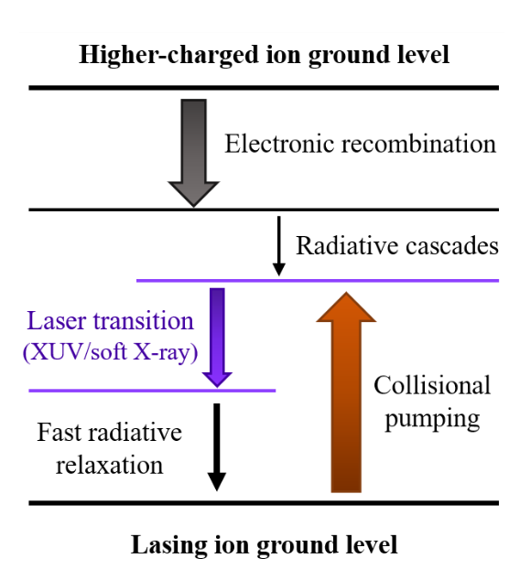
Basic understanding of plasma-based XUV lasers
Idea: creating a plasma so that its electron will pump a transition in the XUV range (collisional XUV laser)
Sketch of the pumped XUV lasing transition in the collisional scheme
XUV low reflectivity and very short gain duration → no-cavity laser
Principle of the Amplified Spontaneous Emission (ASE)
Spontaneous emission amplified by stimulated emission until saturation after a few mm of plasma
→ Poor spatial coherence (poor beam quality)

Slide 20






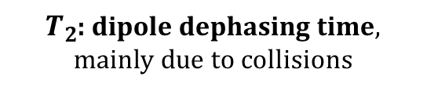

DAGON: a 3D Maxwell-Bloch code
$P$: polarisation
$\frac{∂P}{∂t}=−\frac{P}{T_{2}}−iωDE+Γ$
$\frac{∂D}{∂t}=−\frac{D−D_{0}}{T_{1}}−\frac{d^{2}}{ℏ^{2}ω}Re\left(iPE^{∗}\right)$
$\frac{∂E}{∂t}+c\frac{∂E}{∂z}=i\frac{c²}{2ω}∇_{⊥}E+\frac{iω}{2}\left(μ_{0}c^{2}P−{\left(\frac{ω_{p}}{ω}\right)}^{2}E\right)$
$Γ$: spontaneous emission
$T_{2}$: dipole dephasing time, mainly due to collisions
+ atomic physics data
+ collisional radiative data with OfiKinRad or EHYBRID codes (plasma density and temperature, temporal gain profile, population rates etc…)
$D$: population inversion density
$T_{1}$: population recovering time
$ω_{p}$: plasma frequency

Slide 21
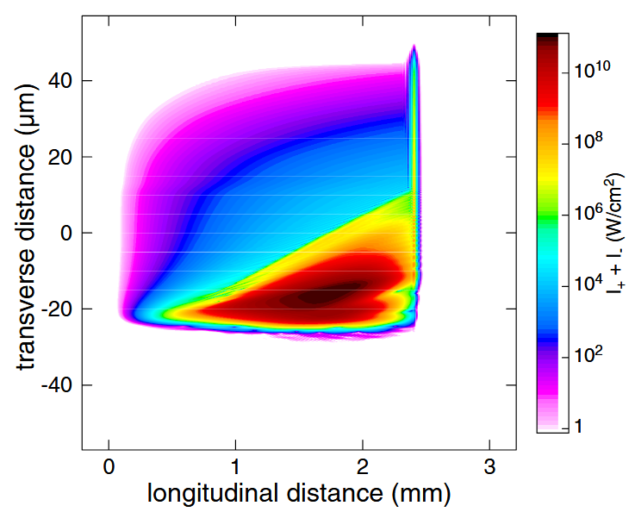
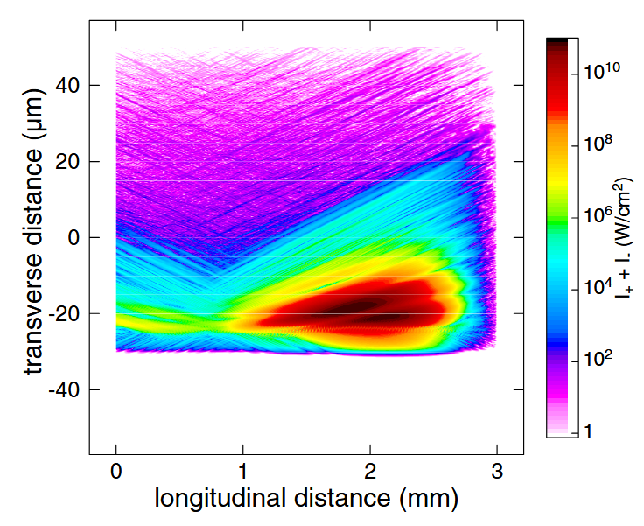
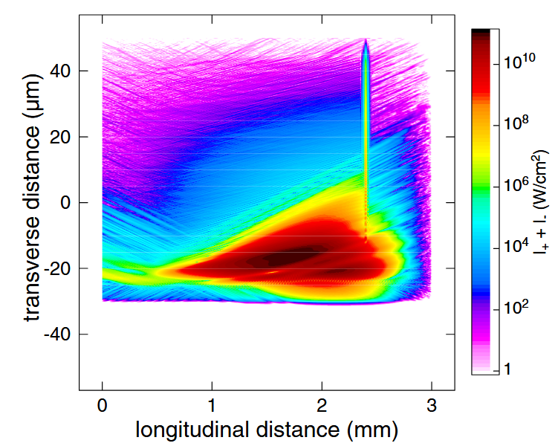
Rabi’s oscillations in the non-adiabatic regime
We are working in a very specific regime: the harmonic is not amplified but triggers a wake ^{[v]} with Rabi’s oscillations ^{[vi]}
This the non-adiabatic regime^{[vi]} : the population inversion is not reduced immediately when the electric field is applied.
Condition to be in this regime:
$$Ω_{O}≥\frac{1}{T_{2}}$$
Dipole dephasing time
(from Maxwell-Bloch simulations)
Asymptotic Rabi’s frequency
(for a fully-inverted population)
2D map of local XRL intensity^{[v]} : (a) with a seed but no ASE, (b) with ASE but no seed, (c) with both ASE and seed
(a)
(b)
(c)
^{[v}I. R. Al’miev et al. , “Dynamical Description of Transient X-Ray Lasers Seeded with High-Order Harmonic Radiation through Maxwell-Bloch Numerical Simulations”, Phys. Rev. Lett. 99, 123902 – Published 21 September, 2007
^{[vi]} Olivier Larroche, Limin Meng, Andréa Le Marec, and Annie Klisnick, "Inversion density threshold for Rabi oscillations and modified small-signal gain in extreme-ultraviolet lasers," Opt. Lett. 38, 2505-2508 (2013)

