Slide 1
CERN: 50 Years of CERN Colliders
One slide per minute and one minute per year!
ISR (10 slides)
SPP̅S (4 slides)
LEP/LEP2 (10 slides)
LEP2 (12 slides)
LHC and Higgs (15 slides)
LEP2 and Higgs: What might have been! (2 Slides)
https://link.aps.org/doi/10.1103/PhysRevAccelBeams.23.124802 DOI: 10.1103/PhysRevAccelBeams.23.124802
Notes:
AKA: “Missed the J/ψ , but got the Z, W, and the Higgs”

Slide 2
The CERN Intersecting Storage Rings (ISR)
The first ever hadron collider
  Accumulated and Collided huge currents (57 Amps per beam!) of enormous dimensions (more than 80mm cross section)
  Unbunched beams with 3% momentum spread
  Aperture > 4% Δp/p
Enormous impact on Accelerator Physics but sadly little effect on particle physics.
? Diagnostics?

Slide 3
ISR Brief History
1956, studies for the second generation of CERN accelerators converged towards a proton–proton collider.
From 1961 onwards, a study of a 300 GeV proton synchrotron (SPS) was carried out. Decision to construct the ISR first.
Approval of the construction of ISR in June 1965,
December 1965, construction budget of 332 million CHF (1965 value) and ﬁrst operation foreseen for mid-1971.
First beams in 1971 and operation for physics from 1971 to 1983.

Slide 4
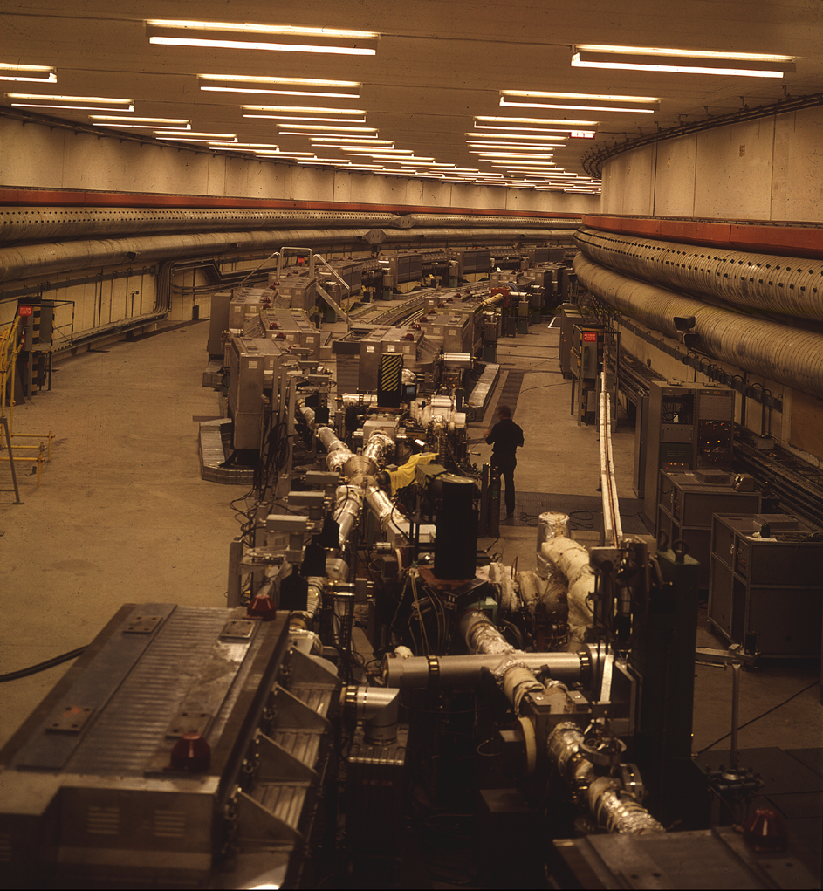
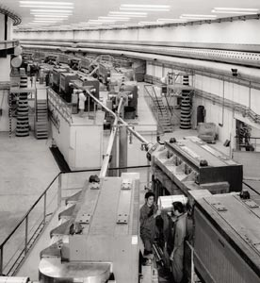
Crossing angle 14.8 deg.
IP5 (no experiment)
Notes:
4
The ISR consisted of two independent storage rings intersecting at eight points with a crossing angle of 14.8 degrees (The circumference of the rings was 943 metres (1.5 times that of the CERN Proton Synchrotron).

Slide 5
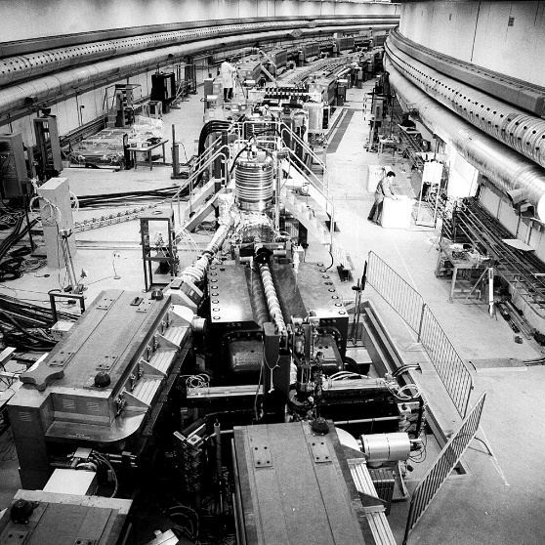
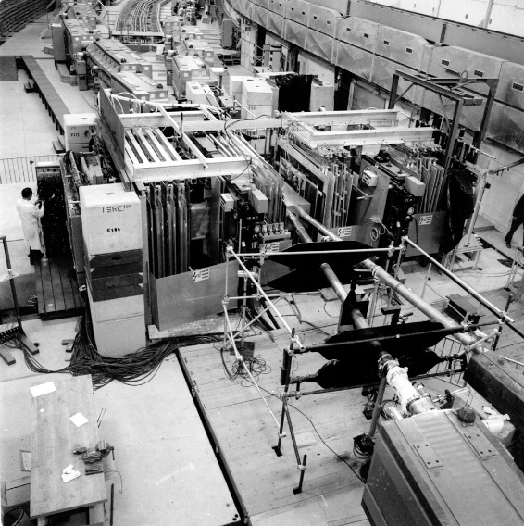
IP1 (left) and IP8

Slide 6
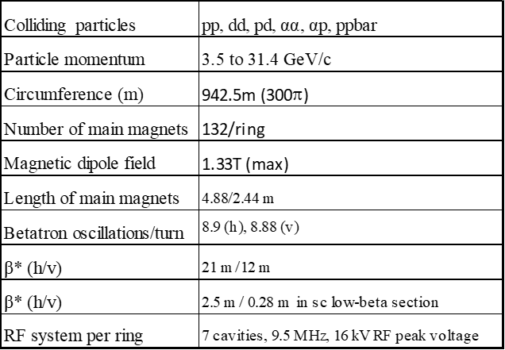
Basic ISR Parameters

Slide 7
Storage Ring
The ISR was a “storage” ring.
Batches (around 200 in total) of 20 bunches from PS, accelerated them to the storage orbit and then “debunched”, by switching off the RF. (Stacking)
Stored beam was debunched (coasting). None of the normal EM beam diagnostics devices could work!
Until the development of Schotty scan, the only two device allowed operators to “see” the coasting beam:
  Gas curtain.
  Beam current transformer

Slide 8
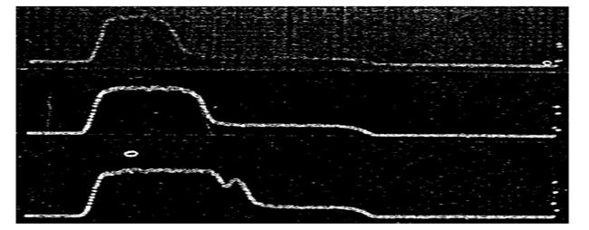
Most Important Discovery (Legacy) Schottky Scans
The three scans were taken at beam currents of 10, 15 and 19.2 amperes. The horizontal axis is the longitudinal frequency and allows evaluation of the beam Δp/p.
Notes:
Schottky noise results from discrete nature of the particles in the beam.
A longitudinal pick-up and some signal averaging, produces a longitudinal Schottky scan.
Figure shows one of the first Schottky scans. Following these longitudinal scans, new pickups allowed us to measure transverse scans (tune values).
Schottky scans completely transformed the way of operating the ISR.
Any “markers” on the longitudinal and transverse scans could be correlated to measure a tune value. The most usual markers for some time were the edges of the stack.

Slide 9
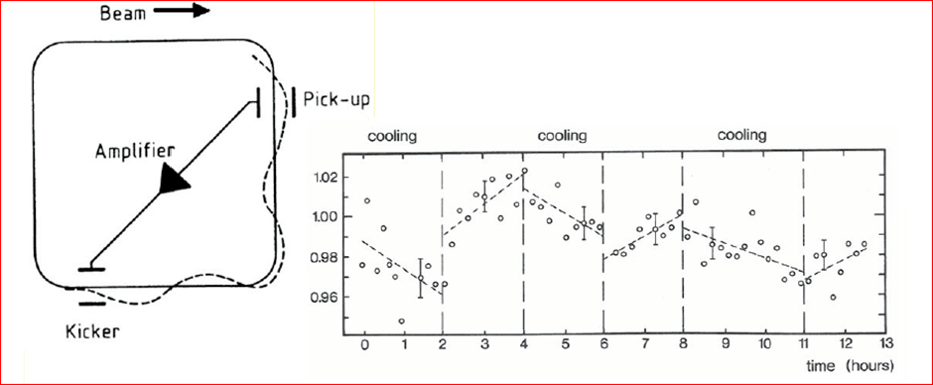
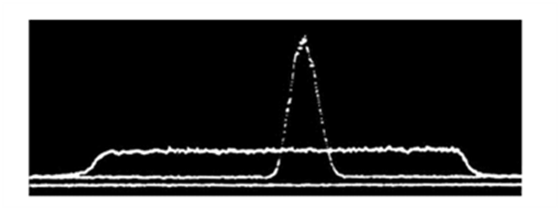
First Demonstration of Stochastic Cooling (ISR)
Vertical beam size (from Luminosity) with and without cooling
(Schnell, Huebner et al.)
Distribution of protons as function of momentum before and after cooling in ICE
Very soon afterwards a similar system was designed for the Initial Cooling Experiment (ICE) with spectacular results as shown
Notes:
The observations of the stochastic signals in the ISR (Schottky scans) immediately turned attention to the possibility of damping the oscillations of the particles (stochastic cooling). Significant effort in this direction was led by Wolfgang Schnell following the initial idea by Simon Van Der Meer. A stochastic cooling test system was built by Wolfgang Schnell’s team as a demonstrator. The most sensitive detection of transverse beam size in the ISR was through the luminosity measurement. This iconic experiment was proposed and coordinated by Kurt Hubner.
The effect is small but highly significant: stochastic cooling worked! Very soon afterwards a similar system was designed for the Initial Cooling Experiment (ICE) with spectacular results as shown in the lower Figure.

Slide 10
Technical Legacy of the ISR
    (Stacking of protons)
    Ultra-high vacuum (clearing electrodes, electron cloud) LHC
    High precision power supplies LHC
    Low impedance machine SPP̅S + LEP + LHC
    Beam beam; pulsed beam-beam “overlap knock-out” ? LHC (ions) + RHIC
    (Space charge compensation)
    Collimation LHC + …
    Luminosity scans (van der Meer scans) LHC + SPP̅S
    (Phase displacement acceleration)
    Schotty noise and scans SPP̅S +…
    Stochastic cooling SPP̅S + ?LHC
    Low beta insertions …LEP SPP̅S LHC
    Proton-antiproton collisions SPP̅S
    (Stacking and phase displacement of deuterons,...)
Notes:
The ISR was not a discovery collider, but it is recognised as one of the most pioneering accelerator projects ever undertaken. Since it was the first pp collider, it allowed answers to a multitude of long-standing questions and development of exciting new ideas for the future of particle colliders. It was also a fantastic training ground for accelerator physicists,

Slide 11
SPP̅S

Slide 12
Conversion of the SPS to the SPP̅S (1)
The SPS was built as a Proton Synchrotron, not as a collider.
Conversion required upgrades:
  A beam line to transfer the antiprotons from the PS to the SPS, and an injection system for the SPS.
  The existing proton transfer line, and injection system was upgraded to 26 GeV/c.
  For lifetime of stored beams, the vacuum pressure was improved by two orders of magnitude
  For increased luminosity, low-beta insertions were installed for the two (UA2 and UA1) experiments

Slide 13
Conversion of the SPS to the SPP̅S (2)
Many beam diagnostics upgrades
Electro-static deflectors were installed to separate the beams, in 9 of the 12 crossing points,
The RF system had to be upgraded with reduced “RF noise” to increase bunched beam lifetime
New transfer lines to and from the AA and from the PS to the SPS (TT70) were installed.

Slide 14
Physics at the SPP̅S
First proton–antiproton collisions (summer 1981).
First physics run at the end of that year (0.2 nb−¹ )
Initially luminosity was low, but high enough (1982,1983) to measure the W and Z .
In 1984, Carlo Rubbia and Simon van der Meer shared the Nobel Prize.
Performance increased dramatically following the inclusion of the Anti-proton Collector (AC).
Beam energy raised to 315 GeV from 1987 to 1991 when the programme was terminated.
The SPP̅S was a hugely ambitious and successful project for CERN.

Slide 15
Legacy of the SPP̅S (4)
Removed all doubt about worries related to bunched proton colliders. (“RF noise”)
SPP̅S operation, used a “Pretzel” shape. LEP later profited from a similar system.
Civil-engineering experience gained with the digging of the large caverns for UA1 and UA2, was extremely useful for the civil engineering of LEP and later the experimental areas of the LHC.

Slide 16
LEP/LEP2

Slide 17
History of LEP/LEP2 with Beam
Approval 30 October 1981
Tunnelling started 1985
1988: July 12: Octant test
1989:
    July 14, First turn
    August 13, First Collisions
    Sept 20-- Nov 5 Physics
1990--1994: Z physics
1995: Z + 65 & 70 GeV
1996: 80.5--86 GeV
1997: 91--92 GeV
1998: 94.5 GeV
1999: 96--102 GeV
2000: 102--104.4 GeV

Slide 18
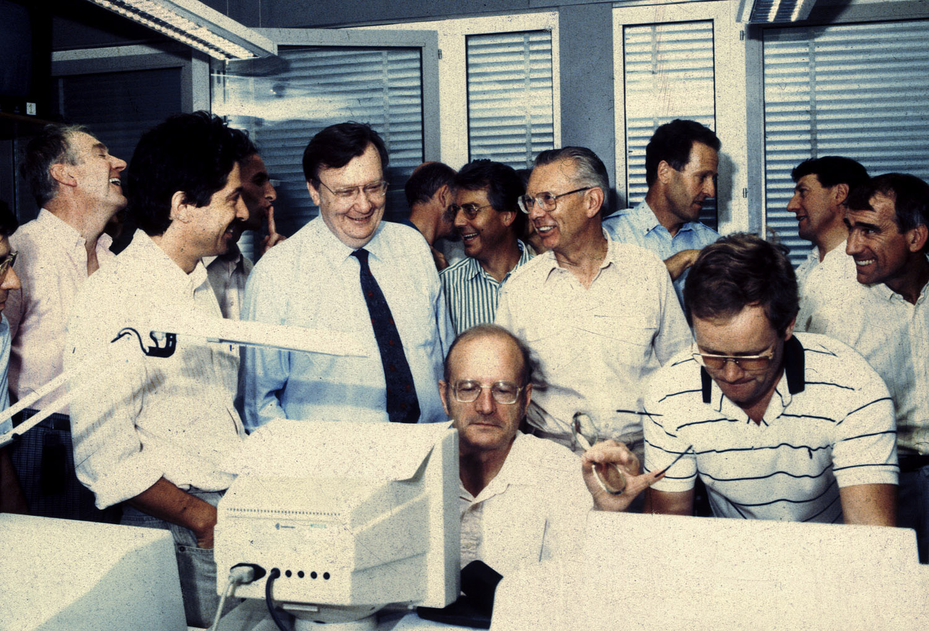
1989 Start-Up of LEP

Slide 19
Modes of Operation
Notes:
Almost every year used a different configuration (optics, bunch number, energy, ).

Slide 20
Summary of LEP Performance

Slide 21
Pretzel Scheme

Slide 22
Bunch Trains Scheme

Slide 23
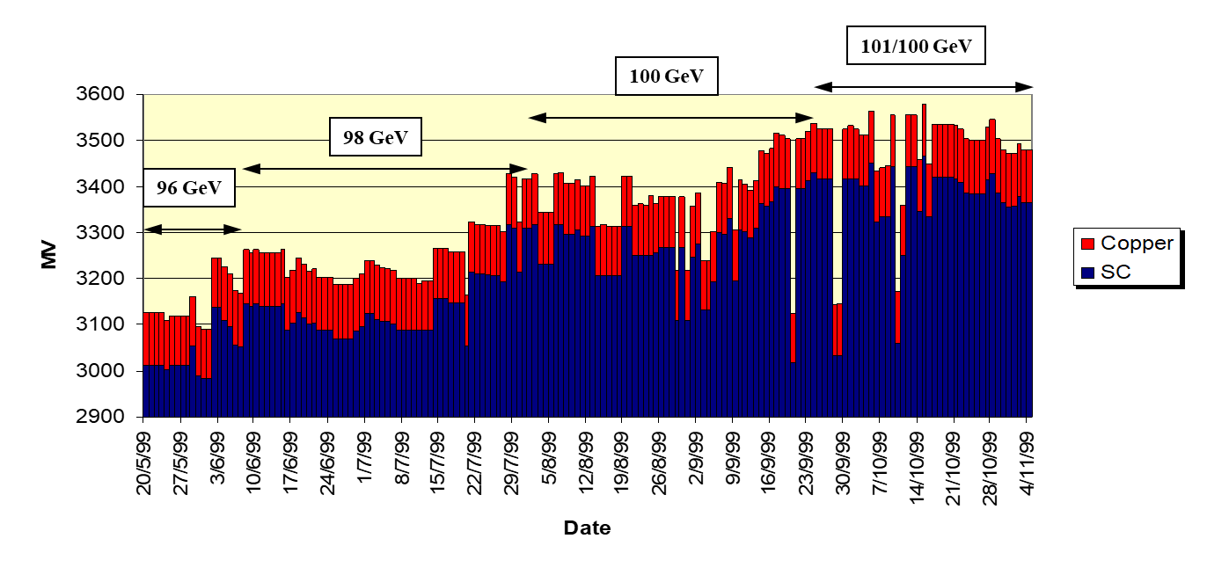
Pushing for Maximum Energy (1999)
Strategy to maximise physics time:
  Run at an energy where we have some RF margin
  Increase the RF voltage gradually
  When stable at sufficient voltage, increase the energy
  Repeat as many times as possible...

Slide 24
LEP Performance (1993-2000)

Slide 25
Higgs search at LEP2 (2000)
14th June 2000: “First” H candidate event 206.7 GeV (ALEPH)
  Reconstructed Higgs mass 114.3 GeV/c2
20th July: LEP Committee
  ALEPH presented excess at high masses
31st July & 21st Aug: events 2 & 3 for ALEPH
  Things were heating up!
5th September: LEP Committee
  Excess only in ALEPH, only 4 jets
September 14th: Research board:
  ONE MONTH run extension GRANTED (LHC startup)
Notes:
2000 was a difficult year at CERN. Competition between continued running of LEP2 and needed transfer of resources for construction and testing of the LHC.

Slide 26
Higgs Search in LEP2 (2000)
October 10^{th:} LEPC: Update of the results
  The signal excess “grew” to 2.6σ
16th October: Missing energy candidate from L3...
November 2nd: scheduled end of LEP operations (following the approved one-month extension)
November 3rd, LEPC: The new data confirms the excess again. The significance grew to 2.9σ
LEP additional running in 2001 was requested: Many concerns on the impact on the LHC schedule (competition from FNAL)
November 3rd LEPC - closed session:
  No recommendation
November 7th: Research board
  No recommendation (vote split 8 - 8)
November 8th DG decision (LM):
“LEP has closed for the last time:”

Slide 27
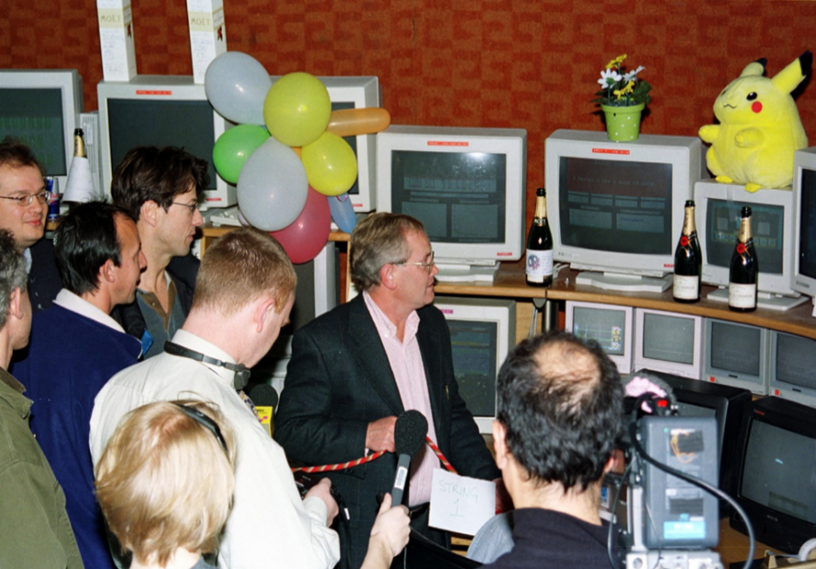
LEP Closure in 2000
In the photo:
Roger Bailey (recently deceased),
Ralph Assmann,
Paul Collier,
Mike Lamont (Presently Director of accelerators…),
Steve Myers
Andy Butterworth

Slide 28
NOT A POPULAR DECISION!
BUT history has shown it to be the right one!
(We now know that the Higgs mass is NOT 114.3 GeV/c2)
However! See the last 2 slides
As a reminder, from 1995 to 2000, CERN was really over-extended
Designing the LHC,
Prototyping the LHC components (SC magnets, cryo etc…)
Operating LEP,
Constructing LEP2 components; superconducting cavities, cryo systems
operating LEP2.
The decision to close LEP allowed massive redeployment of skilled and experienced CERN staff from LEP2 to the LHC design. With this new focus, the design of the LHC gathered increased momentum

Slide 29
LHC and Higgs

Slide 30
“The Long and Winding Road” that led the LHC to Discover the Higgs Boson
Summary and Preview
First LHC performance estimate: LEP Note 440 (April 1983, 41 years ago)
At the time, strong Competition from the US: SSC
SSC: Rise and Fall (1983—1993)
2001 LEP closure and dismanteling: LHC accelerated Preparation
2007 CNGS R2E (Radiation to Electronics), serious LHC implications
September 10, 2008: First LHC Circulating Beam: Success and euphoria.
9 Days later: Accident: disbelief and despair.
2009: Repair and Recovery.
Important decision on Initial LHC Collision Energy:
Beam Operation (2009-2011)
Preparation for 2012
July 4, 2012 Discovery of Higgs (29 years after LEP Note 440)
Notes:
2008 and 2009 were hectic years at CERN. Difficult to summarize in a few slides.

Slide 31
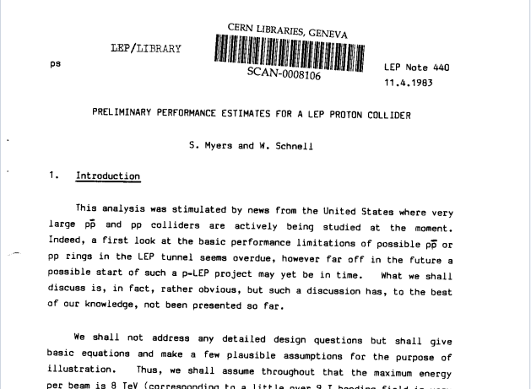
April 1983: First Performance Estimates of the LHC (Myers/Schnell)
This analysis was stimulated by news from the United States where very large ppbar and pp colliders are actively being studied at the moment. Indeed, a first look at the basic performance limitations of possible pp or ppbar rings in the LEP tunnel seems overdue, however far off in the future a possible start of such a p-LEP project may yet be in time. What we shall discuss is, in fact, rather obvious, but such a discussion has, to the best of our knowledge, not been presented so far.
Followed by LEP Notes 450,460,470
Notes:
In the early 1980s, there was a small team at CERN working on the design of the large electron positron collider LEP. In the US there were ongoing design studies for a very large proton collider. This provoked us to ask ourselves: what could be the performance of a proton collider in the 27 km LEP tunnel? I showed some first calculations to my boss Wolfgang Schnell who then made additional valuable contributions. We then decided to publish as a LEP note. Three additional LEP notes quickly followed.

Slide 32
Summary of the Demise of the SSC (1993) and subsequent Approval of the LHC (1994)
SSC project endorsed in 1983 estimated budget $2.8bn
DOE review 1986: estimated budget $3.01bn
1987 Congress informed of budget escalation to $4.4bn
November 1988; State of Texas offer $1bn of funding (Bush)
DOE Review (after site selection), 1990: official budget $8.7b
October 1993 budget estimates escalate to $12bn. US Congress cancel the project after $2bn had already been spent.
The demise of the SSC opened the door to the LHC:
CERN council approved the LHC in December 1994
Notes:
George H. W. Bush (the father) elected US president in 1988 (served 1989-1983, then Clinton). Texas supported the SSC.

Slide 33
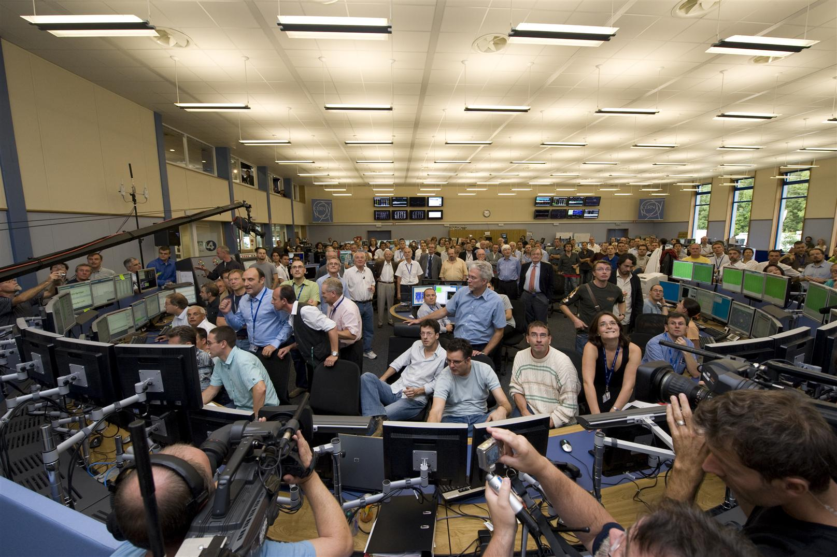
(14 years later) On September 10, 2008; It worked!

Slide 34
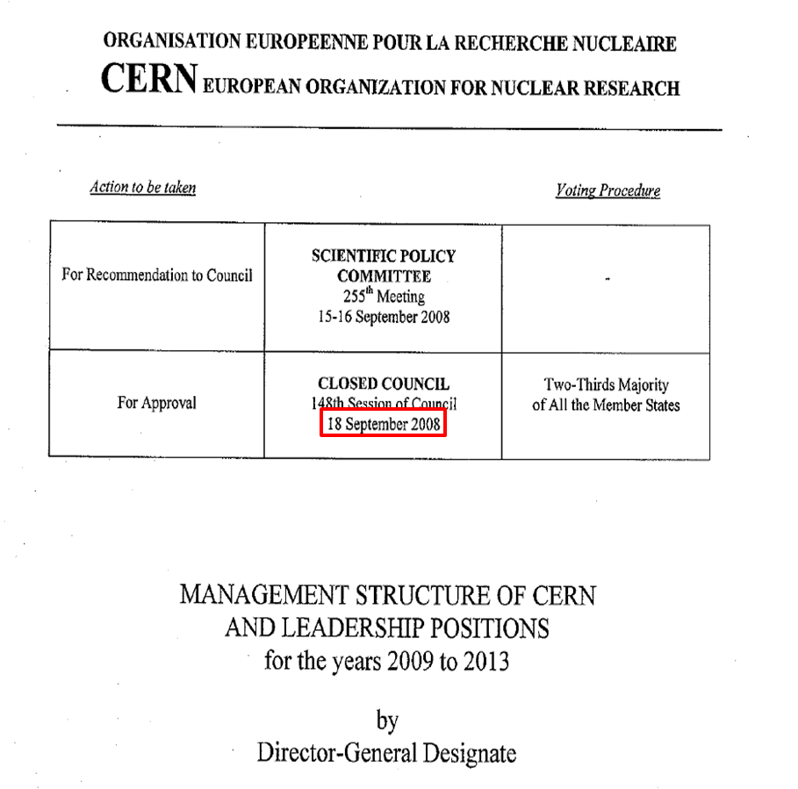
A further 8 days later
September 18: S.Myers appointed Director for Accelerators and Technology with Special responsibilities for the LHC
Rolf Heuer
Notes:
CERN Council approves my nomination as Director of Accelerators and Technology

Slide 35
LHC imploded + exploded
The following day September 19, 2008
  Making the last step of dipole circuit in sector 34, to 9.3kA
  At 8.7kA, Electrical arc developed which punctured the helium enclosure
One inter-magnet connector (out of 100,000) was «badly» soldered and…
The magnet protection system did not protect
Notes:
35

Slide 36
Following the glory of the LHC start-up, immediately followed by this serious failure.
Why was CERN not Crucified by the media ?
4 days before the LHC accident.
On September 15, 2008; Lehman Brothers declared bankruptcy (640B$US).
The press had bigger gooses to cook, fortunately for CERN.

Slide 37
June 2009; “Safe” LHC Energy
During the sector 3-4 repair and technical investigation, studies and tests uncovered a new second problem with the process of soldering in the high-current splices. The soldering process could cause a discontinuity in the busbars and produce “voids” which would prevent contact between the superconducting cable and the copper:
In event of a magnet quench, this could provoke thermal runaway: an accident similar to the previous one.
CERN could not tolerate (survive) a repeat accident
There was not enough time to do a complete repair!
Only possible mitigation: operate at reduced collision energy.
What is the maximum SAFE energy for LHC operation?

Slide 38
Such a Difficult Decision could and should only be based on Measurements and Simulations (August 2009)
Highest measured value of (R_{long}) in 5 sectors at 300K was 53μΩ.
To Operate at 7TeV cm
  Simulations show that resistances of ≤120μΩ were safe from thermal runaway under conservative assumed conditions (i.e. >x2 safety margin)
To Operate at 10TeV cm
  Simulations show that resistances of ≤67μΩ were safe from thermal runaway. (i.e. only a 25% safety margin)
Decision: Operation initially at 7 TeV cm
  During Operation
  monitor carefully all quenches to gain additional information.
  Continue simulations and validation of simulations by experimentation.
Then when considered safe: operate at around 8TeV cm.
Dilemma: Was 7 or 8 TeV cm enough energy to discover the Higgs?
Notes:
Because of the gravity of the situation we made the decision to operate in 2010 at 7TeV cm

Slide 39
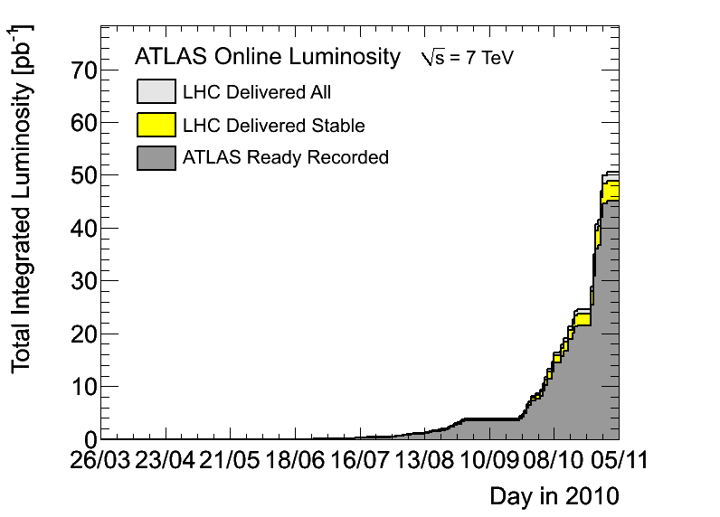
Integrated Luminosity in 2010
45pb-1 recorded

Slide 40
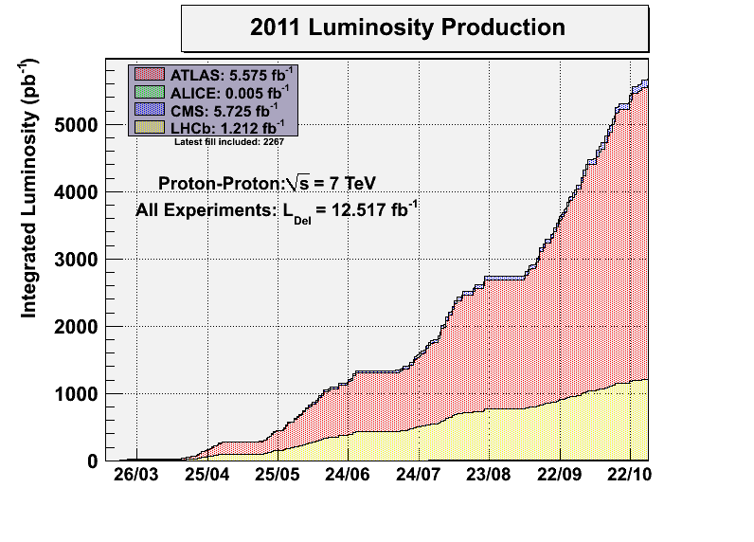
~ 6000 pb-1
Goal 2011
These results were used to predict the integrated luminosity in 2012

Slide 41
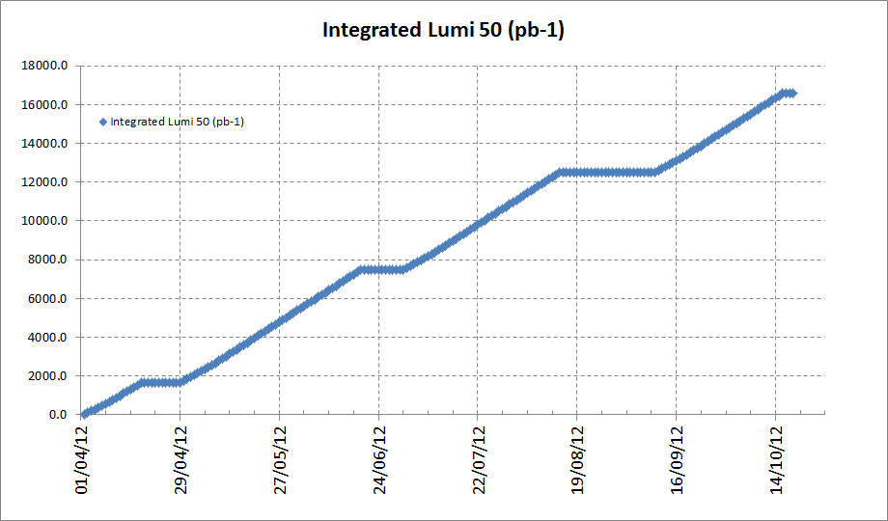
2012 Predicted Integrated Luminosity
Presented to CMS/Atlas on 21/22 Nov. 2011)
Predicted Integrated Luminosity needed to discover 5σ Higgs
E= 4TeV
Beta* = 0.7m
148 days of physics

Slide 42
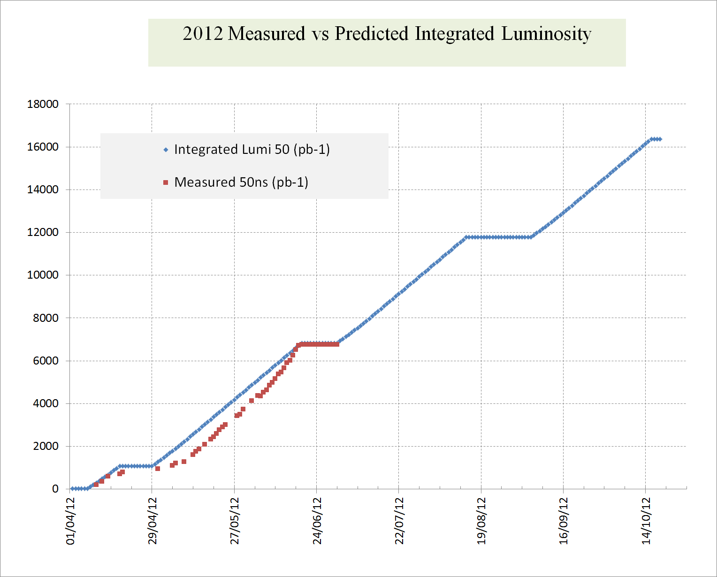
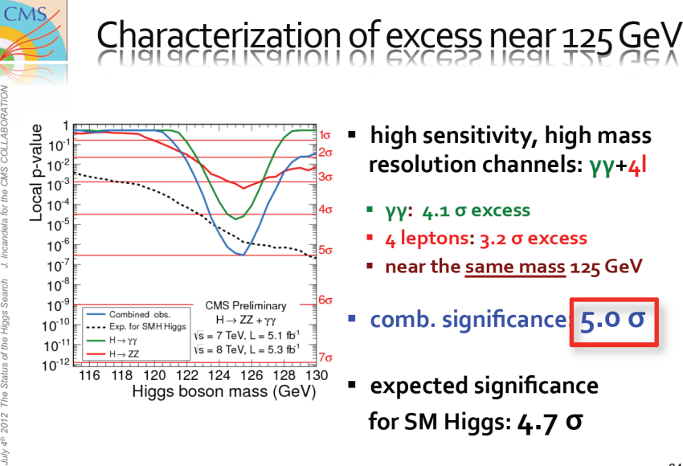
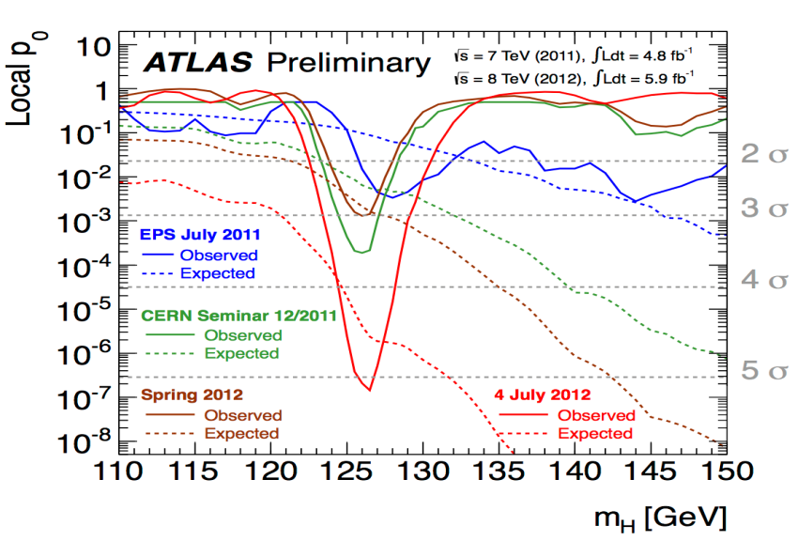
2012 Higgs
4th July: Melbourne

Slide 43
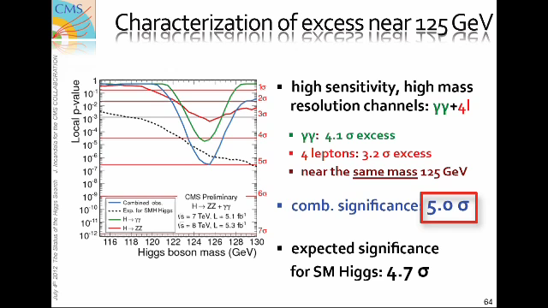
Seminar on Discovery of Higgs’ Boson (4th July 2012)
Notes:
Joe Incandela

Slide 44
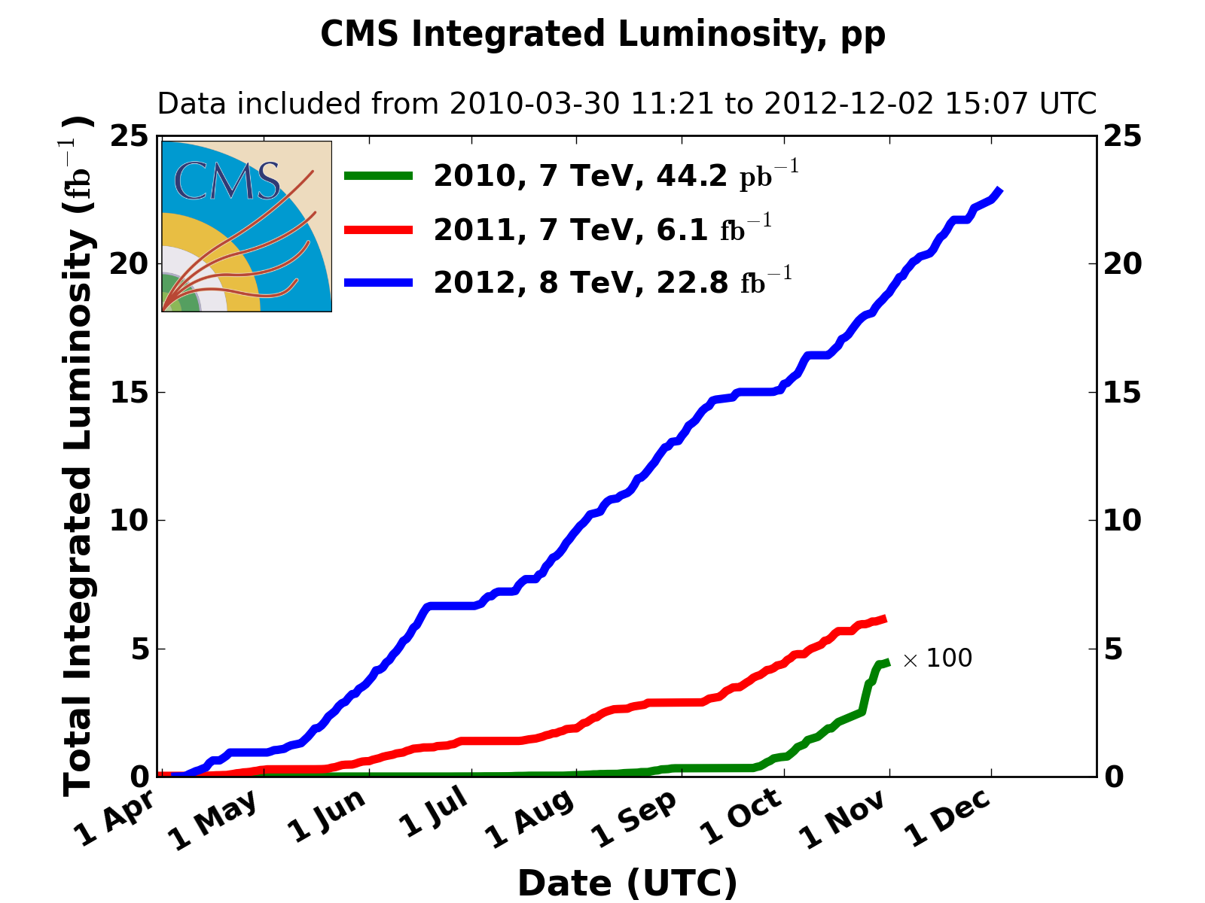
Integrated Luminosity 2010, 2011, 2012
23000
6000
44

Slide 45
Higgs and LEP2: What might have been!
LEP started operation in 1989 and continued during 1990.
In September 1990, the CERN LEP experiments committee (LEPC) organised a meeting in Cogne, Italy to review the future of the collider
Following agreement with the LEPC, I prepared slides showing projected beam energy as a function of the number of installed superconducting (sc) cavities.
The maximum number of sc cavities, was 384 which completely filled all possible spaces around LEP.
When I reached the slide with 288 sc cavities, the DG ordered me to stop, as “there was no mandate for this presentation”.
It was another 5 years before the subject of filling LEP with sc cavities was ever openly discussed. In 1995 a workshop on Physics at LEP2 was organised by Altarelli, Sjostran and Zwirner. Once again, we presented the same options for filling LEP2 with sc cavities and wrote in the paper:

Slide 46
Higgs and LEP2: What might have been!
“By removing all the Cu cavities and making the layout of Points 2 and 6 identical to that of Points 4 and 8, a total of 384 sc cavities could be installed in LEP, …
The following year 1996, the decision was made to discontinue the industrial production of the sc cavities. (288 cavities total)
Knowing now, what we did not know then, is that with 384 sc cavities LEP2+ could have reached around 223 GeV in the centre of mass and possibly discovered the Higgs’ boson 10 years earlier than the LHC.
What might have been!

Slide 47
Thank you for your attention

Slide 48
In 2014, I was retired from CERN and took a new (“contributing pensioner”) role in CERN Medical Applications. Since then, I have not been actively involved in the LHC performance and am therefore reluctant to show any slides on performance after 2013.

Slide 49
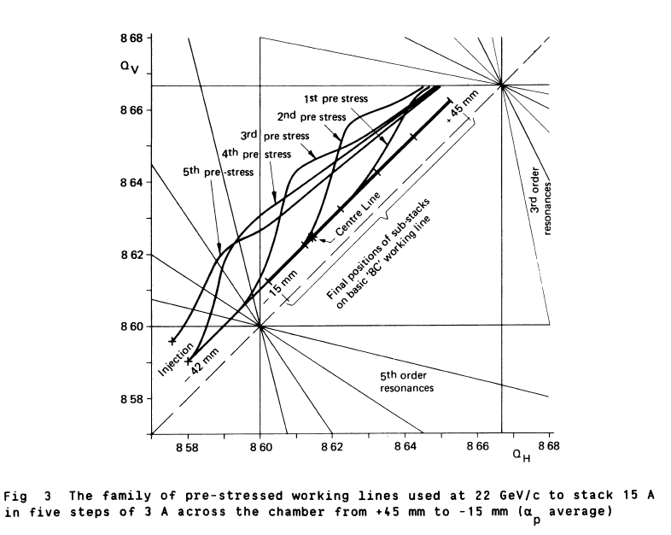
Space Charge Compensation
Notes:
working line
The large tune spread needed for stability and the large momentum spread needed for beam stacking.
The tune range of around .07 caused unavoidable crossing of low order resonances.
The space charge tune shift caused a “sagging” of the working line, rather like loading a beam with heavy weights.
Figure shows space charge compensation while stacking.
The working line was “pre-stressed” for currents steps of 3 amperes.

Slide 50
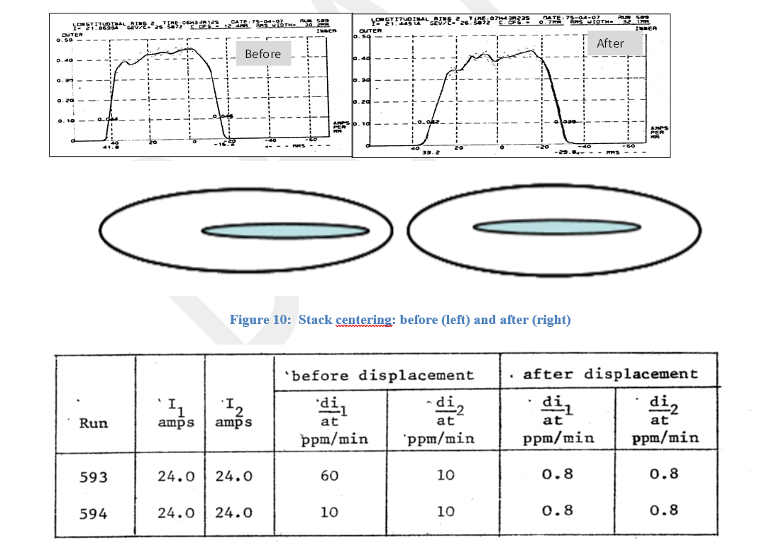
Centring the Stacks
← Higher Energy
Schotkky
Space charge knowledge
Increase dipole field and modify the space charge compensation
Notes:
injection kicker was on a mechanically moveable girder.
When stacking was finished, the girder was moved out. So, the stack was situated on the “outside” of the beam aperture. (see Fig left)
This produced very high background rates.
In 1975, the “background” in the ISR was the most serious operations problem which existed.
Combined use of Schottky and Space Charge compensation allowed to centre the stacks.
Spectacular results.

Slide 51
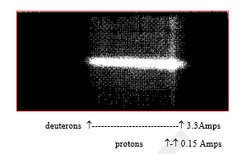
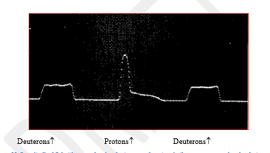
Deuterons and protons
Image from sodium curtain (real space)
Real Space
Image from Schotty Scan (phase space)
Phase Space
Notes:
An interesting experiment: Deuterons and protons in Phase Space
Deuterons and protons have different revolution frequencies (charge/mass ratio
Can occupy the same real space but will be separated in phase space.
Machine experiment in 1976.
3.3 Amps of deuterons were left circulating
A pulse of protons (.15 Amps) was injected into the same ring and accelerated into the deuteron stack.
beam profiles shown from the sodium curtain monitor. Upper Fig shows the positions in real space of both beams.
Lower shows the separation (in phase space) of the beams of protons and deuterons.
Then phase displaced the deuterons to a low energy absorber to get rid of the protons

Slide 52
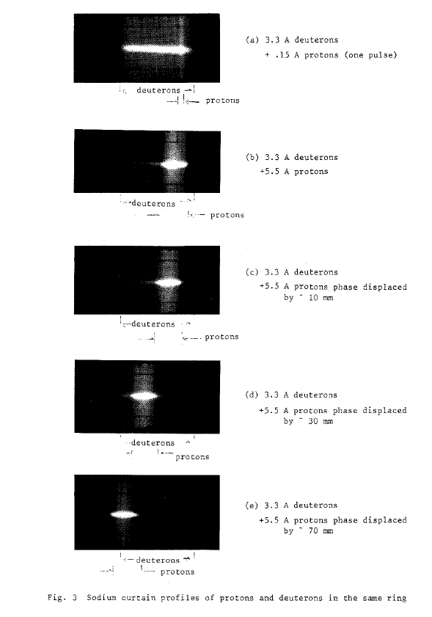
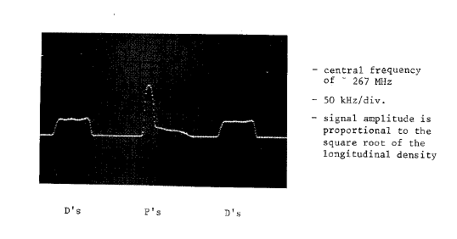
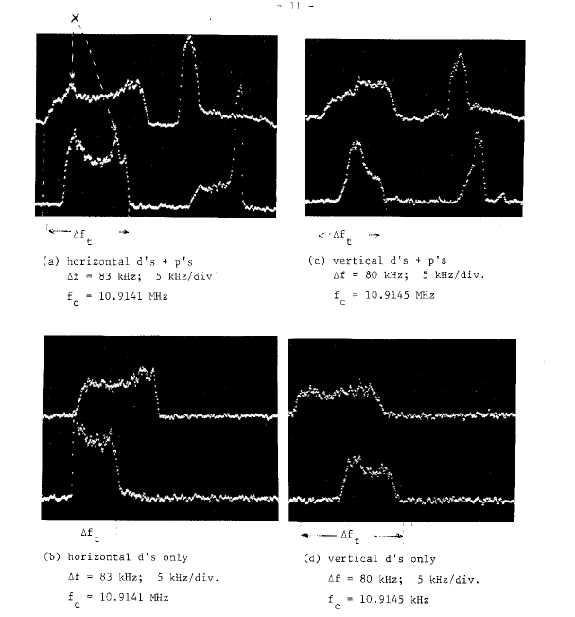

Slide 53
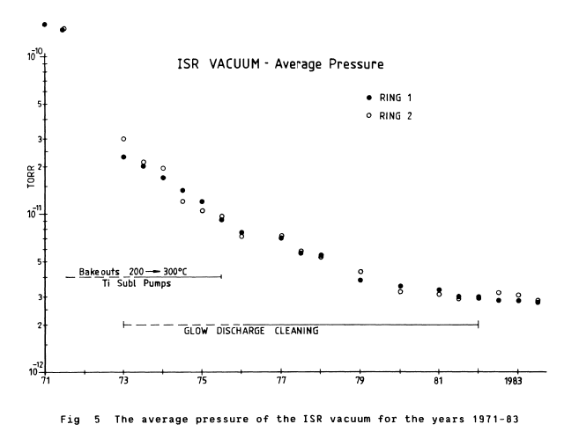
Vacuum Evolution
Notes:
The ISR encountered many technological challenges but one of the most important, the Ultra High Vacuum (UHV), was imperative for a long beam lifetime. The stainless-steel vacuum chambers were baked in situ up to 300◦C in order to allow the very high beam intensities. The weakest vacuum sectors around the circumference were identiﬁed by “vacuum limit ﬁlls” where the intensity was increased to the value at which vacuum “runaway” occurred

Slide 54
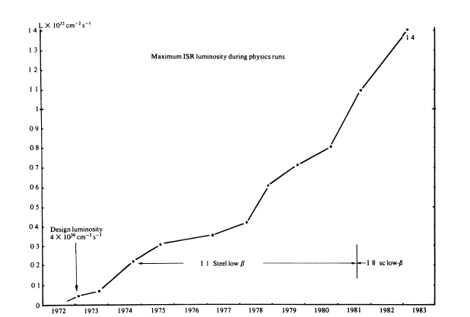
Luminosity Evolution
Luminosity
Steel low beta
Sc low beta
Design Luminosity
Years

Slide 55
Stacking
Notes:
The accumulation relied on a momentum “stacking”.
Visual illustration

Slide 56
Phase Displacement Acceleration
Traverse the coasting beam from low energy to high energy with empty RF buckets produced “phase space acceleration” of the existing beam.
Notes:
The ISR circumference was larger than the PS, the maximum possible energy was 31.4 compared to 26.6 GeV.
Decided to attempt to increase the energy of the accumulated beam to 31.4 GeV/c. Very small RF (16kV maximum RF voltage) system could only capture a very small amount of a beam which had a 3% momentum spread.
In our ignorance of the complexities (space charge, changing tunes, chromaticity, orbits, RF noise effects, absence of diagnostics...) we attempted to phase displace high intensity stacks of protons.
Phase displacement occurs when RF buckets traverse a debunched beam.
Analogy is the release of droplets of mercury into a cylindrical container containing water. The mercury droplets go from high energy to low energy and the water energy is increased by displacement.
Initially the progress was slow and frustrating, but after some better understanding and a few breakthroughs, 31.4GeV/c became the operational beam energy of the ISR.

Slide 57
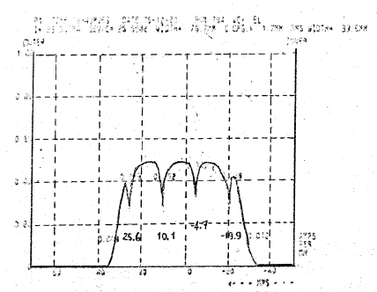
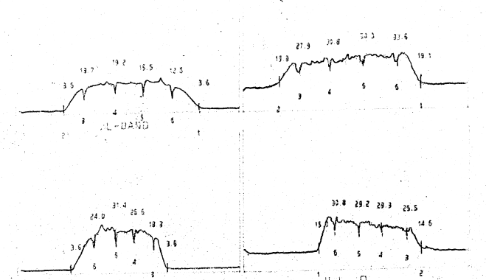
Using Phase displacement to insert “markers” allowed measurement of the working line
Longitudinal Schottky
Δp/p = 4%
Transverse Schottky
Notes:
Phase displace parts of the stack makes markers: split the stack into 5 sub-stacks each separated (markers)
Simple procedure, programme the RF frequency swing from low momentum (outside the stack) to a momentum inside the stack
Causes a small reduction in the average momentum of the traversed part
Produces a “marker” Upper Fig shows a longitudinal Schottky with 4 markers.
Lower Fig also shows the markers clearly in the horizontal and vertical planes

Slide 58
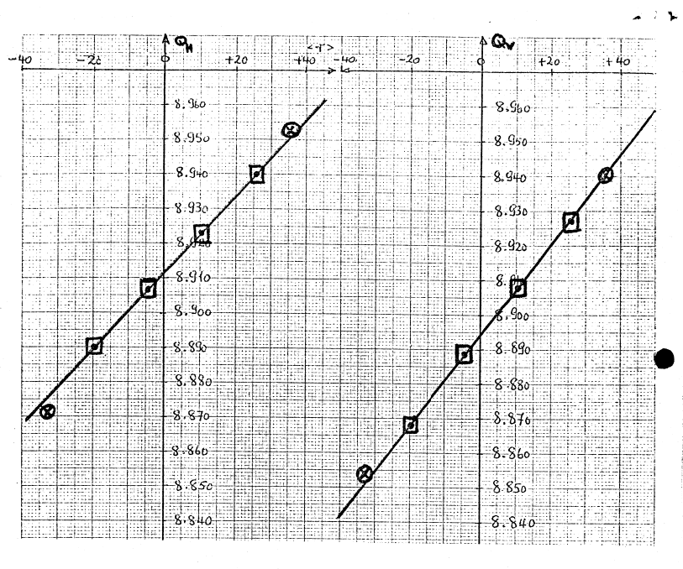
Measurement of the Working Line
Δp/p = 4%
Δp/p = 4%
Notes:
The correlation of these marked scans allowed plotting of the working line (see Figure) in a non-destructive way.
The markers lasted throughout the many hours of the physics runs.

