Slide 1
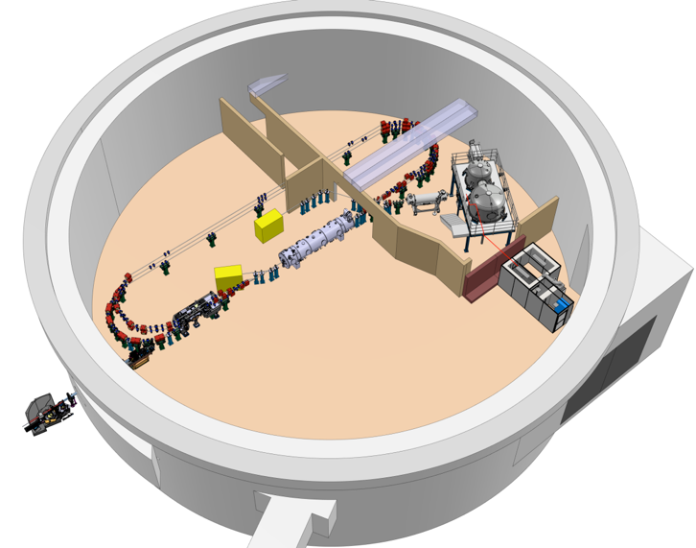
PERLE Collaboration Board 6/12/2024
+ Contributions through iSAS of

Slide 2
PERLE
Scientific and Technical Progress
Discussion on the Phase Implementation

Slide 3
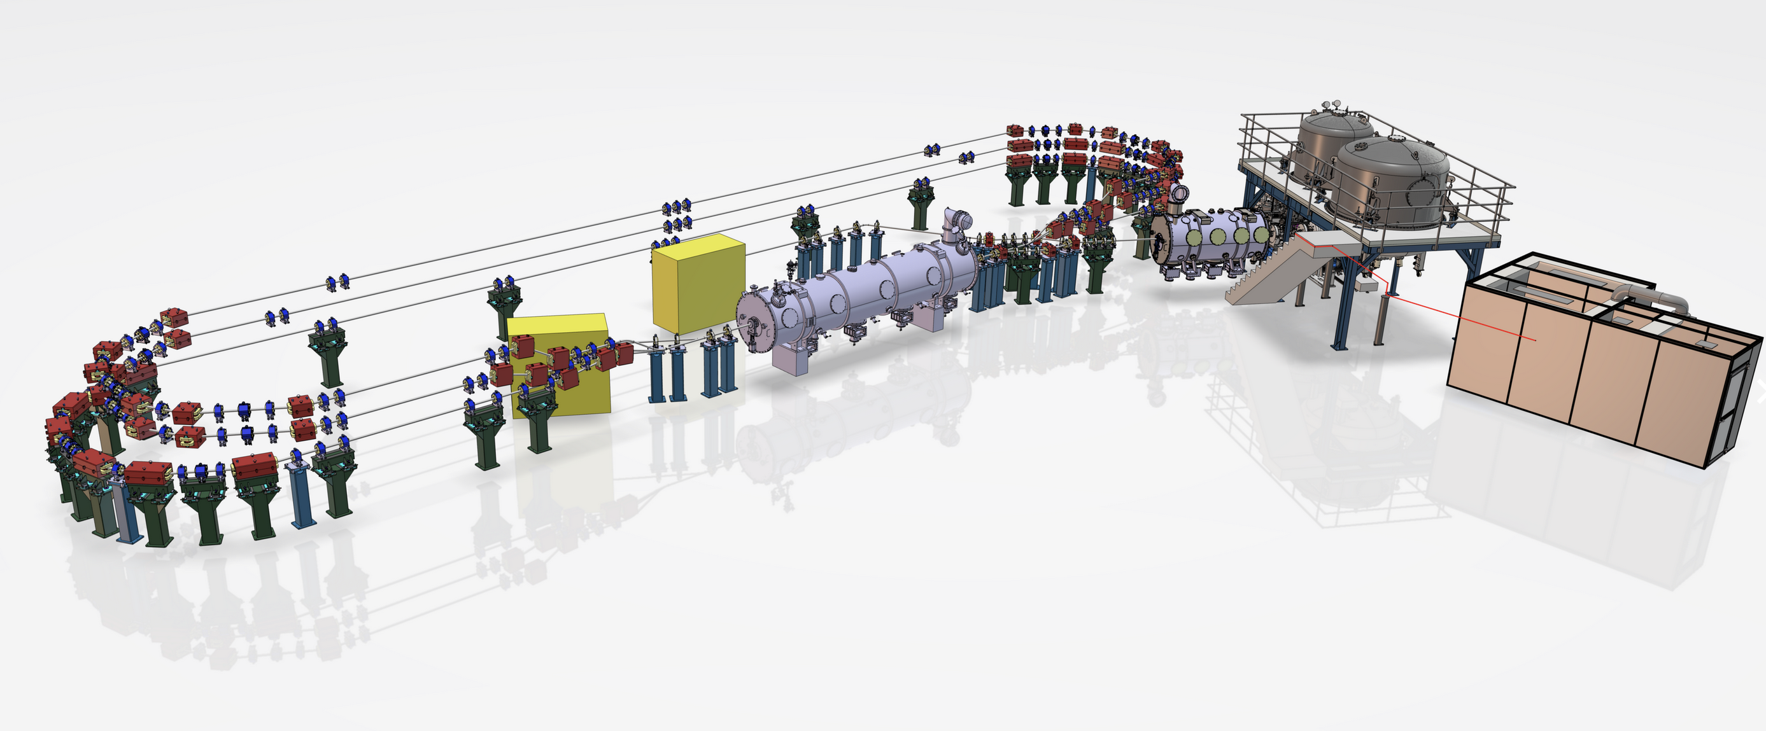
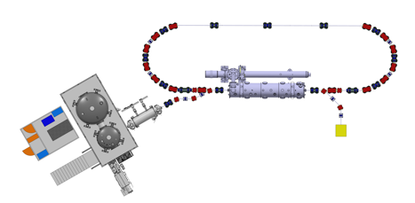
PERLE @250 MeV 3-turns
PERLE @89 MeV 1-turn
Parameters | Values
Injection Energy | 7 MeV
Electron beam energy PHASE 1 (single turn) | 89 MeV
Electron beam energy PHASE 2 (three turns) | 250 MeV
Normalised Emittance γε_{x,y} | 6 mm.mrad
Average beam current | 20 mA
Bunch charge | 500 pC
Bunch length | 3 mm
Bunch spacing in injector | 25 ns
RF frequency | 802 MHz
Duty factor | CW

Slide 4
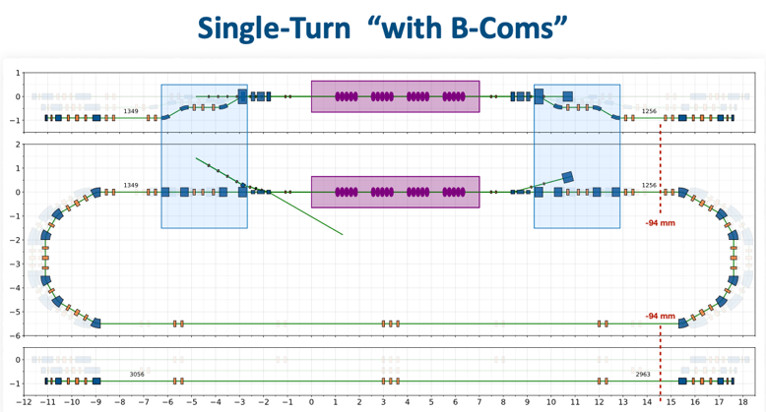
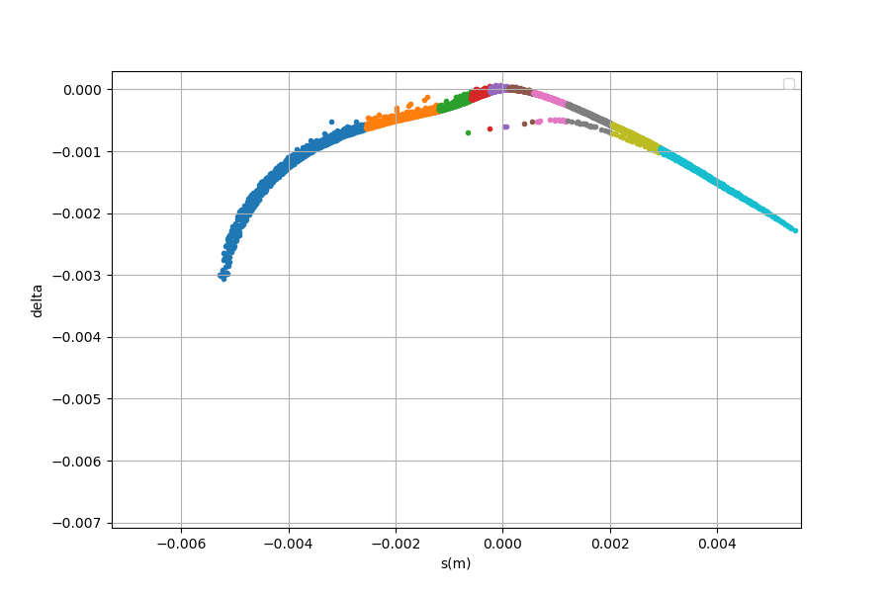
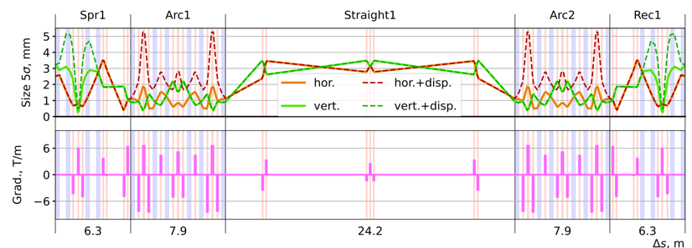
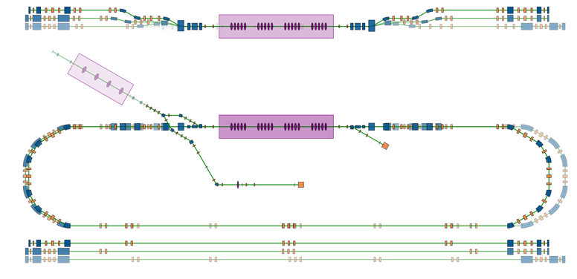
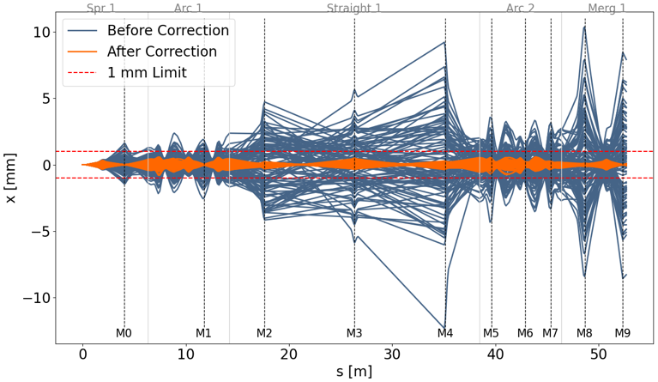
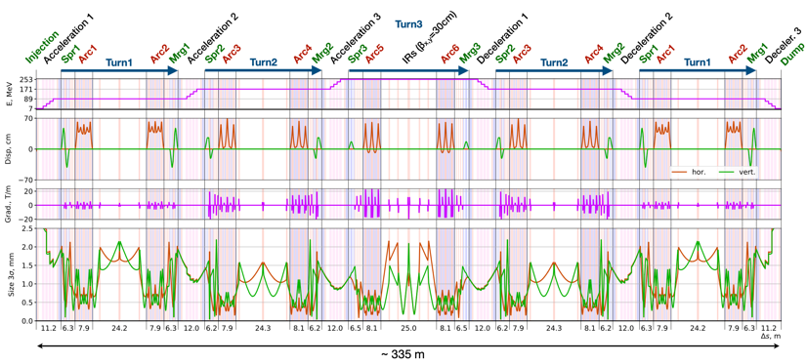
Longitudinal matching for energy spread compression at EP
With energy spread compression
Great progress
on beam dynamics
and on lattice design
1-turn 3-turns
$$σ_{z}=2,1e^{−3}$$
$$σ_{δ}=5,1e^{−4}$$
PERLE 250 MeV version
89 MeV
171 MeV
253 MeV
Booster
Merger
Cryomodule
IP1 (FP)
Diag. Line
7 MeV
7 MeV
IP2
Effect of kickers correction on magnet disalignements

Slide 5
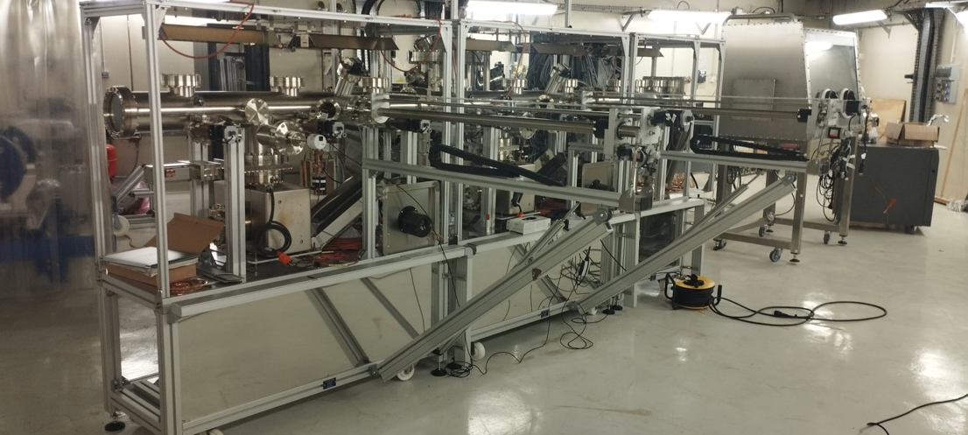
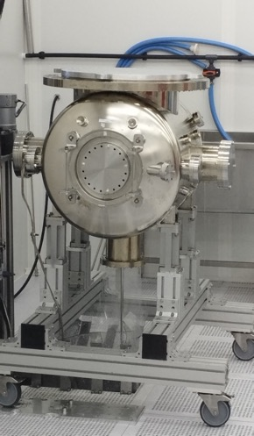
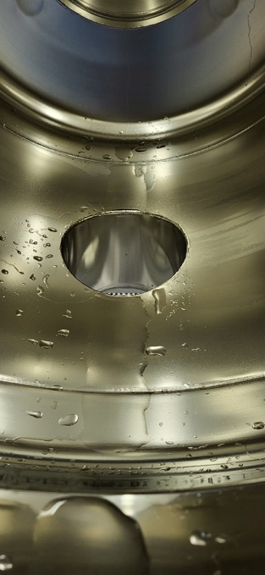
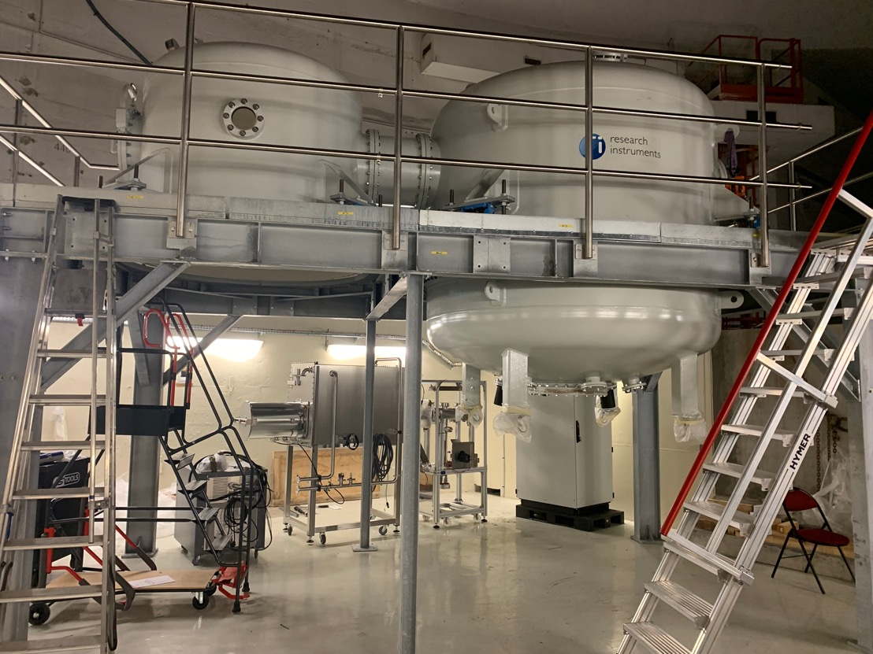
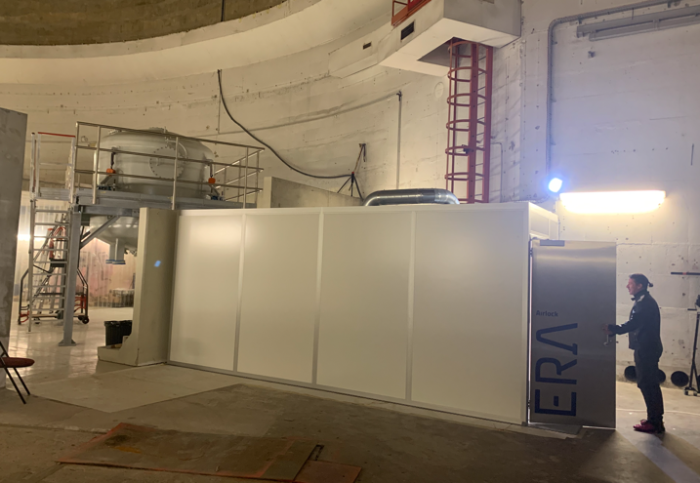
DC Gun installation status
Photocathode Production Facility (PPF) assembly
Gun chamber HPR cleaning in clean room

Slide 6
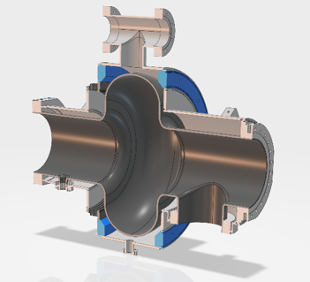
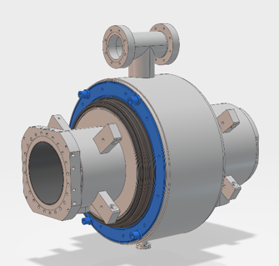
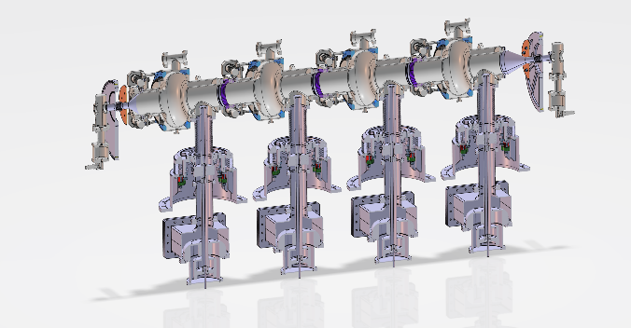
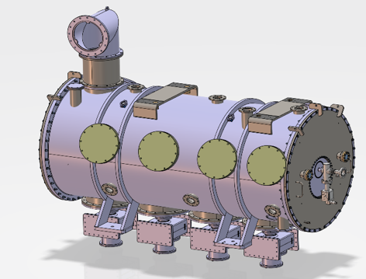
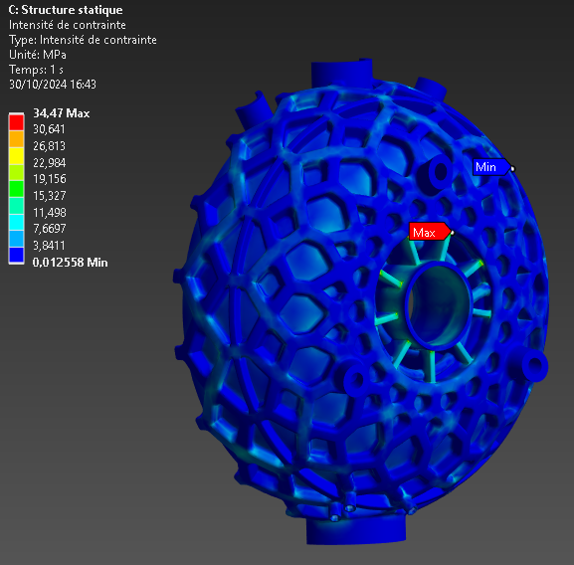
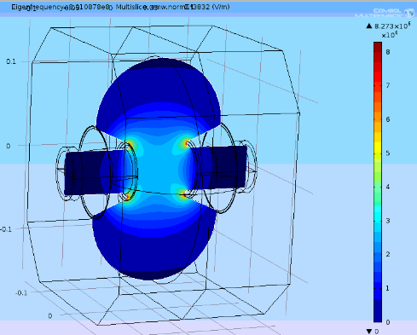
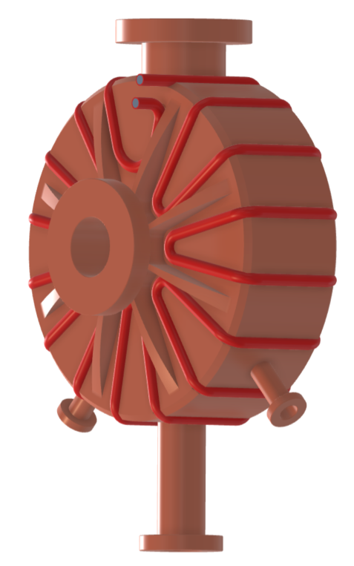
Advancement for the single cell cavity for booster + cryomodule
Traditional
machining (23kg)
Additive
machining (12kg)
Technical design for buncher !

Slide 7
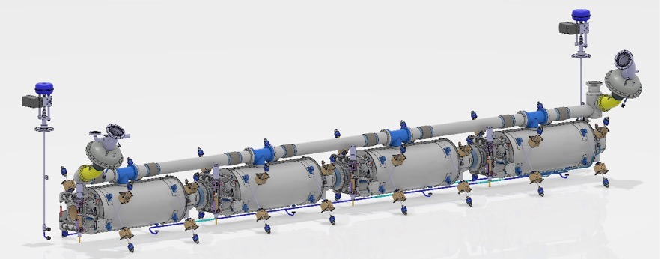
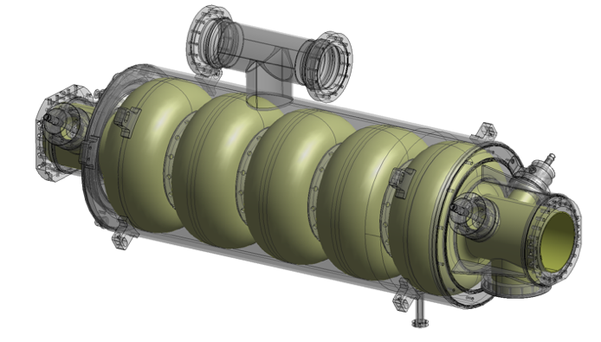
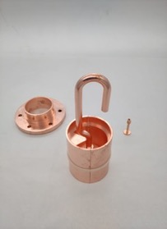
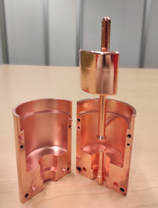
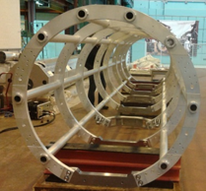
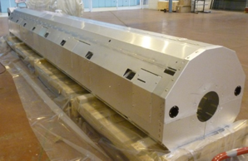
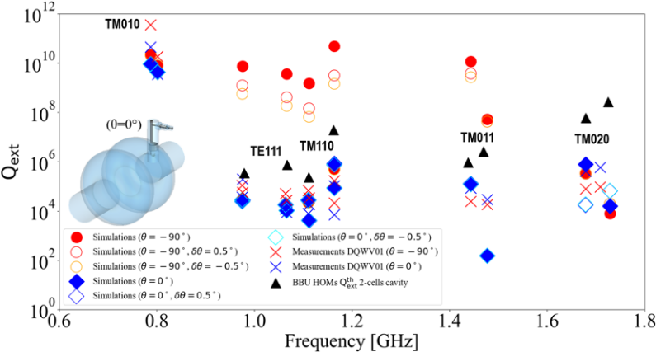
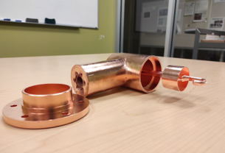
Niobium is procured (for single and multi-cell cavities). the procurement of 4 5-cells cavities is launched
Exisiting already !
Vacuum vessel
HOM Couplers
Probe coupler
Spaceframe
Thermal shield
DQW coupler
Hook coupler

Slide 8
Infrastructures and Security issues

Slide 9
Infrastructure Works for PERLE and end of ThomX
The site of PERLE has been chosen : IGLOO. Already equipped (from the previous CPER works) and better suited for installing accelerator equipment’s. [SuperACO was not well suited, important works would have to be done in order to reinforce the floor].
« Programmistes » to define precisely the works for PERLE infrastructure are actually working and the infrastructure works for PERLE should start spring 2026.
ThomX installation is not compatible with PERLE but the main components will be reused : linac for DESTIN and Fabry-Perot pour ICS@PERLE (ERL4ALL)
ThomX was foreseen to run 2-years after the end of the ANR phase. Less than 10 people are actually working in ThomX. ThomX is followed with a COPIL (bimonthly) in order to assure that we
to reach the best possible brilliance (charge, emittance…),
to run also at 70 MeV electron beam and to reach
To perform the X-rays experiments.
Thomx stops end 2025 and reused for DESTIN and ICS@PERLE
Thus ICS community can continue working on this domain with the 89MeV electron beam from PERLE (see previous slides)

Slide 10
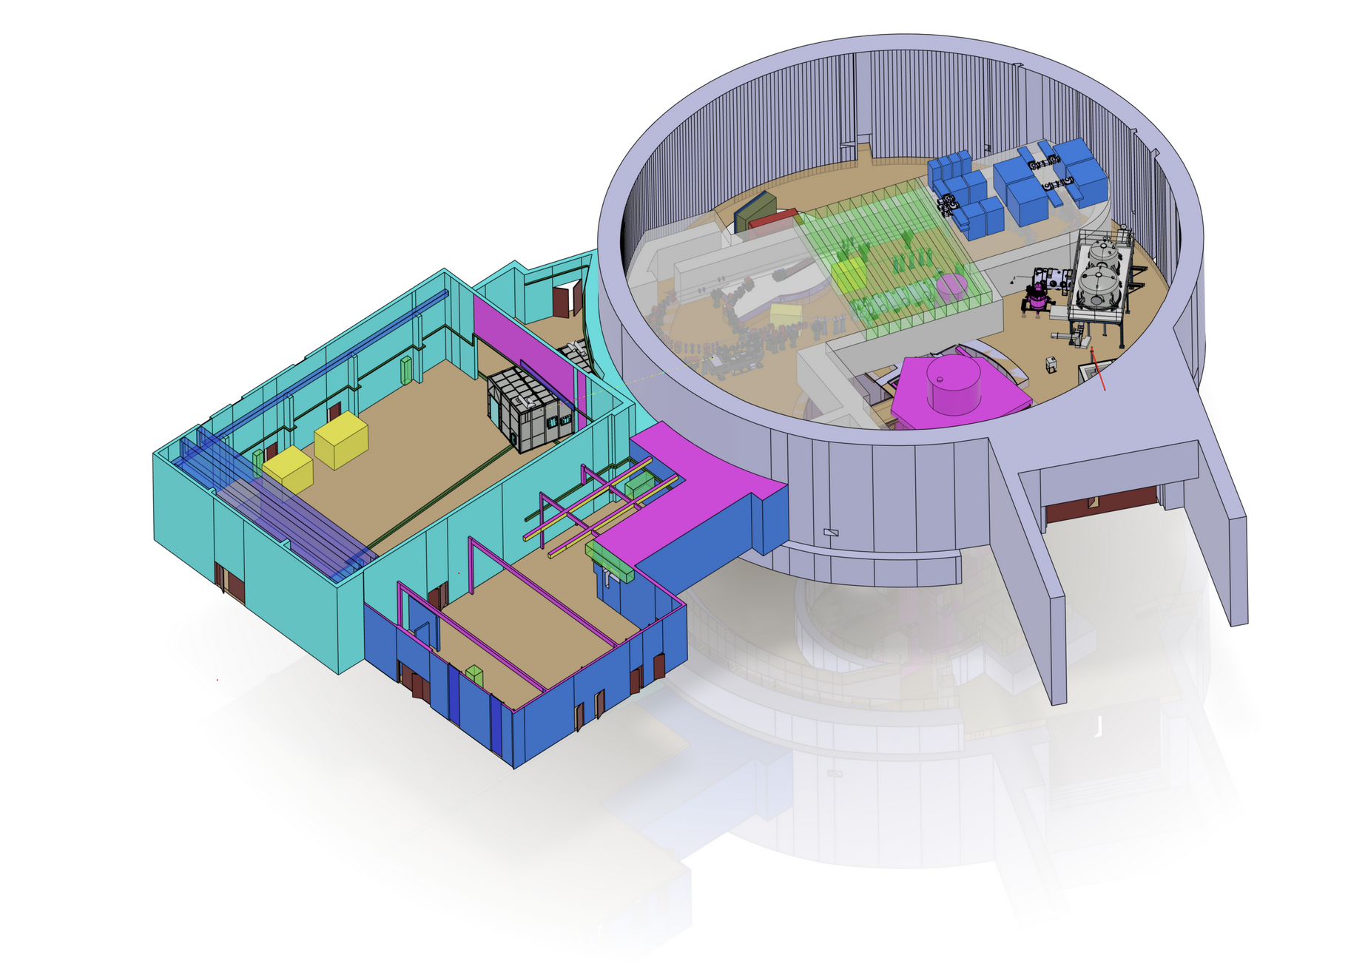
ASN
Many contacts and discussions
with ASN. Positive attitude.
INB regime will be not an option !

Slide 11
Status of the art of the
experiments @ PERLE

Slide 12
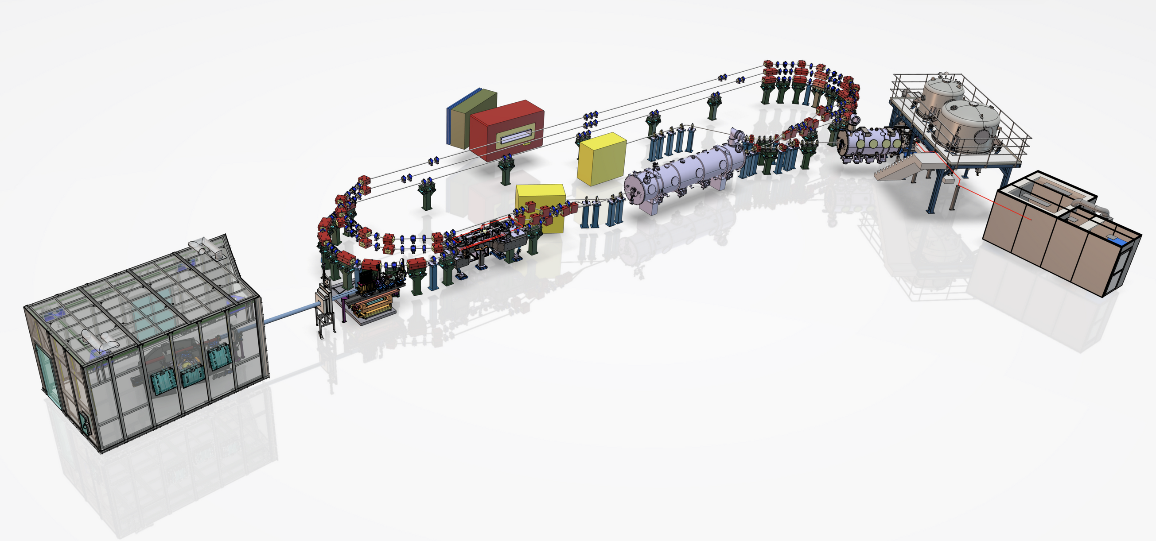
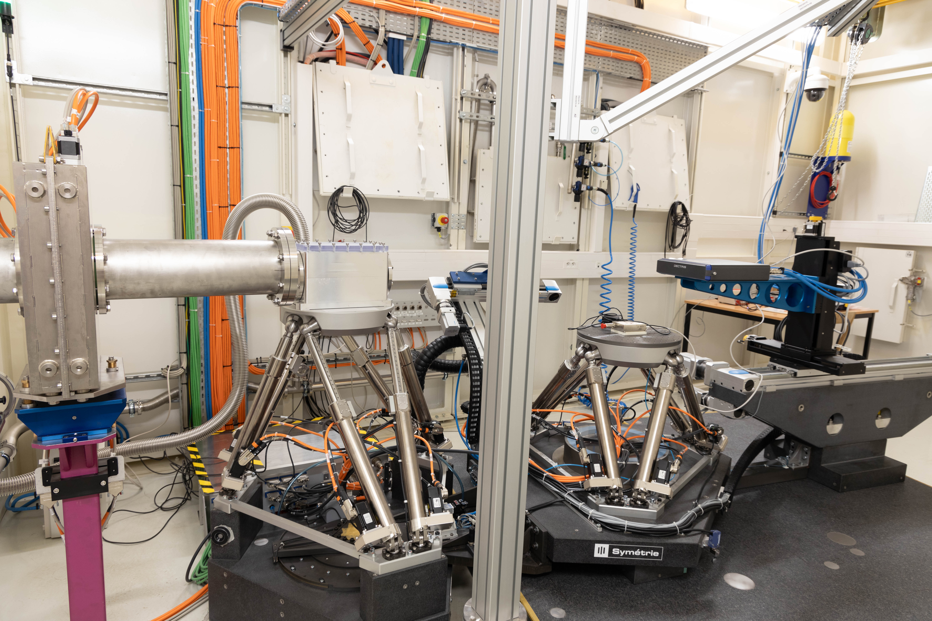
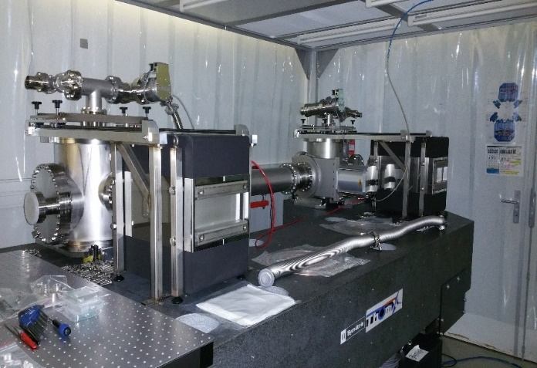
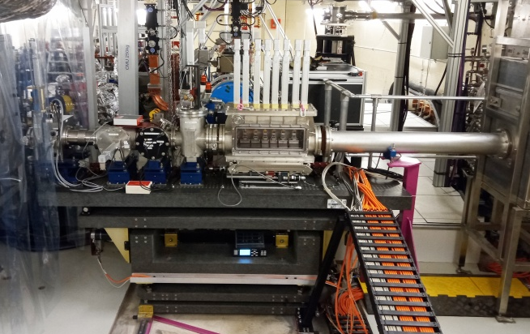
Inverse Campton scattering source @ PERLE
X-LINE in X-HUTCH
Fabry-Perot Cavity
X-LINE elements inside bunker

Slide 13
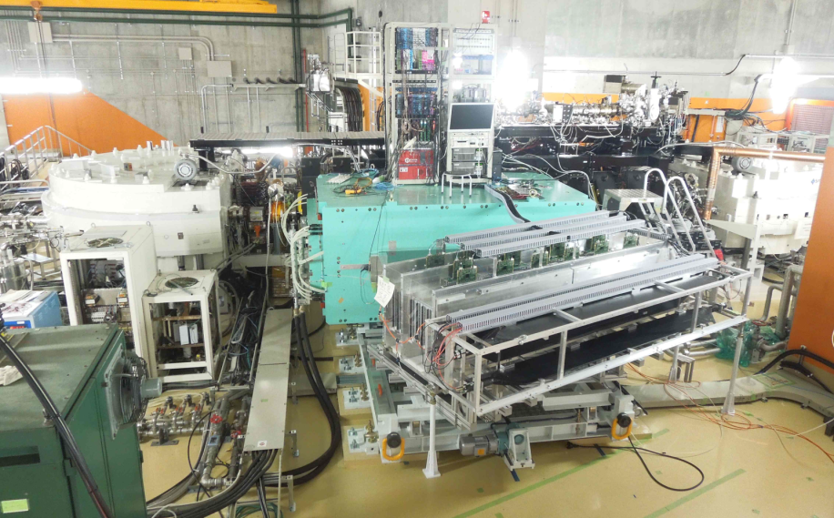
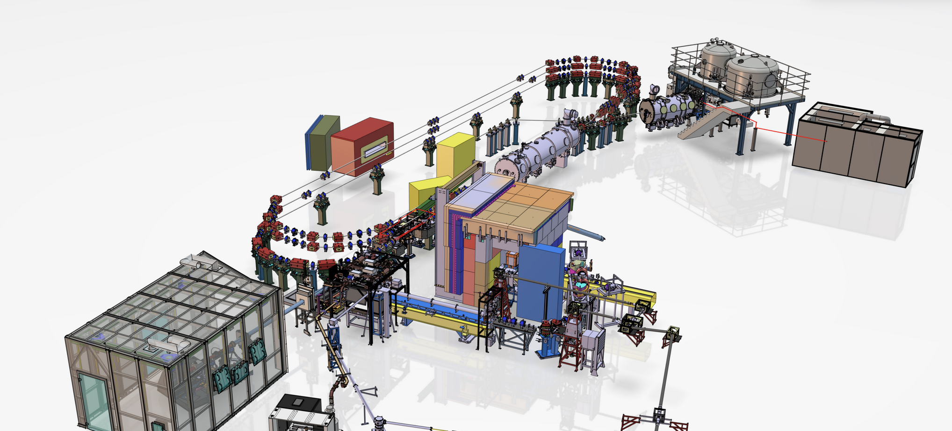
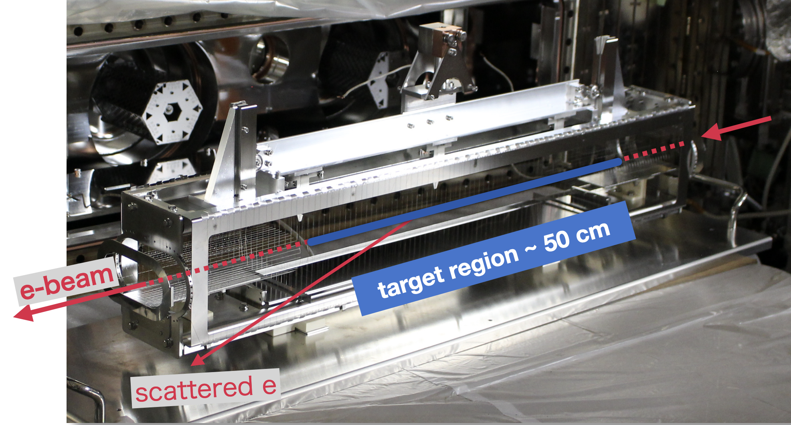
Implementation of DESTIN @ PERLE:
Spectrometer
Ion target location
RIB factory
50 MeV e- Linac

Slide 14
PERLE Organisation and Status of the Collaboration

Slide 15
PERLE Organisation of an International Collaboration
IJCLab and IN2P3 Directions
(COPIL, EAP, CODEC, CS, CSI…)
International Collaboration Board (ICB)
Oliver Bruning (CERN) (Chair)
Rongli Geng (Jlab)
Carsten Welsh (Liverpool University)
Stewart Boogert (Cockcroft Institute)
Deepa Angal-Kalinin (Daresbury-STFC)
Georg Hoffstaetter (Cornell University)
Ibon Bustinduy (ESS-Bilbao)
Hadil Abualrob (An-Najah University)
Maud Baylac (LPSC)
Ex-officio :
Achille Stocchi (Deputy-Spokeperson) (IJCLab)
Walid Kaabi (Technical Project Leader) (IJCLab)
Invité :
Jorgen D’Hondt (Nikhef) for iSAS
Reinforced local one, absolutly needed in the construction phase
Project Directorate / Local French Management Board
Achille Stocchi (Deputy-Spokeperson) DSP, Scientific Coordinator
Walid Kaabi (Technical Project Leader) TPL
Denis Reynet (Systems Engineer) Associate to TPL in charge of the installation
Guillaume Olry Associate to TPL in charge of RH, budget
Sophie Chance (Project Manager/PBS, WBS, planning) PM
Virginie Quipourt (Financial Manager) FM
Aurore Lermitage (Quality Manager) QM
Maud Baylac (External Relations / In-Kind Management)
Frédéric Bouly Associate to SP → Experimental Programs Associate to EP
Contributions from Collaboration members to be increased (see later for discussion)

Slide 16
Few lines for specifying the Meeting Organisation
Réunion DIRECTION DU PROJET: Thr. 15h30-17h30
Participants : The full directorate :
Purpose: Orientation meeting, project milestone/objective follow-up, identification of blocking points (such as financial/market issues, etc.), project decisions, initiate Technical Board if necessary, financial update, vigilance on the WP and activities that are delayed (call for meetings), links with international collaboration.
Input data: Overall project progress, blocking points, strategy, communication, various.
Output data: Updated schedule, action and decision reports, and potential scope definition.
PERLE Project Progress Review (every month) Thr. 13h30-17h30 - to be opened to international partners
Participants: PERLE collaborators (at a minimum, the WP Leaders) + Project Management Team Purpose: Project Status Report by the project leader + the WPs following a template that includes: progress points, impact on planning and critical path, critical topics requiring increased monitoring, updates on implications and HR needs, etc. Input data: Progress status by WPs Output data: Presentations on an Indico + progress update by the Project Management Team.
PERLE Collaboration Meeting (1 fois par an)
Participants: The entire PERLE collaboration Purpose: To inform about the project’s progress + technical and scientific presentations on the various topics.

Slide 17
WBS – Last version

Slide 18
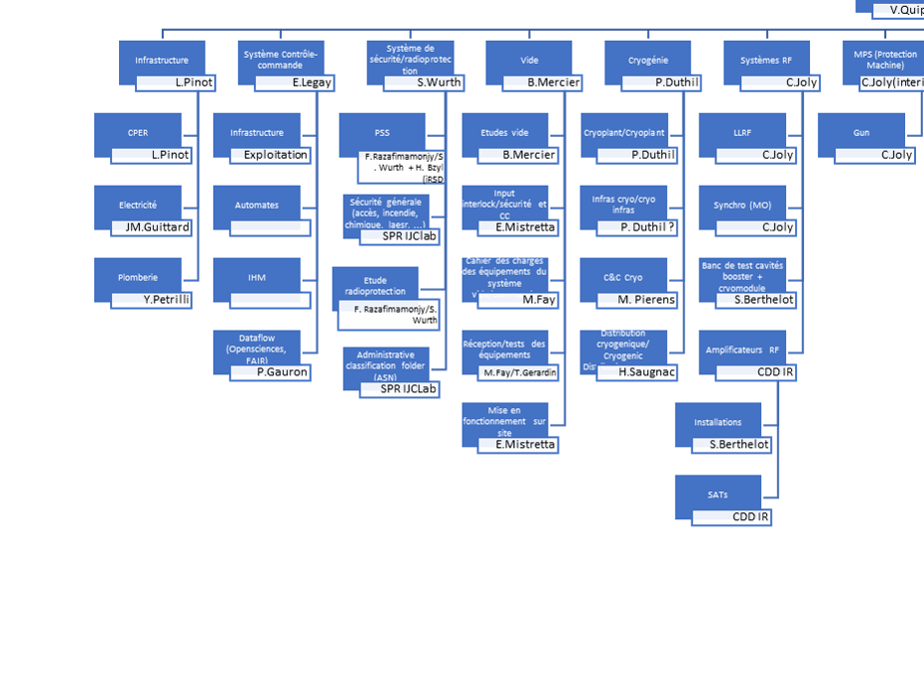
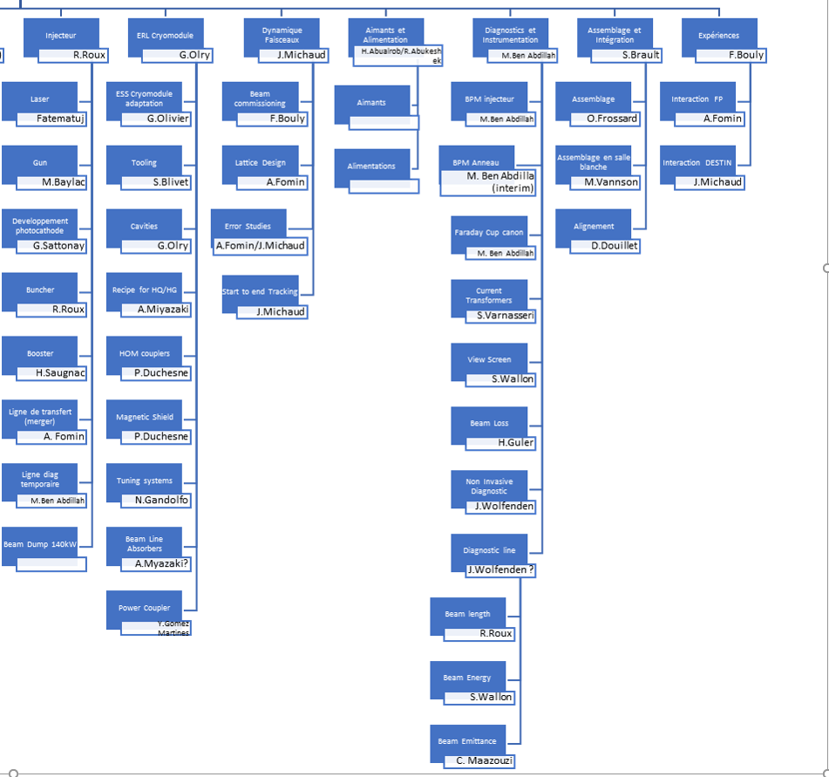
WBS – Last version

Slide 19
Project Phasage - more precise planning in the following
Design
DC Gun @350 keV
Procuirement / Construction / Installation
DC gun
operation
20 mA
Commissioning
Injector @ 7MeV
Injector installed
20 mA
PERLE 1-LOOP 89MeV
IGLOO ready
ERL 1-LOOPS
Cryomodule
tested
First ERL
demonstration
2MW
PERLE 3-LOOPS 250MeV
Cryogenic
installed
Cryomodule
Installed
ERL 3-LOOPS
TDR
3-loop ERL
demonstration
5MW
2024
2025
2026
2027
2028
2029
2030
2031

Slide 20
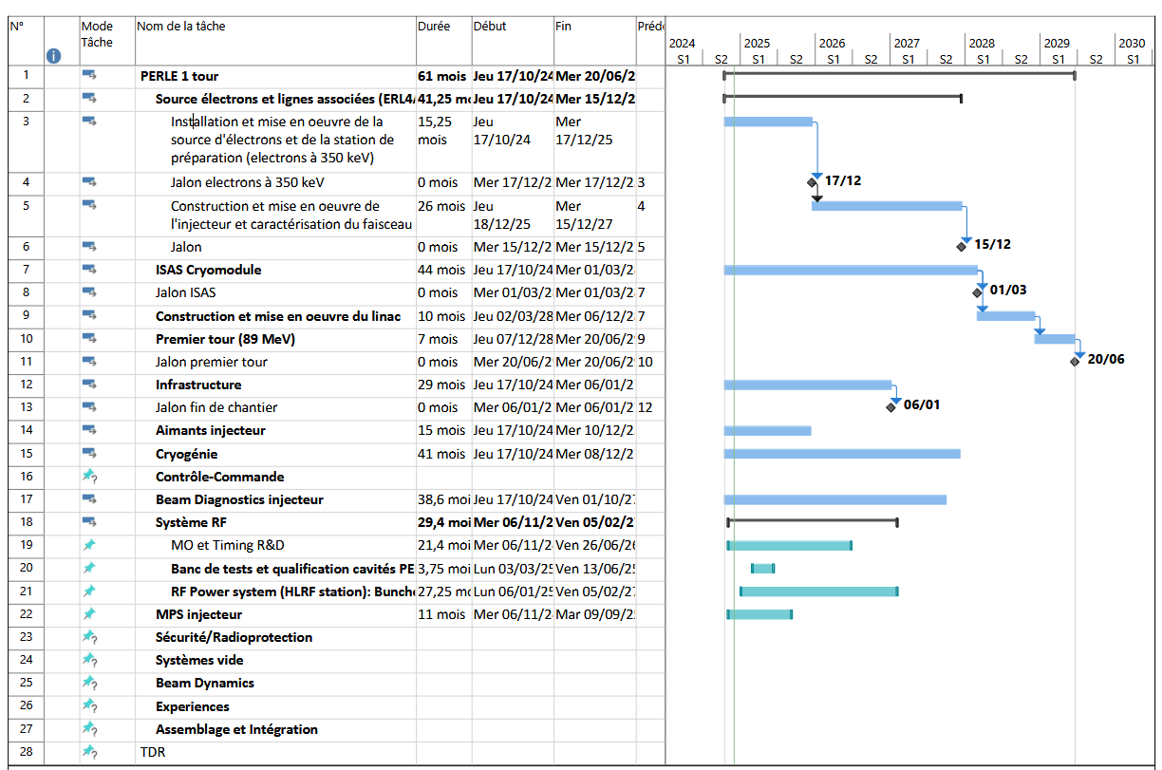
Schematic Macroplanning

Slide 21
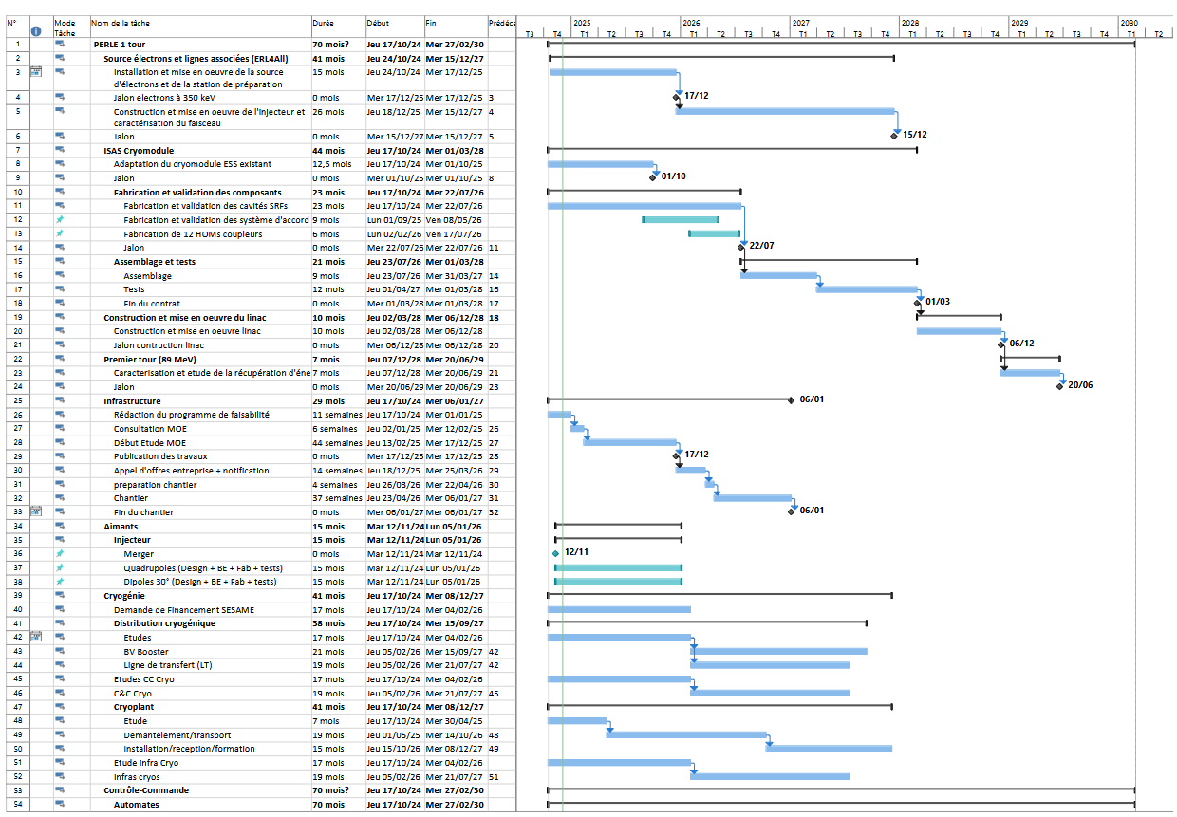
… more detailed one

Slide 22
New Collaborators – discussion on going
IFJ-PAN (Poland) (several meeting on going)
Advanced discussions with to join iSAS and sign the PERLE Collaboration through their extended experience on CM assembly and test and possibly implication on machine installation (cryoplants)
Riga Technical University RTU (Lettonia). (several meeting on going)
Advanced discussions to join iSAS and sign the PERLE Collaboration, through their expertise on 3D printing for crucial components
Buncher cavities
HOM, critical elements of FCP and contribution to the design and the fabrications of the absorbers
We would like to invite them to sign
the Collaboration Agreement
(with the up-to-date Annexe)
CEA, INFN-LASA, ESS contribute to PERLE through the work done in iSAS in WP4, WP5 and WP6. Discussions not yet started to integrate them in the PERLE Collaboration

Slide 23
Financial Situation

Slide 24
Financial situation: Global vision
1-turn machine
Origines | in M€ | Fraction
Available money in 4y (2024-2027)
CNRS/IN2P3/IJCLab | 5.1 | 27%
CPER (Region and State) | 2.0 | 10%
iSAS - Europe | ~1.4 | 7%
In-kind (ESS , future HZB cryoplant) | ~4.0 | 21%
Missing budget MAINLY MAGNETS RF SOURCES | 6.7 | 35%
TOTAL | 19.2 | 100%

Slide 25
Financial situation: Global vision
The important recent news :
LINAC cryomodule
iSAS allowed the realisation of the cryomodule and bring new collaborators : CEA, INFN_LASA and ESS
In-kind of the ESS vessel
1M€ as Matching funds from IN2P3
The Injector
1M€ received + 2M€ from after the Go no Go phase (end 2025) + IJCLab
How to find the extra 6.7M€ ?
General comment : Difficult to find a European / National call for providing these kind of equipements (IOT and magnets…). ..
Discussion with IN2P3. Could do an important effort beside the iSAS matching funds
Discussion with CNRS for a special funding for industry (we need IOT and magnets…). Money from CNRS will go directely on the pockets of industrials !
Find these equipements in-Kind (magnets and sources)

Slide 26
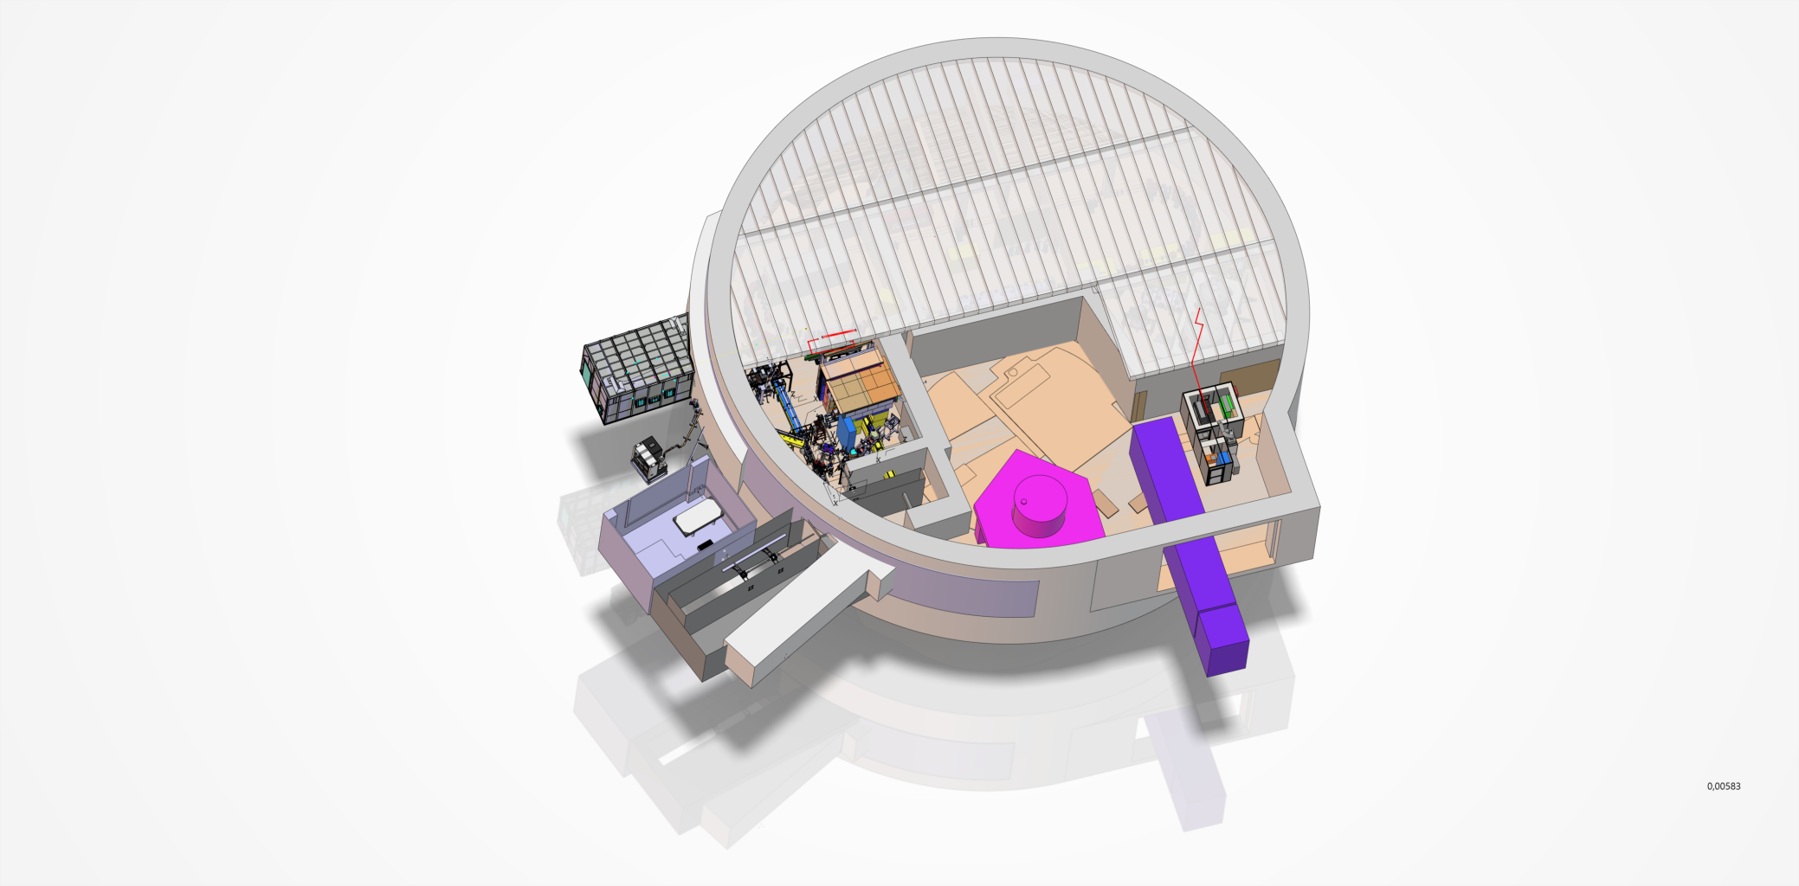
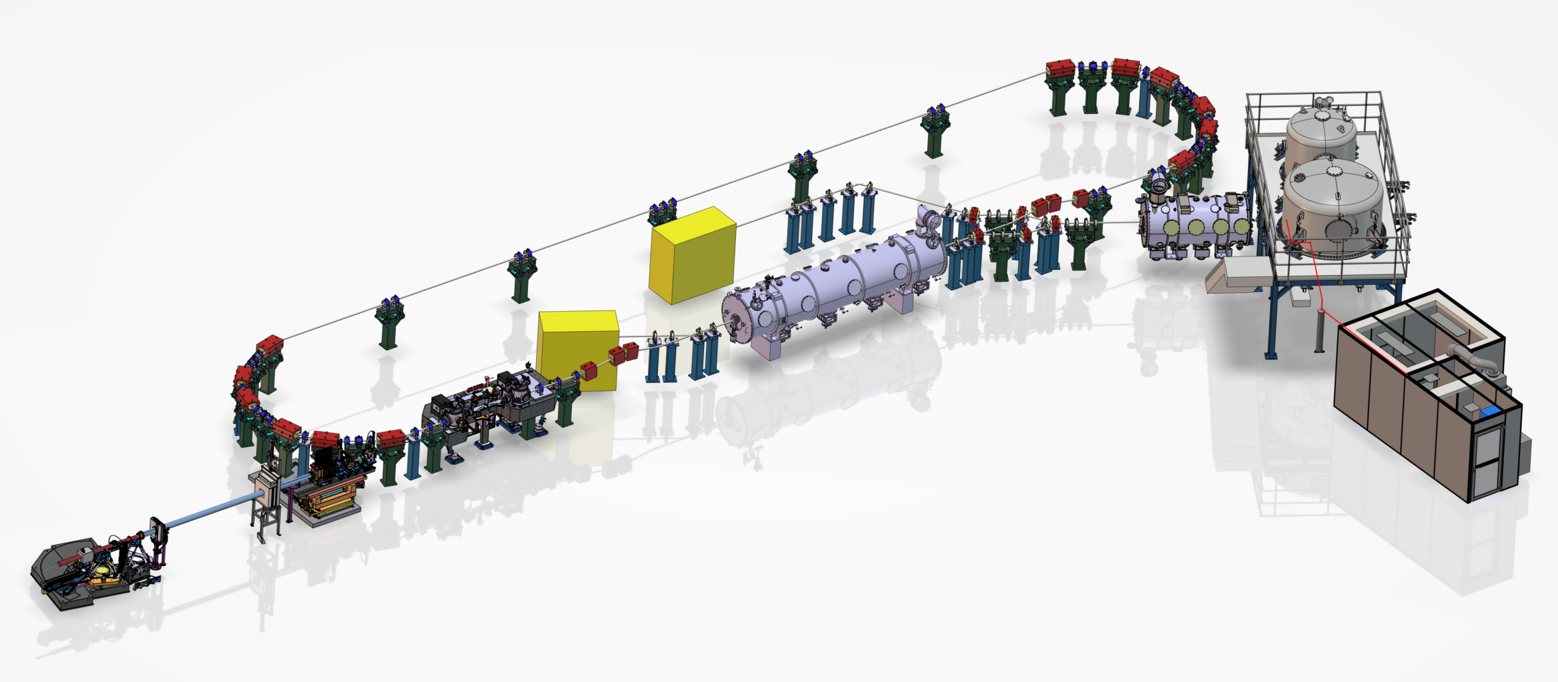
Global view of financial coverage
Infrastructure
CPER
Cryoplant
In-kind+missing
Magnets
Missing
Cryomodule
iSAS/CNRS/IJCLab
RF Sources
Missing
Full Injector
ERL4ALL/CNRS/IJCLab

Slide 27
RH Situation

Slide 28
FTE Evolution since 2020 and projection for the next 3 years (first global picture)
Need to be given by international partners
+4-5 PHD thesis
will start in 2025 !

Slide 29
Tour de Table

Slide 30
Contribution of the present collaborators - summary by IJCLab
CERN
Discussions on :
Delivery of 8 FPC: 4 for the Linac CM (in the framework of iSAS) and extra 4 for the booster
16 HOM couplers (Only 4 initially foreseen within iSAS project)
R&D on 800 single-cell cavity (Mid-T baking, HPR by COBOT)
800MHz RF sources project signed with CERN and Thales (IDEMO)
ESS-Bilbao
work on buncher cavity design (RF/thermal Design). Possible extension of this work with taking the responsibility of the fabrication
Jlab
Possible synergy with ERL@EIC
Contributions on the commission of the DC-gun. Some short visits foreseen in 2025
Continue contribution on beam dynamics studies
Daresbury
Contributions on the commission of the DC-gun. Some short visits foreseen in 2025
contributions on beam dynamics studies
on going
in discussions

Slide 31
In kind contributions
on going/positive
in discussions
HZB
Ongoing and very advanced discussions with HZB to recuperate the cryoplant of BESSY VSR for PERLE: Transfert foreseen in October 2026. Collaboration Agreement for this transfer will be soon signed.
ESS-LUND.
ESS vessel
CERN
Possibility of recuperation of some needed magnets from the CERN spare (mainly on the CTF3 facility)
CBETA
Discussions on going since ~1 year on possible recuperation of quadrupoles and multipoles from CBETA-4loops dismantling
Not possible finally “xLight is still interested in using much of CBETA, if funding can be arranged. CEBTA will be not dismantled yet” (from Georg H.)
PSI
Recent contact for recuperating some magnets

Slide 32
Backup

Slide 33
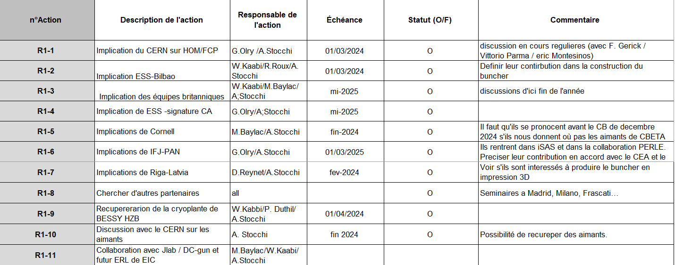
32 risques identifiés ➔ Réduction de 16 risques engagés avec des plans d’action
Financement
Collaborations
Inondation IGLOO

Slide 34
Planning
Ressources Humaines
Suivi et mise à jour régulière par la qualité

Slide 35
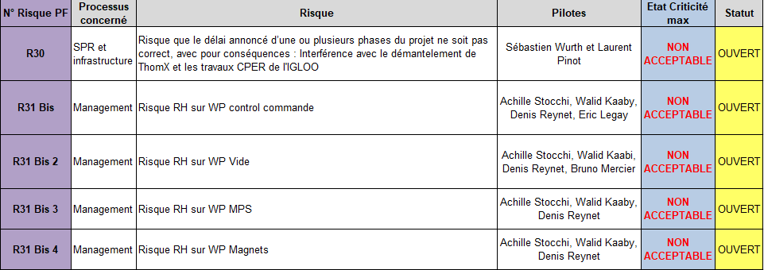
Modification du portefeuille des risques suite au COPIL avec la direction d’IJCLab
Interactions ThomX et CPER
Risque RH : WP critiques

