Slide 1
ALLEGRO barrel ecal
Thermo-mechanical design and analysis
Fernando Aretio-Zárate
Pierre Karst
Chiara Pruiti
Martin Aleksa
Michel Chalifour
03/04/2025
fernando.aretio.zarate@cern.ch

Slide 2
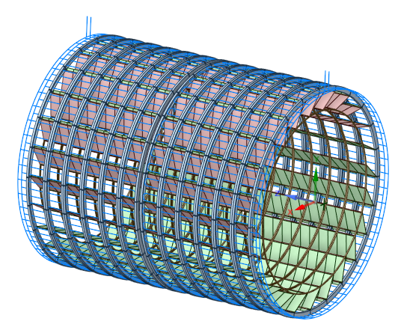
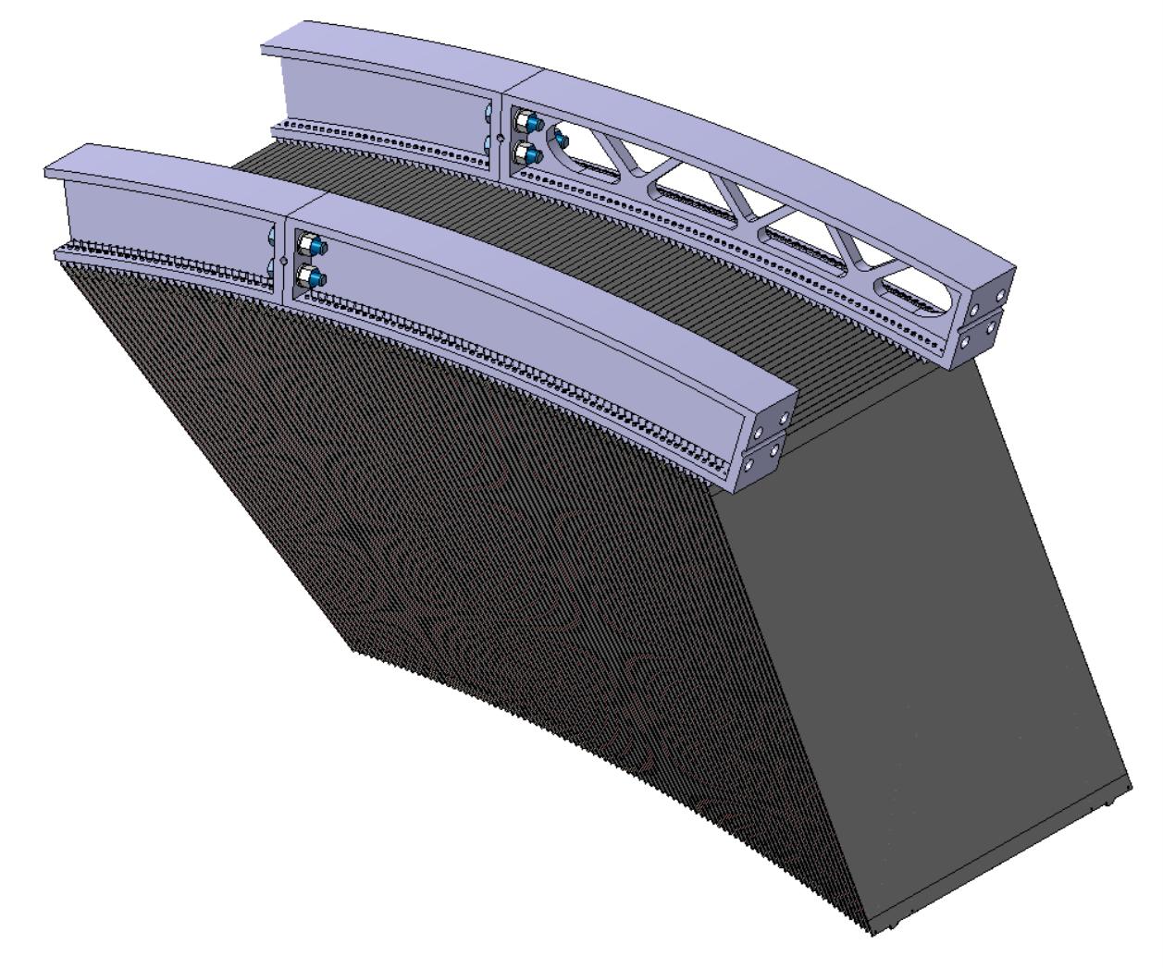
Table of contents
  General components of the barrel calorimeter
  Test beam prototype
  External rings first approach
  How many spacers are needed?
  Mechanical analysis: 2 meters FEA
  Absorbers cold test (2×0.05 mm of AISI304L)
  Thermomechanical properties of one absorber
  Spacers options. Variable gap from 1.2 to 2.4 mm
  Cooling system for the cold electronics
  External ring optimization
  Structure for assembly and support of the prototype
  Prototype for assembly test
  Conclusions

Slide 3
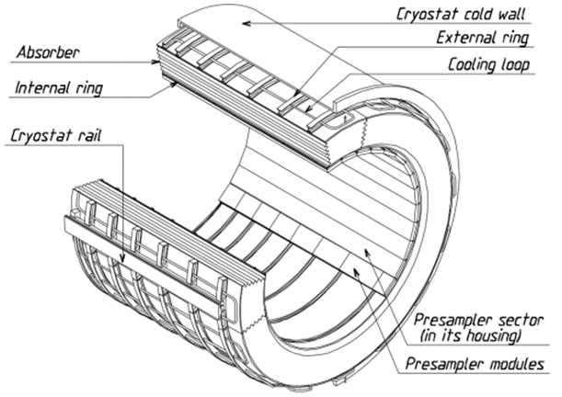
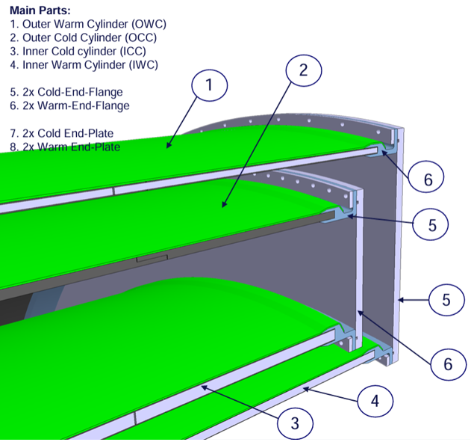
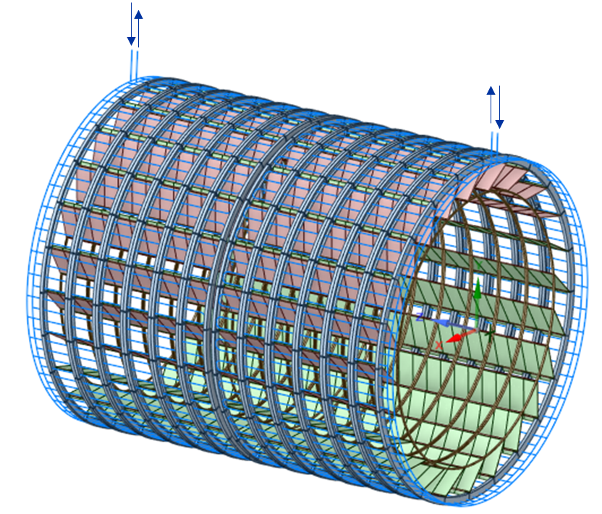
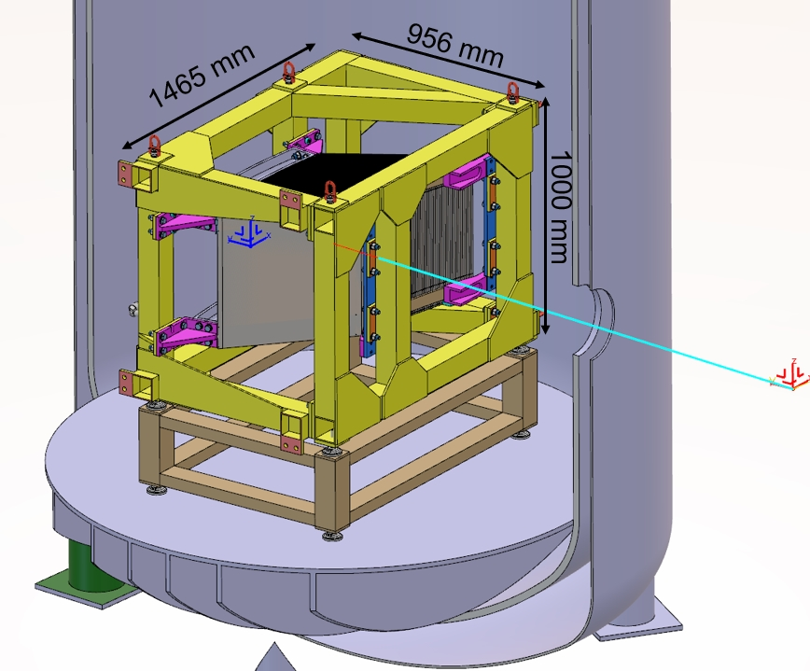
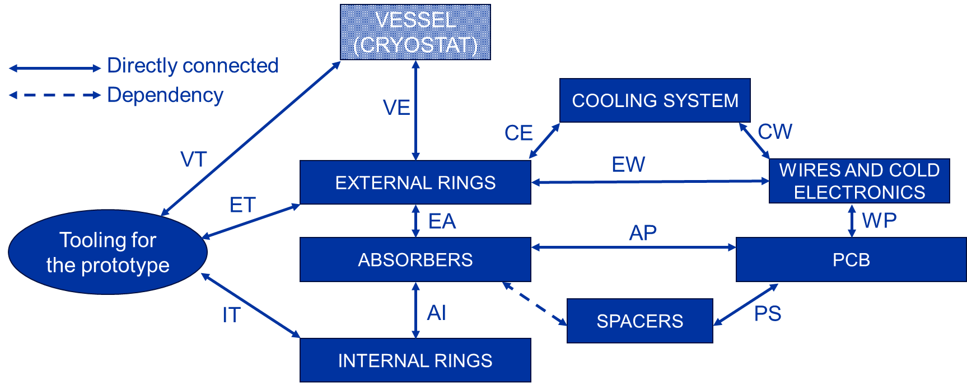
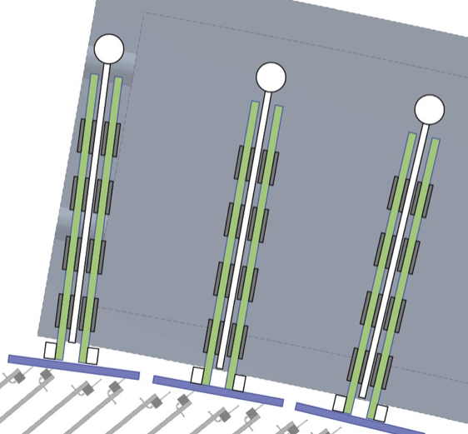
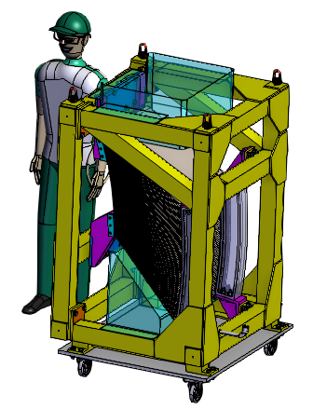
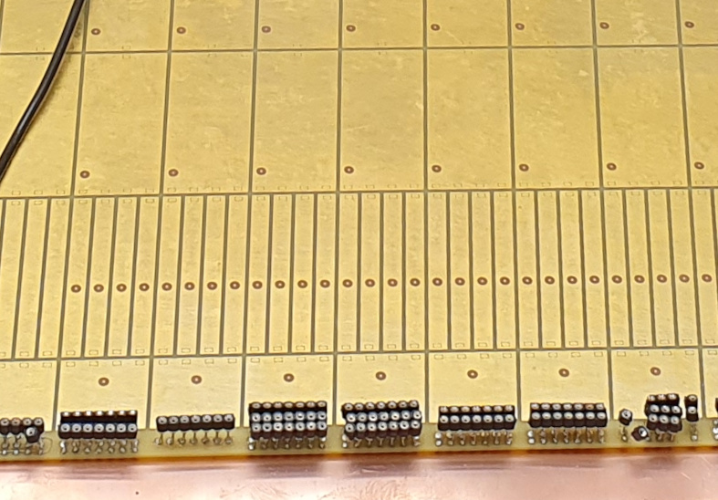
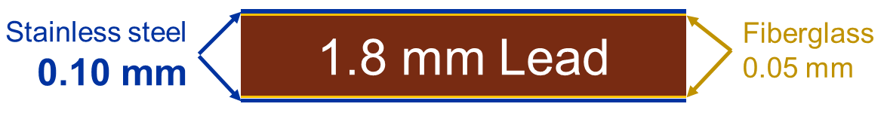
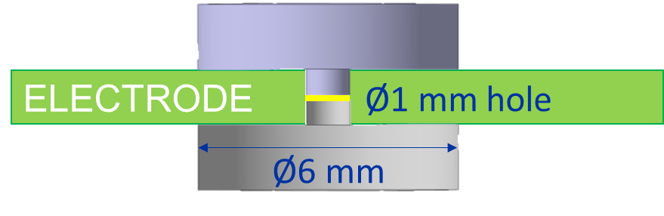
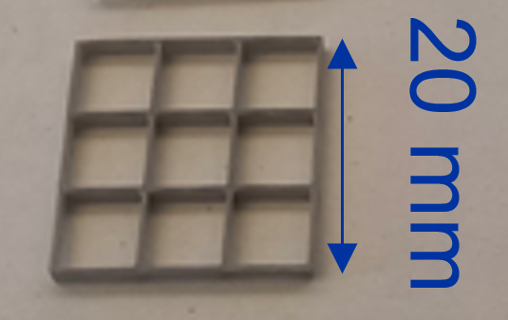
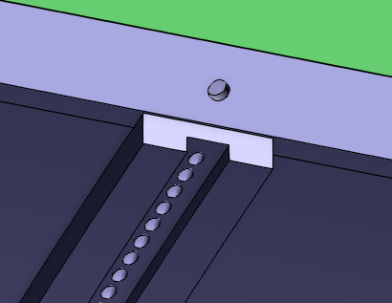
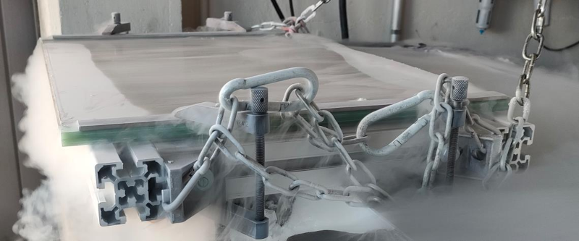
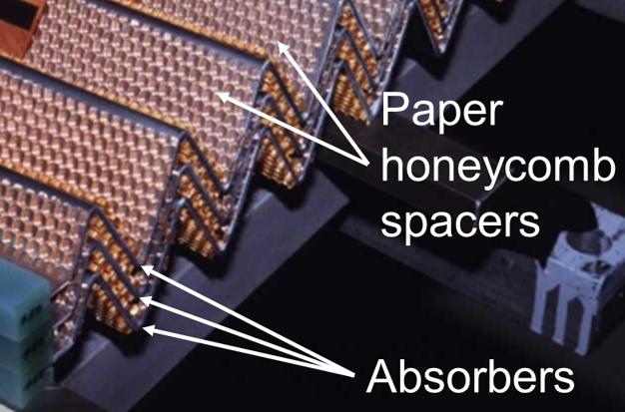
General components of the barrel calorimeter
María Soledad Molina González
Carbon composite cryostat
ATLAS ecal layout
Pierre Karst (ST2410245_01)
BNL: Cable routing in ALLEGRO
Absorber
External rings
Spacers will be pins, 3D printed mesh or paper honeycomb, as in ATLAS experiment
https://allegro.web.cern.ch/plots/ecal_barrel/ecal_barrel/
Absorber cold test
Internal ring
https://cernbox.cern.ch/s/1oWw7zzxiB0DV7L

Slide 4
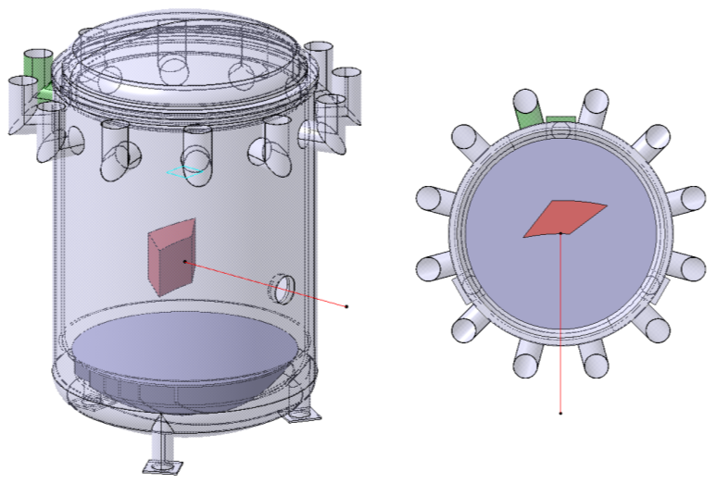
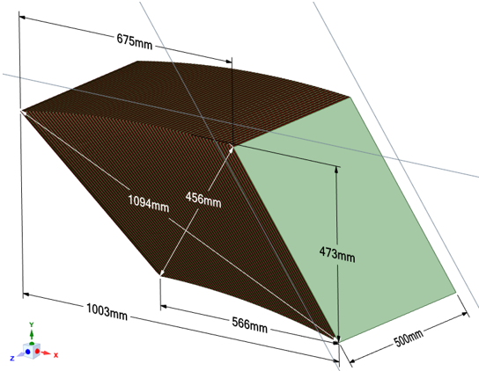
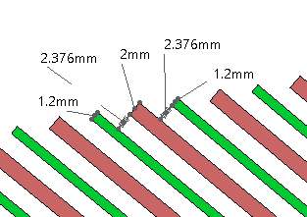
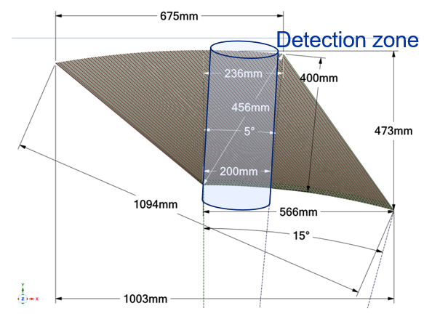
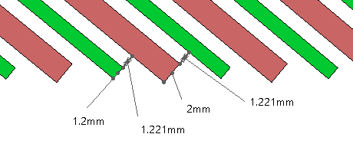
Test beam prototype
  It is considered a sector of 15º, meaning 64 absorbers out of 1536.
    This configuration returns a complete detection zone of 200 mm.

Slide 5
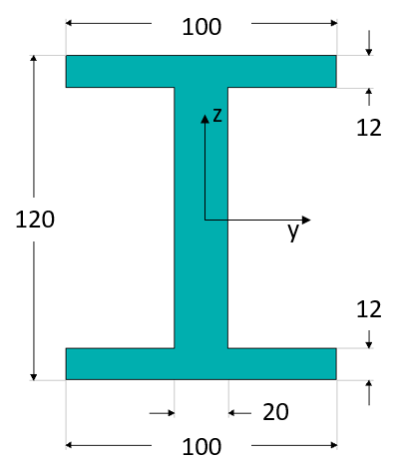
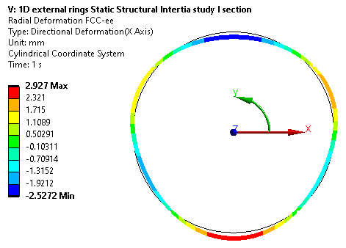
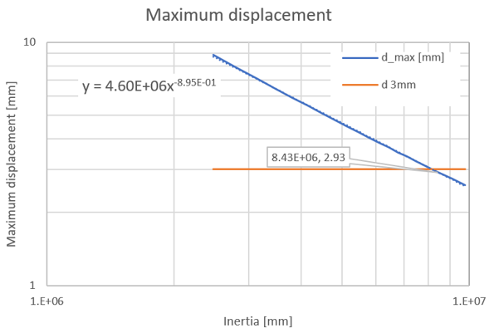

External rings first approach
  First study for the needed external rings was made by considering a half barrel of 63 ton and 7 rings. 63 ton = 65 ton (detection zone) + 10 ton (others) – 12 ton (Archimedes)
  Only one ring, modelled by 1D elements, is studied. So, the load is 9 ton.
  Displacements out of the plane of the ring are constrained and the ring is supported vertically in the sides, simulating the rails.
  Maximum displacement would be less than 3 mm if the inertia is about 8.5 E+6 mm⁴.
  The section showed was selected as starting point for future analyses.
$$I_{yy}=8.5·{10}^{6} mm^{4}$$
External rings
Notes:
3.5 mm due to junctions (+15%).
The ring has been modelled to perform ﬁnite-element (FE) calculations. Figure 6-29 shows the
deformation of a ring under a weight of 12 tons and imposing no displacement in the horizontal
plane of the ring where it rests on the cryostat rail. The maximal deformation for a continuous
ring is 3.0 mm at the top and bottom. This maximal deformation becomes 3.5 mm when taking
into account the weakening effect due to the junctions. At cold, apart for the normal thermal
contraction of the ring, the differential contraction between the stainless steel of the ring and the
aluminium of the rails imposes a deformation of 2 mm in the horizontal plane giving ﬁnally a
maximal deformation of 5.0 mm at the bottom of the ring. Taking into account the higher Young
modulus of the stainless steel at cold and the reduced weight of the calorimeter due to the den-
sity of the liquid argon (d = 1.4), the maximal deformation will be about 4.0 mm. Assuming that
the accuracy of these calculations is 10%, this maximal deformation induces an uncertainty of
0.4 mm on the calorimeter radius, which will have to be recovered from the data.

Slide 6
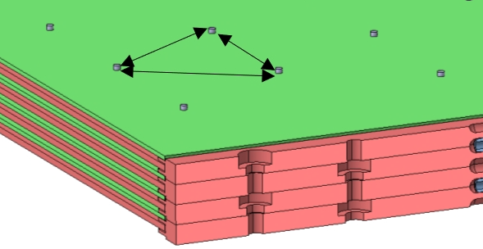
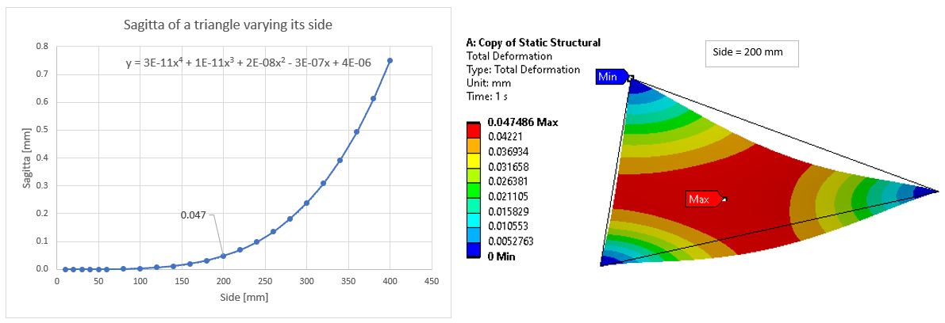
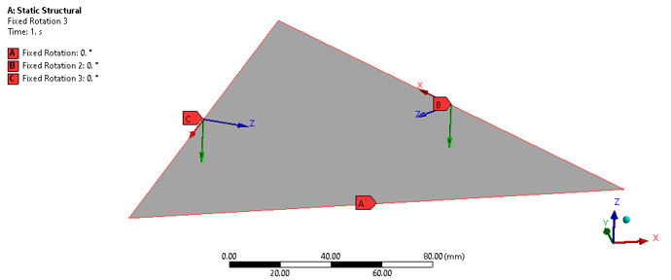
How many spacers are needed?
  The liquid argon is between electrodes and absorbers. So, it is important that the gap remains the same as expected.
  Pins were proposed and a study was made to estimate how many spacers are needed to maintain an acceptable deformation.
  This deflection depends only on the region of the absorber between the pins.
  Symmetry conditions are applied in the edges and the displacement in the vertex are set to zero.
  Distance of 200 mm seems acceptable, as the normal deformation remains less than 50 μm.

Slide 7
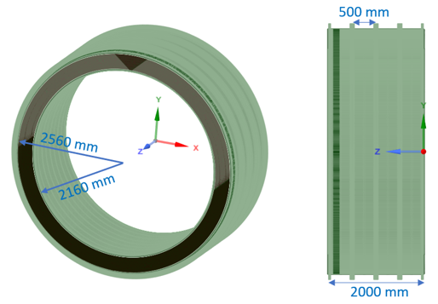
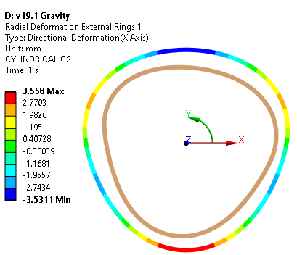
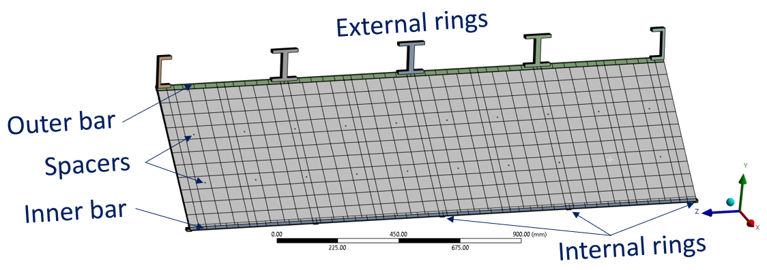
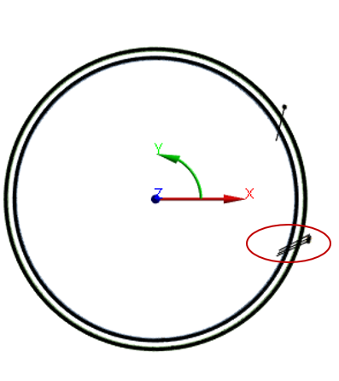
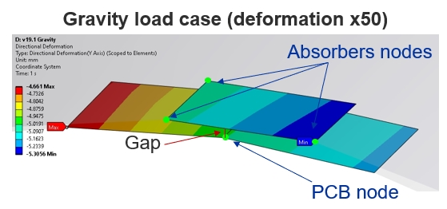
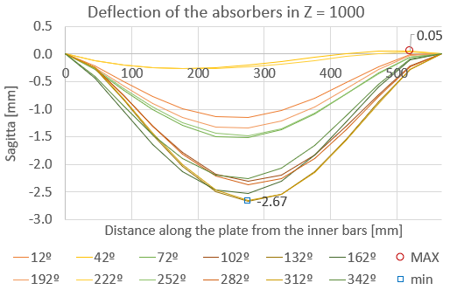
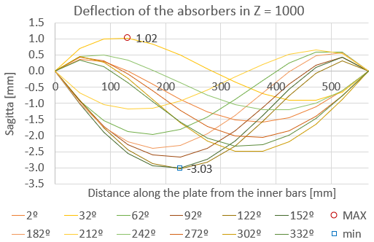
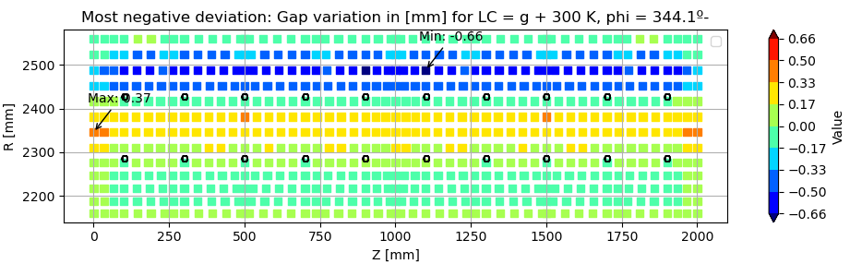
Mechanical analysis: 2 meters FEA
  A FEM of a 2 meters long ecal is built. Rings are placed each 500 mm and spacers each 200 mm.
Warm load case
0º
Weight = 49 ton
No Archimedes' principle is considered
Warm load case
Cold load case
Notes:
Using the studies done before, a FEM of 2 meters is built. It’s a FEM of 2 million elements.
Rings are located every 500 mm and the spacers every 200 mm.
In the edges, half of the section of the rings is taken. So, at the end is as we have 4 complete rings.
The weight of the model is 49 tons (Achimedes principle is not considered), so each ring support a bit less than 12 tons. This is why the deformation of the external ring 3.5 mm, instead of the 3 mm seen before.
A behaviour we cannot see in the 250 mm FEM is the sagitta of the inner bars. While the outer bars, in warm conditions, has a symmetric behaviour respect from each ring, vertical displacement is higher in the central part of the inner bars. This is because the external rings are directly supported in the rails and the inner rings are not supported in the cryostat.
In addition, when cold temperature is applied (87 K) rings in the extremes rotate due to the contraction difference between bars and absorbers. In this model, G10 of short fibres is considered as material. For ATLAS, a special configuration is used so the CTE is the same as the absorbers.
Sagitta of the absorbers is also bigger than in the 250 mm model in the centre of the ecal.
*********************************************************************
There are 5 rings, but they are as 4 “complete” H rings.
So 49 tons / 4 = 12.25 ton per ring. That´s why the deformation of the external ring is 3.5
E_lead = 0.3 GPa (above yielding point)
CTE of the model (v19.1) [E-06 K^-1]:
Lead =29.1
SS304 = 13.4 Fascicule de cryogénie et supraconductivité
FR4 = 15.5
G10 = 31.6 Fascicule de cryogénie et supraconductivité
Absorber = 14.06
2 million elements in the FEM

Slide 8
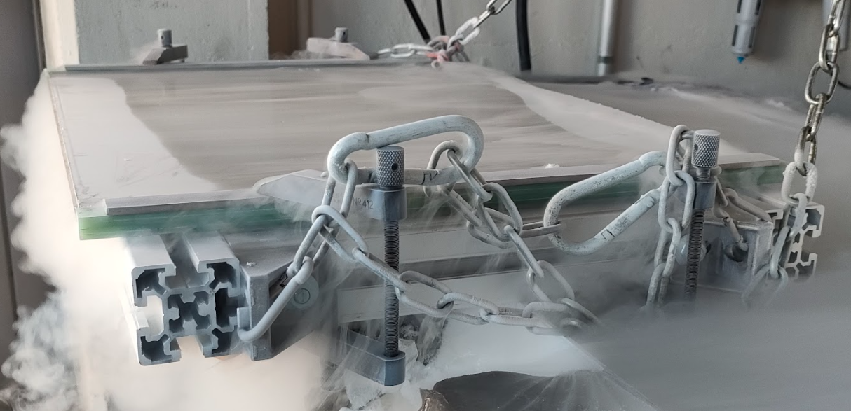
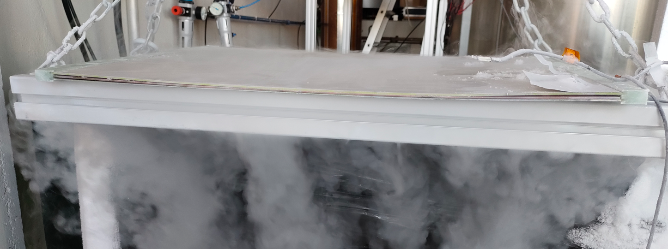
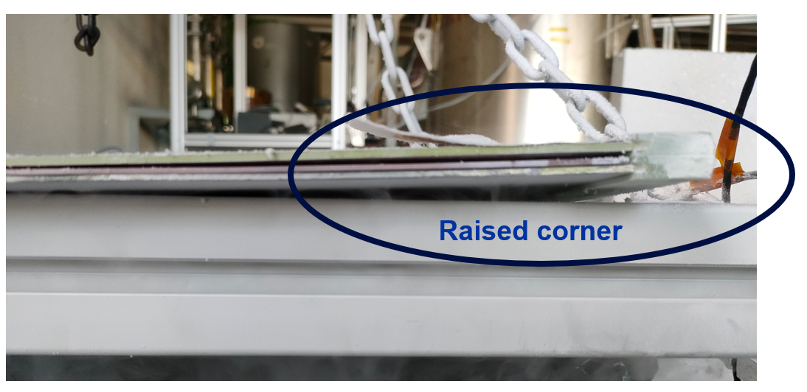
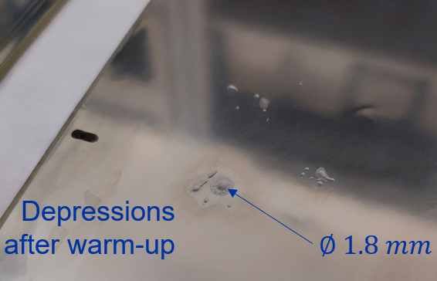
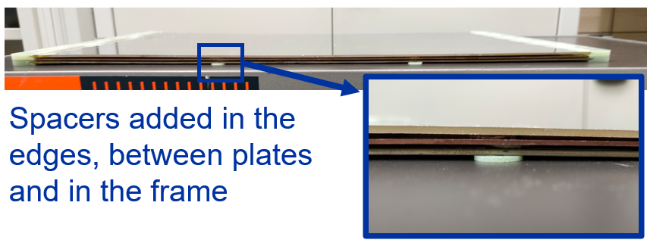
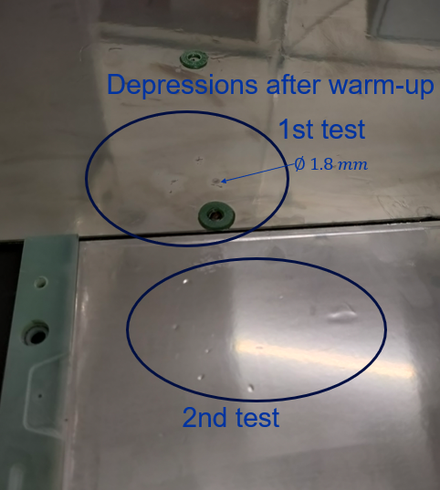
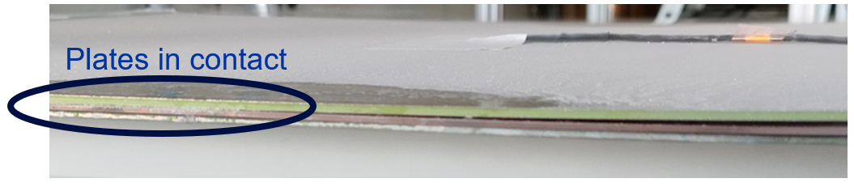
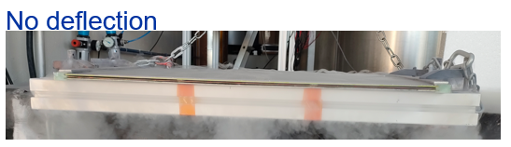
Absorbers cold test (2×0.05 mm of AISI304L)
  The prototype was immerged in liquid nitrogen using two different configurations: supported and clamped.
  Due to the surface defaults, it’s decided to use 0.1 mm layers.
Clamped to the frame
Supported on the frame

Slide 9
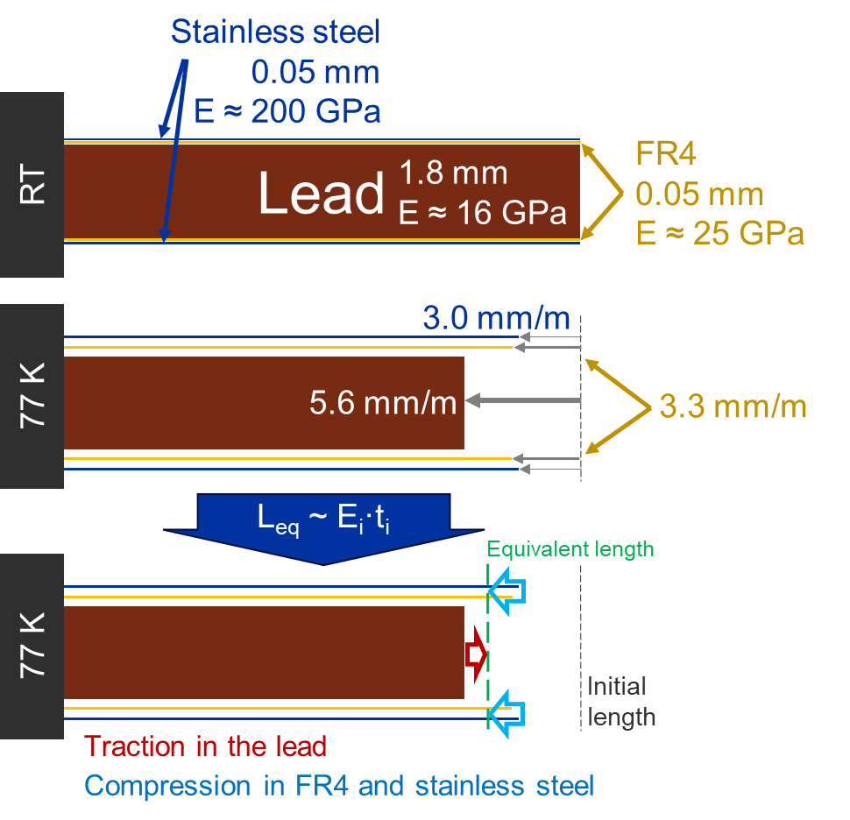
Thermomechanical properties of one absorber
In a composite plate, every material wants to contract differently when they are cooled down. The resultant contraction, as well as the stress of each layer depends on the rigidity and thickness of each layer.
The reference should be the crystallisation temperature of the FR4 (155 ºC), not room temperatura (RT).
Strength and contraction tests were performed, and it was concluded that the stiffness of the lead was underestimated at cold temperatures
 | 𝜎y at RT [MPa] | 𝜎y at 77 K [MPa] | CTE (RT to 77 K) [10⁻⁶ K⁻¹]
Experimental results | 16.0 | 38.0 | 15.6
Laminate theory | 17.2 | 21.1 | 14.0
FEA | 16.0 | 20.0 | 14.5
Using sheets of 0.1 mm, the CTE is 15.26 ·10⁻⁶ K⁻¹

Slide 10
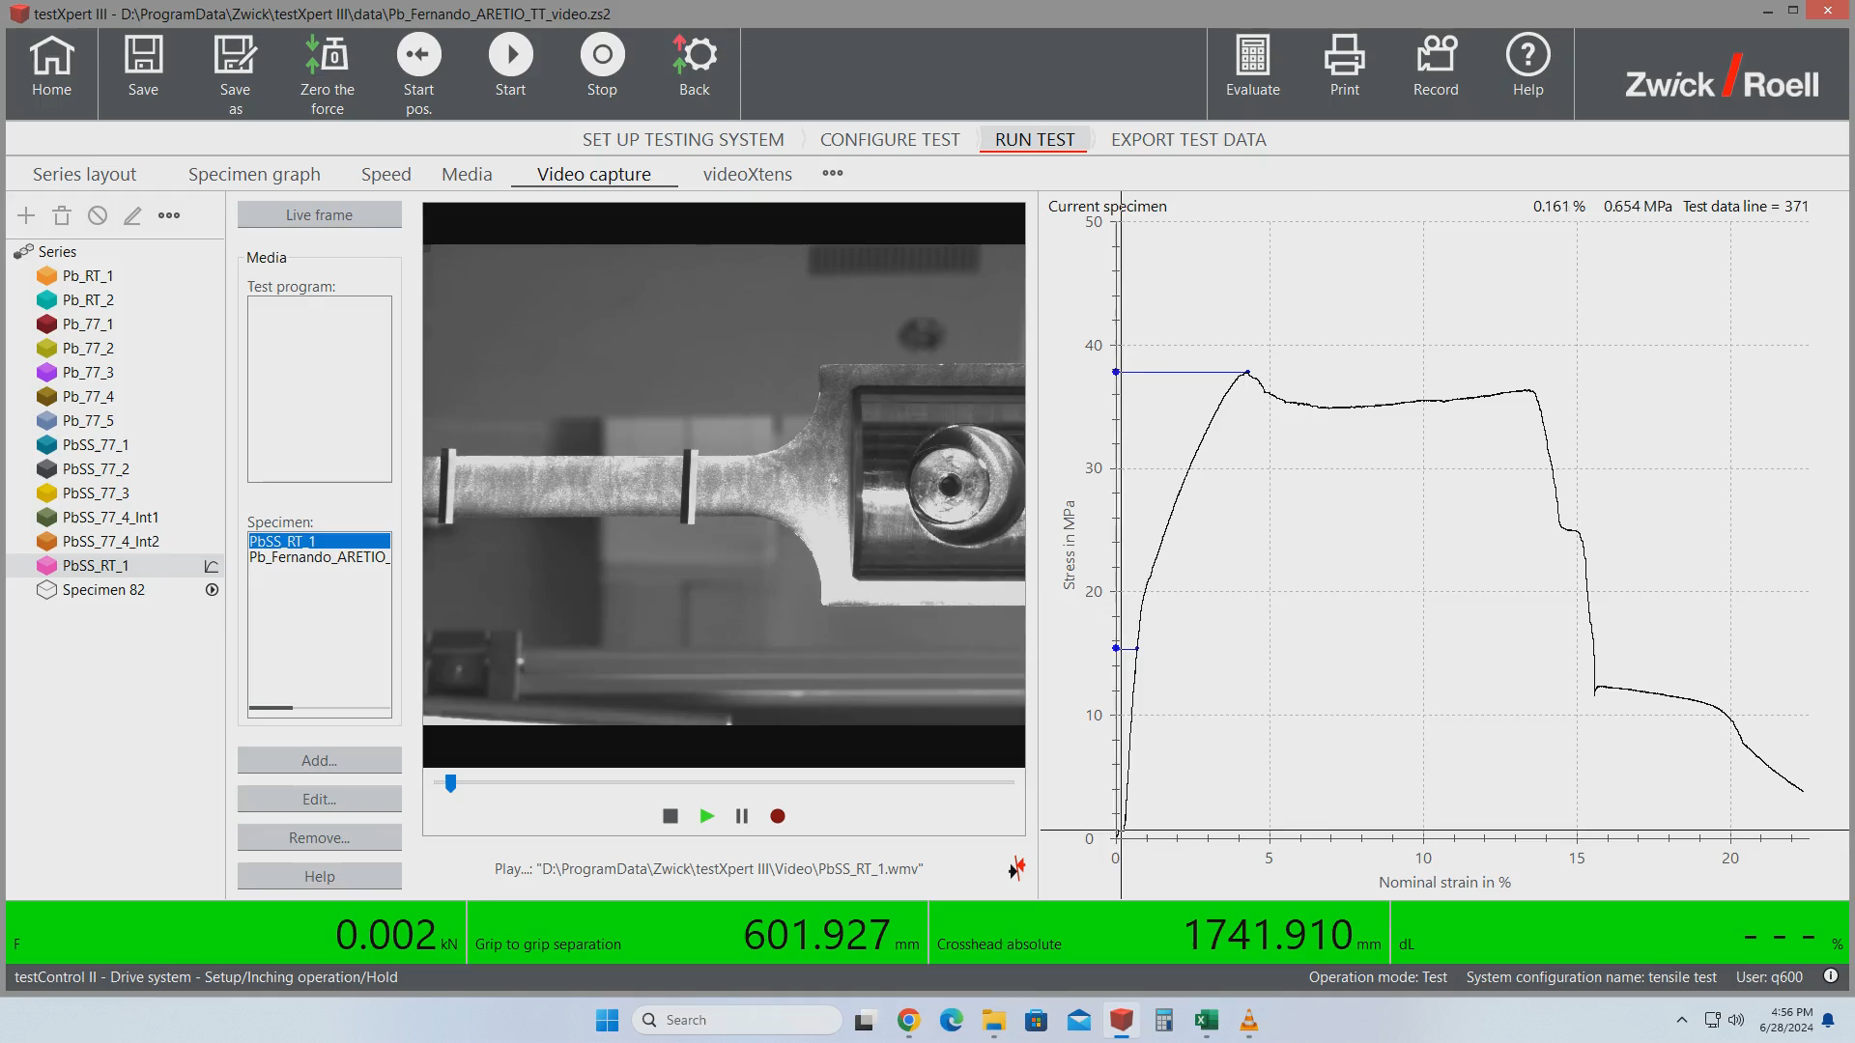
Sandwich strength test (RT): Until yielding point
PbSS_RT_1
Change of slope (E)
Yielding point at 16MPa
B. Ruiz Palenzuela
E. Rodríguez Castro
I. Avilés Santillana

Slide 11

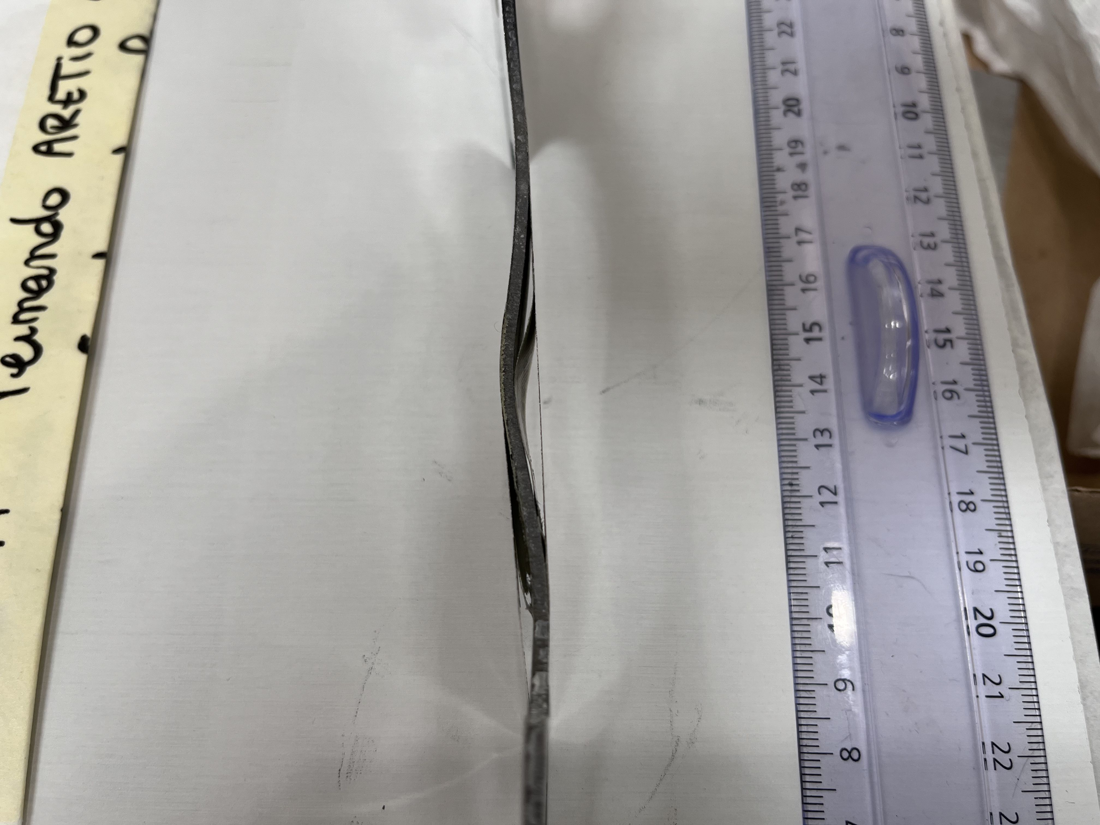
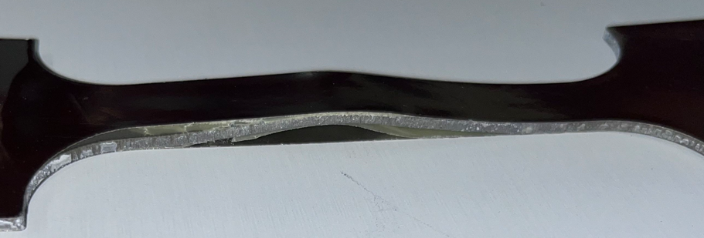
Sandwich strength test (RT): FR4 failure (deglue)
PbSS_RT_1
B. Ruiz Palenzuela
E. Rodríguez Castro
I. Avilés Santillana

Slide 12
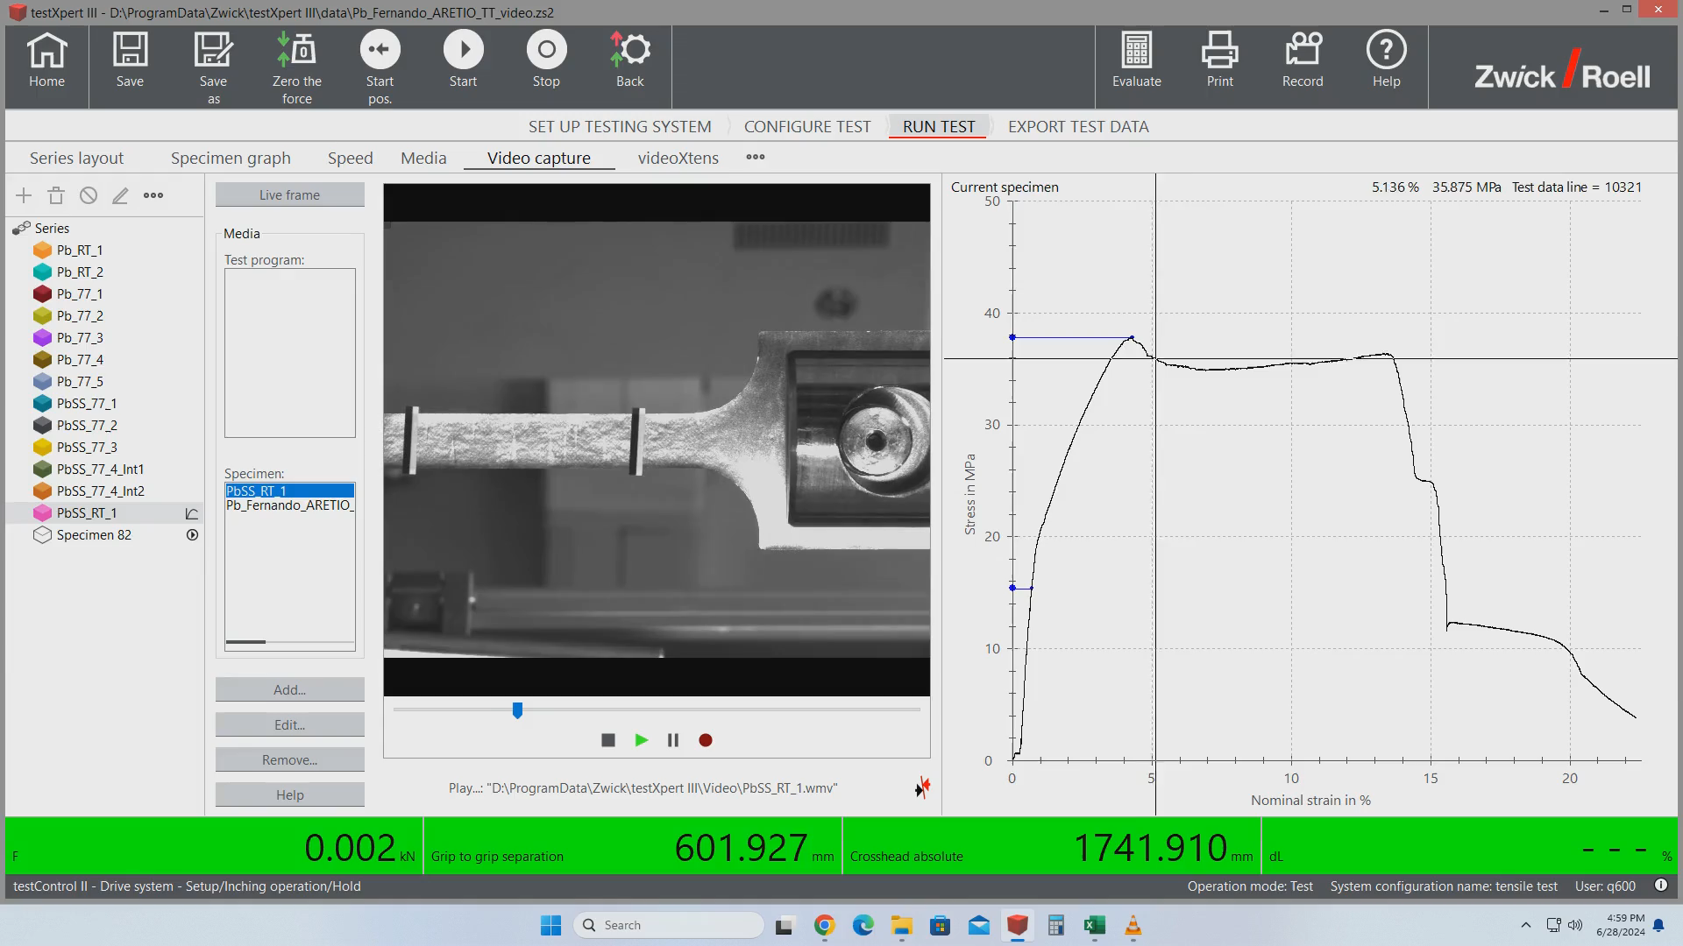
Sandwich strength test (RT): Stainless steel failure 1
PbSS_RT_1
Plastified AISI
Failure of AISI layer 1
B. Ruiz Palenzuela
E. Rodríguez Castro
I. Avilés Santillana

Slide 13
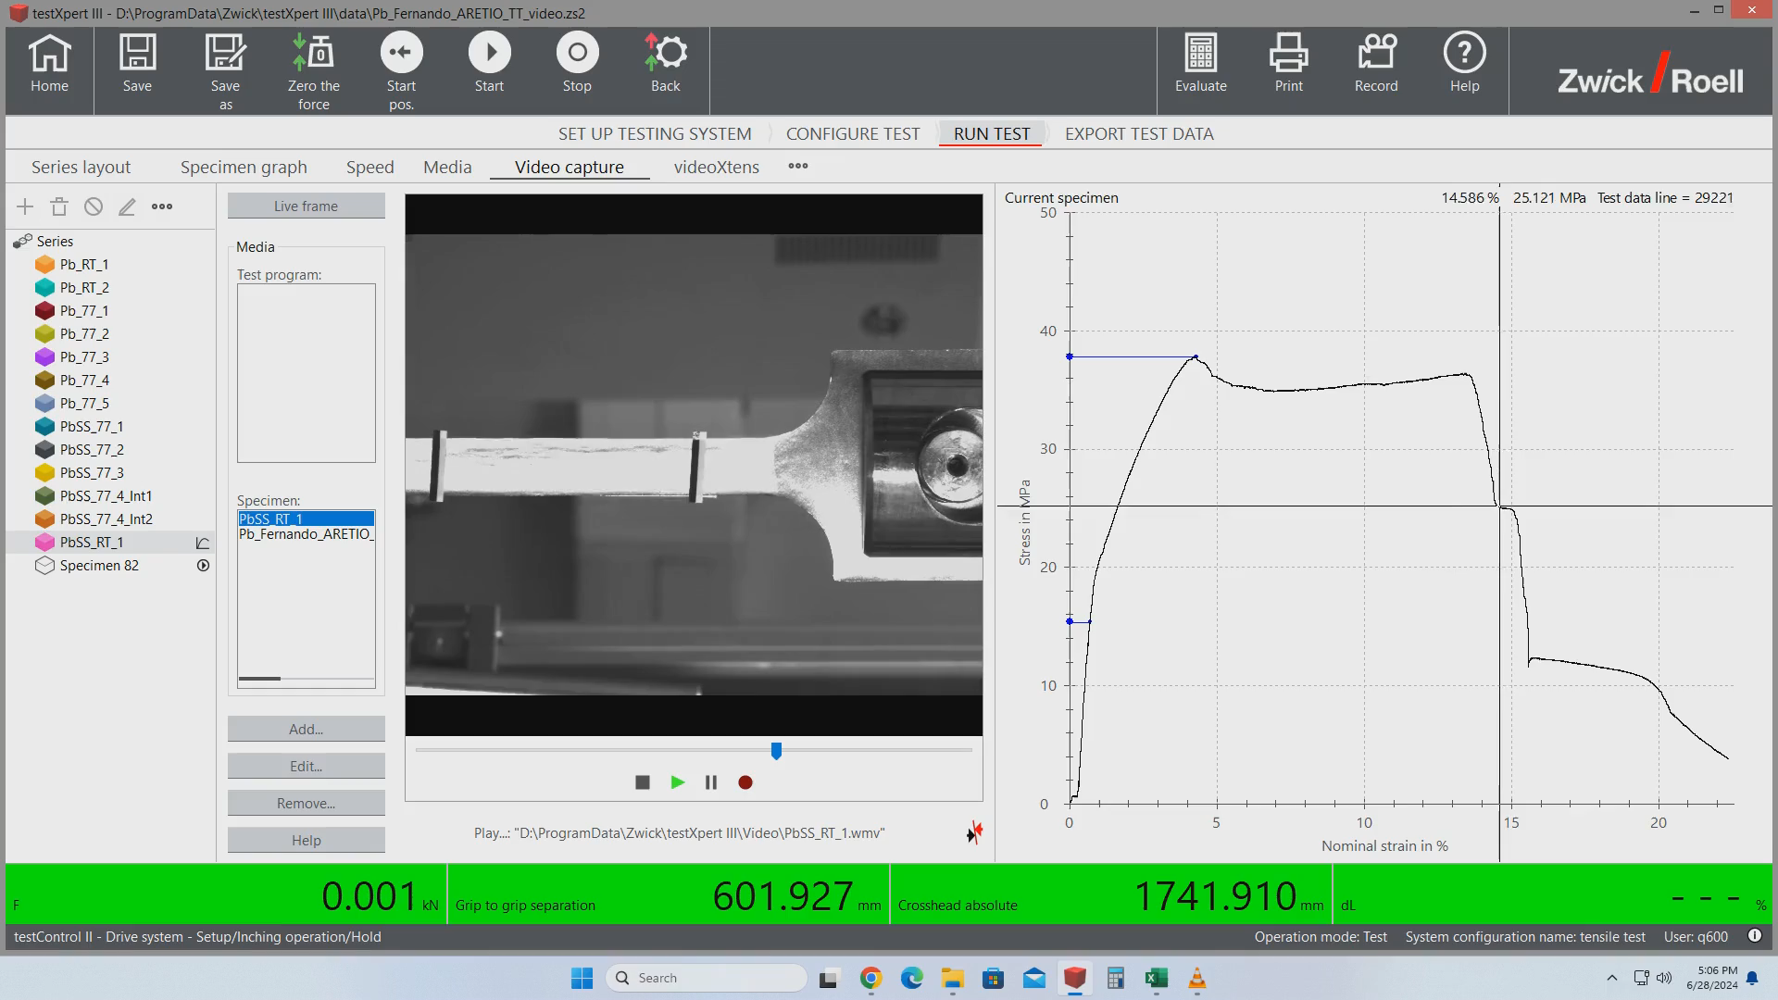
Sandwich strength test (RT): Stainless steel failure 2
PbSS_RT_1
Failure of AISI layer 2
B. Ruiz Palenzuela
E. Rodríguez Castro
I. Avilés Santillana

Slide 14

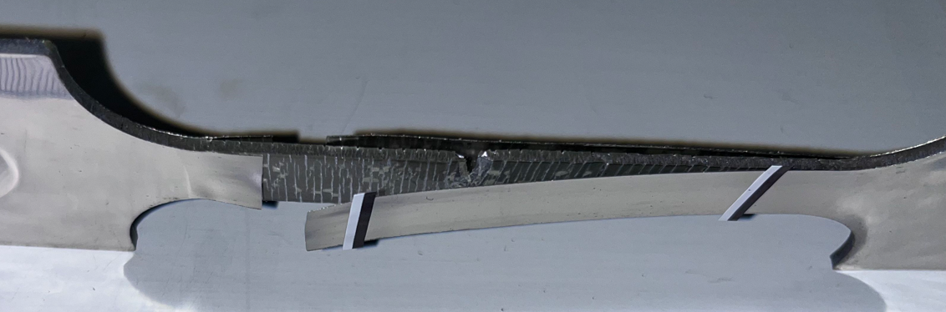
Sandwich strength test (RT): Sandwich failure
PbSS_RT_1
Only lead is working
B. Ruiz Palenzuela
E. Rodríguez Castro
I. Avilés Santillana

Slide 15







Spacers options. Variable gap from 1.2 to 2.4 mm
Pins attached to the PCB
To be produced and tested.
Exact position and good tolerances.
Concentrated forces.
3D printed mesh
Measured and pressure cold tests
Distributed force and easy to build.
Difficult to characterised the material.
Burring is needed after printing.
Honeycomb paper
Ready for assembly test in 2 months.
Distributed force and fast assembly.
Expensive. Tolerances to be checked.

Slide 16


Cooling system for the cold electronics
Having front end electronics means that we shall extract a big amount of heat. Heat power of the ATLAS barrel was 2 kW, and for ALLEGRO it is estimated a maximum of 120 kW (2 million channels, 60 mW/ch).
Global challenges, more and shorter heat exchangers are needed to allocate the nitrogen mass flow (≈1 kg/s) with an acceptable drop pressure. 96 pipes is considered an optimal number for the assembly.
Prevent boiling near the boards: liquid argon conductivity is worse than air and the natural convection is not enough to take the heat from the boards to the heat exchangers.
Pure aluminium plates will connect these parts, so the heat transfer is done by conduction.
Notes:
Air has a thermal conductivity of 0,026 W/(mK). If we replace that air with a lower-conductivity gas, we can slow the heat loss through windows. Argon has a conductivity of 0,018 W/(mK) – 33% lower than that of air.

Slide 17









External ring optimisation
Cabling and cooling system pass through the external rings. So, a topological optimisation was done to make the most possible space not loosing rigidity.
Scale x20
Scale x20
Optimised areas
Area -45%
Max displacement
+1%
Every sector is optimised differently
New web
Scale x20
12 tons of
distributed mass
The optimised area of every sector is superposed and a new web is drawn
Ideal optimisation
To be produced

Slide 18







Structure for assembly and support of the prototype
The same structure will be used for the assembly and stacking of absorbers and electrodes, and as support of the prototype in the test beam.
Mounting and adjustment of the interface and the Rings
Internal rings
External rings
Positioning holes
Stacking of absorbers and electrodes
Test beam configuration
Deformation analysis
Pierre Karst (ST2410245_01)

Slide 19


Prototype for assembly test
The assembly of the absorbers wants to be tested.
Intermediate parts are machined to be bolted to the absorbers and to the rings.
The idea will be replicated for the internal rings.
Dimensions were adjusted so fit the requirements at cold temperature.
All the 3D models are accessible through PLM:
Folder WP3
PLM: ST2414589_01 AA.02 21ALLABE0020
Half 21ALLABERE3001
21ALLABERE3002
Between the rings, an envelope part was design
Half 21ALLABERE3001
21ALLABERE3001
21ALLABEB3002
21ALLABEB3001

Slide 20
Conclusions
  This new geometry presents challenges.
  Well defined baseline design and general studies.
  For some parts there is still development to do.
  Look for suppliers that are not always evident, as for the absorbers.
  External rings: Prototypes in 2 months.
  Internal rings: Design to be done following the idea of the external rings for the interfaces.
  Absorbers: Design finished. Look for suppliers.
  Spacers: Under study. Decision to be done.
  Cooling system: Design in progress.
  Support structure: Design almost finished.
  Assembly: Still some interfaces to be design.
  Tests and analysis: More testing and analysis have to be done for the spacers and the complete assembly.

Slide 21


Thank you for your attention
Questions or suggestions?
fernando.aretio.zarate@cern.ch

Slide 22





ALLEGRO
  ALLEGRO is a full detector concept proposed for FCC-ee. It stands for:
    A Lepton coLlider Experiment with highly Granular calorimetry Read-Out.
  This presentation is focused on the thermo-mechanical design and analysis of the structure of the barrel calorimeter.
Electrode prototype
Calorimeter section concept
Cryostat: ATLAS in aluminium
FCC in composite
Notes:
Allegro is the full detector concept proposed for the FCC-ee. The meaning is
A Lepton coLlider Experiment with highly Granular calorimetry Read-Out.
My work is focused in the thermo-mechanical design and analysis of the structure of the barrel calorimeter. In the configuration we can see here, it´s placed between the drift chamber and the solenoid.
The calorimeter is basically compound by electrodes and absorbers, and they are enclosed in a cryostat containing the noble liquid. This liquid will be Argon, but others as krypton or xenon could also be used.
The cryostat of the ATLAS calorimeter is done in aluminium and for the ALLEGRO is expected to be done in carbon fibre composite.
High granularity is achieved by using multi-layer PCBs, as the one in the image, which correspond to the prototype.
*******************************
How the calorimeter works:
It features layers of metal (either tungsten, copper or lead) that absorb incoming particles, converting them into a “shower” of new, lower energy particles. These particles ionise liquid argon sandwiched between the layers, producing an electric current that is measured. By combining all of the detected currents, physicists can determine the energy of the original particle that hit the detector.
The central region of the calorimeter is specially designed to identify electrons and photons.
*******************************
20200116-FCC-Workshop-LArCalorimetry.pdf (cern.ch)
https://indico.cern.ch/event/838435/contributions/3658385/attachments/1970594/3278249/20200116-FCC-Workshop-LArCalorimetry.pdf
Detector concept from: https://indico.cern.ch/event/1064327/contributions/4893219/attachments/2454064/4206036/FCC-ee-Experiment-Layouts-20220601.pdf
PCB prototype: CERN EP R&D Annual Report 2022

Slide 23




Backup 1: PCB and calorimetry
Notes:
https://indico.cern.ch/event/838435/contributions/3658385/attachments/1970594/3278249/20200116-FCC-Workshop-LArCalorimetry.pdf
https://www.europhysicsnews.org/articles/epn/pdf/2021/03/epn2021523p28.pdf
Calorimeters are specialised in the measurement of photons and electrons. The shower development is characterised by the radiation length X_0 which is defined as the mean distance in which electrons lose all but 1/e of their initial energy by radiation.
Sufficient longitudinal shower containment for typical particle energies requires a depth of above 20 X_0.
Calorimeters using liquefied noble gases (noble liquids) are based on the measurement of the ionization charge produced inside the liquid. The charges move in an applied electri field, inducing a current in readout electrodes proportional to the liberterated charge and hence to the energy deposited by the showering particle.
https://atlas.cern/Discover/Detector/Calorimeter
How the calorimeter works:
It features layers of metal (either tungsten, copper or lead) that absorb incoming particles, converting them into a “shower” of new, lower energy particles. These particles ionise liquid argon sandwiched between the layers, producing an electric current that is measured. By combining all of the detected currents, physicists can determine the energy of the original particle that hit the detector.
The central region of the calorimeter is specially designed to identify electrons and photons.

Slide 24



Backup 2: ATLAS images

Slide 25






Backup 3: External rings structural analysis
  The considered weight for the half barrel is 63 tonnes, considering 10 tonnes of support structure and -12 tonnes of the Archimedes principle. This is an optimistic approach.
  Three types of profile are considered and their geometry is changed to reach maximum deformation of 3 mm.
W2
t2
side
W3
Corresponds to the total length of the half barrel divided in 7 rings. 3172 mm / 7 = 453 mm.
t1
t3
W1
W1 = W2 = 130 mm
t3 = 46 mm
h = 60 mm
side = 95 mm
Weight of one ring: 3.5 tonnes
Weight of one ring: 1.2 tonnes
Weight of one ring: 0.9 tonnes
Notes:
The 63 tonnes come from:
65 ton of detection zone.
10 ton of support structure.
-12 ton of Archimedes principle.

Slide 26








Backup 4: FEM 250 mm long
  Three finite element analyses, using a 250 mm long model, have been carried out using absorbers with 1.8 mm of lead and different stainless-steel thickness : 50 μm, 100 μm, 200 μm.
  Radial displacements of the external ring (3.5 mm for 50 μm, warm condition) is proportional to the total weight. Using 200 μm steel plates increase the weight by 8%, so do the displacements.
  The internal rings (where maximum radial displacement appears) are not only affected by the total weight but also by the stiffness of the absorbers. That makes the radial displacement increases by 3%, instead of 8%.
  Sagitta highly depends on the steel thickness ($w ≈f\left(\frac{1}{\sqrt{t_{SS}}}\right)$).
  Spacers in contact remains about 50% in all the cases.
Notes:
Symmetric boundary conditions are apply in both sides.
Stiffener absorbers does not mean less displacements of the rings because of the increase of weight.
Multiplying the thickness of the steel by 4, weight increase 8.2% and the maximum radial displacement in the internal rings increase 2.6%. For the external rings it’s expected to be 8.2%.
Sagitta in cold conditions are very similar than in warm conditions (less than 2% difference).
If the steel thickness is higher than 0.2 mm the maximum sagitta is less than 1 mm (ATLAS requirement).
About half of the spacers are in contact for all the cases. This percentage is slightly higher in cold conditions.

Slide 27




Backup 5: FEM 2 m long
Scale x50
Scale x50
Scale x50
Scale x50
Notes:
Symmetric boundary conditions are apply in both sides.
Stiffener absorbers does not mean less displacements of the rings because of the increase of weight.
Multiplying the thickness of the steel by 4, weight increase 8.2% and the maximum radial displacement in the internal rings increase 2.6%. For the external rings it’s expected to be 8.2%.
Sagitta in cold conditions are very similar than in warm conditions (less than 2% difference).
If the steel thickness is higher than 0.2 mm the maximum sagitta is less than 1 mm (ATLAS requirement).
About half of the spacers are in contact for all the cases. This percentage is slightly higher in cold conditions.

Slide 28

Backup 6: G10 CTE from ATLAS TDR

Slide 29





Backup 7: Deflection of a beam
$$EI=E_{lead}·I_{lead}+E_{SS}·I_{SS}$$
$$I_{lead}=\frac{1}{12}at_{lead}^{3}$$
 | Lead | SS | Total
a [mm] | 500 | 500
t [mm] | 1.8 | 0.05
z [mm] | 0 | 0.975
n | 1 | 2
I [mm4] | 243 | 0
I_steiner [mm4] | n/a | 24
I_tot [mm4] | 243 | 48
E [MPa] | 13500 | 200000
E·I [N·mm2] | 3.28E+06 | 9.51E+06 | 1.28E+07
E·I [%] | 26% | 74%
$$I_{SS}=2·\left(\frac{1}{12}at_{SS}^{3}+at_{SS}·z_{SS}^{2}\right)$$
Weight of one 500 mm long absorber
4% | m SS | 0.219 | kg
96% | m Lead | 5.613 | kg
0% | m pregreg | 0.021 | kg
 | m_abs | 5.853 | kg
$$≈0$$

Slide 30





Backup 8: Absorber’s deflection
  Three FEA, using a 250 mm long model, have been carried out using absorbers with 1.8mm of lead and different stainless-steel thickness : 50 μm, 100 μm, 200 μm.
  Deflection is calculated as the minimum distance between the deformed absorber and the position of the absorber as a rigid solid. Only gravity load case is studied.
  Deflection depends on the stainless-steel thickness: $Deflection≈f\left(\frac{1}{\sqrt{t_{SS}}}\right)$
Stainless-steel thickness = 50 μm
TOTAL DISPLACEMENTS
Notes:
Next object of study is the deflection of each absorber in the complete wheel of the calorimeter. The model itself it´s not specially complicated, but the number of absorbers and electrodes, as well as the fact the pins are not glued to the electrode, make it a bit tricky to build.
A first model is built. It is 250 mm long, and symmetry is applied in the edges.
Three different thickness of stainless steel are analysed: 50, 100 and 200 microns.
To study the sagitta, we can consider the displacement of each absorber as a sum of two displacements:
the displacement as rigid body, which can be calculated as the straight line of the displaced nodes in the inner and outer radius, where the G10 bars are placed. It´s the green line in the image.
On the other hand, we have the deformation of the absorber itself.
Sagitta is considered as the minimum distance between these two displacements, as it´s shown in the yellow line.
Results are shown in this graph. Maximum sagitta appears in the horizontal absorbers, in the angles 132 and 312 degrees. We can see them here. And the minimum in the vertical ones.
Sagitta depends on the stainless steel thickness, as expected.
CTE of the model (v13.1b) [E-06 K^-1]:
Lead = 29.1
SS304 = 15.5 (mistake?)
FR4 = 15.5
G10 = 11.2
Absorber = 23.21
Using these CTEs we constated that there is almost no difference between the warm and cold load case. The cold load case is at 87 K.

Slide 31





Backup 9: Design and construction
  The first assembly is only compound by 2 absorbers and 1 dummy electrode.
  A frame of FR4 is used to avoid movements during pressing.
  Absorbers are glued to the bars and the bars bolted together

Slide 32


Backup 10: Classical laminate theory
The sandwich material is studied analytically following the Basic mechanics of laminated composites plates, where the following assumptions are made:
  Laminate thickness is very small compared to its other dimensions
  The layers are perfectly bonded (strain continuity across the thickness)
  Line perpendicular to the surface remain straight and perpendicular to the surface after deformation.
  Laminate is linear elastic (however this analysis is done changing the properties, according to temperature and stress, every K or N applied).
  The through-the-thickness stresses and strains are negligible.
Yielding points:
  RT: 17.7 MPa
  77 K : 21.1 MPa
The CTE at 77 K is calculated by the strain difference between 298 K and 77 K, returning 14.0·10⁻⁶ K⁻¹.
Compression prestress in the stainless steel reaches 142 MPa at 77 K

Slide 33





Backup 11: Finite element analysis
Finite elements analysis of the tested geometry sample is performed by using 2D elements and the layered section option in ANSYS.
Deformation x10
Yielding points:
  RT: 16.0 MPa
  77 K : 20.0 MPa
The CTE at 77 K is calculated by the strain difference between 298 K and 77 K, returning 14.5·10⁻⁶ K⁻¹.
Compression prestress in the stainless steel reaches 184 MPa at 77 K.

Slide 34

Backup 12: Strength test summary
Yielding points (Rp_{0.2} in the first slope change) are 16 MPa at RM and 38 MPa at 77 K.
Big drop after the continuity loss. How much of this drop is due to the AISI thermal compression?
Tests demonstrate high repeatability.
Video
Test interrupted (not in the graph) at continuity loss to take the photo

Slide 35


Backup 13: Young´s Modulus, yielding point and CTE
  Association Française du Froid (2019) Fascicule de cryogénie et supraconductivité. (978-2-37620-356-8)
  Stainless steels - Part 2: Technical delivery conditions for sheet/plate and strip of corrosion resisting steels for general purposes. SN EN 10088-2:2014
  Stainless steels - Part 1: List of stainless steels. SN EN 10088-1:2024
  Hofmann, W (1970) Lead and lead alloys. Properties and technology. (DOI 10.1007/978-3-662-28508-4)
  Strength test of pure lead samples (SN EN ISO 6892-1:2020, SN EN ISO 6892-3:2015, ASTM E8/E8M:24)
Stainless steel
Lead

Slide 36


Backup 14: Lead test
Sample thickness: 1.8 mm
Testing Conditions
    Standard method: ISO 6892-3
    Speed: 2.5 × 10⁻⁴ s⁻¹
    Preload: None
    Elongation Control:
    77K & RT (Pb Specimens): Crosshead
    RT (additional Pb Specimen): Videoextensometer
    For all cases, the same setup was used
Similar behaviour is observed for the five specimens at 77K and the three specimens at RT.
The yield values are 8.03 ± 1.34 MPa at 77K and 5.91 ± 0.2 MPa at RT.
B. Ruiz Palenzuela
E. Rodríguez Castro
I. Avilés Santillana

Slide 37




Backup 15: Contraction of the absorber
$$CTE_{abs}=15.3×{10}^{−6} K^{−1}$$
CTE of absorbers (2x0.1mm AISI) comes from AbsorbersContractionMeasuredWithStrainGauges_v1.pdf.
The test was performed from RT (300K) to LN2 (77K)
$${\left.{∆L}/L\right|}_{abs 300 K to 90 K}=3.2 {mm}/{mm}$$

Slide 38


Backup 16: LAr and LN2 diagrams

