Slide 1
Co-Design for Hadron Calorimeters
Tommaso Dorigo
INFN, Sezione di Padova, Italy, and Lulea University of Technology, Sweden
On behalf of the MODE/EUCAIF Calorimetry Optimization Group
(INFN, U. Lund, Lulea TU, U. Oviedo, RPTU, KIT):
S. Abbas, Abhishek, M. Aehle, P. Andreacchio, M. Awais, P. Behrozi, A. Breccia,
R. Carroccio, L. Chen, A. Das, A. De Vita, J. Donini, N. Gauger, R. Keidel, J. Kieseler,
E. Lupi, A. Mikkelsen, F. Nardi, Xuan-Tung Nguyen, F. Sandin, K. Schmidt, P. Vischia, J. Willmore
IJCLAB Orsay, DRD6-Calorimetry Collaboration Meeting
4/4/2025

Slide 2
Contents
Introduction to co-design
What information do we want to extract?
How can we read it out effectively?
A framework for end-to-end optimization

Slide 3
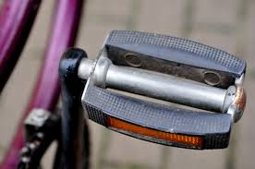
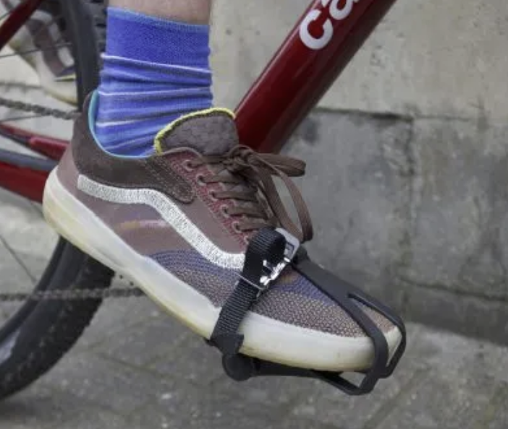
1 - What is Co-Design?
Realizing that the achievement of a goal may require to tailor each part of a system to all others: synergy
Enabling the simultaneous optimization of all parts, to maximize a global utility in a high-dimensional design space: holistic optimization
Bringing together diverse components, technologies, or expertise to create a unified and cohesive system, ensuring seamless interoperability and coordination: integration

Slide 4
1 - What is Co-Design?
Realizing that the achievement of a goal may require to tailor each part of a system to all others: synergy
Enabling the simultaneous optimization of all parts, to maximize a global utility in a high-dimensional design space: holistic optimization
Bringing together diverse components, technologies, or expertise to create a unified and cohesive system, ensuring seamless interoperability and coordination: integration

Slide 5
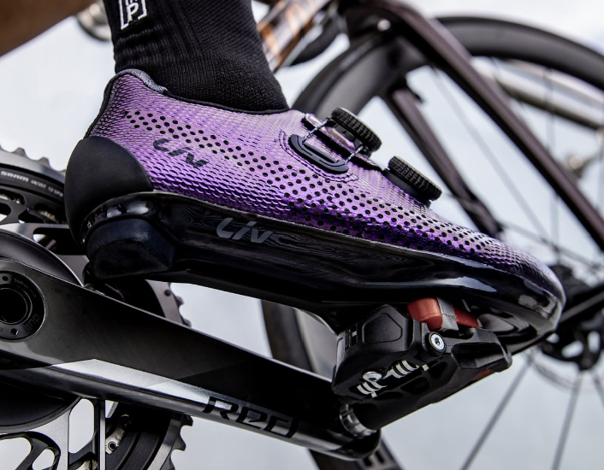
1 - What is Co-Design?
Realizing that the achievement of a goal may require to tailor each part of a system to all others: synergy
Enabling the simultaneous optimization of all parts, to maximize a global utility in a high-dimensional design space: holistic optimization
Bringing together diverse components, technologies, or expertise to create a unified and cohesive system, ensuring seamless interoperability and coordination: integration

Slide 6
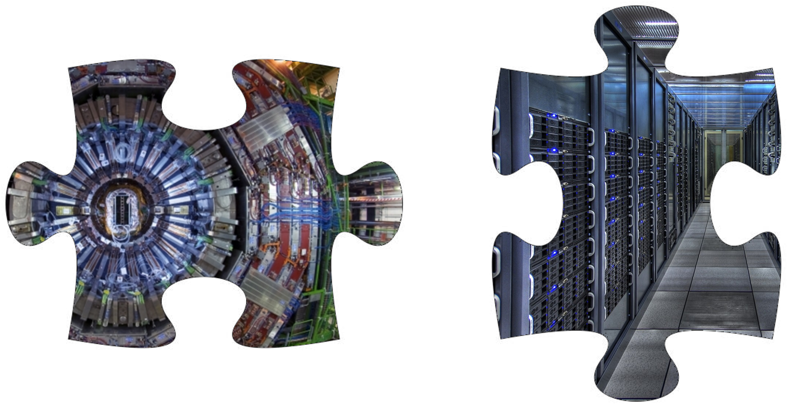
And in Fundamental Science?
Co-design is even more crucial to align our hardware choices (more or less fixed at construction time) to the software that will extract information from the produced data (which evolves with time)
But how do we pull it off?
→ Create end-to-end model of all system components, optimize for end goals (not on intermediate proxies) using SoA AI tools

Slide 7
And in Fundamental Science?
Co-design is even more crucial to align our hardware choices (more or less fixed at construction time) to the software that will extract information from the produced data (which evolves with time)
But how do we pull it off?
→ Create end-to-end model of all system components, optimize for end goals (not on intermediate proxies) using SoA AI tools

Slide 8
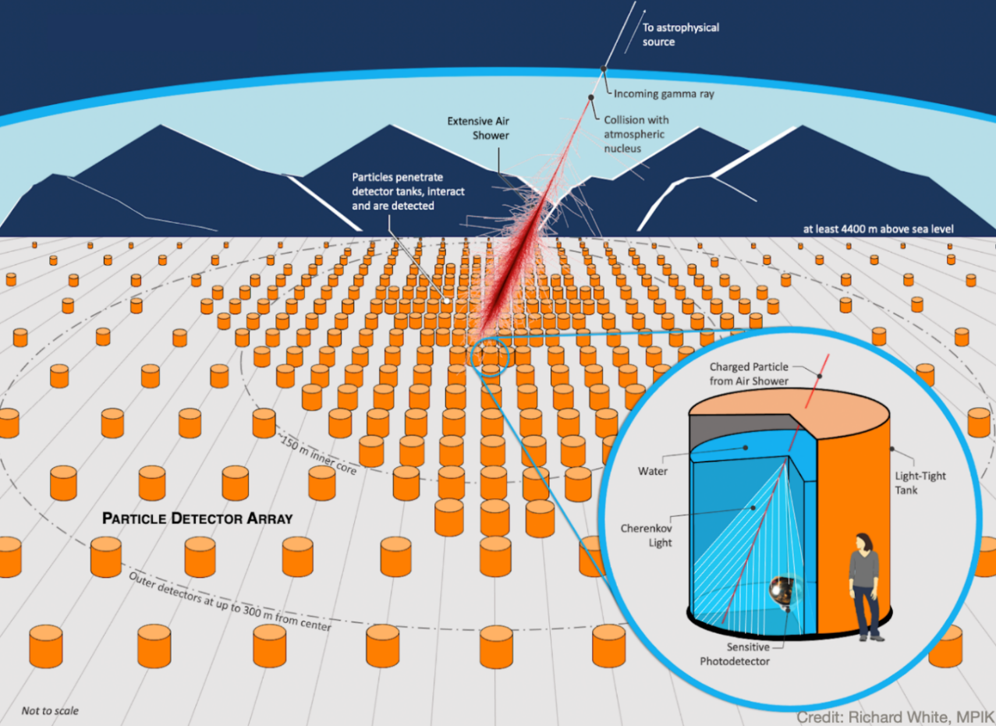
What does it mean in practice?
It means creating a full parametric model of the detector, plugging in a surrogate model of the physics, and a differentiable model of the data reconstruction and inference extraction
Then you can iteratively modify the detector parameters following the gradient of the utility function – like in a NN
Example: optimization pipeline for SWGO

Slide 9
What does it mean in practice?
It means creating a full parametric model of the detector, plugging in a surrogate model of the physics, and a differentiable model of the data reconstruction and inference extraction
Then you can iteratively modify the detector parameters following the gradient of the utility function – like in a NN
Detector parameters x
x→ x + λ dU/dx
Utility evaluation and derivatives dU/dx
Physics surrogate model
Reconstruction and inference
Dumbed down version of an optimization pipeline

Slide 10
Example Optimization Run
T. Dorigo et al., End-to-end optimization of the layout
of a Gamma-Ray Observatory, arXiv:2310.01857
Submitted to Nuclear Physics B Nov 2024
Total utility vs epoch XY positions of tanks Radial distr. of tanks Utility components Log(pointing resolution)
Red: initial, blue:current Red: initial, blue: current
Rel. E resol. vs E Log(pointing res.) vs E Log(E) of showers Azimuthal distribution
Red: initial, blue: current Red: initial, blue: current

Slide 11
“But our detectors are multi-purpose…”
End-to-end optimization requires you to specify precisely what you want. Mission impossible?
No, we do it routinely!
Hadron colliders: fixed bandwidth → pre-define DAQ budget of different trigger primitives
Lepton colliders: fixed energy → pre-define run time of energy scans vs resonance running
See arXiv:2501.13544 for a discussion

Slide 12
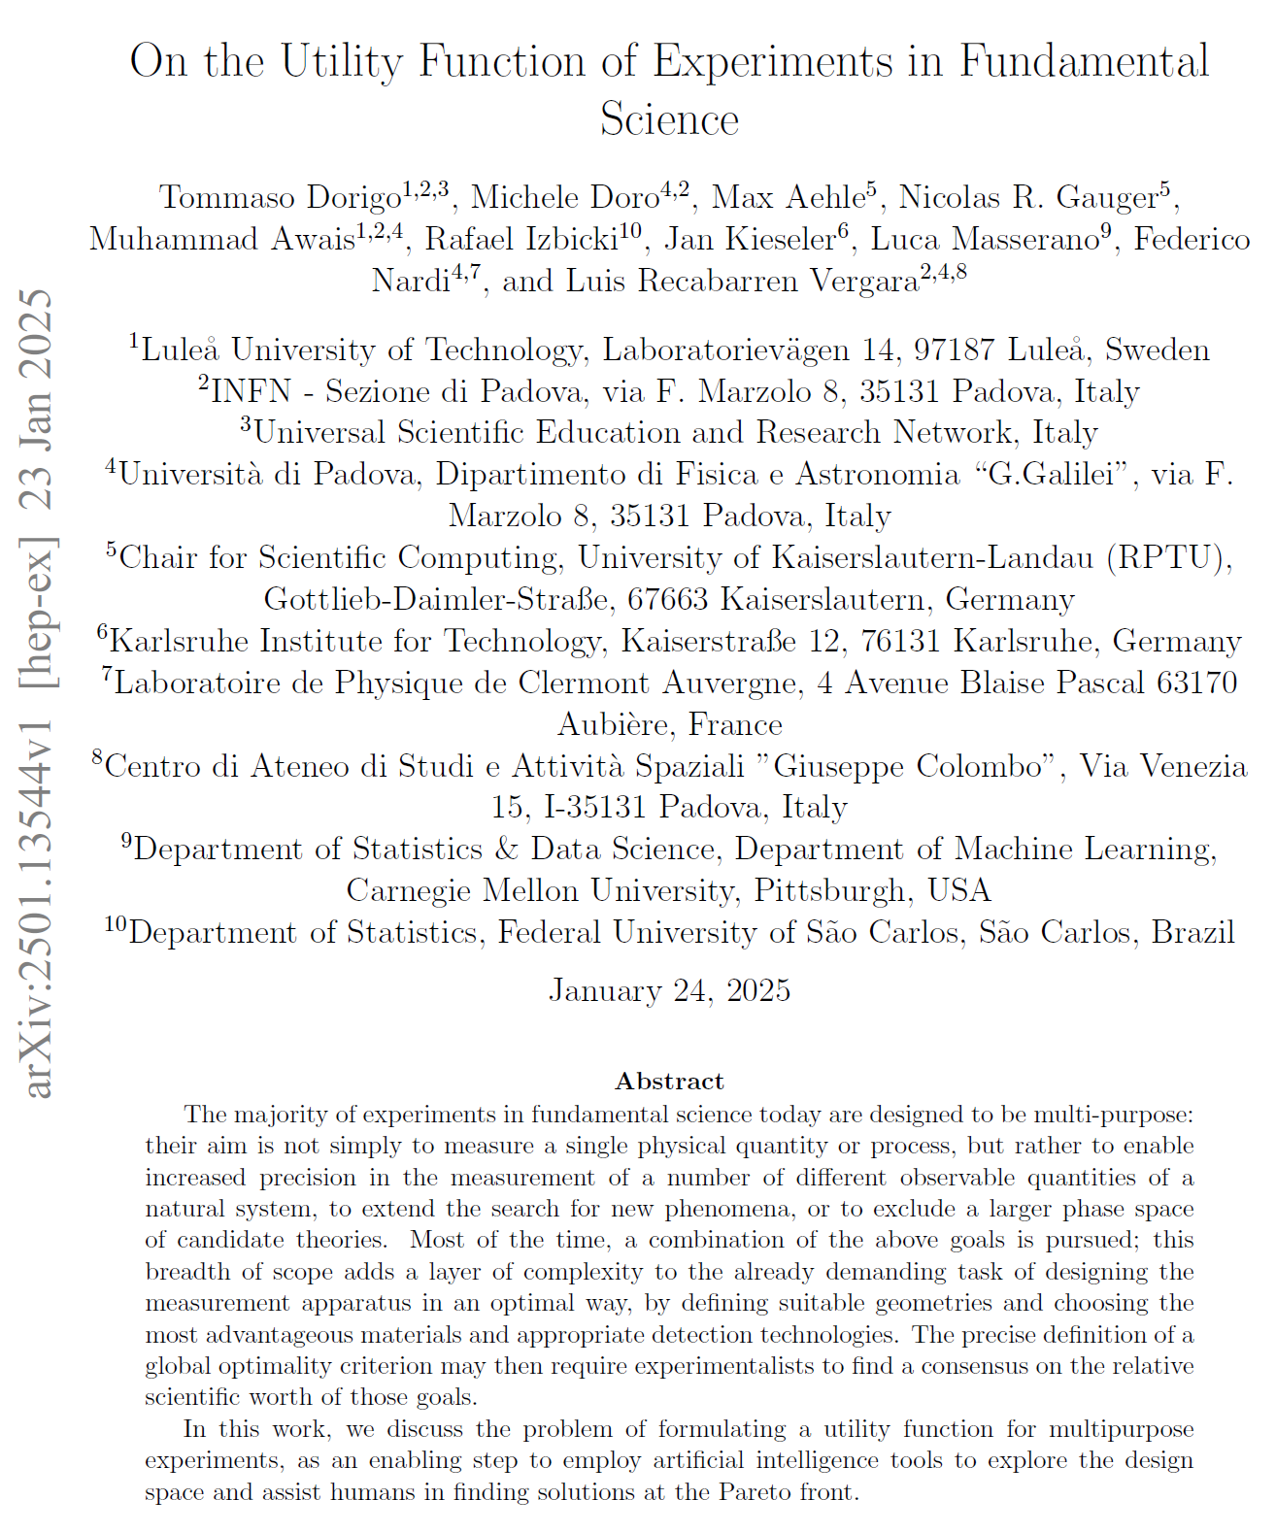
“But our detectors are multi-purpose…”
End-to-end optimization requires you to specify precisely what you want. Mission impossible?
No, we do it routinely!
Hadron colliders: fixed bandwidth → pre-define DAQ budget of different trigger primitives
Lepton colliders: fixed energy → pre-define run time of energy scans vs resonance running
See arXiv:2501.13544 (submitted for publication in Nucl. Phys. B) for a discussion

Slide 13
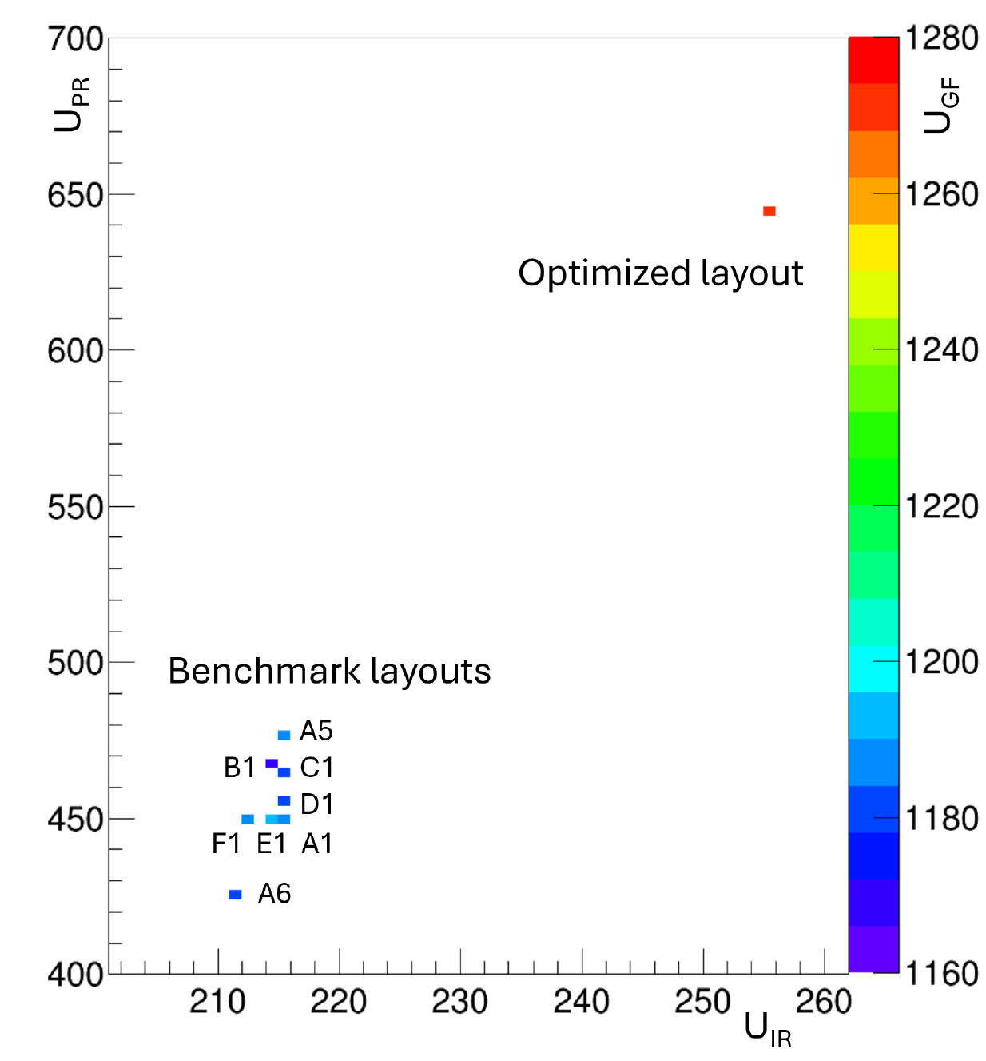
An Example From that Paper
Astrophysics example: optimize ground layout of SWGO array (gamma-ray observatory)
Utility can be formulated as combination of flux precision (U_{GF}), E resolution (U_{IR}), pointing resolution (U_{PR}) → a 3D space
Optimized solution shows how Pareto front lays far away from points of design space corresponding to proposed benchmarks

Slide 14
(Sideline): Co-Design in EUCAIF
EUCAIF: EU Coalition for Artificial Intelligence in Fundamental Physics - an APPEC/NUPECC/ECFA expression of interest
Organize yearly conference → this year in Cagliari June 16-20
WG2 Co-Design: leaders T. Dorigo, P. Vischia → organizing collaborative R&D on AI for co-design optimization of detectors
→ If interested, ask me to add you to ML

Slide 15
2 - What Information We Are After
High granularity / precise timing pursued ubiquitously.
To optimize systems, we need to understand what information can in principle be mined, and its impact on intermediate deliverables (particle flow performance, E resolution, jet tagging)
Is there a cell size scale Δx_{crit} (2) below which we gain access to PID information Q (1)?
What is the relative worth of high position precision vs high timing precision, on final physics objectives?
To address these questions we started to explore p/k/pi discrimination as a function of cell size in a very-high-granularity, homogeneous calorimeter with high timing precision
Q
p/π
(1)
K/π
p/K
(2)
Δx
Δx_{crit}

Slide 16
2 - What Information We Are After
High granularity / precise timing pursued ubiquitously.
To optimize systems, we need to understand what information can in principle be mined, and its impact on intermediate deliverables (particle flow performance, E resolution, jet tagging)
Is there a cell size scale Δx_{crit} (2) below which we gain access to PID information Q (1)?
What is the relative worth of high position precision vs high timing precision, on final physics objectives?
To address these questions we started to explore p/k/pi discrimination as a function of cell size in a very-high-granularity, homogeneous calorimeter with high timing precision
Q
p/π
(1)
K/π
p/K
(2)
Δx
Δx_{crit}

Slide 17
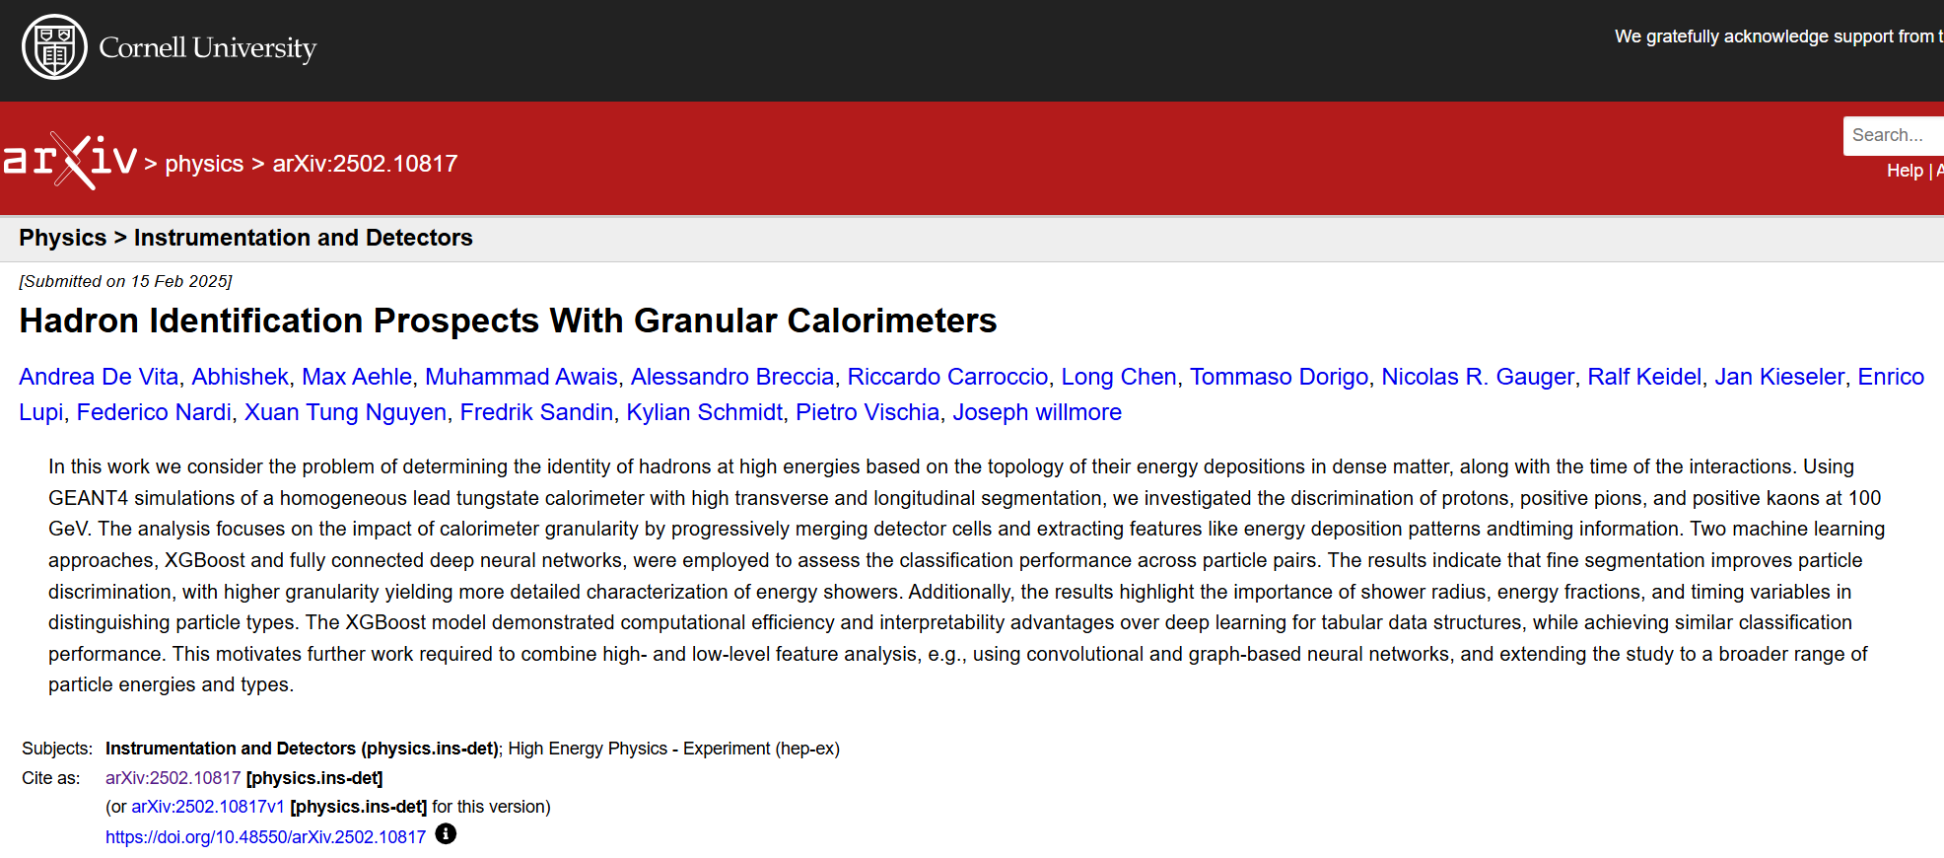
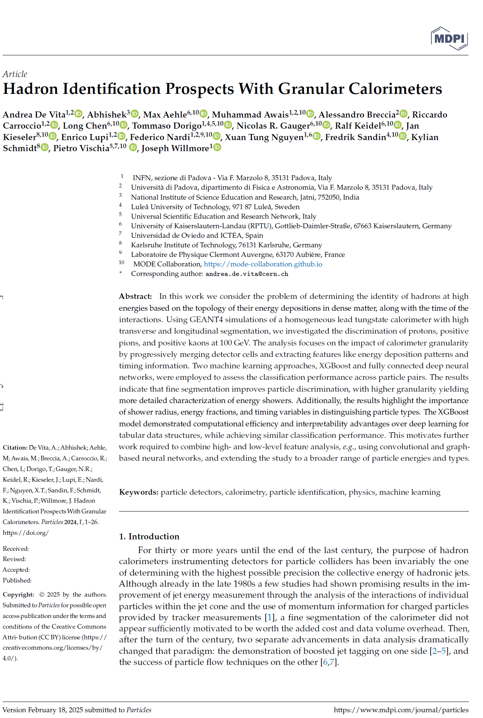
Submitted for publication to MDPI Particles (corresponding author: Andrea De Vita)
Available as arXiv:2502.10817

Slide 18
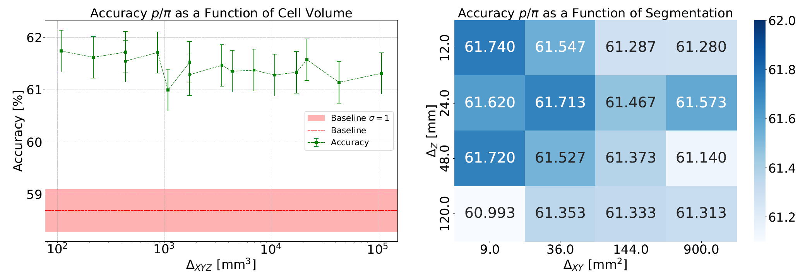
Sample results: p/π discrimination (https://arxiv.org/abs/2502.10817 )

Slide 19
3 – New Frontiers in Readout/Preprocessing
With O(1M) cell instruments, fast readout of hadron showers becomes critical.
→ Can we do on-site dimensionality reduction?
Neuromorphic computing and photonics-based localized preprocessing may be key to dramatically reduce data throughput, improving triggering capabilities and information extraction
Photonics detection and processing also brings potential of partly removing need of high granularity
We studied SNN-based regression of energy, energy xyz centroid, and dispersion in PbWO4 cube where main interaction took place

Slide 20
3 – New Frontiers in Readout/Preprocessing
With O(1M) cell instruments, fast readout of hadron showers becomes critical.
→ Can we do on-site dimensionality reduction?
Neuromorphic computing and photonics-based localized preprocessing may be key to dramatically reduce data throughput, improving triggering capabilities and information extraction
Photonics detection and processing also brings potential of partly removing need of high granularity

Slide 21
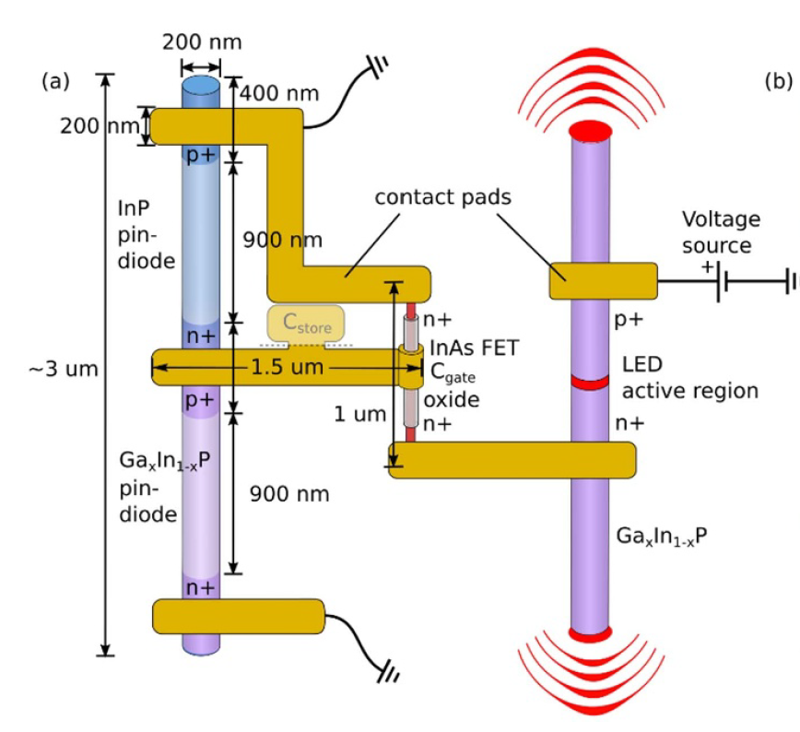
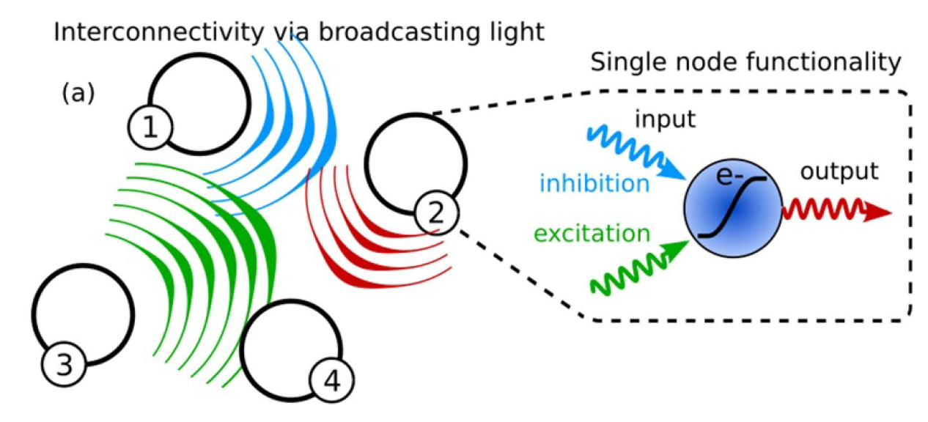
How: Use Nanowires
Nanowires can detect scintillation light and re-emit it, or be inhibited → act as neurons → can be elements of neuromorphic network
Ultrafast, light-based computation
On-detector preprocessing of information
Dimensionality reduction (x1000 or more)
Use native information on shower topology (light fronts)

Slide 22
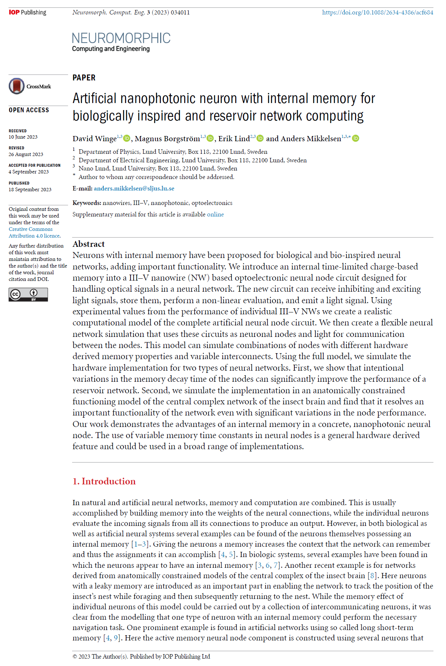
How: Use Nanowires
Nanowires can detect scintillation light and re-emit it, or be inhibited → act as neurons → can be elements of neuromorphic network
Ultrafast, light-based computation
On-detector preprocessing of information
Dimensionality reduction (x1000 or more)
Use native information on shower topology (light fronts)
Stem paper: D. Winge et al., NanoLUND group

Slide 23
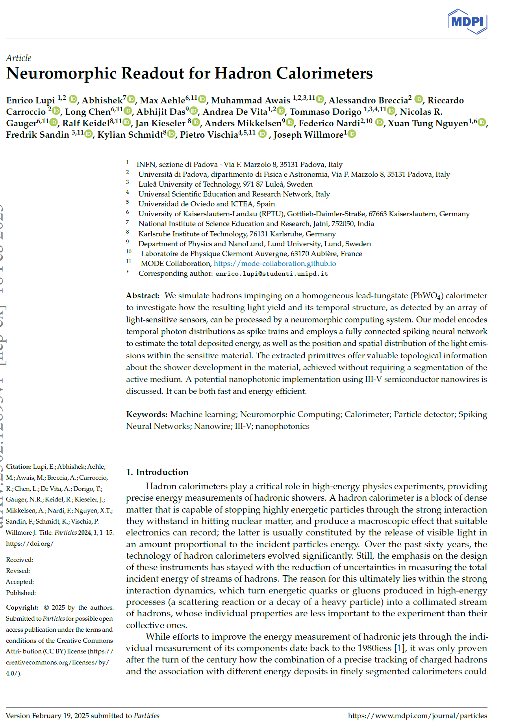
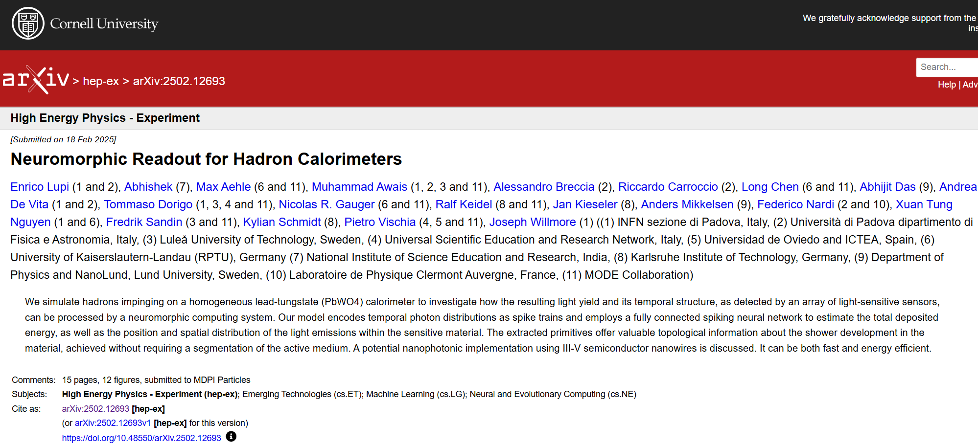
Accepted for publication in MDPI particles (corresponding author: Enrico Lupi)
See arXiv:2502.12693

Slide 24
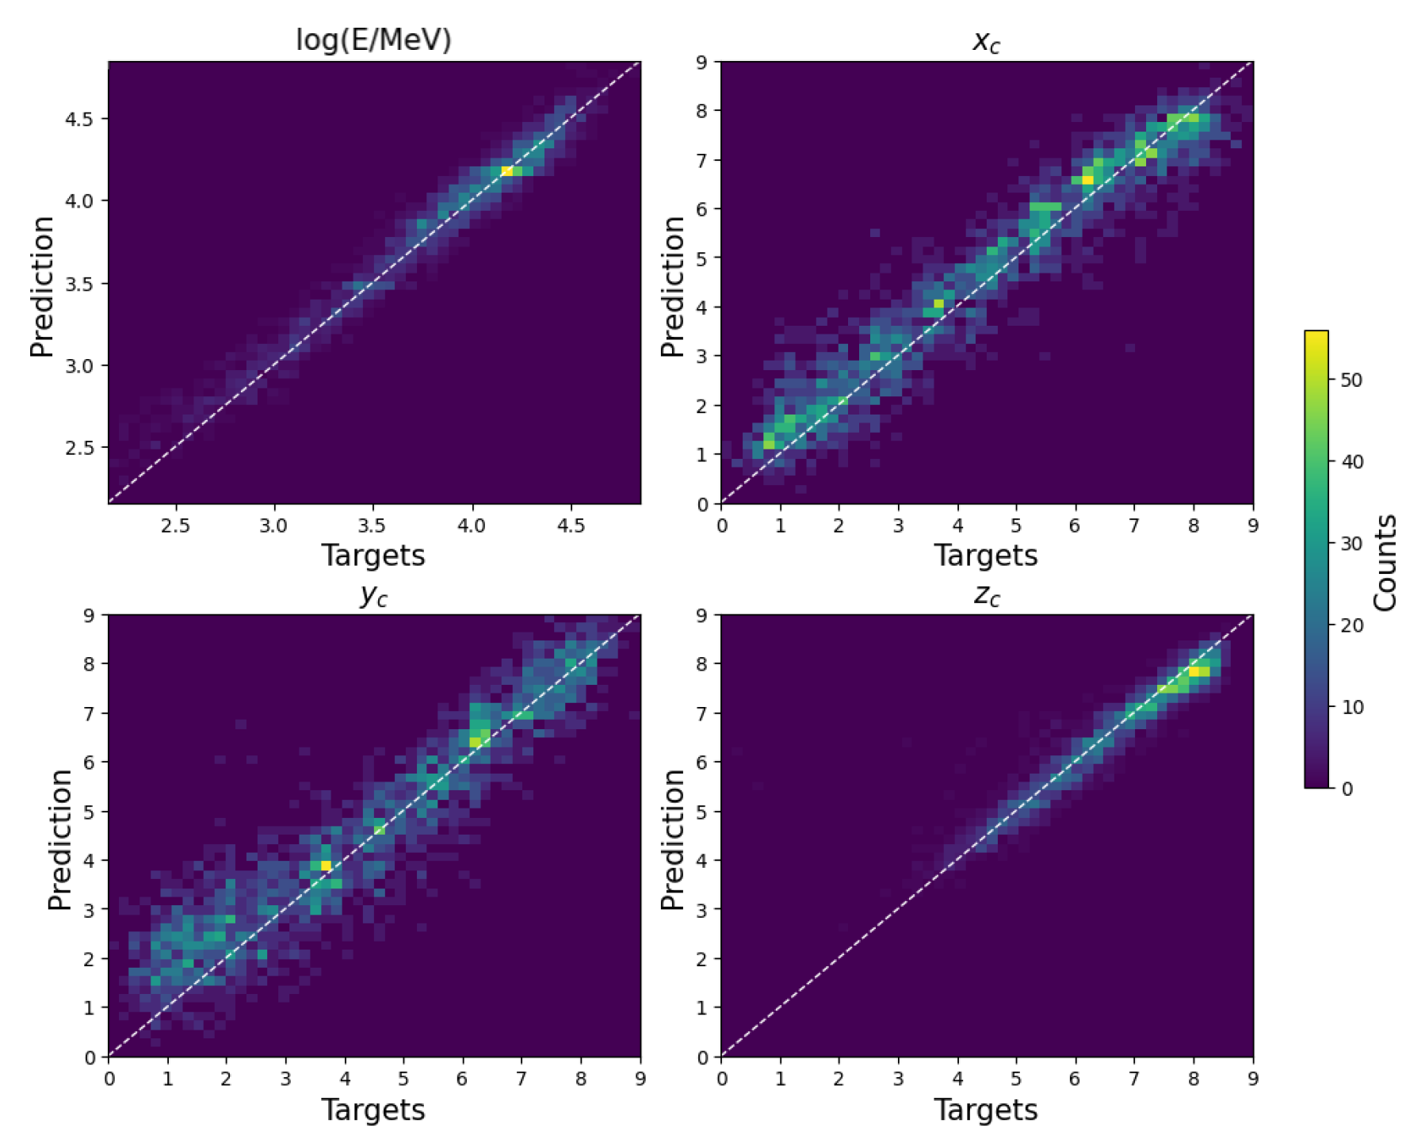
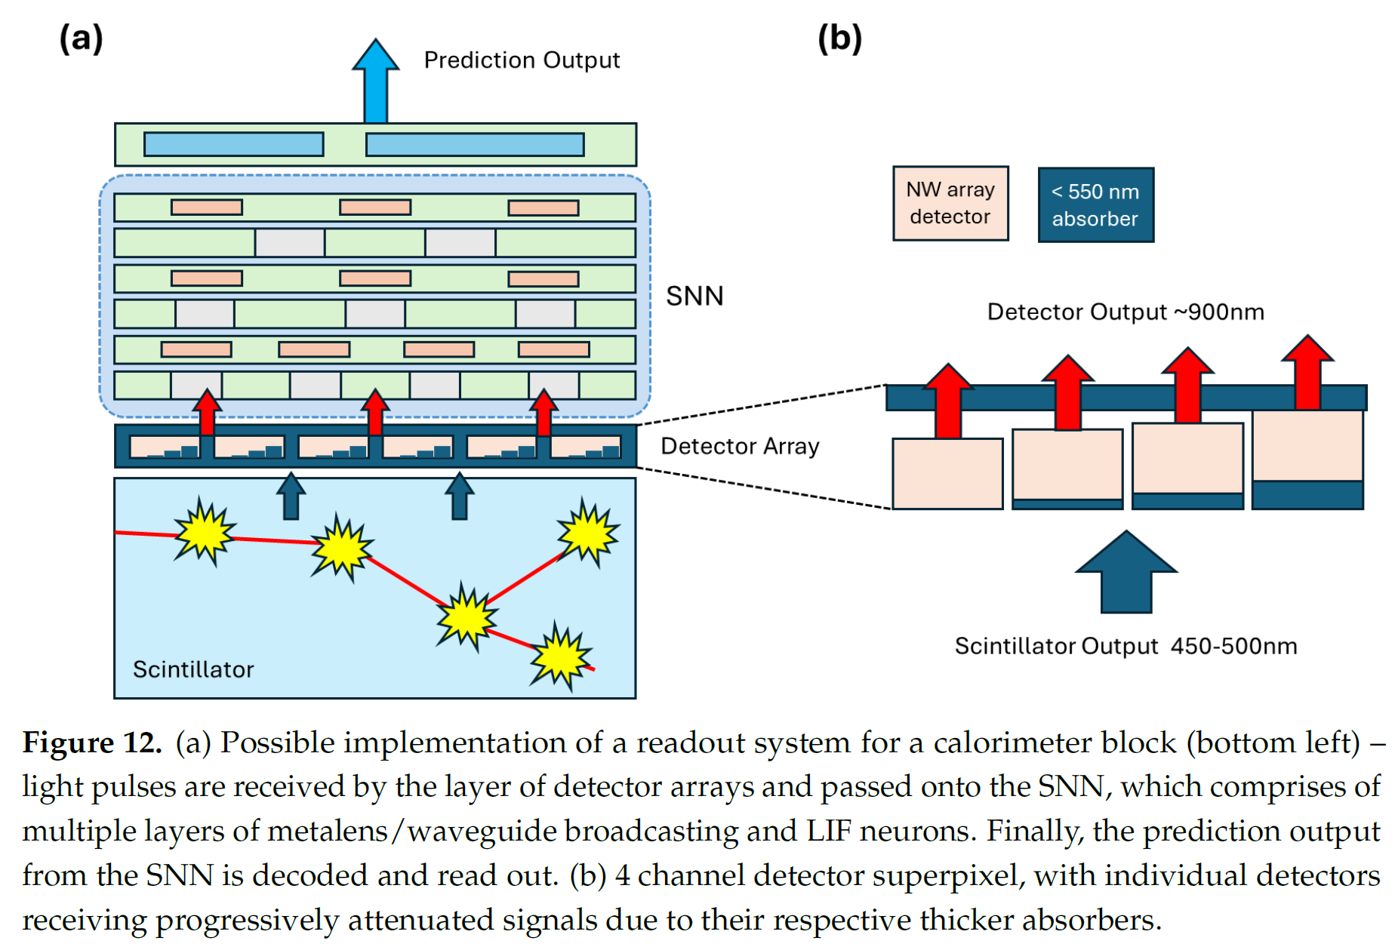
Example from our work (https://arxiv.org/abs/2502.12693 ): SNN-based regression of energy, energy xyz centroid, and dispersion in a PbWO₄ cube

Slide 25
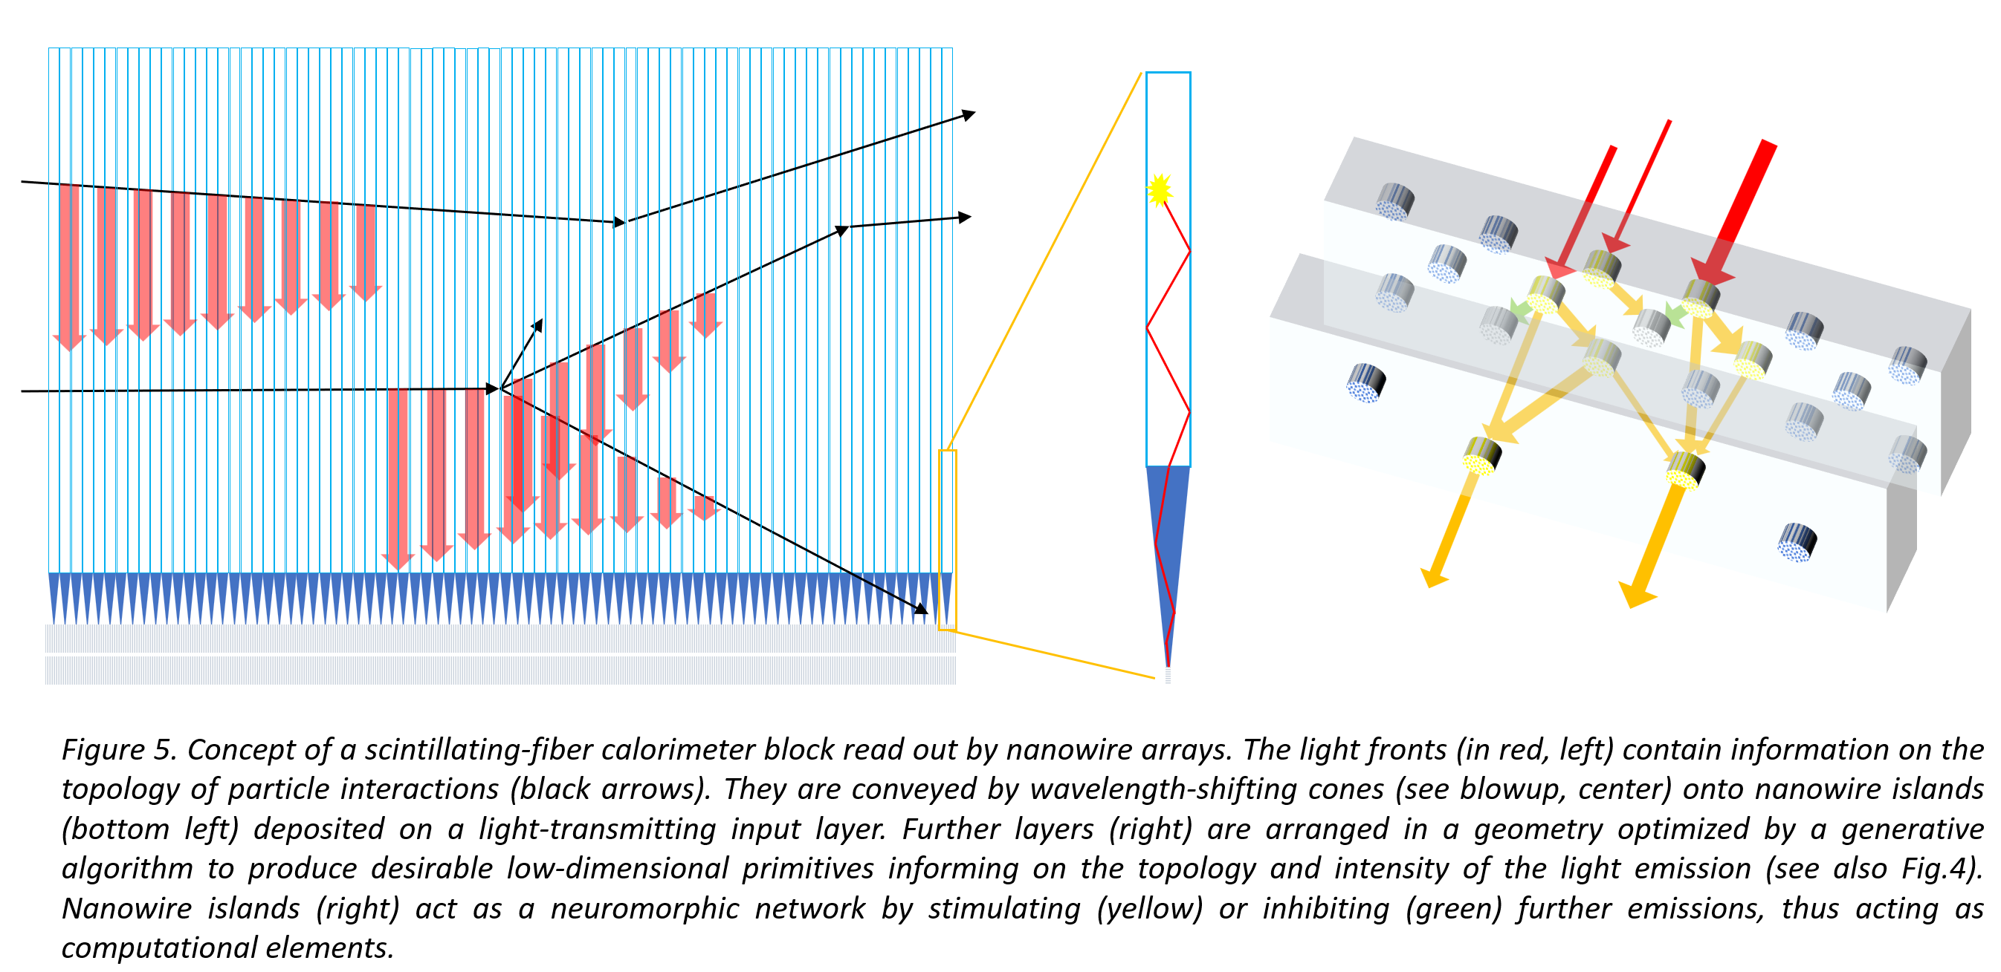
Digression: Idea for Neuromorphic Computing Readout with Nanophotonics
Using scintillating fibers coupled to nanowires, and a generative model to learn 3D geometry of “neurons” in photonic network, we can produce ultrafast, low-throughput dimensionality reduction of calorimeter signals

Slide 26
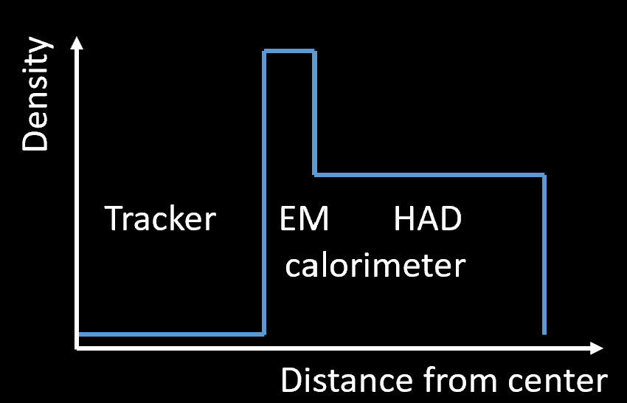
4 – A Framework for End-To-End Optimization
A lot is to be explored in hybridization of tracking and calorimetry. Why density 0 → density 1? There must be a better solution.
But even simple longitudinal segmentation and materials choice of a sampling calorimeter, under cost constraints, is non trivial
→ Prepared AIDO software to explore these possibilities: end-to-end pipeline that generates new Geant4 data on the fly at every epoch of the optimization loop, and approximates with a diffusion model the full data analysis chain.
Most complete example of co-design in place so far.
Density
Tracker EM HAD
calorimeter
Distance from center

Slide 27
4 – A Framework for End-To-End Optimization
A lot is to be explored in hybridization of tracking and calorimetry. Why density 0 → density 1? There must be a better solution.
But even simple longitudinal segmentation and materials choice of a sampling calorimeter, under cost and space constraints, is non trivial
→ Prepared AIDO software to explore these possibilities: end-to-end pipeline that generates new Geant4 data on the fly at every epoch of the optimization loop, and approximates with a diffusion model the full data analysis chain in one fell swoop
Most complete example of co-design in place so far.
Density
Tracker EM HAD
calorimeter
Distance from center

Slide 28
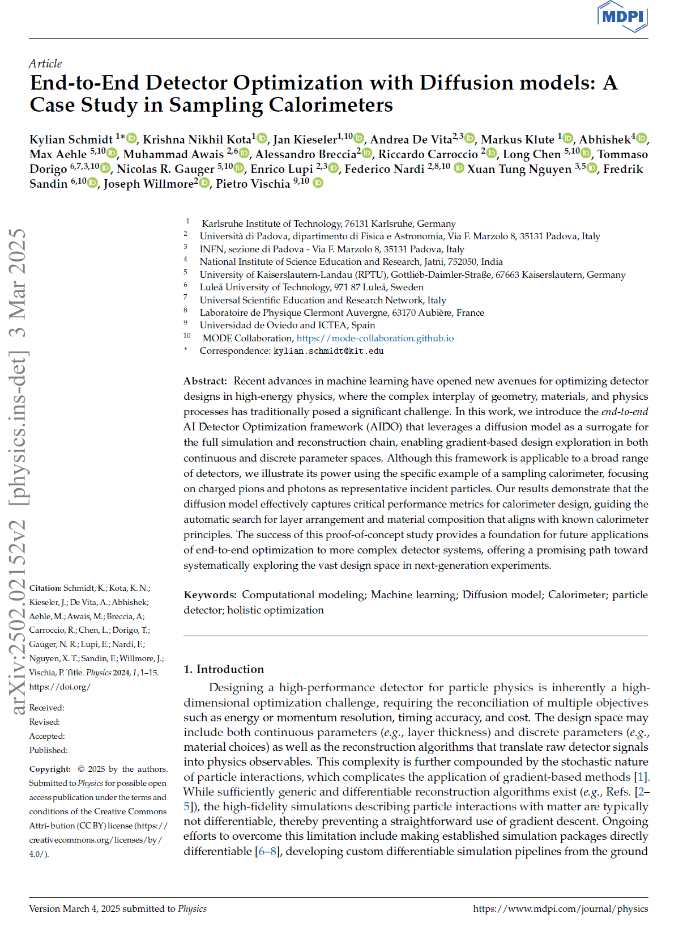
Accepted for publication in MDPI Particles (corresponding author: Kylian Schmidt)
Available at arXiv:2502.02152

Slide 29
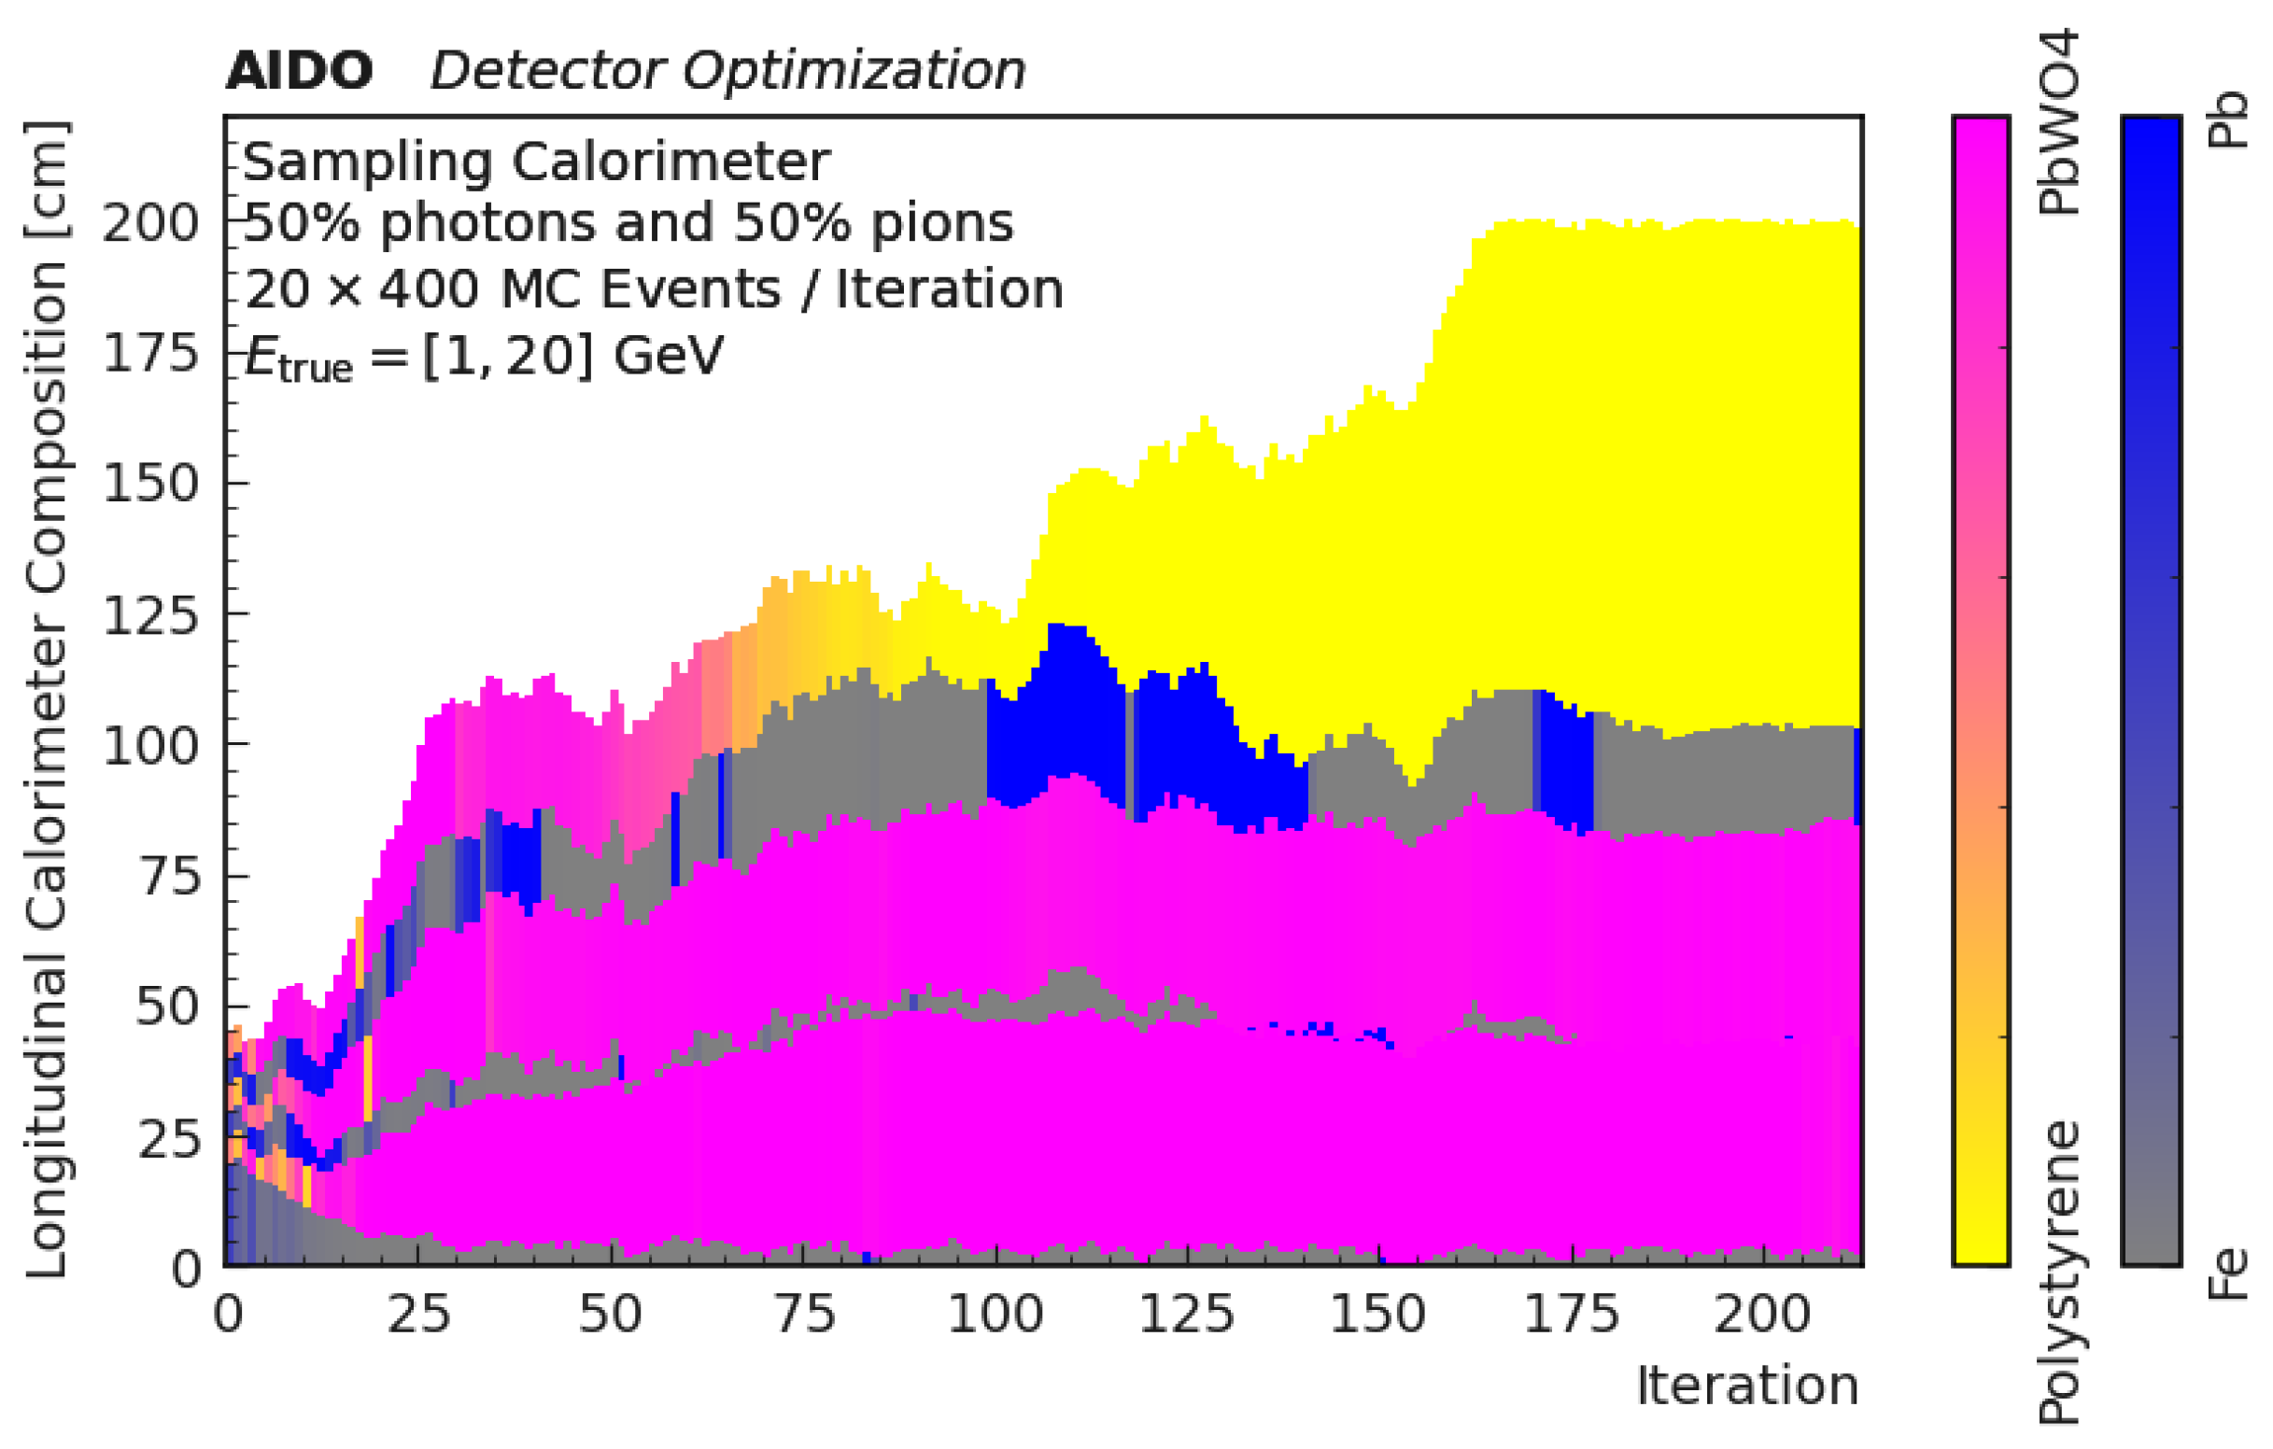
Money Plot: Rediscover “Sound” Layout
Evolution of sampling calorimeter segmentation and materials during learning, maximizing E resolution under cost constraints
→ It works! Now we can ask more pointed questions

Slide 30
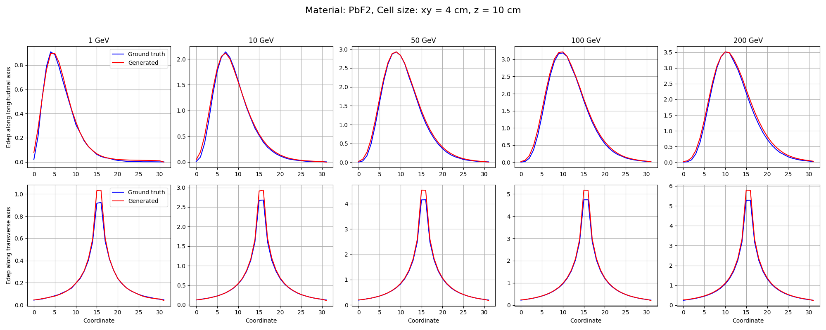
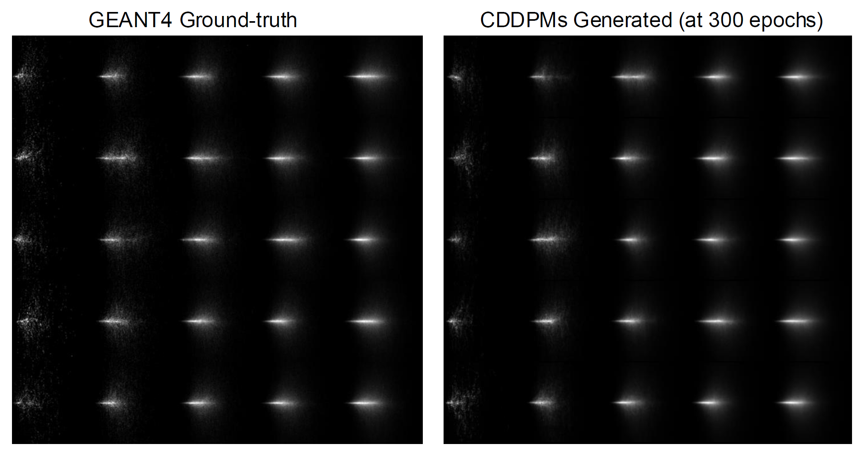
“But how good can a diffusion model be?”
Very.
Long Chen and Xuan-Tung Nguyen (RPTU and INFN) are developing a diffusion model as a surrogate of photon showers in EM calorimeter for muon collider, where background from BIB is different from any previous collider detector
Integration in end-to-end optimization (F. Nardi’s PhD thesis) & paper in preparation
Yet unpublished – do not share

Slide 31
Future prospects
Studies of shower topology and PID information extraction will inform model of neuromorphic system (SNN), capable of creating ultra-fast, on-detector low-D summaries, ready for triggering purposes
Once proven in simulation, same functionality can then be transferred to physical system of nanowires after generative model finds 3D arrangement of neurons that produces required output
End-to-end combined model of detector and information extraction may then discover optimal geometry, given end goals of instrument
Optimization framework (AIDO) available and quite general – can be used for your task, too!

Slide 32
The most important final message
Your optimization problem contains parts that are common to other problems, as well as special bits – only the latter may require software R&D
MODE and EUCAIF WG2, are interested in developing solutions, to create a weaponry of modular software that reduces time-to-results
Let’s talk about your detector optimization and its peculiarities! Huge gains in performance are possible…
I joined DRD6 because I believe you are developing future instruments which need this technology - new detectors can’t ignore the new enabling power of AI tools

Slide 33
Thank you for your attention!

Slide 34
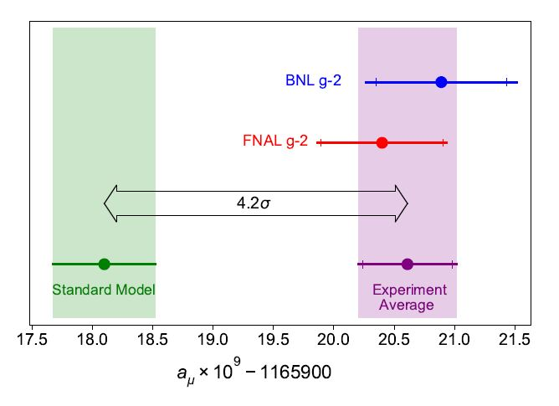
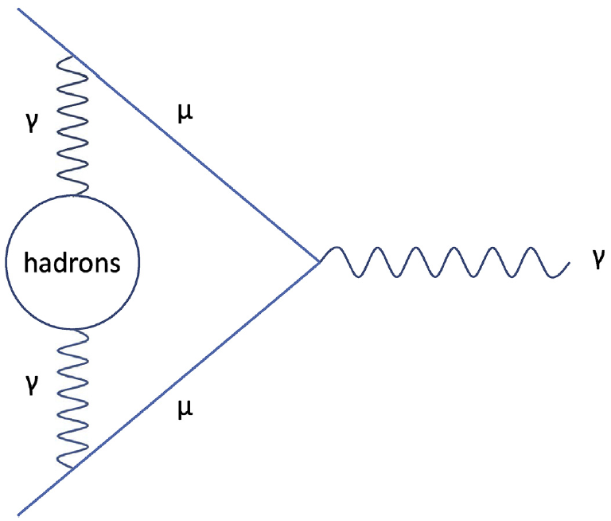
One Example of Geometry Optimization: MUonE
MUonE aims to determine with high precision the probability of elastic muon-electron scattering, as this number may reduce the theory systematics of the g-2 muon anomaly
The experiment must be sensitive to the rate of interactions as a function of momentum transfer, with 10⁻⁴ precision
Above: a long-standing anomaly in the Standard Model, the muon g-2 value
Below: a muon-photon interaction,
with a hadronic quantum loop
Beam
Above: layout of one of 40 1m-long MUonE stations, as per original design proposal

Slide 35
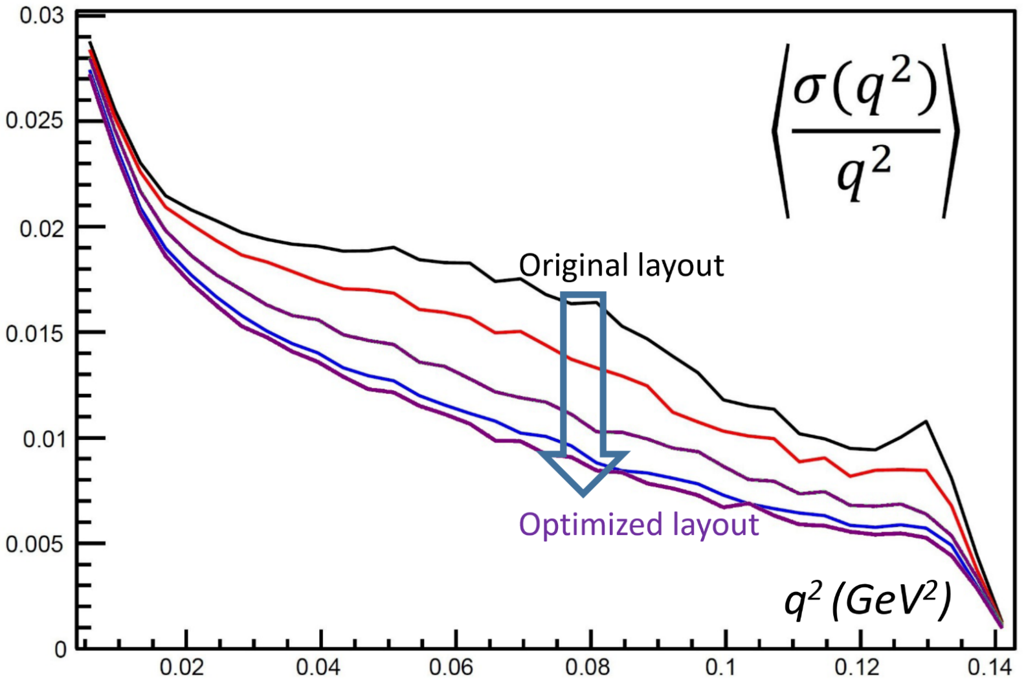
MUonE Optimization
Relevant figure of merit: relative resolution on momentum transfer q²
The original design of the MUonE stations was good, but it failed to use the constraining potential of the 3-particle vertex (a co-design exploitable!) and the strong dependence on geometry of q² resolution (the relevant metric)
A factor of two (!) gain was achieved by discrete optimization scans
Region sensitive to hadronic loop
contributions
Above: relative resolution in event q² for different configurations (the higher, black line is the original proposal by the MUonE coll.)
T. Dorigo, Geometry Optimization of a Muon-Electron Scattering Experiment,
Physics Open 4 (2020) 100022.

