Slide 1





CALOROC for SiPM readout
EIC calorimetry
EIC France 2025
2 - April
Pedro Pablo Dumas Ziehlmann

Slide 2
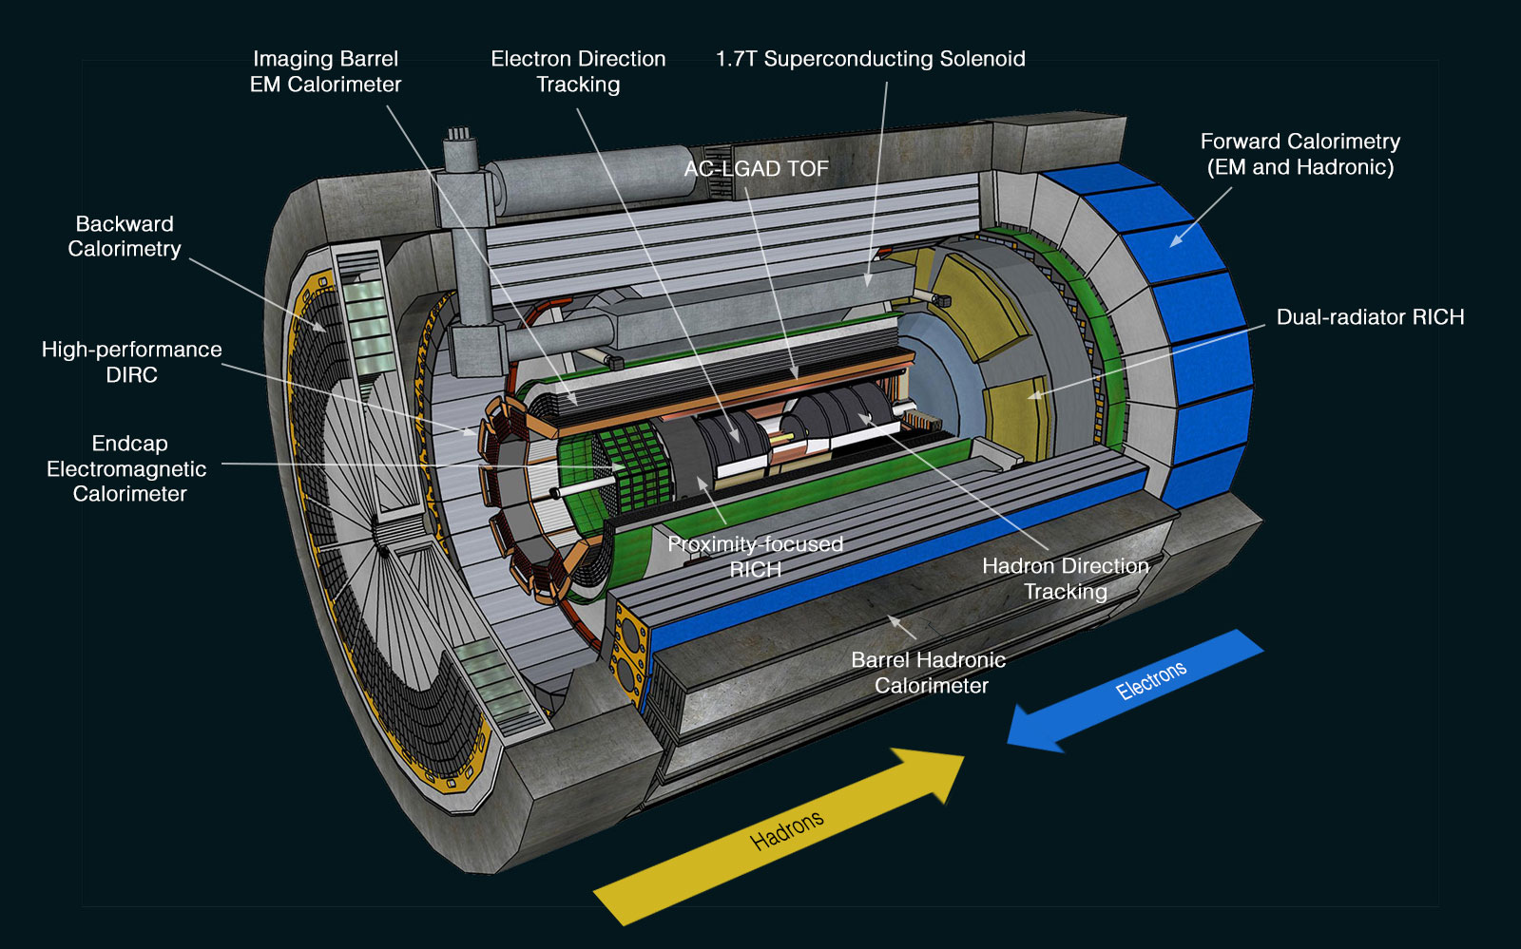
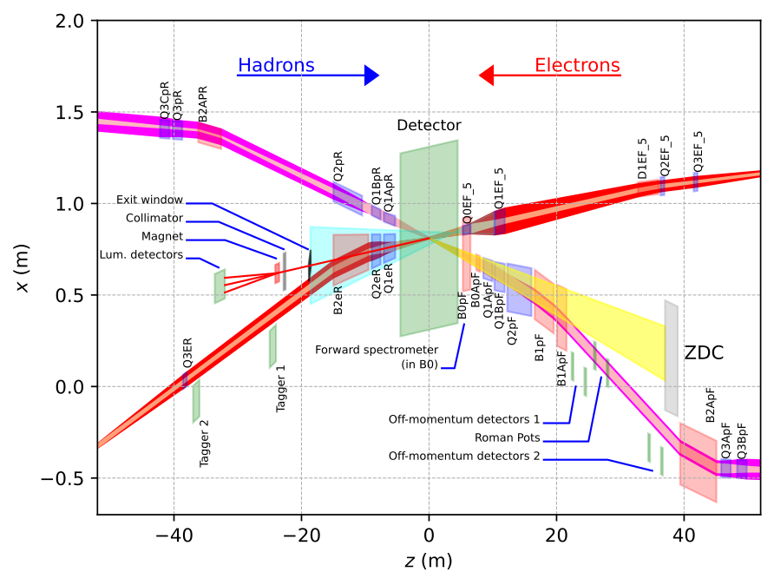
Calorimetry at ePIC
13 Calorimeters:
7 x SiPM – CALOROC
5 x SiPM – Discrete
1 x SiPM – Commercial fADC250
From J. Landgraf
(IDR review)

Slide 3

From H2GCROC to CALOROC
H2GCROC for the endcap calorimeter – Phase II
CALOROC for EIC
6M of Silicon channels
(+ 240k of SiPM)
Same ASIC structure (floorplan)
Same ADC and TDC
Same readout
Radhard (200 Mrad)
Low Power (15 mW per chn)
Precise timing (25 ps)
Common interfaces
Total of 150k ASICs needed
Pre-prod this year
HEP trend => imaging calorimetry
  High number of channels
  Charge and precise timing (<100 ps)
  Low power + System-On-Chip
Based on H2GCROC, CALOROC will provide a versatile and low-power solution for SiPM readout

Slide 4
ROC chips standard structure
H2GCROC (for SiPM readout) is an HL-LHC colored ASICs (external L1 trigger)
  Below is an calorimetry structure (but interfaces for CALOROC will similar)
Dedicated fast command interface : calibration pulses, external L1 trigger.
Data and trigger serial links with CLPS signaling (LpGBT @ 1,28 Gbps)
LHC-like structure :
Ram1 for data storage
Ram2 for L1 accepted events
I2C interface to load the ASIC parameters
(slow control interface)
Analog front-end specific to sensor

Slide 5
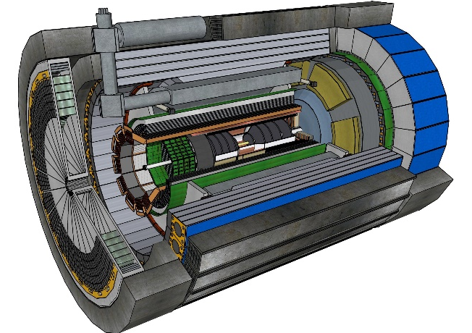
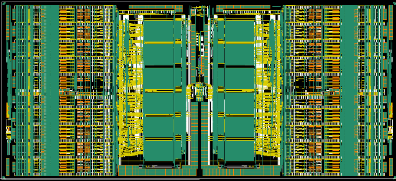
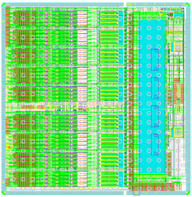
What is CALOROC ?
CALOROC will be available in 2 versions for SiPM readout:
  SiPM range capacitance from 500 pF to 10 nF
  ~ 10 mW / channel
  Radiation hardening (HL-LHC levels)
    200 Mrad and 10¹⁶ n_{eq} / cm² (1 MeV equivalent neutrons)
    SEE hardening on control logic
  Charge and time measurement
  Max triggering rate of 50 kHz / chn
Streaming readout (no external trigger required)
Conservative CALOROC1A based on CMS H2GCROC:
  H2GCROC (ADC, TOT) analog/mixed reuse
  Back-end compatible with EIC + zero-suppress
New CALOROC1B based on gain switching:
  New analog part without TOT (dynamic gain switching)
  Backend « à la HKROC »: auto-trigger, zero-suppress – EIC compatible
HGCROC
HKROC
CALOROC 1A
CMS front end
EIC readout
CALOROC 1B
New front end
EIC readout
CALOROCs will share a common backend
+ pin-pin compatibility

Slide 6
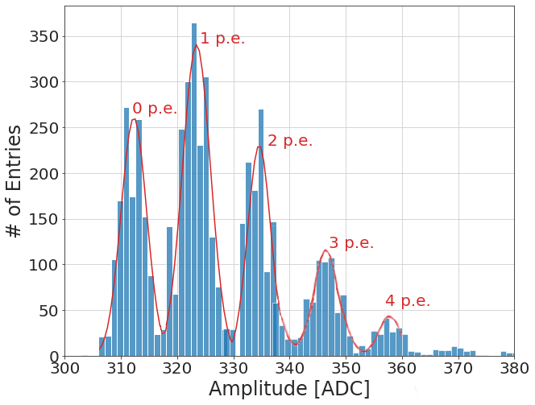
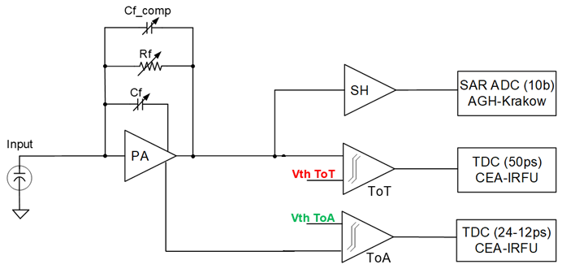
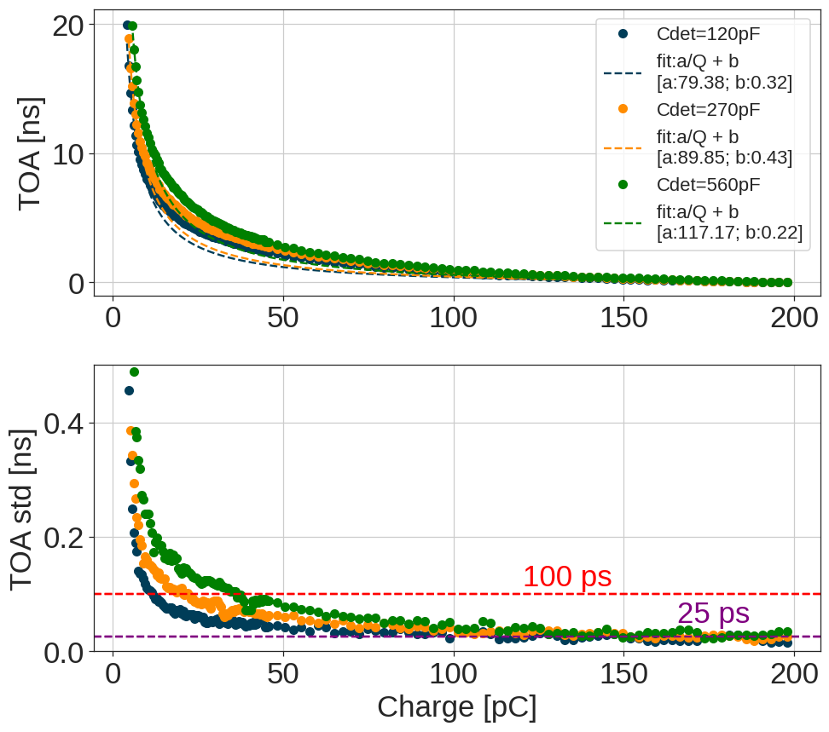
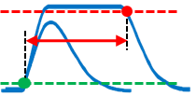
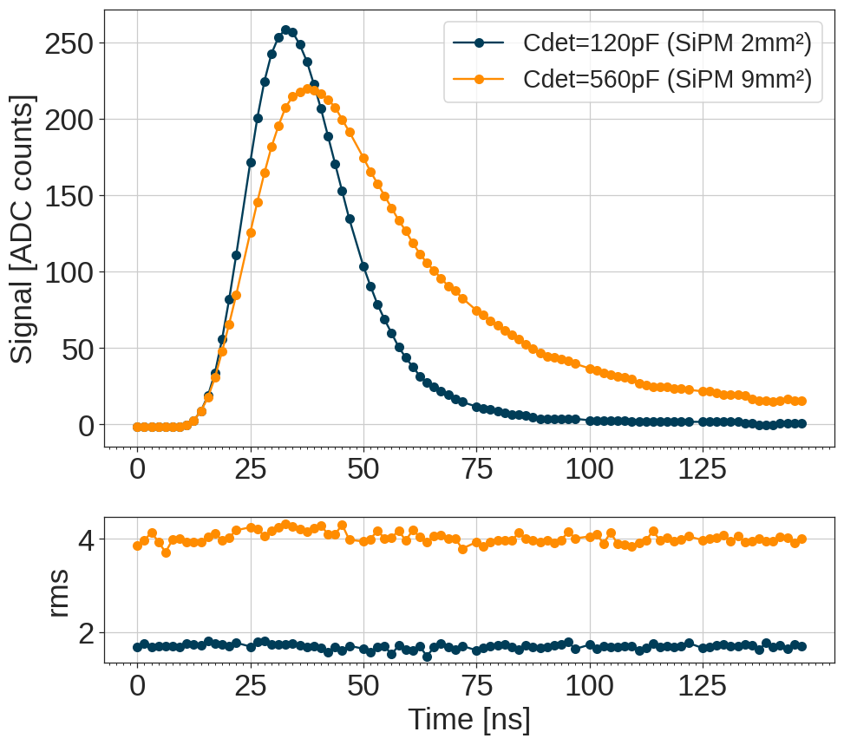
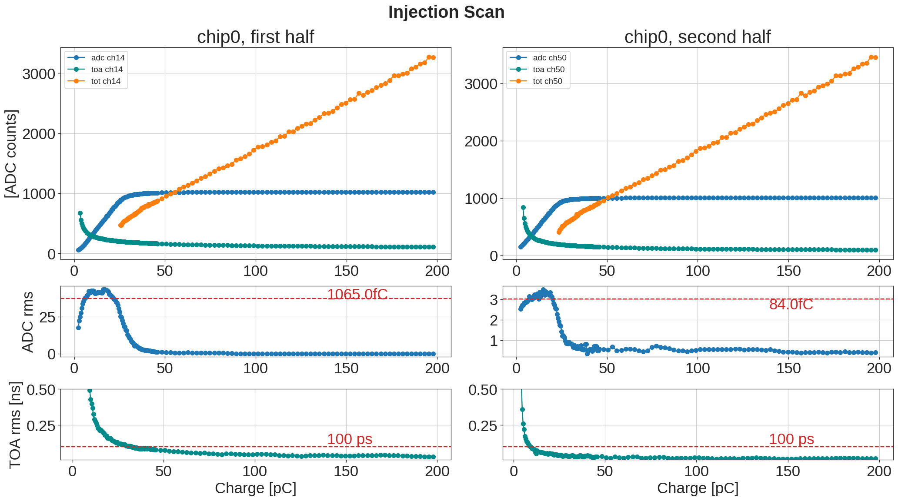
CALOROC1A (based on H2GCROC)
Reuse of analog front-end based on ADC/TOT and TOA: fully characterized *
  15 mW per channel / R adiation performance / SiPM range 100-600 pF
CALOROC1A will only update its back-end to be EIC compatible
* TWEPP 2023 ➔ https://doi.org/10.1088/1748-0221/19/04/C04005

Slide 7
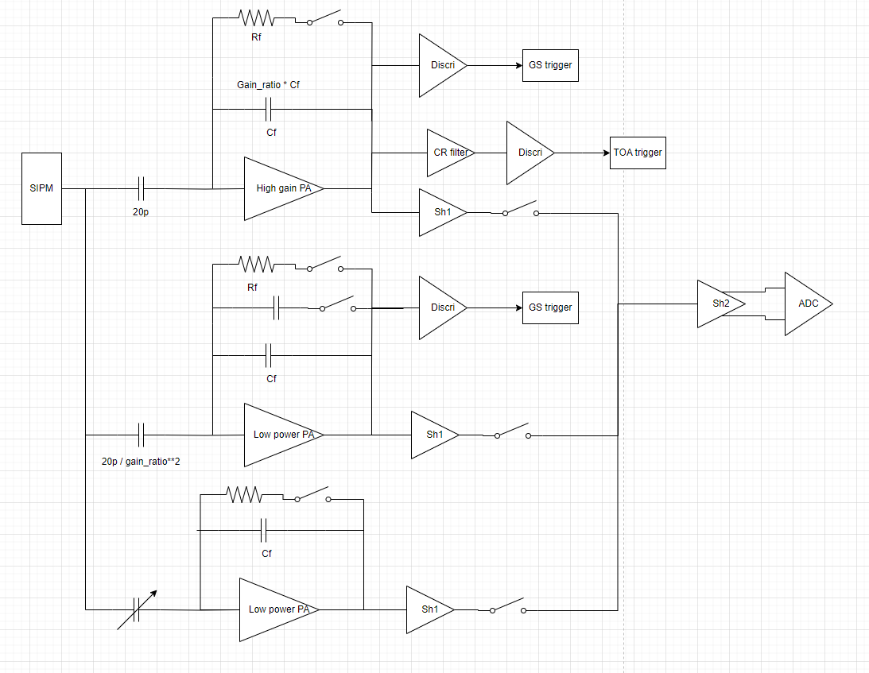
CALOROC1B: Chosen architecture
New dynamic frontend with switched gain:
  High gain
  2x medium gain
  Low Gain
Reuse CMS-H2GCROC ADCs and TDCs:
  10-bit 40 MHz ADC (Krakow)
  25 ps TDC (Saclay)
Shared CALOROCs backend
Common specifications:
  SiPM from 500 pF to 2.5 - 10 nF
  ~ 10 mW/channel
  CMS HL-LHC Radiation level 200 Mrad

Slide 8
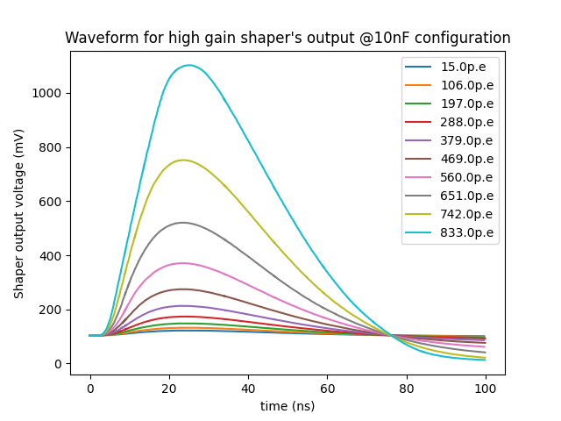
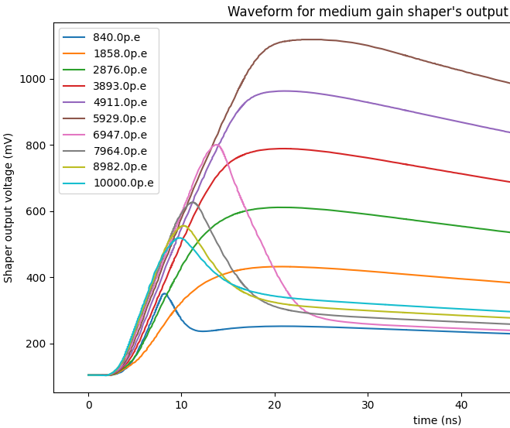
CALOROC1B: Charge and time simulations
Waveform for HG on the left + gain switching on the right:
  Example with Cd of 10 nF

Slide 9
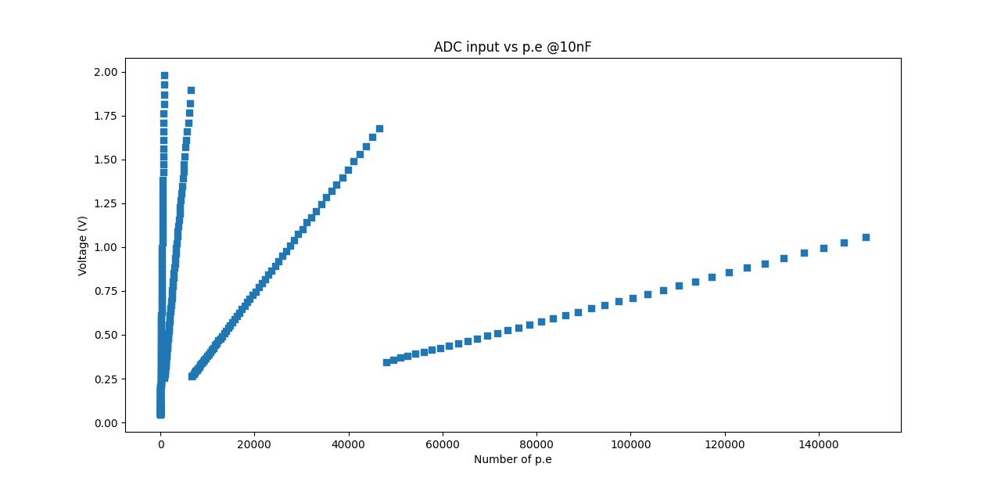
CALOROC1B: Linearity

Slide 10
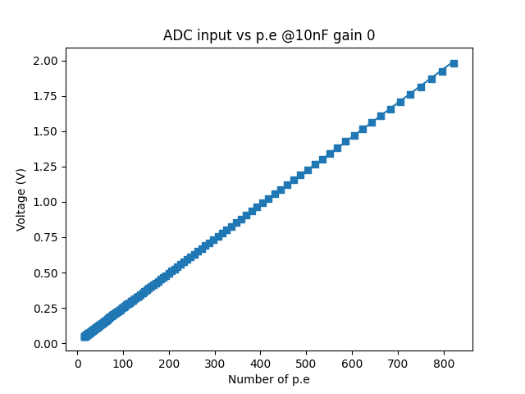
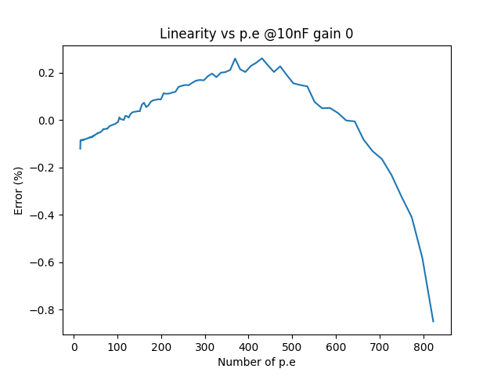
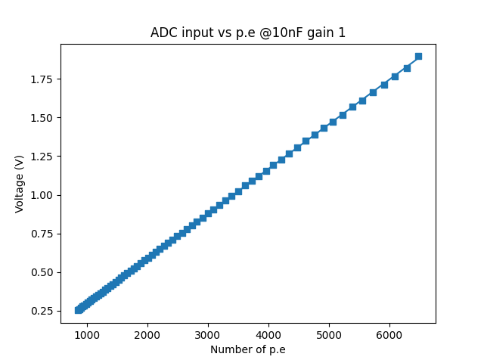
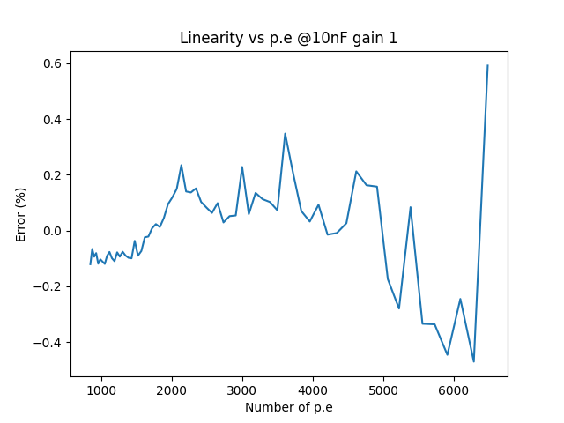
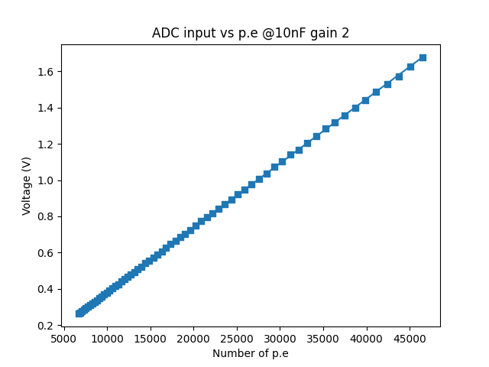
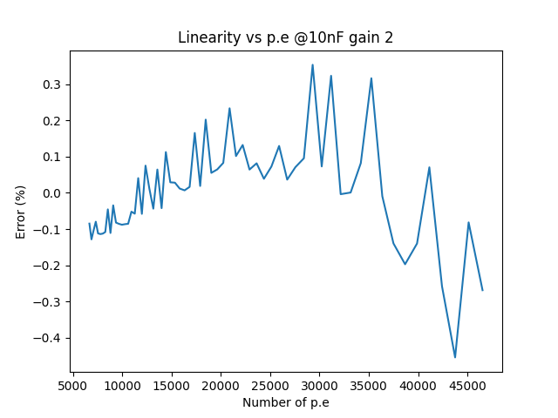
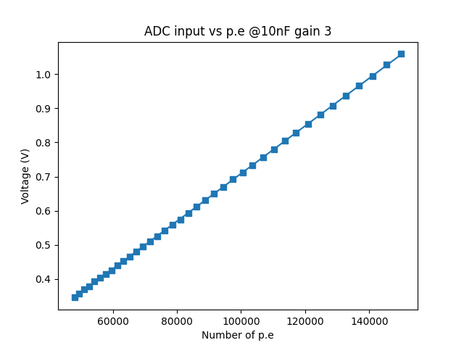
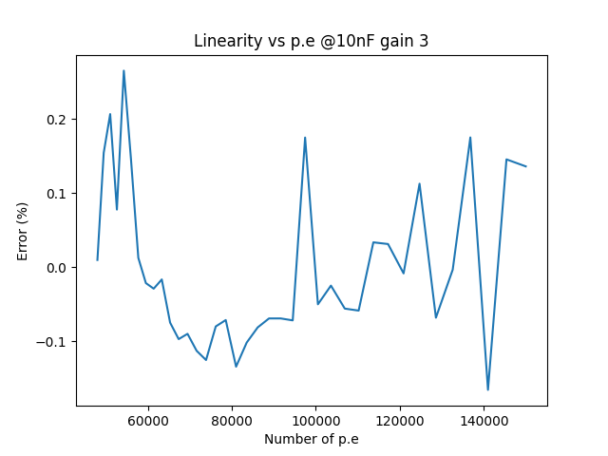
CALOROC1B: Linearity error
Less than 1% linearity error

Slide 11
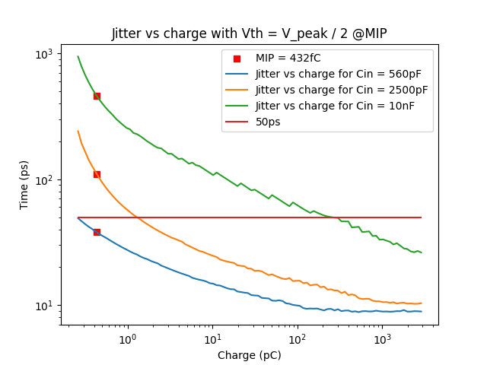
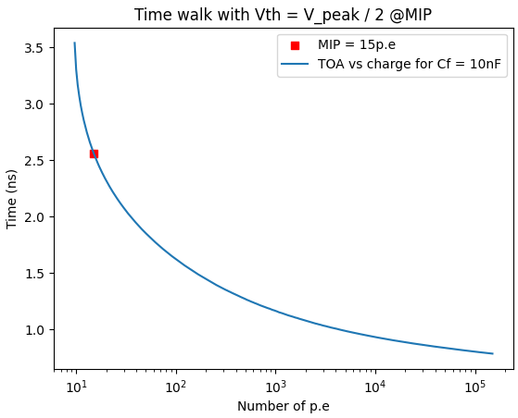
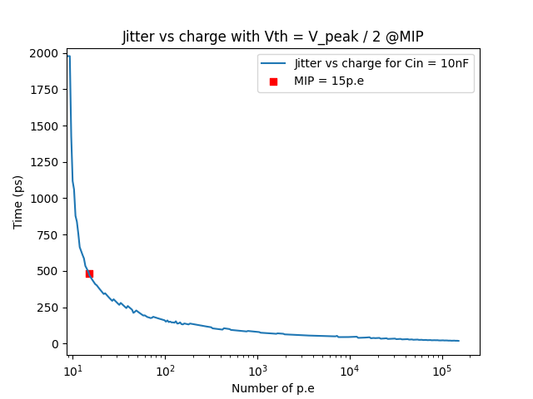
CALOROC1B: Timing precision
Simulated time jitter goes down to 20 ps with < 500 ps for a MIP of 432fC @Cin=10nF
Time walk is below ~2,5 ns

Slide 12
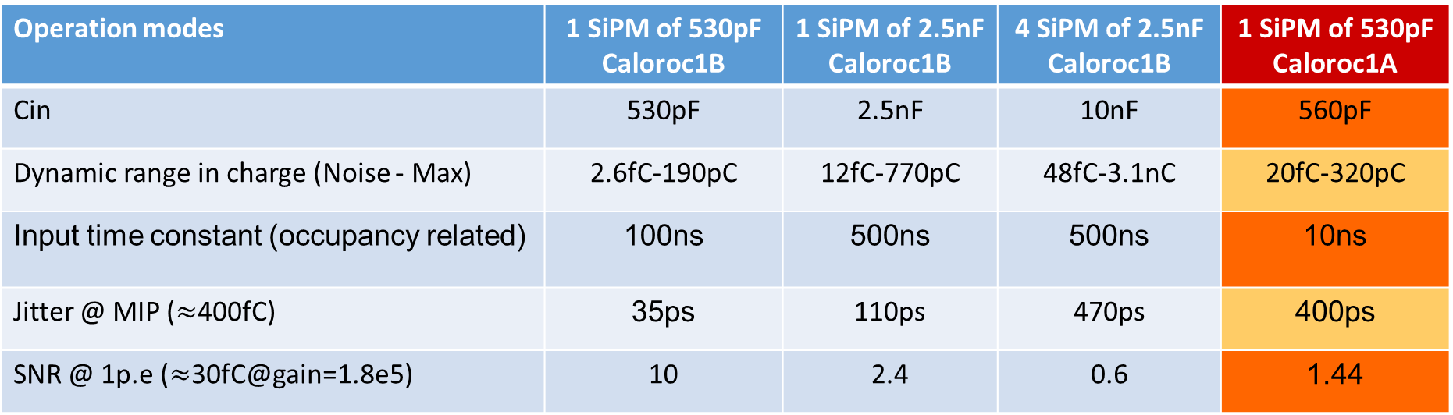
CALOROC1B: SiPM vs SNR
The SiPM configuration has a direct impact on the SNR
  SNR for 1p.e is proportional to Q/C (larger SiPM cap decrease SNR)
  Gain of 1.8e5 electrons per p.e (table below)
CALOROC1b will be able to readout SiPM in the range ~ 500 pF to 10 nF
  Timing measurements will focus on the MIP (~15pe)
Operation modes | 1 SiPM of 530pF Caloroc1B | 1 SiPM of 2.5nF Caloroc1B | 4 SiPM of 2.5nF Caloroc1B | 1 SiPM of 530pF Caloroc1A
Cin | 530pF | 2.5nF | 10nF | 560pF
Dynamic range in charge (Noise - Max) | 2.6fC-190pC | 12fC-770pC | 48fC-3.1nC | 20fC-320pC
Input time constant (occupancy related) | 100ns | 500ns | 500ns | 10ns
Jitter @ MIP ($≈$400fC) | 35ps | 110ps | 470ps | 400ps
SNR @ 1p.e ($≈$30fC@gain=1.8e5) | 10 | 2.4 | 0.6 | 1.44
SiPM: S14160-3010PS 3x3mm (530pF) / S14160-6010PS 6x6mm (2.5nF)

Slide 13
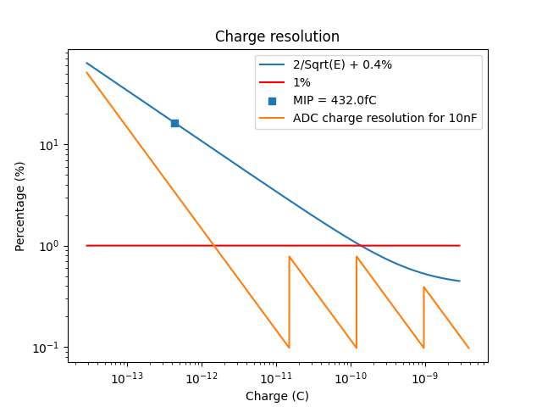
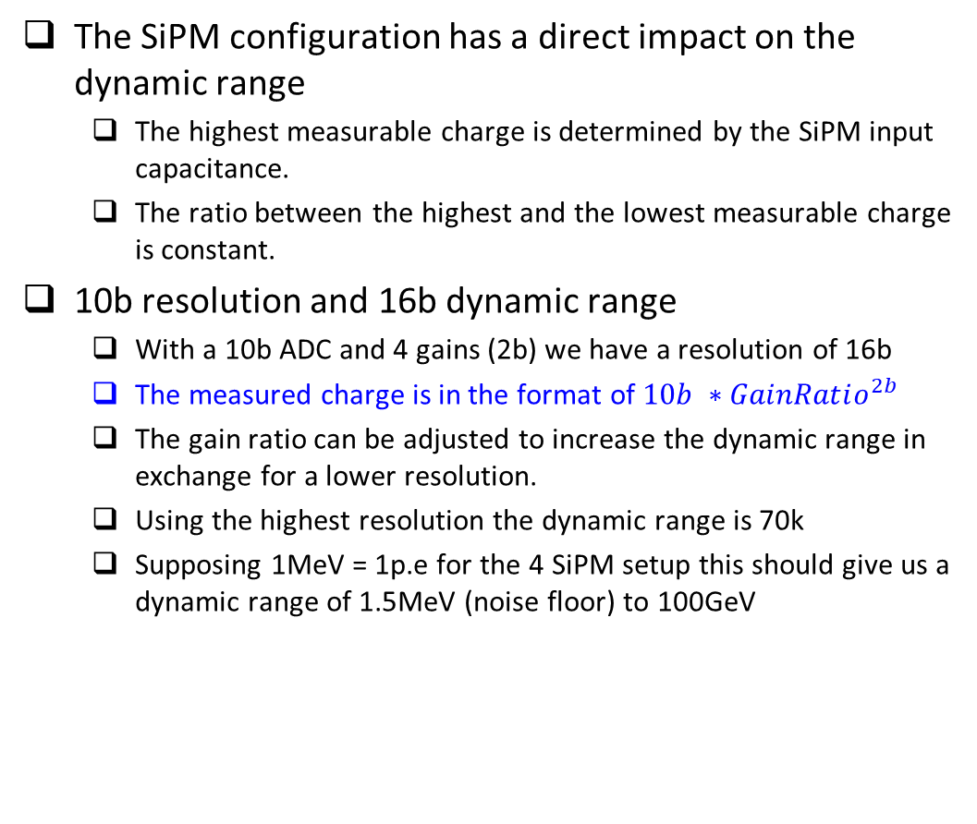
CALOROC1B: Dynamic range and resolution
The SiPM configuration has a direct impact on the dynamic range
  The highest measurable charge is determined by the SiPM input capacitance.
  The ratio between the highest and the lowest measurable charge is constant.
10b resolution and 16b dynamic range
  With a 10b ADC and 4 gains (2b) we have a resolution of 16b
  The measured charge is in the format of $10b ∗GainRatio^{2b}$
  The gain ratio can be adjusted to increase the dynamic range in exchange for a lower resolution.
  Using the highest resolution the dynamic range is 70k
  Supposing 1MeV = 1p.e for the 4 SiPM setup this should give us a dynamic range of 1.5MeV (noise floor) to 100GeV

Slide 14
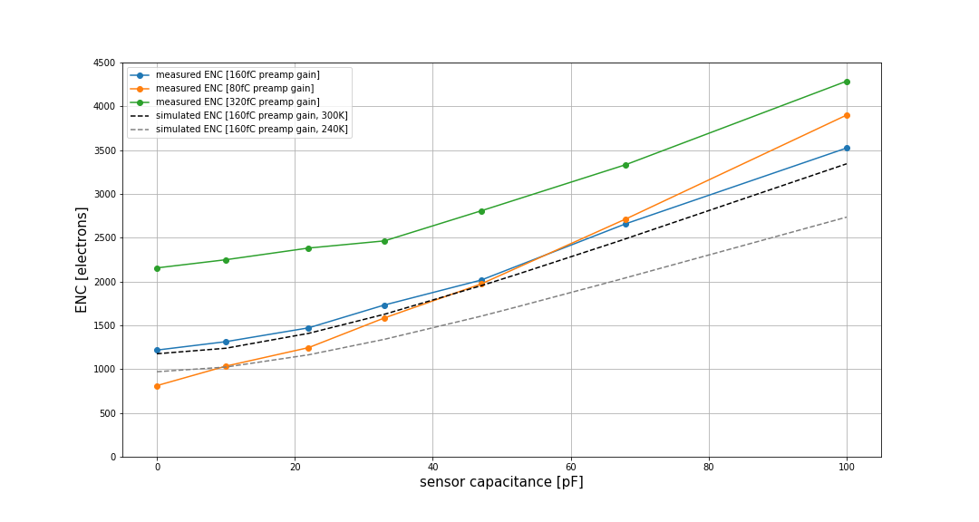
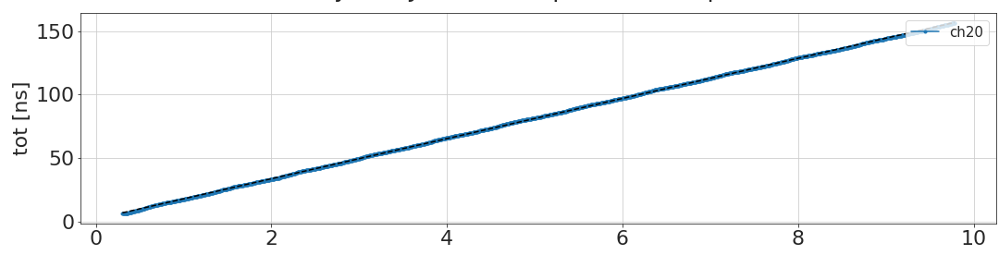
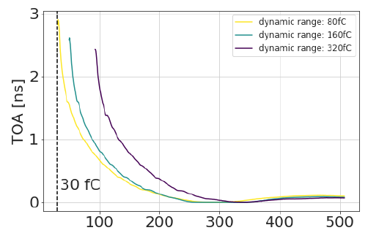
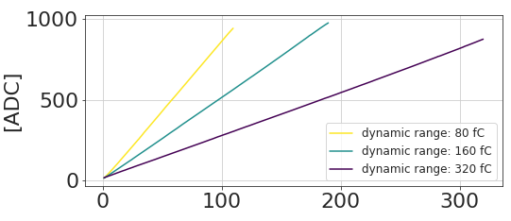
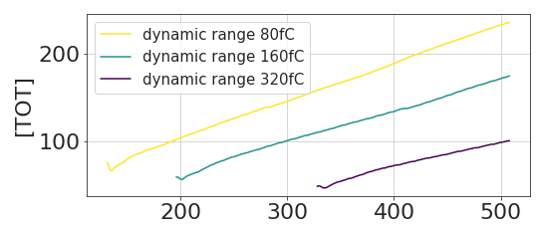
CALOROC1C (based on HGCROC)
Reuse of analog front-end based on ADC/TOT and TOA: fully characterized *
  15 mW per channel / R adiation performance / Si up to 100 pF
measure HGCROC
measure HGCROC
charge (pC)
measure HGCROC
measure HGCROC
measure HGCROC
charge (fC)
charge (fC)
* TWEPP 2023 🡺 https://doi.org/10.1088/1748-0221/19/04/C04005
charge (fC)

Slide 15
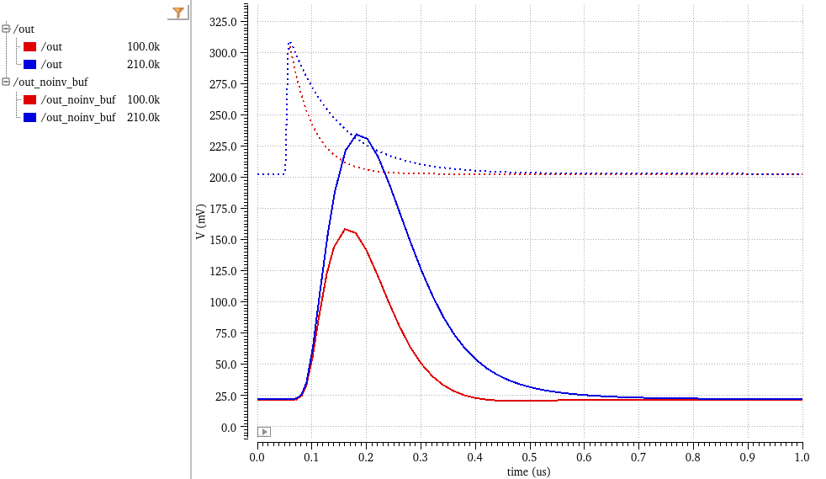
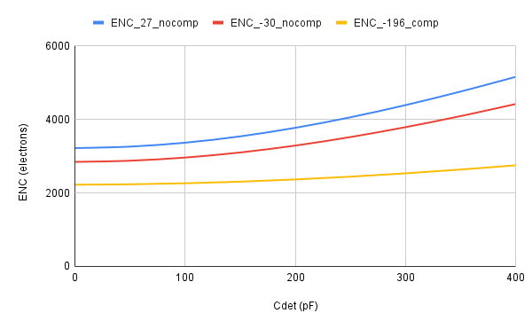
CALOROC1C (based on HGCROC)
CALOROC1C will
  update its back-end (readout streaming)
  slow down the shaping from 25ns to 100ns
Waveform
RMS Noise

Slide 16
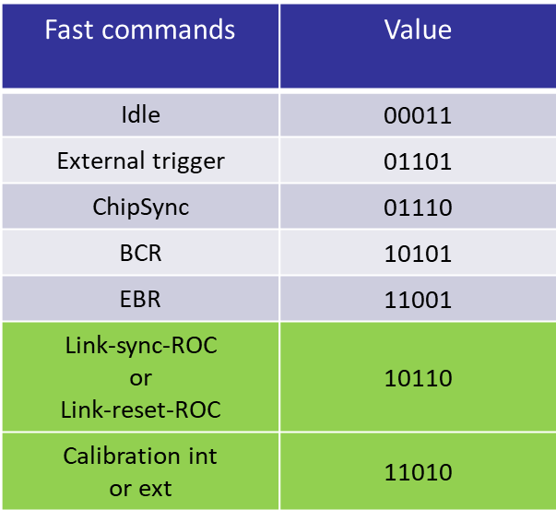
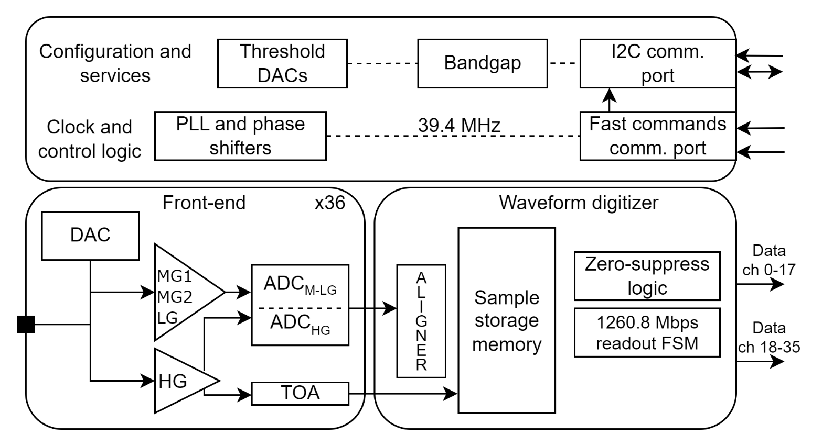
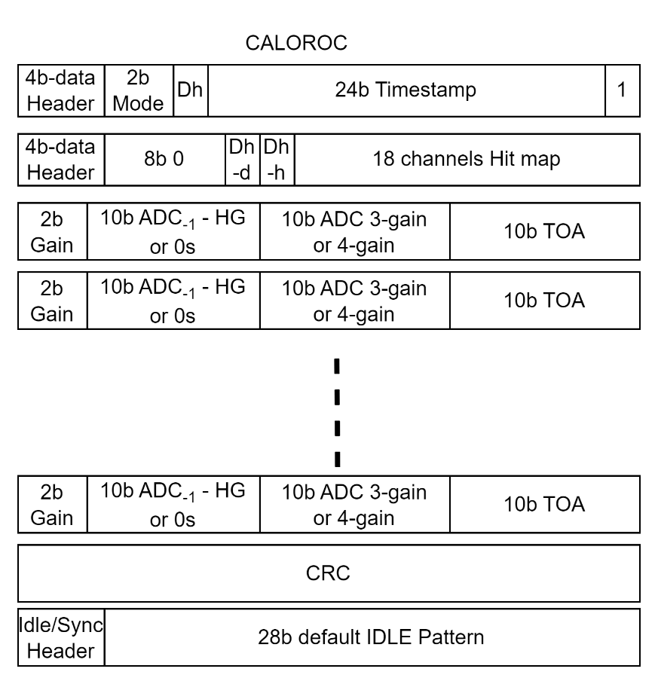
CALOROCs: block diagram and interfaces
CALOROCs will have the same interfaces (comparable to CMS H2GCROC *):
  Fast command to dynamically control the ASIC
  I2C to set the parameters
  High speed serial links (CernLowPowerSignal compatible)
CALOROC1A or 1B
* CERN EDMS ➔ https://edms.cern.ch/document/2954073/1

Slide 17
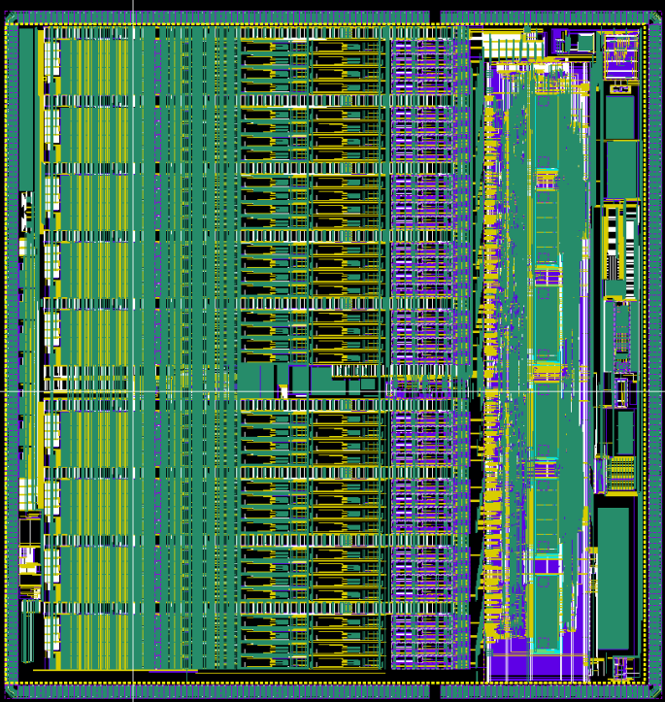
Conclusion
Conservative CALOROC1A:
  Based on CMS SiPM H2GCROC + SRO
New CALOROC1B:
  New analog front end
  Higher dynamic range and input capacitance
  Same backend (and pinout)
CALOROC1C for Si/LAr detectors:
  Based on CMS Si HGCROC + SEO
All Calorocs share the same backend
All Calorocs will be sent to fabrication this month
CALOROCs are targeted to include all features + radiation hardness on the first submission

