Slide 1




















SiW-ECAL Status
/ DRD6
Vincent Boudry
Institut Polytechnique de Paris
for the SiW-ECAL groups
DRD6 3rd collaboration meeting
01/04/25 @ IJCLab

Slide 2




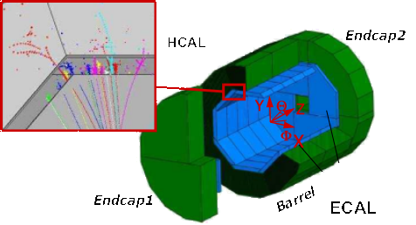
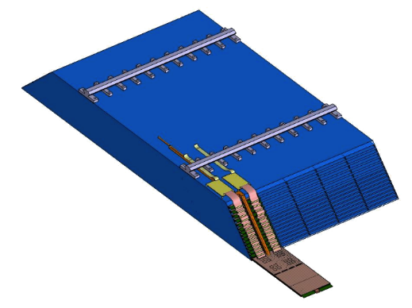
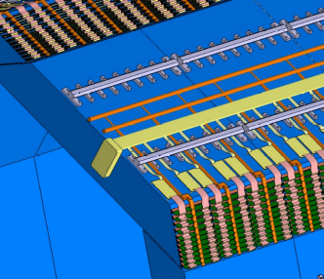

Design Constraints
B = 2 – 3.5 T
Physical
Instrumental
Electronics
Mechanical
Thermal
Production / Integration
Mininal Margins
Structure
+ timing
Cooling
PP ↔ Cont
DAQ

Slide 3

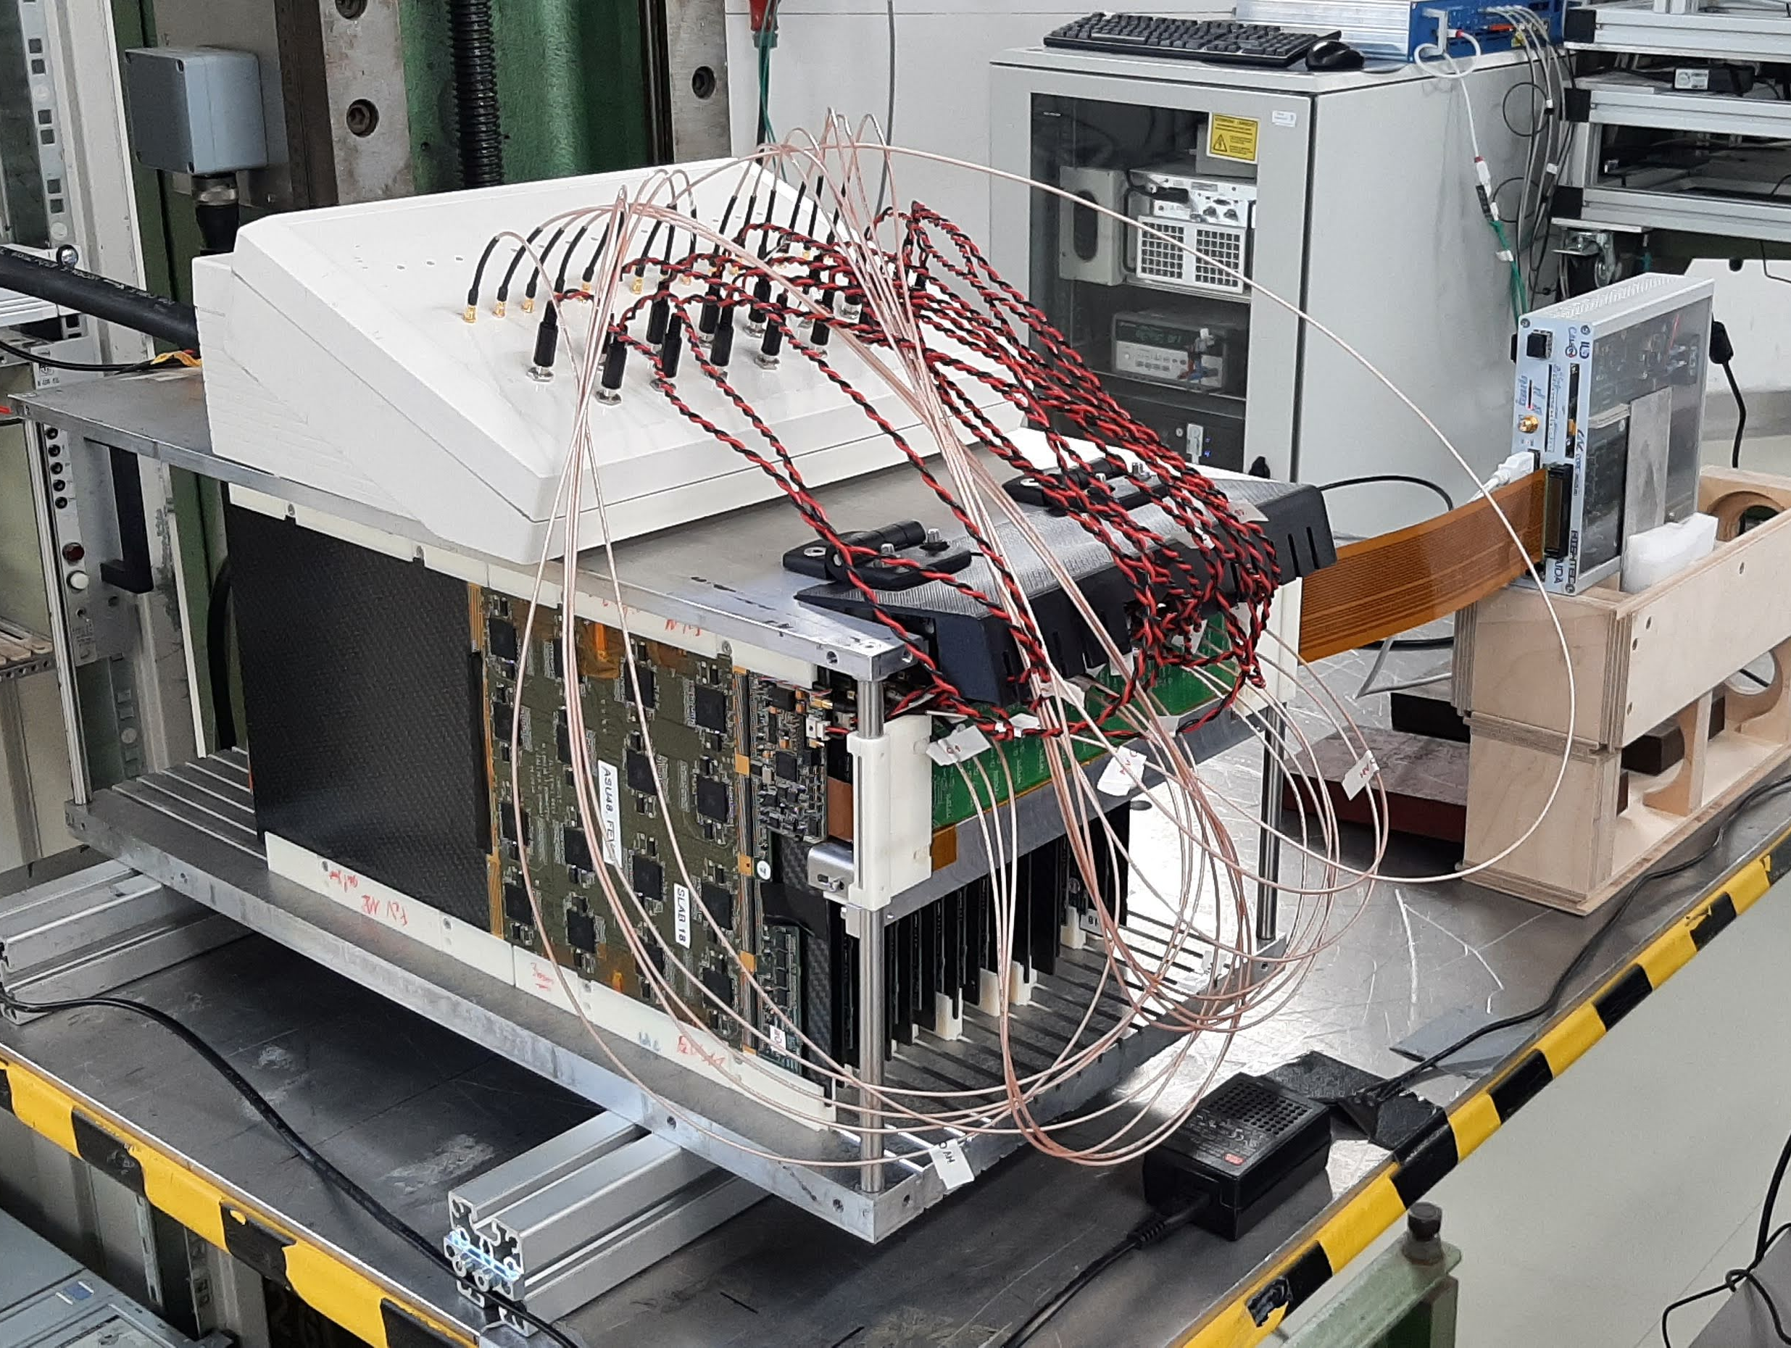
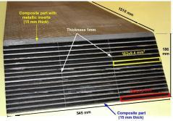
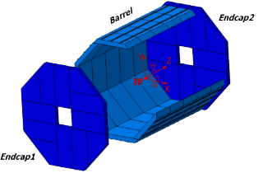
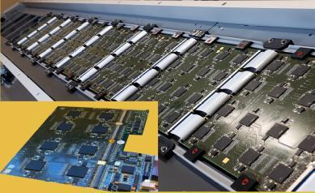
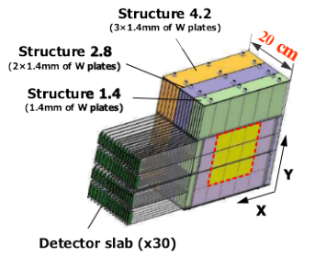
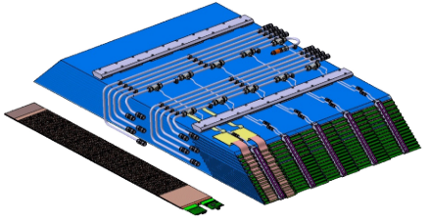

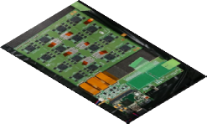
Timeline of SiW-ECAL Prototypes
‘dead space free’
Carbon Fibre-W
Structure
× (40+24)
× 4
× 8
× 2
Technological (now)
  Embedded electronics
    Power-Pulsed, Auto-Trig, delayed RO
    S/N = (MPV/σNoise) ≥ ~12 (trig)
  Compatible w/ 8+ modules-slab
  5×5 mm² on 320–650m 9×9 cm²
  × 26–30 layers
    8k (slab) ~ 30k (calo) channels
× 45
Physical (2005-11)
  1×1 cm² on 500μm 6×6 cm²
  Pad glued on PCB
  Floating GR
  × 30 layers (10k chan).
  External readout
  Proof of principe
Pilote ➡︎ Full Detector
  1M ➡ ︎ 70M channels
  on 725μm 12×12 cm² 8’’ Wafers ?
  Pre-industrial building
  Full integration (⊃ cooling)
  Final ASIC
We are here
‘Almost ready’ for LC
To be revisited for CC

Slide 4
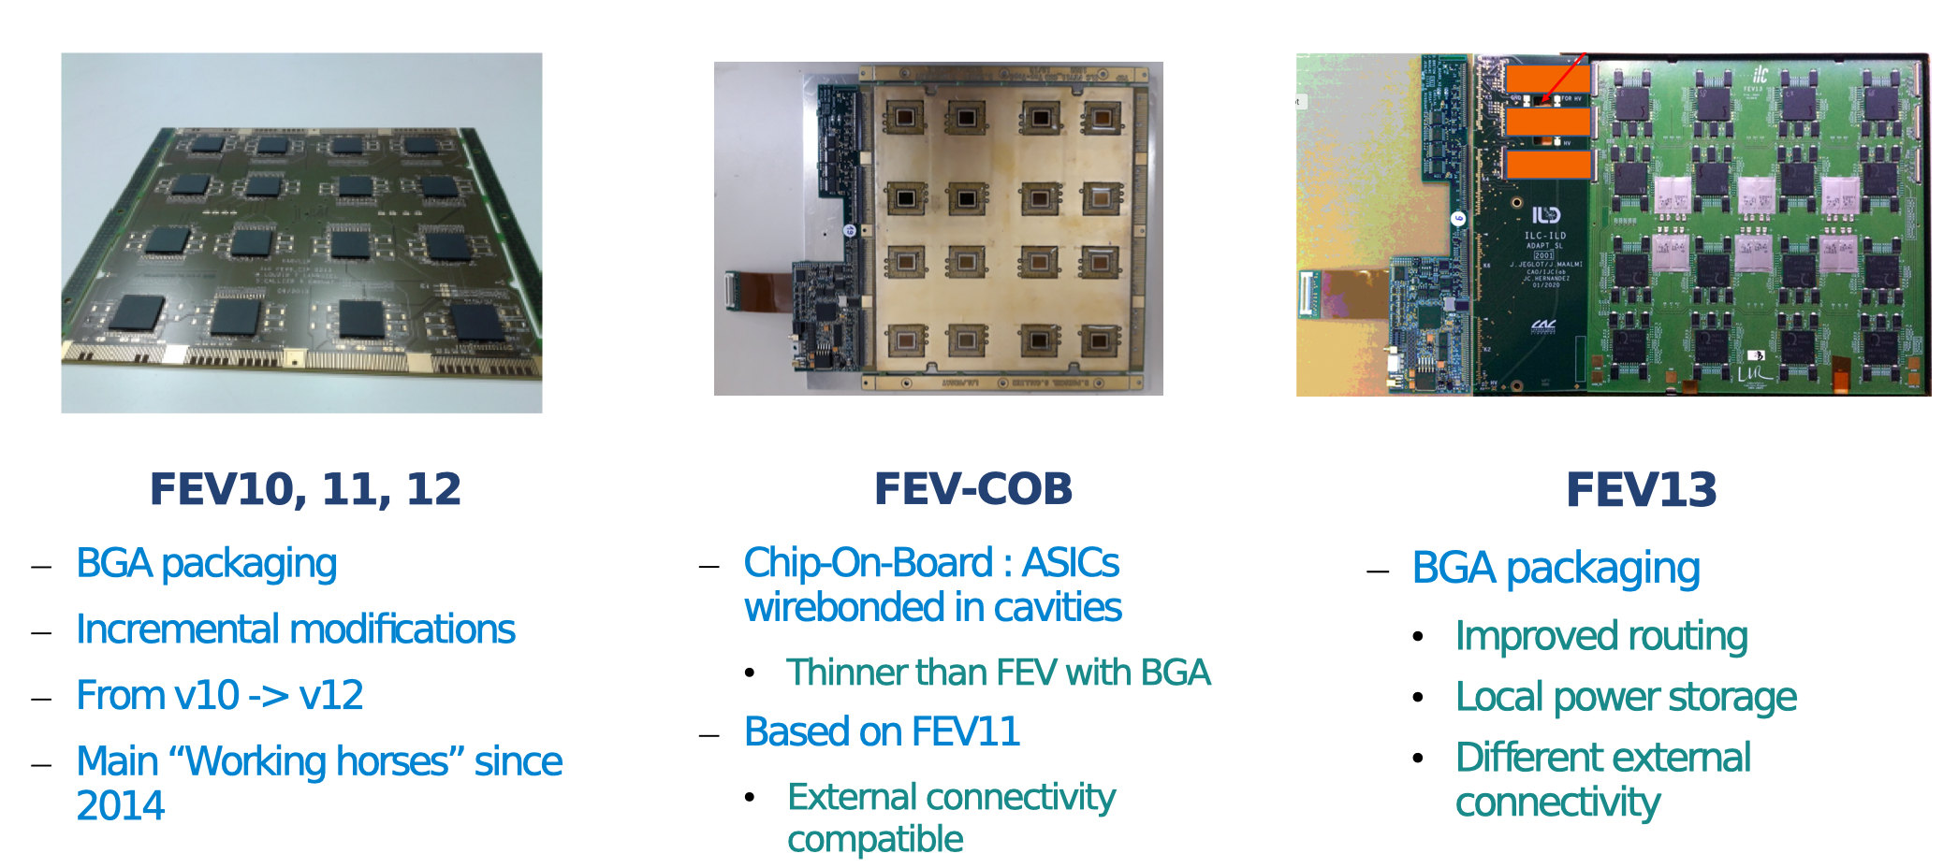
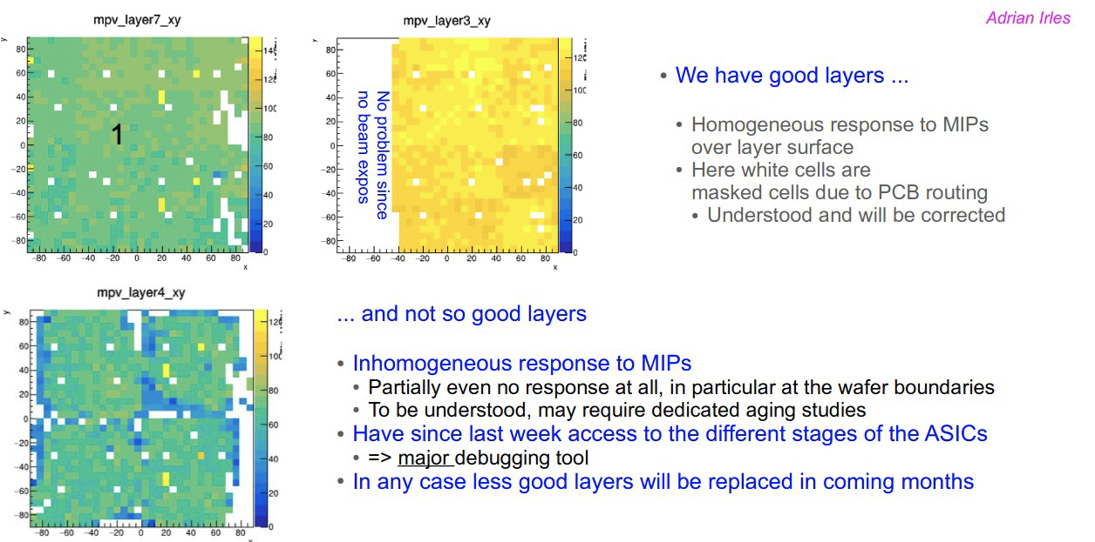
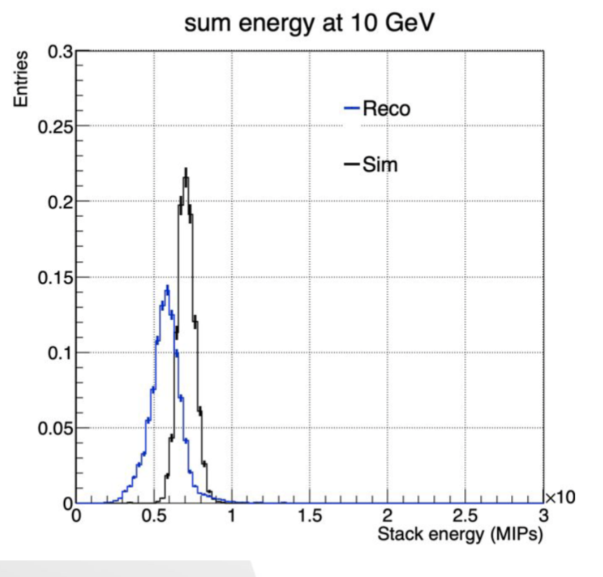
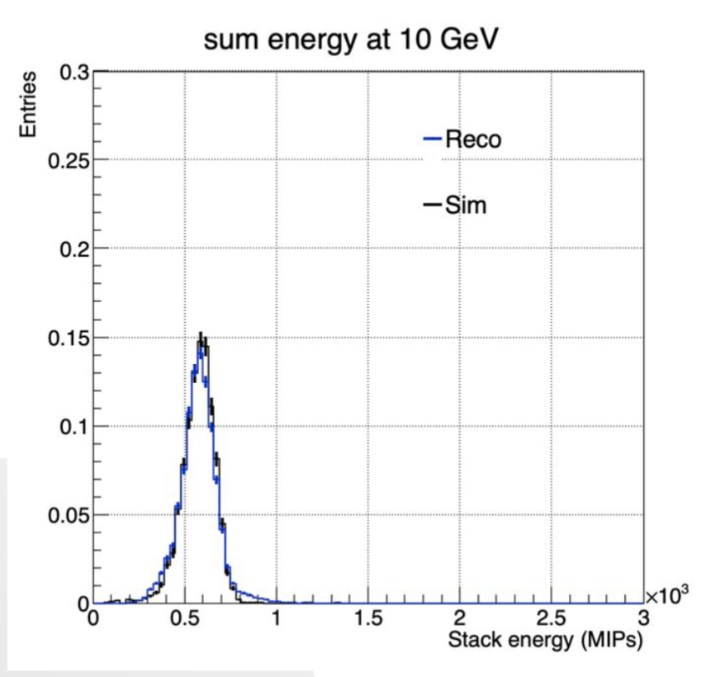
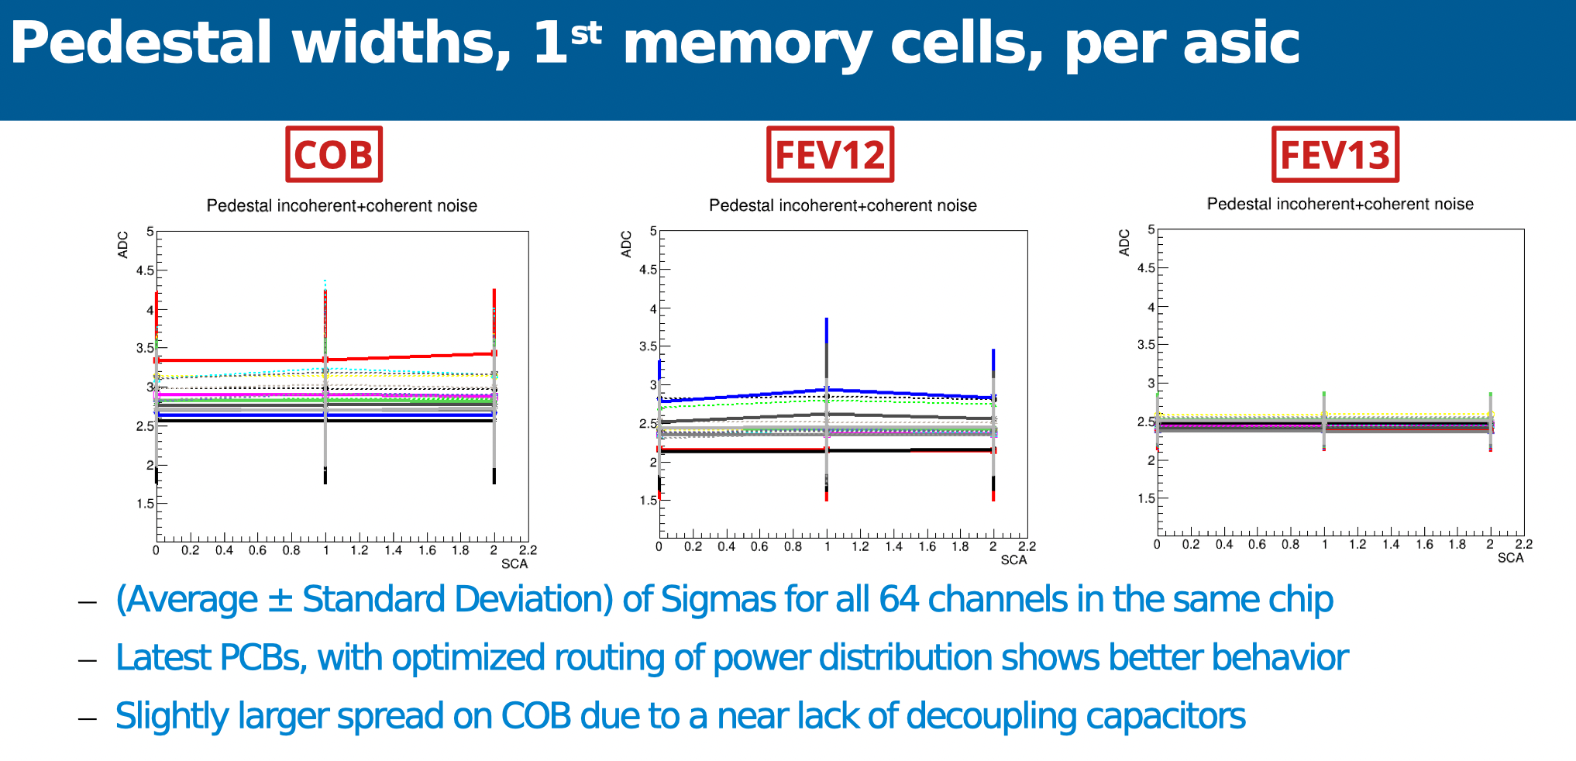
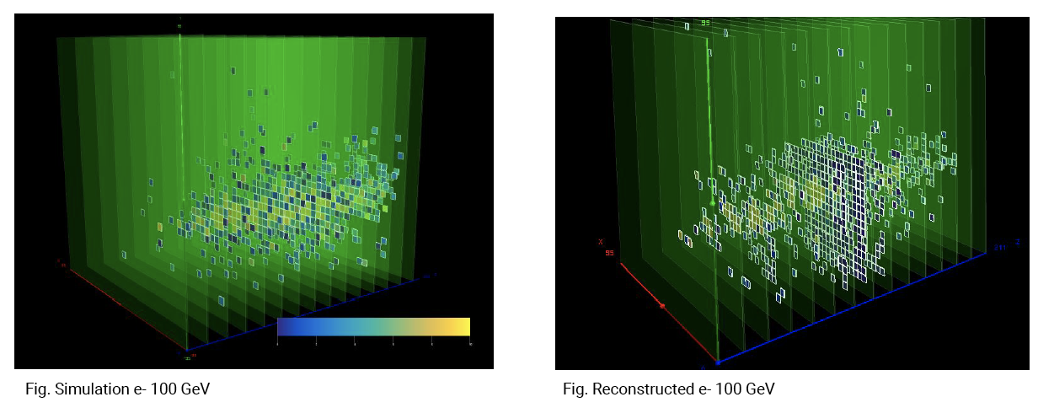
Technological Prototype Beam test at DESY & CERN
2022 DESY & CERN BT
Masking
Beam
profiling
Yuichi Okugawa (PhD in Feb. 2024)

Slide 5
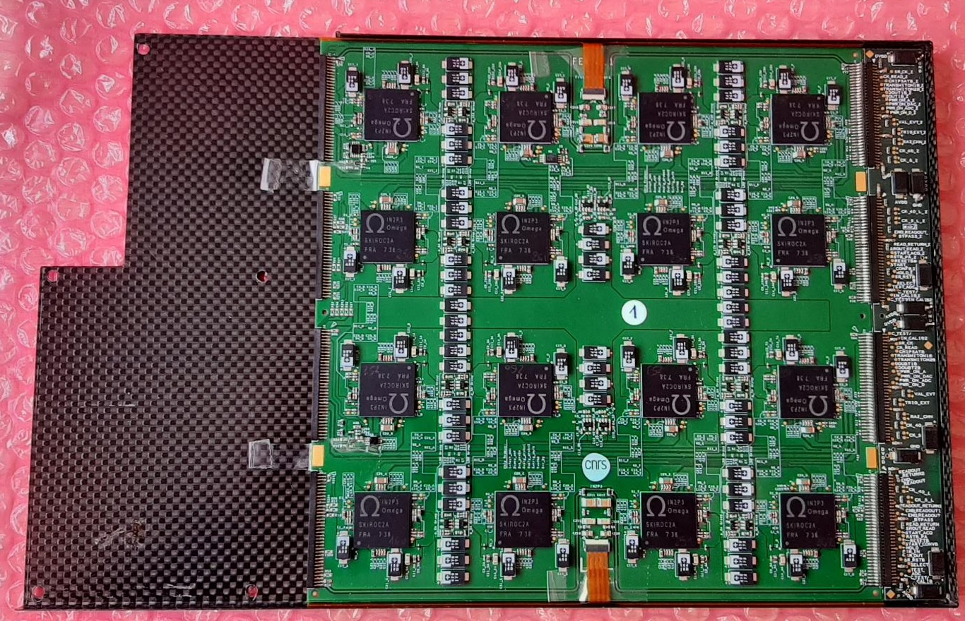
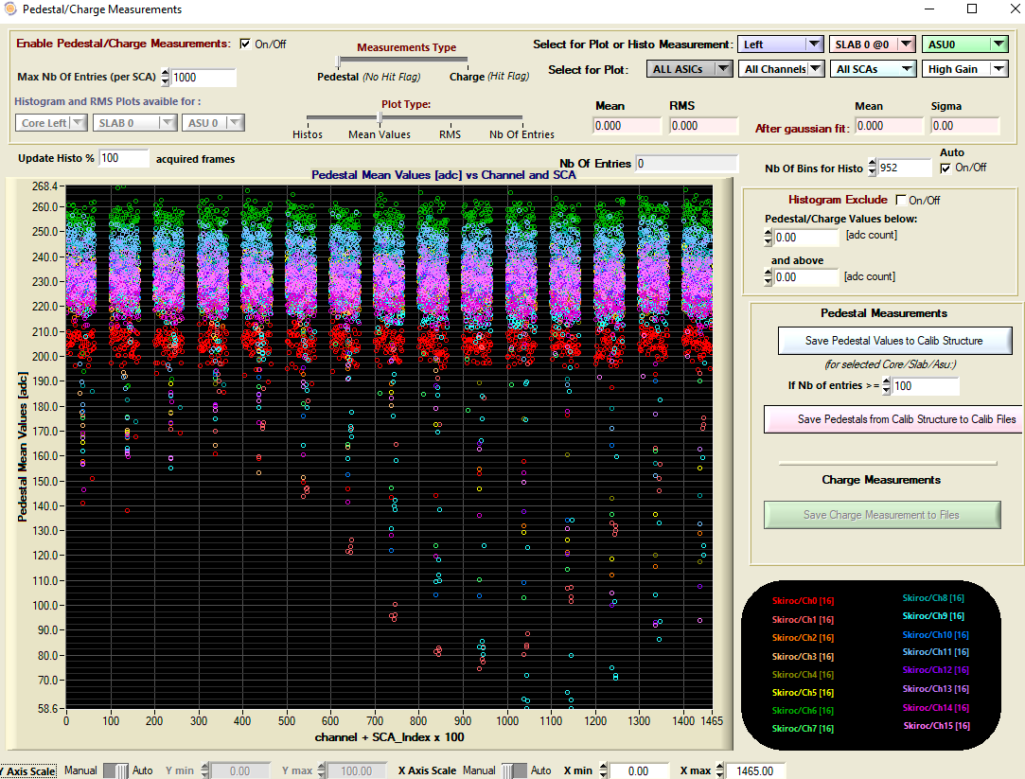
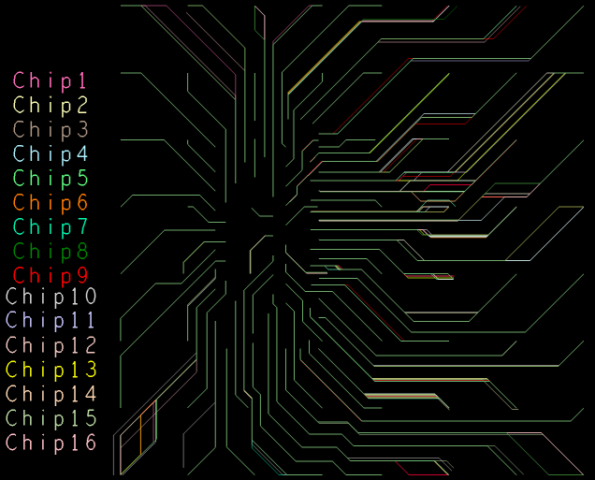
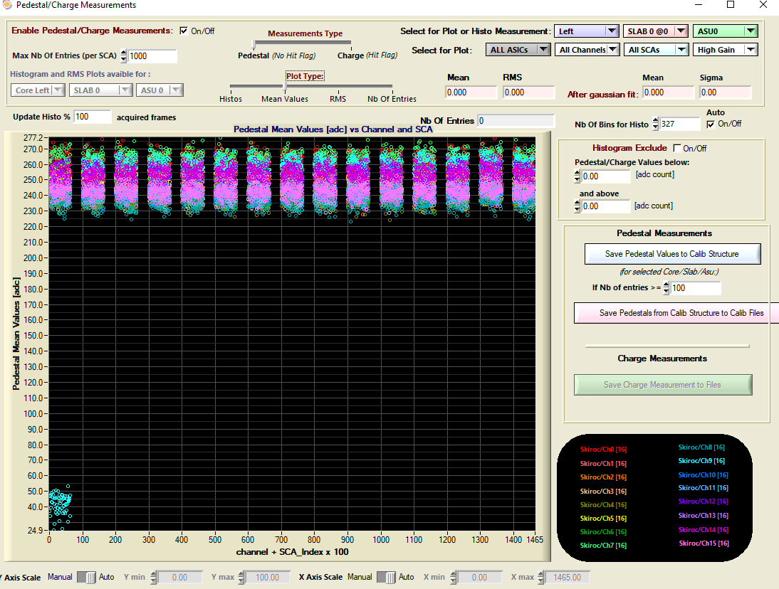
New FE boards (2023)
Improvements:
  Power distributions
    Local LV power regulation: LDO’s
    Local HV filtering & Supply
  Signal distribution (buffering), data paths
  Monitoring (single ID, temp, probe analogue line)
  ASIC shielding/routing
Status:
  Noise uniformity dramatically improved (ex: outliers in thr. / 20)
  version 2.1 produced
    4 cabled, 2nd metrology, 2 equipped with sensors (Fev’25)
FEV11
Pedestal measurements vs. Ch# + Mem#×100)
SIngle channel ➞ the fault on the ASIC/packaging
FEV2.0

Slide 6
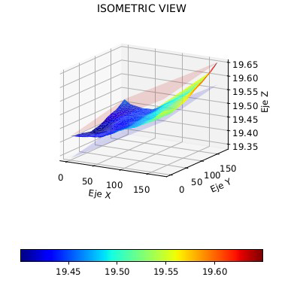
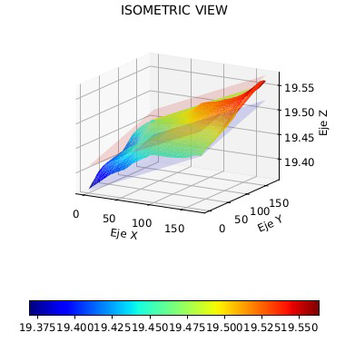
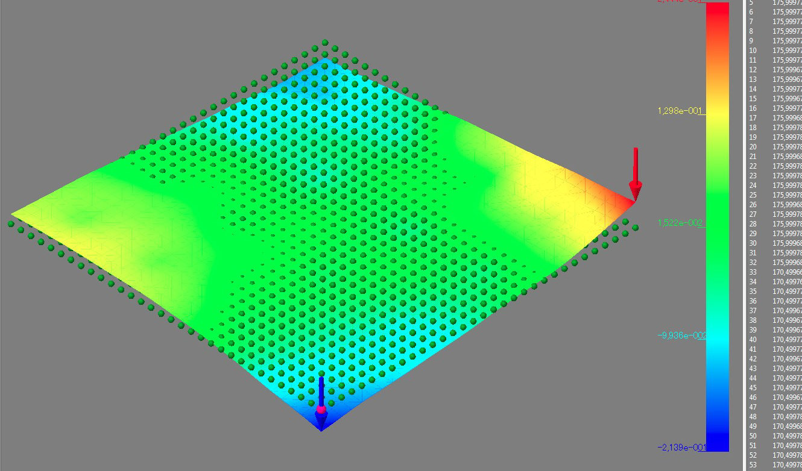
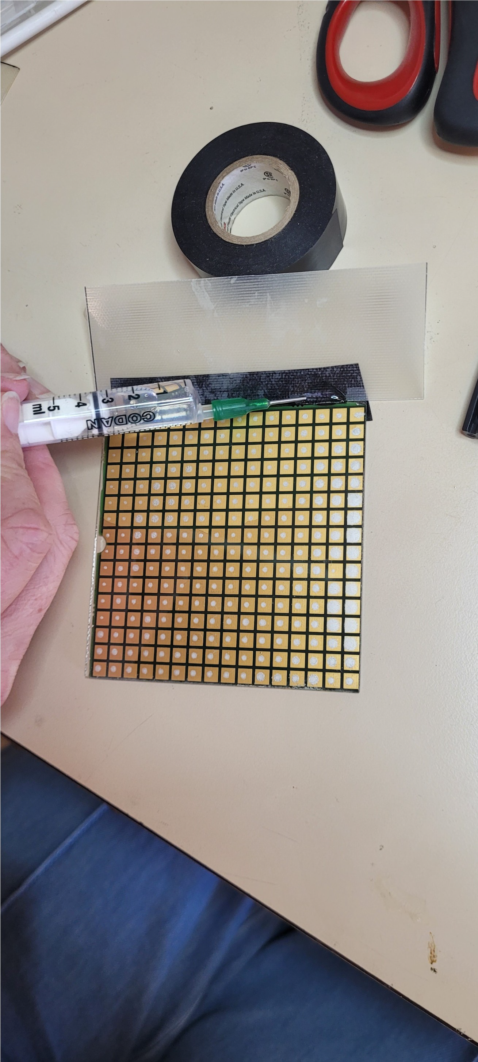
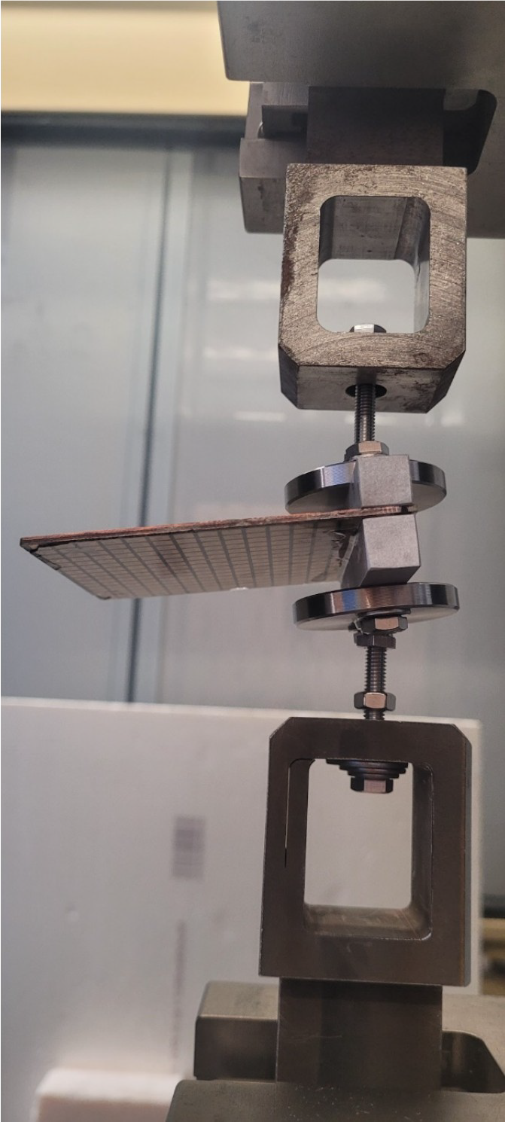
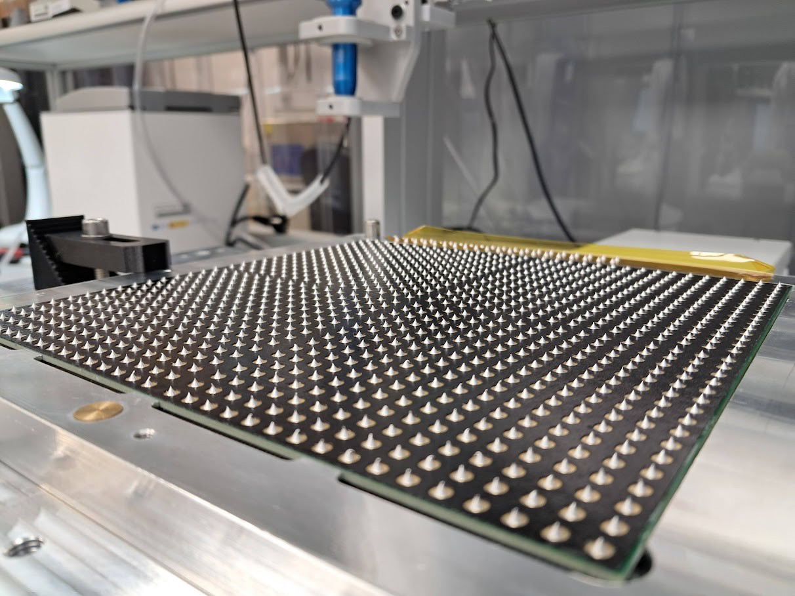
Hybridization studies (2024):
How to assemble silicon sensors & PCB ?
See Adrián’s presention in
side SiW-ECAL meeting
for a complete overview
Revisiting gluing (IFIC, IJClab, DMLAB)
  PCB metrology
    Bef. & After
    curing &
    soldering
  Glue formula &
  preparation
  Gluing methods
    Robot
    Stencil
  Reenforcement
    Filling glue
    Adhesive films
Flatness of PCB
IJClab (méca)
IFIC (optical)
Conductive glue + filling
(~invisible) on a glass plate
Same PCB before / after 10-day dry storage
Measurements by C. Orero, IFIC
Puncturated
adhesive film (DMLab)
+
conductive glue dots

Slide 7
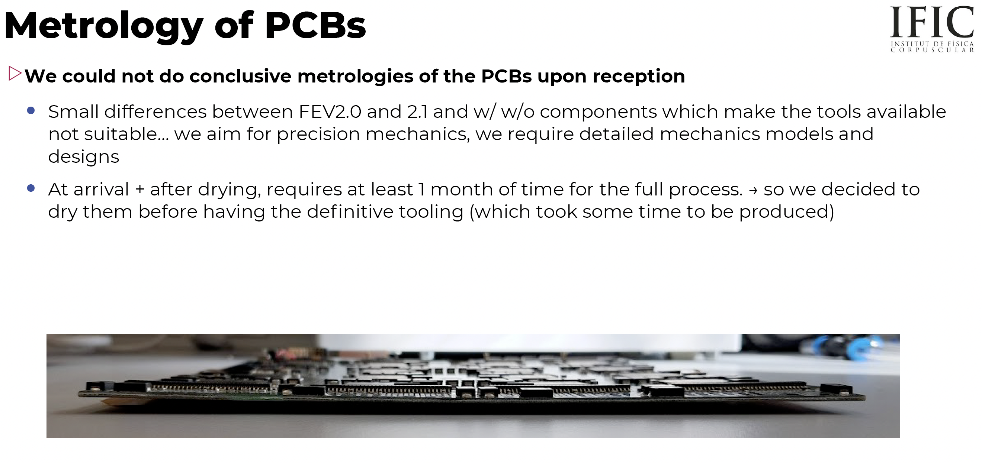
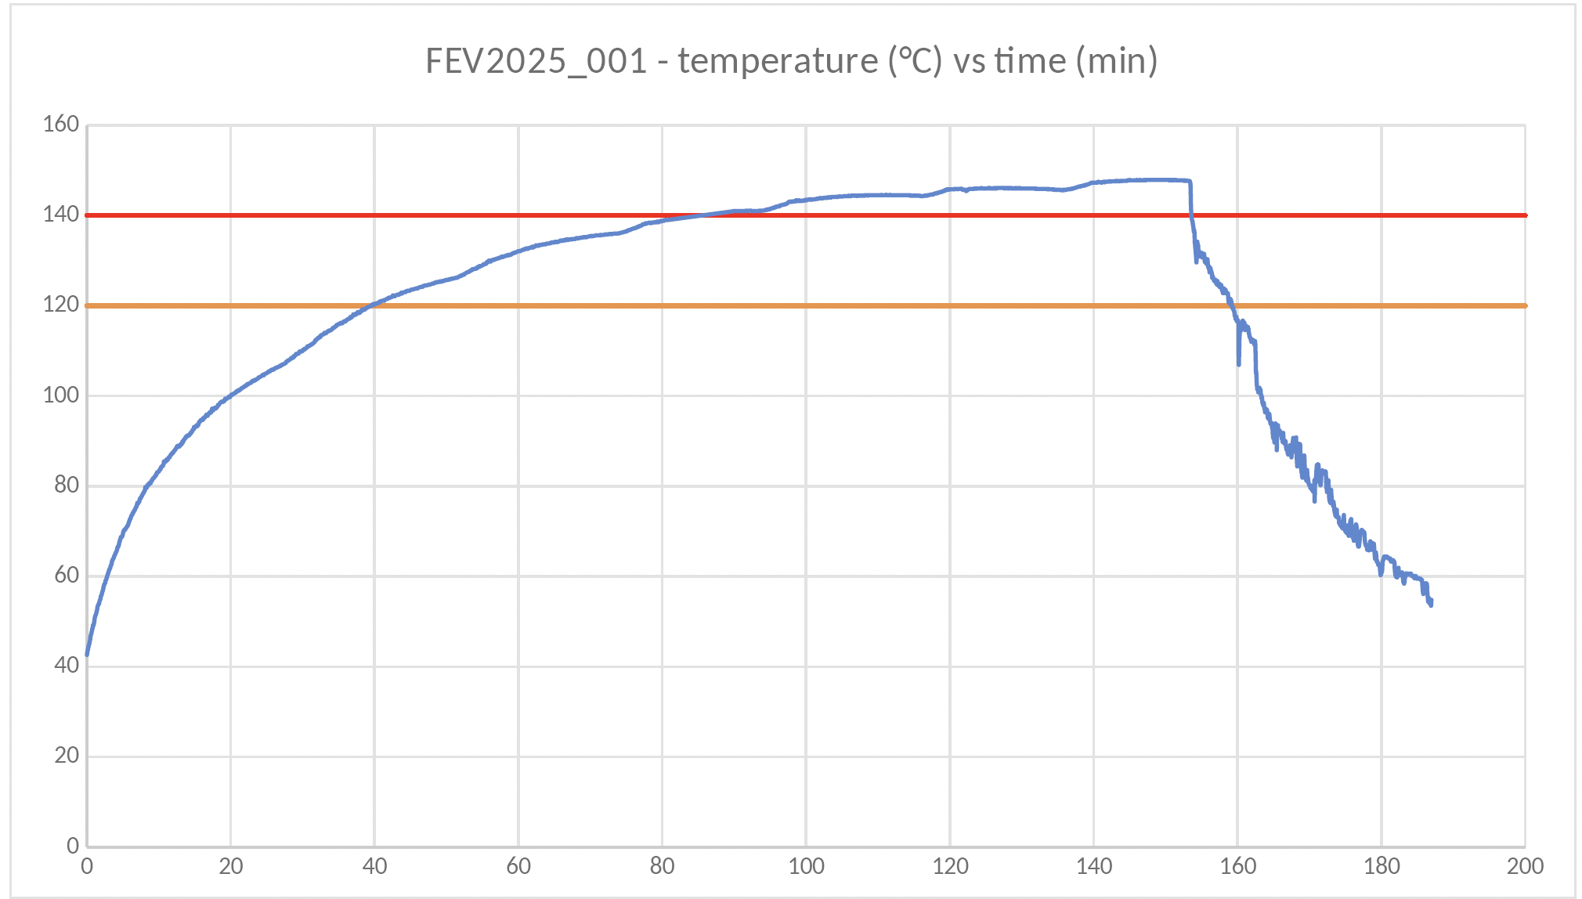

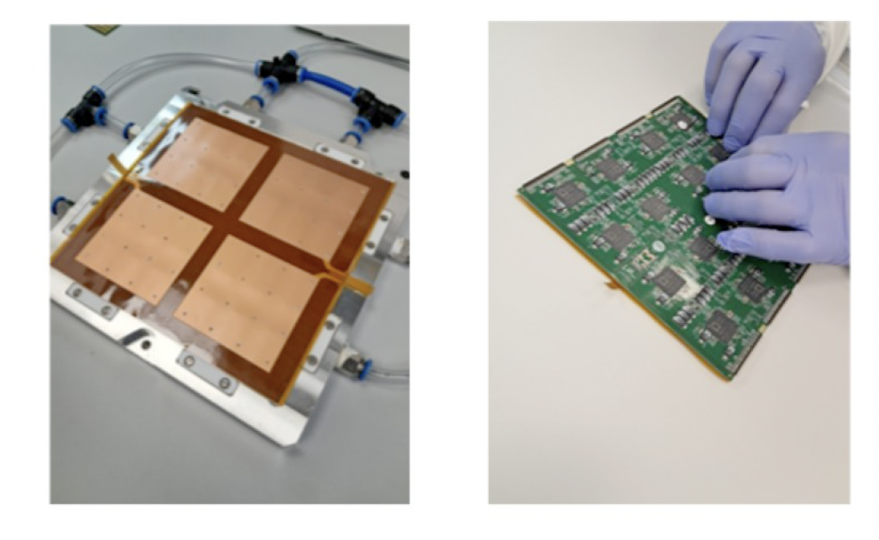

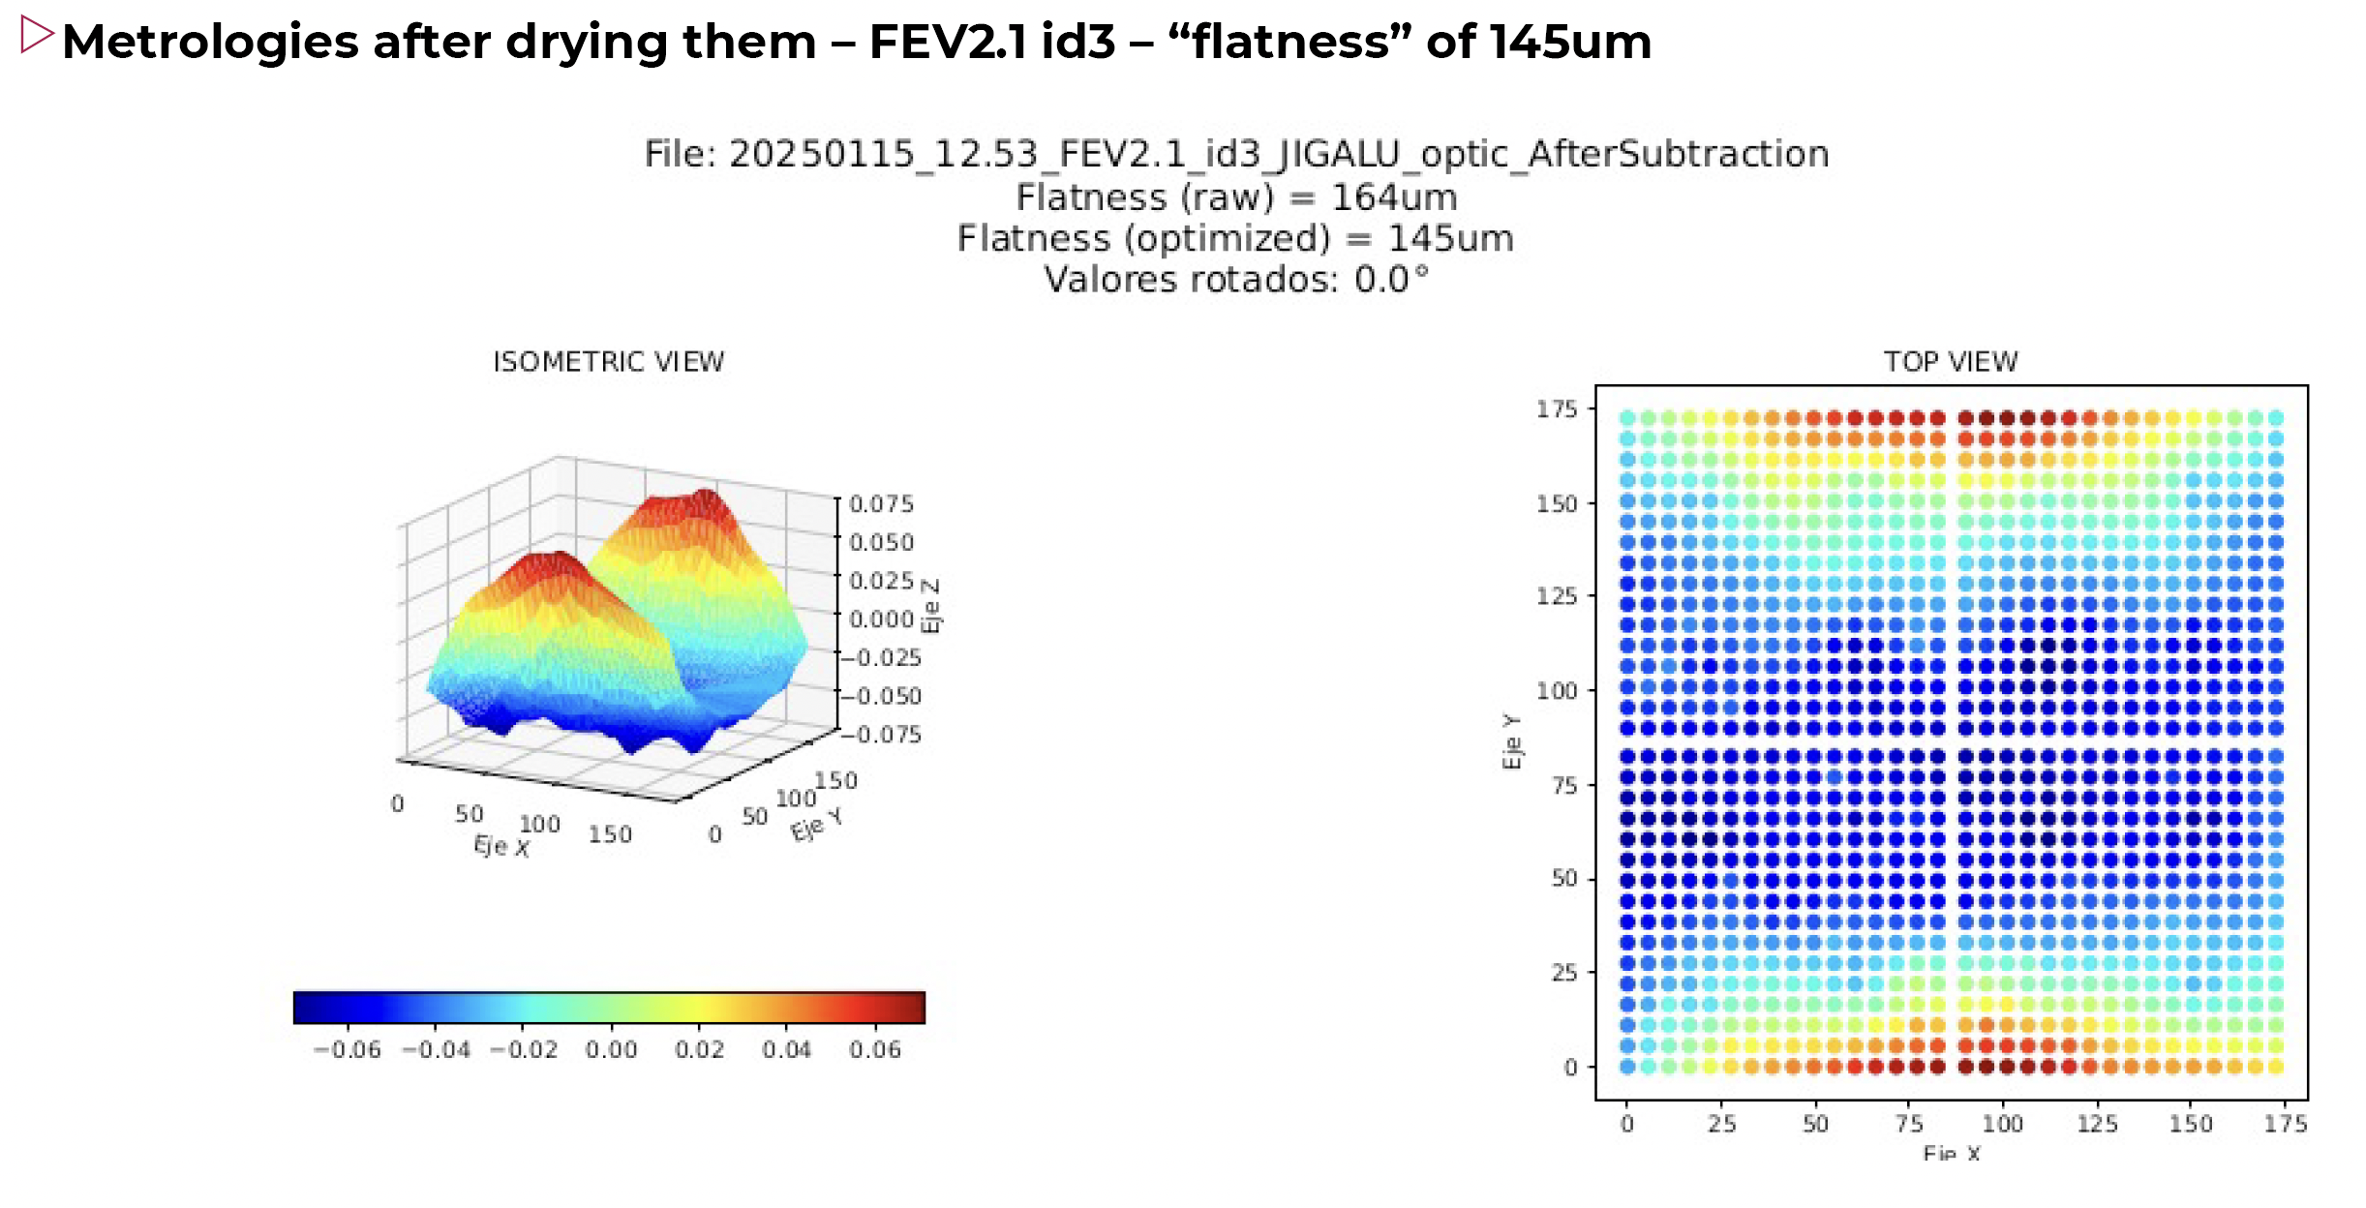
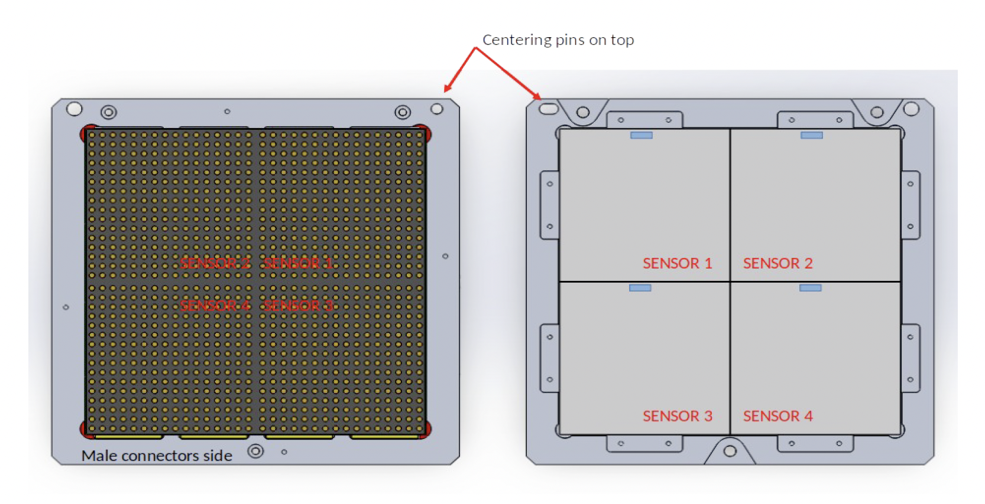

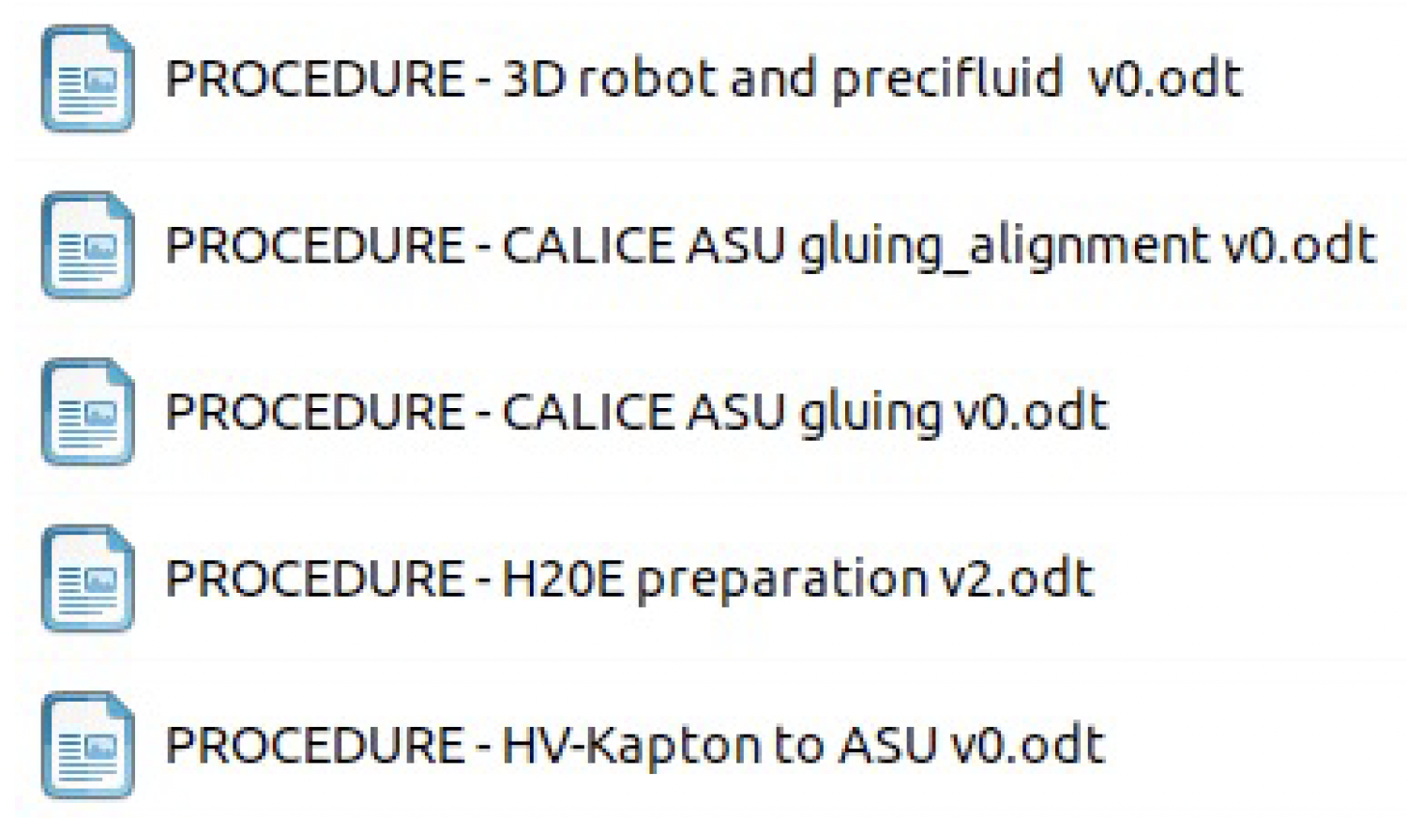
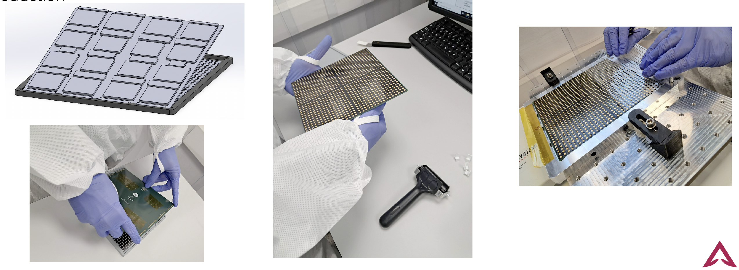
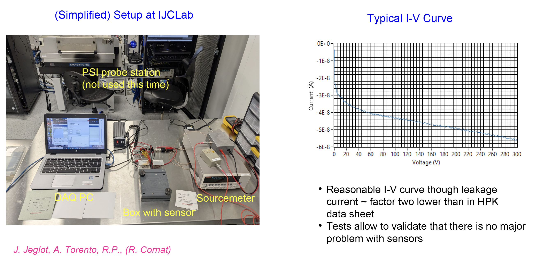

ASU2025_001 + 002 (2025)

Slide 8
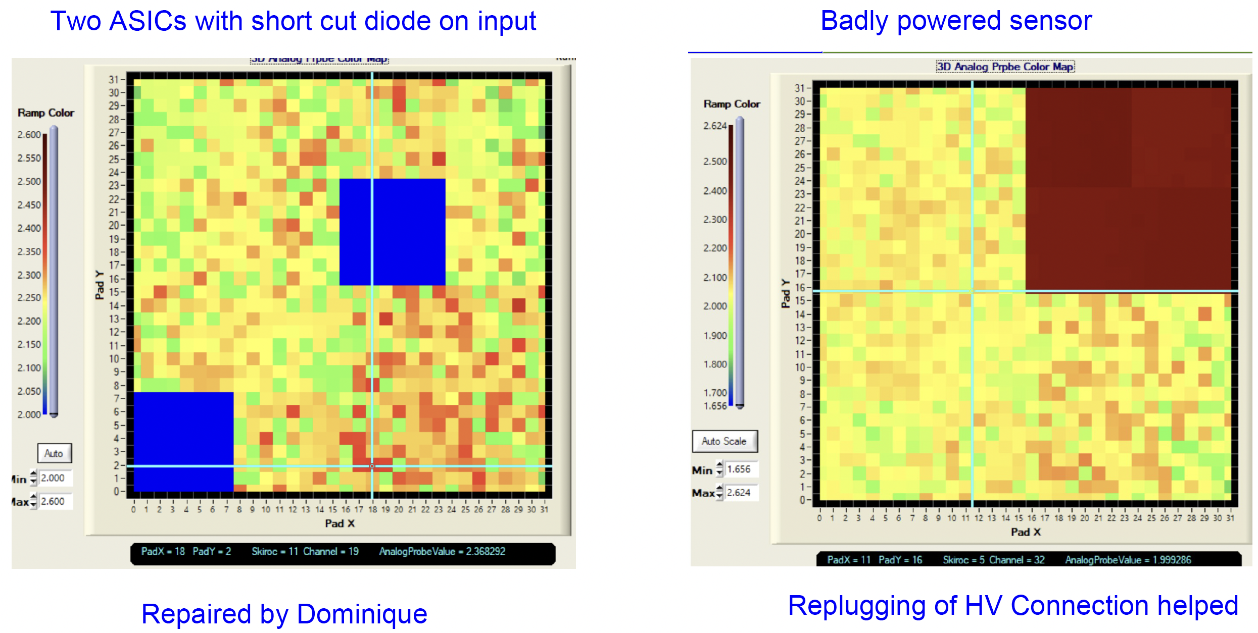
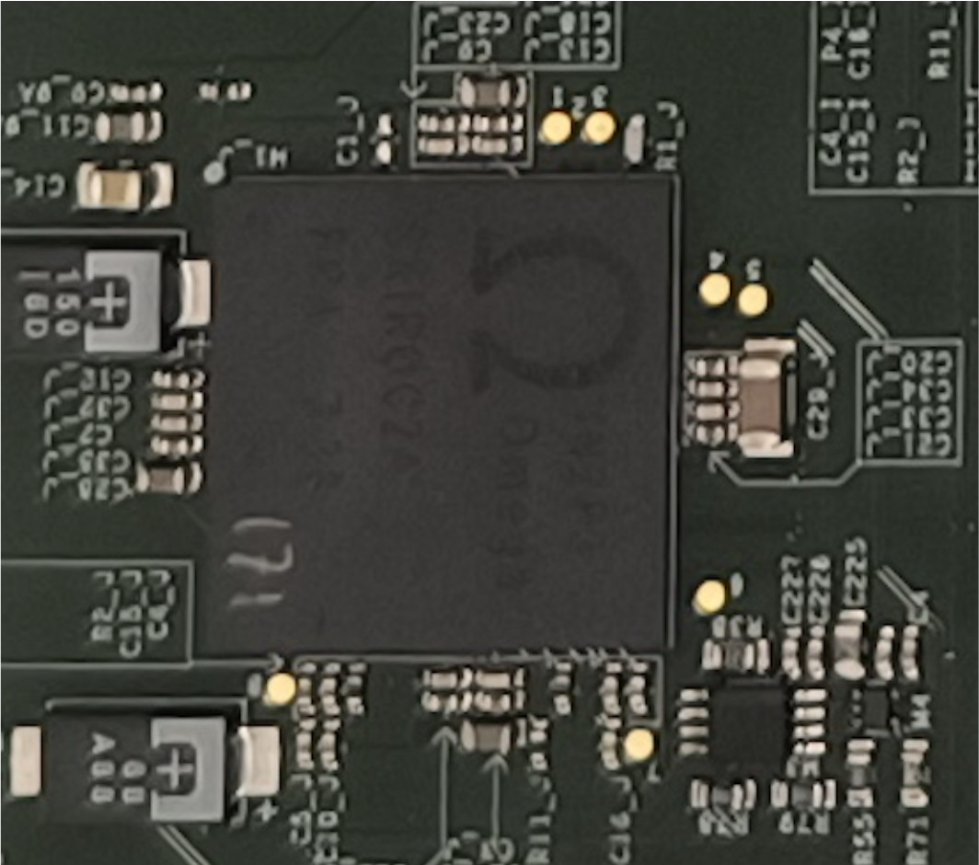
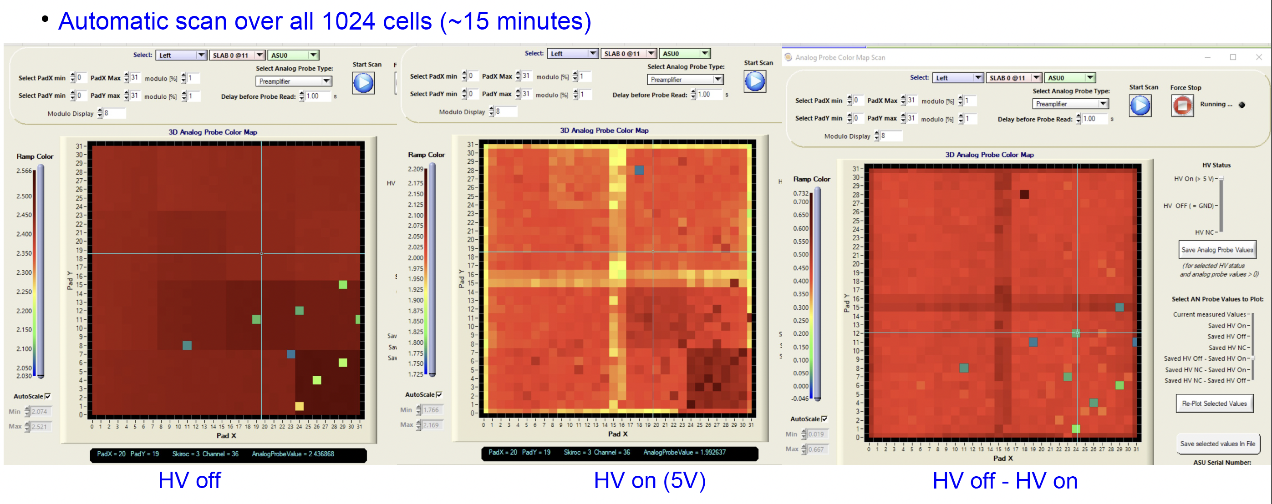
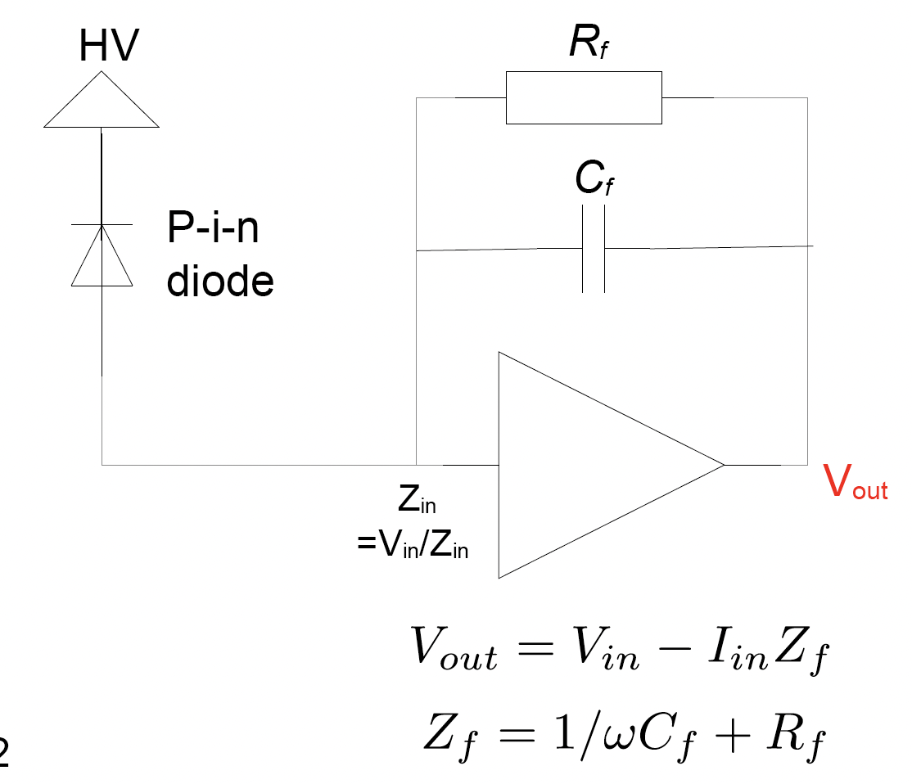
Commissioning:
Analogue Probes
See Roman’s presention in
side SiW-ECAL meeting
for a complete overview
Analogue Probes
1 value (LV, Channel, …)
➞ common line

Slide 9
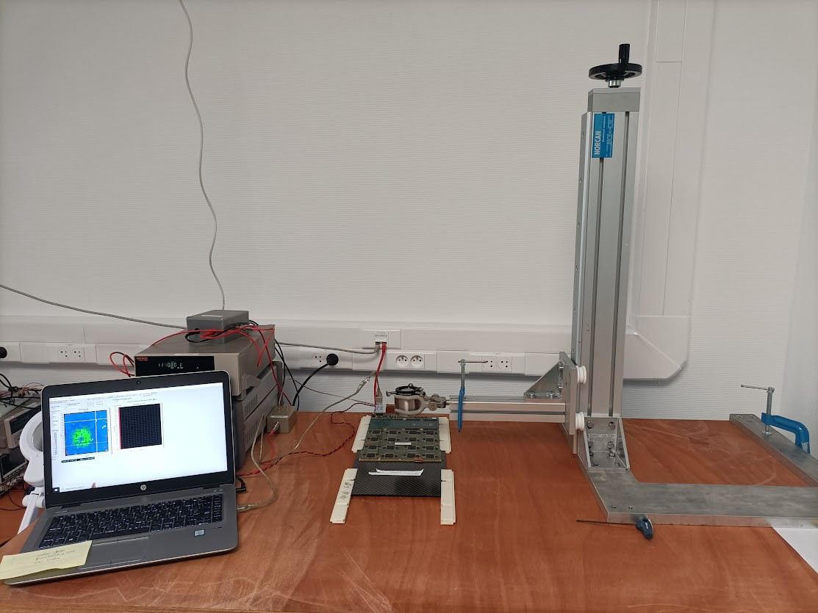
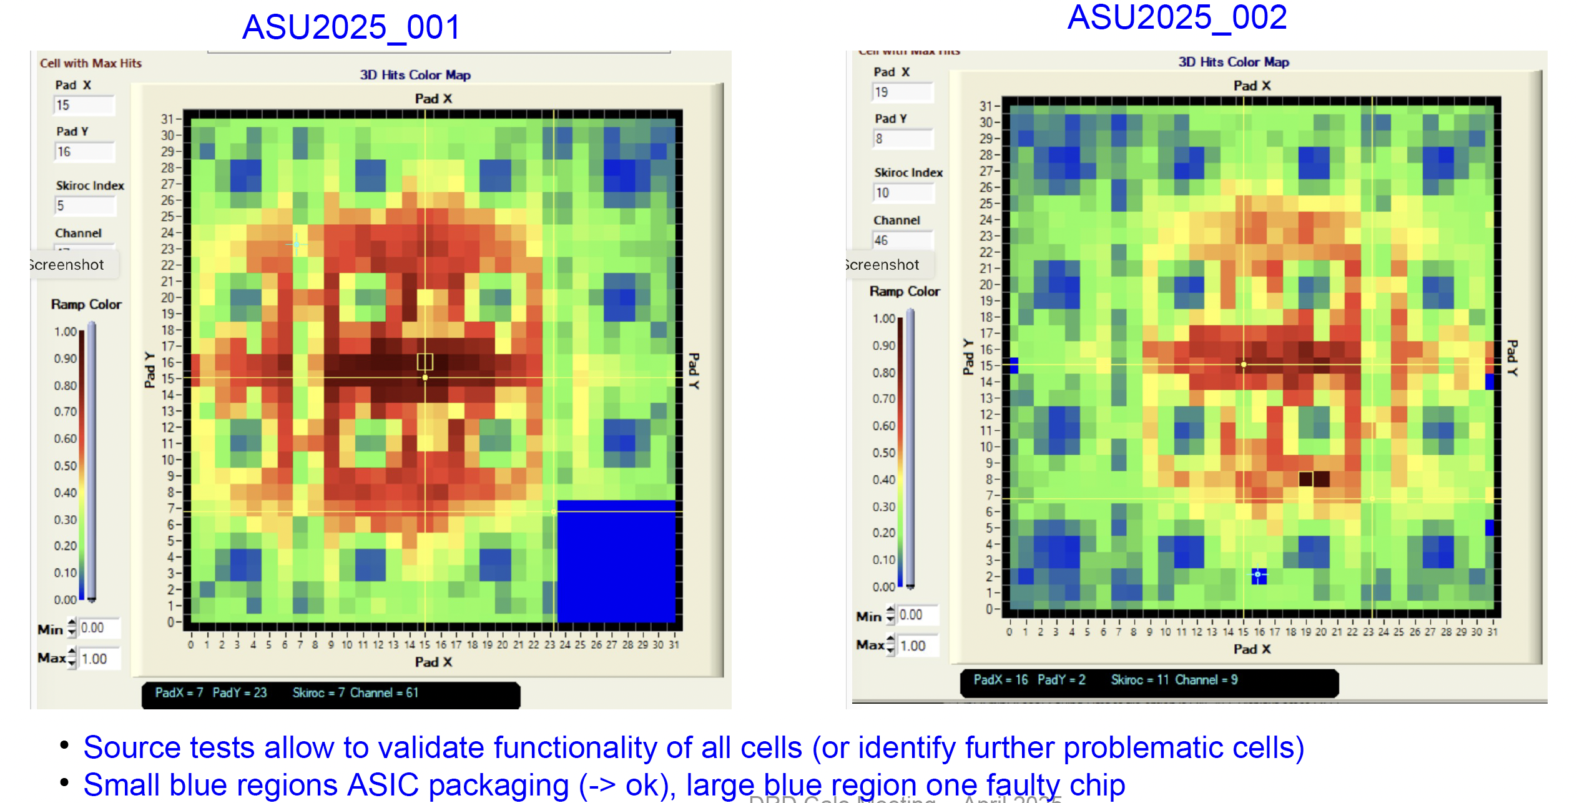
Commissioning: ⁹⁰Sr
Tests made one week
before BT at DESY
Beam test reports:
  See (next) Yukun’s presentation

Slide 10
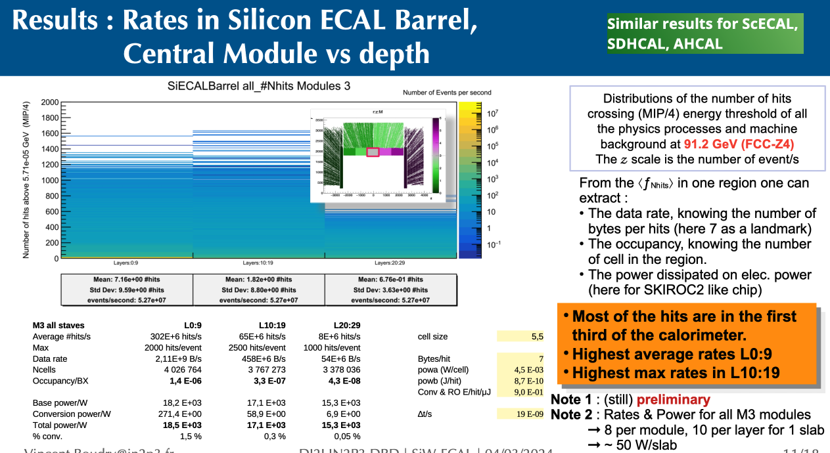
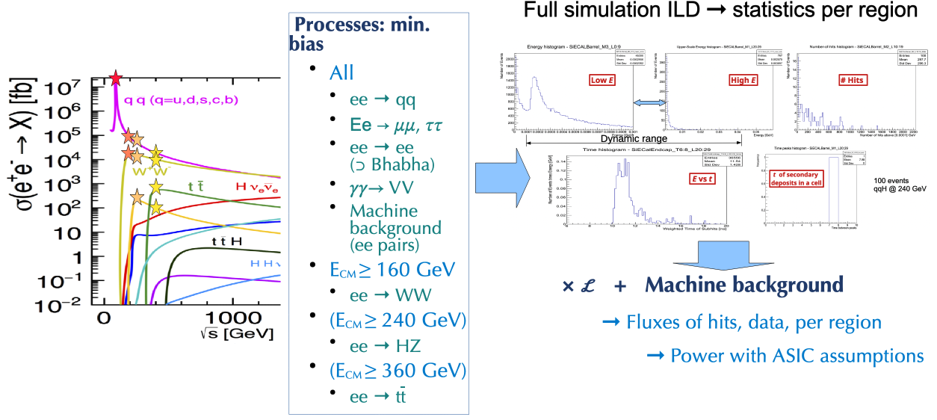
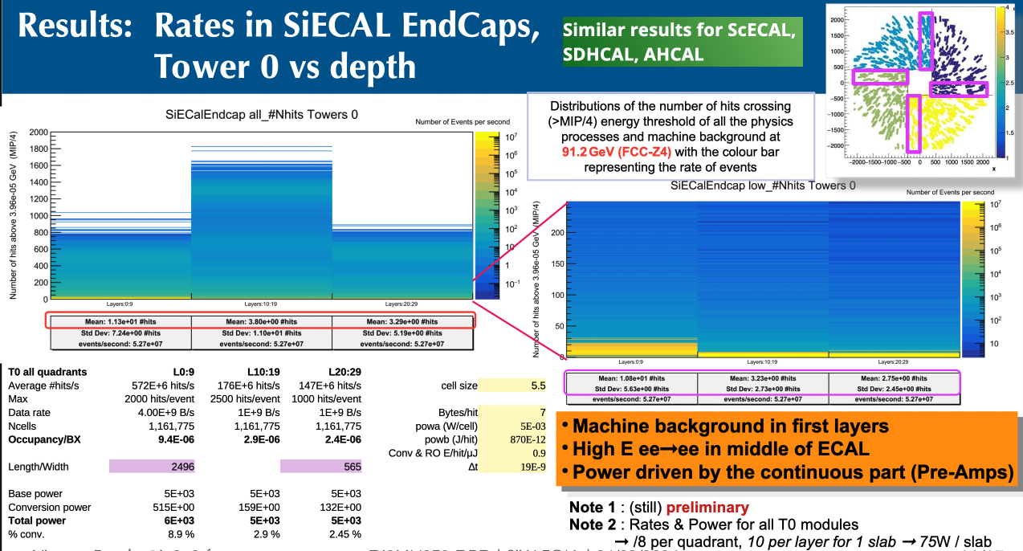
Fluxes in Calorimeters
Take Home:
  Even at Z peak power dominated by pre-amp
  (⬌ conversion power in negligible)
  Tool is there, missing:
    Digitization (easier way in Key4HEP ?)
    Mapping needs to be adapted
    for each calorimeter readout topology

Slide 11
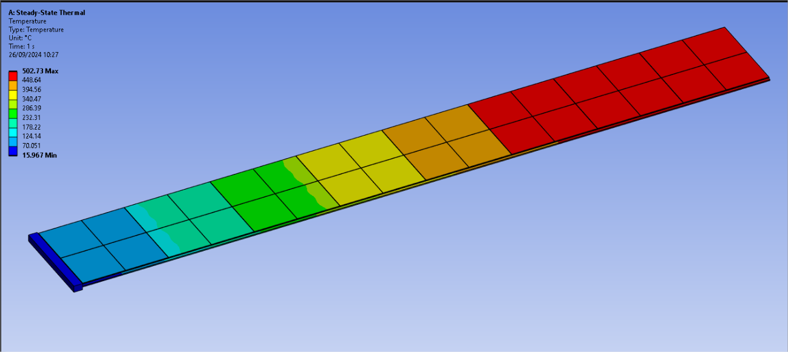
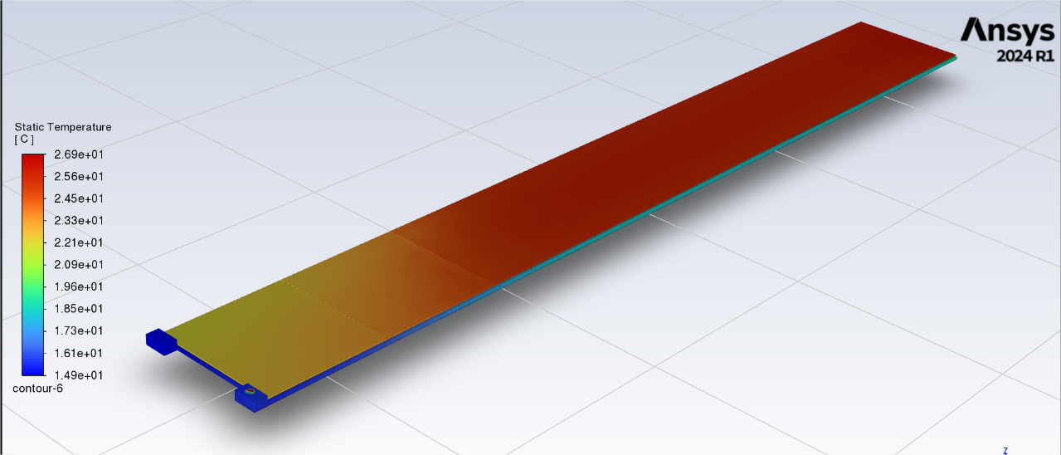
ECAL adaptation : flat cold plate, preliminary thermal studies
Uniform solutions:
© Oscar Ferreira, François Joubert @ LLR
“Standart Slab”:
  8 ASU (1440mm)z,
  8192 ch / 128 ASICs
  100 W
Passive cooling: Cu of 2mm (W, C ignored)
Adiabatic, but for heat bridge at the end
∆T = 500°C on Wafer surface at 𝑡 = ∞
Connections ?
“Standart Slab”:
  8 ASU (1440mm), 8192 ch / 128 ASICs
  128 W (1W/ASIC ~16 mW /ch)
Active cooling:
  Hollowed Cu of 4mm, with 1ℓ/min of water @ 15°C
Adiabatic, but for heat bridge at the end
∆T = 12°C on Wafer surface at 𝑡 = ∞
Status:
  Limited flow of water seems enough…
  Now looking into pipe in 4-mm Cu layer
    Replaces W in 1st half of SiW-ECAL
    Replaces ½ the W in the second part
  To be validated on simulations

Slide 12
Centimetric Timing

Slide 13
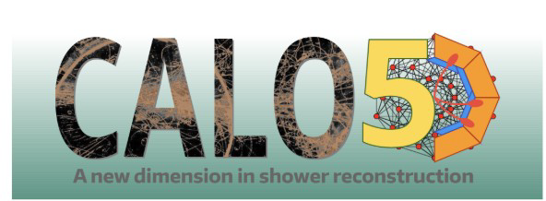
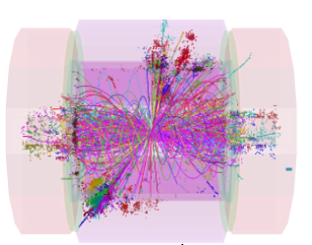
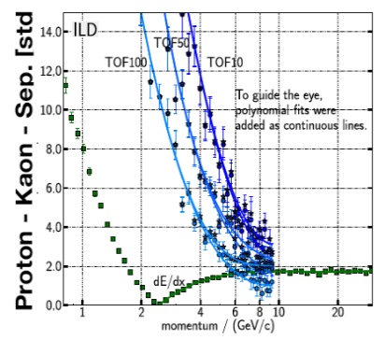
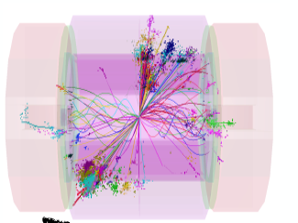
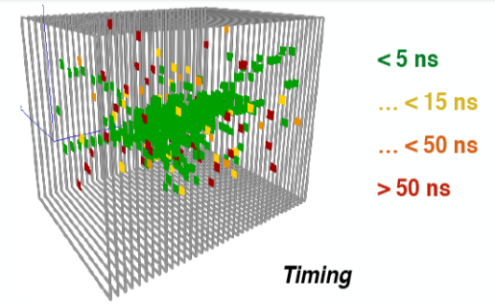
Timing in Calorimeters:
0.1–1 ns range
1 cm/c = 30 ps
Started in KIT, JGU, IJClab,
LLR and IP2I (Lyon): Calo5D & T-Calo
Particle ID by Time-of-Flight
  Complementary to d𝐸/d𝑥
    Here with 100 ps on
    10 ECAL hits
Ease Particle Flow with 𝒪(30) ps ?
  Cleaning of late neutrons &
  back scattering (ns)
  𝒪(30) ps for mips… HGCAL / 100!
  Identify primers in showers
  Help against confusion
  better separation of showers
    Requires ‘4D clustering’
Cleaning of Events
time
cut
(1 ns)
[CLIC CDR: 1202.5940]
adapted from L. Emberger
S. Dharani, U. Einhaus, J. List
Ch. Graf

Slide 14
Time measurement methods
ToA : TDC + ADC
CFD : TDC + Gating
Thr.
Thr.
0
Valid
Valid
CFD
0
t
t’
Slew time (vs amplitude)
Time ~ cst (vs pedestal, noise)
Shaping : ADC × n
In SKIROC2. Validation of digi
on beam tests…
0
Time fit (vs shaping)

Slide 15



Conclusions
SiW-ECAL technological prototypes
  2022: Heterogeneous 15 layers
    1st full calorimeter working [DESY22, CERN22]
      Shower seen, Detailled simulation ready
      Analysis on-going ➞ resolutions, ...
    Numerous emerging issues
      gluing, HV filtering at high energy
  2024 2025–26: Uniform 15 layers
    ➞ New VFE boards
      Cleaner PS & Clock distributions; more uniform
    Gluing being revisited
    Material available.
    To be tested in 2025
      ➞ Provide reference sample for GEANT4
      ➞ With funding ➞ “full” LUXE, EBES, Lohengrin ?, SHiP ?
    Start FE board on HKROC ?
SiW-ECAL design for HET factories
  2023–25: Power budget & performances
  to be re visited
    Occupancy, power, data fluxes (on-going)
      ➞ Granularity; Passive or Active cooling
      ➞ new ASIC attributes (← CALOROC Pres Dulucq)
    2025–27: PFA & Timing & Physics performances
  2025–27 : Blue-print for a SiW-ECAL detector
  for the next ee collider
    ➞ planning for a pilote module @ T0 collider-8y -5y
    (1 Mch, 1/60th of real detector)
      semi-industrial, quality, ASICs, …
+1
+1
+1

Slide 16

Planning towards a pilot module… just in case
T0-8 : production start
?

