Slide 1
WP4 High-Order Mode dampers and Fundamental Power couplers
CERN : Sebastien Jerome Calvo, Karin Canderan, Marco Garlasche, Eric Montesinos, Vittorio Parma, Calum James Sharp
INFN : Dario Giove – deputy (INFN)
CNRS : Patricia Duchesne (IJCLab), Yolanda Gómez Martínez - convener(LPSC), Gilles Olivier (IJCLab), Guillaume Olry (IJCLab)

Slide 2
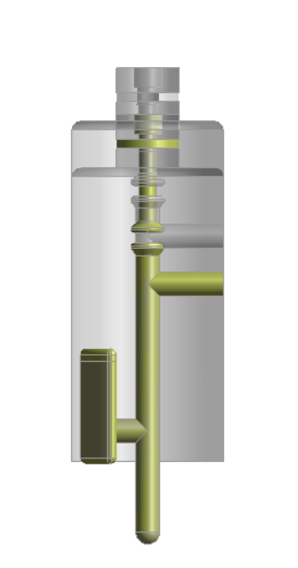
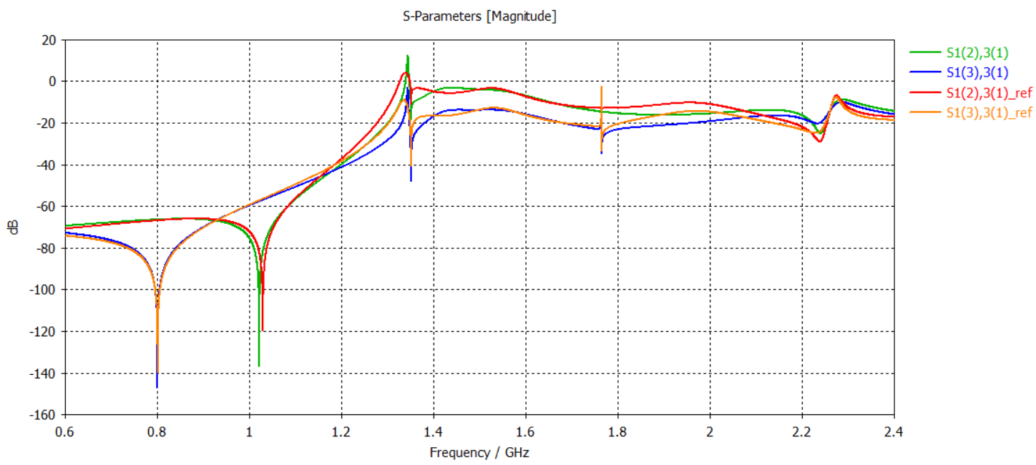
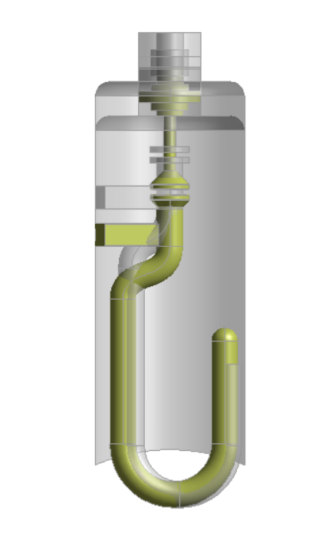
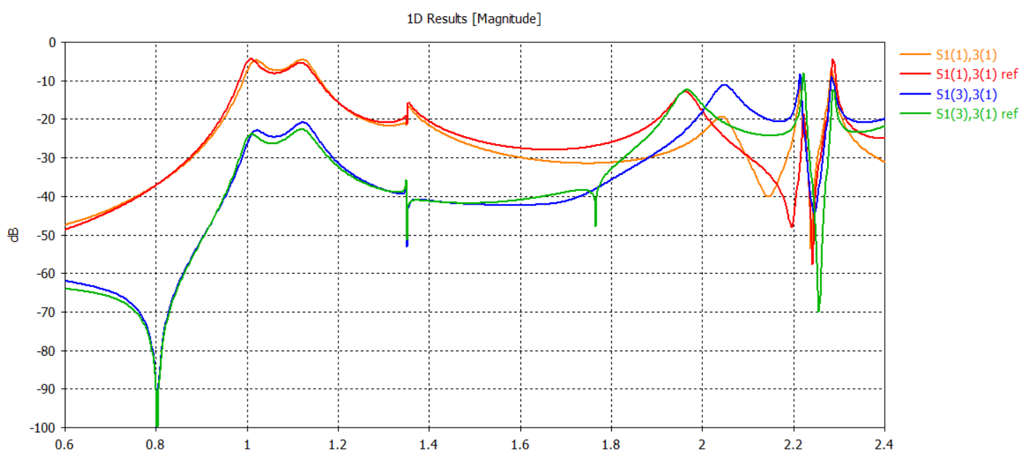
WP4: Status/evolution of tasks
Task 4.2: HOM couplers design (March 24 – Sept 25)
HOM couplers for WP6
In the configuration 2H2P (the best for the moment):
RF optimization done for the Hook and Probe HOM couplers (by P.Duchesne).
An analysis of static charges and dynamic thermal loads (only FM) done without an active cooling circuit inside the antenna (by P. Duchesne):
- Probe coupler : P_{Joule antenne Nb} = 11 mW@22,4 MV/m → T_{max antenna}= 3,5 K
Hook coupleur: P_{Joule antenne Nb} = 37 mW@22,4MV/m → T_{max antenna} = 4,5 K
Due to the uncertainties on the material properties, the thermal contacts and the thermal loads, an active cooling circuit inside the antenna is provided so that the antenna remains superconducting during operation.
→One solution found, more studies ongoing and the final choice by late July 25.
→ Review on 17/01/25
HOM couplers 800 MHz v2 and 1.3 GHz.
→FCC HOM coupleur in the meeting of 17/01/25
→Meeting focus on 1.3 GHz HOM in March 2025.
Courbes de transmission
Modes monopolaires
TM011
TM021
Probe Coupler
TE111/TM110
TM111
Modes dipolaires
Hook Coupler
1

Slide 3
WP4: Status/evolution of tasks
Task 4.3: Fabrication of HOM couplers (from May 25 to November 2025@HOM C WP6/March 28)
Welding machining is planned by CERN. Specification like tightnes required (in Nb for liquid He) in HOM coupleurs are difficult to have with the additive manufacturing.
Pending the decision (PERLE projet – CERN) to increase HOM couplers production at CERN from 4 units to 16 units (request of WP6).
2

Slide 4
WP4: Status/evolution of tasks
Task 4.3: Test of HOM couplers (from Nov 25 to June 26)
Nothing to report
D1 HOM test ‘Report qualification HOM couplers on cavities at 300 K by CNRS’ : 1st December 2026
3

Slide 5
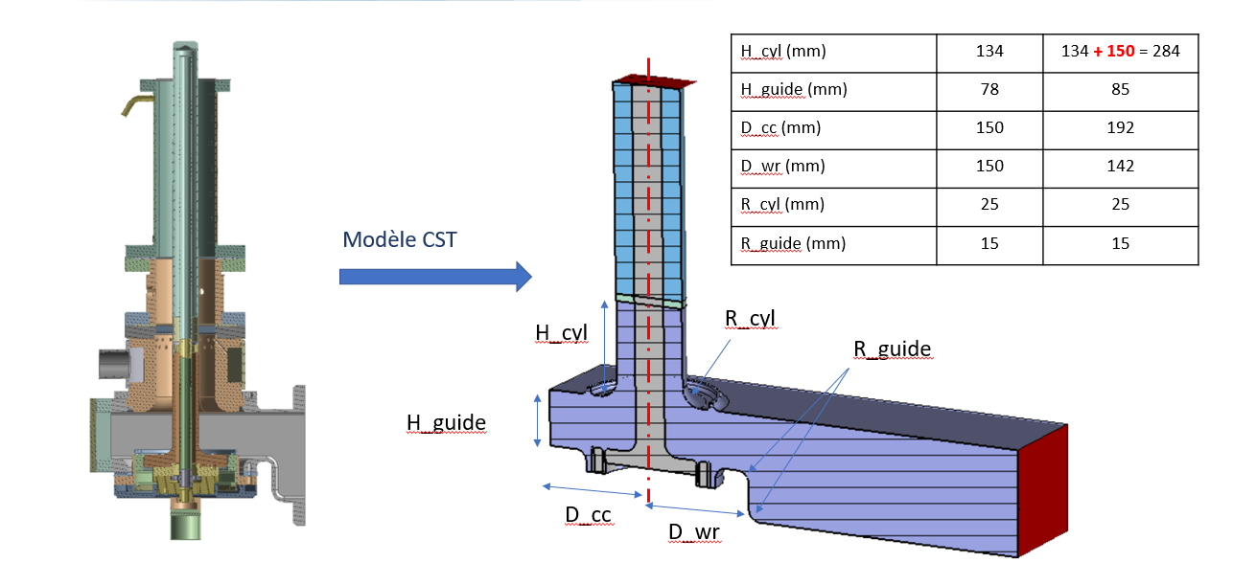
WP4: Status/evolution of tasks
Task 4.5: 800 MHz FP couplers design (from March 24 to July 25)
SPL FPC disc window (704 MHz, Q_{ext}= 1.2 x 10⁶, cryomodule interfaces) from the CERN chosen.
The study of the adaptation to SPL FPC to PERLE FPC are very well advanced:
The length of the antenna (as same shape that SPL) which depends of the choice of the Q_{ext} (to be chosen between 100 Hz, Q_{ext} = 8 10⁶ and 150 Hz, Q_{ext} = 5.34 10⁶)
The adaptation from 704 MHz to 801 MHz and compatible with the integration in the PERLE cryomodule (Waveguide modification):
4

Slide 6
WP4: Status/evolution of tasks
Task 4.6: Fabrication of 800 MHz FP couplers (from July 25 to June 26)
4 FPC SPL disc couplers with the waveguide adaptation to be manufactured by the CERN
To follow the news given in the steering Committee of 8/07/2025 respecting the 4 double outer conductor (no partner in charge):
The RF conditioning in a test bench is planned without them.
Finally we don’t need them until coupleurs are mounted in the PERLE cryomodule so December 2026.
WP6 have been taken this item in charge:
2 double outer conductor ESS prototypes ESS owned (compatible with PERLE): available
PMB owned the other 2 double outer conductor ESS prototypes. In awaiting PMB approval via CEA. If not, 2 to manufacture.
5

Slide 7
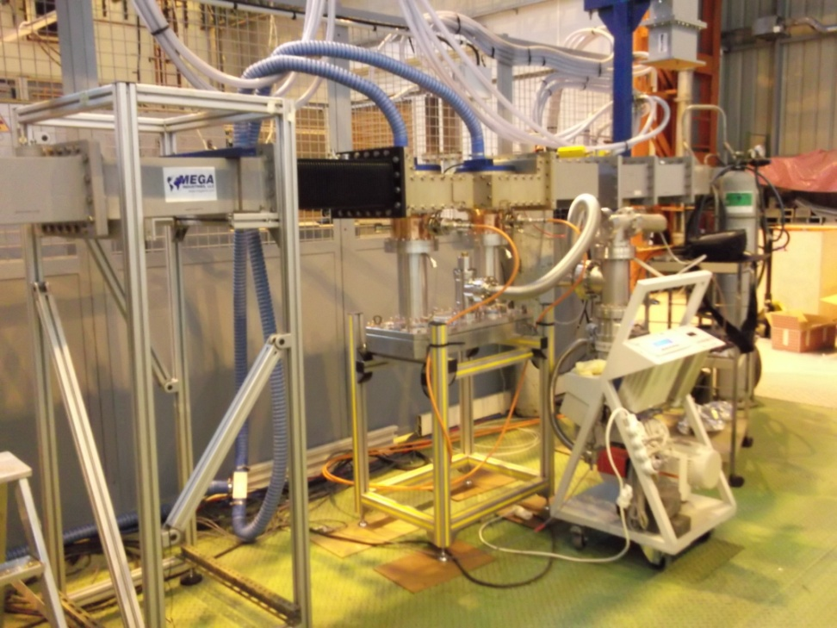
WP4: Status/evolution of tasks
Task 4.6: Test/RF conditionning of FP couplers (from Feb 26 to Dec 26)
To follow the news given in the steering Committee of 18/10/24 respecting the question raised by Eric Montesinos (CERN) ‘to skip the FPC processing (earn of time and money but with un increase of risk projet) and to decide to proceed directly with the FPCs onto the cavities?‘
3 possibilities:
To conditioning at 800 MHz at 50 kW at CERN (iSAS proposal)
To conditionning at 704 MHz at the existing the CERN test bench
To skip the FPC conditionning and to decide to proceed directly with the FPCs onto the cavities.
→Pending the decision (PERLE projet – CERN) of the choice of the type of the RF conditioning.
To note : Eric Montesinos evaluate that the design & manufacture of the 800 MHz test bench can carry a 1 year.
M7 Test report of FPC couplers: 1st December 2026
D2 RF coupler test ‘Report on RF test of 800MHz FPC at 50 kW by CERN’ : 1st June 2027
Test bench at CERN at 704 MHz
6

Slide 8
WP4: Status/evolution of tasks
Task 4.1 : General coordination
WP4 monthly meetings, 7 meetings hold on:
On 16/05/24 : focus on FP couplers specification and general organisation
On 25/06/24 : Focus on HOM coupler for WP6. Patricia Duchesne (IJCLab)’s presentation of the work carried out (EM simulation, RF designs,..)
On 3/09/24 : Focus on planning. WP4 planning compatible with WP6 planning
On 15/10/24 : Focus on FP couplers for WP6. Eric Montesinos (CERN)‘s presentation of the status (preparations and modifications)
On 6/11/24 : Focus on FP couplers.
On 29/11/24: Focus HOM et FP couplers.
On 4/12/2024: Focus on RF conditioning of FP couplers
On 17/01/25 : Focus on 800 MHz HOM couplers
On February (survey ongoing) : energy saving of the technologies?
On March : Focus in 1.3 GHz couplers
Reports at https://box.in2p3.fr/s/jH3tpNsLgoZ9p8M. Please tell me if you want to be acces.
Eric Montesinos (CERN) retired in December 2024.
Sebastien Jerome Calvo (CERN) and Calum James Sharp (CERN) news onboarding.
Tasks summed up :
All task with no deviations.
Point of attention : Pending several decisions between the PERLE project and the CERN, which could change deliverables and milestones of WP4.
7

Slide 9
WP4: Milestones (M) and deliverables (D) (reminder)
2025
M1 Design report of FPC coupler: 1st July 2025
M2 Design report of HOM coupler: 1st September 2025
2026
M3 Intermediary general rapport : 1st February 2026
M4 Engineering report of the fabrication of HOM couplers : 1st February 2026
M5 Test report of HOM couplers: 1st June 2026
M6 Engineering report of the fabrication of FPCs :1st June 2026
M7 Test report of FPC couplers: 1st December 2026
D1 HOM test ‘Report qualification HOM couplers on cavities at 300 K by CNRS’ : 1st December 2026
2027
D2 RF coupler test ‘Report on RF test of 800MHz FPC at 50 kW by CERN’ : 1st June 2027

Slide 10
Thank-you for your attention

