Slide 1

Innovate for Sustainable Accelerating Systems
WP6: Integration into Accelerator and Collider Ris
Guillaume OLRY
On behalf WP6 partners

Slide 2
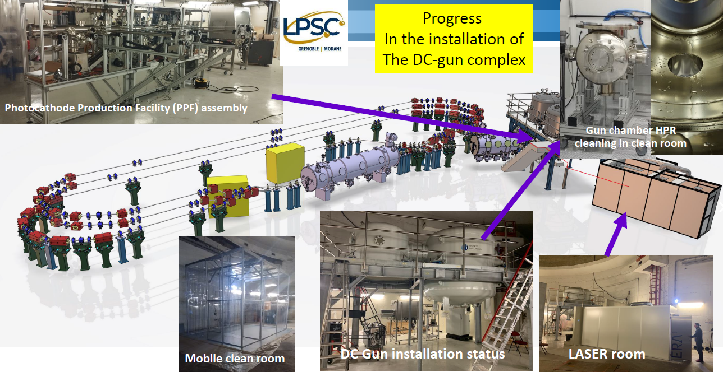
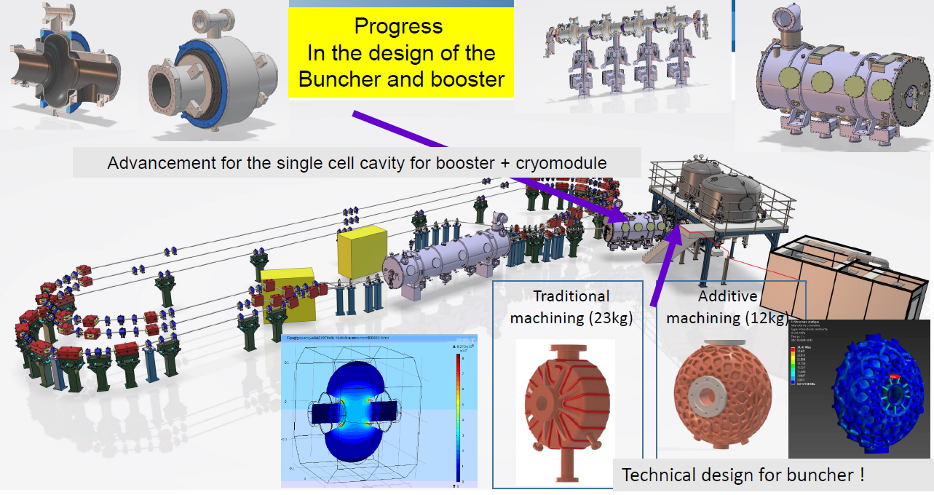
WP6 – task 6.1 Coordination
General coordination:
Deputy: Arnaud Madur (Thanks!)
Last meeting on Dec 12th.
Next meeting on Jan 14th.
Sharing of latest news about the PERLE project:
*INJECTOR
  DC gun installation is progressing very well
  Design of the buncher cavity and the booster cryomodule: in progress
  June 2024: additional fundings through CNRS « Projet à risques »: 3M€ over 4 years (→ Oct 2028) with a GO/NOGO phase (1M€, 18 months).

Slide 3
PERLE @ IJCLAB in the igloo
RF sources
Cryoplant

Slide 4
WP6 – task 6.2 Retrofitting FRTs:
PostDoc has now started (Oct 24) and is starting to get to grips with FRT equivalent circuits, and calculating power losses and tuning range
→ first develop an FRT resonator suitable for PERLE/UK-light source, and then to look at integrating it into a coaxial HOM coupler around M6
A PhD student has also started working on FRT for UK-XFEL who will work in synergy with the PDRA working on ISAS
Meeting to be set up soon with HZB and CERN (→ WP1)

Slide 5
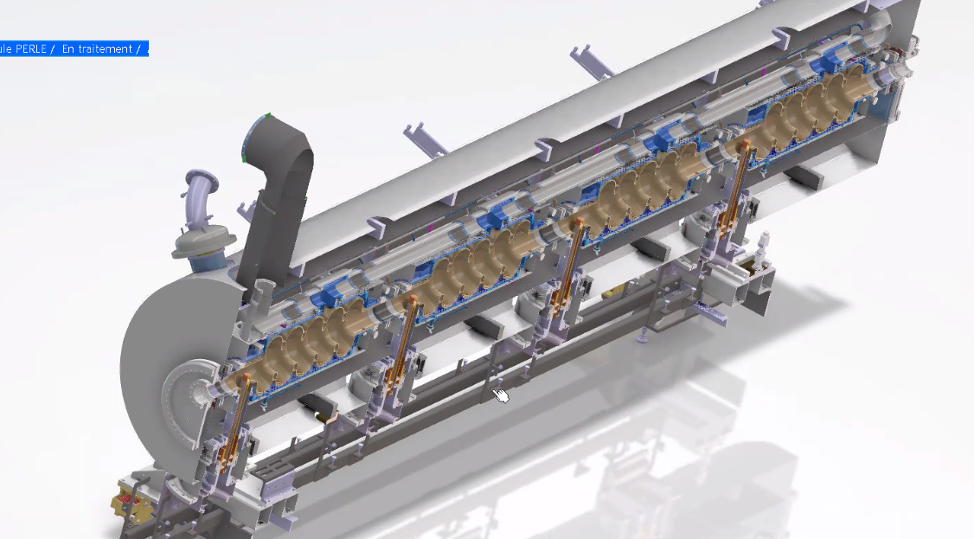
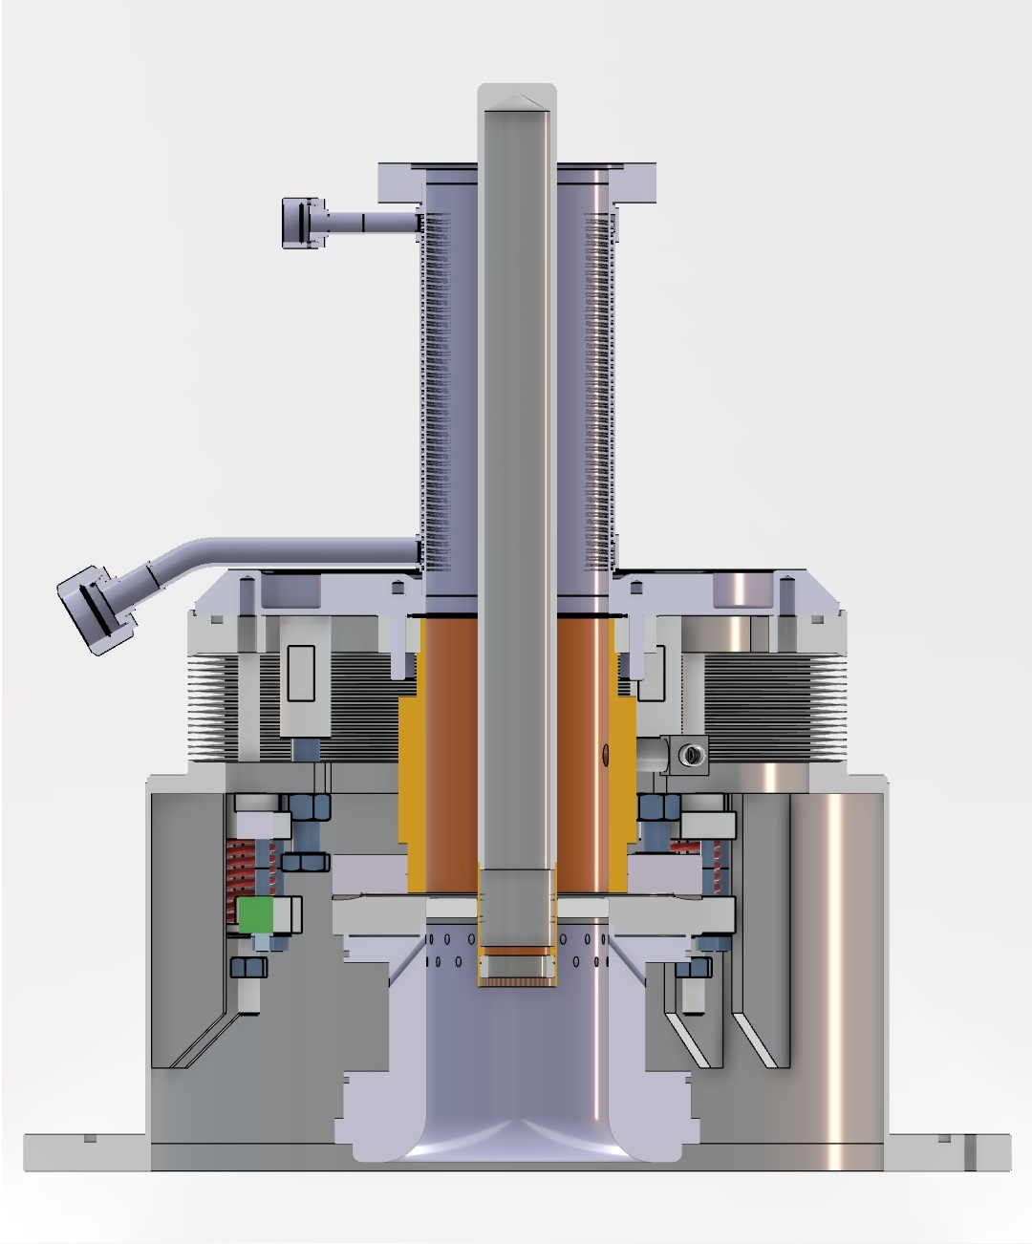
WP6 – task 6.3 Adapt the existing ESS cryomodule
Modifications of the existing ESS cryomodule & Integration of the HOM couplers and FPC (Sebastien BLIVET/ Gilles OLIVIER)
RF couplers: disk type only (with modified and new parts) + ESS double-wall-tubes

Slide 6
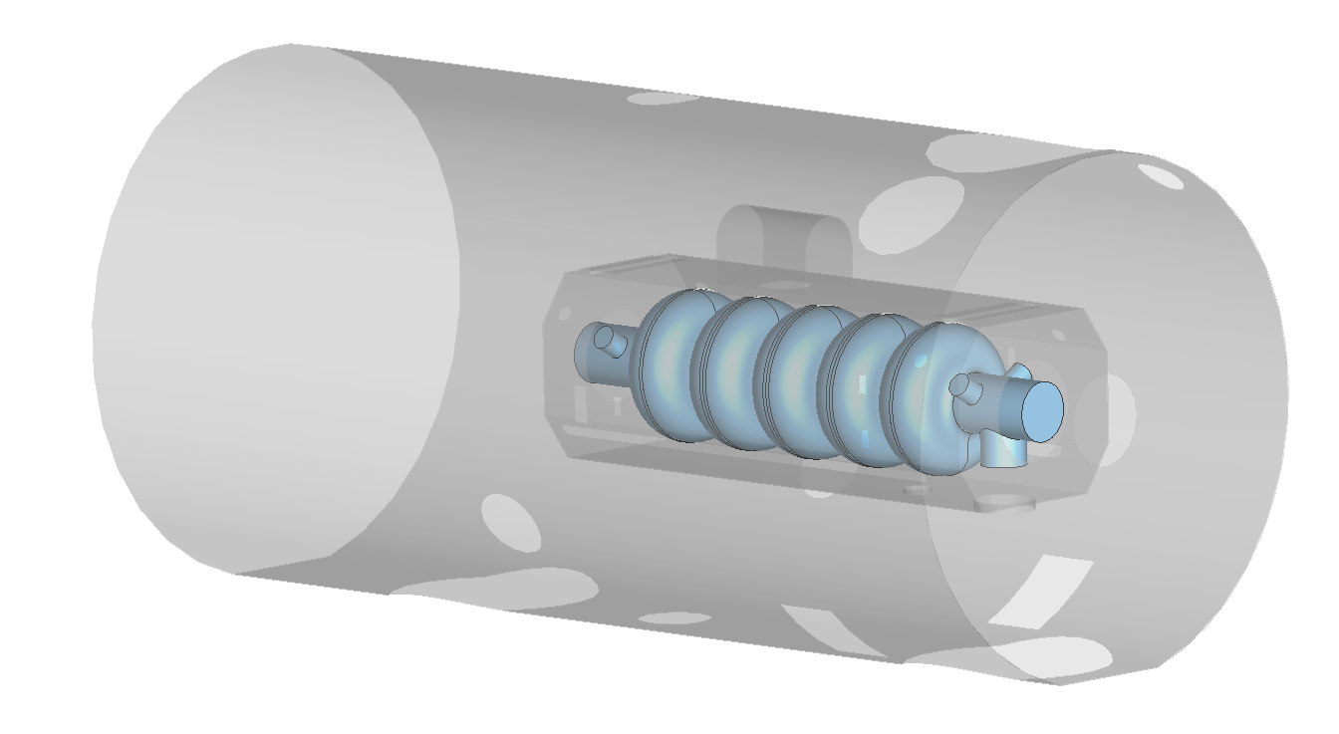
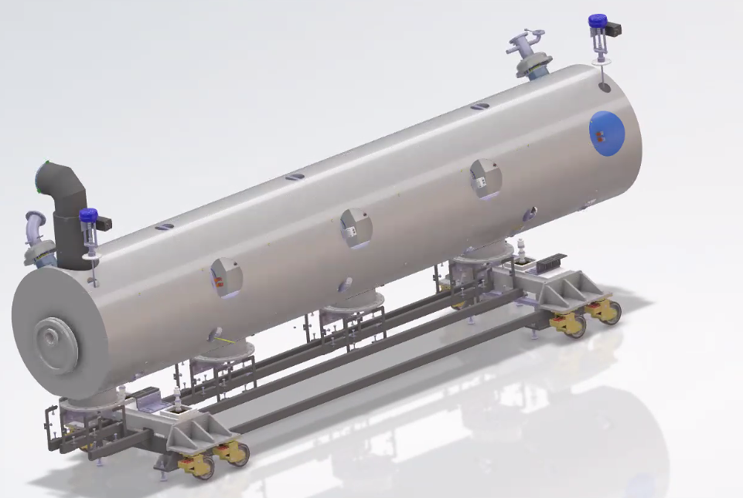
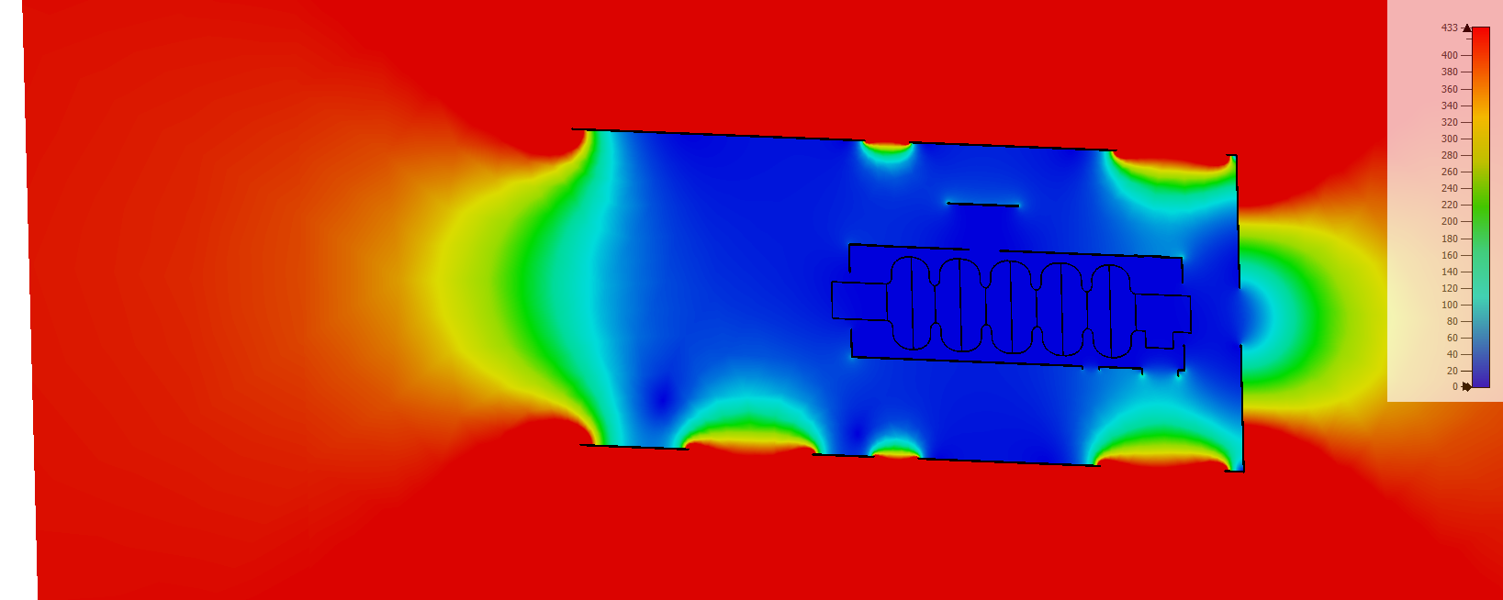
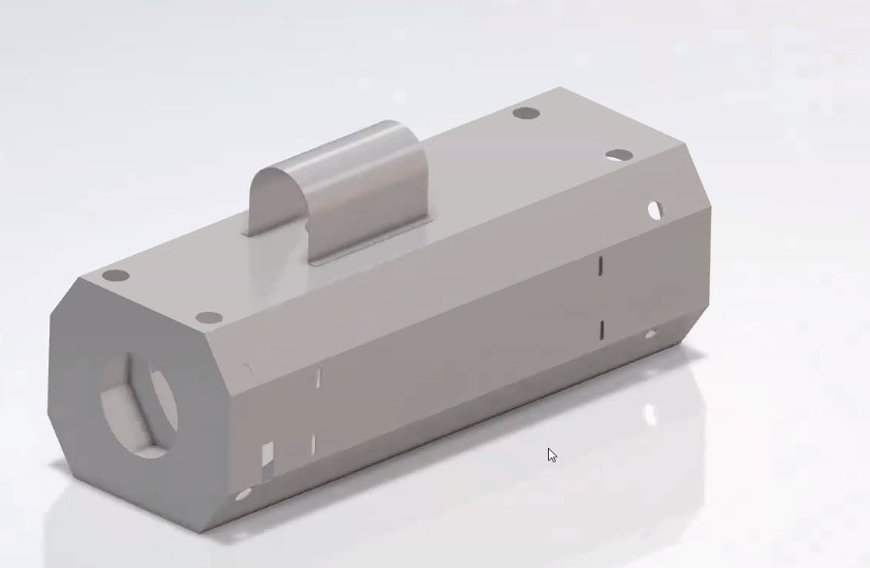
WP6 – task 6.3 Adapt the existing ESS cryomodule
Magnetic shielding (Patricia Duchesne)
Requirement: Residual B field < 1mG
A double magnetic shield is mandatory to get less than 1 mG on the cavity surface. Design/calculation on going with 2mm thick µ metal + 2mm thick Cryophy
433 mG
Mu metal @ ~300K
(spaceframe Temp)
µ=30000
Cryophy @ 2K
µ=30000
 | B Min (mG) | B Max (mG) | Lieu
Endcell1 | 0.32 | 0.83 | Côté bas
Endcell2 | 0.3 | 0.7
Middlecell1 | 0.3 | 0.95
Middlecell2 | 0.3 | 0.96
Middlecell3 | 0.3 | 0.9

Slide 7
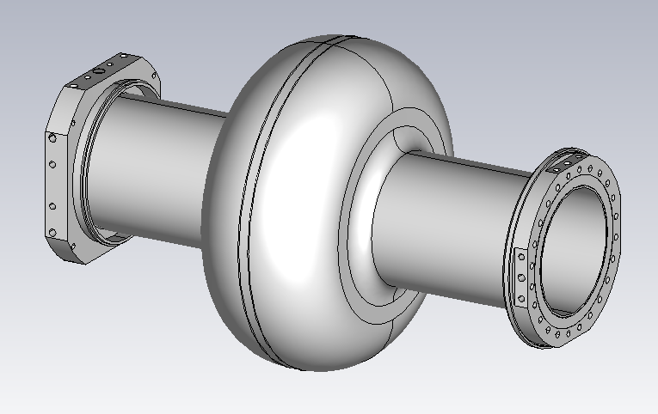
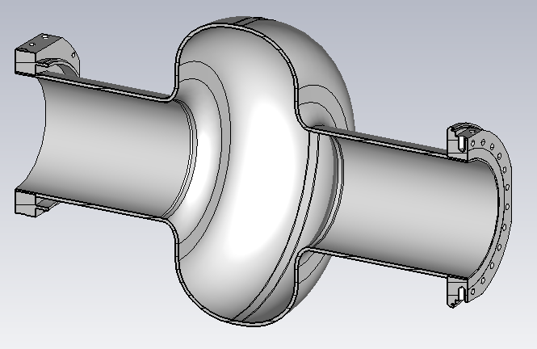
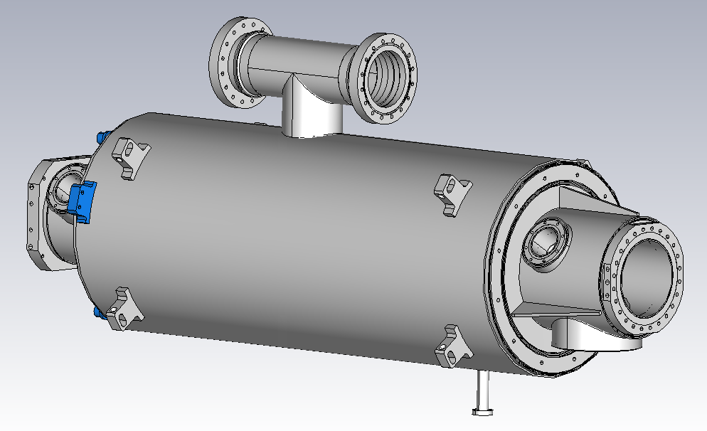
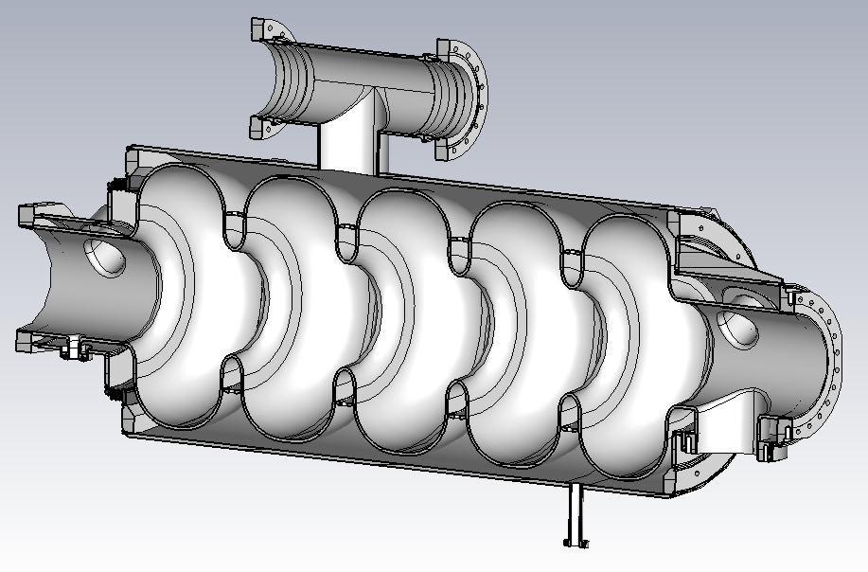
WP6 – Task 6.4: Fabrication and validation of cryomodule components
Cavities
Niobium material (Akira Miyazaki): Ordered. Delivery expected in March 25
Cavities (Akira Miyazaki): Offers received on Dec 19th. Analysis is on-going... IJCLAB will enter into negotiation phase. Delivery for cavities expected end of 2026 → estimated delay of about 4 months w.r to initial planning
1-cell bare cavity (Qty: 1):
Prototype for the 5-cell cav fabrication
Tested @ IJCLAB. Go/NoGo for the 5cell cavity preparation
5-cell jacketed cavities (Qty x4):
Jacketed
Tested @ INFN Lasa

Slide 8
WP6 – Task 6.4: Fabrication and validation of cryomodule components
Tuning systems
Adaptation if the Tuning systems used for the Myrrha Spoke cavities.
Not critical. Purchase order planned in 2026.
HOM couplers (→ linked to WP4)
2 Hook and 2 probe type will be used (no DQW)
Thermal calculations by Patricia Duchesne to be completed by mid-January
Mechanical design including cooling to be completed mid-January and transmitted to WP4 (CERN)
Question:
In WP4: post-doc position on HOM studies. Still relevant?
Absorbers (Akira Miyazaki)
PhD @IJCLAB on this topic. Discussions on going with a candidate.
Action:
Start the design of the absorbers! Could it be done by the post-doc who was supposed to work on HOM?

Slide 9
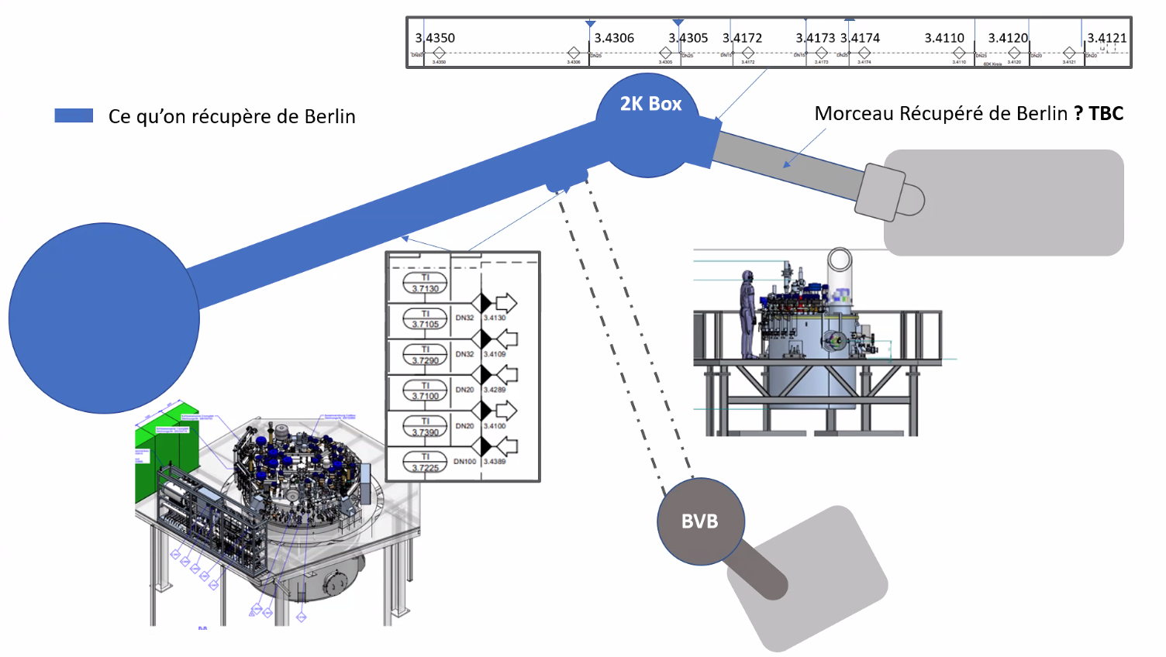
WP6 – Task 6.5: Assembly and test of adapted cryomodule
Status
• Clean room assembly of the cavity string and cryostating phase.
Not started
• Preparation of the test stand @ Lund.
Internal discussion @ IJCLAB started on Heat Exchanger. Heat exchanger in the CM not compatible with the PERLE Cryo distribution (2K produced in the 2K box) but mandatory for the test @ Lund. Heat Exchanger must be removed when the CM goes back to IJCLAB. Not a technical showstopper. Analysis of impact on the planning to be done.
• Cryogenic and RF test of the cryomodule.
Cryogenics: ongoing analysis of the interfaces, especially the cryomodule-to-valve box connexion.
RF connexions (waveguides-to-couplers): to be identical as the ones used at Lund
iSAS Cryomodule
PERLE Booster

Slide 10
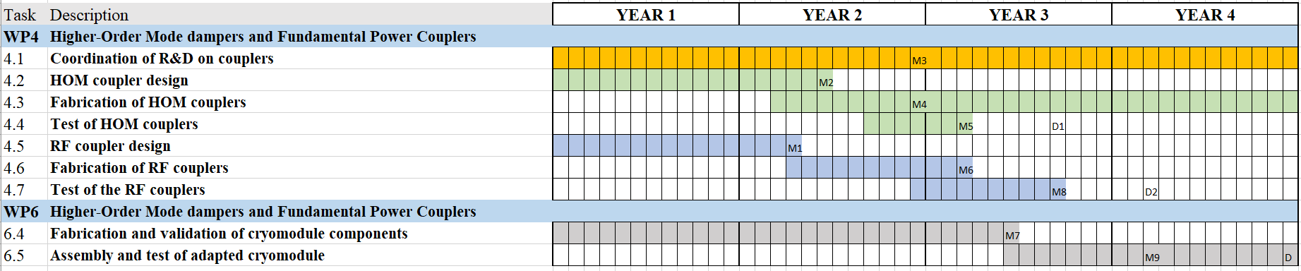
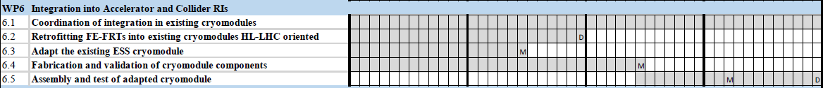
WP6 : plans to achieve milestones & deliverables
Planning
Jan 2025
Milestones
M6.1
August 2025
M6.2
April 2026
M6.3
January 2027
Deliverables

Slide 11

WP6 : plans to achieve milestones & deliverables
Planning : to be updated
M6.1
M6.2
M6.3
M6.2
expected
Delay: assembly in clean room → may be postponed by 4 months.
M6.1
expected
M6.3
expected

