Slide 1
iSAS Steering committee meeting
10th January, 2025

Slide 2
iSAS Steering Committee meeting
Agenda
Objectives
To review WP progress & to discuss the scientific coordination of the project
To facilitate cross-coordination between WP
Agenda items
Report from the Coordination Panel - 10 min
Reports from WPs – 10 min each WP
Notes will be found in the meeting Indico page (WP status report template enclosed)
iSAS project Indico page

Slide 3
iSAS Steering Committee meeting
iSAS organisation
The Coordination panel, who leads the scientific coordination of the project, meets every 6 weeks
Every other meeting becomes a Steering committee to review WP progress in cross-coordination with WP Leaders & Deputies, every trimester
Update: Dave Newbold, Governing Board Chairperson in the iSAS project for STFC, has handed over his responsibilities to Peter McIntosh, from STFC as well
Thank you Peter for your participation to the iSAS project

Slide 4
iSAS Governing Board meeting

Slide 5
iSAS Steering Committee meeting
Advisory Board
4th Advisory Board member to welcome into the project
Mandated: Frederick Bordry (Chair)
Roberto Losito (CERN)
Eugenio Nappi (TIARA)
Maxim Titov (LDG)
Declined: Caterina Biscari (LEAPS)
Pending mandate: 4th member (LEAPS)

Slide 6
iSAS Steering Committee meeting
Consortium agreement
Consortium Agreement (CA) in progress
v2 almost ready (last pending comments)
Shared NDA option for industrial partners & advisory Board members, signed by CNRS as Coordinator in the name of the consortium
Pending comments: UKRI (STFC)

Slide 7
iSAS Steering Committee meeting
Decision on the integration of 3 new partners
Nikhef (The Netherlands)
Riga Technical University (RTU) (Latvia)
Institute of Nuclear Physics (IFJ PAN) (Poland)
Roles/tasks
RTU after several discussions, not clear yet if they ill join the project
IFJ PAN in WP6 discussions in progress
Amendment to integrate them (if validation from Governing Board) to be finalised early 2025

Slide 8
iSAS Steering Committee meeting
Governing Board
Next meeting
14th March in Padova
Consortium Agreement (CA) final reading, including shared NDA option
Amendment to the Grant Agreement to finalise, including new partners & WP6 modifications

Slide 9
iSAS Coordination panel meeting
Padova 2025
Practical details
LNL, INFN, Padova, 3 days in-person meeting in March 2025 (including travel) + Zoom link
Save the date sent - registrations in progress
Info up-to-date to be found on this page
Any questions? Organisation team: Cristian Pira, Silvia Martin, Adèle de Valera
Agenda
Day 1 March 12 – Parallel WP meetings
Day 2 March 13 – Plenary session, possibly iFAST 2 invited talk by Maurizio Vretenar
Day 3 March 14 – Industry workshop, Governing board meeting, visit of LNL
Advisory board report to be sent 2 weeks after

Slide 10
iSAS Steering Committee meeting
Verifiable metric for energy-saving performances
How to quantify the energy savings of the technologies developed in iSAS?
How to define the energy-saving of each technology ?
Proposal from Maud Baylac & Fred Bouly
Discussion with WP Leaders
Milestone: Verifiable metric for energy-saving performances (WP9 M#32) In progress

Slide 11
External relations
M. Baylac (CNRS-LPSC)

Slide 12
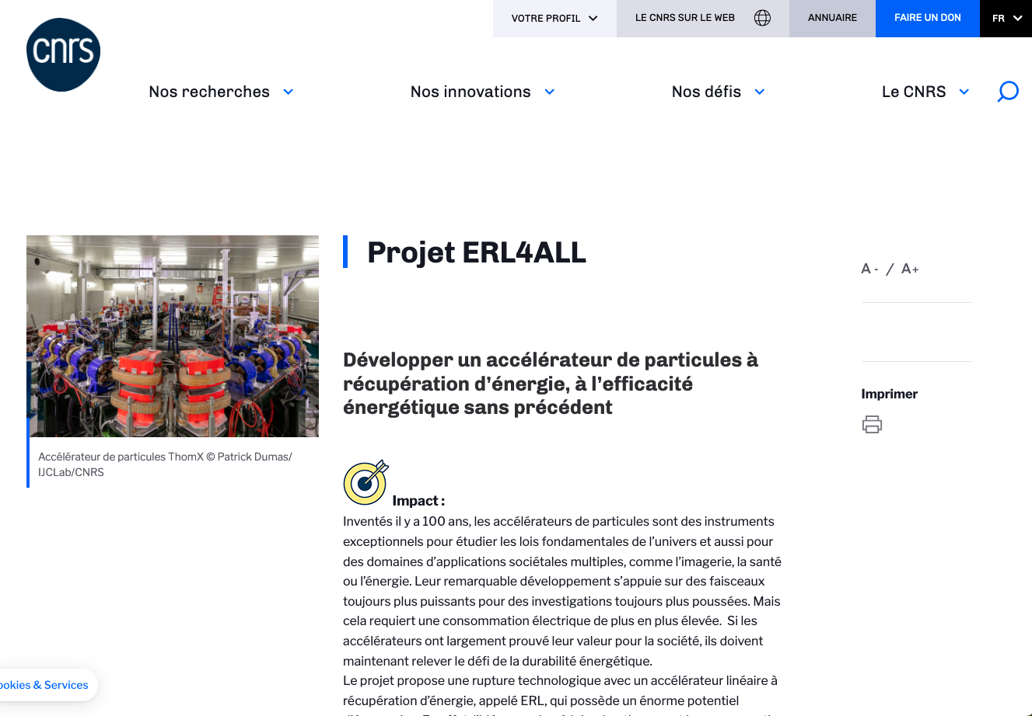
Relations at national level
New budget granted for the PERLE ERL
High risk and impact research program, funded by French ministry through research organization, including CNRS
12 projects within CNRS nationwide (2 within IN2P3)
Project ERL4ALL to finance the PERLE injector

Slide 13
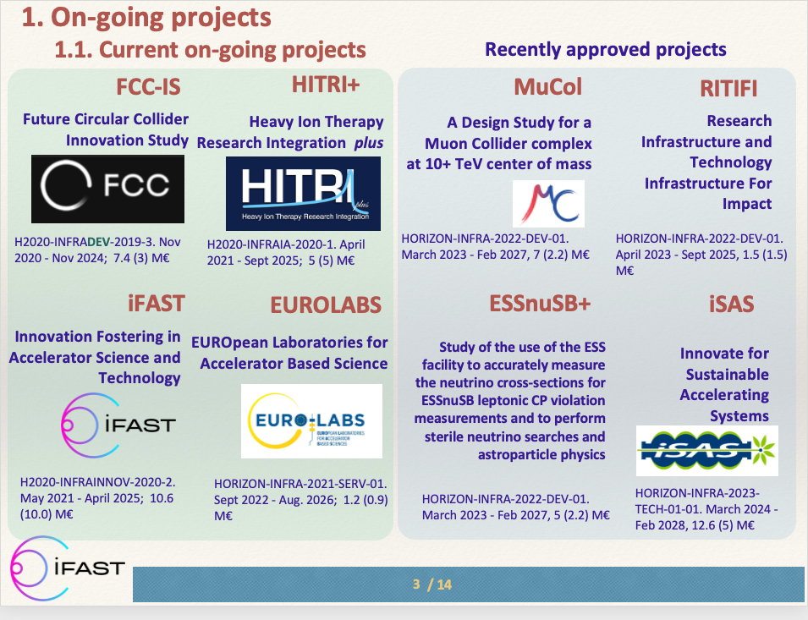
Relations at EU/international level
Test Infrastructure and Accelerator Research Area (TIARA)
Presentation of future Horizon Europe projects for Accelerators
iSAS considered as one of the flagship project
Innovation Fostering in Accelerator Science and Technology (IFAST)
Presentation of 3 EU projects at the annual IFAST meeting (April)
TIARA
AMICI
IFAST
Collaboration with the future program, IFAST2, to be considered
Invited presentation at 15th conference Heavy Ion Accelerator Technology (HIAT), Michigan, June 2025
J.M. Perez (chair of TIARA), presentation at the IFAST annual meeting (April 2024)

Slide 14
iSAS Steering Committee meeting
Work plan
Up to date with Milestones & Deliverables status by timeline for the 1st project year:

Slide 15
iSAS Steering Committee meeting
Upcoming related meetings
Every other meeting the Coordination panel becomes the Steering committee (includes the WP leaders & deputies), so as to integrate a cross-coordination of feedback
Indico page for Coordination panel - Steering committee meetings
Coordination panel - Feb 21 at 10 am CET
Steering committee - April 4 at 10 am CET
Coordination panel - May 16 at 10 am CET
Steering committee - June 27 at 10 am CET -> July 9 at 2 pm CET (tbc)

Slide 16
Thank you!

