Slide 1


WP4: High-Order Mode (HOM) dampers & Fundamental Power couplers (FPC) Stering Committee, July 9, 2025
All information contained in this presentation and any accompanying documents is for iSAS project only, and must be treated as strictly confidential.
Any dissemination, distribution or other use of this information without the consent of its owner is prohibited.
Funded by the European Union. Views and opinions expressed are however those of the authors only and do not necessarily reflect those of the European Union or the European Commission. Neither the European Union nor the granting authority can be held responsible for them.

Slide 2
WP4 – HOM et FPC: status/evolution of Task 4.1
General coordination of WP4
13 WP4 meetings held
2 Technical reviews done
800MHz HOM couplers
800MHz FPC couplers
Milestone1 (FPC design report) sent in time (on June 2025)
Post doc position transfer INFN to IJCLab on progress
WP4 work plan sent

Slide 3
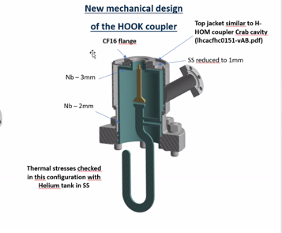
WP4 – HOM and FPC: status/evolution of Task 4.2
HOM coupler design
For 802 MHz HOM studies:
Studies done:
RF calculations (P.Duchesne)
Thermal calculations (P.Duchesne & K .Candera)
Multipacting simulations (A.Placais)
Calculations of beam-stability impedance thresholds for PERLE’s configurations (IJCLab)
Feasibility fabrication (M.Garlasche, S. Barriere)
c/o IJC Lab
Review with externals experts on 27 March with expert members (Carmelo Barbagallo/CERN and Shahnam Gorgi Zadeh/CERN)
Baseline proposed : 2 Hook/cav

Slide 4
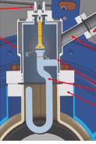
WP4 – HOM and FPC: status/evolution of Task 4.2
HOM coupler design
For 802 MHz HOM studies:
Current events
Last optimization to be finished before August 2025
of the feedthrough
upper thermal simulations
For 1.3 GHz HOM studies :
In preliminary phase
The presentation of BriXSinO HOM was carried out on 8/07/25.
With the acceptance of IJCLab, INFN propose to scale the 800 MHz Hook HOM coupler to 1,3GHz.
A detailed recovery plan will be submitted within the end of July 2025
Milestone 2 ‘ HOM design report’ ( August 2025):
Design report possible with the final studies of the 800 MHz HOM coupler & preliminaires studies on 1,3 GHz HOM.

Slide 5
WP4 – HOM and FPC: status/evolution of Task 4.3
Fabrication of HOM couplers
Past developments
2 Meetings (CNRS/CERN) focused on 800 MHz HOM fabrication held ( on 17/01/25 and 6/06/25).
Current developments
Begining of the fabrication pending the latest optimization of the design.
A change in the date of this milestone 3 (fabrication of HOM couplers)is requested.
Delay of fabrication : 4 months for procurement of Nb + 9 months for the fabrication of 1 HOM
The Milestone 3 ‘s timeline M24 (Feb 26) is no compatible for both types of HOM couplers fabrication ( 800 MHz @October 2026 and 1.3 GHz@to be estimated).
4 additional HOM requested by IJC Lab : if funded through iSAS, would need the same time ( 4 + 13 moths), minus the procurement of Nb if the decision of procurement of material if made in time.

Slide 6
WP4 – HOM and FPC: status/evolution of Task 4.4
Test of HOM couplers for WP6
Nothing to report.
Not started yet.
Subtasks to be defined

Slide 7
WP4 – HOM and FPC: status/evolution of Task 4.5
FP coupler design
Past developments
Technical review carried out on 13/05/2025
Studies done:
RF studies ( P. Duchesne & J.Angot):
The modification of the SPL doorknob transition (from 704 MHz to 802 MHz)
S11 studies and the antenna penetration
Sensitivity analysis
Multipactor studies ( A. Placais & Y. Gómez Martínez)
Integration in the WP6 cryomodule and test bench (C. Sharp, Gi.Olivier & S. Blivet)
Thermal studies (C.Sharp & K. Candera & P. Duchesne )
Standing wave & traveling wave
With and withour RF power
For differents antenna coolings
Assembly of the coupler ( C.Sharp)
Feasibility production ( M. Garlasche & S. Barriere)
Milestone1 (FPC design report) sent in time (on June 2025)

Slide 8
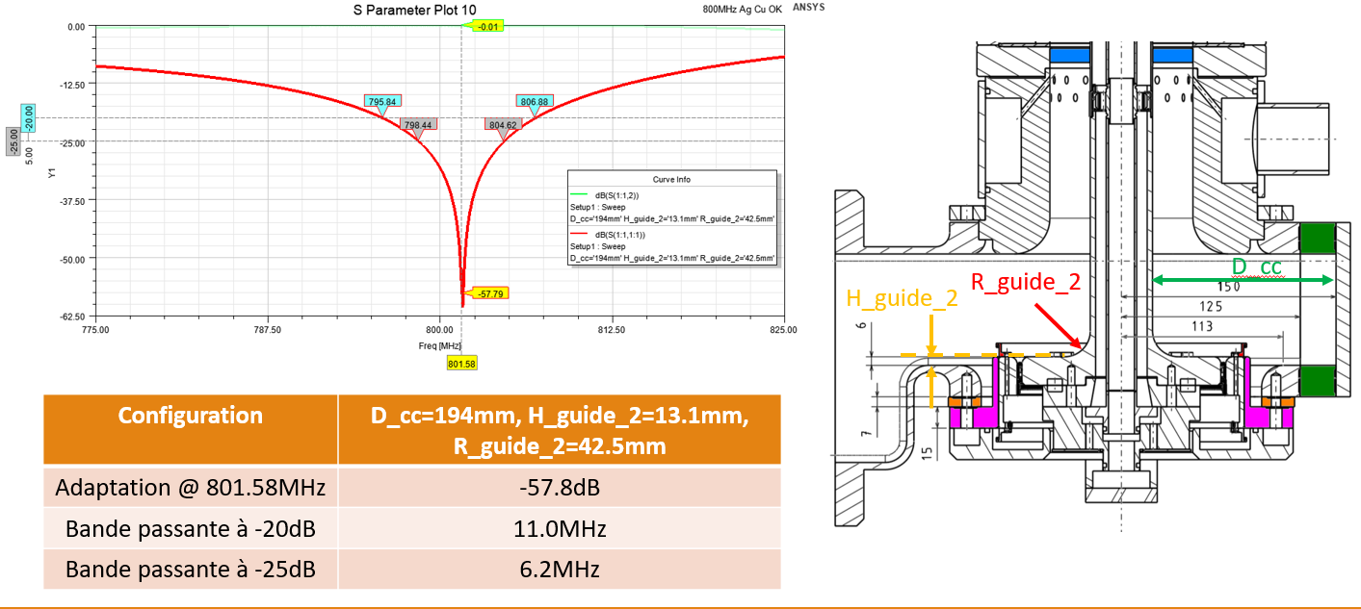
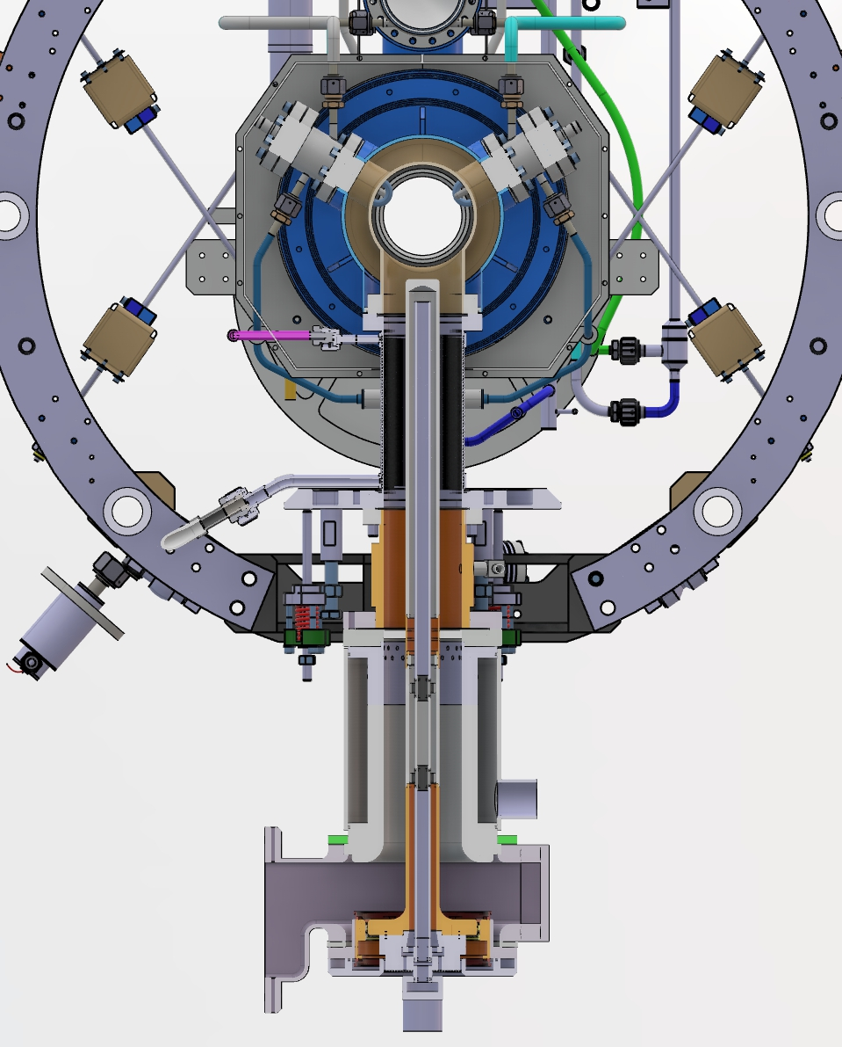
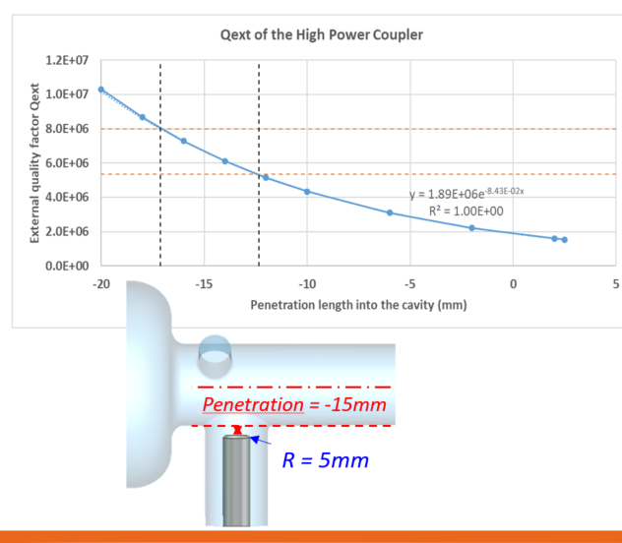
WP4 – HOM and FPC: status/evolution of Task 4.5
FP coupler design
c/o J.Angot
Length increased
of 150 mm
FPC in the WP6 cryomodule
c/o S.Blivet & G. Olivier
c/o P. Duchesne

Slide 9
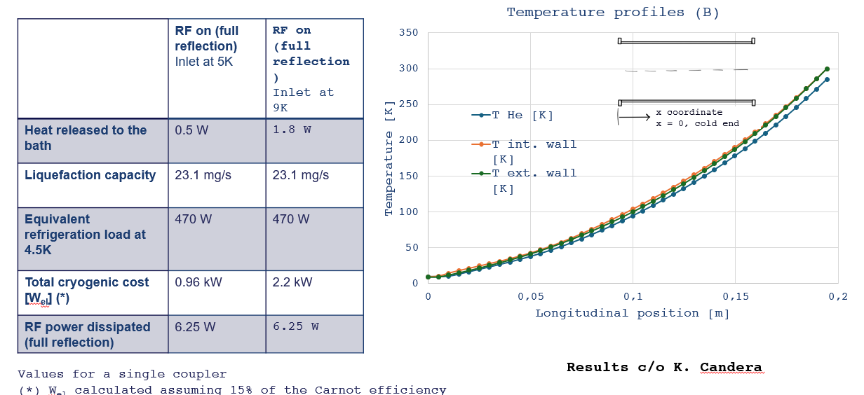
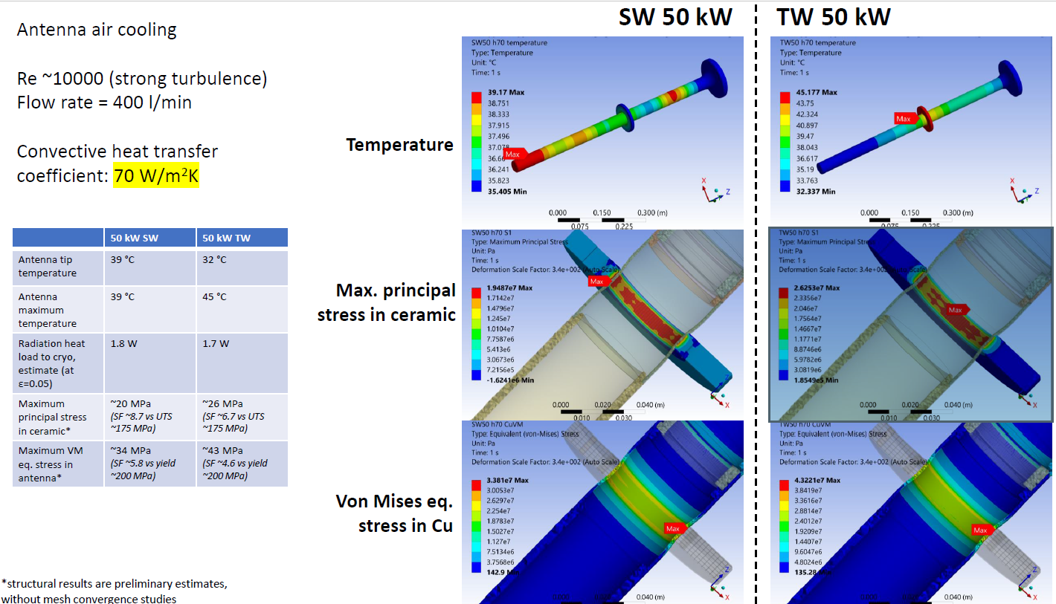
WP4 – HOM and FPC: status/evolution of Task 4.5
FP coupler design
Results c/o C. Sharp

Slide 10
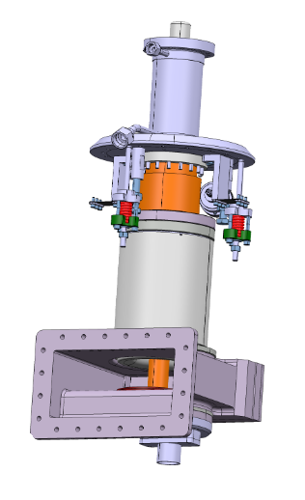
WP4 – HOM and FPC: status/evolution of Task 4.6
Fabrication of FP couplers
Past developments
Nothing to report
Current developments
Just beginning.
c/o S.Blivet

Slide 11
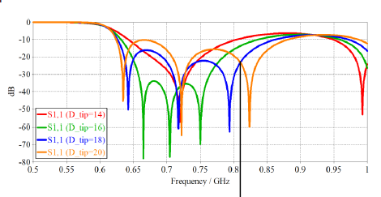
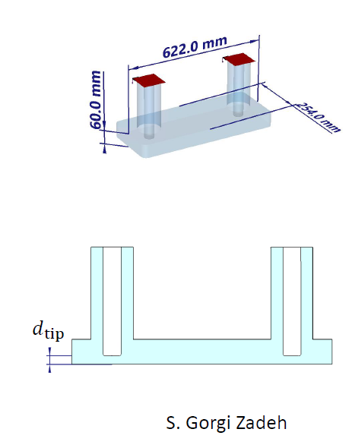
WP4 – HOM and FPC: status/evolution of Task 4.7
Test of FP couplers
The RF conditioning at 800 MHz@ 50 kW CW was chosen (type of RF conditioning proposed in the proposal) in the technical review carried out on 13/05/2025.
Possibility to use the 704 MHz test box at 800 MHz.
Others possibilities were: To conditioning at 704 MHz at the existing CERN test bench or o skip the FPC conditioning and to decide to proceed directly with the FPCs onto the cavities.

Slide 12
WP4 – HOM and FPC : financial status on 09/07/2025
Funds transfert Funds engaged
Beneficiary | EU Budget k€ (with 25% overheads) | Including | Funds engaged
INFN | 153, 750 - 120 (07/25) | 30 pm temporary staff (120 k€) transfert to CNRS/ IJCLab ( 07/25) → 0 k€ Travel (3 k€) | -
CERN | 418, 437 | Equipement (228,75 k€) Consumables (50 k€) 6 pm temporary staff WP4&WP5 (53 k€) Travel (3 k€) | - - 53 k€ -
CNRS | 0 k€ + 120 ( 07/25) | 0 → 30 pm temporary staff from INFN WP4 (120 k€) ( 07/25) (Matching funds for travel…) | -
TOTAL | 572, 187 | - | 53 k€
July 2025 : Dr. Dario Giove has submit the request to assign the activity of recruitment of postdoc staff and its budget (120,000 €) from the beneficiary INFN to the CNRS (within WP4) and the INFN transfer progress.

Slide 13
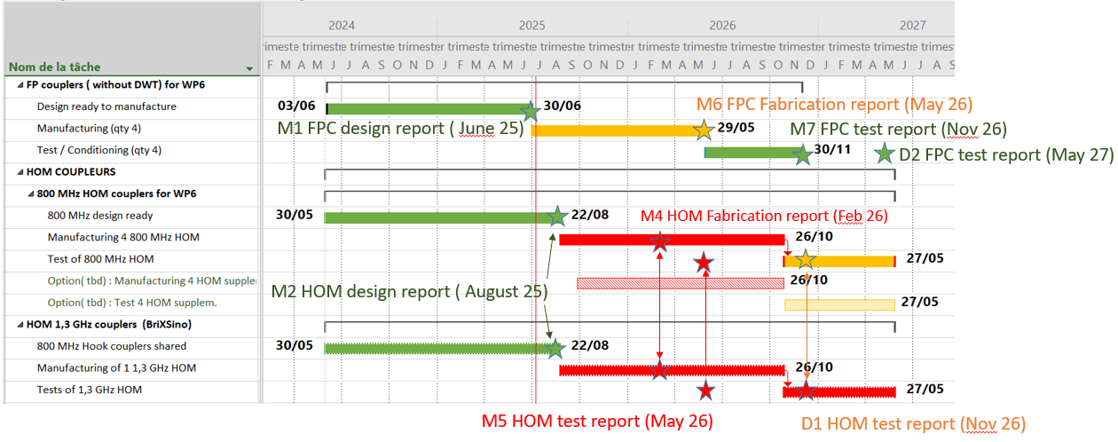
WP4 – HOM and FPC : planning
Delay to be estimated
(scaling HOM from 800 MHz to 1,3 GHz)

Slide 14
Thank-you for your attention
Yolanda Gómez Martínez on behalf of the WP4 team:
CERN : Sebastien Jerome Calvo, Karin Canderan, Marco Garlasche, Vittorio Parma, Calum James Sharp …
INFN : Dario Giove (deputy), …
CNRS / IJCLab : Patricia Duchesne, Gilles Olivier, Guillaume Olry, Sebastien Blivet, …
CNRS / LPSC : J. Angot, Yolanda Gómez Martínez (convener), Adrien Plaçais.

Slide 15
WP4 – HOM and FPC :
plans to achieve milestones & deliverables
Timeline | M Milestone / D Delivery | Task | Resp
June 25 | (M1) FPC design report | 4.5 : WP6 FPC design | CERN
August 25 | (M2) HOM design report | 4.2: HOM Design | INFN
Feb 26 | (M3) Impact risk analysis WP4 | 4.1: Coordination WP4 | CNRS
Feb 26 | (M4) HOM engineering report of the fabrication | 4.3: HOM Fabrication | CERN
Mai 26 | (M5) HOM test report | 4.4: HOM test | CNRS
Mai 26 | (M6) FPC engineering report of the fabrication | 4.6: WP6 FPC fabrication | CERN
Nov 26 | (D1) Report qualification HOM couplers on cavities at 300 K |  | CNRS
Nov 26 | (M7) FPC test report: | 4.7: WP6 FPC test (50 kW CW) | CERN
Mai 27 | (D2) Report on RF test of 800 MHz FPC at 50 kW CW |  | CERN

