Slide 1

Innovate for Sustainable Accelerating Systems
WP6: Integration into Accelerator and Collider Ris
Guillaume OLRY
On behalf WP6 partners
09 July 2025

Slide 2
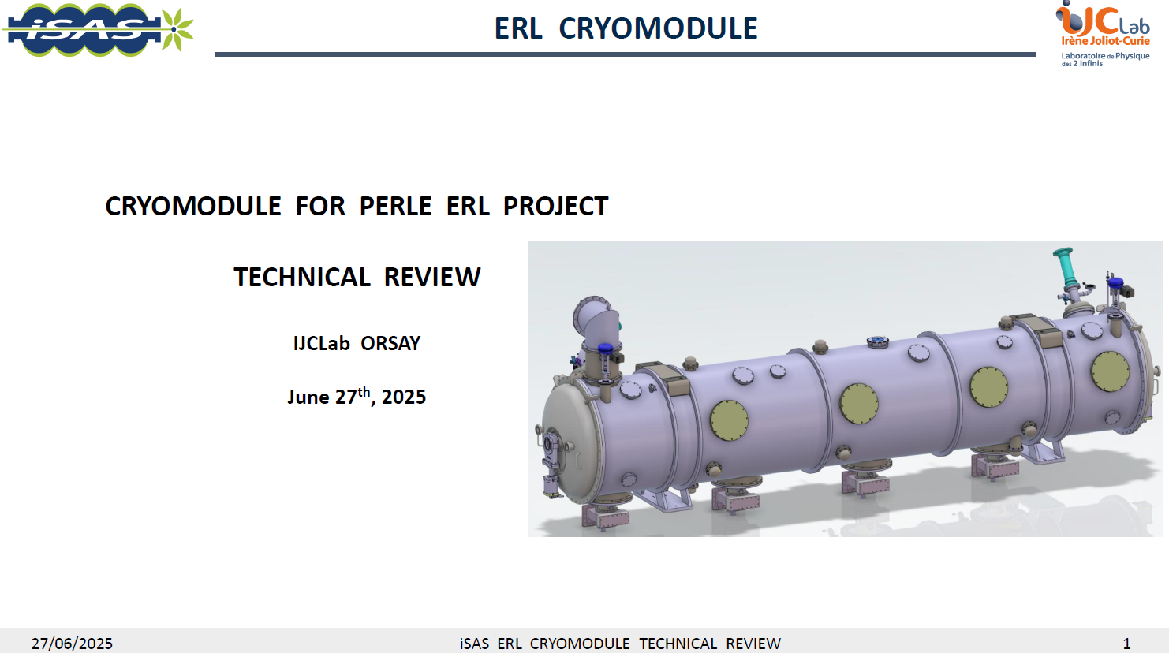
WP6 – task 6.1 Coordination
Technical Review on cryomodule adaptation: done! No issues.
Post-doc position @ INFN in WP4: agreement with Dario (INFN). Funds transfer to IJCLAB under progress. EU will be updated through the amendment process. Topics to the studied (to be discussed and approved with WP4). Several possibilities: the cold (+ warm?) absorbers, HOM couplers (fabrication?, tests at warm & cold?...).
PhD Thesis on cryogenic absorbers financed by ACS company: candidate selected! Thesis will start October 1st.
Integration of Advisory Board recommendations - WP work plans to be detailed. (Almost) nothing done...my apologies. First draft : end of July
Timeline in project months (M) |  |  |  | M/D | # | Related WP | Related task | Description |  | Status | Comments
Y2 | M18 | August | 2025 | M | 22 | WP6 | 6.3 Adapt the existing ESS cryomodule | Configure ESS CM to host optimized HOM and FPC |  | In progress | Test infra to be prepped & available
Y2 | M24 | Feb | 2026 | M | 37 | WP6 | 6.1 Coordination of integration in existing CM | Impact risk analysis WP6 |  | Not started
Y2 | M24 | Feb | 2026 | D | 20 | WP6 | 6.2 Retrofitting FE-FRT into existing CM HL-LHC oriented | Concept. design of a combined FE-FRT-HOM coupler |  | In progress | {{ Interconnexion }} w/ WP1 Task 1.2-1.4: impact WP1 -> WP6
Y3 | M30 | August | 2026 | M | 23 | WP6 | 6.4 Fabrication & validation of CM components | Validation of all SRF components for adapted CM |  | In progress | {{ Interconnexion }} w/ WP4 Task 4.2: impact WP4 -> WP6
Y4 | M39 | May | 2027 | M | 24 | WP6 | 6.5 Assembly & test of adapted cryomodule | Assembly of adapted CM |  | Not started | Test infra to be prepped & available
Y4 | M46 | Dec | 2027 | D | 21 | WP6 | 6.5 Assembly & test of adapted cryomodule | Report on test of adapted CM |  | Not started | {{ Interconnexion }} w/ WP4 Task 4.3 & 4.6: impact WP4 -> WP6

Slide 3
WP6 – task 6.1 Coordination
Integration of Advisory Board recommendations - WP work plans to be detailed.
M/D | # | Related WP | Related task | Description | Timeline in project months (M) |  |  |  |  | Status | Comments
 |  | WP6 | WP6 - Integration into accelerator (PERLE) & collider Ris /CNRS |  | Y2 | M15 | May | 2025 |  |  | Last update timestamp
 |  | WP6 | 6.1 Coordination of integration in existing CM /CNRS
 |  |  |  | WP Coordination /Guillaume Olry |  |  |  |  |  | In progress | All throughout the project (timeline-wise)
M | 37 | WP6 | 6.1 | Impact risk analysis WP6 /Person resp | Y2 | M24 | Feb | 2026 |  | Not started
 |  |  |  | * Subtask A name /Person resp |  | MX |  |  |  | Not started
 |  |  |  | * Subtask B name /Person resp |  | MX |  |  |  | Not started
 |  |  |  | * Close out |  | M24 |  |  |  | Not started
 |  | WP6 | 6.2 Retrofitting FE-FRT into existing CM HL-LHC oriented /UL |  |  |  |  |  |  |  | {{ Interconnexion }} w/ WP1 Task 1.2-1.4: impact WP1 -> WP6
D | 20 | WP6 | 6.2 | Concept. design of a combined FE-FRT-HOM coupler /Graeme Burt |  | M24 | Feb | 2026 |  | In progress
 |  |  |  | * Subtask A name /Person resp |  | MX |  |  |  | Not started
 |  |  |  | * Subtask B name /Person resp |  | MX |  |  |  | Not started
 |  |  |  | * Close out |  | M24 |  |  |  | Not started
 |  | WP6 | 6.3 Adapt the existing ESS cryomodule /CNRS
M | 22 | WP6 | 6.3 | Configure ESS CM to host optimized HOM and FPC /Gilles Olivier | Y2 | M18 | August | 2025 |  | In progress
 |  |  |  | * HOM couplers integration/Sébastien Blivet |  | MX |  |  |  | In progress
 |  |  |  | * FPC integration/ Sébastien Blivet |  | MX |  |  |  | In progress
 |  |  |  | * Vacuum vessel adaptation/ Sébastien Blivet
 |  |  |  | * Magnetic shield design/ Patricia Duchesne
 |  |  |  | (* Beam absorbers) out of iSAS scope
 |  |  |  | * Close out |  | M18 |  |  |  | Not started
 |  | WP6 | 6.4 Fabrication & validation of CM components /INFN |  |  |  |  |  |  |  | {{ Interconnexion }} w/ WP4 Task 4.2: impact WP4 -> WP6
M | 23 | WP6 | 6.4 | Validation of all SRF components for adapted CM /Dario Giove | Y3 | M30 | August | 2026 |  | In progress
 |  |  |  | * Procurement of the Niobium material /Guillaume Olry |  | MX |  |  |  | Done
 |  |  |  | ** Reception of delivery |  | M13 |  |  |  | In progress
 |  |  |  | * 5-cell cavities procurement /Akira Miyazaki |  | MX |  |  |  | In progress
 |  |  |  | ** Call for tenders #1 |  | MX |  |  |  | Done
 |  |  |  | ** Modification of specs |  | MX |  |  |  | Done
 |  |  |  | ** Call for tenders #2 |  | M14 |  |  |  | In progress
 |  |  |  |  |  |  |  |  |  |  | Test infra prepped
 |  |  |  |  |  |  |  |  |  |  | Test infra available
 |  |  |  | * Close out |  | M30 |  |  |  | Not started
 |  | WP6 | 6.5 Assembly & test of adapted cryomodule /CEA |  |  |  |  |  |  |  | {{ Interconnexion }} w/ WP4 Task 4.3 & 4.6: impact WP4 -> WP6
M | 24 | WP6 | 6.5 | Assembly of adapted CM /Arnaud Madur | Y4 | M39 | May | 2027 |  | Not started
 |  |  |  | * Subtask A name /Person resp |  | MX |  |  |  | Not started | Test infra to be prepped
 |  |  |  | * Subtask B name /Person resp |  | MX |  |  |  | Not started | Test infra to be available
 |  |  |  | * Close out |  | M39 |  |  |  | Not started
D | 21 | WP6 | 6.5 | Report on test of adapted CM /Nuno Elias | Y4 | M46 | Dec | 2027 |  | Not started
 |  |  |  | * Subtask A name /Person resp |  | MX |  |  |  | Not started
 |  |  |  | * Subtask B name /Person resp |  | MX |  |  |  | Not started
 |  |  |  | * Close out |  | M46 |  |  |  | Not started

Slide 4
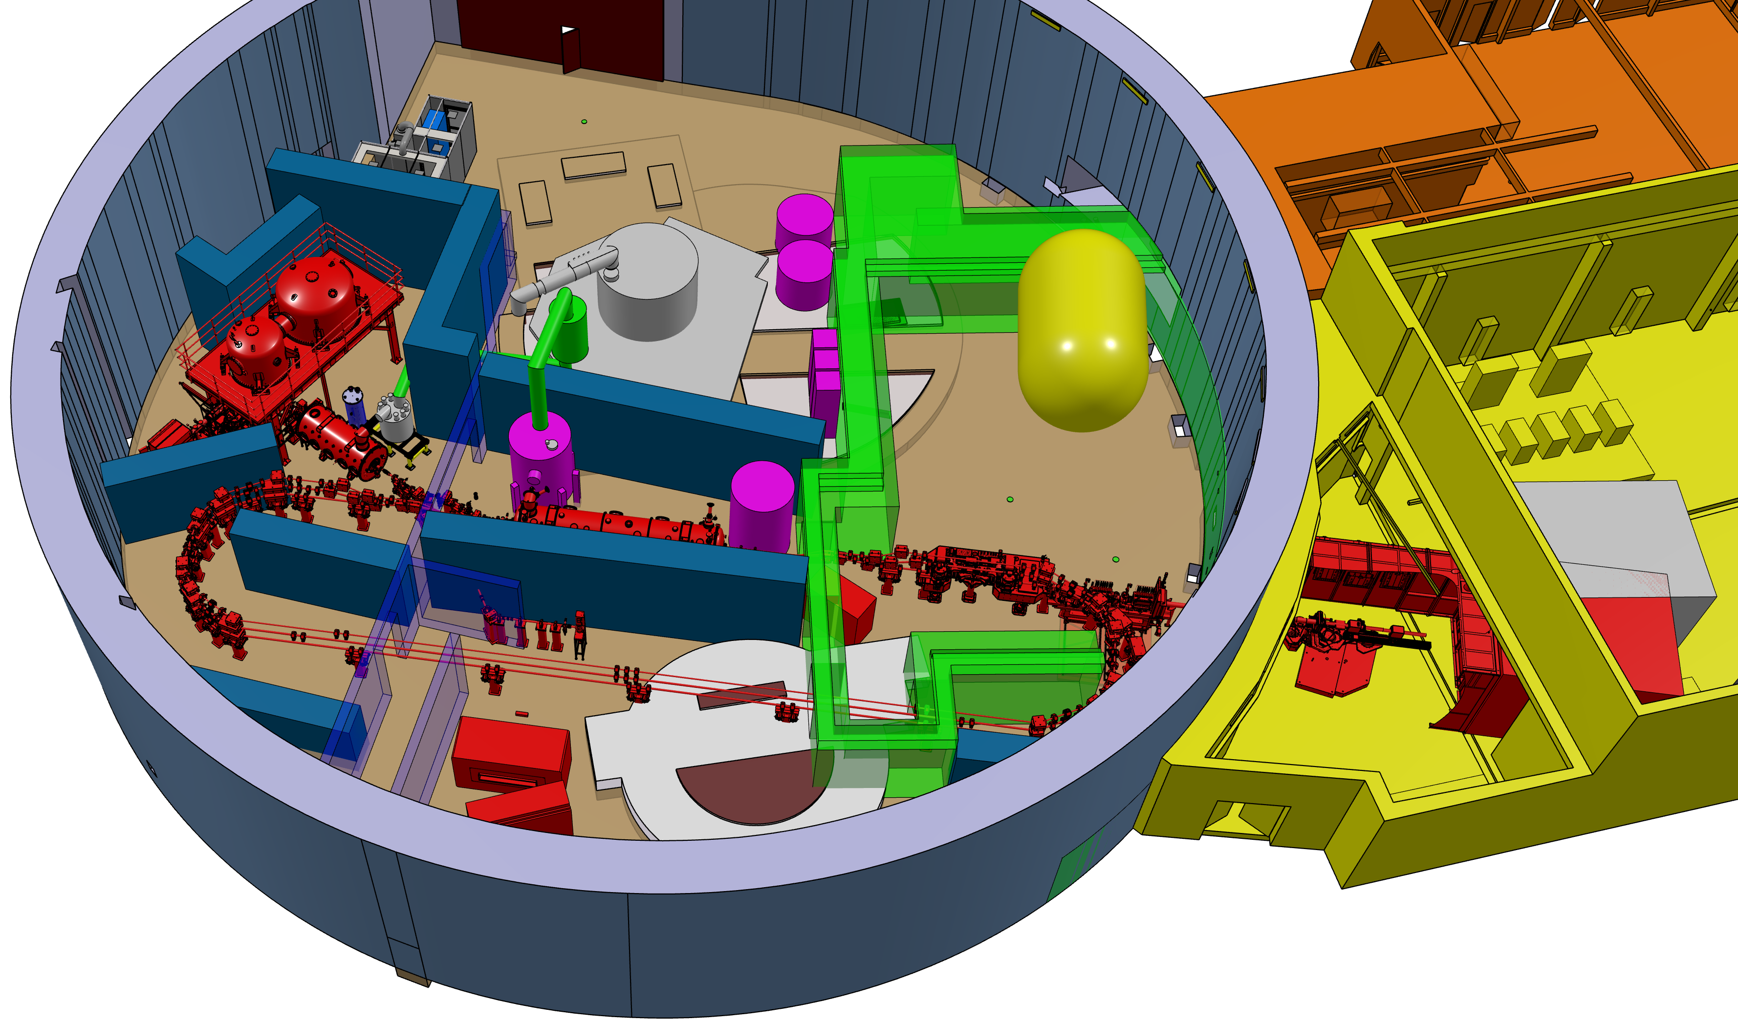
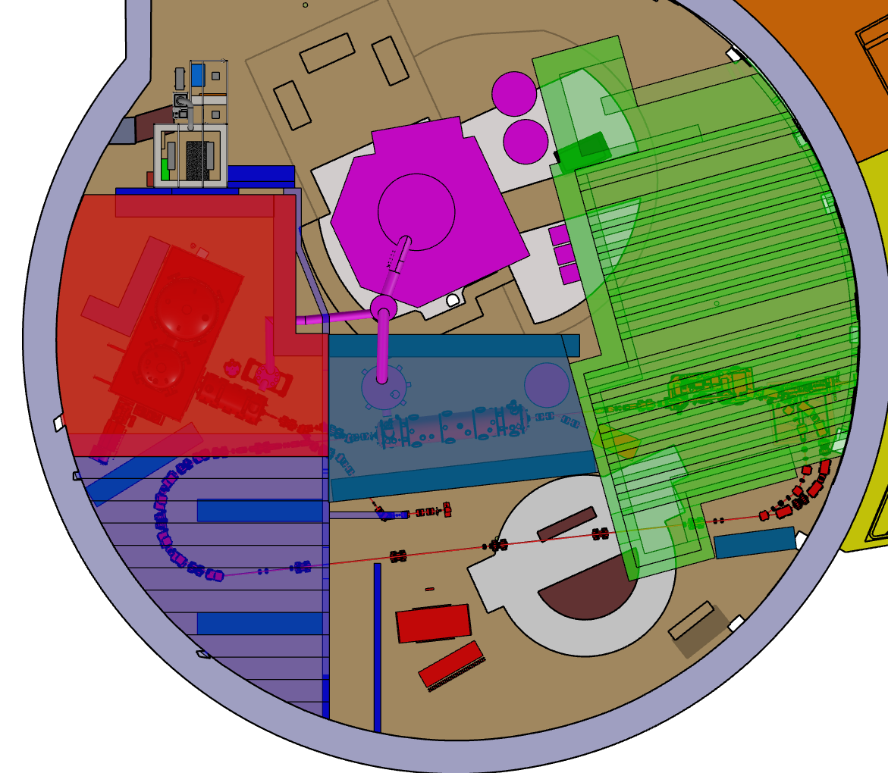
WP6 – task 6.1 Coordination
Implementation of the cryomodule into the PERLE building is progressing well.
Cryomodule
Top view with concrete roofs
PERLE machine

Slide 5
WP6 – task 6.2 Retrofitting FRTs:
Meeting to be planned with WP1 to have an update on this topic → Graeme will organize it. Still to be done.
Proposal: 15 minutes dedicated to the subject at the next meeting (Sept 3rd)

Slide 6
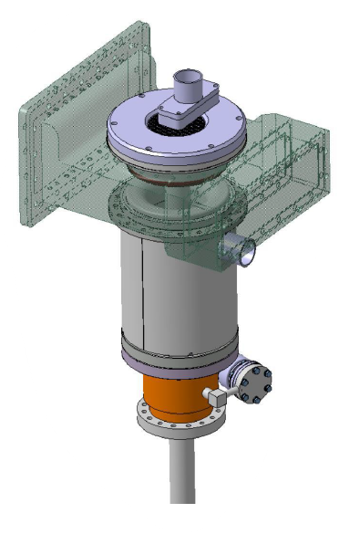
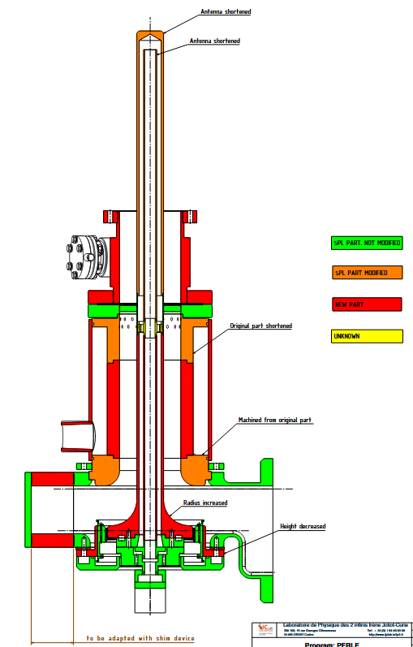
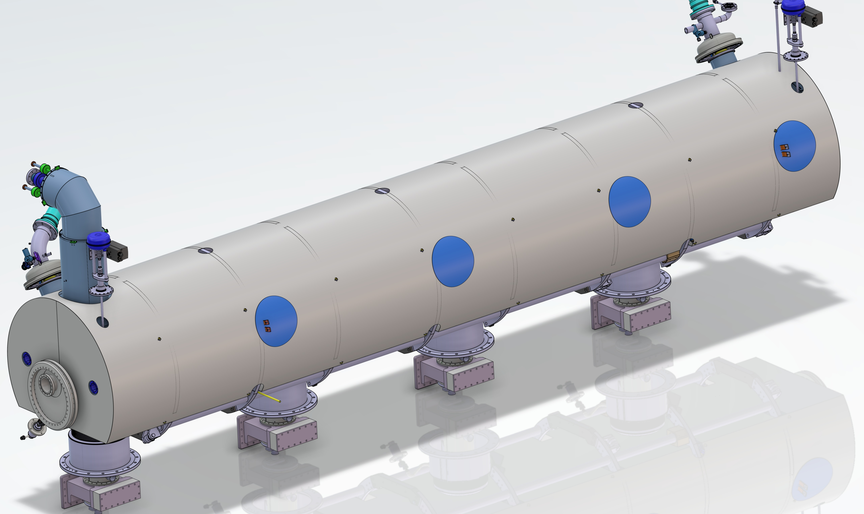
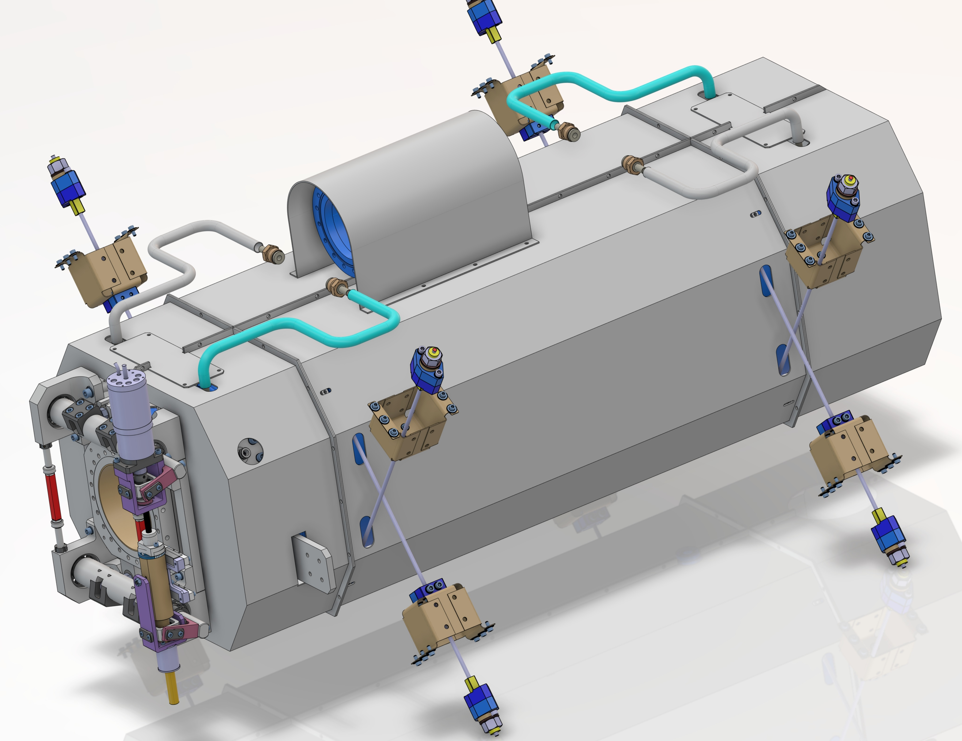
WP6 – task 6.3 Adapt the existing ESS cryomodule
RF couplers (drived by the WP4): in progress.
(WP4)Design completed
(WP6)Integration into the cryomodule : done.
(WP4)Fabrication study: on-going at CERN.
Magnetic shielding (P.Duchesne): in progress.
Technical meeting: 17 june. No issue. Leadtime production is about 12 weeks maximum.
First quotations received. Mu-metal shield is the cost driver → x2 the cost of the 4 cold magnetic shields. Total cost estimate ~130k€
Purchase of the raw material first by end of 2025?

Slide 7
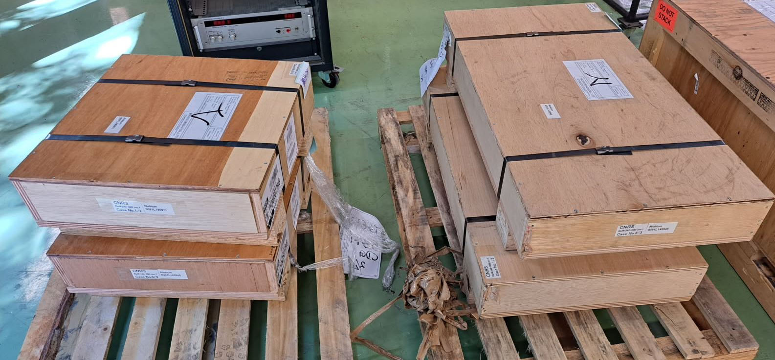
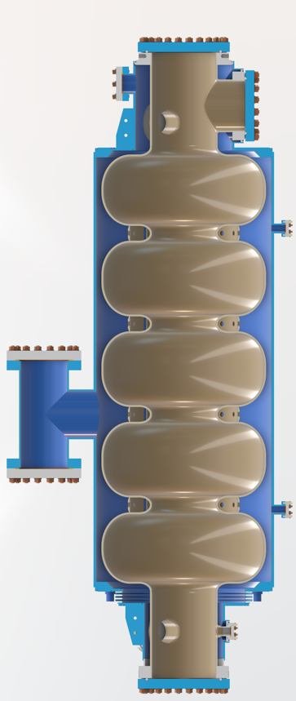
WP6 – Task 6.4: Fabrication and validation of cryomodule components
Cavities (G.Olry)
Niobium material (A.Miyazaki): delivered (June 12th)
Everything is ok.
Cavities fabrication (G.Olry): on the critical path.
1st Call for tender: cancelled.
2nd Call for tender: New technical specifications validated. Documentation sent to purchase dpt and is being reviewed for weeks. Publication before end of July still possible?
New baseline for preparation:
EP to be done at CEA Saclay (1st try with ESS proto cavity)
HT + Mid-T bake at IJCLAB
→ Cavities testing (INFN): on hold (but not critical, linked to the cavitiy fabrication).
Vertical test configuration : possible with and without the helium jacket. CF 16 (inlet) and CF40 (outlet) have be added.
Follow-up meeting in September with LASA

Slide 8
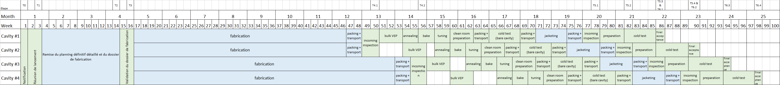
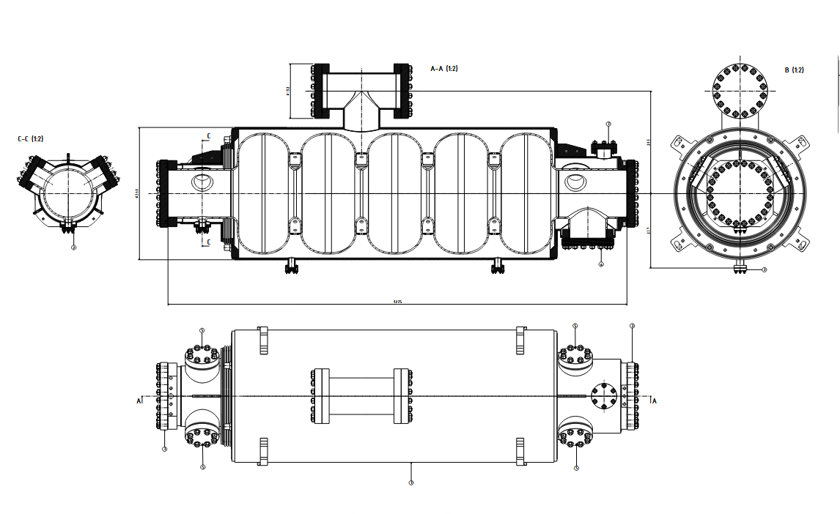
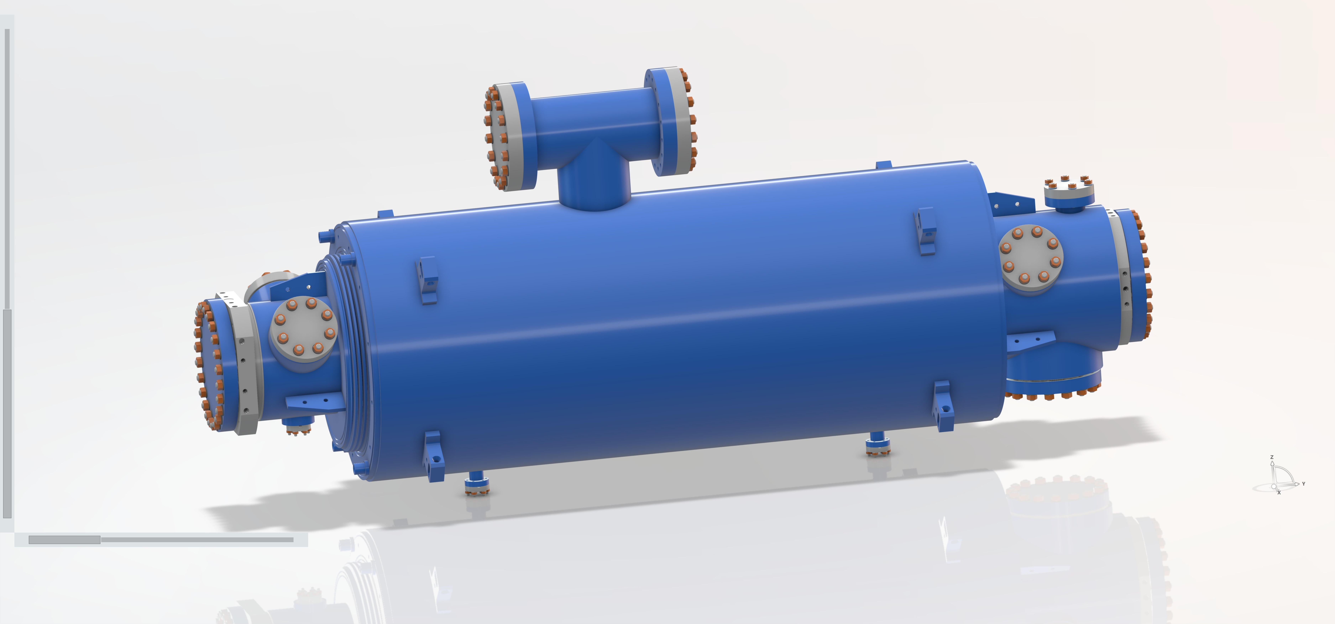
WP6 – Task 6.4: Fabrication and validation of cryomodule components
Cavities (G.Olry): Expected planning
Delivery of cavities by pair
~12 months for cav #1 & #2
~14 months for cav #3 & #4
~12 months for cavity preparation and testing
EP @ CEA
Heat treatments + freq tuning + clean room preparation @ IJCLAB
Cavity testing @ INFN-LASA

Slide 9
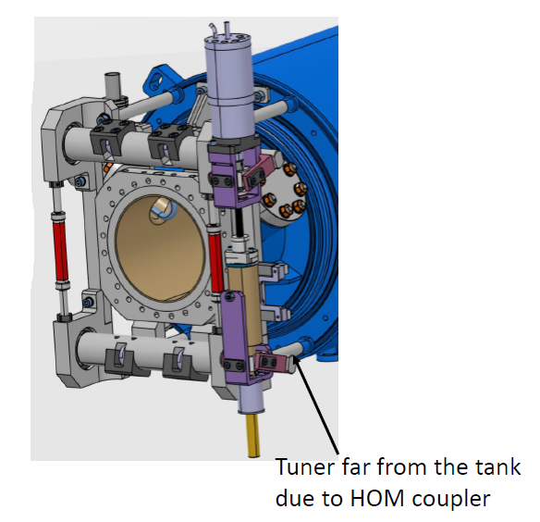
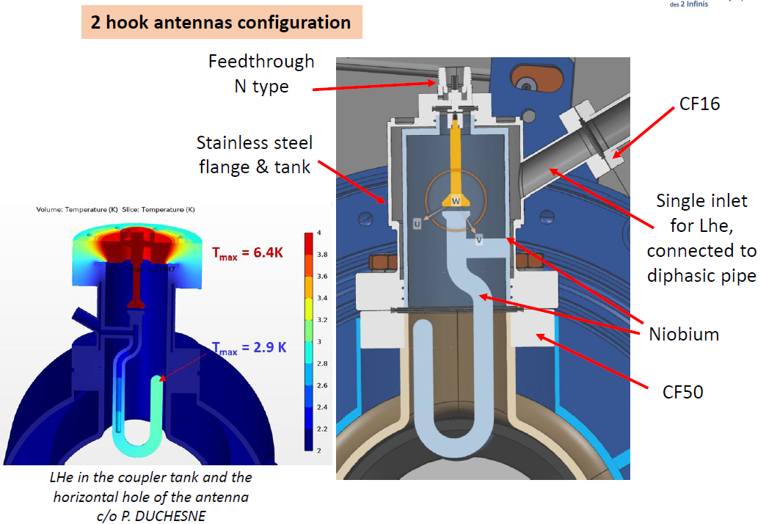
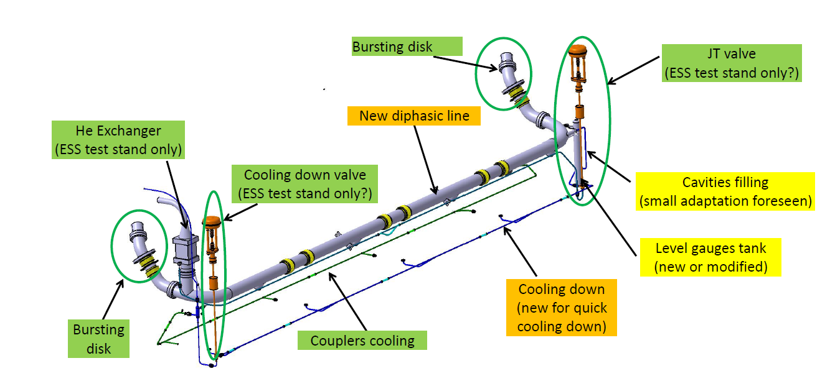
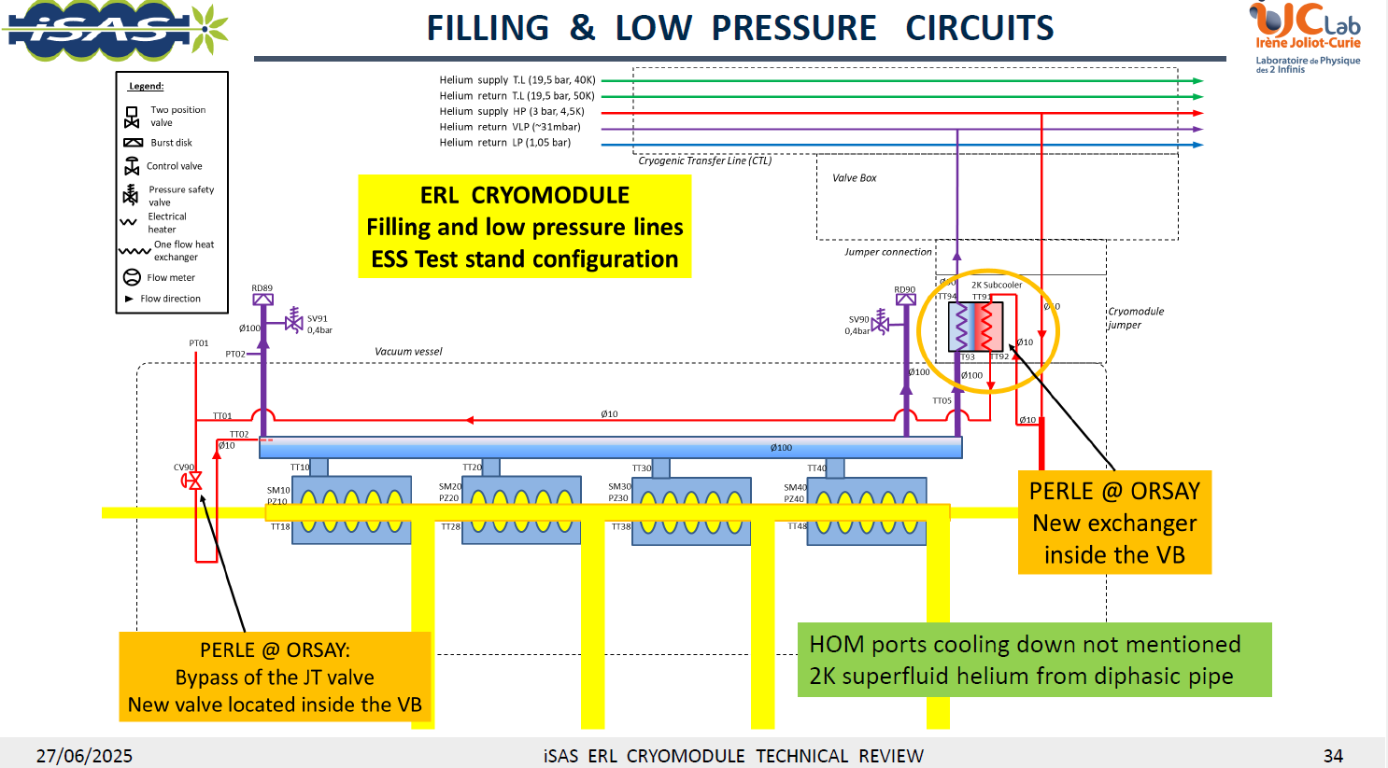
WP6 – Task 6.4: Fabrication and validation of cryomodule components
Tuning systems: on hold (but not critical).
Integration done (NB: tuner far from the cavity due to HOM couplers ports dimensions).
Purchase orders still planned beginning of 2026.
Individual test: end of 2026
HOM couplers (drived by WP4): in progress.
RF & Mechanical designs 99,9% finalized
Last optimization on the RF feedthrough to be finished soon (cost and production time savings)
Cryogenic circuit: in progress.
Two configurations studied and validated: ESS test stand and PERLE operation

Slide 10
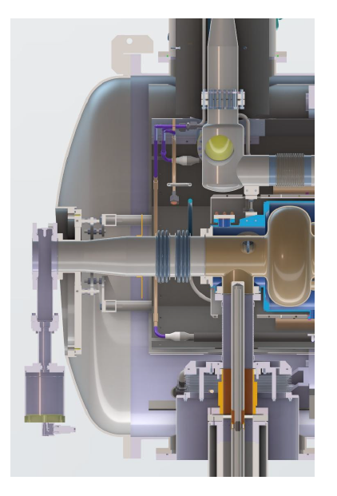
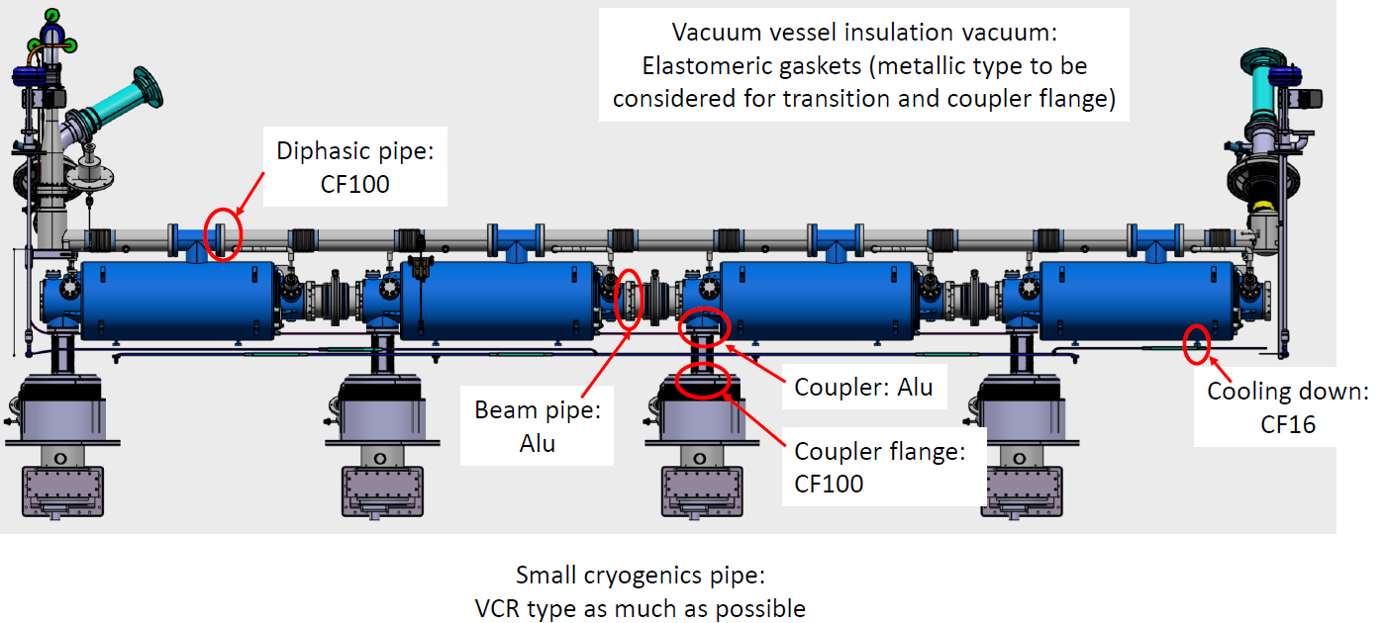
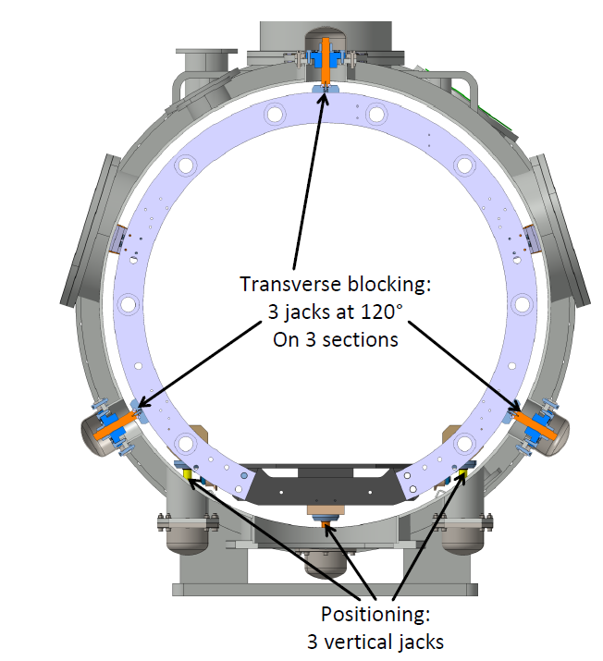
WP6 – Task 6.4: Fabrication and validation of cryomodule components
Vacuum vessel/Spaceframe/Flanges...: in progress.
Spaceframe
Several flange types → No welded pipes.
New warm-to-cold transition

Slide 11
WP6 – Task 6.4: Fabrication and validation of cryomodule components
Components provided by WP4:
4 Hook type HOM couplers (+ 4 as an option, under discussion with CERN)
4 Fundamental Power Couplers (modified SPL type)
Components provided by WP6:
Niobium → ordered in 2024 → received (June 2025)
x4 5-cell cavities → to be ordered in 2025 (hopefully, but on the critical path now)
x4 Tuning systems → 2026
x1 warm magnetic shield → to be ordered in 2025 (maybe partially: raw material)
x4 cold magnetic shields → to be ordered in 2025 (maybe partially: raw material)
Cryogenic circuit → 2026
x2 gate valves → 2026
x2 new dished end-caps → 2026
Not included in iSAS
Beam Line Absorbers: warm (x2) cold (x3?). Fabricated/validated before the start of the cavity string assembly? → to be confirmed.

Slide 12
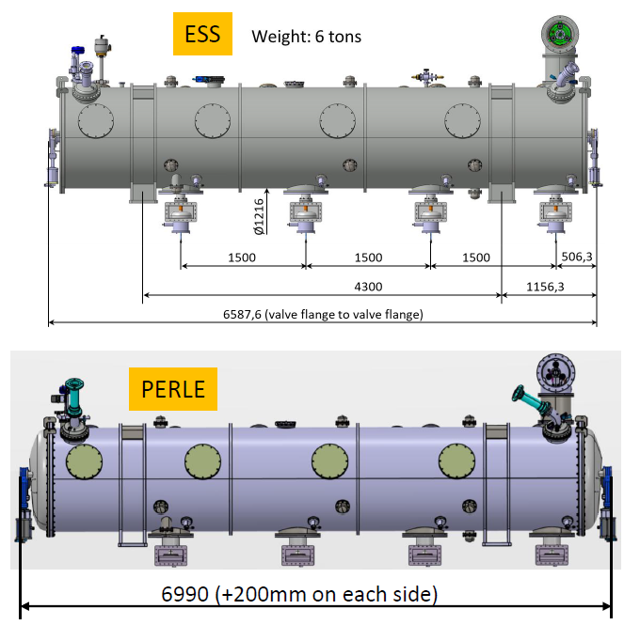
WP6 – Task 6.5: Assembly and test of adapted cryomodule
• Clean room assembly of the cavity string and cryostating phase.
Not started → need to finish the CM adaptation
• Preparation of the test stand @ Lund.
Not started.
Points of attention during the technical review:
Cryomodule footprint (+40cm total) into the bunker
Air cooling of the PERLE couplers (vs. water cooling for ESS couplers)
PERLE doorknobs dimensions vs. ESS ones : to be checked
• Cryogenic and RF test of the cryomodule.
Not started

Slide 13
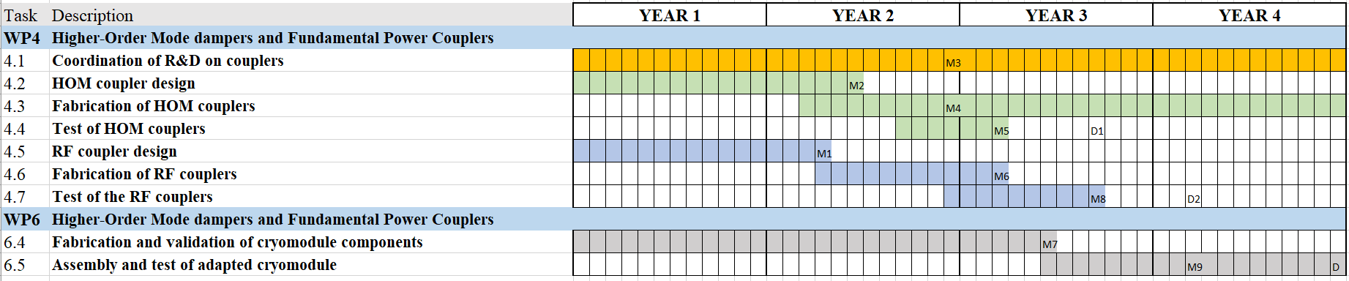
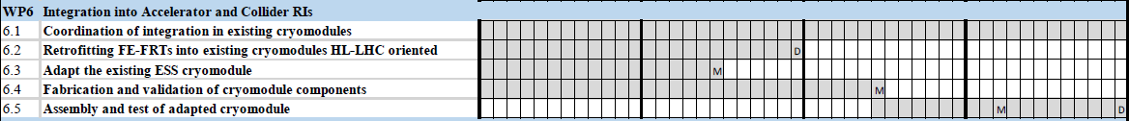
WP6 : plans to achieve milestones & deliverables
Planning
Feb 2025
Feb 2026
Feb 2027
Feb 2028
Due date
Milestones
M6.1
August 2025
M6.2
April 2026
M6.3
January 2027
Delay to be evaluated
Deliverables
D6.1
Feb 2026
D6.2
Feb 2028

Slide 14






WP6 – Planning
Niobium material
Call for tender completed
Adaptation/modifications of the ESS Cryomodule
HOM Couplers fabrication
Cryomodule assembly
Niobium material
Delivery
HOM and Power Couplers designs finished
Power Couplers fabrication
Power couplers conditioning
Cryomodule test
2024
2025
2026
2027
2028
Last 5cell cavity
Tested
First 5 cell cavity
Delivery
5 cell cavities fabrication
2nd call for tender publication
5 cell cavities fabrication
Purchase Order
Critical path
Ordering cavities this summer
Last cavity to be tested by mid-2027

