Slide 1

iSAS Steering committee meeting
9th July, 2025

Slide 2
iSAS Steering Committee meeting
Agenda
Objectives
To review WP progress & to discuss the scientific coordination of the project
To facilitate cross-coordination between WP
Agenda items
Report from the Coordination Panel - 10 min
Reports from WPs – 10 min each WP – exceptionally starting from WP7
Notes will be found in the meeting Indico page (WP status report template enclosed)
iSAS project Indico page

Slide 3
iSAS Steering Committee meeting
Consortium agreement
Consortium Agreement (CA) in progress
INFN feedback on v2 still missing
v3 to be sent by Julie Gendron
Shared NDA for industrial partners in progress
To be signed still by Cryoelectra, Plasmatherm & RI

Slide 4
iSAS Steering Committee meeting
Amendment to the Grant agreement
Amendment (AMD) in progress
New PO to be appointed soon: it will be Sotiris Kakarantzas
That means the AMD can proceed again (was on stand by after Elena Garbarino left)

Slide 5
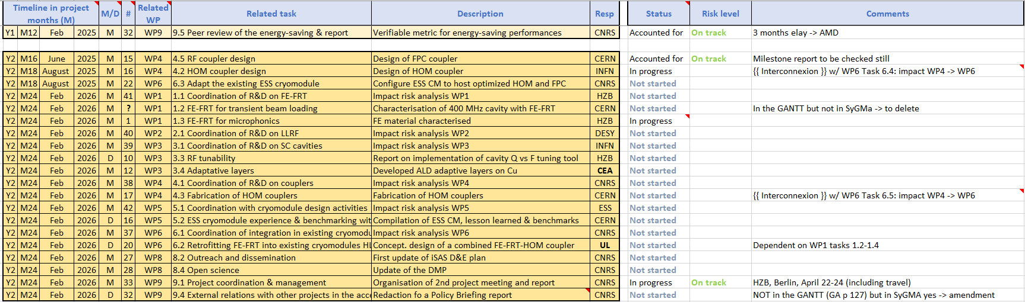
iSAS Steering Committee meeting
Work plan
Milestones & Deliverables status by timeline for the 2nd project year (to be updated post Steering Committee feedback):

Slide 6
iSAS Steering Committee meeting
Complementary follow-up tools
As a follow up to the Advisory board recommendations shared in the last Steering committee, the project coordination proposed to complement the current coordination tools available with WPs work plans & WPs budget follow-up
WPs work plans in progress
Do you have feedback, questions or comments on the templates shared?
WPs budget follow-up in progress
To share financial officer contact within your institute - for check & later yearly update

Slide 7
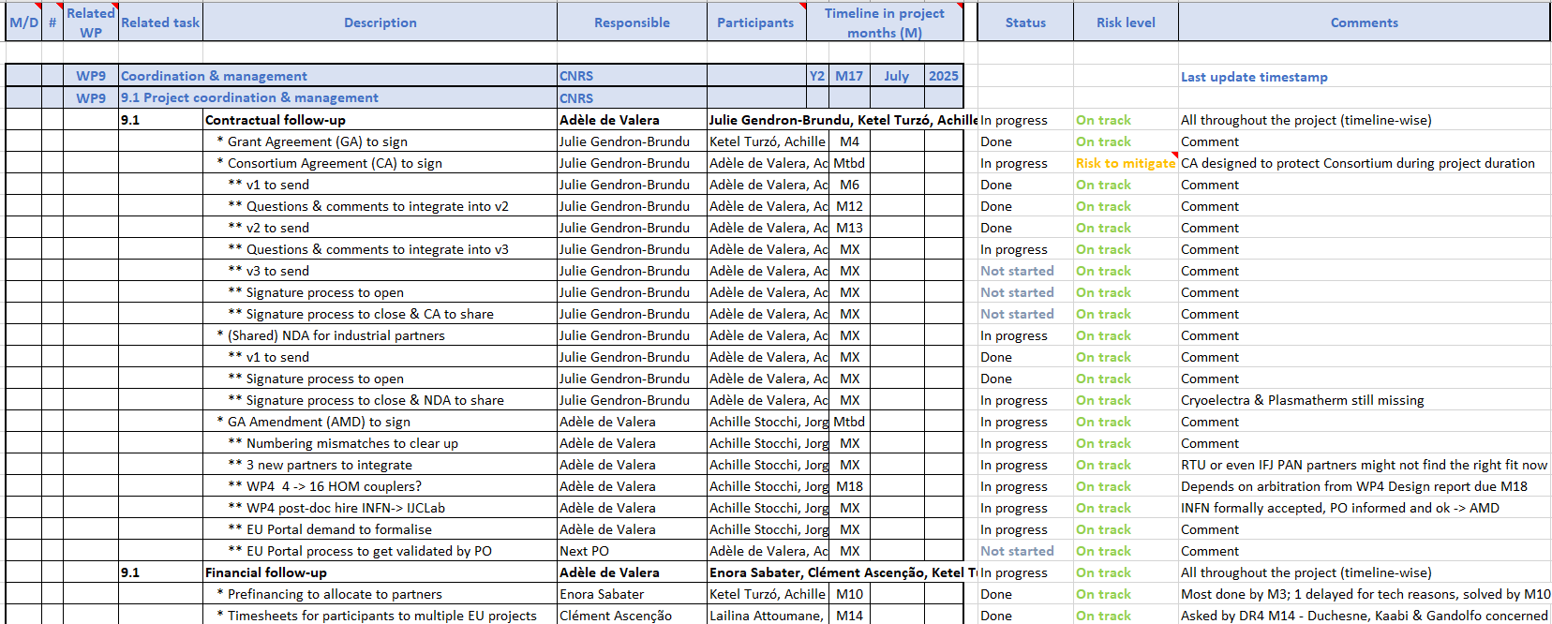
iSAS Steering Committee meeting
WP9 work plans
Coordination & management
Extract:

Slide 8
iSAS Steering Committee meeting
Upcoming related meetings
Every other meeting the Coordination panel becomes the Steering committee (includes the WP leaders & deputies), so as to integrate a cross-coordination of feedback
Indico page for Coordination panel - Steering committee meetings
Coordination panel – Sept 30 at 10 am CET
Steering committee - Nov 4 at 10 am CET
Coordination panel - Dec 16 at 10 am CET
Steering committee - Jan 27 at 10 am CET
Coordination panel – March 10 at 10 am CET
Steering committee – April 21 at 10 am CET
Coordination panel – June 2 at 10 am CET

Slide 9
iSAS Steering Committee meeting
Upcoming other meetings
iSAS project Indico page
Industry Board meeting – July 15 at 3 pm CET
Governing Board meeting – Oct 1 at 2 pm CET
Advisory Board meeting – Oct 7 at 9:30 am CET
2nd annual project meeting in Berlin – April 22-24

Slide 10
Thank you!

