Slide 1
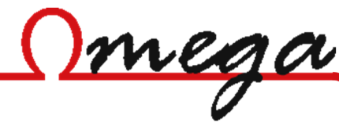


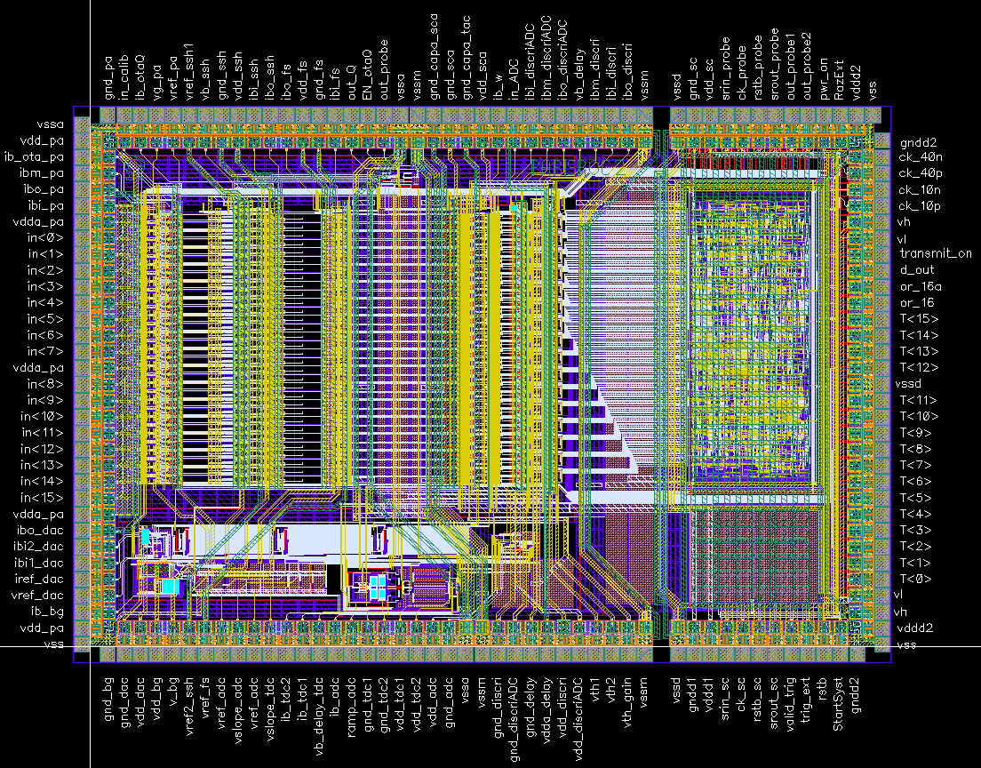
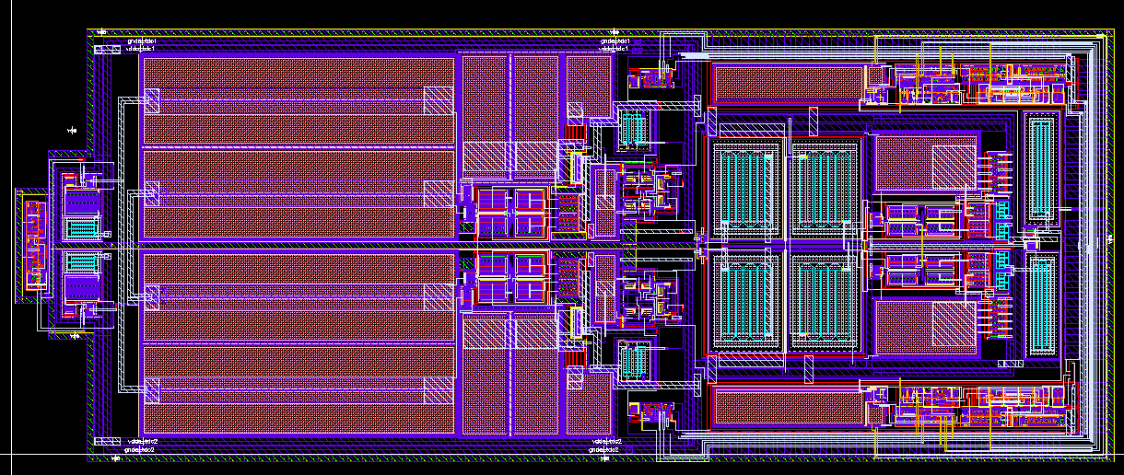
PARISROC V2
Tests and Results on the TDC
Sébastien Drouet – Bengyun Ky – Eric Wanlin IPN Orsay

Slide 2
PARISROC2 TDC Principle:
2 Ramps recovery
Event
Discriminator
1 channel
Memory cell X2
Multiplexor
To ADC
Memory cell X2
Ramp 1 and 2: global
Memory Cell: individual

Slide 3
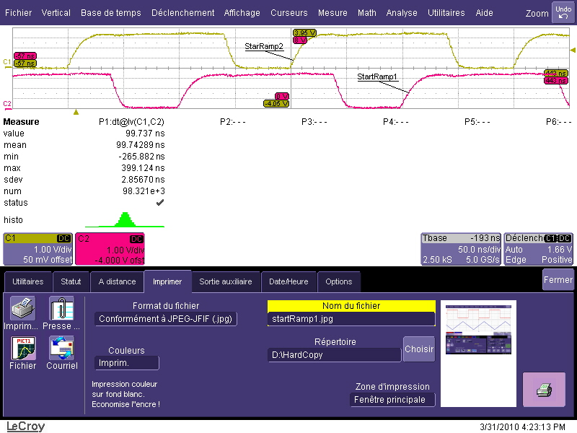
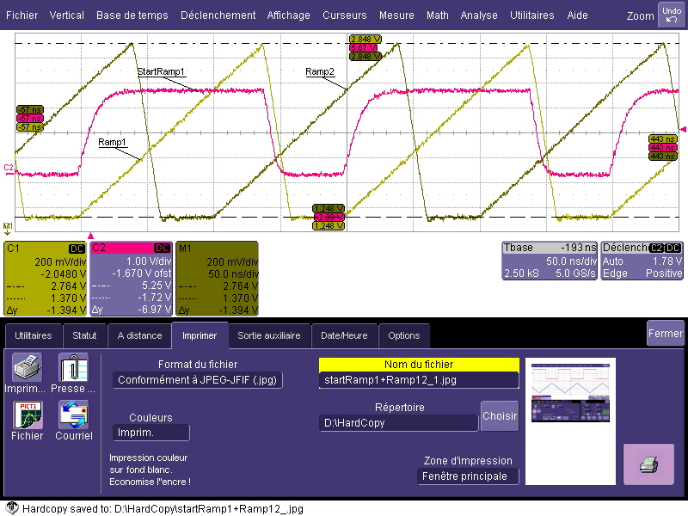
Analog and Digital Probes
StartRamp1 and 2
StartRamp1, Ramp1 and 2

Slide 4
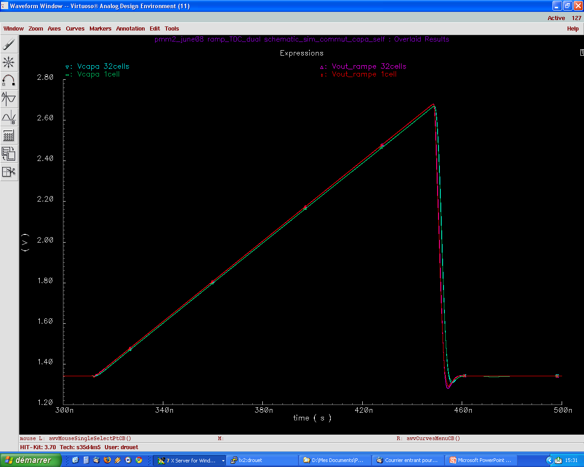
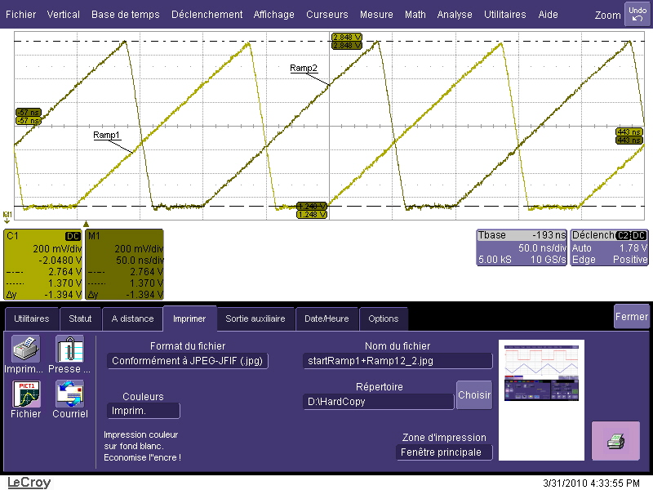
Simulation versus Reality
Analog Probe Output (Scope view)
Voltage span: [1.34 to 2.67] = 1.33 V
Time span: [312ns to 448ns] = 136ns
Voltage span: 1.39 V
Time span: 137ns
Recovery: 37ns

Slide 5
Ramp reconstruction setup
ASIC setup:
  Channel 0 unmasked, other masked
  External Trigger
Generator setup:
  Synchronization with StartRamp1 (digital Probe1)
  Output connected to trig_ext pin
  Output delayed by 1ns step, from 0 to 399ns

Slide 6
Ramp1 Reconstruction
Linear zone between 95ns and 234ns
Non-linearity due to ramp2 reset
ResolCap1=219.4ps/ch
RésolCap2=219.2ps/ch
Fit difference = 5.3m ch/m
Peak to peak Fit Error = 0.53 ch = 116ps
INL Error = ± 6.7ch = ±1.47ns

Slide 7
Ramp1 Noise
This plot is the row data noise for each step of 1ns.
Do not forget that the generator have a 107ps jitter.
Capacitor | Row Noise (Quadratic Mean) | TDC Noise (Quadratic Mean) | Max TDC Noise
Cap1 | 0.68ch = 149ps | 104ps | 359ps
Cap2 | 0.65ch = 142ps | 93ps | 334ps

Slide 8
Ramp2 Reconstruction
Linear zone between 95ns and 234ns
Non-linearity due to ramp2 reset
ResolCap1=217.4ps/ch
RésolCap2=217.3ps/ch
Fit difference = 2.7m ch/m
Peak to peak Fit Error = 0.27 ch = 59ps
INL Error = 7.4ch = ±1.61ns

Slide 9
Ramp2 Noise
This plot is the row data noise for each step of 1ns.
Do not forget that the generator have a 107ps jitter.
Capacitor | Row Noise (Quadratic Mean) | TDC Noise (Quadratic Mean) | Max TDC Noise
Cap1 | 0.67ch = 146ps | 99ps | 317ps
Cap2 | 0.68ch = 148ps | 102ps | 310ps

Slide 10
Ramps Reconstruction
RAMP1
ResolCap1=220.1 ps/ch
RésolCap2=219.8 ps/ch
DiffCap1Cap2 = 9.08 ch
Fit difference = 6.4m ch/m
Peak to peak Fit Error = 0.64 ch = 141ps
INL Error = ± 6.4ch = ±1.41ns
RAMP2
ResolCap1=217.6 ps/ch
RésolCap2=217.7 ps/ch
DiffCap1Cap2 = 1.31 ch
Fit difference = 2.8m ch/m
Peak to peak Fit Error = 0.28 ch = 61ps
INL Error = ± 7.1ch = ±1.54ns

Slide 11
Ramps Noise
These plots are the row data noise for each step of 1ns.
Do not forget that the generator have a 107ps jitter.
Capacitor | Row Noise (Quadratic Mean) | TDC Noise (Quadratic Mean) | Max TDC Noise
Ramp1.Cap1 | 0.69ch = 152ps | 108ps | 337ps
Ramp1.Cap2 | 0.66ch = 145ps | 98ps | 340ps
Ramp2.Cap1 | 0.71ch = 154ps | 111ps | 299ps
Ramp2.Cap2 | 0.73ch = 159ps | 118ps | 364ps

Slide 12
Ramp reconstruction setup
ASIC setup:
  Channel 0 unmasked, other masked
  External Trigger
  Descreased TDC bias currents → goal: decreased ramp reset pertubations
Generator setup:
  Synchronization with StartRamp1 (digital Probe1)
  Output connected to trig_ext pin
  Output delayed by 1ns step, from 0 to 399ns

Slide 13
Ramps Reconstruction

Slide 14
Ramps Reconstruction
RAMP1
ResolCap1 = 217.5 ps/ch
RésolCap2 = 217.2 ps/ch
DiffCap1Cap2 = 9.8 ch
Fit difference = 5.9m ch/m
Peak to peak Fit Error = 0.59 ch = 128ps
INL Error = ± 3.1ch = ±674ps
RAMP2
ResolCap1=216.3 ps/ch
RésolCap2=216.4 ps/ch
DiffCap1Cap2 = 1.06 ch
Fit difference = 1.4m ch/m
Peak to peak Fit Error = 0.14 ch = 30ps
INL Error = ± 2.4ch = ±519ps

Slide 15
Ramps Noise
These plots are the row data noise for each step of 1ns.
Do not forget that the generator have a 107ps jitter.
Capacitor | Row Noise (Quadratic Mean) | TDC Noise (Quadratic Mean) | Max TDC Noise
Ramp1.Cap1 | 0.67ch = 146ps | 99ps | 322ps
Ramp1.Cap2 | 0.68ch = 148ps | 102ps | 306ps
Ramp2.Cap1 | 0.71ch = 154ps | 111ps | 341ps
Ramp2.Cap2 | 0.68ch = 147ps | 101ps | 356ps

Slide 16
CH0 / CH15 Comparasion

Slide 17
Conclusion
Descreased TDC bias currents → decreased ramp reset pertubations!
No noise difference between the use of lab power supply and of PMm² card converters
It seems that Ramps on CH0 and CH15 are identical
After calibration and correction, the precision will be ±111ps (quadratic mean noise) or ±356ps (max noise)

