Slide 1

Accelerator Overview
or
“the Quadrature of the Circle”*
LPNHE, 17 July 2025
Frank Zimmermann
*Louis Fayard

Slide 2
references & further reading
ESPPU submissions https://indico.cern.ch/event/1439855/contributions/
#233 (FCC-ee), #247 (FCC-ee), #243 (HFM), #275 (ILC), #40 (LCF), #140 (LC Vision), #78 (CLIC), #188 (LEP3), #214 (LHeC), #207 (MC), #57 (HALHF)
FCC Feasibility Study Report + FCC-related ESPPU docs https://indico.cern.ch/event/1534205/
ESPPU 2025 Symposium https://agenda.infn.it/event/44943
M. Benedikt, FCC-ee (incl. common infrastr.); F. Zimmermann, FCC-hh
S. Stapnes, A Linear Collider at CERN; J. List, Linear Collider Vision
T. Virdee, LEP3; J. d’Hondt, LHeC
D. Schulte, Muon Collider; M. Turner, High gradient wakefield accelerators
SFP 2025 talks https://cgsfp2025.sciencesconf.org/
C. Diaconu, Stratégie Européenne pour la Physique des Particules
C. Grojean, Future Circular Collider: What? Why? When?
EPS-HEP presentations https://www.eps-hep2025.eu/
P. Burrows, Summary of Large Projects
M. Seidel, Accelerator R&D

Slide 3
colliders constructed and operated
Colliders with
superconducting RF system
Colliders with
superconducting arc magnet system
Colliders with
superconducting magnets & RF
advances by new technologies and new materials
A. Ballarino

Slide 4
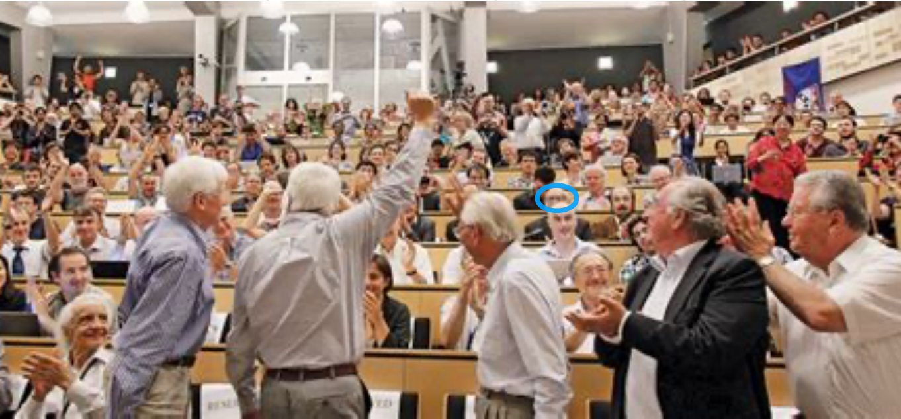
4 July, 13 years ago
C. Grojean, SFP2025 Troyes

Slide 5
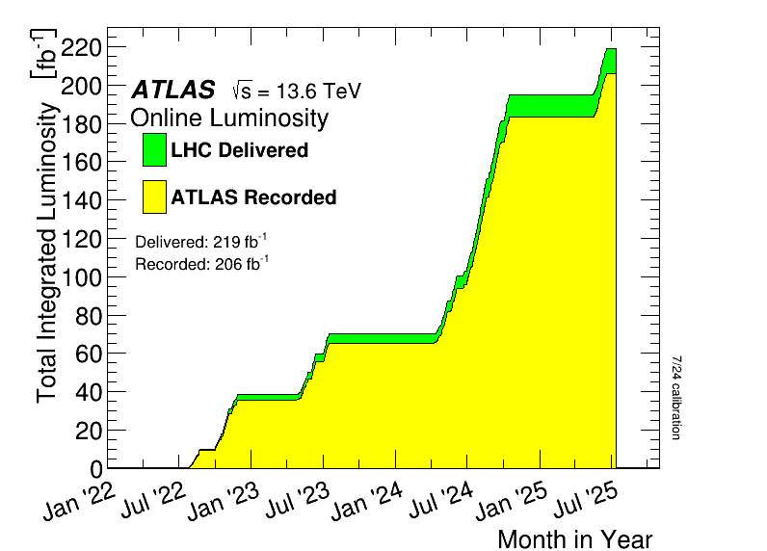
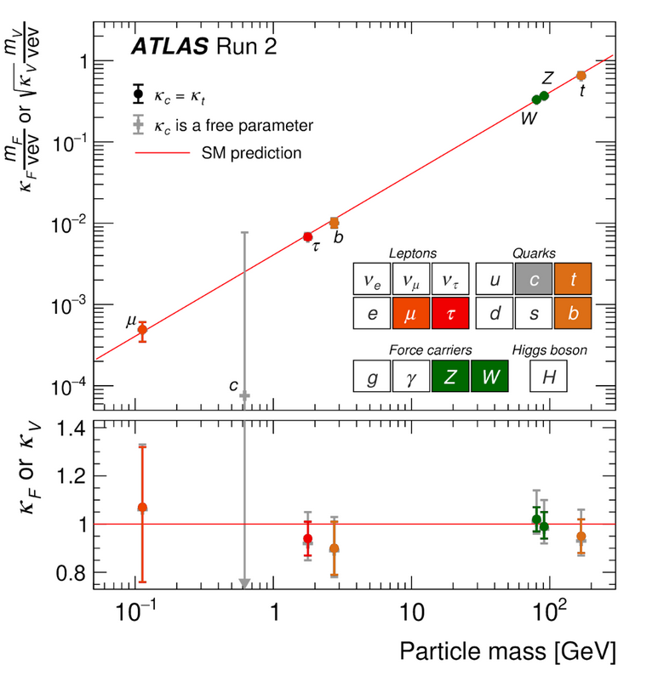
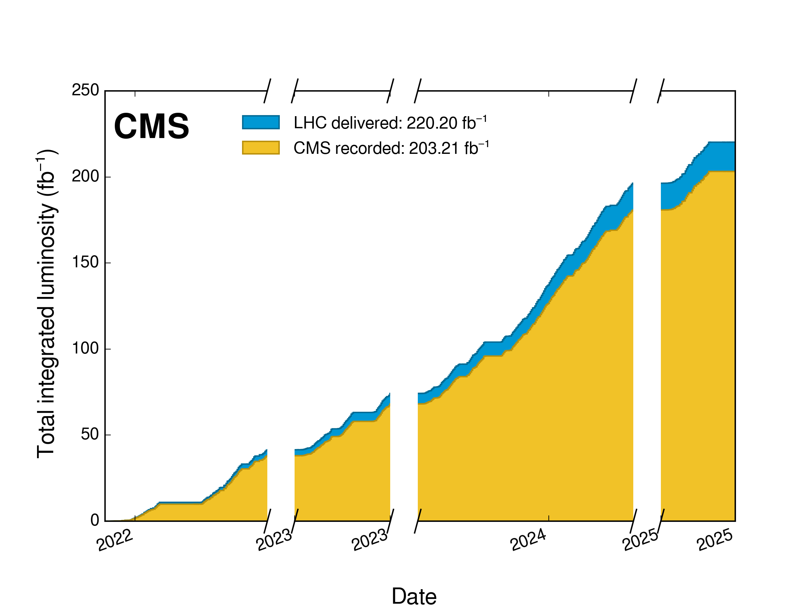
the first Higgs factory: LHC and HL-LHC
LHC and HL-LHC are heavy-particle factories
LHC has already produced
> 25 million Higgs bosons
HL-LHC will produce > 360 million Higgs bosons, >200 thousand Higgs boson pairs, >13 billion top quarks etc
M. Kado & M. Cepeda

Slide 6
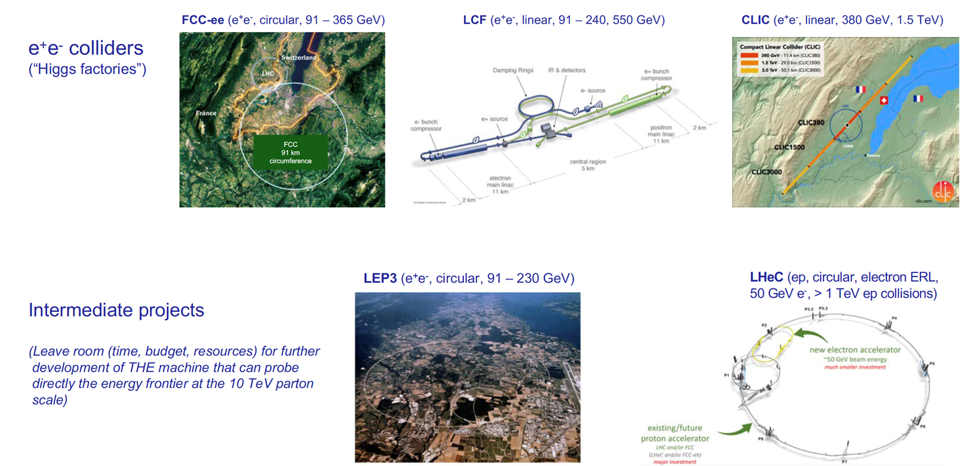
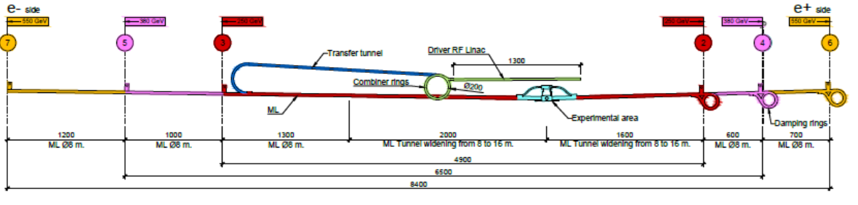
next CERN collider after HL-LHC – contenders
HAHLF (asymmetric, e+ conv., e- plasma wakefield)
HAL
K. Jakobs, ESPP open symposium
also: FCC-hh “fast-track” and/or HE-LHC

Slide 7
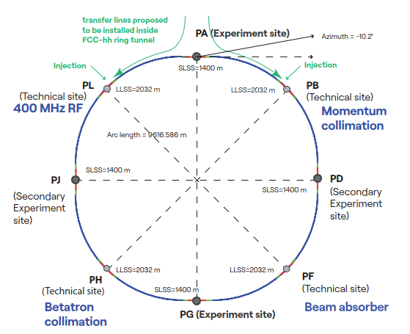
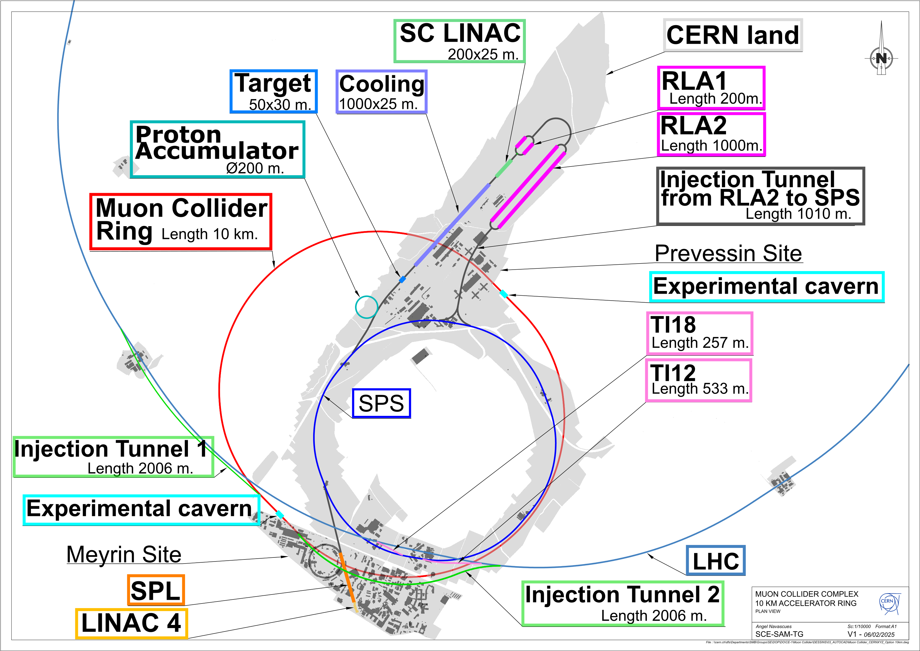
future 10 TeV parton-scale collider options
FCC-hh
p-p collisions at 85-120 TeV
also A-A, A-p and ep/A options
Muon collider at CERN
μ−μ collisions at 3.2 and 7.6 TeV
ALIVE & ALEGRO
e+e- or γγ collisions at ~10 TeV based on plasma wakefielld acceleration

Slide 8
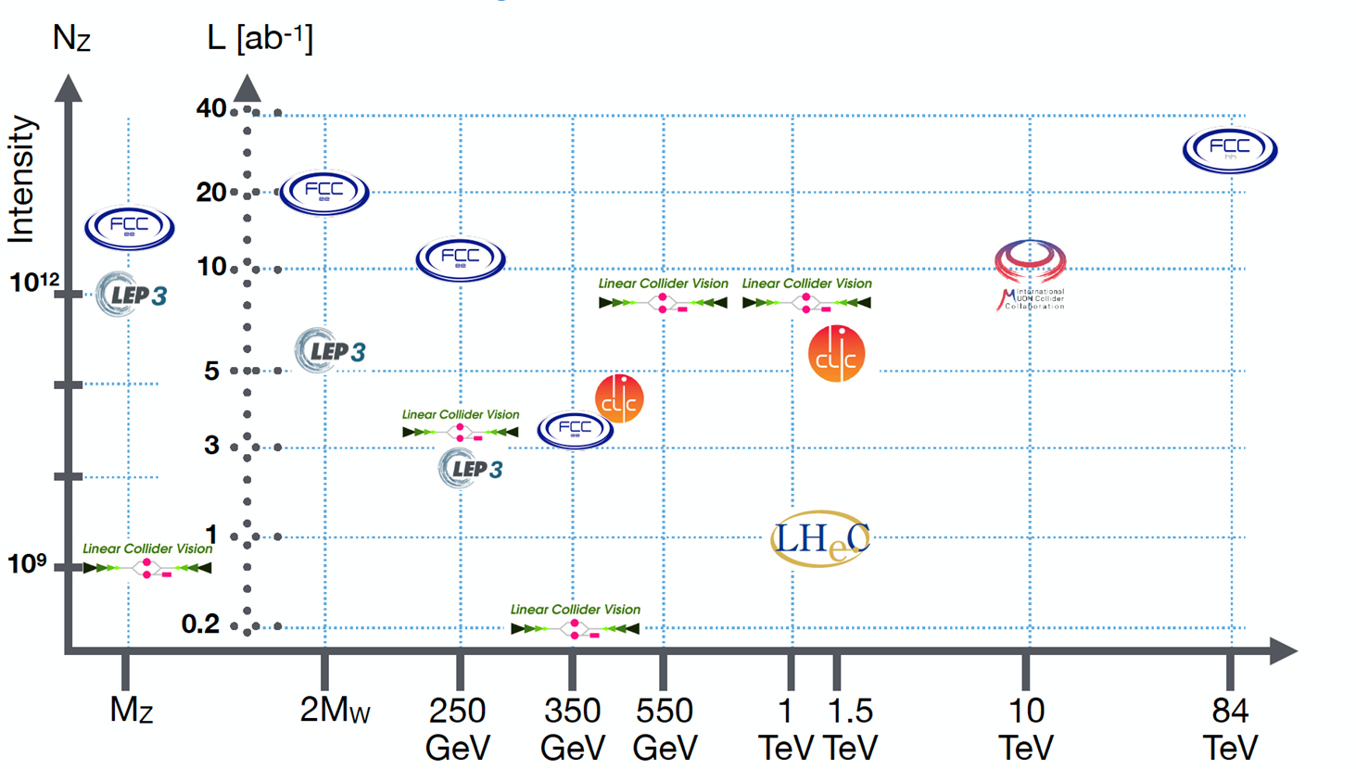
comparing future collider capabilities
J. de Blas, ESPP open symposium

Slide 9
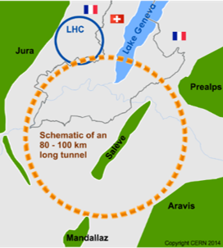
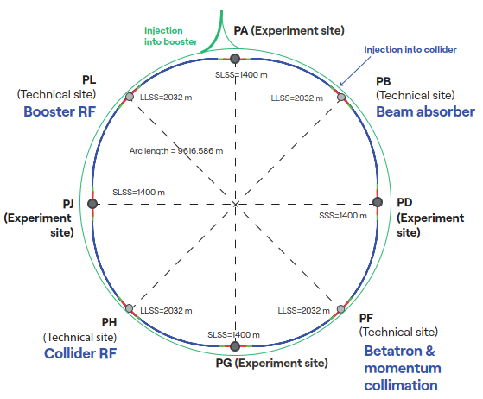
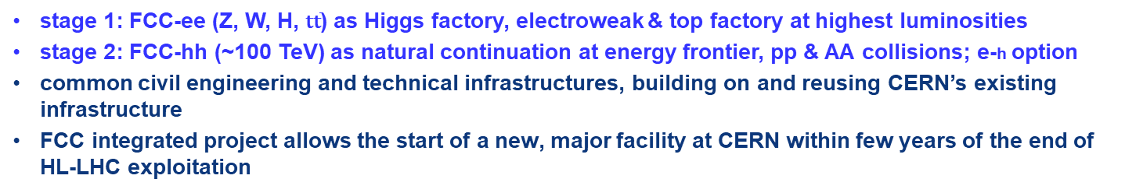
FCC integrated programme
stage 1: FCC-ee (Z, W, H, $\text{t}\overline{\text{t}}$) as Higgs factory, electroweak & top factory at highest luminosities
stage 2: FCC-hh (~100 TeV) as natural continuation at energy frontier, pp & AA collisions; e-h option
common civil engineering and technical infrastructures, building on and reusing CERN’s existing infrastructure
FCC integrated project allows the start of a new, major facility at CERN within few years of the end of HL-LHC exploitation
FCC-ee
FCC-hh
2020 - 2045
2046 - 2065
2070 - 2100

Slide 10
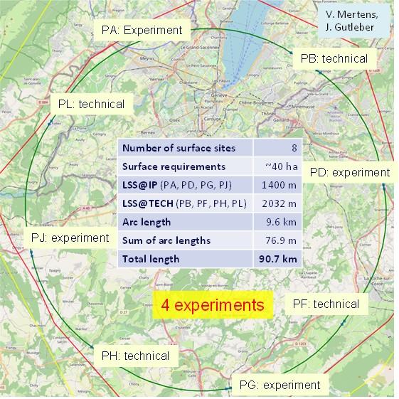
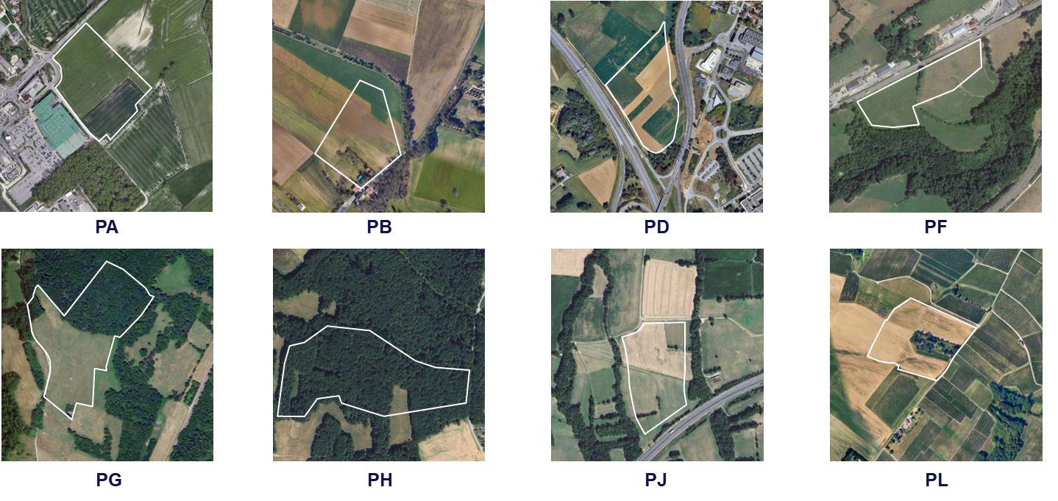
FCC placement, surface sites, environmental analysis
Surface site locations: 7 sites in FR and 1 site in CH
Optimisation done with municipalities, land plot needs communicated to Host States
  Environmental initial state analysis at all eight surface site locations (~600 ha covered, over 4 seasons) did not reveal any principal showstoppers for the project
  Basis for detailed optimisation of surface sites, and reference for environmental impact assessment

Slide 11
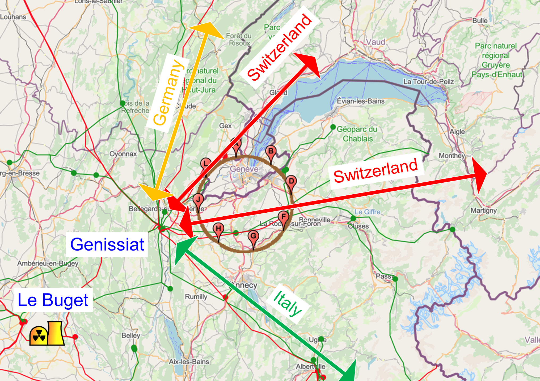
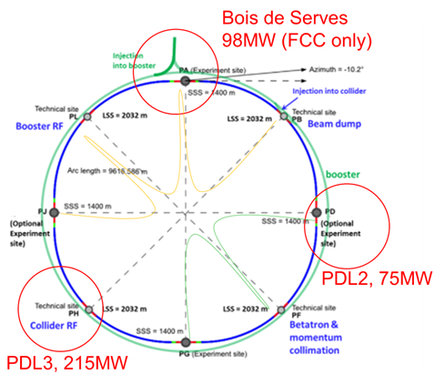
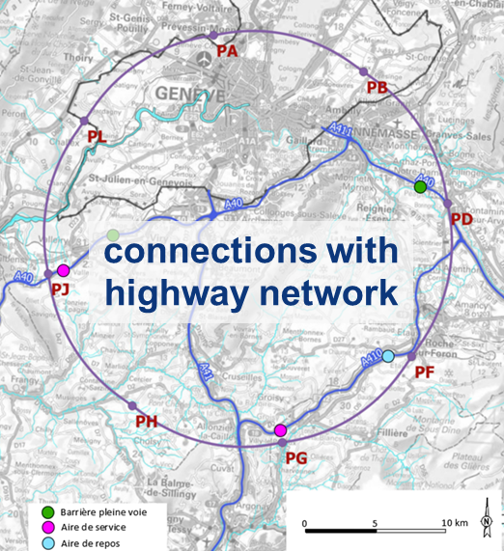
FCC connections: high-voltage grid, transport, water
Electrical energy
Electrical peak power 260-380 MW
Annual energy consumption 1.2-1.85 TWh
Loads distributed on three main sub-stations:
Point A with existing CERN station PA – PB – PL – PJ
Point D with a new sub-station PD – PF – PG
Point H with a new dedicated sub-station for collider RF
Connections confirmed by RTE (French el. grid operator)
requested loads have no significant impact on grid
Concept & rating of the 3 sub-stations compatible with FCC-hh
Road access
Cooling water concept
Road accesses developed for all 8 surface sites
Four possible highway connections defined
Less than 4 km of new roads required
Potential source of cooling water is Lake Geneva (PA).
Existing supply line with lake water provided by SIG to CERN LHC P8 (LHCb) is sufficient for FCC-ee.
Maximum yearly consumption (ttbar): 3 Mm³ (~CERN today)
Pipework in the tunnel will connect to the remaining points.
Main cooling towers placed at experiment points (PA, PD, PG, PJ), & RF sites (PL, PH).

Slide 12
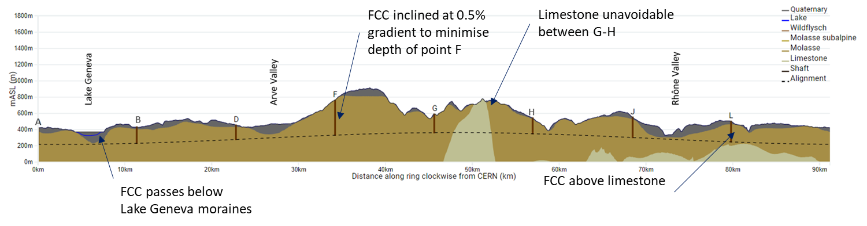
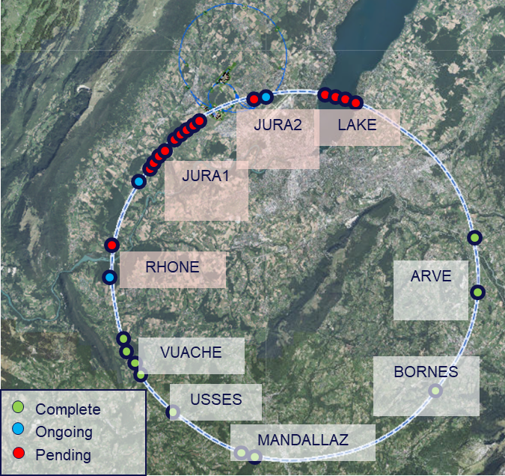
FCC tunnel geology, initial sub-surface investigations
  Tunneling mainly in molasse layer (soft rock), well suited for fast, low-risk TBM construction; 6 million m³ excavated volume → 8.5 million m³ excavation material on surface; CE designs of all underground structures exist; mean shaft depth ~240 m
  28 boreholes and 80 km of seismics planned between October 2024 and December 2025
  Site investigation results provide:
  Locations of geologic interfaces, permitting to fix tunnel vertical position & inclination
  Molasse versus limestone/moraines
  Southern work package status mid May 2025
  Geophysics acquisition & interpretation completed (40 km)
  All drillings completed (logging and testing ongoing)
  Preliminary results positive, confirming 3D geological model.
  Limestone passage Mandallaz less extensive
  Northern work package status mid May 2025
  3 drill sites in France currently active, 2 more to start soon
  Still pending permits for the works in Switzerland

Slide 13
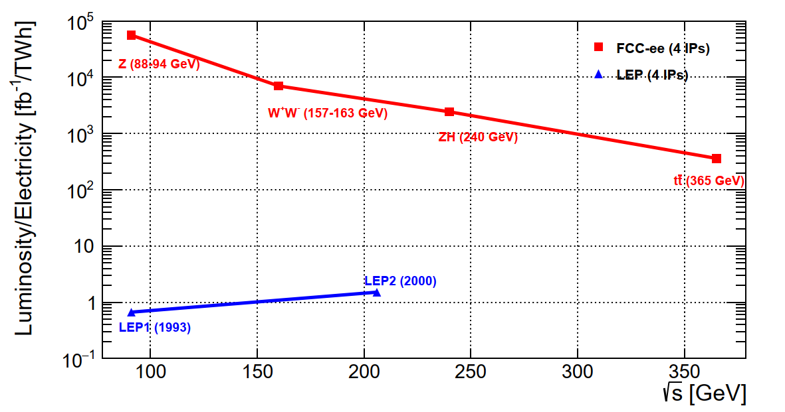
FCC-ee collider concept for maximum luminosity
double ring collider
many bunches, high current, like LHC and B factories, different from LEP
top-up injection
standard at modern light sources, like SLS
used at recent e⁺e⁻ colliders, PEP-II (USA), KEKB (Japan), BEPCII (China)
crab-waist collision scheme
successfully demonstrated at DAΦNE (Italy) and SuperKEKB (Japan)
SC radiofrequency system
Nb/Cu 400 MHz SC cavities pioneered at former CERN LEP
bulk Nb 800 MHz SC cavities similar to ESS (Sweden), EuXFEL (Germany)
revolutionary highly efficient RF power sources
new operation scheme for flexible energy switching & reduced complexity
Combining concepts from past and present lepton colliders yields giant step in efficiency:
→10⁴ - 10⁵ x luminosity/energy of LEP
→ sustainable physics

Slide 14
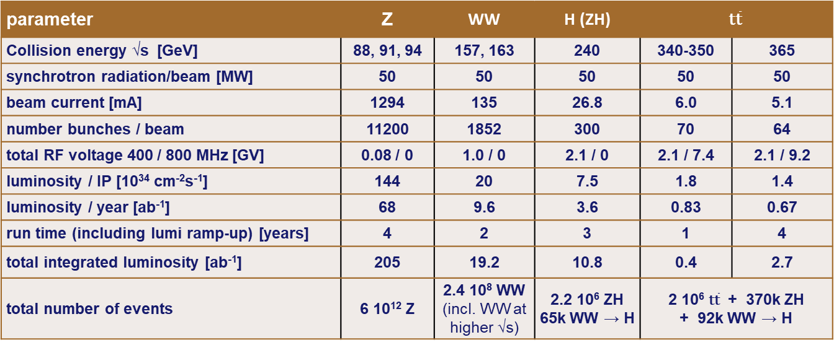
FCC-ee design parameters

Slide 15
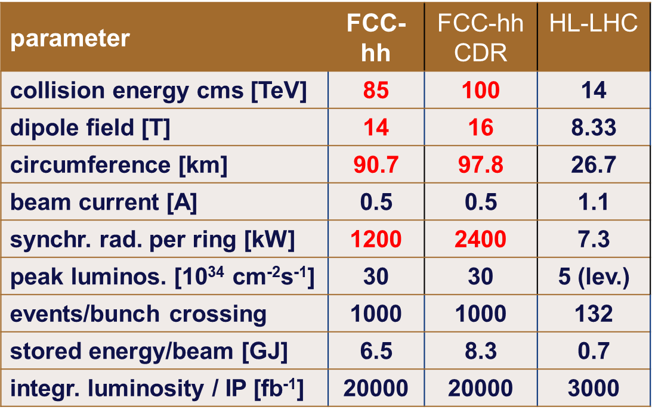
FCC-hh design parameters

Slide 16
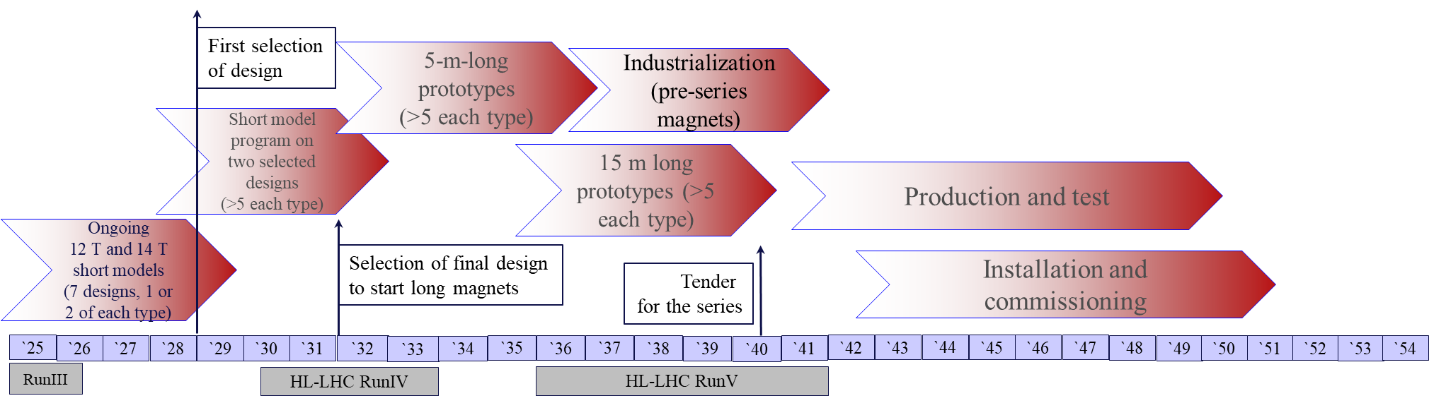
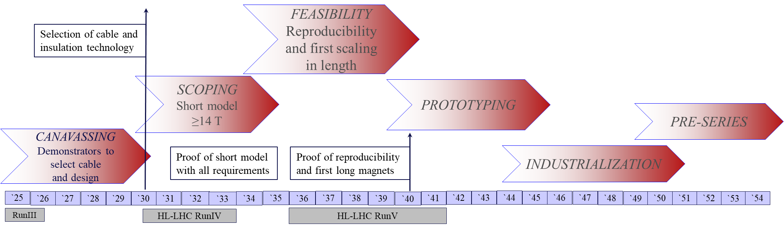
FCC-hh high-field magnets – two parallel roadmaps: Nb₃Sn & HTS
14 T Nb₃Sn targets: select design by 2028/29, then scaling in length
TRL 7 in 2032-40
HTS targets: by 2035 short model dipole with all features (aperture, field ≥14T, field quality, protection, …)
TRL 7 in 2040-45

Slide 17
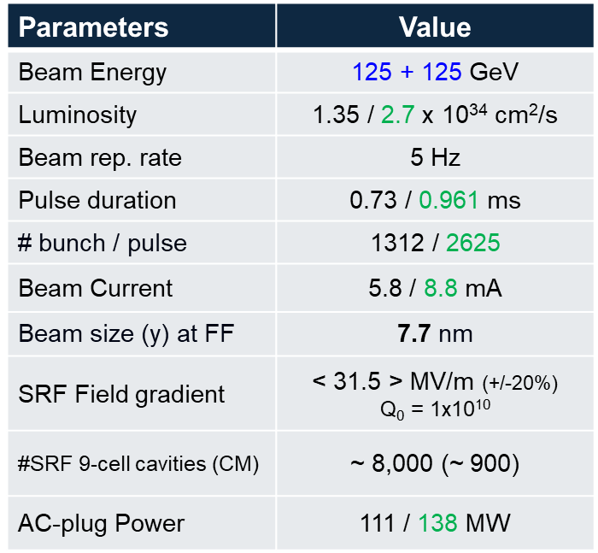
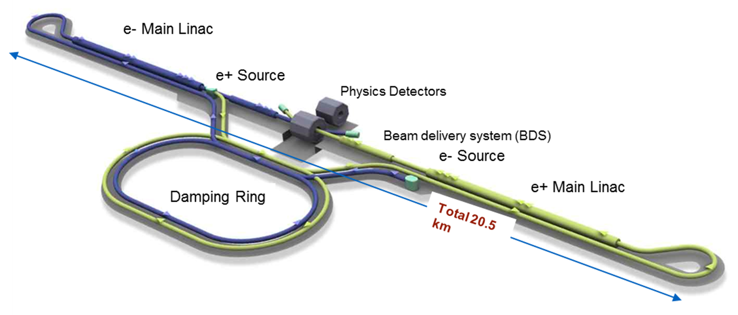
ILC

Slide 18
Linear Collider Facility (LCF) at CERN
Starting luminosity = 2x ILC baseline (10 Hz)

Slide 19
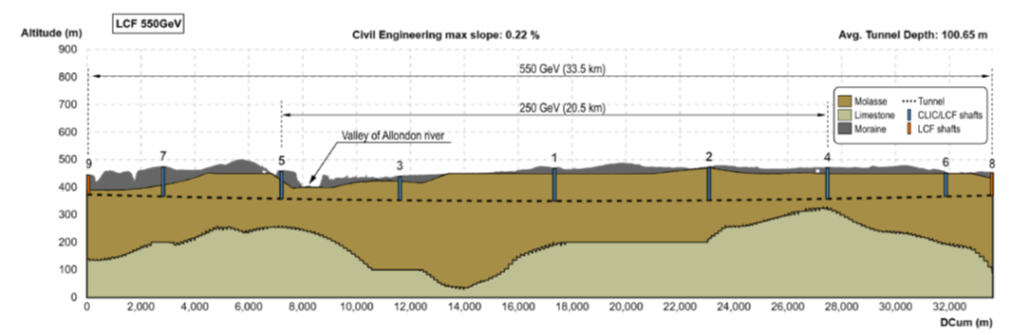
LCF siting & operation timeline

Slide 20
Linear Collider Facility (LCF) – points to consider
e⁺ source (2-4x ILC rate)
- undulator 230 m, half aperture < 3 mm,
with 3 nC bunch charge
[EuXFEL typical: 0.23 nC]
- rotating target : 1 m diameter wheel
spinning at 2000 RPM in vacuum
beam delivery system
- wake fields, spot size

Slide 21
Linear Collider Vision
Energies > 550 GeV → longer linacs and/or higher gradients
CLIC technology offers gradients 70 –100 MV/m
(Also: C³, HELEN …)
Wakefield accelerators offer possibility of GV/m gradients
Gamma-gamma colliders
→ pathways to 10 TeV pCM collisions
P. Burrows, EPS-HEP Marseille

Slide 22
CLIC-380 layout
Baseline electron polarisation ±80%

Slide 23
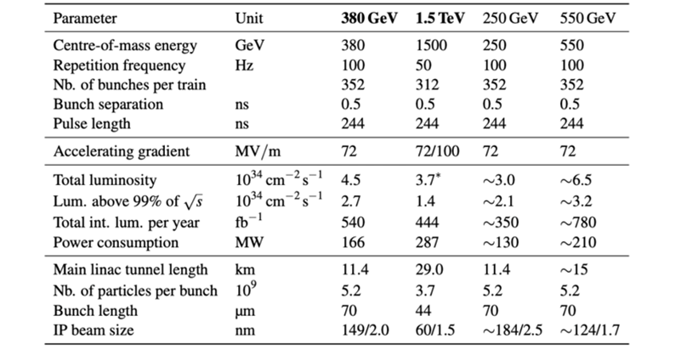
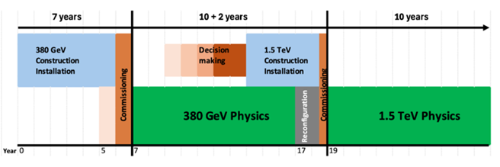
CLIC-380 design parameters

Slide 24
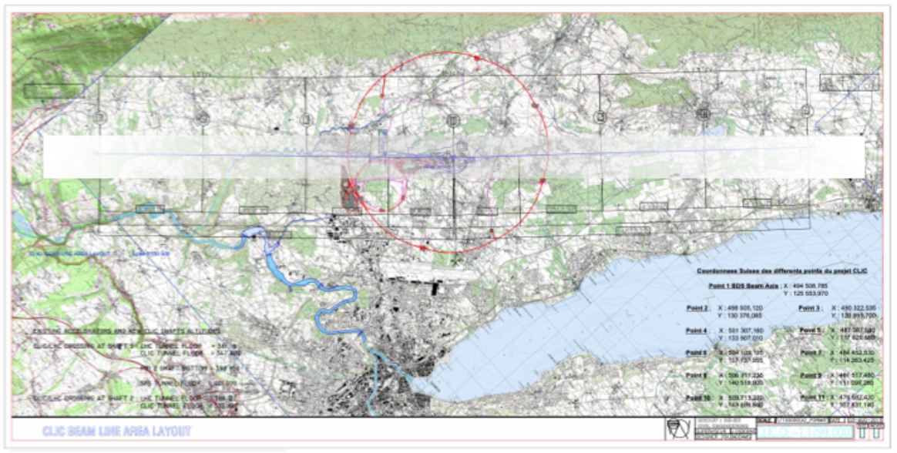

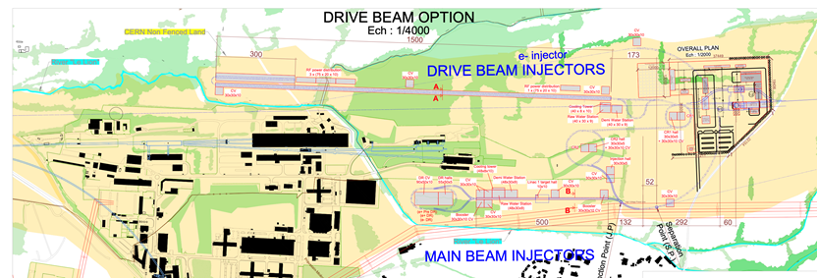
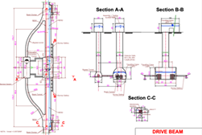
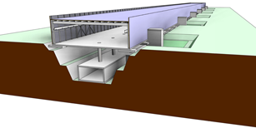
CLIC siting studies
Layout used for costing and drawings. Not final, can be translated, rotated and shafts can be moved.

Slide 25
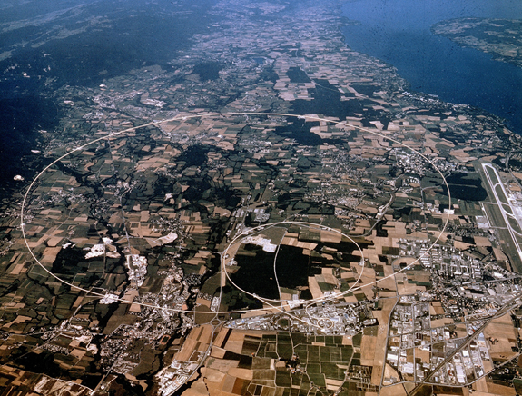
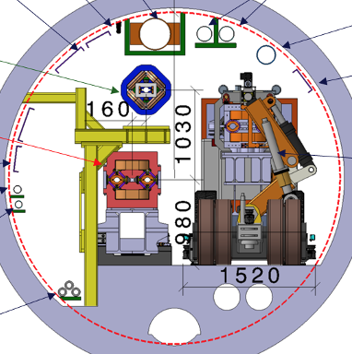
arXiv:2504.00541
LEP3
arXiv:1112.2518, arXiv:2504.00541
A high luminosity electron-positron Higgs boson factory in the LHC tunnel
‘A possible back-up to the preferred option (FCC-ee and FCC-hh) for the next accelerator for CERN’ T. Virdee

Slide 26
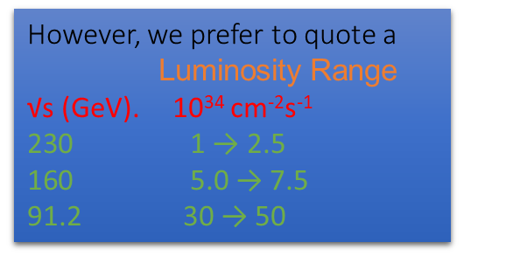
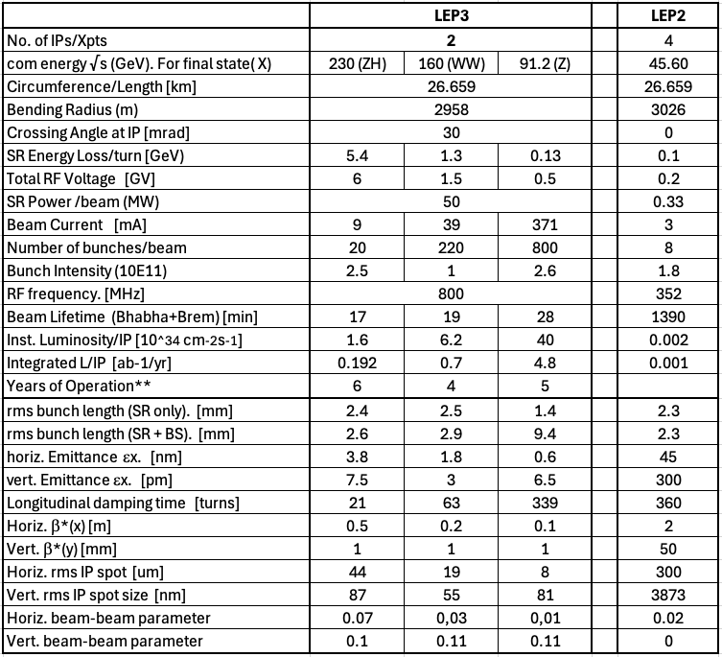
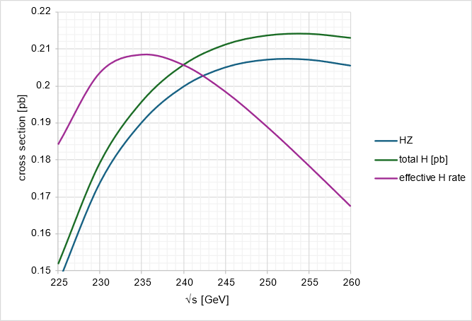
LEP3 design parameters
P. Burrows, EPS-HEP Marseille

Slide 27
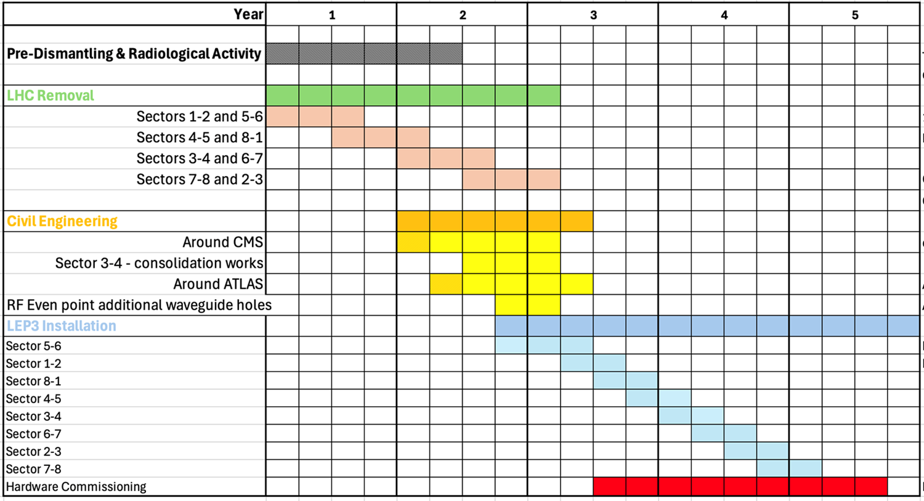
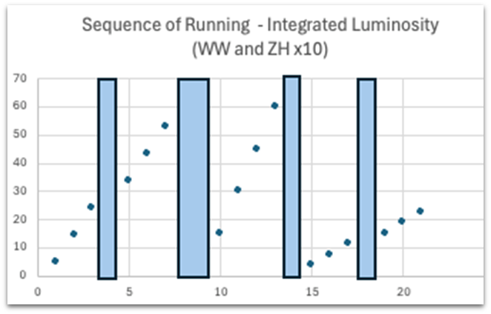
LEP3 running scenario
P. Burrows, EPS-HEP Marseille
Possible LEP3 installation schedule
No. of IPs 2
Energy for ZH 230 GeV
Fix SR power loss 50 MW/beam
SR energy loss/turn ~ 5.4 GeV
Total RF voltage installed ~ 6 GV
Crossing angle 30 mrad
One running scenario:
e.g. 6 yrs at 230 GeV,
4 years around WW, 6 years around Z
Est. total no. events
4.2 x10⁵ H,
3.7 x 10⁷ WW at 157 and 163 GeV
1.7 x 10¹² Z at & around 91.2 GeV
(cf. 10⁹/ 6.10¹²Z for ILC/FCC-ee)
‘Can’t reach t-tbar threshold’

Slide 28
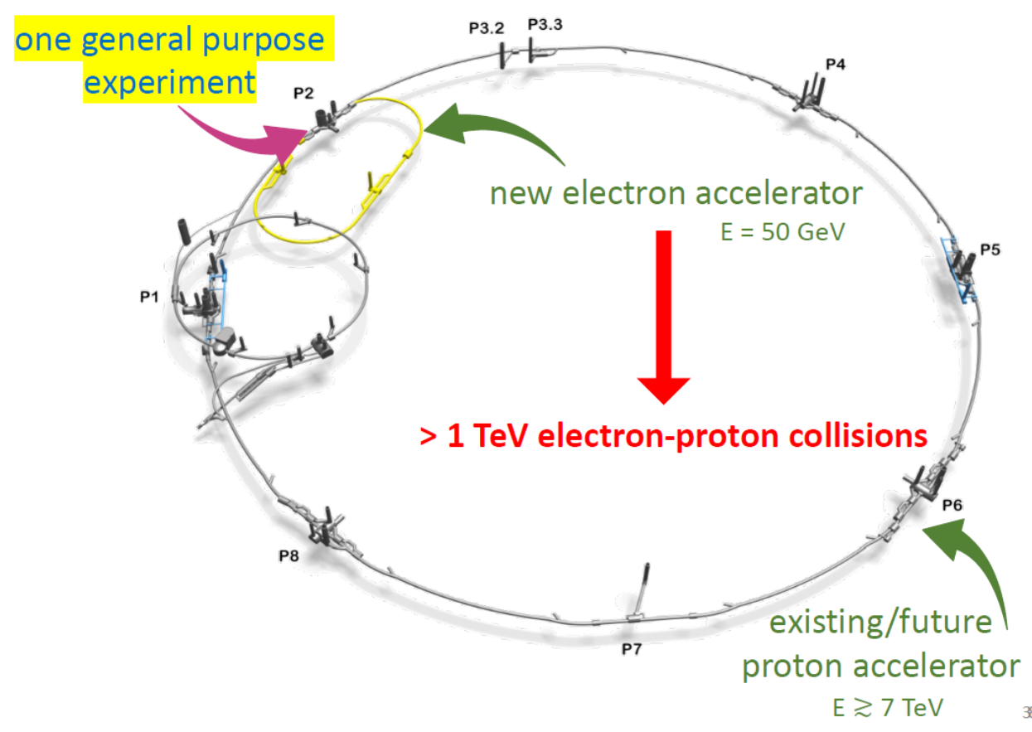
LHeC
PAC09, IPAC2013, arXiv:2503.17727

Slide 29
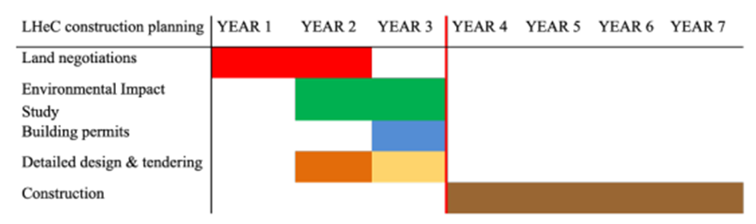
LHeC specs & timeline
J. d’Hondt, osen symposium ESPP
802 MHz, 20 MV/m, cw, 6x20 mA in 3-turn SRF ERL, 50 GeV (1/3 of LHC). Start operation after HL-LHC (>2041), luminosity > 10³⁴ cm⁻²s⁻¹. 6 years of operation: 1 ab⁻¹ (e.g. 2043-2048). 120 MW from HL-LHC + 100 MW from e-beam.
Instantaneous e- beam power ~ 1 GW

Slide 30
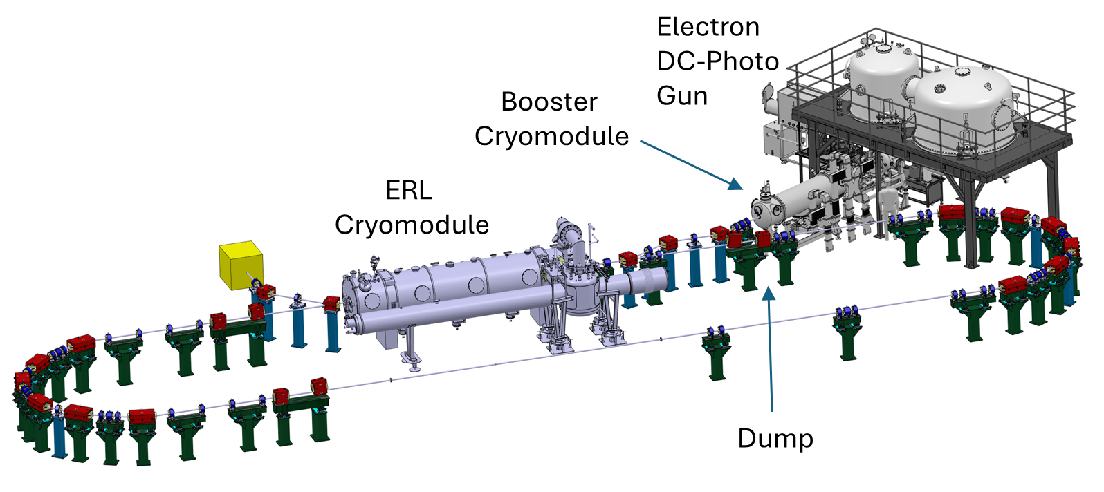
LHeC demonstrator : PERLE at IJCLab
Powerful ERL for Experiments (PERLE)
principal SRF technology demonstrator for LHeC

Slide 31
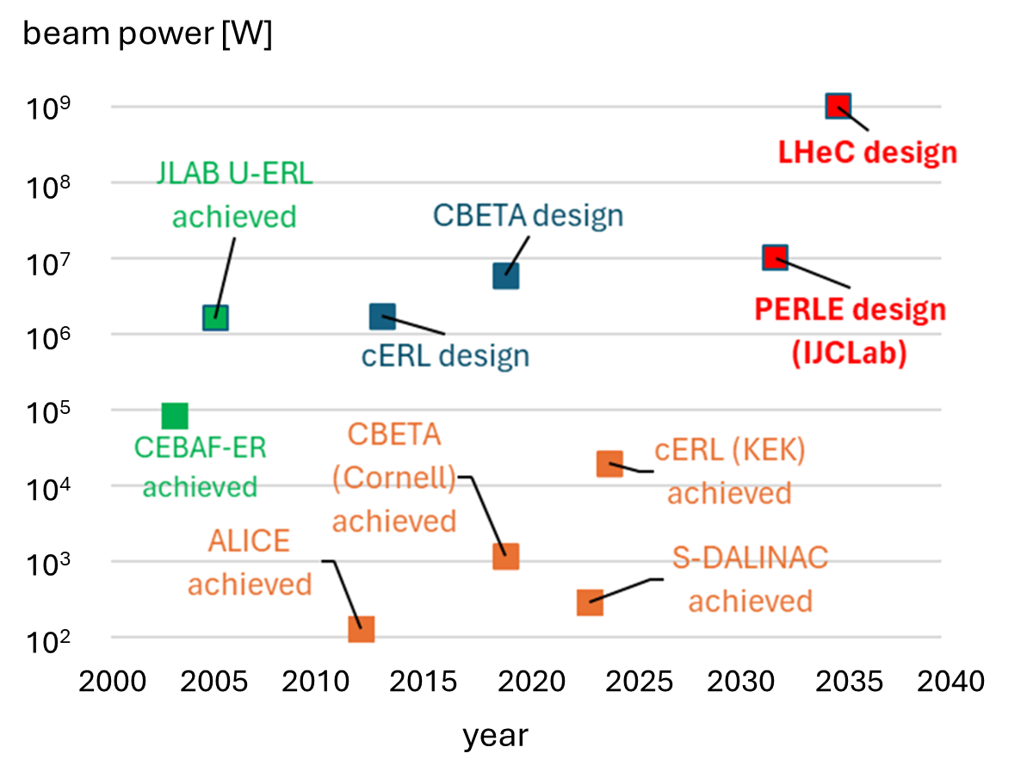
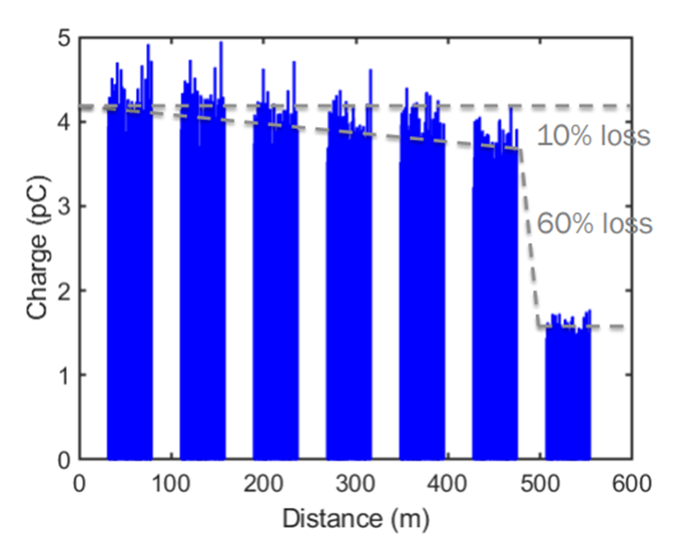
the ERL challenge
CBETA transmission

Slide 32
cost estimates
project | scenario / energy / details | cost
FCC-ee | Z, WW, ZH, + 4 exp. CERN part | 14.0 BCHF
 | + 4 exp. non CERN part | +1.3 BCHF
 | + upgrade to ttbar | +1.3 BCHF
FCC-hh | 85 TeV pp, as second stage | +19.1 BCHF
FCC-hh | 85 TeV pp, standalone | 27.3 BCHF
LCF | 250 GeV | 8.5 BCHF
 | 550 GeV | +5.5 BCHF
CLIC | 380 GeV | 7.3 BCHF
 | 1500 GeV | +7,1 BCHF
LEP3 | ZH at 230 GeV + 2 exp CERN part | 3.9 BCHF
 | + 2 exp non CERN part | +0.9 (0.3) BCHF
project | scenario | cost
LHeC | 9 km new tunnel, 50 GeV e⁻ | 2 BCHF
Muon Collider | 3.2 TeV at CERN | 12.0 BCHF
 | 7.6 TeV at CERN | 17.0 BCHF
 | 10 TeV green field | 19 BCHF
HALHF | e⁻ 375 GeV, e⁺ 41.7 GeV (250 GeV c.m.) | 3.8 BCHF
 | 380 GeV | 4.9 BCHF
 | 550 GeV | 6.3 BCHF
ALIVE | p-driven, 10 TeV | ?
ALEGRO | e⁺e⁻ & γγ, ≥10 TeV | ?

Slide 33
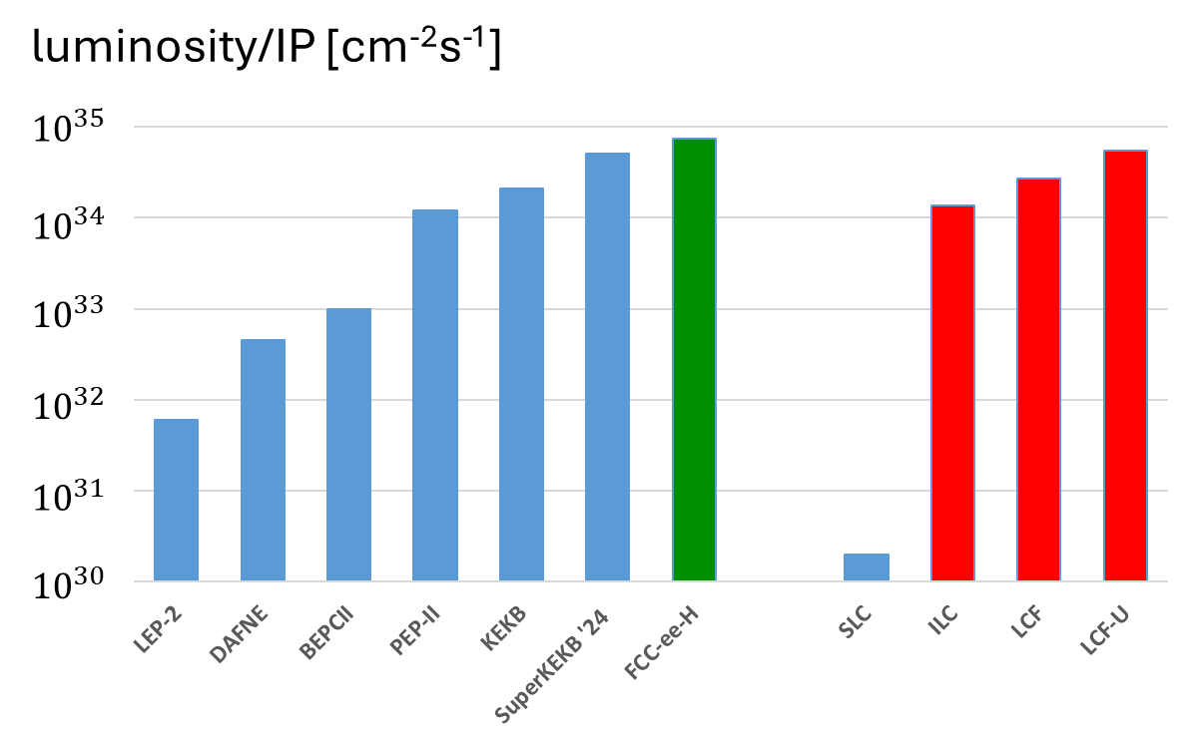
luminosity of circular and linear e⁺e⁻ (Higgs) factories
required
achieved
required
linear
circular
achieved
CC: experience from several circular colliders up to comparable luminosity + 4 IPs
few years of running at each energy to reach goals
LC: extrapolation over 4 orders of magnitude → longer commissioning, bigger risk, 1 or 2 IPs

Slide 34
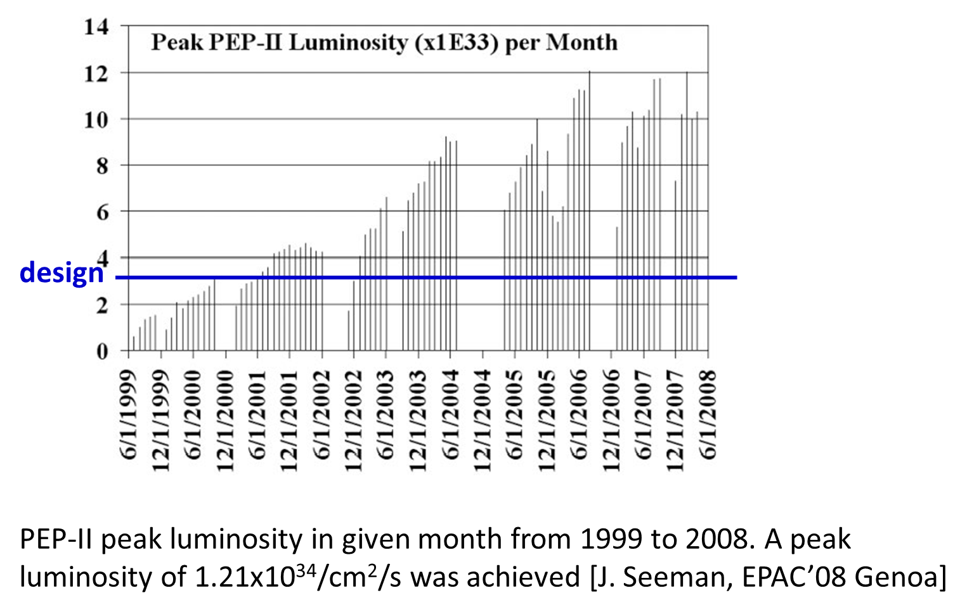
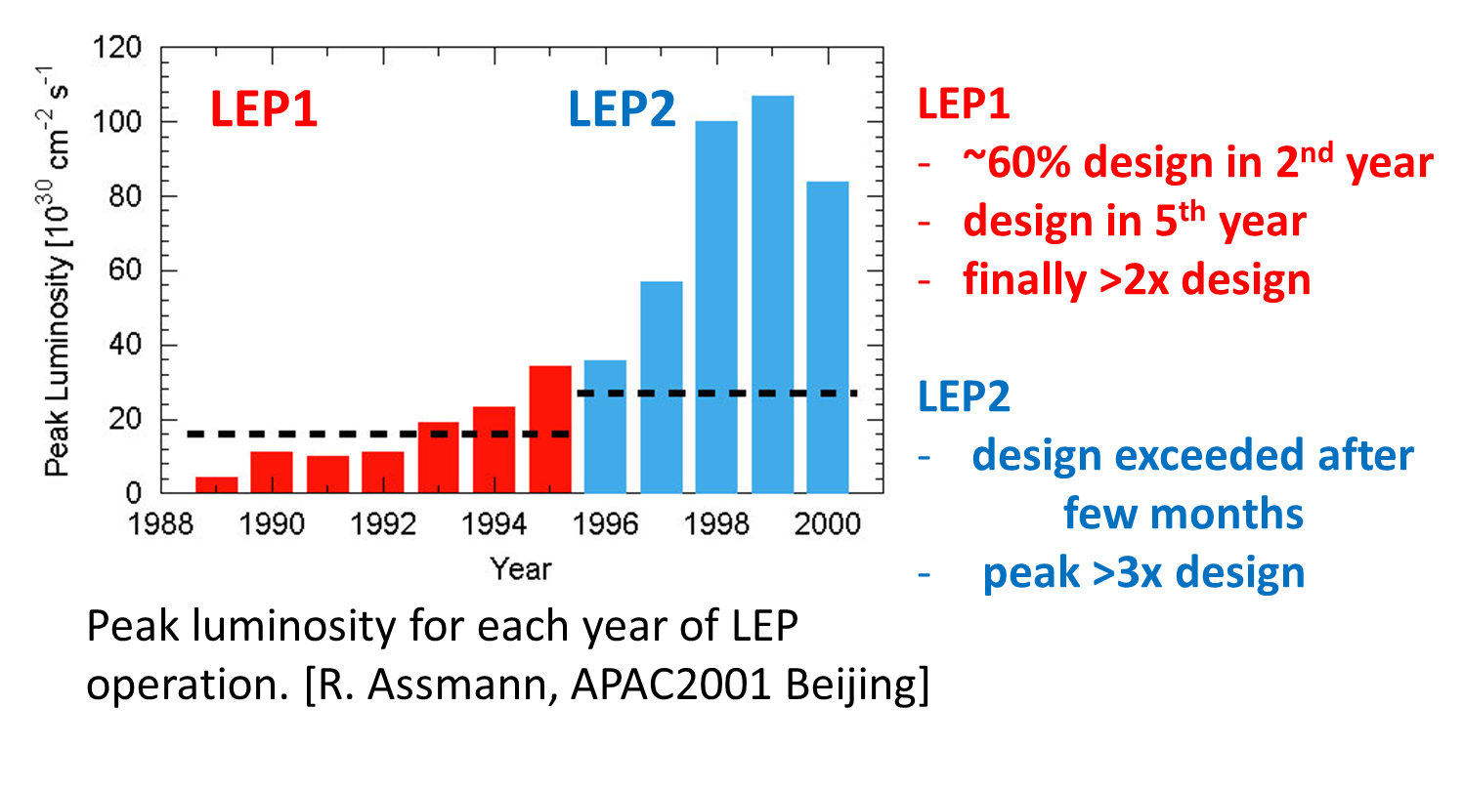
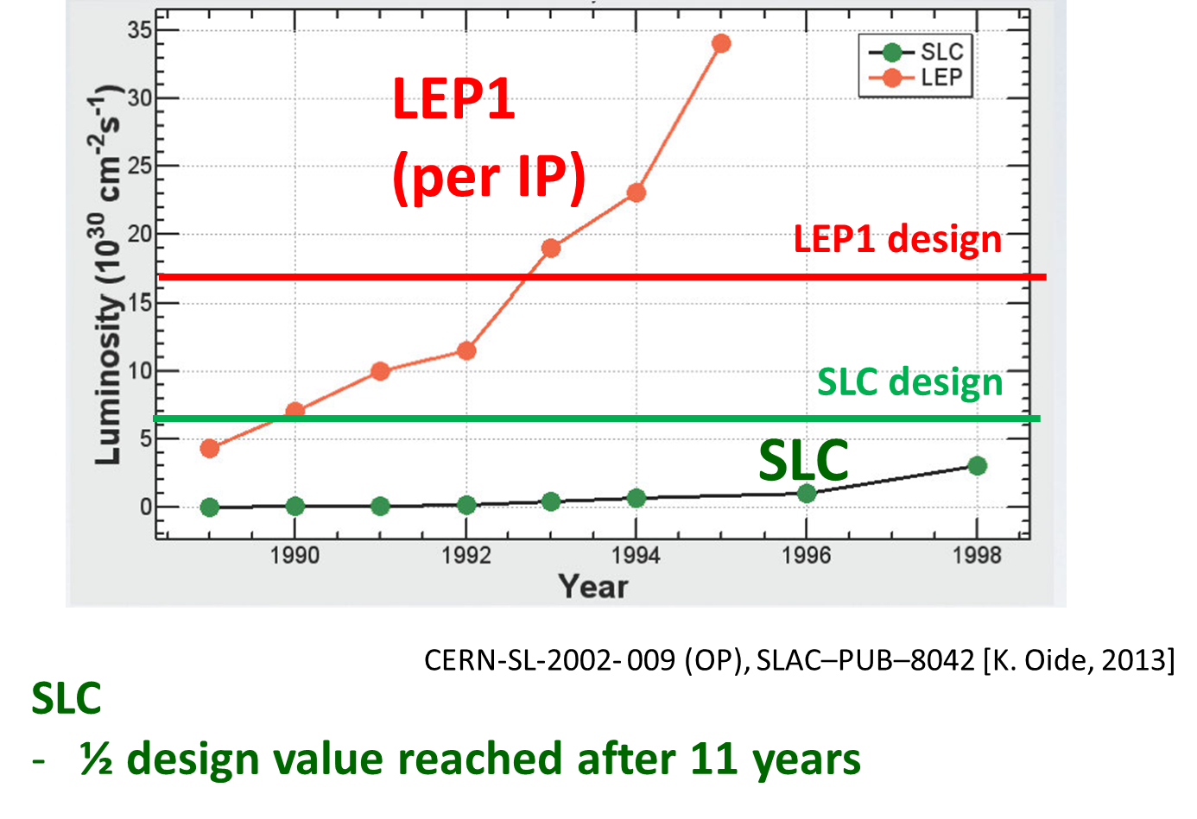
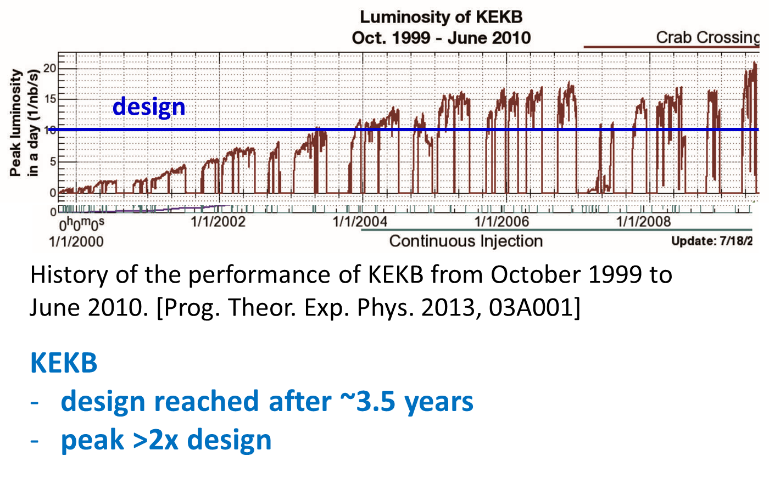
commissioning records

Slide 35

a performant Higgs programme
Collider cost should be normalised to its physics output, e.g. Higgs precision.
It would take ~30-50 years for other projects to achieve what can be done at FCC-ee in 8 years;
→ consequences in terms of electricity/money/carbon footprint
arXiv:2412.13130
C. Grojean

Slide 36
(My) view on future collider in Europe / at CERN:
FCC(-ee): local implementation most advanced; wide physics scope, matches size of CERN community, fast commissioning, base for FCC-hh, strong support, unique opportunity – we should not squander this
LEP3: second cheapest alternative, using existing tunnel – cannot be faster than FCC-ee, requires dismantling of the LHC, technical design would need more studies
LHeC: cheapest option, only one experiment, requires HL-LHC to run
LC: requires implementation with local & regional authorities, not all accelerator design points are clear (to me), 1 or at most 2 experiments, big extrapolations from SLC and EuXFEL, more risk than circular machine
Muon collider: technologies still to be developed and their feasibility to be proven
HALHF & pure plasma collider – fundamental questions about plasma-based colliders, still highly speculative
thank you !

Slide 37

Helmut Schmidt,
*Hamburg-Barmbek
chancellor of West Germany from 1974 to 1982
“Wer Visionen hat, sollte zum Arzt gehen.”
“Anyone who has visions should go to the doctor.”
Bundestags-
wahlkampf
1980

